Slide 1
Neural Networks
Introduction to Neural Networks. Control Systems Applications.
M.V. Iordache, EEGR4933 Automatic Control Systems, Spring 2019, LeTourneau University

Slide 2
Artificial Neural Networks
Inspired by biological neural networks.
Consist of interconnected artificial neurons.
Artificial neurons and neural networks are quite simple (primitive) in comparison to their biological counterparts.
Nonetheless, they provide a very important class of methods with applications in various domains, including Control Systems.

Slide 3
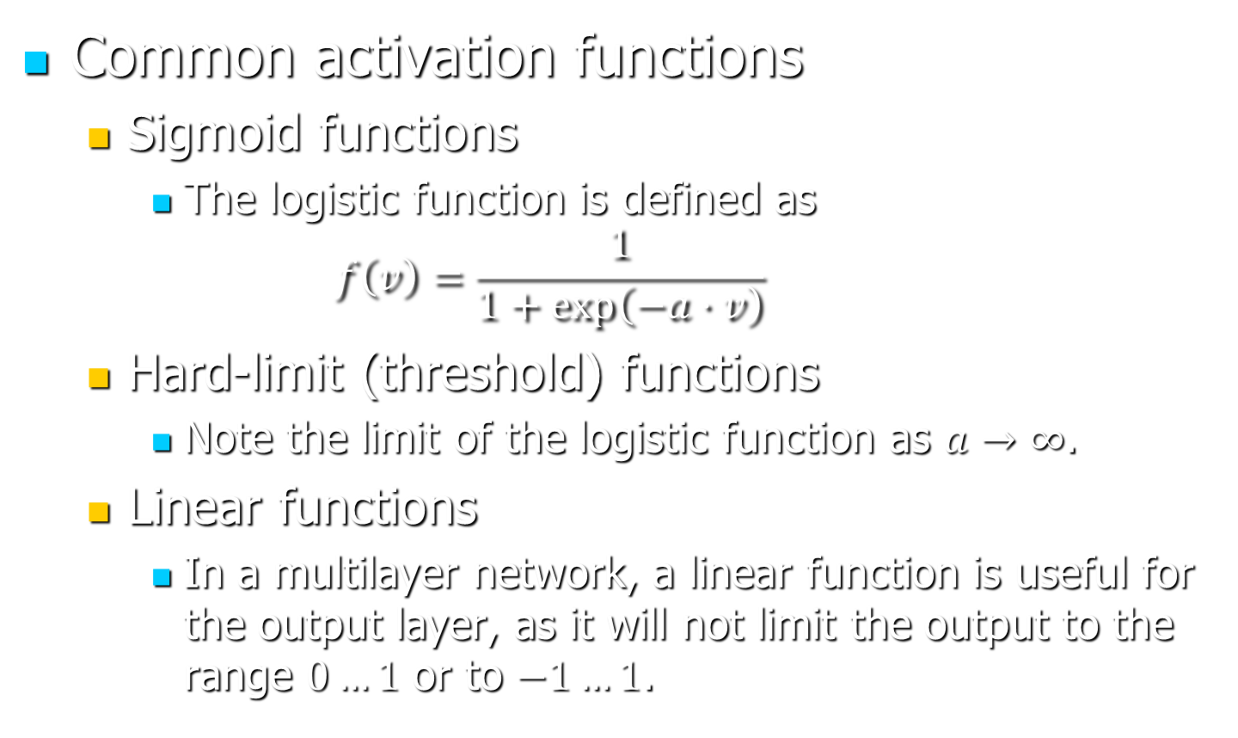
The Artificial Neuron
Common activation functions
Sigmoid functions
The logistic function is defined as
$$f\left(v\right)=\frac{1}{1+\exp\left(−a⋅v\right)}$$
Hard-limit (threshold) functions
Note the limit of the logistic function as $a→∞$.
Linear functions
In a multilayer network, a linear function is useful for the output layer, as it will not limit the output to the range $0…1$ or to $−1…1$.

Slide 4
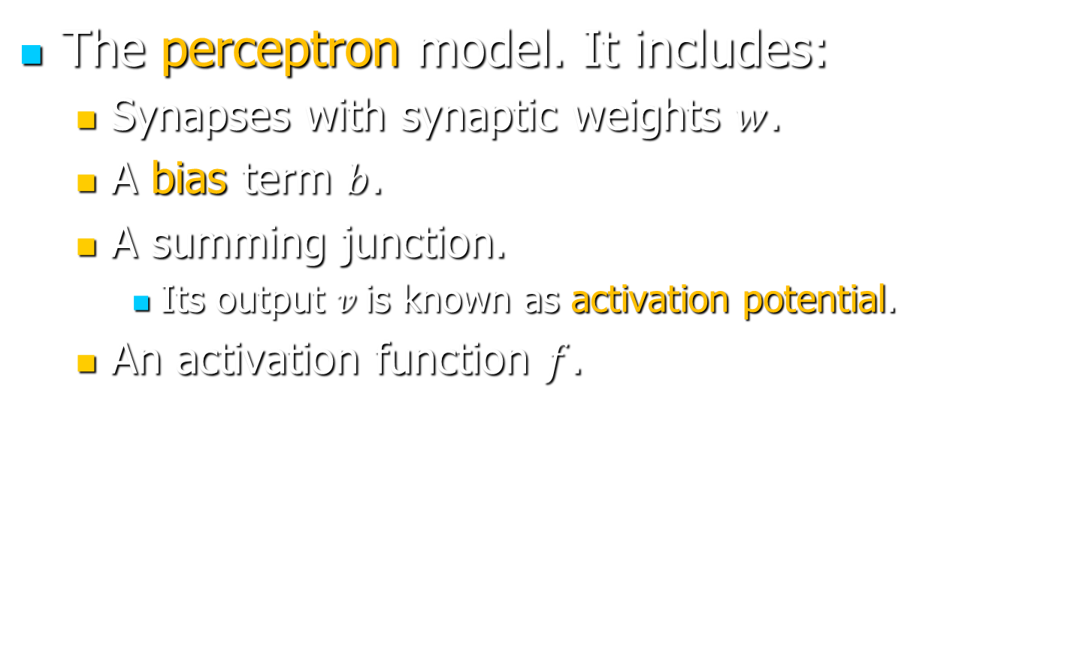
The Artificial Neuron
The perceptron model. It includes:
Synapses with synaptic weights $w$.
A bias term $b$.
A summing junction.
Its output $v$is known as activation potential.
An activation function $f$.

Slide 5
Network Architecture
Multilayer feedforward.
Recurrent.

Slide 6
Learning Methods
Supervised learning
Batch learning
On-line learning
Reinforcement learning
Unsupervised learning

Slide 7
NN Training in MATLAB
The data set is divided in three subsets:
Training data set: Used to tune weights and biases.
Validation data set: Training stops when the validation set error begins to increase.
This could indicate that the network begins to overfit data.
Test data set: It does not affect training.
A poor division of the data set can be detected when the minima of the test set error and the validation set error are reached at considerably different iterations.
% Define feedforward NN with one hidden layer of 20 neurons
net = feedforwardnet(20);
% Specify the fractions of the data set that should be used for training, validation, and test:
net.divideParam.trainRatio = 0.7; net.divideParam.valRatio = 0.2;
net.divideParam.testRatio = 0.1;

Slide 8

NN Training in MATLAB
Example: A NN with 2 inputs and 2 outputs should approximate the functions $\sin\left(2t+0.2t^{2}\right)$ and $\cos\left(2t+0.2t^{2}\right)$ over the interval $t = 0…10$.
% Let's first calculate the data set:
U = 0:0.05:10; a = 2;
Yr = [sin(a*U+0.1*a*U.^2); cos(a*U+0.1*a*U.^2)];
% Define the NN with two hidden layers, 20 neurons
% on the first layer and 10 on the next.
net = feedforwardnet([20 10]);
% Use the log sigmoid function for the hidden layers
net.layers{1}.transferFcn = 'logsig';
net.layers{2}.transferFcn = 'logsig';
% Use the linear function for the output layer
net.layers{3}.transferFcn = 'purelin';

Slide 9
NN Training in MATLAB
% The number of inputs and outputs is inferred
% from the dimension of the data set.
% Train the network with the data set [U; U], Yr.
% Since Yr has two rows, 2 outputs are needed.
% Since [U; U] has two rows, two inputs are needed.
nett = train(net,[U; U],Yr)
% Let's check the response of the trained NN for:
t = 0:0.001:10;
yy = [sin(a*t+0.1*a*t.^2); cos(a*t+0.1*a*t.^2)];
Y = sim(nett,[t; t]);
% Plot the results
figure(1)
plot(U, Yr , 'o', t, Y, t, yy, ':')

Slide 10
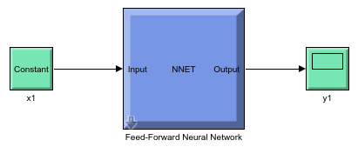
Using the NN in Simulink
% Set first any necessary parameters.
% For example, for a network with delays, the sample
% time should be specified (sample time information
% is not necessary in the previous example):
nett.sampletime = 0.01;
% Generate a Simulink model
gensim(nett);

Slide 11
Neural Networks
Can be applied to Control Systems
System Identification
Inverse Modeling
Model Reference Control
Feedforward structure inappropriate: output depends exclusively on current input!
Typically in CS: output depends on current input and previous input and output levels.
Notes:
Recall that for a linear system the output is the convolution product of tf (in time domain) and input. Thus, it does not depend exclusively on current input.

Slide 12
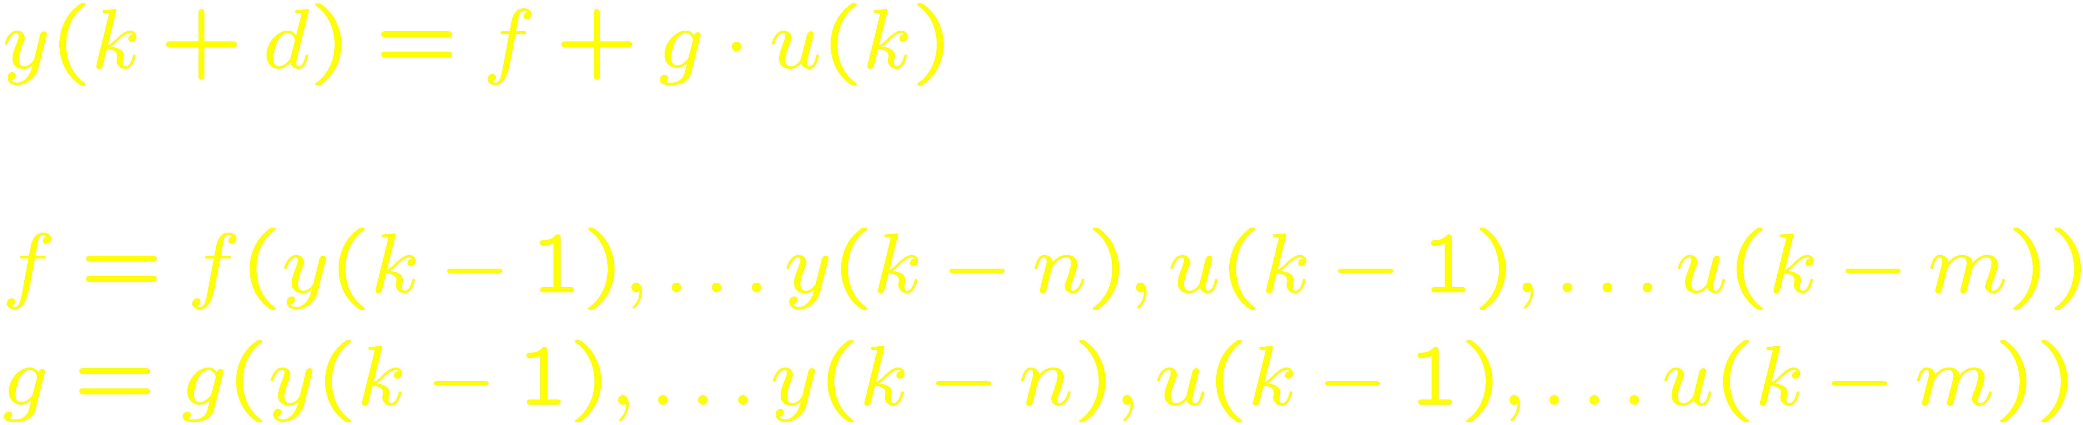
Neural Networks
Feedforward networks: inappropriate here.
Recurrent networks with time delay used instead.
Discrete time models used.
In particular, NARMA models.
Notes:
NARMA: Nonlinear Autoregressive Moving Average.

Slide 13
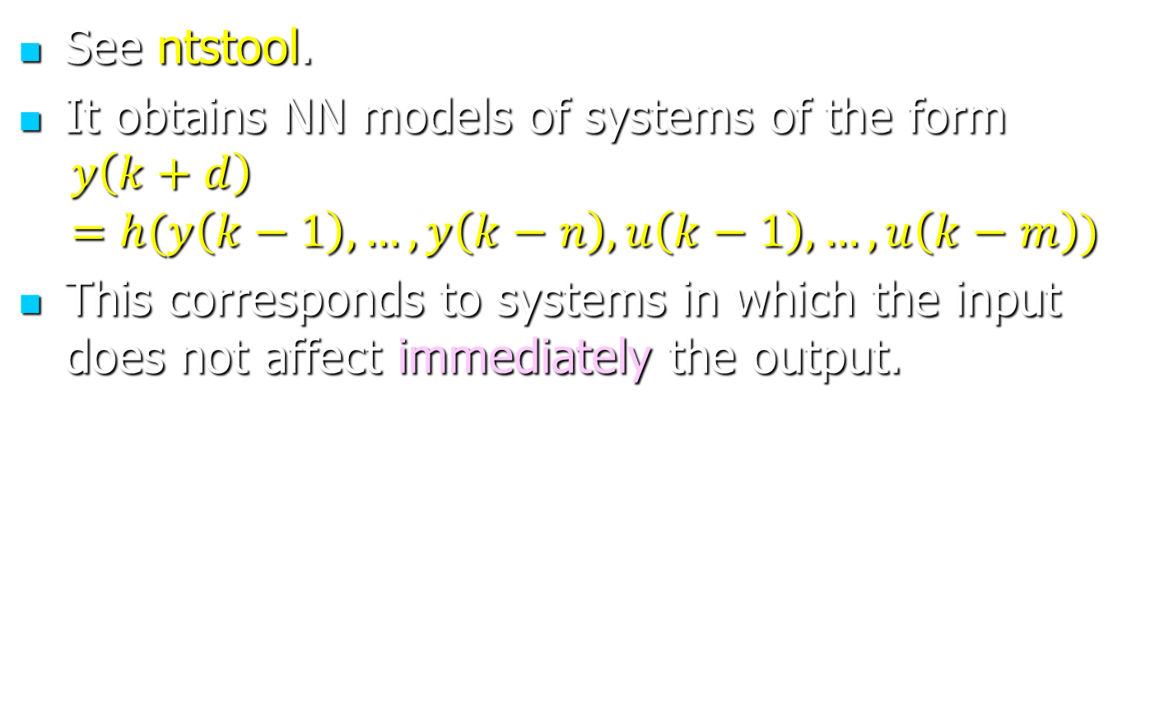
System Identification in MATLAB
See ntstool.
It obtains NN models of systems of the form
$$y\left(k+d\right)=h(y\left(k−1\right),…,y\left(k−n\right),u\left(k−1\right),…, u\left(k−m\right))$$
This corresponds to systems in which the input does not affect immediately the output.

