Slide 1
Transfer-Function Based Analysis
Approximations, Jury’s Stability Test, Steady-State Response, Time Response
M.V. Iordache, EEGR4933 Automatic Control Systems, Spring 2019, LeTourneau University

Slide 2
Designing SD Control Systems
A precise solution is to find the controller directly in the z-domain
  Use state estimation and state feedback.
  OR other methods.

Slide 3
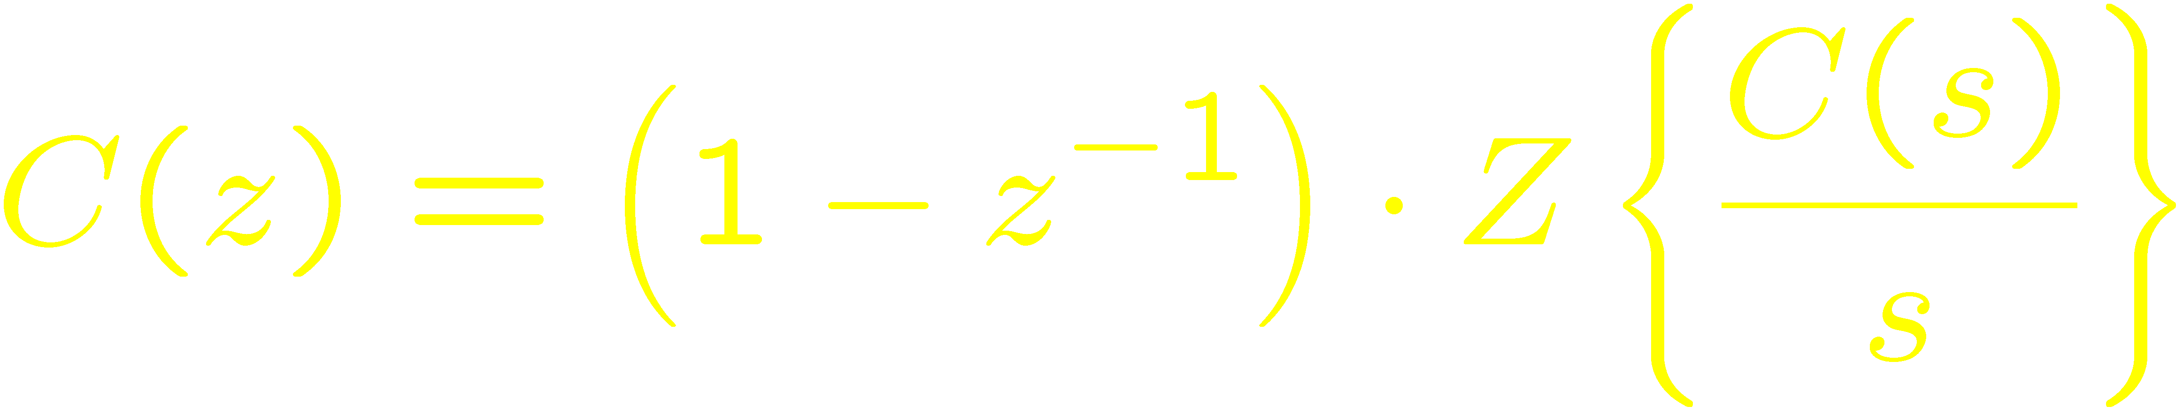
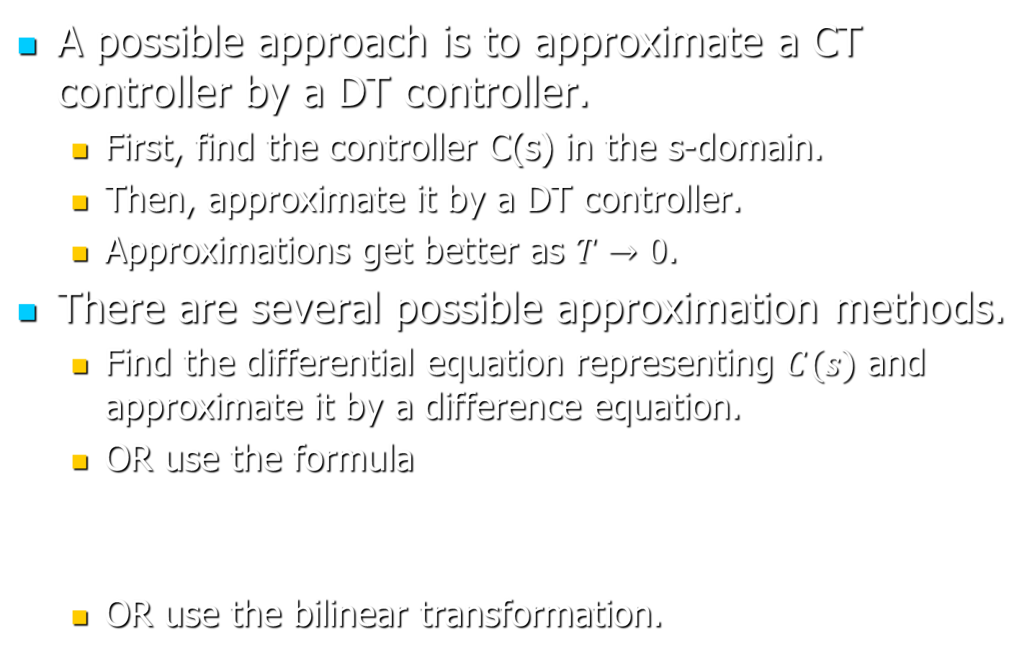
Designing SD Control Systems
A possible approach is to approximate a CT controller by a DT controller.
  First, find the controller C(s) in the s-domain.
  Then, approximate it by a DT controller.
  Approximations get better as $T→0$.
There are several possible approximation methods.
  Find the differential equation representing $C(s)$ and approximate it by a difference equation.
  OR use the formula
  OR use the bilinear transformation.

Slide 4
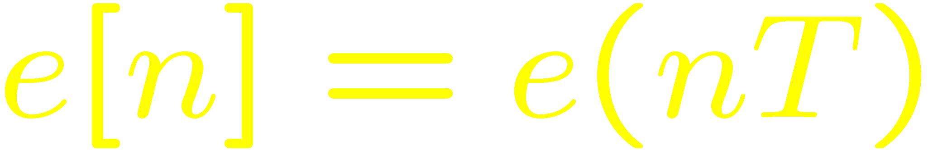
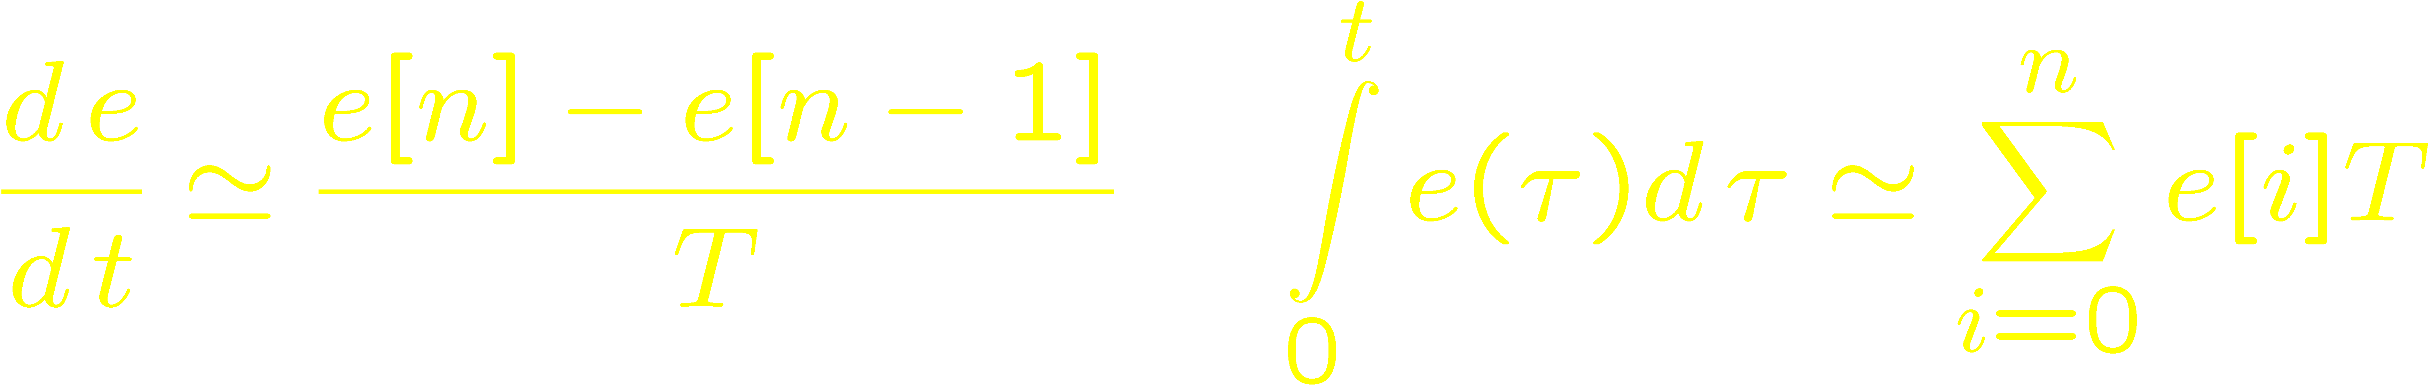
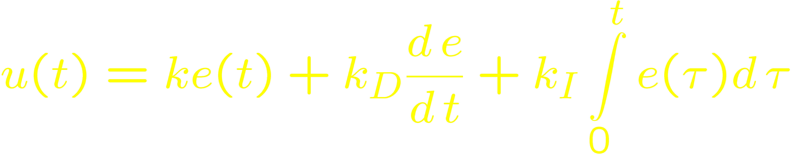
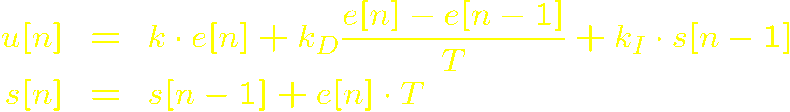
Approximation by difference equations
Let
Analog PID controller
Digital PID controller

Slide 5
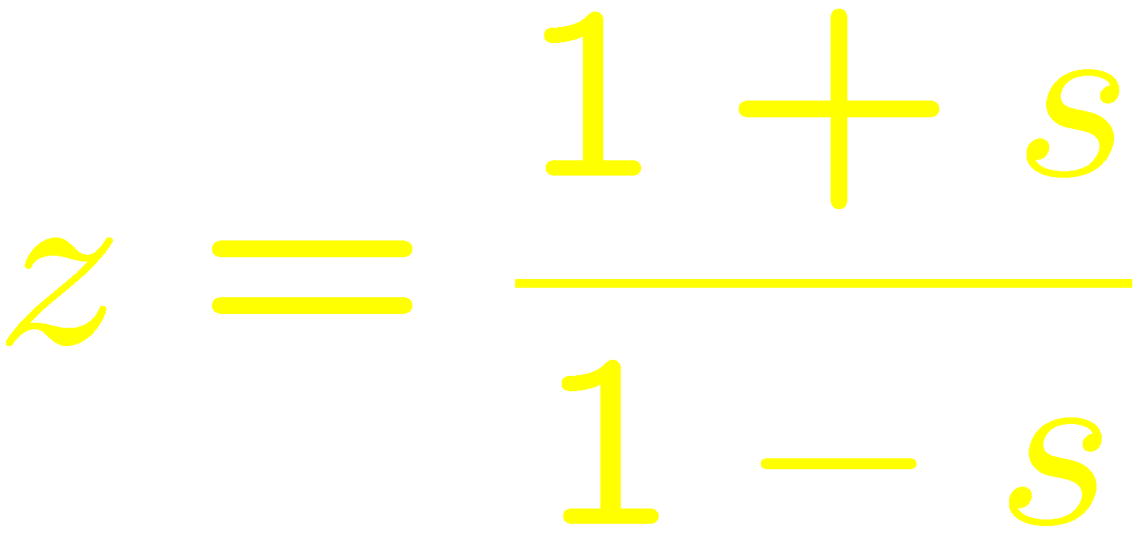
Stability Calculations
The Routh-Hurwitz criterion may be used when z is substituted with
Alternatively, Jury’s test may be applied directly.

Slide 6
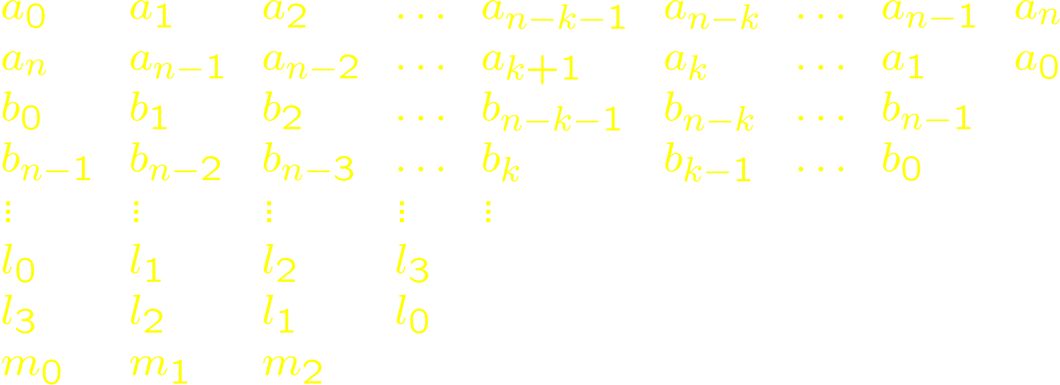
Array for Jury’s Stability Test
Write the pole equation as Q(z) = 0 with
and a_{n} > 0. The array is:

Slide 7
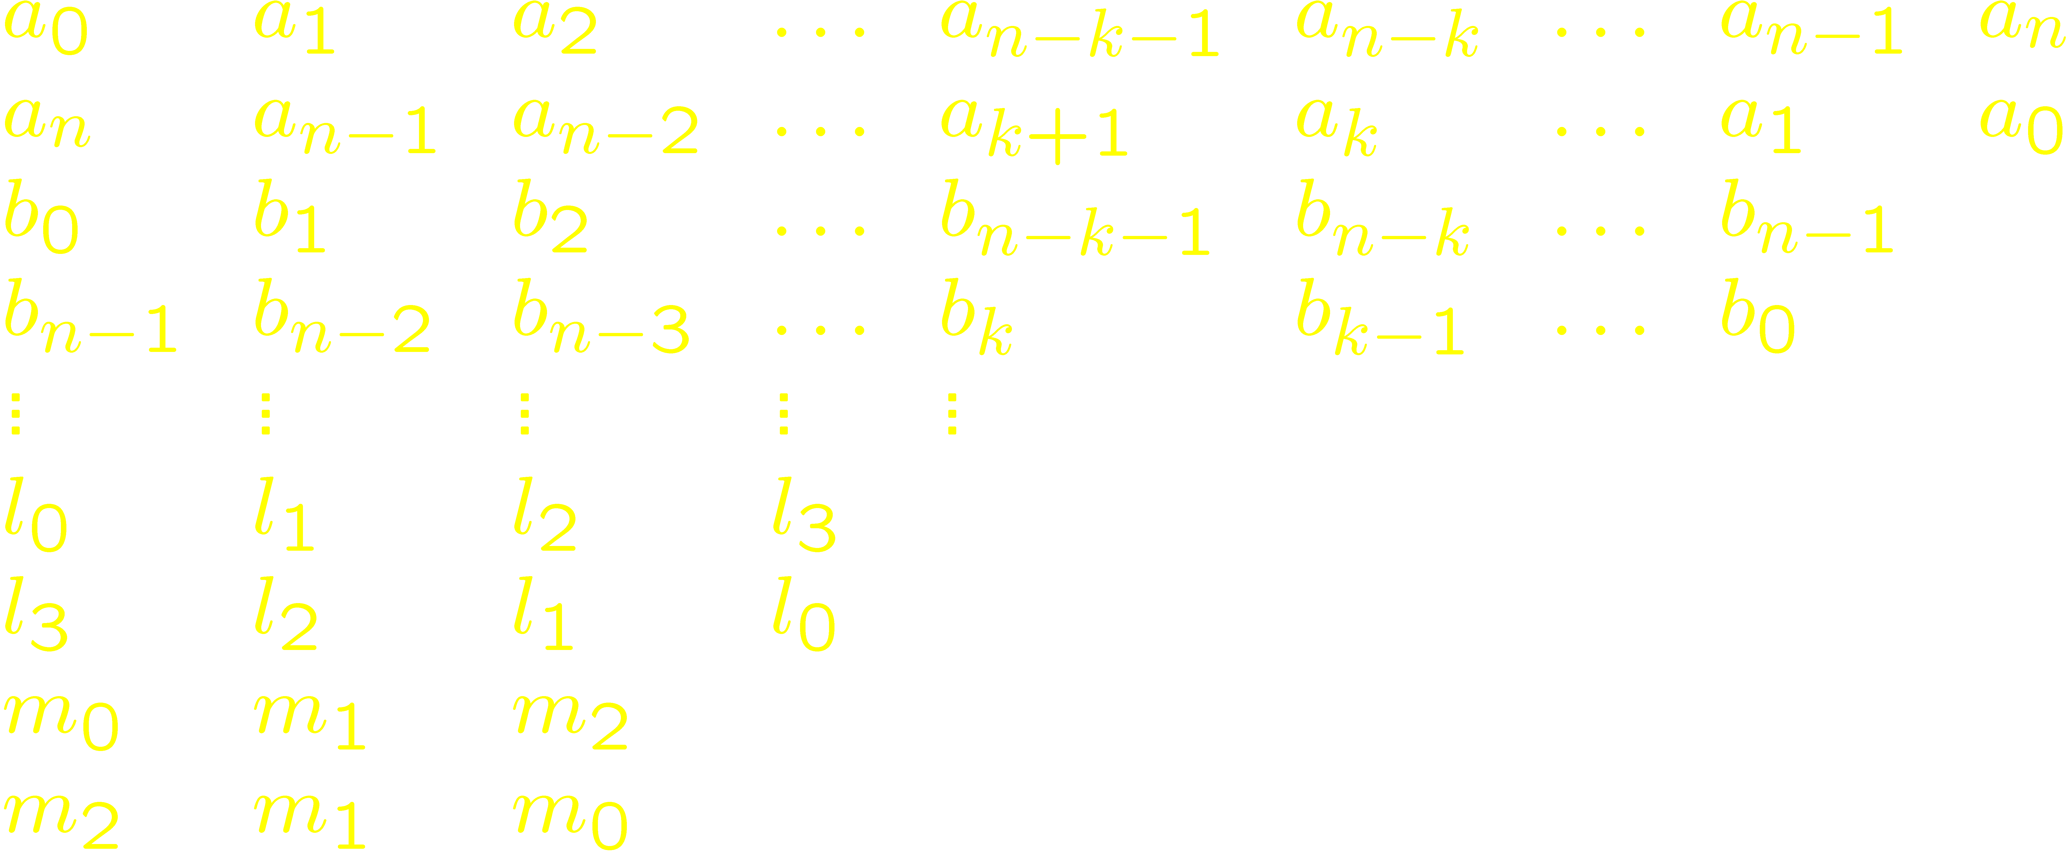
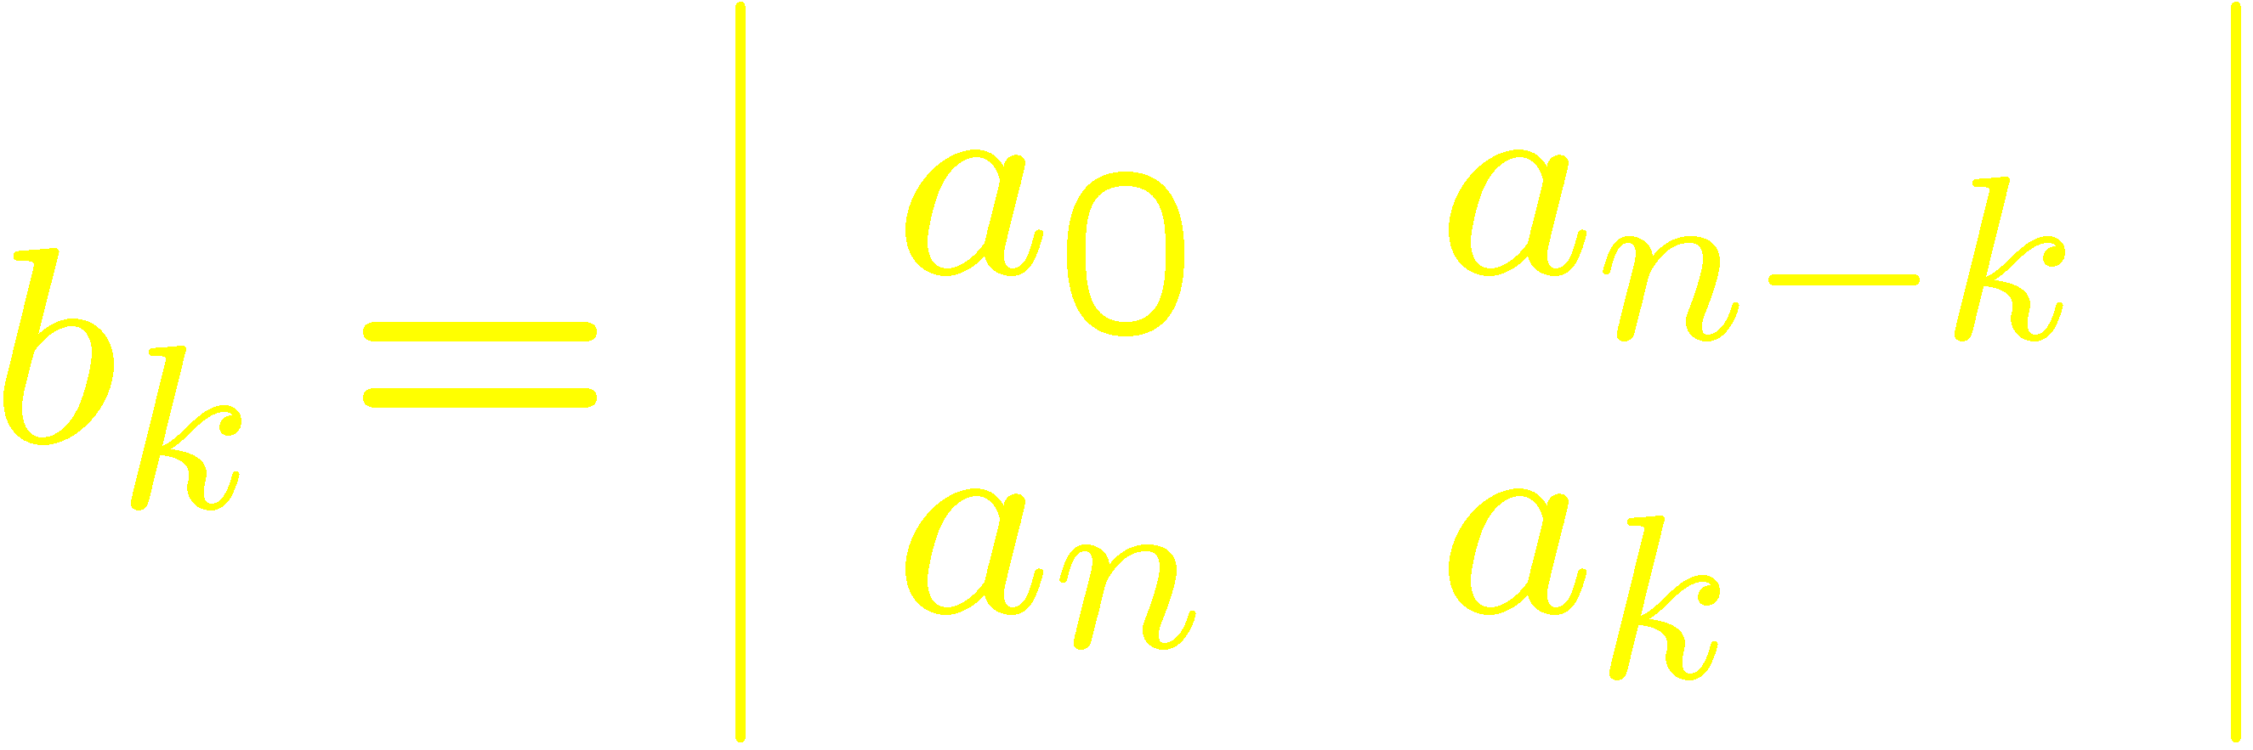
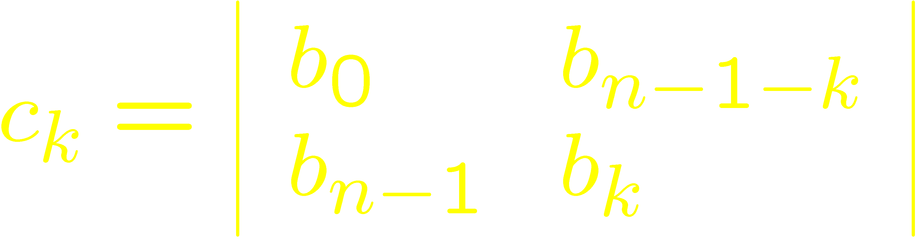
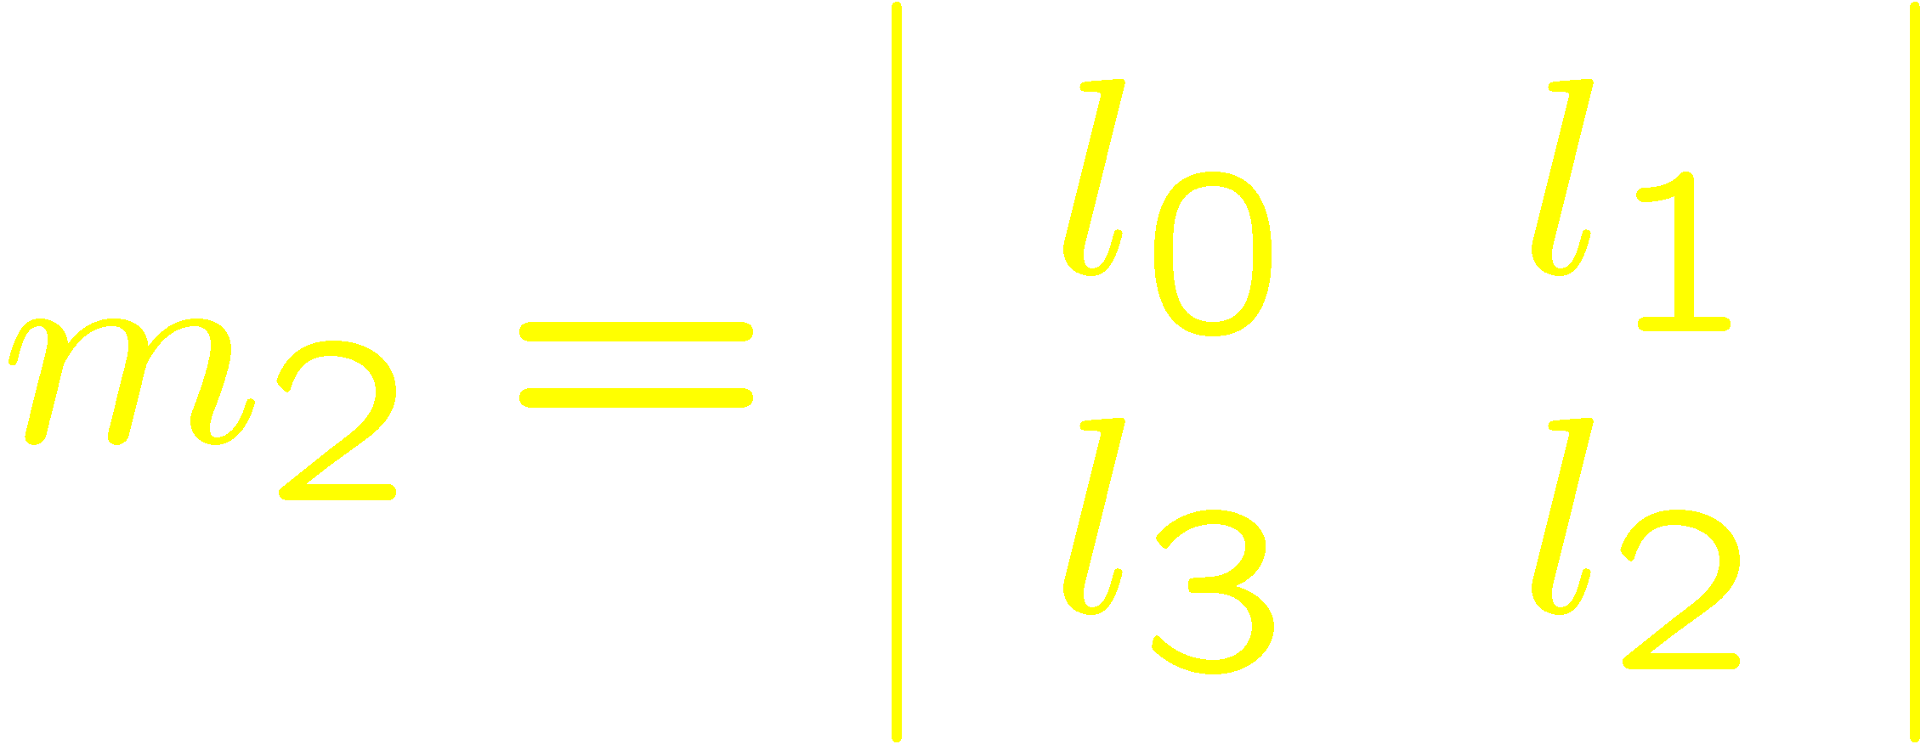
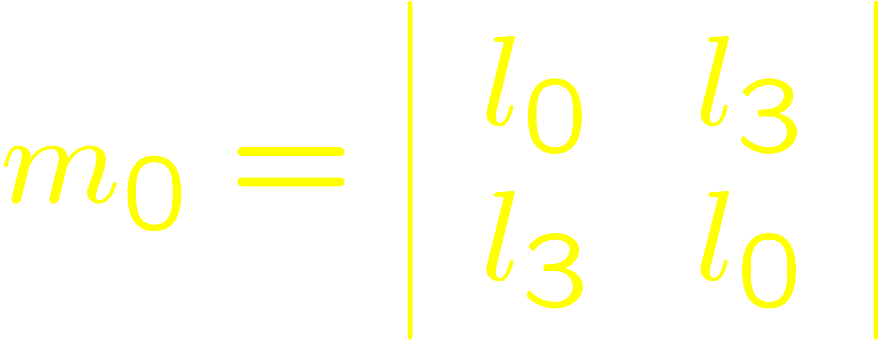

Slide 8
Stability Conditions
Notes:
The first three conditions can be justified rather easily. From Vieta’s formulas, the product of the roots is ${{\left(−1\right)}^{n}a}_{0}/a_{n}$, so we must have $a_{n}>|a_{0}|$ if the roots are inside the unit circle. Moreover, when varying $z$ on the real axis from $−∞$ to $+∞$, $Q(z)$ will have $m$ sign changes, where $m$ is the number of real roots of $Q(z)$. If all roots are inside the unit circle, then there must be no sign changes when $z$ varies from $1$ to $∞$, implying that $Q(1)$ must have the sign of $Q(∞)$, which is +; moreover, there will be no sign changes when $z$ varies from $−∞$ to $−1$, implying that $Q(−1)$ must have the sign of ${\left(−1\right)}^{m}Q(1)$. Now $n−m$ is an even number, since complex poles, if any, are in pairs. Therefore, ${\left(−1\right)}^{m}={\left(−1\right)}^{n}$. We conclude that we must have $Q\left(1\right)>0$ and ${\left(−1\right)}^{n}Q\left(−1\right)>0$.

Slide 9
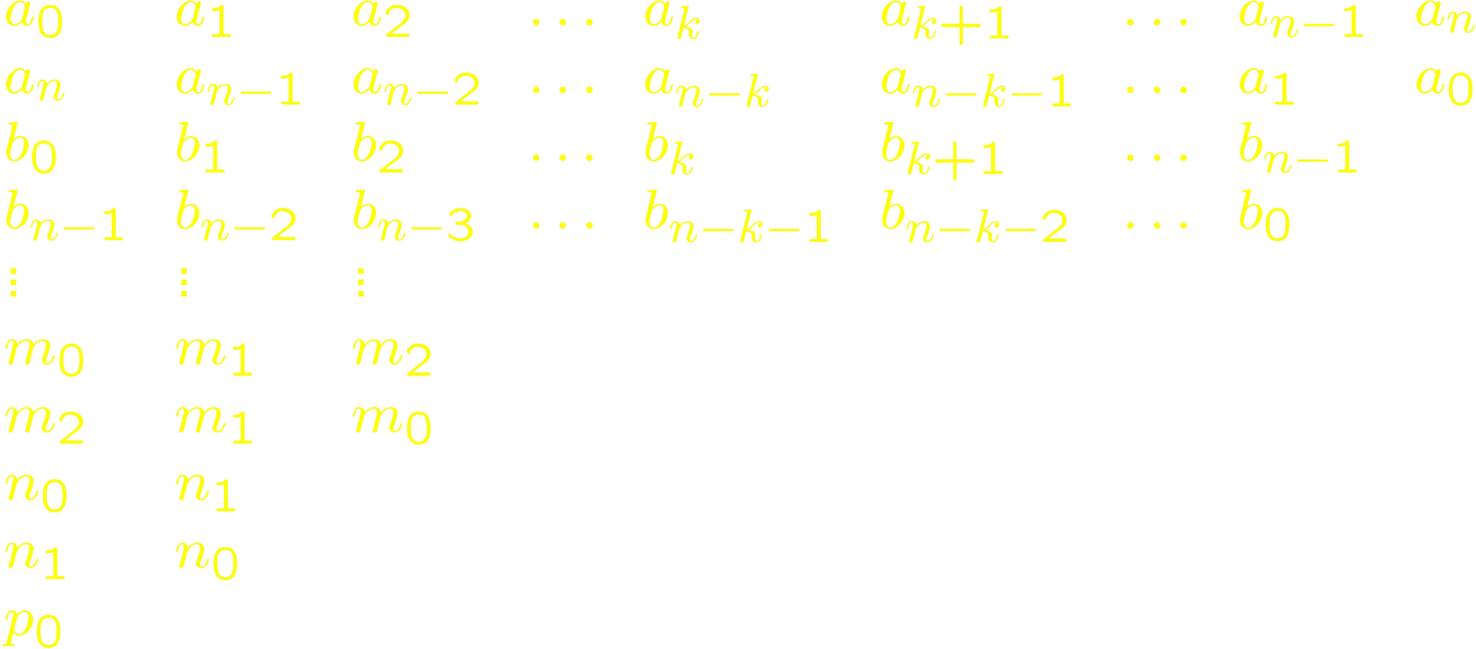
Simplified Stability Test
Write the pole equation as Q(z) = 0 with
The array is:

Slide 10
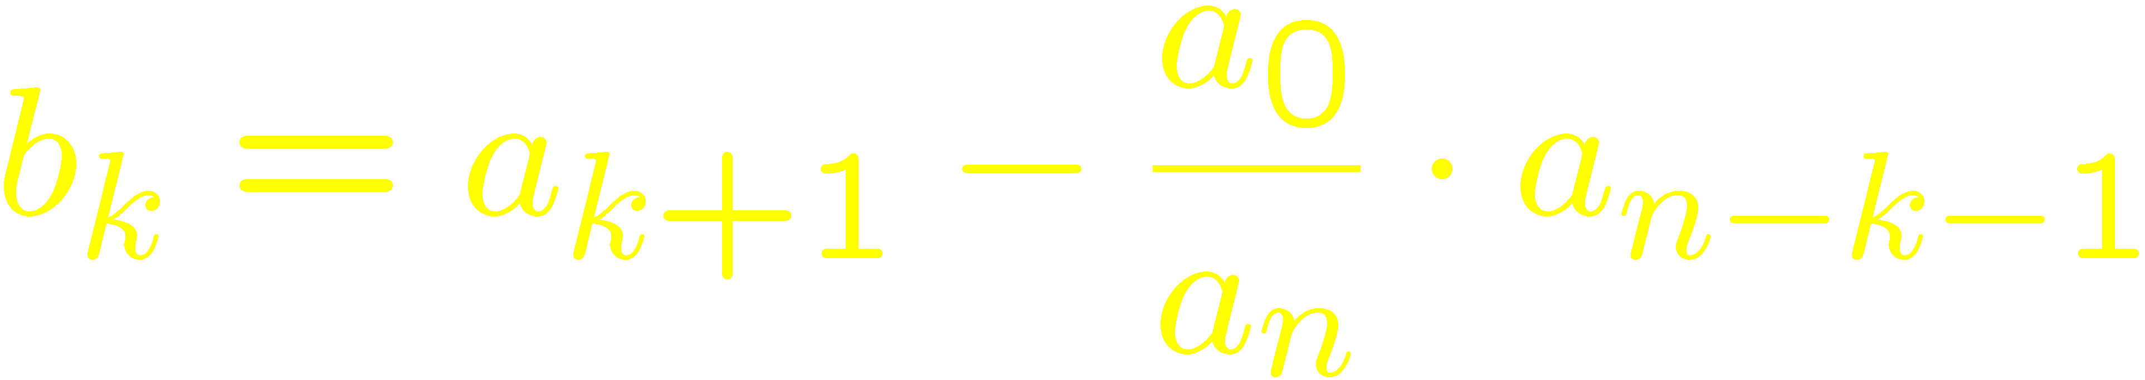
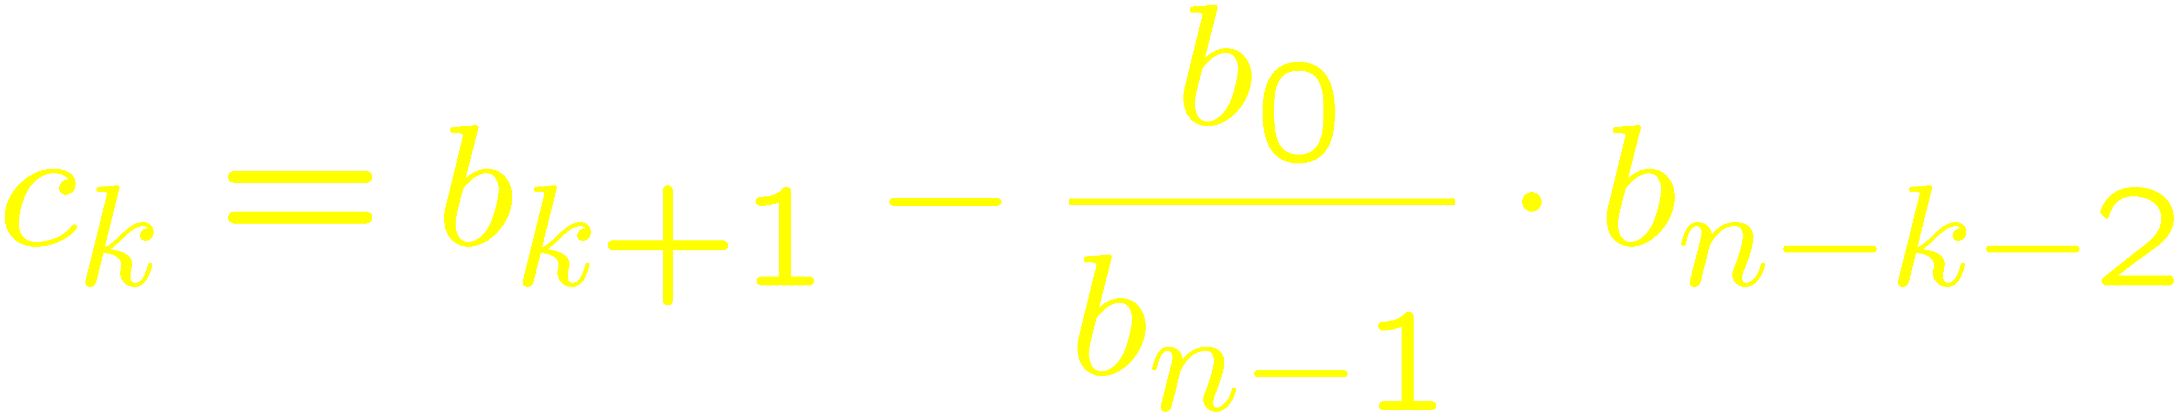
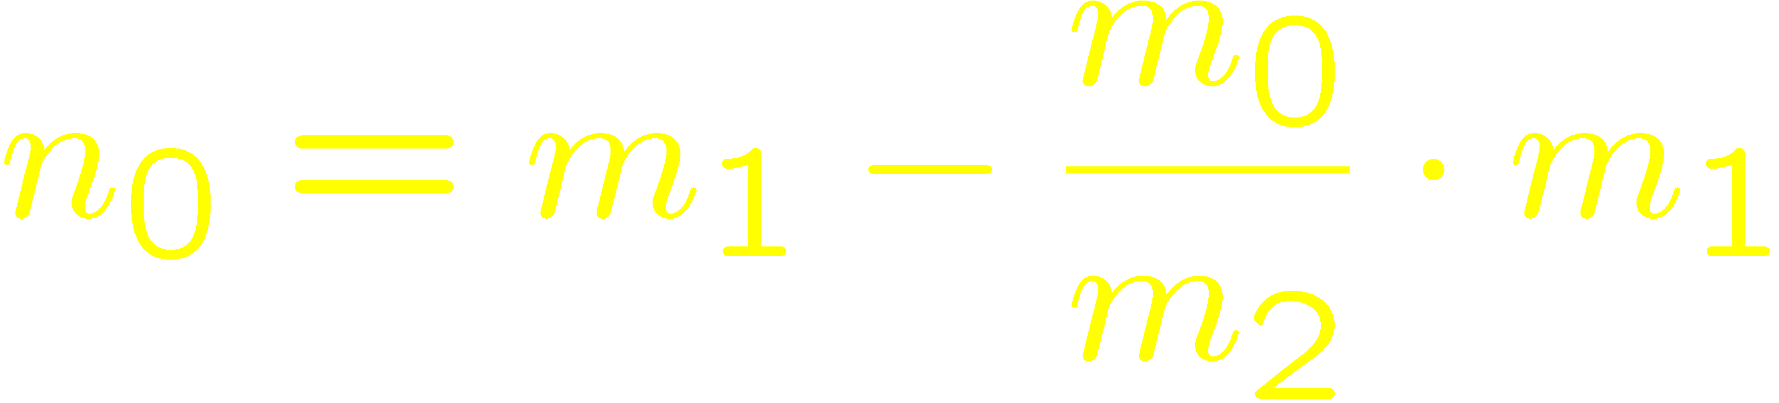
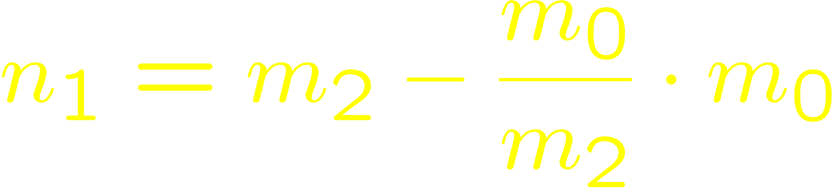

Slide 11
Stability Condition
For stability, a_{n} , b_{n-1} , c_{n-2} , … must not be zero and must have the same sign.

Slide 12
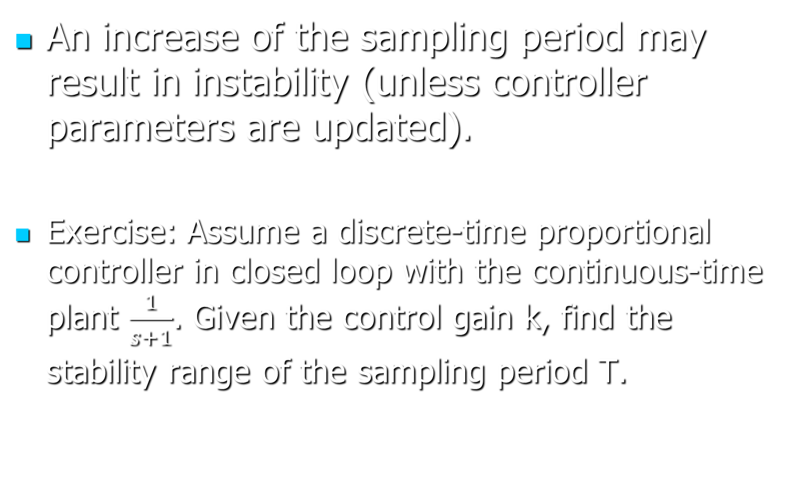
Stability and the sampling period
An increase of the sampling period may result in instability (unless controller parameters are updated).
Exercise: Assume a discrete-time proportional controller in closed loop with the continuous-time plant $\frac{1}{s+1}$. Given the control gain k, find the stability range of the sampling period T.
Notes:
Note: The example assumes a ZOH that converts to continuous time the output of the controller.

Slide 13
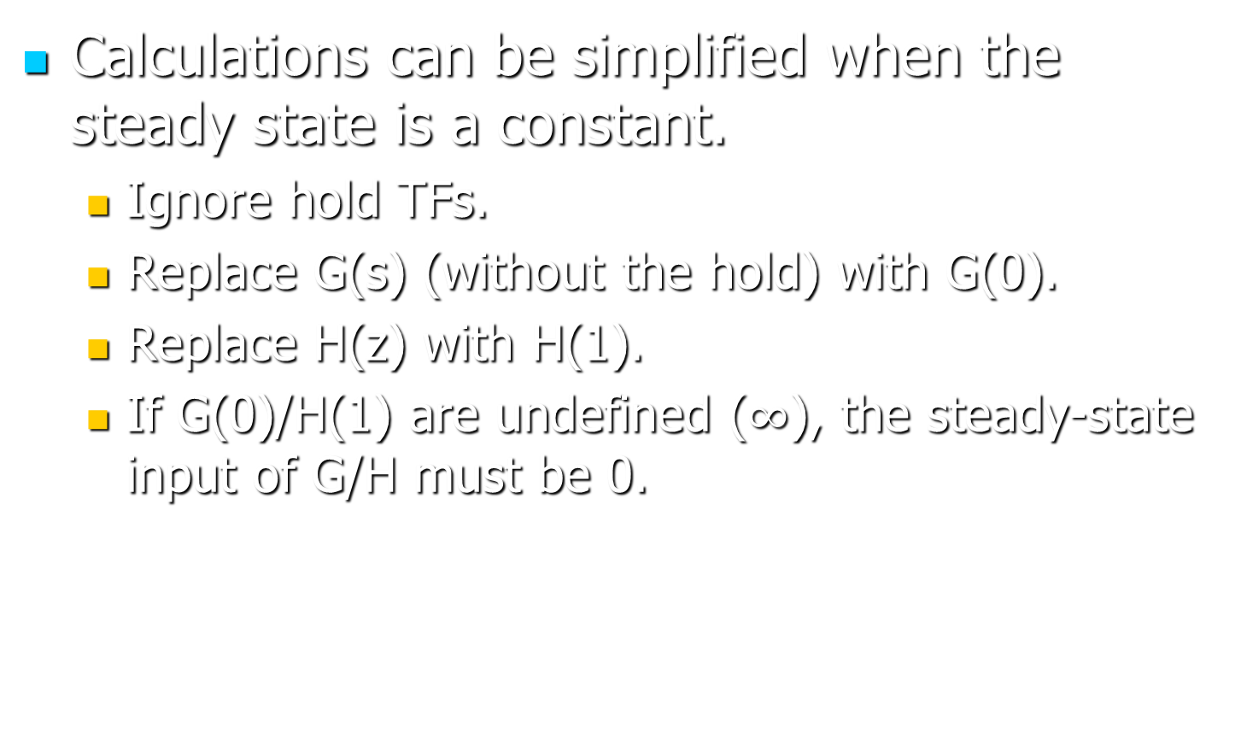
Steady-state calculations
Calculations can be simplified when the steady state is a constant.
  Ignore hold TFs.
  Replace G(s) (without the hold) with G(0).
  Replace H(z) with H(1).
  If G(0)/H(1) are undefined ($∞$), the steady-state input of G/H must be 0.

Slide 14
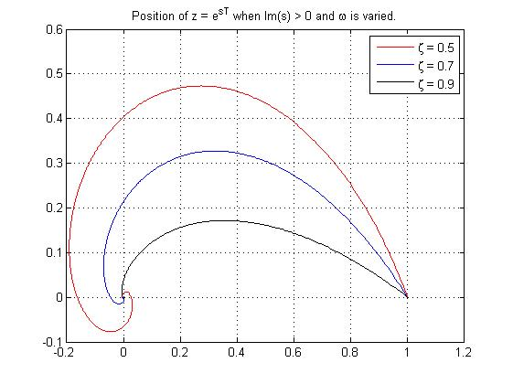
Time Response
For pole placement, note the root locus and the curve of constant damping ratio.

Slide 15

Time Response
The curve is almost linear near the (1,0) point.
  For small $T$, poles will be close to (1,0).
  The linear region has a $−\frac{\sqrt{1−ζ^{2}}}{ζ}$ slope, as in the s domain.
Notes:
% MATLAB code for the figure:
T = 0.01; zlist = [0.5, 0.7, 0.9];
subplot(1,2,1); wmax = 1000; w = 0:wmax/1e3:wmax; hold off;
for zeta = zlist
c = exp(w*T*(-zeta + sqrt(1-zeta^2)*1i));
plot(real(c), imag(c)); hold on;
end
grid on; legend('\zeta = 0.5', '\zeta = 0.7', '\zeta = 0.9'); axis square;
title('Curves of constant \zeta');
subplot(1,2,2); wmax = 10; w = 0:wmax/100:wmax; hold off;
xr = 0; yr = 1;
for zeta = zlist
c = exp(w*T*(-zeta + sqrt(1-zeta^2)*1i));
xr = max([xr, real(c(length(c)))]); yr = min([yr, imag(c(length(c)))]);
plot(real(c), imag(c)); hold on;
end
axis square; axis([xr 1 0 yr]); title('Close-up view');
grid on; legend('\zeta = 0.5', '\zeta = 0.7', '\zeta = 0.9');

Slide 16
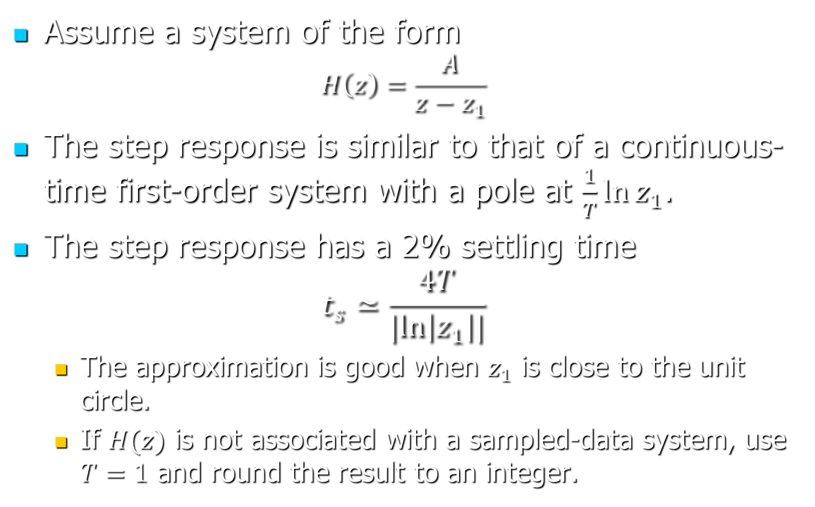
First-Order Systems
Assume a system of the form
$$H\left(z\right)=\frac{A}{z−z_{1}}$$
The step response is similar to that of a continuous-time first-order system with a pole at $\frac{1}{T}\ln{z_{1}}$.
The step response has a 2% settling time
$$t_{s}≃\frac{4T}{|ln\left|z_{1}\right||}$$
  The approximation is good when $z_{1}$ is close to the unit circle.
  If $H(z)$ is not associated with a sampled-data system, use $T=1$ and round the result to an integer.

Slide 17
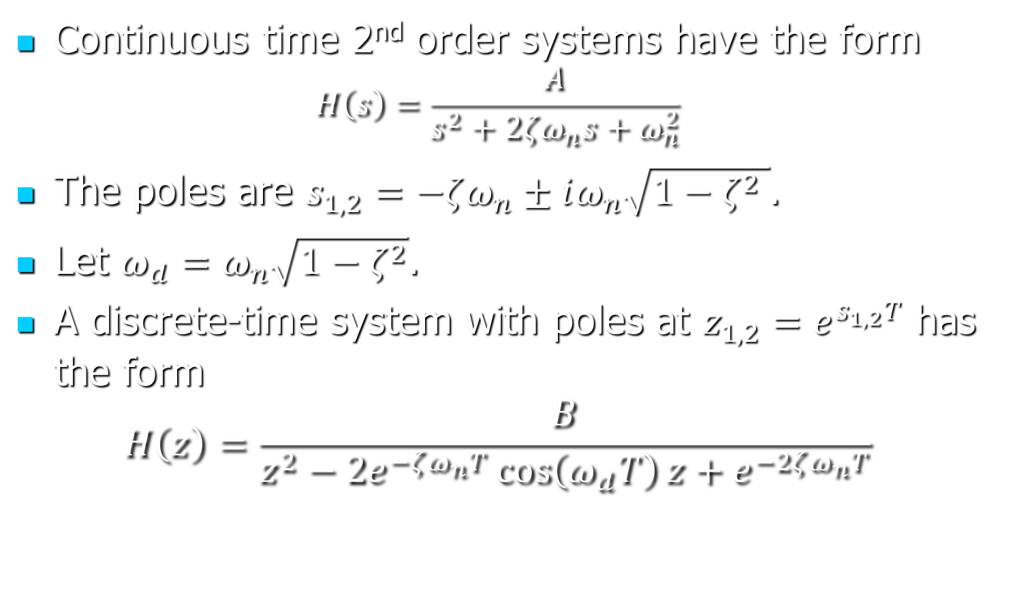
Second-Order Systems
Continuous time 2nd order systems have the form
$$H\left(s\right)=\frac{A}{s^{2}+2ζω_{n}s+ω_{n}^{2}}$$
The poles are $s_{1,2}=−ζω_{n}±iω_{n}\sqrt{1−ζ^{2} }$.
Let $ω_{d}=ω_{n}\sqrt{1−ζ^{2}}$.
A discrete-time system with poles at $z_{1,2}=e^{s_{1,2}T}$ has the form
$$H\left(z\right)=\frac{B}{z^{2}−2e^{−ζω_{n}T}\cos\left(ω_{d}T\right)z+e^{−2ζω_{n}T}}$$

Slide 18
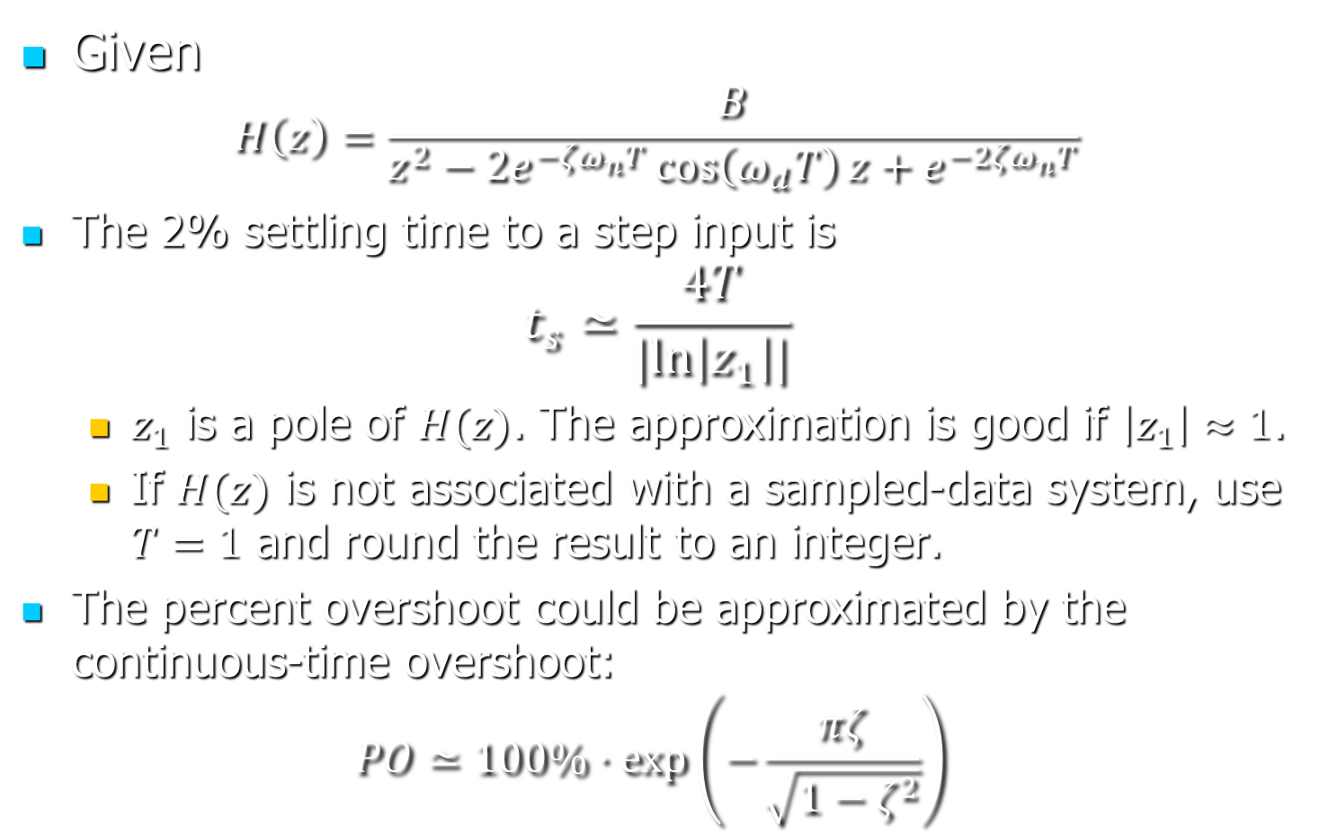
Second-Order Systems
Given
$$H\left(z\right)=\frac{B}{z^{2}−2e^{−ζω_{n}T}\cos\left(ω_{d}T\right)z+e^{−2ζω_{n}T}}$$
The 2% settling time to a step input is
$$t_{s}≃\frac{4T}{|ln\left|z_{1}\right||}$$
  $z_{1}$ is a pole of $H(z)$. The approximation is good if $\left|z_{1}\right|≈1$.
  If $H(z)$ is not associated with a sampled-data system, use $T=1$ and round the result to an integer.
The percent overshoot could be approximated by the continuous-time overshoot:
$$PO≃100\%⋅\exp\left(−\frac{πζ}{\sqrt{1−ζ^{2}}}\right)$$

Slide 19
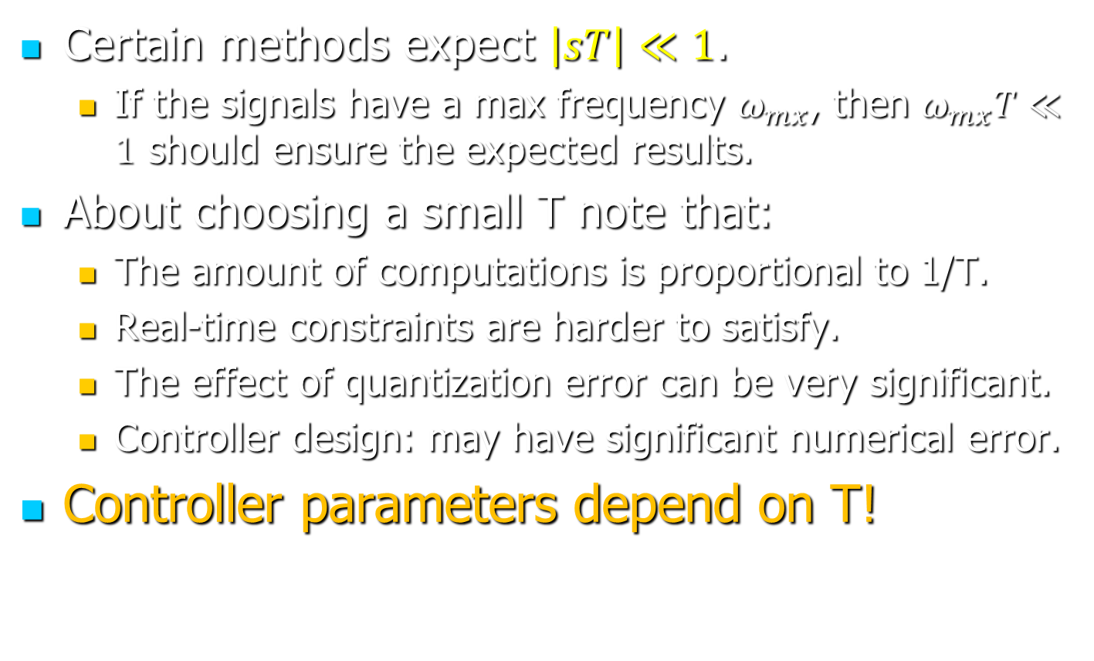
The Sample Period
Certain methods expect $\left|sT\right|≪1$.
  If the signals have a max frequency $ω_{mx}$, then $ω_{mx}T≪1$ should ensure the expected results.
About choosing a small T note that:
  The amount of computations is proportional to 1/T.
  Real-time constraints are harder to satisfy.
  The effect of quantization error can be very significant.
  Controller design: may have significant numerical error.
Controller parameters depend on T!

