Slide 1
State Feedback for Discrete-Time Systems
Pole Placement, State Estimation, Integral Control, LQR, Kalman Estimators
M.V. Iordache, EEGR4933 Automatic Control Systems, Spring 2019, LeTourneau University

Slide 2
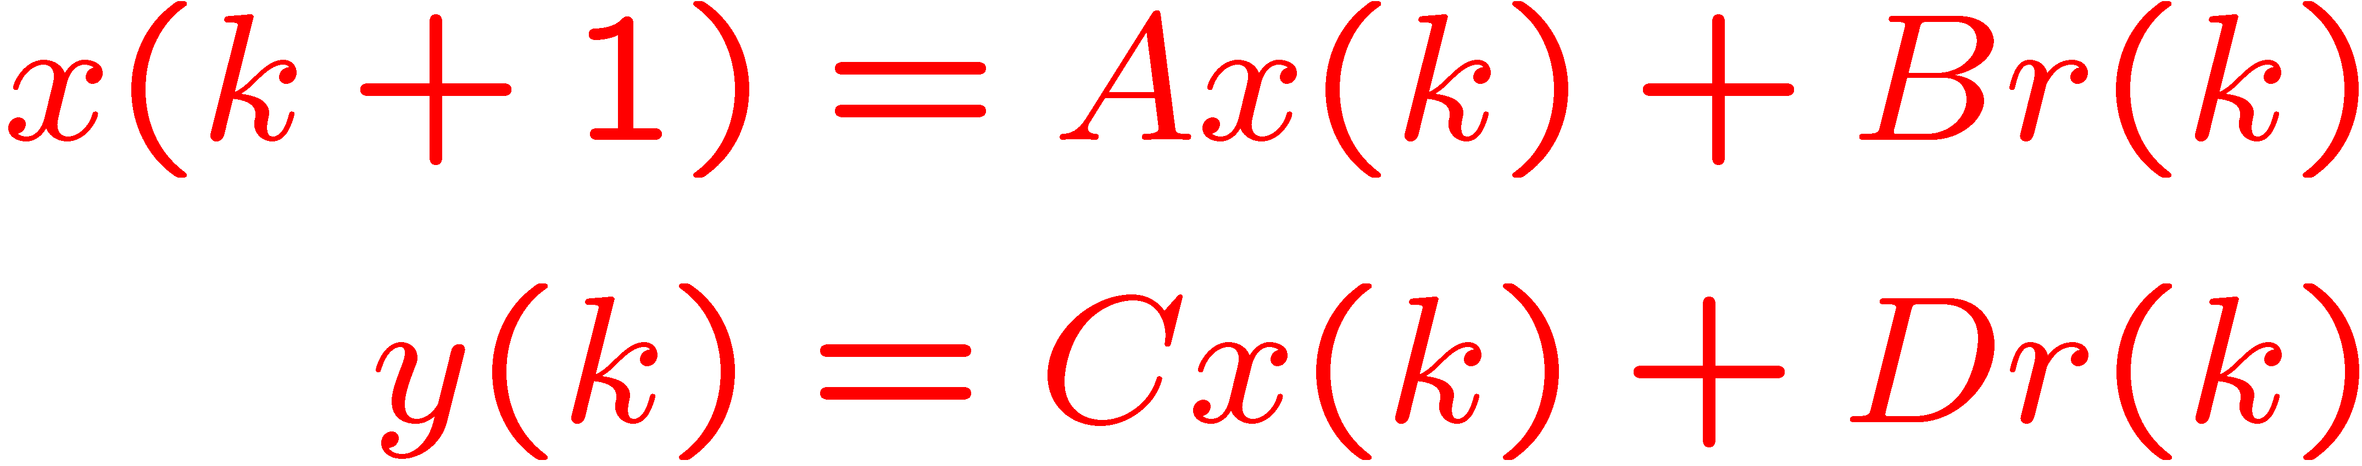
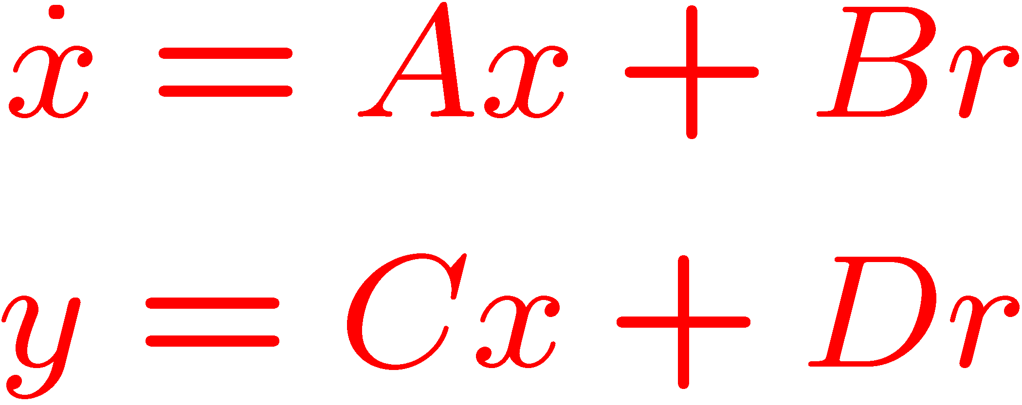
State Space Representation
Discrete time representation
Recall the continuous time representation
Input
Output
r(t)
y(t)
Input
Output
r(t)
y(t)

Slide 3
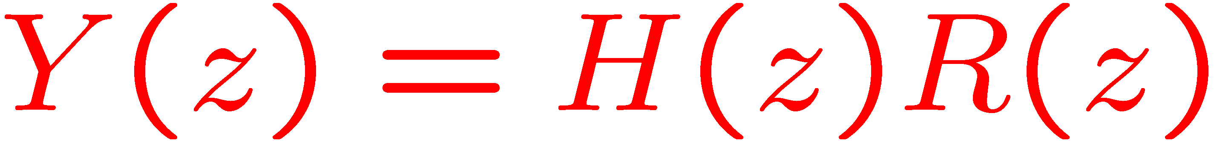
Relation between SS and TF models
Conversions TF → SS and SS → TF possible.
Input
Output
r(t)
y(t)
Input
Output
r(t)
y(t)

Slide 4
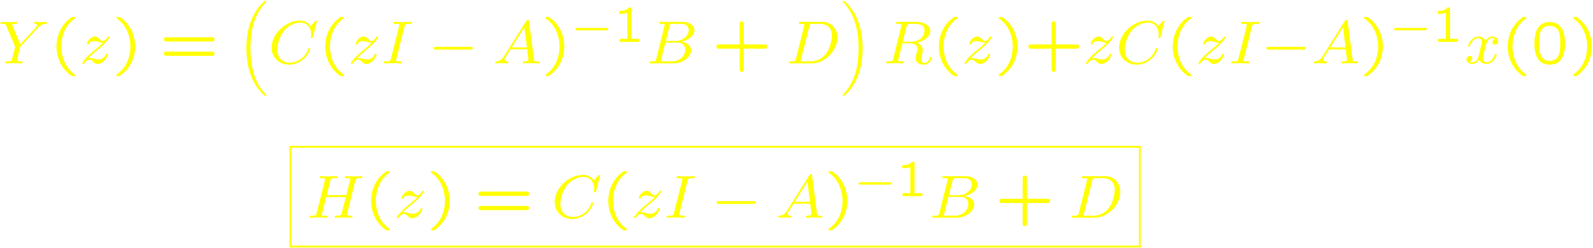
Transfer Function of SS Model
Assumes zero initial conditions: x(0) = 0.
Input
Output
r(t)
y(t)

Slide 5
Solution of the SS equation
Note that y(k) and x(k) depend on
x(0) – the initial state
r(k) – the input
Input
Output
r(t)
y(t)

Slide 6
Stability
BIBO stability: necessary for most engineering systems.
For SS models: x(k) is also required to be bounded.
For stability, all eigenvalues of A must be inside the unit circle.
This ensures more than just boundedness:
If r(k) → r_{SS} then x(k) → x_{SS} = – (A – I)⁻¹Br_{SS}
In particular, for zero input, x(k) decays exponentially from x(0) to 0.

Slide 7
Controllability
Is there for any x(0) some input u(k) that leads in finite time the state x to the origin? If yes, the system is (completely state) controllable (controllable to the origin).
Is there for any state s some input u(k) that leads in finite time the state x from the origin to s? If yes, the system is reachable (controllable from the origin).
Reachability implies that for any k₁, z₁, and z₂, there is k₂>k₁ and some input u(k) that transfers the state from x(k₁) = z₁ to x(k₂) = z₂.
Notes:
The minimum value of $k_{2}$ for which any $z_{2}$ could be reached is $k_{2} = k_{1} + n$, where $n$ is the number of state variables. Reachability does not imply that it is practical to drive the state anywhere in the state space. From a practical viewpoint, the reachable space is limited by the bounds of the control input.

Slide 8
Controllability
Reachability implies controllability.
If A is invertible, controllability implies reachability.
Assume n state variables.
The system is reachable when the controllability matrix has rank n (full rank).
Notes:
An example of a controllable system that is not reachable: $A=\left[\begin{matrix}0 & 1 \\ 0 & 0\end{matrix}\right]$ and $B=\left[\begin{matrix}0 \\ 0\end{matrix}\right]$. The origin is reached from any initial state in two time steps. However, the controllability matrix has the rank 1 and the system is not reachable.

Slide 9
Observability
Is there some finite time k₁ such that x(0) can be determined from u(0), u(1), …, u(k₁) and y(0), y(1), …, y(k₁)? If yes, the system is (completely state) observable.
The system is observable when the observability matrix has rank n (full rank).

Slide 10
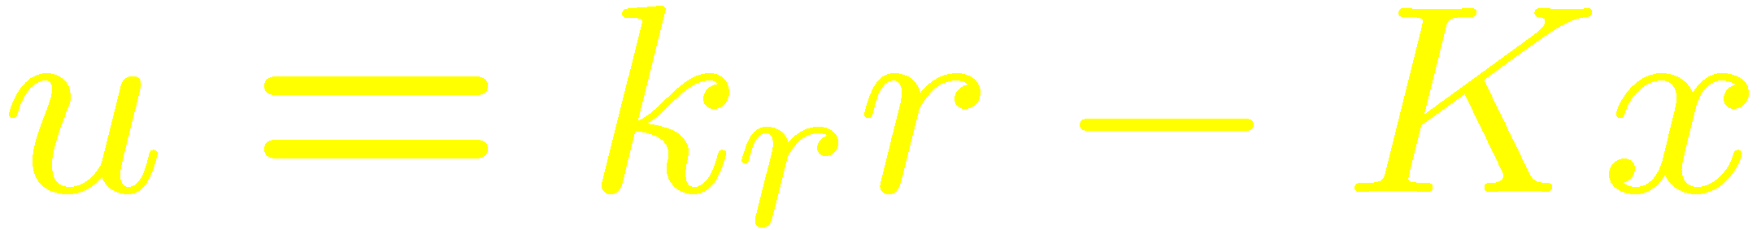
State Feedback
In output feedback, the input depends on the output.
In state feedback, the input depends on the state.
Linear state feedback
State feedback changes the position of the eigenvalues λ of the system. Now they satisfy:

Slide 11
State Feedback
K determines the poles of the system.
Arbitrary pole placement is possible for systems that are reachable (controllable from the origin).
Pole placement can be used to:
Stabilize an unstable system by placing all poles inside the unit circle.
Make a stable system faster by moving the dominant pole(s) away from the unit circle.

Slide 12
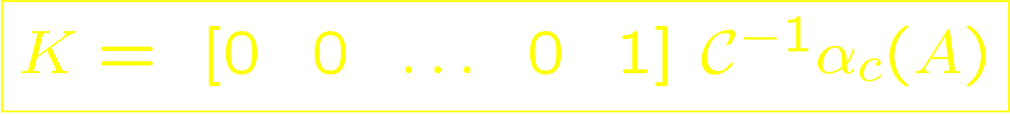
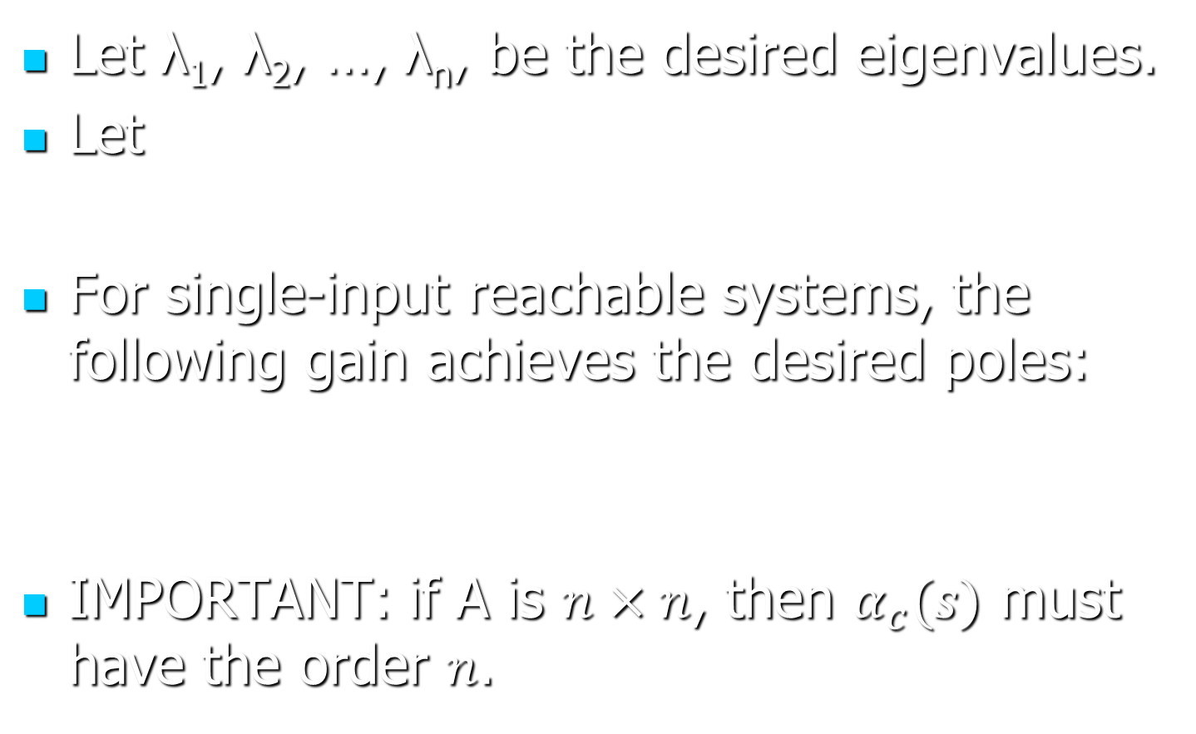
Ackerman’s Formula
Let λ₁, λ₂, …, λ_{n}, be the desired eigenvalues.
Let
For single-input reachable systems, the following gain achieves the desired poles:
IMPORTANT: if A is $n×n$, then $α_{c}(s)$ must have the order $n$.

Slide 13
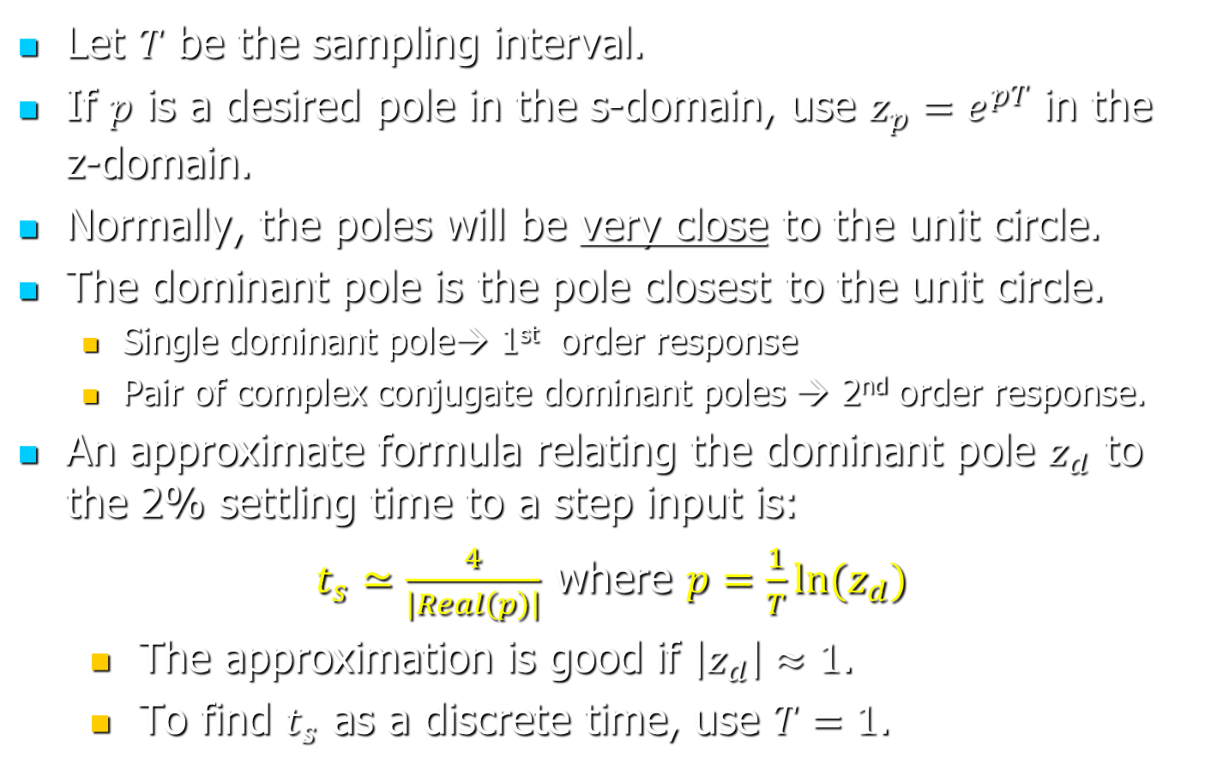
Where to Place the Poles
Let $T$ be the sampling interval.
If $p$ is a desired pole in the s-domain, use $z_{p}=e^{pT}$ in the z-domain.
Normally, the poles will be very close to the unit circle.
The dominant pole is the pole closest to the unit circle.
Single dominant pole→ 1st order response
Pair of complex conjugate dominant poles → 2nd order response.
An approximate formula relating the dominant pole $z_{d}$ to the 2% settling time to a step input is:
$t_{s}≃\frac{4}{\left|Real\left(p\right)\right|}$ where $p=\frac{1}{T}ln⁡(z_{d})$
The approximation is good if $\left|z_{d}\right|≈1$.
To find $t_{s}$ as a discrete time, use $T=1$.

Slide 14
Pole Placement Limitations
Linear models are usually valid for small enough inputs.
Actuators may not be able to apply the requested input if the desired response is too fast.
Typically the state x cannot be measured directly → state estimation.

Slide 15
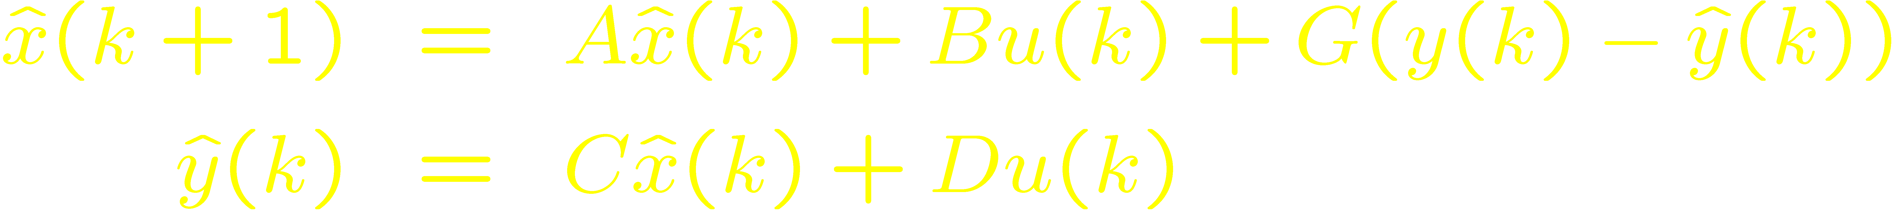
State Estimation
Typically the state x cannot be measured directly. However, we can estimate it based on the plant model, y, and u.
Correction term needed because
x(0) is unknown.
Models are not precise.
There are disturbances and measurement noise.

Slide 16
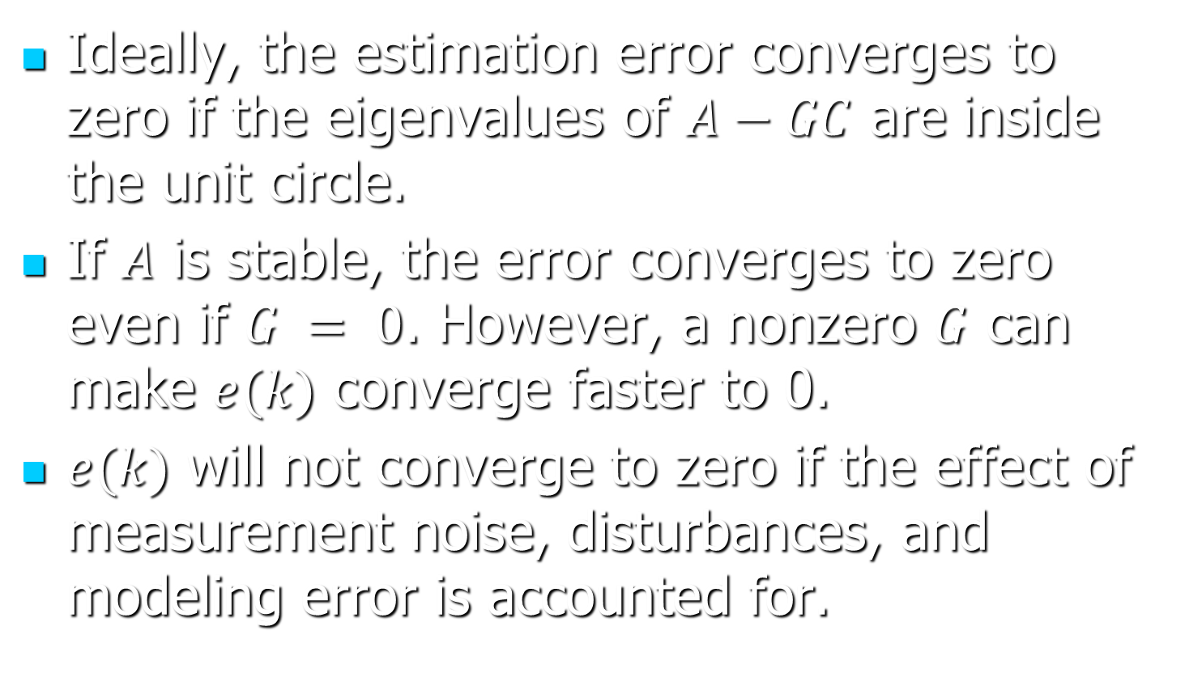
State Estimation
Ideally, the estimation error converges to zero if the eigenvalues of $A−GC$ are inside the unit circle.
If $A$ is stable, the error converges to zero even if $G = 0$. However, a nonzero $G$ can make $e(k)$ converge faster to 0.
$e(k)$ will not converge to zero if the effect of measurement noise, disturbances, and modeling error is accounted for.

Slide 17
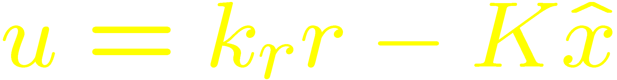
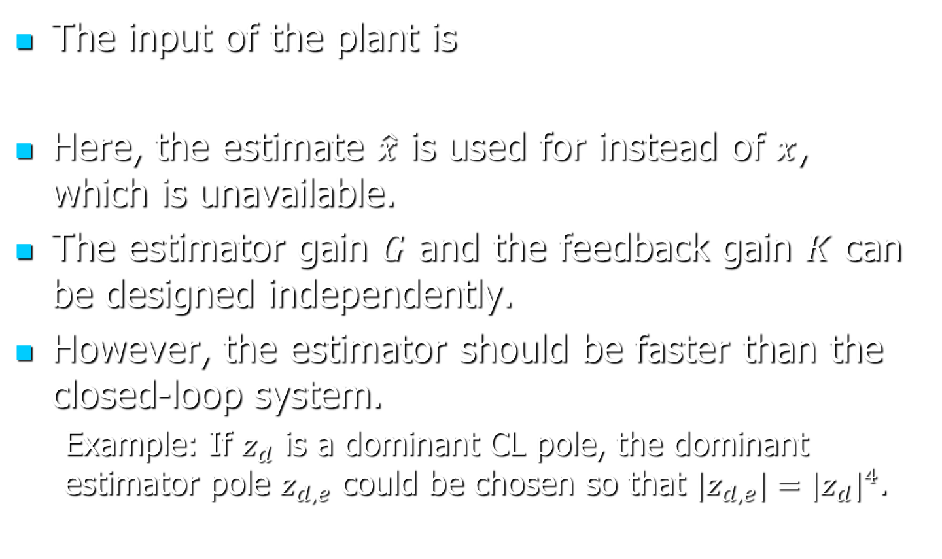
Closed-Loop with State Estimation
The input of the plant is
Here, the estimate $\hat{x}$ is used for instead of $x$, which is unavailable.
The estimator gain $G$ and the feedback gain $K$ can be designed independently.
However, the estimator should be faster than the closed-loop system.
Example: If $z_{d}$ is a dominant CL pole, the dominant estimator pole $z_{d,e}$ could be chosen so that ${{|z}_{d,e}|=|z_{d}|}^{4}$.

Slide 18
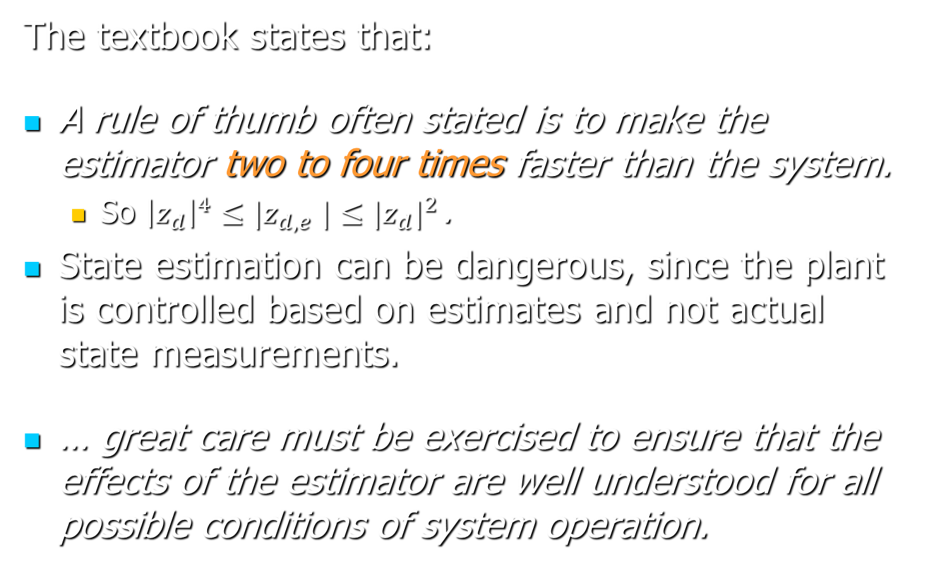
Closed-Loop with State Estimation
The textbook states that:
A rule of thumb often stated is to make the estimator two to four times faster than the system.
So ${{\left|z_{d}\right|}^{4}{≤|z}_{d,e}|≤|z_{d}|}^{2}$ .
State estimation can be dangerous, since the plant is controlled based on estimates and not actual state measurements.
… great care must be exercised to ensure that the effects of the estimator are well understood for all possible conditions of system operation.
Notes:
See section 10.3 of the textbook.

Slide 19
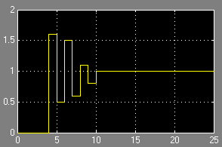
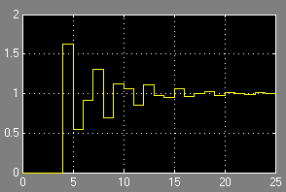
Deadbeat Control
Steady state reached in a finite (and small) number of steps.
Deadbeat response
Non-deadbeat response

Slide 20
Deadbeat Control
Corresponds to FIR closed-loop transfer functions.
If n is the order of the FIR and a unit step input is applied, the output reaches its steady state after n sampling periods.
In sampled data systems, deadbeat control is practical for low sampling rates.
Design: Given A, B, C, D, place all poles at zero.
The ideal state estimator has the same matrices A, B, C, D, and so does not change the transfer function.

Slide 21
Integral Control
Approach:
Define new state variable(s):
Design stabilizing state feedback controller.
How it works: assume that the inputs converge to a constant steady state. Then:

Slide 22
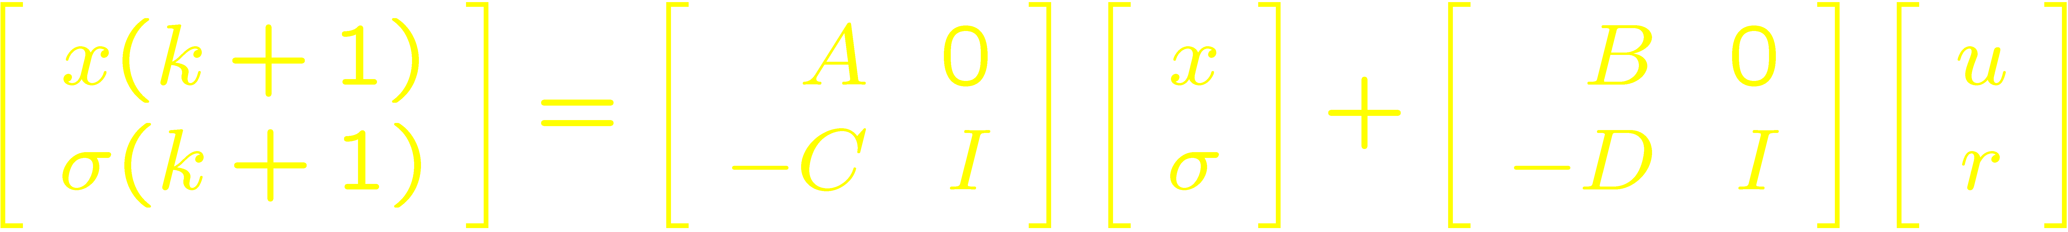
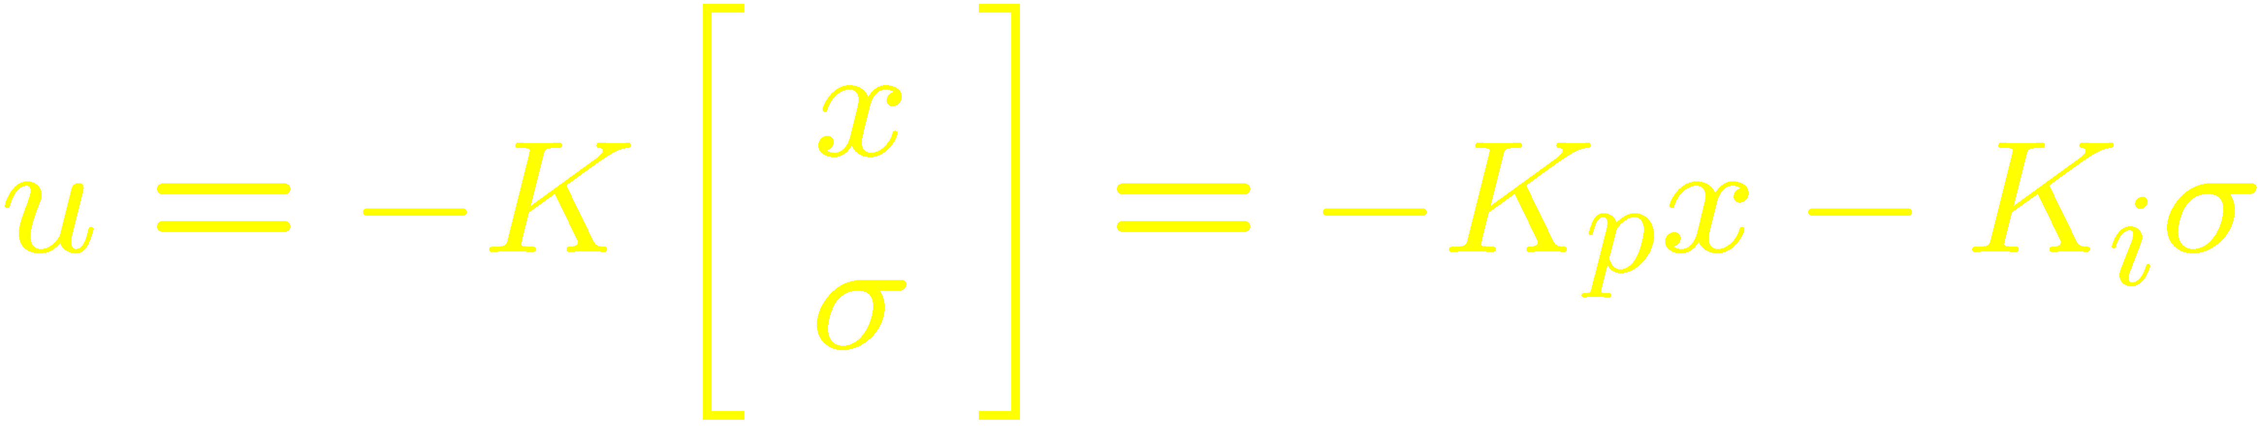
Integral Control
Note the ss representation:
Proportional + integral terms:

Slide 23
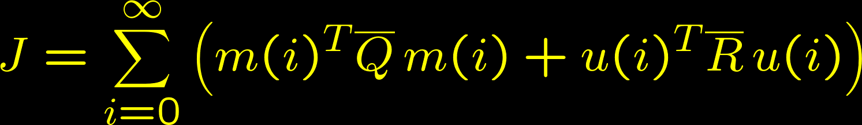
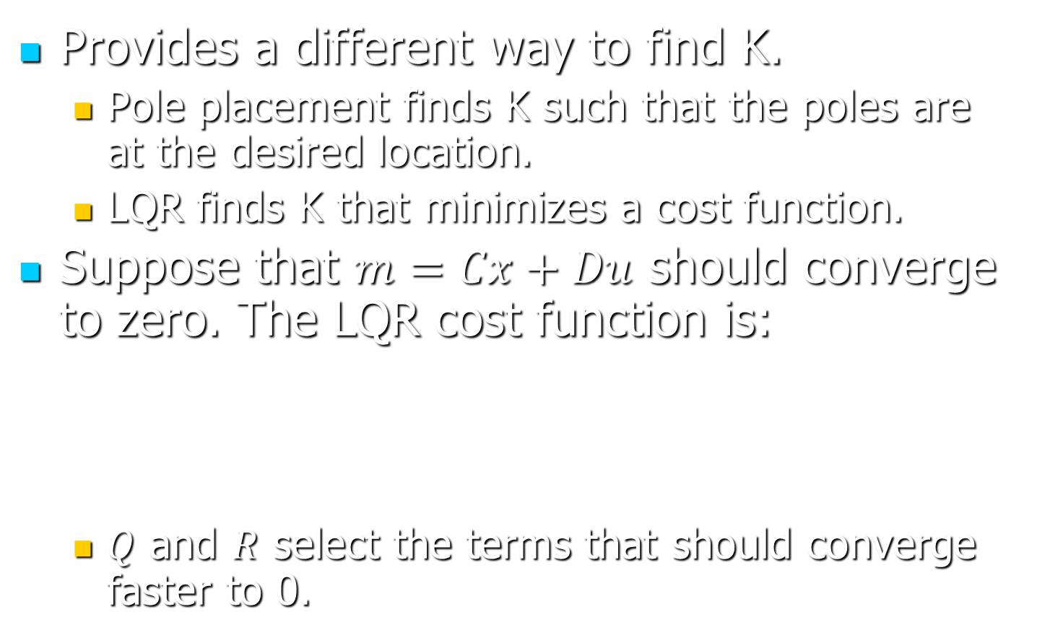
LQR Design
Provides a different way to find K.
Pole placement finds K such that the poles are at the desired location.
LQR finds K that minimizes a cost function.
Suppose that $m=Cx+Du$ should converge to zero. The LQR cost function is:
$Q$ and $R$ select the terms that should converge faster to 0.

Slide 24
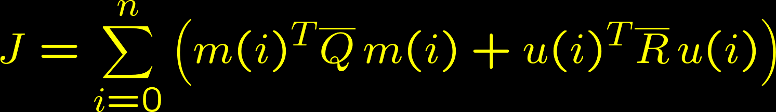
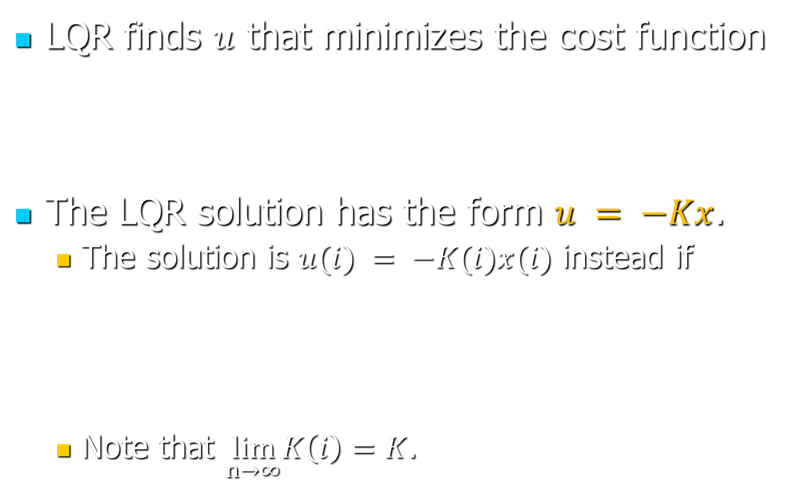
LQR Design
LQR finds $u$ that minimizes the cost function
The LQR solution has the form $u = −Kx$.
The solution is $u(i) = −K(i)x(i)$ instead if
Note that $\lim_{n→∞}K\left(i\right)=K$.

Slide 25
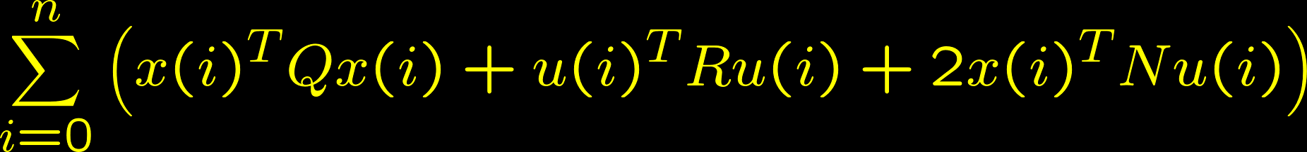
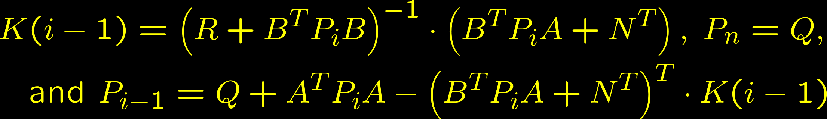

Finite Horizon LQR
To find K, substitute $m=Cx+Du$ and rewrite $J$ as
$u(i) = −K(i)x(i)$ for $i=0, 1, …,n−1$, where:
Notes:
Note that $u(n)$ has no effect on $x\left(0, …, n\right)$, so it can be determined separately so as to minimize J.

Slide 26
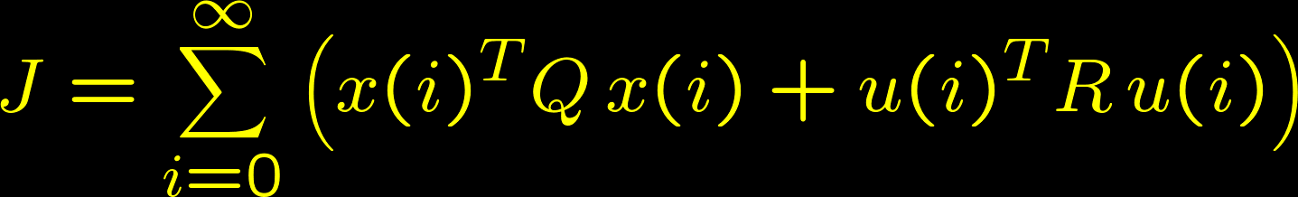
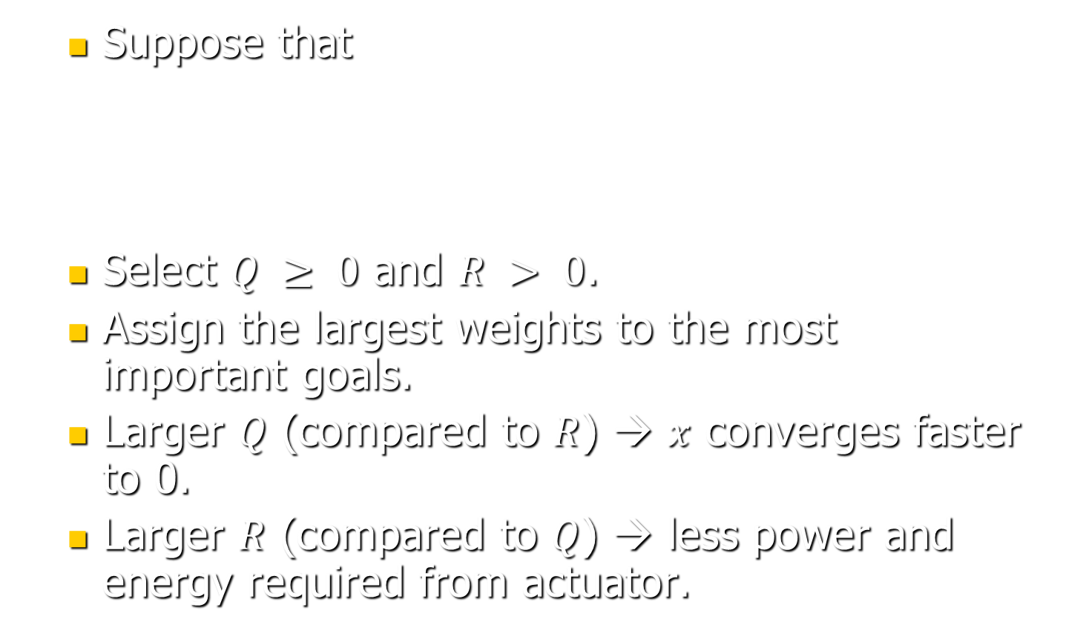
LQR Design—Choosing Q & R
Suppose that
Select $Q ≥ 0$ and $R > 0$.
Assign the largest weights to the most important goals.
Larger $Q$ (compared to $R$) → $x$ converges faster to 0.
Larger $R$ (compared to $Q$) → less power and energy required from actuator.

Slide 27
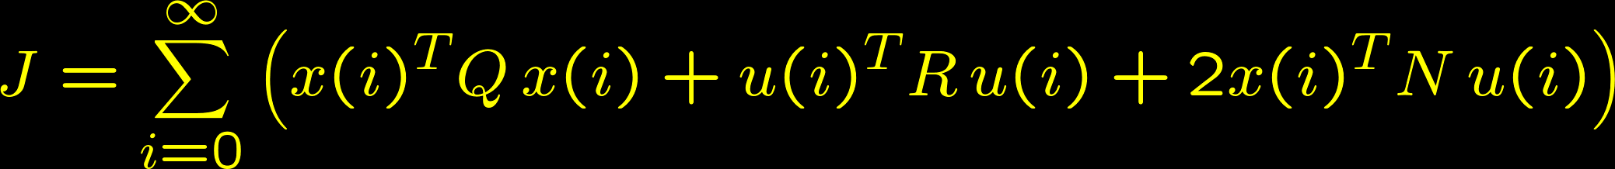

LQR Design—Choosing Q & R
Suppose that
Substitute $m=Cx+Du$ and write $J$ in the form
Ensure $R > 0$ and $Q−NR^{−1}N^{T}≥ 0$.

Slide 28
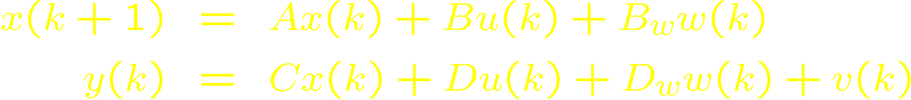
The Kalman Estimator
Real systems are affected by noise (v) and disturbances (w):
Since v and w are unknown, estimators always have some error.
The Kalman estimator minimizes the error.

Slide 29
The Kalman Estimator
The pole placement method:
Finds G that places poles at desired location.
Estimation error converges to zero assuming zero noise and disturbances.
The Kalman estimator method:
Finds G that minimizes estimation error.
The error is still zero for zero noise and disturbances.
The Kalman estimator is optimal under conditions that can be achieved only approximately in practice.

Slide 30
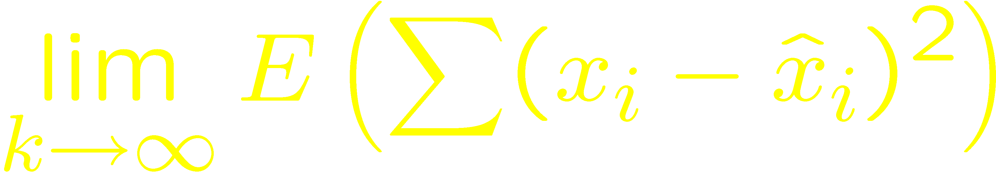
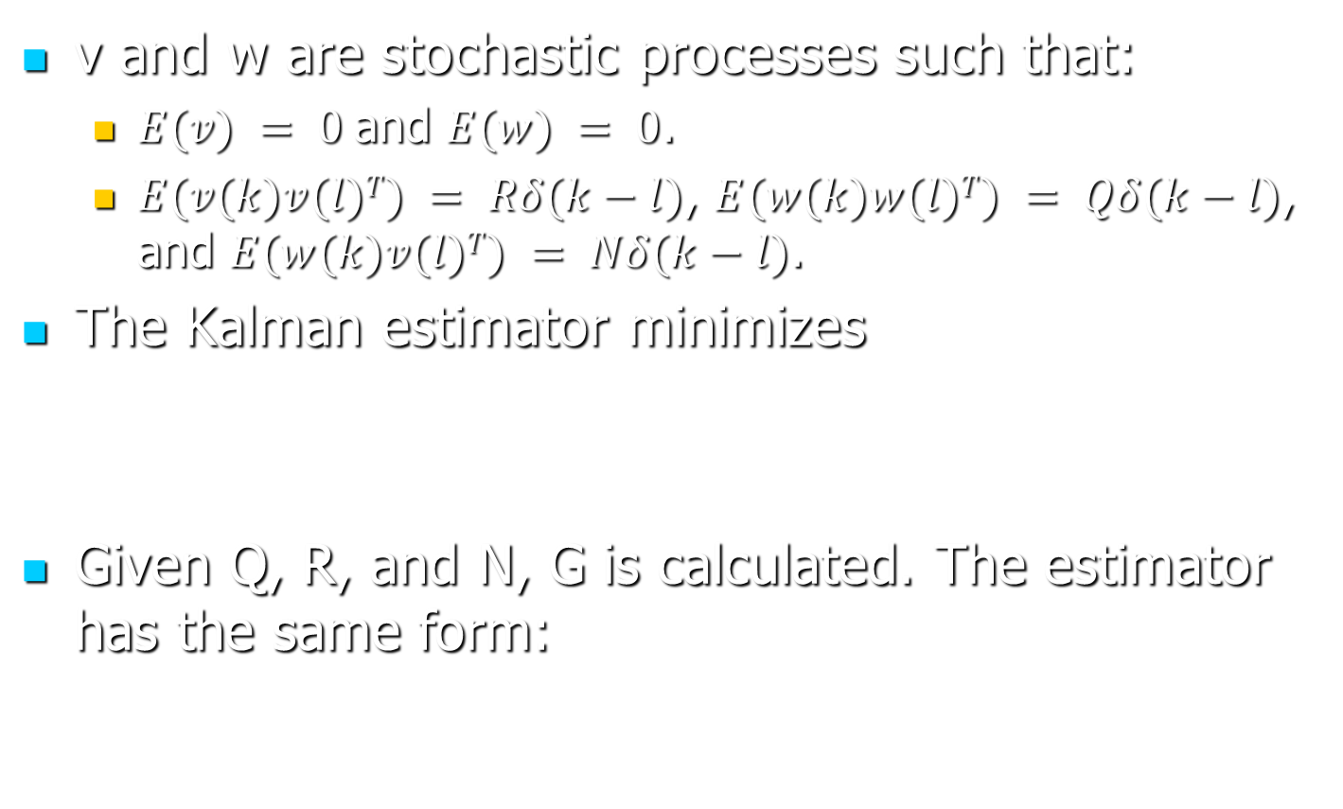
The Kalman Estimator
v and w are stochastic processes such that:
$E(v) = 0$and $E(w) = 0$.
$E(v(k)v(l)T) = Rδ(k−l)$, $E(w(k)w(l)T) = Qδ(k−l)$, and $E(w(k)v(l)T) = Nδ(k−l)$.
The Kalman estimator minimizes
Given Q, R, and N, G is calculated. The estimator has the same form:
Notes:
Note that for the discrete-time state estimator, $δ(k)$ is not the Dirac function but the impulse function, which is well defined: $δ\left(k\right)=1$ for $k=0$ and $δ\left(k\right)=0$ for $k≠0$.

Slide 31
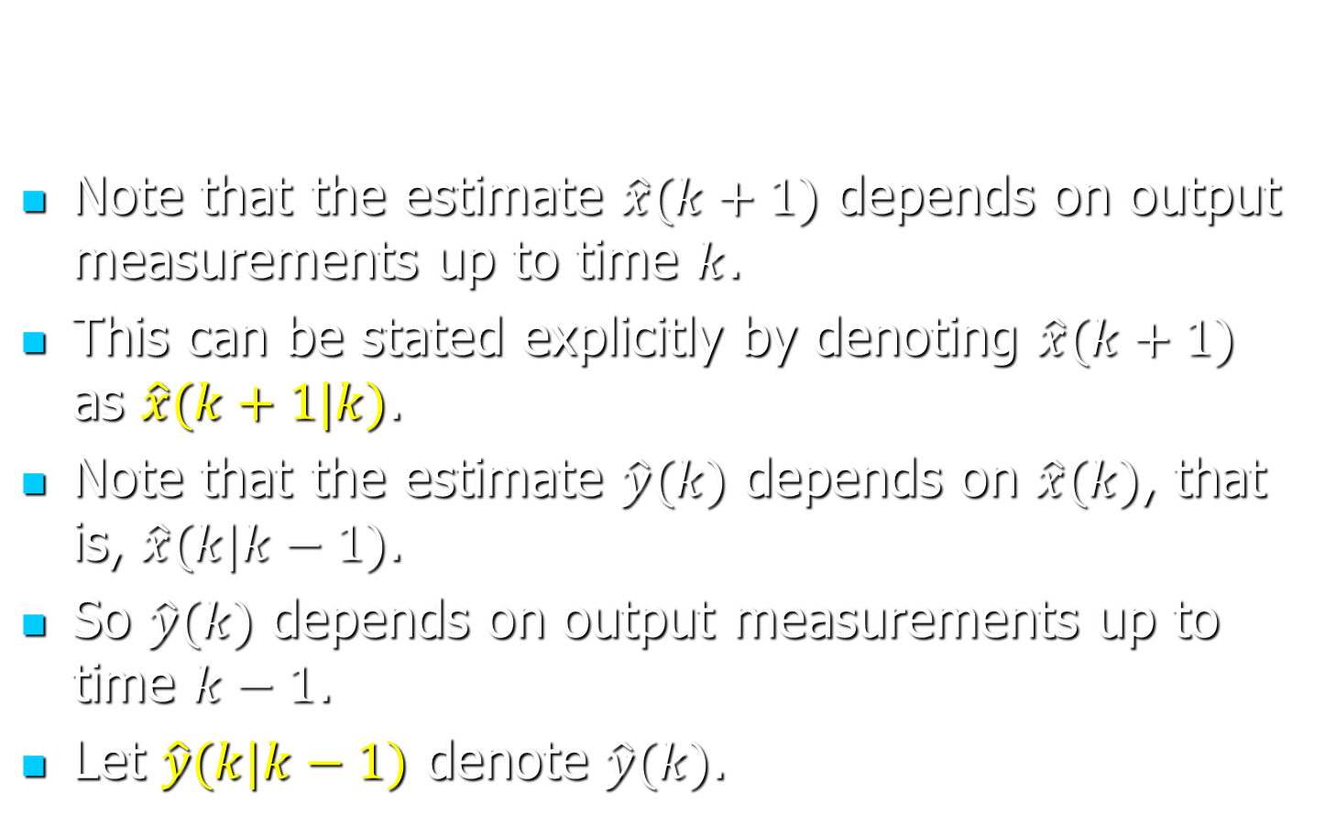
The Kalman Estimator
Note that the estimate $\hat{x}(k+1)$ depends on output measurements up to time $k$.
This can be stated explicitly by denoting $\hat{x}(k+1)$ as $\hat{x}(k+1|k)$.
Note that the estimate $\hat{y}(k)$ depends on $\hat{x}(k)$, that is, $\hat{x}(k|k−1)$.
So $\hat{y}(k)$ depends on output measurements up to time $k−1$.
Let $\hat{y}(k|k−1)$ denote $\hat{y}(k)$.

Slide 32
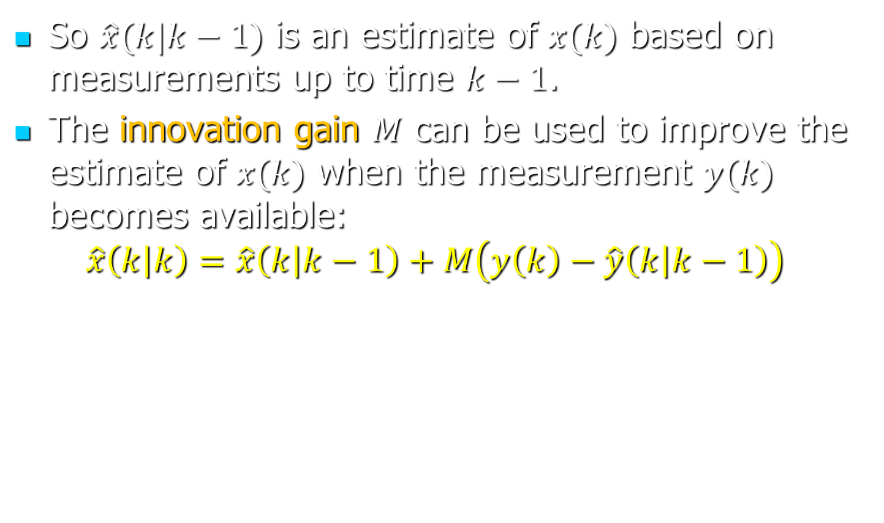
The Kalman Estimator
So $\hat{x}(k|k−1)$ is an estimate of $x(k)$ based on measurements up to time $k−1$.
The innovation gain $M$ can be used to improve the estimate of $x(k)$ when the measurement $y(k)$ becomes available:
$$\hat{x}\left(k | k\right)=\hat{x}\left(k | k−1\right)+M\left(y\left(k\right)−\hat{y}\left(k | k−1\right)\right)$$

Slide 33
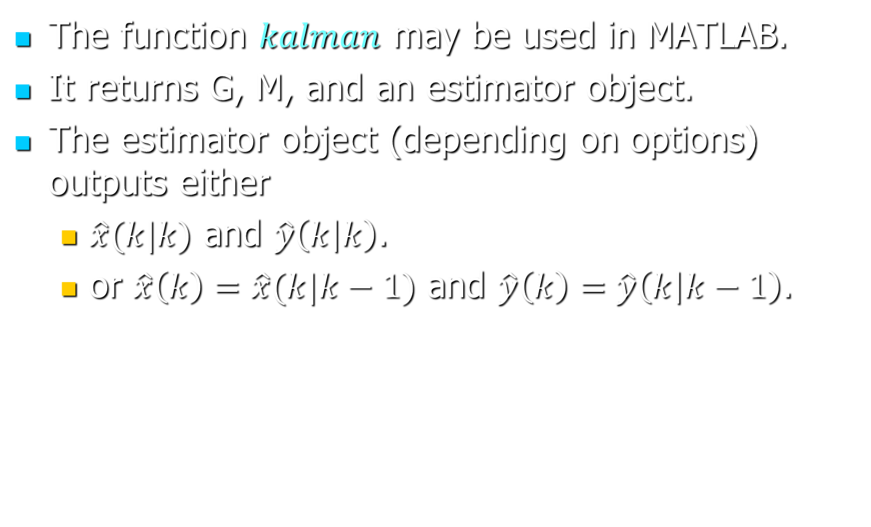
The Kalman Estimator
The function $kalman$ may be used in MATLAB.
It returns G, M, and an estimator object.
The estimator object (depending on options) outputs either
$\hat{x}(k|k)$ and $\hat{y}\left(k | k\right)$.
or $\hat{x}\left(k\right)=\hat{x}(k|k−1)$ and $\hat{y}\left(k\right)=\hat{y}\left(k | k−1\right)$.

Slide 34
LQG Design
Use the Kalman estimator for the state estimate.
Use the LQR design for the state feedback gain.
If TF of plant is given, convert TF to a state space model.
LQG and integral control can be combined.

