Slide 1
Sampled-Data Systems
Dealing with Systems that Have Both Discrete and Continuous-Time Modules
M.V. Iordache, EEGR4933 Automatic Control Systems, Spring 2019, LeTourneau University

Slide 2
Sampled Data Systems
How to analyze systems that involve both continuous-time and discrete-time signals?
Model A/D converters as ideal samplers.
Model D/A converters as data hold systems.
Use the starred transform.

Slide 3
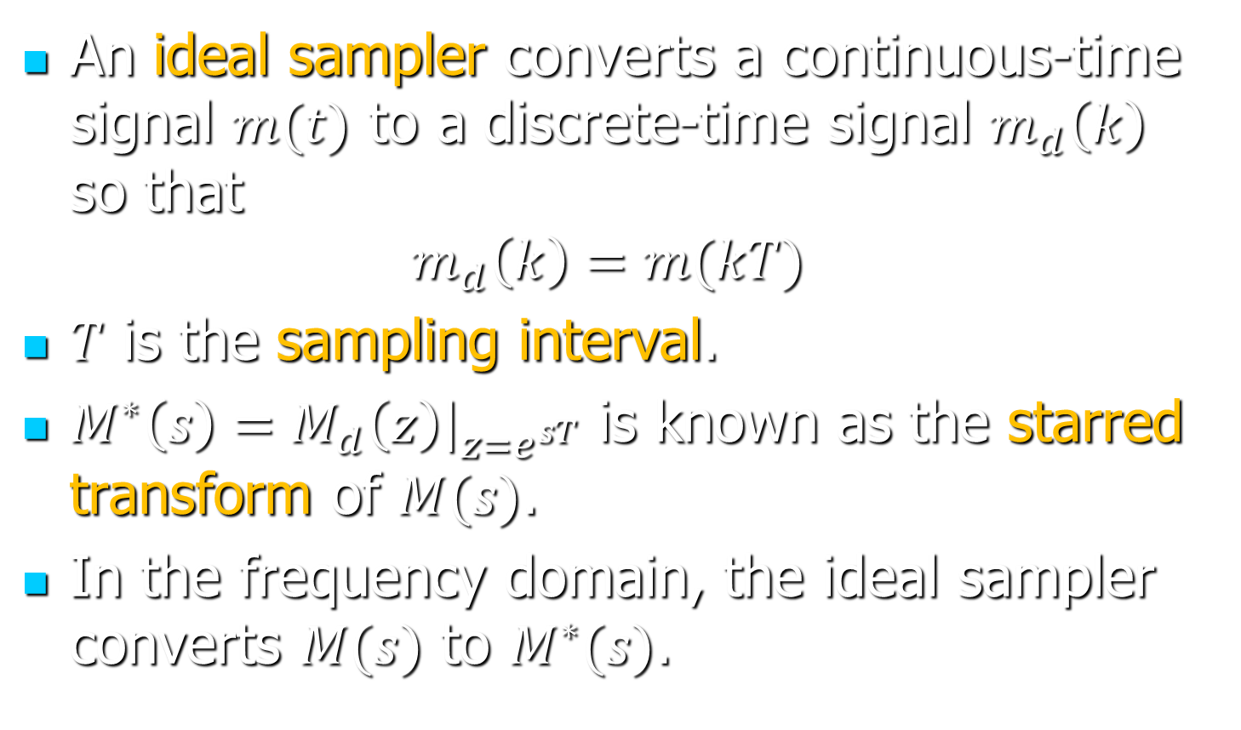
Ideal Samplers
An ideal sampler converts a continuous-time signal $m(t)$ to a discrete-time signal $m_{d}\left(k\right)$ so that
$$m_{d}\left(k\right)=m(kT)$$
$T$ is the sampling interval.
$M^{∗}\left(s\right)=M_{d}\left(z\right){\left.​\right|}_{z=e^{sT}}$ is known as the starred transform of $M(s)$.
In the frequency domain, the ideal sampler converts $M(s)$ to $M^{∗}(s)$.

Slide 4
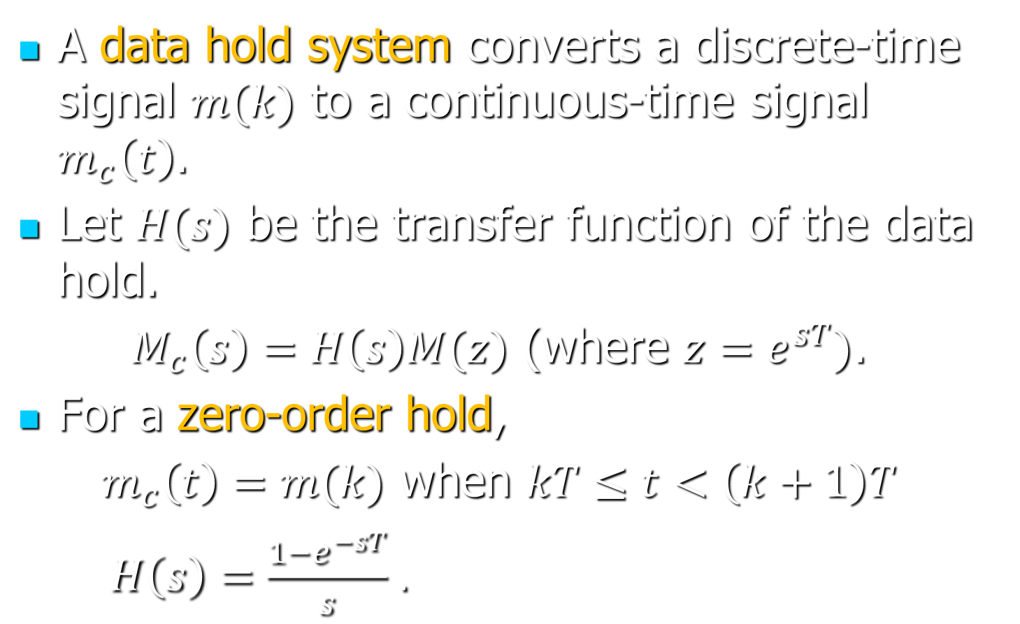
Data Hold Systems
A data hold system converts a discrete-time signal $m(k)$ to a continuous-time signal $m_{c}\left(t\right)$.
Let $H(s)$ be the transfer function of the data hold.
$M_{c}\left(s\right)=H\left(s\right)M(z)$ (where $z=e^{sT})$.
For a zero-order hold,
$m_{c}\left(t\right)=m(k)$ when $kT≤t<\left(k+1\right)T$
$H\left(s\right)=\frac{1−e^{−sT}}{s}$ .

Slide 5
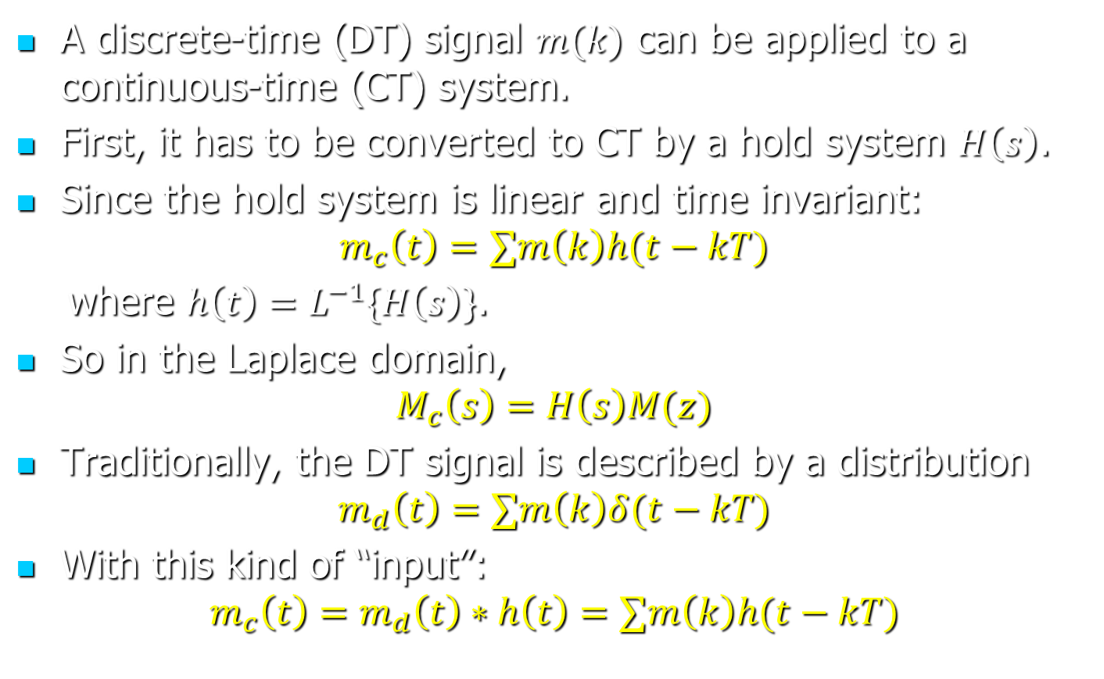
Representing DT Signals in CT
A discrete-time (DT) signal $m(k)$ can be applied to a continuous-time (CT) system.
First, it has to be converted to CT by a hold system $H\left(s\right)$.
Since the hold system is linear and time invariant:
$$m_{c}\left(t\right)=∑m\left(k\right)h(t−kT)$$
where $h\left(t\right)=L^{−1}\{H\left(s\right)\}$.
So in the Laplace domain,
$$M_{c}\left(s\right)=H\left(s\right)M(z)$$
Traditionally, the DT signal is described by a distribution
$$m_{d}\left(t\right)=∑m\left(k\right)δ(t−kT)$$
With this kind of “input”:
$$m_{c}\left(t\right)=m_{d}\left(t\right)∗h\left(t\right)=∑m\left(k\right)h(t−kT)$$

Slide 6

The Starred Transform
How to calculate $R^{∗}$:
Find $r\left(t\right)=L^{−1}\{R\left(s\right)\}$.
Let $r_{d}\left(k\right)=r(kT)$.
Find $R_{d}\left(z\right)=Z\{r_{d}\left(k\right)\}$.
Let $R^{∗}\left(s\right)=R_{d}(e^{sT})$.

Slide 7
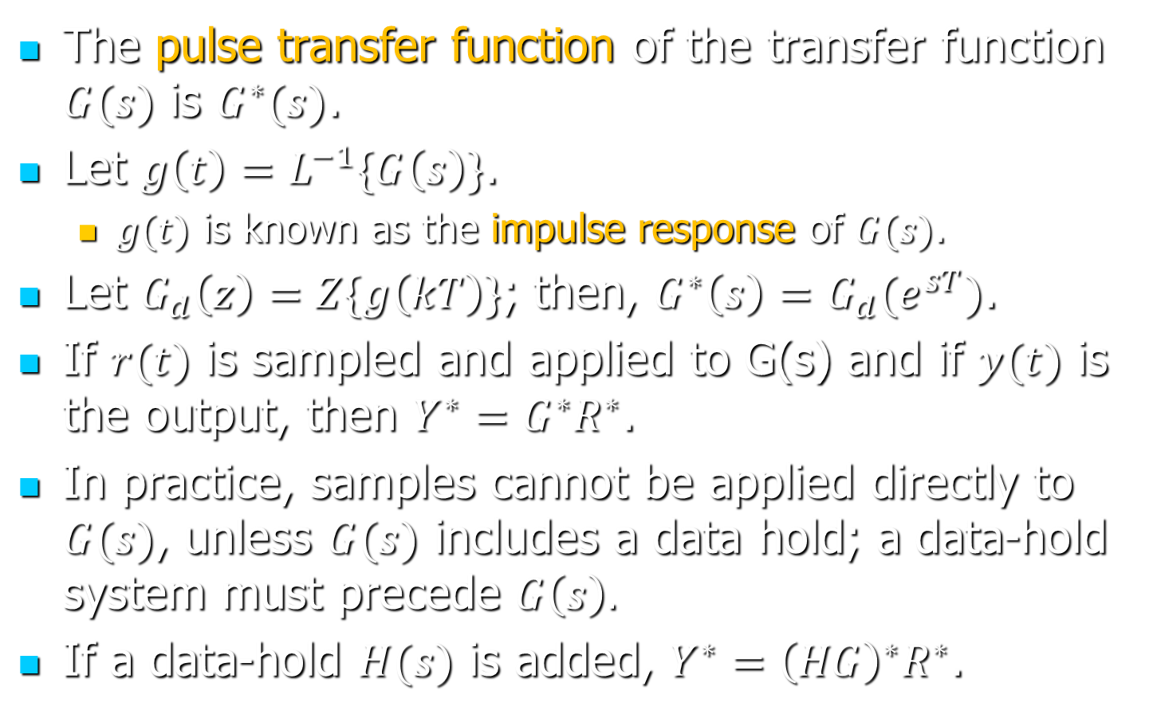
The Pulse Transfer Function
The pulse transfer function of the transfer function $G(s)$ is $G^{∗}(s)$.
Let $g\left(t\right)=L^{−1}\{G\left(s\right)\}$.
$g(t)$ is known as the impulse response of $G(s)$.
Let $G_{d}\left(z\right)=Z\{g\left(kT\right)\}$; then, $G^{∗}\left(s\right)=G_{d}(e^{sT})$.
If $r(t)$ is sampled and applied to G(s) and if $y(t)$ is the output, then $Y^{∗}=G^{∗}R^{∗}$.
In practice, samples cannot be applied directly to $G(s)$, unless $G(s)$ includes a data hold; a data-hold system must precede $G\left(s\right).$
If a data-hold $H(s)$ is added, $Y^{∗}={\left(HG\right)}^{∗}R^{∗}$.

Slide 8
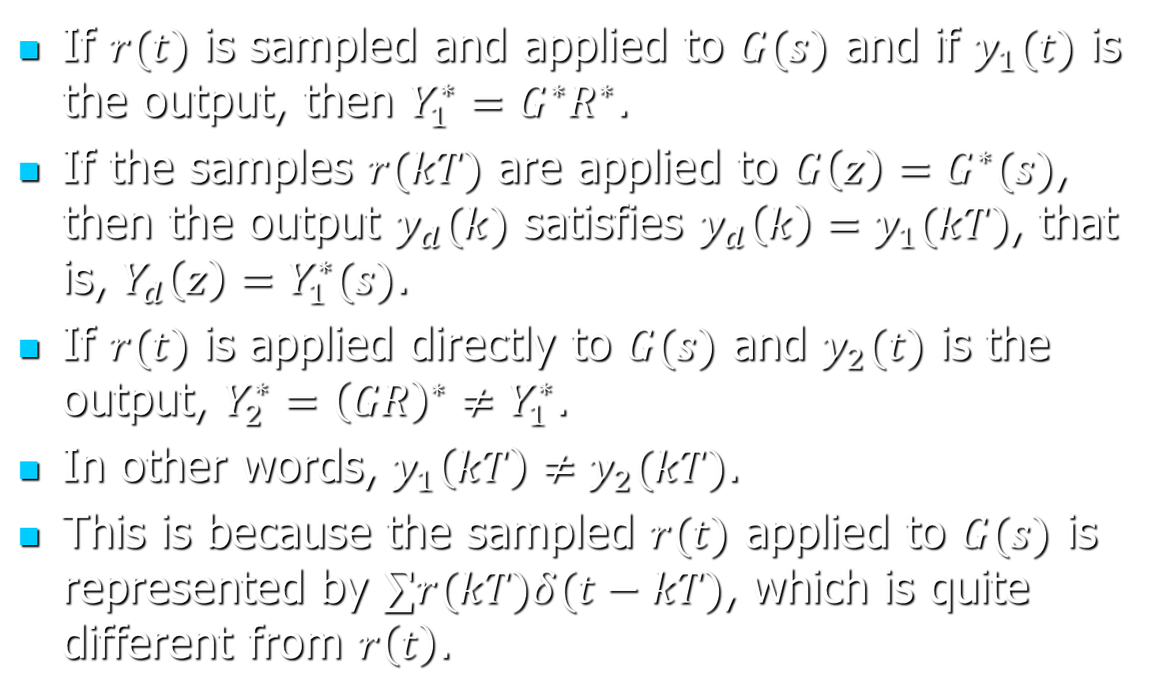
The Pulse Transfer Function
If $r(t)$ is sampled and applied to $G(s)$ and if $y_{1}(t)$ is the output, then $Y_{1}^{∗}=G^{∗}R^{∗}$.
If the samples $r(kT)$ are applied to $G\left(z\right)=G^{∗}(s)$, then the output $y_{d}(k)$ satisfies $y_{d}\left(k\right)=y_{1}(kT)$, that is, $Y_{d}\left(z\right)=Y_{1}^{∗}(s)$.
If $r(t)$ is applied directly to $G(s)$ and $y_{2}(t)$ is the output, $Y_{2}^{∗}={\left(GR\right)}^{∗}≠Y_{1}^{∗}$.
In other words, $y_{1}\left(kT\right)≠y_{2}(kT)$.
This is because the sampled $r(t)$ applied to $G(s)$ is represented by $∑r(kT)δ(t−kT)$, which is quite different from $r\left(t\right)$.

Slide 9

MATLAB Example
Let $T$ be the sampling interval.
To find $Y^{∗}$, write c2d($Y(s)$, $T$, 'impulse')/$T$.
Example: Find ${\left(\frac{e^{−3.2sT}}{s+3}\right)}^{∗}$ when $T=0.1$.
s = tf('s'); % define the Laplace variable
T = 0.1; % indicate the sampling interval
% The starred transform is calculated with
c2d(exp(-3.2*T*s)/(s+3), T, 'impulse')*(1/T)
% The reason we divide by T is that c2d considers an impulse
% function 1/T*delta(k) instead of delta(k), and thus
% multiplies the starred transform by T.

Slide 10

MATLAB Example
Example: Find ${\left(\frac{e^{−3.2sT}}{s+3}\right)}^{∗}$ in terms of $T$.
% Define first the needed symbolic variables
s = sym('s'); k = sym('k'); t = sym('t');
% It is important that the symbolic solver knows that T is
% a positive real number.
T = sym('T', 'positive');
x = ilaplace(exp(-3.2*T*s)/(s+3)); % inverse Laplace transf.
xk = subs(x, 't', k*T); % substitute t with k*T to find x(kT)
xz = ztrans(xk); % find the z-transform
xz = collect(xz); % the result can be simplified
pretty(xz) % display the z-transform

Slide 11
Diagrams with Analog and Digital Blocks
A signal Y(z) may be found with Mason’s formula.
This assumes the block diagram is converted to the z domain.
How to convert it:
Merge s-domain blocks and split paths involving s-domain blocks so as to be able to replace every signal with a starred signal and s-domain blocks with starred TF blocks.

Slide 12
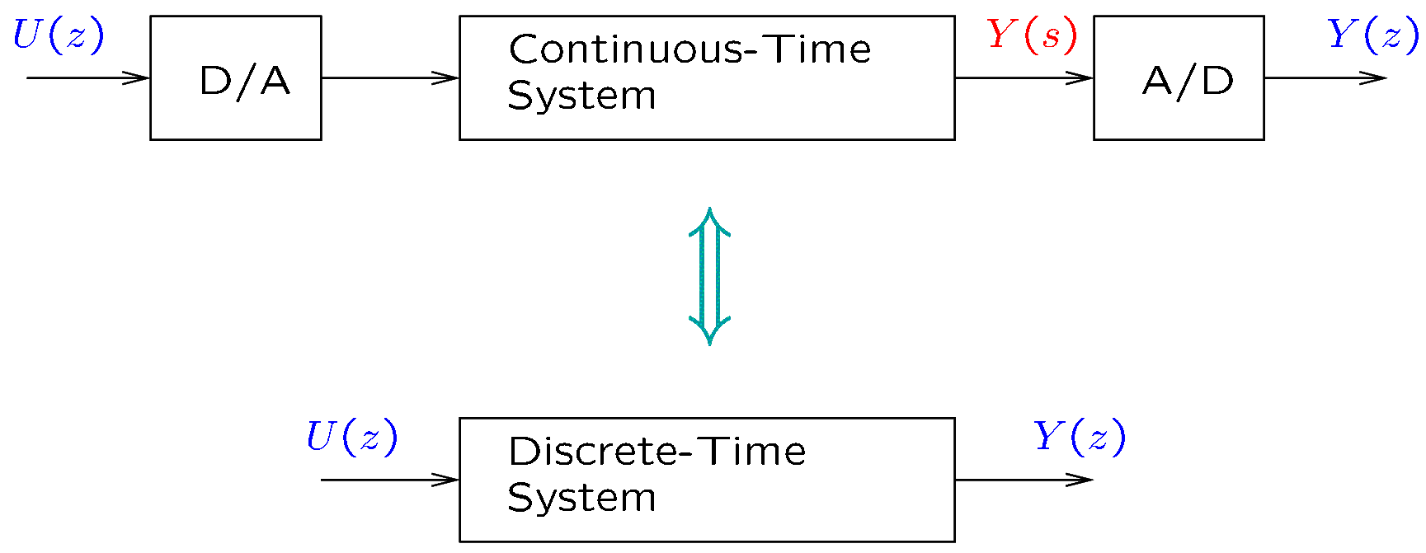
Conversions to Discrete Time
In certain contexts, a continuous-time system may be substituted with a discrete-time system.
We will consider the following equivalence:

Slide 13
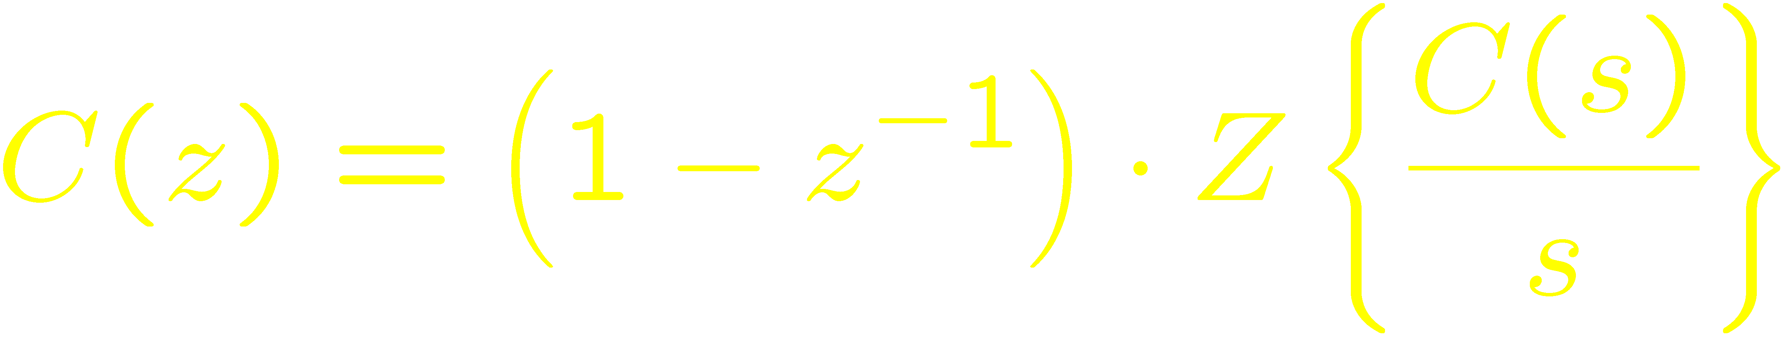
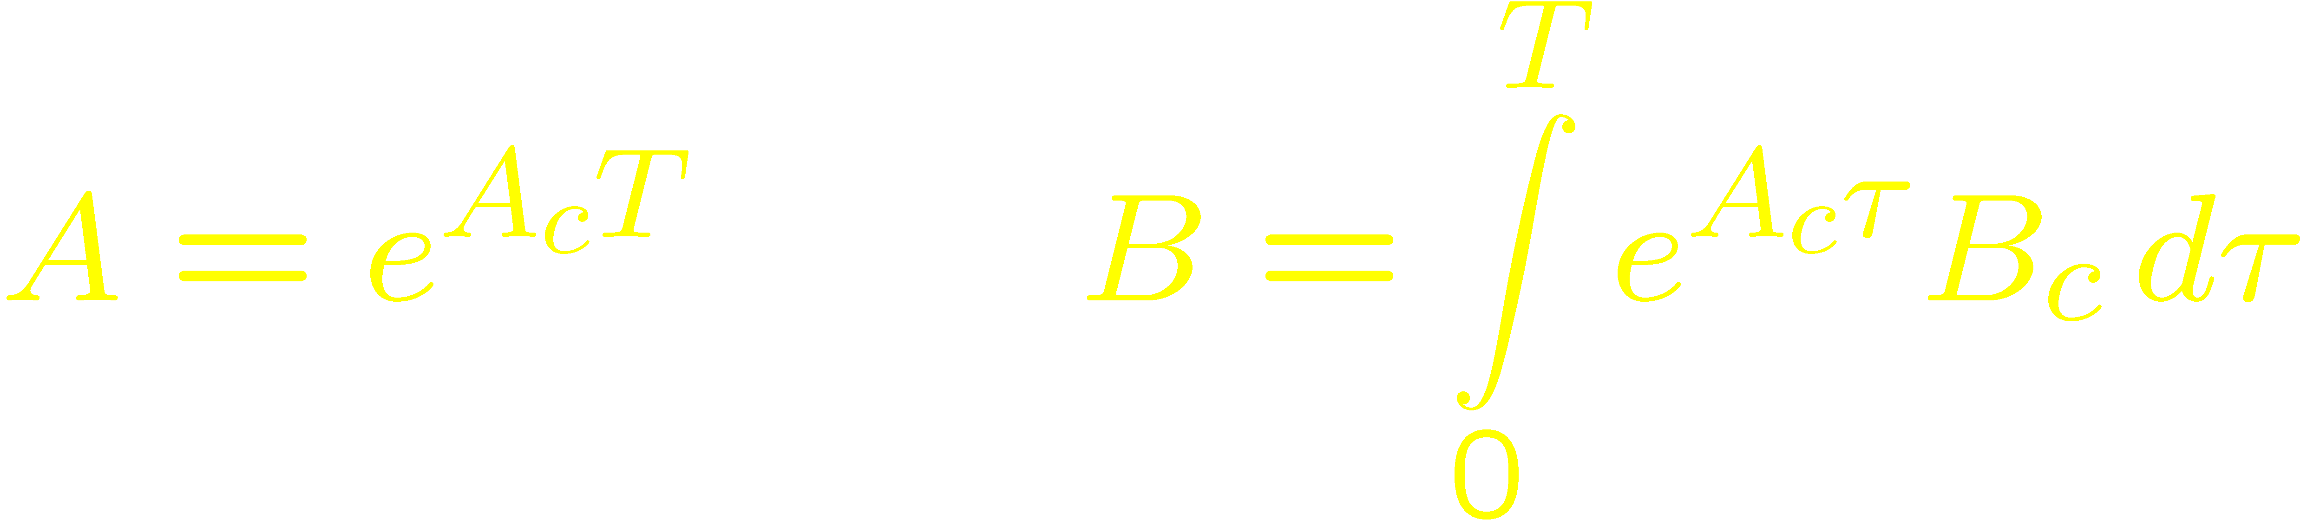
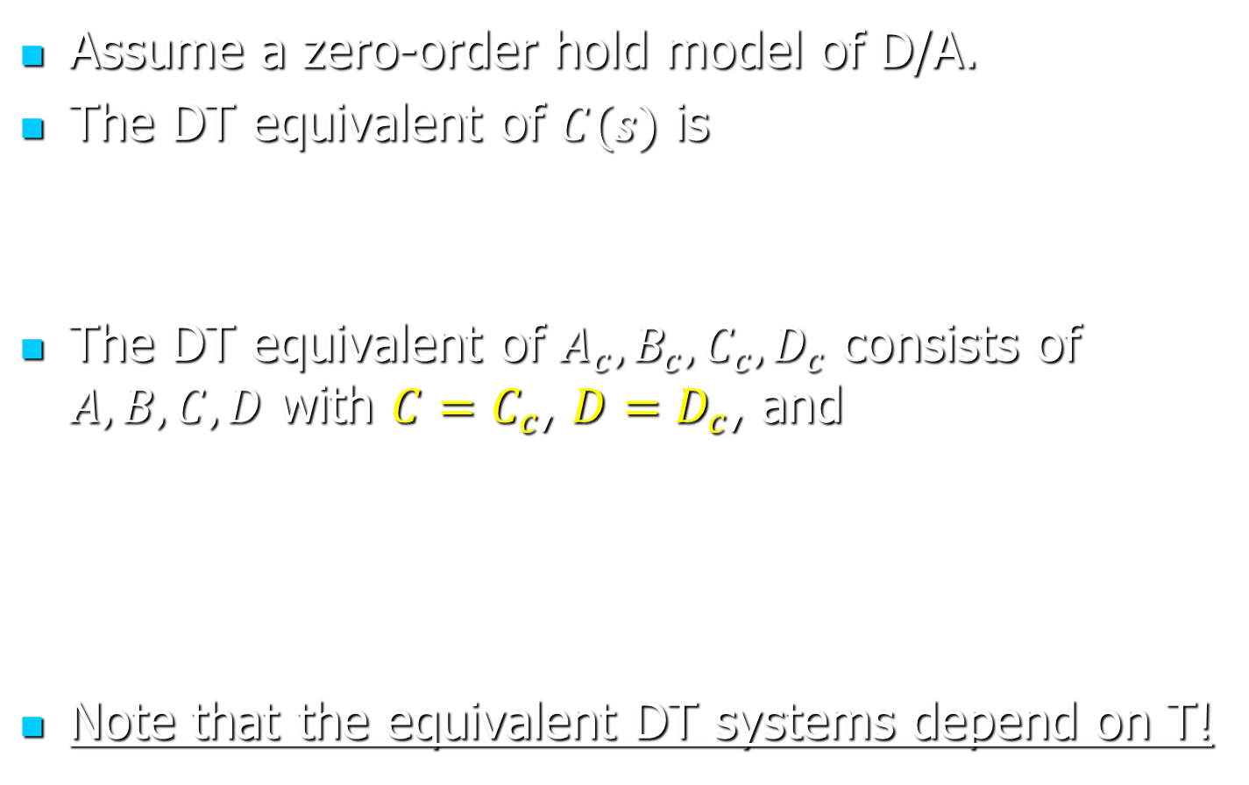
Conversions to Discrete Time
Assume a zero-order hold model of D/A.
The DT equivalent of $C(s)$ is
The DT equivalent of $A_{c}, B_{c}, C_{c}, D_{c}$ consists of $A, B, C, D$ with $C=C_{c}$, $D=D_{c}$, and
Note that the equivalent DT systems depend on T!

Slide 14

MATLAB Example
Let $T$ be the sampling interval.
To find the DT equivalent of $sys$, write c2d($sys$, $T$, 'zoh').
s = tf('s'); % define the Laplace variable
T = 0.01; % indicate the sampling interval
% Find the DT equivalent of 1/(s*(s+15))
c2d(1/(s*(s+15)), T, 'zoh')
% To find a state space equivalent, the same procedure may
% be used.
sys = ss(1/(s*(s+15)); % find a state space representation
sysd = c2d(sys, T, 'zoh'); % convert sys to discrete time

Slide 15
MATLAB Example
The symbolic toolbox can also be used.
This is especially useful for parametrized matrices (as in gain scheduling).
s = sym('s');
b = sym('b');
t = sym('t');
T = sym('T');
Ac = [0 0; b 1]; % b is a parameter
Bc = [1; 0];
% Do not use exp(Ac*T) to find A, since the exponential of a
% matrix has a different meaning in MATLAB.
At = ilaplace((s*eye(2)-Ac)^-1); % it will be a function of t
B = int(At*Bc, t, 0, T)
A = subs(At, t, T) % substitute t with T

Slide 16
Conversions between CT and DT
In MATLAB, c2d and d2c may be used.
There are several possible conversion methods.
We have mentioned the zero-order hold method.
Other methods:
First-order hold.
Approximate differential equations as difference equations.
The bilinear (Tustin) transformation.
Matched pole-zeros.
…

Slide 17
Limitations
It is possible to convert a system from DT to CT or CT to DT.
In MATLAB, c2d and d2c may be used.
However:
The resulting systems are not equivalent in every respect to the original systems!
Conversions should be used only when the theory permits them.

Slide 18
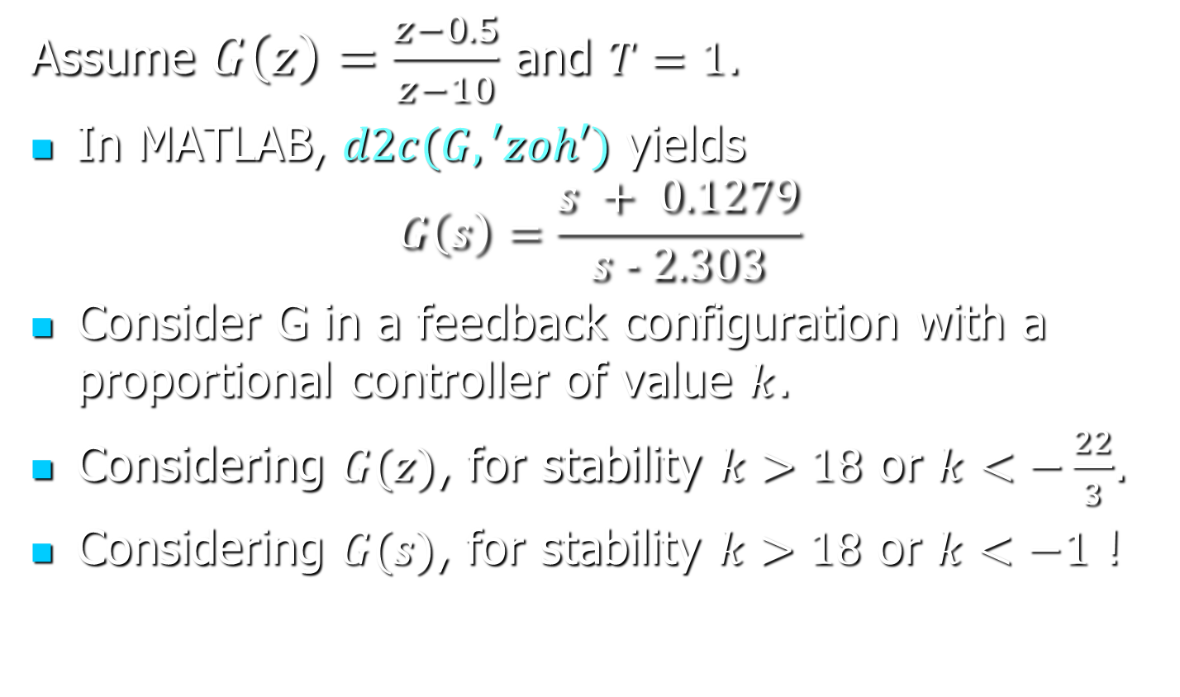
Limitations—Example
Assume $G\left(z\right)=\frac{z−0.5}{z−10}$ and $T=1$.
In MATLAB, $d2c(G, ′zoh′)$ yields
$$G\left(s\right)=\frac{s + 0.1279}{s − 2.303}$$
Consider G in a feedback configuration with a proportional controller of value $k$.
Considering $G(z)$, for stability $k>18$ or $k<−\frac{22}{3}$.
Considering $G(s)$, for stability $k>18$ or $k<−1$ !

Slide 19
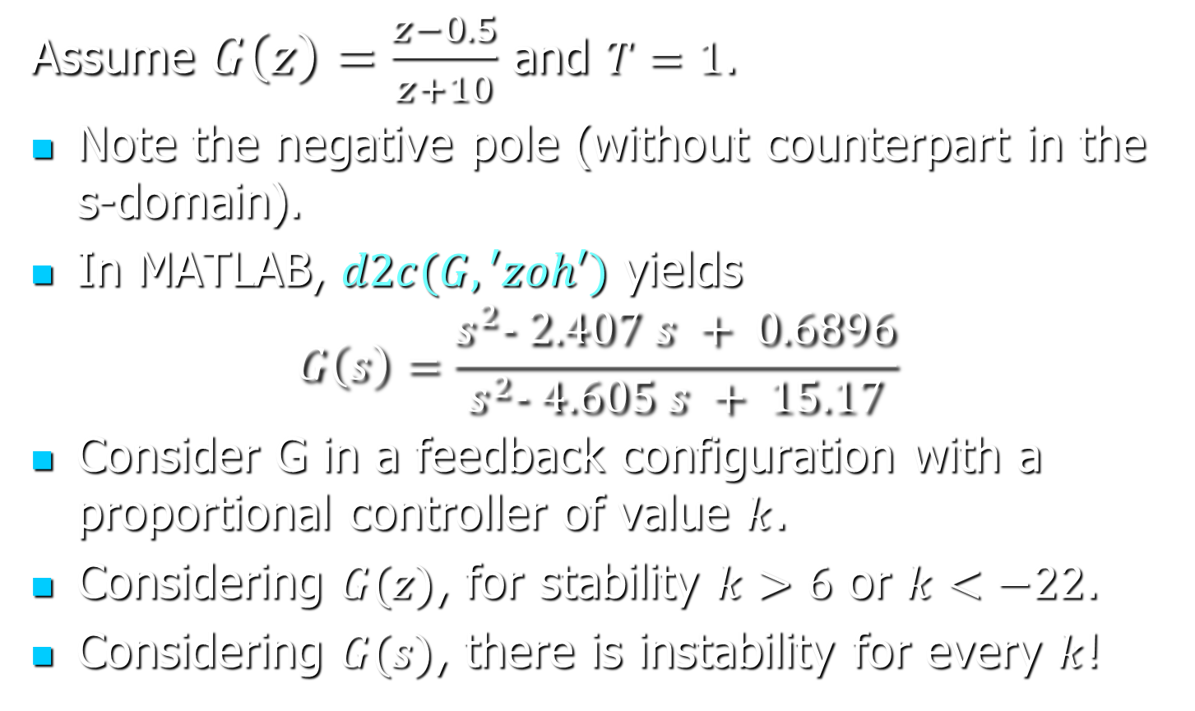
Limitations—Example
Assume $G\left(z\right)=\frac{z−0.5}{z+10}$ and $T=1$.
Note the negative pole (without counterpart in the s-domain).
In MATLAB, $d2c(G, ′zoh′)$ yields
$$G\left(s\right)=\frac{s^{2}− 2.407 s + 0.6896}{s^{2}− 4.605 s + 15.17}$$
Consider G in a feedback configuration with a proportional controller of value $k$.
Considering $G(z)$, for stability $k>6$ or $k<−22$.
Considering $G(s)$, there is instability for every $k$!

Slide 20
Designing SD Control Systems
A precise solution is to find the controller directly in the z-domain
Use state estimation and state feedback.
OR other methods.

Slide 21
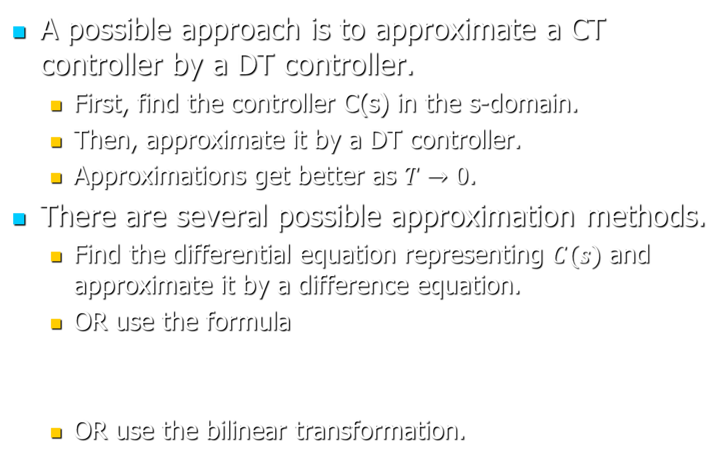
Designing SD Control Systems
A possible approach is to approximate a CT controller by a DT controller.
First, find the controller C(s) in the s-domain.
Then, approximate it by a DT controller.
Approximations get better as $T→0$.
There are several possible approximation methods.
Find the differential equation representing $C(s)$ and approximate it by a difference equation.
OR use the formula
OR use the bilinear transformation.

Slide 22
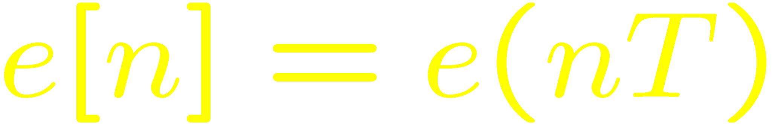
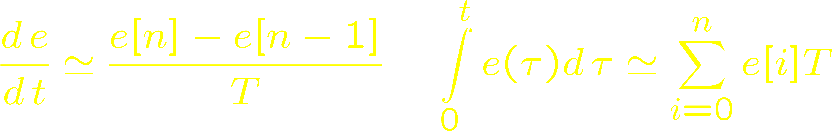
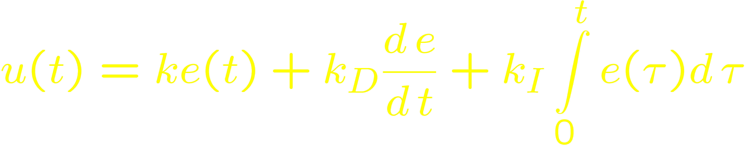
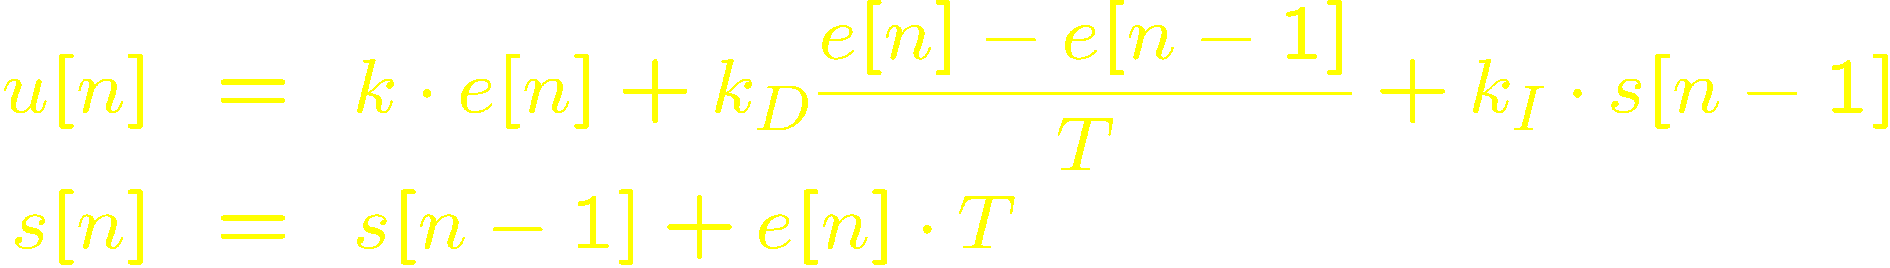
Approximation by difference equations
Let
Analog PID controller
Digital PID controller

Slide 23
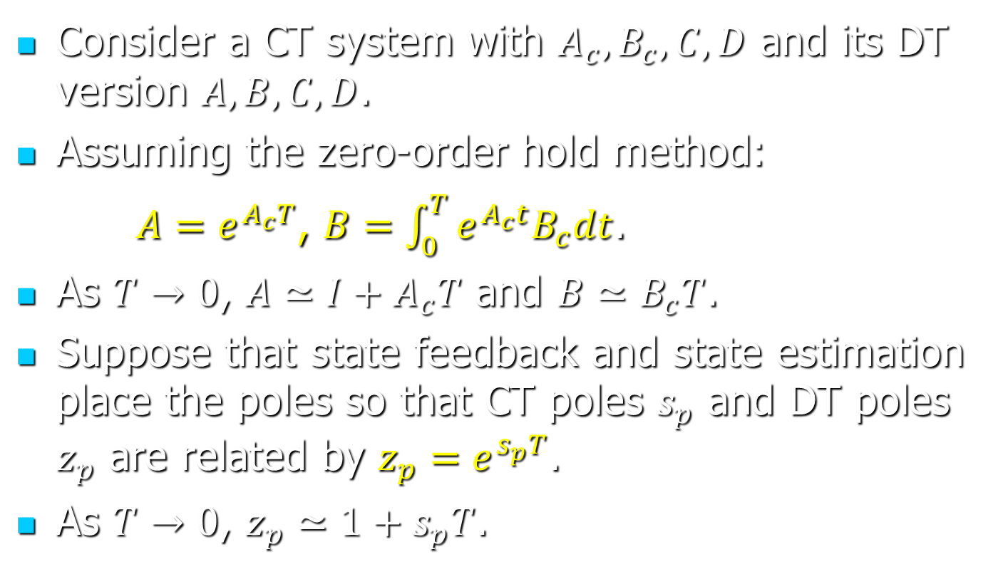
Approximating State-Space Models
Consider a CT system with $A_{c}, B_{c}, C, D$ and its DT version $A, B, C, D$.
Assuming the zero-order hold method:
$A=e^{A_{c}T}$, $B=\int_{0}^{T}{e^{A_{c}t}B_{c}dt}$.
As $T→0$, $A≃I+A_{c}T$ and $B≃B_{c}T$.
Suppose that state feedback and state estimation place the poles so that CT poles $s_{p}$ and DT poles $z_{p}$ are related by $z_{p}=e^{s_{p}T}$.
As $T→0$, $z_{p}≃1+s_{p}T$.

Slide 24
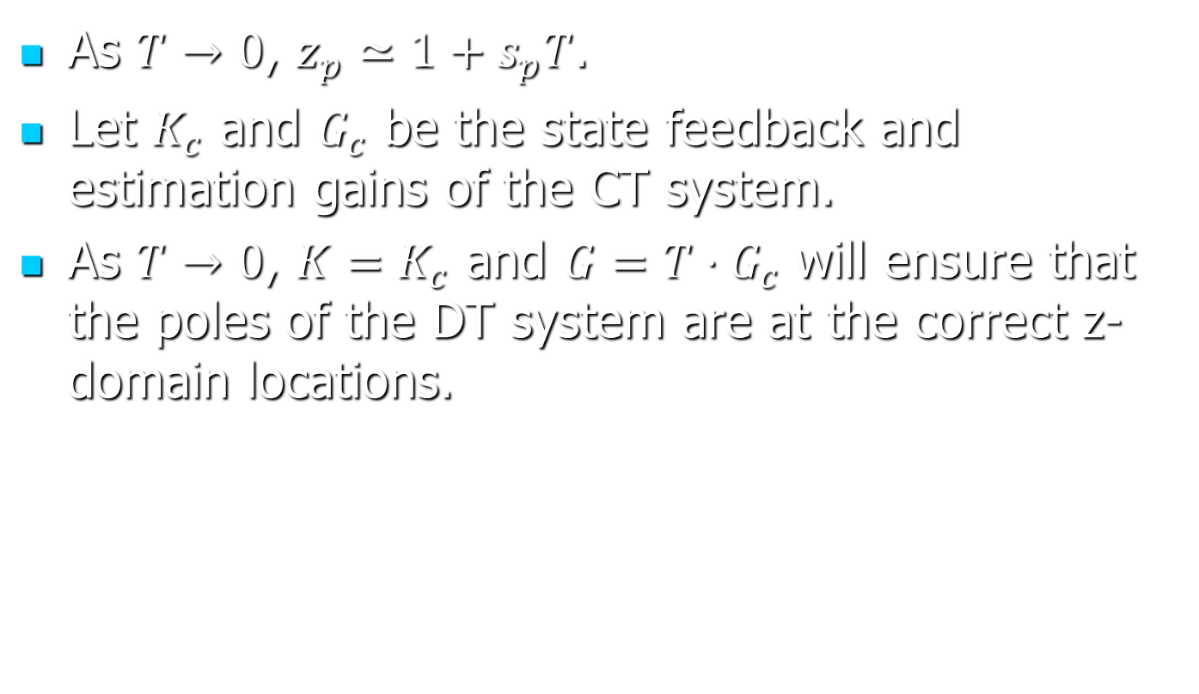
Approximating State-Space Models
As $T→0$, $z_{p}≃1+s_{p}T$.
Let $K_{c}$ and $G_{c}$ be the state feedback and estimation gains of the CT system.
As $T→0$, $K=K_{c}$ and $G=T⋅G_{c}$ will ensure that the poles of the DT system are at the correct z-domain locations.
Notes:
Sketch of proof: We will check that if $λ$ is an eigenvalue of the CT system, then $1+λT$ is an eigenvalue of the DT system. If $\left(A_{c}−B_{c}K_{c}\right)v=λv$, then $\left(I+A_{c}T−B_{c}TK_{c}\right)v=\left(1+λT\right)v$. Moreover, if $\left(A_{c}−G_{c}C\right)v=λv$, then $\left(I+A_{c}T−G_{c}TC\right)v=\left(1+λT\right)v$.

