Slide 1
Discrete-Time Systems
Difference Equations, the Z-Transform
M.V. Iordache, EEGR4933 Automatic Control Systems, Spring 2019, LeTourneau University

Slide 2
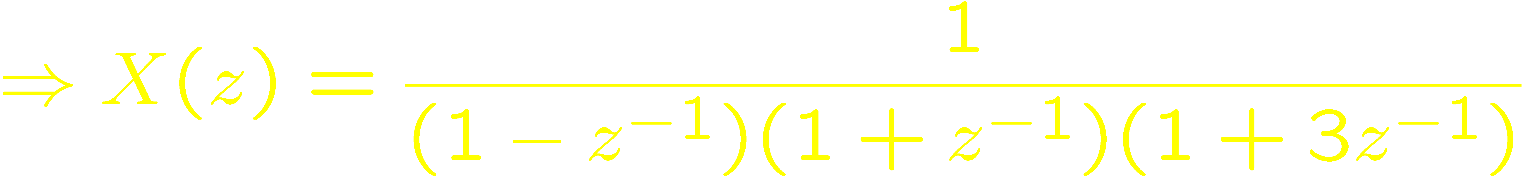
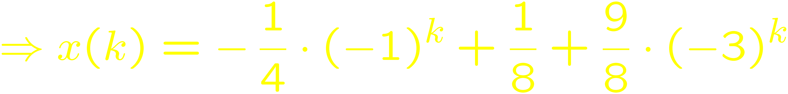
The Z-Transform
The Laplace transform can be used to solve differential equations.
The z-transform can be used to solve difference equations.
Example:

Slide 3
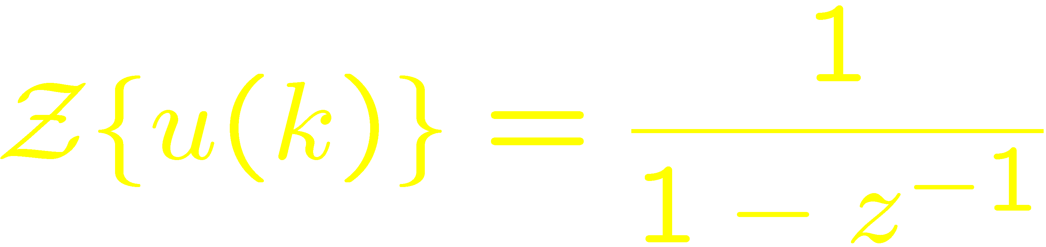
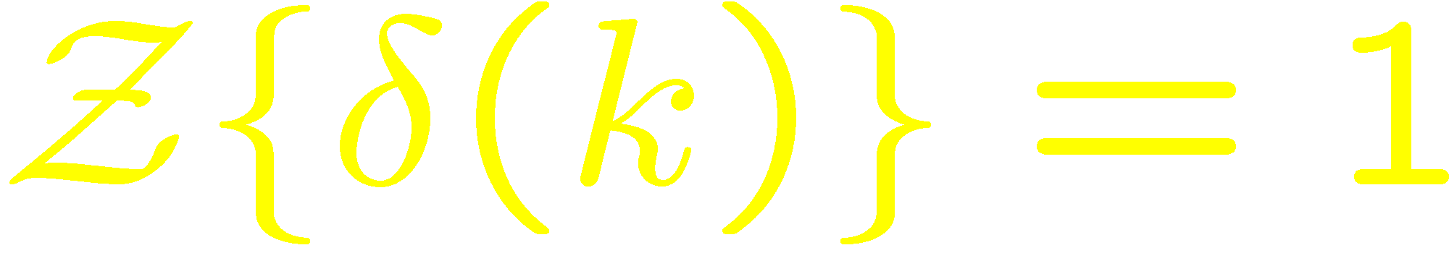
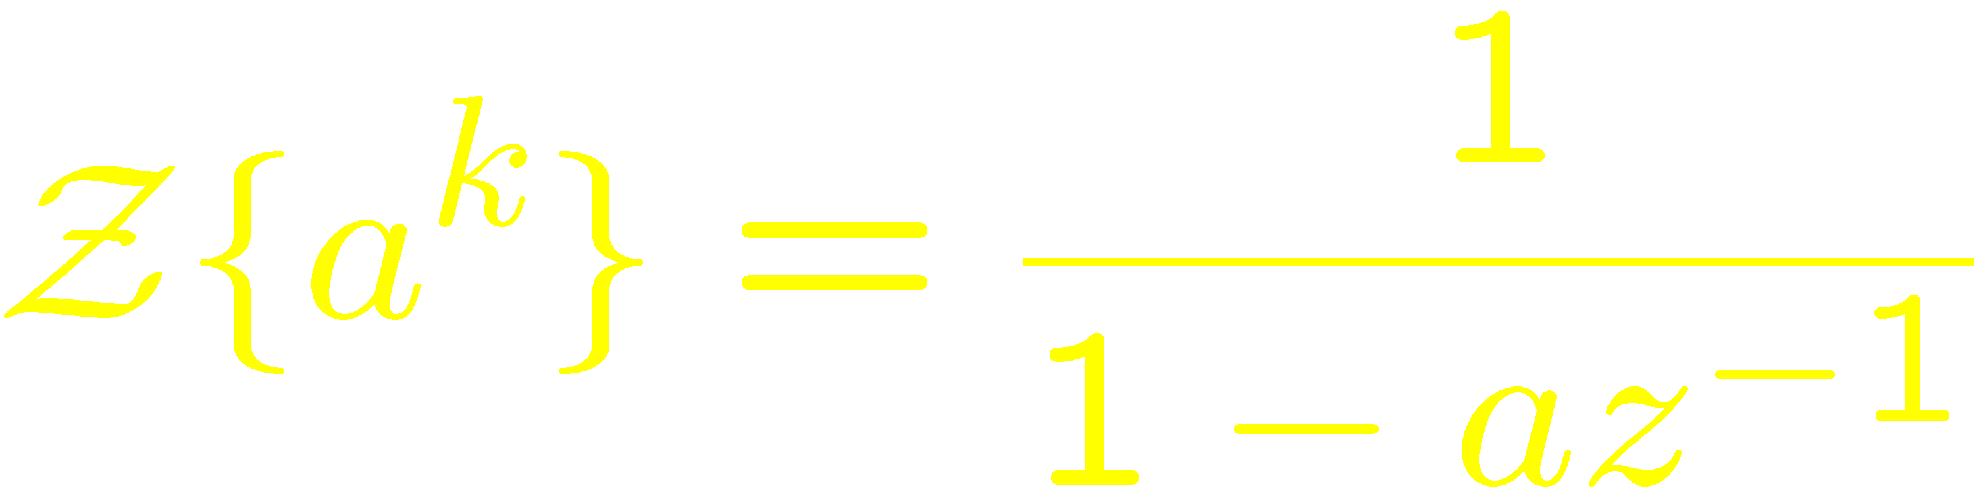
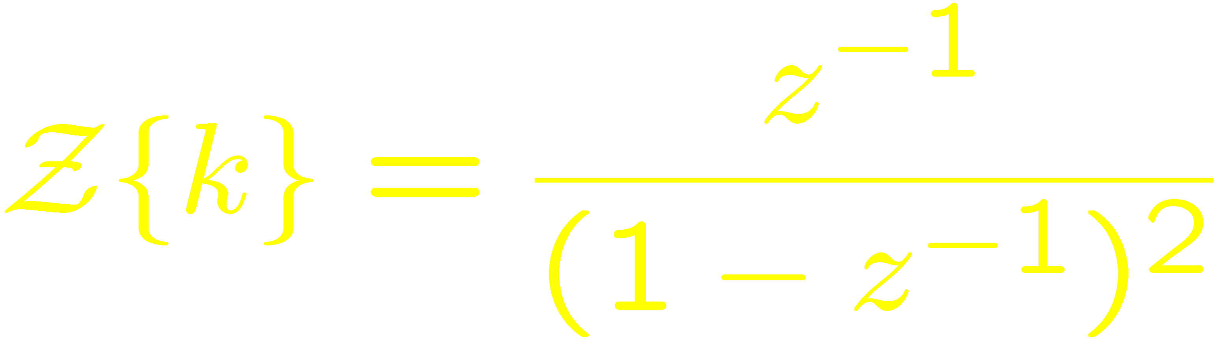
The Z-Transform—Basic Formulas
Unit step
Delta function
Power function
Linear function

Slide 4
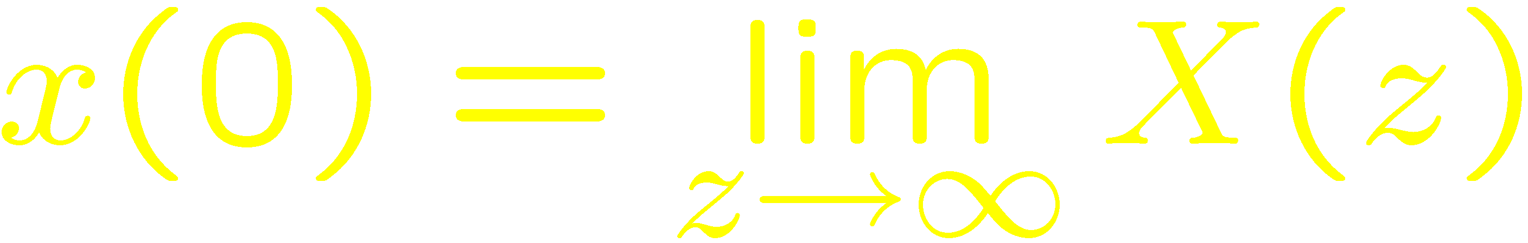
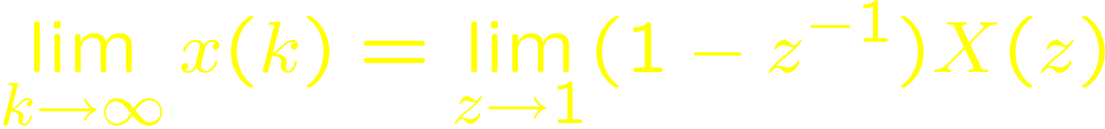
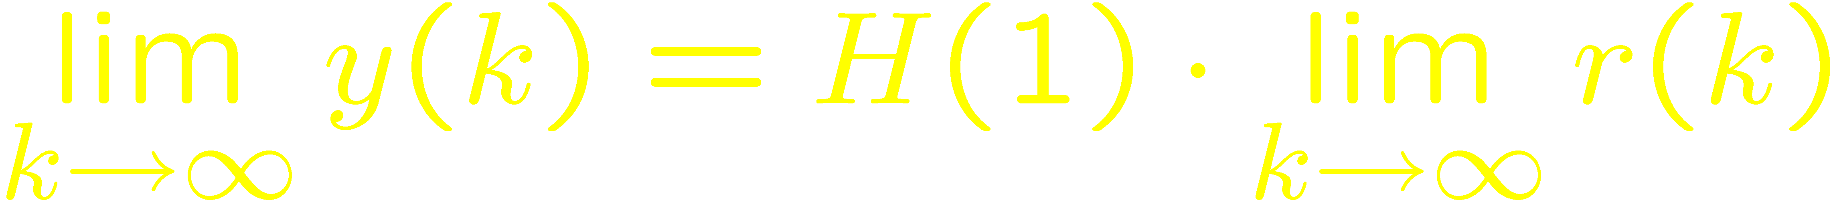
The Z-Transform—Basic Formulas
Initial value theorem
Final value theorem (if constant steady state)
SS response of H(z) (if constant ss and H(1) defined):

Slide 5
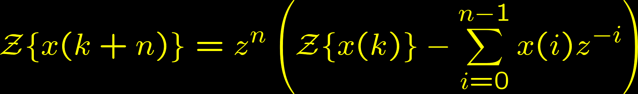
The Z-Transform—Basic Formulas
Delay:
However,

Slide 6
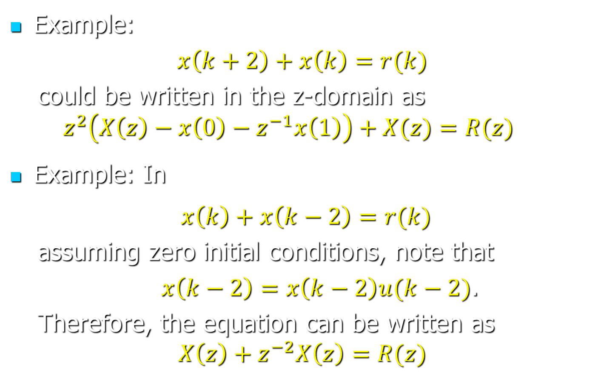
The Z-Transform—Basic Formulas
Example:
$x\left(k+2\right)+x\left(k\right)=r(k)$
  could be written in the z-domain as
  $$z^{2}\left(X\left(z\right)−x\left(0\right)−z^{−1}x\left(1\right)\right)+X(z)=R(z)$$
Example: In
$x\left(k\right)+x\left(k−2\right)=r(k)$
  assuming zero initial conditions, note that
  $x\left(k−2\right)=x\left(k−2\right)u(k−2)$.
  Therefore, the equation can be written as
$$X\left(z\right)+z^{−2}X\left(z\right)=R(z)$$

Slide 7

MATLAB Example
Find the z-transform of $3δ\left(k−1\right)+4⋅2^{k−1}u(k−4)$
% Set to 1 the value of heaviside(0), to make heaviside()
% identical to the unit step function.
sympref('HeavisideAtOrigin',1);
% Define k as a symbolic variable
k = sym('k');
% Note that kroneckerDelta is the delta function
res = ztrans(3*kroneckerDelta(k-1)+ 4*2^(k-1)*heaviside(k-4))
% The result can usually be simplified and
% displayed in more friendly way with 'pretty'
res = simplify(res);
pretty(res)

Slide 8

MATLAB Example
Find the inverse z-transform of $\frac{z−4}{\left(z−1\right){\left(z+3\right)}^{2}}$
% Set to 1 the value of heaviside(0), to make heaviside()
% identical to the unit step function.
sympref('HeavisideAtOrigin',1);
% Define z as a symbolic variable
z = sym('z');
% Find the inverse z transform
res = iztrans((z-4)/(z-1)/(z+3)^2)
% The result can usually be simplified and
% displayed in more friendly way with 'pretty'
res = simplify(res);
pretty(res)

Slide 9
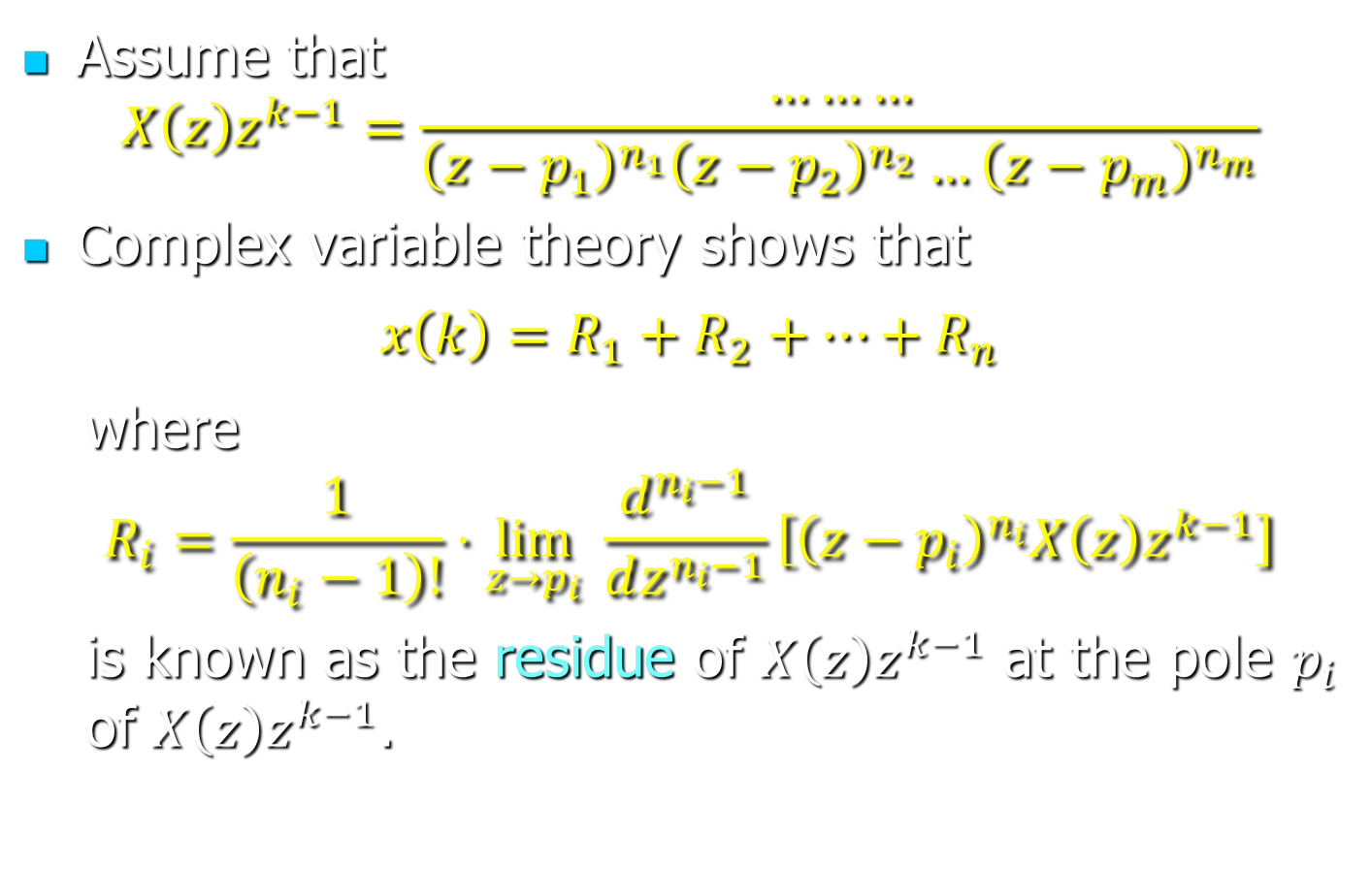
The Inverse Z-Transform
Assume that
$$X\left(z\right)z^{k−1}=\frac{………}{{\left(z−p_{1}\right)}^{n_{1}}{\left(z−p_{2}\right)}^{n_{2}}…{\left(z−p_{m}\right)}^{n_{m}}}$$
Complex variable theory shows that
$$x\left(k\right)=R_{1}+R_{2}+…+R_{n}$$
  where
$$R_{i}=\frac{1}{\left(n_{i}−1\right)!}⋅\lim_{z→p_{i}}{ \frac{d^{n_{i}−1}}{dz^{n_{i}−1}}\left[{\left(z−p_{i}\right)}^{n_{i}}X\left(z\right)z^{k−1}\right]}$$
  is known as the residue of $X\left(z\right)z^{k−1}$ at the pole $p_{i}$ of $X\left(z\right)z^{k−1}$.
Notes:
Source: “Discrete-Time Control Systems” by Ogata, 2nd edition, page 690.

Slide 10
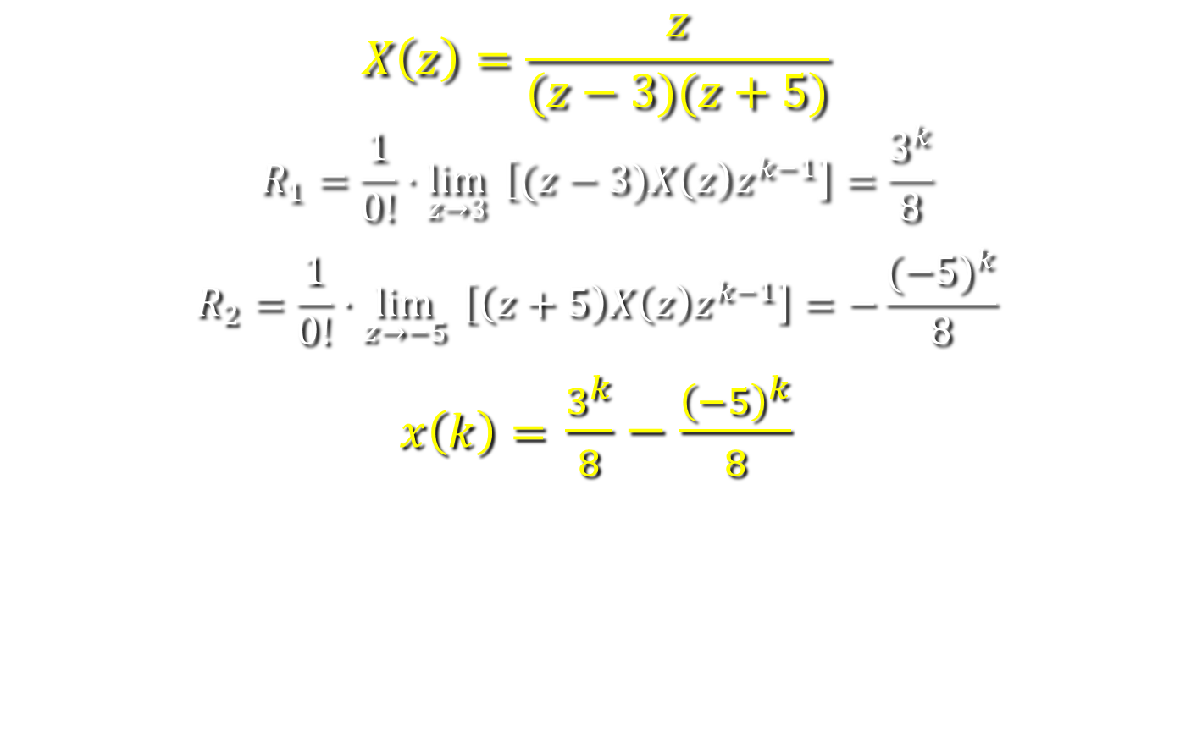
The Inverse Z-Transform—Example
$$X\left(z\right)=\frac{z}{(z−3)(z+5)}$$
$$R_{1}=\frac{1}{0!}⋅\lim_{z→3}{ \left[(z−3)X\left(z\right)z^{k−1}\right]=\frac{3^{k}}{8}}$$
$$R_{2}=\frac{1}{0!}⋅\lim_{z→−5}{ \left[\left(z+5\right)X\left(z\right)z^{k−1}\right]=−\frac{{(−5)}^{k}}{8}}$$
$x\left(k\right)=$ $\frac{3^{k}}{8}−\frac{{\left(−5\right)}^{k}}{8}$

Slide 11
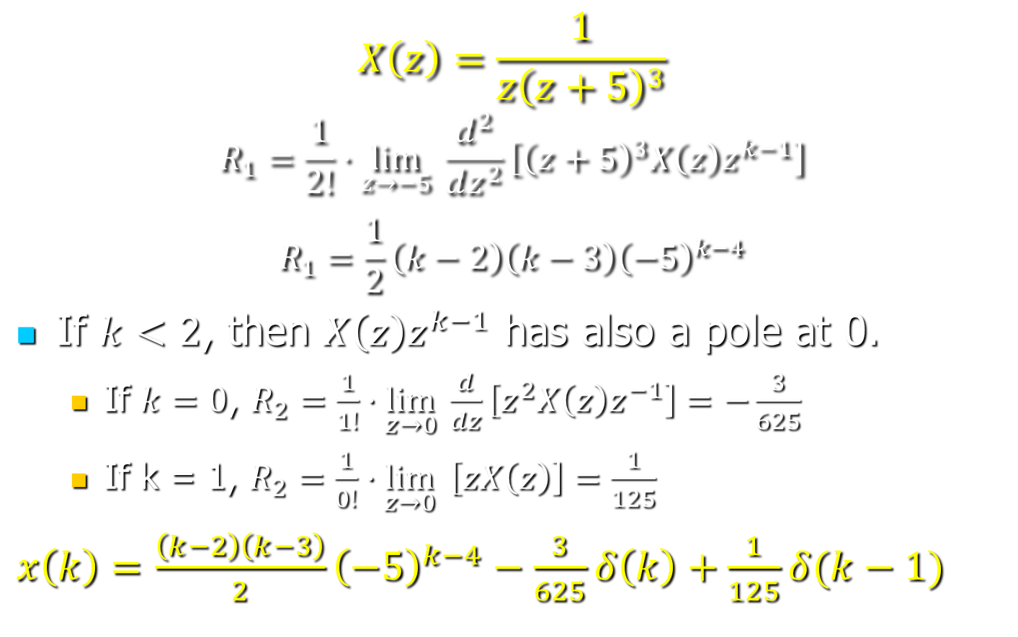
The Inverse Z-Transform—Example
$$X\left(z\right)=\frac{1}{{z\left(z+5\right)}^{3}}$$
$$R_{1}=\frac{1}{2!}⋅\lim_{z→−5}{ \frac{d^{2}}{dz^{2}}\left[{\left(z+5\right)}^{3}X\left(z\right)z^{k−1}\right]}$$
$$R_{1}=\frac{1}{2}\left(k−2\right)\left(k−3\right){\left(−5\right)}^{k−4}$$
If $k<2$, then $X\left(z\right)z^{k−1}$ has also a pole at 0.
  If $k=0$, $R_{2}=\frac{1}{1!}⋅\lim_{z→0}{ \frac{d}{dz}\left[z^{2}X\left(z\right)z^{−1}\right]}=−\frac{3}{625}$
  If k = 1, $R_{2}=\frac{1}{0!}⋅\lim_{z→0}{ \left[zX\left(z\right)\right]}=\frac{1}{125}$
$x\left(k\right)=$ $\frac{\left(k−2\right)\left(k−3\right)}{2}{\left(−5\right)}^{k−4}−\frac{3}{625}δ\left(k\right)+\frac{1}{125}δ(k−1)$

Slide 12
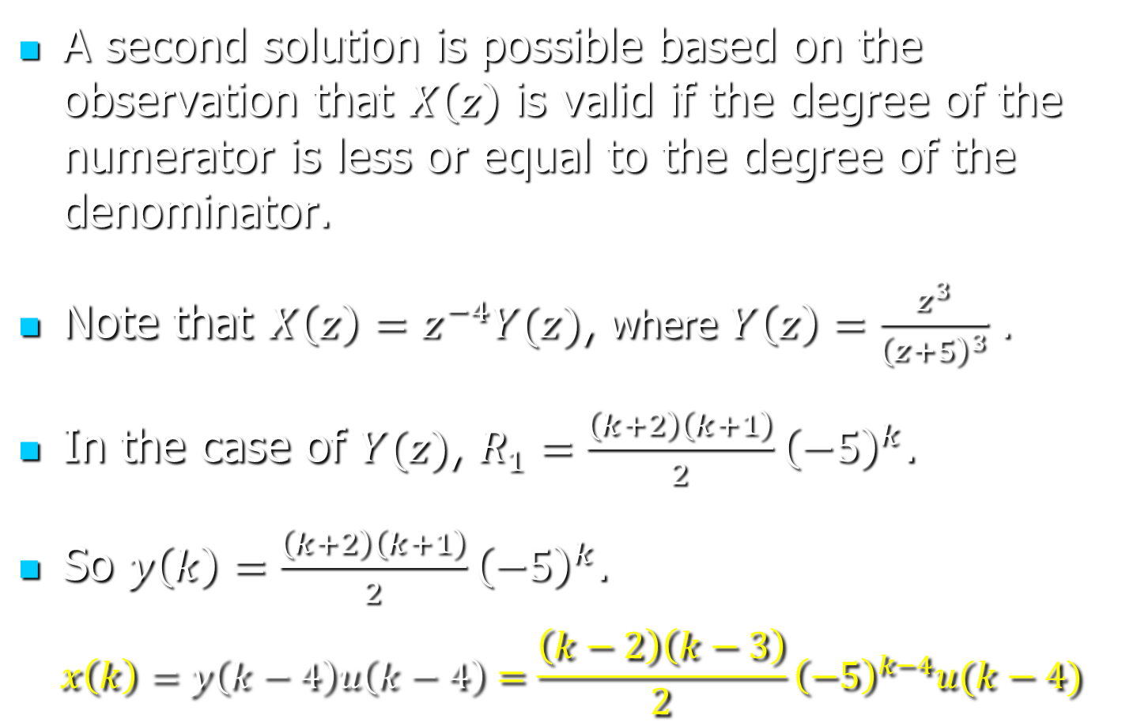
The Inverse Z-Transform—Example
A second solution is possible based on the observation that $X\left(z\right)$ is valid if the degree of the numerator is less or equal to the degree of the denominator.
Note that $X\left(z\right)=z^{−4}Y(z)$, where $Y\left(z\right)=\frac{z^{3}}{{\left(z+5\right)}^{3}}$ .
In the case of $Y(z)$, $R_{1}=\frac{\left(k+2\right)\left(k+1\right)}{2}{\left(−5\right)}^{k}$.
So $y\left(k\right)=\frac{\left(k+2\right)\left(k+1\right)}{2}{\left(−5\right)}^{k}$.
$$x\left(k\right)=y\left(k−4\right)u\left(k−4\right)=\frac{\left(k−2\right)\left(k−3\right)}{2}{\left(−5\right)}^{k−4}u(k−4)$$

