Slide 1
Nonlinear Systems. Systems with Delays.
Delays, Linearization, Gain Scheduling, Fuzzy Control
M.V. Iordache, EEGR4933 Automatic Control Systems, Spring 2019, LeTourneau University

Slide 2
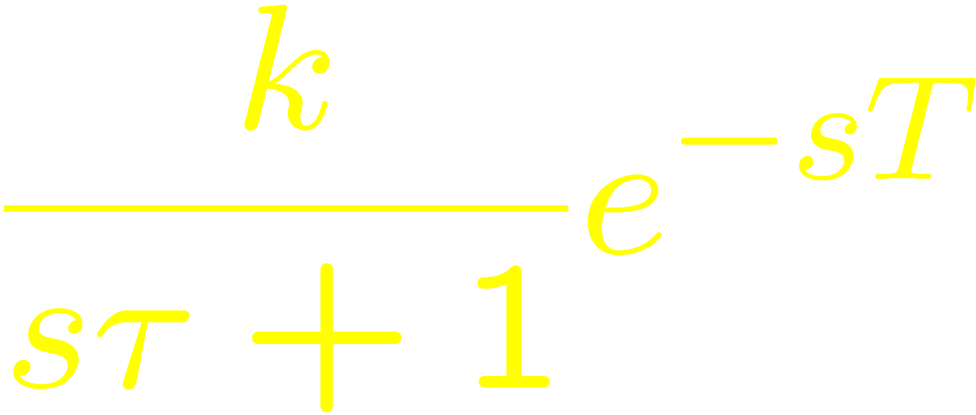
Systems with Delays
Delays can make a control system unstable.
The Smith predictor provides a possible solution.
A controller enhanced with a Smith predictor can be designed with methods for systems without delays.
When a precise model of the plant is unavailable, an approximate model could be used.
For example, a first order approximation of a system with delays is represented by

Slide 3
Nonlinear Systems
Nonlinear systems are common and important in practical applications.
Systems considered to be linear are usually only approximately linear.
The control methods learned so far can be extended to nonlinear systems.

Slide 4
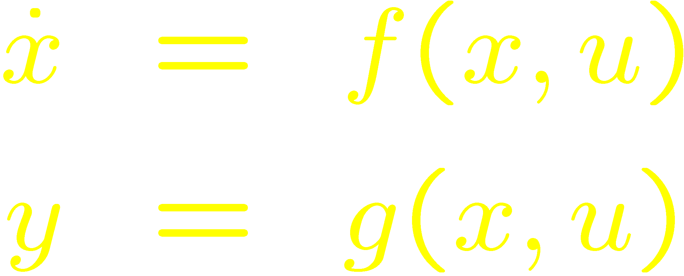
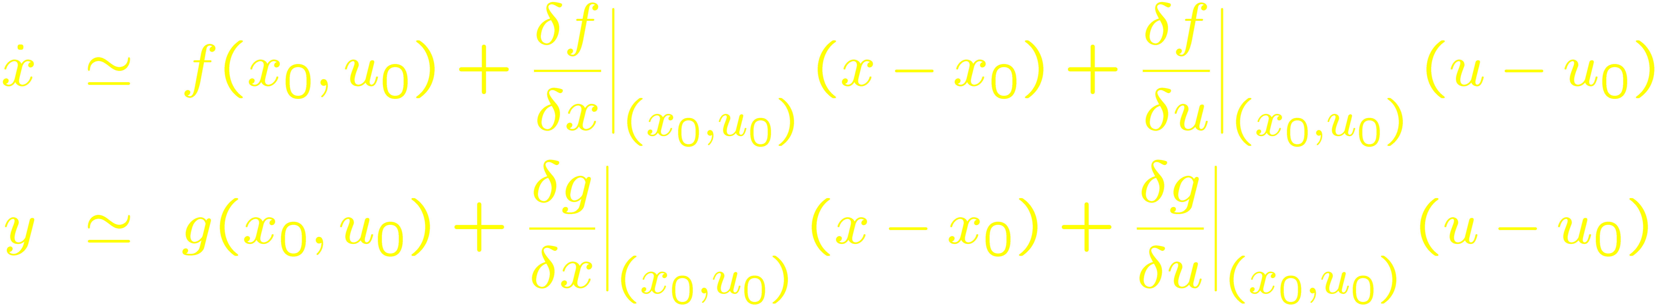
Linearization
Linear system theory can be extended to nonlinear systems by means of linearization.
Assume a nonlinear system of the form
Given x₀ and u₀:

Slide 5
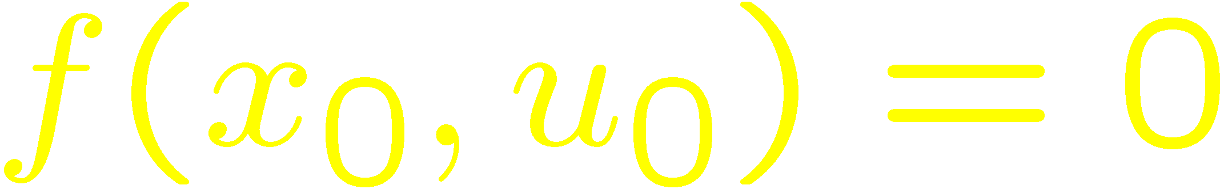
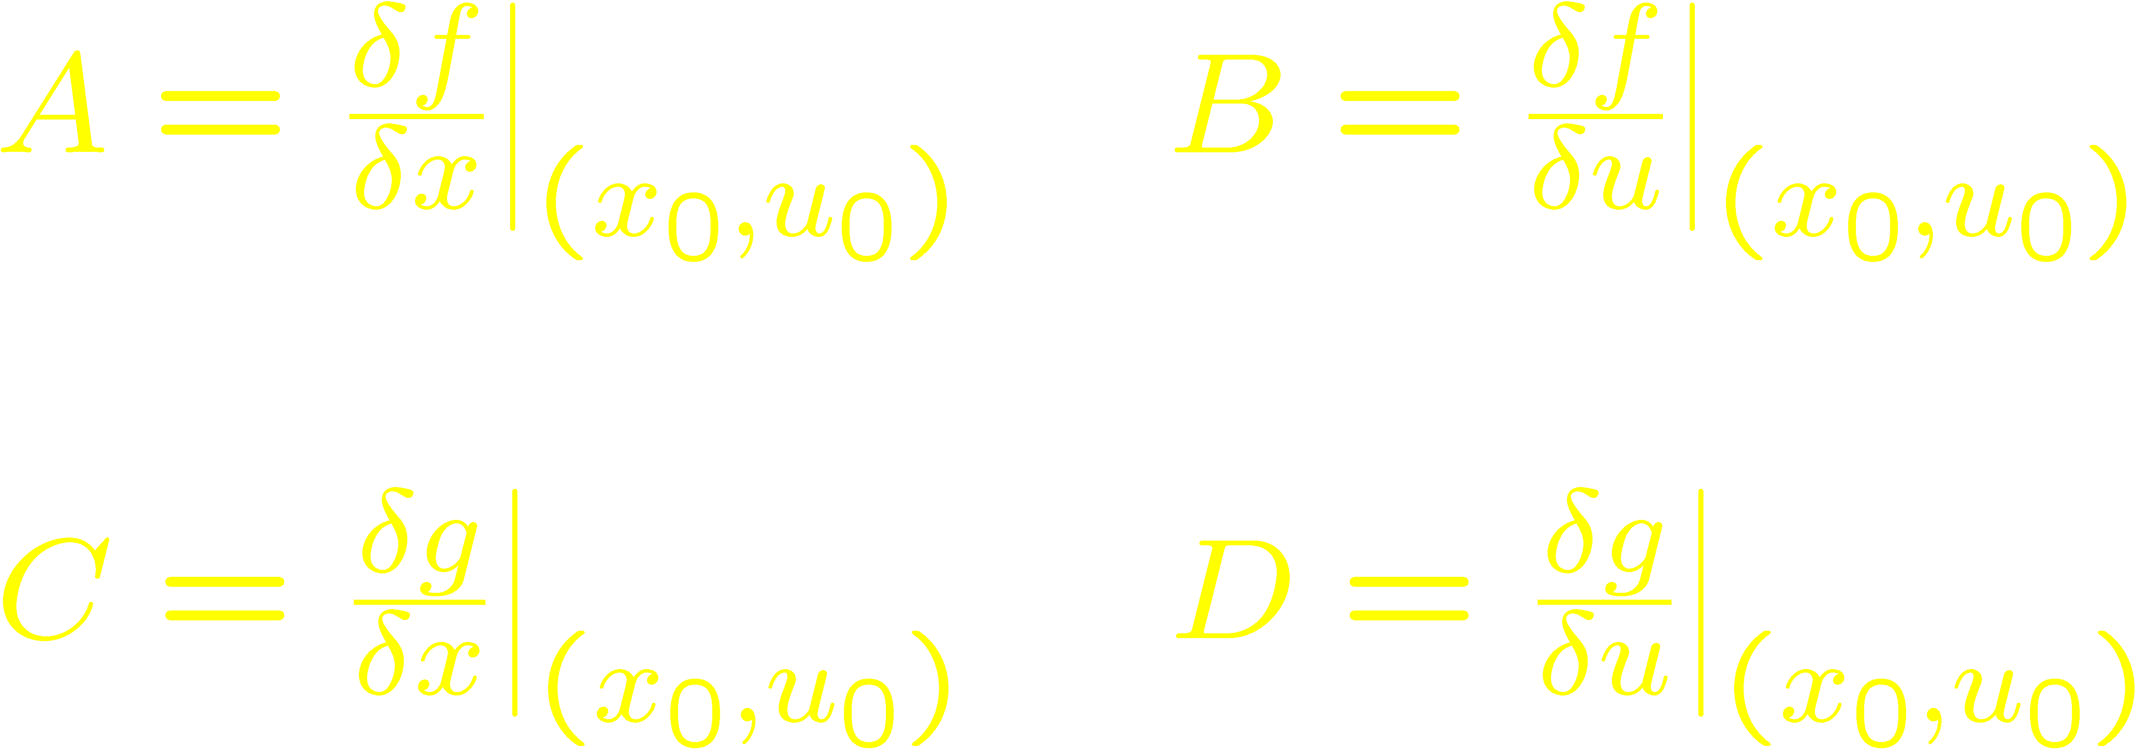
Linearization
Assume (x₀,u₀) is a setpoint:
Let
Linearization results in a linear system in terms of x_{d}, u_{d}, and y_{d}.
The linearization error can be modeled by a disturbance.

Slide 6
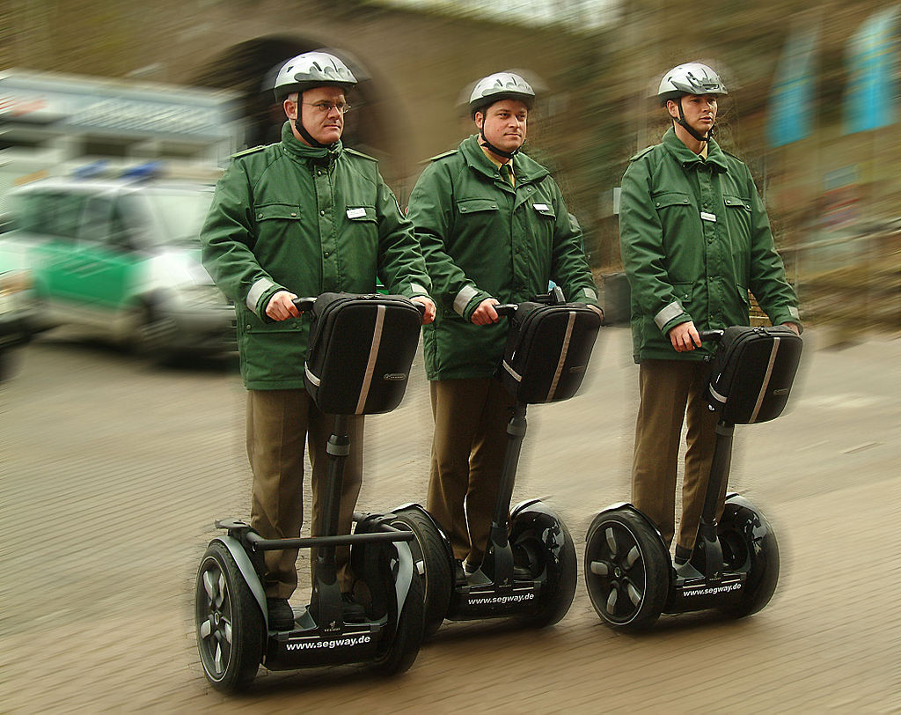
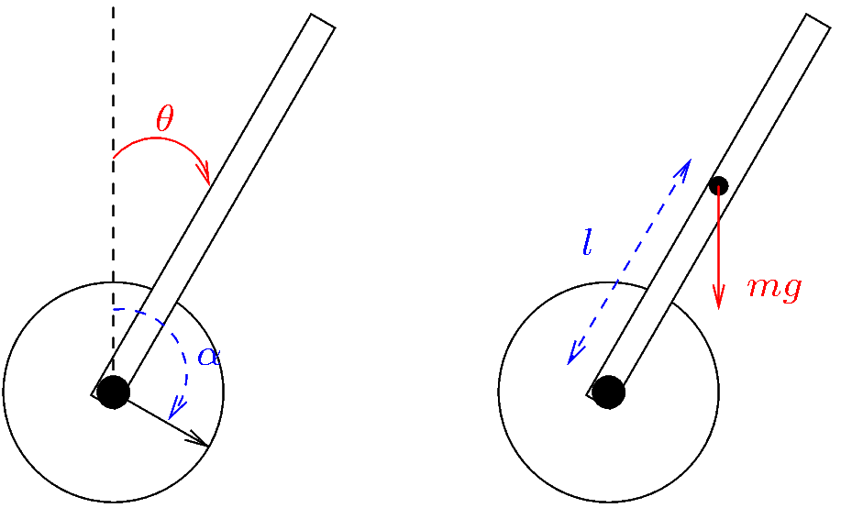
Example—Segway
The Segway resembles an inverted pendulum.
A controller is used to balance the system.
The system is nonlinear.
A simplified model will be used.
Image downloaded in March 2019 from
https://en.wikipedia.org/wiki/Segway#/media/File:Segway_Polizei_4.jpg

Slide 7
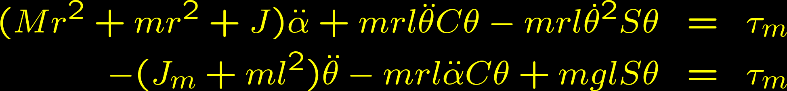
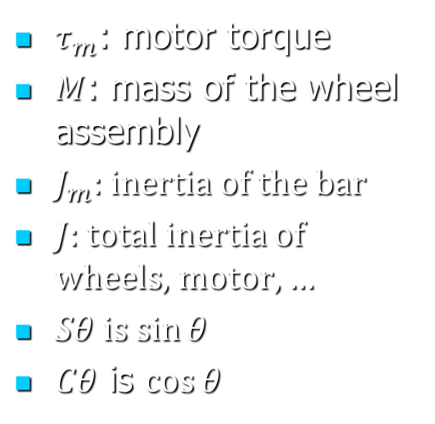
Example—Segway
$τ_{m}$: motor torque
$M$: mass of the wheel assembly
$J_{m}$: inertia of the bar
$J$: total inertia of wheels, motor, …
$Sθ$ is $\sin{θ}$
$Cθ$ is $\cos{θ}$

Slide 8
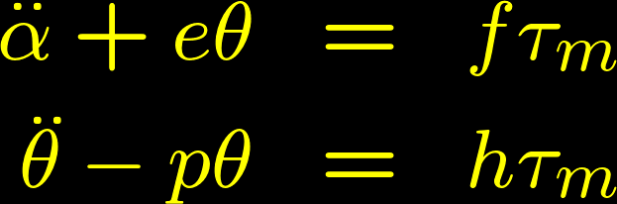
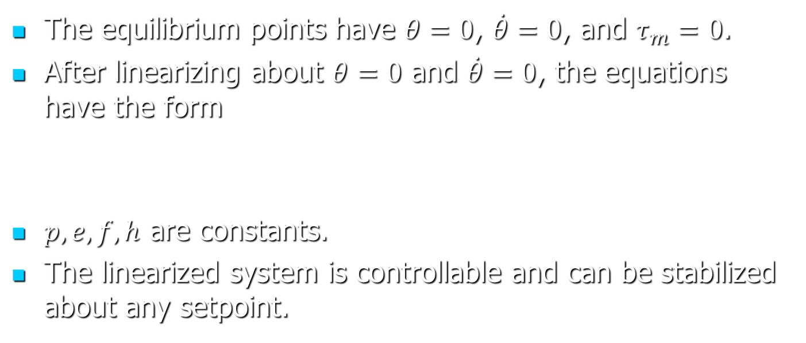
Example—Segway
The equilibrium points have $θ=0$, $\dot{θ}=0$, and $τ_{m}=0$.
After linearizing about $θ=0$ and $\dot{θ}=0$, the equations have the form
$p, e, f, h$ are constants.
The linearized system is controllable and can be stabilized about any setpoint.

Slide 9
Gain Scheduling
Controller parameters changed depending on the operating condition of the plant.
Controller parameters determined by scheduling variables.
Scheduling variables
Describe the condition of operation of the plant.
Determine (x₀,u₀) and (A, B, C, D) of linearized model.

Slide 10

Gain Scheduling—Example
$${\dot{x}}_{1}=\tan\left(x_{1}\right)+x_{2}$$
$${\dot{x}}_{2}=x_{1}+u$$
$$y=x_{2}$$
Assume that $y$ should track the reference $r$.
The example is from Nonlinear Systems, 2nd edition, by H. Khalil.

Slide 11
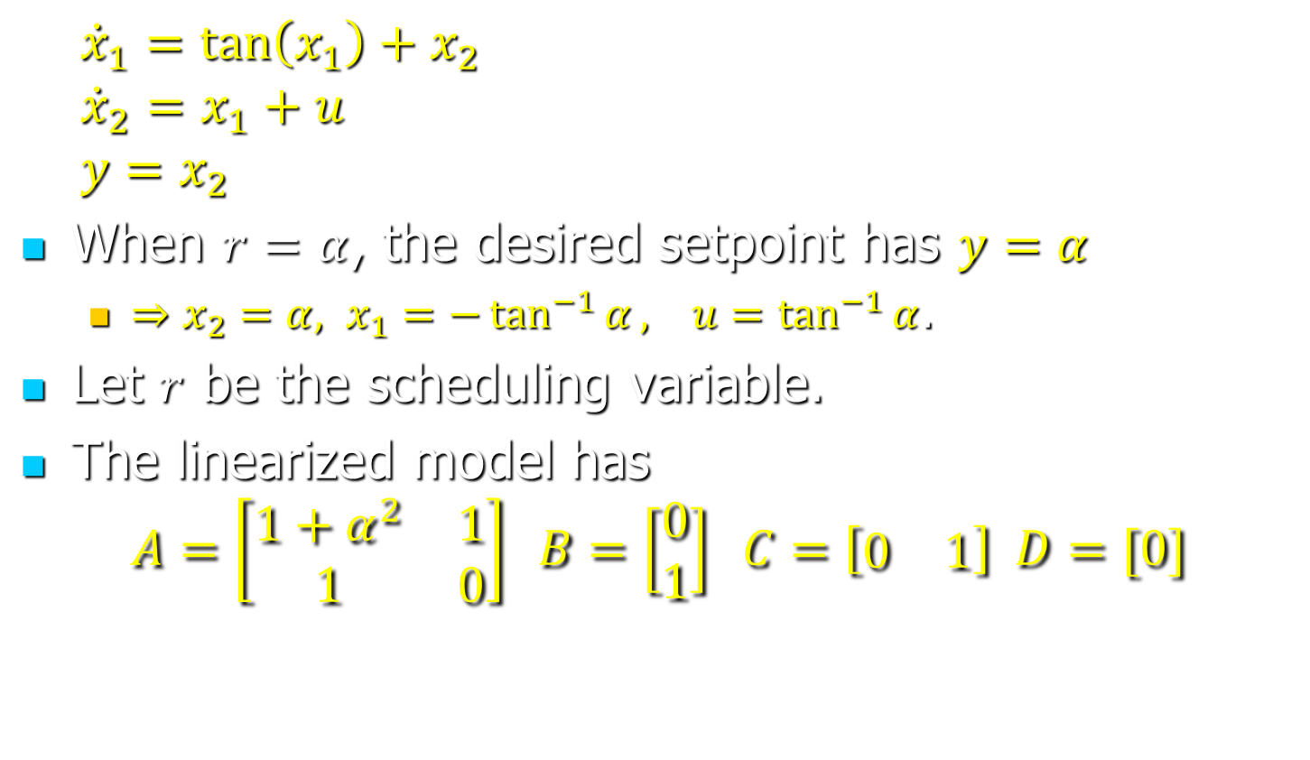
Gain Scheduling—Example
$${\dot{x}}_{1}=\tan\left(x_{1}\right)+x_{2}$$
$${\dot{x}}_{2}=x_{1}+u$$
$$y=x_{2}$$
When $r=α$, the desired setpoint has $y=α$
$⇒x_{2}=α, x_{1}=−\tan^{−1}{α}, u=\tan^{−1}{α}$.
Let $r$ be the scheduling variable.
The linearized model has
$$A=\left[\begin{matrix}1+α^{2} & 1 \\ 1 & 0\end{matrix}\right] B=\left[\begin{matrix}0 \\ 1\end{matrix}\right] C=\left[\begin{matrix}0 & 1\end{matrix}\right] D=[0]$$

Slide 12
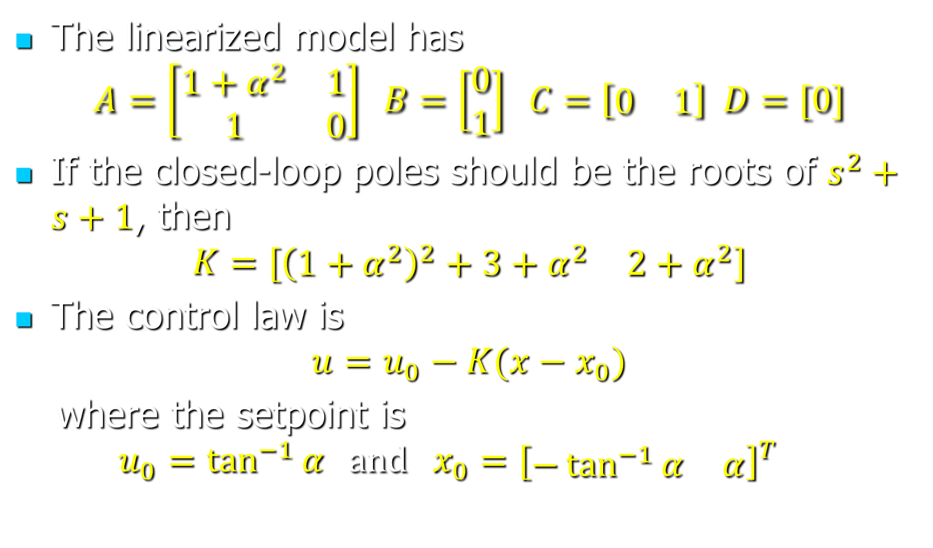
Gain Scheduling—Example
The linearized model has
$$A=\left[\begin{matrix}1+α^{2} & 1 \\ 1 & 0\end{matrix}\right] B=\left[\begin{matrix}0 \\ 1\end{matrix}\right] C=\left[\begin{matrix}0 & 1\end{matrix}\right] D=[0]$$
If the closed-loop poles should be the roots of $s^{2}+s+1$, then
$$K=[\begin{matrix}{\left(1+α^{2}\right)}^{2}+3+α^{2} & 2+α^{2}\end{matrix}]$$
The control law is
$$u=u_{0}−K(x−x_{0})$$
where the setpoint is
$$u_{0}=\tan^{−1}{α} and x_{0}=[{\begin{matrix}−\tan^{−1}{α} & α\end{matrix}]}^{T}$$

Slide 13
Gain Scheduling
How to choose scheduling variables:
Find parameters on which (x₀,u₀) and (A, B, C, D) depend.
Select parameters that can be determined from input and output measurements.
Reference inputs (if any) may appear as scheduling variables.
Example: The speed and the flight path angle could be used for an airplane.
Notes:
The flight path angle is the angle of the velocity w.r.t. the horizontal. It normally equals the pitch angle.

Slide 14
Gain Scheduling
Desired: “Bumpless” plant operation.
Approach:
Select the scheduling variables σ
Find linear model (parameterized by σ).
Design controller (parameterized by σ).
How it works:
Gradually change σ to the desired value σ_{f} (the value corresponding to the desired operating point).
The controller ensures the state of the plant converges to the setpoint determined by σ.

Slide 15
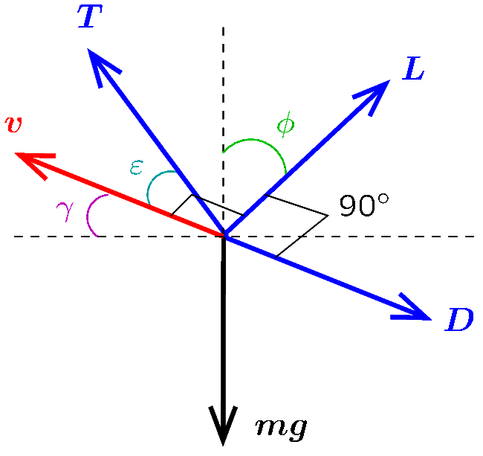
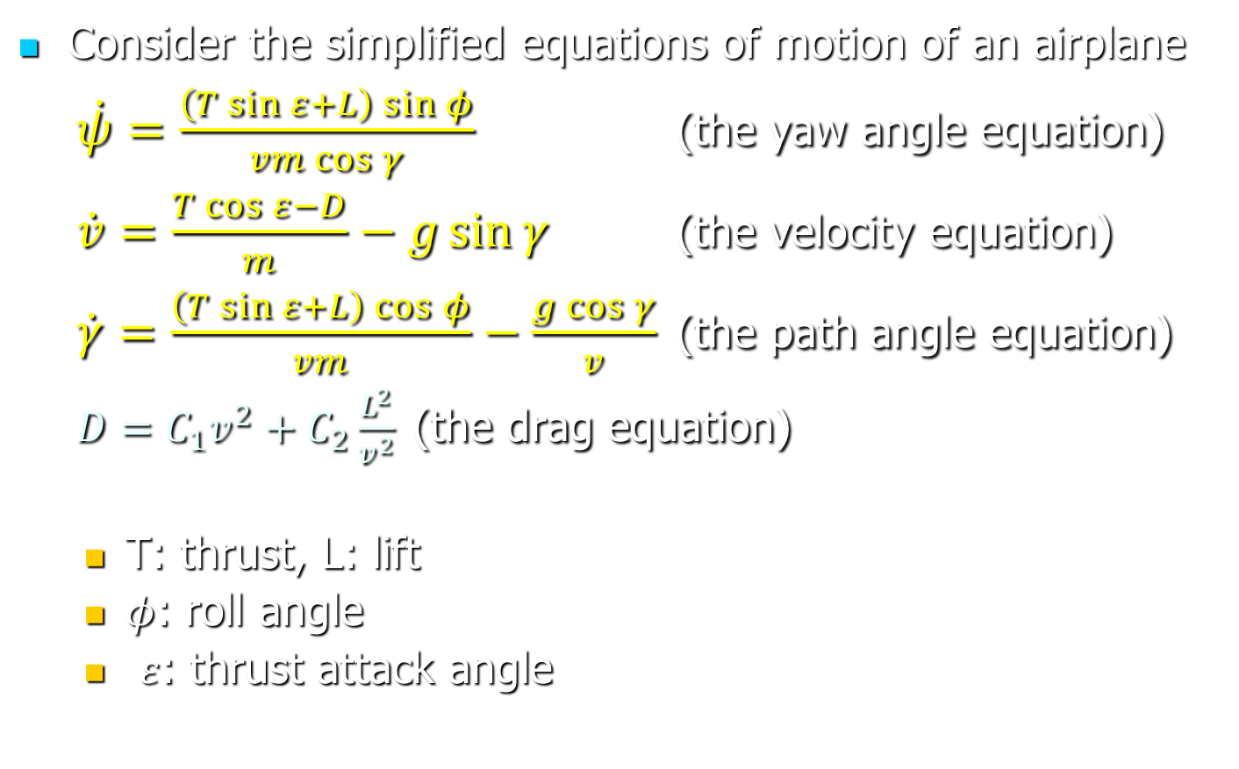
Gain Scheduling—Example
Consider the simplified equations of motion of an airplane
$\dot{ψ}=\frac{\left(T\sin{ε}+L\right)\sin{φ}}{vm\cos{γ}}$ (the yaw angle equation)
$\dot{v}=\frac{T\cos{ε}−D}{m}−g\sin{γ}$ (the velocity equation)
$\dot{γ}=\frac{\left(T\sin{ε}+L\right)\cos{φ}}{vm}−\frac{g\cos{γ}}{v}$ (the path angle equation)
$D=C_{1}v^{2}+C_{2}\frac{L^{2}}{v^{2}}$ (the drag equation)
T: thrust, L: lift
$φ$: roll angle
$ε$: thrust attack angle
Notes:
The equations of motion are derived at http://www.perfectlogic.com/articles/Avionics/FlightDynamics/FlightPart3.html
T, D, and L are in the same plane; mg does not necessarily belong to this plane. D is in the opposite direction of the velocity and L is normal to the velocity. $γ$, the flight path angle, is the angle between the velocity and the horizontal. $ε$, the thrust attack angle, when there is no roll, is the pitch angle minus $γ$. T is in the plane of L and v.

Slide 16
Gain Scheduling—Example
An integral control solution is mentioned at
http://www.perfectlogic.com/articles/Avionics/FlightDynamics/FlightPart4.html

Slide 17
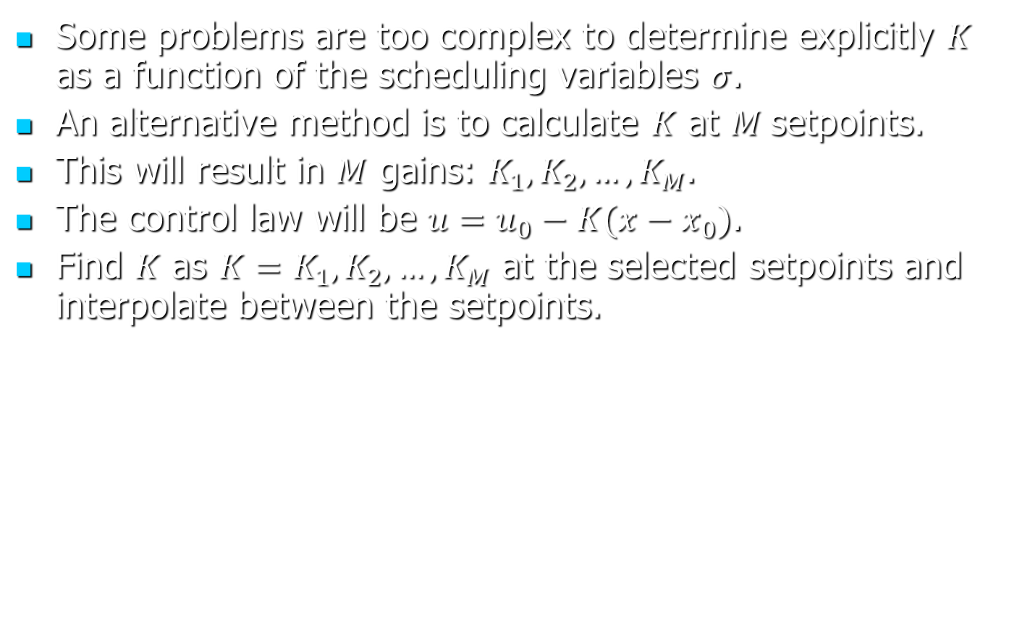
Gain Scheduling
Some problems are too complex to determine explicitly $K$ as a function of the scheduling variables $σ$.
An alternative method is to calculate $K$ at $M$setpoints.
This will result in $M$ gains: $K_{1}, K_{2},…, K_{M}$.
The control law will be $u=u_{0}−K(x−x_{0})$.
Find $K$ as $K=K_{1}, K_{2},…, K_{M}$ at the selected setpoints and interpolate between the setpoints.

Slide 18

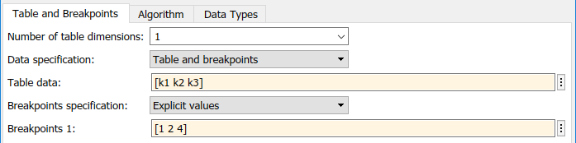
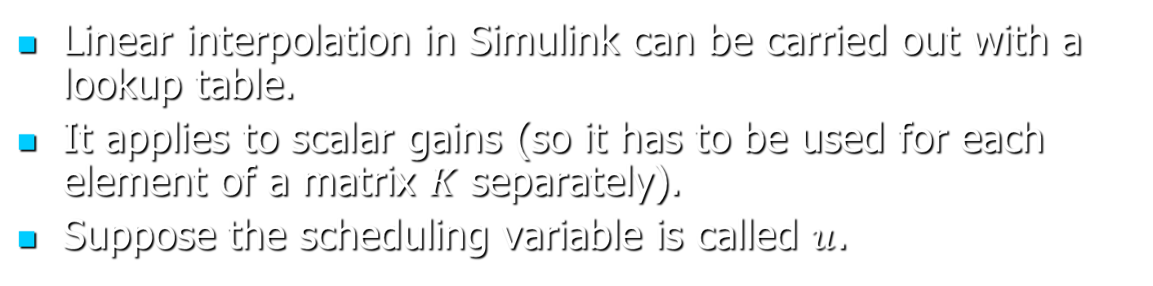
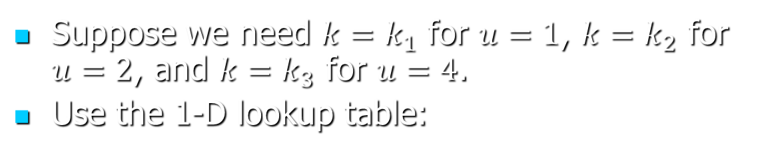
Gain Scheduling—Example
Linear interpolation in Simulink can be carried out with a lookup table.
It applies to scalar gains (so it has to be used for each element of a matrix $K$ separately).
Suppose the scheduling variable is called $u$.
Suppose we need $k=k_{1}$ for $u=1$, $k=k_{2}$ for $u=2$, and $k=k_{3}$ for $u=4$.
Use the 1-D lookup table:

Slide 19
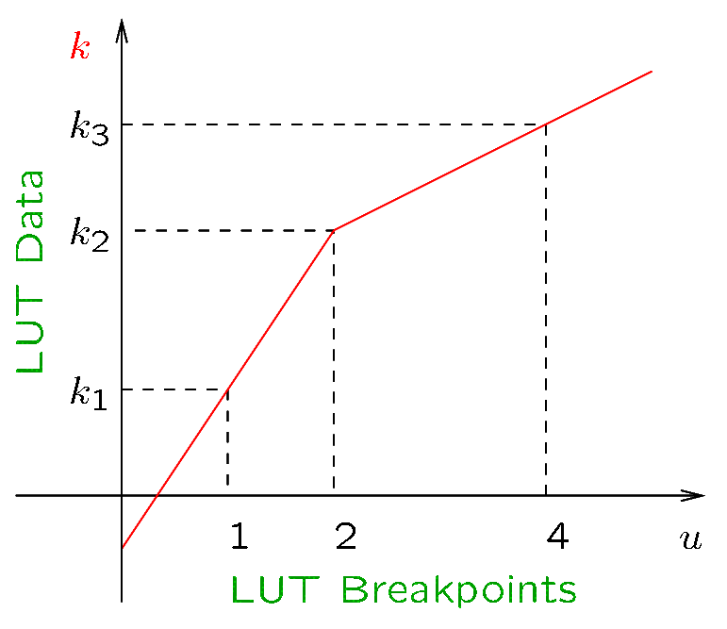
Gain Scheduling—Example
The lookup table can perform linear interpolation.
See gsch1.m and gsch1s.slx on Canvas for an example.

Slide 20
Fuzzy Control
Expert knowledge on how to control a system can be placed in a rule base.
The output will change abruptly unless some interpolation scheme is used.
Fuzzy control provides such an interpolation scheme.
Fuzzy control requires more information than just the rule base: it needs functions that assess how close the inputs are to the values that activate rules of the rule base.

Slide 21
Membership Functions
The rules of a rule base are activated when the inputs satisfy certain conditions.
The functions that asses how close are the conditions from being satisfied or falsified are called membership functions.
Membership functions take values between 0 and 1.

Slide 22
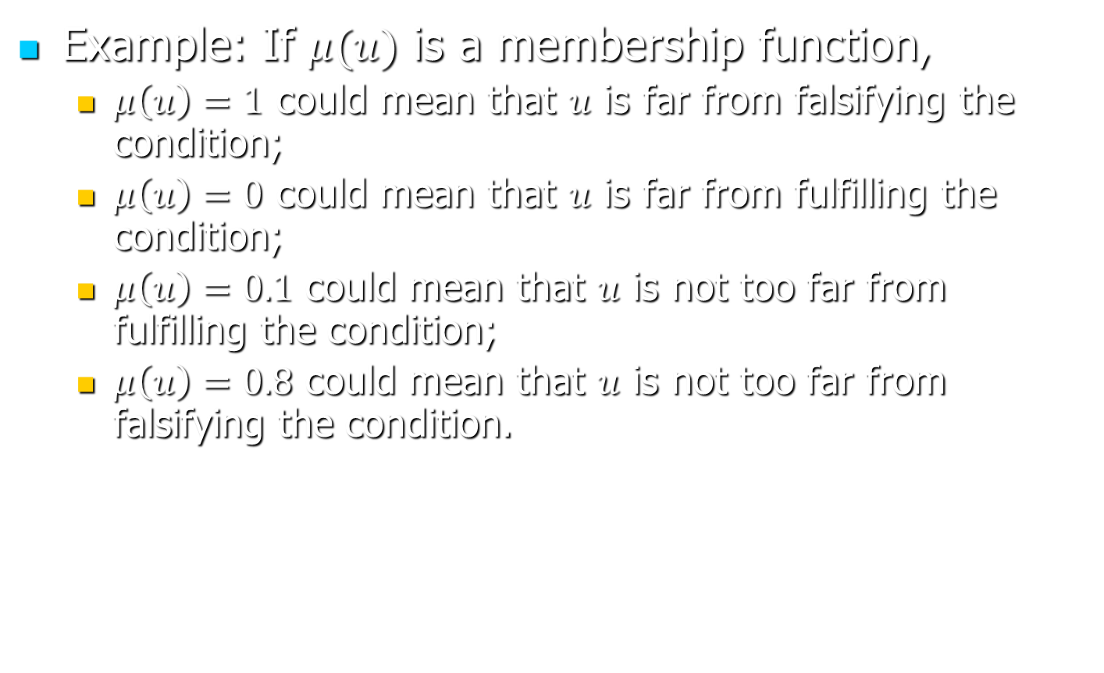
Membership Functions
Example: If $μ(u)$ is a membership function,
$μ\left(u\right)=1$ could mean that $u$ is far from falsifying the condition;
$μ\left(u\right)=0$ could mean that $u$ is far from fulfilling the condition;
$μ\left(u\right)=0.1$ could mean that $u$ is not too far from fulfilling the condition;
$μ\left(u\right)=0.8$ could mean that $u$ is not too far from falsifying the condition.

Slide 23
Rules
A rule is written in terms of the operators AND, OR, NOT.
Example of rule
IF (A OR Z) AND NOT N THEN Y₂
Premise
Conclusion

Slide 24
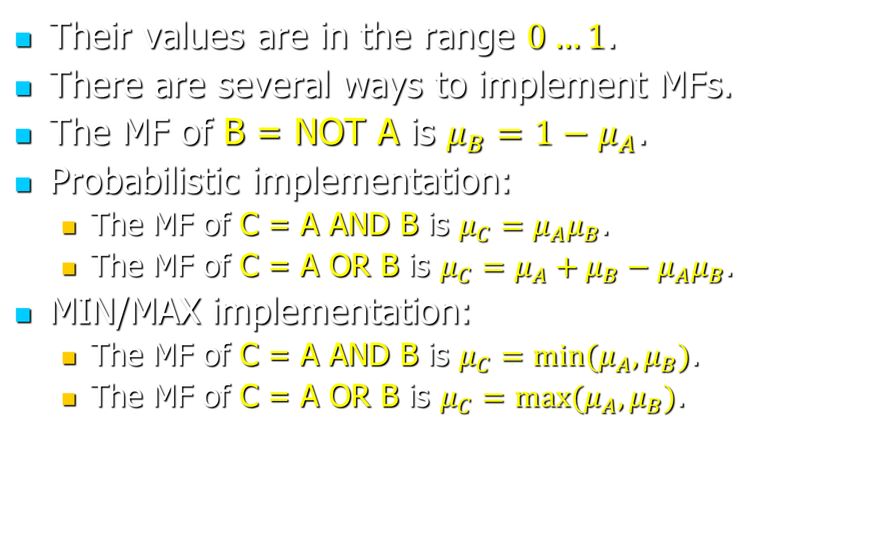
Membership Functions
Their values are in the range $0…1$.
There are several ways to implement MFs.
The MF of B = NOT A is $μ_{B}=1−μ_{A}$.
Probabilistic implementation:
The MF of C = A AND B is $μ_{C}=μ_{A}μ_{B}$.
The MF of C = A OR B is $μ_{C}=μ_{A}+μ_{B}−μ_{A}μ_{B}$.
MIN/MAX implementation:
The MF of C = A AND B is $μ_{C}=min⁡(μ_{A},μ_{B})$.
The MF of C = A OR B is $μ_{C}=max⁡(μ_{A},μ_{B})$.

Slide 25
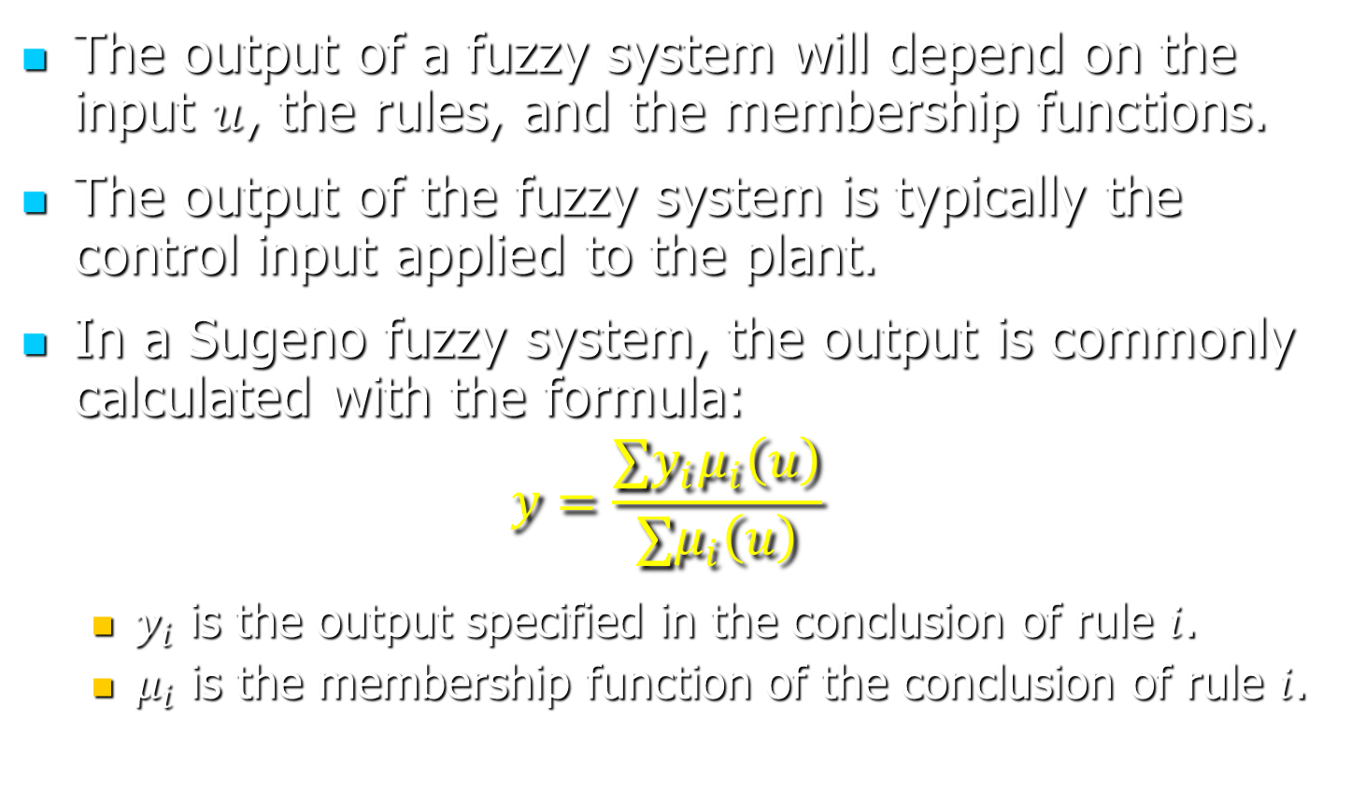
Output
The output of a fuzzy system will depend on the input $u$, the rules, and the membership functions.
The output of the fuzzy system is typically the control input applied to the plant.
In a Sugeno fuzzy system, the output is commonly calculated with the formula:
$$y=\frac{∑y_{i}μ_{i}\left(u\right)}{∑μ_{i}\left(u\right)}$$
$y_{i}$ is the output specified in the conclusion of rule $i$.
$μ_{i}$ is the membership function of the conclusion of rule $i$.

Slide 26
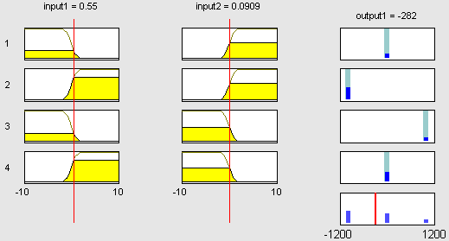
Sugeno Fuzzy Systems
Probabilistic AND/OR

Slide 27
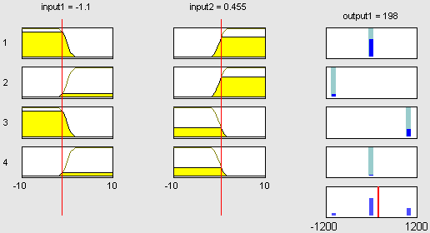
Sugeno Fuzzy Systems
Probabilistic AND/OR

Slide 28
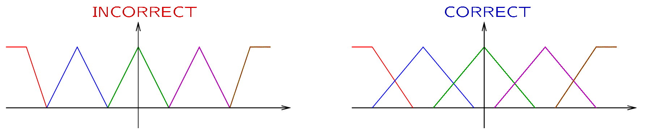
Remarks
Use few membership functions.
To avoid abrupt output changes, membership functions should overlap.

Slide 29
Mamdani Approach
A rule-base is given.
Fuzzy sets are given for all inputs and outputs. (Fuzzification)
Input value + fuzzy sets (FS) → degrees of membership (DMs).
DMs + premise → DM of premise.
DM of premise + output FS → conclusion FS (Implication)
Conclusion FSs → Aggregated FS (Aggregation)
Aggregated FS → output value (Defuzzification)

Slide 30
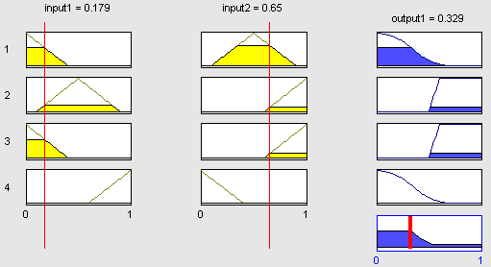
Mamdani Fuzzy Systems
Min/Max AND/OR

Slide 31
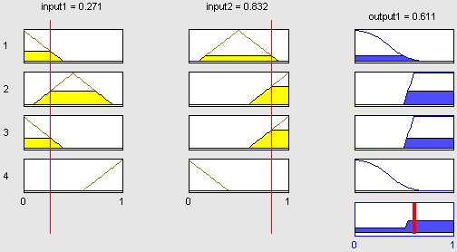
Mamdani Fuzzy Systems
Min/Max AND/OR

Slide 32
Applications
Gain scheduling:
Linearize system at N operating points.
Find linear control law for each point.
Use a Sugeno FIS of first order.
The input could be the (estimated) state vector.
One rule per operating point.
The conclusion of each rule: the corresponding control law.
The membership functions are used to identify the rule (or rules) that apply at a given state.

Slide 33
Applications
Fuzzy inference can be combined with neural networks.
Neural network methods used to estimate the parameters of the membership functions.

