Slide 1
The State Space Model
Properties, Stability, Controllability, and Observability
M.V. Iordache, EEGR4933 Automatic Control Systems, Spring 2019, LeTourneau University

Slide 2
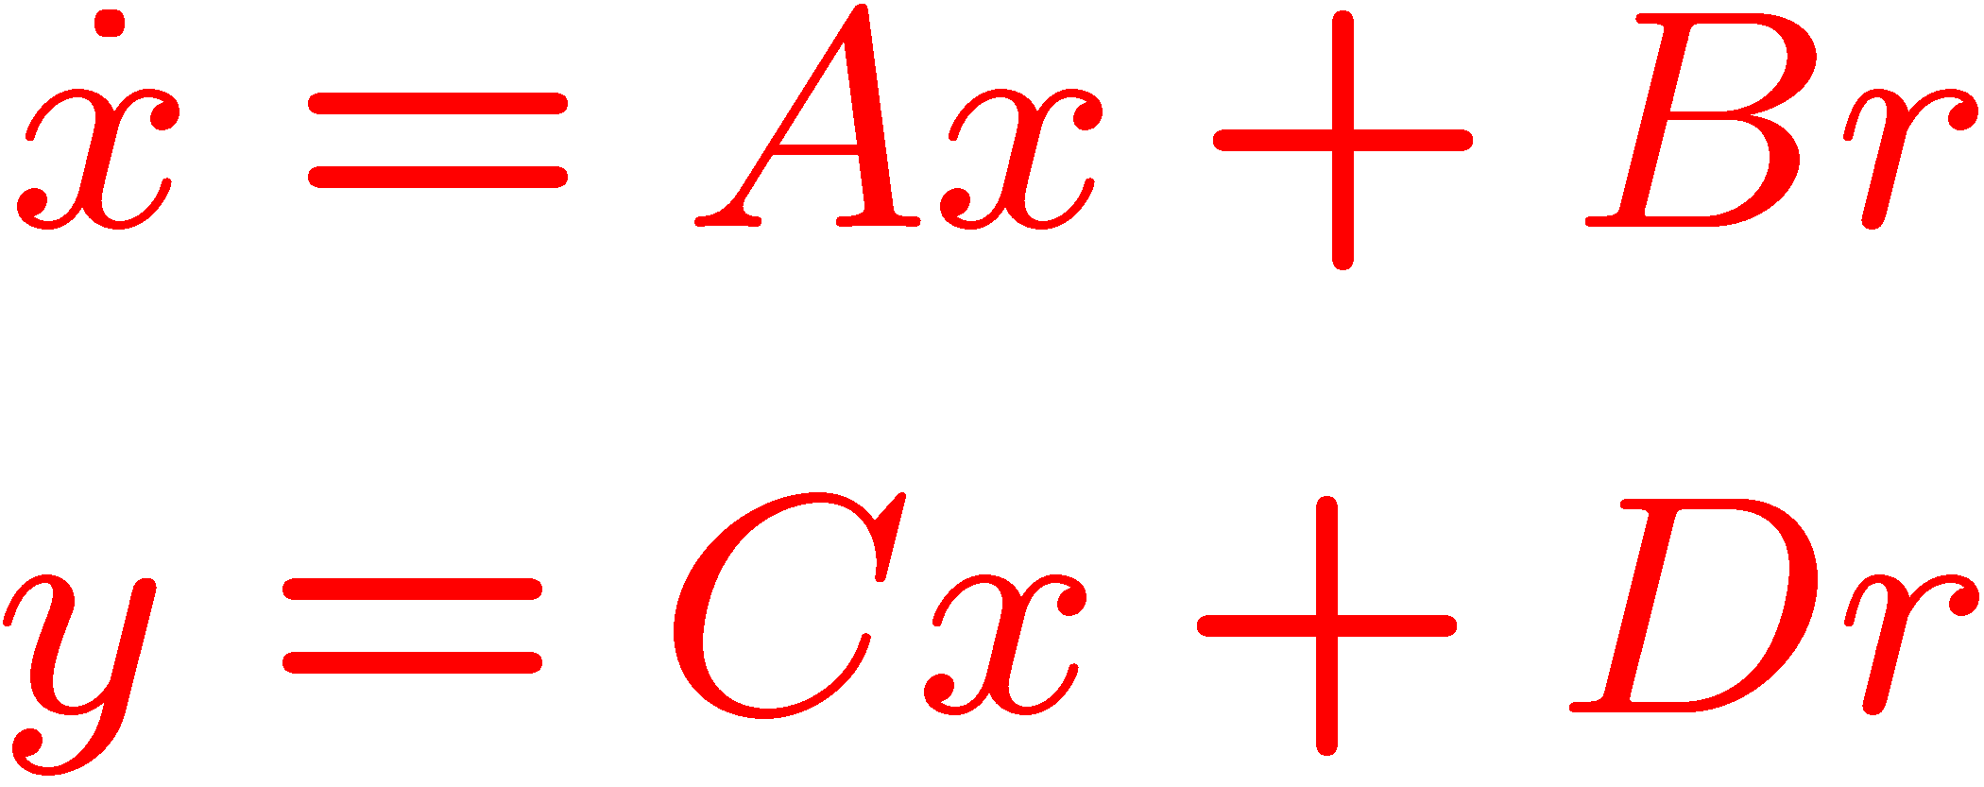
State Space Representation
A very common representation is
A, B, C, D are matrices.
r, x, and y are vectors.
x is the state vector.
Input
Output
r(t)
y(t)

Slide 3
State Space Representation
x: state vector.
x may represent system variables (displacement, velocity, voltage, temperature, pressure, etc.)
Sometimes x does not have an obvious physical meaning.
y: output. May represent:
Sensor output (frequency, flow rate, current, etc.)
Simulation output (variables we wish to visualize).
r: input (such as force, torque, voltage, etc.)

Slide 4
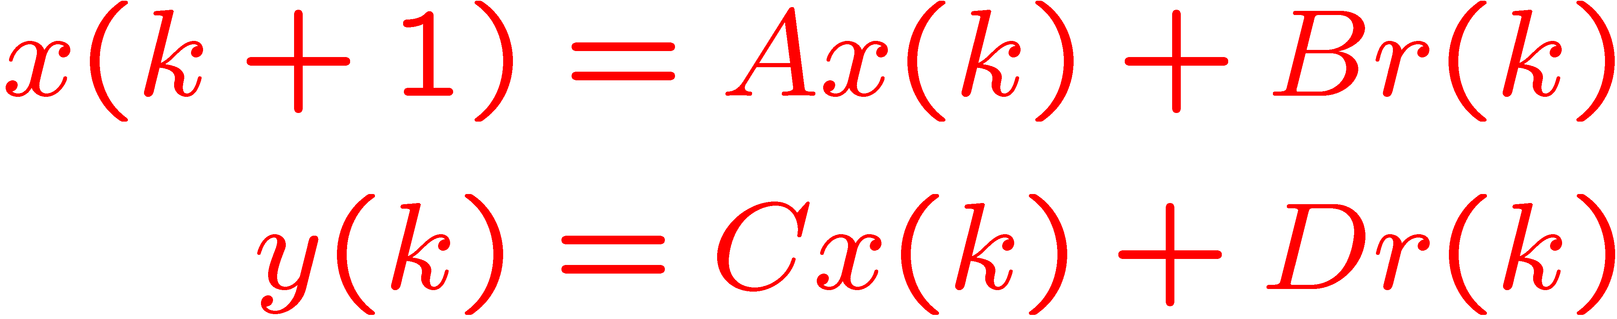
State Space Representation
Note also the discrete time representation
Recall the continuous time representation
Input
Output
r(k)
y(k)
Input
Output
r(t)
y(t)

Slide 5
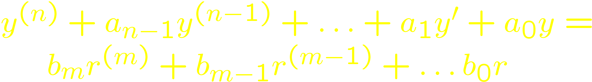
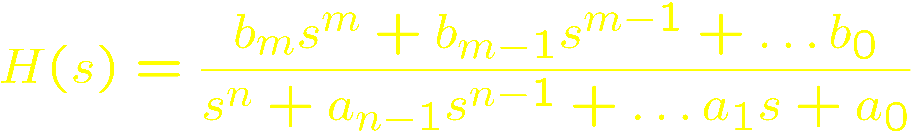
Transfer Functions
An I/O relationship
is expressed by a TF

Slide 6
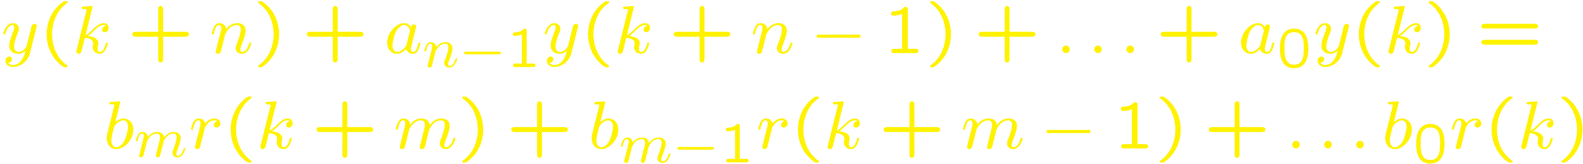

Transfer Functions
An I/O relationship
is expressed by a TF

Slide 7
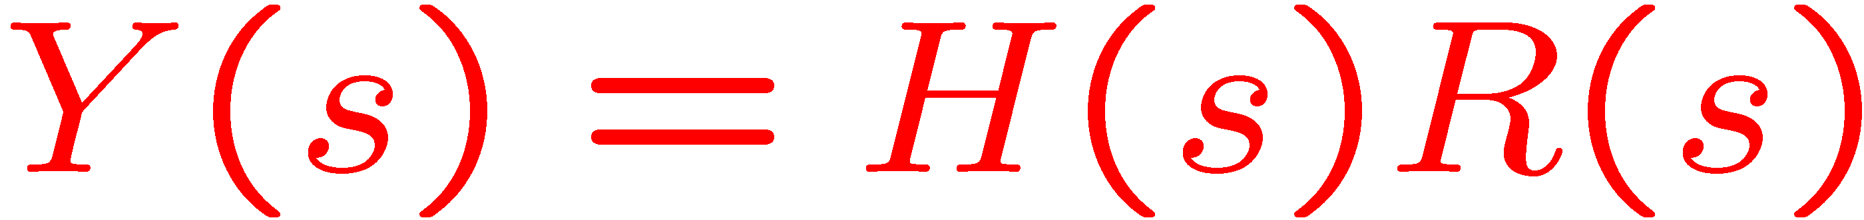
Relation between SS and TF models
Conversions TF → SS and SS → TF possible.
Input
Output
r(t)
y(t)
Input
Output
r(t)
y(t)

Slide 8
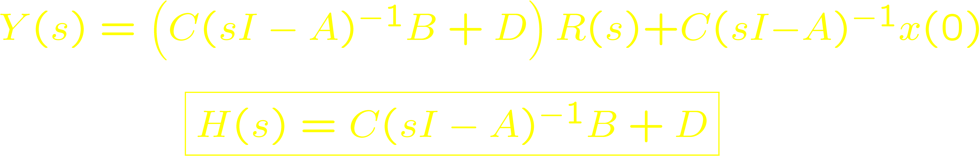
Transfer Function of SS Model
Assumes zero initial conditions: x(0) = 0.
Input
Output
r(t)
y(t)

Slide 9

MATLAB Examples
Find a state-variable representation of $\frac{4s−5}{s^{2}+3s−2}$.
Verify the control canonical form of $\frac{4s−5}{s^{2}+3s−2}$.
s = tf('s'); % define the s variable
H = (4*s-5)/(s^2+3*s-2); % define the TF
sys = ss(H) % obtains a SS representation
A = [0 1; 2 -3]; B = [0; 1];
C = [-5 4]; D = 0;
sys = ss(A, B, C, D); % obtain SS object
tf(sys) % calculate its TF

Slide 10

MATLAB Examples
Verify the $C{\left(sI−A\right)}^{−1}B+D$ formula for a third order system.
A = [-2 1 0; -3 0 1; 4 0 0]; B = [5; 6; 8];
C = [1 0 0]; D = [3];
s = sym('s'); % define s as symbolic var.
res = C*inv(s*eye(3)-A)*B+D; % calculate TF
pretty(simplify(res)); % show the TF
tf(ss(A, B, C, D)) % verify TF

Slide 11
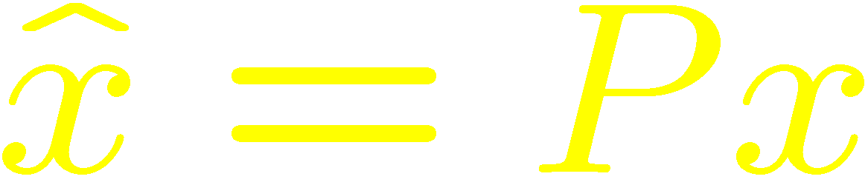
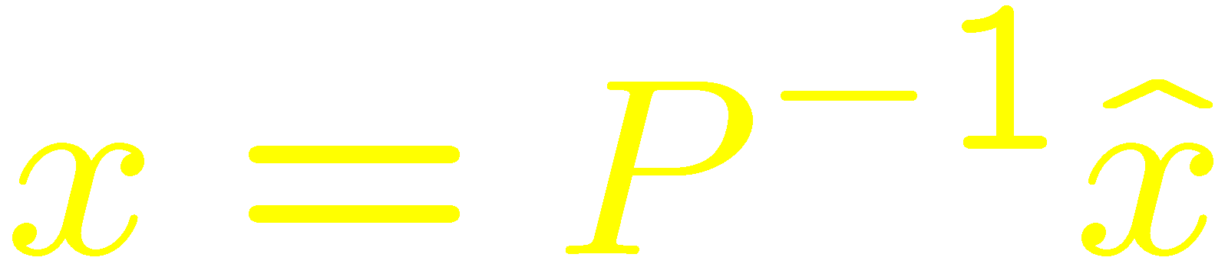
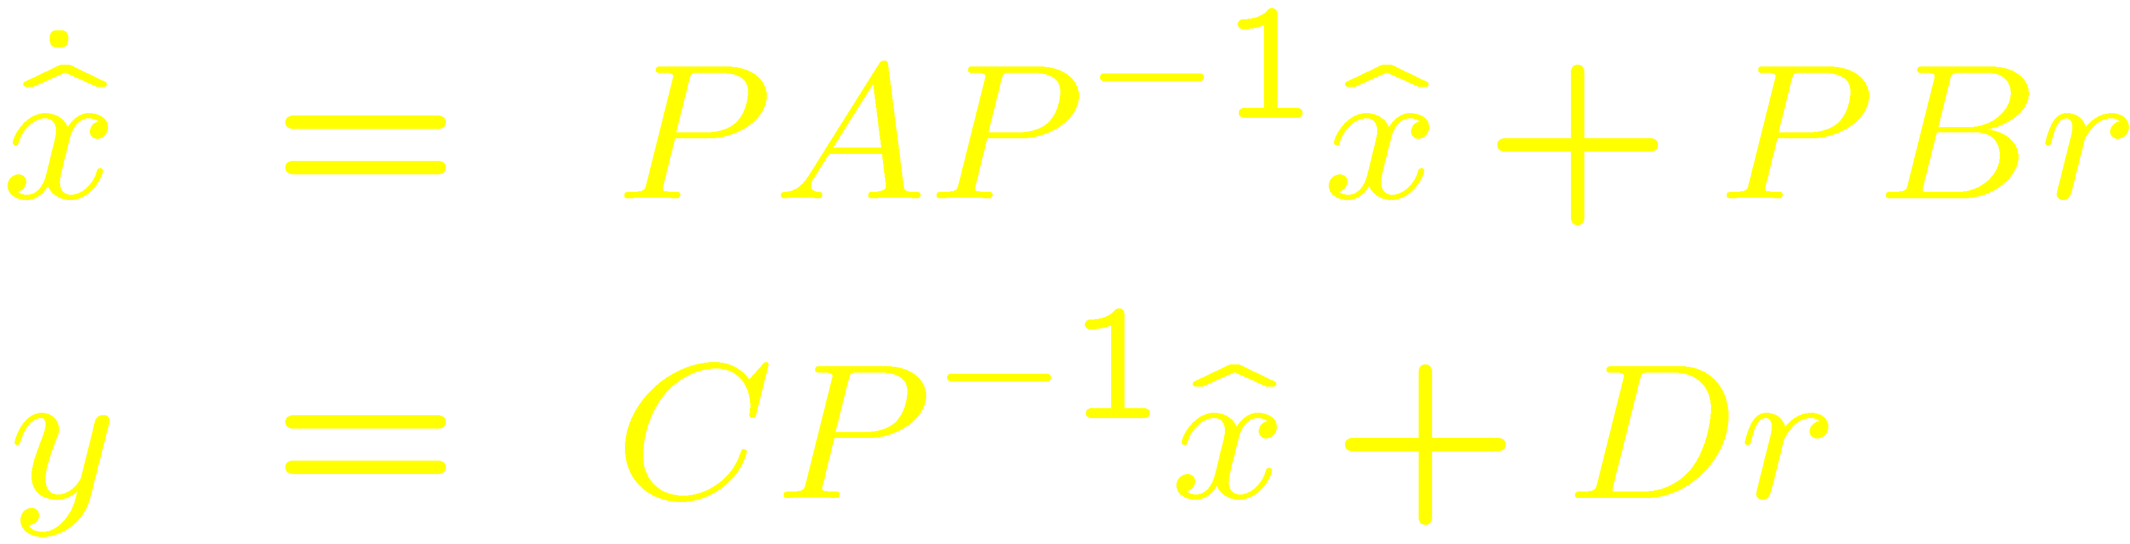
Similarity Transformations
A state variable model is not unique.
A new state variable model can be obtained by a change of variables
By substituting
an equivalent model is obtained:

Slide 12
Solution of the SS equation
Note that x(t) depends on
x(0) – the initial state
r(t) – the input
Input
Output
r(t)
y(t)

Slide 13
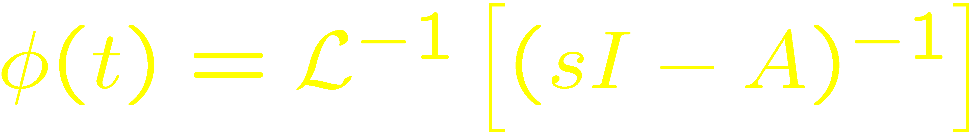
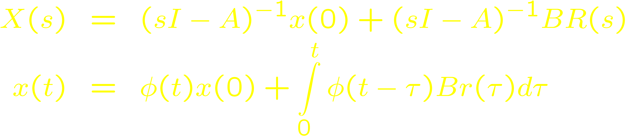
Solution of the SS equation
Note that x(t) depends on
x(0) – the initial state
r(t) – the input
Let

Slide 14
Solution of the SS equation
MATLAB example:
% define the system
a = [1 -2; 2 -3]; b = [1; -1];
c = eye(2); d = zeros(2,1);
sys = ss(a, b, c, d);
% define a step input that begins at time 1.01
t1 = 0:0.01:1; % t1 = 0, 0.01, ..., 0.99, 1
t2 = 1.01:0.01:10; % t2 = 1.01. 1.02, ..., 10
r = [zeros(1,length(t1)), ones(1,length(t2))];
% simulate
x0 = [-1; 2]; % define the initial condition
t = [t1, t2]; % simulation at t = 0, 0.01, ... 10
lsim(sys, r, t, x0); % simulate the system

Slide 15
Stability
BIBO stability: necessary for most engineering systems.
For SS models: x(t) is also required to be bounded.
For stability, all eigenvalues of A must be in the LHP.
This ensures more than just boundedness:
If r(t) → r_{SS} then x(t) → x_{SS} = – A⁻¹Br_{SS}
In particular, for zero input, x(t) decays exponentially from x(0) to 0.

Slide 16
Stability
In the case of discrete-time systems, for stability, all eigenvalues of A must be inside the unit circle.
This ensures more than just boundedness:
If r(n) → r_{SS} then x(n) → x_{SS} = (I– A)⁻¹Br_{SS}
In particular, for zero input, x(n) decays exponentially from x(0) to 0.

Slide 17
Stability
MATLAB example:
a = [13.44 -8.295; 23.1 -14.175];
ev = eig(a) % find the eigenvalues
abs(ev) % find the absolute value, to determine whether the roots are inside the unit circle

Slide 18
Controllability
Is there for any x(0) some input r(t) that leads in finite time the state x to the origin? If yes, the system is controllable.
There are also partially controllable systems.
Controllable means here completely state controllable.
A system is reachable if any point in the state space can be reached in finite time when starting with x(0) = 0.
Notes:
Reachability does not imply that it is practical to drive the state anywhere in the state space. From a practical viewpoint, the reachable space is limited by the bounds of the control input.

Slide 19
Controllability
In continuous-time, reachability and controllability imply each other.
In discrete-time, controllability implies reachability only when A is invertible.
Reachability implies that there is some input r(t) that transfers the state from x(t₁) = z₁ to x(t₂) = z₂ for any t₁, t₂>t₁, z₁, and z₂.
A system is reachable when the controllability matrix has full rank.
Notes:
Reachability does not imply that it is practical to drive the state anywhere in the state space. From a practical viewpoint, the reachable space is limited by the bounds of the control input.

Slide 20
Observability
Is there some finite time t₁ such that x(0) can be determined from r(t) and y(t) for 0 ≤ t ≤ t₁? If yes, the system is observable.
There are also partially observable systems.
Observable means here completely state observable.
A system is observable when the observability matrix has full rank.
Notes:
This definition follows the textbook (see section 10.6). Alternatively, consider the zero-input response of a system; the system is observable at time $t_{0}$ if $y\left(t\right)=0$for all $t≥t_{0}$ implies $x(t_{0})=0$. This second definition corresponds to Definition 3.3 at page 249 of Linear Systems by Antasklis and Michel, 1997.

