Slide 1
Approximating Transfer Functions
How to Obtain a Lower Order Approximate Transfer Function
M.V. Iordache, EEGR3523 Mechatronics, Spring 2020, LeTourneau University

Slide 2
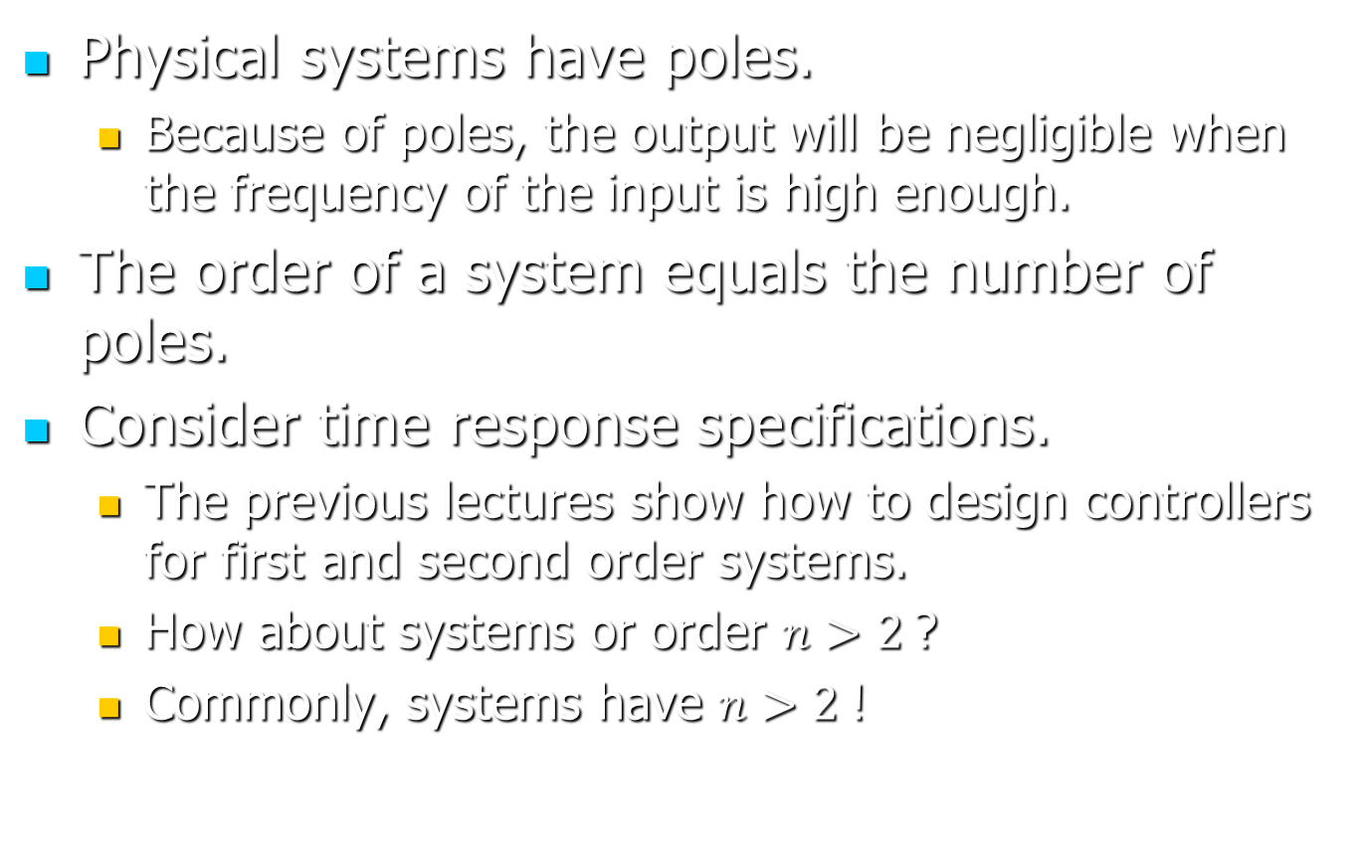
Higher Order Systems
Physical systems have poles.
Because of poles, the output will be negligible when the frequency of the input is high enough.
The order of a system equals the number of poles.
Consider time response specifications.
The previous lectures show how to design controllers for first and second order systems.
How about systems or order $n>2$?
Commonly, systems have $n>2$!

Slide 3
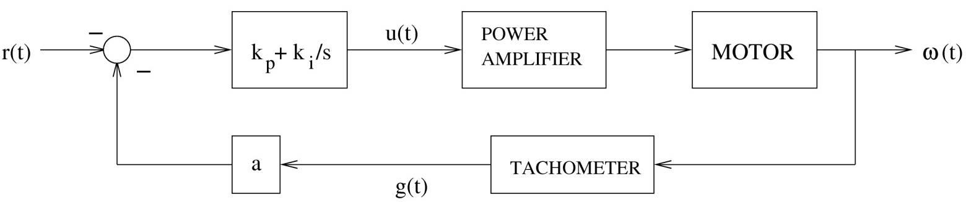
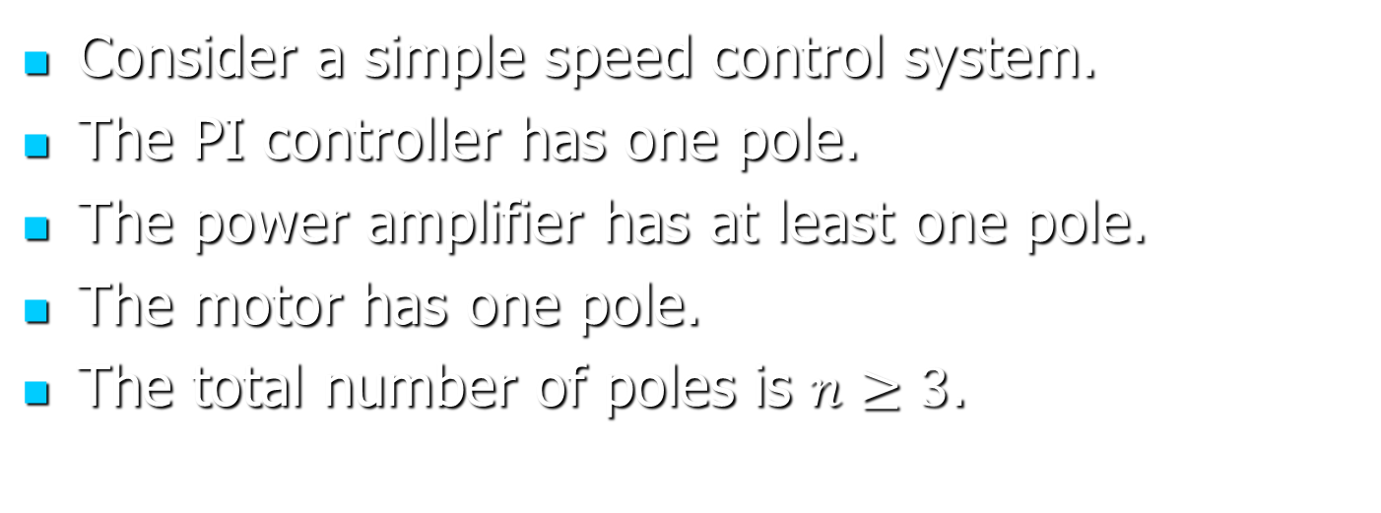
Higher Order Systems—Example
Consider a simple speed control system.
The PI controller has one pole.
The power amplifier has at least one pole.
The motor has one pole.
The total number of poles is $n≥3$.

Slide 4
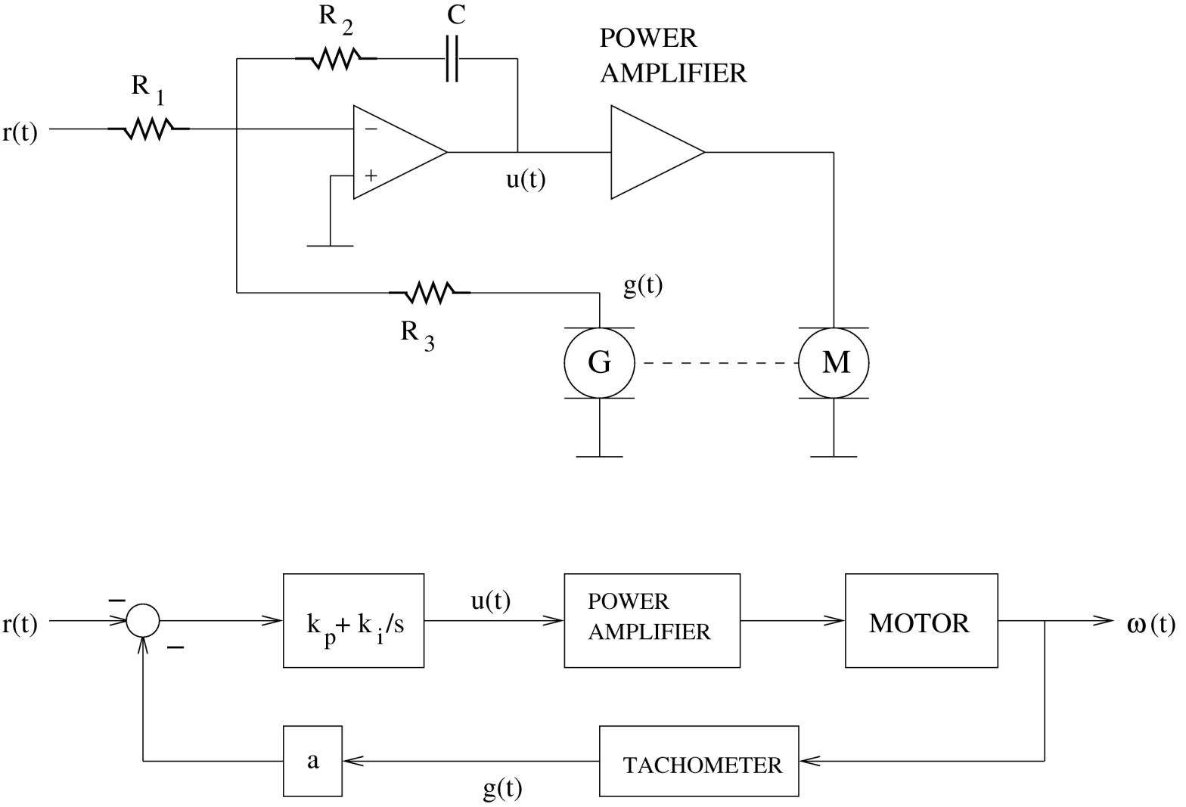
Higher Order Systems—Example
Consider an analog implementation of the controller.

Slide 5
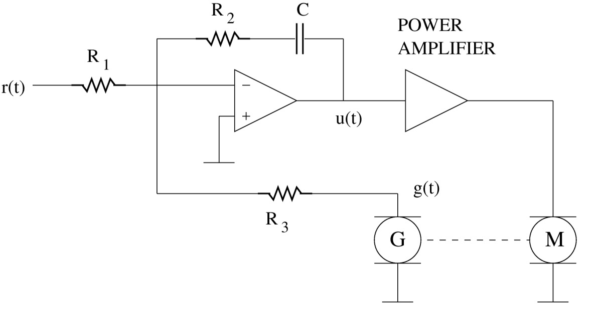
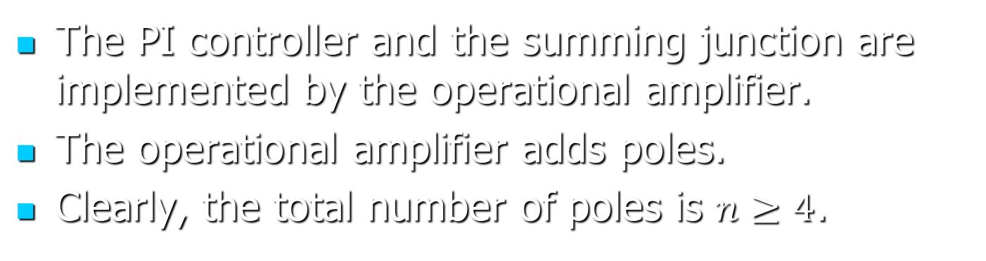
Higher Order Systems—Example
The PI controller and the summing junction are implemented by the operational amplifier.
The operational amplifier adds poles.
Clearly, the total number of poles is $n≥4$.

Slide 6
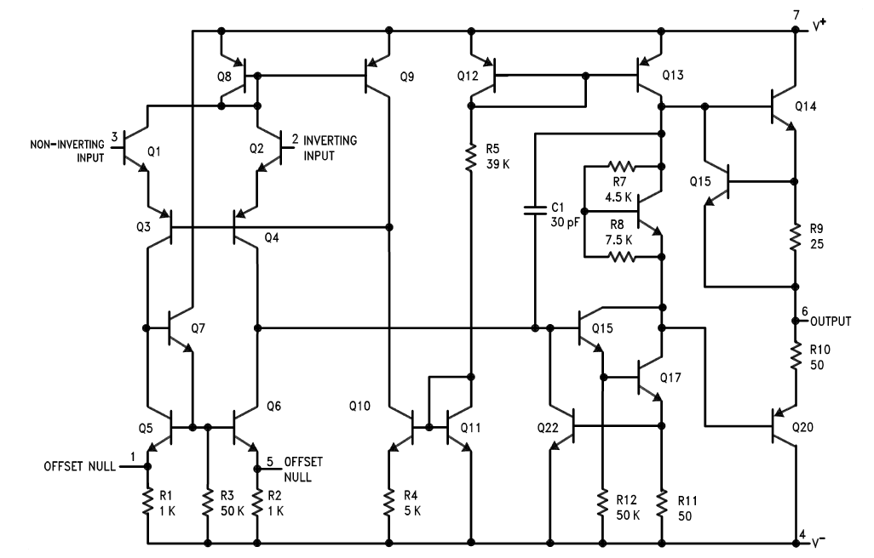
The figure shows the implementation of a classic operational amplifier (741).
There are 22 transistors.
Transistors have poles …
Note that operational amplifiers have multiple poles!

Slide 7
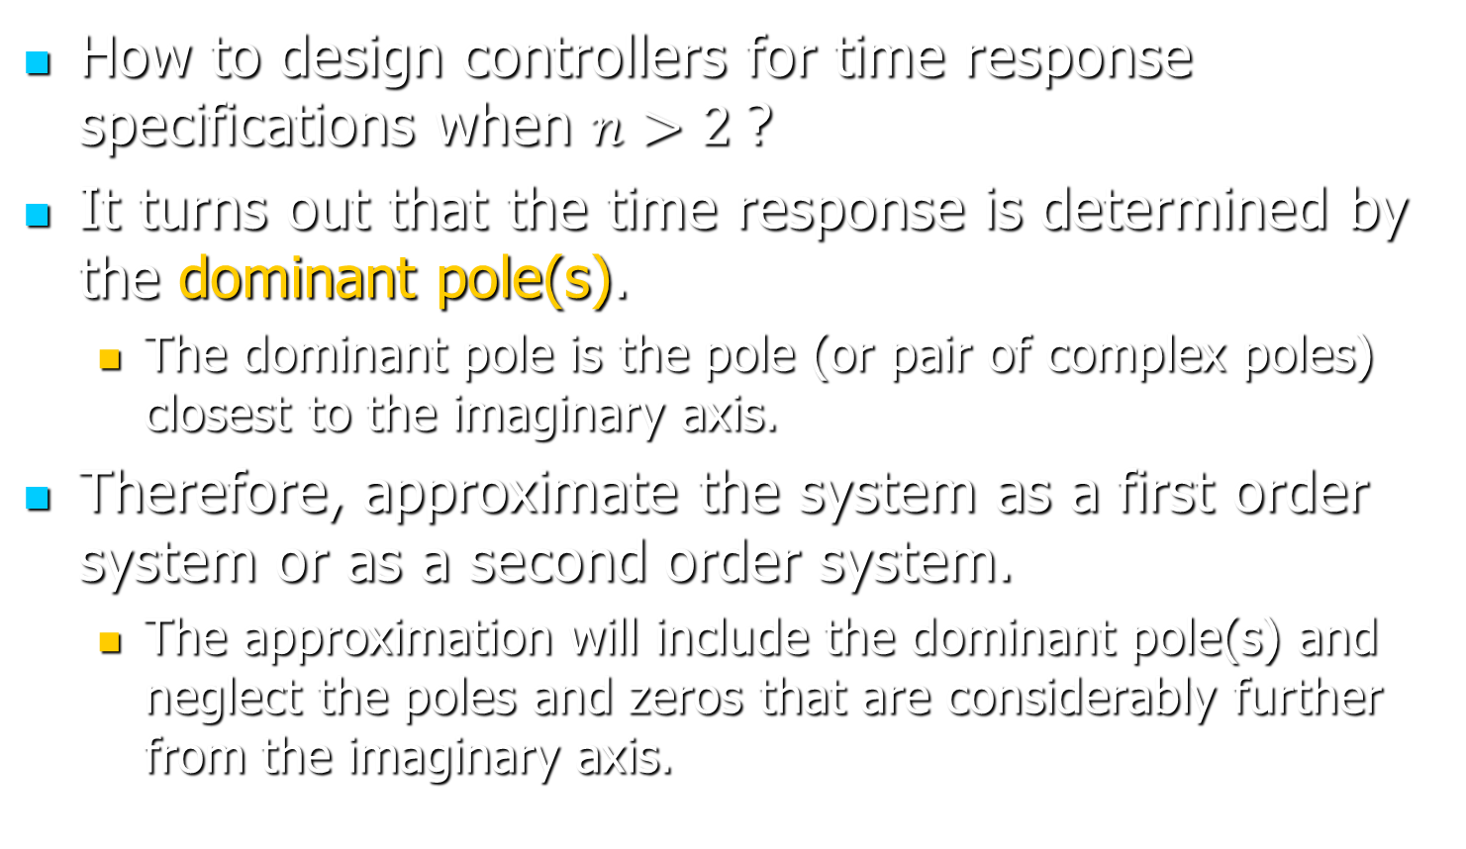
Higher Order Systems
How to design controllers for time response specifications when $n>2$?
It turns out that the time response is determined by the dominant pole(s).
The dominant pole is the pole (or pair of complex poles) closest to the imaginary axis.
Therefore, approximate the system as a first order system or as a second order system.
The approximation will include the dominant pole(s) and neglect the poles and zeros that are considerably further from the imaginary axis.

Slide 8
Approximations—Principle
Assume a stable system.
The poles and zeros sufficiently close to the imaginary axis are kept; the others are neglected.
NEGLECT
KEEP
NEGLECT

Slide 9
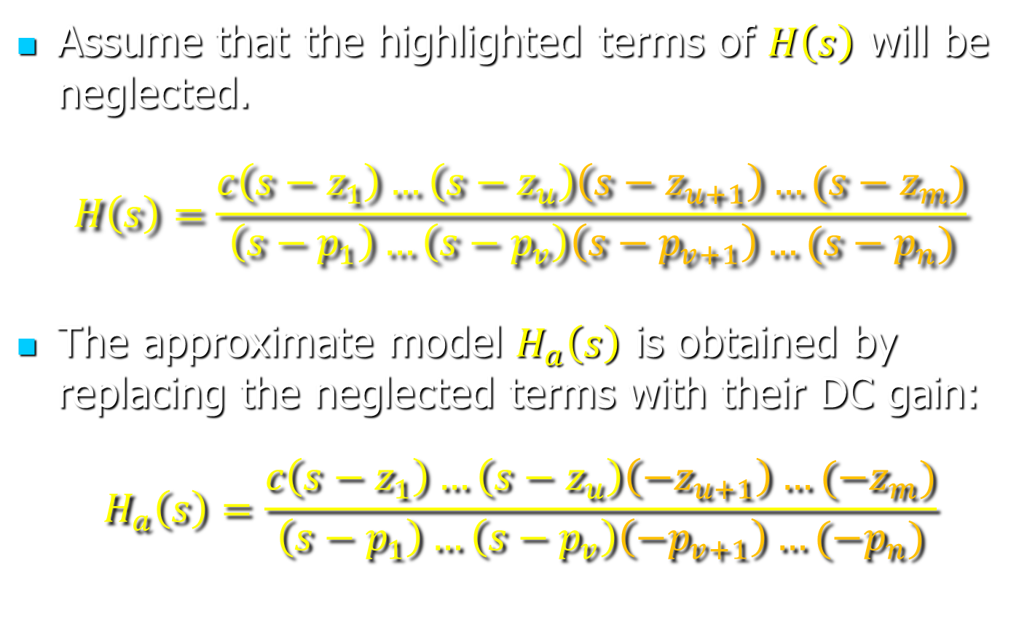
Approximations—Principle
Assume that the highlighted terms of $H\left(s\right)$ will be neglected.
$$H\left(s\right)=\frac{c\left(s−z_{1}\right)…\left(s−z_{u}\right)\left(s−z_{u+1}\right)…(s−z_{m})}{\left(s−p_{1}\right)…\left(s−p_{v}\right)\left(s−p_{v+1}\right)…(s−p_{n})}$$
The approximate model $H_{a}\left(s\right)$ is obtained by replacing the neglected terms with their DC gain:
$$H_{a}\left(s\right)=\frac{c\left(s−z_{1}\right)…\left(s−z_{u}\right)\left(−z_{u+1}\right)…(−z_{m})}{\left(s−p_{1}\right)…\left(s−p_{v}\right)\left(−p_{v+1}\right)…(−p_{n})}$$

Slide 10

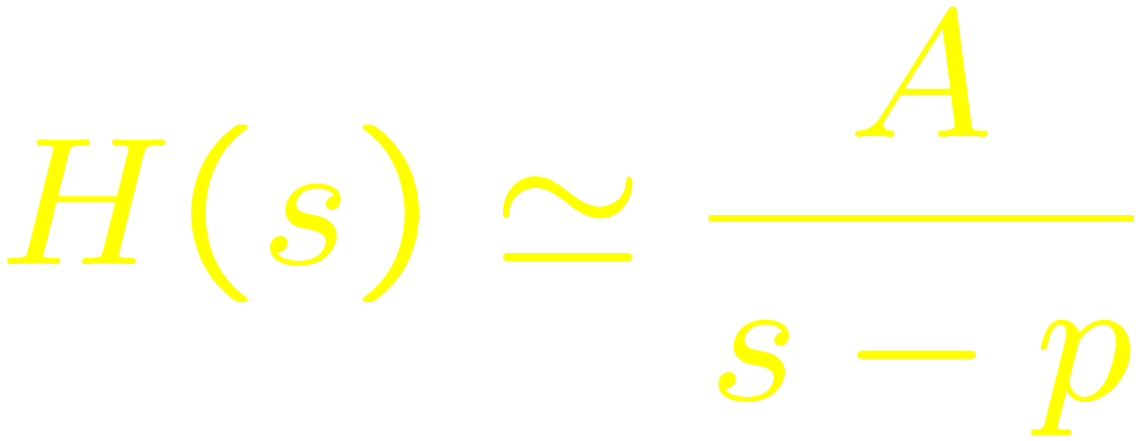
Dominant Poles
Consider the pole-zero plot of stable system.
If the system has a single dominant pole, a first order approximation could be appropriate:
Dominant pole

Slide 11
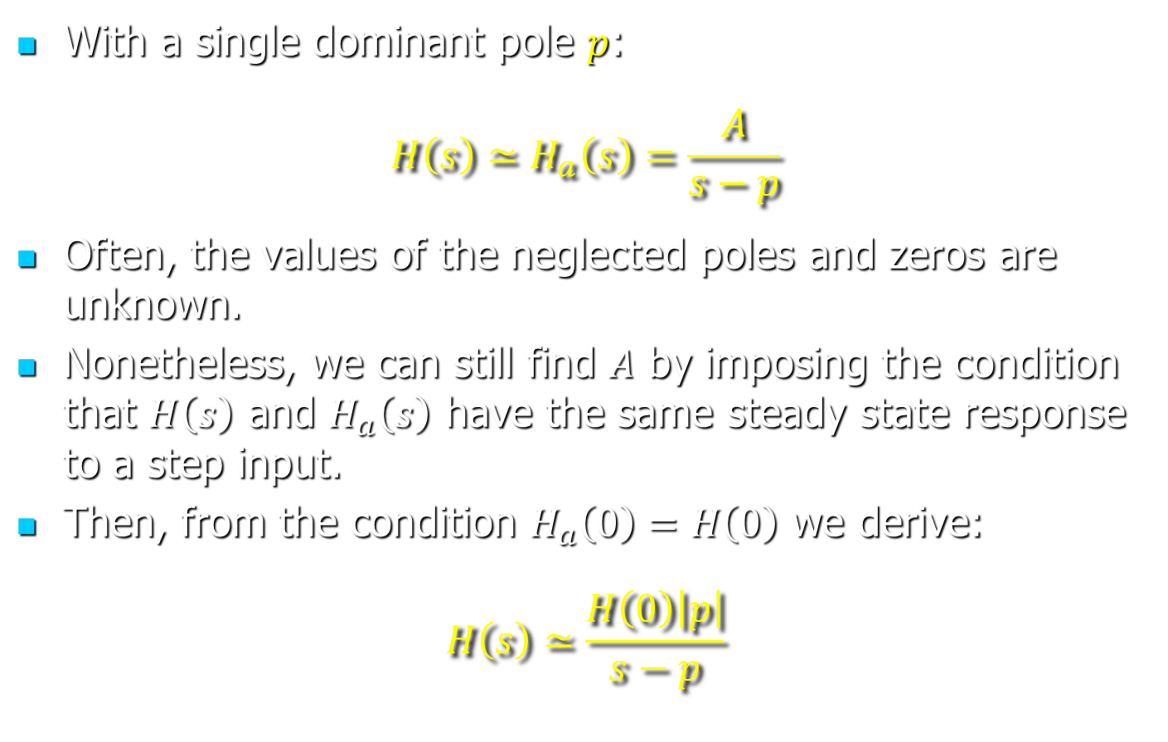
Dominant Poles
With a single dominant pole $p$:
$$H\left(s\right)≃H_{a}\left(s\right)=\frac{A}{s−p}$$
Often, the values of the neglected poles and zeros are unknown.
Nonetheless, we can still find $A$ by imposing the condition that $H\left(s\right)$ and $H_{a}\left(s\right)$ have the same steady state response to a step input.
Then, from the condition $H_{a}\left(0\right)=H\left(0\right)$ we derive:
$$H\left(s\right)≃\frac{H\left(0\right)\left|p\right|}{s−p}$$

Slide 12
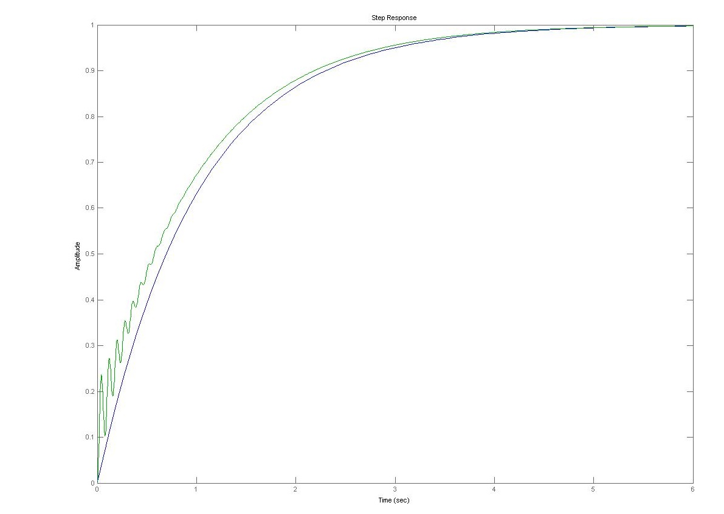
First order approximation
Response
Response of 1st order approximation

Slide 13
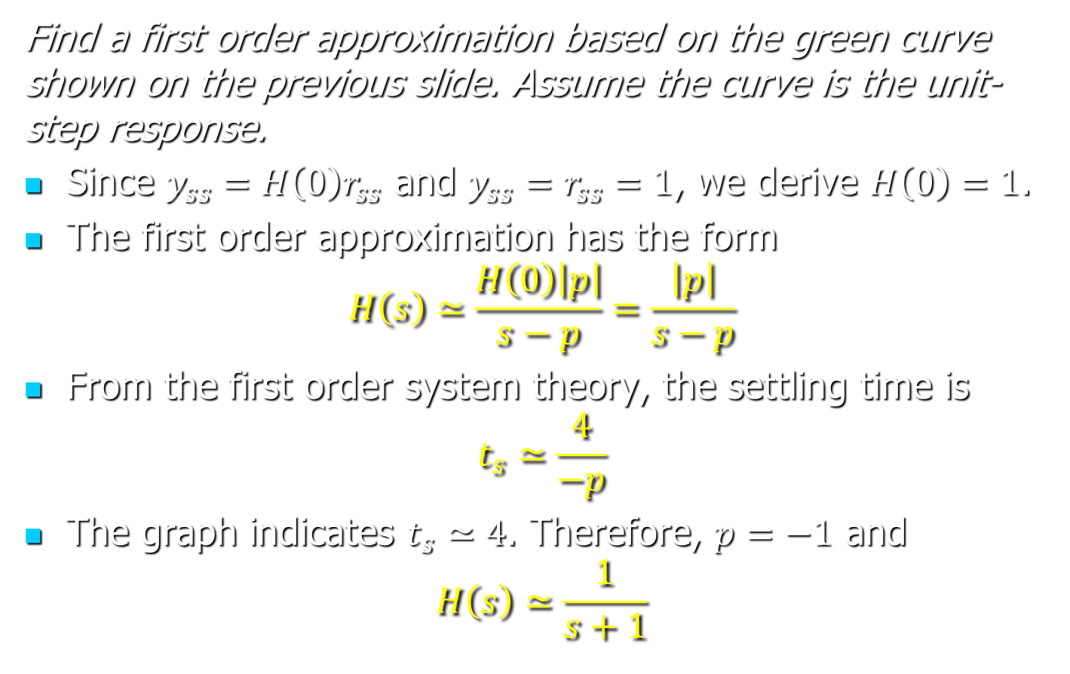
Approximation—Example
Find a first order approximation based on the green curve shown on the previous slide. Assume the curve is the unit-step response.
Since $y_{ss}=H\left(0\right)r_{ss}$ and $y_{ss}=r_{ss}=1$, we derive $H\left(0\right)=1$.
The first order approximation has the form
$$H\left(s\right)≃\frac{H\left(0\right)\left|p\right|}{s−p}=\frac{\left|p\right|}{s−p}$$
From the first order system theory, the settling time is
$$t_{s}≃\frac{4}{−p}$$
The graph indicates $t_{s}≃4$. Therefore, $p=−1$ and
$$H\left(s\right)≃\frac{1}{s+1}$$

Slide 14
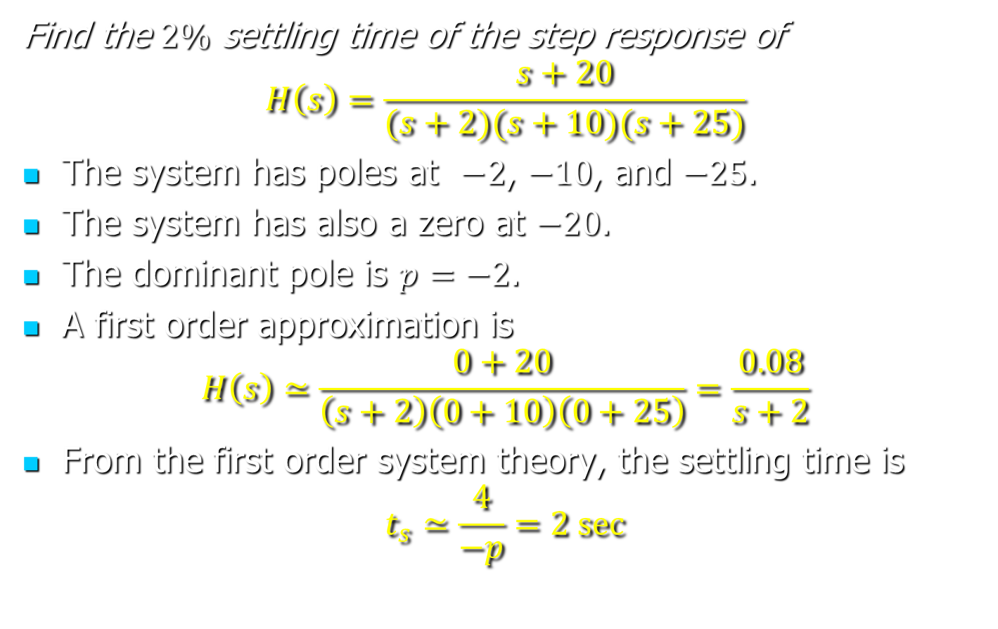
Approximation—Example
Find the $2\%$ settling time of the step response of
$$H\left(s\right)=\frac{s+20}{(s+2)(s+10)(s+25)}$$
The system has poles at $−2$, $−10$, and $−25$.
The system has also a zero at $−20$.
The dominant pole is $p=−2$.
A first order approximation is
$$H\left(s\right)≃\frac{0+20}{\left(s+2\right)\left(0+10\right)\left(0+25\right)}=\frac{0.08}{s+2}$$
From the first order system theory, the settling time is
$$t_{s}≃\frac{4}{−p}=2 sec$$

Slide 15



Dominant Poles
Consider the pole-zero plot of stable system.
If the system as a pair of complex dominant poles, a second order approximation could be appropriate.
Dominant poles

Slide 16

Dominant Poles
Dominant poles
Let $p$ be a dominant pole.
The step response will have, approximately, the damping factor $ζ$ and the natural frequency $ω_{n}$, where
$ω_{n}=|p|$ and $ζω_{n}=−Real(p)$

Slide 17
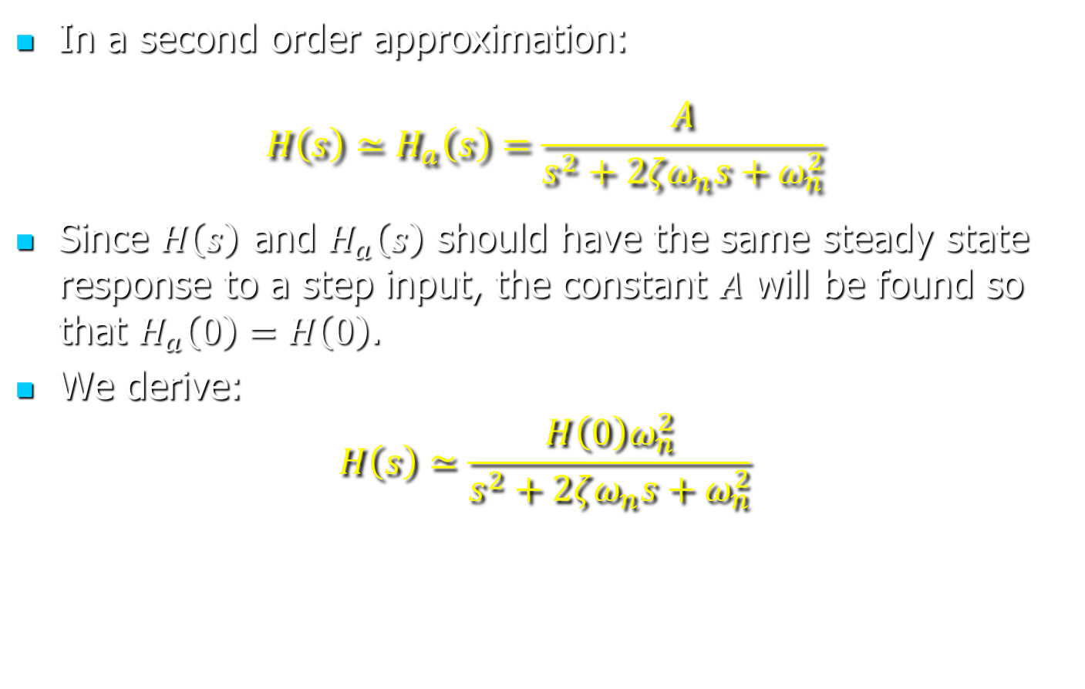
Dominant Poles
In a second order approximation:
$$H\left(s\right)≃H_{a}\left(s\right)=\frac{A}{s^{2}+2ζω_{n}s+ω_{n}^{2}}$$
Since $H\left(s\right)$ and $H_{a}\left(s\right)$ should have the same steady state response to a step input, the constant $A$ will be found so that $H_{a}\left(0\right)=H\left(0\right)$.
We derive:
$$H\left(s\right)≃\frac{H\left(0\right)ω_{n}^{2}}{s^{2}+2ζω_{n}s+ω_{n}^{2}}$$

Slide 18
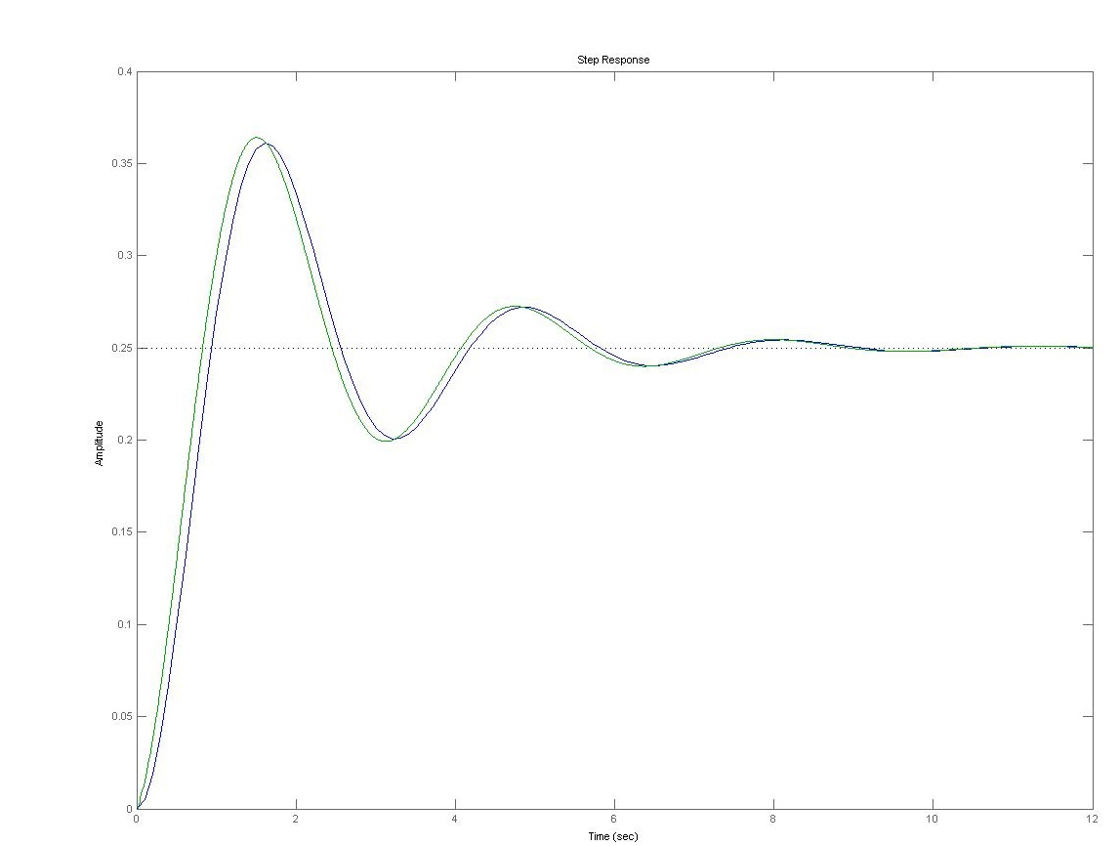
Second-order approximation
Response of 2nd order approximation
Response

Slide 19
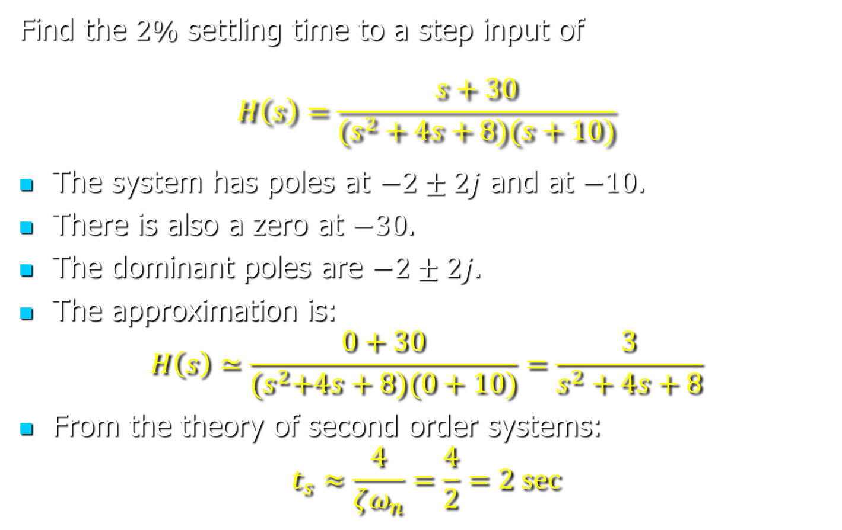
Approximation—Example
Find the $2\%$ settling time to a step input of
$$H\left(s\right)=\frac{s+30}{(s^{2}+4s+8)(s+10)}$$
The system has poles at $−2±2j$ and at $−10$.
There is also a zero at $−30$.
The dominant poles are $−2±2j$.
The approximation is:
$$H\left(s\right)≃\frac{0+30}{{(s}^{2}+4s+8)(0+10)}=\frac{3}{s^{2}+4s+8}$$
From the theory of second order systems:
$$t_{s}≈\frac{4}{ζω_{n}}=\frac{4}{2}=2 sec$$

Slide 20
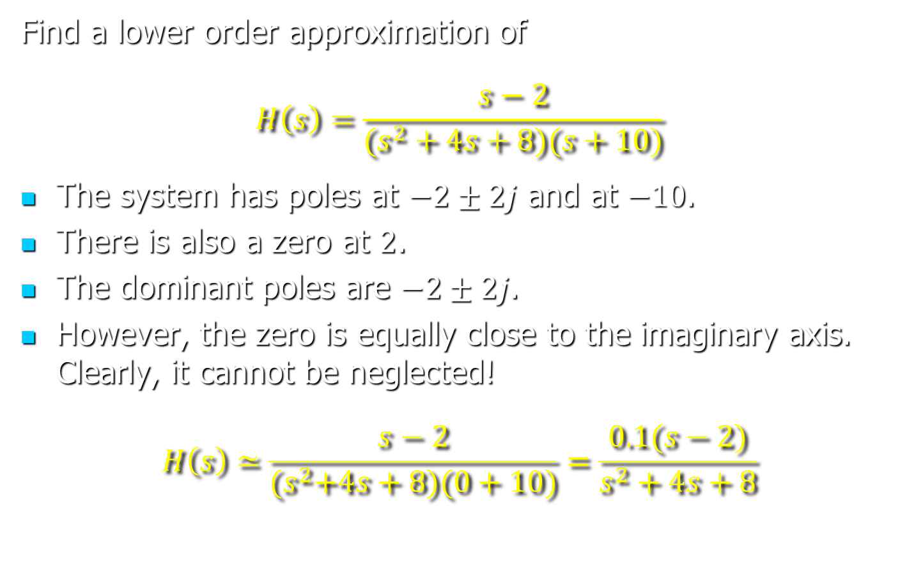
Approximation—Example
Find a lower order approximation of
$$H\left(s\right)=\frac{s−2}{(s^{2}+4s+8)(s+10)}$$
The system has poles at $−2±2j$ and at $−10$.
There is also a zero at $2$.
The dominant poles are $−2±2j$.
However, the zero is equally close to the imaginary axis. Clearly, it cannot be neglected!
$$H\left(s\right)≃\frac{s−2}{{(s}^{2}+4s+8)(0+10)}=\frac{0.1(s−2)}{s^{2}+4s+8}$$

Slide 21
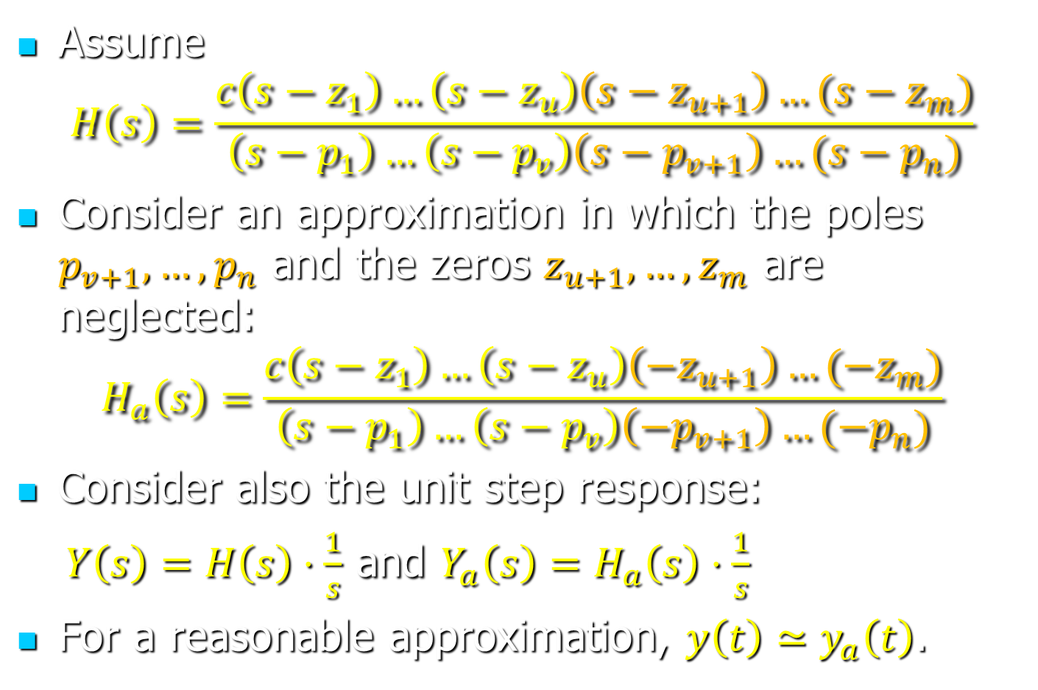
Justifying the Approximations
Assume
$$H\left(s\right)=\frac{c\left(s−z_{1}\right)…\left(s−z_{u}\right)\left(s−z_{u+1}\right)…(s−z_{m})}{\left(s−p_{1}\right)…\left(s−p_{v}\right)\left(s−p_{v+1}\right)…(s−p_{n})}$$
Consider an approximation in which the poles $p_{v+1}, …, p_{n}$ and the zeros $z_{u+1}, …, z_{m}$ are neglected:
$$H_{a}\left(s\right)=\frac{c\left(s−z_{1}\right)…\left(s−z_{u}\right)\left(−z_{u+1}\right)…(−z_{m})}{\left(s−p_{1}\right)…\left(s−p_{v}\right)\left(−p_{v+1}\right)…(−p_{n})}$$
Consider also the unit step response:
$Y\left(s\right)=H\left(s\right)⋅\frac{1}{s}$ and $Y_{a}\left(s\right)=H_{a}\left(s\right)⋅\frac{1}{s}$
For a reasonable approximation, $y\left(t\right)≃y_{a}\left(t\right)$.

Slide 22
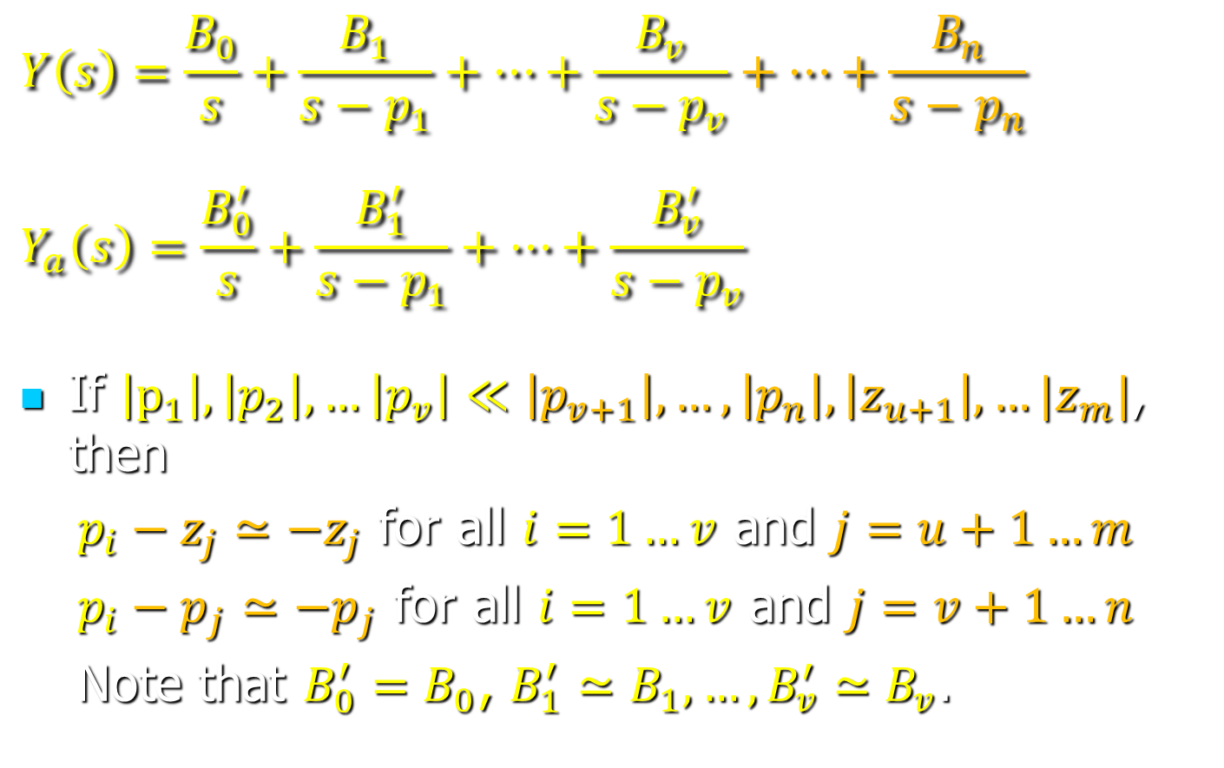
Justifying the Approximations
$$Y\left(s\right)=\frac{B_{0}}{s}+\frac{B_{1}}{s−p_{1}}+…+\frac{B_{v}}{s−p_{v}}+…+\frac{B_{n}}{s−p_{n}}$$
$$Y_{a}\left(s\right)=\frac{B_{0}^{′}}{s}+\frac{B_{1}^{′}}{s−p_{1}}+…+\frac{B_{v}^{′}}{s−p_{v}}$$
If $\left|p_{1}\right|, \left|p_{2}\right|, …\left|p_{v}\right|≪\left|p_{v+1}\right|, …, \left|p_{n}\right|, \left|z_{u+1}\right|, …|z_{m}|$, then
$p_{i}−z_{j}≃−z_{j}$ for all $i=1…v$ and $j=u+1…m$
$p_{i}−p_{j}≃−p_{j}$ for all $i=1…v$ and $j=v+1…n$
Note that $B_{0}^{′}=B_{0}$, $B_{1}^{′}≃B_{1}, …, B_{v}^{′}≃B_{v}$.

Slide 23
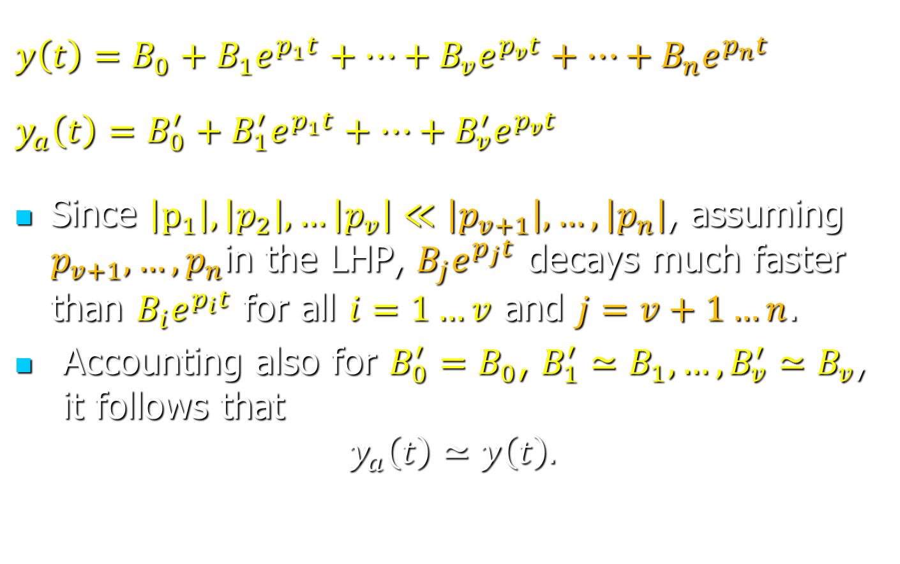
Justifying the Approximations
$$y\left(t\right)=B_{0}+B_{1}e^{p_{1}t}+…+B_{v}e^{p_{v}t}+…+B_{n}e^{p_{n}t}$$
$$y_{a}\left(t\right)=B_{0}^{′}+B_{1}^{′}e^{p_{1}t}+…+B_{v}^{′}e^{p_{v}t}$$
Since $\left|p_{1}\right|, \left|p_{2}\right|, …\left|p_{v}\right|≪\left|p_{v+1}\right|, …, \left|p_{n}\right|$, assuming $p_{v+1}, …, p_{n}$in the LHP, $B_{j}e^{p_{j}t}$ decays much faster than $B_{i}e^{p_{i}t}$ for all $i=1…v$ and $j=v+1…n$.
Accounting also for $B_{0}^{′}=B_{0}$, $B_{1}^{′}≃B_{1}, …, B_{v}^{′}≃B_{v}$, it follows that
$$y_{a}\left(t\right)≃y\left(t\right).$$

