Slide 1
The Time Response
First and Second Order Systems.
M.V. Iordache, EEGR3523 Mechatronics, Spring 2021, LeTourneau University

Slide 2
Control Systems Design
Involves several steps:
Find models for plant, sensors, actuators.
Select control structure, based on specifications (feedforward, feedback, …).
Select controller type (PID, lead, lag, …).
Design controller.
If specification cannot be satisfied, go to step 2.
Tune controller parameters based on system simulation.
Tune controller parameters on the real plant.

Slide 3
Specifications
So far we have studied
Stability
    any bounded input → bounded output.
Steady state error
    how much the steady state may deviate from its prescribed value under constant disturbances.
At this time we will consider
Time Response Specifications

Slide 4
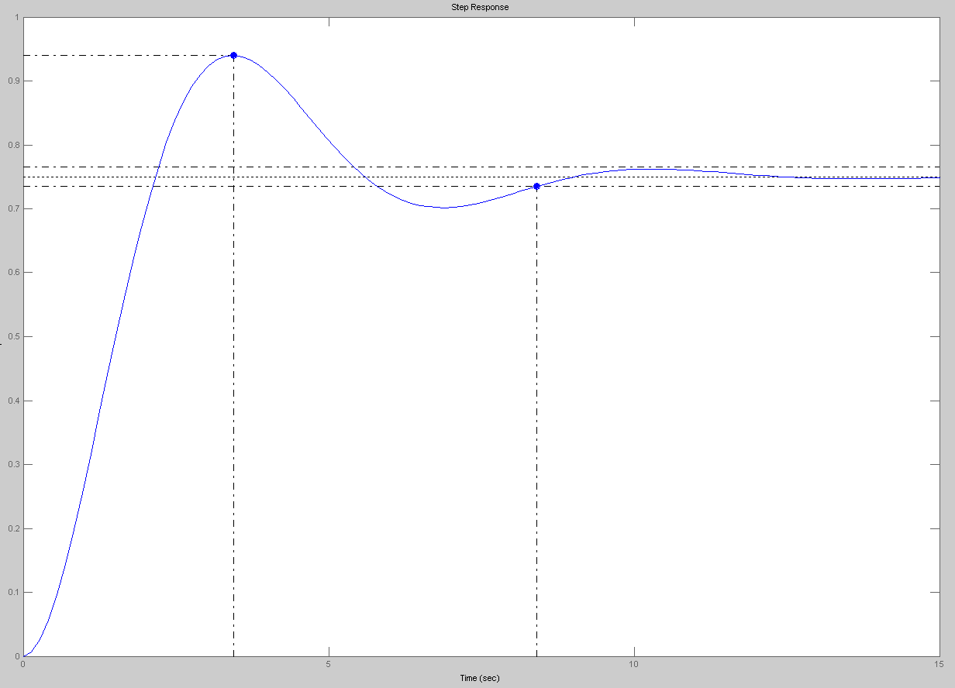
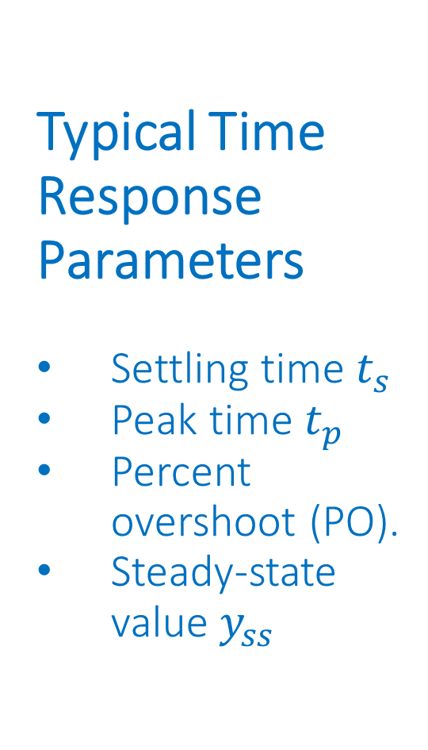
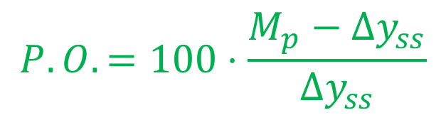


t_{p} (peak time)
Typical Time Response Parameters
Settling time $t_{s}$
Peak time $t_{p}$
Percent overshoot (PO).
Steady-state value $y_{ss}$
t_{s} (2% settling time)
$M_{p}$ peak magnitude
$${Δy}_{ss}$$
$$P.O.=100⋅\frac{M_{p}−{Δy}_{ss}}{{Δy}_{ss}}$$

Slide 5
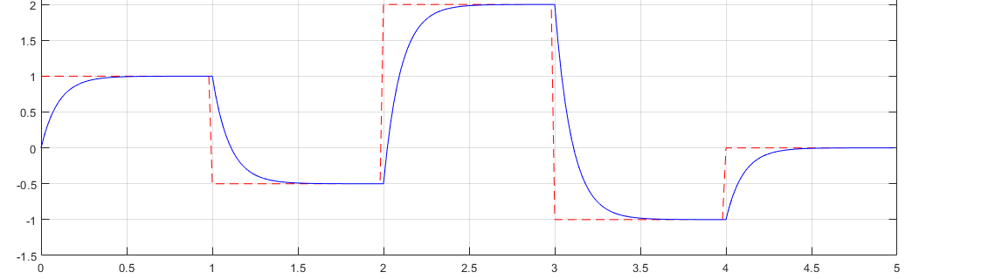
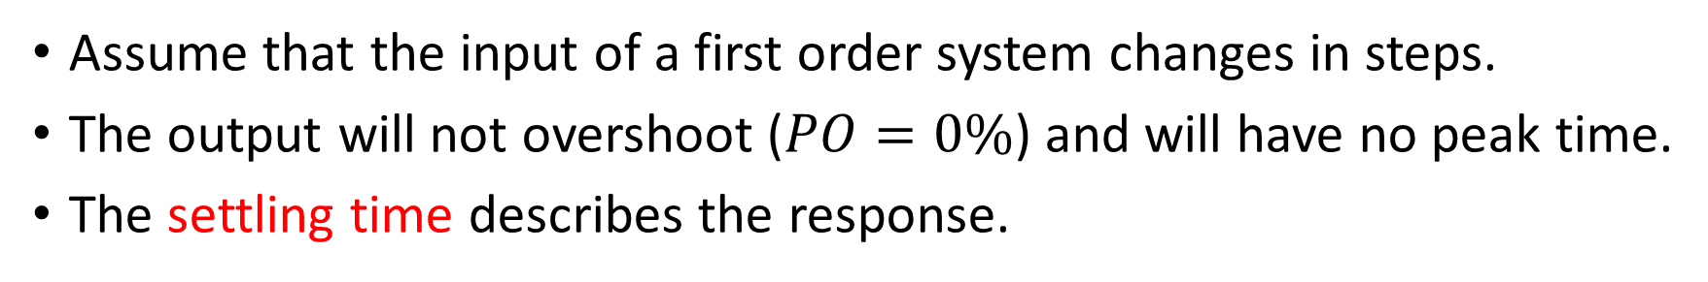
First Order Systems
Ideal response (proportional to input)
Actual response
Assume that the input of a first order system changes in steps.
The output will not overshoot ($PO=0\%$) and will have no peak time.
The settling time describes the response.
Notes:
presm/Firstorder.png. MATLAB code: s = tf('s'); H = 10/(s+10); t = 0:0.02:5; n = length(t); m = floor(n/5); vect =[1, -0.5, 2, -1, 0]; u = [ones(1,m)*vect(1), ones(1,m)*vect(2), ones(1,m)*vect(3),ones(1,m)*vect(4), ones(1,m)*vect(5)]; t = t(1:length(u)); y = lsim(H,u,t); plot(t,u,'r--',t,y,'b-'); grid on; axis([0 5 -1.5 2.5])

Slide 6

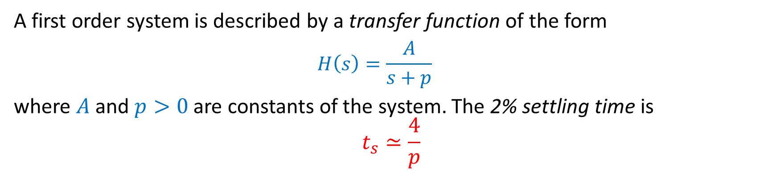





First Order Systems
2% of $Δy_{ss1}$
$$t_{s}$$
$${Δy}_{ss1}$$
$${Δy}_{ss2}$$
$$t_{s}$$
2% of $Δy_{ss2}$
A first order system is described by a transfer function of the form
  $$H\left(s\right)=\frac{A}{s+p}$$
where $A$ and $p>0$ are constants of the system. The 2% settling time is
$$t_{s}≃\frac{4}{p}$$

Slide 7
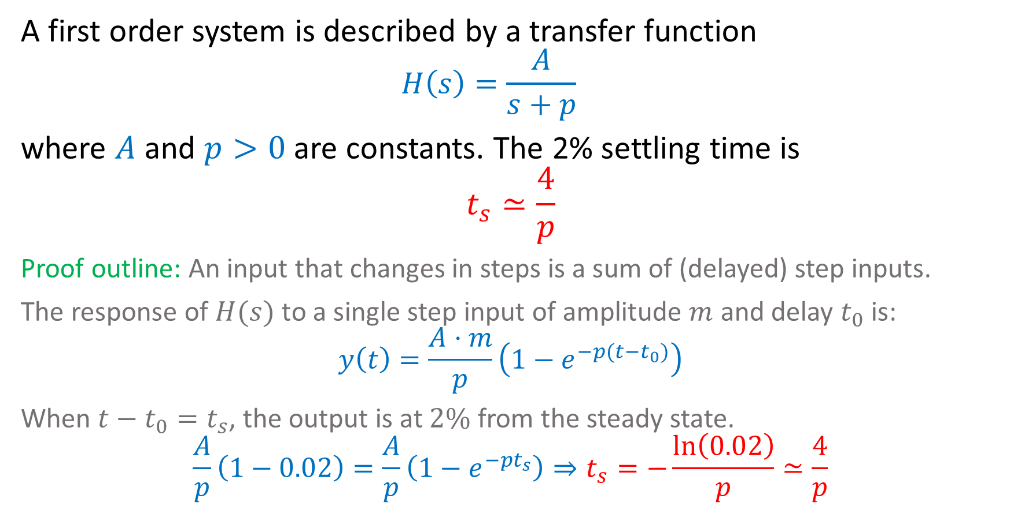
First Order Systems
A first order system is described by a transfer function
  $$H\left(s\right)=\frac{A}{s+p}$$
where $A$ and $p>0$ are constants. The 2% settling time is
$$t_{s}≃\frac{4}{p}$$
Proof outline: An input that changes in steps is a sum of (delayed) step inputs.
The response of $H(s)$ to a single step input of amplitude $m$ and delay $t_{0}$ is:
$$y\left(t\right)=\frac{A⋅m}{p}\left(1−e^{−p(t−t_{0})}\right)$$
When $t−t_{0}=t_{s}$, the output is at $2\%$ from the steady state.
$$\frac{A}{p}\left(1−0.02\right)=\frac{A}{p}\left(1−e^{−pt_{s}}\right)⇒t_{s}=−\frac{\ln\left(0.02\right)}{p}≃\frac{4}{p}$$

Slide 8
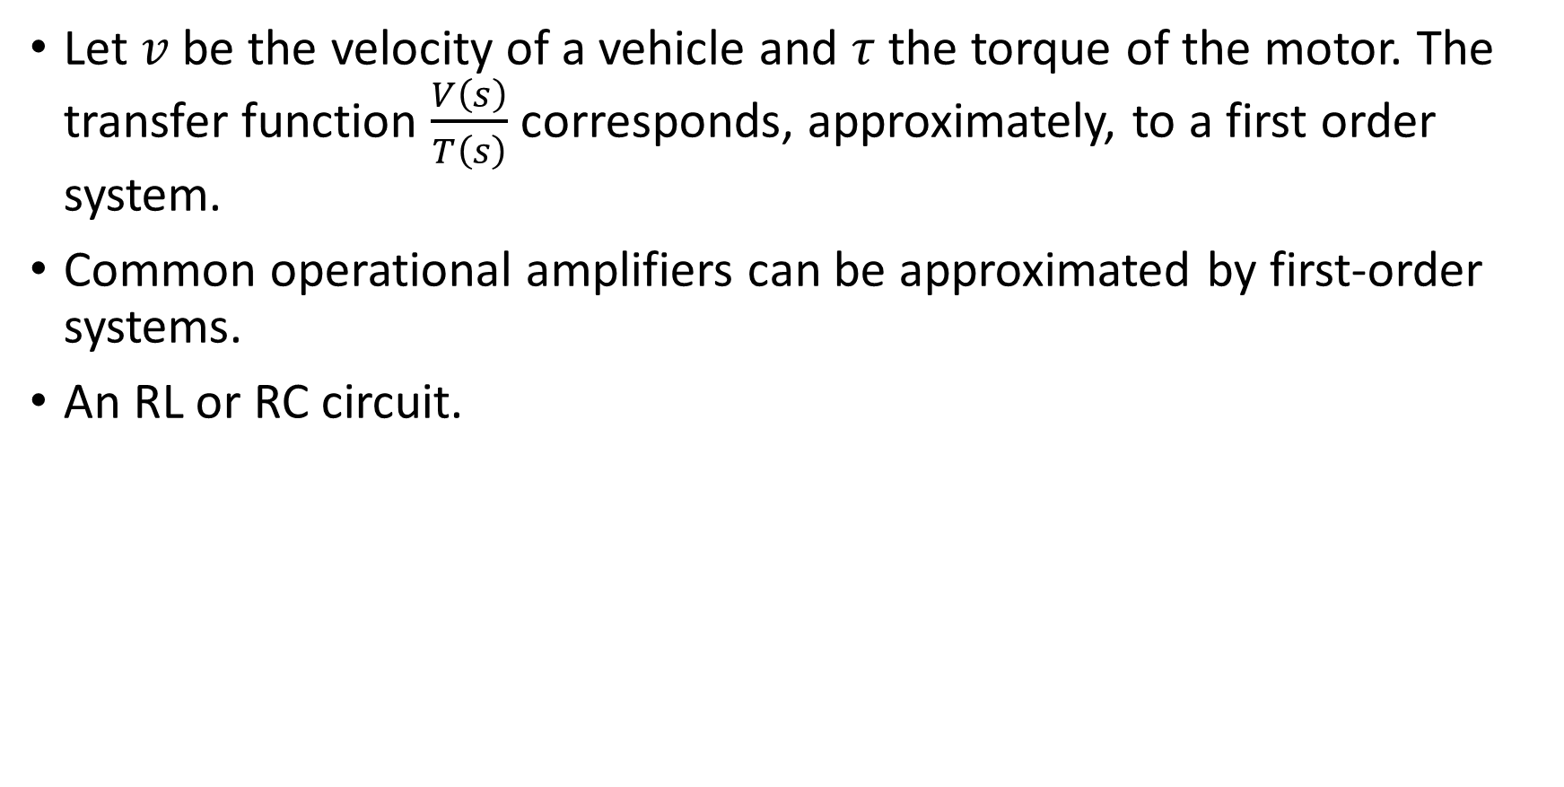
First Order Systems—Examples
Let $v$ be the velocity of a vehicle and $τ$ the torque of the motor. The transfer function $\frac{V\left(s\right)}{T\left(s\right)}$ corresponds, approximately, to a first order system.
Common operational amplifiers can be approximated by first-order systems.
An RL or RC circuit.

Slide 9
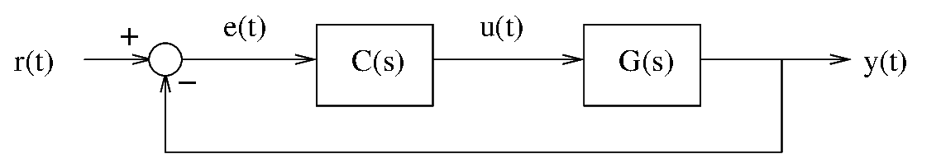
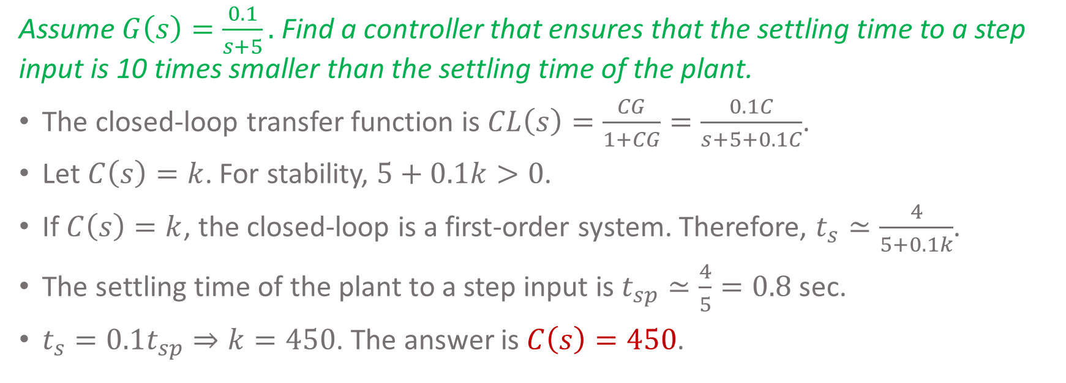
First Order Systems—Example
Assume $G\left(s\right)=\frac{0.1}{s+5}.$ Find a controller that ensures that the settling time to a step input is 10 times smaller than the settling time of the plant.
The closed-loop transfer function is $CL\left(s\right)=\frac{CG}{1+CG}=\frac{0.1C}{s+5+0.1C}$.
Let $C\left(s\right)=k$. For stability, $5+0.1k>0$.
If $C\left(s\right)=k$, the closed-loop is a first-order system. Therefore, $t_{s}≃\frac{4}{5+0.1k}$.
The settling time of the plant to a step input is $t_{sp}≃\frac{4}{5}=0.8$sec.
$t_{s}=0.1t_{sp}⇒k=450$. The answer is $C\left(s\right)=450$.

Slide 10
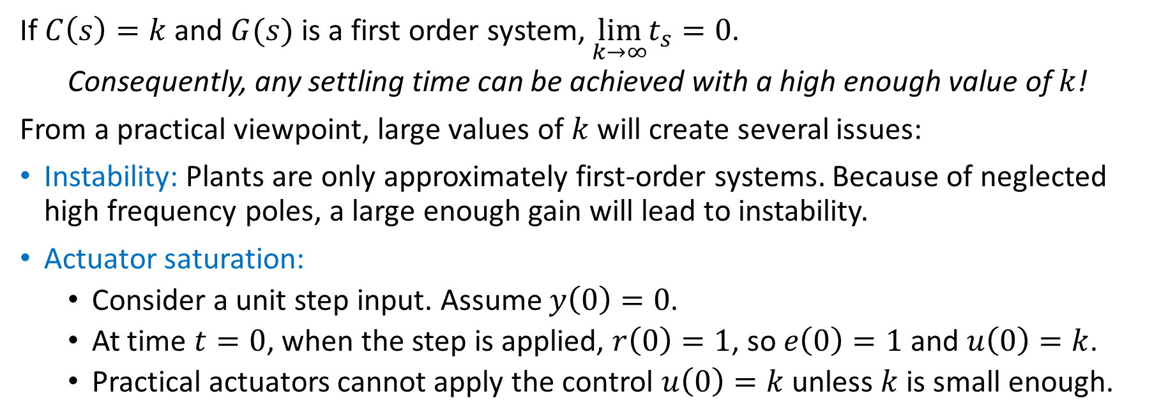
First Order Systems
If $C\left(s\right)=k$ and $G(s)$ is a first order system, $\lim_{k→∞}t_{s}=0$.
  Consequently, any settling time can be achieved with a high enough value of $k$!
From a practical viewpoint, large values of $k$ will create several issues:
Instability: Plants are only approximately first-order systems. Because of neglected high frequency poles, a large enough gain will lead to instability.
Actuator saturation:
  Consider a unit step input. Assume $y\left(0\right)=0$.
  At time $t=0$, when the step is applied, $r\left(0\right)=1$, so $e\left(0\right)=1$ and $u\left(0\right)=k$.
  Practical actuators cannot apply the control $u\left(0\right)=k$ unless $k$ is small enough.

Slide 11
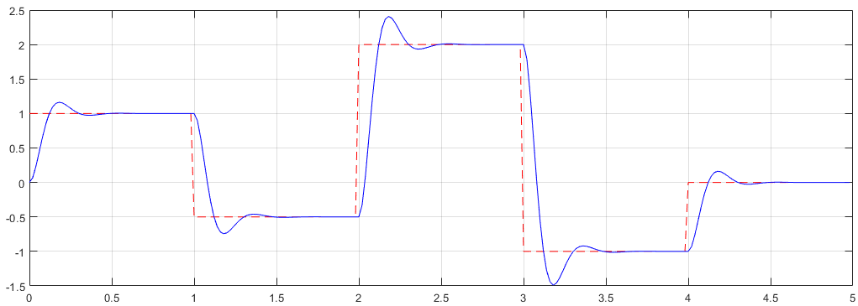
Second Order Systems
Ideal response (proportional to input)
Actual response
They can overshoot when the input changes in steps.
Two important parameters: the settling time and the percent overshoot.
Notes:
presm/secondorder.png. MATLAB: s = tf('s'); H = 400/(s^2+20*s+400); t = 0:0.02:5; n = length(t); m = floor(n/5); vect =[1, -0.5, 2, -1, 0]; u = [ones(1,m)*vect(1), ones(1,m)*vect(2), ones(1,m)*vect(3),ones(1,m)*vect(4), ones(1,m)*vect(5)]; t = t(1:length(u)); y = lsim(H,u,t); plot(t,u,'r--',t,y,'b-'); grid on; %axis([0 5 -1.5 2.5])

Slide 12





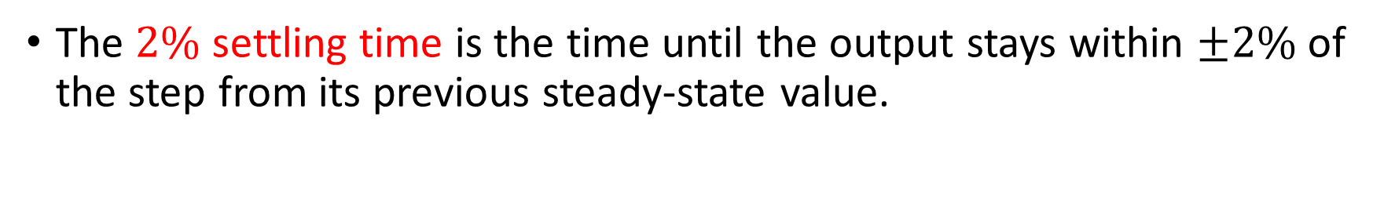

Second Order Systems
2% of $Δy_{ss1}$
$$t_{s}$$
$${Δy}_{ss1}$$
$${Δy}_{ss2}$$
$$t_{s}$$
2% of $Δy_{ss2}$
The $2\%$ settling time is the time until the output stays within $±2\%$ of the step from its previous steady-state value.

Slide 13
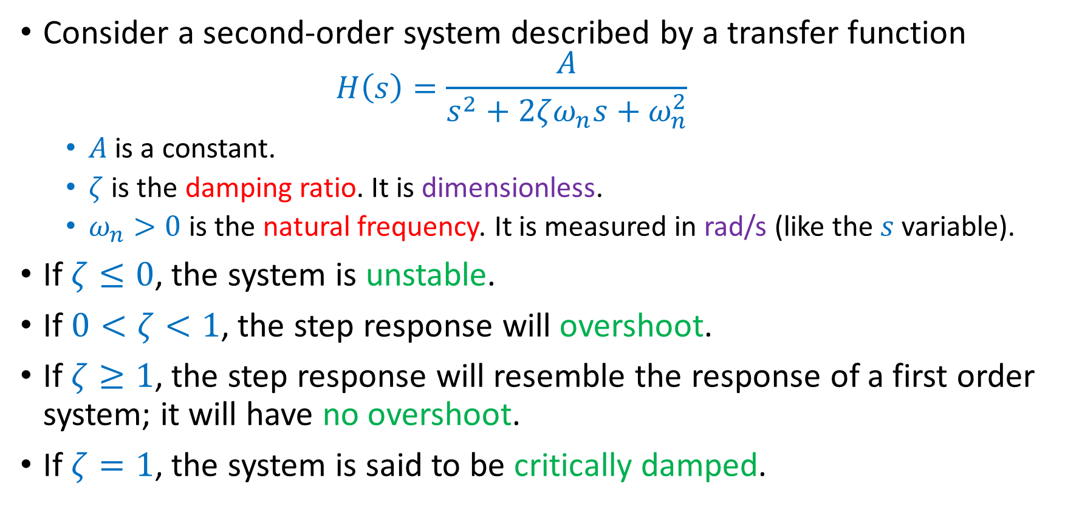
Second Order Systems
Consider a second-order system described by a transfer function
  $$H\left(s\right)=\frac{A}{s^{2}+2ζω_{n}s+ω_{n}^{2}}$$
  $A$ is a constant.
  $ζ$ is the damping ratio. It is dimensionless.
  $ω_{n}>0$ is the natural frequency. It is measured in rad/s (like the $s$ variable).
If $ζ≤0$, the system is unstable.
If $0<ζ<1$, the step response will overshoot.
If $ζ≥1$, the step response will resemble the response of a first order system; it will have no overshoot.
If $ζ=1$, the system is said to be critically damped.

Slide 14

Second Order Systems
Assume $0<ζ<1$.
The unit-step response is
$$y\left(t\right)=\frac{A}{ω_{n}^{2}}\left(1−\frac{e_{ }^{−ζω_{n}t}}{\sqrt{1−ζ^{2}}}\sin\left(ω_{d}t+φ\right)\right)$$
where
  $ω_{d}=ω_{n}\sqrt{1−ζ^{2}}$ is the damped natural frequency.
  $φ=\cos^{−1}{ζ}$.

Slide 15
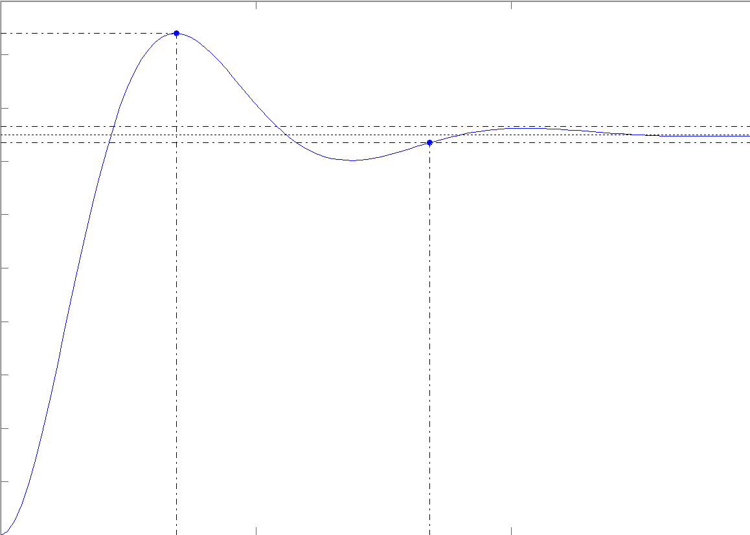

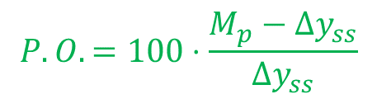
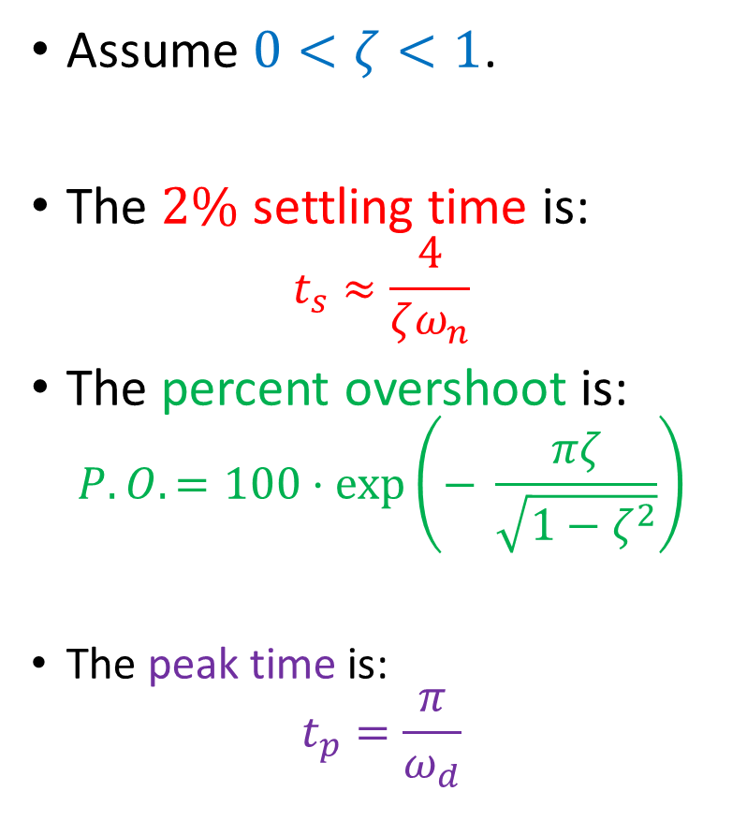



Second Order Systems
Assume $0<ζ<1$.
The $2\%$ settling time is:
$$t_{s}≈\frac{4}{ζω_{n}}$$
The percent overshoot is:
$$P.O.=100⋅\exp\left(− \frac{πζ}{\sqrt{1−ζ^{2}}}\right)$$
The peak time is:
$$t_{p}=\frac{π}{ω_{d}}$$
$t_{p}$ (peak time)
$t_{s}$ (2% settling time)
$M_{p}$ peak magnitude
$${Δy}_{ss}$$
$$P.O.=100⋅\frac{M_{p}−{Δy}_{ss}}{{Δy}_{ss}}$$

Slide 16

Second Order Systems—Examples
Let $x$ be the position of a vehicle and $τ$ the torque of the motor. The transfer function $\frac{X\left(s\right)}{T\left(s\right)}$ corresponds, approximately, to a second order system.
A block connected to a spring.
An RLC circuit.

Slide 17
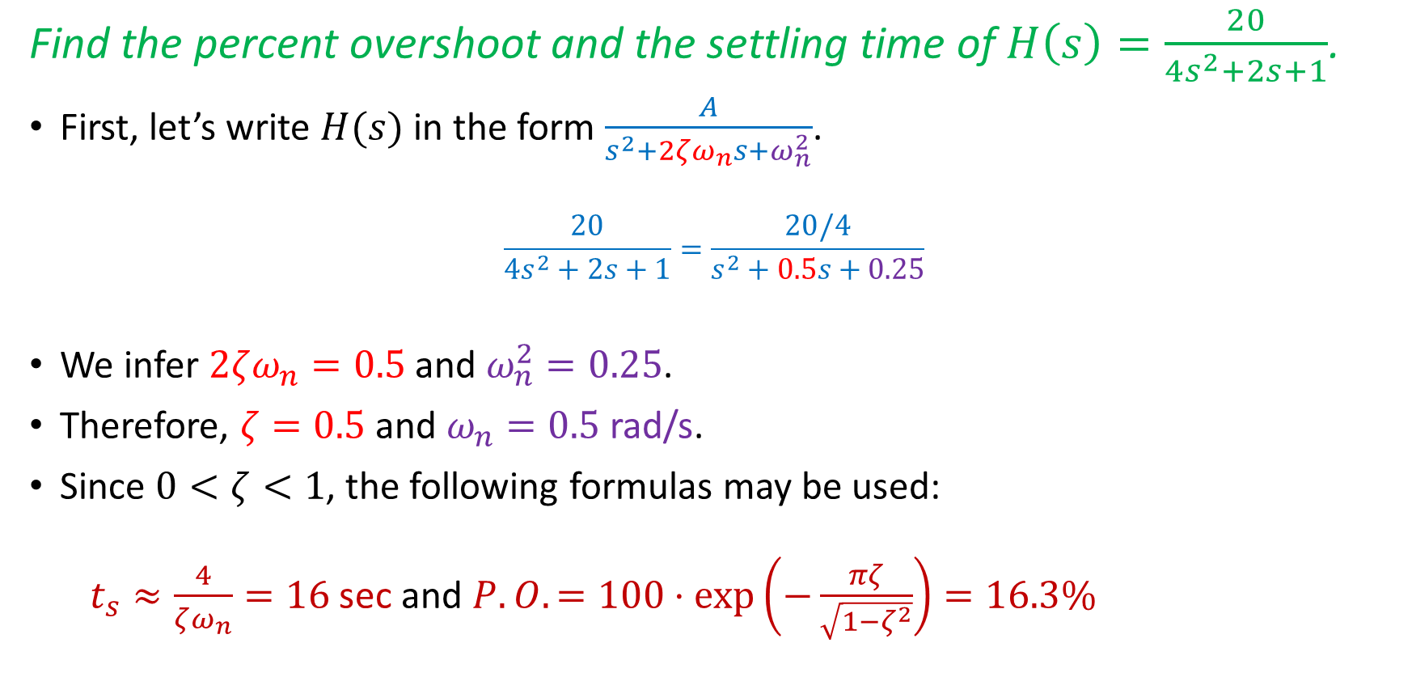
Second Order Systems—Example
Find the percent overshoot and the settling time of $H\left(s\right)=\frac{20}{4s^{2}+2s+1}$.
First, let’s write $H(s)$ in the form $\frac{A}{s^{2}+2ζω_{n}s+ω_{n}^{2}}$.
$$\frac{20}{4s^{2}+2s+1}=\frac{20/4}{s^{2}+0.5s+0.25}$$
We infer $2ζω_{n}=0.5$ and $ω_{n}^{2}=0.25$.
Therefore, $ζ=0.5$ and $ω_{n}=0.5$rad/s.
Since $0<ζ<1$, the following formulas may be used:
  $t_{s}≈\frac{4}{ζω_{n}}=16$sec and $P.O.=100⋅\exp\left(−\frac{πζ}{\sqrt{1−ζ^{2}}}\right)=16.3\%$

Slide 18
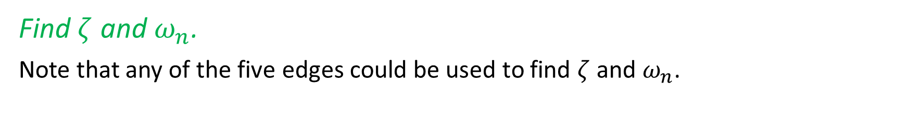
Second Order Systems—Example
Find $ζ$ and $ω_{n}$.
Note that any of the five edges could be used to find $ζ$ and $ω_{n}$.

Slide 19
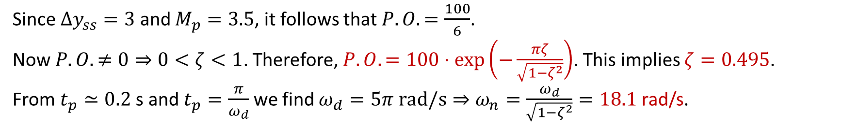



Second Order Systems—Example
$${Δy}_{ss}$$
$$t_{p}$$
$$M_{p}$$
Since $Δy_{ss}=3$ and $M_{p}=3.5$, it follows that $P.O.=\frac{100}{6}$.
Now $P.O. ≠0⇒$ $0<ζ<1$. Therefore, $P.O.=100⋅\exp\left(−\frac{πζ}{\sqrt{1−ζ^{2}}}\right)$. This implies $ζ=0.495$.
From $t_{p}≃0.2$s and $t_{p}=\frac{π}{ω_{d}}$ we find $ω_{d}=5π rad/s⇒ω_{n}=\frac{ω_{d}}{\sqrt{1−ζ^{2}}}=18.1$rad/s.

Slide 20
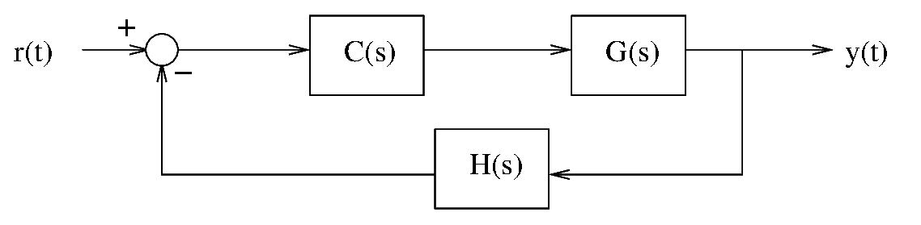
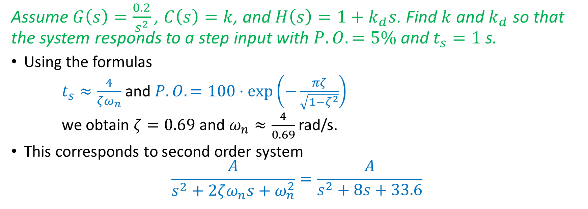
Second Order Systems—Example
Assume $G\left(s\right)=\frac{0.2}{s^{2}}$, $C\left(s\right)=k$, and $H\left(s\right)=1+k_{d}s$. Find $k$ and $k_{d}$ so that the system responds to a step input with $P.O.=5\%$ and $t_{s}=1$s.
Using the formulas
$t_{s}≈\frac{4}{ζω_{n}}$ and $P.O.=100⋅\exp\left(−\frac{πζ}{\sqrt{1−ζ^{2}}}\right)$
we obtain $ζ=0.69$ and $ω_{n}≈\frac{4}{0.69}$rad/s.
This corresponds to second order system
$$\frac{A}{s^{2}+2ζω_{n}s+ω_{n}^{2}}=\frac{A}{s^{2}+8s+33.6}$$

Slide 21
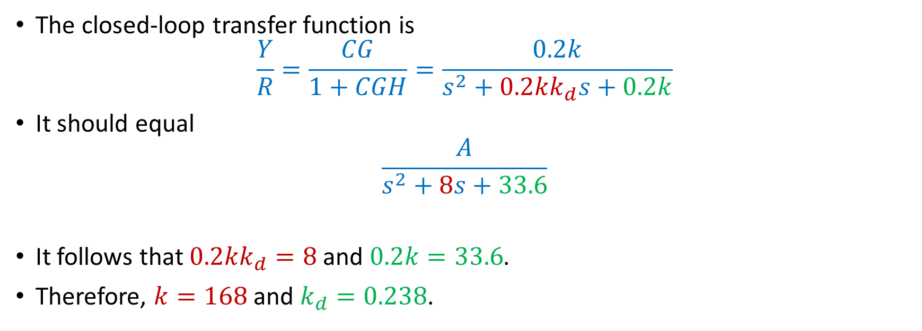
Second Order Systems—Example
The closed-loop transfer function is
$$\frac{Y}{R}=\frac{CG}{1+CGH}=\frac{0.2k}{s^{2}+0.2kk_{d}s+0.2k}$$
It should equal
$$\frac{A}{s^{2}+8s+33.6}$$
It follows that $0.2kk_{d}=8$ and $0.2k=33.6$.
Therefore, $k=168$ and $k_{d}=0.238$.

