Slide 1
Stepper Motors
M.V. Iordache, EEGR3523 Mechatronics, Spring 2020, LeTourneau University

Slide 2
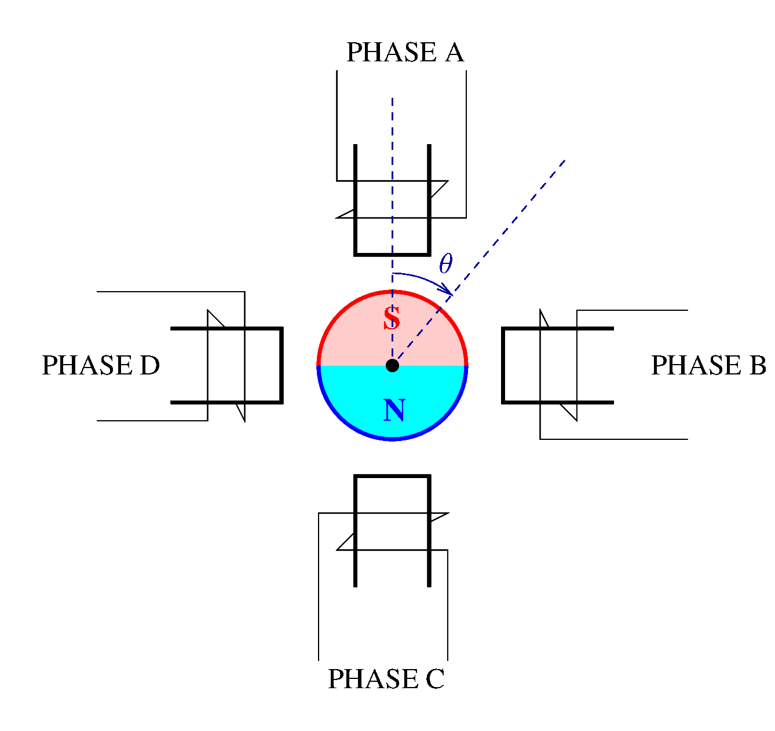
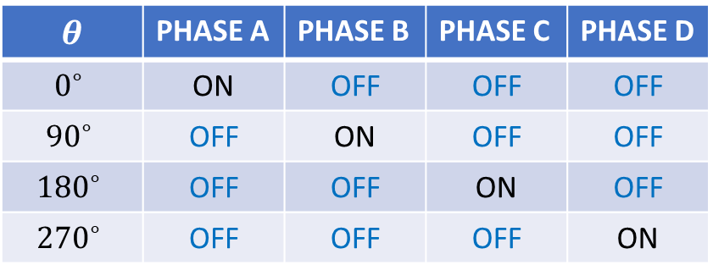

Principle
The stepper motor is a brushless motor that moves in steps.
The figure illustrates its principle.
Suppose that when a phase is ON, its pole has the north
polarity.
Then, the rotor will align its south pole with the
stator pole that is ON.
Depending on which phase is on, the
motor shaft will be at a different angle $θ$.
$$θ$$ | PHASE A | PHASE B | PHASE C | PHASE D
$$0^{∘}$$ | ON | OFF | OFF | OFF
$${90}^{∘}$$ | OFF | ON | OFF | OFF
$${180}^{∘}$$ | OFF | OFF | ON | OFF
$${270}^{∘}$$ | OFF | OFF | OFF | ON
Notes:
presm/stepper.fig

Slide 3
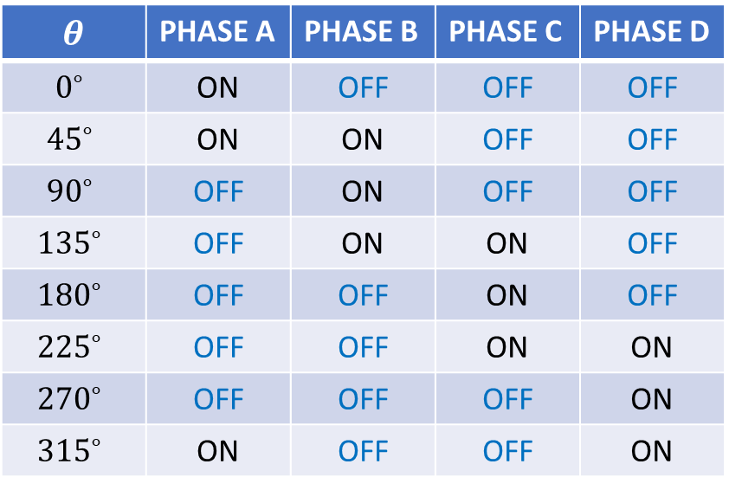

Principle
In this example, the rotor turns in steps and the step angle is ${90}^{∘}$.
By turning two adjacent poles at the same time, we could
reduce the angle to ${45}^{∘}$. This is known as half-stepping.
By turning on two poles with different intensities, we could
position the rotor at any angle. This is known
as micro-stepping.
$$θ$$ | PHASE A | PHASE B | PHASE C | PHASE D
$$0^{∘}$$ | ON | OFF | OFF | OFF
$${45}^{∘}$$ | ON | ON | OFF | OFF
$${90}^{∘}$$ | OFF | ON | OFF | OFF
$${135}^{∘}$$ | OFF | ON | ON | OFF
$${180}^{∘}$$ | OFF | OFF | ON | OFF
$${225}^{∘}$$ | OFF | OFF | ON | ON
$${270}^{∘}$$ | OFF | OFF | OFF | ON
$${315}^{∘}$$ | ON | OFF | OFF | ON
Notes:
presm/stepper.fig

Slide 4
Principle
In this example, the voltage applied to a phase may always have the same sign; it is never necessary to reverse the polarity of a stator pole from north to south.
Therefore, this motor may be driven by an unipolar drive, since the voltage applied to a phase always has the same sign.
It is common, however, to connect more than one pole to the same phase.
In this case, a bipolar drive may be necessary.
A bipolar drive is capable of applying both
positive and negative voltages to a phase.
Notes:
presm/stepper.fig

Slide 5
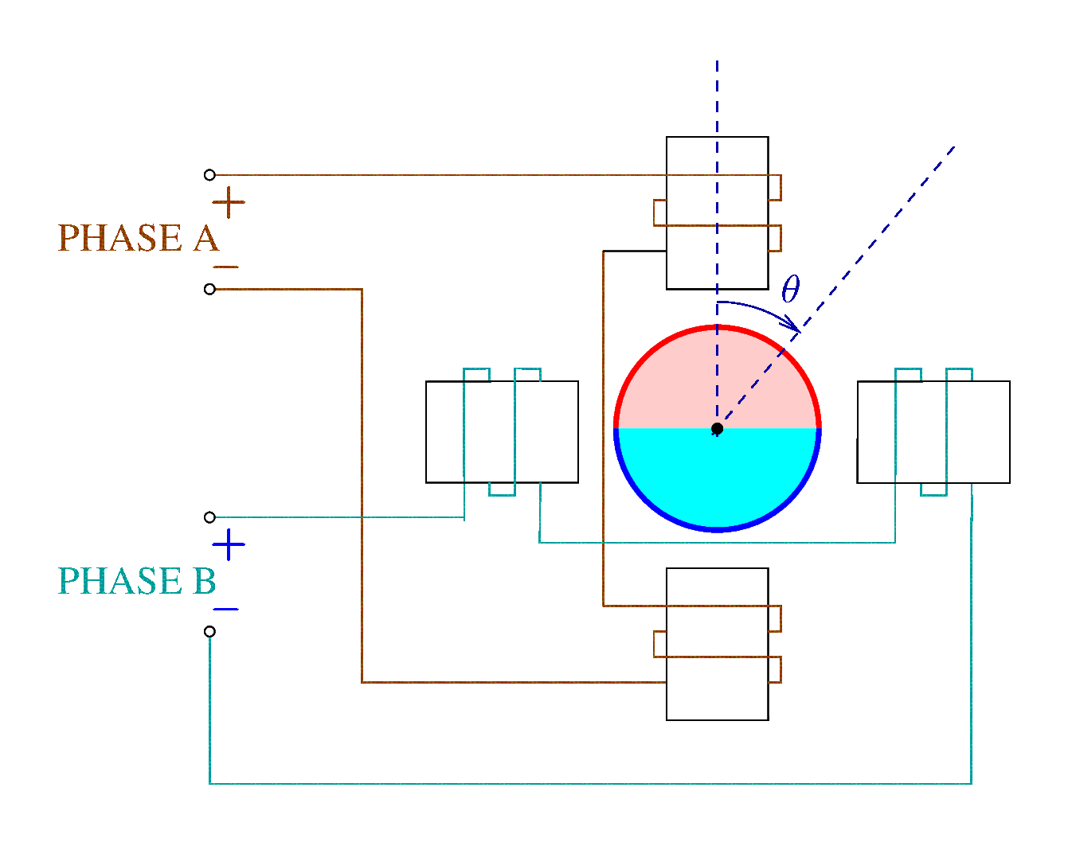
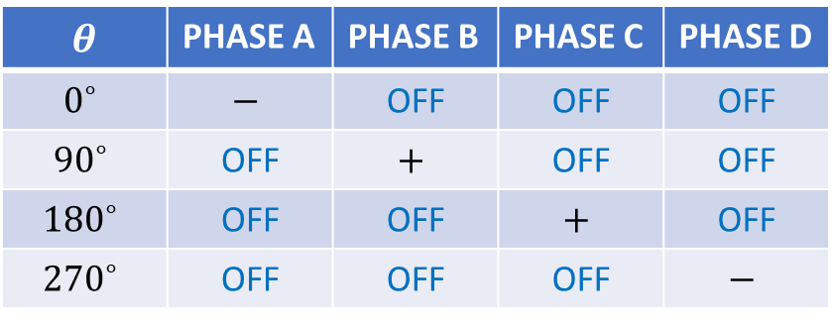
Principle
The figure shows a motor requiring a bipolar drive.
The position of the rotor depends on which phase is on and the polarity of the voltage applied to the phase.
$$θ$$ | PHASE A | PHASE B | PHASE C | PHASE D
$$0^{∘}$$ | $$−$$ | OFF | OFF | OFF
$${90}^{∘}$$ | OFF | $$+$$ | OFF | OFF
$${180}^{∘}$$ | OFF | OFF | $$+$$ | OFF
$${270}^{∘}$$ | OFF | OFF | OFF | $$−$$
Notes:
microcontrollers/fig/stepper.fig

Slide 6
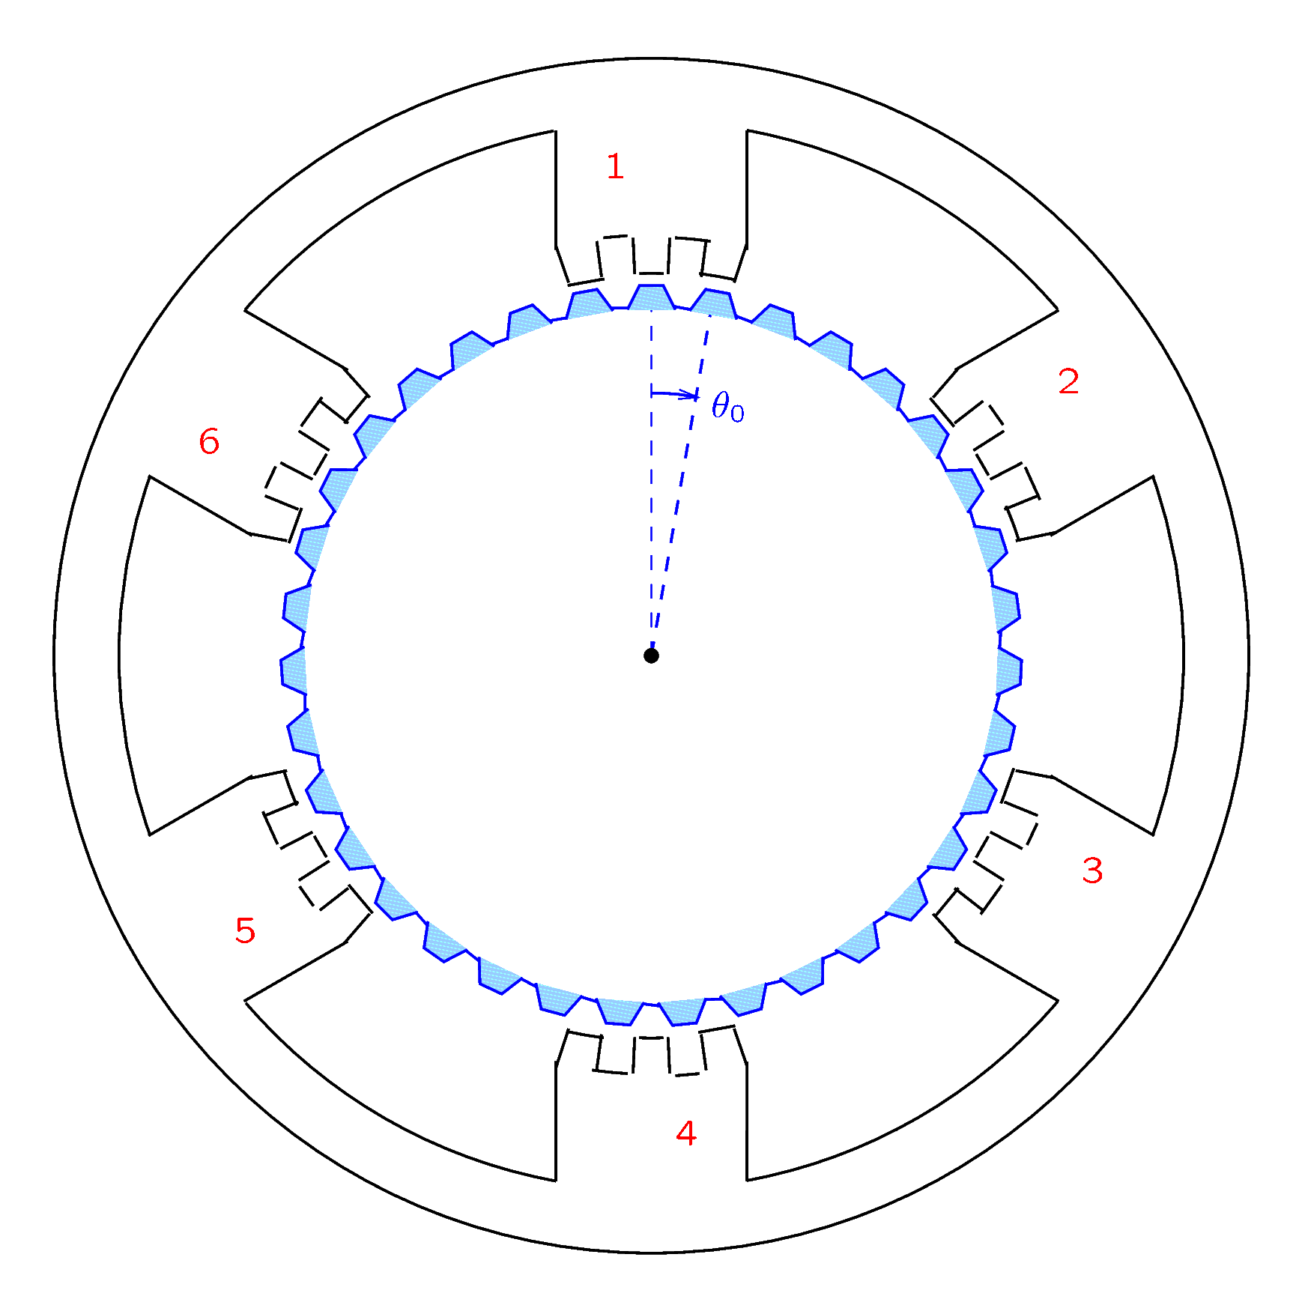
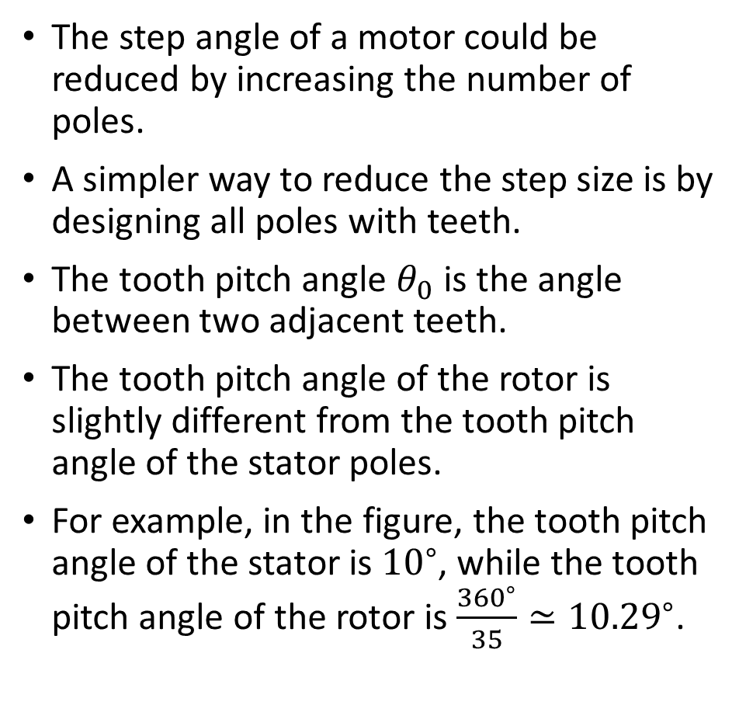
Construction
The step angle of a motor could be reduced by increasing the number of poles.
A simpler way to reduce the step size is by designing all poles with teeth.
The tooth pitch angle $θ_{0}$ is the angle between two adjacent teeth.
The tooth pitch angle of the rotor is slightly different from the tooth pitch angle of the stator poles.
For example, in the figure, the tooth pitch angle of the stator is ${10}^{∘}$, while the tooth pitch angle of the rotor is $\frac{{360}^{∘}}{35}≃{10.29}^{∘}$.
Notes:
presm/teeth.fig

Slide 7

Construction
If pole 1 is activated, the rotor will be in the shown position.
If pole 1 is deactivated and pole 2 is turned on, the rotor will turn counterclockwise by an angle $\frac{θ_{0}}{6}={1.71}^{∘}$.
Thus, the step angle of this motor is only ${1.71}^{∘}$.

Slide 8
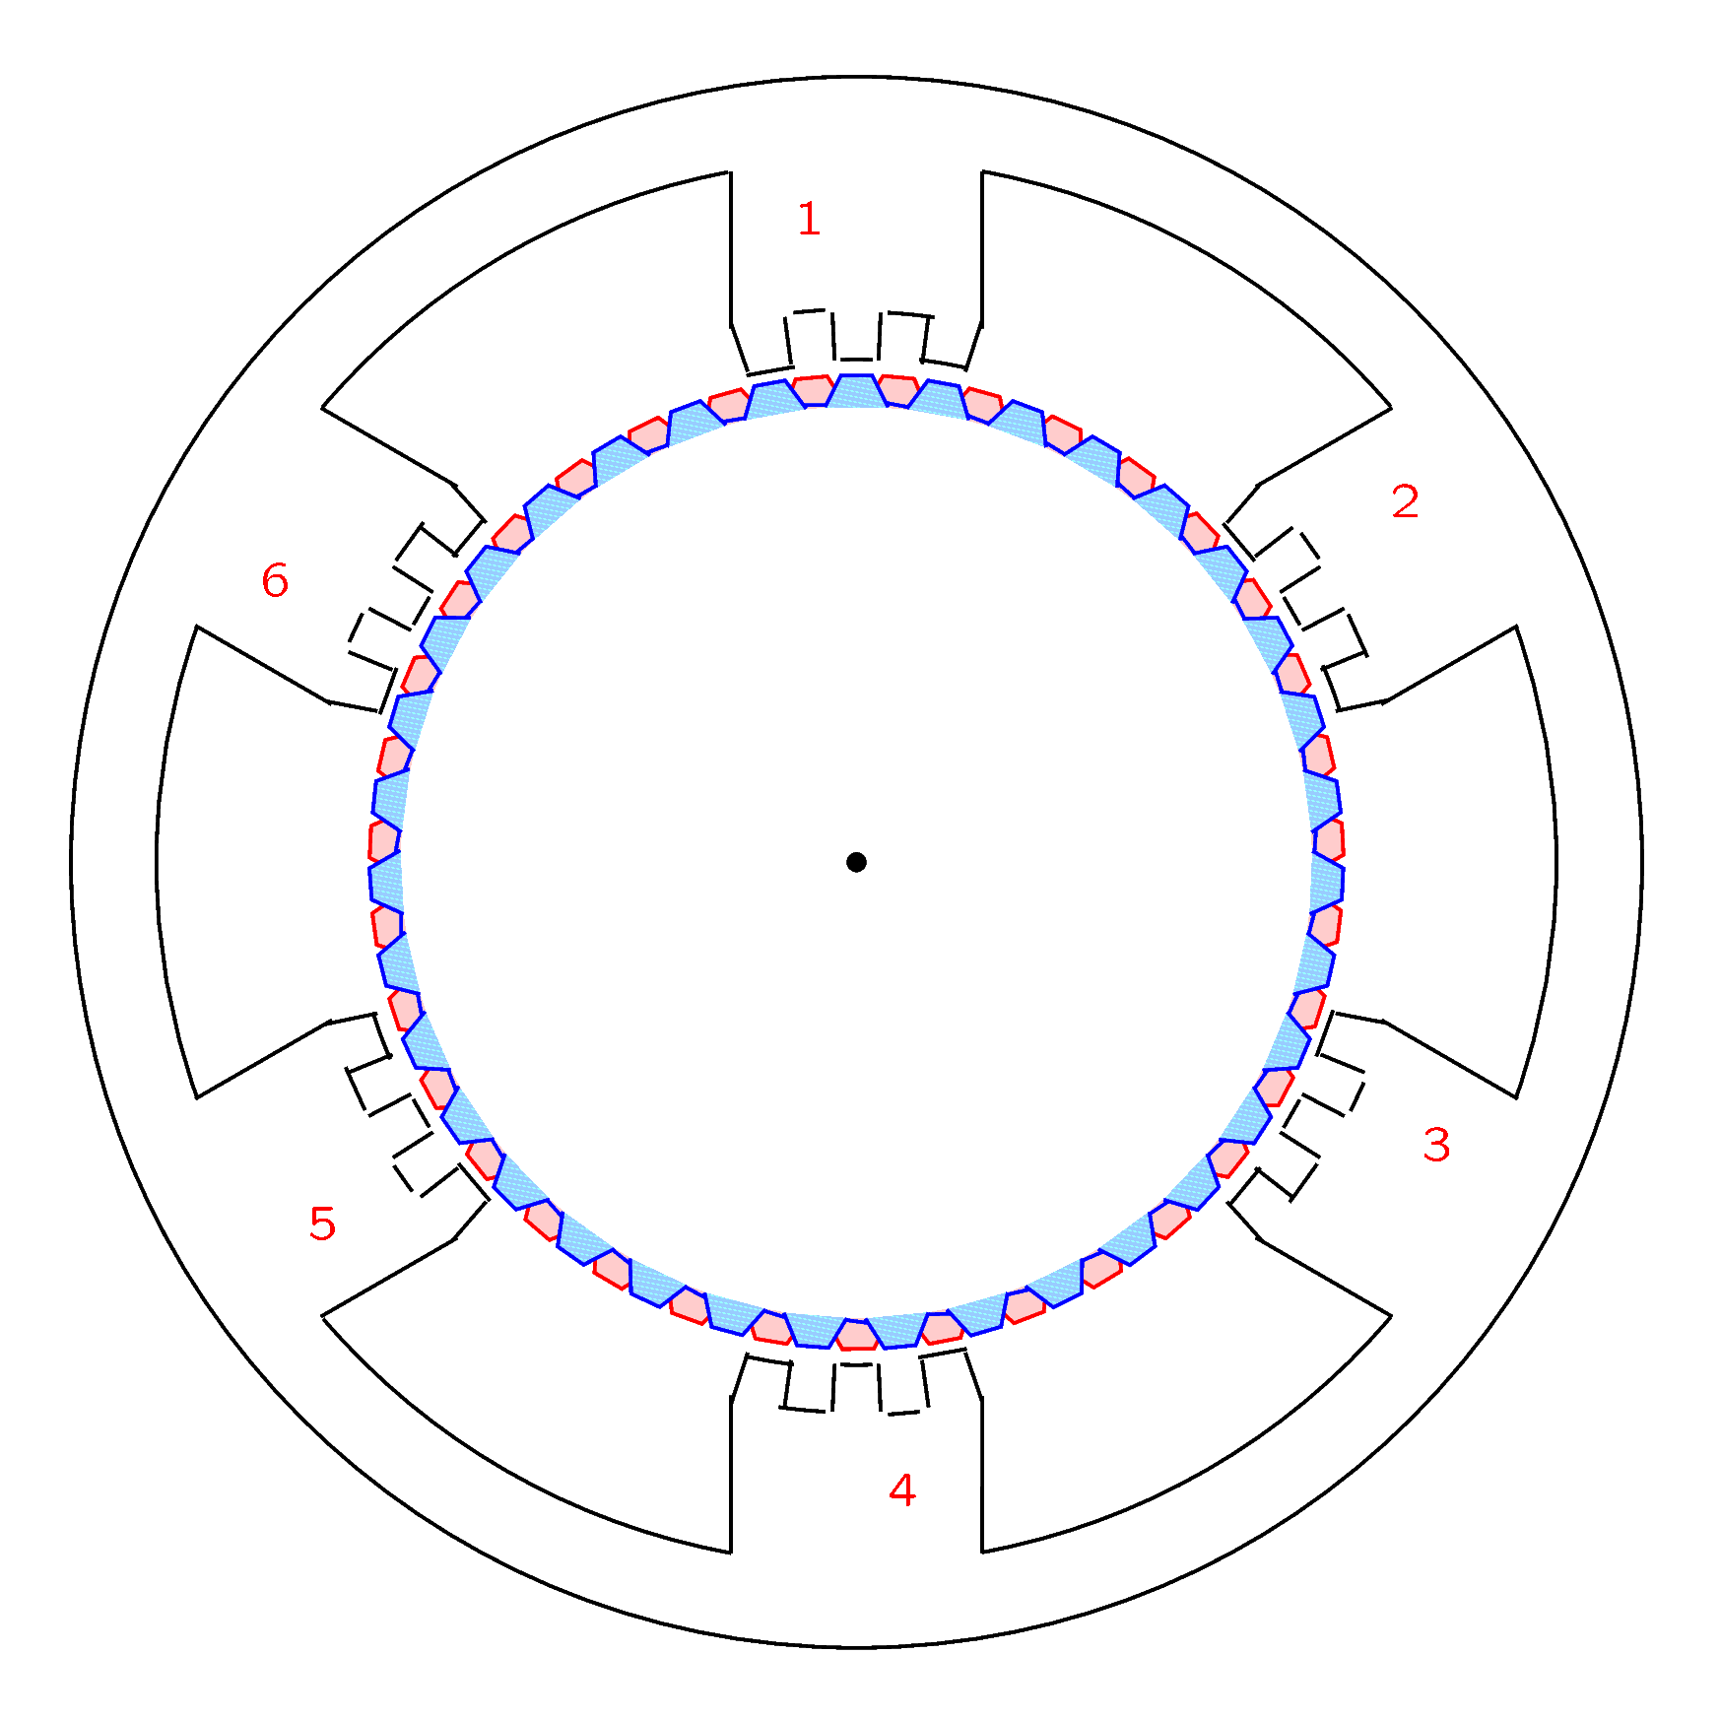
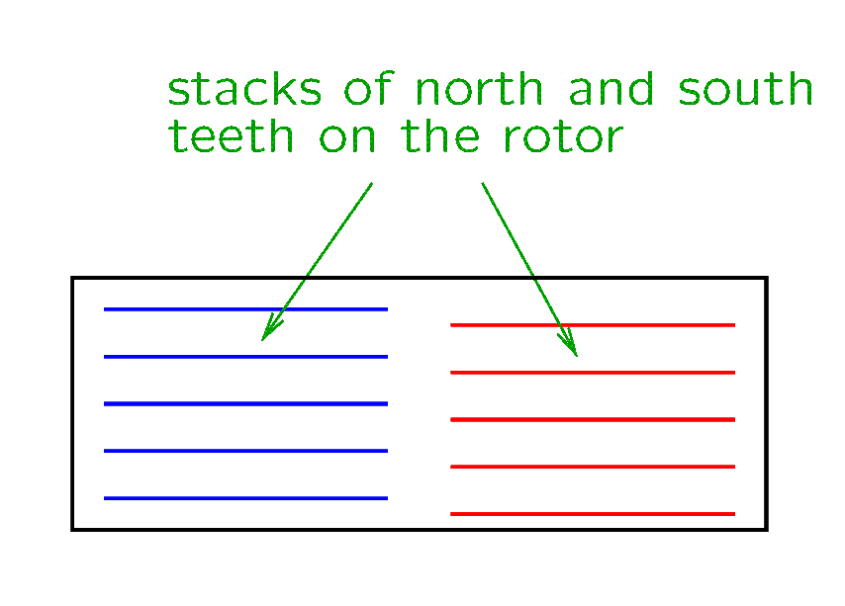
Construction
For some motors, the rotor has two stacks of teeth, one stack with the north polarity and one stack with the south polarity.
The stacks of north and south poles are not aligned, so that there is one south tooth between two north teeth.
Notes:
presm/stacks.fig and teeth2.fig

Slide 9
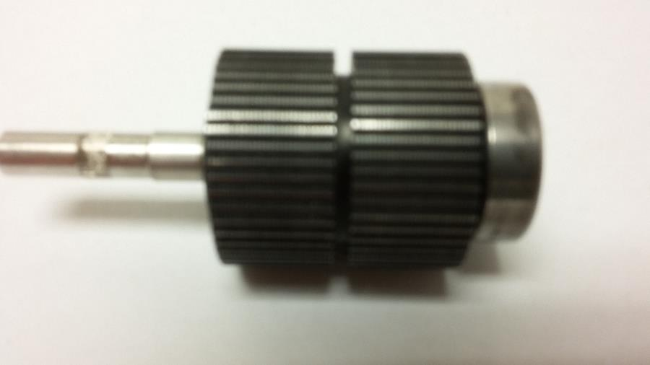
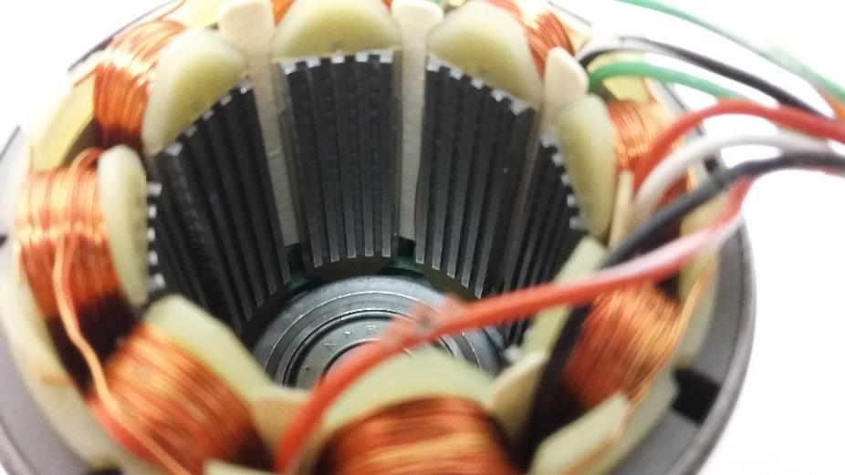
Construction
Teeth on the pole faces of a stepper with 8 stator poles
Two stacks of teeth on the rotor
Notes:
presm/stacks.fig

Slide 10
Construction
So far we have considered permanent magnet stepper motors, which have a magnetized rotor.
Variable reluctance stepper motors have a rotor made from a material of high magnetic permeability. Thus, the teeth of the rotor will align themselves with the teeth of the pole (or poles) that are turned on.

Slide 11
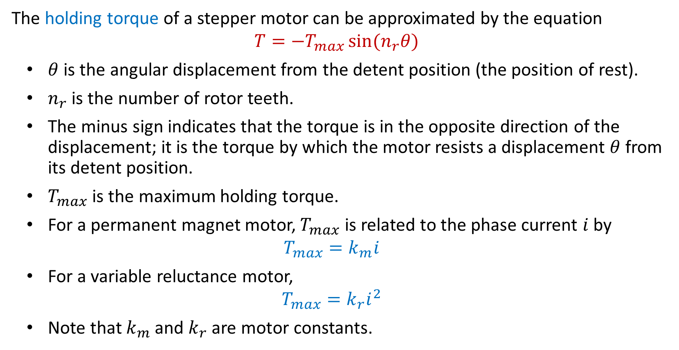
Torque
The holding torque of a stepper motor can be approximated by the equation
$$T=−T_{max}\sin{(n_{r}θ)}$$
$θ$ is the angular displacement from the detent position (the position of rest).
$n_{r}$ is the number of rotor teeth.
The minus sign indicates that the torque is in the opposite direction of the displacement; it is the torque by which the motor resists a displacement $θ$ from its detent position.
$T_{max}$ is the maximum holding torque.
For a permanent magnet motor, $T_{max}$ is related to the phase current $i$ by
$$T_{max}=k_{m}i$$
For a variable reluctance motor,
$$T_{max}=k_{r}i^{2}$$
Note that $k_{m}$ and $k_{r}$ are motor constants.

Slide 12
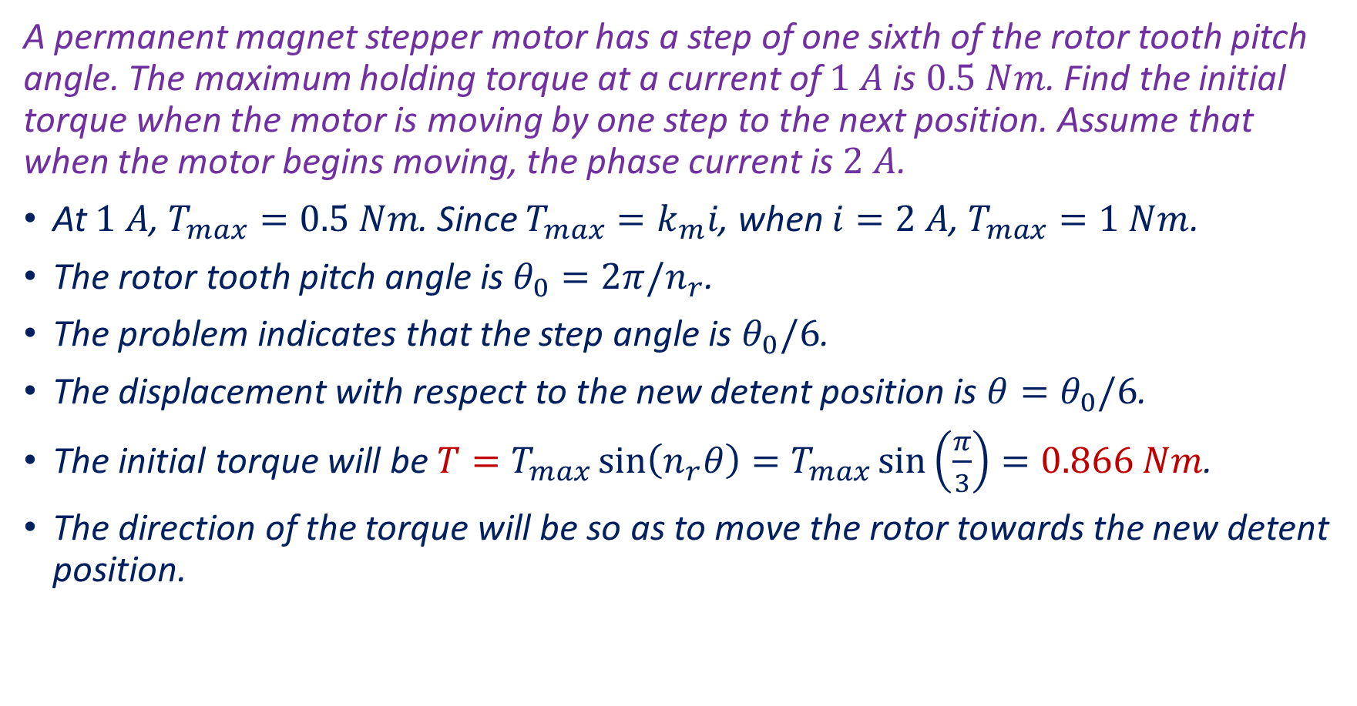
Example
A permanent magnet stepper motor has a step of one sixth of the rotor tooth pitch angle. The maximum holding torque at a current of $1 A$ is $0.5 Nm$. Find the initial torque when the motor is moving by one step to the next position. Assume that when the motor begins moving, the phase current is $2 A$.
At $1 A$, $T_{max}=0.5 Nm$. Since $T_{max}=k_{m}i$, when $i=2 A$, $T_{max}=1 Nm$.
The rotor tooth pitch angle is $θ_{0}=2π/n_{r}$.
The problem indicates that the step angle is $θ_{0}/6$.
The displacement with respect to the new detent position is $θ=θ_{0}/6$.
The initial torque will be $T=T_{max}\sin\left(n_{r}θ\right)=T_{max}\sin\left(\frac{π}{3}\right)=0.866 Nm$.
The direction of the torque will be so as to move the rotor towards the new detent position.

Slide 13
Electric Machines in Nature
In biological cells, an enzyme known as the ATP Synthase involves a rotary electric machine that can operate either as a motor or as a generator.
This electric machine was predicted by Paul D. Boyer, who received the Nobel prize in 1997 when the presence of the electric machine was demonstrated experimentally.

