Slide 1
Single-Phase Induction Motors
M.V. Iordache, EEGR3523 Mechatronics, Spring 2020, LeTourneau University

Slide 2
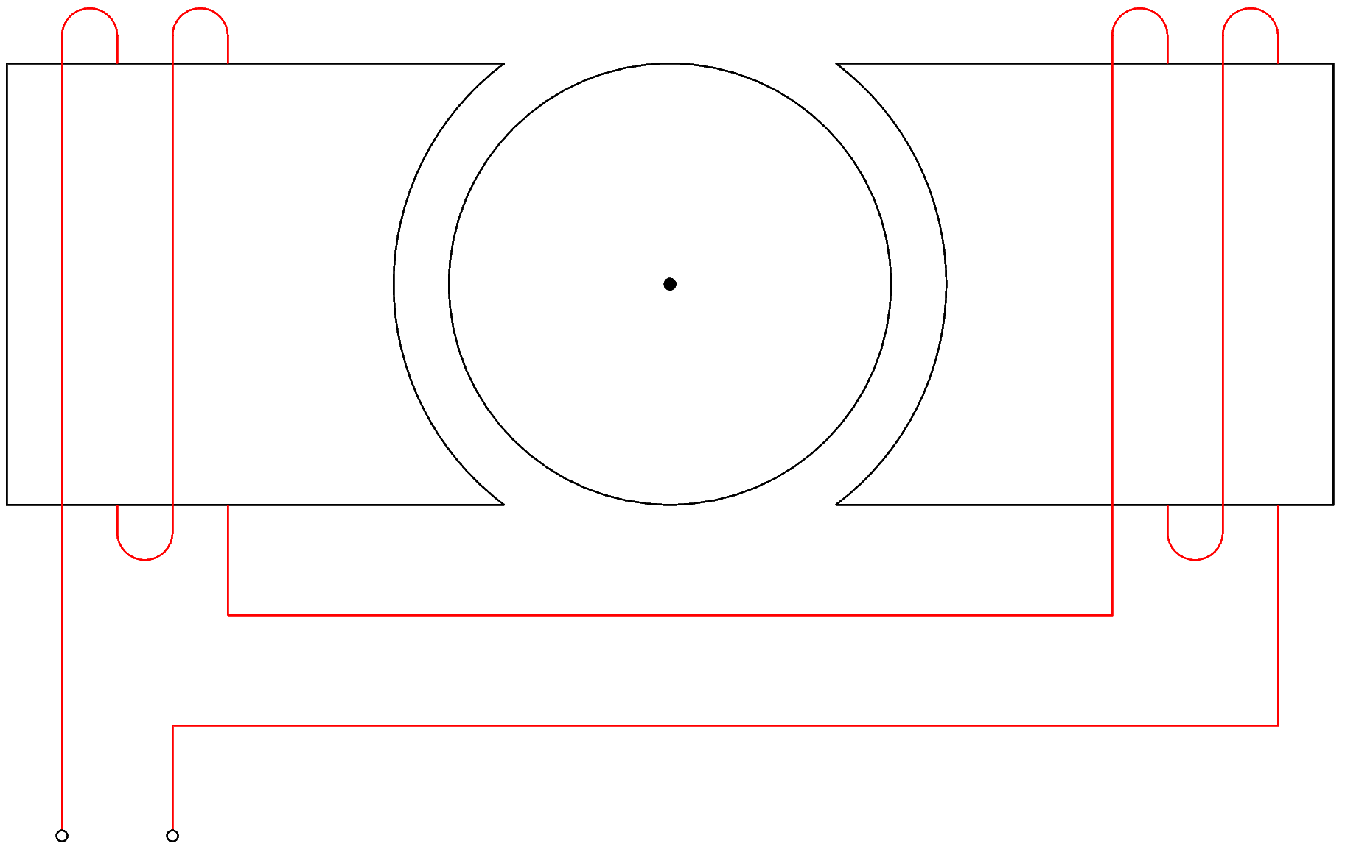
Introduction
AC motors rely on a rotating magnetic field.
The rotor of a synchronous motor follows the field at the same speed.
The rotor of an induction motor rotates because of the currents induced in it by the rotating field.
In a single phase motor, however, the magnetic field of the stator does not rotate.
For example, consider a single-phase motor with two stator poles.
Depending on the direction of the current, the
direction of the field is left-to-right or right-to-left.
The field pulsates, but does not rotate!
Additional stator poles connected to the same phase
will not make the field rotate.
Notes:
docs/sum/shaded2.fig

Slide 3
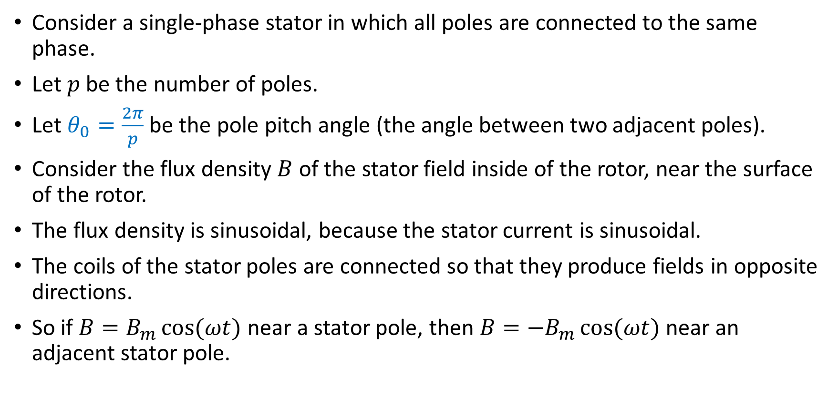
The Stator Field
Consider a single-phase stator in which all poles are connected to the same phase.
Let $p$ be the number of poles.
Let $θ_{0}=\frac{2π}{p}$ be the pole pitch angle (the angle between two adjacent poles).
Consider the flux density $B$ of the stator field inside of the rotor, near the surface of the rotor.
The flux density is sinusoidal, because the stator current is sinusoidal.
The coils of the stator poles are connected so that they produce fields in opposite directions.
So if $B=B_{m}\cos{(ωt)}$ near a stator pole, then $B=−B_{m}\cos{(ωt)}$ near an adjacent stator pole.
Notes:
docs/sum/shaded2.fig

Slide 4
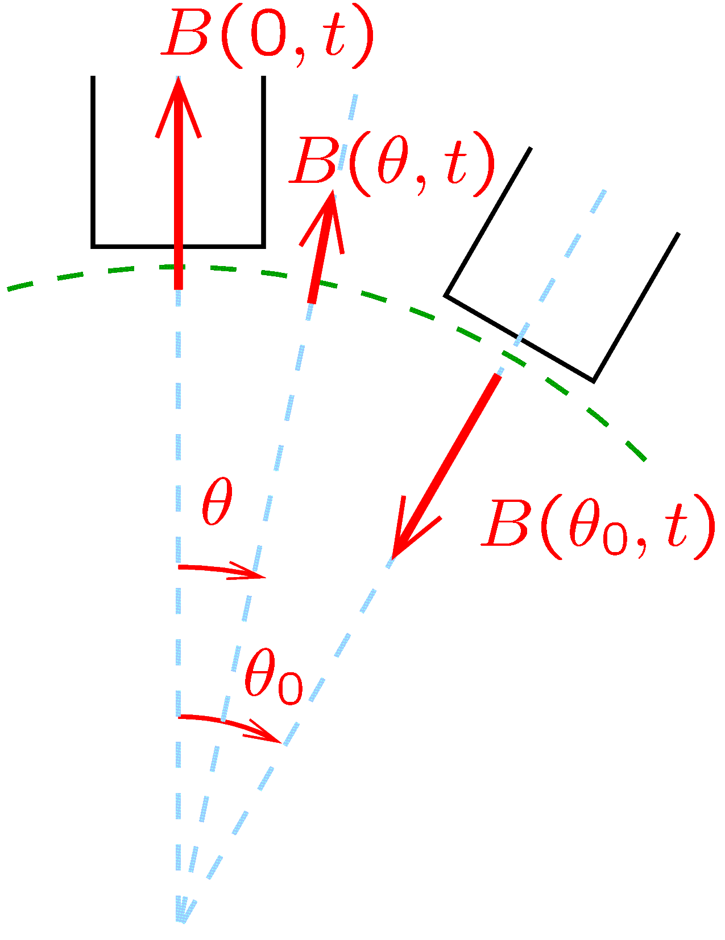
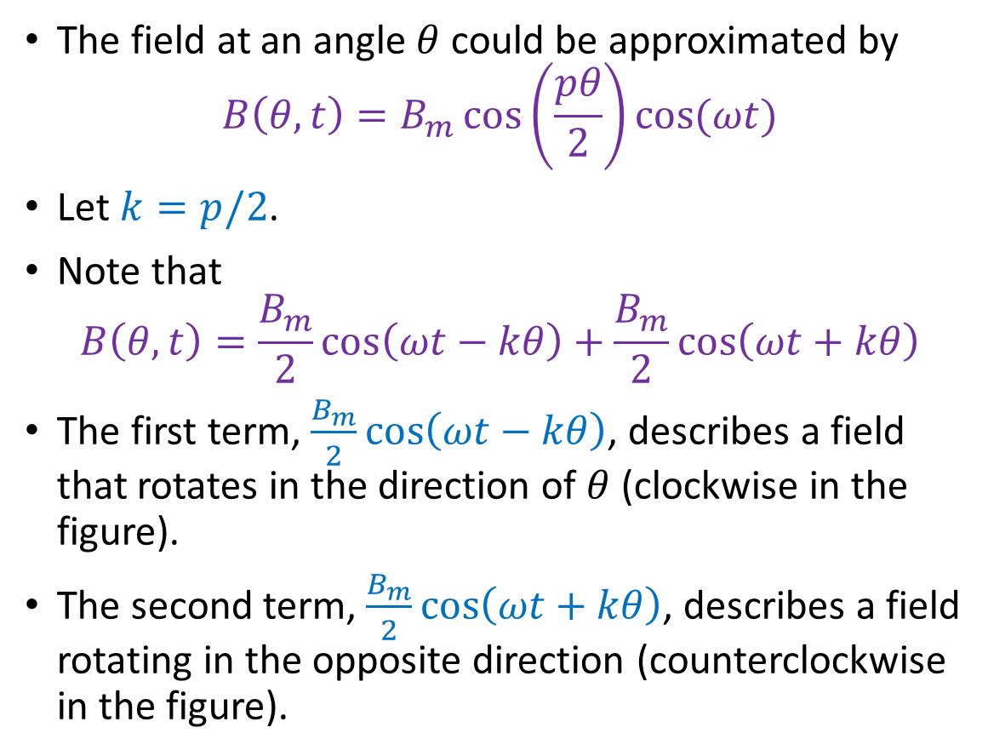
The Stator Field
The field at an angle $θ$ could be approximated by
$$B\left(θ,t\right)=B_{m}\cos\left(\frac{pθ}{2}\right)\cos{(ωt)}$$
Let $k=p/2$.
Note that
$$B\left(θ,t\right)=\frac{B_{m}}{2}\cos\left(ωt−kθ\right)+\frac{B_{m}}{2}\cos\left(ωt+kθ\right)$$
The first term, $\frac{B_{m}}{2}\cos\left(ωt−kθ\right)$, describes a field that rotates in the direction of $θ$ (clockwise in the figure).
The second term, $\frac{B_{m}}{2}\cos\left(ωt+kθ\right)$, describes a field rotating in the opposite direction (counterclockwise in the figure).
Notes:
presm/sfield.fig

Slide 5
The Stator Field
We conclude that the stator field of a single phase motor consists of two rotating fields rotating in opposite directions.
The torques generated by the rotating fields are equal and in opposite directions.
Unless we ensure that one of the rotating fields is stronger, the motor will not start.
Once the rotor rotates, the torque produced by the field rotating in the same direction will be stronger, and the motor will run.
Notes:
docs/sum/shaded2.fig

Slide 6
Single-Phase Induction Motors
Single-phase induction motors, in order to be self-starting, create an additional phase.
Split-phase motors have:
A main winding, that is always powered.
A starting winding, that is connected only when the motor starts.
The starting winding is disconnected by a centrifugal switch when the rotor reaches a sufficiently high speed.
The starting winding has a higher resistance and a different reactance/resistance ratio.
In this way, the current of the starting winding is out of phase with the current of the main winding.
This creates a second phase and in this way a predominant rotating field.
Notes:
docs/sum/shaded2.fig

Slide 7
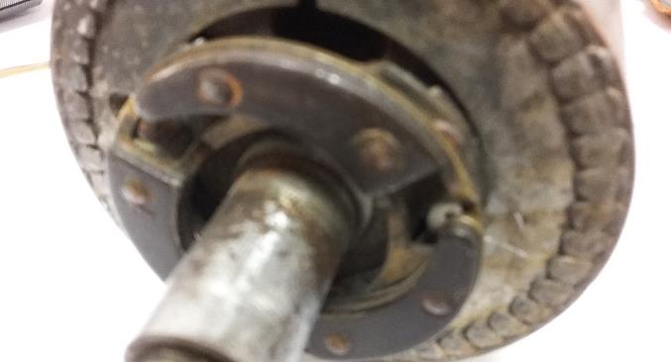
Single-Phase Induction Motors
Capacitor-start motors have:
A main winding, that is always powered.
A starting winding, connected in series with a capacitor.
The capacitor causes the current of the starting winding to be out of phase with the current of the main winding.
This creates a second phase and in this way a predominant rotating field.
Some motors disconnect the starting winding after the rotor has reached a predetermined speed.
Spring-loaded parts that are shifted off-center by the centrifugal force. They can turn off a switch at high enough speed.
Notes:
docs/sum/shaded2.fig

Slide 8
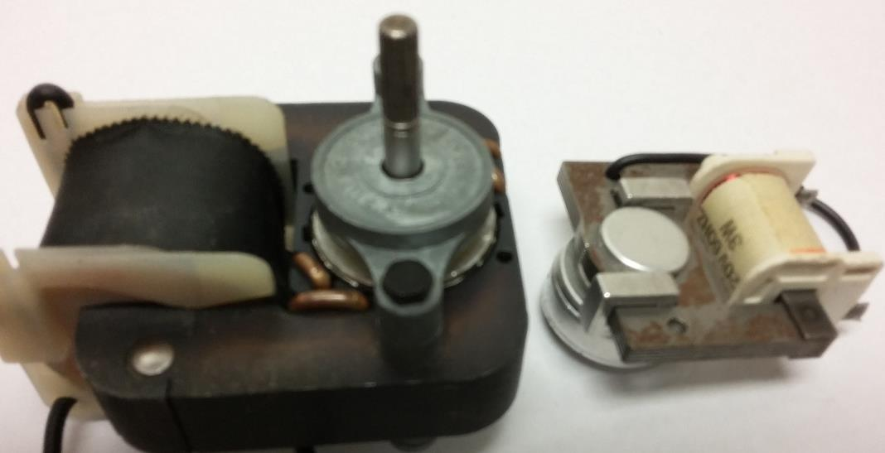
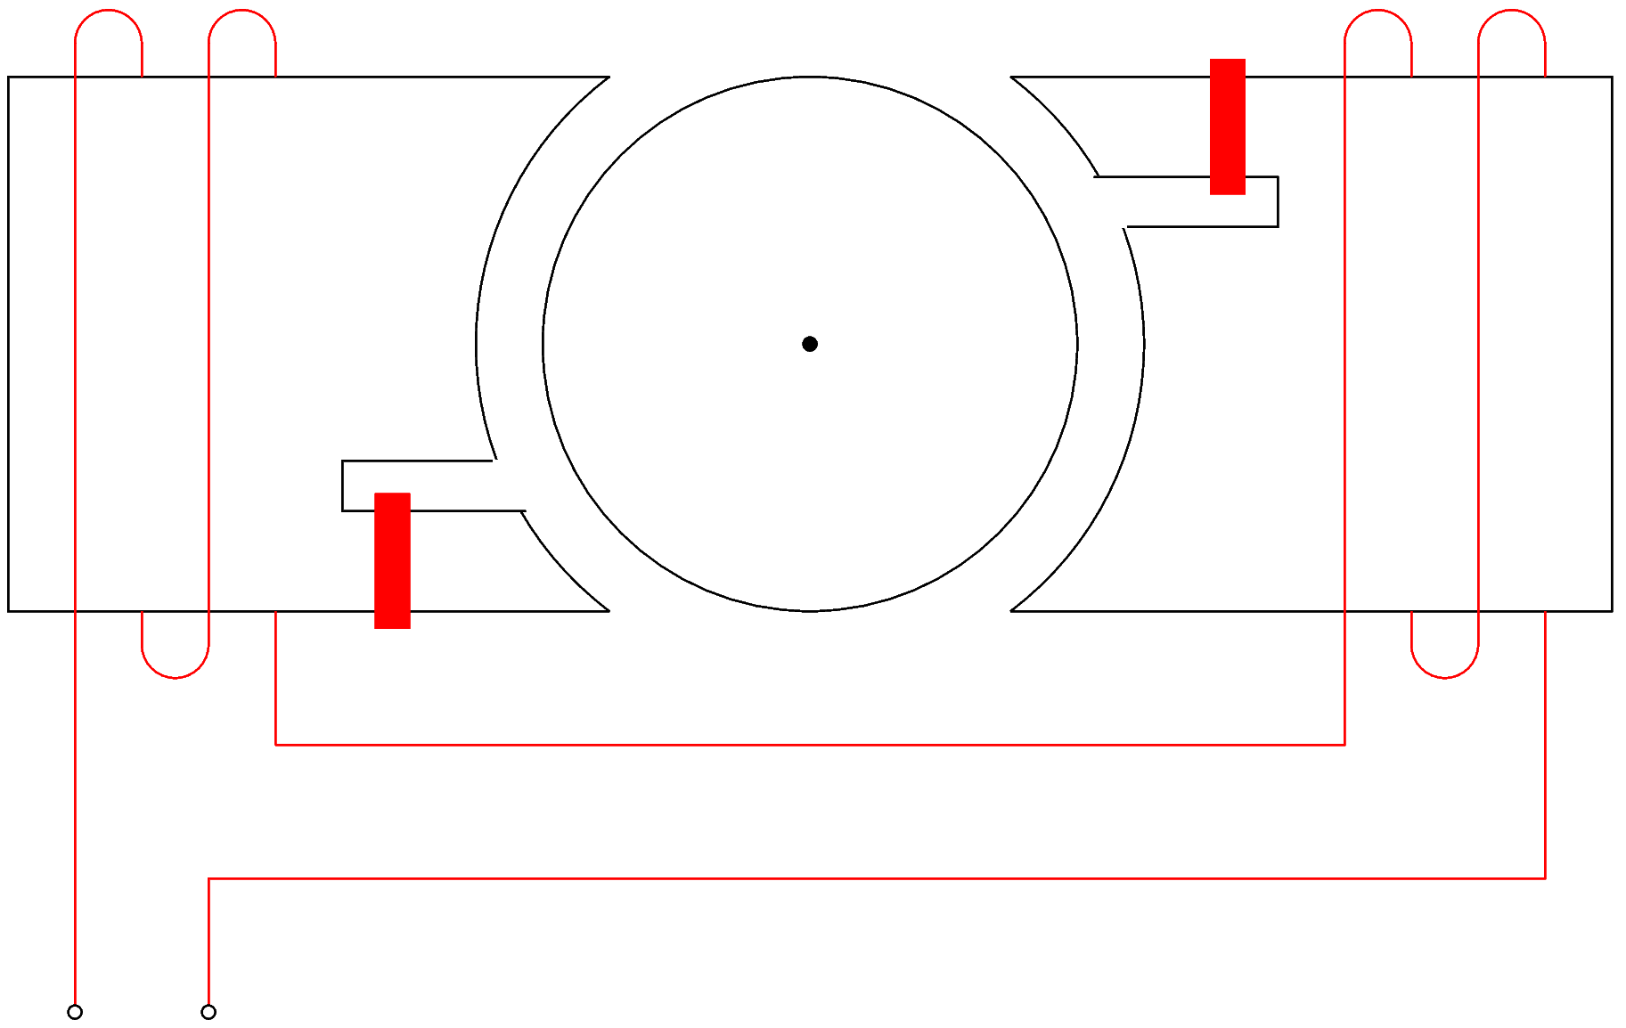
Single-Phase Induction Motors
Shaded-pole motors have:
A short-circuited conductive strap (called shading band) wound on a portion of each pole.
This creates a lag, and in this way a predominant rotating field that turns from the main face of the pole towards the shaded portion of the pole.
Shading band
Shading bands
Notes:
docs/sum/shaded.fig

Slide 9
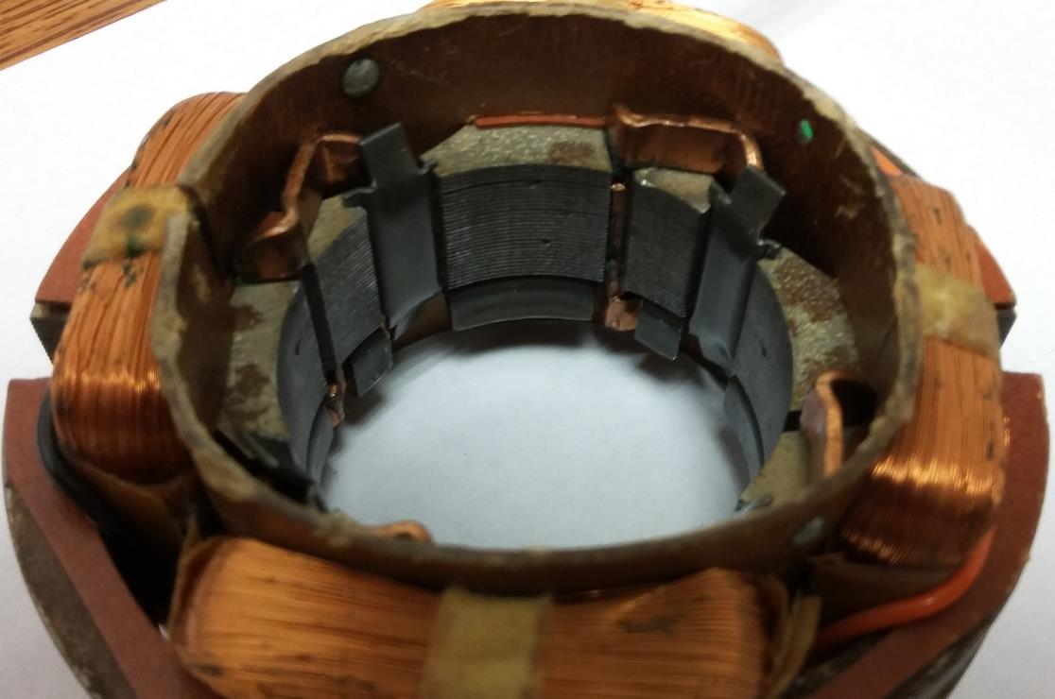
Single-Phase Induction Motors
Single-phase induction motors are typically for relatively low power applications.
The rotor is typically of the squirrel-cage type.
Shading bands in a 4-pole stator.
Notes:
docs/sum/shaded2.fig

Slide 10
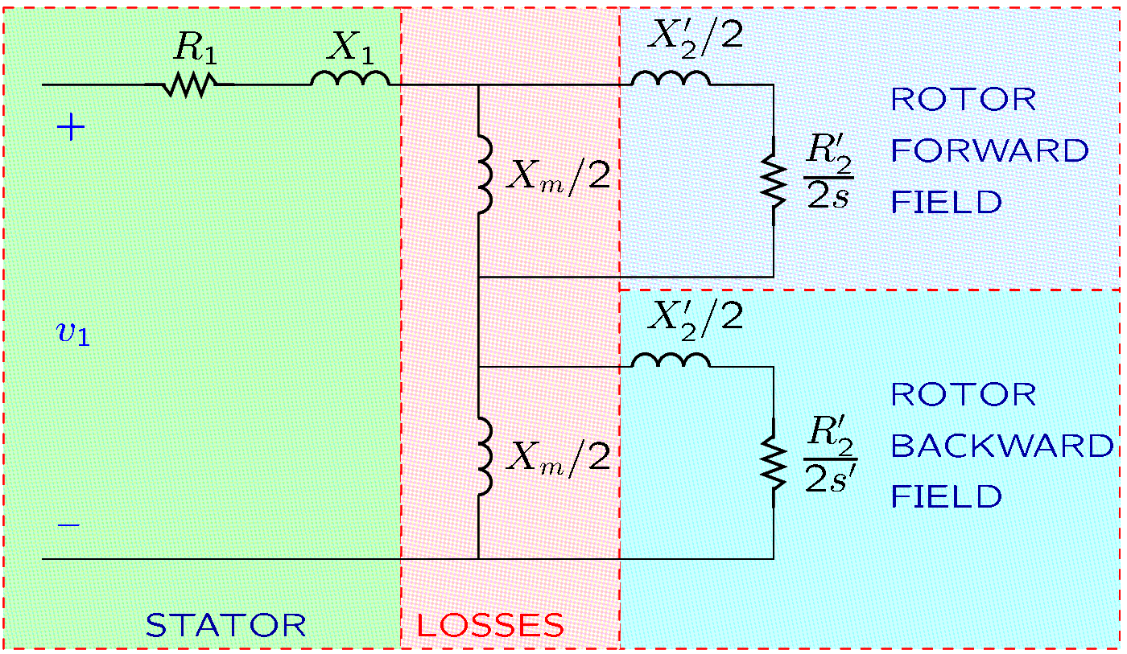
Electric Model of Single-Phase Induction Motors
The model resembles the per-phase model of polyphase induction motors.
There are differences because single phase motors have two rotating fields.
Notes:
docs/online/sphase.fig

Slide 11

Electric Model of Single-Phase Induction Motors
Let $n$ be the speed of the motor.
The slip with respect to the forward field is $s=\frac{n_{s}−n}{n_{s}}$.
The slip with respect to the backward field is $s^{′}=\frac{−n_{s}−n}{{−n}_{s}}=2−s$.
$R_{1}$ and $X_{1}$ are the stator resistance
and reactance, respectively.
$R_{2}^{′}$ and $X_{2}^{′}$ correspond to the
resistance and reactance,
respectively, of the rotor.
$X_{m}$ models that the magnetic
coupling of the rotor and stator is
imperfect.
Notes:
docs/online/sphase.fig

Slide 12
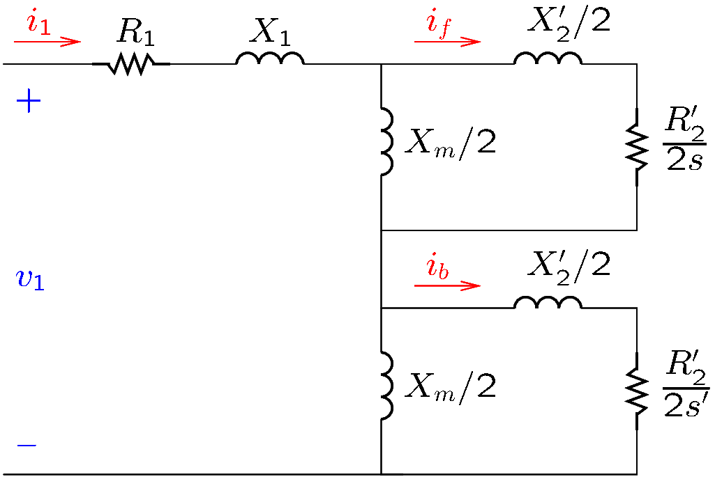
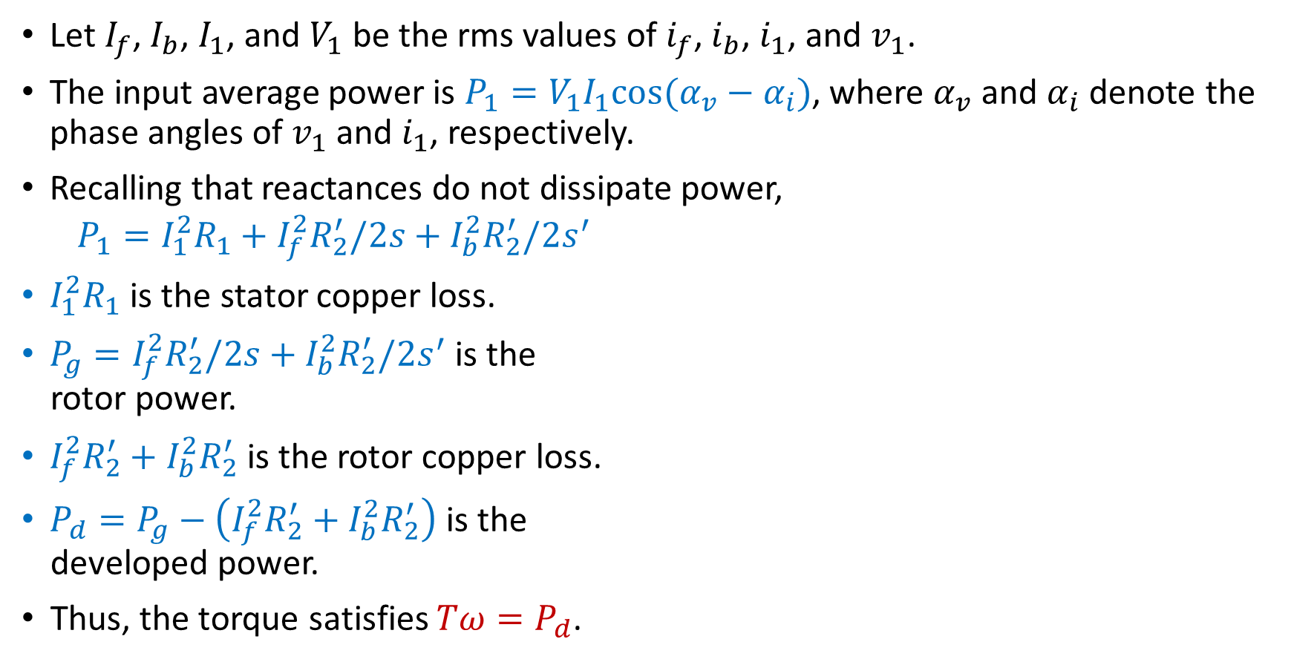
Electric Model of Single-Phase Induction Motors
Let $I_{f}$, $I_{b}$, $I_{1}$, and $V_{1}$ be the rms values of $i_{f}$, $i_{b}$, $i_{1}$, and $v_{1}$.
The input average power is $P_{1}=V_{1}I_{1}cos⁡(α_{v}−α_{i})$, where $α_{v}$ and $α_{i}$ denote the phase angles of $v_{1}$ and $i_{1}$, respectively.
Recalling that reactances do not dissipate power,
$$P_{1}=I_{1}^{2}R_{1}+I_{f}^{2}R_{2}^{′}/2s+I_{b}^{2}R_{2}^{′}/2s^{′}$$
$I_{1}^{2}R_{1}$ is the stator copper loss.
$P_{g}=I_{f}^{2}R_{2}^{′}/2s+I_{b}^{2}R_{2}^{′}/2s^{′}$is the
rotor power.
$I_{f}^{2}R_{2}^{′}+I_{b}^{2}R_{2}^{′}$is the rotor copper loss.
$P_{d}=P_{g}−\left(I_{f}^{2}R_{2}^{′}+I_{b}^{2}R_{2}^{′}\right)$ is the
developed power.
Thus, the torque satisfies $Tω=P_{d}$.
Notes:
docs/online/sphase2.fig

Slide 13
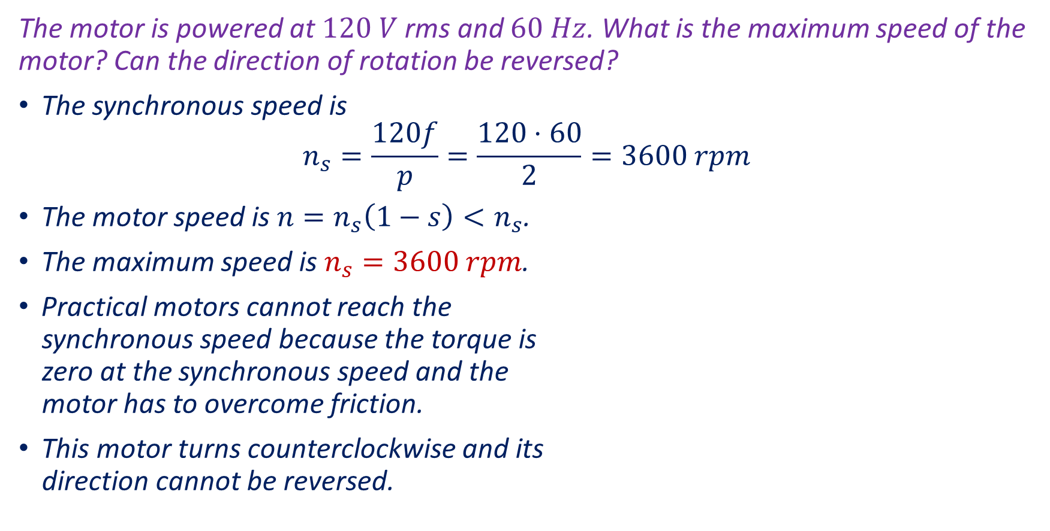
Example 1
The motor is powered at $120 V$ rms and $60 Hz$. What is the maximum speed of the motor? Can the direction of rotation be reversed?
The synchronous speed is
$$n_{s}=\frac{120f}{p}=\frac{120⋅60}{2}=3600 rpm$$
The motor speed is $n=n_{s}\left(1−s\right)<n_{s}$.
The maximum speed is $n_{s}=3600 rpm$.
Practical motors cannot reach the
synchronous speed because the torque is
zero at the synchronous speed and the
motor has to overcome friction.
This motor turns counterclockwise and its
direction cannot be reversed.

Slide 14
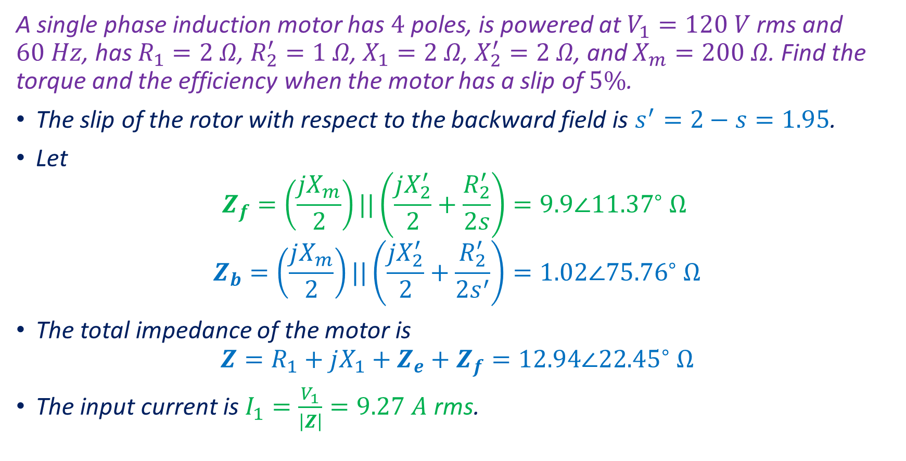
Example 2
A single phase induction motor has $4$ poles, is powered at $V_{1}=120 V$ rms and $60 Hz$, has $R_{1}=2 Ω$, $R_{2}^{′}=1 Ω$, $X_{1}=2 Ω$, $X_{2}^{′}=2 Ω$, and $X_{m}=200 Ω$. Find the torque and the efficiency when the motor has a slip of $5\%$.
The slip of the rotor with respect to the backward field is $s^{′}=2−s=1.95$.
Let
$$Z_{f}=\left(\frac{jX_{m}}{2}\right)||\left(\frac{jX_{2}^{′}}{2}+\frac{R_{2}^{′}}{2s}\right)=9.9∠{11.37}^{∘} Ω$$
$$Z_{b}=\left(\frac{jX_{m}}{2}\right)||\left(\frac{jX_{2}^{′}}{2}+\frac{R_{2}^{′}}{2s^{′}}\right)=1.02∠{75.76}^{∘} Ω$$
The total impedance of the motor is
$$Z=R_{1}+jX_{1}+Z_{e}+Z_{f}=12.94∠22.45^{∘} Ω$$
The input current is $I_{1}=\frac{V_{1}}{\left|Z\right|}=9.27 A$ rms.
Notes:
p =4; xm = 200;x2 = 2; x1 = 2; r1 = 2; r2 = 1; v1 = 120; f = 60; s = 0.05; sb = 2-s; zf = par(j*xm/2, j*x2/2+r2/2/s); z_f = mpolar(zf), zb = par(j*xm/2, j*x2/2+r2/2/sb); z_b = mpolar(zb), z = r1+j*x1+zf+zb; z_t = mpolar(z), i1 = v1/z; p1 = abs(i1)^2*real(z); pd = abs(i1)^2*(1-s)*(real(zf)-real(zb)); n = 120*f/p*(1-s); w = n/60*2*pi; T = pd/w, eta = pd/p1, eta2 = (1-s)*(real(zf)-real(zb))/real(z)

Slide 15
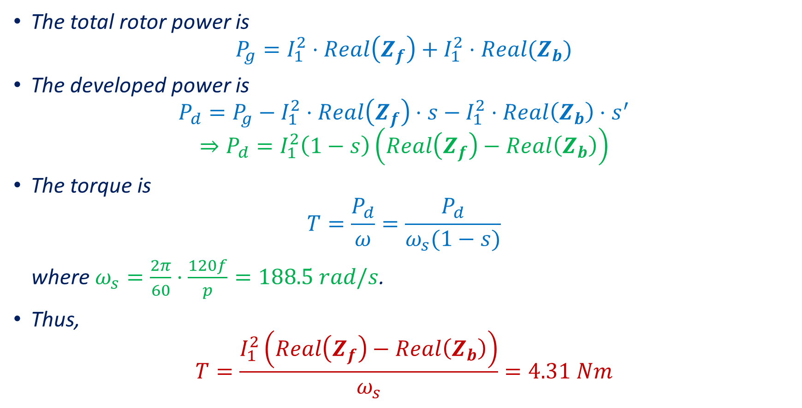
Example 2
The total rotor power is
$$P_{g}=I_{1}^{2}⋅Real\left(Z_{f}\right)+I_{1}^{2}⋅Real(Z_{b})$$
The developed power is
$$P_{d}=P_{g}−I_{1}^{2}⋅Real\left(Z_{f}\right)⋅s−I_{1}^{2}⋅Real\left(Z_{b}\right)⋅s^{′}$$
$$⇒P_{d}=I_{1}^{2}\left(1−s\right)\left(Real\left(Z_{f}\right)−Real\left(Z_{b}\right)\right)$$
The torque is
$$T=\frac{P_{d}}{ω}=\frac{P_{d}}{ω_{s}(1−s)}$$
where $ω_{s}=\frac{2π}{60}⋅\frac{120f}{p}=188.5 rad/s$.
Thus,
$$T=\frac{I_{1}^{2}\left(Real\left(Z_{f}\right)−Real\left(Z_{b}\right)\right)}{ω_{s}}=4.31 Nm$$

Slide 16

Example 2
The efficiency is
$$η=\frac{P_{d}}{P_{1}}=\frac{I_{1}^{2}\left(1−s\right)\left(Real\left(Z_{f}\right)−Real\left(Z_{b}\right)\right)}{I_{1}^{2}Real(Z)}$$
$$η=\frac{\left(1−s\right)\left(Real\left(Z_{f}\right)−Real\left(Z_{b}\right)\right)}{Real\left(Z\right)}=75.12\%$$

