Slide 1
AC Machines
Principle. Synchronous Motors. Induction Motors.
M.V. Iordache, EEGR3523 Mechatronics, Spring 2021, LeTourneau University

Slide 2
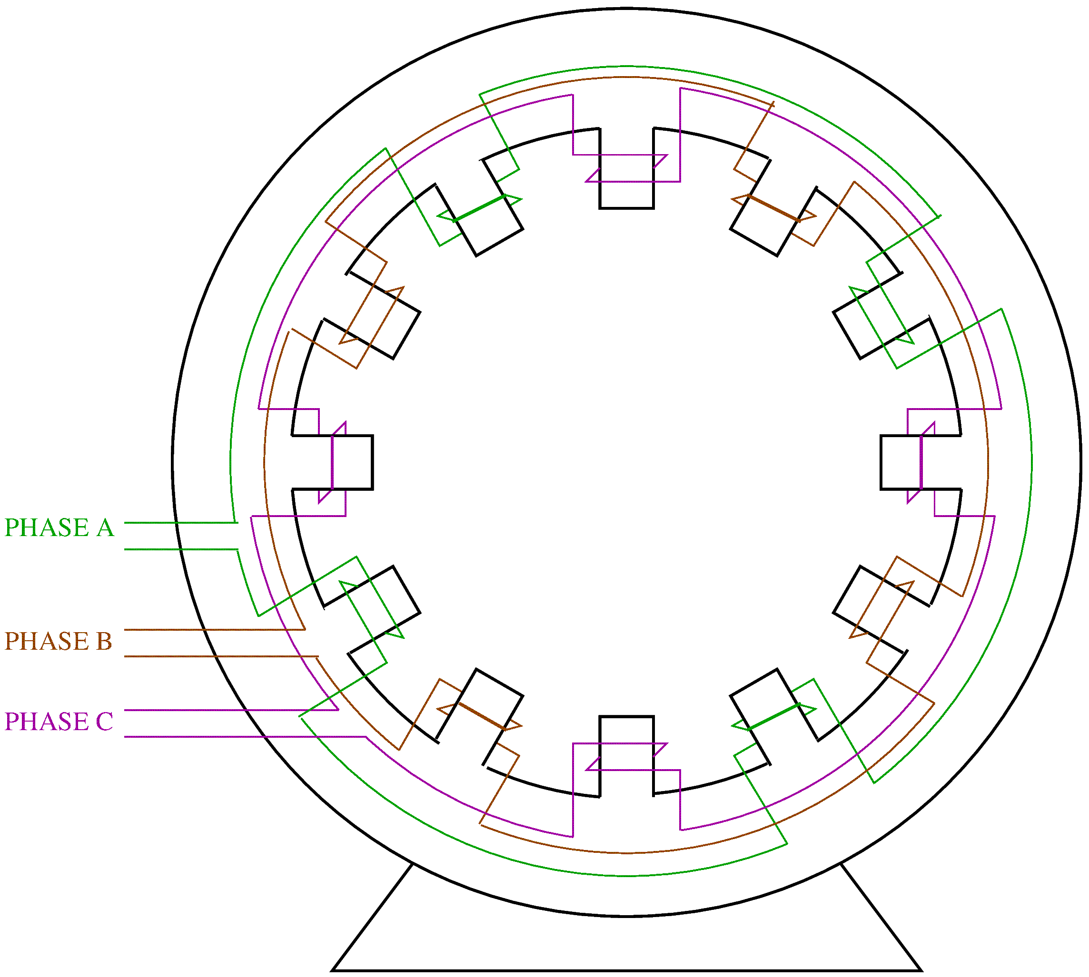
Principle of Operation
AC motors use a rotating magnetic field.
A rotating magnetic field is obtained when the distribution of the magnetic field inside the motor changes in time, so as to give the appearance of rotation.
To illustrate the rotating field, consider the figure showing the stator of an AC machine.
The stator has 12 poles connected to three phases.
There are 4 poles per phase.
For this machine, the stator is the armature.
Notes:
presm/rotfield.fig

Slide 3
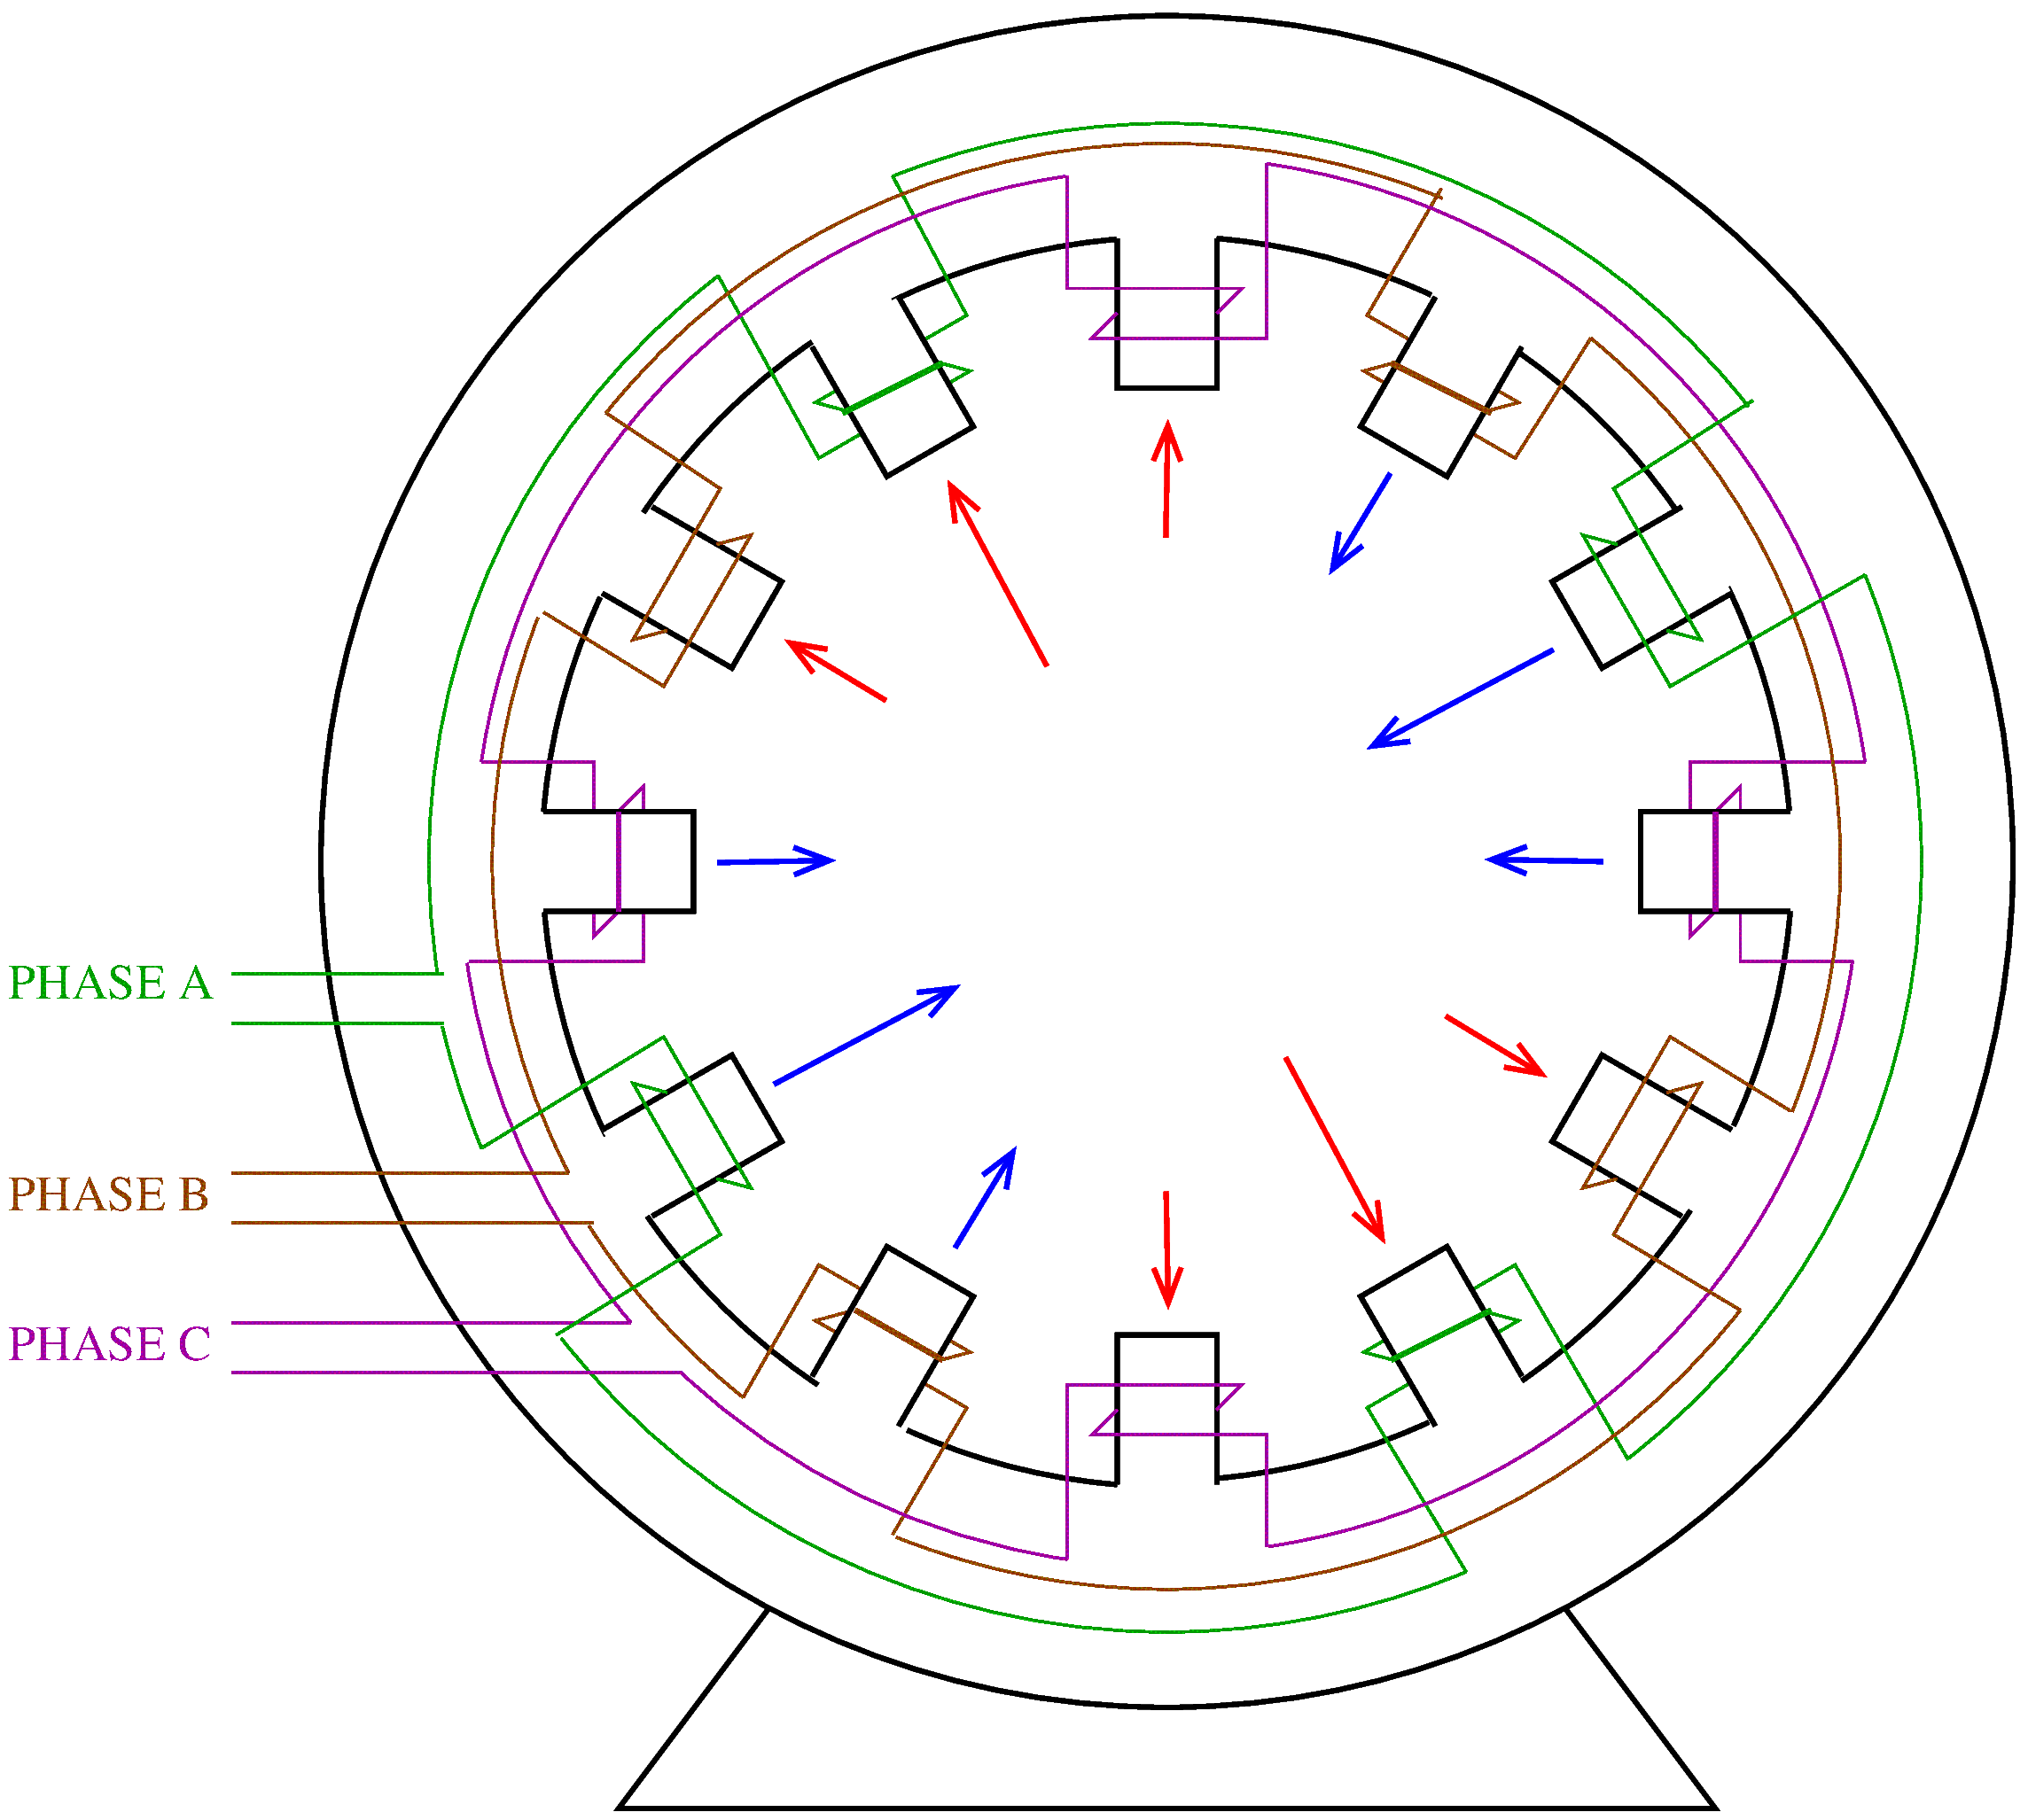
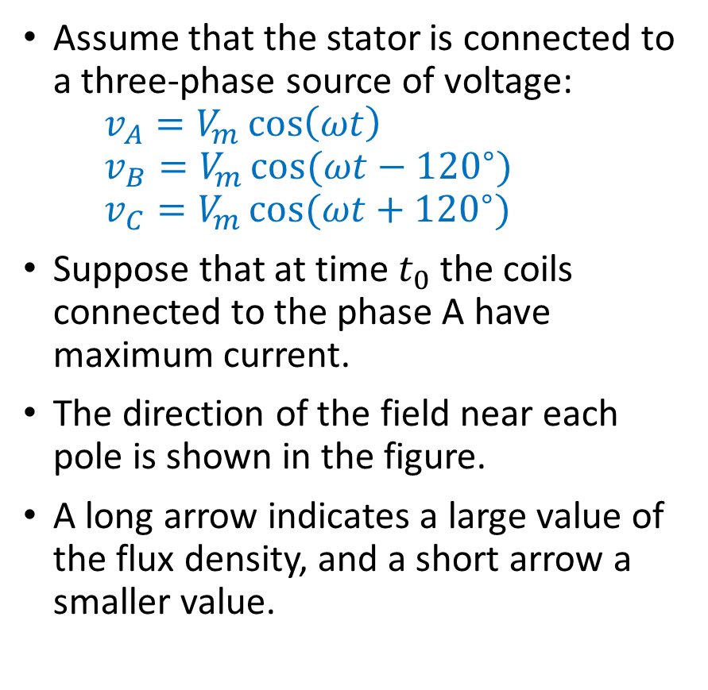
Principle of Operation
Assume that the stator is connected to a three-phase source of voltage:
$$v_{A}=V_{m}\cos\left(ωt\right)$$
$$v_{B}=V_{m}\cos{(ωt−{120}^{∘})}$$
$$v_{C}=V_{m}\cos{(ωt+{120}^{∘})}$$
Suppose that at time $t_{0}$ the coils connected to the phase A have maximum current.
The direction of the field near each pole is shown in the figure.
A long arrow indicates a large value of the flux density, and a short arrow a smaller value.

Slide 4
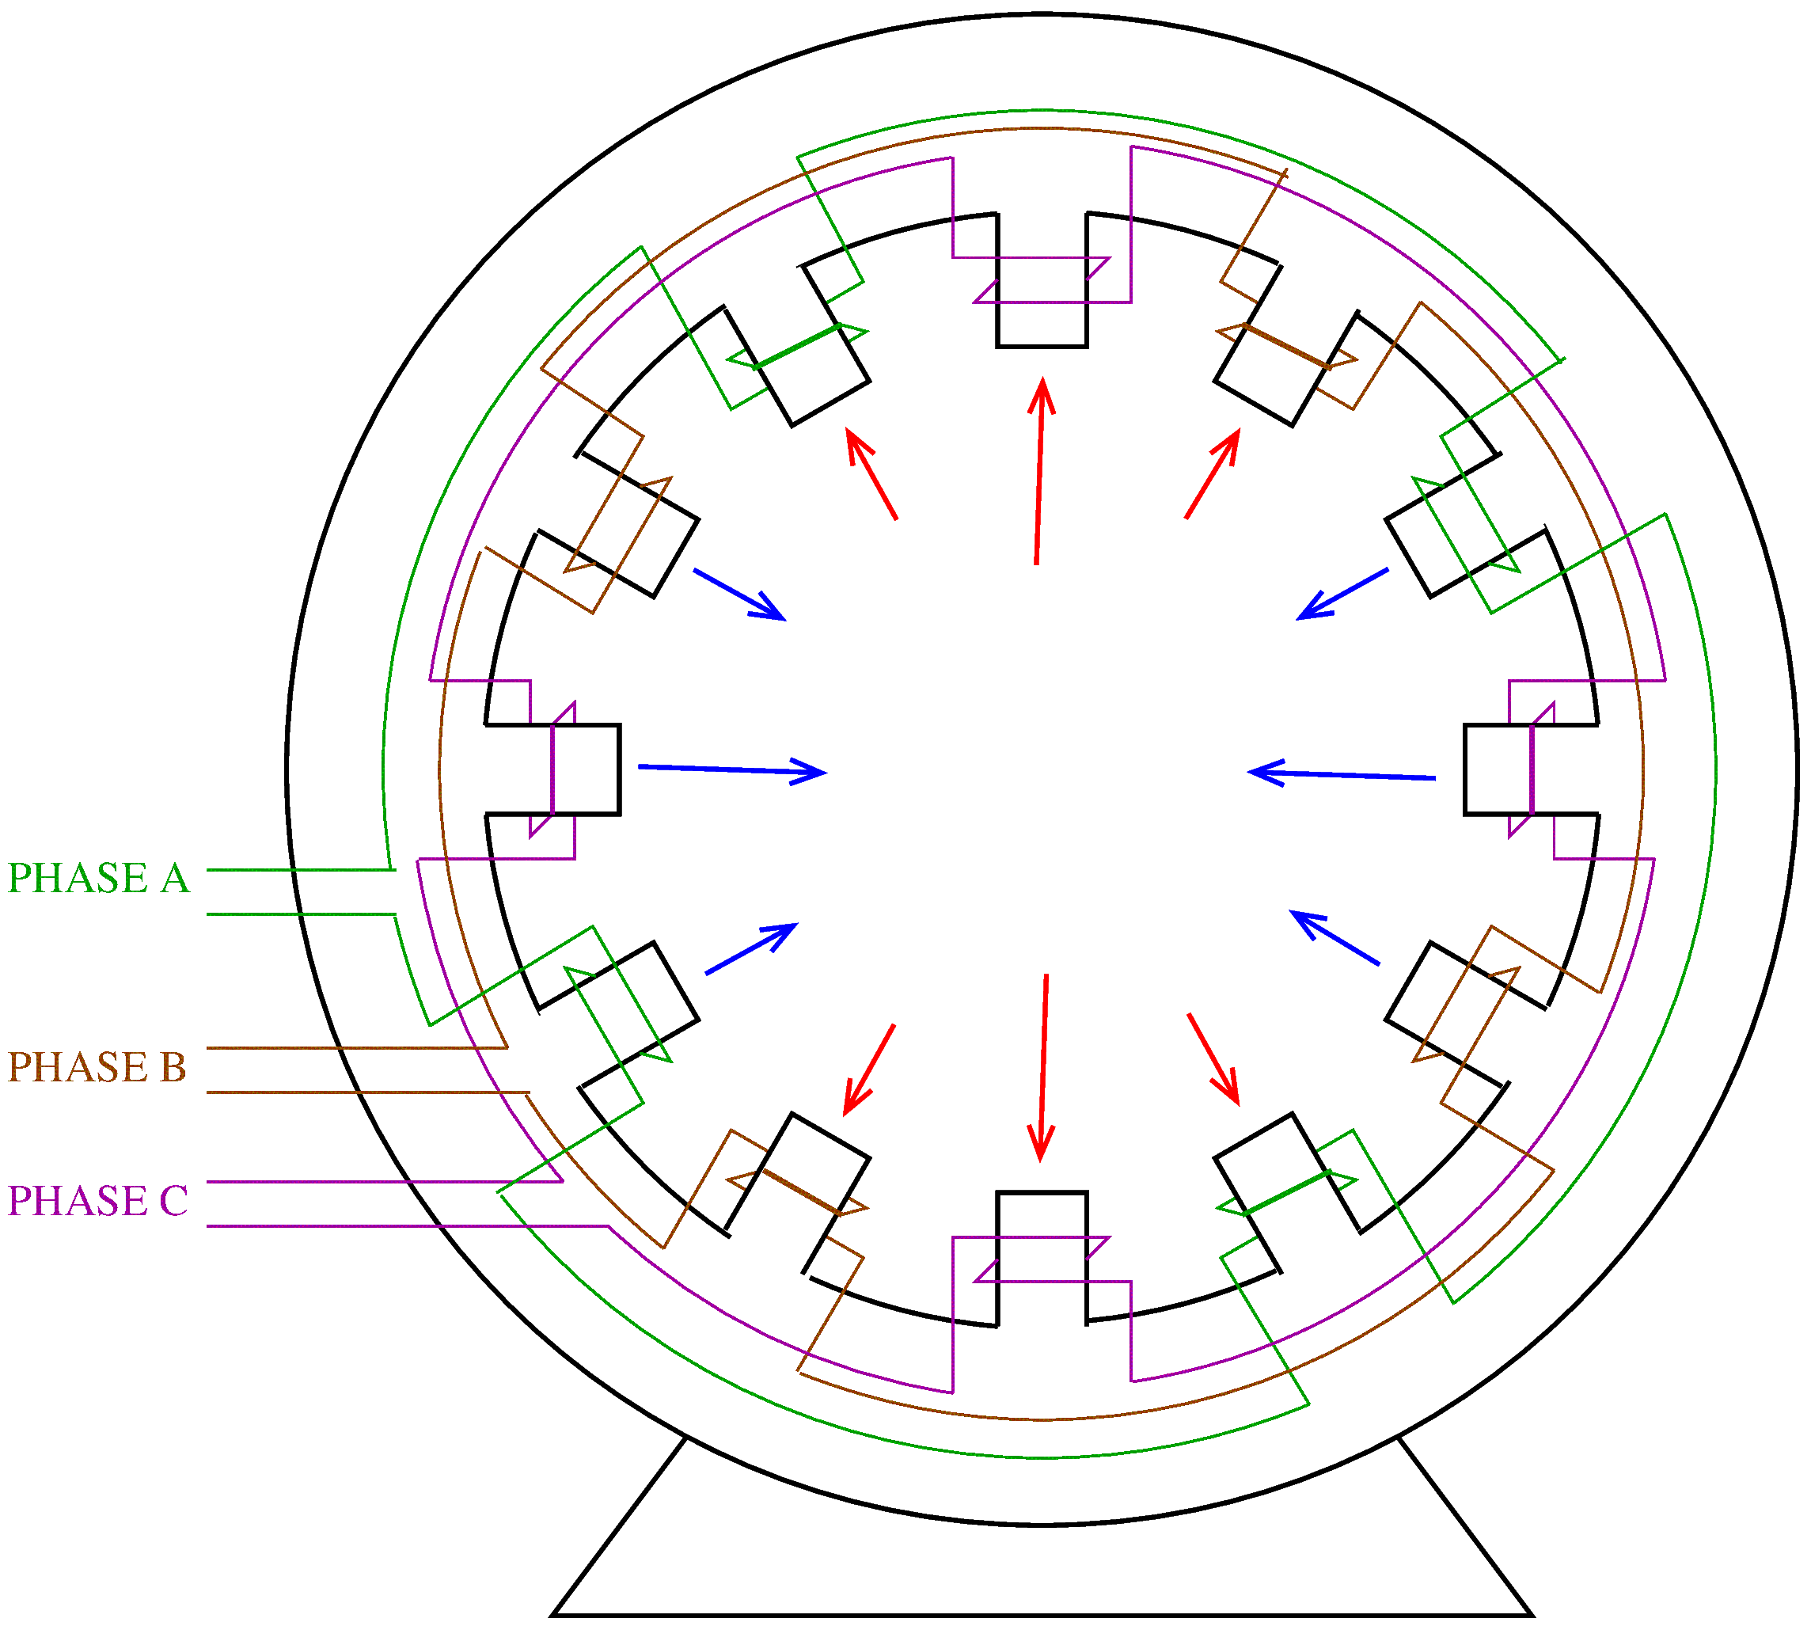
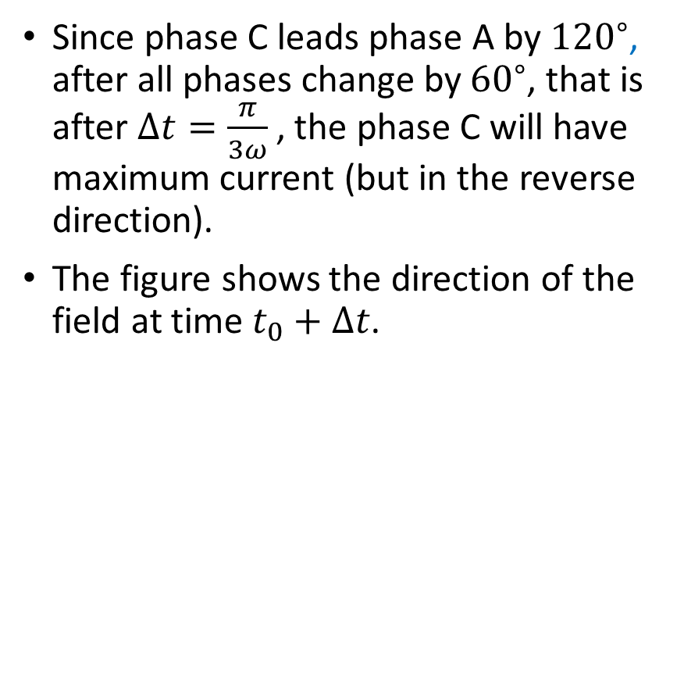
Principle of Operation
Since phase C leads phase A by ${120}^{∘}$, after all phases change by ${60}^{∘}$, that is after $Δt=\frac{π}{3ω}$, the phase C will have maximum current (but in the reverse direction).
The figure shows the direction of the field at time $t_{0}+Δt$.

Slide 5
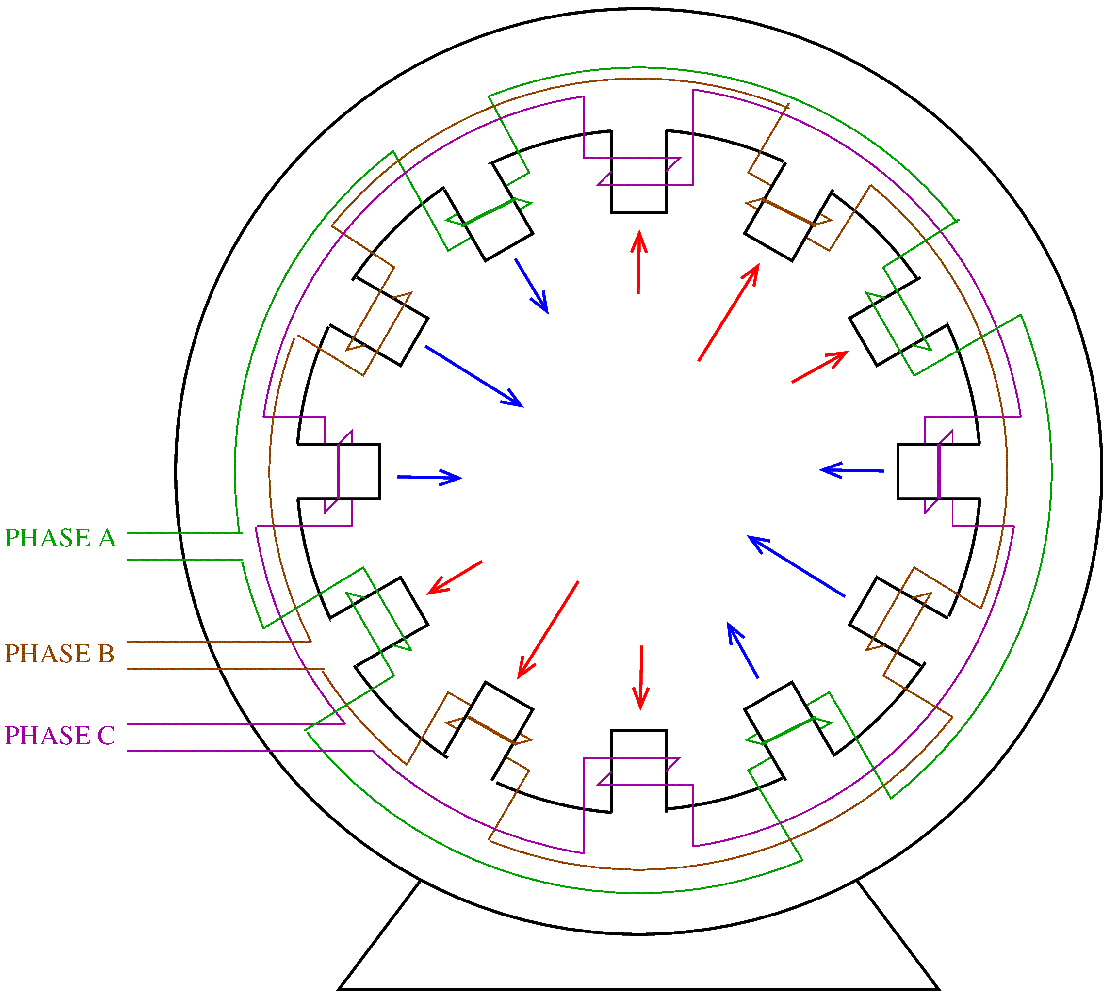
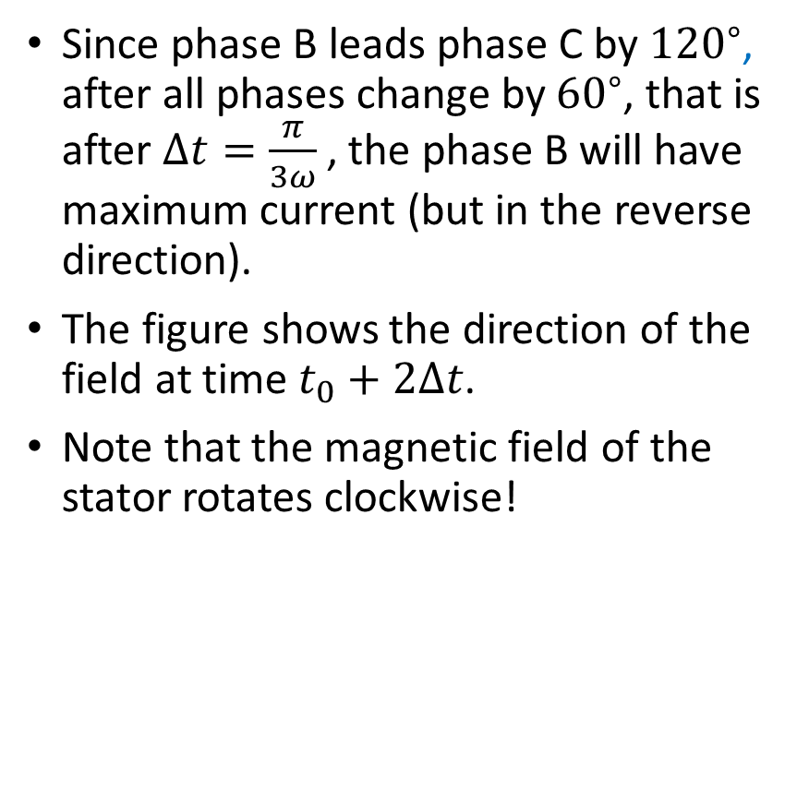
Principle of Operation
Since phase B leads phase C by ${120}^{∘}$, after all phases change by ${60}^{∘}$, that is after $Δt=\frac{π}{3ω}$, the phase B will have maximum current (but in the reverse direction).
The figure shows the direction of the field at time $t_{0}+2Δt$.
Note that the magnetic field of the stator rotates clockwise!

Slide 6
Principle of Operation
AC motors use the rotating field of the stator in one of two ways.
In synchronous motors, the rotor poles have a constant magnetic polarity. The rotor aligns itself with the rotating field and turns at the same speed.
In induction motors, the rotating magnetic field induces currents in the rotor. The interaction of the induced currents with the rotating field creates torque.
Note that the windings of the stator poles are usually overlapping (see Fig. 5-3 in the textbook).
  This makes the stator magnetic field more uniform.

Slide 7
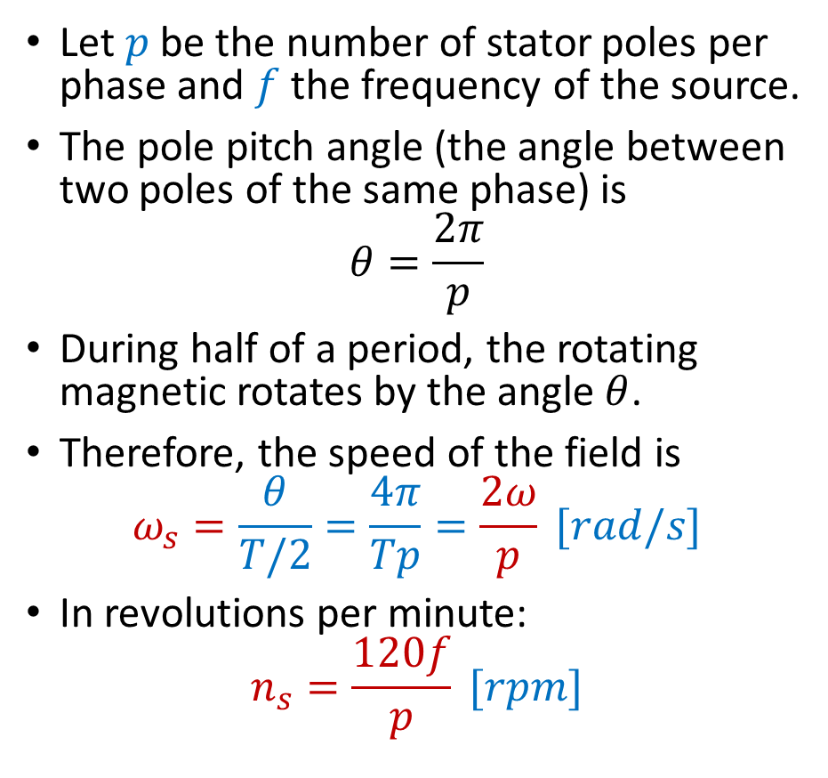
The Rotating Magnetic Field
Let $p$ be the number of stator poles per phase and $f$ the frequency of the source.
The pole pitch angle (the angle between two poles of the same phase) is
$$θ=\frac{2π}{p}$$
During half of a period, the rotating magnetic rotates by the angle $θ$.
Therefore, the speed of the field is
$$ω_{s}=\frac{θ}{T/2}=\frac{4π}{Tp}=\frac{2ω}{p} [rad/s]$$
In revolutions per minute:
$$n_{s}=\frac{120f}{p} [rpm]$$

Slide 8
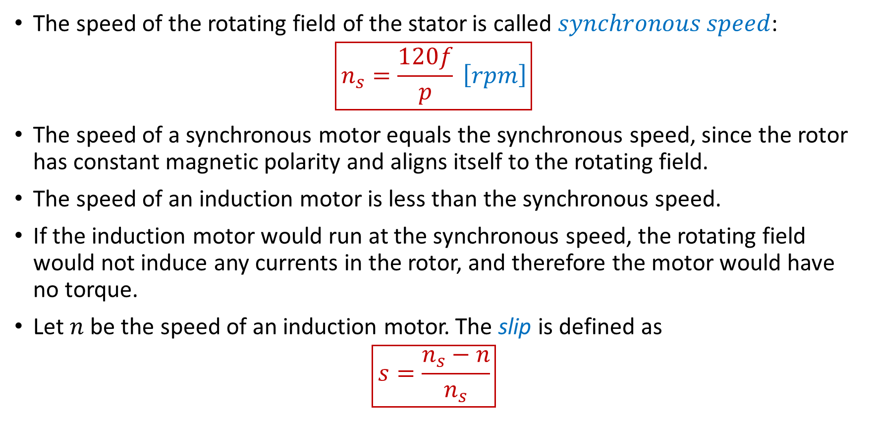
The Synchronous Speed
The speed of the rotating field of the stator is called $synchronous speed$:
$$\boxed{n_{s}=\frac{120f}{p} \left[rpm\right]}$$
The speed of a synchronous motor equals the synchronous speed, since the rotor has constant magnetic polarity and aligns itself to the rotating field.
The speed of an induction motor is less than the synchronous speed.
If the induction motor would run at the synchronous speed, the rotating field would not induce any currents in the rotor, and therefore the motor would have no torque.
Let $n$ be the speed of an induction motor. The slip is defined as
$$\boxed{s=\frac{n_{s}−n}{n_{s}}}$$

Slide 9
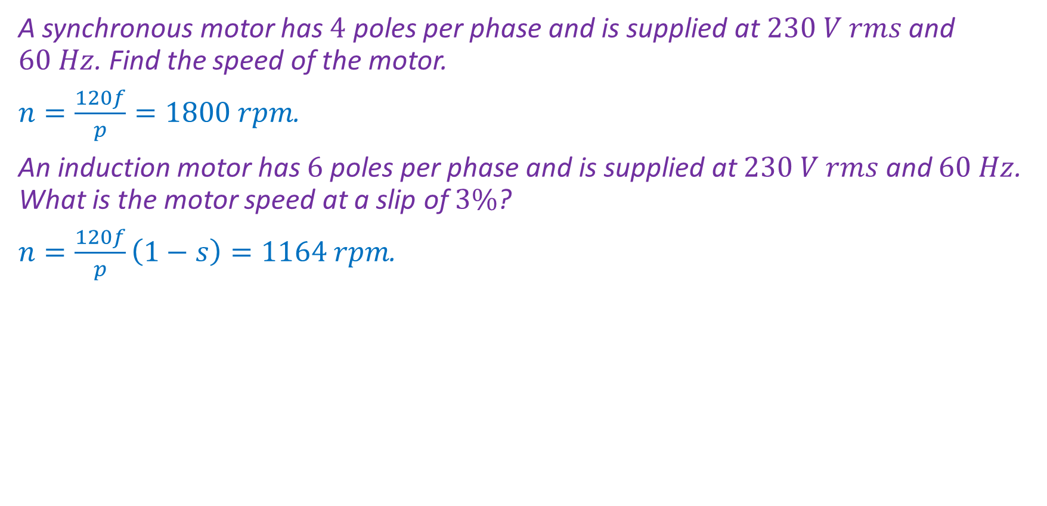
Examples
A synchronous motor has $4$ poles per phase and is supplied at $230 V rms$ and $60 Hz$. Find the speed of the motor.
$n=\frac{120f}{p}=1800 rpm$.
An induction motor has $6$ poles per phase and is supplied at $230 V rms$ and $60 Hz$. What is the motor speed at a slip of $3\%$?
$n=\frac{120f}{p}\left(1−s\right)=1164 rpm$.

Slide 10
Induction Motors
In an induction motor, the rotor coils are shorted.
Thus, there are closed current paths through the rotor and the rotating magnetic field of the stator will induce currents in the rotor.
The interaction of the rotor currents and the stator field creates torque.
The rotor may be:
  A squirrel cage rotor.
  A wound rotor.

Slide 11
Induction Motors—Wound Rotor
The wound-rotor motor, also known as slip-ring motor, connects the rotor windings to external variable resistors.
The resistors are connected to the rotor by means of brushes touching slip rings attached to the rotor.
The resistors can be adjusted to control the induced currents, and in this way torque and speed.

Slide 12
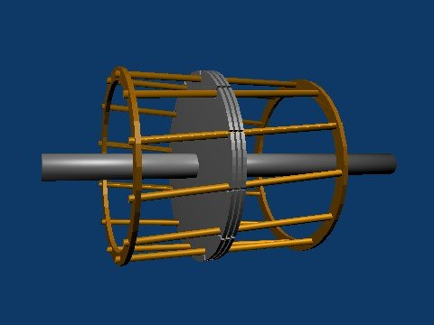
Induction Motors—Squirrel Cage
Squirrel cage motors are brushless.
They are very common.
A copper structure resembling a cage is enclosed in the rotor core.
Since the copper bars are shorted by the end rings, currents can flow freely through the bars.
The stator rotating field induces currents in the bars, and the interaction of the currents with the field creates torque.
The figure shows the cage-like structure and three core laminations in the middle.
The cage is enclosed in the core of the rotor.
Figure from https://en.wikipedia.org/wiki/Induction_motor, CC BY-SA 3.0, downloaded on Apr. 25, 2020.

Slide 13
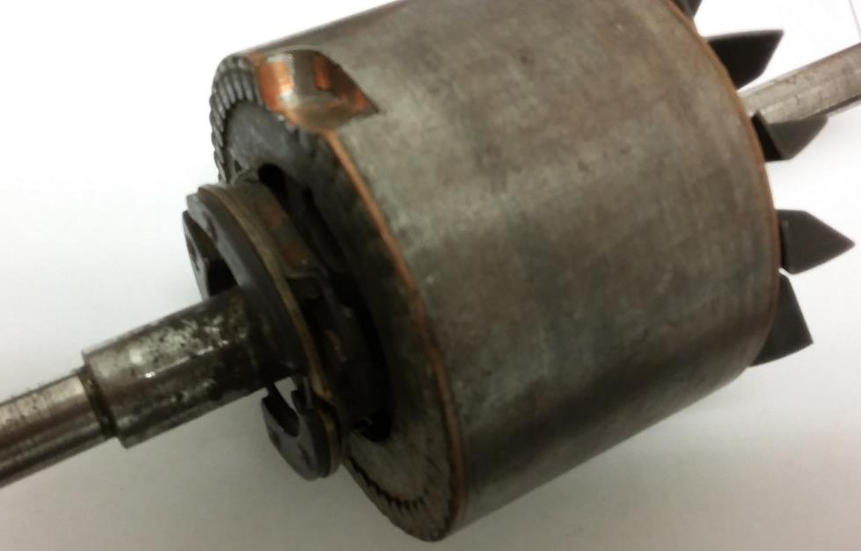
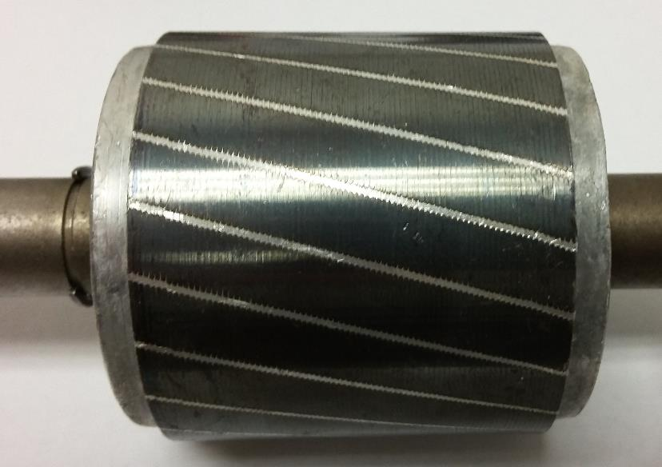
Induction Motors—Squirrel Cage
Squirrel cage rotors.
A cut in the rotor reveals an end ring and copper bars inside the rotor core.

Slide 14
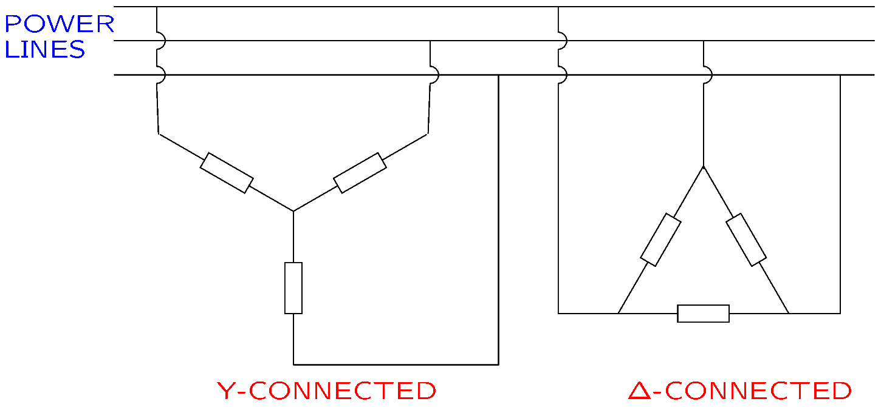

Review of Three Phase Systems
In a three phase system, sources and loads are connected in the wye ($Y$) configuration or the delta ($Δ)$ configuration.
Notes:
cfig/dy.fig

Slide 15
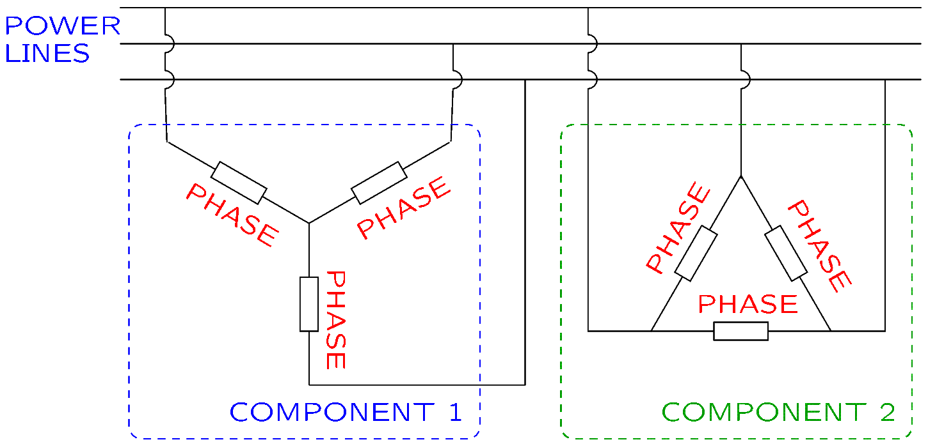

Review of Three Phase Systems
A three phase component can be represented with three subcomponents, called phases, connected in $Y$ or $Δ$.
Notes:
cfig/dy2.fig

Slide 16
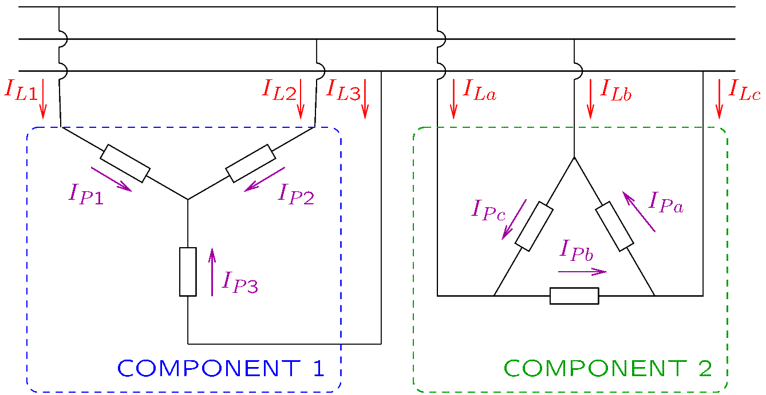
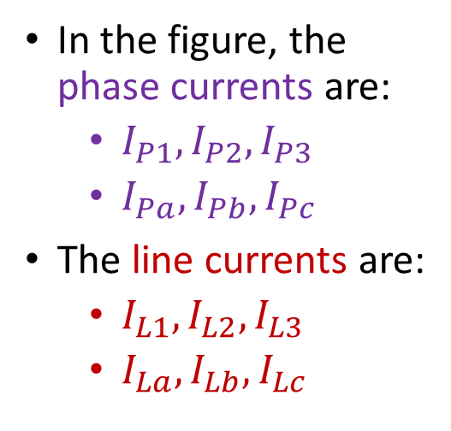
Review of Three Phase Systems
The current flowing through a phase is called phase current.
The current flowing through a conductor that powers a component is called line current.
In the figure, the phase currents are:
  $I_{P1},I_{P2},I_{P3}$
  $I_{Pa},I_{Pb}, I_{Pc}$
The line currents are:
  $I_{L1},I_{L2},I_{L3}$
  $I_{La},I_{Lb}, I_{Lc}$
Notes:
cfig/dy3.fig

Slide 17
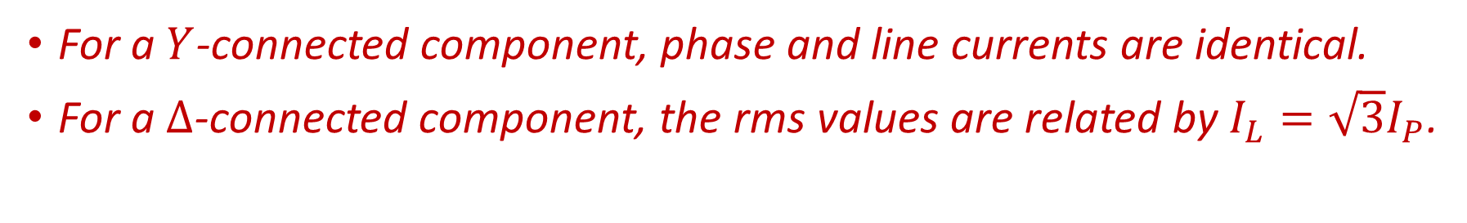
Review of Three Phase Systems
For a $Y$-connected component, phase and line currents are identical.
For a $Δ$-connected component, the rms values are related by $I_{L}=\sqrt{3}I_{P}$.
In the figure, the phase currents are:
  $I_{P1},I_{P2},I_{P3}$
  $I_{Pa},I_{Pb}, I_{Pc}$
The line currents are:
  $I_{L1},I_{L2},I_{L3}$
  $I_{La},I_{Lb}, I_{Lc}$
Notes:
cfig/dy3.fig

Slide 18
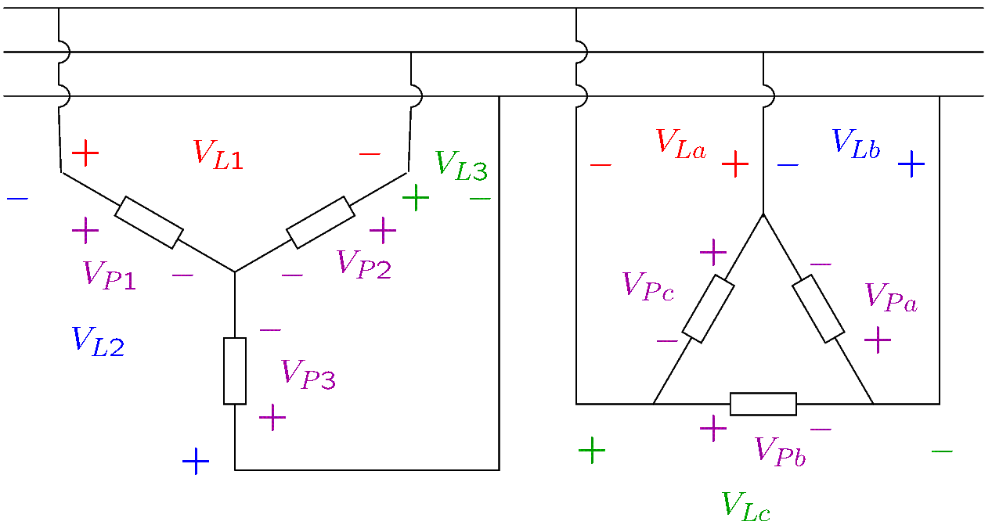
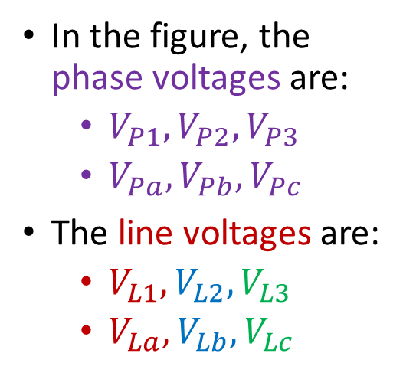
Review of Three Phase Systems
The voltage on a phase is called phase voltage.
The voltage between two power lines is called line-to-line voltage, or shortly, line voltage.
In the figure, the phase voltages are:
  $V_{P1},V_{P2},V_{P3}$
  $V_{Pa},V_{Pb}, V_{Pc}$
The line voltages are:
  $V_{L1},V_{L2},V_{L3}$
  $V_{La},V_{Lb}, V_{Lc}$
Notes:
cfig/dy4.fig

Slide 19
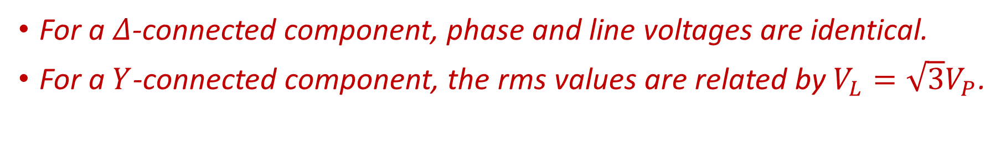
Review of Three Phase Systems
For a $Δ$-connected component, phase and line voltages are identical.
For a $Y$-connected component, the rms values are related by $V_{L}=\sqrt{3}V_{P}$.
In the figure, the phase voltages are:
  $V_{P1},V_{P2},V_{P3}$
  $V_{Pa},V_{Pb}, V_{Pc}$
The line voltages are:
  $V_{L1},V_{L2},V_{L3}$
  $V_{La},V_{Lb}, V_{Lc}$
Notes:
cfig/dy4.fig

Slide 20
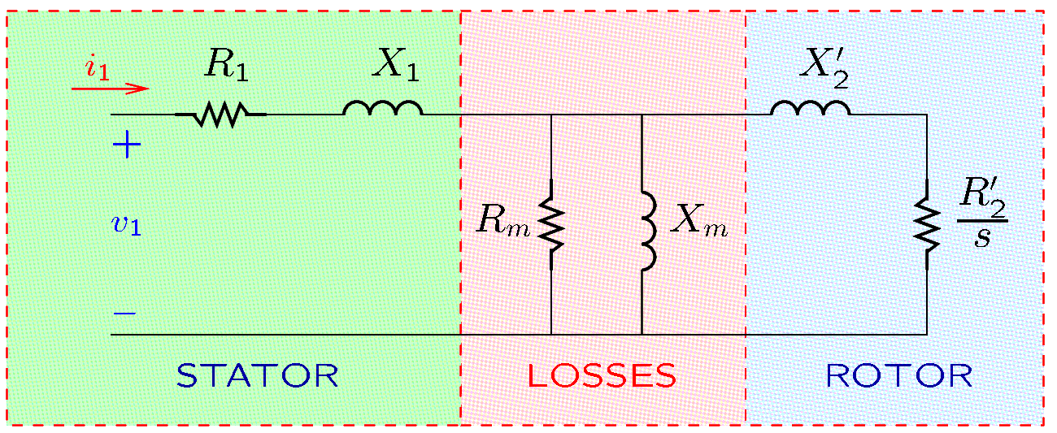
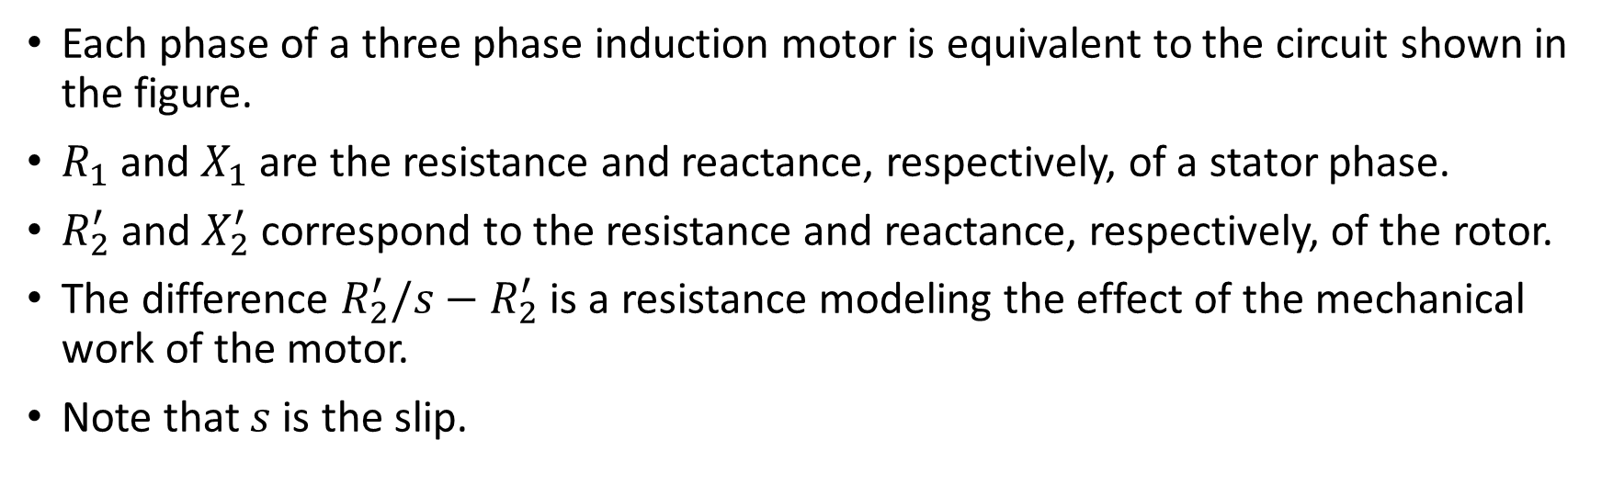
Induction Motors—Electrical Model
Each phase of a three phase induction motor is equivalent to the circuit shown in the figure.
$R_{1}$ and $X_{1}$ are the resistance and reactance, respectively, of a stator phase.
$R_{2}^{′}$ and $X_{2}^{′}$ correspond to the resistance and reactance, respectively, of the rotor.
The difference $R_{2}^{′}/s−R_{2}^{′}$ is a resistance modeling the effect of the mechanical work of the motor.
Note that $s$ is the slip.
Notes:
docs/online/polyphase.fig

Slide 21
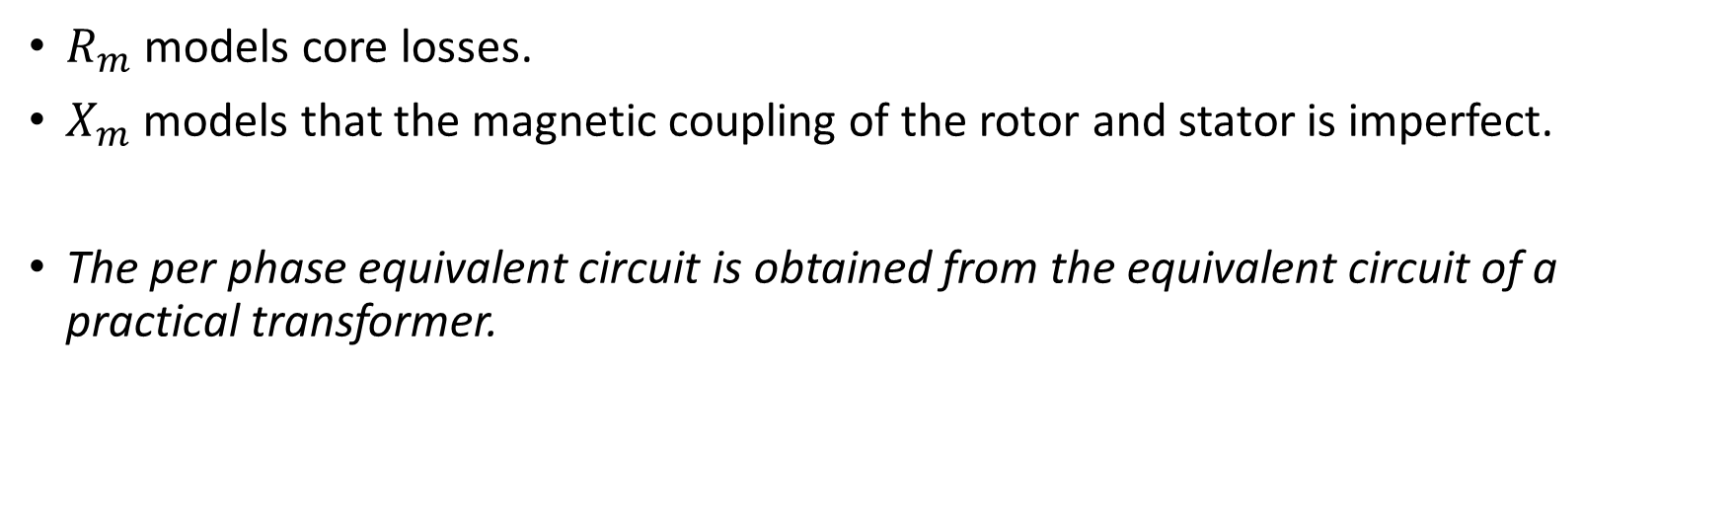
Induction Motors—Electrical Model
$R_{m}$ models core losses.
$X_{m}$ models that the magnetic coupling of the rotor and stator is imperfect.
The per phase equivalent circuit is obtained from the equivalent circuit of a practical transformer.

Slide 22
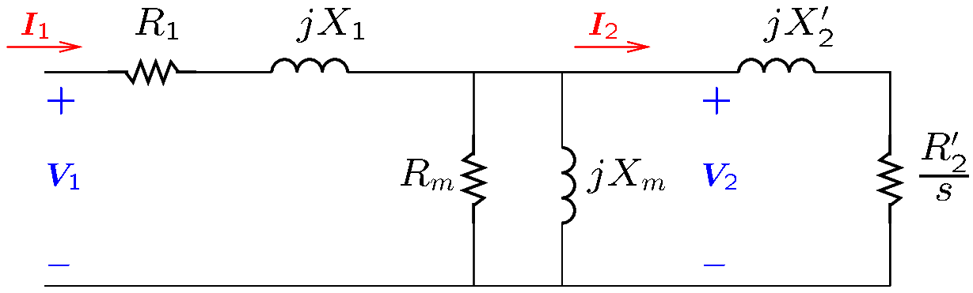
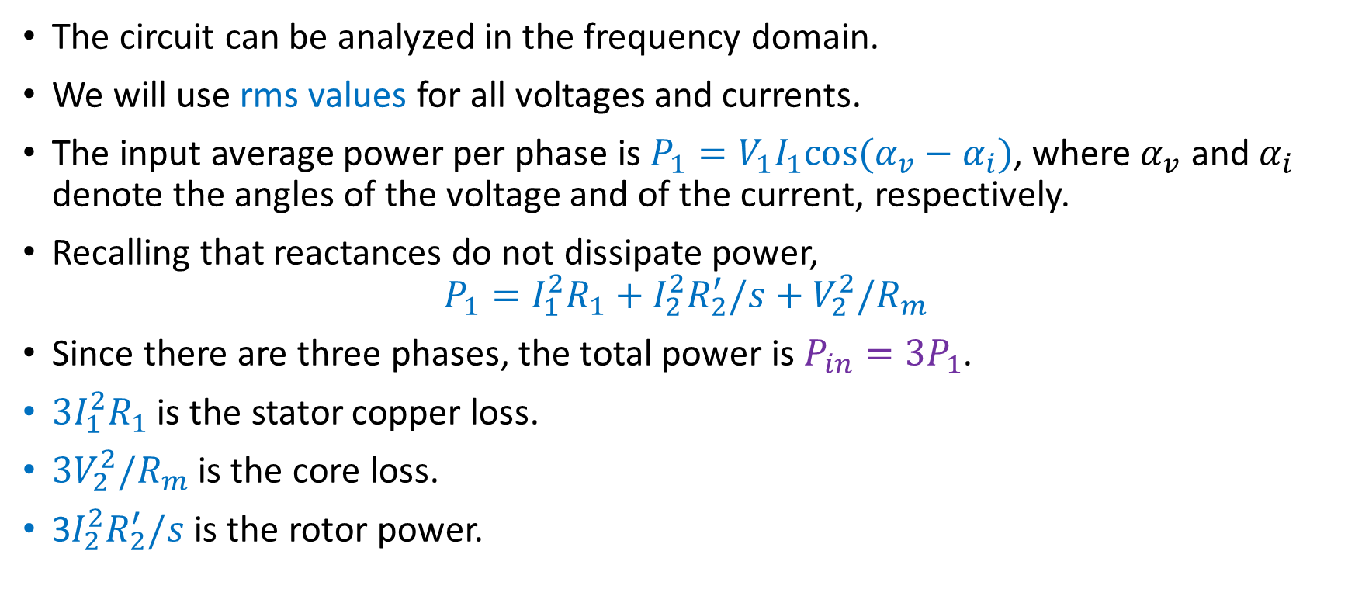
Induction Motors—Electrical Model
The circuit can be analyzed in the frequency domain.
We will use rms values for all voltages and currents.
The input average power per phase is $P_{1}=V_{1}I_{1}cos⁡(α_{v}−α_{i})$, where $α_{v}$ and $α_{i}$ denote the angles of the voltage and of the current, respectively.
Recalling that reactances do not dissipate power,
$$P_{1}=I_{1}^{2}R_{1}+I_{2}^{2}R_{2}^{′}/s+V_{2}^{2}/R_{m}$$
Since there are three phases, the total power is $P_{in}=3P_{1}$.
${3I}_{1}^{2}R_{1}$ is the stator copper loss.
${3V}_{2}^{2}/R_{m}$ is the core loss.
$\text{3}I_{2}^{2}R_{2}^{′}/s$ is the rotor power.
Notes:
docs/online/polyphase2.fig

Slide 23
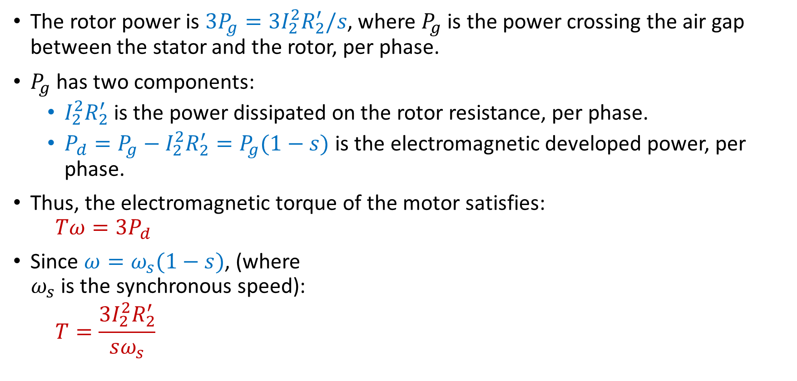
Induction Motors—Electrical Model
The rotor power is ${3P}_{g}={3I}_{2}^{2}R_{2}^{′}/s$, where $P_{g}$ is the power crossing the air gap between the stator and the rotor, per phase.
$P_{g}$ has two components:
  $I_{2}^{2}R_{2}^{′}$ is the power dissipated on the rotor resistance, per phase.
  $P_{d}=P_{g}−I_{2}^{2}R_{2}^{′}=P_{g}(1−s)$ is the electromagnetic developed power, per phase.
Thus, the electromagnetic torque of the motor satisfies:
$$Tω=3P_{d}$$
Since $ω=ω_{s}(1−s)$, (where
$ω_{s}$ is the synchronous speed):
$$T=\frac{{3I}_{2}^{2}R_{2}^{′}}{sω_{s}}$$
Notes:
docs/online/polyphase2.fig

Slide 24
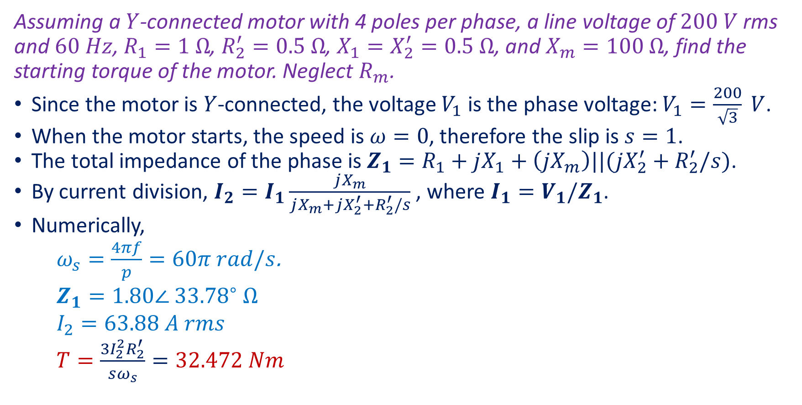
Induction Motors—Example
Assuming a $Y$-connected motor with 4 poles per phase, a line voltage of $200 V$ rms and $60 Hz$, $R_{1}=1 Ω$, $R_{2}^{′}=0.5 Ω$, $X_{1}=X_{2}^{′}=0.5 Ω$, and $X_{m}=100 Ω$, find the starting torque of the motor. Neglect $R_{m}$.
Since the motor is $Y$-connected, the voltage $V_{1}$ is the phase voltage: $V_{1}=\frac{200}{\sqrt{3}} V$.
When the motor starts, the speed is $ω=0$, therefore the slip is $s=1$.
The total impedance of the phase is $Z_{1}=R_{1}+jX_{1}+\left(jX_{m}\right)||(jX_{2}^{′}+R_{2}^{′}/s)$.
By current division, $I_{2}=I_{1}\frac{jX_{m}}{jX_{m}+jX_{2}^{′}+R_{2}^{′}/s}$, where $I_{1}=V_{1}/Z_{1}$.
Numerically,
$ω_{s}=\frac{4πf}{p}=60π rad/s$.
$$Z_{1}=1.80∠ {33.78}^{∘} Ω$$
$$I_{2}=63.88 A rms$$
$T=\frac{{3I}_{2}^{2}R_{2}^{′}}{sω_{s}}=32.472 Nm$
Notes:
docs/online/polyphase2.fig
f = 60; p = 4; r1 = 1; r2 = 0.5; x1 = 0.5; x2 = 0.5; xm = 100; v1 = 200/sqrt(3); ws = 4*pi*f/p; z1 = r1 + j*x1 + par(j*xm, r2 + j*x2); i2 = v1/z1*j*xm/(j*x2+j*xm+r2); T = 3*r2/ws*abs(i2)^2

Slide 25
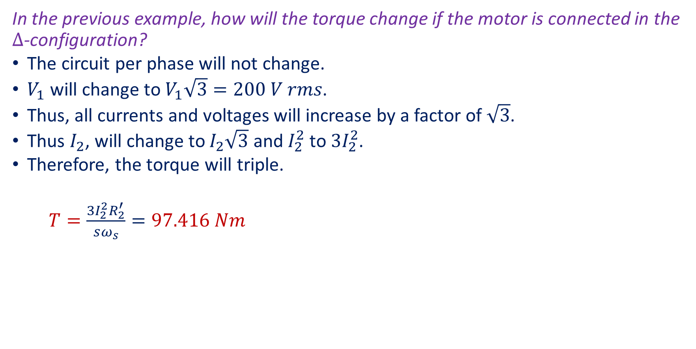
Induction Motors—Example 2
In the previous example, how will the torque change if the motor is connected in the $Δ$-configuration?
The circuit per phase will not change.
$V_{1}$ will change to $V_{1}\sqrt{3}=200 V rms$.
Thus, all currents and voltages will increase by a factor of $\sqrt{3}$.
Thus $I_{2}$, will change to $I_{2}\sqrt{3}$ and $I_{2}^{2}$ to $3I_{2}^{2}$.
Therefore, the torque will triple.
$T=\frac{{3I}_{2}^{2}R_{2}^{′}}{sω_{s}}=97.416 Nm$
Notes:
docs/online/polyphase2.fig

Slide 26
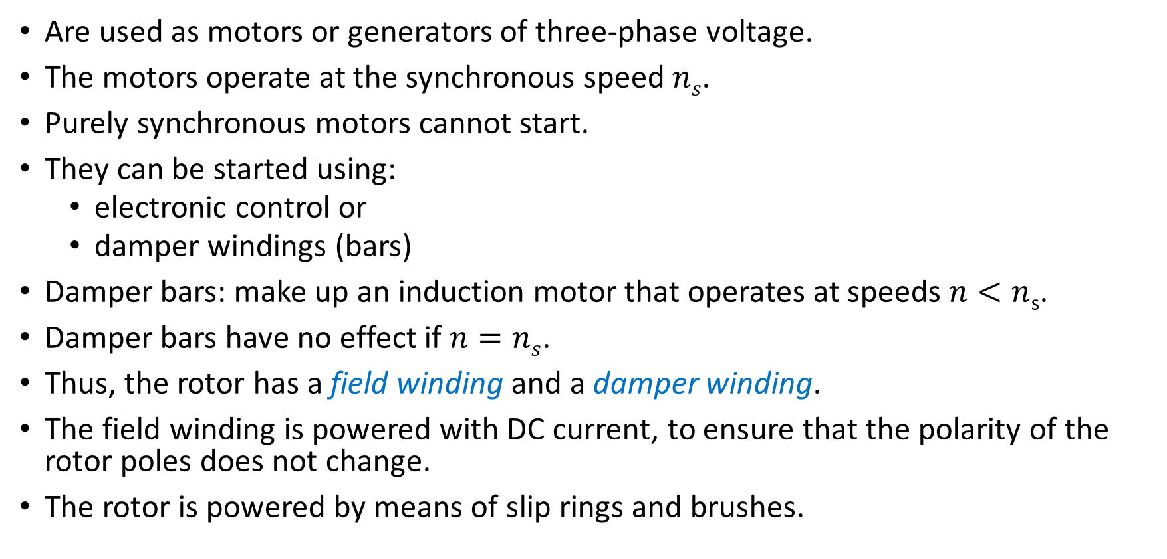
Synchronous Machines
Are used as motors or generators of three-phase voltage.
The motors operate at the synchronous speed $ns$.
Purely synchronous motors cannot start.
They can be started using:
  electronic control or
  damper windings (bars)
Damper bars: make up an induction motor that operates at speeds $n<n$_{s}.
Damper bars have no effect if $n=ns$.
Thus, the rotor has a field winding and a damper winding.
The field winding is powered with DC current, to ensure that the polarity of the rotor poles does not change.
The rotor is powered by means of slip rings and brushes.

Slide 27
Synchronous Machines and BLDC motors
Synchronous motors in which the rotor consists of permanent magnets are similar to brushless DC motors.
While synchronous motors use three-phase voltage, brushless DC (BLDC) motors use an electronic controller that converts DC voltage to pulses.
By applying pulses sequentially to each phase, a rotating magnetic field is obtained.
To control accurately the speed, and so that the BLDC motors are self starting, the controllers need feedback.
Feedback is provided by
  Hall sensors (which sense a magnetic field) or
  Shaft encoders (which determine the angular position of the motor shaft).

