Slide 1
MOTOR SELECTION
M.V. Iordache, EEGR3523 Mechatronics, Spring 2021, LeTourneau University

Slide 2
Motor Selection
It is recommended to ensure that the load inertia, as seen by the motor, is no more than 10 times the motor inertia.
Use the velocity profile to find the peak torque.
Any torque applied for a sufficiently long amount of time should be less than the continuous operation torque of the motor.
If the torque changes quickly, find the rms torque and check that it does not exceed the continuous operation torque.
Motors are damaged by excessive heat, when they reach a high enough temperature.
Higher torques are possible if the motors are cooled.

Slide 3
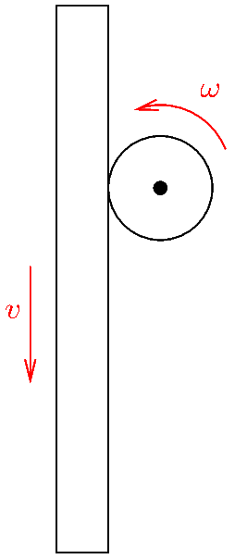
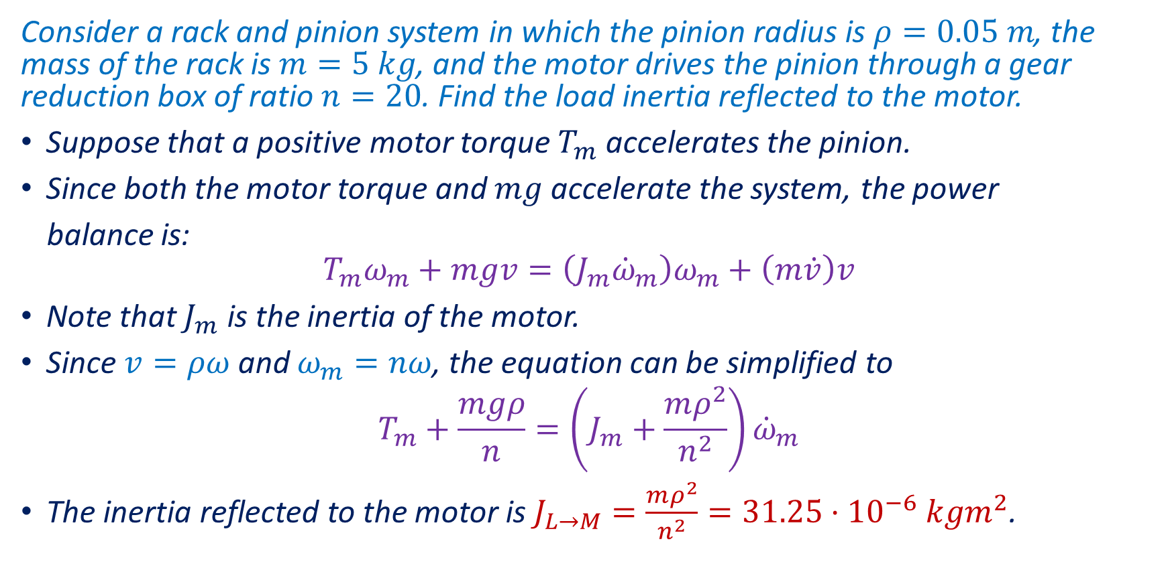
Load Inertia—Example
Consider a rack and pinion system in which the pinion radius is $ρ=0.05 m$, the mass of the rack is $m=5 kg$, and the motor drives the pinion through a gear reduction box of ratio $n=20$. Find the load inertia reflected to the motor.
Suppose that a positive motor torque $T_{m}$ accelerates the pinion.
Since both the motor torque and $mg$ accelerate the system, the power
balance is:
$$T_{m}ω_{m}+mgv=\left(J_{m}{\dot{ω}}_{m}\right)ω_{m}+\left(m\dot{v}\right)v$$
Note that $J_{m}$ is the inertia of the motor.
Since $v=ρω$ and $ω_{m}=nω$, the equation can be simplified to
$$T_{m}+\frac{mgρ}{n}=\left(J_{m}+\frac{mρ^{2}}{n^{2}}\right){\dot{ω}}_{m}$$
The inertia reflected to the motor is $J_{L→M}=\frac{mρ^{2}}{n^{2}}=31.25⋅{10}^{−6} kgm^{2}$.
Notes:
online/rack.fig

Slide 4
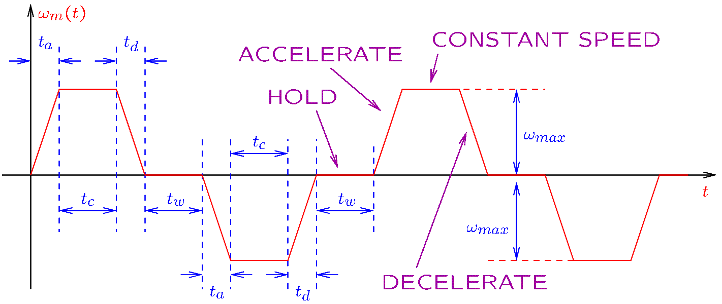
Velocity Profile
Consider a manufacturing setting in which a motor has to perform again and again the same task.
Over time, the velocity of the motor could look like this:
Notes:
online/profile.fig

Slide 5
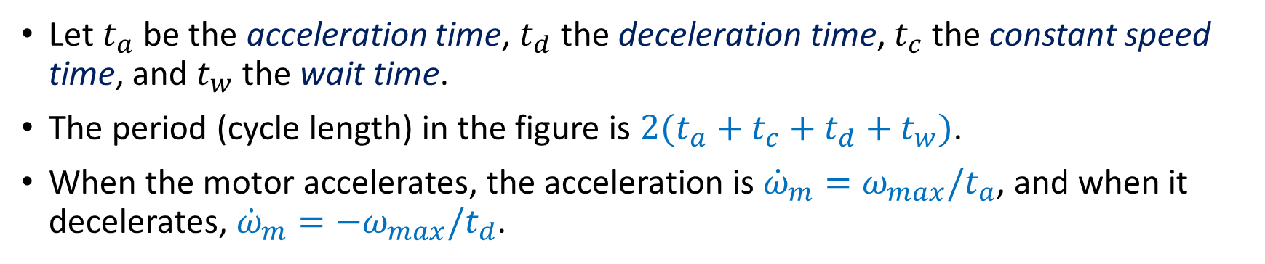
Velocity Profile
Let $t_{a}$ be the acceleration time, $t_{d}$ the deceleration time, $t_{c}$ the constant speed time, and $t_{w}$ the wait time.
The period (cycle length) in the figure is $2(t_{a}+t_{c}+t_{d}+t_{w})$.
When the motor accelerates, the acceleration is ${\dot{ω}}_{m}=ω_{max}/t_{a}$, and when it decelerates, ${\dot{ω}}_{m}=−ω_{max}/t_{d}$.
Given the motor accelerations, we can find the peak torque.

Slide 6
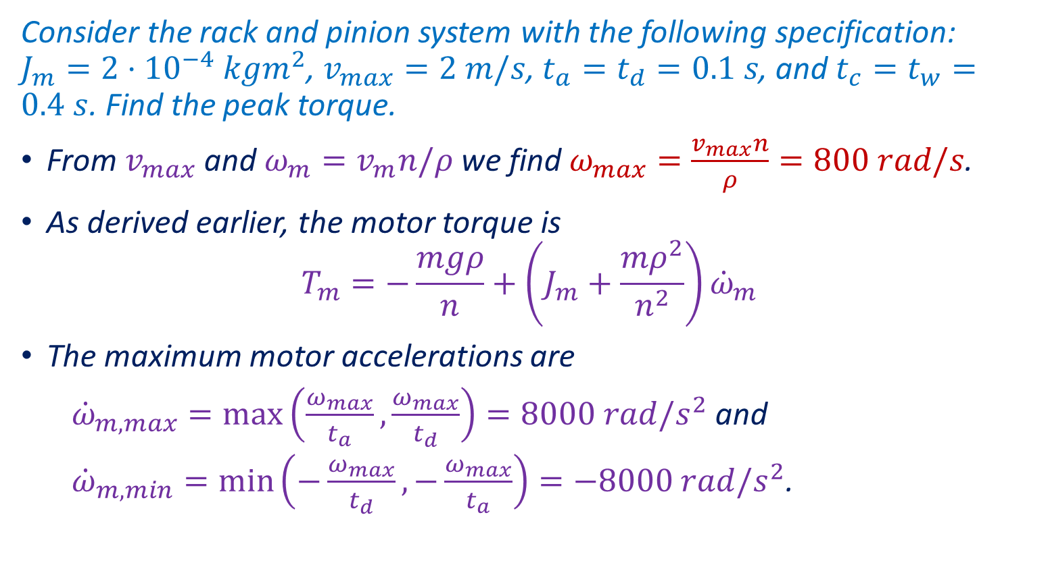
Peak Torque—Example
Consider the rack and pinion system with the following specification:
$J_{m}={2⋅10}^{−4} kgm^{2}$, $v_{max}=2 m/s$, $t_{a}=t_{d}=0.1 s$, and $t_{c}=t_{w}=0.4 s$. Find the peak torque.
From $v_{max}$ and $ω_{m}=v_{m}n/ρ$ we find $ω_{max}=\frac{v_{max}n}{ρ}=800 rad/s$.
As derived earlier, the motor torque is
$$T_{m}=−\frac{mgρ}{n}+\left(J_{m}+\frac{mρ^{2}}{n^{2}}\right){\dot{ω}}_{m}$$
The maximum motor accelerations are
${\dot{ω}}_{m,max}=\max\left(\frac{ω_{max}}{t_{a}},\frac{ω_{max}}{t_{d}}\right)=8000 rad/s^{2}$ and
${\dot{ω}}_{m,min}=\min\left(−\frac{ω_{max}}{t_{d}},−\frac{ω_{max}}{t_{a}}\right)=−8000 rad/s^{2}$.

Slide 7
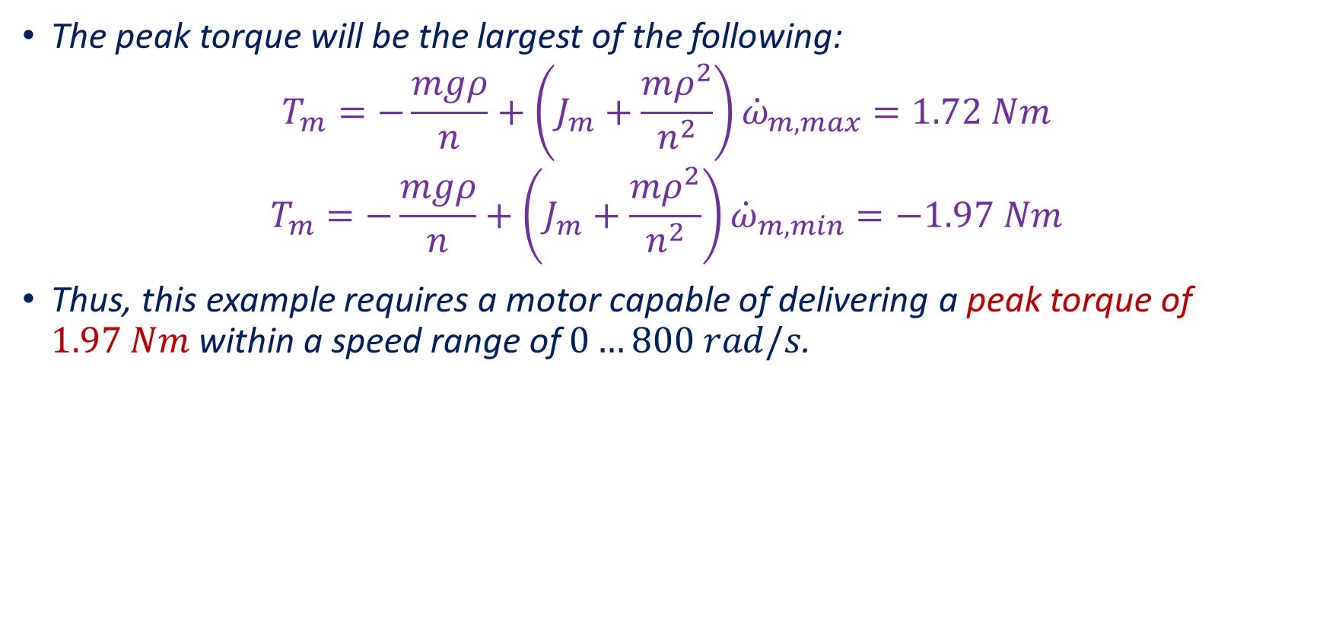
Peak Torque—Example
The peak torque will be the largest of the following:
$$T_{m}=−\frac{mgρ}{n}+\left(J_{m}+\frac{mρ^{2}}{n^{2}}\right){\dot{ω}}_{m,max}=1.72 Nm$$
$$T_{m}=−\frac{mgρ}{n}+\left(J_{m}+\frac{mρ^{2}}{n^{2}}\right){\dot{ω}}_{m,min}=−1.97 Nm$$
Thus, this example requires a motor capable of delivering a peak torque of $1.97 Nm$ within a speed range of $0…800 rad/s$.

Slide 8
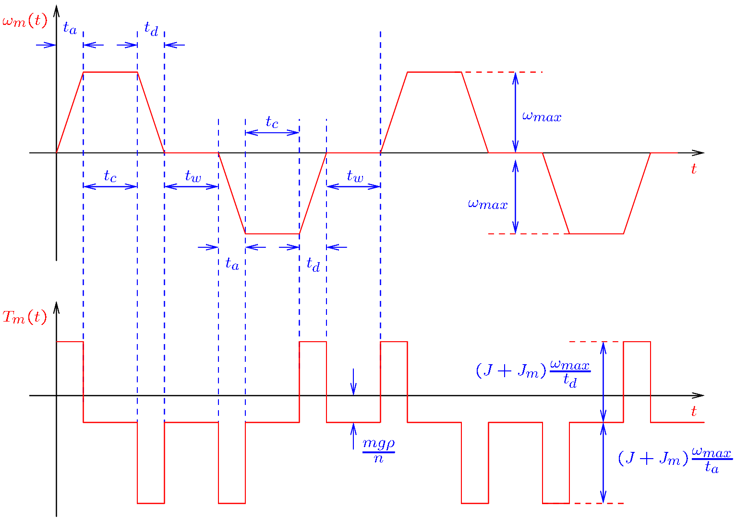
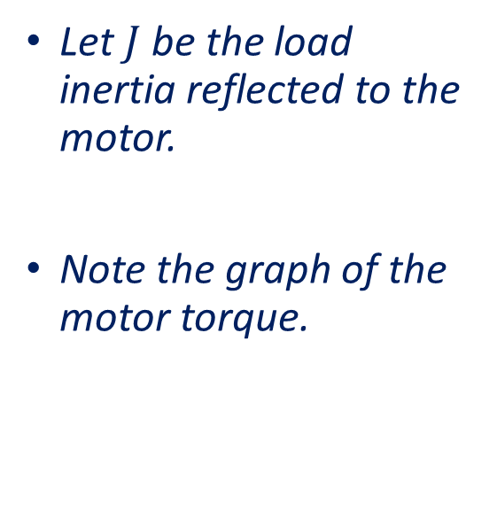
Peak Torque—Example
Let $J$ be the load inertia reflected to the motor.
Note the graph of the motor torque.
Notes:
online/rack2.fig

Slide 9
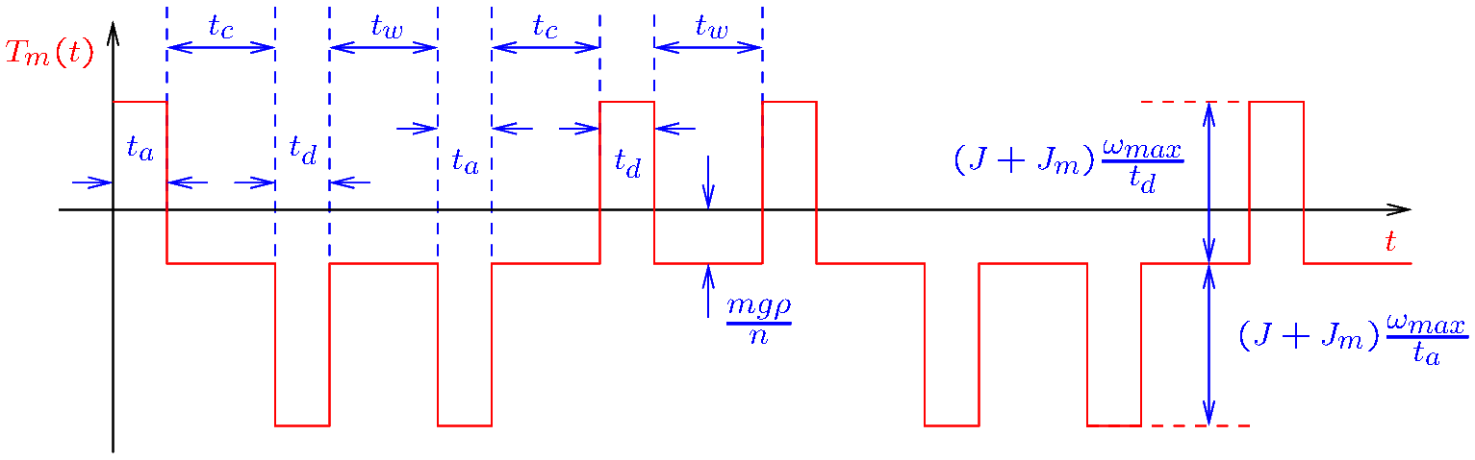
RMS Torque
The root mean square (rms) torque is the square root of the mean of the square of the torque.
The rms torque should fit the continuous operation torque specification of a motor.
Example: Given the following torque graph, find the rms torque.
Notes:
online/rack3.fig

Slide 10

RMS Torque
Example: Given the following torque graph, find the rms torque. You may assume $t_{d}=t_{a}$.
Let $T=\left(J+J_{m}\right)ω_{max}/t_{d}$ and $T_{0}=mgρ/n$.
Let us consider an entire period (cycle).
For each time interval, the squared torque is multiplied by the length of the time interval.
$$T_{rms}=\sqrt{\frac{{\left(T−T_{0}\right)}^{2}t_{a}+T_{0}^{2}t_{c}+{\left(T+T_{0}\right)}^{2}t_{d}+T_{0}^{2}t_{w}+{\left(T+T_{0}\right)}^{2}t_{a}+T_{0}^{2}t_{c}+{\left(T−T_{0}\right)}^{2}t_{d}+T_{0}^{2}t_{w} }{t_{a}+t_{c}+t_{d}+t_{w}+t_{a}+t_{c}+t_{d}+t_{w}}}$$
Notes:
online/rack3.fig

Slide 11
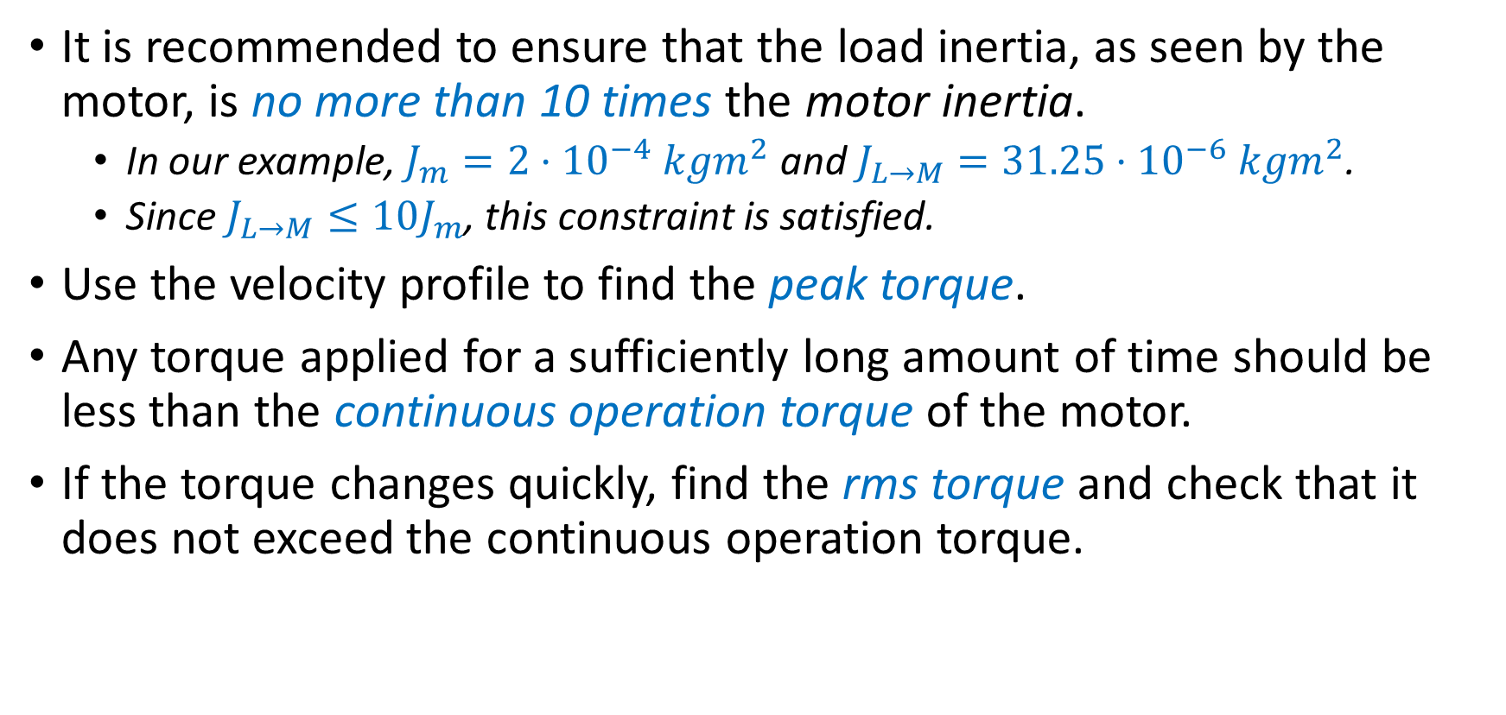
Motor Selection
It is recommended to ensure that the load inertia, as seen by the motor, is no more than 10 times the motor inertia.
In our example, $J_{m}={2⋅10}^{−4} kgm^{2}$ and $J_{L→M}=31.25⋅{10}^{−6} kgm^{2}$.
Since $J_{L→M}≤10J_{m}$, this constraint is satisfied.
Use the velocity profile to find the peak torque.
Any torque applied for a sufficiently long amount of time should be less than the continuous operation torque of the motor.
If the torque changes quickly, find the rms torque and check that it does not exceed the continuous operation torque.

Slide 12
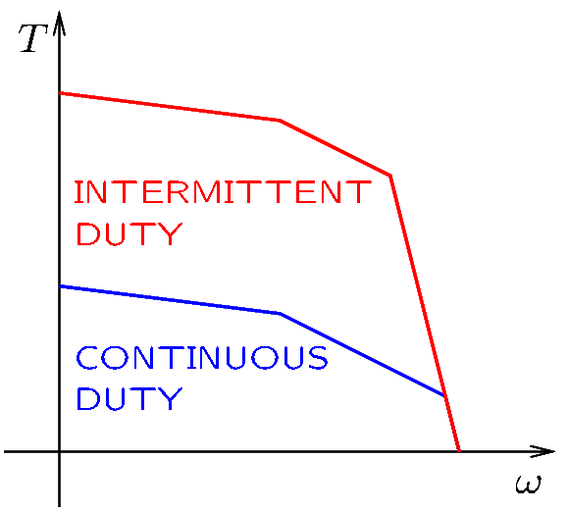
Motor Selection
In a torque-speed motor specification, the area under the intermittent duty curve is a zone in which the motor may be operated briefly.
The area under the continuous duty curve is a zone in which the motor may be continuously operated.
The peak torque should be under the intermittent duty curve.
The rms torque should be under the continuous duty curve.
Notes:
online/torque.fig

