Slide 1
DC Machines—Part 3
Losses. Construction.
M.V. Iordache, EEGR3523 Mechatronics, Spring 2020, LeTourneau University

Slide 2
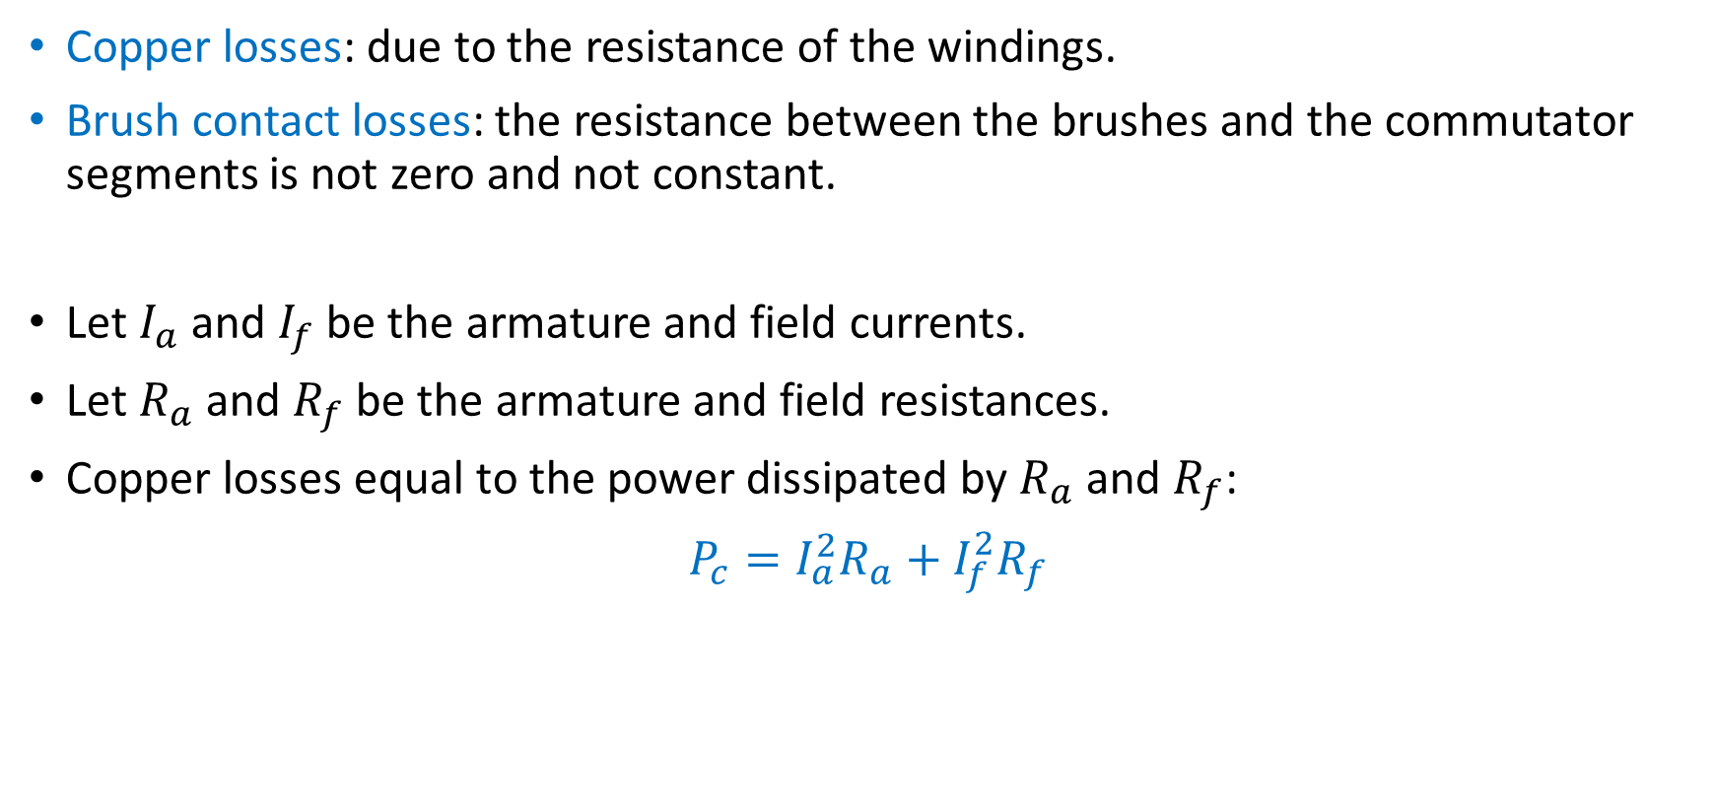
Electrical Losses
Copper losses: due to the resistance of the windings.
Brush contact losses: the resistance between the brushes and the commutator segments is not zero and not constant.
Let $I_{a}$ and $I_{f}$ be the armature and field currents.
Let $R_{a}$ and $R_{f}$ be the armature and field resistances.
Copper losses equal to the power dissipated by $R_{a}$ and $R_{f}$:
$P_{c}=I_{a}^{2}R_{a}+I_{f}^{2}R_{f}$

Slide 3
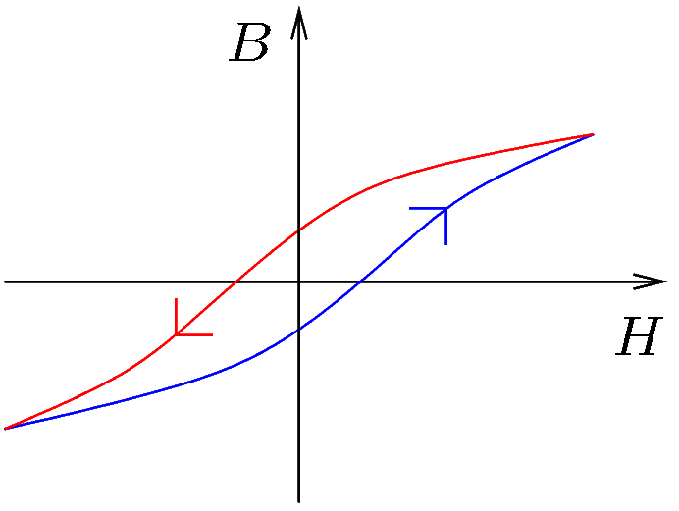
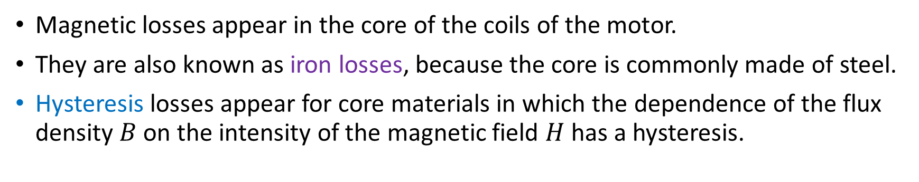
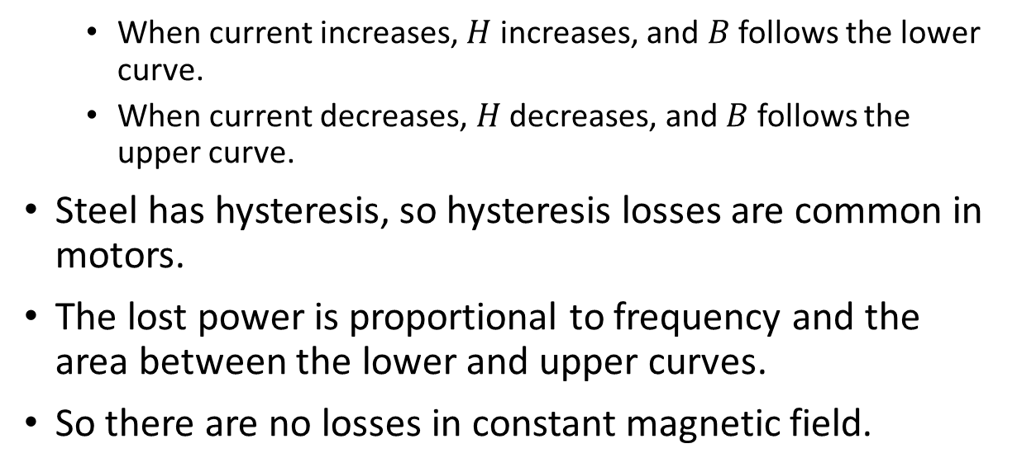
Magnetic Losses
Magnetic losses appear in the core of the coils of the motor.
They are also known as iron losses, because the core is commonly made of steel.
Hysteresis losses appear for core materials in which the dependence of the flux density $B$ on the intensity of the magnetic field $H$ has a hysteresis.
When current increases, $H$ increases, and $B$ follows the lower curve.
When current decreases, $H$ decreases, and $B$ follows the upper curve.
Steel has hysteresis, so hysteresis losses are common in motors.
The lost power is proportional to frequency and the area between the lower and upper curves.
So there are no losses in constant magnetic field.
Notes:
presm/hysteresis.fig

Slide 4
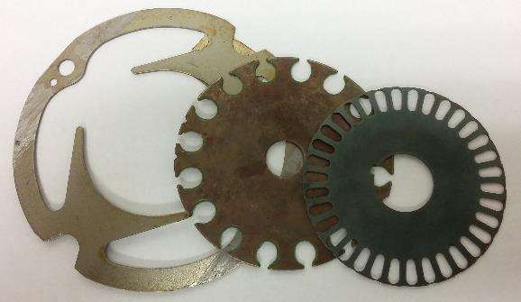
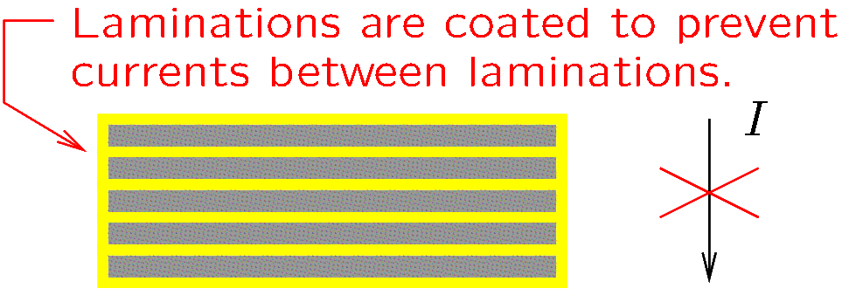
Magnetic Losses
Eddy current losses are significant when the core conducts well electricity.
A time-varying magnetic field induces currents in the core.
Since the resistivity of the core is not zero, power will be dissipated in the core due to the Eddy currents.
In constant magnetic field there are no Eddy currents, and thus no losses.
To reduce Eddy currents, cores are made of sheet-steel laminations.
Laminations are insulated one from the other.
There are Eddy currents in each sheet, but no currents
from one sheet to another.
Notes:
presm/laminate.fig

Slide 5
Other Losses
Mechanical losses are due to friction.
Bearing friction.
Brush friction (friction between the brush and the commutator).
Windage (friction with the air).
Stray load: Any other loss not covered before.
In the textbook, stray load losses are taken as 1% of the output as a rule of thumb.

Slide 6
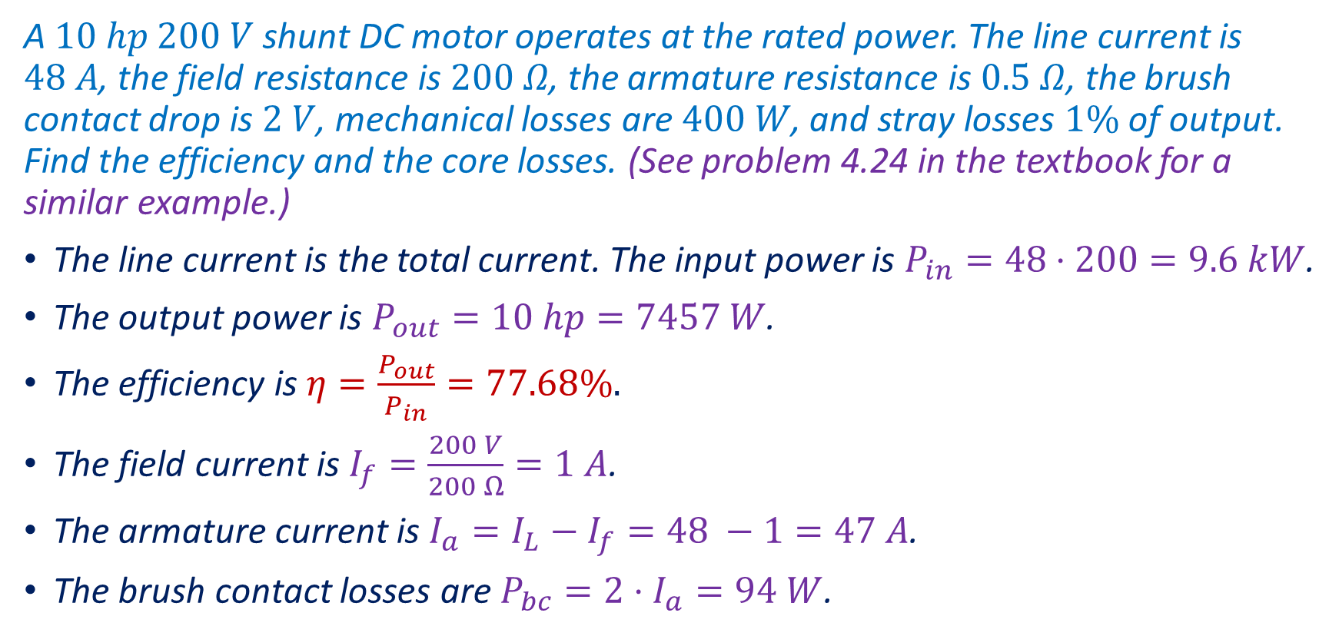
Example
A $10 hp$ $200 V$ shunt DC motor operates at the rated power. The line current is $48 A$, the field resistance is $200 Ω$, the armature resistance is $0.5 Ω$, the brush contact drop is $2 V$, mechanical losses are $400 W$, and stray losses $1\%$ of output. Find the efficiency and the core losses. (See problem 4.24 in the textbook for a similar example.)
The line current is the total current. The input power is $P_{in}=48⋅200=9.6 kW$.
The output power is $P_{out}=10 hp=7457 W$.
The efficiency is $η=\frac{P_{out}}{P_{in}}=77.68\%.$
The field current is $I_{f}=\frac{200 V}{200 Ω}=1 A$.
The armature current is $I_{a}=I_{L}−I_{f}=48 −1=47 A$.
The brush contact losses are $P_{bc}=2⋅I_{a}=94 W$.
Notes:
Octave:
Ra = 0.5; Rf = 200; V = 200; IL = 48; Po = 10*745.7; Pm = 400; Vbr = 2; Piron = V*IL - Po - Pm - 0.01*Po - Vbr*(IL-V/Rf)- V^2/Rf-(IL-V/Rf)^2*Ra

Slide 7

Example (Continued)
The copper losses are $P_{c}=I_{a}^{2}R_{a}+I_{f}^{2}R_{f}={47}^{2}⋅0.5+1^{2}⋅200=1304.5 W$.
The stray losses are $P_{s}=0.01⋅P_{out}=74.57 W$.
The mechanical losses are given: $P_{m}=400 W$.
The core losses are the magnetic losses.
$P_{iron}=P_{in}−P_{out}−P_{bc}−P_{c}−P_{s}−P_{m}=269.93 W$.

Slide 8
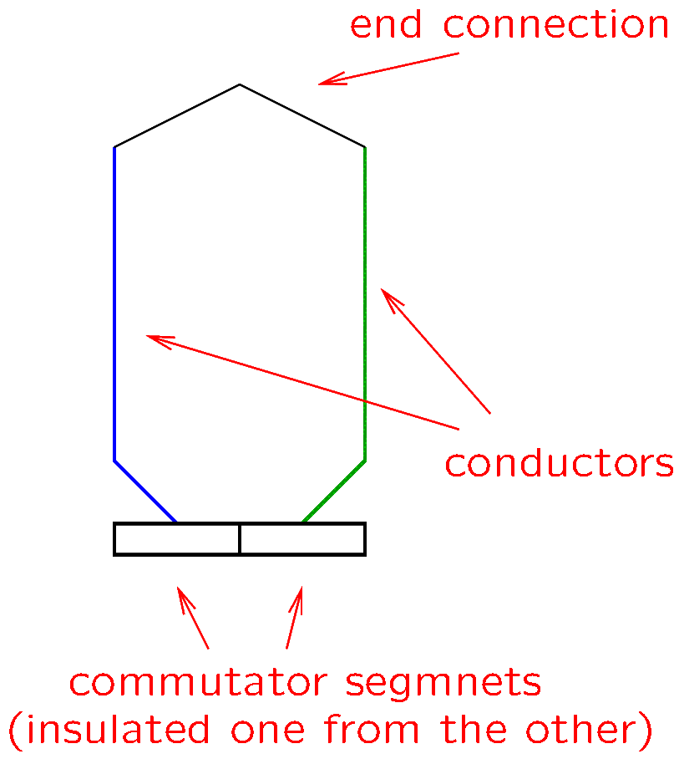
Construction of DC Motors
The coils of large motors consist of many turns connected in series, where each turn has two conductors.
Notes:
presm/turn.fig

Slide 9
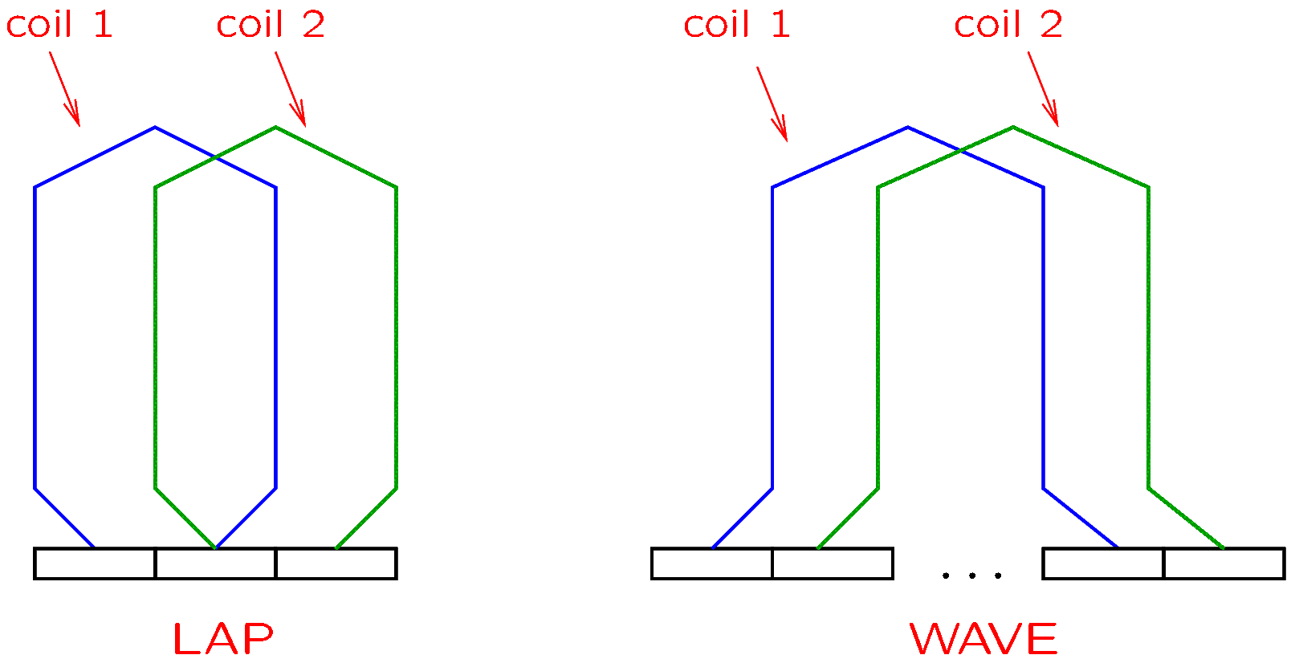
Construction of DC Motors
There are two types of windings:
Lap windings: Each armature coil connected to adjacent commutator segments.
Wave windings: The armature coils are not connected to adjacent segments.
Notes:
presm/lapwave.fig

Slide 10
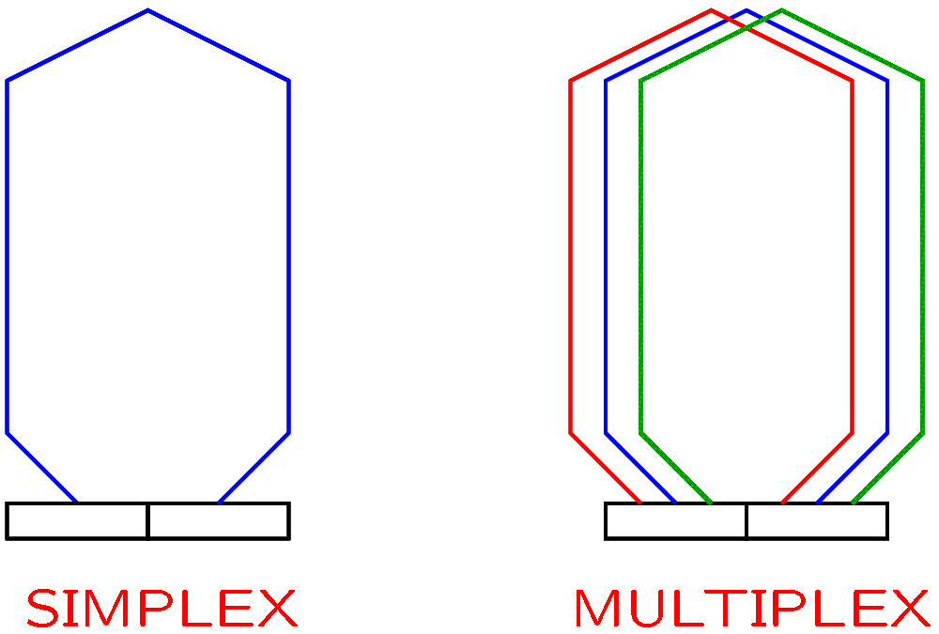
Construction of DC Motors
Windings may be:
Simplex: no parallel coils.
Multiplex: several parallel coils.
Notes:
presm/lapwave.fig

Slide 11
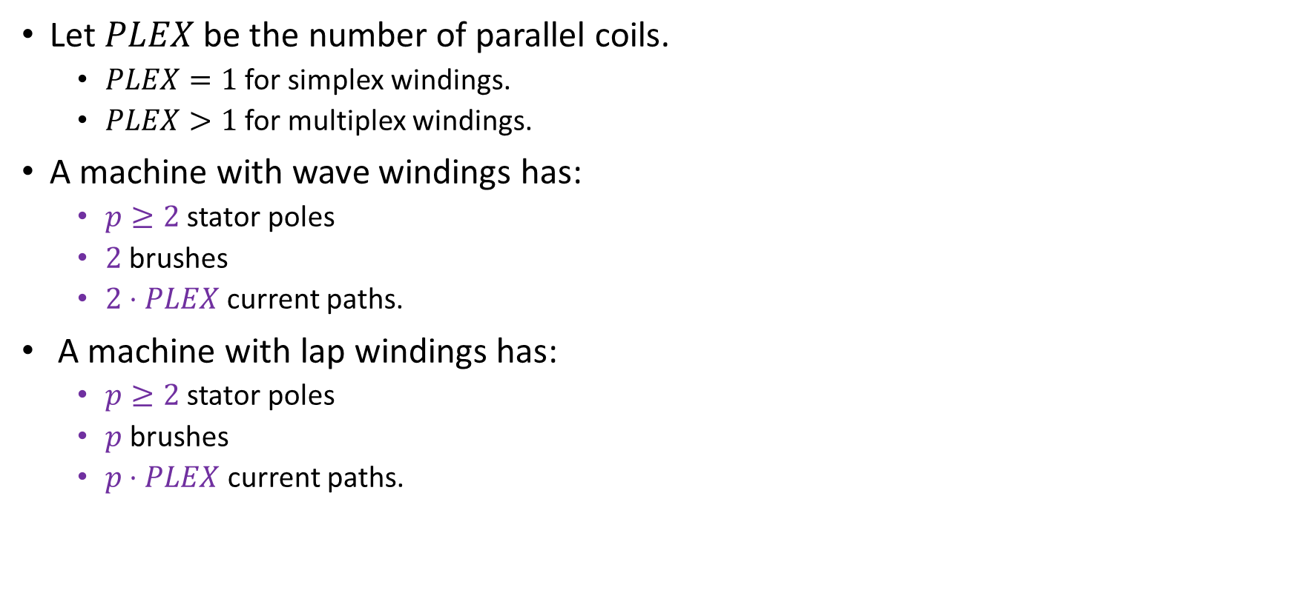
Construction of DC Motors
Let $PLEX$ be the number of parallel coils.
$PLEX=1$ for simplex windings.
$PLEX>1$ for multiplex windings.
A machine with wave windings has:
$p≥2$ stator poles
$2$ brushes
$2⋅PLEX$ current paths.
A machine with lap windings has:
$p≥2$ stator poles
$p$ brushes
$p⋅PLEX$ current paths.

Slide 12

Construction of DC Motors
Let
$p$ be the number of stator poles.
$z$ be the total number of conductors.
$a$ be the number of current paths.
The back electromotive force has the equation
$$E=k_{a}Φω$$
where $Φ$ is the flux per pole and
$$k_{a}=\frac{zp}{2πa}$$

Slide 13
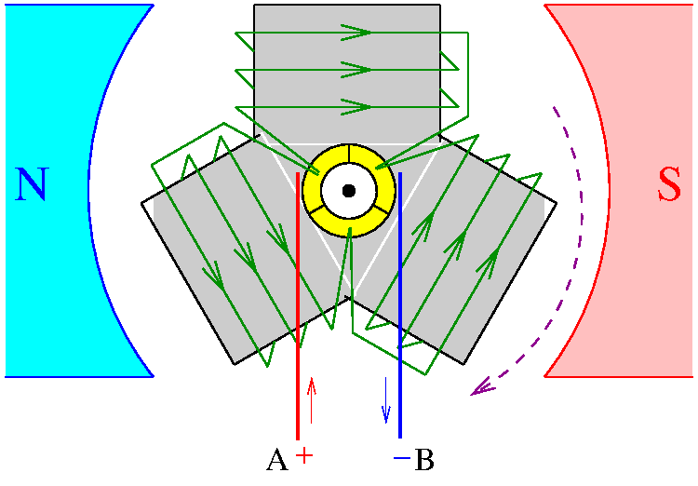
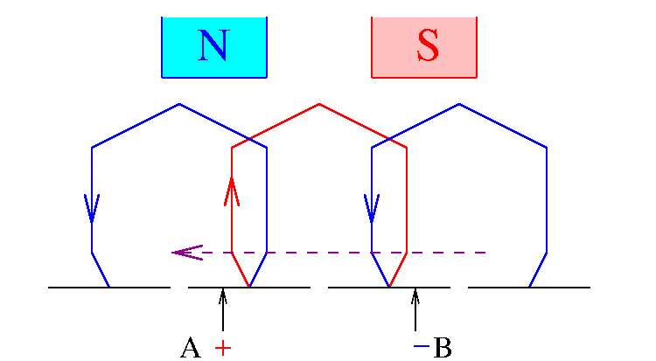

Examples
To describe a motor more easily, it is convenient to “flatten” it and draw it flat.
A developed diagram “is obtained by imagining the armature surface to be removed and then laid out flat” (Quoting from http://machineryequipmentonline.com/electric-equipment/two-layer-winding-and-multiplex-winding/ , as of April 18, 2020.)
Below, there are two current paths ($a = 2$) between the two brushes, one shown in red and one in blue.
Stator poles
These two are
the same segments

Slide 14
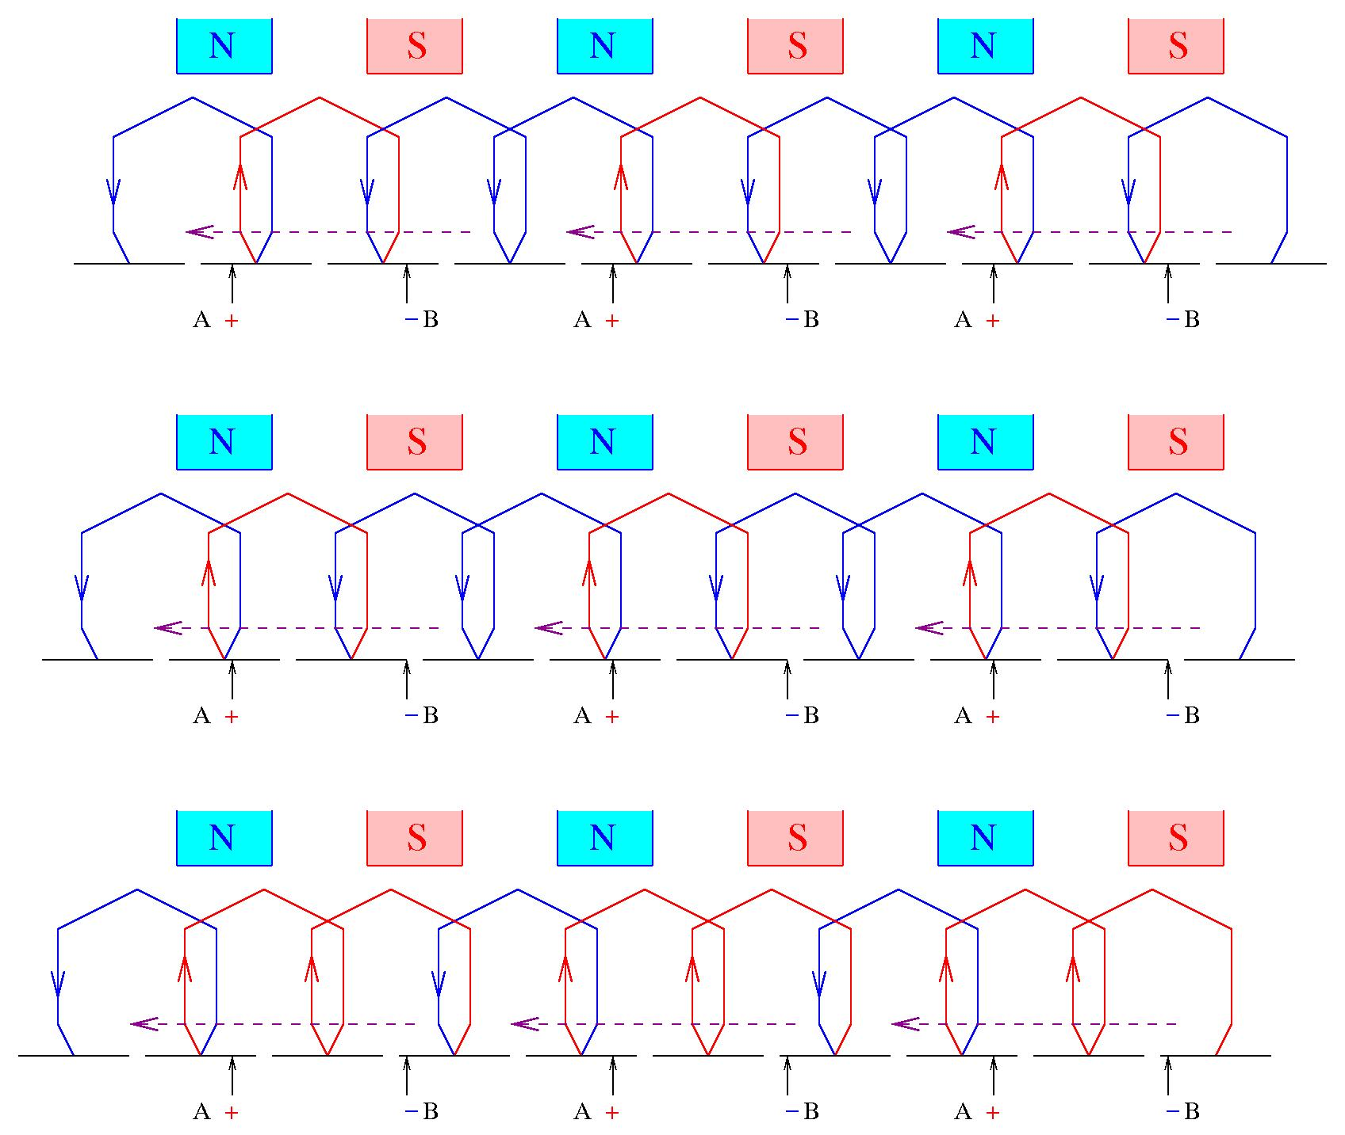
A red coil has the south polarity and a blue coil the north polarity.
So a south stator pole repels a red coil and attracts a blue coil.
The brushes and the stator poles are fixed.
The armature moves from right to left.
As it moves, the polarity of the current is switched by the commutator, so that the force is consistently from right to left.

Slide 15
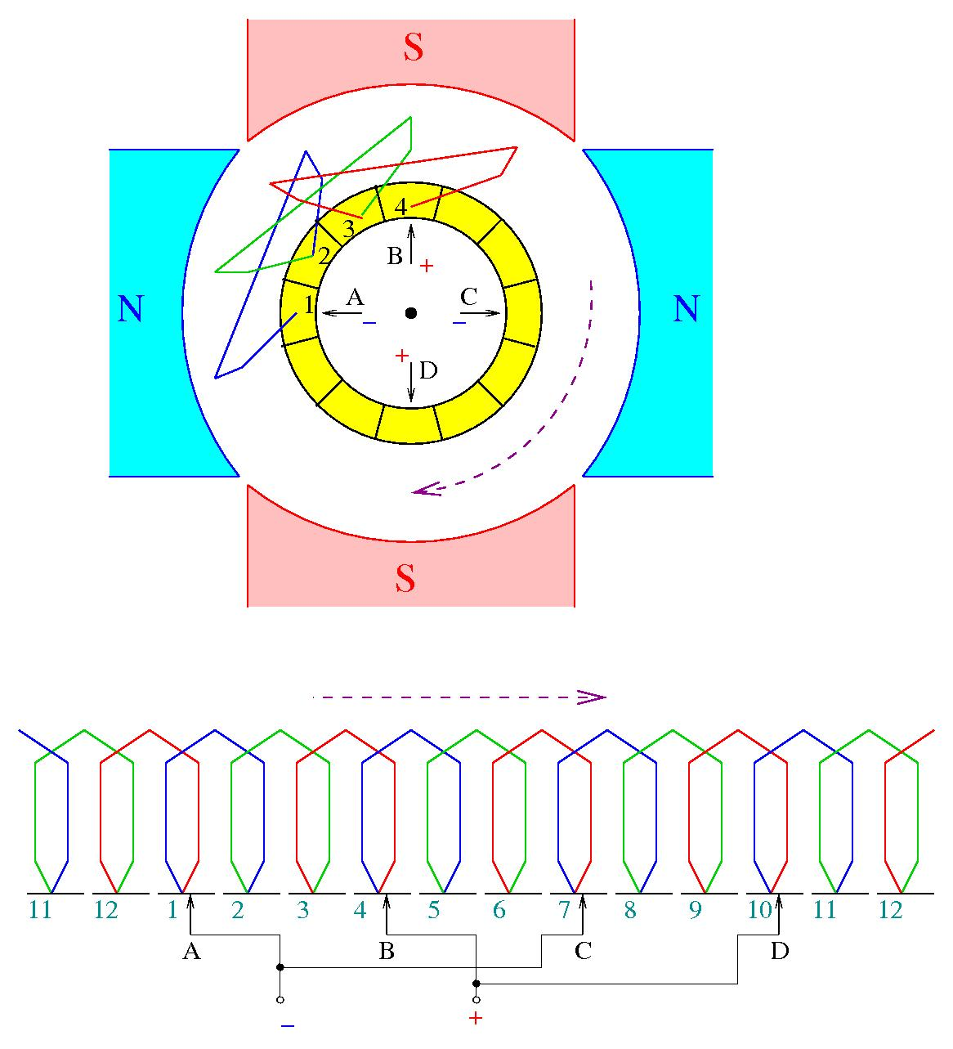

DC Machine with Lap Windings and 4 Stator Poles
Note that $p=4$ and $a=4$.
There are four current paths:
One between brush A and brush B
One between brush B and brush C
One between brush C and brush D
One between brush D and brush A

Slide 16
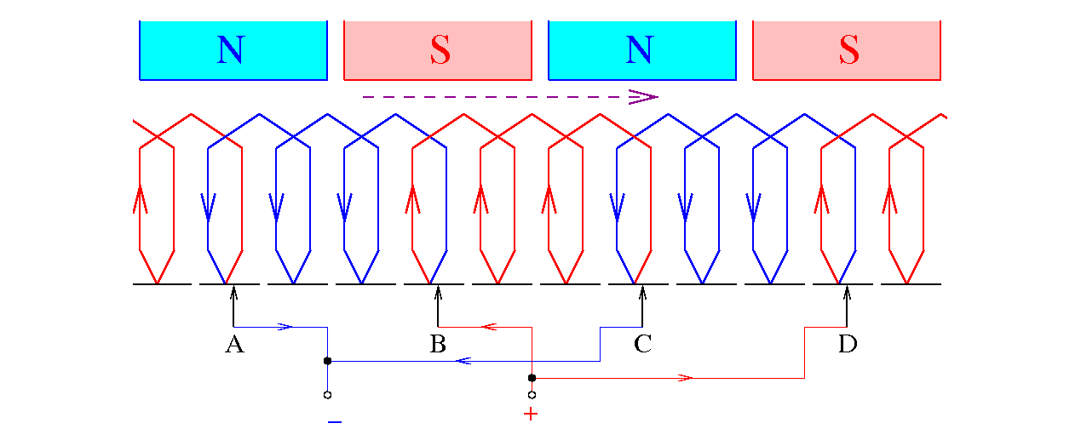

DC Machine with Lap Windings and 4 Stator Poles
Note that $p=4$ and $a=4$.
Two current paths marked in red and two marked in blue.

Slide 17
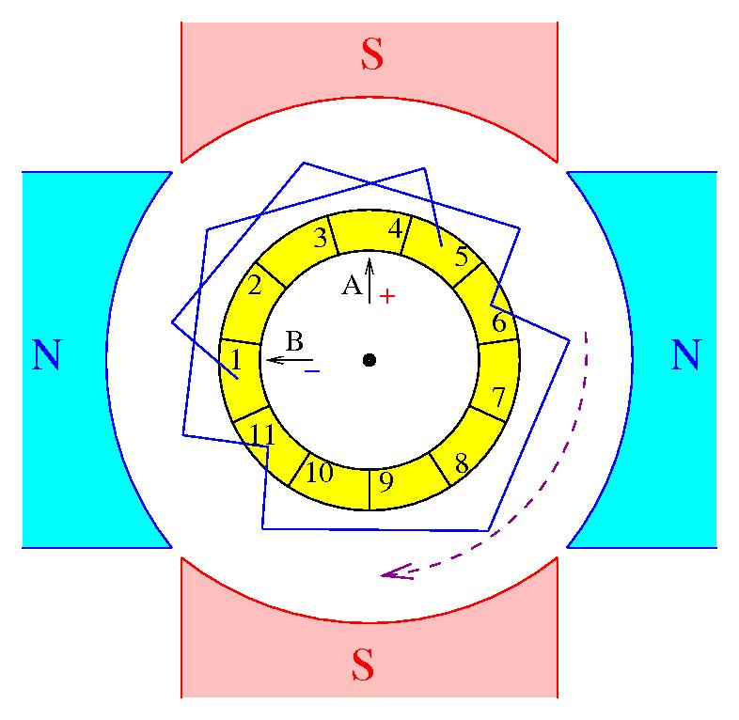
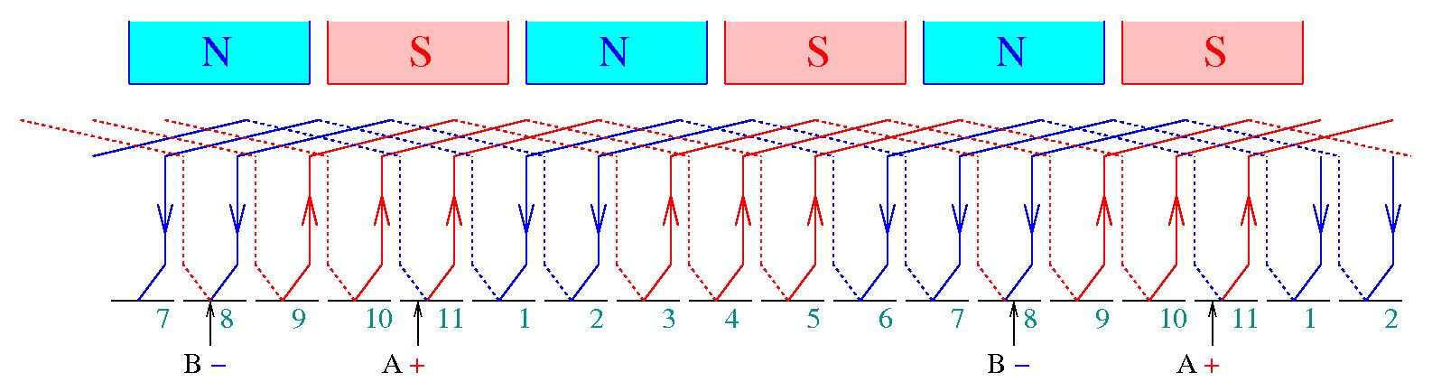
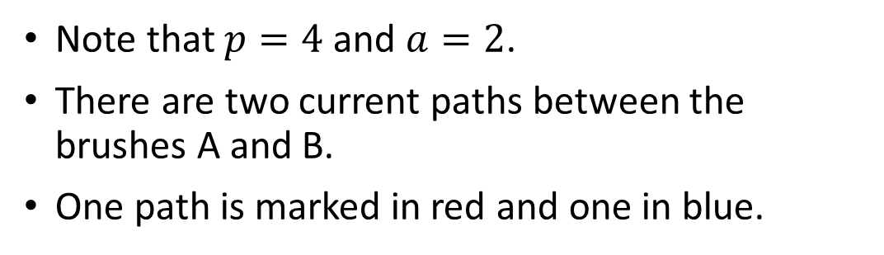
DC Machine with Wave Windings and 4 Stator Poles
Note that $p=4$ and $a=2$.
There are two current paths between the brushes A and B.
One path is marked in red and one in blue.

