Slide 1
DC Machines—Electrical Model and Equations
DC Motors and Generators
M.V. Iordache, EEGR3523 Mechatronics, Spring 2020, LeTourneau University

Slide 2
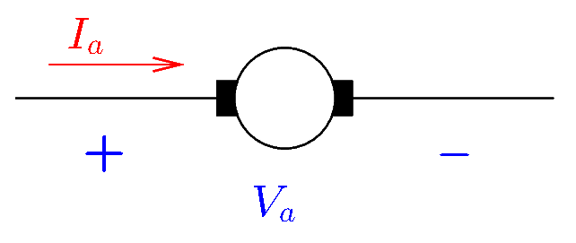
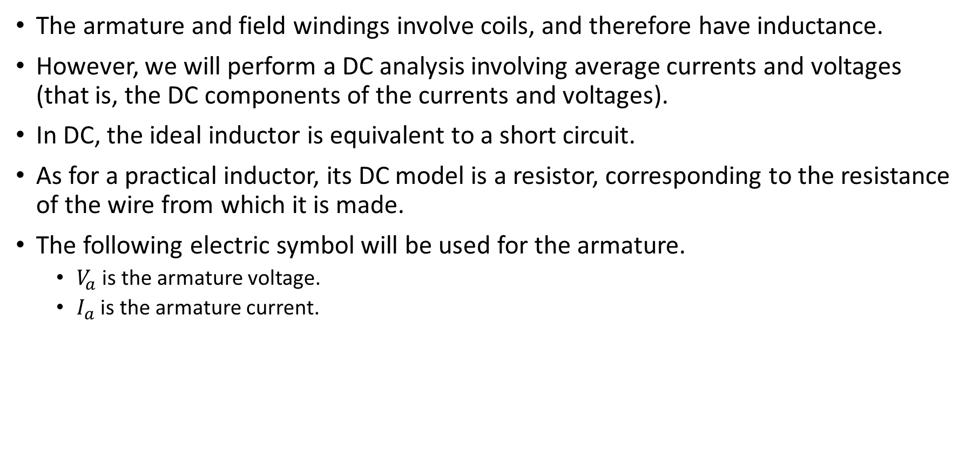
Electric Model
The armature and field windings involve coils, and therefore have inductance.
However, we will perform a DC analysis involving average currents and voltages (that is, the DC components of the currents and voltages).
In DC, the ideal inductor is equivalent to a short circuit.
As for a practical inductor, its DC model is a resistor, corresponding to the resistance of the wire from which it is made.
The following electric symbol will be used for the armature.
  $V_{a}$ is the armature voltage.
  $I_{a}$ is the armature current.
Notes:
presm/armature.fig

Slide 3
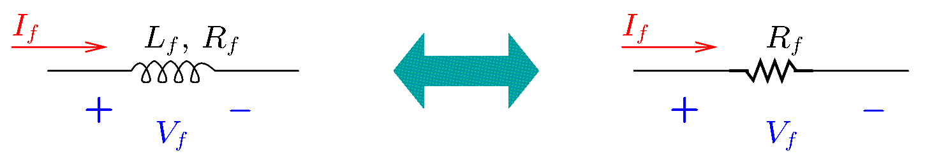
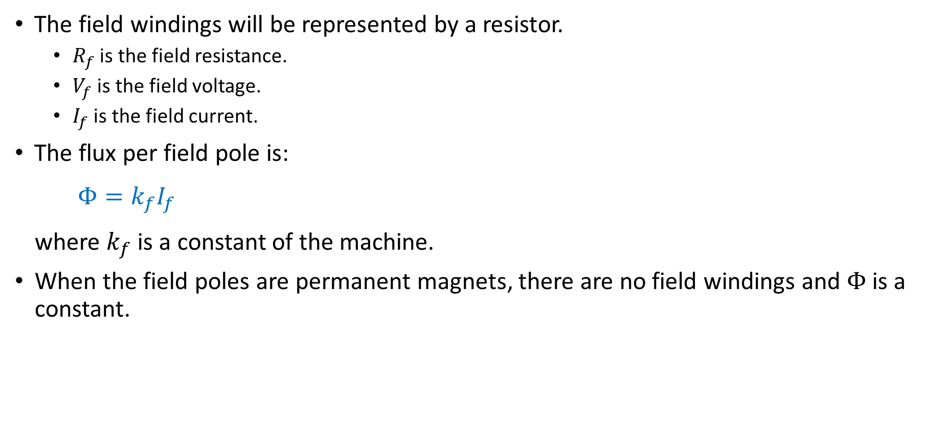
Electric Model
The field windings will be represented by a resistor.
  $R_{f}$ is the field resistance.
  $V_{f}$ is the field voltage.
  $I_{f}$ is the field current.
The flux per field pole is:
$$Φ=k_{f}I_{f}$$
where $k_{f}$ is a constant of the machine.
When the field poles are permanent magnets, there are no field windings and $Φ$ is a constant.
Notes:
presm/armmdl.fig

Slide 4
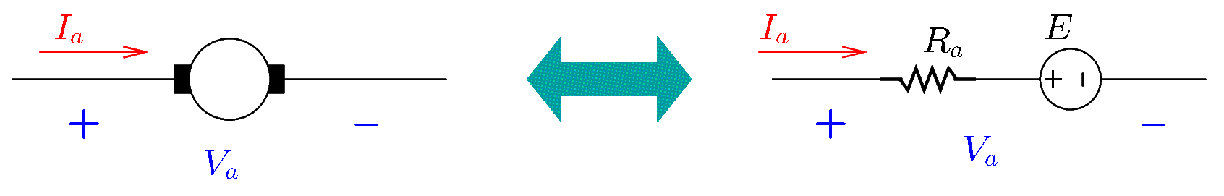
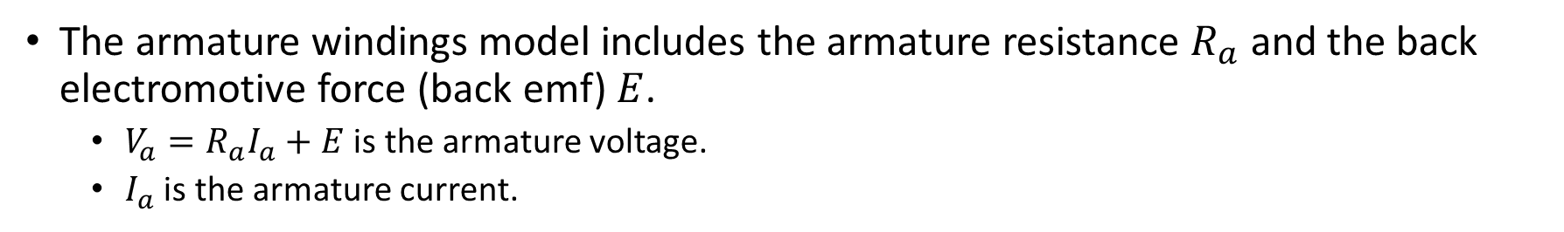
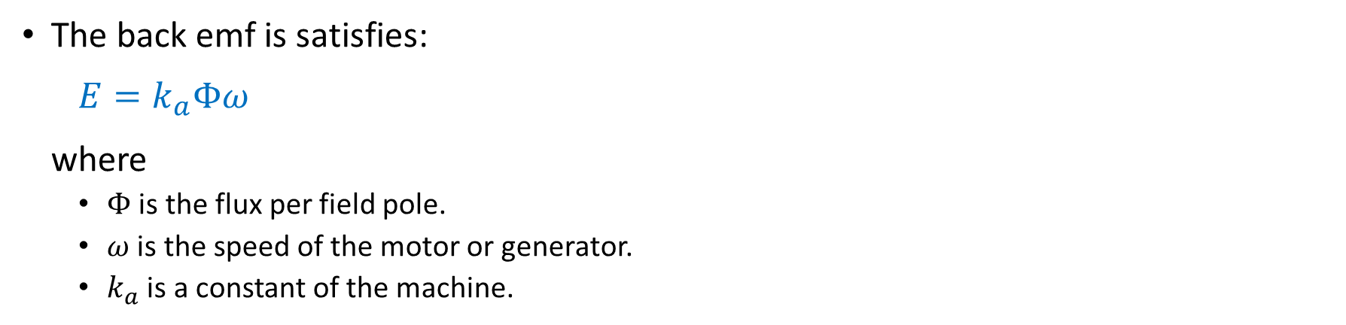
Electric Model
The armature windings model includes the armature resistance $R_{a}$ and the back electromotive force (back emf) $E$.
  $V_{a}=R_{a}I_{a}+E$ is the armature voltage.
  $I_{a}$ is the armature current.
The back emf is satisfies:
$$E=k_{a}Φω$$
where
  $Φ$ is the flux per field pole.
  $ω$ is the speed of the motor or generator.
  $k_{a}$ is a constant of the machine.
Notes:
presm/fieldmdl.fig

Slide 5
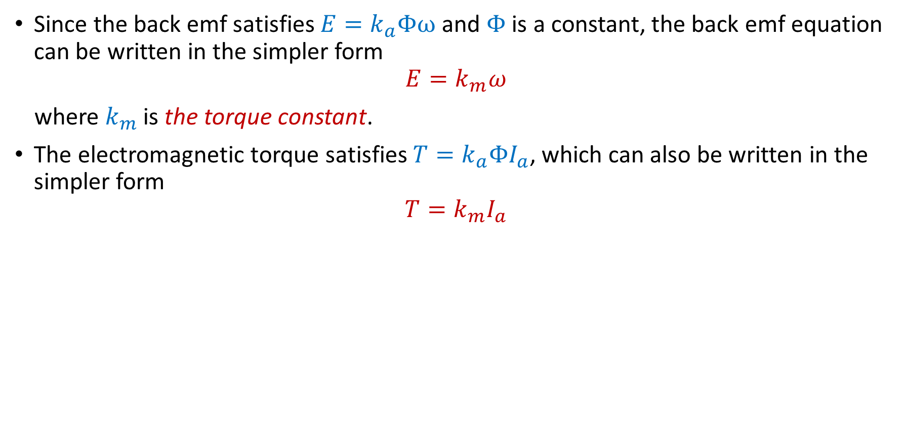
Permanent Magnet Machines
Since the back emf satisfies $E=k_{a}Φω$ and $Φ$ is a constant, the back emf equation can be written in the simpler form
$$E=k_{m}ω$$
where $k_{m}$ is the torque constant.
The electromagnetic torque satisfies $T=k_{a}ΦI_{a}$, which can also be written in the simpler form
$$T=k_{m}I_{a}$$

Slide 6
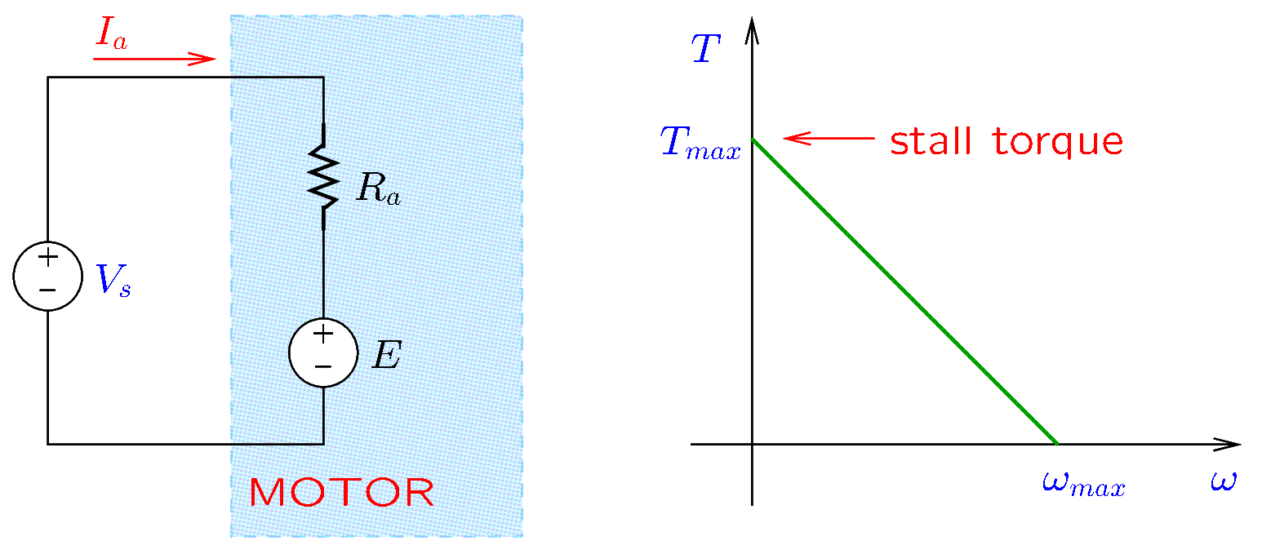
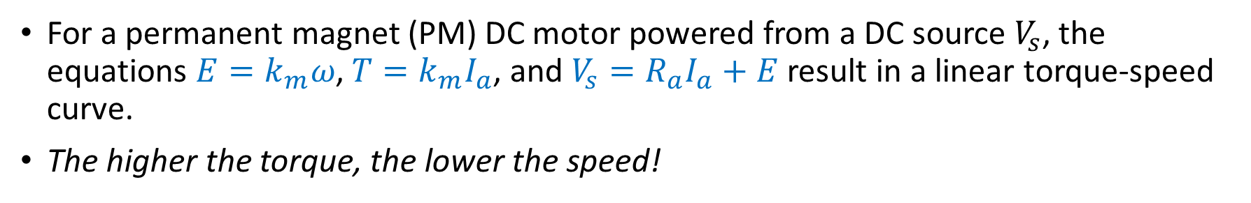
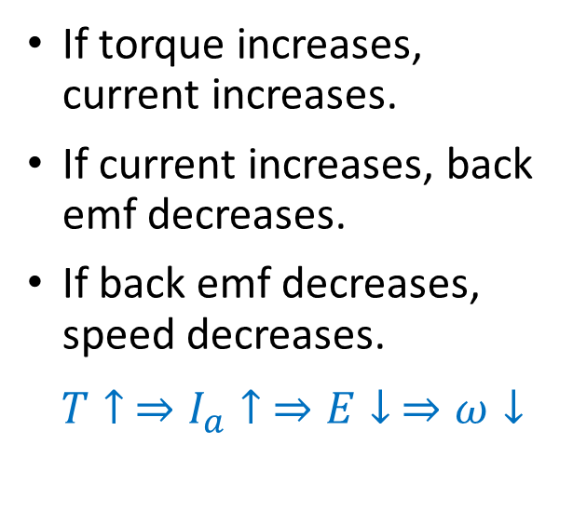
PM Motors
For a permanent magnet (PM) DC motor powered from a DC source $V_{s}$, the equations $E=k_{m}ω$, $T=k_{m}I_{a}$, and $V_{s}=R_{a}I_{a}+E$ result in a linear torque-speed curve.
The higher the torque, the lower the speed!
If torque increases, current increases.
If current increases, back emf decreases.
If back emf decreases, speed decreases.
$$T↑ ⇒I_{a}↑ ⇒E↓ ⇒ω↓$$
Notes:
presm/dcmotor.fig

Slide 7
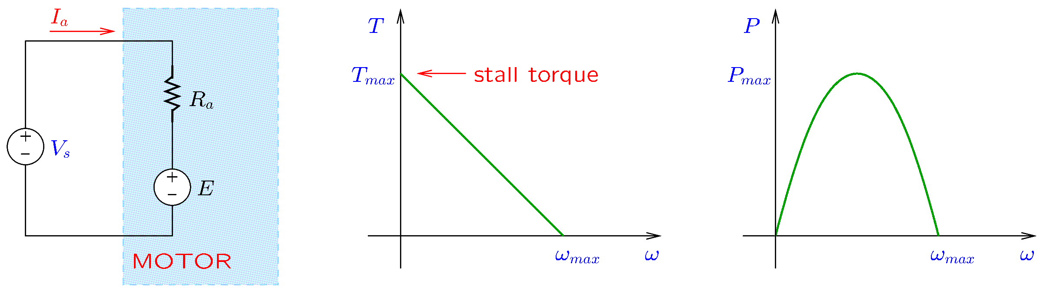
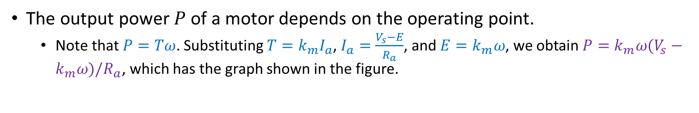
PM Motors
The output power $P$ of a motor depends on the operating point.
  Note that $P=Tω$. Substituting $T=k_{m}I_{a}$, $I_{a}=\frac{V_{s}−E}{R_{a}}$, and $E=k_{m}ω$, we obtain $P=k_{m}ω(V_{s}−k_{m}ω)/R_{a}$, which has the graph shown in the figure.
Notes:
presm/dcmotor.fig

Slide 8
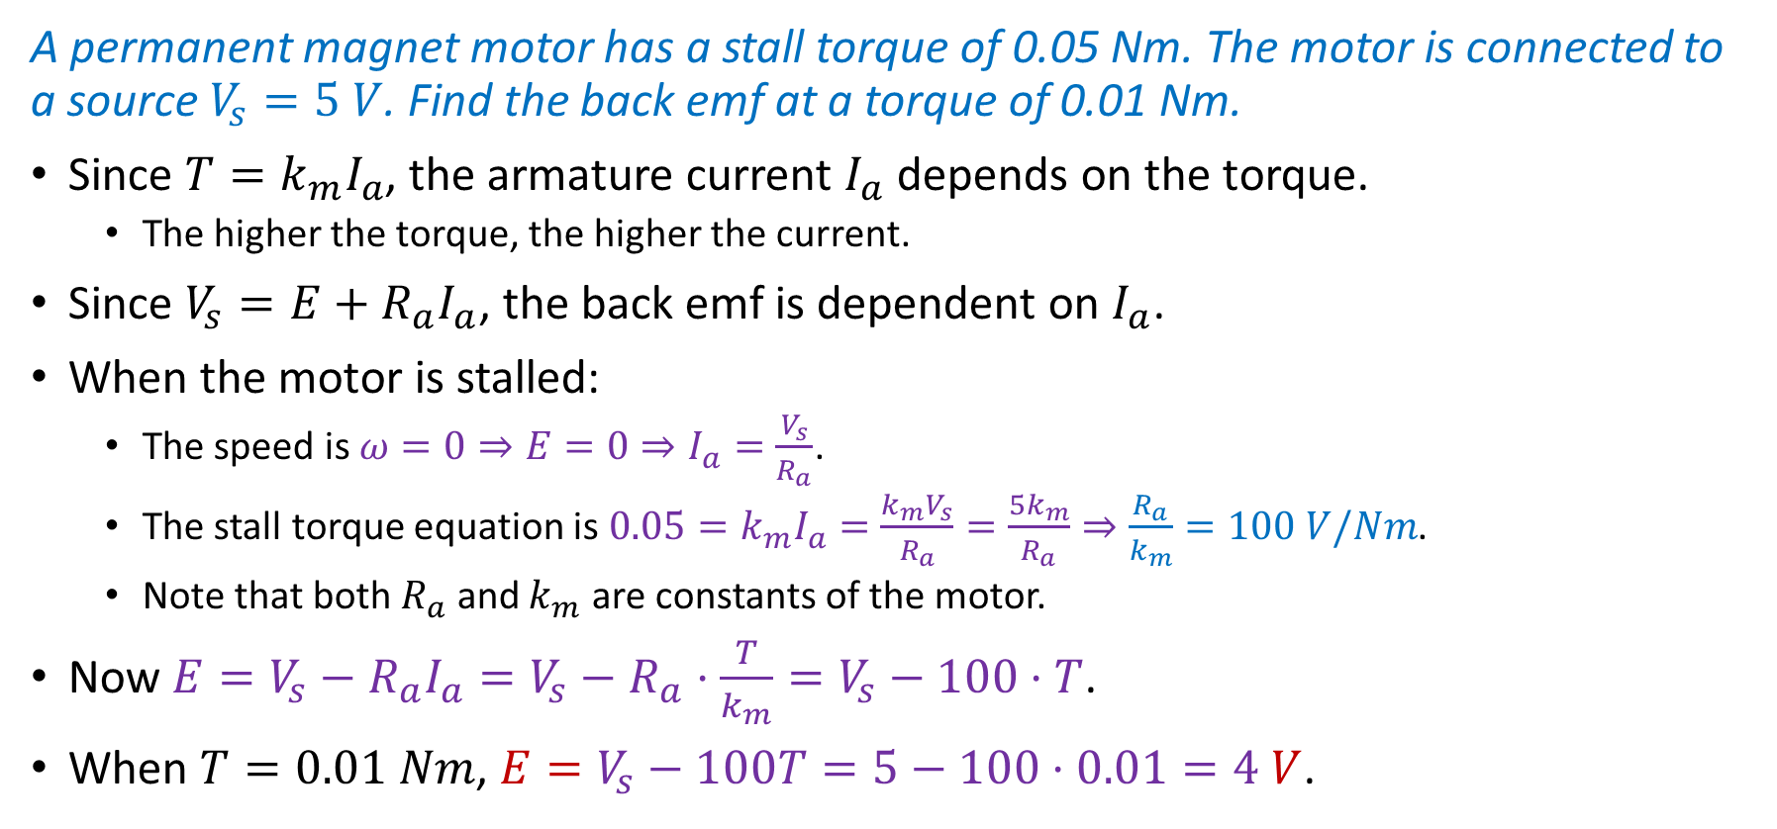
PM Motors—Example 1
A permanent magnet motor has a stall torque of 0.05 Nm. The motor is connected to a source $V_{s}=5 V$. Find the back emf at a torque of 0.01 Nm.
Since $T=k_{m}I_{a}$, the armature current $I_{a}$ depends on the torque.
  The higher the torque, the higher the current.
Since $V_{s}=E+R_{a}I_{a}$, the back emf is dependent on $I_{a}$.
When the motor is stalled:
  The speed is $ω=0⇒E=0⇒I_{a}=\frac{V_{s}}{R_{a}}$.
  The stall torque equation is $0.05=k_{m}I_{a}=\frac{k_{m}V_{s}}{R_{a}}=\frac{5k_{m}}{R_{a}}⇒\frac{R_{a}}{k_{m}}=100 V/Nm$.
  Note that both $R_{a}$ and $k_{m}$ are constants of the motor.
Now $E=V_{s}−R_{a}I_{a}=V_{s}−R_{a}⋅\frac{T}{k_{m}}=V_{s}−100⋅T$.
When $T=0.01 Nm$, $E=V_{s}−100T=5−100⋅0.01=4 V$.

Slide 9
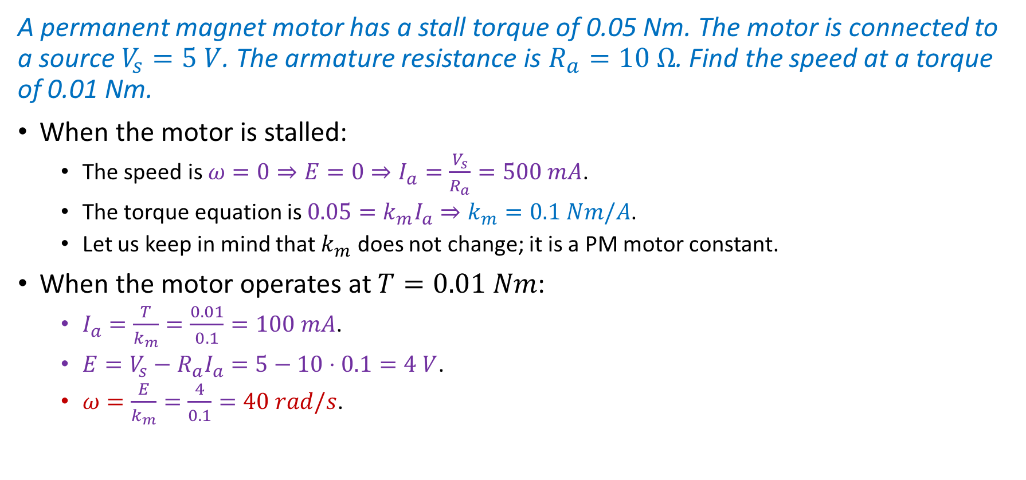
PM Motors—Example 2
A permanent magnet motor has a stall torque of 0.05 Nm. The motor is connected to a source $V_{s}=5 V$. The armature resistance is $R_{a}=10 Ω$. Find the speed at a torque of 0.01 Nm.
When the motor is stalled:
  The speed is $ω=0⇒E=0⇒I_{a}=\frac{V_{s}}{R_{a}}=500 mA$.
  The torque equation is $0.05=k_{m}I_{a}⇒k_{m}=0.1 Nm/A$.
  Let us keep in mind that $k_{m}$ does not change; it is a PM motor constant.
When the motor operates at $T=0.01 Nm$:
  $I_{a}=\frac{T}{k_{m}}=\frac{0.01}{0.1}=100 mA$.
  $E=V_{s}−R_{a}I_{a}=5−10⋅0.1=4 V$.
  $ω=\frac{E}{k_{m}}=\frac{4}{0.1}=40 rad/s$.

Slide 10
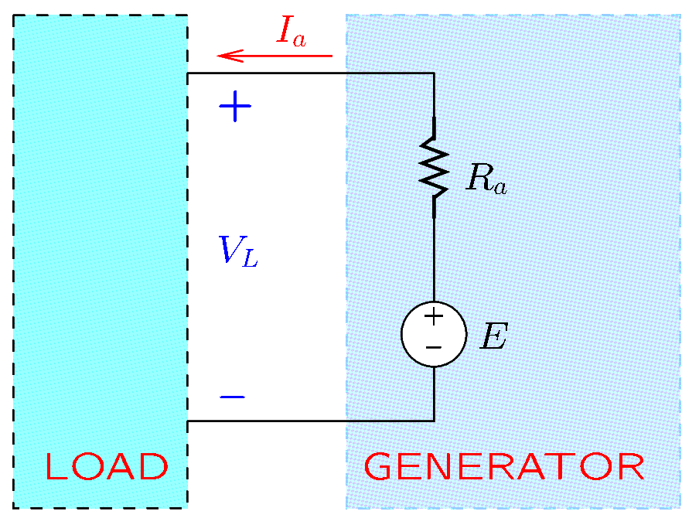
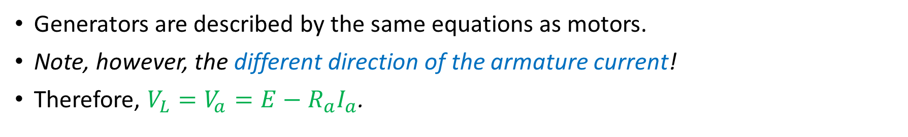

PM Generators
Generators are described by the same equations as motors.
Note, however, the different direction of the armature current!
Therefore, $V_{L}=V_{a}=E−R_{a}I_{a}$.
The torque applied to the generator is
$$T=k_{m}I_{a}$$
The back emf is
$$E=k_{m}ω$$
Notes:
presm/dcgen.fig

Slide 11
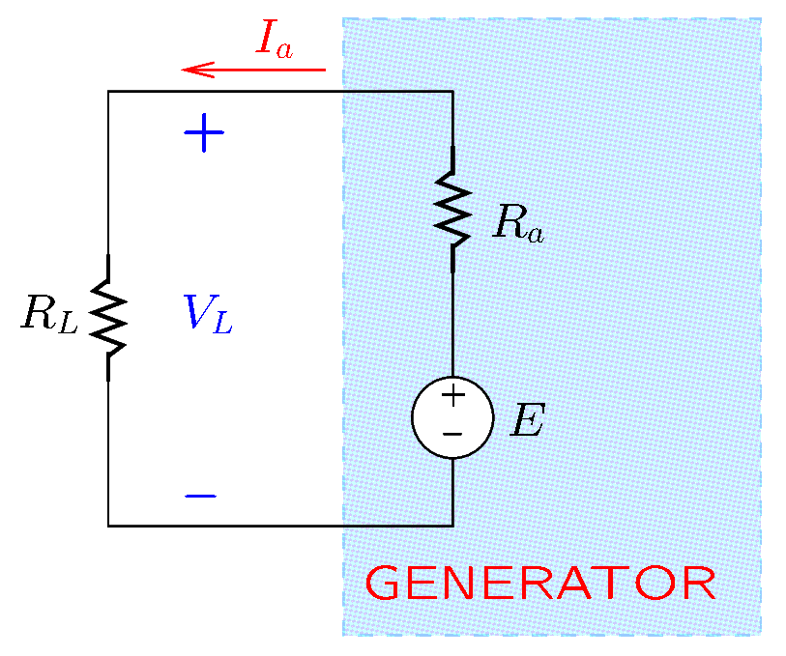
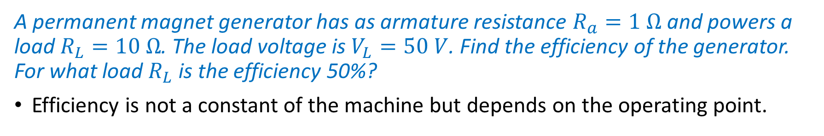
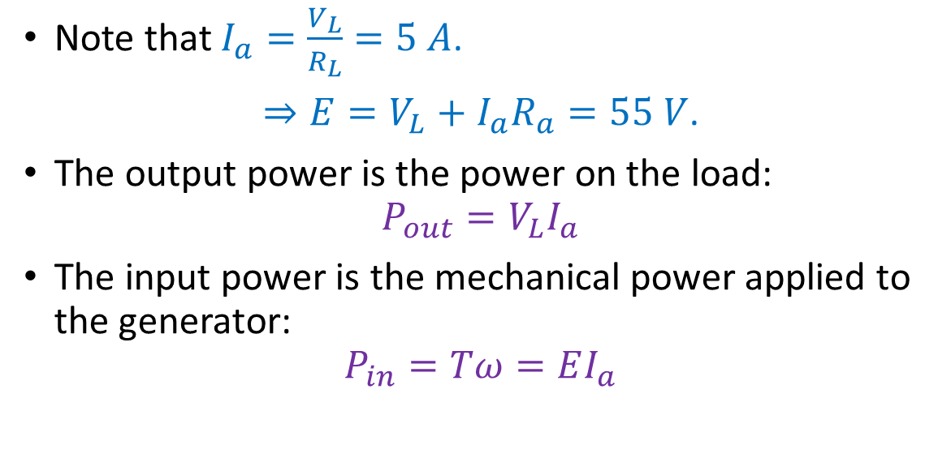
PM Generators—Example
A permanent magnet generator has as armature resistance $R_{a}=1 Ω$ and powers a load $R_{L}=10 Ω$. The load voltage is $V_{L}=50 V$. Find the efficiency of the generator. For what load $R_{L}$ is the efficiency 50%?
Efficiency is not a constant of the machine but depends on the operating point.
Note that $I_{a}=\frac{V_{L}}{R_{L}}=5 A$.
$⇒E=V_{L}+I_{a}R_{a}=55 V$.
The output power is the power on the load:
$$P_{out}=V_{L}I_{a}$$
The input power is the mechanical power applied to the generator:
$$P_{in}=Tω=EI_{a}$$

Slide 12


PM Generators—Example (Continued)
The efficiency is
$$η=\frac{P_{out}}{P_{in}}=\frac{V_{L}I_{a}}{EI_{a}}=\frac{V_{L}}{E}=90.9\%$$
If the efficiency is only $50\%$, then $\frac{V_{L}}{E}=0.5$.
Note that $E$ and $V_{L}$ will not have the same values as in the case of 90.9% efficiency.
Now $V_{L}=0.5E⇒I_{a}R_{L}=0.5(I_{a}R_{L}+I_{a}R_{a})$
$$⇒R_{L}=0.5\left(R_{L}+R_{a}\right)$$
$⇒R_{L}=R_{a}=1 Ω$.

Slide 13
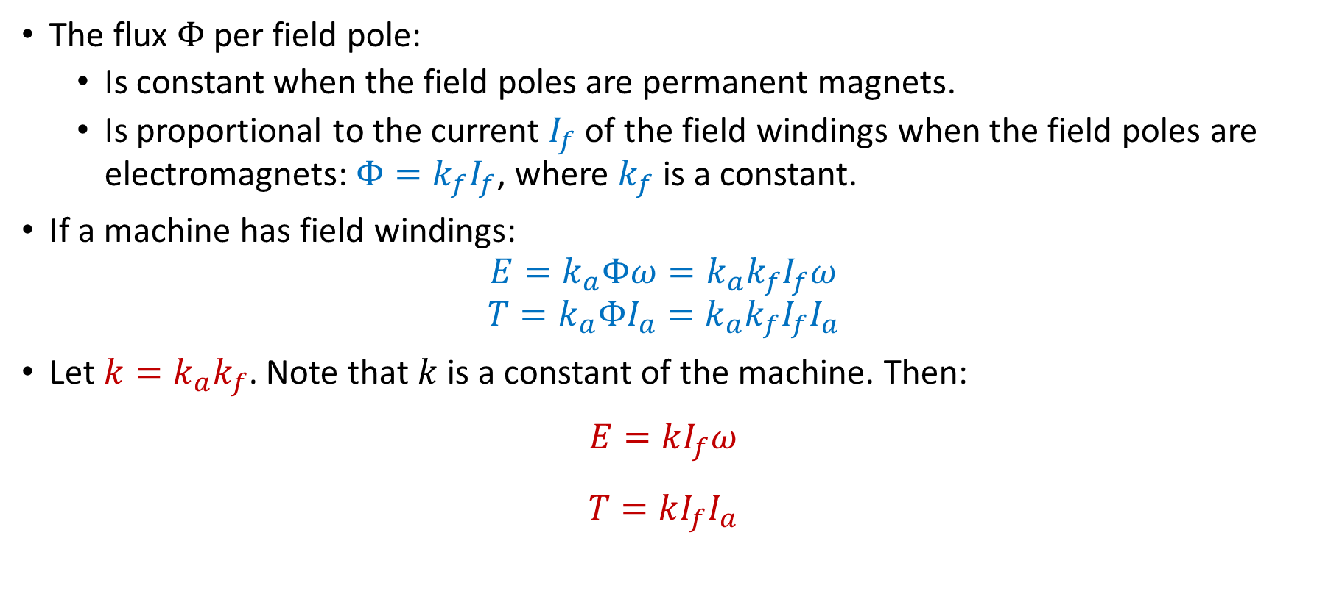
DC Machines with Field Windings
The flux $Φ$ per field pole:
  Is constant when the field poles are permanent magnets.
  Is proportional to the current $I_{f}$ of the field windings when the field poles are electromagnets: $Φ=k_{f}I_{f}$, where $k_{f}$ is a constant.
If a machine has field windings:
$$E=k_{a}Φω=k_{a}k_{f}I_{f}ω$$
$$T=k_{a}ΦI_{a}=k_{a}k_{f}I_{f}I_{a}$$
Let $k=k_{a}k_{f}$. Note that $k$ is a constant of the machine. Then:
$$E=kI_{f}ω$$
$$T=kI_{f}I_{a}$$

Slide 14
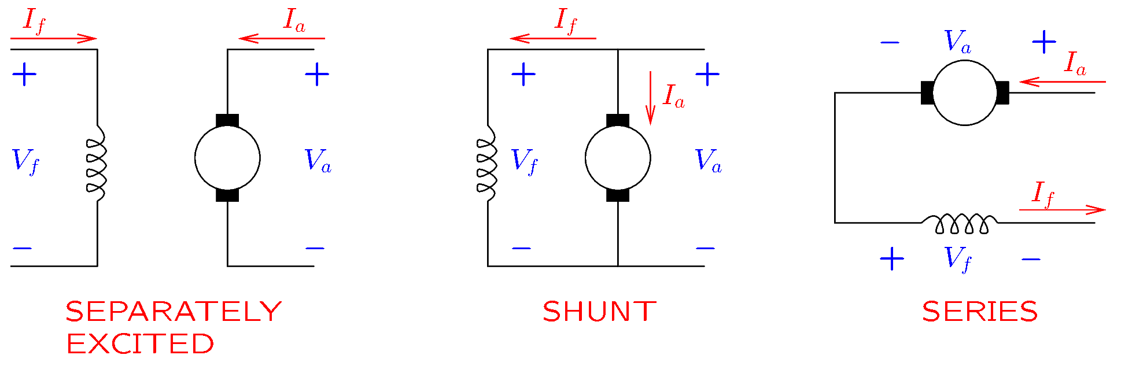
DC Machines with Field Windings
The field and armature windings may be connected
  to different circuits for a separately excited motor or generator;
  in parallel for a shunt motor or generator;
  in series for a series motor (aka universal motor).
Notes:
presm/motors.fig

Slide 15

DC Machines with Field Windings
Considering the equations $E=kI_{f}ω$ and $T=kI_{f}I_{a}$, if $V_{f}$ is maintained constant, then the term $kI_{f}=kV_{f}/R_{f}$ will be a constant.
Therefore, for separately excited and shunt machines, $kI_{f}$ is similar to the torque constant $k_{m}$ of the PM machines.
For series machines, however, since $I_{f}=I_{a}$, the term $kI_{f}$ cannot be a constant!

Slide 16

DC Machines with Field Windings
Separately excited machines resemble PM machines.
Shunt motors tend to maintain constant speed.
Series motors work with both DC and AC supplies. Thus, they are known as universal motors.
  Series motors work well with AC because $I_{a}$ and $I_{f}$ are in phase (since they are identical).

Slide 17
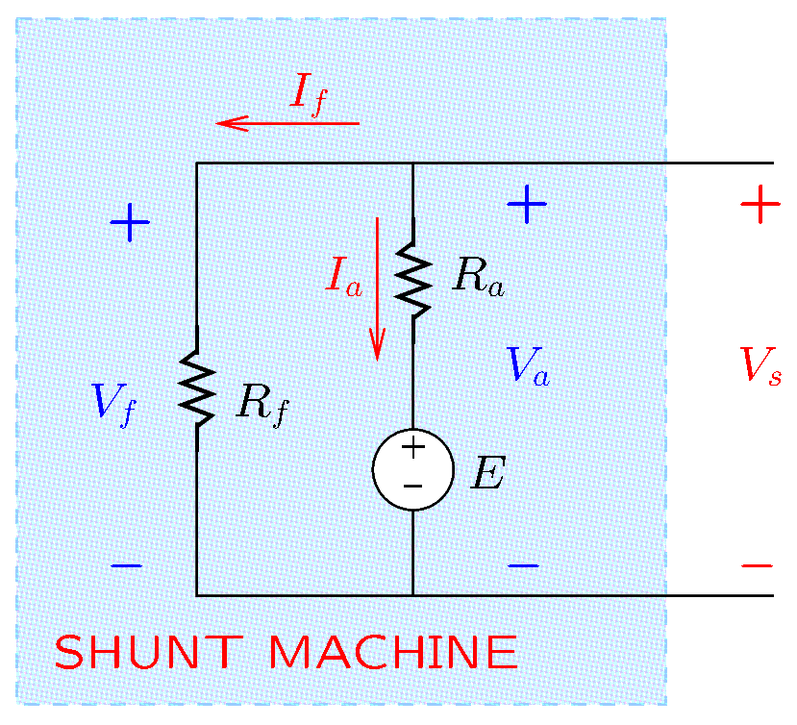
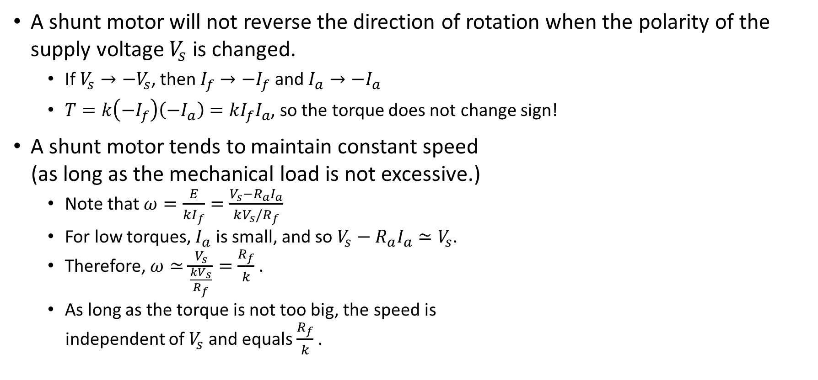
Shunt Machines
A shunt motor will not reverse the direction of rotation when the polarity of the supply voltage $V_{s}$ is changed.
  If $V_{s}→−V_{s}$, then $I_{f}→−I_{f}$ and $I_{a}→−I_{a}$
  $T=k\left(−I_{f}\right)\left(−I_{a}\right)=kI_{f}I_{a}$, so the torque does not change sign!
A shunt motor tends to maintain constant speed
(as long as the mechanical load is not excessive.)
  Note that $ω=\frac{E}{kI_{f}}=\frac{V_{s}−R_{a}I_{a}}{kV_{s}/R_{f}}$
  For low torques, $I_{a}$ is small, and so $V_{s}−R_{a}I_{a}≃V_{s}$.
  Therefore, $ω≃\frac{V_{s}}{\frac{kV_{s}}{R_{f}}}=\frac{R_{f}}{k}$.
  As long as the torque is not too big, the speed is
  independent of $V_{s}$ and equals $\frac{R_{f}}{k}$.
Notes:
presm/shunt.fig

Slide 18
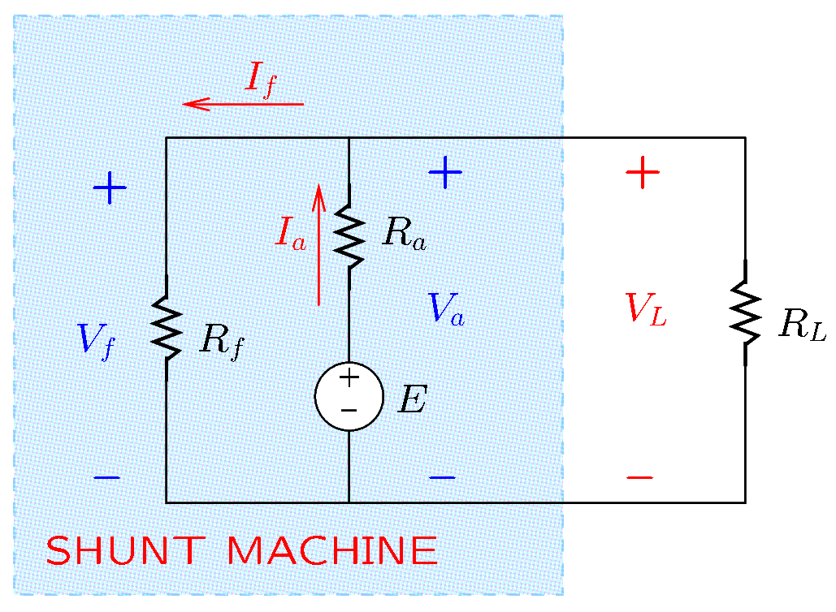
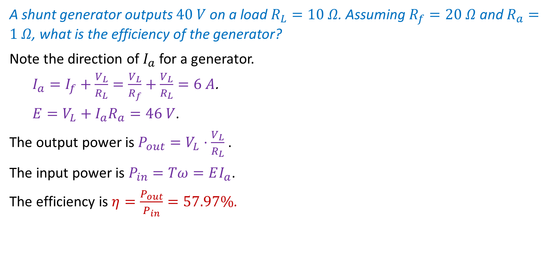
Shunt Machines—Example 1
A shunt generator outputs $40 V$ on a load $R_{L}=10 Ω$. Assuming $R_{f}=20 Ω$ and $R_{a}=1 Ω$, what is the efficiency of the generator?
Note the direction of $I_{a}$ for a generator.
  $I_{a}=I_{f}+\frac{V_{L}}{R_{L}}=\frac{V_{L}}{R_{f}}+\frac{V_{L}}{R_{L}}=6 A$.
  $E=V_{L}+I_{a}R_{a}=46 V$.
The output power is $P_{out}=V_{L}⋅\frac{V_{L}}{R_{L}}$ .
The input power is $P_{in}=Tω=EI_{a}$.
The efficiency is $η=\frac{P_{out}}{P_{in}}=57.97\%$.
Notes:
presm/shunt2.fig

Slide 19
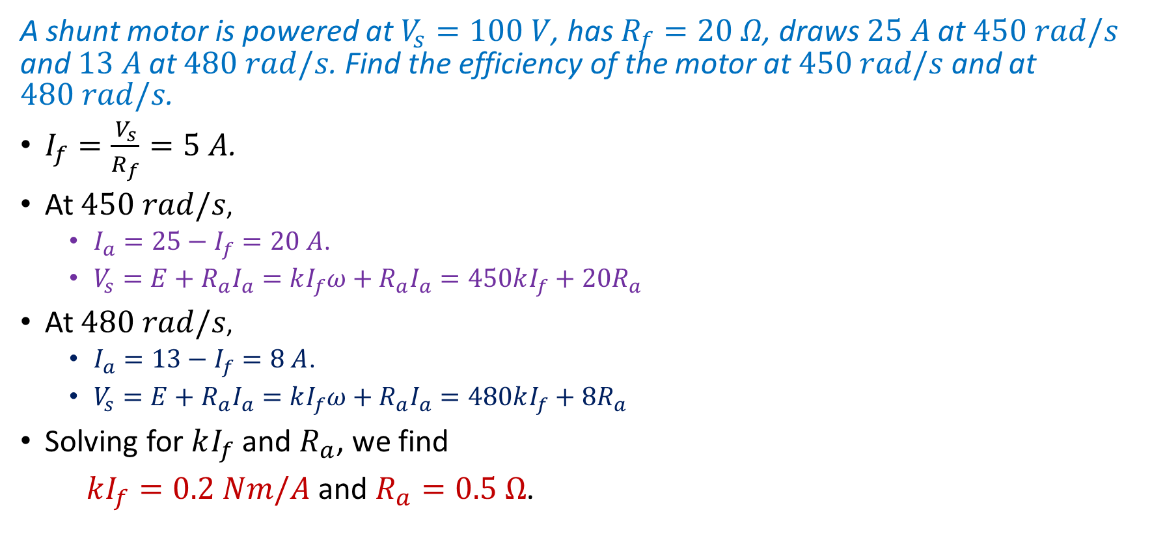
Shunt Machines—Example 2
A shunt motor is powered at $V_{s}=100 V$, has $R_{f}=20 Ω$, draws $25 A$ at $450 rad/s$ and $13 A$ at $480 rad/s$. Find the efficiency of the motor at $450 rad/s$ and at $480 rad/s$.
$I_{f}=\frac{V_{s}}{R_{f}}=5 A$.
At $450 rad/s$,
  $I_{a}=25−I_{f}=20 A$.
  $V_{s}=E+R_{a}I_{a}=kI_{f}ω+R_{a}I_{a}=450kI_{f}+20R_{a}$
At $480 rad/s$,
  $I_{a}=13−I_{f}=8 A$.
  $V_{s}=E+R_{a}I_{a}=kI_{f}ω+R_{a}I_{a}=480kI_{f}+8R_{a}$
Solving for $kI_{f}$ and $R_{a}$, we find
$kI_{f}=0.2 Nm/A$ and $R_{a}=0.5 Ω$.
Notes:
presm/shunt.fig

Slide 20

Shunt Machines—Example 2 (Continued)
The input power is $P_{in}=V_{s}(I_{a}+I_{f})$.
The output power is $P_{out}=Tω$. Substituting $Tω=EI_{a}$ and $E=V_{s}−I_{a}R_{a}$:
$P_{out}=\left(V_{s}−I_{a}R_{a}\right)I_{a}$.
The efficiency is $η=\frac{P_{out}}{P_{in}}$ .
At $450 rad/s$:
  $I_{a}=25−I_{f}=20 A$.
  $η=72\%$
At $480 rad/s$:
  $I_{a}=13−I_{f}=8 A$.
  $η=59\%$
Notes:
presm/shunt.fig

Slide 21
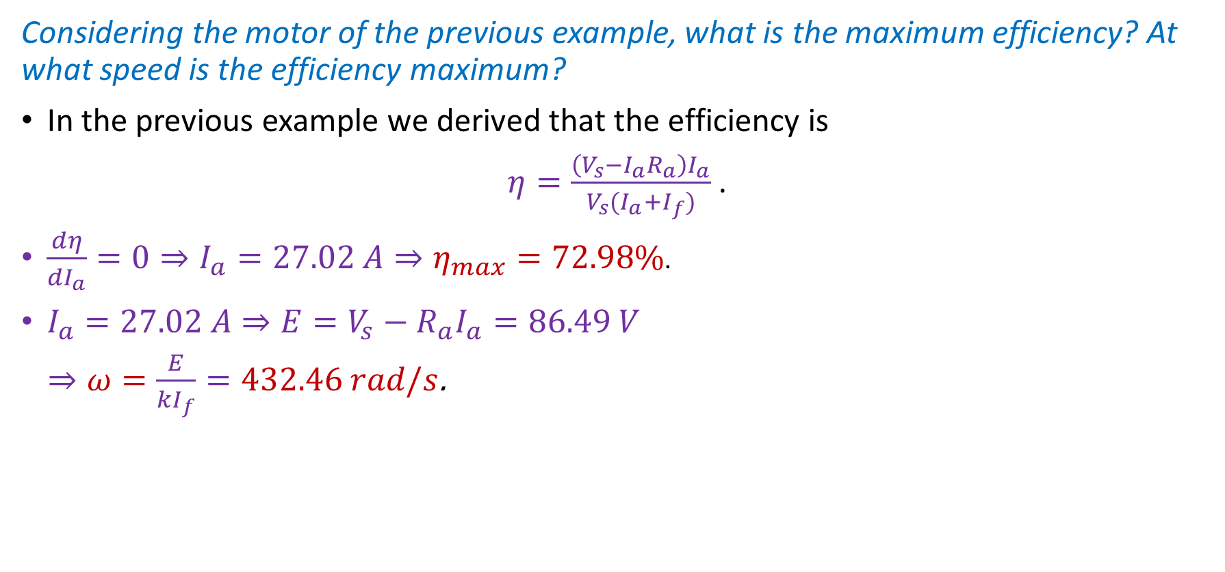
Shunt Machines—Example 3
Considering the motor of the previous example, what is the maximum efficiency? At what speed is the efficiency maximum?
In the previous example we derived that the efficiency is
$η=\frac{\left(V_{s}−I_{a}R_{a}\right)I_{a}}{V_{s}(I_{a}+I_{f})}$ .
$\frac{dη}{dI_{a}}=0⇒I_{a}=27.02 A⇒η_{max}=72.98\%$.
$I_{a}=27.02 A⇒E=V_{s}−R_{a}I_{a}=86.49 V$
$⇒ω=\frac{E}{kI_{f}}=432.46 rad/s$.
Notes:
presm/shunt.fig

Slide 22
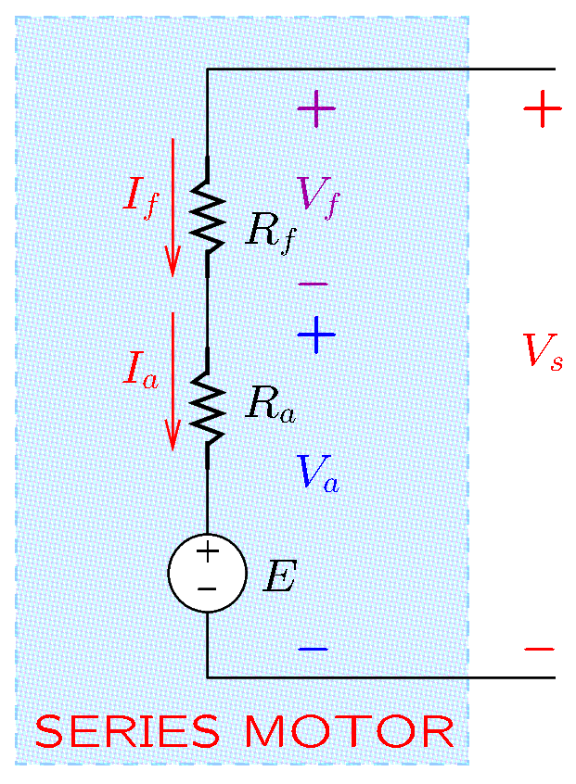
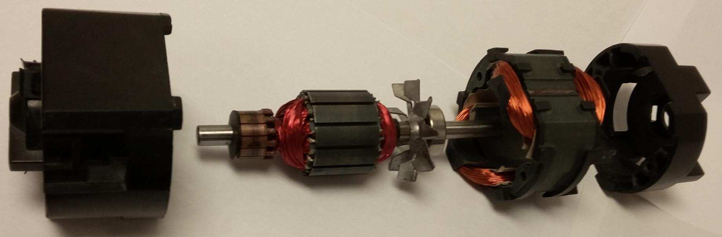
Series Motors
Series motors connect the field and the armature windings in series.
Series motors work with both DC and AC supplies. Thus, they are known as universal motors.
Notes:
presm/series.fig

Slide 23
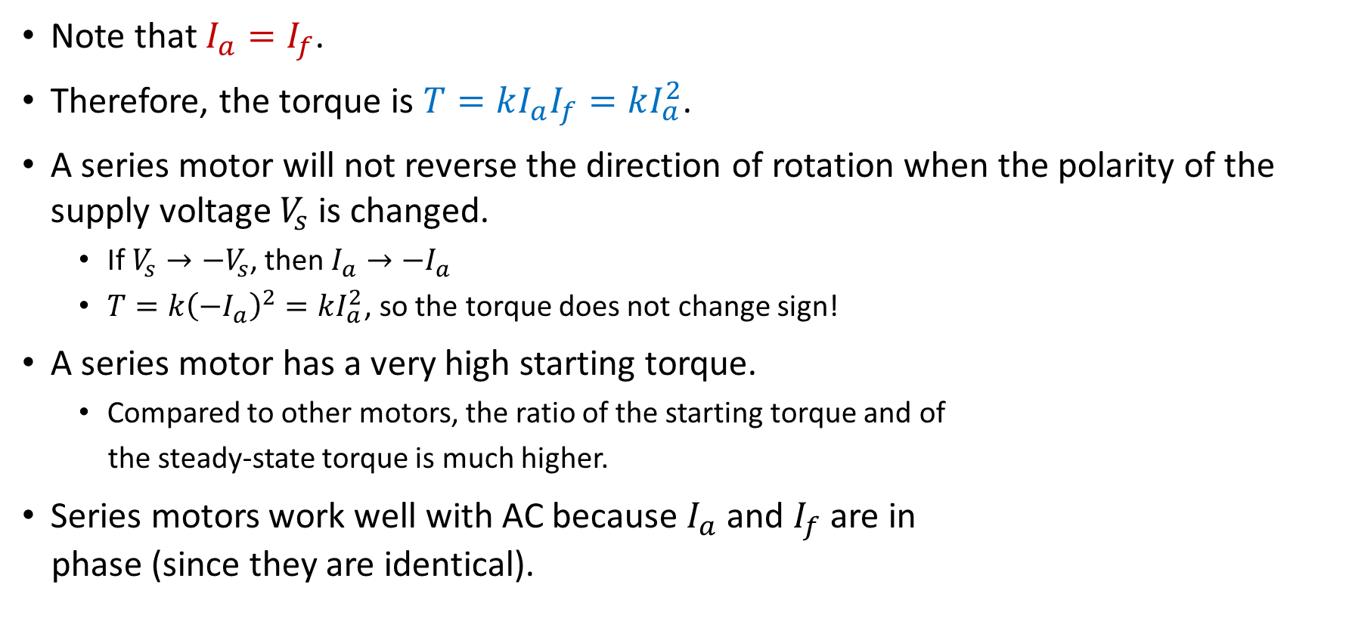
Series Motors
Note that $I_{a}=I_{f}$.
Therefore, the torque is $T=kI_{a}I_{f}=kI_{a}^{2}$.
A series motor will not reverse the direction of rotation when the polarity of the supply voltage $V_{s}$ is changed.
  If $V_{s}→−V_{s}$, then $I_{a}→−I_{a}$
  $T=k{\left(−I_{a}\right)}^{2}=kI_{a}^{2}$, so the torque does not change sign!
A series motor has a very high starting torque.
  Compared to other motors, the ratio of the starting torque and of
  the steady-state torque is much higher.
Series motors work well with AC because $I_{a}$ and $I_{f}$ are in
phase (since they are identical).
Notes:
presm/series.fig

Slide 24
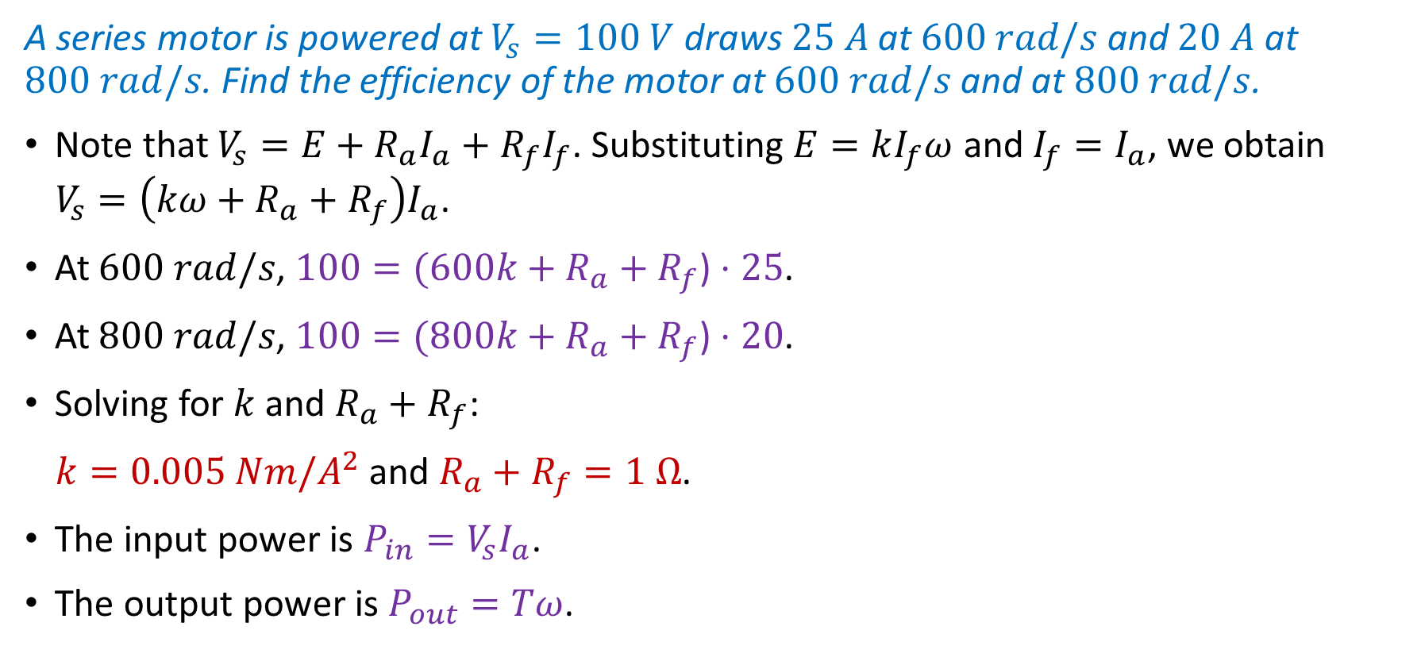
Series Motors—Example
A series motor is powered at $V_{s}=100 V$ draws $25 A$ at $600 rad/s$ and $20 A$ at $800 rad/s$. Find the efficiency of the motor at $600 rad/s$ and at $800 rad/s$.
Note that $V_{s}=E+R_{a}I_{a}+R_{f}I_{f}$. Substituting $E=kI_{f}ω$ and $I_{f}=I_{a}$, we obtain
$V_{s}=\left(kω+R_{a}+R_{f}\right)I_{a}$.
At $600 rad/s$, $100=(600k+R_{a}+R_{f}\text{)}⋅25$.
At $800 rad/s$, $100=(800k+R_{a}+R_{f}\text{)}⋅20$.
Solving for $k$ and $R_{a}+R_{f}$:
$k=0.005 Nm/A^{2}$ and $R_{a}+R_{f}=1 Ω$.
The input power is $P_{in}=V_{s}I_{a}$.
The output power is $P_{out}=Tω$.
Notes:
presm/series.fig

Slide 25

Series Motors—Example (Continued)
Since $Tω=EI_{a}$, the efficiency is
$$η=\frac{P_{out}}{P_{in}}=\frac{EI_{a}}{V_{s}I_{a}}=\frac{E}{V_{s}}$$
Note that $E=V_{s}−\left(R_{a}+R_{f}\right)I_{a}$.
At $600 rad/s$, $E=100−1⋅25=75 V⇒η=75\%$.
At $800 rad/s$, $E=100−1⋅20=80 V⇒η=80\%$.
Notes:
presm/series.fig

