Slide 1
Review of the Laplace Transform
Applications to Differential Equations and System Modeling
M.V. Iordache, EEGR3523 Mechatronics, Spring 2019, LeTourneau University

Slide 2
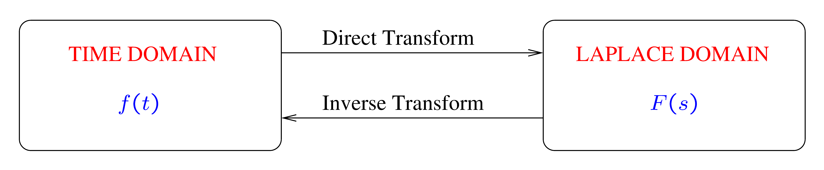
The Laplace Transform
System models involve differential equations.
The Laplace transform provides a convenient method to solve differential equations.
Notation:
Lower case for time-domain functions: f(t), g(t), …
Upper case for their Laplace transform: F(s), G(s), …

Slide 3
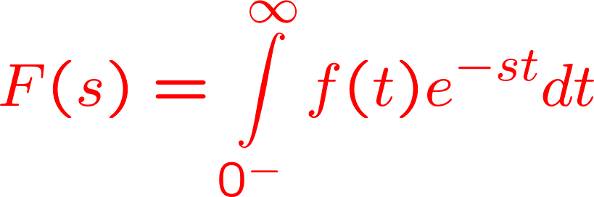
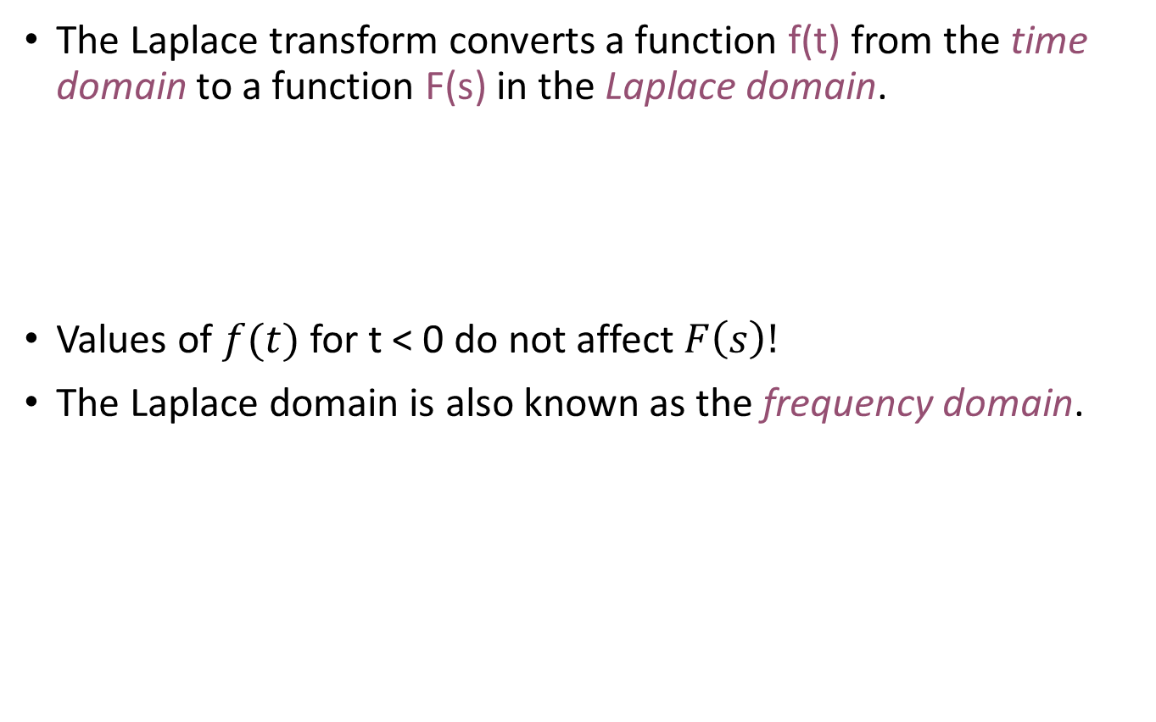
The Laplace Transform
The Laplace transform converts a function f(t) from the time domain to a function F(s) in the Laplace domain.
Values of $f(t)$ for t < 0 do not affect $F\left(s\right)!$
The Laplace domain is also known as the frequency domain.

Slide 4
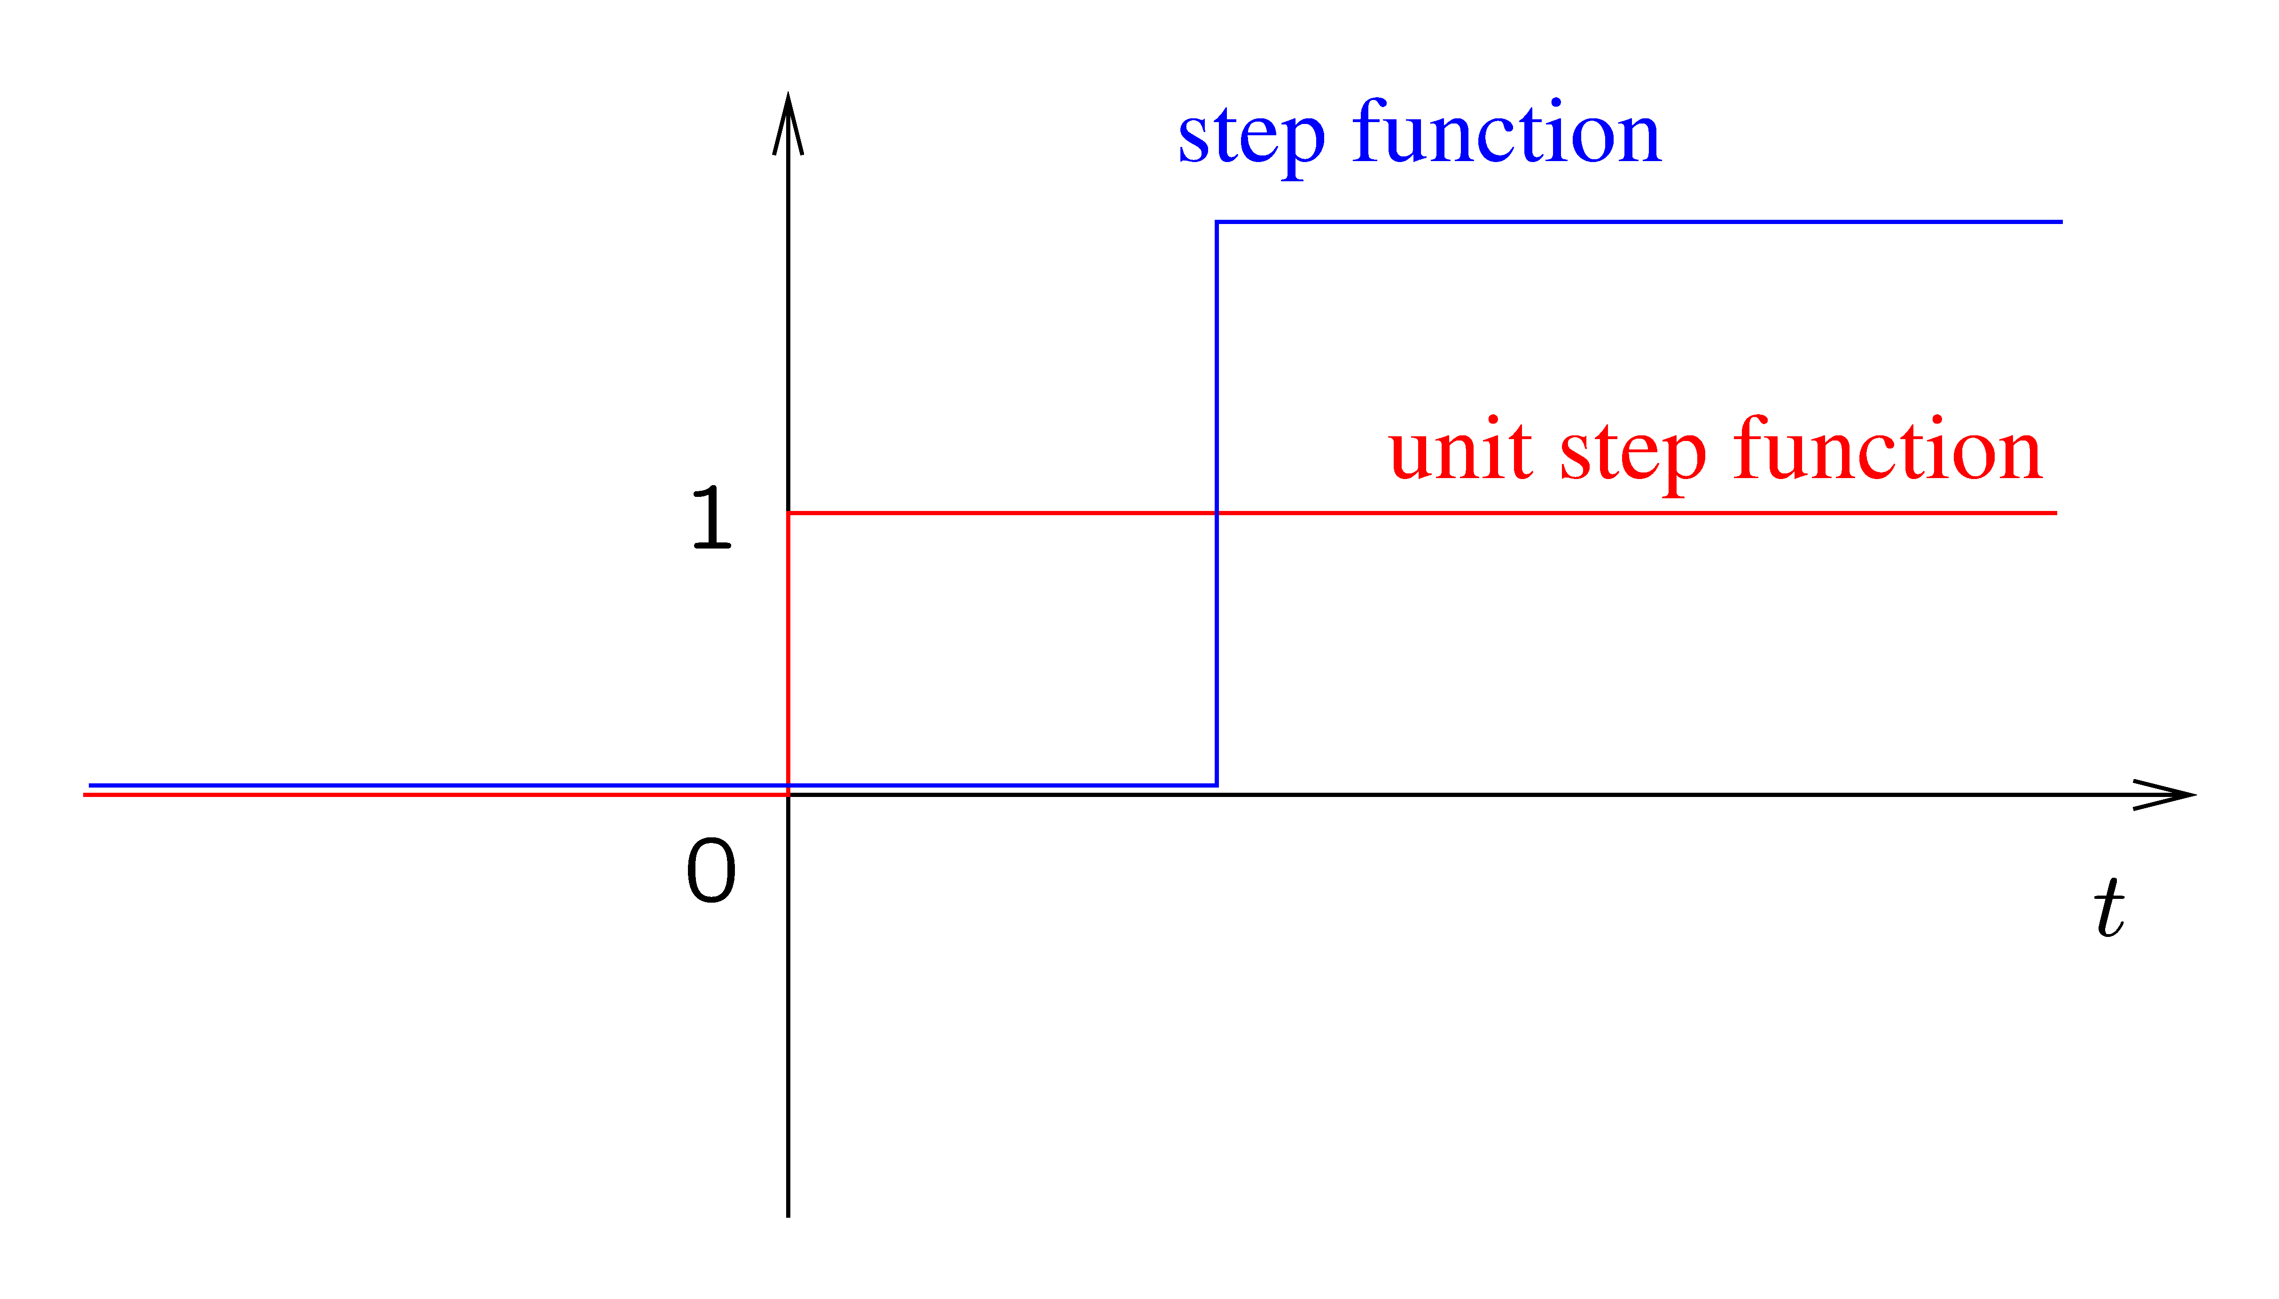
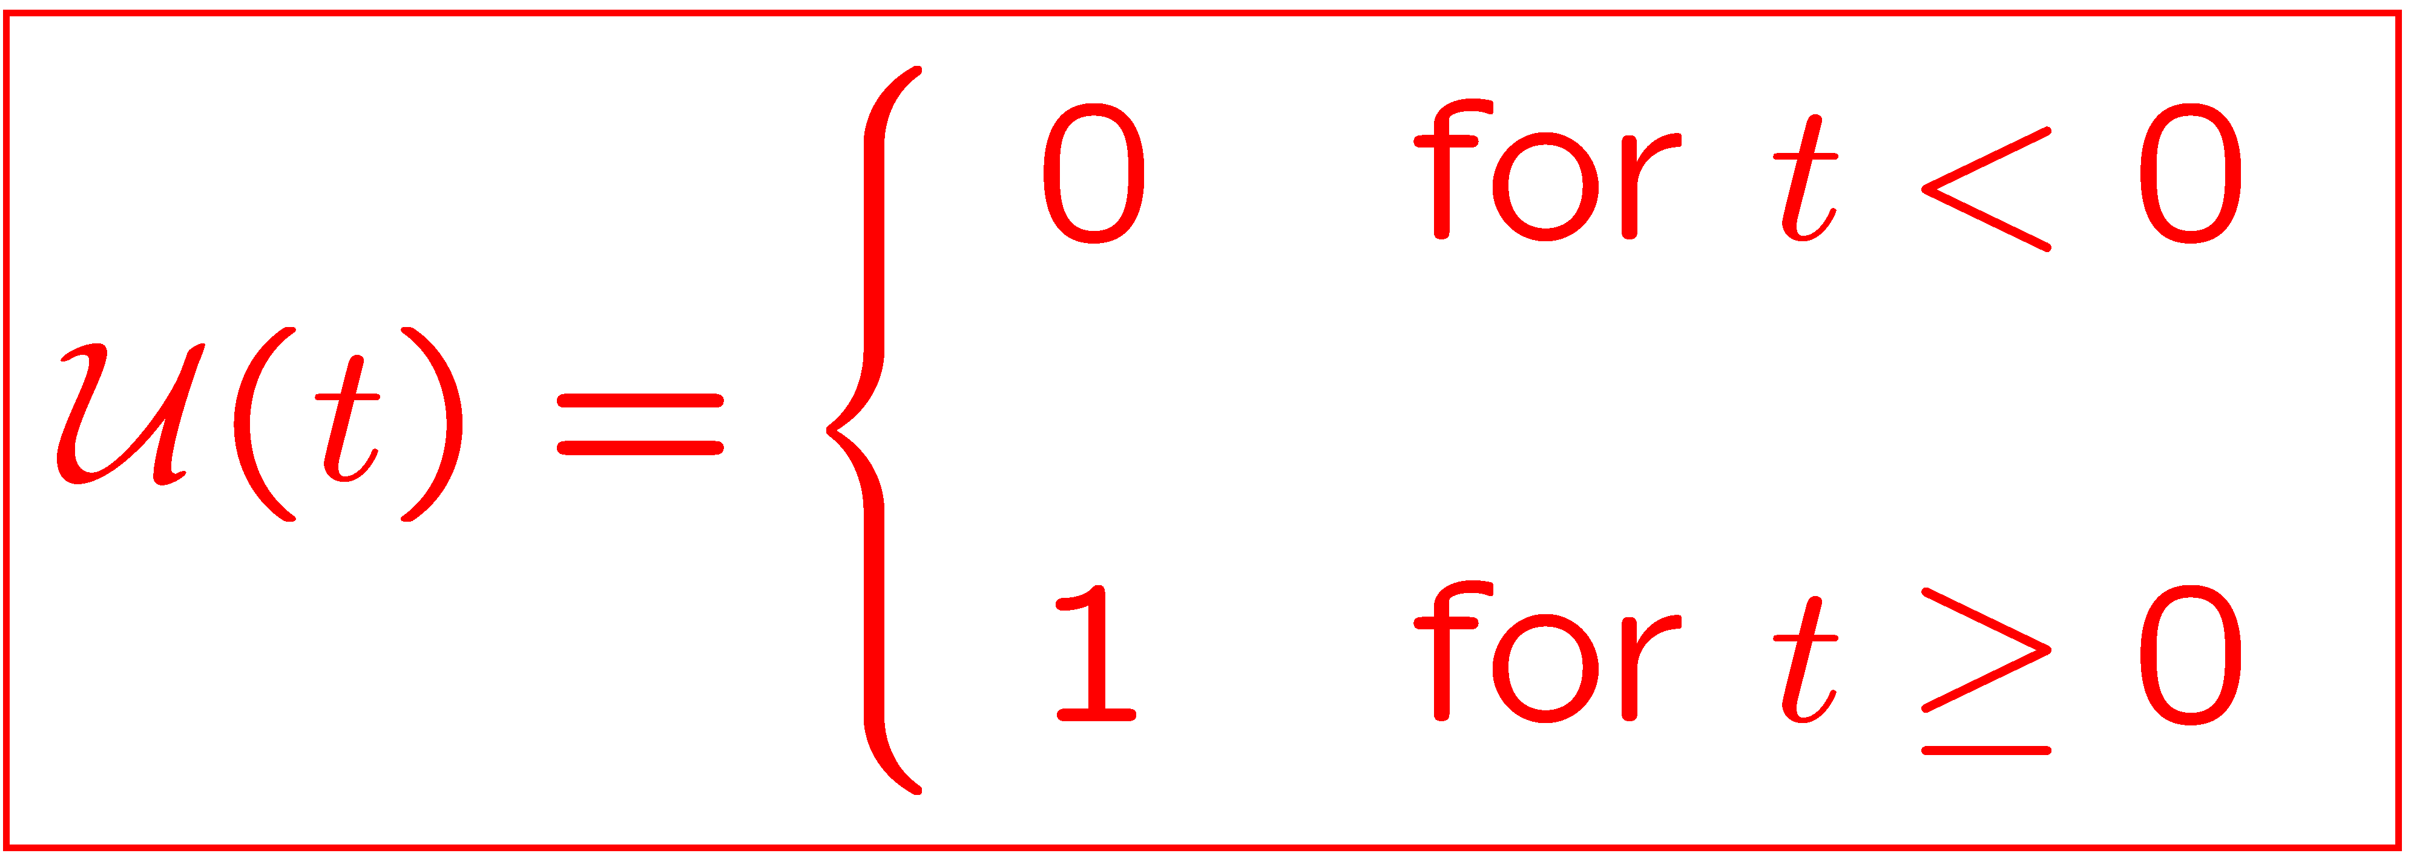
The Step Function
The unit step function is a step function defined as

Slide 5
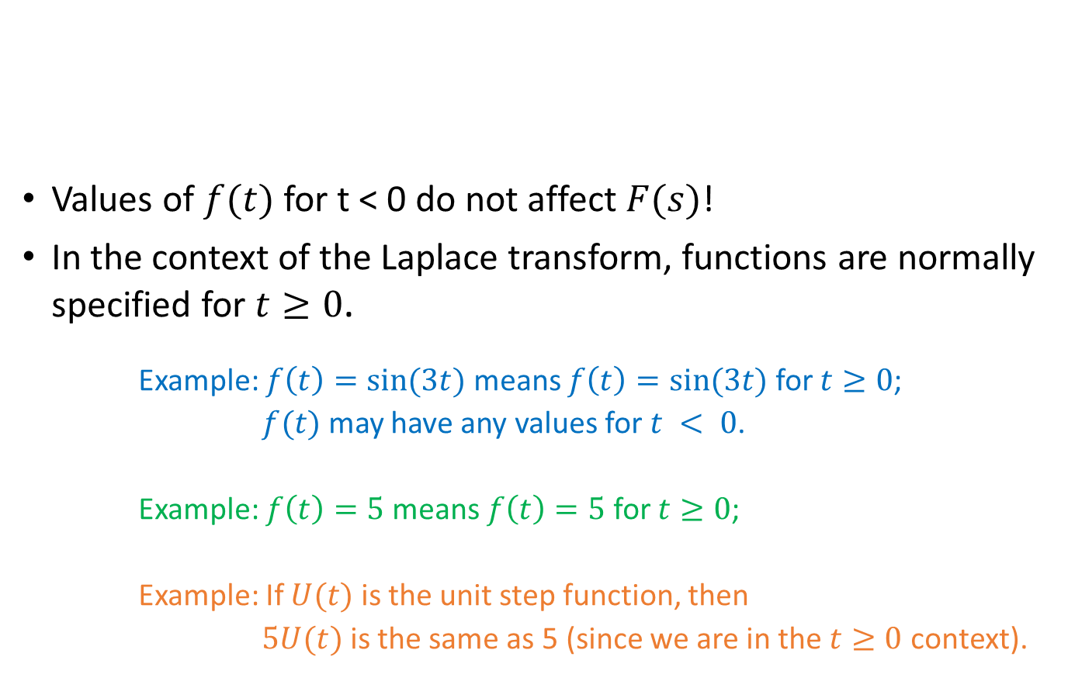
The Laplace Transform
Values of $f(t)$ for t < 0 do not affect $F(s)$!
In the context of the Laplace transform, functions are normally specified for $t≥0$.
Example: $f\left(t\right)=sin⁡(3t)$ means $f\left(t\right)=sin⁡(3t)$ for $t≥0$;
$f(t)$ may have any values for $t < 0$.
Example: $f\left(t\right)=5$means $f\left(t\right)=5$for $t≥0$;
Example: If $U(t)$ is the unit step function, then
$5U(t)$ is the same as 5 (since we are in the $t≥0$ context).

Slide 6
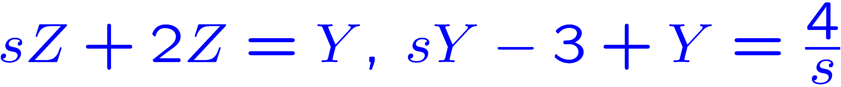
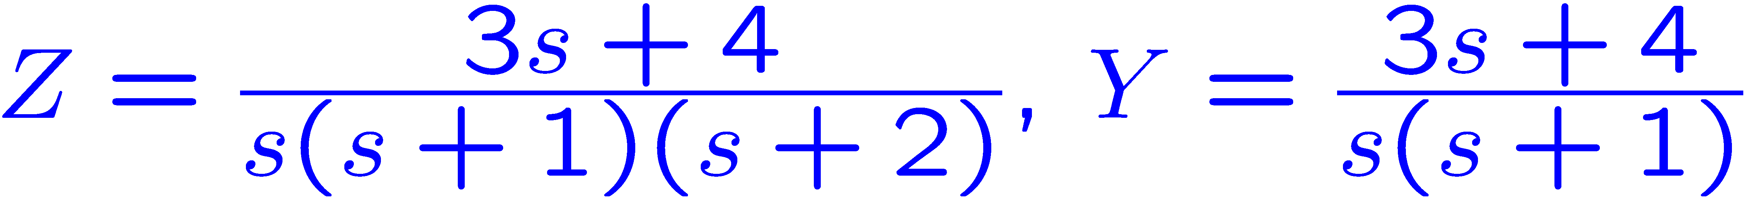
Applying the Laplace Transform
Assume a system of differential equations is given.
The Laplace transform can be applied to find the unknowns beginning with time t = 0.
Convert the equations to the Laplace domain.
Solve for the unknowns in the Laplace domain.
Apply the inverse Laplace transform to convert the result to the time domain.

Slide 7
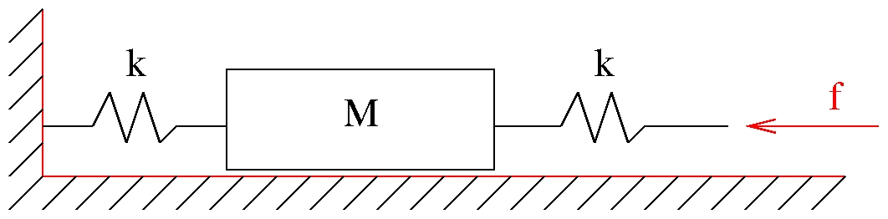
Example
All components are ideal:
No friction
Springs of zero mass
Find the displacements as a function of time.

Slide 8

Example
Given:
The initial displacement $z_{1}$and the initial velocity $v_{1}$.
The force f.
M and k.
Find the displacements as a function of time.
z₂
z₁

Slide 9
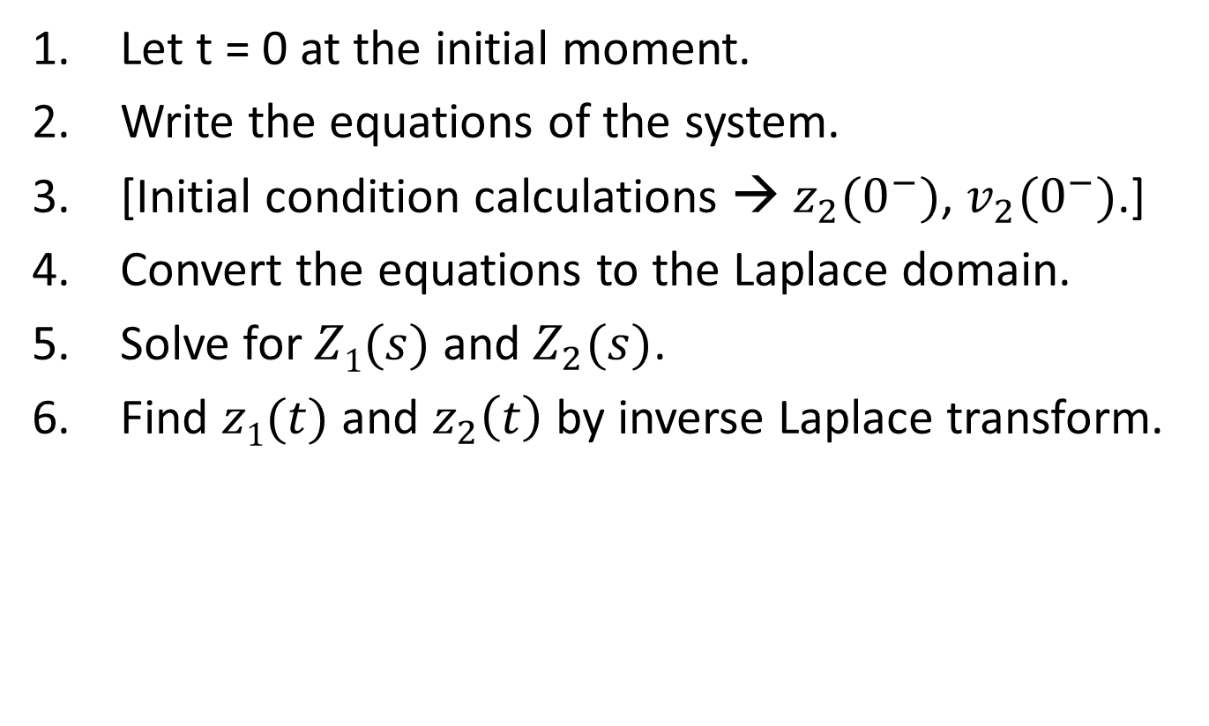
Example
Let t = 0 at the initial moment.
Write the equations of the system.
[Initial condition calculations → $z_{2}(0^{−})$, $v_{2}(0^{−})$.]
Convert the equations to the Laplace domain.
Solve for $Z1(s)$ and $Z_{2}(s)$.
Find $z1(t)$ and $z_{2}\left(t\right)$ by inverse Laplace transform.
z₂
z₁

Slide 10

Example—Initial Conditions
$f$ and $z_{1}\left(0^{−}\right)$ are given.
$$f=k\left(z_{1}−z_{2}\right)$$
$$⇒f\left(0^{−}\right)=k(z_{1}\left(0^{−}\right)−z_{2}\left(0^{−}\right))⇒z_{2}\left(0^{−}\right)=z_{1}(0^{−})−\frac{f(0^{−})}{k}$$
$$⇒\dot{f}\left(0^{−}\right)=k\left(v_{1}\left(0^{−}\right)−v_{2}\left(0^{−}\right)\right)⇒v_{2}\left(0^{−}\right)=v_{1}\left(0^{−}\right)−\frac{\dot{f}(0^{−})}{k}$$
z₂
z₁

Slide 11

Example—In the Laplace Domain
$$F=k\left(Z_{1}−Z_{2}\right)$$
$$0=Ms^{2}Z_{2}−Mv_{2}\left(0^{−}\right)−Msz_{2}\left(0^{−}\right)+kZ_{2}+k(Z_{2}−Z_{1})$$
$Z_{2}=\frac{F+Mv_{2}\left(0^{−}\right)+Msz_{2}(0^{−})}{Ms^{2}+k}$ $Z_{1}=Z_{2}+\frac{F}{k}$
z₂
z₁

Slide 12
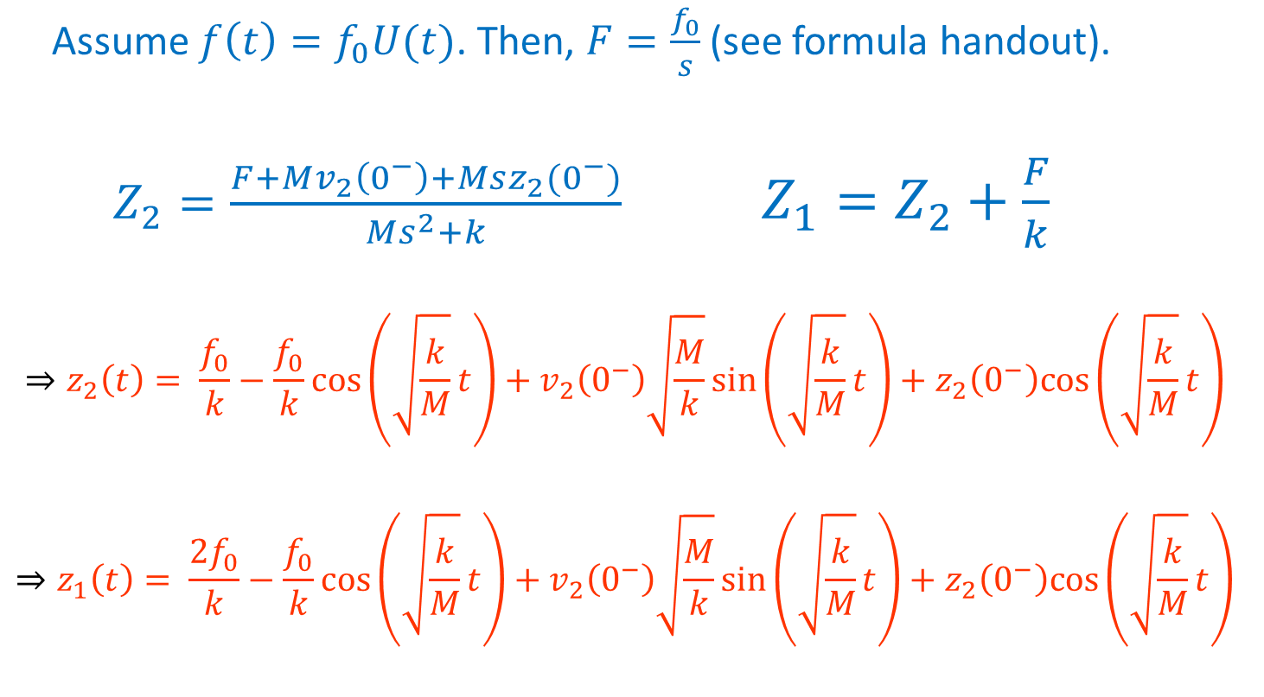
Example—Back to the Time Domain
Assume $f\left(t\right)=f_{0}U(t)$. Then, $F=\frac{f_{0}}{s}$(see formula handout).
$Z_{2}=\frac{F+Mv_{2}\left(0^{−}\right)+Msz_{2}(0^{−})}{Ms^{2}+k}$ $Z_{1}=Z_{2}+\frac{F}{k}$
$$⇒z_{2}\left(t\right)= \frac{f_{0}}{k}−\frac{f_{0}}{k}\cos\left(\sqrt{\frac{k}{M}}t\right)+v_{2}\left(0^{−}\right)\sqrt{\frac{M}{k}}\sin\left(\sqrt{\frac{k}{M}}t\right)+z_{2}\left(0^{−}\right)cos\left(\sqrt{\frac{k}{M}}t\right)⁡$$
$$⇒z_{1}\left(t\right)= \frac{{2f}_{0}}{k}−\frac{f_{0}}{k}\cos\left(\sqrt{\frac{k}{M}}t\right)+v_{2}\left(0^{−}\right)\sqrt{\frac{M}{k}}\sin\left(\sqrt{\frac{k}{M}}t\right)+z_{2}\left(0^{−}\right)cos\left(\sqrt{\frac{k}{M}}t\right)⁡$$

Slide 13
Calculating the Laplace Transform
For direct Laplace transform
Apply the formulas on the handout.
For inverse Laplace transform:
Apply partial fraction decomposition first when necessary.
Apply the formulas on the handout.

Slide 14
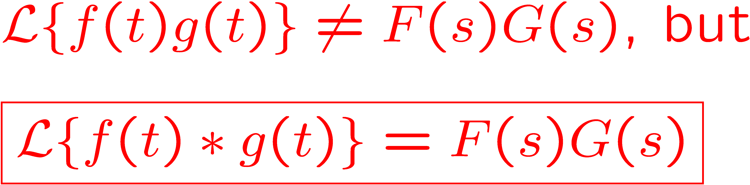
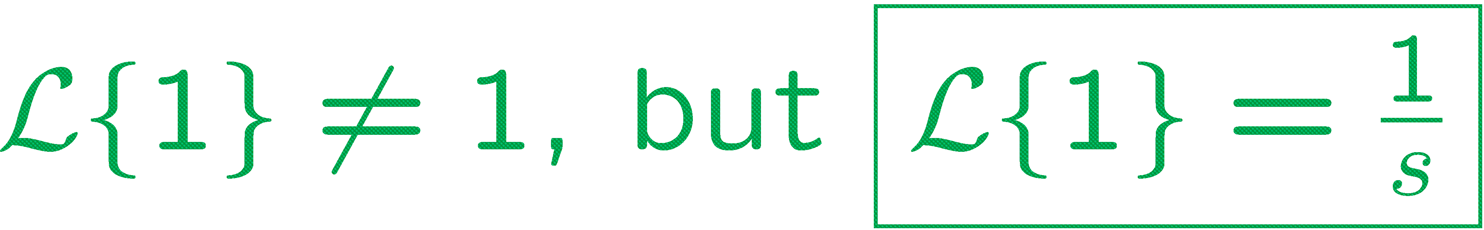
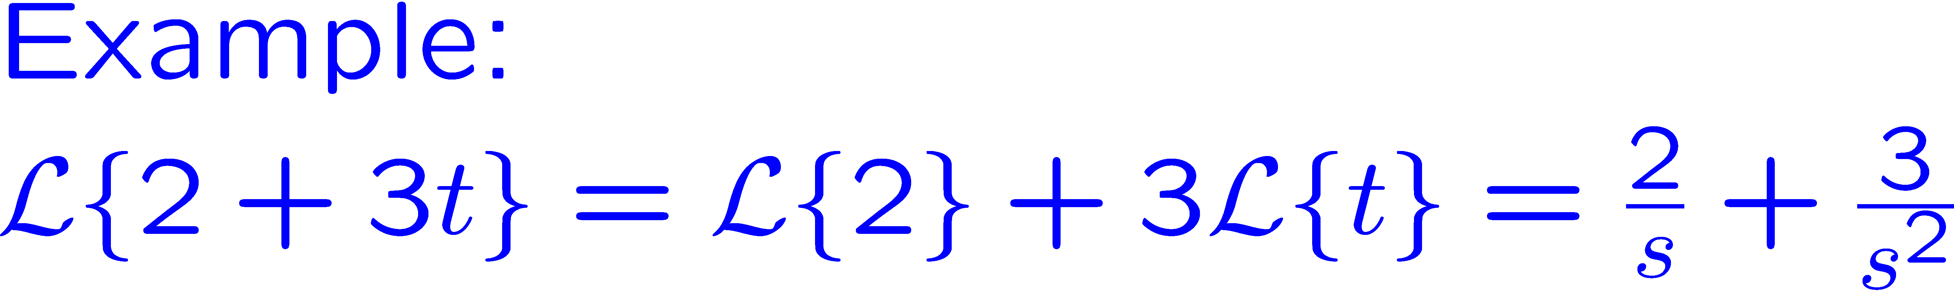
Most Common Mistakes

Slide 15
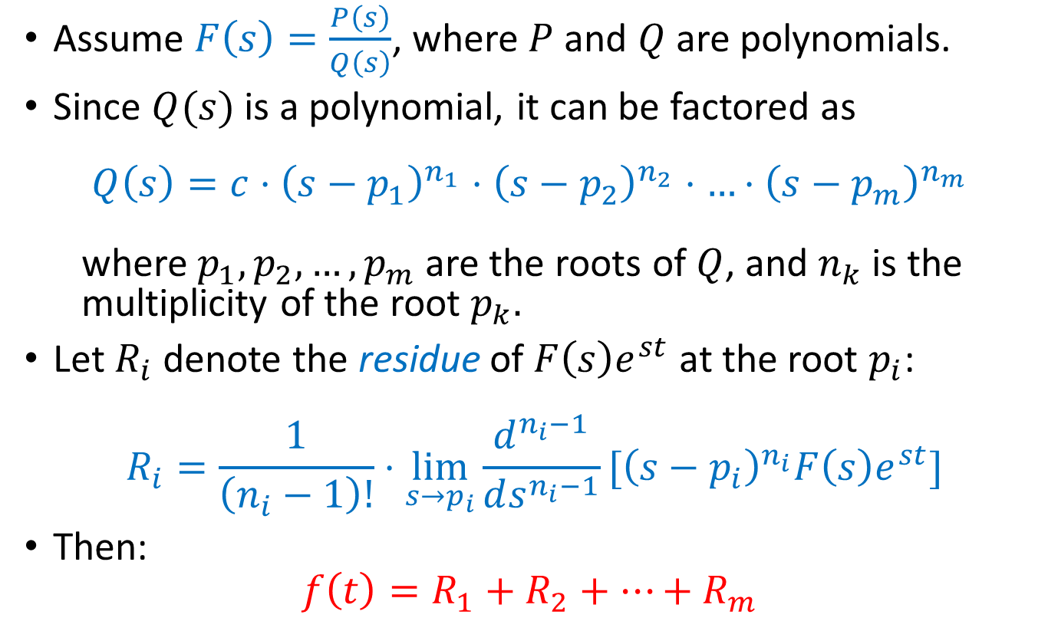
Alternative Method for Inverse LT (Optional)
Assume $F\left(s\right)=\frac{P\left(s\right)}{Q\left(s\right)}$, where $P$ and $Q$ are polynomials.
Since $Q(s)$ is a polynomial, it can be factored as
$$Q\left(s\right)=c⋅{\left(s−p_{1}\right)}^{n_{1}}⋅{\left(s−p_{2}\right)}^{n_{2}}⋅…⋅{\left(s−p_{m}\right)}^{n_{m}}$$
where $p_{1}, p_{2}, …, p_{m}$ are the roots of $Q$, and $n_{k}$ is the multiplicity of the root $p_{k}.$
Let $R_{i}$ denote the residue of $F\left(s\right)e^{st}$ at the root $p_{i}$:
$$R_{i}=\frac{1}{\left(n_{i}−1\right)!}⋅\lim_{s→p_{i}}\frac{d^{n_{i}−1}}{ds^{n_{i}−1}}[{\left(s−p_{i}\right)}^{n_{i}}F\left(s\right)e^{st}]$$
Then:
$$f\left(t\right)=R_{1}+R_{2}+…+R_{m}$$
Notes:
For a similar treatment of the inverse z-transform, see the Appendix B of K. Ogata, “Discrete-Time Control Systems”, 2nd edition.

Slide 16
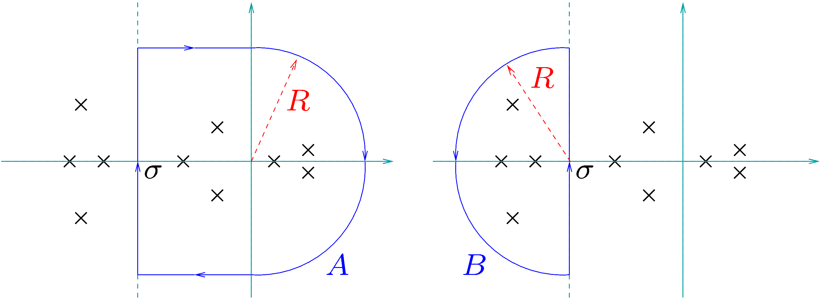

Alternative Method for Inverse LT—Justification
$$f\left(t\right)=\frac{1}{2πi}\int_{σ−i∞}^{σ+i∞}{F\left(s\right)e^{st}ds}=\frac{1}{2πi}⋅\lim_{R→∞}{\int_{σ−iR}^{σ+iR}{F\left(s\right)e^{st}ds}}$$
By Cauchy’s Theorem:
$$−\frac{1}{2πi}\int_{A}{F\left(s\right)e^{st}ds=\sum_{Re\left(p_{i}\right)>σ}{R_{i}}} and \frac{1}{2πi}\int_{B}{F\left(s\right)e^{st}ds=\sum_{Re\left(p_{i}\right)<σ}{R_{i}}}$$
The figure shows the curves A and B in the complex plane; the position of a root $p_{i}$ is marked by an x.
Notes:
Figure: presm/Residue

Slide 17

Alternative Method for Inverse LT—Justification
As $R→∞$:
The integral along the horizontal lines vanishes.
If $t<0$, the integral along the semicircle of A vanishes.
If $t>0$, the integral along the semicircle of B vanishes.

Slide 18

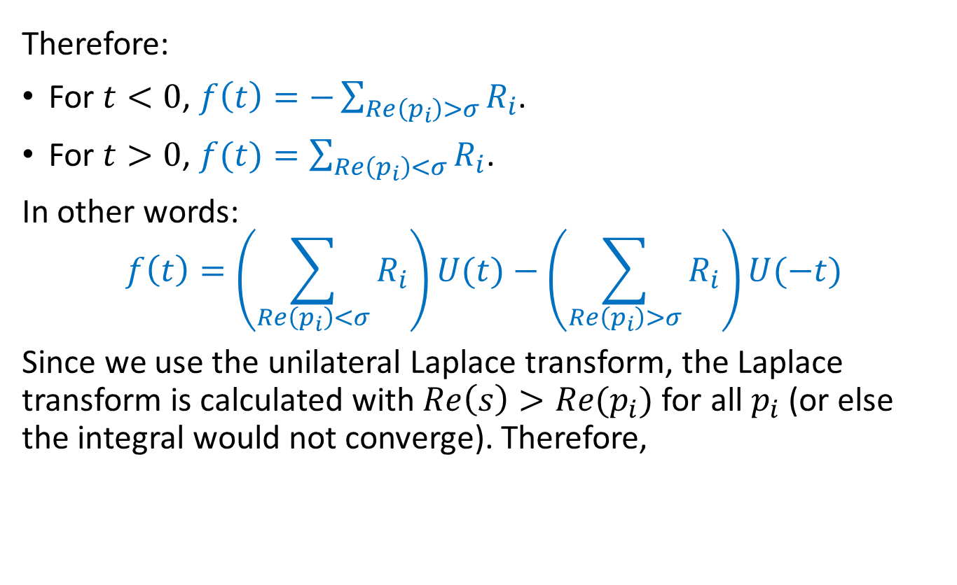
Alternative Method for Inverse LT—Justification
Therefore:
For $t<0$, $f\left(t\right)=−\sum_{Re\left(p_{i}\right)>σ}{R_{i}}$.
For $t>0$, $f(t)=\sum_{Re\left(p_{i}\right)<σ}{R_{i}}$.
In other words:
$$f\left(t\right)=\left(\sum_{Re\left(p_{i}\right)<σ}{R_{i}}\right)U(t)−\left(\sum_{Re\left(p_{i}\right)>σ}{R_{i}}\right)U(−t)$$
Since we use the unilateral Laplace transform, the Laplace transform is calculated with $Re\left(s\right)>Re(p_{i})$ for all $p_{i}$ (or else the integral would not converge). Therefore,
$$f\left(t\right)=\left(R_{1}+R_{2}+…+R_{m}\right)U(t)$$

Slide 19
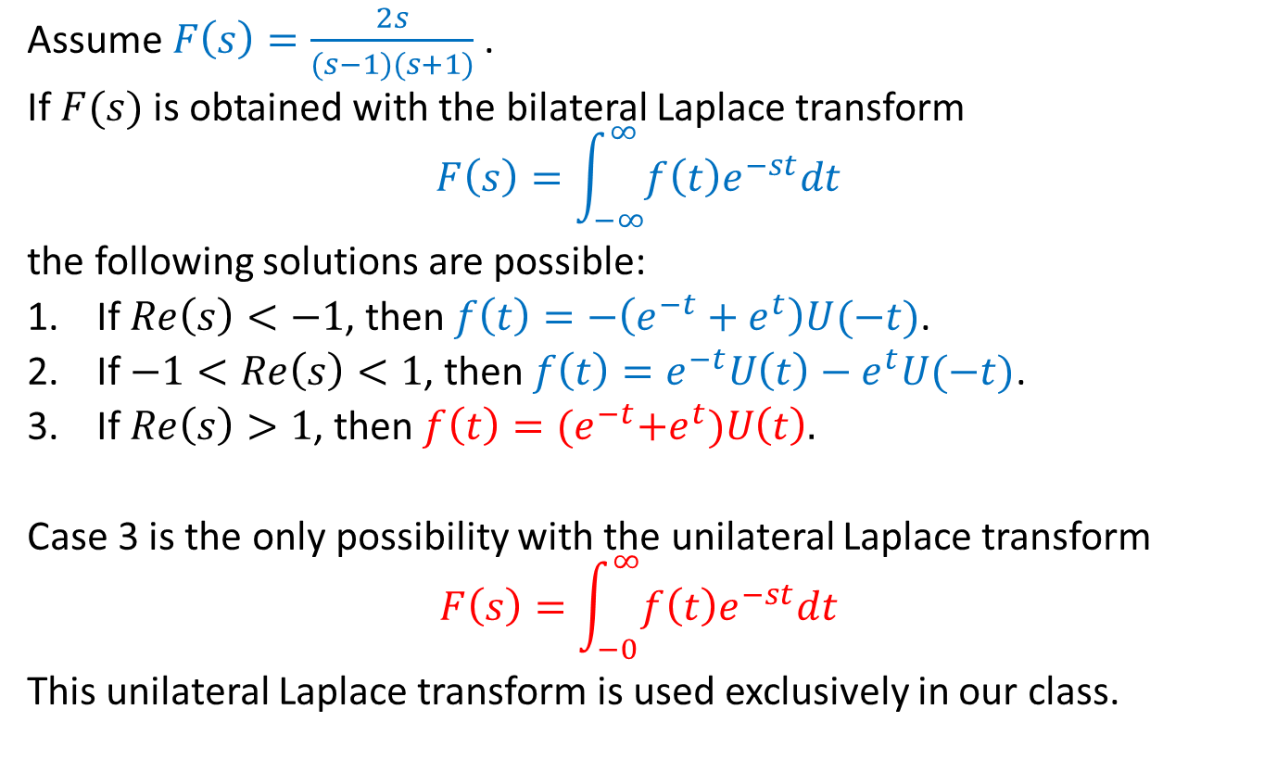
Alternative Method for Inverse LT—Example
Assume $F\left(s\right)=\frac{2s}{(s−1)(s+1)}$.
If $F(s)$ is obtained with the bilateral Laplace transform
$$F\left(s\right)=\int_{−∞}^{∞}{f\left(t\right)e^{−st}dt}$$
the following solutions are possible:
If $Re\left(s\right)<−1$, then $f\left(t\right)=−\left(e^{−t}+e^{t}\right)U(−t)$.
If $−1<Re\left(s\right)<1$, then $f\left(t\right)=e^{−t}U\left(t\right)−e^{t}U(−t)$.
If $Re\left(s\right)>1$, then $f\left(t\right)={(e}^{−t}+e^{t})U\left(t\right).$
Case 3 is the only possibility with the unilateral Laplace transform
$$F\left(s\right)=\int_{−0}^{∞}{f\left(t\right)e^{−st}dt}$$
This unilateral Laplace transform is used exclusively in our class.

