Slide 1
Controller Design for Steady-State Error Specifications
Compensating Error. Anti-Windup Control.
M.V. Iordache, EEGR3523 Mechatronics, Spring 2021, LeTourneau University

Slide 2
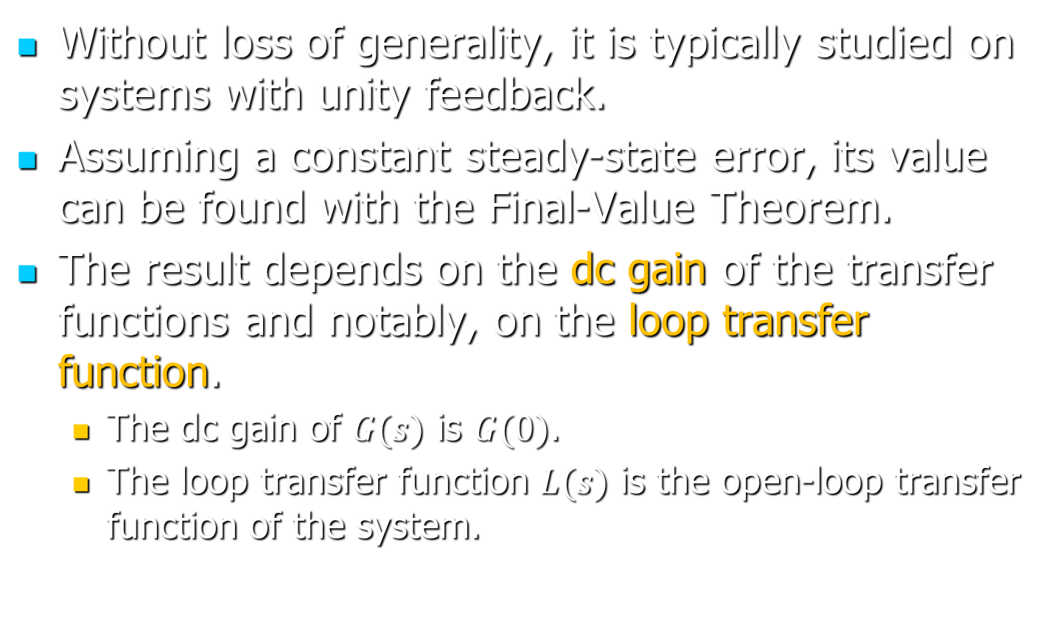
The Steady-State Error
Without loss of generality, it is typically studied on systems with unity feedback.
Assuming a constant steady-state error, its value can be found with the Final-Value Theorem.
The result depends on the dc gain of the transfer functions and notably, on the loop transfer function.
  The dc gain of $G(s)$ is $G(0)$.
  The loop transfer function $L(s)$ is the open-loop transfer function of the system.

Slide 3
The Steady-State Error
The steady-state error is zero when the system is stable and either:
  The input has no poles outside of the LHP.
  The closed-loop TF cancels the poles of the input that are outside of the LHP (Internal Model Principle).

Slide 4

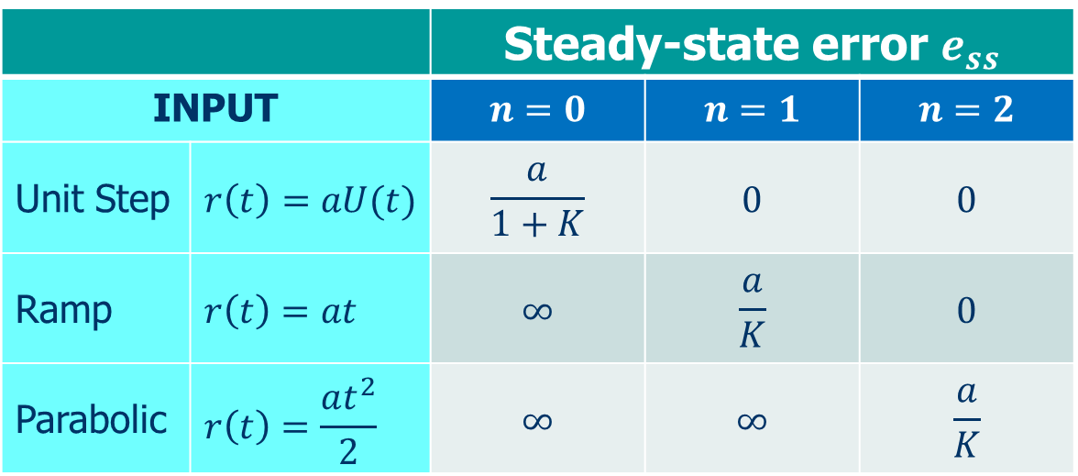
The Steady-State Error
In a type-$n$ system $L(s)$ has $n$ poles at 0.
  The definition is for systems with unity dc gain feedback.
  The steady-state error depends on the input and the error constant $K=\lim_{s→0} s^{n}L(s)$.
 |  | Steady-state error $e_{ss}$
INPUT |  | $$n=0$$ | $$n=1$$ | $$n=2$$
Unit Step | $$r\left(t\right)=aU(t)$$ | $$\frac{a}{1+K}$$ | $$0$$ | $$0$$
Ramp | $$r\left(t\right)=at$$ | $$∞$$ | $$\frac{a}{K}$$ | $$0$$
Parabolic | $$r\left(t\right)=\frac{at^{2}}{2}$$ | $$∞$$ | $$∞$$ | $$\frac{a}{K}$$

Slide 5
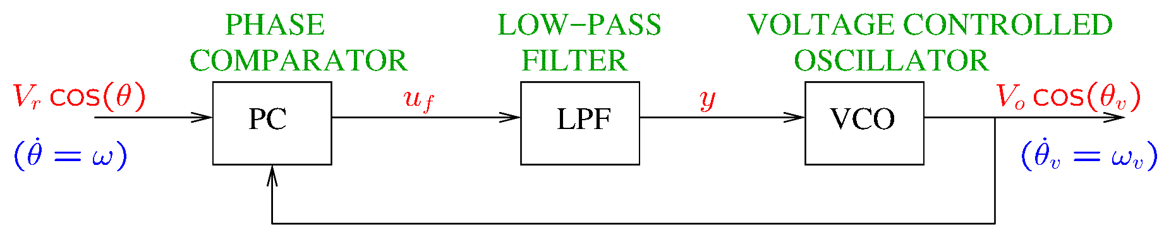
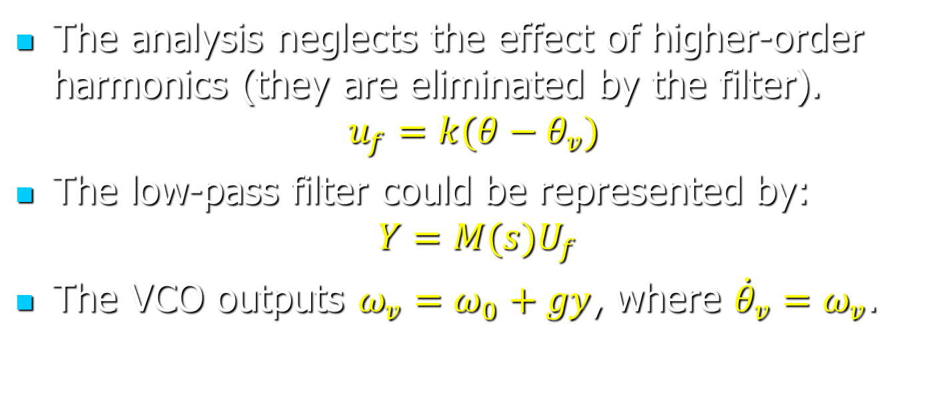
Example: Phase-Locked Loop
The analysis neglects the effect of higher-order harmonics (they are eliminated by the filter).
$$u_{f}=k(θ−θ_{v})$$
The low-pass filter could be represented by:
$$Y=M(s)U_{f}$$
The VCO outputs $ω_{v}=ω_{0}+gy$, where ${\dot{θ}}_{v}=ω_{v}$.

Slide 6
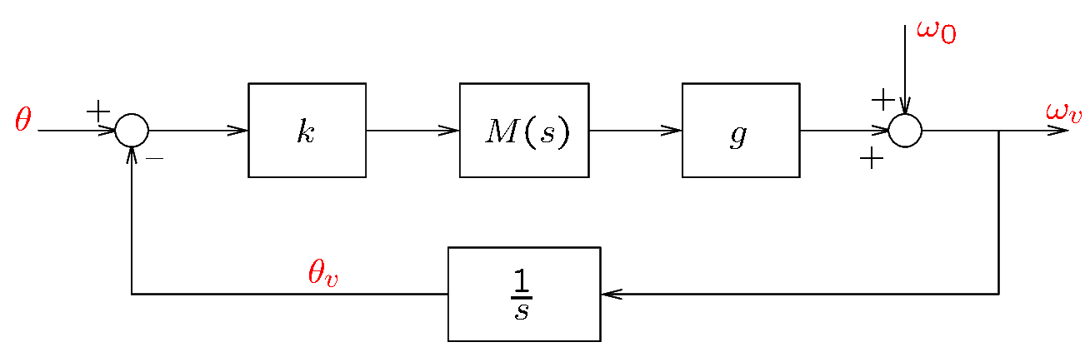
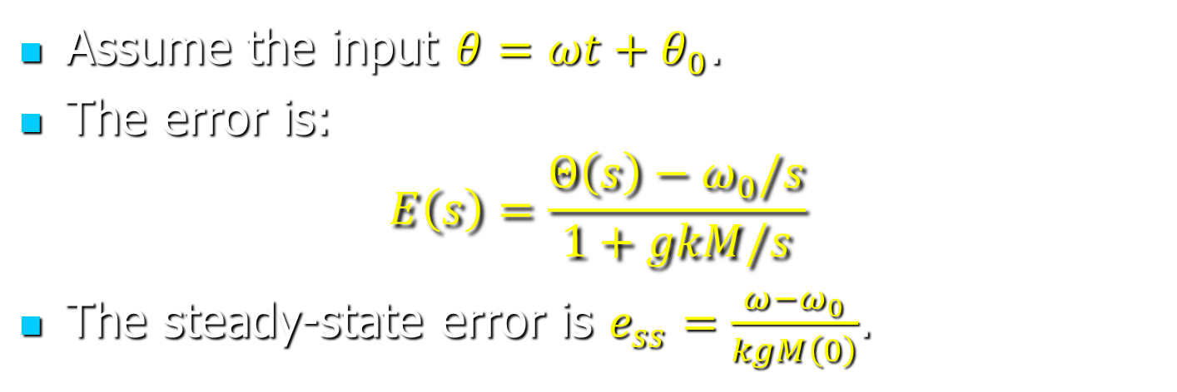
Example: Phase-Locked Loop
Assume the input $θ=ωt+θ_{0}$.
The error is:
$$E\left(s\right)=\frac{Θ\left(s\right)−ω_{0}/s}{1+gkM/s}$$
The steady-state error is $e_{ss}=\frac{ω−ω_{0}}{kgM\left(0\right)}$.

Slide 7
The Steady-State Error
A constant non-zero error could be corrected by pre-multiplying the input with a constant gain. However:
  This is not a robust solution: system parameters can change somewhat in time.
  This will not compensate disturbances.
Sources of disturbances:
  Unknown inputs from the environment (e.g. wind, temperature)
  Modeling errors (e.g. linearization error)
  Unmodeled phenomena (e.g. friction)

Slide 8
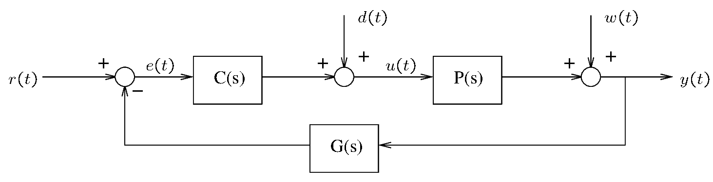
The Steady-State Error
Error is affected by disturbances.
Disturbances can be modeled as
  Output disturbances
  Input disturbances

Slide 9
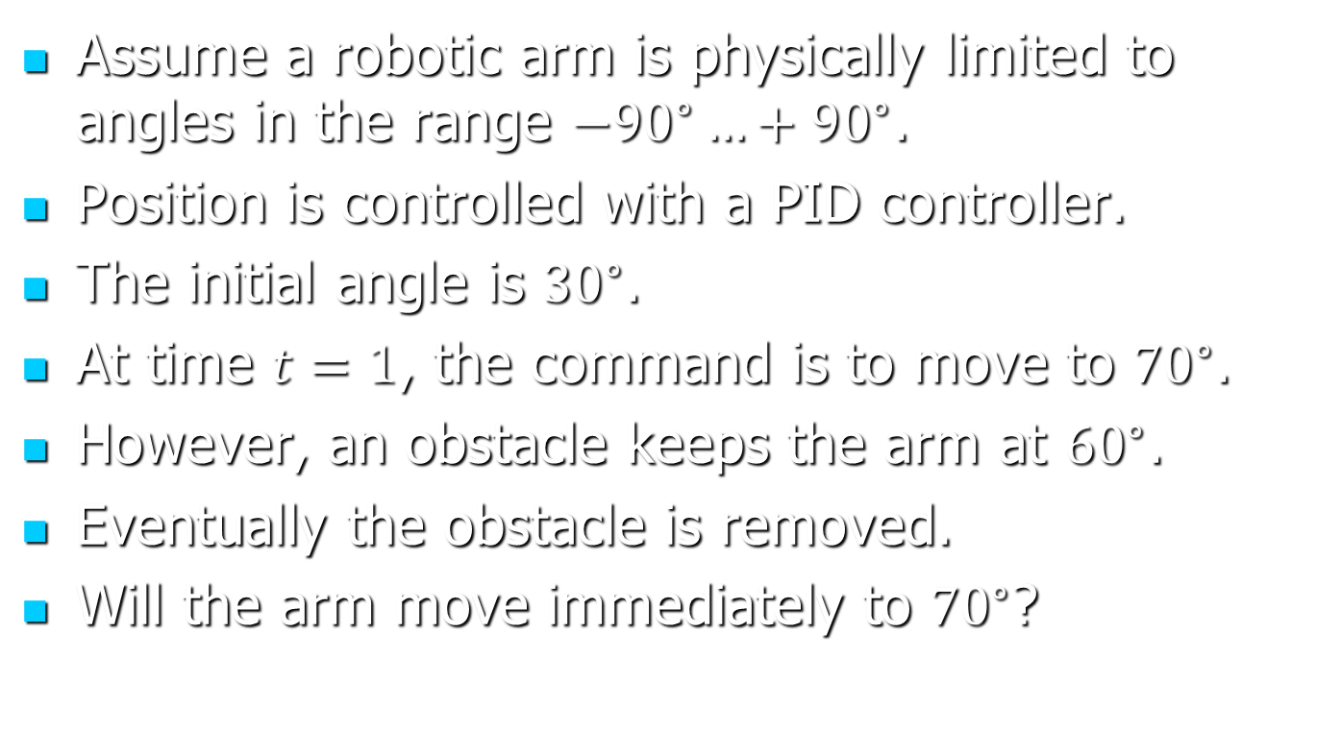
Implementation—Example
Assume a robotic arm is physically limited to angles in the range $−{90}^{∘}…+{90}^{∘}$.
Position is controlled with a PID controller.
The initial angle is ${30}^{∘}$.
At time $t=1$, the command is to move to ${70}^{∘}$.
However, an obstacle keeps the arm at ${60}^{∘}$.
Eventually the obstacle is removed.
Will the arm move immediately to ${70}^{∘}$?

Slide 10
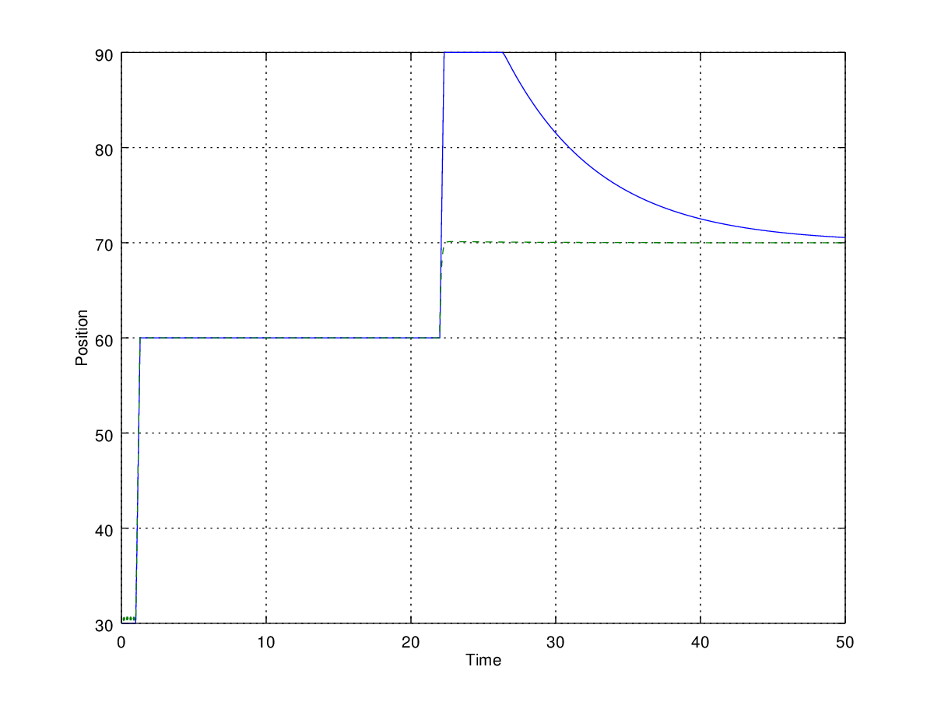
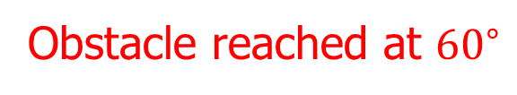
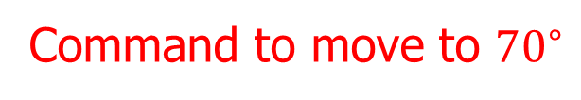
Implementation—Example
Actual curve
Obstacle removed
Expected curve
Obstacle reached at ${60}^{∘}$
Command to move to ${70}^{∘}$
Notes:
antiwindup1.png, windupdemo.m

Slide 11
Anti-Windup Control
In the example, the problem is caused by integrator windup (also known as reset windup).
The solution is to use an anti-windup method.
In general, anti-windup control is necessary due to actuator saturation.

Slide 12
Anti-Windup Control by Clamping
Set a low and a high limit for the control signal.
Use regular PID control as long as the control signal is within the set limits.
Disable integration when integration would make the control signal go further beyond the set limits.
In this way integration is enabled only when needed (when the error is reasonably small and can be corrected).

