Slide 1
Introduction. System Modeling.
Electrical and Mechanical Components. Motion Mechanisms. Laplace Domain Equations.
M.V. Iordache, EEGR3523 Mechatronics, Spring 2021, LeTourneau University

Slide 2
Mechatronics—Introduction
What is Mechatronics?
At a first glance:
Mechanics + Electronics → Mechatronics
Mechatronics: The introduction of electronic controls into mechanical components. (Web definition)

Slide 3
Mechatronic designs involve:
Mechanical systems
Electrical systems
Actuators (such as motors)
Sensors
Control systems
  Implemented in software and/or hardware

Slide 4
The design approach of Mechatronics:
Subsystems of different nature (such as electrical and mechanical) are designed together, rather than independently.
Manufacturing considered also at design time.

Slide 5
Topics
Modeling of mechanical and electrical systems
Mathematical models
  Provide a common representation of systems of different nature.
  Transfer functions, state space models, block diagrams.
System response
  Describes how variables change in time.
  Simulation.
Control systems
  Control algorithms that guarantee the system response to satisfy stability, time, and error specifications.
  PID control.
Actuators
  Electric machines (motors and generators).

Slide 6
System Models
A first step in the mathematical modeling of systems is obtaining a simplified model in terms of elementary mechanical and electrical components.
Simplified mechanical models involve:
  Blocks, springs, dampers, …
Simplified electrical models involve:
  Resistors, inductors, capacitors, dependent sources, …
For a summary of mechanical and electrical components, see the models.pdf handout.

Slide 7
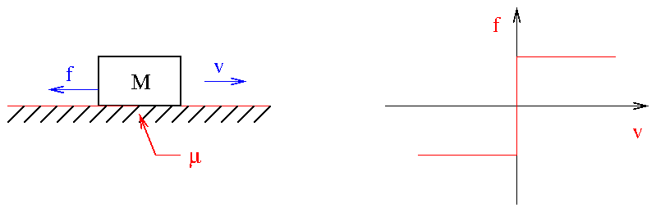

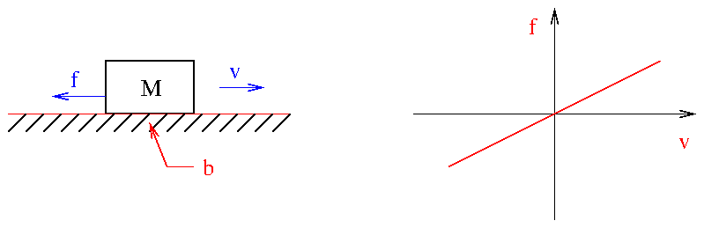

Mechanical Modeling—Friction
Coulomb or dry friction.
Viscous friction (for lubricated surfaces).

Slide 8
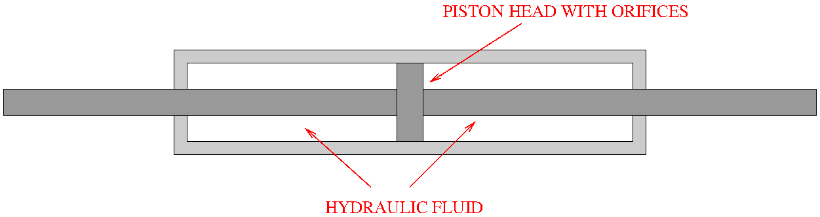
How to make a damper …
A damper resembles a shock absorber.
A shock absorber might not operate according to the same linear equation.

Slide 9
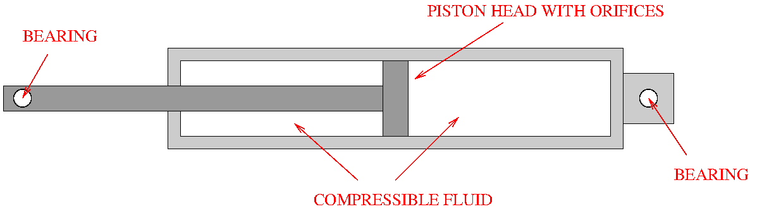
How to make a damper …
The figure illustrates the principle of a damper or shock absorber.
Not only friction, but also compression/extension due to stem volume.
Various enhancements possible.

Slide 10
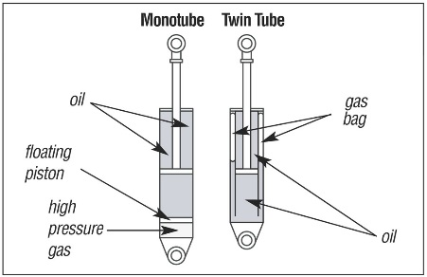
Shock absorbers
From https://en.wikipedia.org/wiki/Shock_absorber#/media/File:Shock_Absorbers_Detail.jpg
Downloaded on June 3, 2016. Public domain. Author: http://www.hyperracing.com/

Slide 11
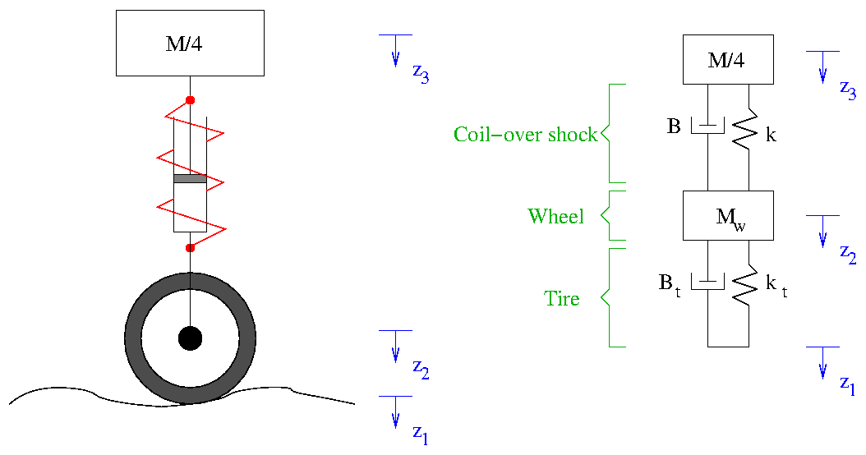
System Models -- Example
A first step in the mathematical modeling of systems is obtaining a simplified model in terms of elementary mechanical and electrical components.

Slide 12
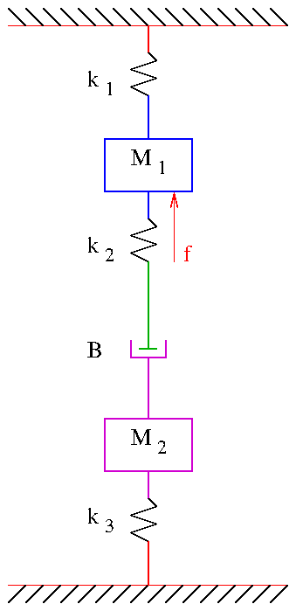
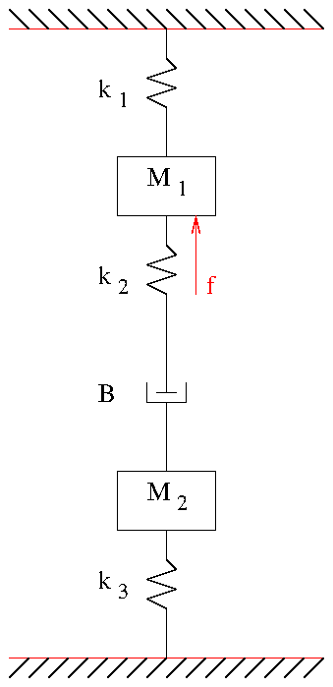
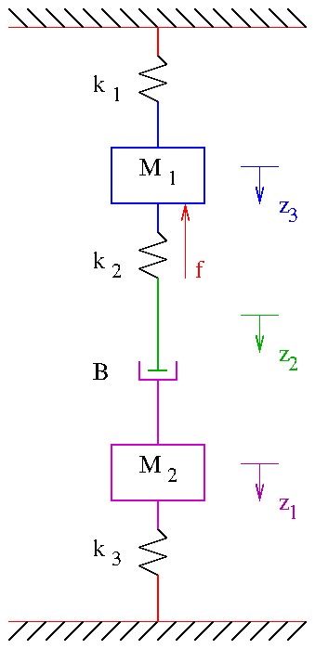
Writing the Equations …
Identify the rigid parts of the system.
Associate a displacement variable to each moving part.
  For simplicity, use the same direction for all variables.
Each displacement variable will have one equation.

Slide 13
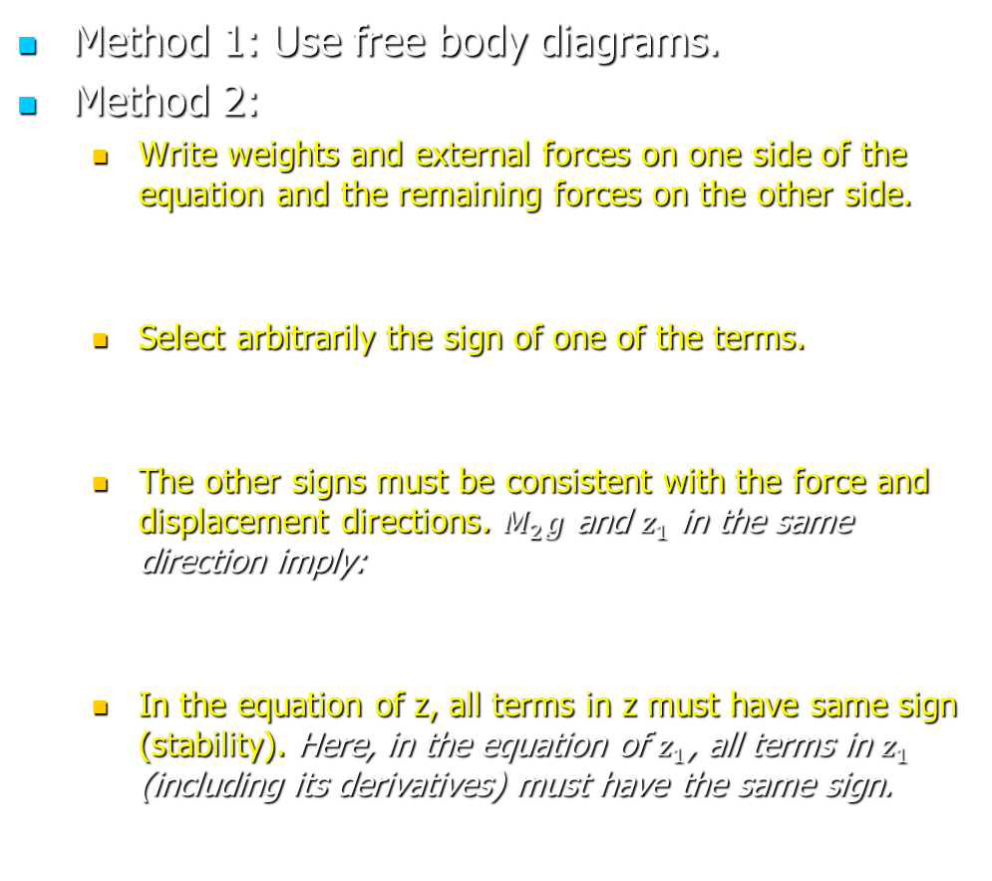
Writing the Equations …
Method 1: Use free body diagrams.
Method 2:
  Write weights and external forces on one side of the equation and the remaining forces on the other side.
  Select arbitrarily the sign of one of the terms.
  The other signs must be consistent with the force and displacement directions. $M_{2}g$ and $z_{1}$ in the same direction imply:
  In the equation of z, all terms in z must have same sign (stability). Here, in the equation of $z_{1}$, all terms in $z_{1}$ (including its derivatives) must have the same sign.

Slide 14
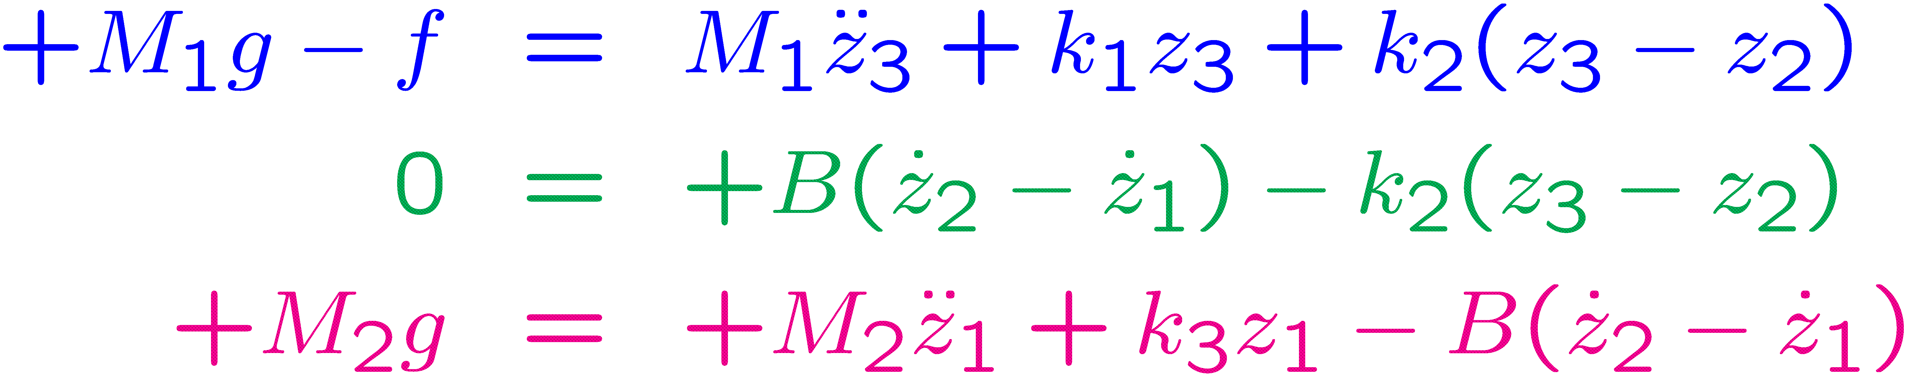
Writing the Equations …
There will be one equation for each displacement variable:

Slide 15
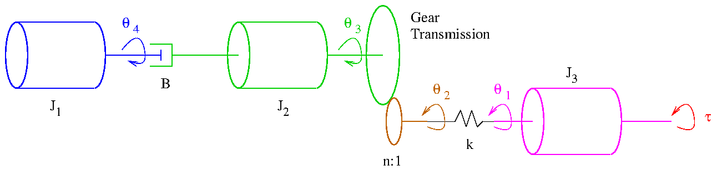
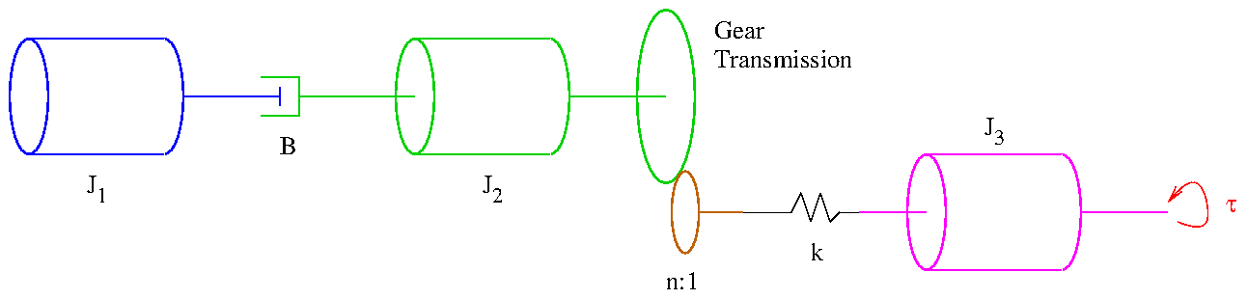
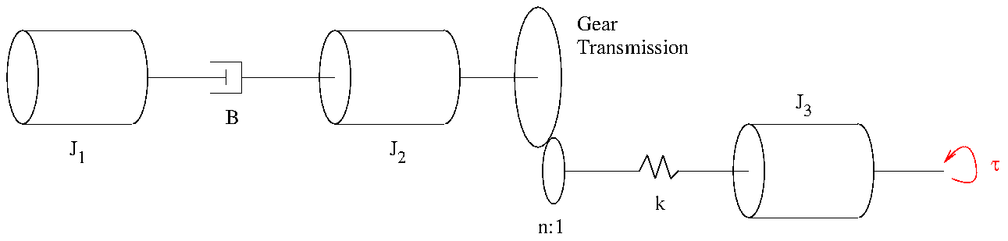
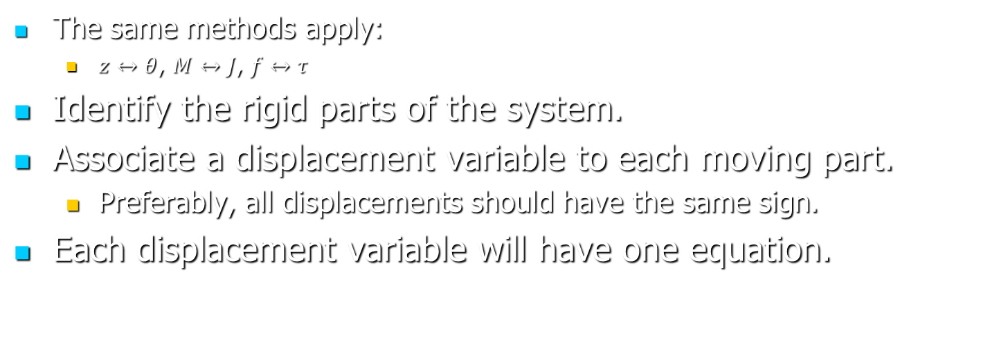
Rotatory Systems
The same methods apply:
  $z↔θ$, $M↔J$, $f↔τ$
Identify the rigid parts of the system.
Associate a displacement variable to each moving part.
  Preferably, all displacements should have the same sign.
Each displacement variable will have one equation.

Slide 16
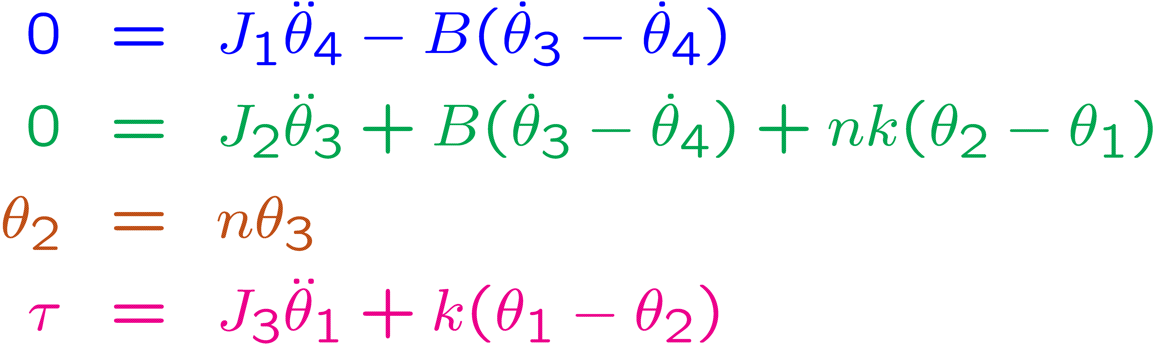

Writing the Equations …
There will be one equation for each displacement variable:
In the equation of $θ$ all terms in $θ$ must have the same sign.
  In the equation of $θ_{3}$ all terms in $θ_{3}$ have the same sign. This remains true after substituting $θ_{2}=nθ_{3}$.
The gear ratio n
modifies both torque
and displacement.

Slide 17
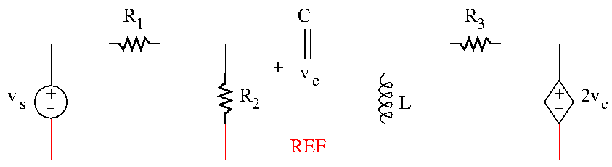
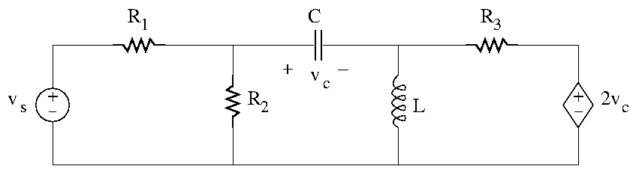
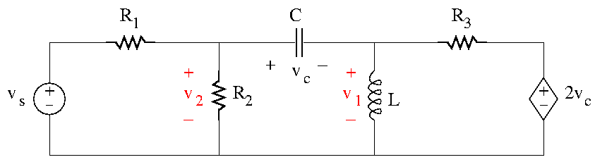
Electrical Systems
Nodal analysis recommended.
  Select reference node.
  Mark unknown nodal voltages.
  Write KCL for each node of unknown voltage.
  Substitute the current of each circuit element using the element equation.

Slide 18
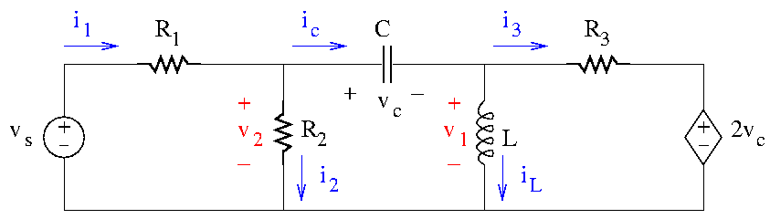
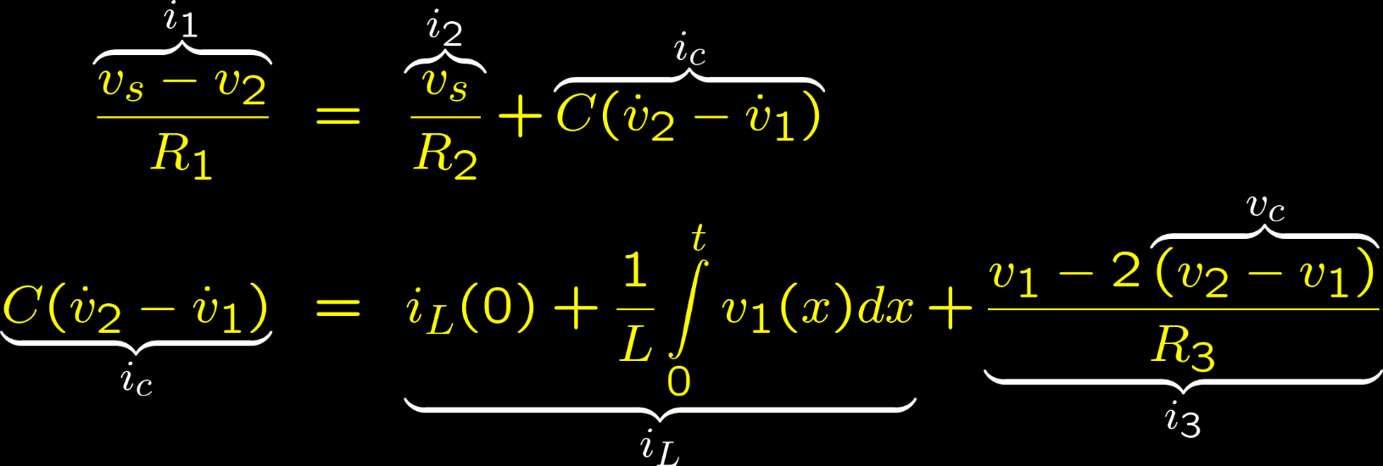
Writing the Equations …
Write KCL for each node of unknown voltage.
Substitute the current of each circuit element using the element equation.

Slide 19
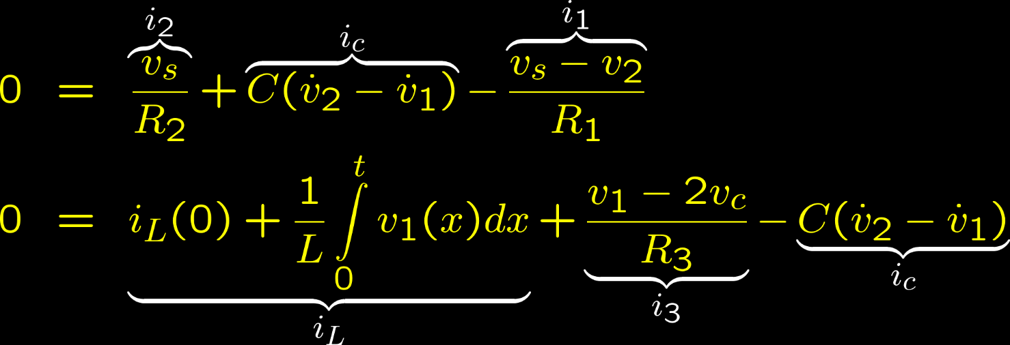
Signs …
In the equation of the node of voltage v, before substituting dependent source expressions, if all terms in v are written on the same side of the equation, they have the same sign.

Slide 20
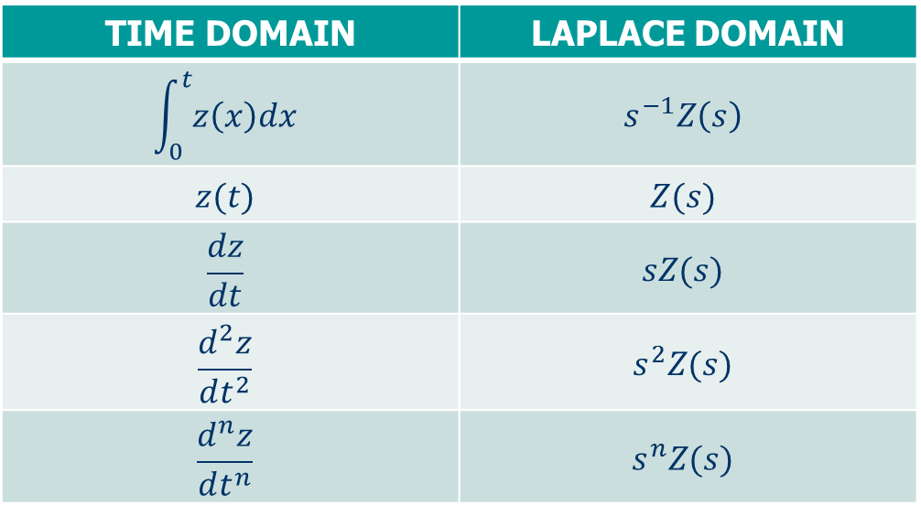
Laplace Domain Equations
Models → systems of differential equations.
Differential equations can be studied in the Laplace domain.
The Laplace transform substitutes functions of time f(t) with functions F(s) that depend on the Laplace variable s.
With zero initial conditions, the following substitutions apply.
TIME DOMAIN | LAPLACE DOMAIN
$$\int_{0}^{t}{z\left(x\right)dx}$$ | $$s^{−1}Z\left(s\right)$$
$$z(t)$$ | $$Z(s)$$
$$\frac{dz}{dt}$$ | $$sZ(s)$$
$$\frac{d^{2}z}{dt^{2}}$$ | $$s^{2}Z(s)$$
$$\frac{d^{n}z}{dt^{n}}$$ | $$s^{n}Z(s)$$

Slide 21

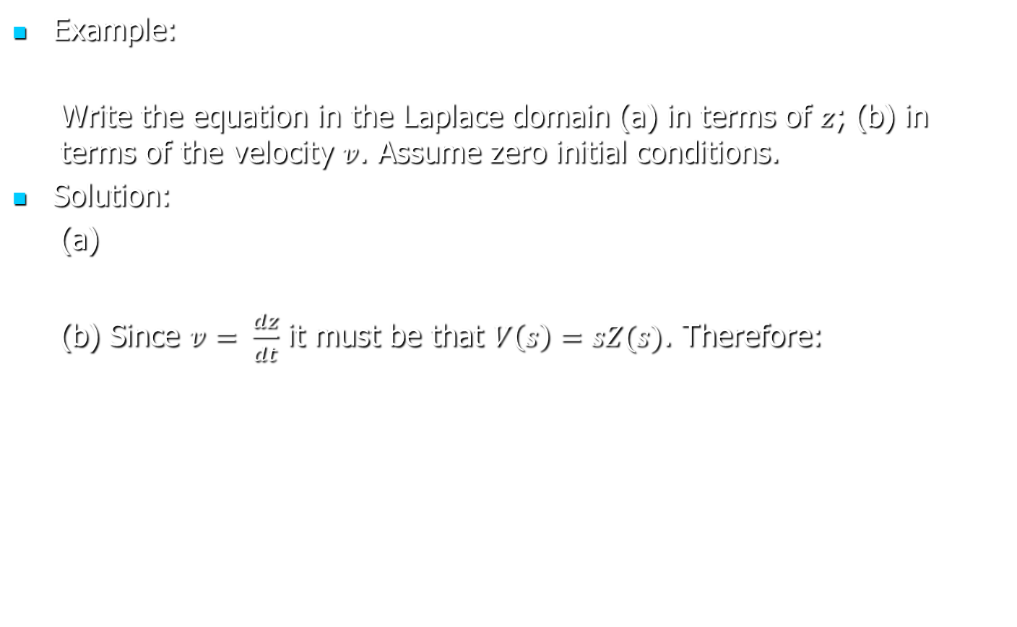
Laplace Domain Equations
Example:
  Write the equation in the Laplace domain (a) in terms of $z$; (b) in terms of the velocity $v$. Assume zero initial conditions.
Solution:
  (a)
  (b) Since $v= \frac{dz}{dt}$ it must be that $V\left(s\right)=sZ(s)$. Therefore:

Slide 22
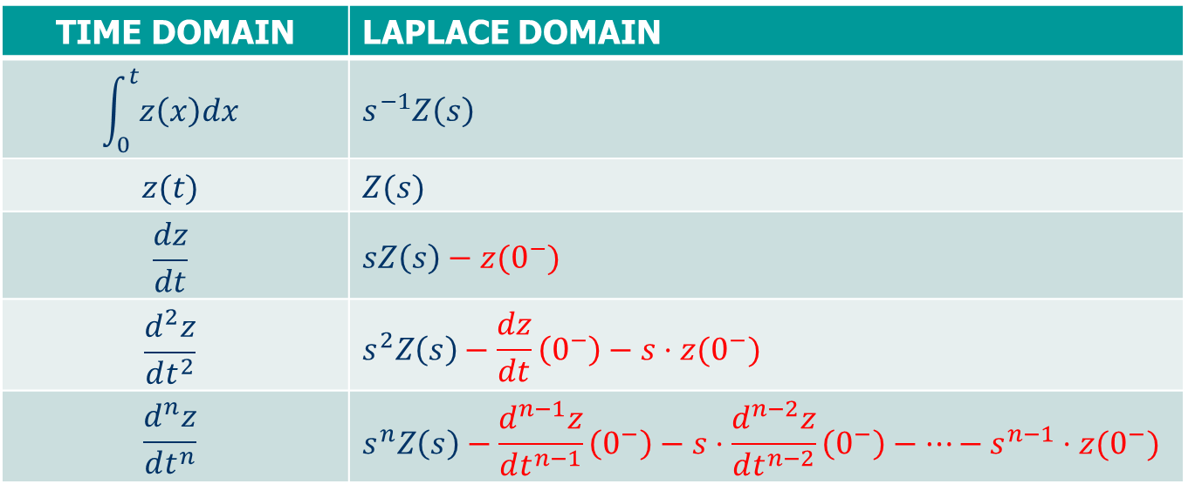
Laplace Domain Equations
With nonzero initial conditions, the following substitutions apply.
TIME DOMAIN | LAPLACE DOMAIN
$$\int_{0}^{t}{z\left(x\right)dx}$$ | $$s^{−1}Z\left(s\right)$$
$$z(t)$$ | $$Z(s)$$
$$\frac{dz}{dt}$$ | $$sZ\left(s\right)−z(0^{−})$$
$$\frac{d^{2}z}{dt^{2}}$$ | $$s^{2}Z\left(s\right)−\frac{dz}{dt}\left(0^{−}\right)−s⋅z(0^{−})$$
$$\frac{d^{n}z}{dt^{n}}$$ | $$s^{n}Z\left(s\right)−\frac{d^{n−1}z}{dt^{n−1}}\left(0^{−}\right)−s⋅\frac{d^{n−2}z}{dt^{n−2}}\left(0^{−}\right)−…−s^{n−1}⋅z(0^{−})$$

Slide 23
Laplace Domain Equations
Example:
  Write the equation in the Laplace. Assume nonzero initial conditions.
Solution:

Slide 24
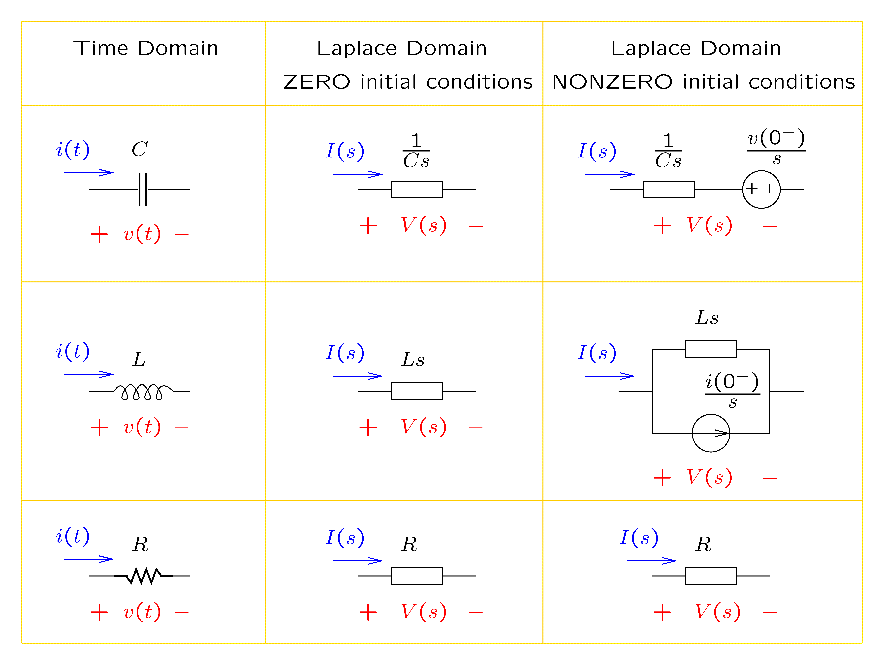
Circuits in the Laplace Domain

Slide 25
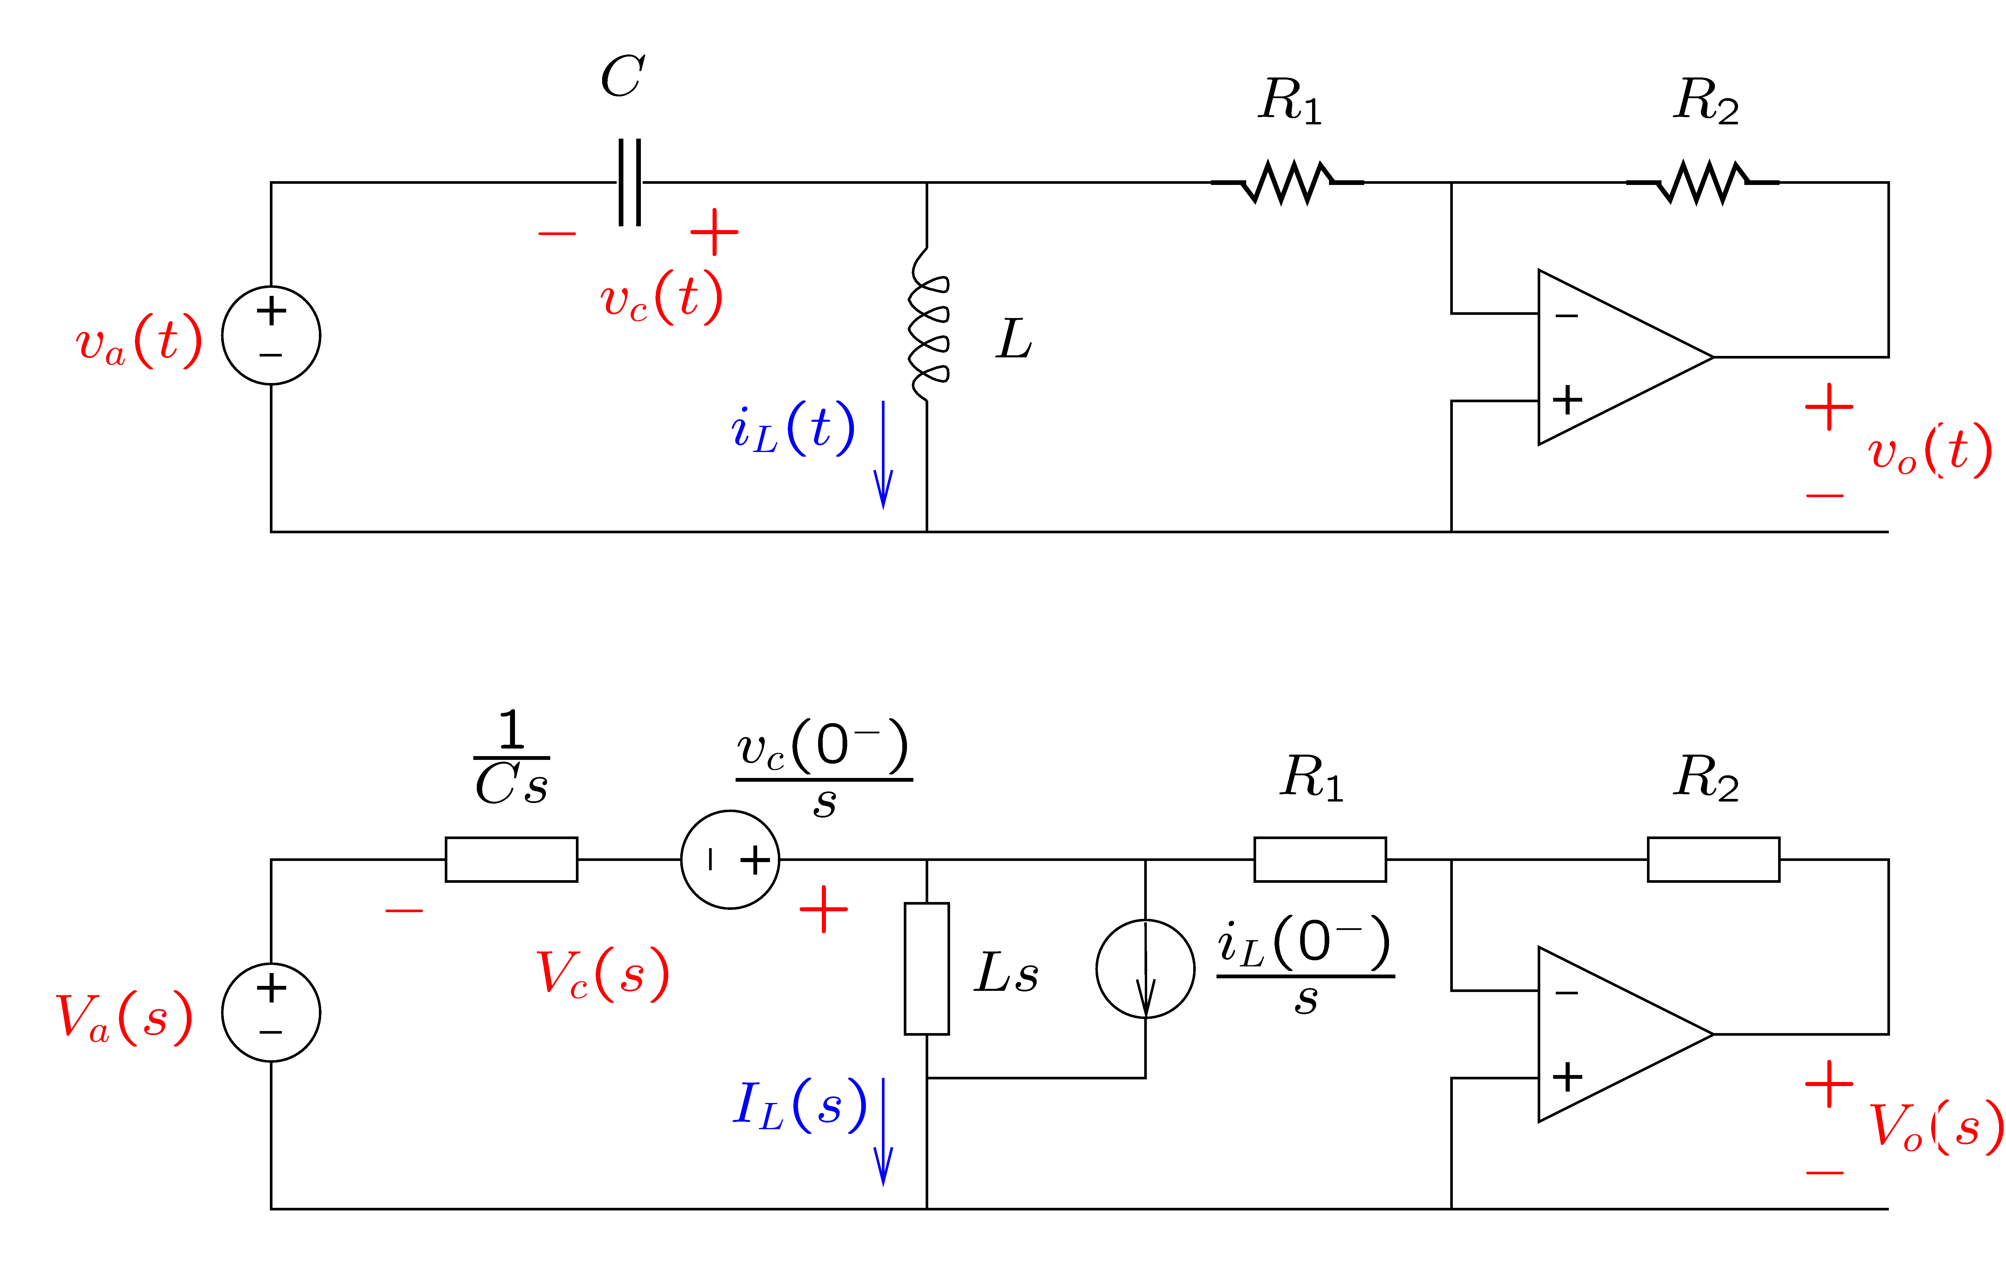
Impedance Diagrams
Impedance diagrams represent electric circuits in the Laplace domain.

Slide 26
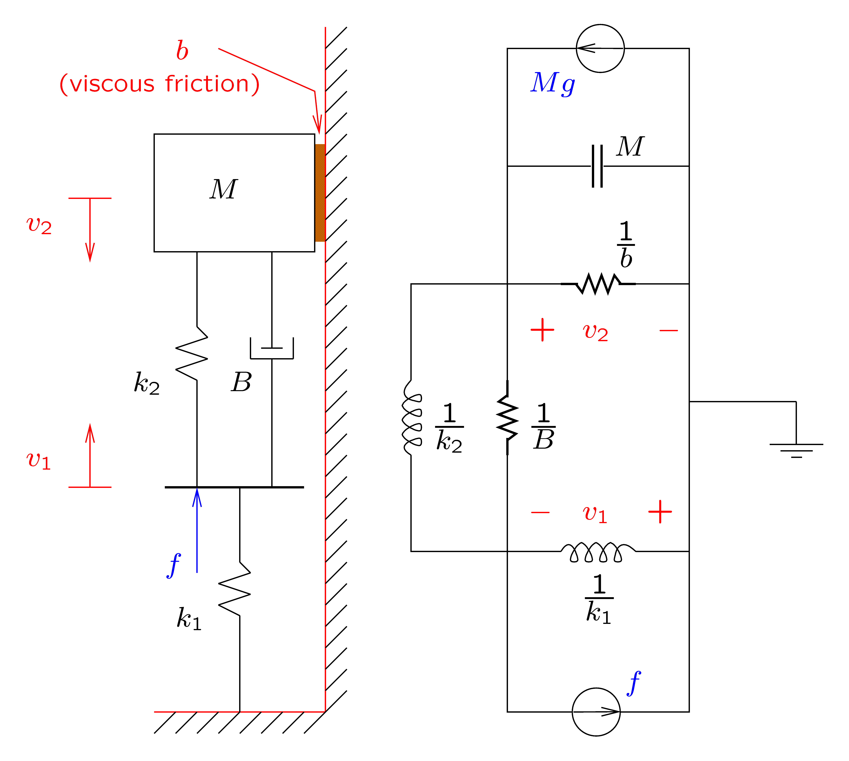
Analogies
Electric analogy of mechanical systems:
  M → C
  k → 1/L
  B → 1/R
  f → i
  v → v.

Slide 27
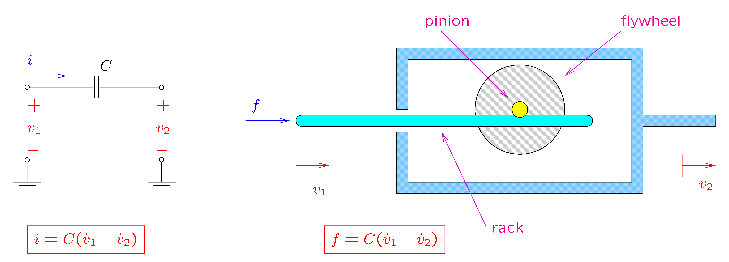
Impedance Diagrams
Impedance diagrams applied also to mechanical systems, using the electric system analogy:
  M → C, k → 1/L, B → 1/R, f → i, and v → v.
A block is represented by a ground connected capacitor.
Mechanical equivalent of an ungrounded capacitor: the inerter (invented by Prof. Malcolm C. Smith).

Slide 28
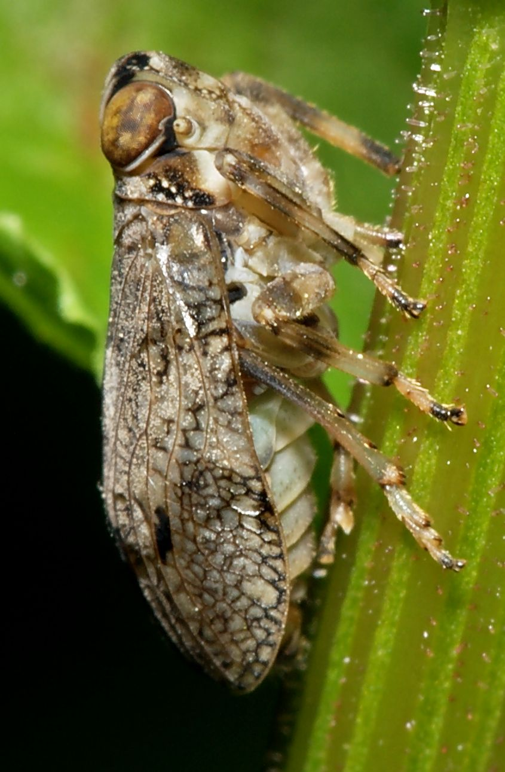
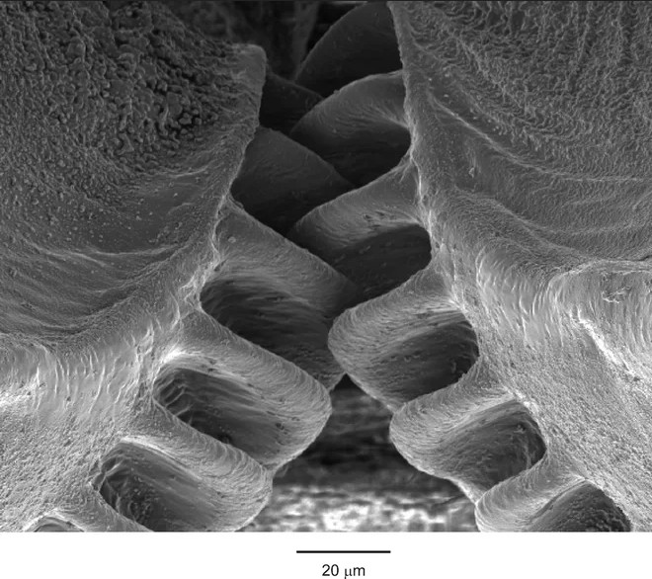
Motion Mechanisms
Gear transmission in creation.
Sarefo, Issus.coleoptratus.1, CC BY-SA 4.0
University of Cambridge (Profs. Malcolm Burrows & Gregory Sutton), Interactive gears in the hind legs of Issus coleoptratus from Cambridge gears-3, CC BY-SA 3.0

Slide 29
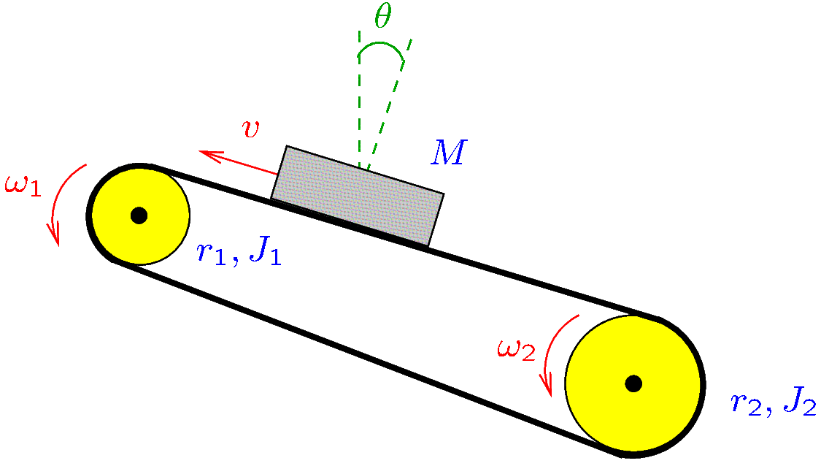
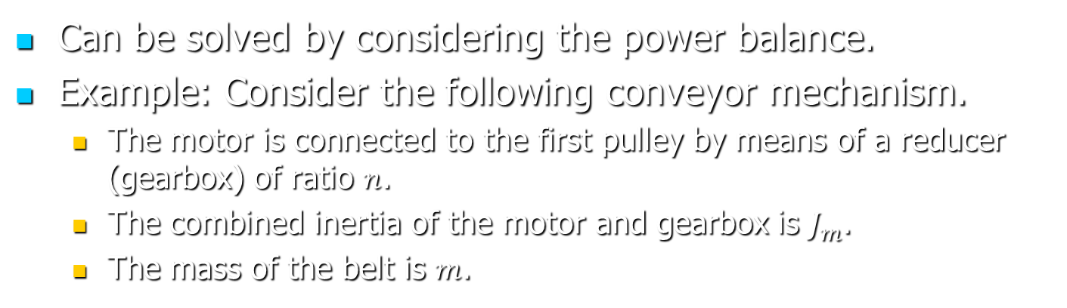
Motion Mechanisms
Can be solved by considering the power balance.
Example: Consider the following conveyor mechanism.
  The motor is connected to the first pulley by means of a reducer (gearbox) of ratio $n$.
  The combined inertia of the motor and gearbox is $J_{m}$.
  The mass of the belt is $m$.

Slide 30
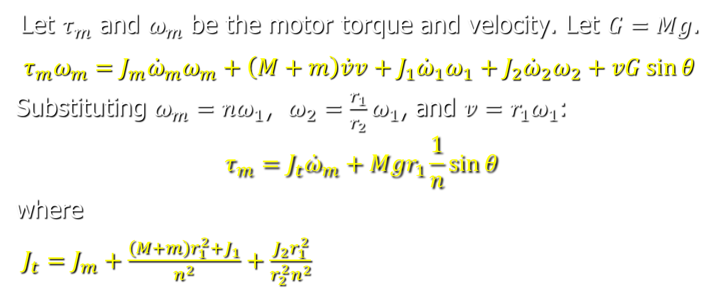
Motion Mechanisms
Let $τ_{m}$ and $ω_{m}$ be the motor torque and velocity. Let $G=Mg$.
$$τ_{m}ω_{m}=J_{m}{\dot{ω}}_{m}ω_{m}+\left(M+m\right)\dot{v}v+J_{1}{\dot{ω}}_{1}ω_{1}+J_{2}{\dot{ω}}_{2}ω_{2}+vG\sin{θ}$$
Substituting $ω_{m}=nω_{1}$, $ω_{2}=\frac{r_{1}}{r_{2}}ω_{1}$, and $v=r_{1}ω_{1}$:
$$τ_{m}=J_{t}{\dot{ω}}_{m}+Mgr_{1}\frac{1}{n}\sin{θ}$$
where
$J_{t}=J_{m}+\frac{\left(M+m\right)r_{1}^{2}+J_{1}}{n^{2}}+\frac{J_{2}r_{1}^{2}}{r_{2}^{2}n^{2}}$

Slide 31
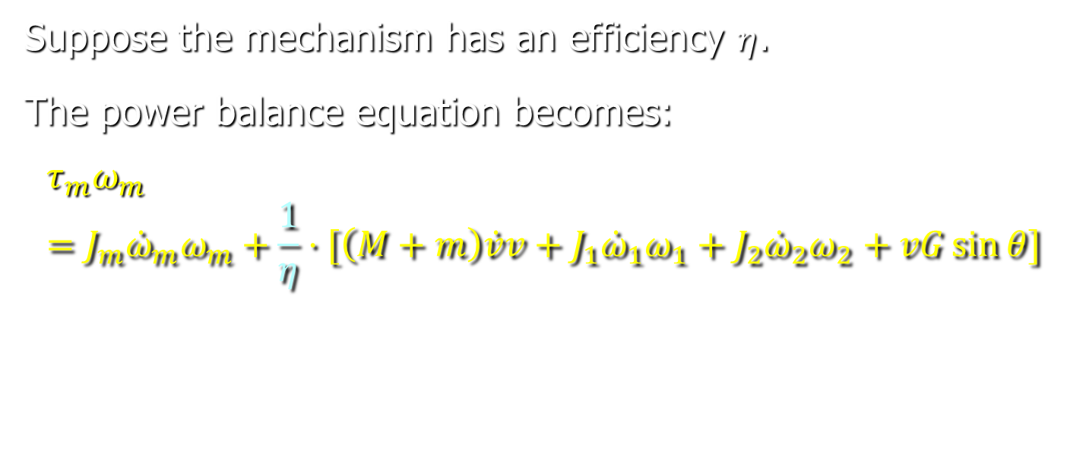
Motion Mechanisms
Suppose the mechanism has an efficiency $η$.
The power balance equation becomes:
$$τ_{m}ω_{m}=J_{m}{\dot{ω}}_{m}ω_{m}+\frac{1}{η}⋅[\left(M+m\right)\dot{v}v+J_{1}{\dot{ω}}_{1}ω_{1}+J_{2}{\dot{ω}}_{2}ω_{2}+vG\sin{θ}]$$

