Slide 1
State-Space Models
Definition. Obtaining State-Space Models.
M.V. Iordache, EEGR3523 Mechatronics, Spring 2019, LeTourneau University

Slide 2
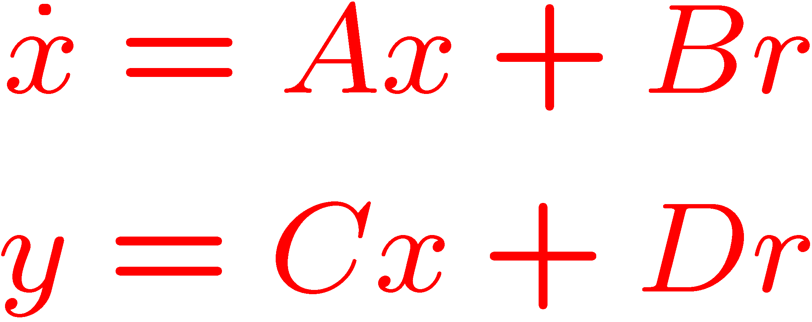
The State Space Representation
A very common representation is
A, B, C, D are matrices.
r, x, and y are vectors.
x is the state vector.
Input
Output
r(t)
y(t)

Slide 3
The State Space Representation
x: state vector.
  x may represent system variables (displacement, velocity, voltage, temperature, pressure, etc.)
  Sometimes x does not have an obvious physical meaning.
y: output. May represent:
  Sensor output (frequency, flow rate, current, etc.)
  Simulation output (variables we wish to visualize).
r: input (such as force, torque, voltage, etc.)
SS models: not unique! Equivalent models obtained depending on the choice of x.

Slide 4
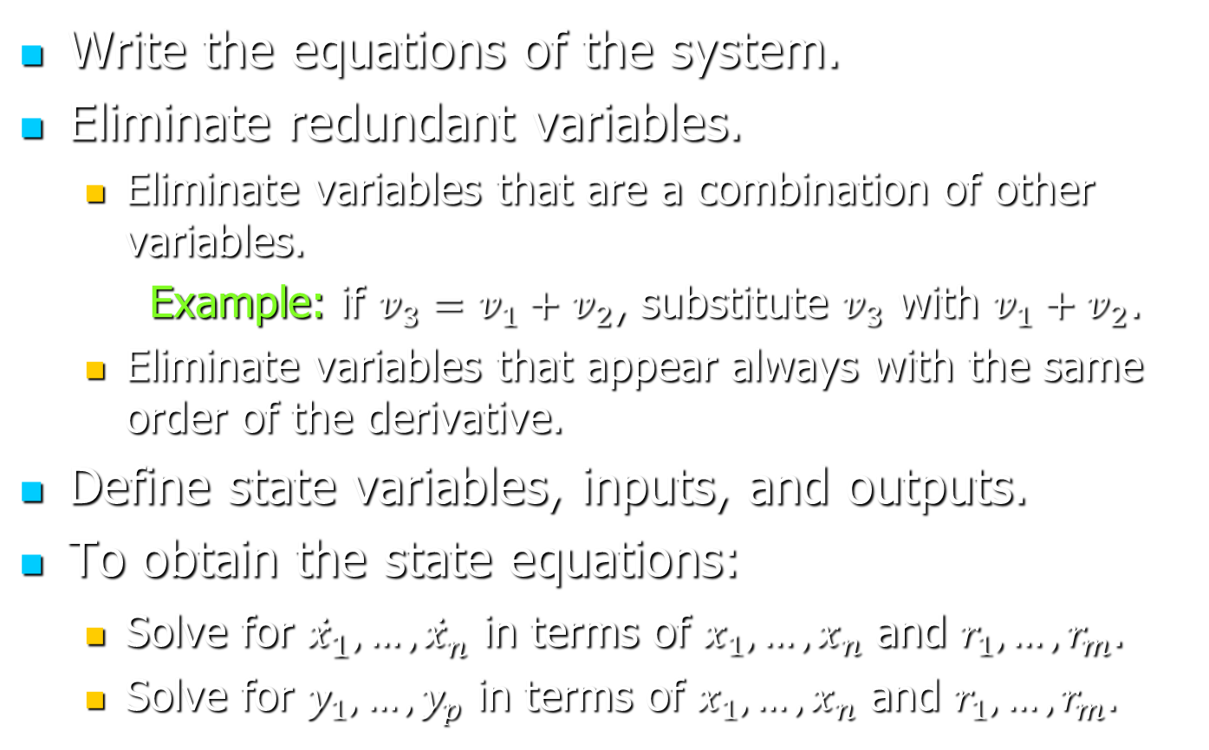
Obtaining state equations
Write the equations of the system.
Eliminate redundant variables.
  Eliminate variables that are a combination of other variables.
  Example: if $v_{3}=v_{1}+v_{2}$, substitute $v_{3}$ with $v_{1}+v_{2}$.
  Eliminate variables that appear always with the same order of the derivative.
Define state variables, inputs, and outputs.
To obtain the state equations:
  Solve for ${\dot{x}}_{1}, …,{\dot{x}}_{n}$ in terms of $x_{1}, …, x_{n}$ and $r_{1}, …, r_{m}$.
  Solve for $y_{1},…, y_{p}$ in terms of $x_{1}, …, x_{n}$ and $r_{1}, …, r_{m}$.

Slide 5
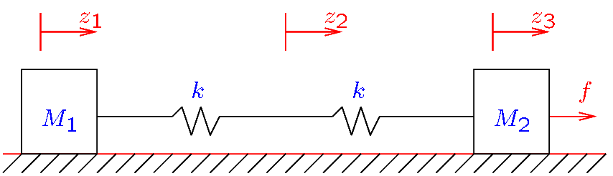
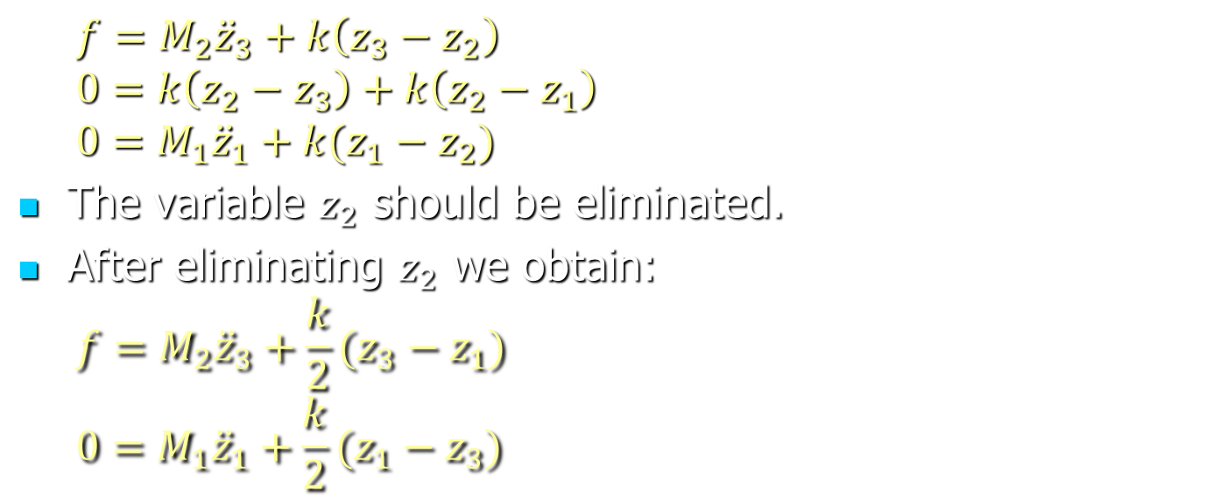
Obtaining state equations
Eliminating redundant variables—an example:
  $$f=M_{2}{\ddot{z}}_{3}+k\left(z_{3}−z_{2}\right)$$
  $$0=k\left(z_{2}−z_{3}\right)+k\left(z_{2}−z_{1}\right)$$
  $$0=M_{1}{\ddot{z}}_{1}+k(z_{1}−z_{2})$$
The variable $z_{2}$ should be eliminated.
After eliminating $z_{2}$ we obtain:
  $$f=M_{2}{\ddot{z}}_{3}+\frac{k}{2}(z_{3}−z_{1})$$
  $$0=M_{1}{\ddot{z}}_{1}+\frac{k}{2}(z_{1}−z_{3})$$

Slide 6
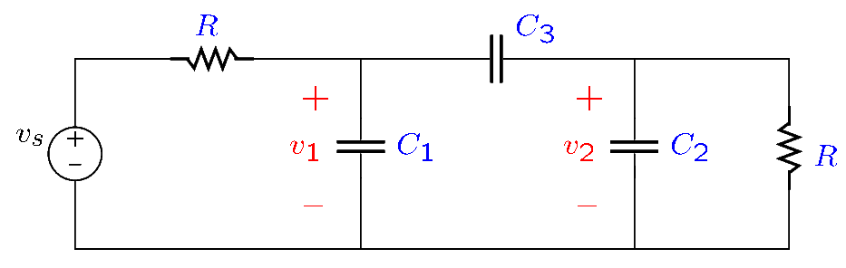
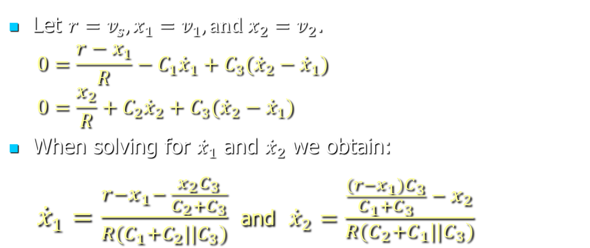
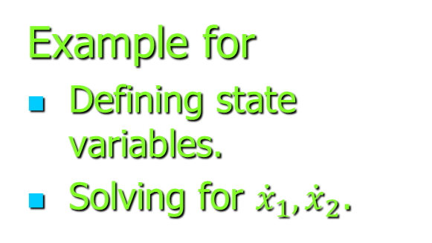
Obtaining state equations
Example for
Defining state variables.
Solving for ${\dot{x}}_{1}, {\dot{x}}_{2}$.
Let $r=v_{s}, x_{1}=v_{1},and x_{2}=v_{2}$.
  $$0=\frac{r−x_{1}}{R}−C_{1}{\dot{x}}_{1}+C_{3}({\dot{x}}_{2}−{\dot{x}}_{1})$$
  $$0=\frac{x_{2}}{R}+C_{2}{\dot{x}}_{2}+C_{3}({\dot{x}}_{2}−{\dot{x}}_{1})$$
When solving for ${\dot{x}}_{1}$ and ${\dot{x}}_{2}$ we obtain:
  ${\dot{x}}_{1}=\frac{r−x_{1}− \frac{x_{2}C_{3}}{C_{2}+C_{3}}}{R(C_{1}+C_{2}||C_{3})}$ and ${\dot{x}}_{2}=\frac{\frac{(r−x_{1})C_{3}}{C_{1}+C_{3}} −{ x}_{2}}{R(C_{2}+C_{1}||C_{3})}$

Slide 7
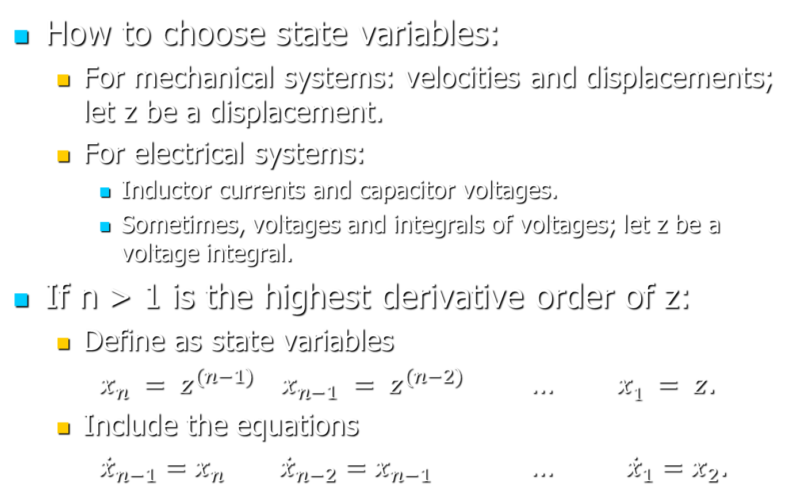
Obtaining state equations
How to choose state variables:
  For mechanical systems: velocities and displacements; let z be a displacement.
  For electrical systems:
    Inductor currents and capacitor voltages.
    Sometimes, voltages and integrals of voltages; let z be a voltage integral.
If n > 1 is the highest derivative order of z:
  Define as state variables
  $x_{n} = z^{(n−1)}$ $x_{n−1} = z^{(n−2)}$ … $x1 = z$.
  Include the equations
  ${\dot{x}}_{n−1}=x_{n}$ ${\dot{x}}_{n−2}=x_{n−1}$ … ${\dot{x}}_{1}=x_{2}$.

Slide 8
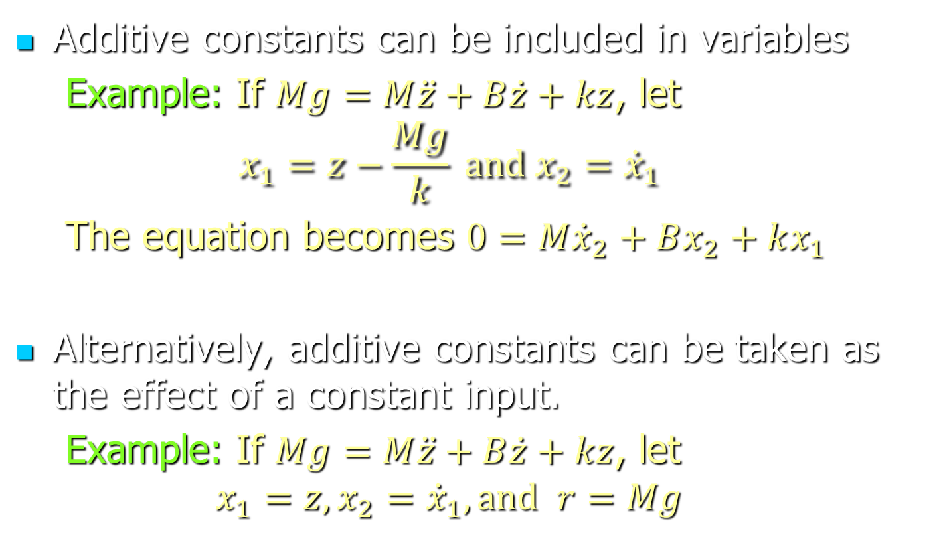
Obtaining state equations
Additive constants can be included in variables
  Example: If $Mg=M\ddot{z}+B\dot{z}+kz$, let
  $$x_{1}=z−\frac{Mg}{k} and x_{2}={\dot{x}}_{1}$$
  The equation becomes $0=M{\dot{x}}_{2}+Bx_{2}+kx_{1}$
Alternatively, additive constants can be taken as the effect of a constant input.
  Example: If $Mg=M\ddot{z}+B\dot{z}+kz$, let
  $$x_{1}=z, x_{2}={\dot{x}}_{1}, and r=Mg$$

Slide 9
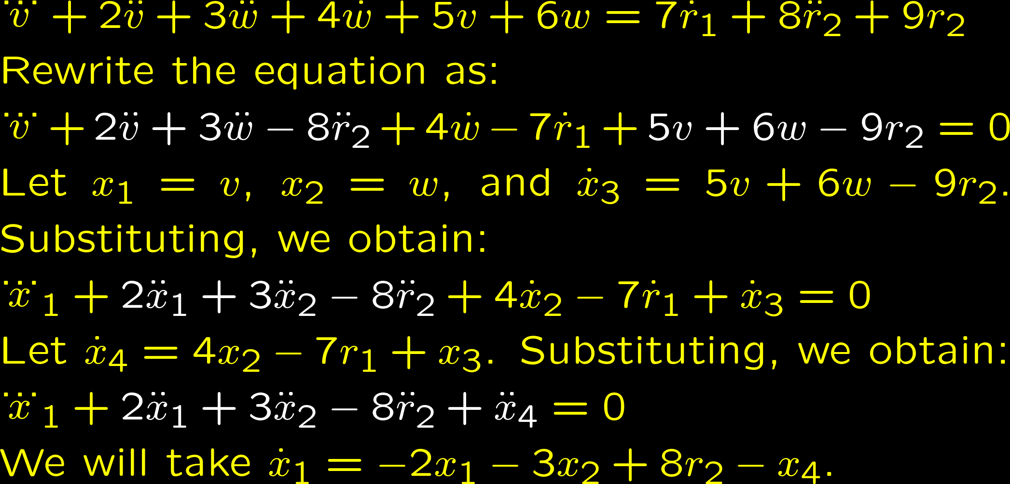
Obtaining state equations
The Derivative Grouping method may be used when the equations contain derivatives of input variables.
  Example:

Slide 10
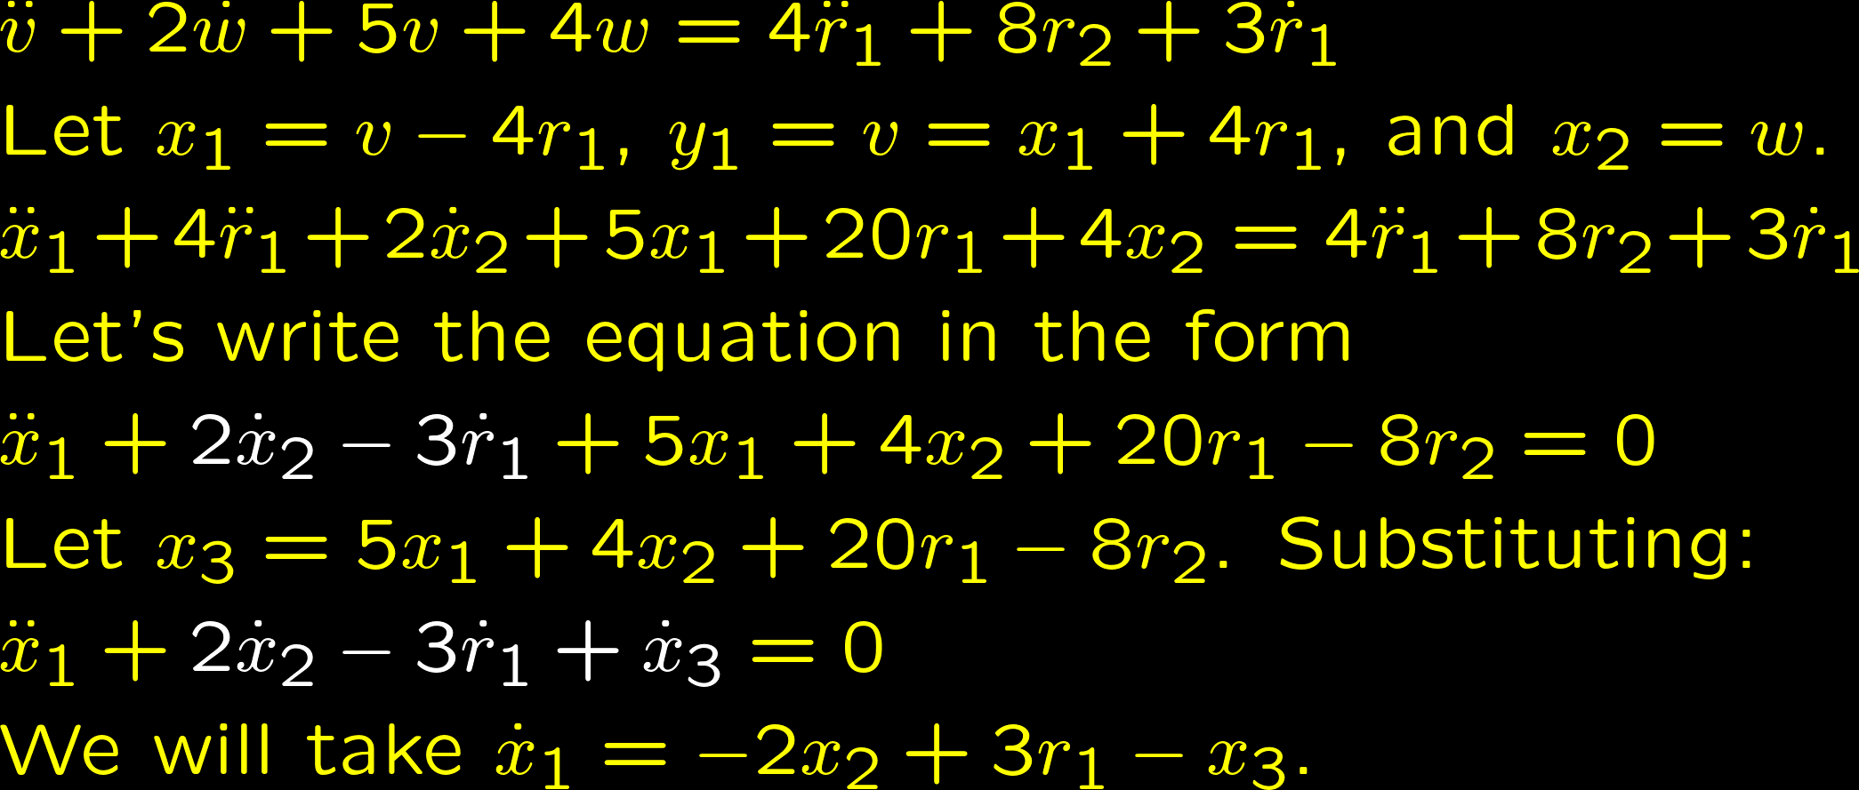
Obtaining state equations
If the highest order derivative of a variable equals the highest order derivative of an input, the variable could be represented by an output.
  Example:

Slide 11
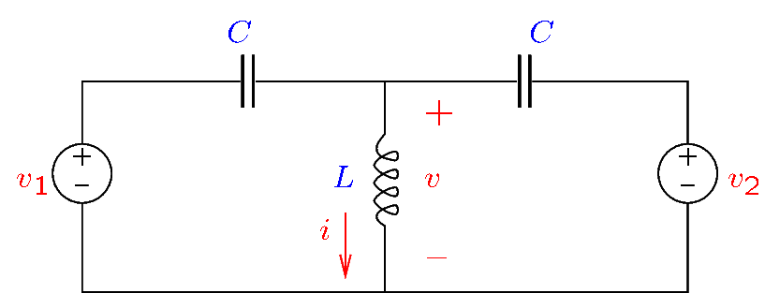
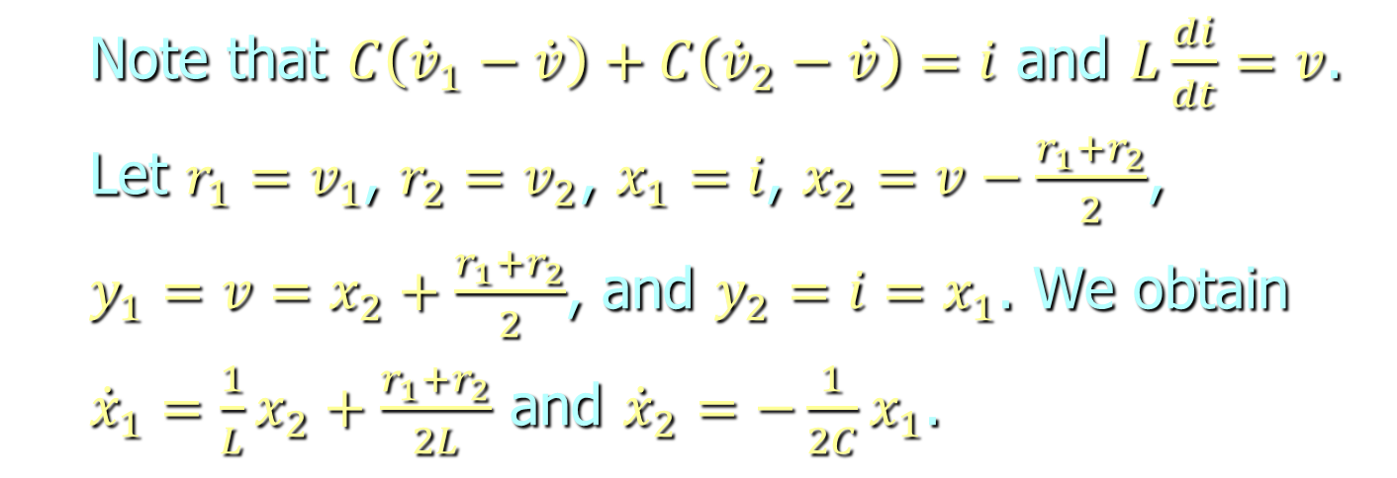
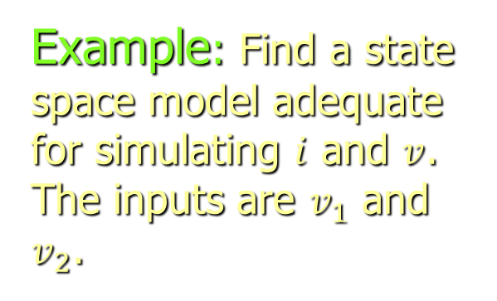
Obtaining state equations
Example: Find a state space model adequate for simulating $i$ and $v$. The inputs are $v_{1}$ and $v_{2}$.
  Note that $C\left({\dot{v}}_{1}−\dot{v}\right)+C\left({\dot{v}}_{2}−\dot{v}\right)=i$ and $L\frac{di}{dt}=v$.
  Let $r_{1}=v_{1}$, $r_{2}=v_{2}$, $x_{1}=i$, $x_{2}=v−\frac{r_{1}+r_{2}}{2}$,
  $y_{1}=v=x_{2}+\frac{r_{1}+r_{2}}{2}$, and $y_{2}=i=x_{1}$. We obtain
  ${\dot{x}}_{1}=\frac{1}{L}x_{2}+\frac{r_{1}+r_{2}}{2L}$ and ${\dot{x}}_{2}=−\frac{1}{2C}x_{1}$.

Slide 12
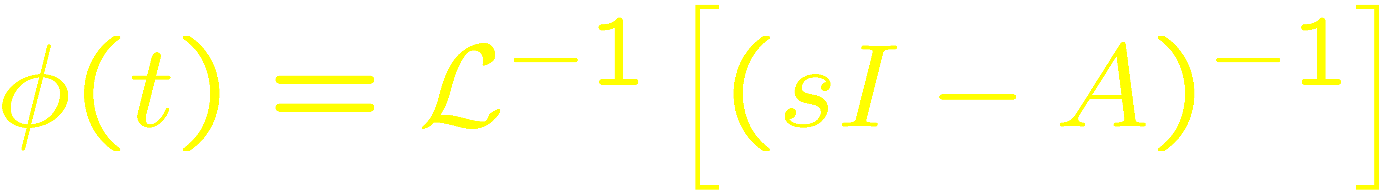
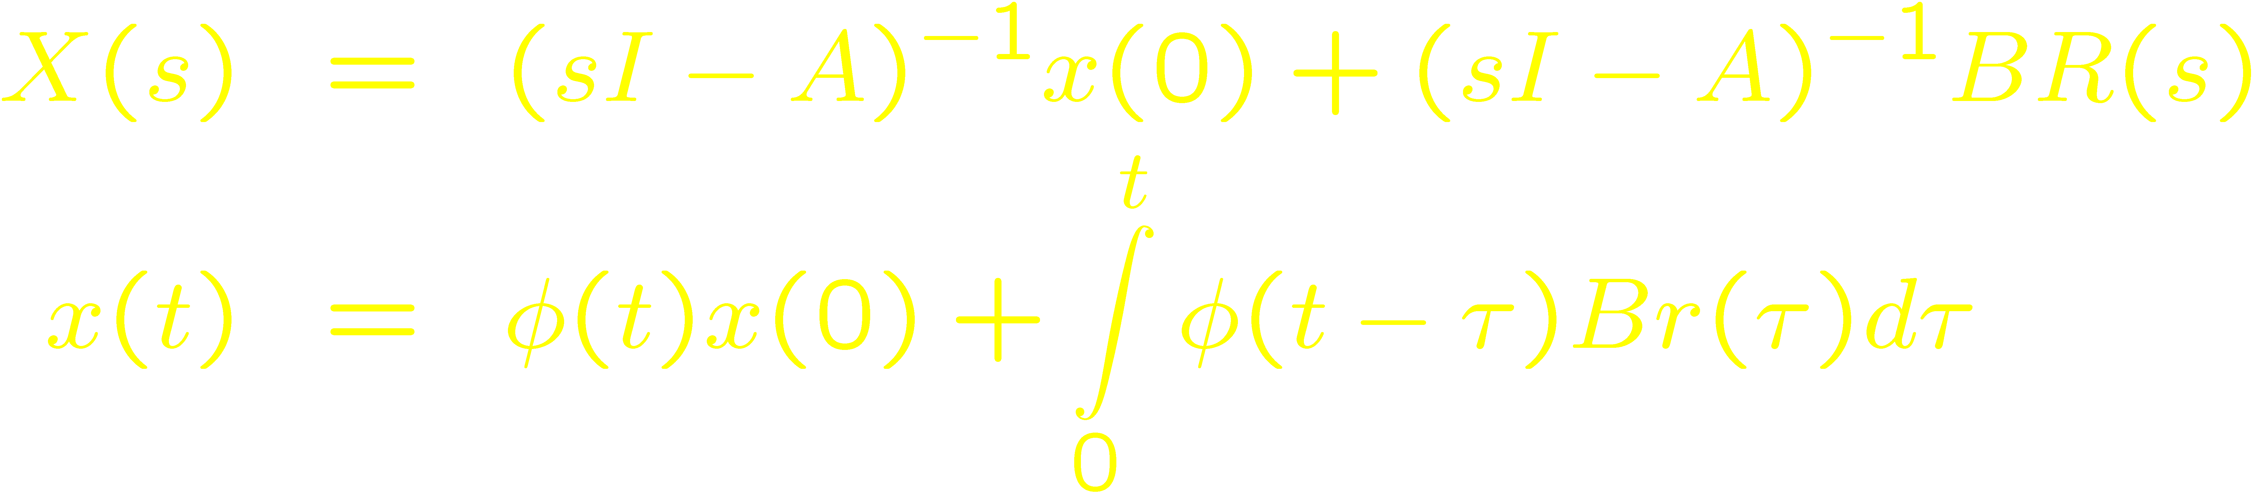
Solution of the SS Equation
Note that x(t) depends on
  x(0) – the initial state
  r(t) – the input
Let

Slide 13

The Relation of SS and TF Models
Conversions TF → SS and SS → TF possible.
Input
Output
r(t)
y(t)
Input
Output
r(t)
y(t)

Slide 14
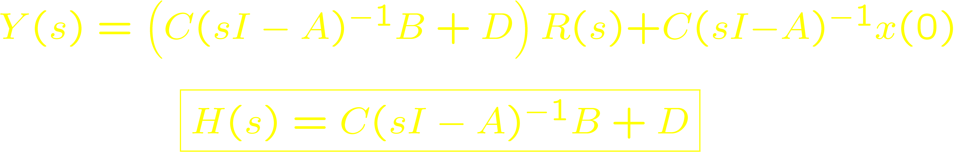
Transfer Function of SS Model
Assumes zero initial conditions: x(0) = 0.
Input
Output
r(t)
y(t)

