Slide 1
Transfer Functions
Obtaining TF Models. Transient and Steady-State Responses.
M.V. Iordache, EEGR3523 Mechatronics, Spring 2019, LeTourneau University

Slide 2
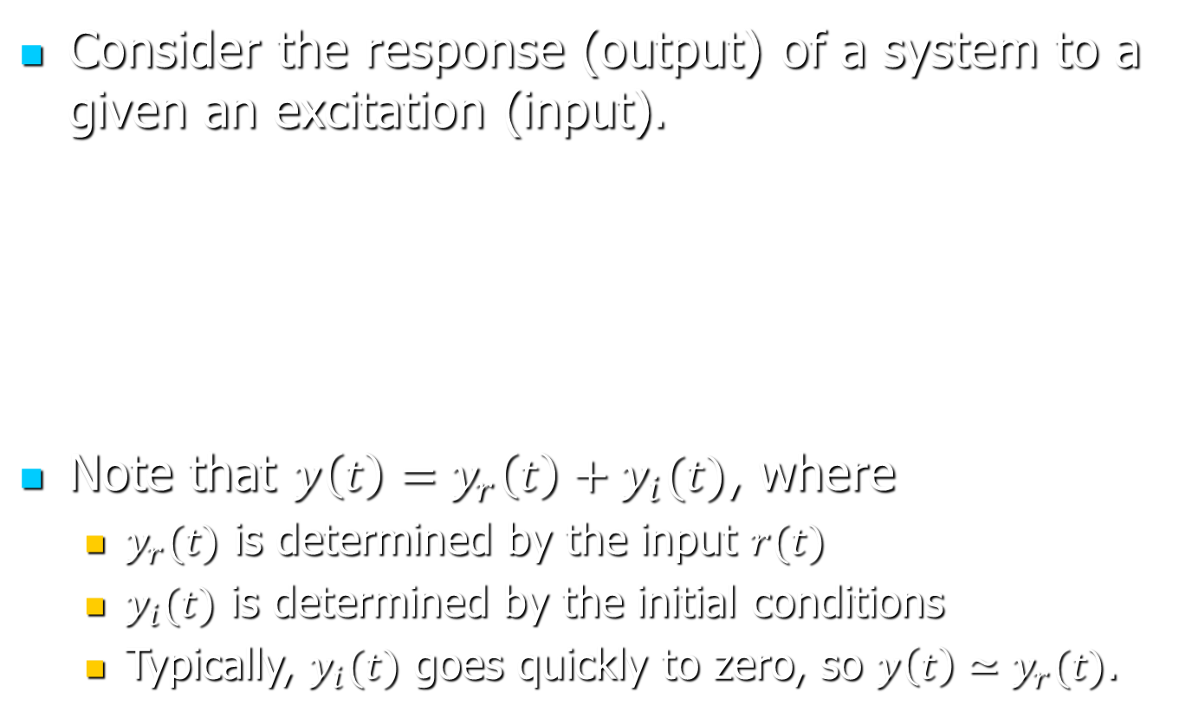
System Response
Consider the response (output) of a system to a given an excitation (input).
Note that $y\left(t\right)=y_{r}\left(t\right)+y_{i}(t)$, where
$y_{r}(t)$ is determined by the input $r(t)$
$y_{i}(t)$ is determined by the initial conditions
Typically, $y_{i}(t)$ goes quickly to zero, so $y\left(t\right)≃y_{r}(t)$.
System
Input
Output
r(t)
y(t)

Slide 3

Transfer Functions
Are system models allowing to determine the response (output) of the system based on the excitation (input) of the system.
If H(s) is the TF:
System
Input
Output
r(t)
y(t)

Slide 4
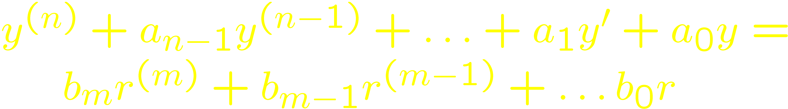
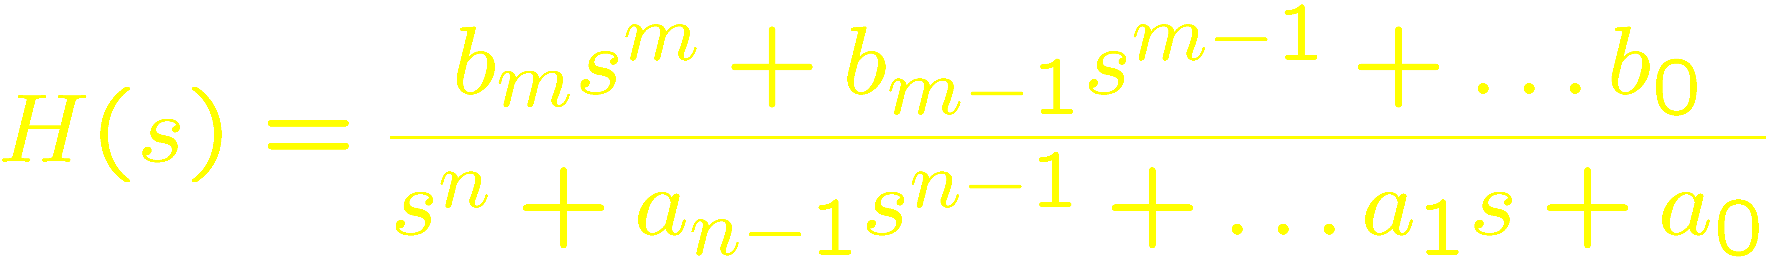
Transfer Functions
An I/O relationship
is expressed by a TF

Slide 5
Recall DEQ terminology …
Ordinary, when no partial derivatives.
Linear, if all factors depend linearly on y⁽⁰⁾… y^{(n)}.
y’’ + t²y = r is linear
yy’’+5y’ = r is nonlinear
The LT used for ordinary linear diff eqs with constant coefficients.
y’’ + t²y = r (NO LT)
y’’ + 6y = r (USE LT)

Slide 6
Transfer Functions
Describe any linear time-invariant (LTI) system.
Linear: ar₁+br₂→ay₁+by₂
Time-invariant: system equations independent of time.
Multiple inputs and/or outputs → H(s) is a matrix.

Slide 7
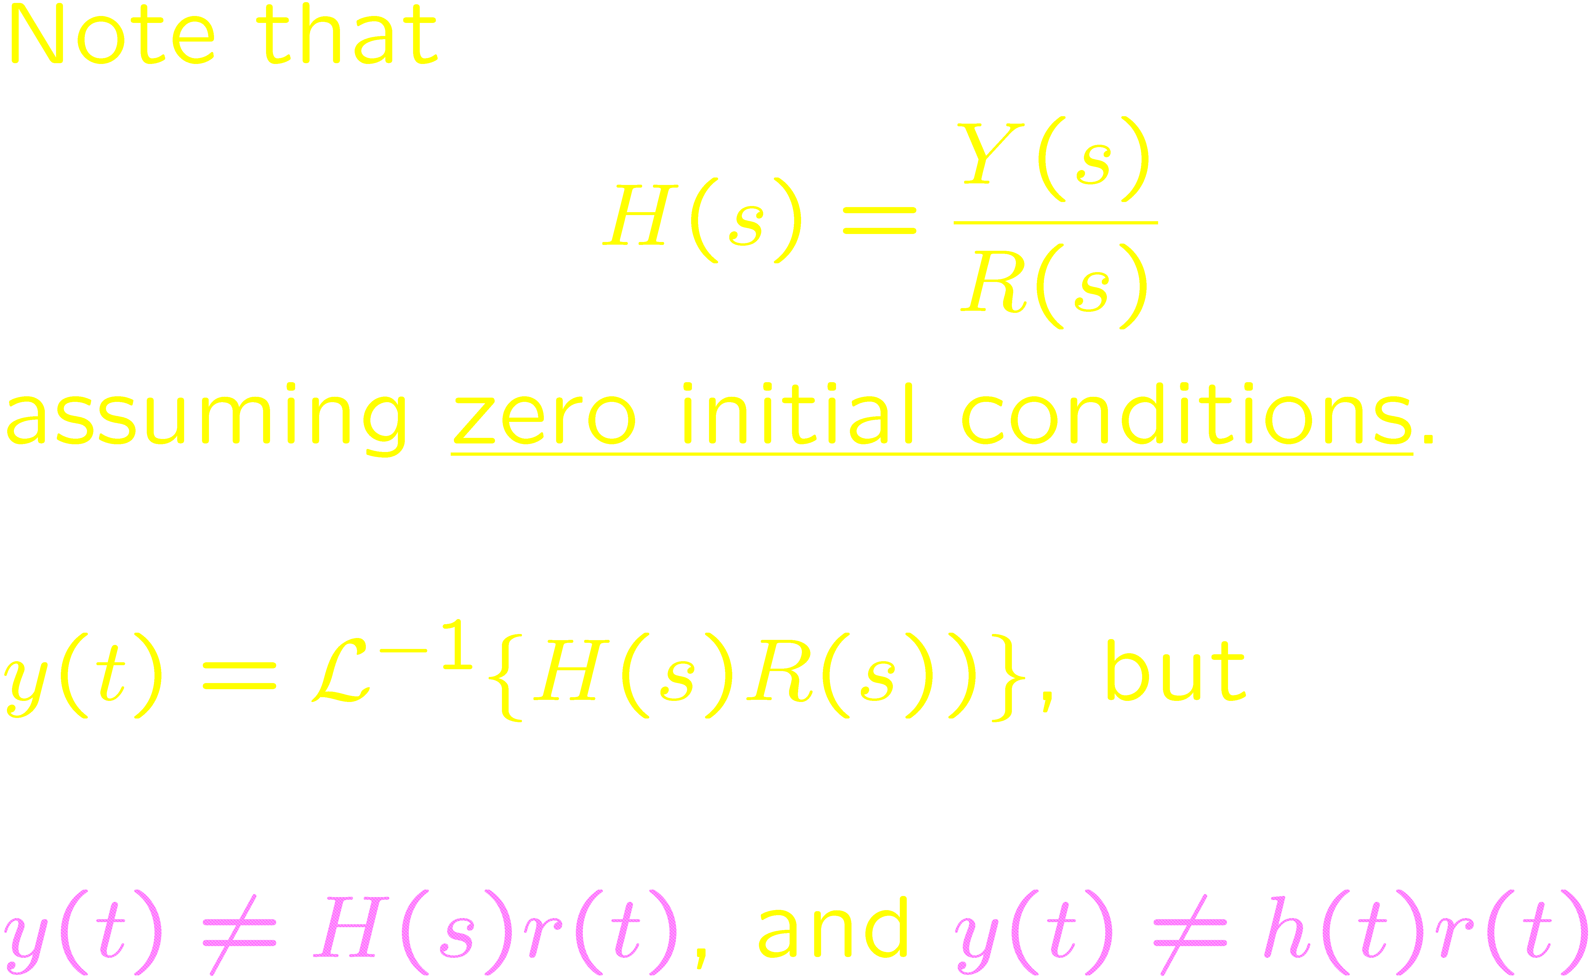
Transfer Functions

Slide 8
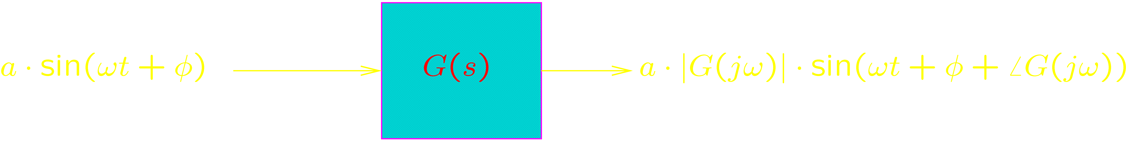
More on Transfer Functions G(s)
g(t) is called the impulse response.
G(jw) describes the magnitude and phase shift of the steady state response to a sinewave of angular frequency w.
This property of G(jw) applies when all singularities of G(s) are in the LHP.

Slide 9
Measuring Transfer Functions
Using LabVIEW.
Bode analyzers

Slide 10
What can we tell about y(t) by looking at Y(s)?
Singularities (poles)
Stable response: y(t) converges to a constant value.
When sY(s) has no poles in the RHP and on the imaginary axis.
Marginally stable response: y(t) is a bounded oscillation.
When sY(s) has no poles in the RHP and at the origin and has simple poles on the imaginary axis.
Unstable response: y(t) is unbounded.
When Y(s) has poles in the RHP or multiple poles at the same location on the imaginary axis.
The Final Value Theorem.
Assumes sY(s) has no poles in the RHP and on the imaginary axis.
The Initial Value Theorem.
Notes:
Mention also the application of the Laplace transform on a DC to DC converter example (handout!).

Slide 11
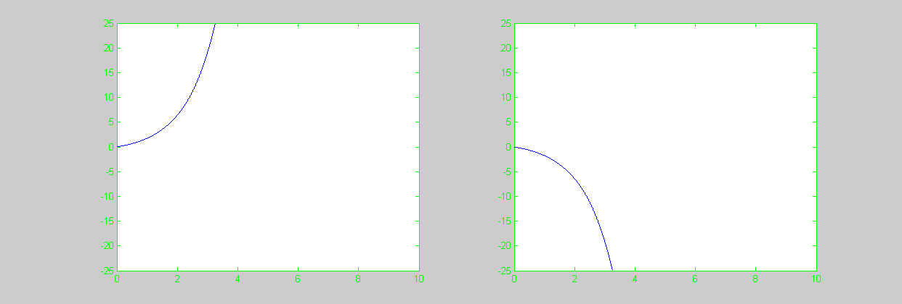
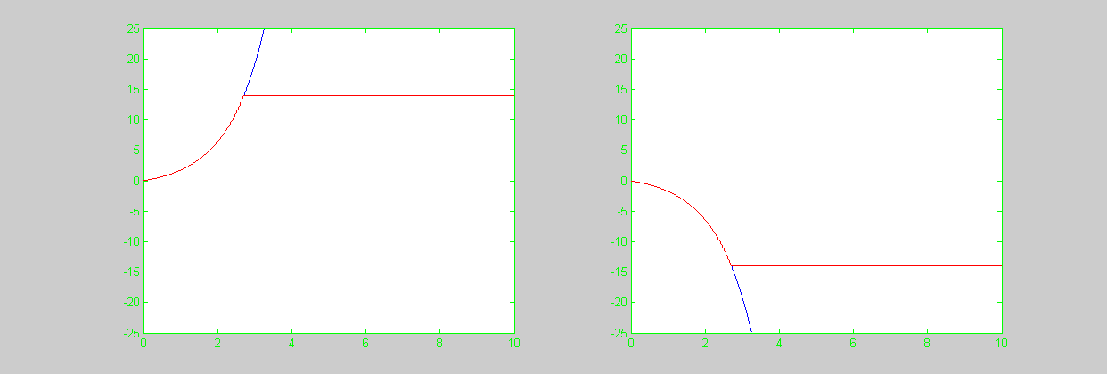
Unstable Responses
Min possible level
Max possible level

Slide 12
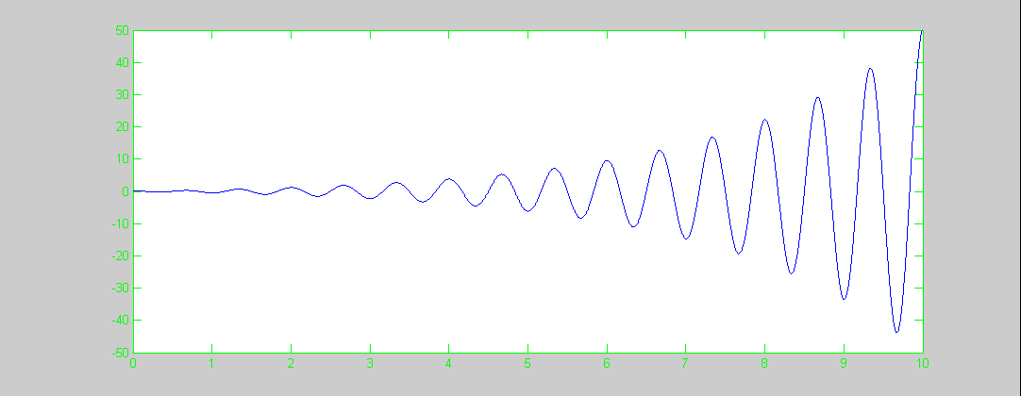
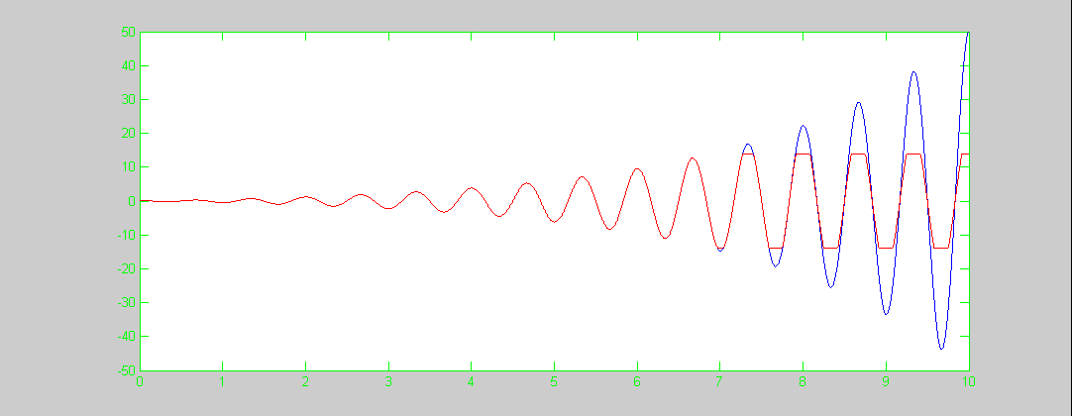
Unstable Response

Slide 13
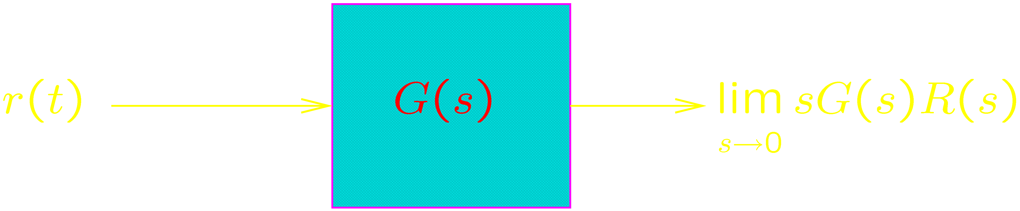
The Steady State Response
If the Final Value Theorem Applies:
For harmonic excitation, use the Fourier transform approach:

Slide 14
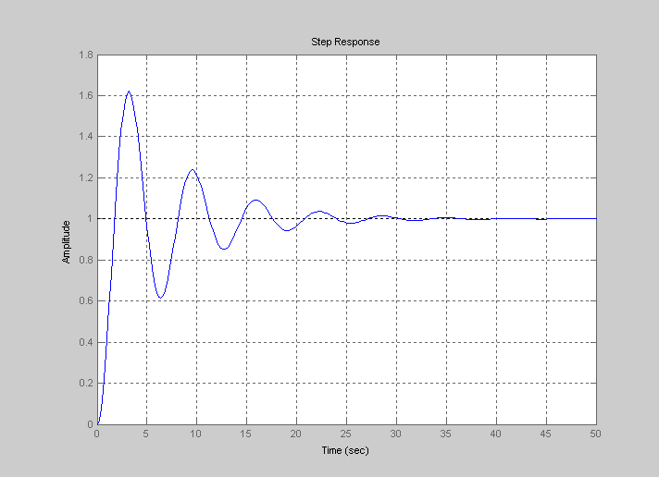
The Steady State Response
Transient
Steady state

Slide 15
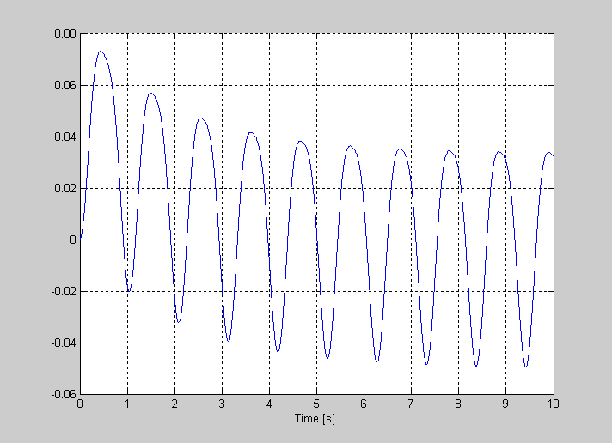
The Steady State Response
Transient
Steady state

Slide 16
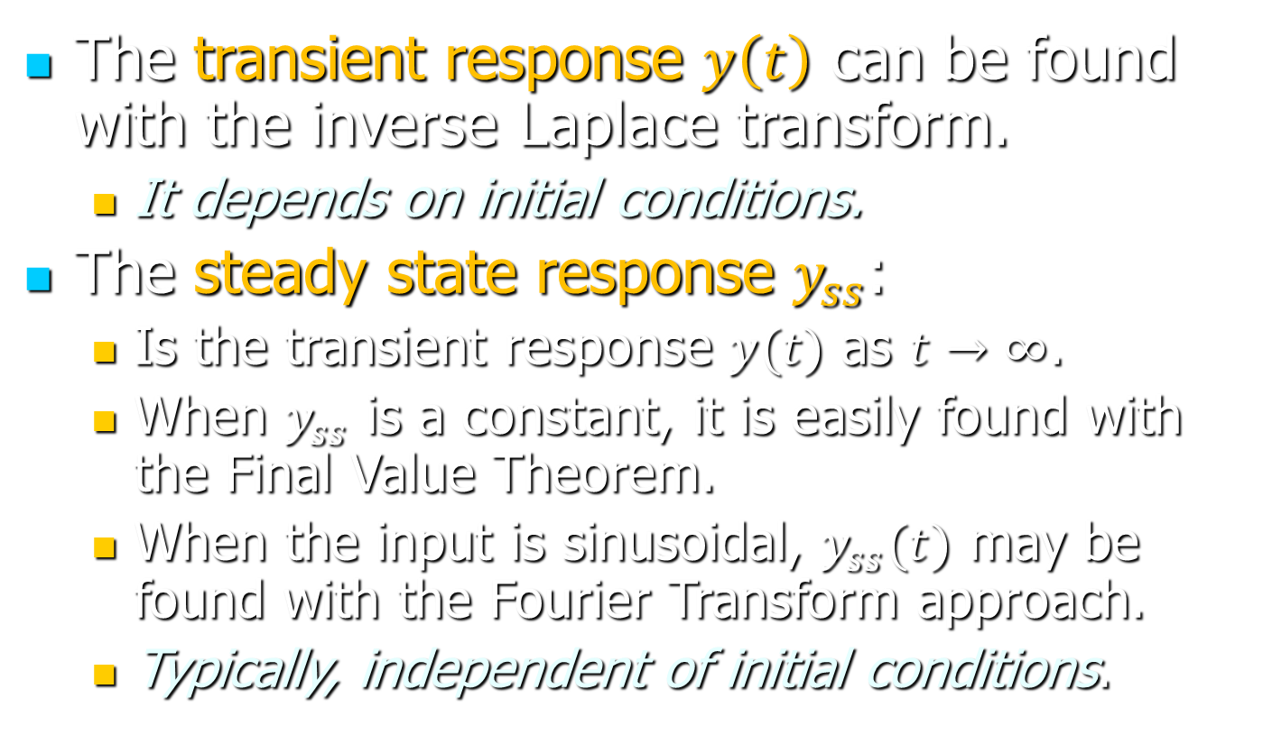
The Steady State Response
The transient response $y\left(t\right)$ can be found with the inverse Laplace transform.
It depends on initial conditions.
The steady state response $y_{ss}$:
Is the transient response $y(t)$ as $t→∞$.
When $y_{ss}$ is a constant, it is easily found with the Final Value Theorem.
When the input is sinusoidal, $y_{ss}(t)$ may be found with the Fourier Transform approach.
Typically, independent of initial conditions.

