Slide 1
DC Machines
An Introduction to DC Motors and Generators
M.V. Iordache, EEGR3523 Mechatronics, Spring 2019, LeTourneau University

Slide 2
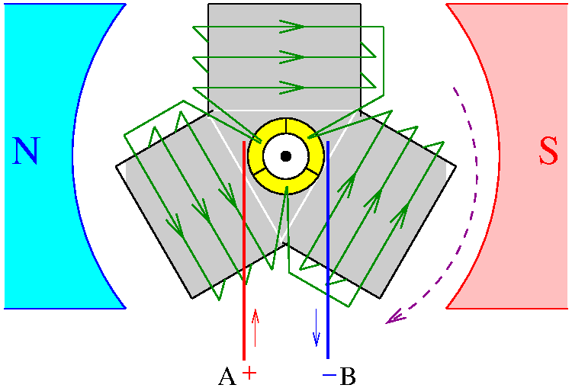
Electric Machine Components
Stator (fixed)
Rotor (rotating part)
Armature (main current carrying component)
Stator
Stator
pole
Stator
pole
Rotor and armature

Slide 3
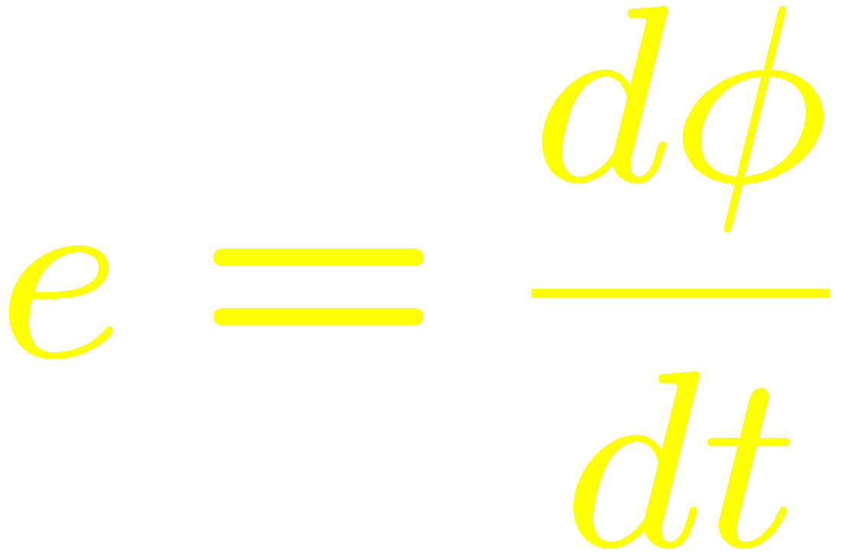


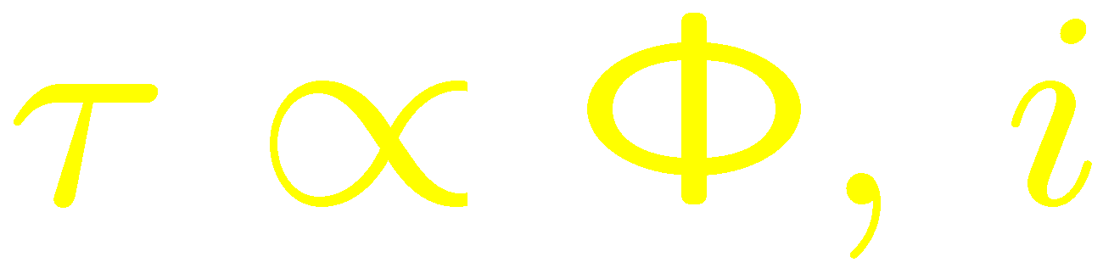
Introduction to Electric Machines
Back e.m.f. (electromotive force)
Let denote the flux per (stator) pole.

Slide 4
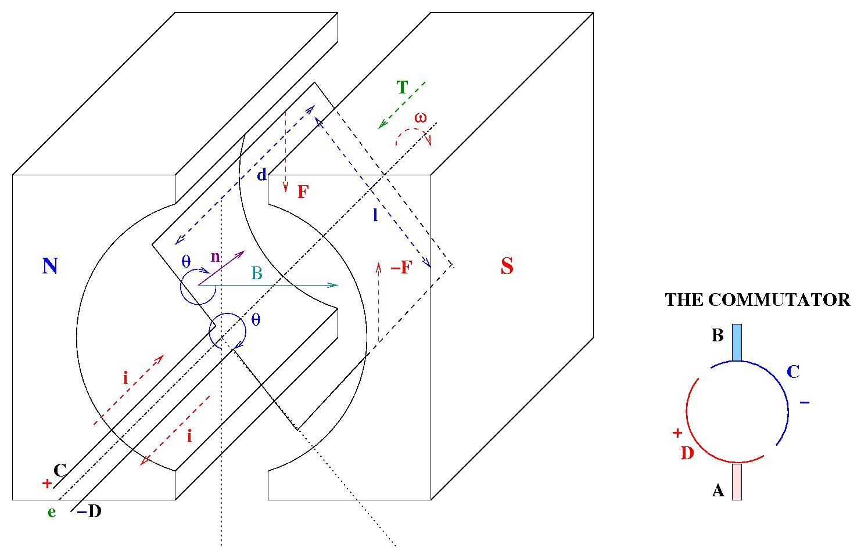

Slide 5
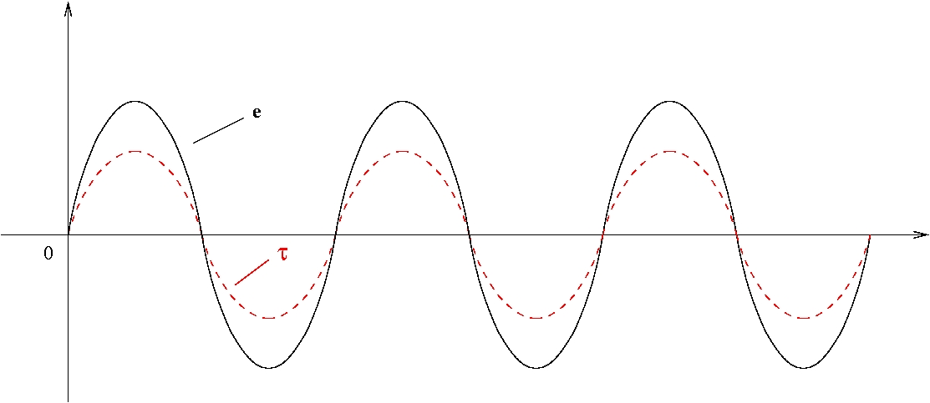
Without commutation …
The average of the generated torque is 0!

Slide 7
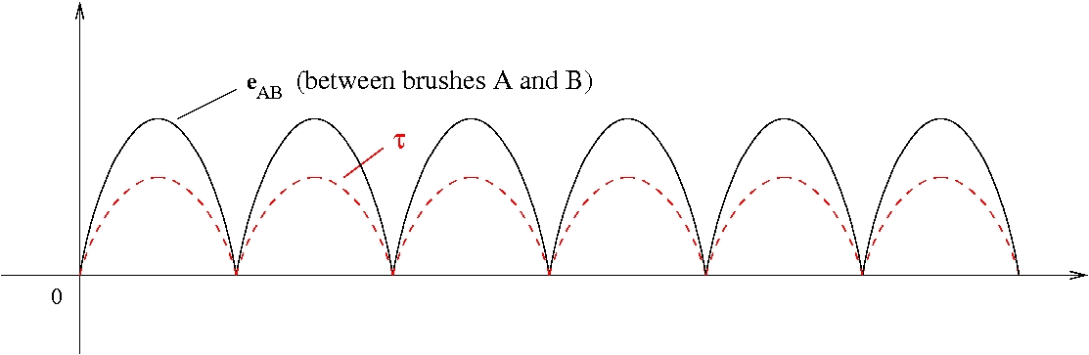
With commutation …
Nonzero average torque.
DC generators …

Slide 8
Electric Machine Components
Stator and rotor
Commutator: attached to rotor. Consists of brushes and commutator segments.
Commutator segments
Brush

Slide 9

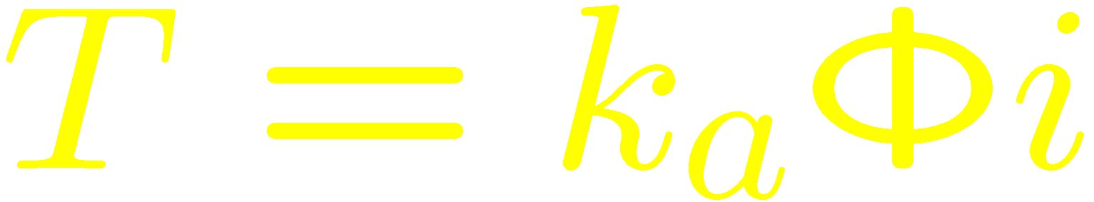
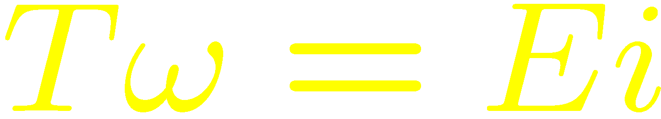
Introduction to Electric Machines
Back e.m.f.: proportional to speed and flux per pole.
Torque: proportional to current and flux per pole.
Thus,

Slide 10

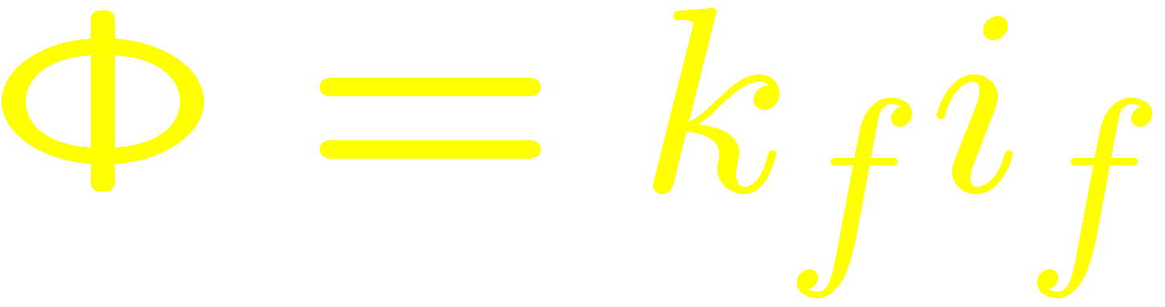
Construction of DC Brushed Machines
With permanent magnet stator.
Flux per pole:
With electromagnet type stator. Stator winding called field winding.
Flux per pole:
Field and armature winding connections:
Separately excited, series, shunt, …

Slide 11
Motor Selection
It is recommended to ensure that the load inertia is no more than 10 times the motor inertia.
Use the velocity profile to find the peak torque.
Any torque applied for a sufficiently long amount of time should be less than the continuous operation torque of the motor.
If the torque changes quickly, find the rms torque and check that it does not exceed the continuous operation torque.
Motors are damaged by heat, when they reach a high enough temperature.
Higher torques are possible if the motors are kept cool.

Slide 12
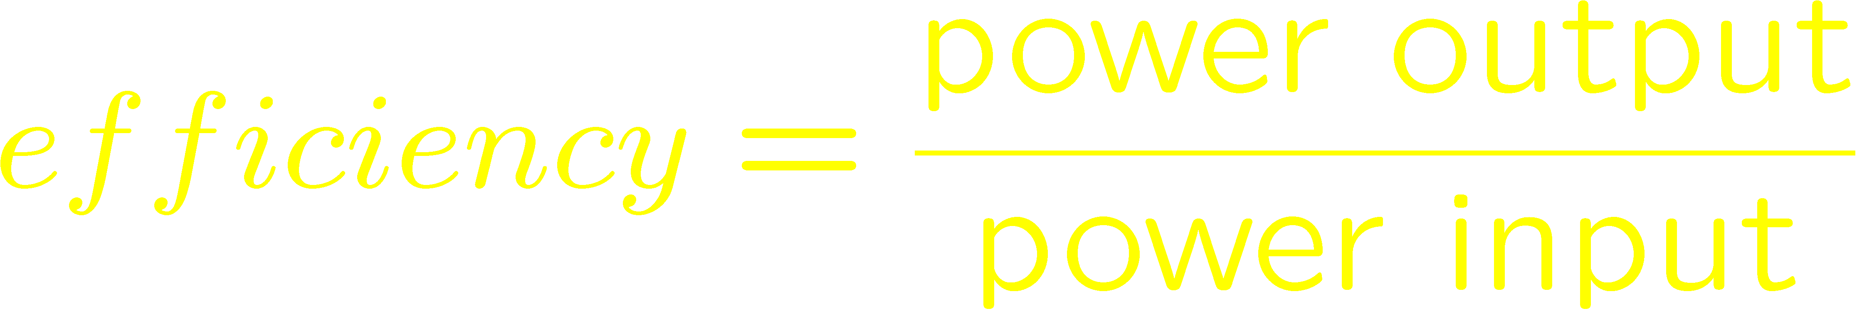
Efficiency
Losses:
Electrical (copper and brush contact)
Magnetic (hysteresis and Eddy currents)
Mechanical (friction: bearing, brush, windage)
Stray load

Slide 13
Construction of DC Brushed Machines
With permanent magnet stator.
Flux per pole:
With electromagnet type stator. Stator winding called field winding.
Flux per pole:
Field and armature winding connections:
Separately excited, series, shunt, …
Armature winding
Lap winding or wave winding
Simplex or multiplex.

Slide 14
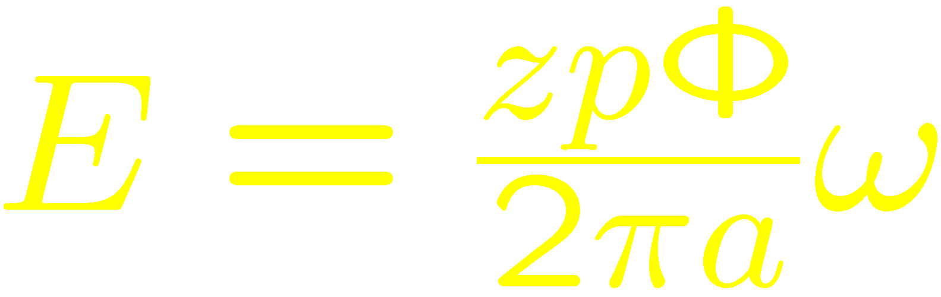
Construction of DC Machines
Several poles (p). Flux per pole:
Number of armature conductors (z).
(Two conductors per turn.)
Number of current paths (a).
Simplex wave winding: 2 paths.
Simplex lap winding: p paths.
Multiplex winding: PLEX times more paths.
Back e.m.f.:

Slide 15
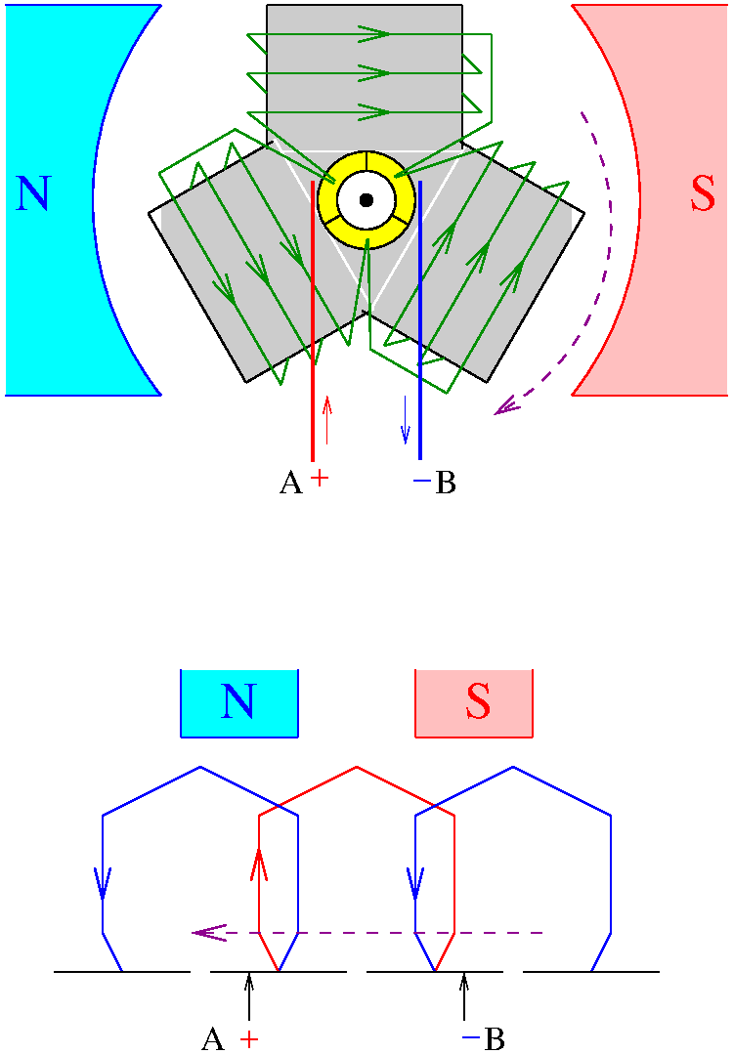

Slide 16
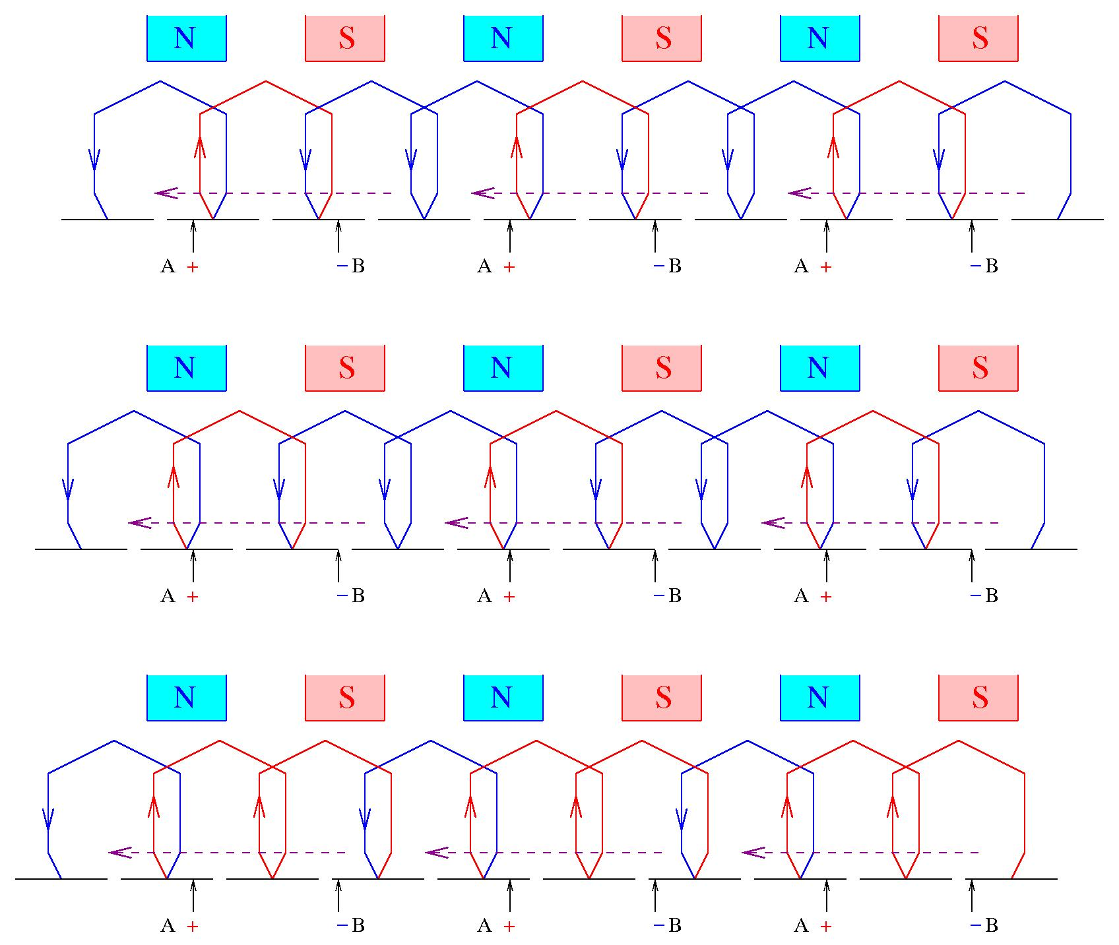

Slide 17
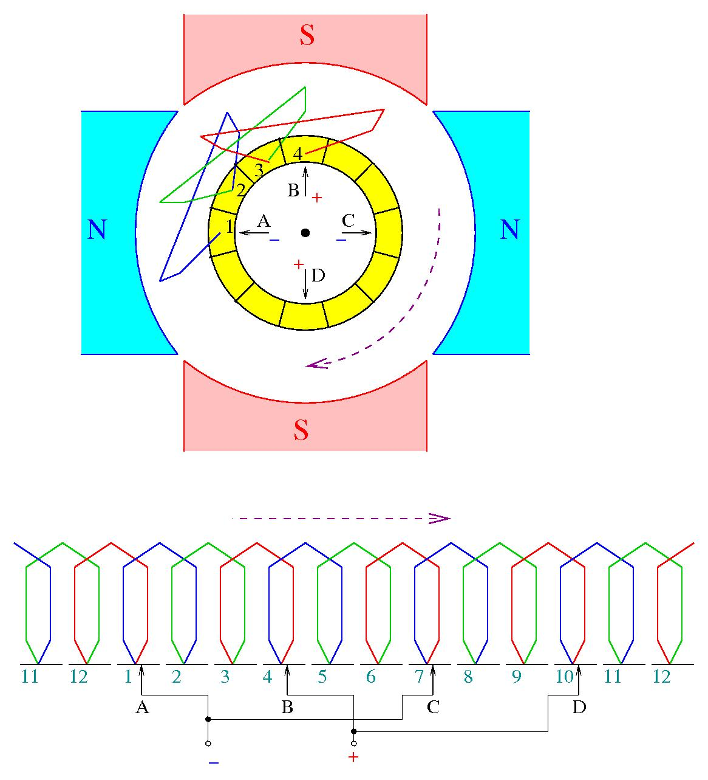

Slide 18
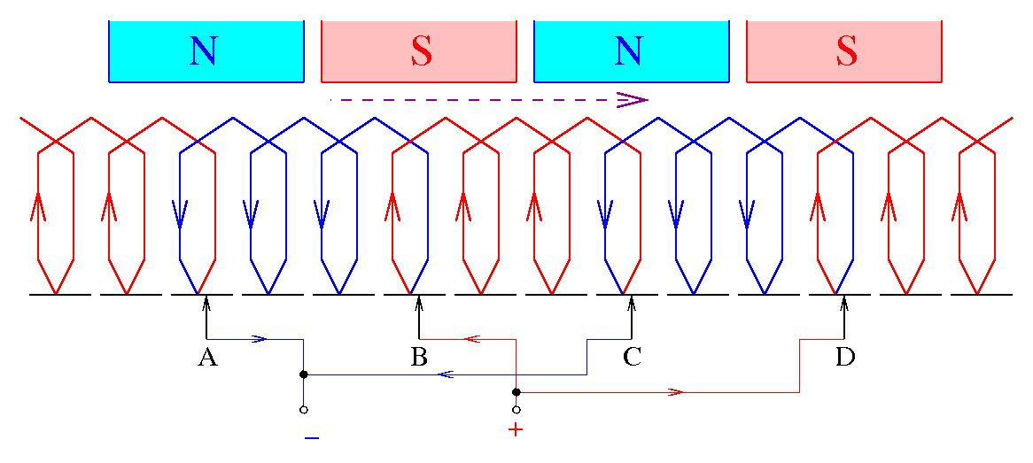

Slide 19
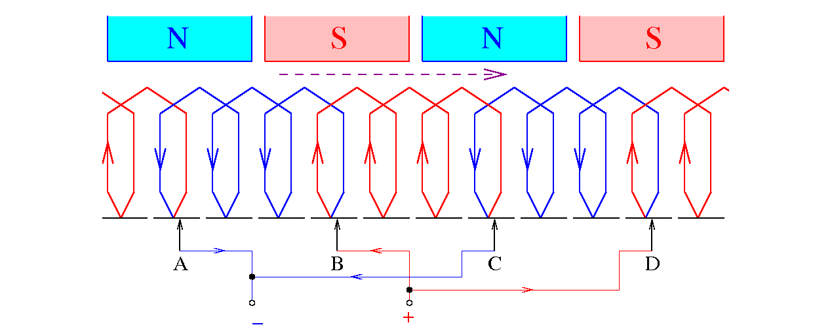

Slide 20
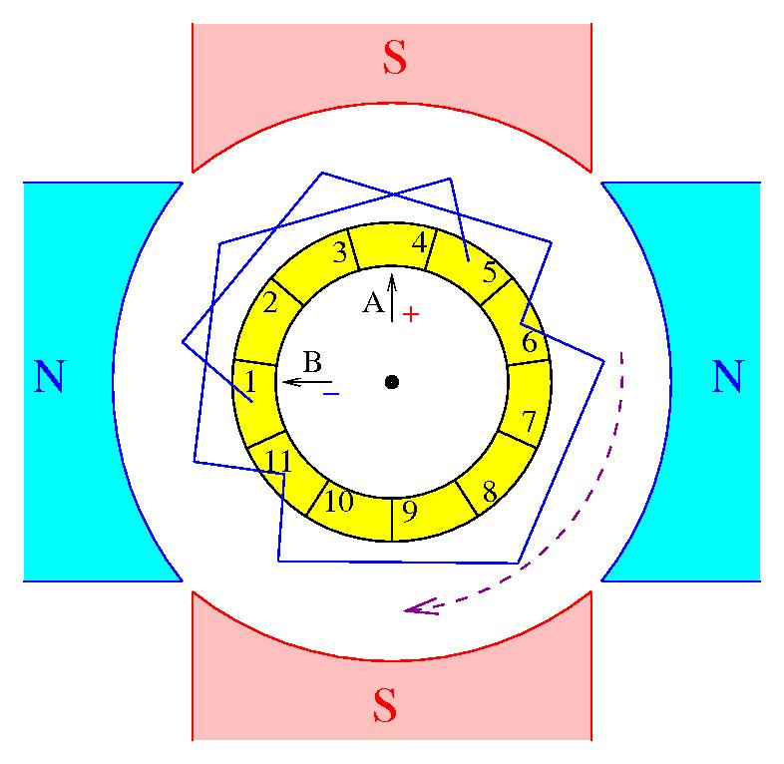

Slide 21
