Slide 1
Time-Response Specifications
First and Second Order Systems. First and Second Order Approximations.
M.V. Iordache, EEGR3523 Mechatronics, Spring 2019, LeTourneau University

Slide 2
Specifications
Stability
  any bounded input → bounded output.
Steady state error
  how much the steady state may deviate from nominal value under constant disturbances.
Time Response
  settling time and overshoot requirements.
…

Slide 3
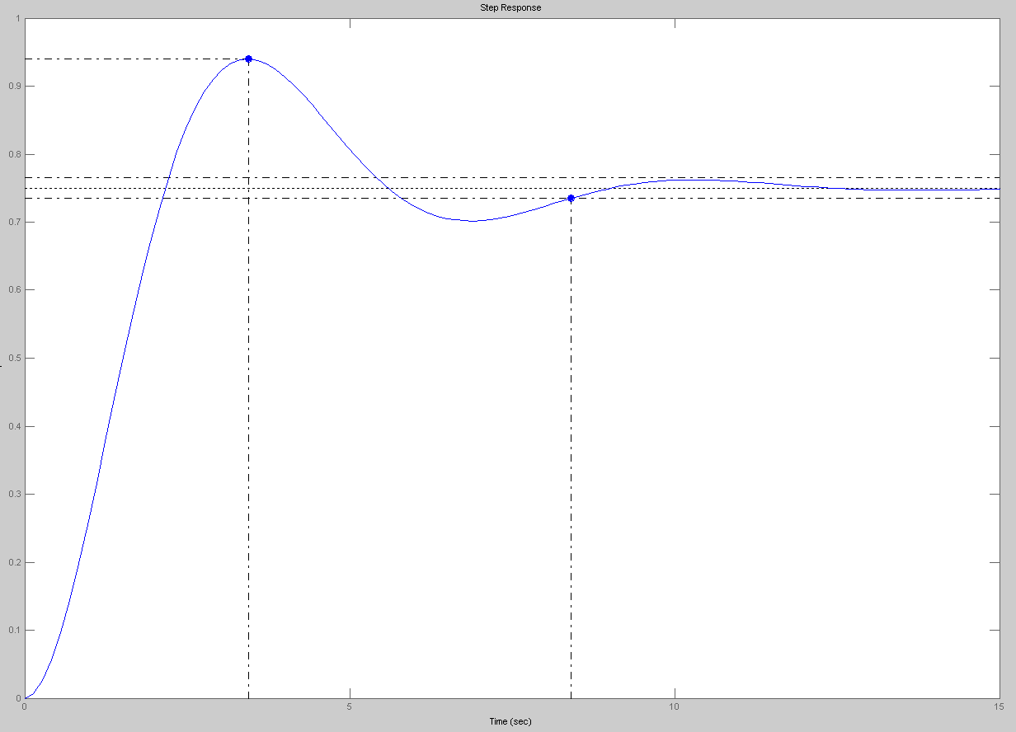
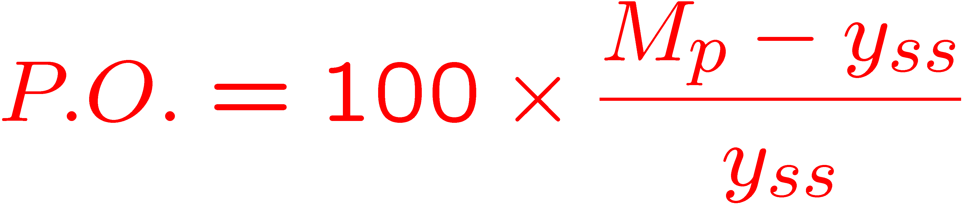
Time Response
t_{p} (peak time)
M_{p} peak magnitude
y_{ss}
t_{s} (2% settling time)

Slide 4
Time Response
First order systems
  Settling time
Second order systems:
  Settling time
  Percent overshoot
  Peak time

Slide 5
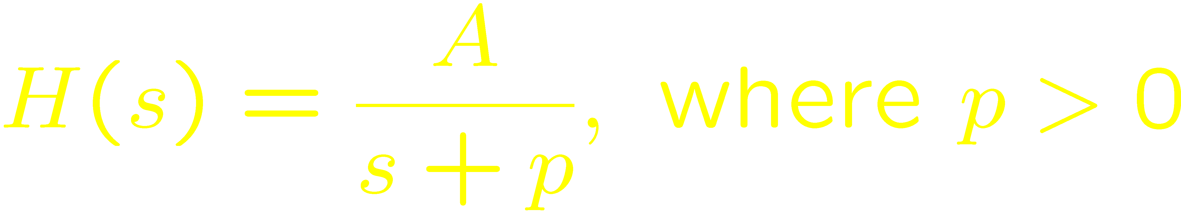
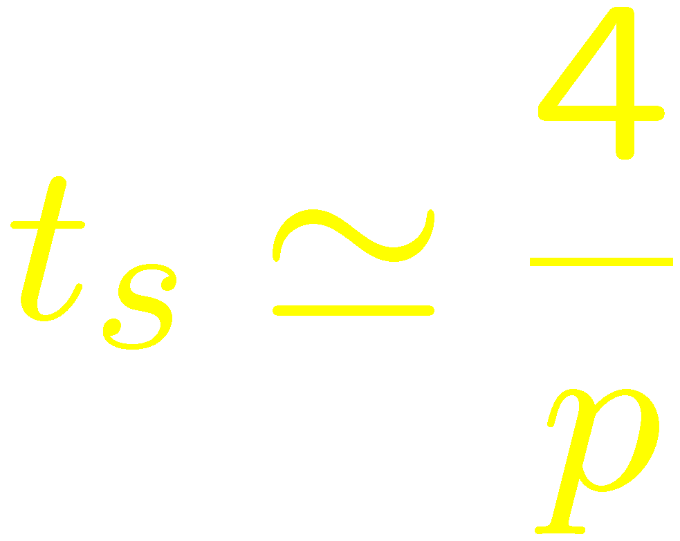
Time Response of 1st Order Systems
First order systems:
No overshoot, no peak time
2% settling time:

Slide 6
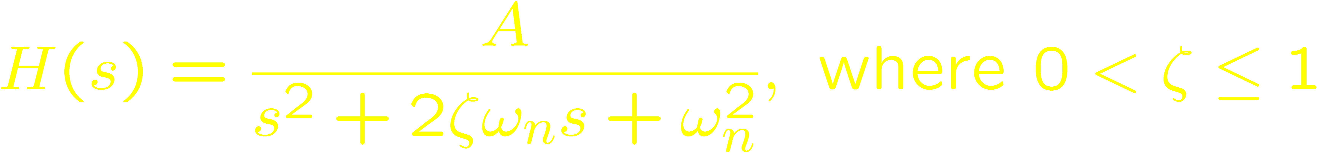
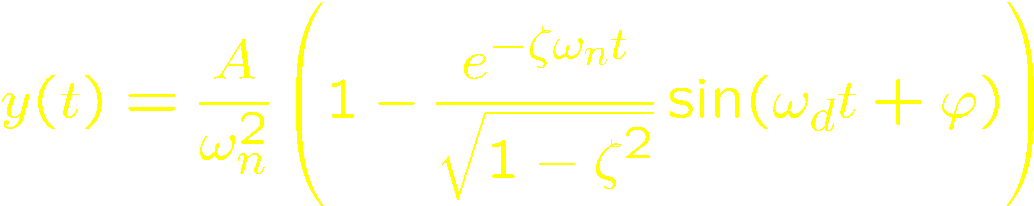
Time Response of 2nd Order Systems
Second order systems:
The response to a unit step input
where

Slide 7
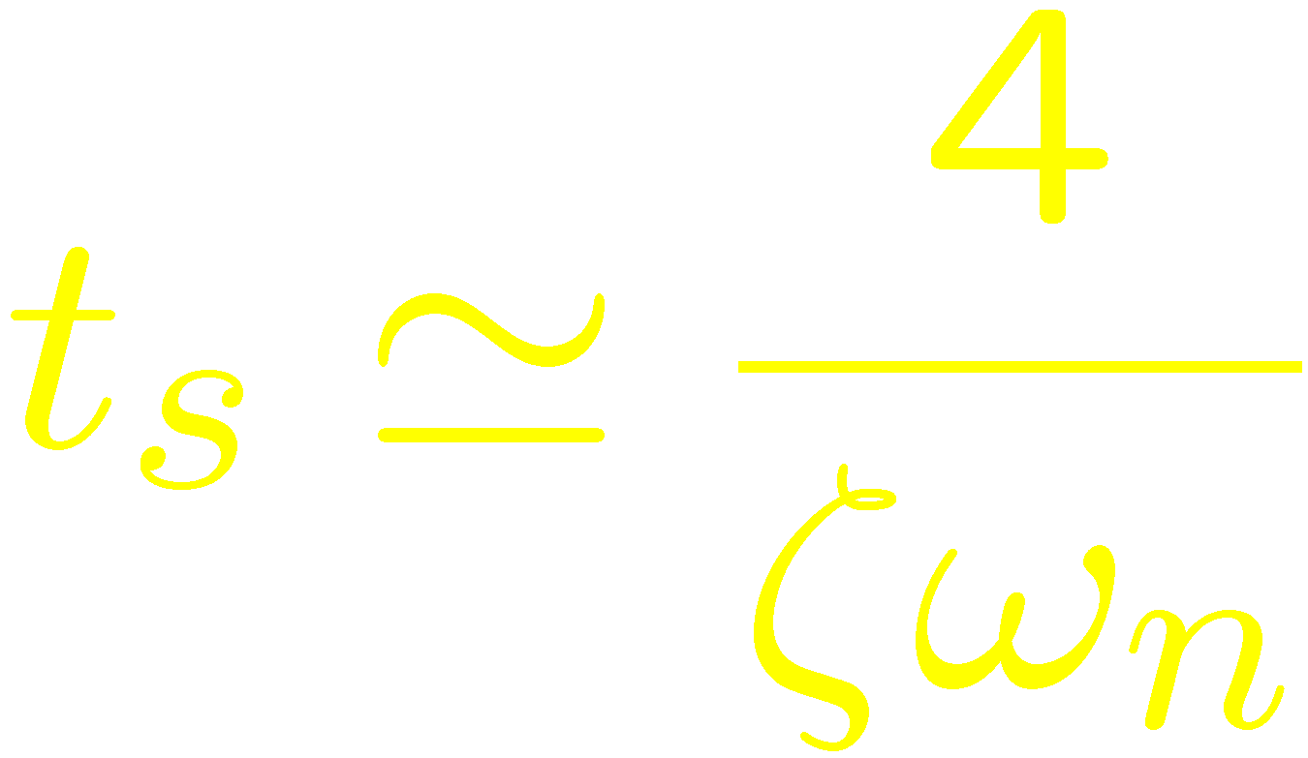
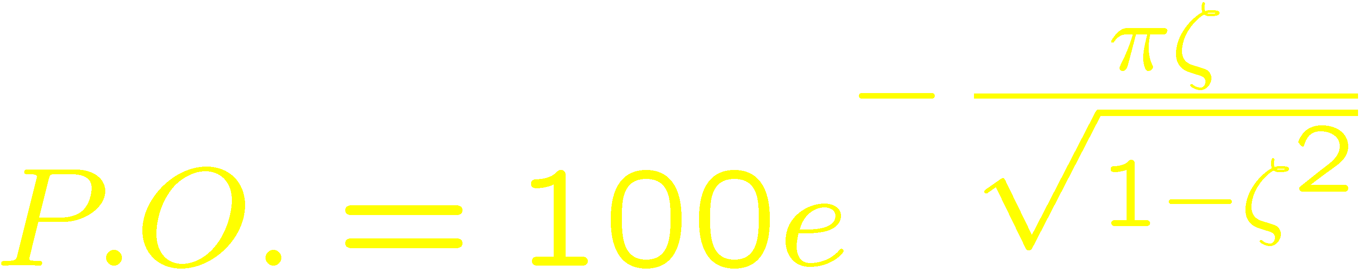
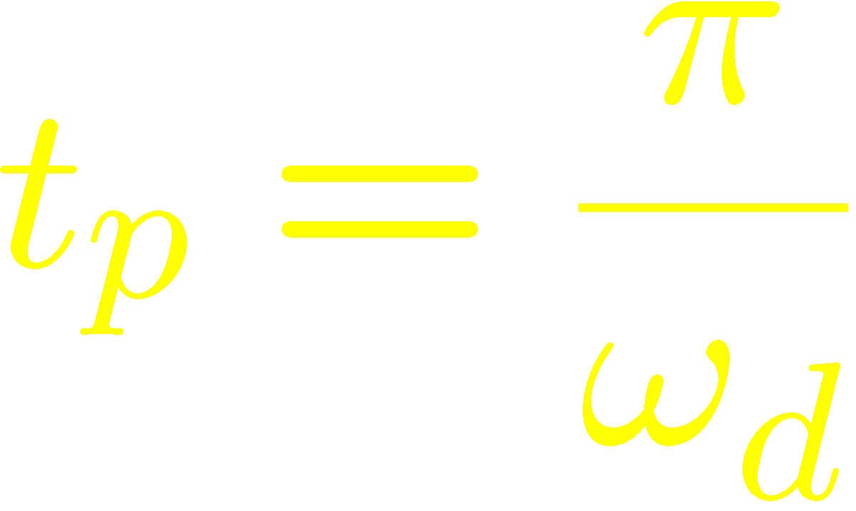
Time Response of 2nd Order Systems
2% settling time:
Overshoot
Peak time

Slide 8
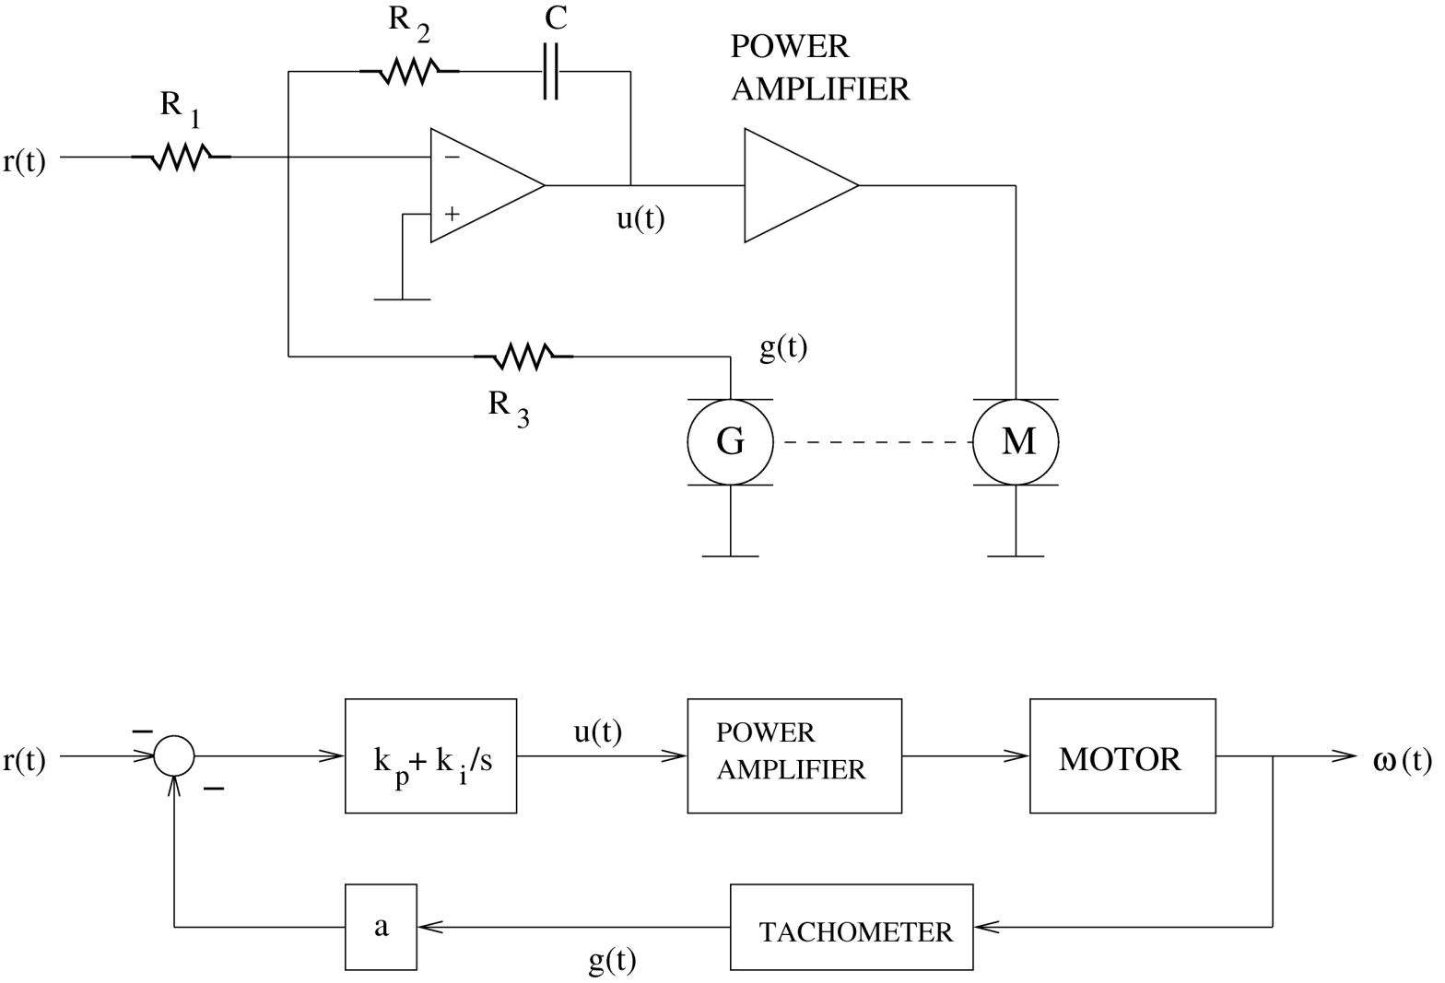
Systems may have multiple poles
A simple speed control system

Slide 9
Systems of order n
How to design controllers for time response specs when n > 2?
Approximate system as a first order system or as a second order system.
Time response: determined by the dominant pole(s).
The dominant pole(s): the pole (or pair of complex poles) closest to the imaginary axis.

Slide 10
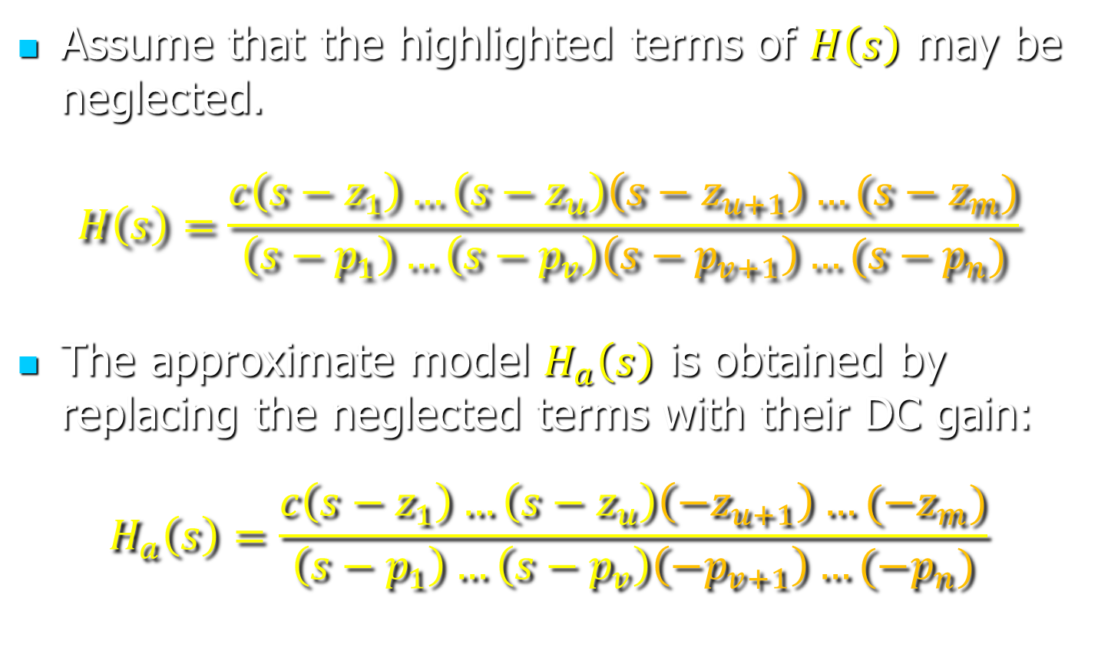
Approximations—Principle
Assume that the highlighted terms of $H\left(s\right)$ may be neglected.
$$H\left(s\right)=\frac{c\left(s−z_{1}\right)…\left(s−z_{u}\right)\left(s−z_{u+1}\right)…(s−z_{m})}{\left(s−p_{1}\right)…\left(s−p_{v}\right)\left(s−p_{v+1}\right)…(s−p_{n})}$$
The approximate model $H_{a}\left(s\right)$ is obtained by replacing the neglected terms with their DC gain:
$$H_{a}\left(s\right)=\frac{c\left(s−z_{1}\right)…\left(s−z_{u}\right)\left(−z_{u+1}\right)…(−z_{m})}{\left(s−p_{1}\right)…\left(s−p_{v}\right)\left(−p_{v+1}\right)…(−p_{n})}$$

Slide 11

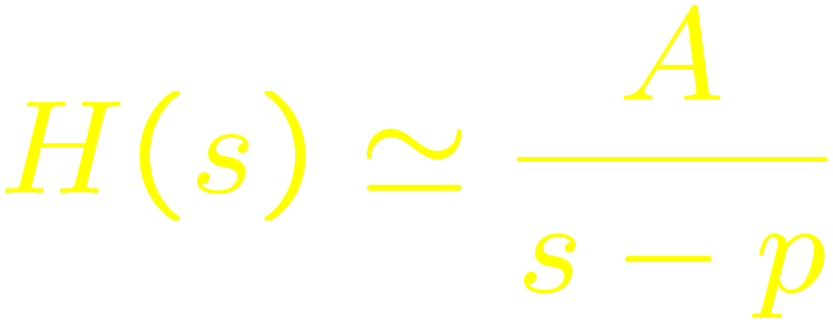
Dominant Poles
Assume pole-zero plot of stable system.
Real dominant pole → 1st order approxim.:
Dominant pole

Slide 12
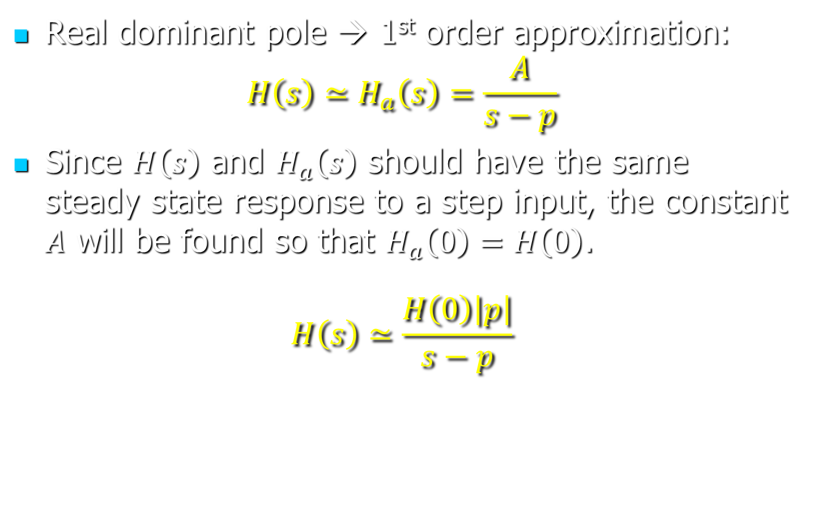
Dominant Poles
Real dominant pole → 1st order approximation:
$$H\left(s\right)≃H_{a}\left(s\right)=\frac{A}{s−p}$$
Since $H\left(s\right)$ and $H_{a}\left(s\right)$ should have the same steady state response to a step input, the constant $A$ will be found so that $H_{a}\left(0\right)=H\left(0\right)$.
$$H\left(s\right)≃\frac{H\left(0\right)\left|p\right|}{s−p}$$

Slide 13
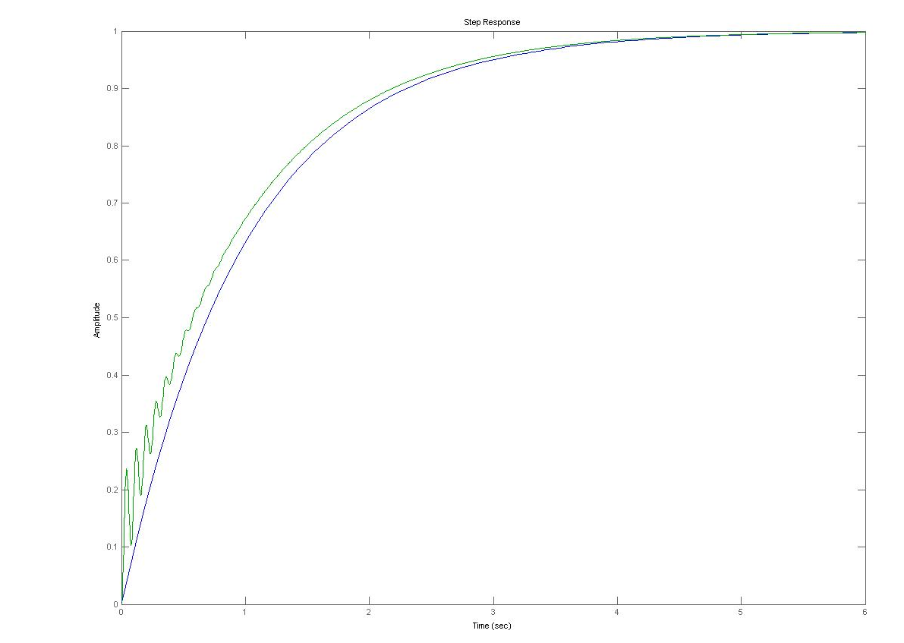
First-order approximation
Response
Response of 1st order approximation

Slide 14

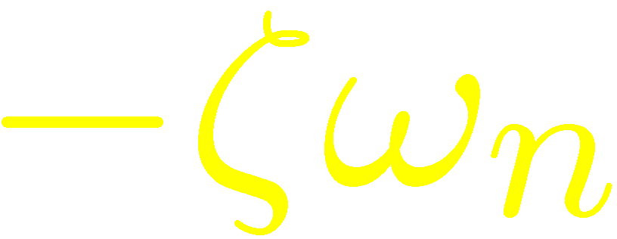

Dominant Poles
Assume pole-zero plot of stable system.
Complex dominant poles → 2nd order approxim.:
Dominant poles

Slide 15
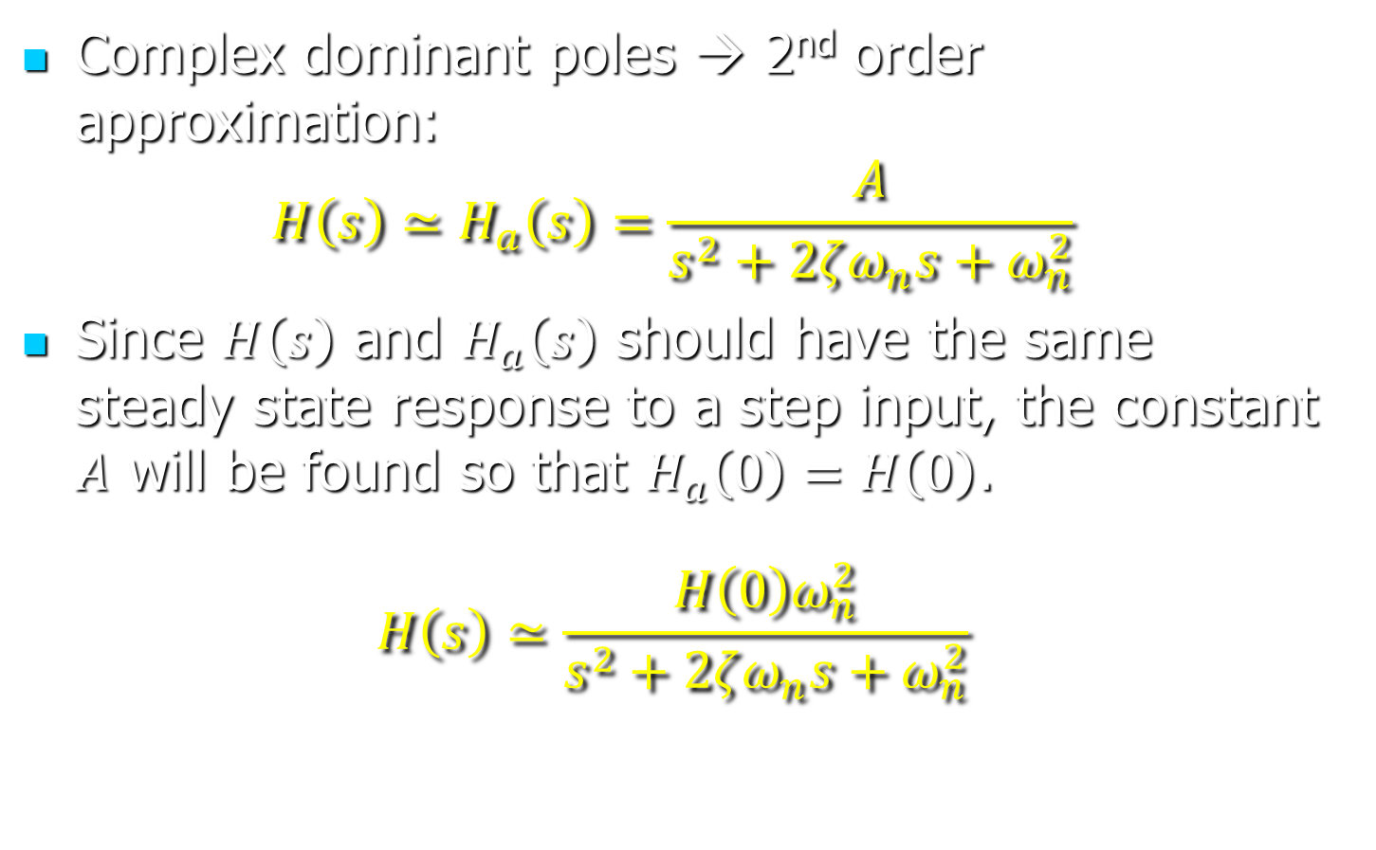
Dominant Poles
Complex dominant poles → 2nd order approximation:
$$H\left(s\right)≃H_{a}\left(s\right)=\frac{A}{s^{2}+2ζω_{n}s+ω_{n}^{2}}$$
Since $H\left(s\right)$ and $H_{a}\left(s\right)$ should have the same steady state response to a step input, the constant $A$ will be found so that $H_{a}\left(0\right)=H\left(0\right)$.
$$H\left(s\right)≃\frac{H\left(0\right)ω_{n}^{2}}{s^{2}+2ζω_{n}s+ω_{n}^{2}}$$

Slide 16
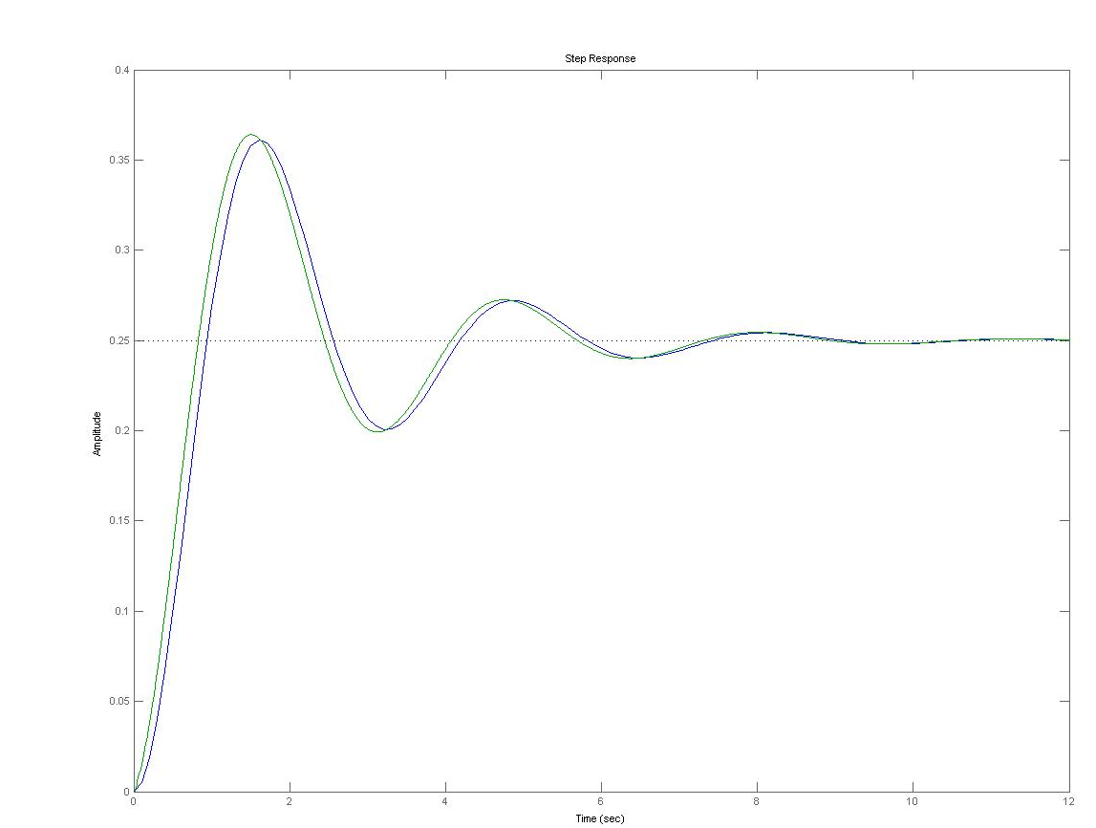
Second-order approximation
Response of 2nd order approximation
Response

Slide 17
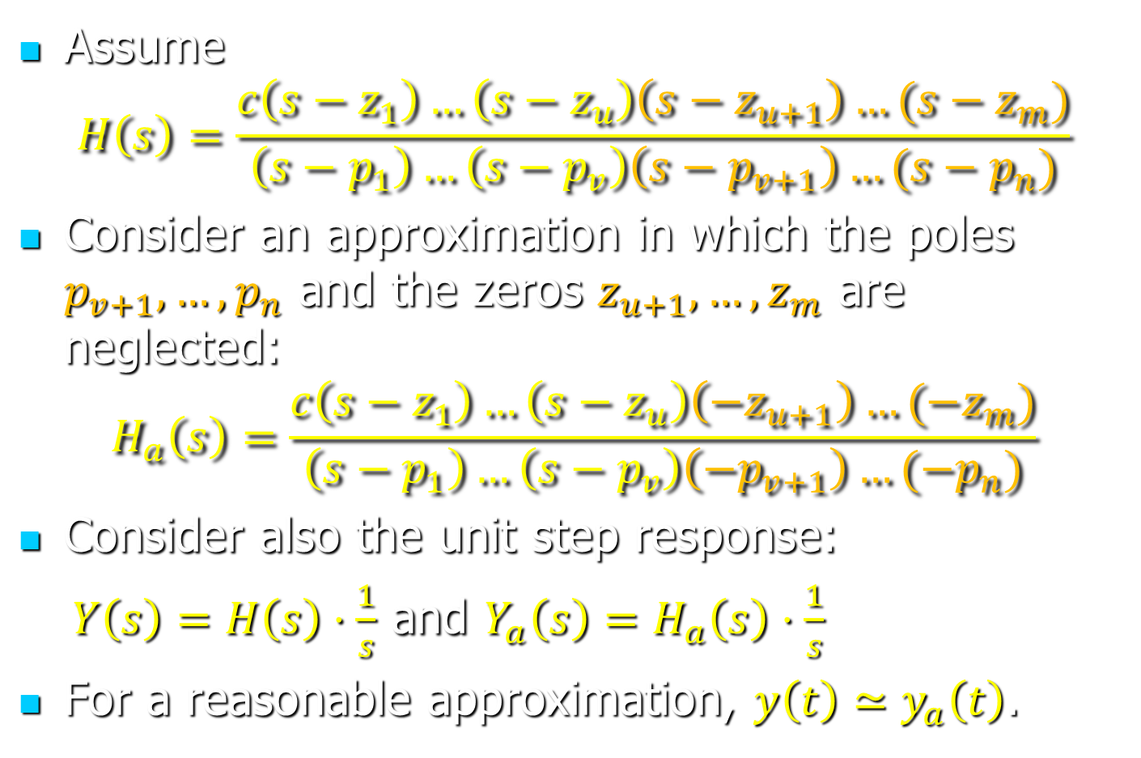
Justifying the Approximations
Assume
$$H\left(s\right)=\frac{c\left(s−z_{1}\right)…\left(s−z_{u}\right)\left(s−z_{u+1}\right)…(s−z_{m})}{\left(s−p_{1}\right)…\left(s−p_{v}\right)\left(s−p_{v+1}\right)…(s−p_{n})}$$
Consider an approximation in which the poles $p_{v+1}, …, p_{n}$ and the zeros $z_{u+1}, …, z_{m}$ are neglected:
$$H_{a}\left(s\right)=\frac{c\left(s−z_{1}\right)…\left(s−z_{u}\right)\left(−z_{u+1}\right)…(−z_{m})}{\left(s−p_{1}\right)…\left(s−p_{v}\right)\left(−p_{v+1}\right)…(−p_{n})}$$
Consider also the unit step response:
  $Y\left(s\right)=H\left(s\right)⋅\frac{1}{s}$ and $Y_{a}\left(s\right)=H_{a}\left(s\right)⋅\frac{1}{s}$
For a reasonable approximation, $y\left(t\right)≃y_{a}\left(t\right)$.

Slide 18
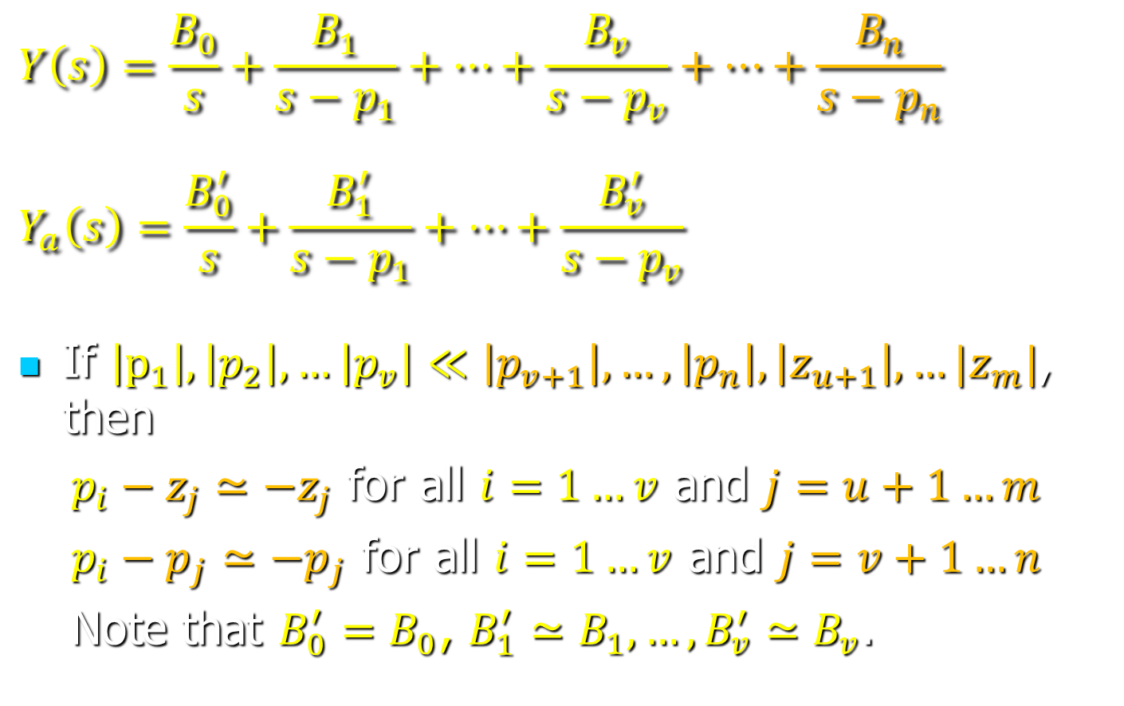
Justifying the Approximations
$$Y\left(s\right)=\frac{B_{0}}{s}+\frac{B_{1}}{s−p_{1}}+…+\frac{B_{v}}{s−p_{v}}+…+\frac{B_{n}}{s−p_{n}}$$
$$Y_{a}\left(s\right)=\frac{B_{0}^{′}}{s}+\frac{B_{1}^{′}}{s−p_{1}}+…+\frac{B_{v}^{′}}{s−p_{v}}$$
If $\left|p_{1}\right|, \left|p_{2}\right|, …\left|p_{v}\right|≪\left|p_{v+1}\right|, …, \left|p_{n}\right|, \left|z_{u+1}\right|, …|z_{m}|$, then
  $p_{i}−z_{j}≃−z_{j}$ for all $i=1…v$ and $j=u+1…m$
  $p_{i}−p_{j}≃−p_{j}$ for all $i=1…v$ and $j=v+1…n$
  Note that $B_{0}^{′}=B_{0}$, $B_{1}^{′}≃B_{1}, …, B_{v}^{′}≃B_{v}$.

Slide 19
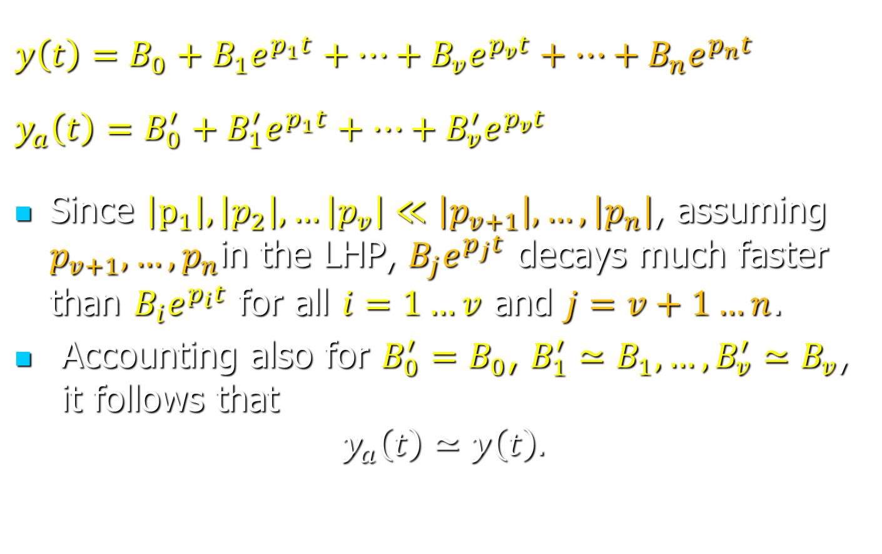
Justifying the Approximations
$$y\left(t\right)=B_{0}+B_{1}e^{p_{1}t}+…+B_{v}e^{p_{v}t}+…+B_{n}e^{p_{n}t}$$
$$y_{a}\left(t\right)=B_{0}^{′}+B_{1}^{′}e^{p_{1}t}+…+B_{v}^{′}e^{p_{v}t}$$
Since $\left|p_{1}\right|, \left|p_{2}\right|, …\left|p_{v}\right|≪\left|p_{v+1}\right|, …, \left|p_{n}\right|$, assuming $p_{v+1}, …, p_{n}$in the LHP, $B_{j}e^{p_{j}t}$ decays much faster than $B_{i}e^{p_{i}t}$ for all $i=1…v$ and $j=v+1…n$.
Accounting also for $B_{0}^{′}=B_{0}$, $B_{1}^{′}≃B_{1}, …, B_{v}^{′}≃B_{v}$, it follows that
$$y_{a}\left(t\right)≃y\left(t\right).$$

