Slide 1
Stability of Control Systems
BIBO Stability. The Routh-Hurwitz Criterion.
M.V. Iordache, EEGR3523 Mechatronics, Spring 2019, LeTourneau University

Slide 2
Control Systems—Stability
Stability is essential!
How instability manifests:
The system does not respond to inputs AND
The output oscillates OR is saturated at maximum high/low level.

Slide 3
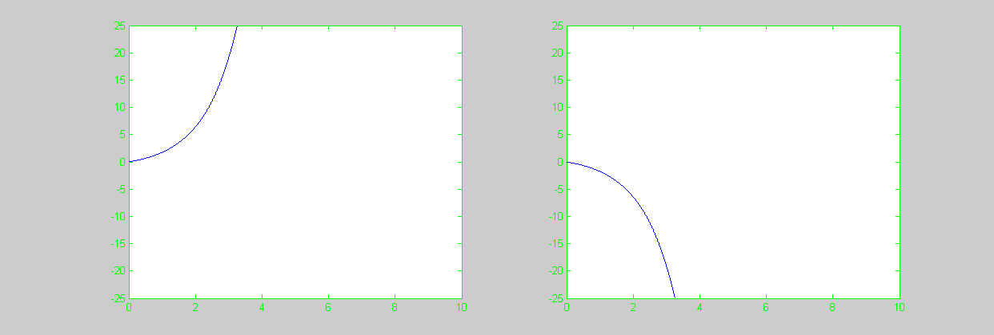
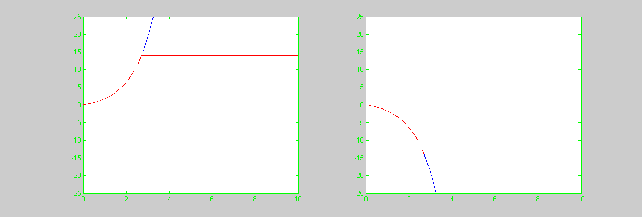
Manifestations of Instability

Slide 4
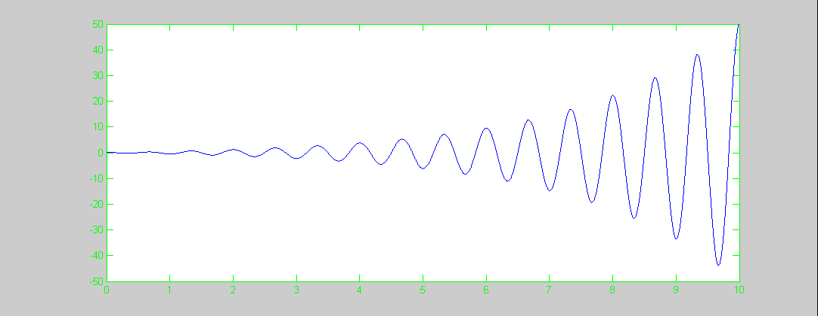
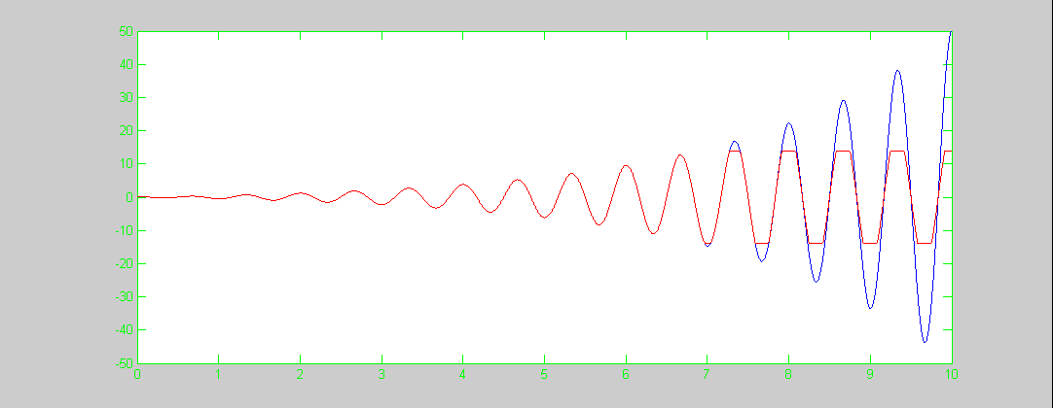
Manifestations of Instability

Slide 5
Why Study Stability
Control systems are designed to enhance the performance of a plant. However:
An improper selection of control parameters can cause instability even when the plant is stable.
A proper selection of control parameters will result in stability even when the plant is unstable.

Slide 6
BIBO Stability
A system model that responds to every bounded input with a bounded output is said to be BIBO stable.
Assuming reasonably accurate models, the linear model of a stable system will be BIBO stable.
A linear system is BIBO stable if and only if it has no poles outside of the LHP.
The Routh array and the Routh-Hurwitz criterion can be used to test whether there are poles outside of the LHP.
More importantly, they can be used to select control parameters that ensure stability.

Slide 7
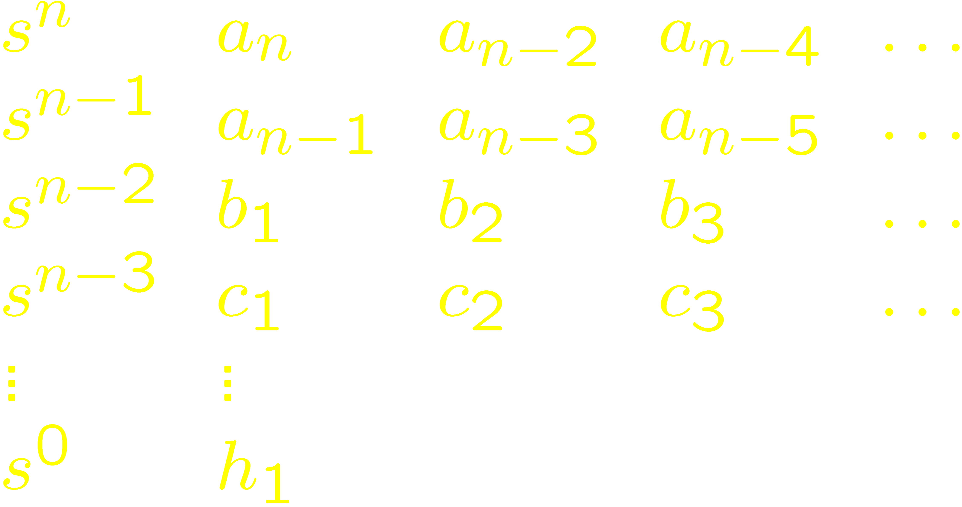
The Routh Array
Given
define

Slide 8
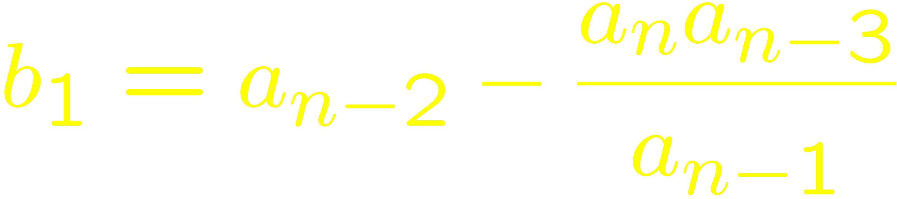

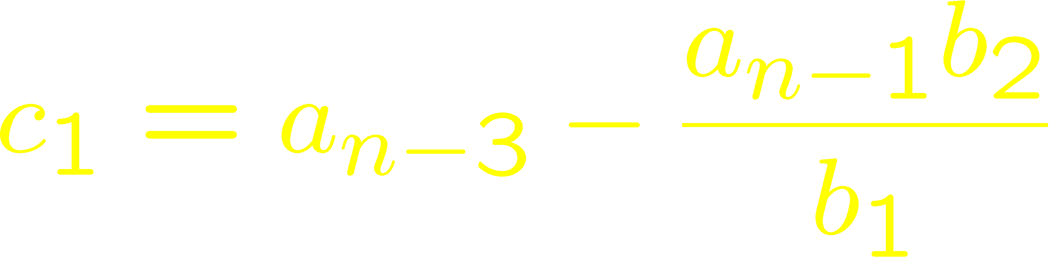
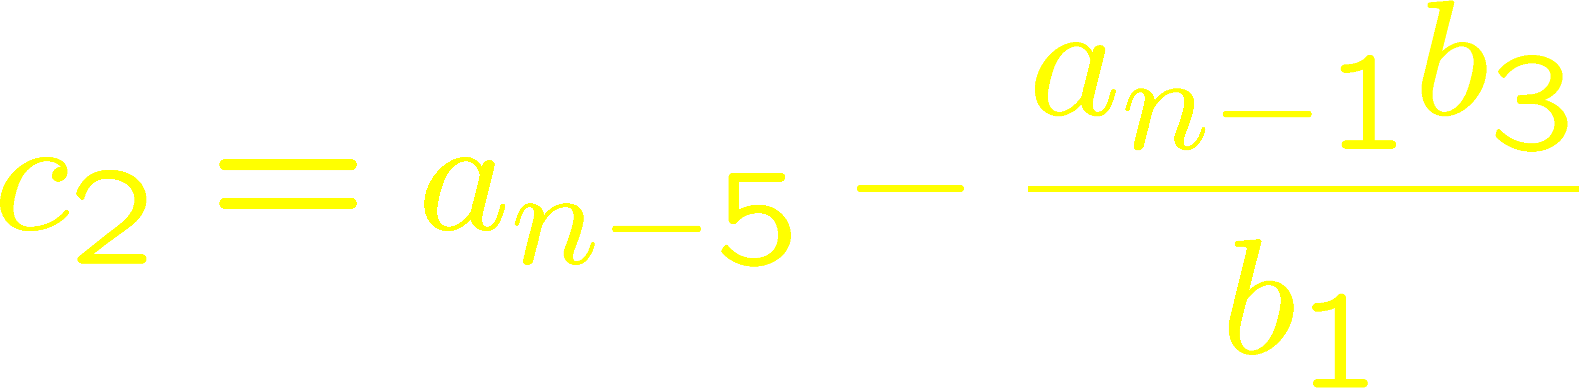
The Routh Array

Slide 9
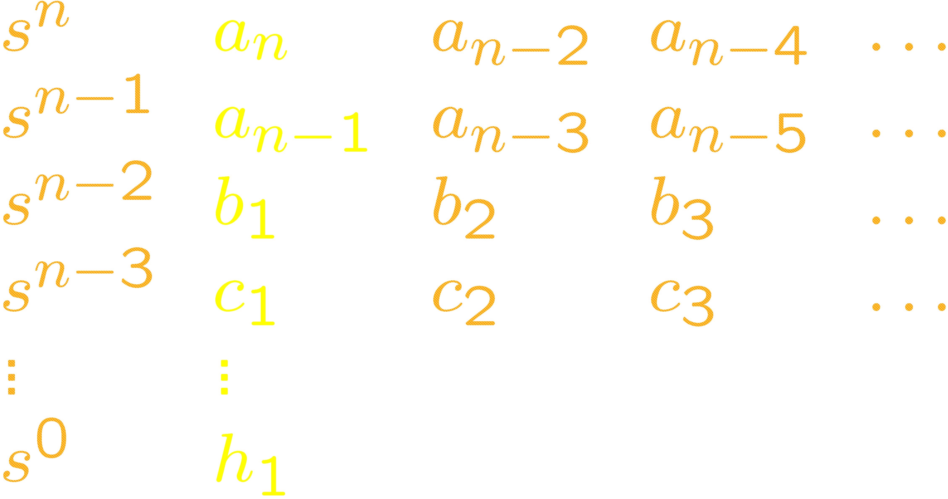
The Routh-Hurwitz Criterion
All roots in LHP if and only if
are nonzero and with the same sign.
If all roots in LHP, then
are also nonzero and with the same sign.

Slide 10
The Routh-Hurwitz Criterion
Given
Check first whether
are nonzero and with the same sign.
If yes, then find the Routh array and check the first column.
The Routh array is not necessary when n < 3.

Slide 11
The Routh-Hurwitz Criterion
Used to determine the range of the control parameters for which a control system is stable.
It can be applied to systems of any order.

Slide 12
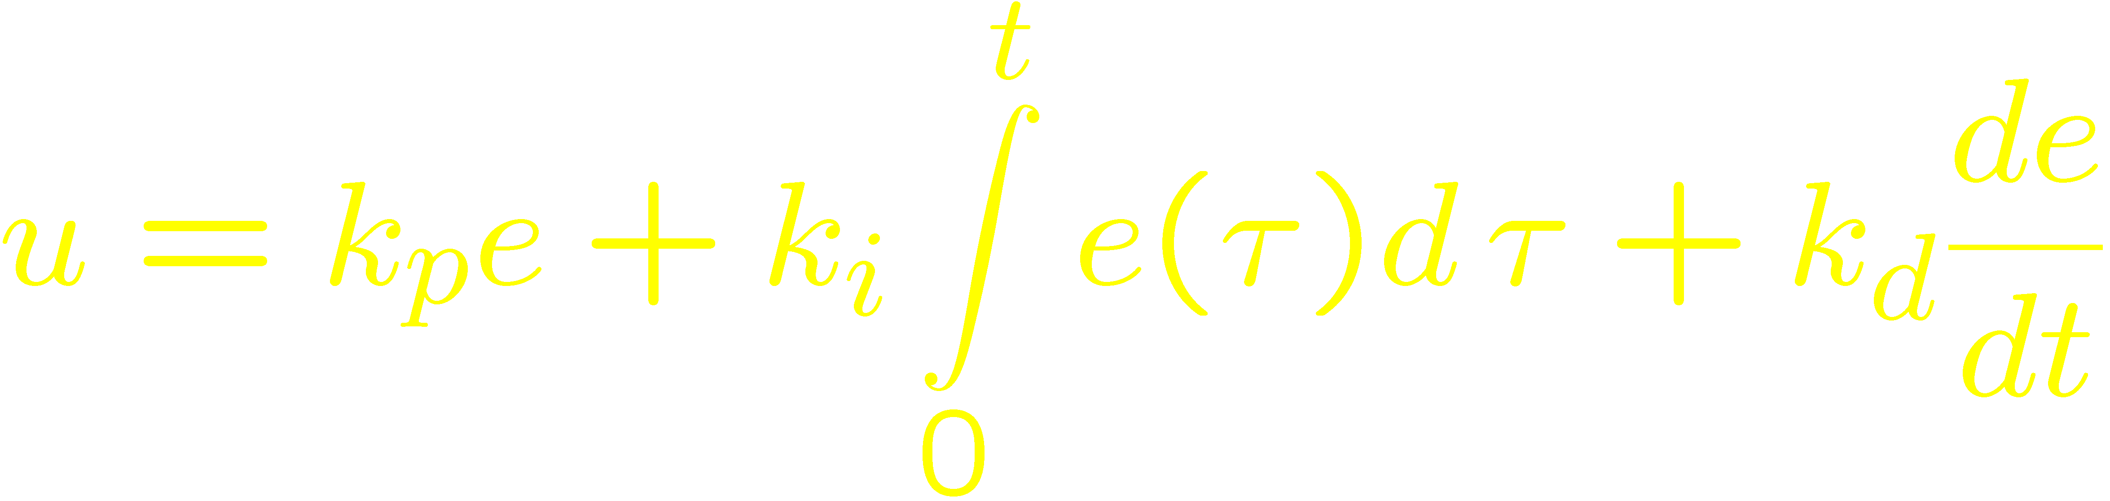
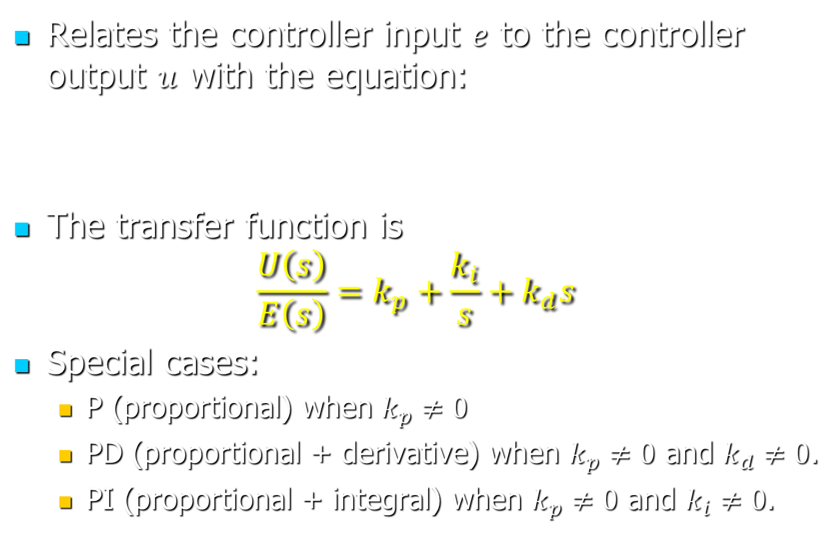
PID Control
Relates the controller input $e$ to the controller output $u$ with the equation:
The transfer function is
$$\frac{U\left(s\right)}{E\left(s\right)}=k_{p}+\frac{k_{i}}{s}+k_{d}s$$
Special cases:
P (proportional) when $k_{p}≠0$
PD (proportional + derivative) when $k_{p}≠0$ and $k_{d}≠0$.
PI (proportional + integral) when $k_{p}≠0$ and $k_{i}≠0$.

