Slide 1
Nodal Analysis
A General Method for Solving Circuits
M.V. Iordache, EEGR2053 Electric Circuits, Spring 2020, LeTourneau University

Slide 2
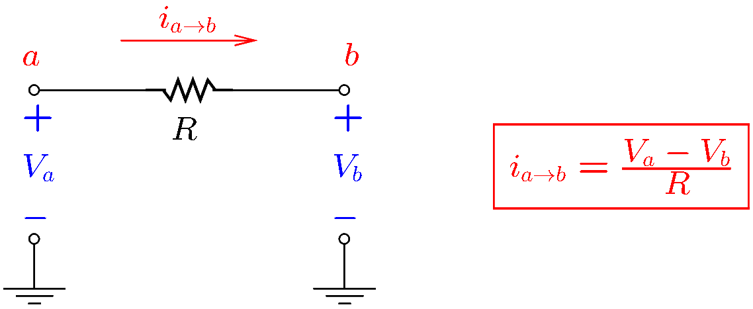
An important formula
Nodal equations can be written quickly if you remember this formula:
Notes:
sum/nodalpr

Slide 3
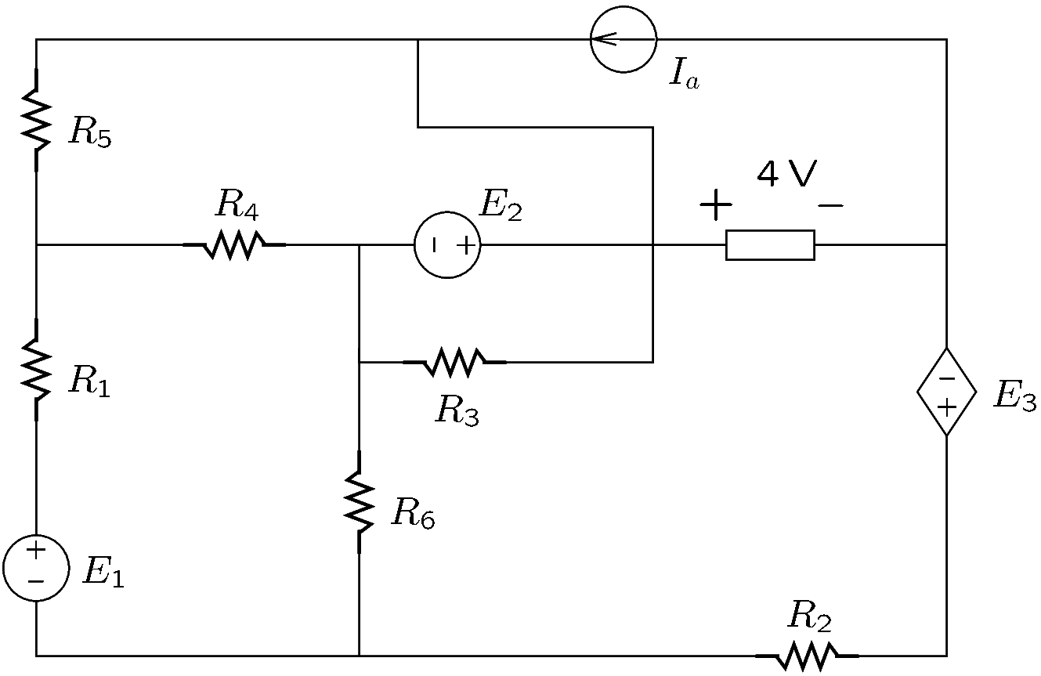
Select a reference node
Any node may serve as a reference node.
The choice is arbitrary.
Nodal analysis finds node voltages with respect to the reference node.
A reference node will be denoted by REF, or by the electric-ground symbol.
Notes:
sum/nodalpr

Slide 4
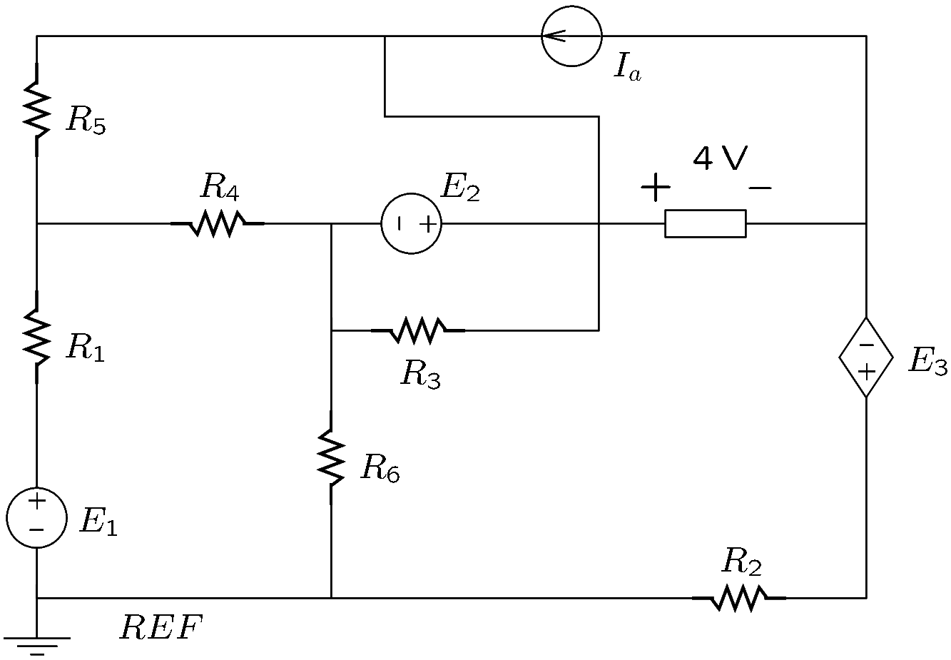
Mark the reference node
The node at the bottom left corner was chosen as the reference.

Slide 5
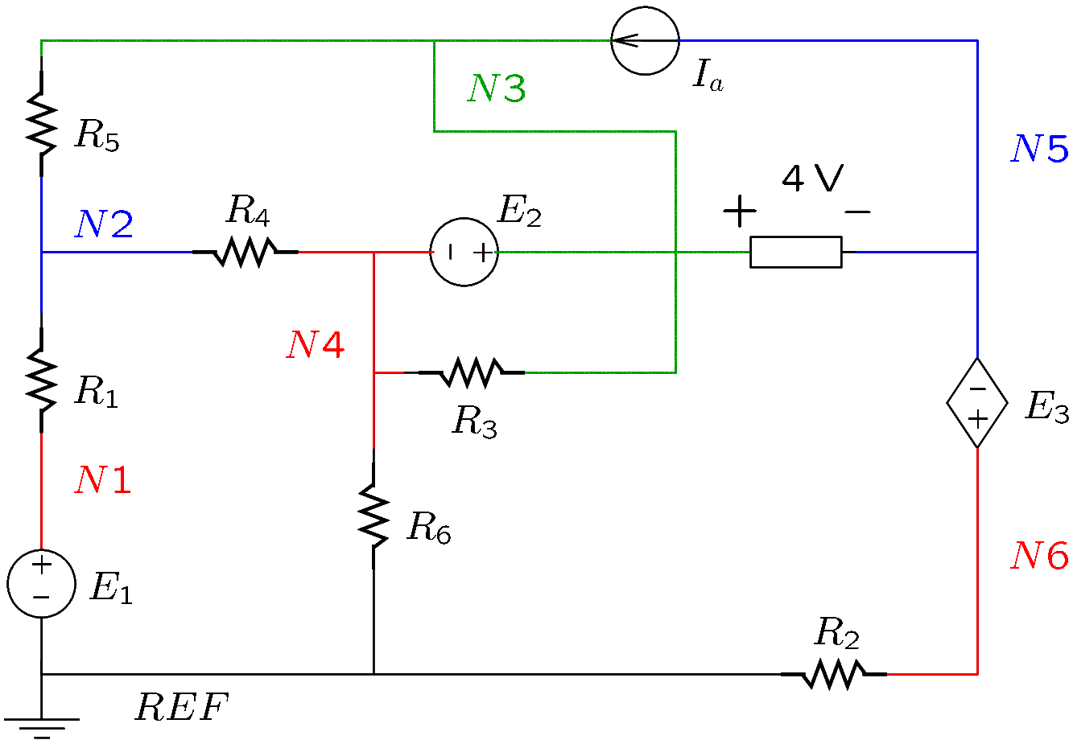
Identify the nodes of the circuit
The nodes are N1 … N6 and REF.

Slide 6
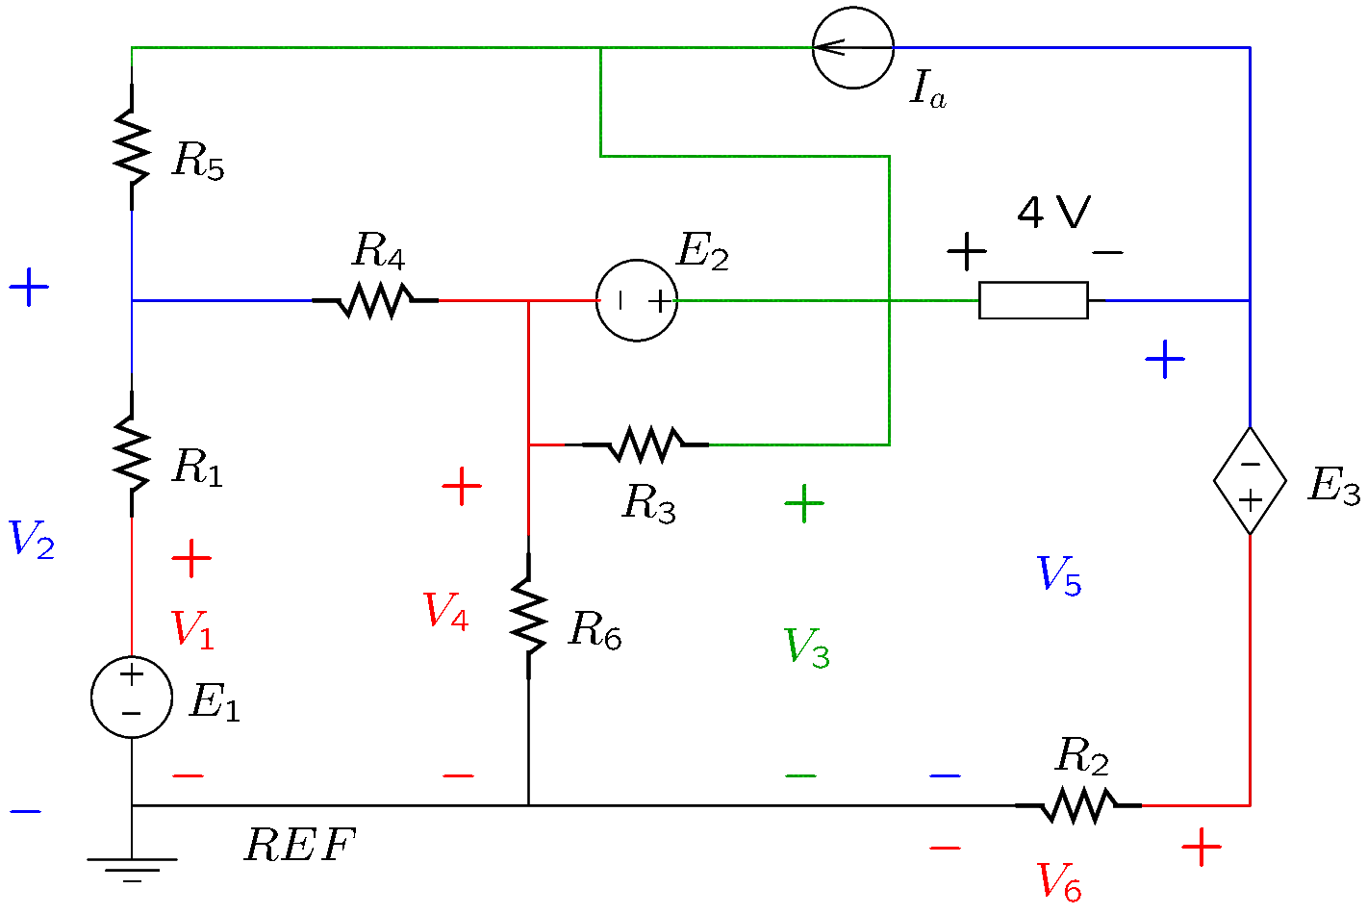
Identify nodal voltages
Nodal analysis solves for node voltages with respect to REF.

Slide 7
Identify the supernodes
A supernode is a network in which every node is connected to some other node by a source of voltage or by a component of known voltage.
A path must exist between any two nodes that goes only through branches containing sources of voltage or components of known voltage.
The network must be maximal; do not leave outside of the supernode a node that is connected to it by a source of voltage or a component of known voltage.
Include into the network all components connected between any two nodes of the supernode.

Slide 8
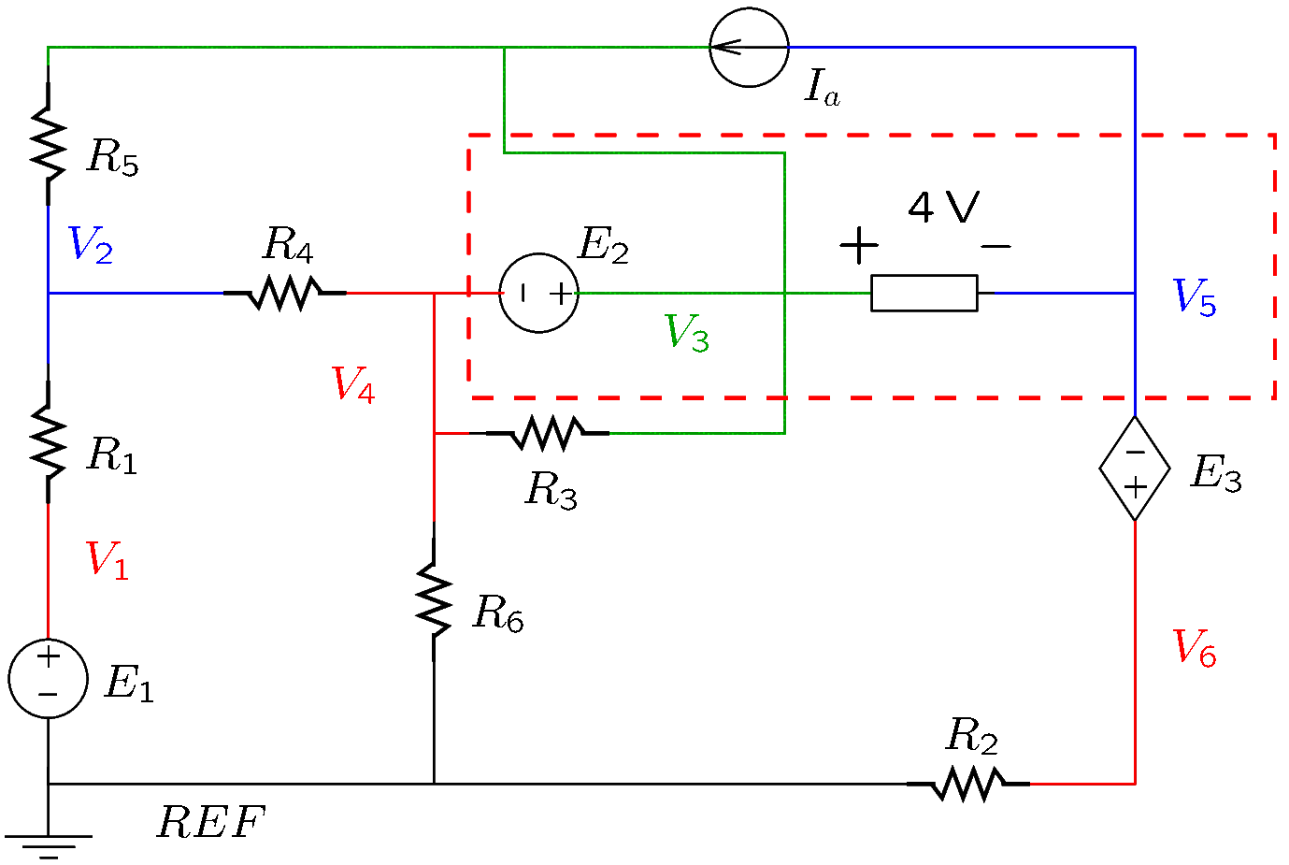
Supernodes
This network is not a supernode: it does not include node 6, so it is not maximal.

Slide 9
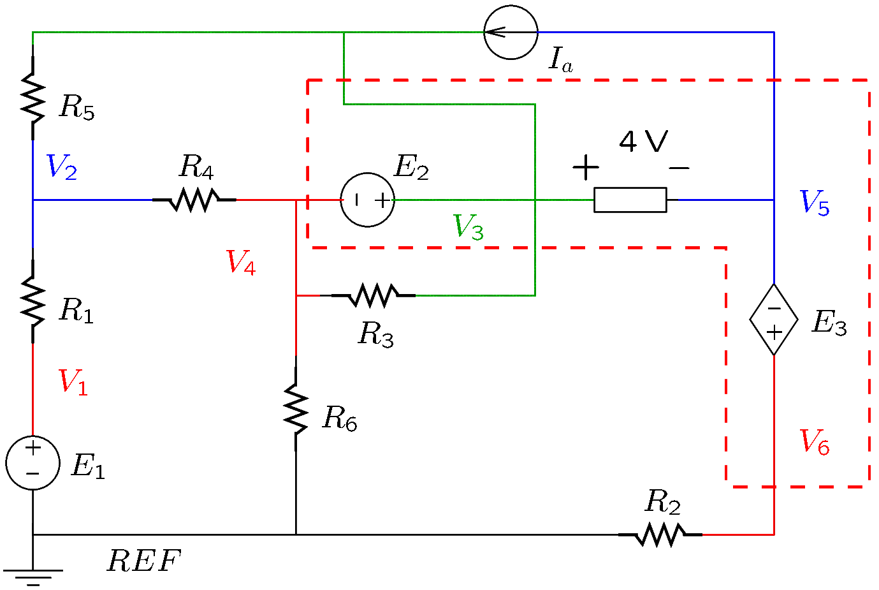
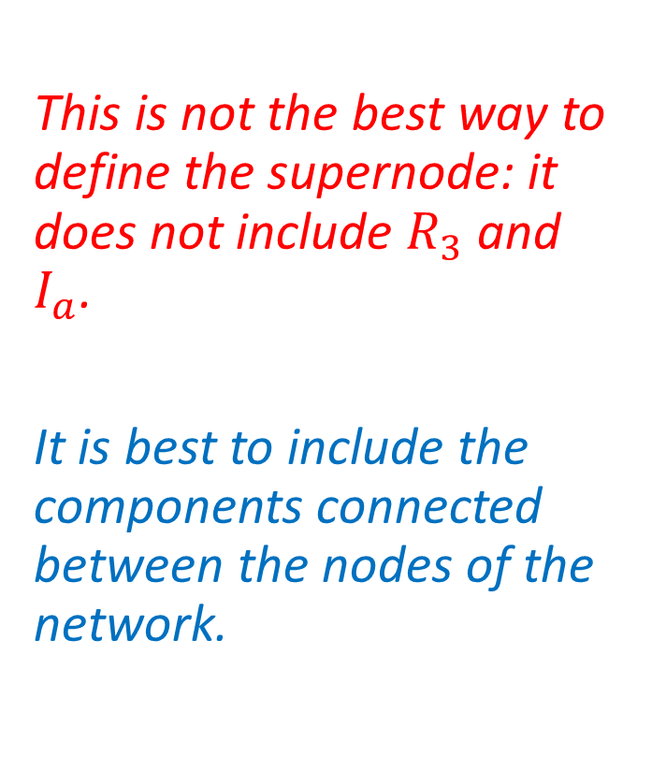
Supernodes
This is not the best way to define the supernode: it does not include $R_{3}$ and $I_{a}$.
It is best to include the components connected between the nodes of the network.

Slide 10
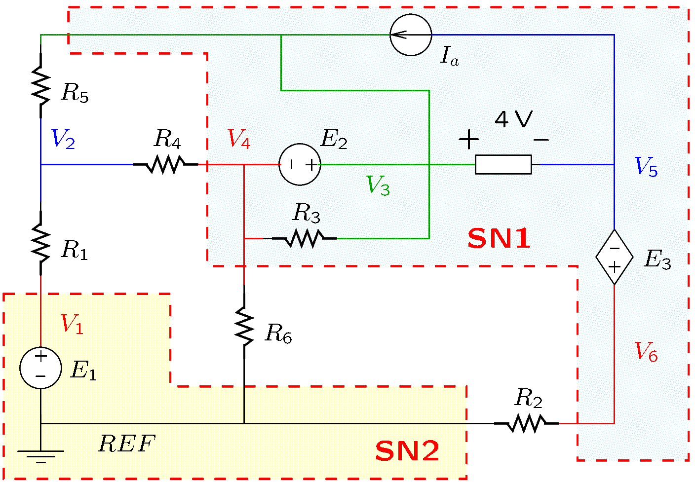
Supernodes
The circuit has two supernodes:
SN1 and SN2.

Slide 11
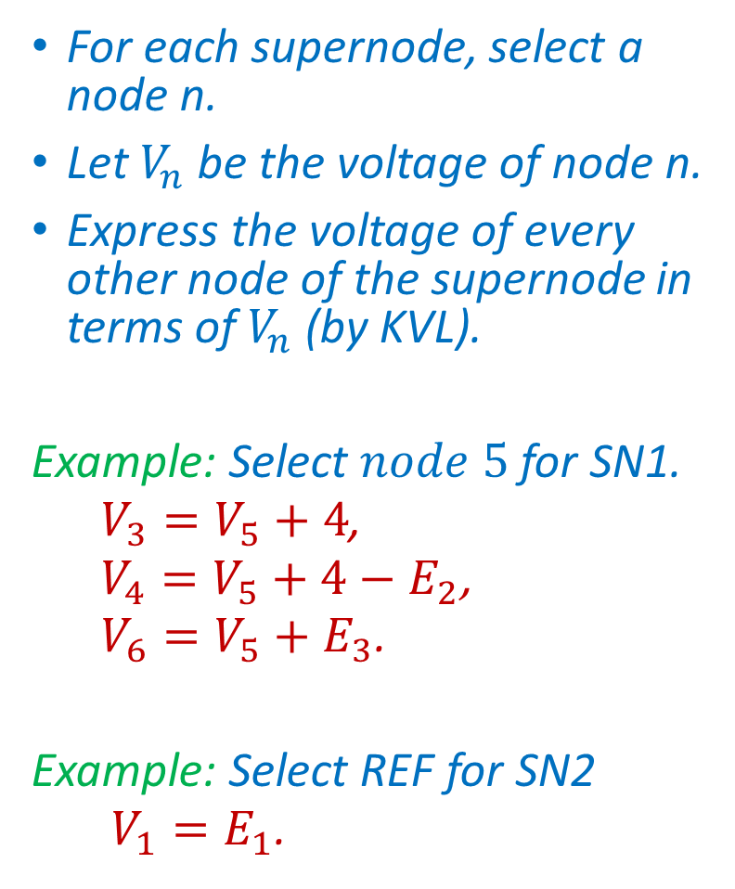
Supernode voltages
For each supernode, select a node n.
Let $V_{n}$ be the voltage of node n.
Express the voltage of every other node of the supernode in terms of $V_{n}$ (by KVL).
Example: Select $node 5$for SN1.
$V_{3}=V_{5}+4$,
$V_{4}=V_{5}+4−E_{2}$,
$V_{6}=V_{5}+E_{3}$.
Example: Select REF for SN2
$V_{1}=E_{1}$.

Slide 12
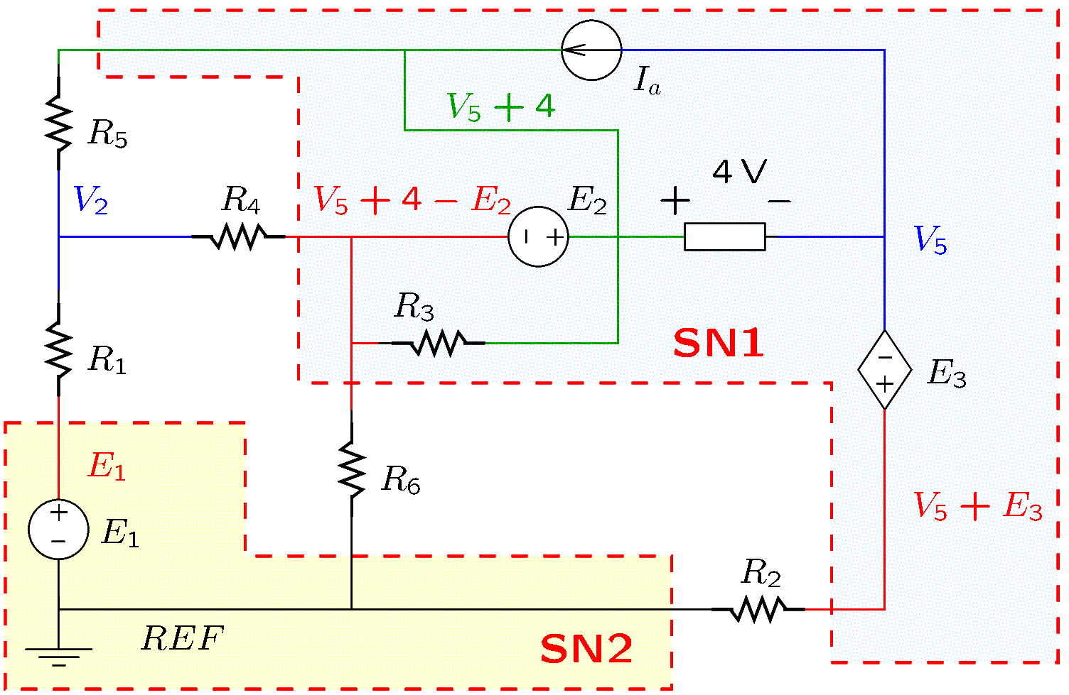
Supernode voltages

Slide 13
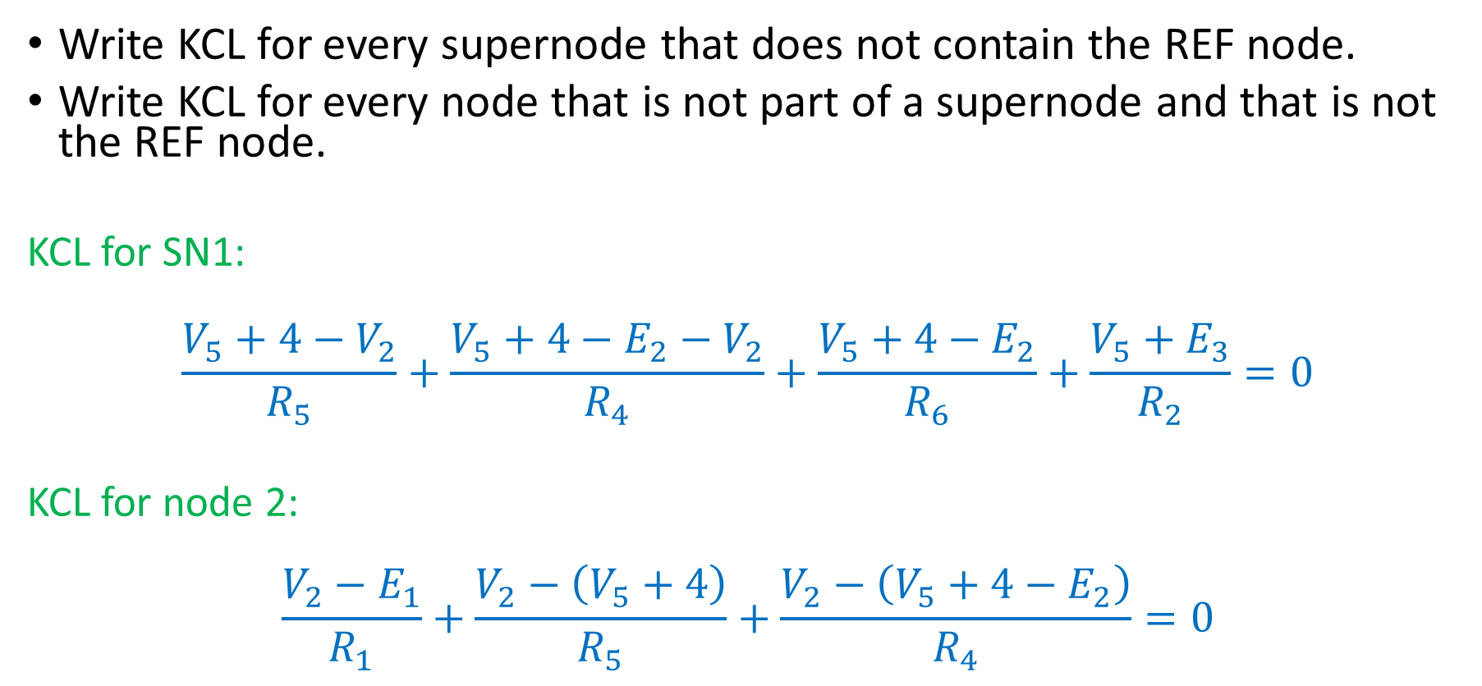
Write KCL
Write KCL for every supernode that does not contain the REF node.
Write KCL for every node that is not part of a supernode and that is not the REF node.
KCL for SN1:
$$\frac{V_{5}+4−V_{2}}{R_{5}}+\frac{V_{5}+4−E_{2}−V_{2}}{R_{4}}+\frac{V_{5}+4−E_{2}}{R_{6}}+\frac{V_{5}+E_{3}}{R_{2}}=0$$
KCL for node 2:
$$\frac{V_{2}−E_{1}}{R_{1}}+\frac{V_{2}−\left(V_{5}+4\right)}{R_{5}}+\frac{V_{2}−\left(V_{5}+4−E_{2}\right)}{R_{4}}=0$$

