Slide 1
Review—Part 2
M.V. Iordache, EEGR2053 Electric Circuits, Spring 2020, LeTourneau University

Slide 2
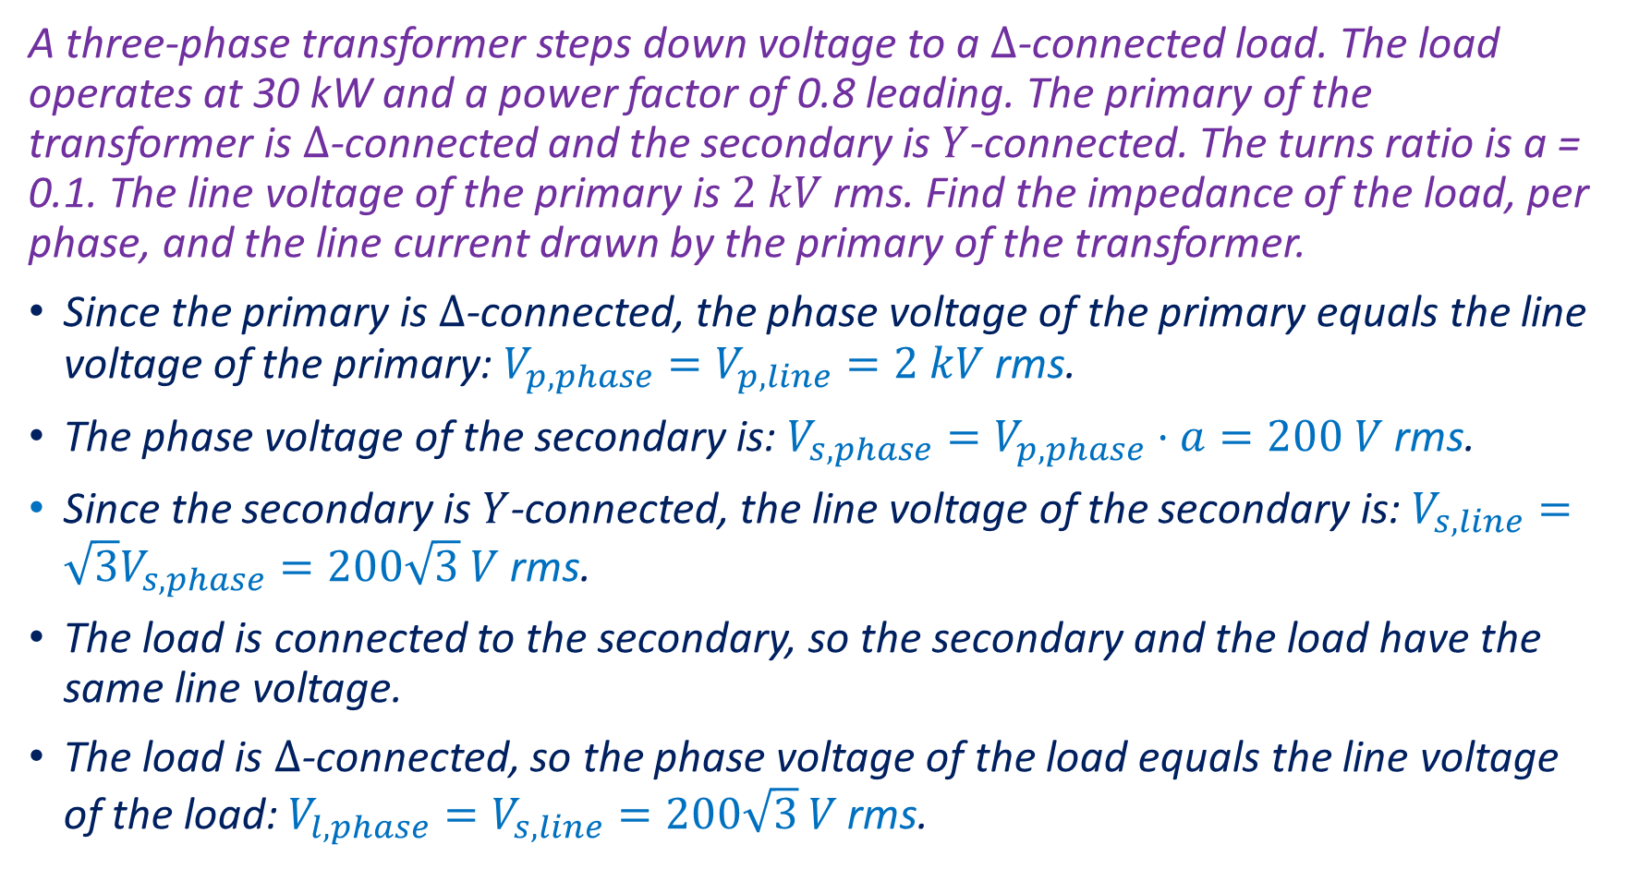
Example 1
A three-phase transformer steps down voltage to a $Δ$-connected load. The load operates at 30 kW and a power factor of 0.8 leading. The primary of the transformer is $Δ$-connected and the secondary is $Y$-connected. The turns ratio is a = 0.1. The line voltage of the primary is $2 kV$ rms. Find the impedance of the load, per phase, and the line current drawn by the primary of the transformer.
Since the primary is $Δ$-connected, the phase voltage of the primary equals the line voltage of the primary: $V_{p,phase}=V_{p,line}=2 kV$ rms.
The phase voltage of the secondary is: $V_{s,phase}=V_{p,phase}⋅a=200 V$ rms.
Since the secondary is $Y$-connected, the line voltage of the secondary is: $V_{s,line}=\sqrt{3}V_{s,phase}=200\sqrt{3} V$ rms.
The load is connected to the secondary, so the secondary and the load have the same line voltage.
The load is $Δ$-connected, so the phase voltage of the load equals the line voltage of the load: $V_{l,phase}=V_{s,line}=200\sqrt{3} V \text{rms}\text{.}$

Slide 3
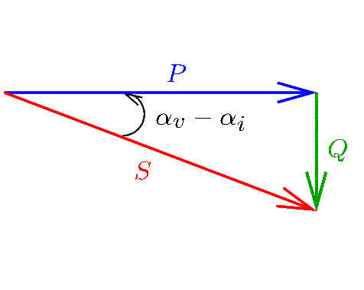
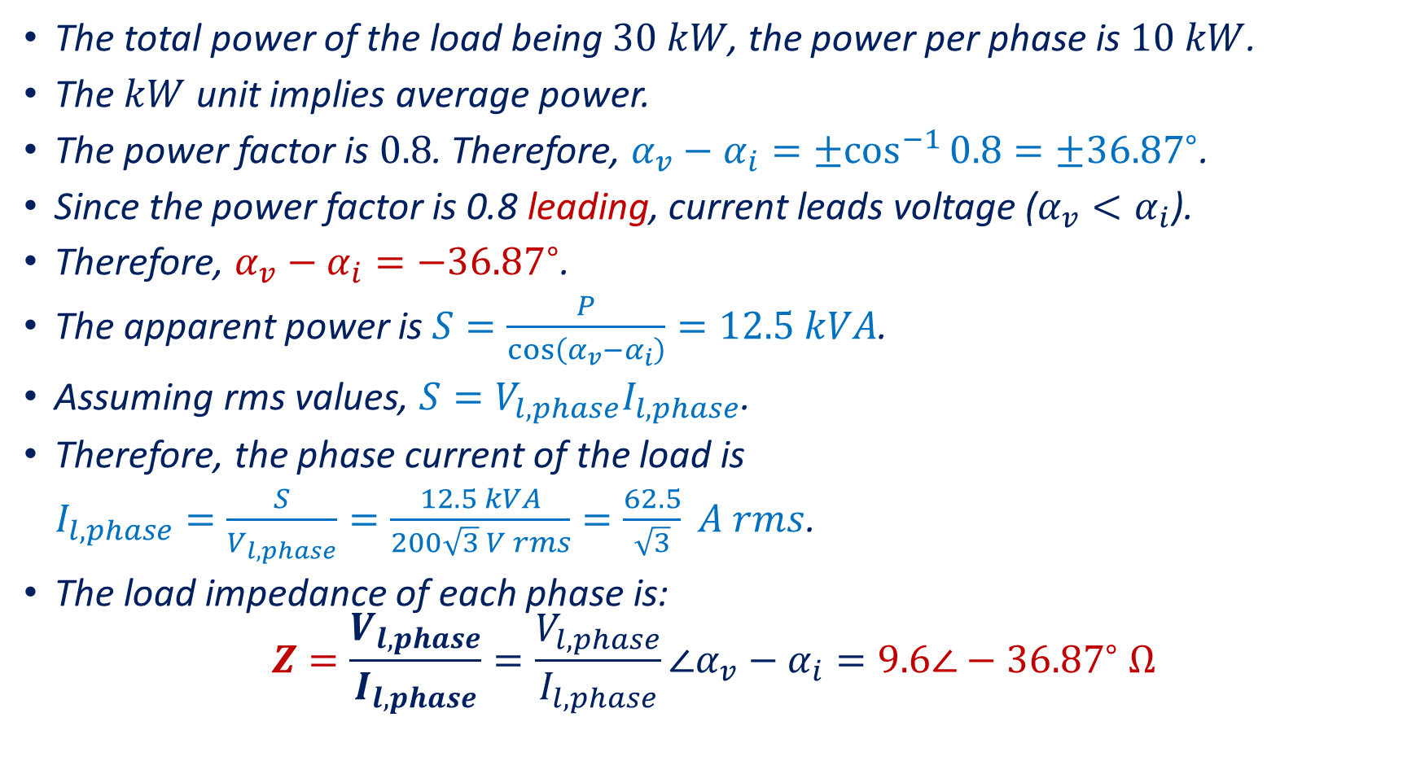
Example 1 (Continued)
The total power of the load being $30 kW$, the power per phase is $10 kW$.
The $kW$ unit implies average power.
The power factor is $0.8$. Therefore, $α_{v}−α_{i}={±cos}^{−1}{0.8}=±{36.87}^{∘}$.
Since the power factor is 0.8 leading, current leads voltage ($α_{v}<α_{i}$).
Therefore, $α_{v}−α_{i}=−{36.87}^{∘}$.
The apparent power is $S=\frac{P}{\cos\left(α_{v}−α_{i}\right)}=12.5 kVA$.
Assuming rms values, $S=V_{l,phase}I_{l,phase}$.
Therefore, the phase current of the load is
$I_{l,phase}=\frac{S}{V_{l,phase}}=\frac{12.5 kVA}{200\sqrt{3} V rms}=\frac{62.5}{\sqrt{3}} A rms$.
The load impedance of each phase is:
$$Z=\frac{V_{l,phase}}{I_{l,phase}}=\frac{V_{l,phase}}{I_{l,phase}}∠α_{v}−α_{i}=9.6∠−{36.87}^{∘} Ω$$
Notes:
cdoc/sum/power4.fig

Slide 4
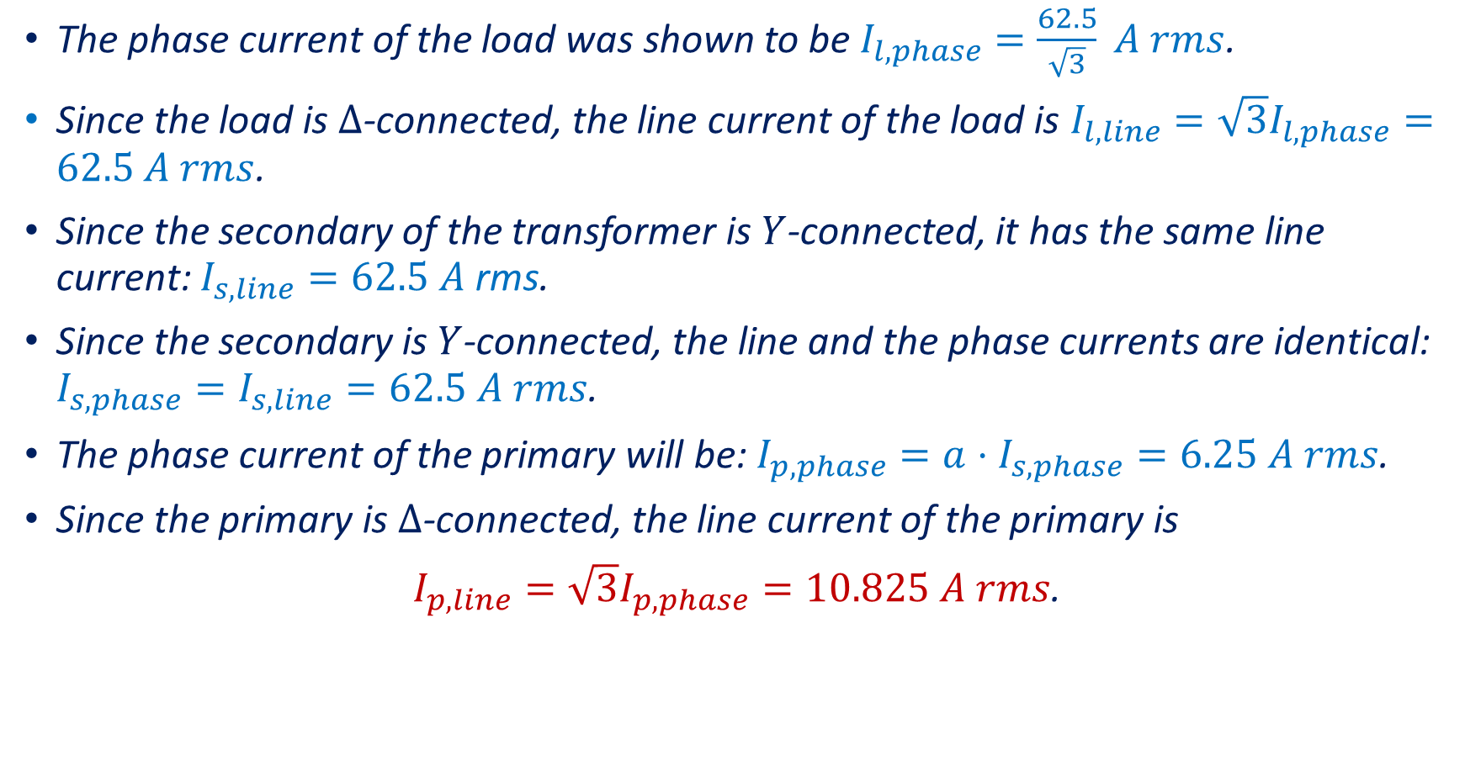
Example 1 (Continued)
The phase current of the load was shown to be $I_{l,phase}=\frac{62.5}{\sqrt{3}} A rms$.
Since the load is $Δ$-connected, the line current of the load is $I_{l,line}=\sqrt{3}I_{l,phase}=62.5 A rms$.
Since the secondary of the transformer is $Y$-connected, it has the same line current: $I_{s,line}=62.5 A$ rms.
Since the secondary is $Y$-connected, the line and the phase currents are identical: $I_{s,phase}=I_{s,line}=62.5 A rms$.
The phase current of the primary will be: $I_{p,phase}=a⋅I_{s,phase}=6.25 A rms$.
Since the primary is $Δ$-connected, the line current of the primary is
$I_{p,line}=\sqrt{3}I_{p,phase}=10.825 A rms$.
Notes:
cdoc/sum/power4.fig

Slide 5
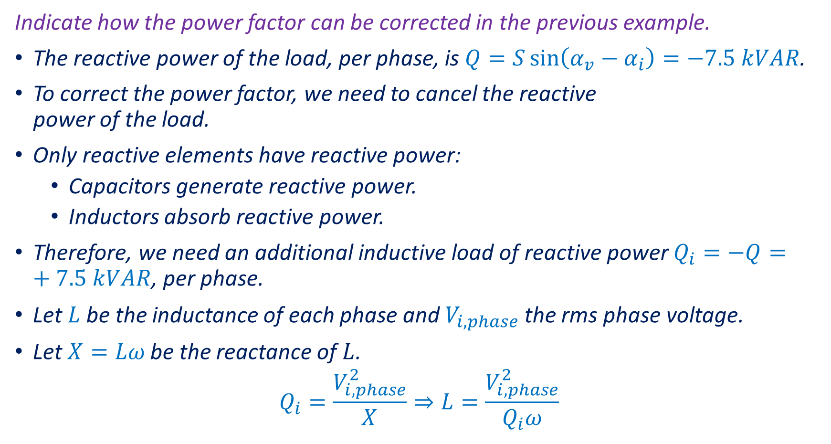
Example 2
Indicate how the power factor can be corrected in the previous example.
The reactive power of the load, per phase, is $Q=S\sin\left(α_{v}−α_{i}\right)=−7.5 kVAR$.
To correct the power factor, we need to cancel the reactive
power of the load.
Only reactive elements have reactive power:
  Capacitors generate reactive power.
  Inductors absorb reactive power.
Therefore, we need an additional inductive load of reactive power $Q_{i}=−Q=+7.5 kVAR$, per phase.
Let $L$ be the inductance of each phase and $V_{i,phase}$ the rms phase voltage.
Let $X=Lω$ be the reactance of $L$.
$$Q_{i}=\frac{V_{i,phase}^{2}}{X}⇒L=\frac{V_{i,phase}^{2}}{Q_{i}ω}$$
Notes:
cdoc/sum/power4.fig

Slide 6

Example 2 (Continued)
Note that if the inductors are $Y$-connected, their value will be three times smaller than if they are $Δ$-connected.
Assuming $Y$-connected inductors and a $60 Hz$ frequency:
$$L=\frac{V_{i,phase}^{2}}{Q_{i}ω}=\frac{{\left(200\sqrt{3} V/\sqrt{3}\right)}^{2}}{7.5 kVAR⋅2π⋅60 Hz}=14.147 mH$$
Notes:
cdoc/sum/power4.fig

Slide 7
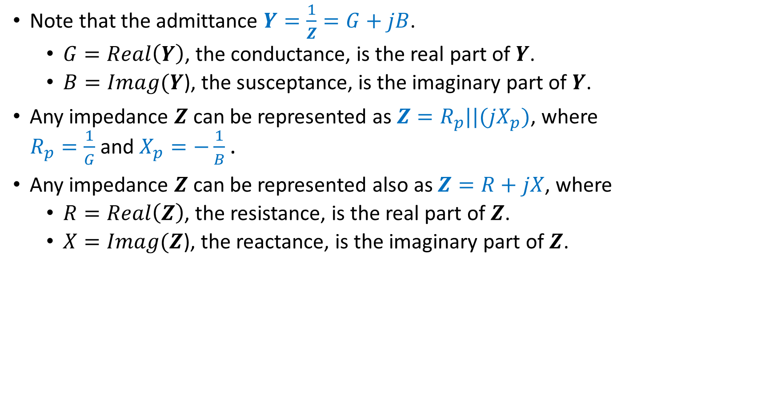
Remarks
Note that the admittance $Y=\frac{1}{Z}=G+jB$.
  $G=Real\left(Y\right)$, the conductance, is the real part of $Y$.
  $B=Imag(Y$), the susceptance, is the imaginary part of $Y$.
Any impedance $Z$ can be represented as $Z=R_{p}||(jX_{p})$, where
$R_{p}=\frac{1}{G}$ and $X_{p}=−\frac{1}{B}$.
Any impedance $Z$ can be represented also as $Z=R+jX$, where
  $R=Real\left(Z\right)$, the resistance, is the real part of $Z$.
  $X=Imag(Z$), the reactance, is the imaginary part of $Z$.
Notes:
cdoc/sum/power4.fig

Slide 8
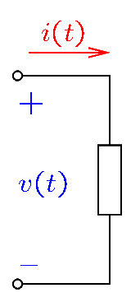
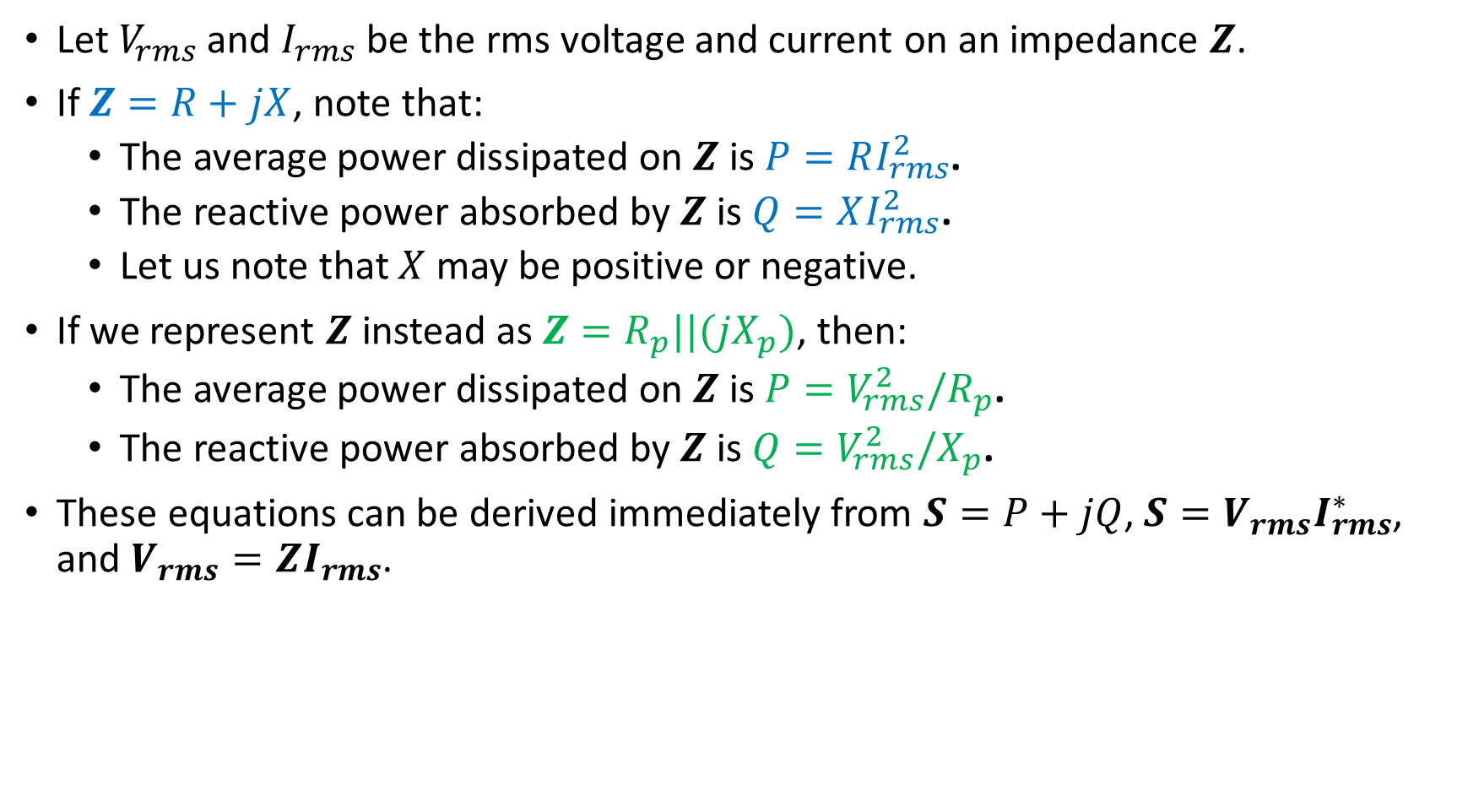
Remarks
Let $V_{rms}$ and $I_{rms}$ be the rms voltage and current on an impedance $Z$.
If $Z=R+jX$, note that:
  The average power dissipated on $Z$ is $P=RI_{rms}^{2}$.
  The reactive power absorbed by $Z$ is $Q=XI_{rms}^{2}$.
  Let us note that $X$ may be positive or negative.
If we represent $Z$ instead as $Z=R_{p}||(jX_{p})$, then:
  The average power dissipated on $Z$ is $P=V_{rms}^{2}/R_{p}$.
  The reactive power absorbed by $Z$ is $Q=V_{rms}^{2}/X_{p}$.
These equations can be derived immediately from $S=P+jQ$, $S=V_{rms}I_{rms}^{∗}$, and $V_{rms}=ZI_{rms}$.
Notes:
cdoc/sum/power4.fig

Slide 9

Remarks
Thus, for a resistor: $Z=R$, $P={RI}_{rms}^{2}=V_{rms}^{2}/R$ and $Q=0$.
For a capacitor: $Z=jX$, $X=−1/ωC$, $P=0$ and $Q={XI}_{rms}^{2}=V_{rms}^{2}/X$.
For an inductor: $Z=jX$, $X=ωL$, $P=0$ and $Q={XI}_{rms}^{2}=V_{rms}^{2}/X$.
Notes:
cdoc/sum/power4.fig

Slide 10
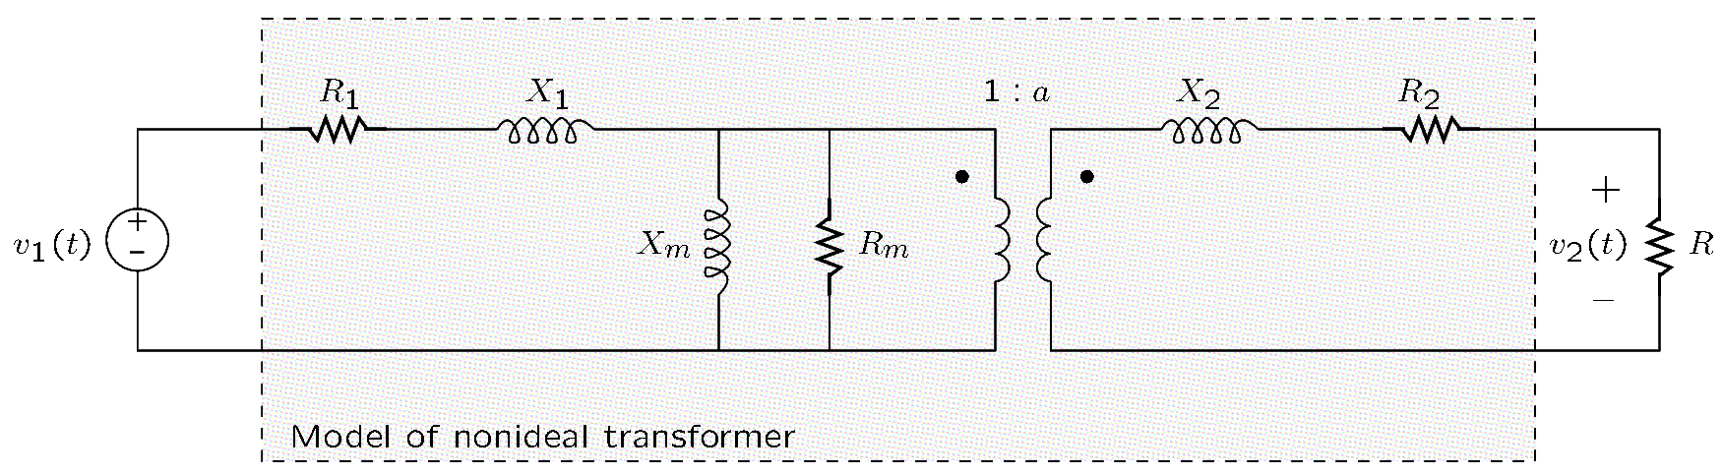
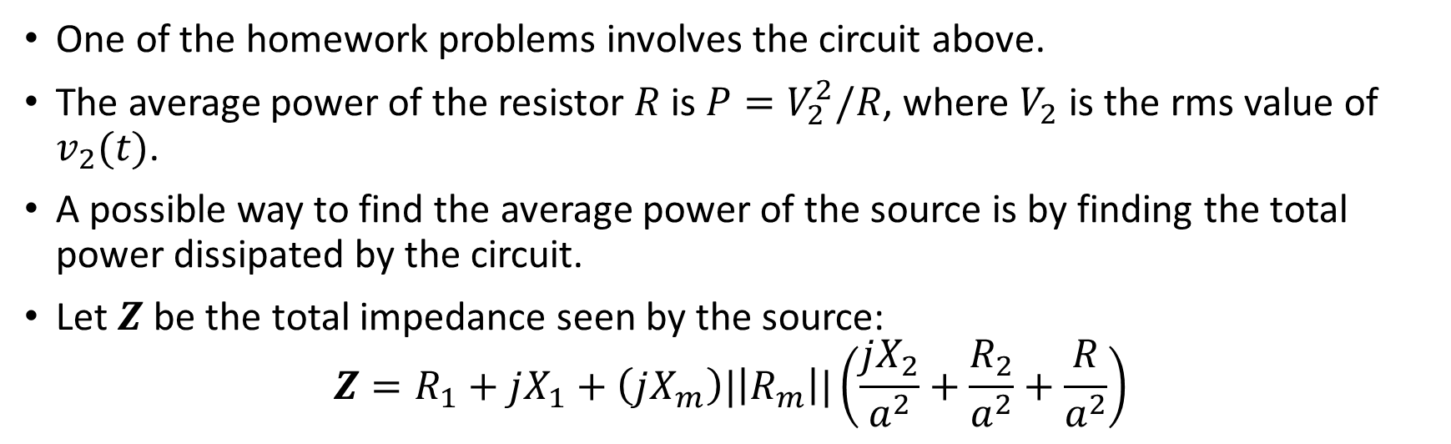
Example
One of the homework problems involves the circuit above.
The average power of the resistor $R$ is $P=V_{2}^{2}/R$, where $V_{2}$ is the rms value of $v_{2}(t)$.
A possible way to find the average power of the source is by finding the total power dissipated by the circuit.
Let $Z$ be the total impedance seen by the source:
$$Z=R_{1}+jX_{1}+\left(jX_{m}\right)|\left|R_{m}\right||\left(\frac{jX_{2}}{a^{2}}+\frac{R_{2}}{a^{2}}+\frac{R}{a^{2}}\right)$$
Notes:
cdoc/sum/power4.fig

Slide 11
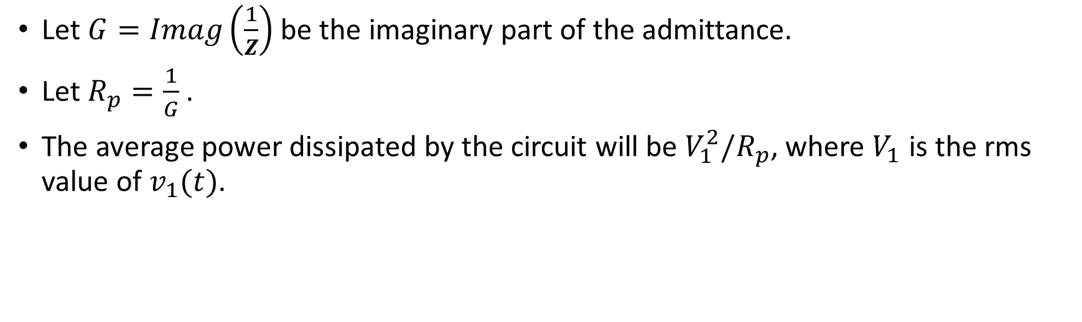
Example (Continued)
Let $G=Imag\left(\frac{1}{Z}\right)$ be the imaginary part of the admittance.
Let $R_{p}=\frac{1}{G}$.
The average power dissipated by the circuit will be $V_{1}^{2}/R_{p}$, where $V_{1}$ is the rms value of $v_{1}(t)$.
Notes:
cdoc/sum/power4.fig

