Slide 1
THREE PHASE SYSTEMS
An Introduction
M.V. Iordache, EEGR2053 Electric Circuits, Spring 2020, LeTourneau University

Slide 2
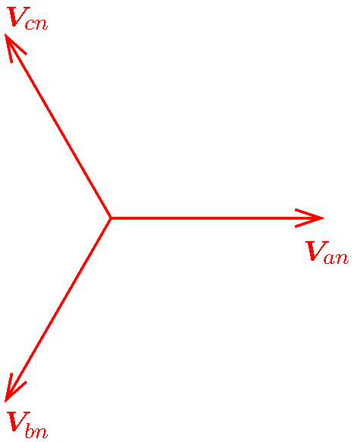
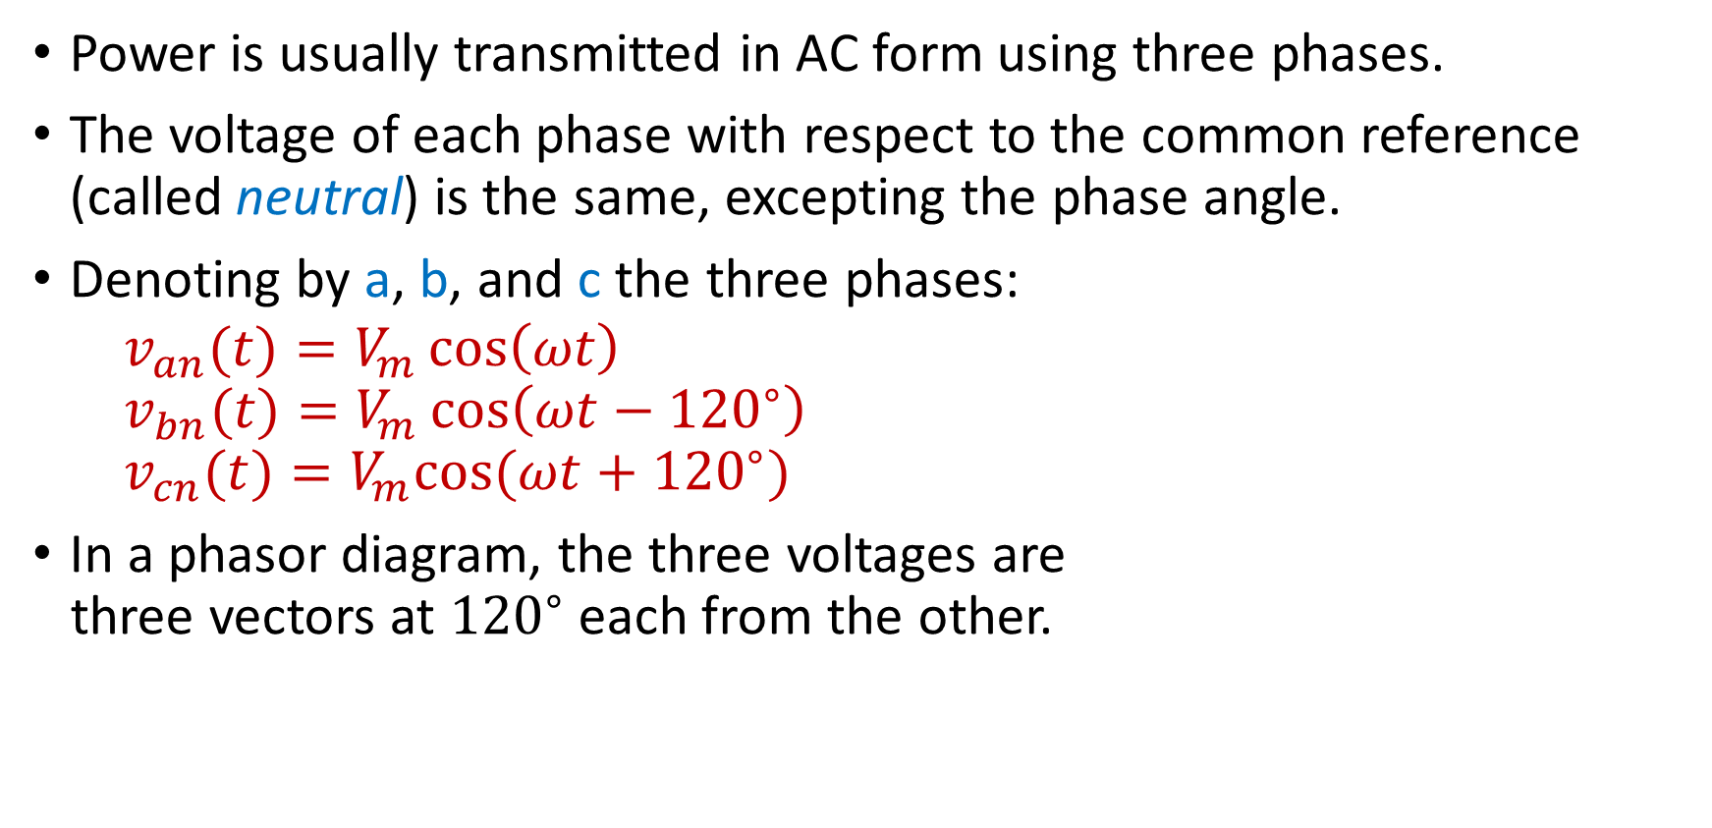
Introduction
Power is usually transmitted in AC form using three phases.
The voltage of each phase with respect to the common reference (called neutral) is the same, excepting the phase angle.
Denoting by a, b, and c the three phases:
$$v_{an}(t)=V_{m}\cos\left(ωt\right)$$
$$v_{bn}(t)=V_{m}\cos\left(ωt−{120}^{∘}\right)$$
$$v_{cn}(t)=V_{m}cos⁡(ωt+{120}^{∘})$$
In a phasor diagram, the three voltages are
three vectors at ${120}^{∘}$ each from the other.
Notes:
cfig/threephase.fig

Slide 3
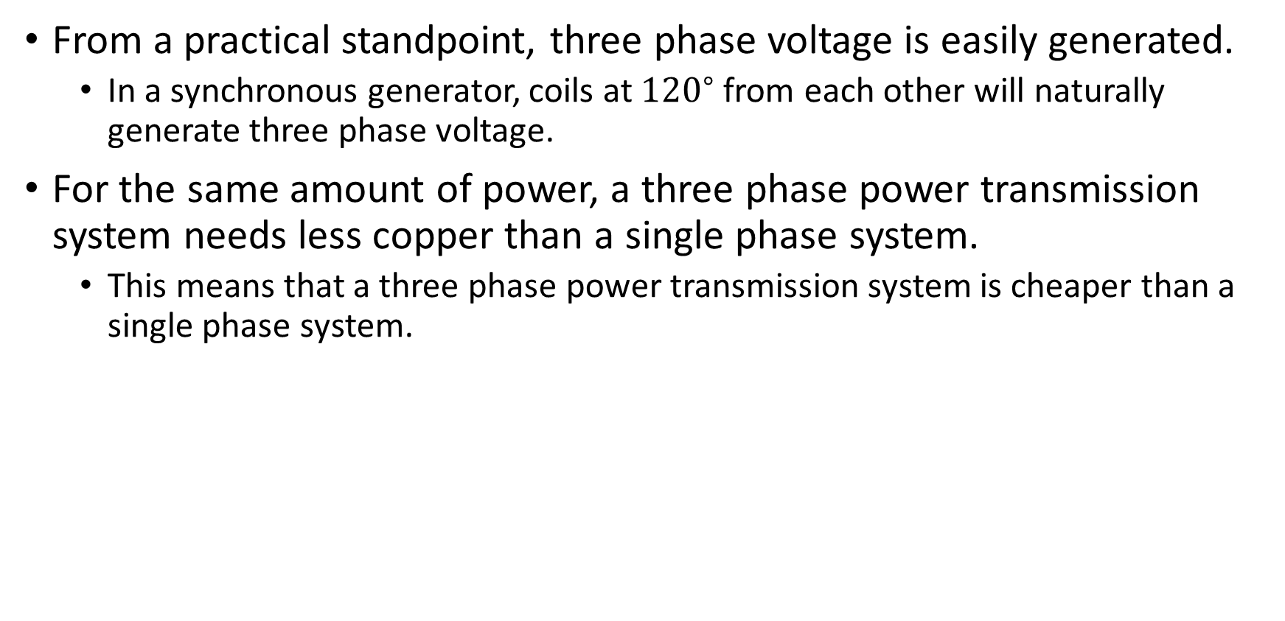
Introduction
From a practical standpoint, three phase voltage is easily generated.
  In a synchronous generator, coils at ${120}^{∘}$ from each other will naturally generate three phase voltage.
For the same amount of power, a three phase power transmission system needs less copper than a single phase system.
  This means that a three phase power transmission system is cheaper than a single phase system.

Slide 4
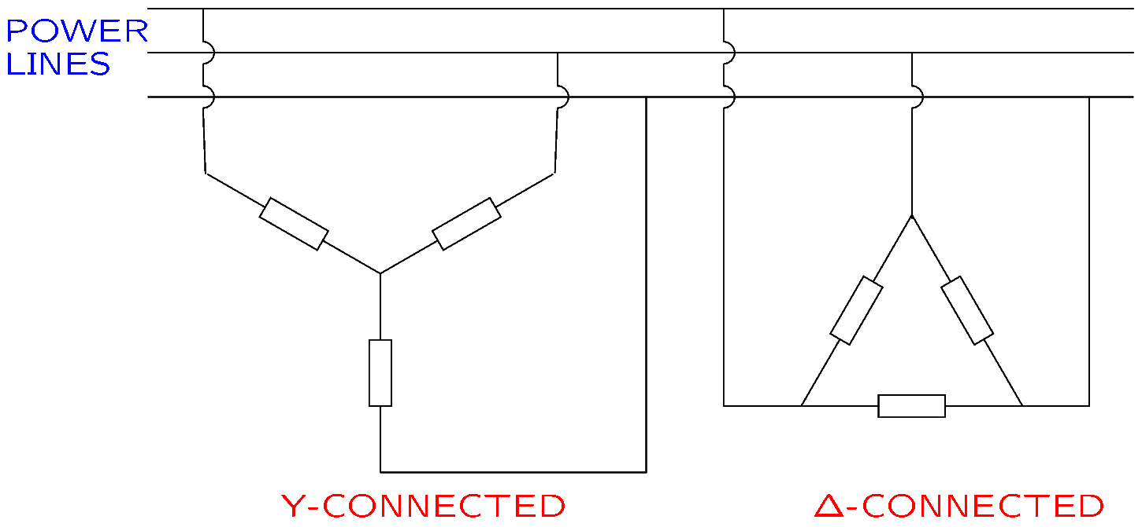

Definitions
In a three phase system, sources and loads are connected in the wye ($Y$) configuration or the delta ($Δ)$ configuration.
Notes:
cfig/dy.fig

Slide 5
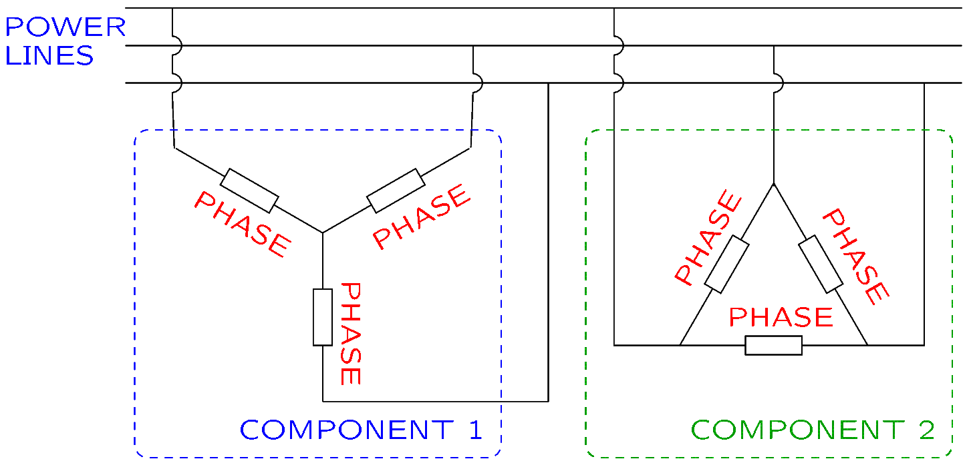

Definitions
A three phase component can be represented with three subcomponents, called phases, connected in $Y$ or $Δ$.
Notes:
cfig/dy2.fig

Slide 6
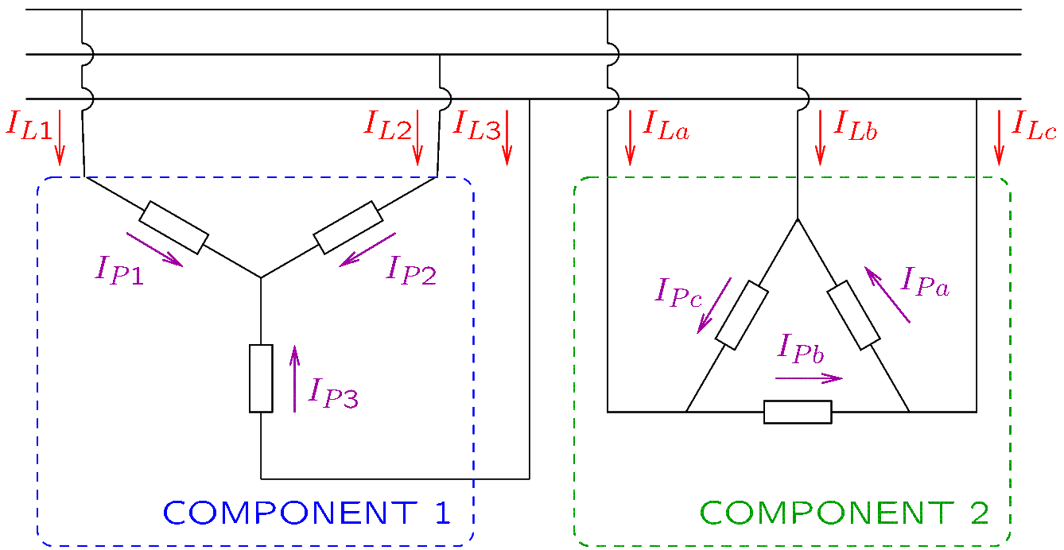
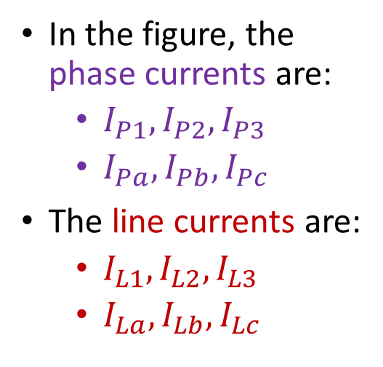
Definitions—Currents
The current flowing through a phase is called phase current.
The current flowing through a conductor that powers a component is called line current.
In the figure, the phase currents are:
  $I_{P1},I_{P2},I_{P3}$
  $I_{Pa},I_{Pb}, I_{Pc}$
The line currents are:
  $I_{L1},I_{L2},I_{L3}$
  $I_{La},I_{Lb}, I_{Lc}$
Notes:
cfig/dy3.fig

Slide 7
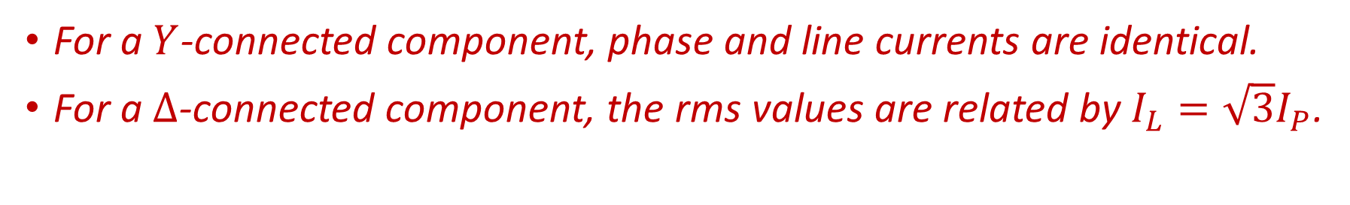
Definitions—Currents
For a $Y$-connected component, phase and line currents are identical.
For a $Δ$-connected component, the rms values are related by $I_{L}=\sqrt{3}I_{P}$.
In the figure, the phase currents are:
  $I_{P1},I_{P2},I_{P3}$
  $I_{Pa},I_{Pb}, I_{Pc}$
The line currents are:
  $I_{L1},I_{L2},I_{L3}$
  $I_{La},I_{Lb}, I_{Lc}$
Notes:
cfig/dy3.fig

Slide 8
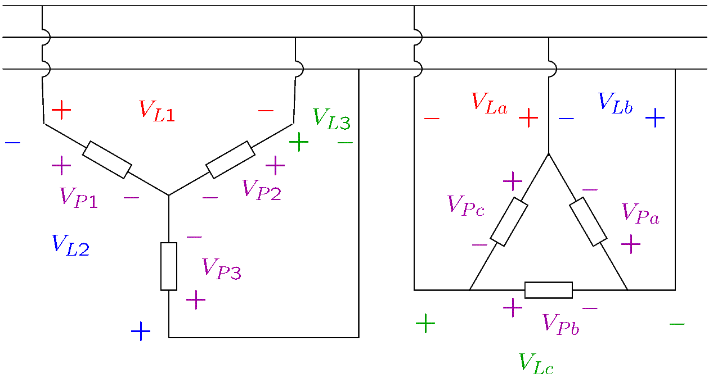
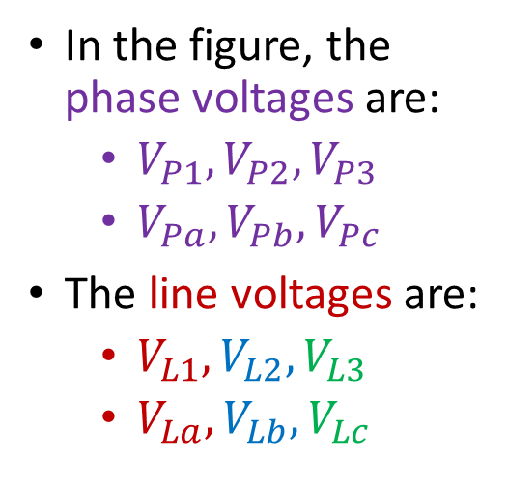
Definitions—Voltages
The voltage on a phase is called phase voltage.
The voltage between two power lines is called line-to-line voltage, or shortly, line voltage.
In the figure, the phase voltages are:
  $V_{P1},V_{P2},V_{P3}$
  $V_{Pa},V_{Pb}, V_{Pc}$
The line voltages are:
  $V_{L1},V_{L2},V_{L3}$
  $V_{La},V_{Lb}, V_{Lc}$
Notes:
cfig/dy4.fig

Slide 9
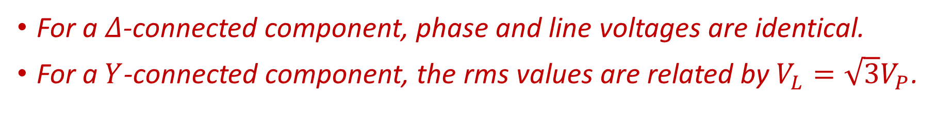
Definitions—Voltages
For a $Δ$-connected component, phase and line voltages are identical.
For a $Y$-connected component, the rms values are related by $V_{L}=\sqrt{3}V_{P}$.
In the figure, the phase voltages are:
  $V_{P1},V_{P2},V_{P3}$
  $V_{Pa},V_{Pb}, V_{Pc}$
The line voltages are:
  $V_{L1},V_{L2},V_{L3}$
  $V_{La},V_{Lb}, V_{Lc}$
Notes:
cfig/dy4.fig

Slide 10
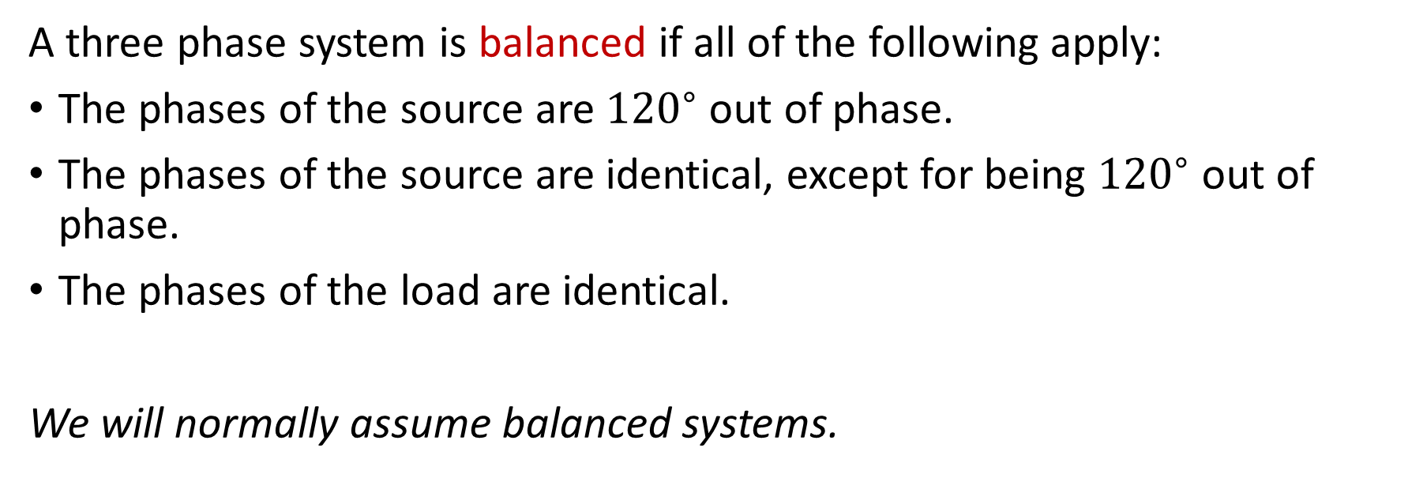
Definitions—Balanced System
A three phase system is balanced if all of the following apply:
The phases of the source are ${120}^{∘}$ out of phase.
The phases of the source are identical, except for being ${120}^{∘}$ out of phase.
The phases of the load are identical.
We will normally assume balanced systems.

Slide 11
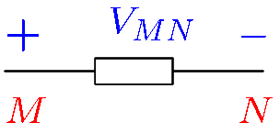
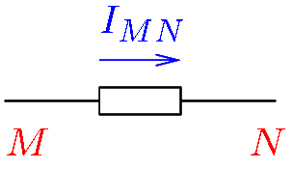
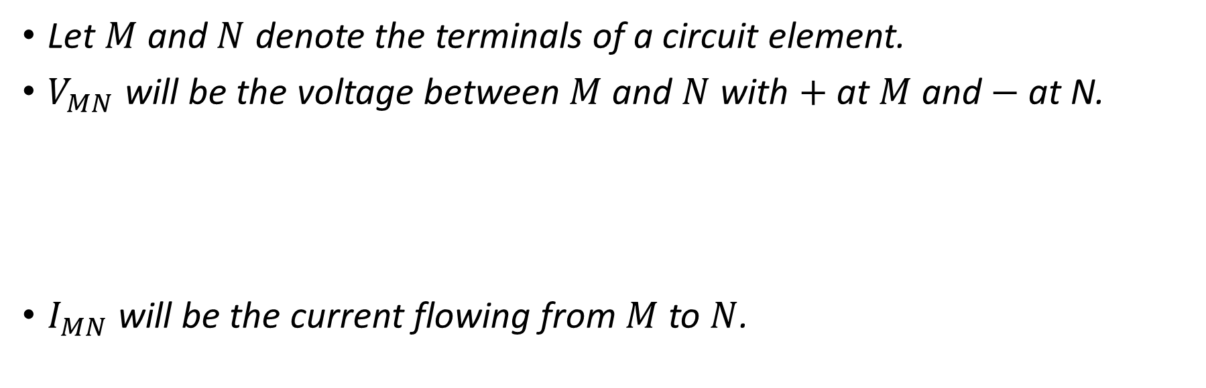
Notation
Let $M$ and $N$ denote the terminals of a circuit element.
$V_{MN}$ will be the voltage between $M$ and $N$ with $+$ at $M$ and $−$ at N.
$I_{MN}$ will be the current flowing from $M$ to $N$.
Notes:
cfig/notation.fig and notation2.fig

Slide 12
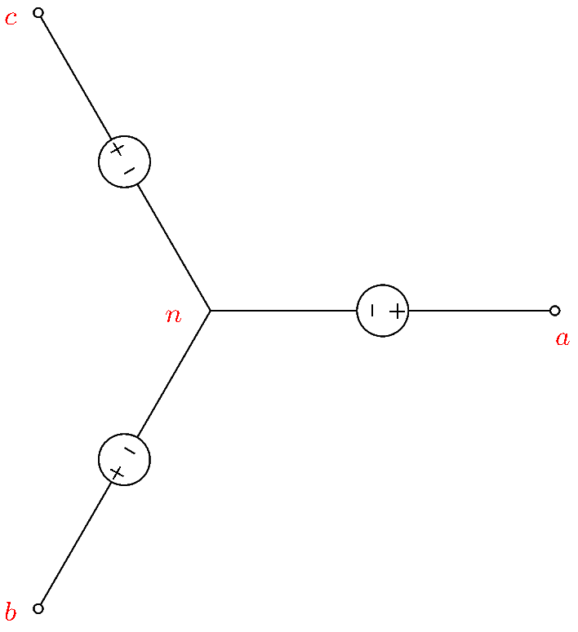
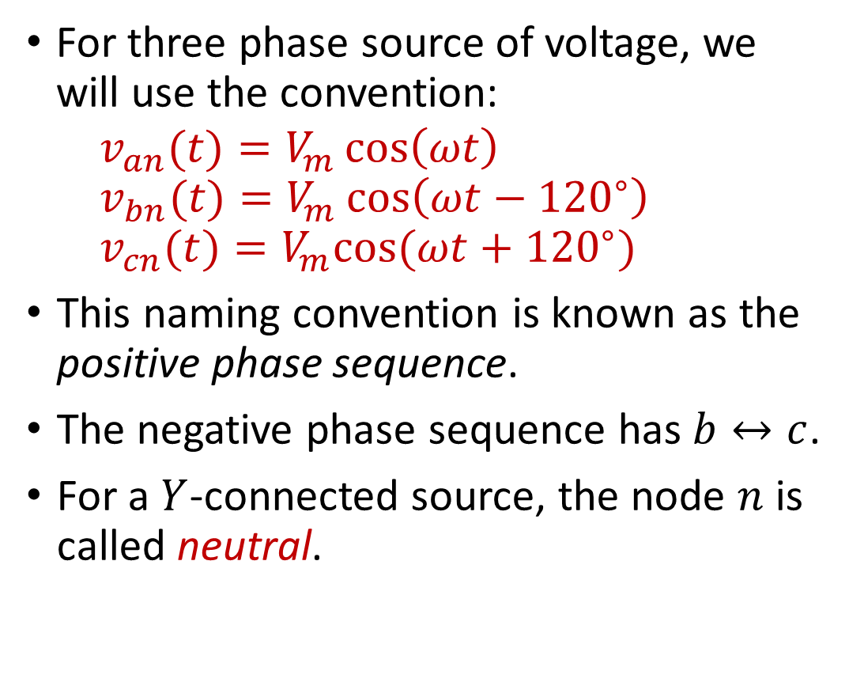
Convention
For three phase source of voltage, we will use the convention:
$$v_{an}(t)=V_{m}\cos\left(ωt\right)$$
$$v_{bn}(t)=V_{m}\cos\left(ωt−{120}^{∘}\right)$$
$$v_{cn}(t)=V_{m}cos⁡(ωt+{120}^{∘})$$
This naming convention is known as the positive phase sequence.
The negative phase sequence has $b↔c$.
For a $Y$-connected source, the node $n$ is called neutral.
Notes:
cdoc/sum/wye2.fig

Slide 13
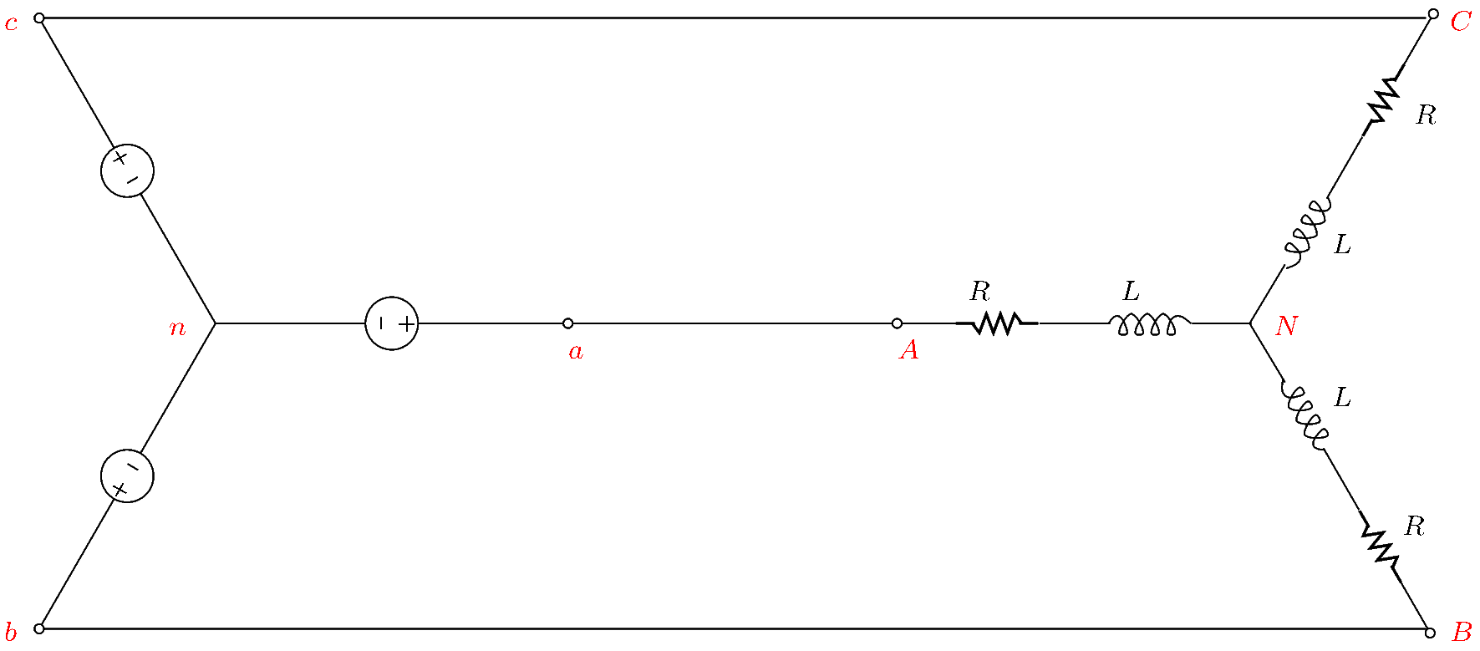
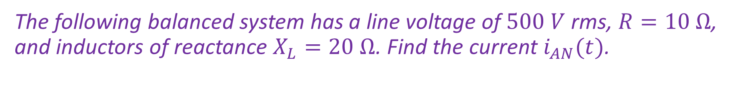
Example
The following balanced system has a line voltage of $500 V$ rms, $R=10 Ω$, and inductors of reactance $X_{L}=20 Ω$. Find the current $i_{AN}(t)$.
Notes:
cdoc/sum/wye1.fig

Slide 14

Example (Continued)
Note that for a balanced system, the nodes $n$ and $N$ are at the same potential: $V_{nN}=0$.
For a balanced system, the equivalent circuit per phase may be used.
Notes:
cdoc/sum/wye1.fig

Slide 15
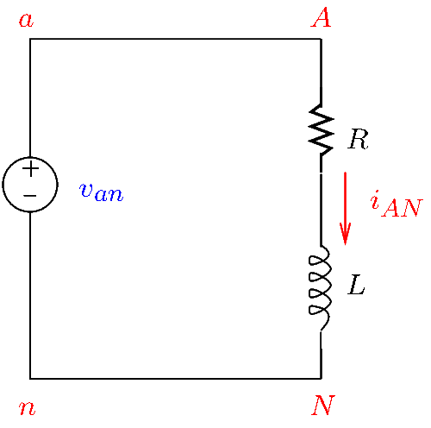

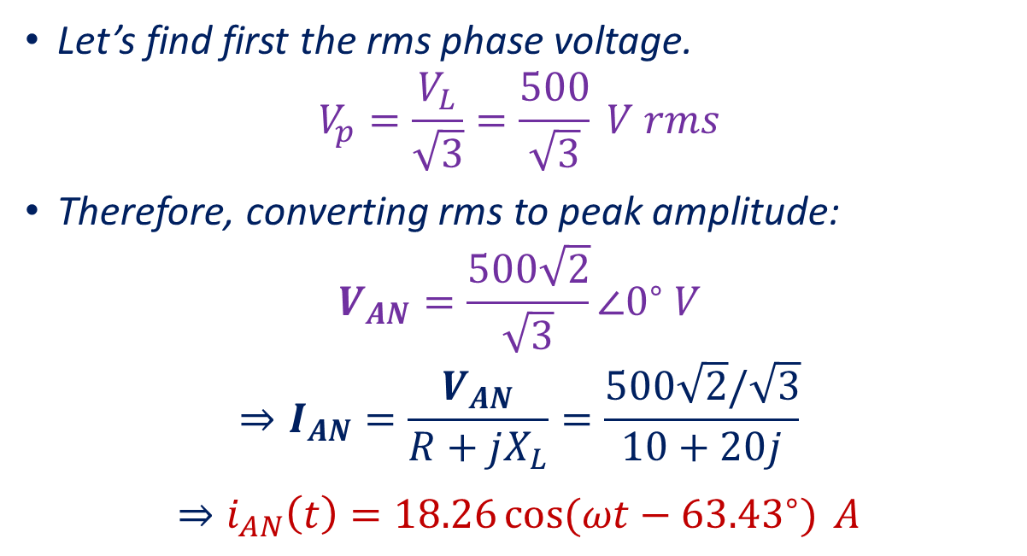
Example (Continued)
In the equivalent circuit per phase:
  The nodes $n$ and $N$ are connected.
  We draw only one phase of the source and of the load.
Let’s find first the rms phase voltage.
$$V_{p}=\frac{V_{L}}{\sqrt{3}}=\frac{500}{\sqrt{3}} V rms$$
Therefore, converting rms to peak amplitude:
$$V_{AN}=\frac{500\sqrt{2}}{\sqrt{3}}∠0^{∘} V$$
$$⇒I_{AN}=\frac{V_{AN}}{R+jX_{L}}=\frac{500\sqrt{2}/\sqrt{3}}{10+20j}$$
$$⇒i_{AN}\left(t\right)=18.26\cos{(ωt−{63.43}^{∘})} A$$
Notes:
cdoc/sum/perphase.fig

