Slide 1
AC Power—Part 3
Apparent Power, Power Factor, and Power Factor Correction
M.V. Iordache, EEGR2053 Electric Circuits, Spring 2020, LeTourneau University

Slide 2
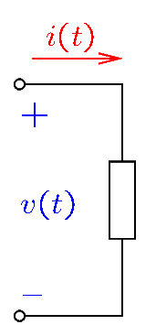
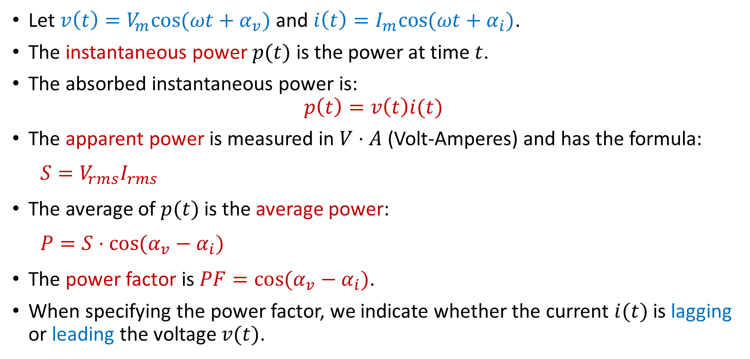
Power—Review
Let $v\left(t\right)=V_{m}cos⁡(ωt+α_{v})$ and $i\left(t\right)=I_{m}cos⁡(ωt+α_{i})$.
The instantaneous power $p(t)$ is the power at time $t$.
The absorbed instantaneous power is:
$$p\left(t\right)=v\left(t\right)i(t)$$
The apparent power is measured in $V⋅A$ (Volt-Amperes) and has the formula:
$$S=V_{rms}I_{rms}$$
The average of $p(t)$ is the average power:
$$P=S⋅cos⁡(α_{v}−α_{i})$$
The power factor is $PF=cos⁡(α_{v}−α_{i})$.
When specifying the power factor, we indicate whether the current $i(t)$ is lagging or leading the voltage $v(t)$.
Notes:
cfig/elem.fig

Slide 3
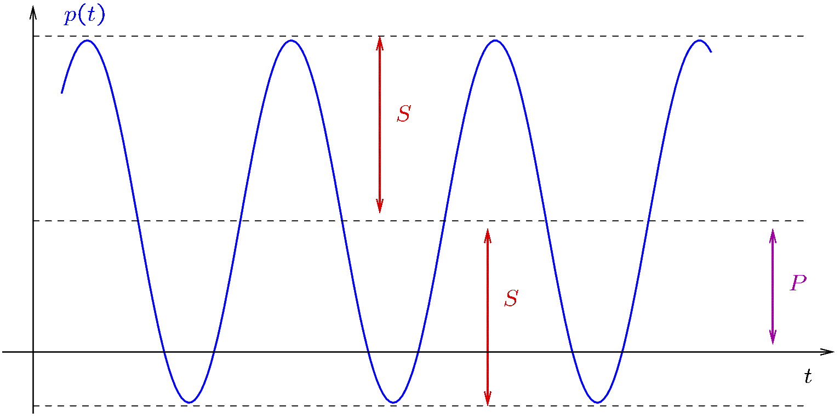

Power—Physical Meaning
Let $v\left(t\right)=V_{m}cos⁡(ωt+α_{v})$ and $i\left(t\right)=I_{m}cos⁡(ωt+α_{i})$.
The instantaneous power $p\left(t\right)=v\left(t\right)i(t)$ can also be written as:
$$p\left(t\right)=\frac{V_{m}I_{m}}{2}cos⁡(α_{v}−α_{i})+\frac{V_{m}I_{m}}{2}cos⁡(2ωt+α_{v}+α_{i})$$
$$⇒p\left(t\right)=P+S⋅cos⁡(2ωt+α_{v}+α_{i})$$
$P$ is the average of $p(t)$.
$S$ is the amplitude of $p(t)$.
Notes:
cfig/pt2.fig

Slide 4
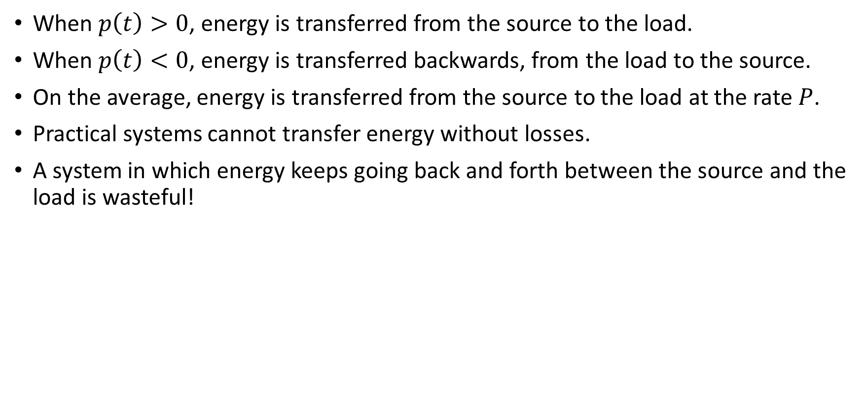
Power—Physical Meaning
When $p\left(t\right)>0$, energy is transferred from the source to the load.
When $p\left(t\right)<0$, energy is transferred backwards, from the load to the source.
On the average, energy is transferred from the source to the load at the rate $P$.
Practical systems cannot transfer energy without losses.
A system in which energy keeps going back and forth between the source and the load is wasteful!
Notes:
cfig/pt2.fig

Slide 5
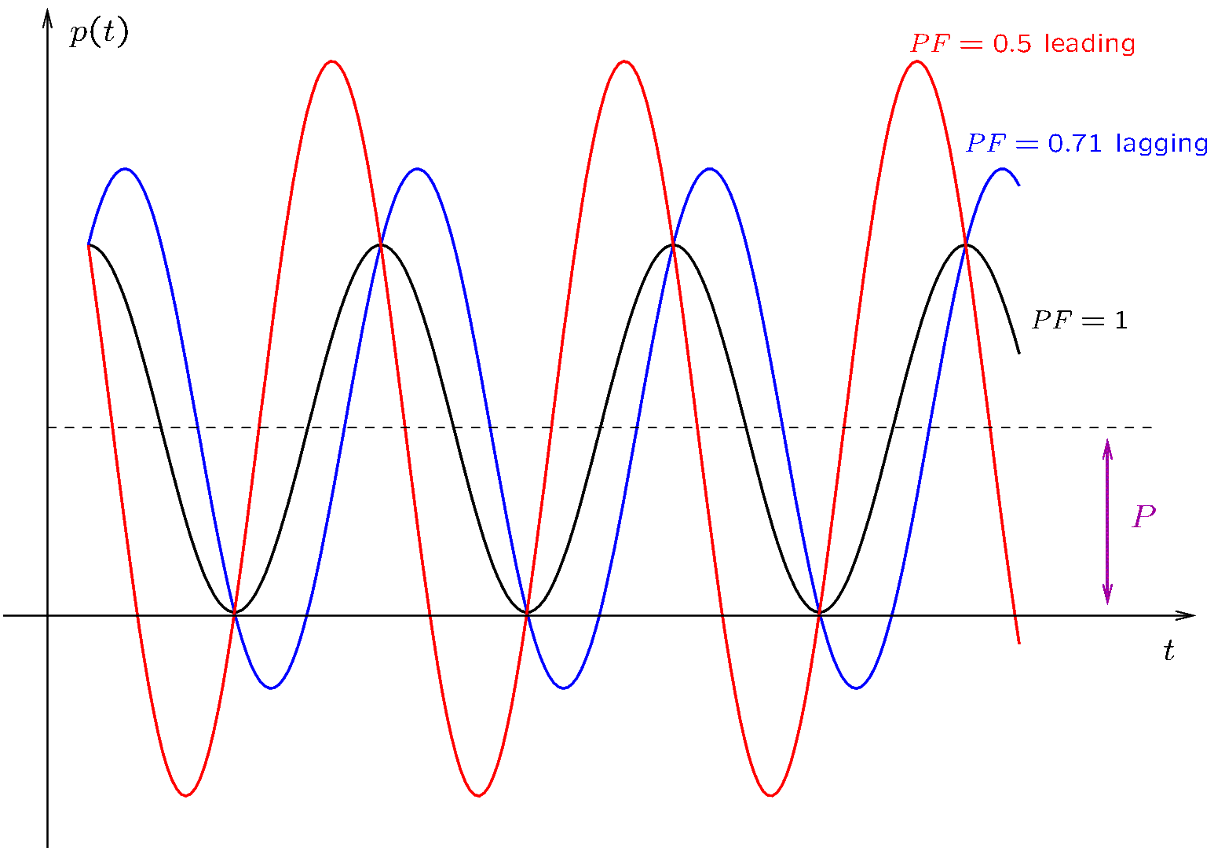
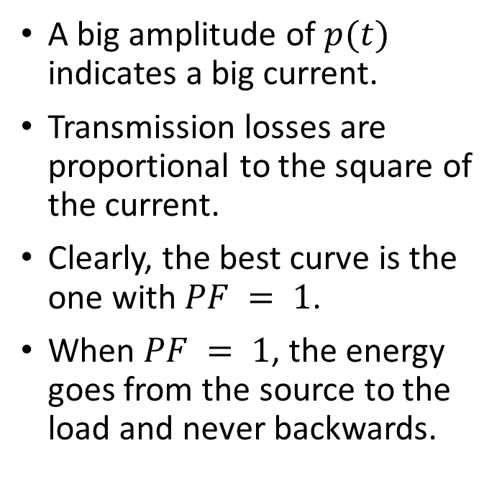
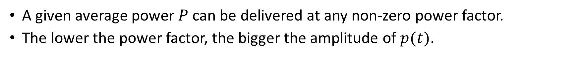
Power—Physical Meaning
A given average power $P$ can be delivered at any non-zero power factor.
The lower the power factor, the bigger the amplitude of $p(t)$.
A big amplitude of $p(t)$ indicates a big current.
Transmission losses are proportional to the square of the current.
Clearly, the best curve is the one with $PF = 1$.
When $PF = 1$, the energy goes from the source to the load and never backwards.
Notes:
Note that $p\left(t\right)=P+P⋅\cos\left(2ωt+2α_{v}\right)+Q⋅\sin{(2ωt+2α_{v})}$. Using voltage as a reference, that is, $α_{v}$ is kept a constant, (a similar result is when current is used as a reference), all p(t) curves intersect at the times when $2ωt+2α_{v}=kπ$. If the current is the reference, the curves will intersect at the other points where they equal 2P or zero.
cfig/pf.fig

Slide 6
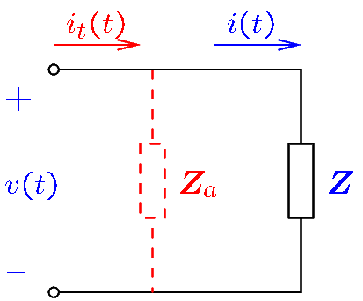
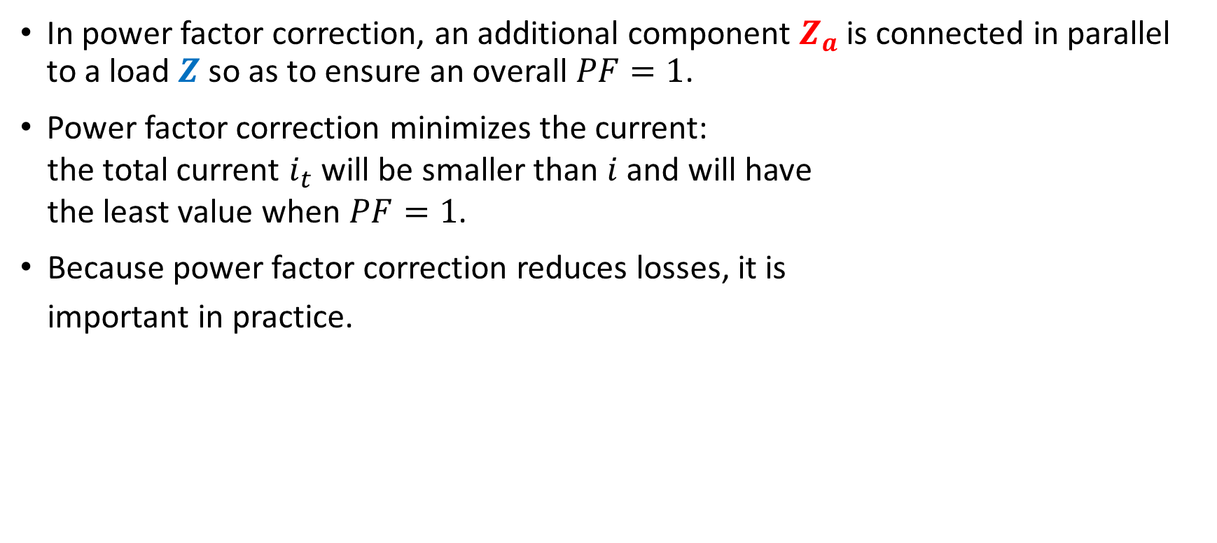
Power Factor Correction
In power factor correction, an additional component $Z_{a}$ is connected in parallel to a load $Z$ so as to ensure an overall $PF=1$.
Power factor correction minimizes the current:
the total current $i_{t}$ will be smaller than $i$ and will have
the least value when $PF=1$.
Because power factor correction reduces losses, it is
important in practice.
Notes:
cfig/pfc.fig

Slide 7
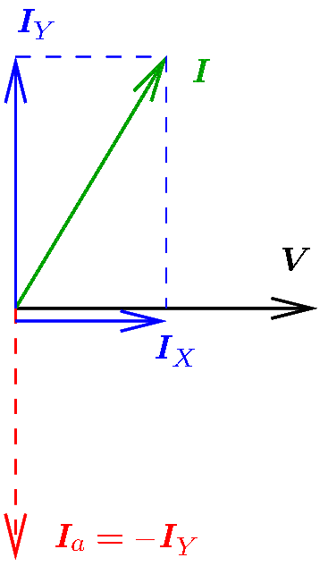
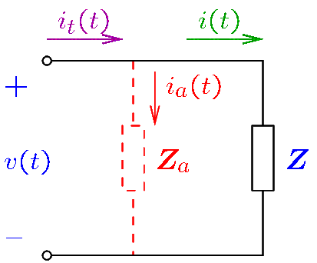

Power Factor Correction Methods
Method 1: Using $V$ as a reference, sketch a phasor diagram. Select $Z_{a}$ so that $I_{Y}=−I_{a}$.
Method 2: Use $Z_{a}=−\frac{1}{jB}$, where $B$ is the susceptance of $Z$.
Method 3: Select $Z_{a}$ so as to cancel the reactive power of $Z$. This method will be studied in a future lecture.
Notes:
cfig/pfc2.fig and phasor4.fig

Slide 8
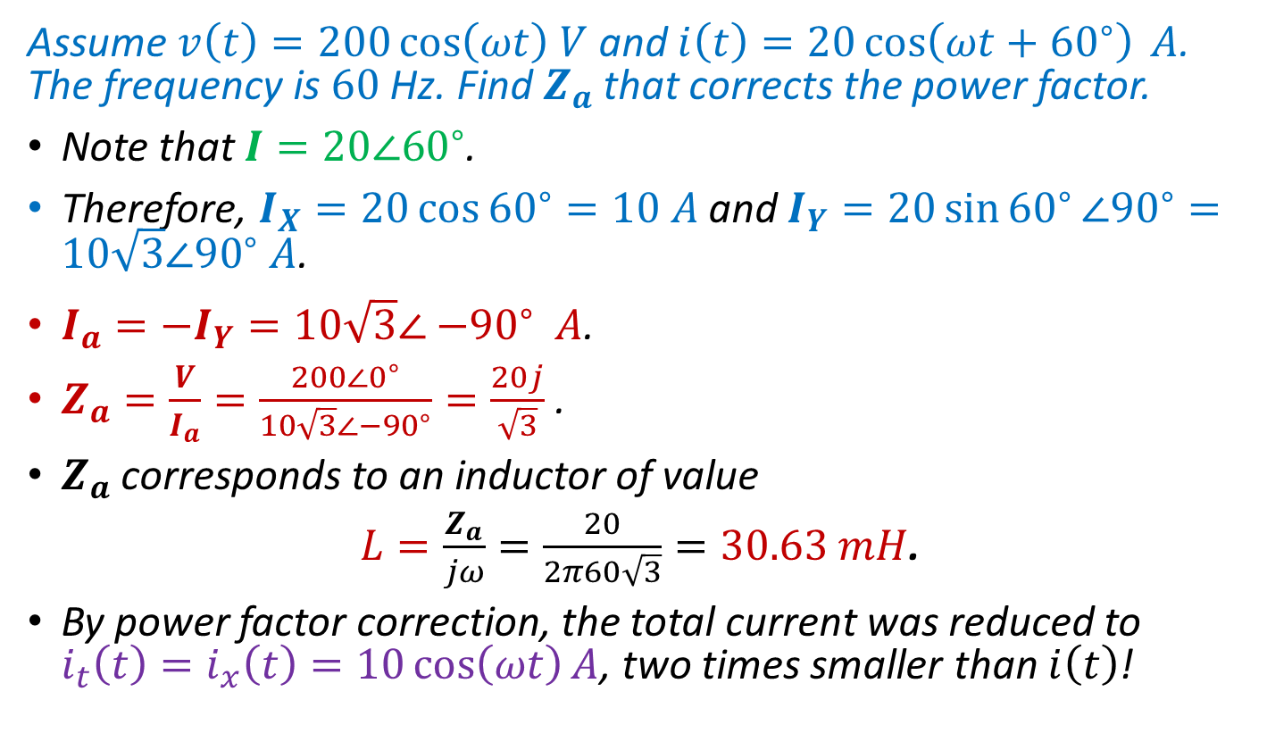
Example 1
Assume $v\left(t\right)=200\cos\left(ωt\right) V$ and $i\left(t\right)=20\cos\left(ωt+{60}^{∘}\right) A$. The frequency is $60$Hz. Find $Z_{a}$ that corrects the power factor.
Note that $I=20∠60^{∘}$.
Therefore, $I_{X}=20\cos{{60}^{∘}}=10 A$ and $I_{Y}=20\sin{{60}^{∘}}∠{90}^{∘}=10\sqrt{3}∠{90}^{∘} A$.
$I_{a}=−I_{Y}=10\sqrt{3}∠{−90}^{∘} A\text{.}$
$Z_{a}=\frac{V}{I_{a}}=\frac{200∠0^{∘}}{10\sqrt{3}∠−{90}^{∘}}=\frac{20j}{\sqrt{3}}$.
$Z_{a}$ corresponds to an inductor of value
$L=\frac{Z_{a}}{jω}=\frac{20}{2π60\sqrt{3}}=30.63 mH$.
By power factor correction, the total current was reduced to $i_{t}\left(t\right)=i_{x}\left(t\right)=10\cos\left(ωt\right)A$, two times smaller than $i\left(t\right)$!
Notes:
cfig/pfc2.fig and phasor4.fig

Slide 9
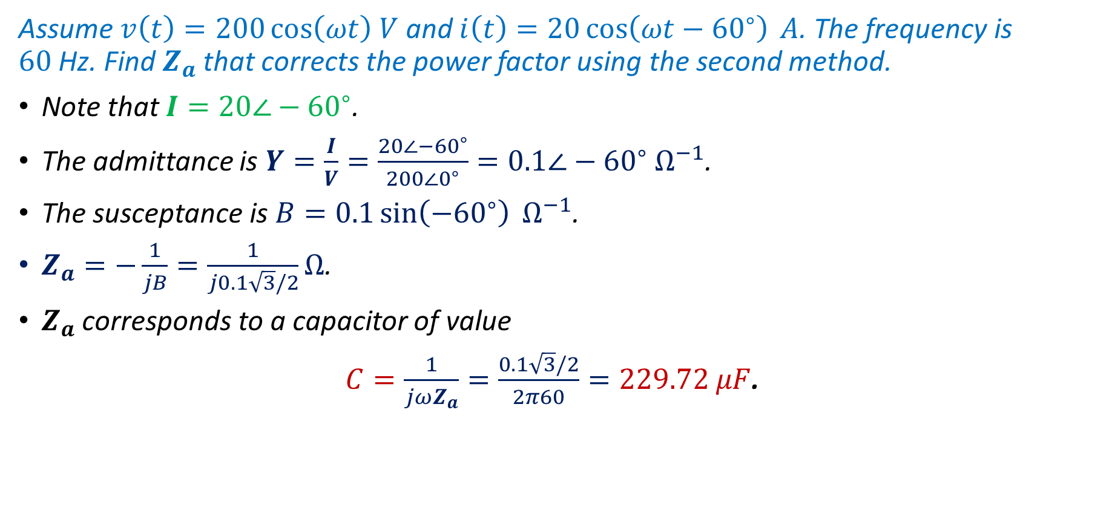
Example 2
Assume $v\left(t\right)=200\cos\left(ωt\right) V$ and $i\left(t\right)=20\cos\left(ωt−{60}^{∘}\right) A$. The frequency is $60$Hz. Find $Z_{a}$ that corrects the power factor using the second method.
Note that $I=20∠−60^{∘}$.
The admittance is $Y=\frac{I}{V}=\frac{20∠−{60}^{∘}}{200∠0^{∘}}=0.1∠−{60}^{∘} Ω^{−1}$.
The susceptance is $B=0.1\sin\left(−{60}^{∘}\right) Ω^{−1}$.
$Z_{a}=−\frac{1}{jB}=\frac{1}{j0.1\sqrt{3}/2}Ω$.
$Z_{a}$ corresponds to a capacitor of value
$C=\frac{1}{jωZ_{a}}=\frac{0.1\sqrt{3}/2}{2π60}=229.72 μF$.
Notes:
cfig/pfc2.fig

Slide 10
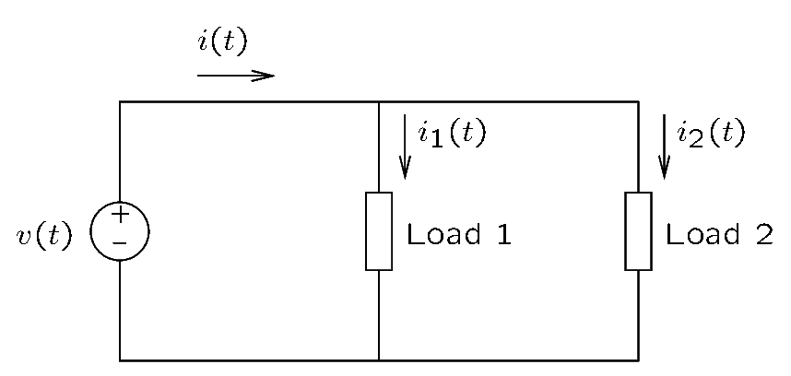
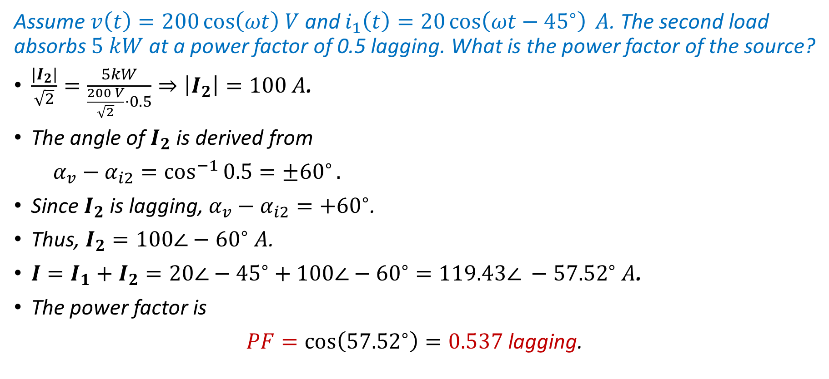
Example 3
Assume $v\left(t\right)=200\cos\left(ωt\right) V$ and $i_{1}\left(t\right)=20\cos\left(ωt−{45}^{∘}\right) A$. The second load absorbs $5 kW$ at a power factor of 0.5 lagging. What is the power factor of the source?
$\frac{{|I}_{2}|}{\sqrt{2}}=\frac{5kW}{\frac{200 V}{\sqrt{2}}⋅0.5}⇒\left|I_{2}\right|=100 A$.
The angle of $I_{2}$ is derived from
$α_{v}−α_{i2}=\cos^{−1}{0.5={±60}^{∘}}.$
Since $I_{2}$ is lagging, $α_{v}−α_{i2}=+{60}^{∘}$.
Thus, $I_{2}=100∠−{60}^{∘} A$.
$I=I_{1}+I_{2}=20∠−{45}^{∘}+100∠−{60}^{∘}=119.43∠ −{57.52}^{∘} A$.
The power factor is
$PF=\cos\left({57.52}^{∘}\right)=0.537$ lagging.
Notes:
sum/power1.fig

