Slide 1
AC Power—Part 2
RMS Values, Apparent Power, and Power Factor
M.V. Iordache, EEGR2053 Electric Circuits, Spring 2020, LeTourneau University

Slide 2
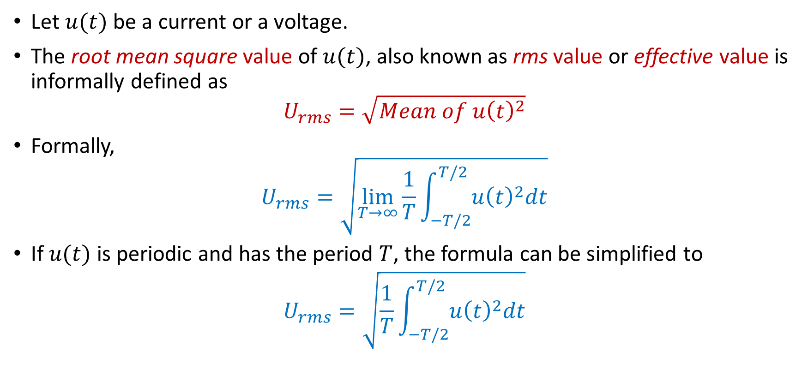
RMS Values—Review
Let $u(t)$ be a current or a voltage.
The root mean square value of $u(t)$, also known as rms value or effective value is informally defined as
$$U_{rms}=\sqrt{Mean of u{\left(t\right)}^{2}}$$
Formally,
$$U_{rms}=\sqrt{\lim_{T→∞}{\frac{1}{T}\int_{−T/2}^{T/2}{u{\left(t\right)}^{2}dt}}}$$
If $u(t)$ is periodic and has the period $T$, the formula can be simplified to
$$U_{rms}=\sqrt{\frac{1}{T}\int_{−T/2}^{T/2}{u{\left(t\right)}^{2}dt}}$$

Slide 3
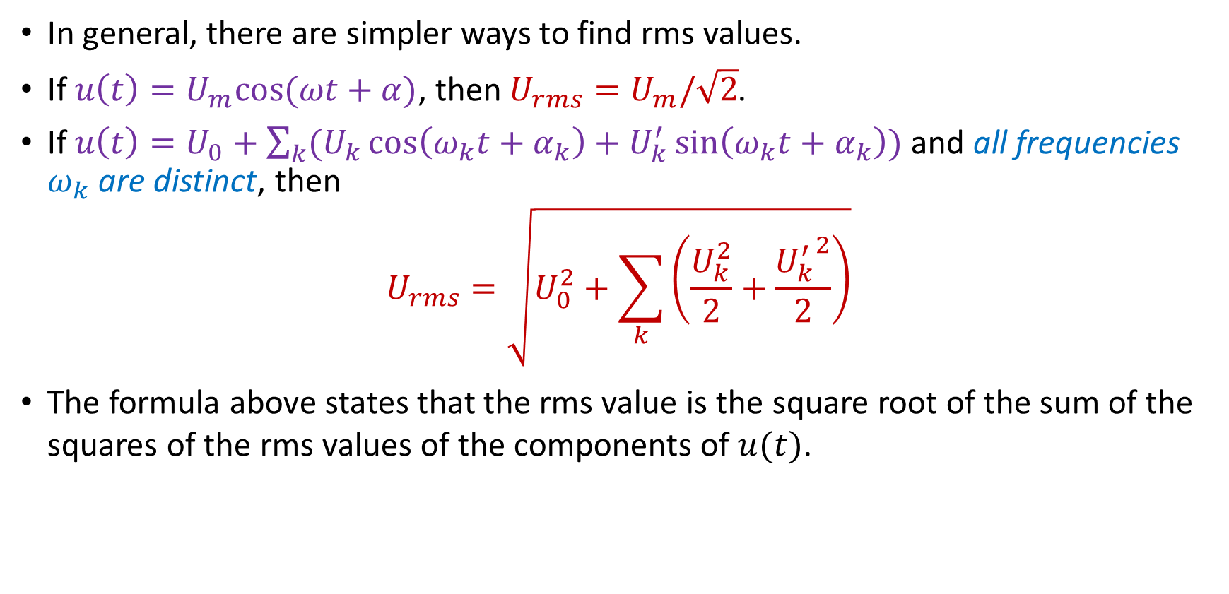
RMS Values
In general, there are simpler ways to find rms values.
If $u\left(t\right)=U_{m}cos⁡(ωt+α)$, then $U_{rms}=U_{m}/\sqrt{2}$.
If $u\left(t\right)=U_{0}+\sum_{k}{(U_{k}\cos\left(ω_{k}t+α_{k}\right)+U_{k}^{′}\sin\left(ω_{k}t+α_{k}\right))}$ and all frequencies $ω_{k}$ are distinct, then
$$U_{rms}=\sqrt{U_{0}^{2}+\sum_{k}{\left(\frac{U_{k}^{2}}{2}+\frac{{U_{k}^{′}}^{2}}{2}\right)}}$$
The formula above states that the rms value is the square root of the sum of the squares of the rms values of the components of $u(t)$.

Slide 4
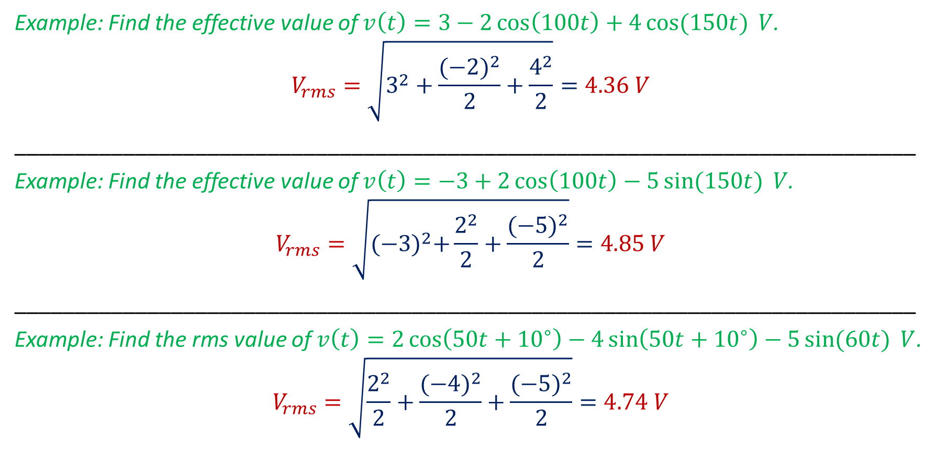
RMS Values—Examples
Example: Find the effective value of $v\left(t\right)=3−2\cos\left(100t\right)+4\cos{(150t)} V$.
$$V_{rms}=\sqrt{3^{2}+\frac{{(−2)}^{2}}{2}+\frac{4^{2}}{2}}=4.36 V$$
___________________________________________________________________________
Example: Find the effective value of $v\left(t\right)=−3+2\cos\left(100t\right)−5\sin{(150t)} V$.
$$V_{rms}=\sqrt{{(−3)}^{2}+\frac{2^{2}}{2}+\frac{{(−5)}^{2}}{2}}=4.85 V$$
___________________________________________________________________________
Example: Find the rms value of $v\left(t\right)=2\cos\left(50t+{10}^{∘}\right)−4\sin\left(50t+{10}^{∘}\right)−5\sin{(60t)} V$.
$$V_{rms}=\sqrt{\frac{2^{2}}{2}+\frac{{(−4)}^{2}}{2}+\frac{{(−5)}^{2}}{2}}=4.74 V$$

Slide 5
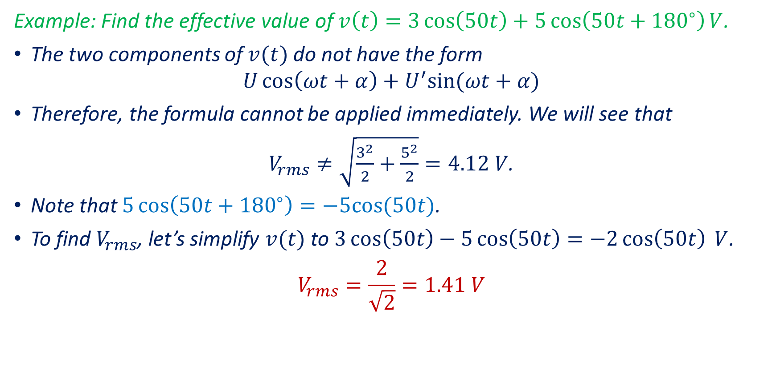
RMS Values—Examples
Example: Find the effective value of $v\left(t\right)=3\cos\left(50t\right)+5\cos\left(50t+{180}^{∘}\right)V$.
The two components of $v(t)$ do not have the form
$$U\cos\left(ωt+α\right)+U^{′}sin⁡(ωt+α)$$
Therefore, the formula cannot be applied immediately. We will see that
$V_{rms}≠\sqrt{\frac{3^{2}}{2}+\frac{5^{2}}{2}}=4.12 V$.
Note that $5\cos\left(50t+{180}^{∘}\right)=−5cos⁡(50t)$.
To find $V_{rms}$, let’s simplify $v(t)$ to $3\cos\left(50t\right)−5\cos\left(50t\right)=−2\cos\left(50t\right) V$.
$$V_{rms}=\frac{2}{\sqrt{2}}=1.41 V$$

Slide 6
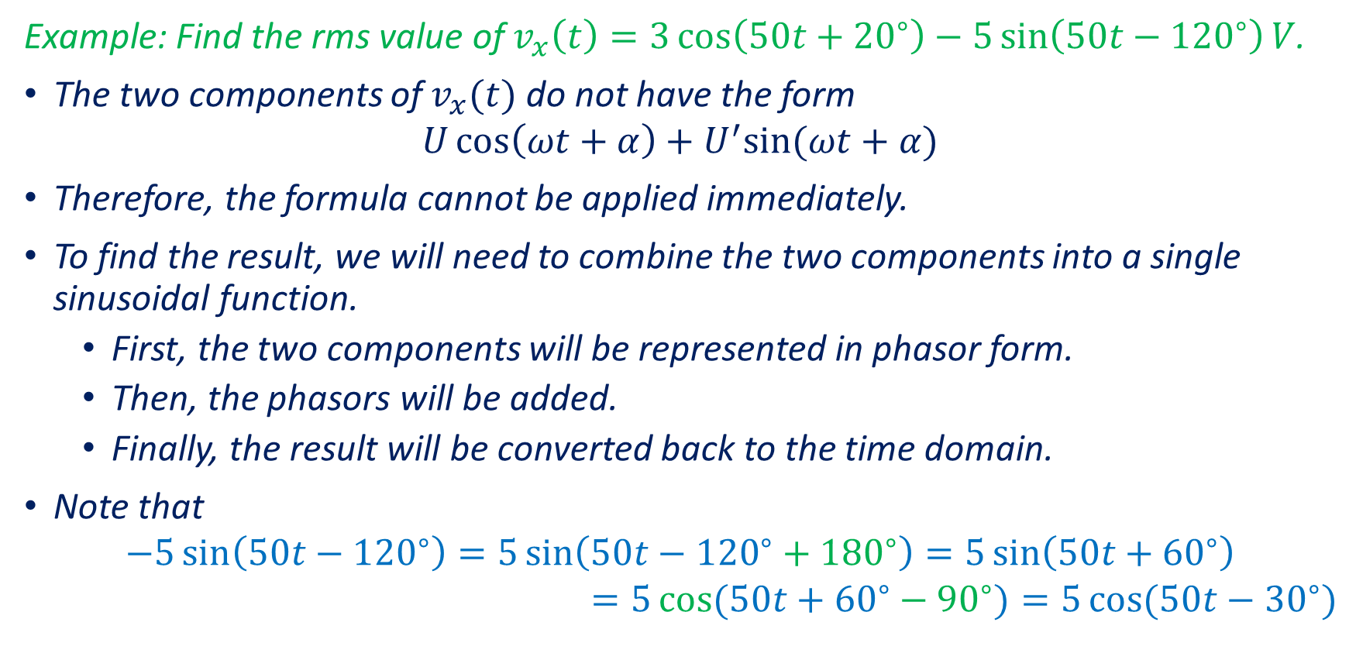
RMS Values—Examples
Example: Find the rms value of $v_{x}\left(t\right)=3\cos\left(50t+{20}^{∘}\right)−5\sin\left(50t−{120}^{∘}\right)V$.
The two components of $v_{x}(t)$ do not have the form
$$U\cos\left(ωt+α\right)+U^{′}sin⁡(ωt+α)$$
Therefore, the formula cannot be applied immediately.
To find the result, we will need to combine the two components into a single sinusoidal function.
First, the two components will be represented in phasor form.
Then, the phasors will be added.
Finally, the result will be converted back to the time domain.
Note that
$$−5\sin\left(50t−{120}^{∘}\right)=5\sin\left(50t−{120}^{∘}+{180}^{∘}\right)=5\sin\left(50t+{60}^{∘}\right)$$
$$=5\cos{(50t+{60}^{∘}−{90}^{∘})}=5\cos{(50t−{30}^{∘})}$$

Slide 7
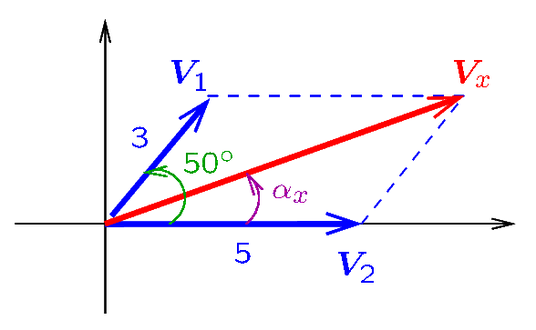
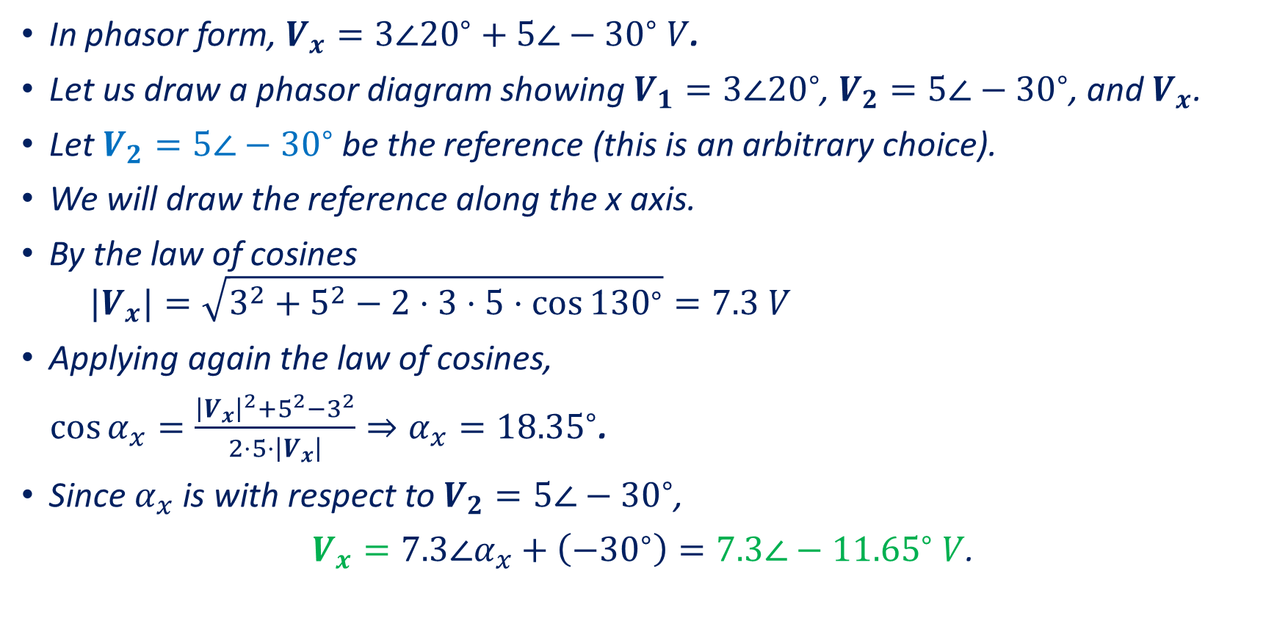
RMS Values—Example (Continued)
In phasor form, $V_{x}=3∠{20}^{∘}+5∠−{30}^{∘} V$.
Let us draw a phasor diagram showing $V_{1}=3∠{20}^{∘}$, $V_{2}=5∠−{30}^{∘}$, and $V_{x}$.
Let $V_{2}=5∠−{30}^{∘}$ be the reference (this is an arbitrary choice).
We will draw the reference along the x axis.
By the law of cosines
$${|V}_{x}|=\sqrt{3^{2}+5^{2}−2⋅3⋅5⋅\cos{{130}^{∘}}}=7.3 V$$
Applying again the law of cosines,
$\cos{α_{x}}=\frac{{\left|V_{x}\right|}^{2}+5^{2}−3^{2}}{2⋅5⋅\left|V_{x}\right|}⇒α_{x}={18.35}^{∘}$.
Since $α_{x}$ is with respect to $V_{2}=5∠−{30}^{∘}$,
$V_{x}=7.3∠α_{x}+\left(−{30}^{∘}\right)=7.3∠−{11.65}^{∘} V$.
Notes:
cfig/phasor3.fig

Slide 8

RMS Values—Example (Continued)
We have found that $v_{x}\left(t\right)=7.3\cos\left(50t−{11.65}^{∘}\right) V.$
At this point we can calculate the rms value:
$$V_{x,rms}=\frac{7.3}{\sqrt{2}}=5.16 V$$

Slide 9
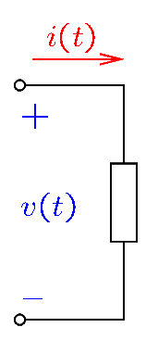
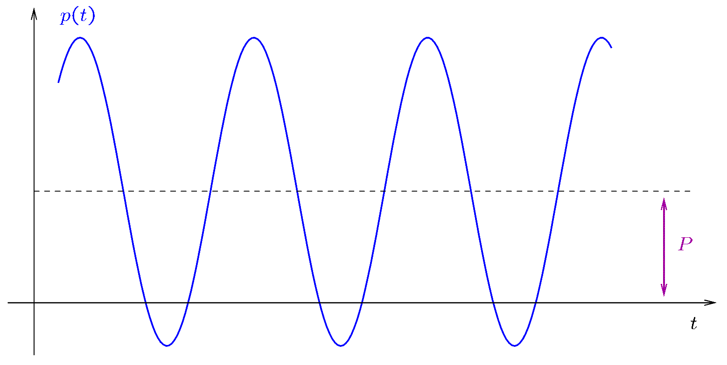

Power—Review
The instantaneous power $p(t)$ is the power at time $t$.
The absorbed instantaneous power is:
$$p\left(t\right)=v\left(t\right)i(t)$$
If $v\left(t\right)=V_{m}cos⁡(ωt+α_{v})$ and $i\left(t\right)=I_{m}cos⁡(ωt+α_{i})$, the
average of $p(t)$ is:
$$P=V_{rms}I_{rms}cos⁡(α_{v}−α_{i})$$
Notes:
cfig/elem.fig and pt2.fig

Slide 10
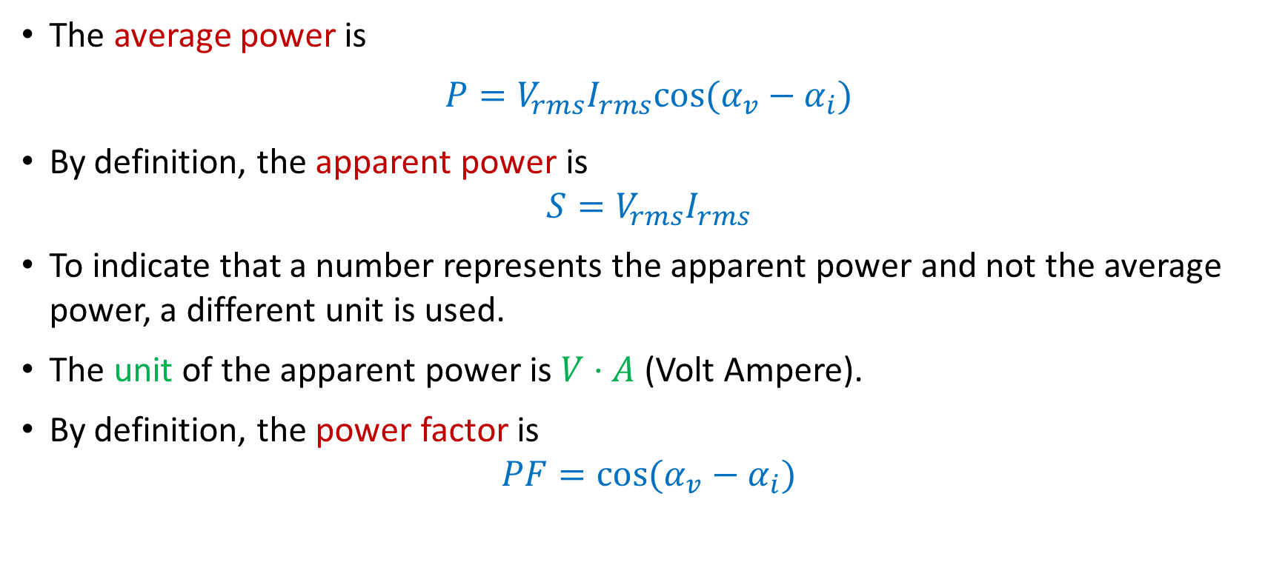
Power
The average power is
$$P=V_{rms}I_{rms}cos⁡(α_{v}−α_{i})$$
By definition, the apparent power is
$$S=V_{rms}I_{rms}$$
To indicate that a number represents the apparent power and not the average power, a different unit is used.
The unit of the apparent power is $V⋅A$ (Volt Ampere).
By definition, the power factor is
$$PF=cos⁡(α_{v}−α_{i})$$

Slide 11
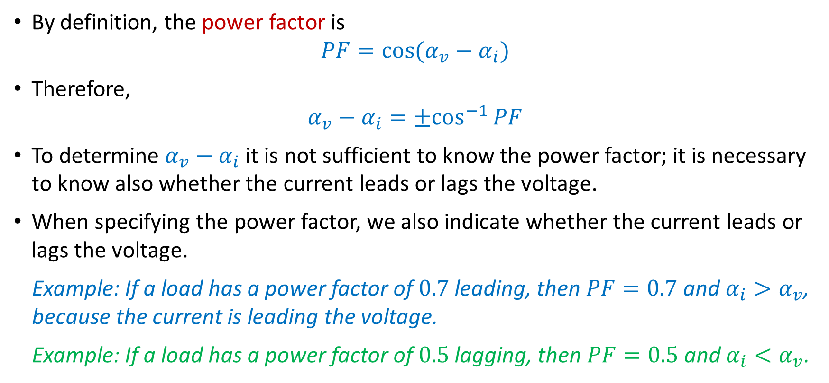
Power
By definition, the power factor is
$$PF=cos⁡(α_{v}−α_{i})$$
Therefore,
$$α_{v}−α_{i}={±cos}^{−1}{PF}$$
To determine $α_{v}−α_{i}$ it is not sufficient to know the power factor; it is necessary to know also whether the current leads or lags the voltage.
When specifying the power factor, we also indicate whether the current leads or lags the voltage.
Example: If a load has a power factor of $0.7$ leading, then $PF=0.7$ and $α_{i}>α_{v}$, because the current is leading the voltage.
Example: If a load has a power factor of $0.5$ lagging, then $PF=0.5$ and $α_{i}<α_{v}$.

Slide 12
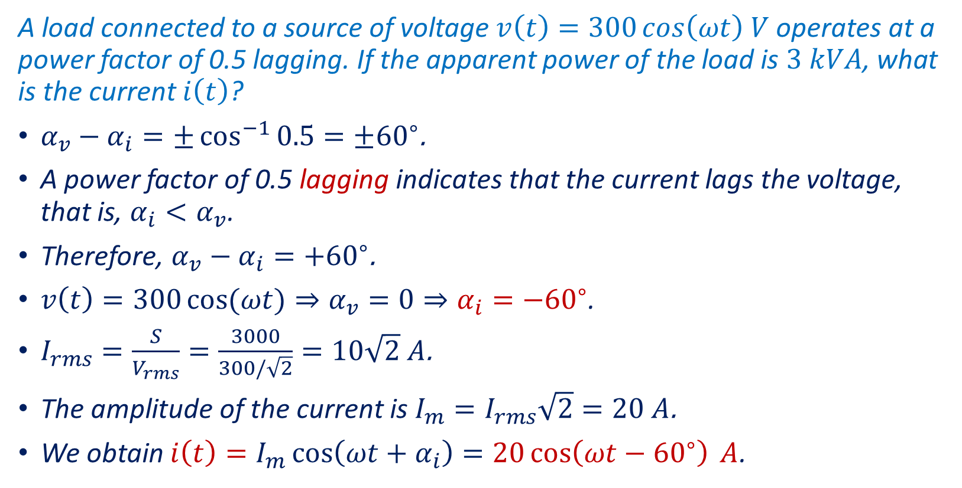
Power—Examples
A load connected to a source of voltage $v\left(t\right)=300\cos\left(ωt\right) V$ operates at a power factor of 0.5 lagging. If the apparent power of the load is $3 kVA$, what is the current $i\left(t\right)$?
$α_{v}−α_{i}=±\cos^{−1}{0.5}=±{60}^{∘}$.
A power factor of 0.5 lagging indicates that the current lags the voltage, that is, $α_{i}<α_{v}$.
Therefore, $α_{v}−α_{i}=+{60}^{∘}$.
$v\left(t\right)=300\cos{(ωt)}⇒α_{v}=0⇒α_{i}=−{60}^{∘}$.
$I_{rms}=\frac{S}{V_{rms}}=\frac{3000}{300/\sqrt{2}}=10\sqrt{2} A$.
The amplitude of the current is $I_{m}=I_{rms}\sqrt{2}=20 A$.
We obtain $i\left(t\right)=I_{m}\cos\left(ωt+α_{i}\right)=20\cos\left(ωt−{60}^{∘}\right) A$.

Slide 13
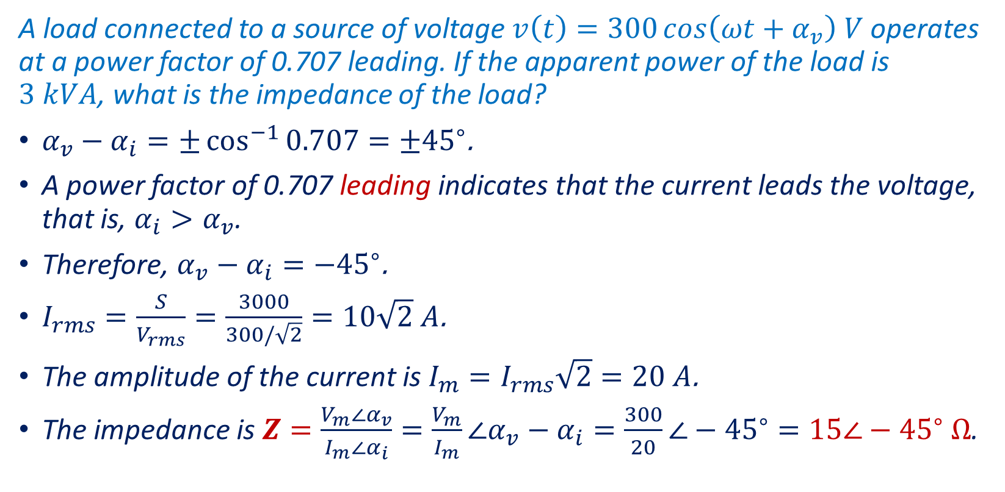
Power—Examples
A load connected to a source of voltage $v\left(t\right)=300\cos\left(ωt+α_{v}\right) V$ operates at a power factor of 0.707 leading. If the apparent power of the load is $3 kVA$, what is the impedance of the load?
$α_{v}−α_{i}=±\cos^{−1}{0.707}=±{45}^{∘}$.
A power factor of 0.707 leading indicates that the current leads the voltage, that is, $α_{i}>α_{v}$.
Therefore, $α_{v}−α_{i}=−{45}^{∘}$.
$I_{rms}=\frac{S}{V_{rms}}=\frac{3000}{300/\sqrt{2}}=10\sqrt{2} A$.
The amplitude of the current is $I_{m}=I_{rms}\sqrt{2}=20 A$.
The impedance is $Z=\frac{V_{m}∠α_{v}}{I_{m}∠α_{i}}=\frac{V_{m}}{I_{m}}∠α_{v}−α_{i}=\frac{300}{20}∠−{45}^{∘}=15∠−{45}^{∘} Ω$.

