Slide 1
AC Power
Instantaneous Power, Average Power, RMS Values.
M.V. Iordache, EEGR2053 Electric Circuits, Spring 2020, LeTourneau University

Slide 2
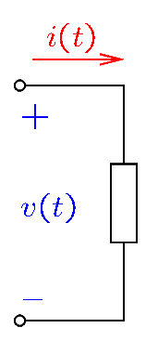
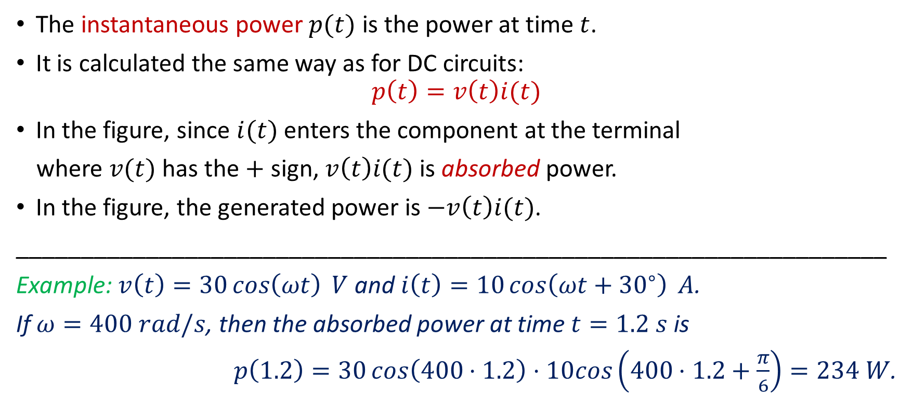
Instantaneous Power
The instantaneous power $p(t)$ is the power at time $t$.
It is calculated the same way as for DC circuits:
$$p\left(t\right)=v\left(t\right)i(t)$$
In the figure, since $i(t)$ enters the component at the terminal
where $v(t)$ has the $+$ sign, $v\left(t\right)i(t)$ is absorbed power.
In the figure, the generated power is $−v\left(t\right)i(t)$.
___________________________________________________________________
Example: $v\left(t\right)=30\cos\left(ωt\right) V$ and $i\left(t\right)=10\cos\left(ωt+{30}^{∘}\right) A$.
If $ω=400 rad/s$, then the absorbed power at time $t=1.2 s$ is
$p\left(1.2\right)=30\cos\left(400⋅1.2\right)⋅10cos\left(400⋅1.2+\frac{π}{6}\right)=234 W$.
Notes:
cfig/elem.fig

Slide 3
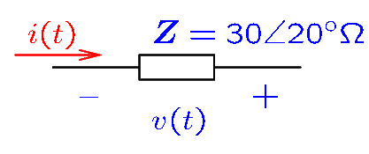
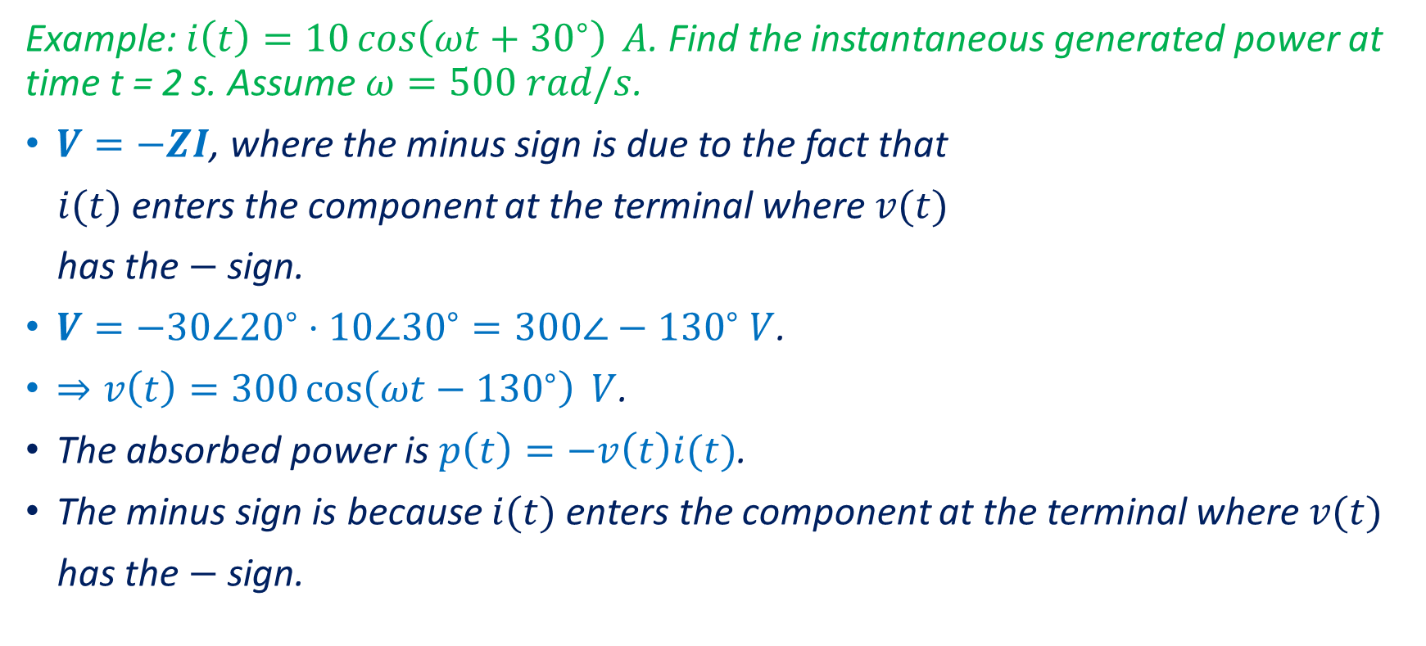
Instantaneous Power—Example
Example: $i\left(t\right)=10\cos\left(ωt+{30}^{∘}\right) A$. Find the instantaneous generated power at time t = 2 s. Assume $ω=500 rad/s$.
$V=−ZI$, where the minus sign is due to the fact that
$i(t)$ enters the component at the terminal where $v(t)$
has the $−$ sign.
$V=−30∠{20}^{∘}⋅10∠{30}^{∘}=300∠−{130}^{∘} V$.
$⇒v\left(t\right)=300\cos\left(ωt−{130}^{∘}\right) V$.
The absorbed power is $p\left(t\right)=−v\left(t\right)i(t)$.
The minus sign is because $i(t)$ enters the component at the terminal where $v(t)$
has the $−$ sign.
Notes:
cfig/elem.fig

Slide 4
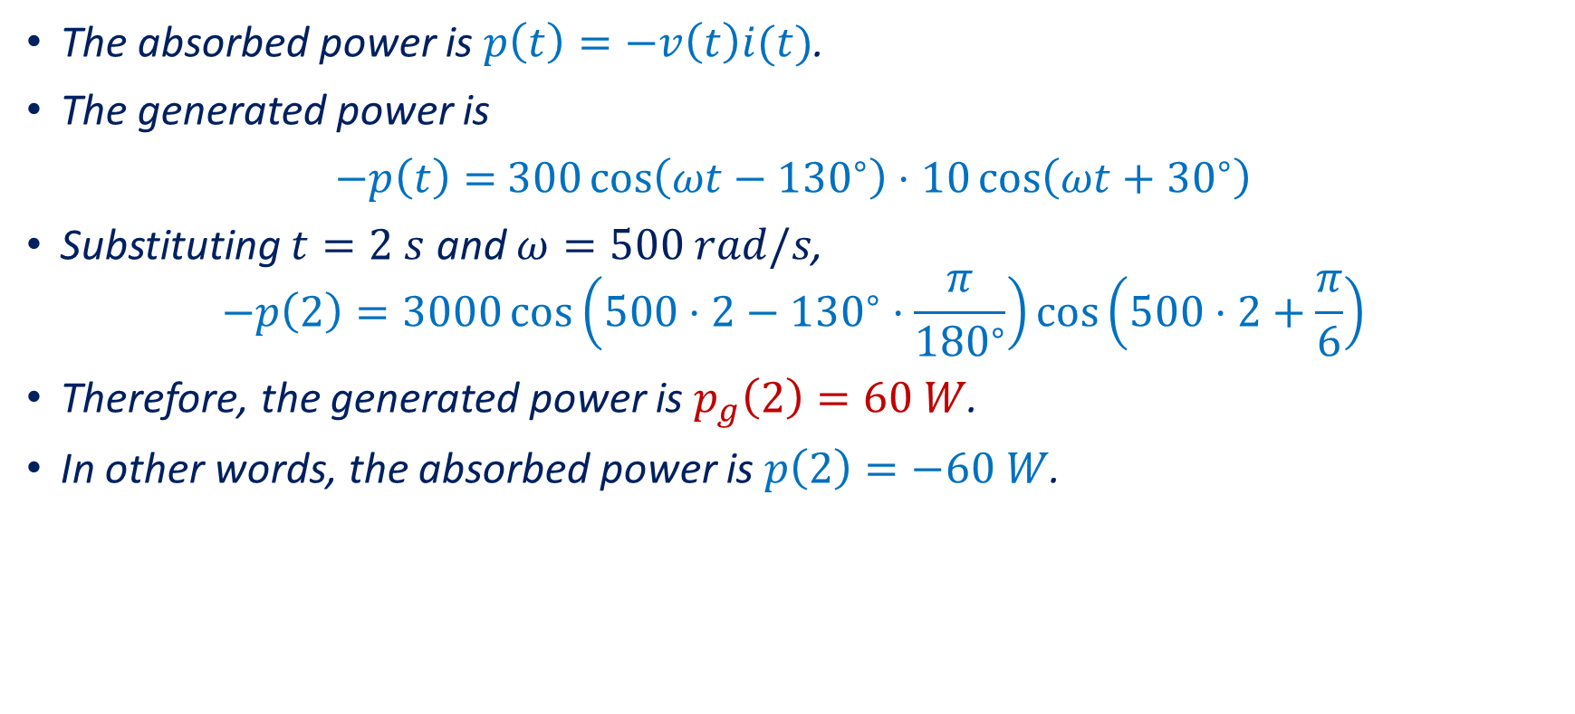
Instantaneous Power—Example
The absorbed power is $p\left(t\right)=−v\left(t\right)i(t)$.
The generated power is
$−p\left(t\right)=$ $300\cos\left(ωt−{130}^{∘}\right)⋅10\cos\left(ωt+{30}^{∘}\right)$
Substituting $t=2 s$ and $ω=500 rad/s$,
$$−p\left(2\right)=3000\cos\left(500⋅2−{130}^{∘}⋅\frac{π}{{180}^{∘}}\right)\cos\left(500⋅2+\frac{π}{6}\right)$$
Therefore, the generated power is $p_{g}\left(2\right)=60 W$.
In other words, the absorbed power is $p\left(2\right)=−60 W$.
Notes:
cfig/elem.fig

Slide 5
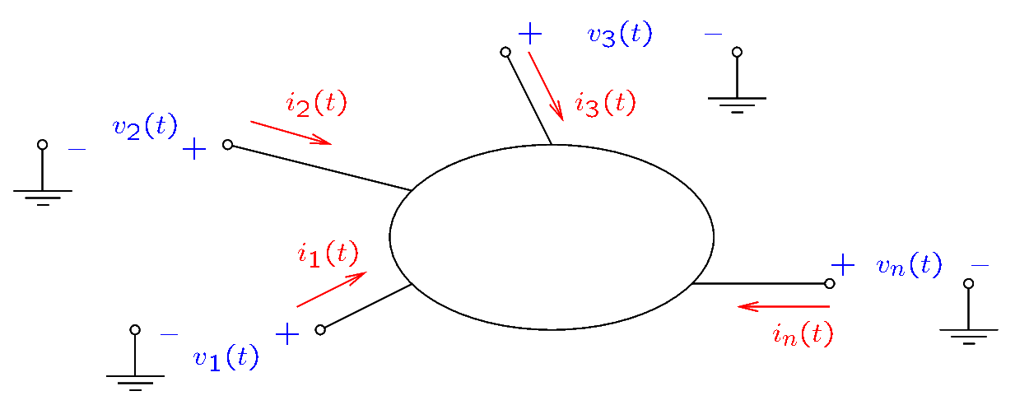
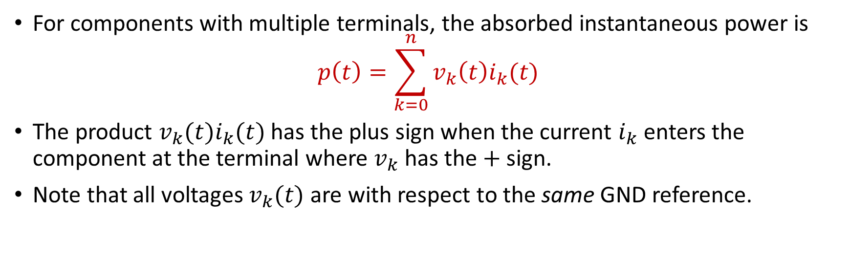
Instantaneous Power
For components with multiple terminals, the absorbed instantaneous power is
$$p\left(t\right)=\sum_{k=0}^{n}{v_{k}\left(t\right)i_{k}(t)}$$
The product $v_{k}(t)i_{k}(t)$ has the plus sign when the current $i_{k}$ enters the component at the terminal where $v_{k}$ has the $+$ sign.
Note that all voltages $v_{k}(t)$ are with respect to the same GND reference.
Notes:
cfig/elem.fig

Slide 6
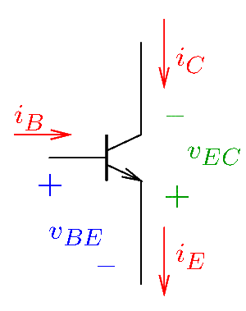
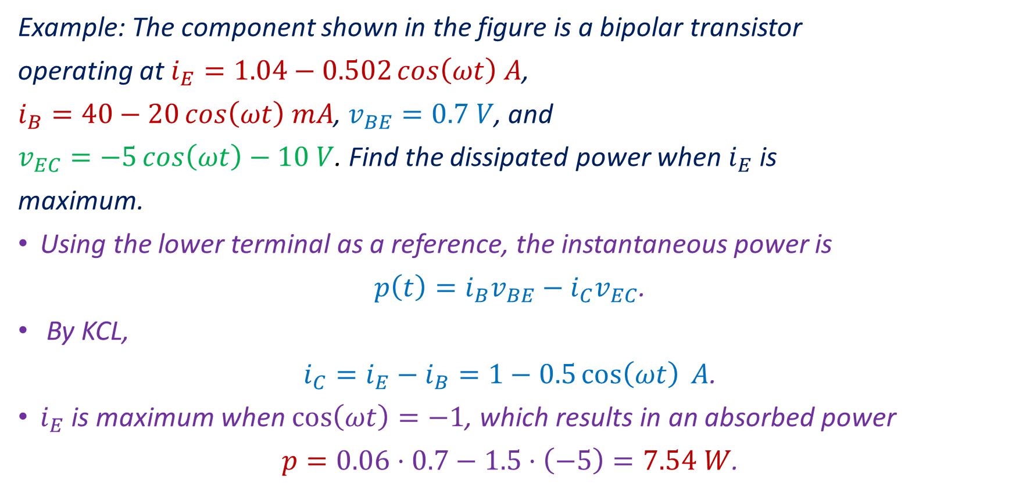
Instantaneous Power—Example
Example: The component shown in the figure is a bipolar transistor
operating at $i_{E}=1.04−0.502\cos\left(ωt\right) A$,
$i_{B}=40−20\cos\left(ωt\right) mA$, $v_{BE}=0.7 V$, and
$v_{EC}=−5\cos\left(ωt\right)−10 V$. Find the dissipated power when $i_{E}$ is
maximum.
Using the lower terminal as a reference, the instantaneous power is
$p\left(t\right)=i_{B}v_{BE}−i_{C}v_{EC}$.
By KCL,
$i_{C}=i_{E}−i_{B}=1−0.5\cos\left(ωt\right) A$.
$i_{E}$ is maximum when $\cos\left(ωt\right)=−1$, which results in an absorbed power
$p=0.06⋅0.7−1.5⋅\left(−5\right)=7.54 W$.
Notes:
cfig/elem.fig

Slide 7
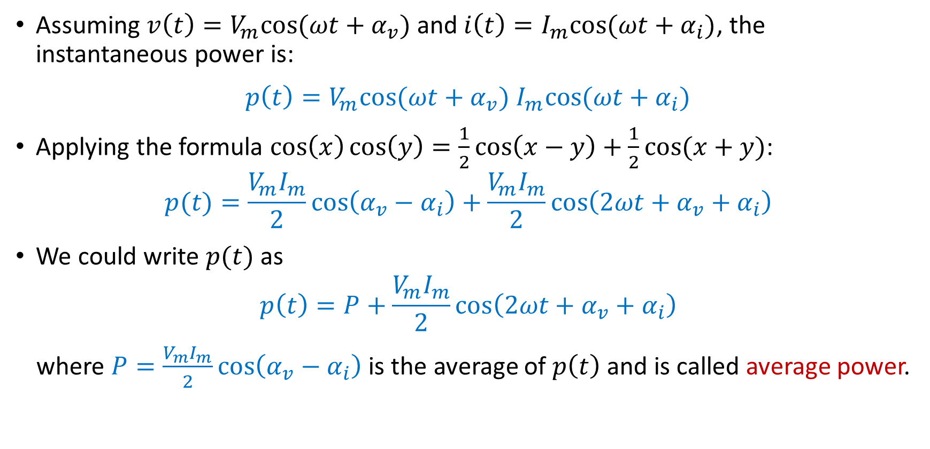
Average Power
Assuming $v\left(t\right)=V_{m}cos⁡(ωt+α_{v})$ and $i\left(t\right)=I_{m}cos⁡(ωt+α_{i})$, the instantaneous power is:
$p\left(t\right)=V_{m}cos⁡(ωt+α_{v})$ $I_{m}cos⁡(ωt+α_{i})$
Applying the formula $\cos\left(x\right)\cos\left(y\right)=\frac{1}{2}\cos\left(x−y\right)+\frac{1}{2}cos⁡(x+y)$:
$$p(t)=\frac{V_{m}I_{m}}{2}\cos\left(α_{v}−α_{i}\right)+\frac{V_{m}I_{m}}{2}\cos\left(2ωt+α_{v}+α_{i}\right)$$
We could write $p(t)$ as
$$p\left(t\right)=P+\frac{V_{m}I_{m}}{2}\cos\left(2ωt+α_{v}+α_{i}\right)$$
where $P=\frac{V_{m}I_{m}}{2}\cos\left(α_{v}−α_{i}\right)$ is the average of $p\left(t\right)$ and is called average power.
Notes:
cfig/elem.fig

Slide 8
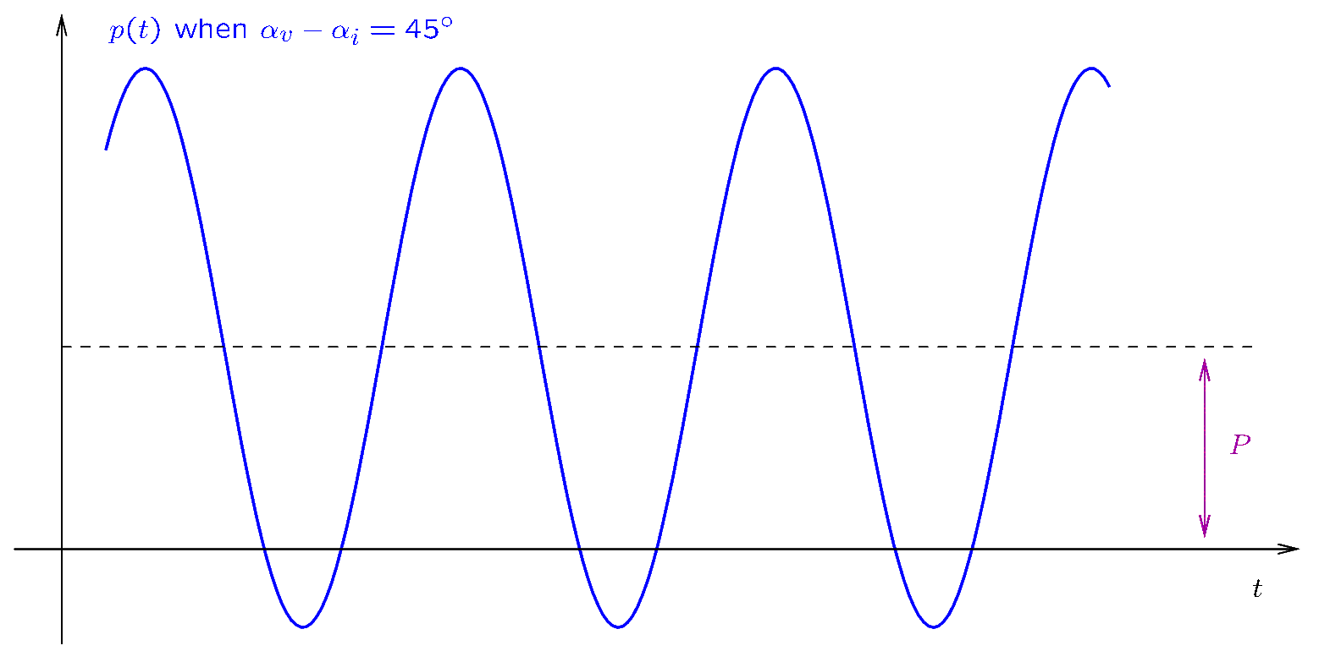

Average Power
The instantaneous power $p(t)$ may have both positive and negative values.
$P$ is its average of $p(t)$.
Notes:
cfig/pt.fig

Slide 9
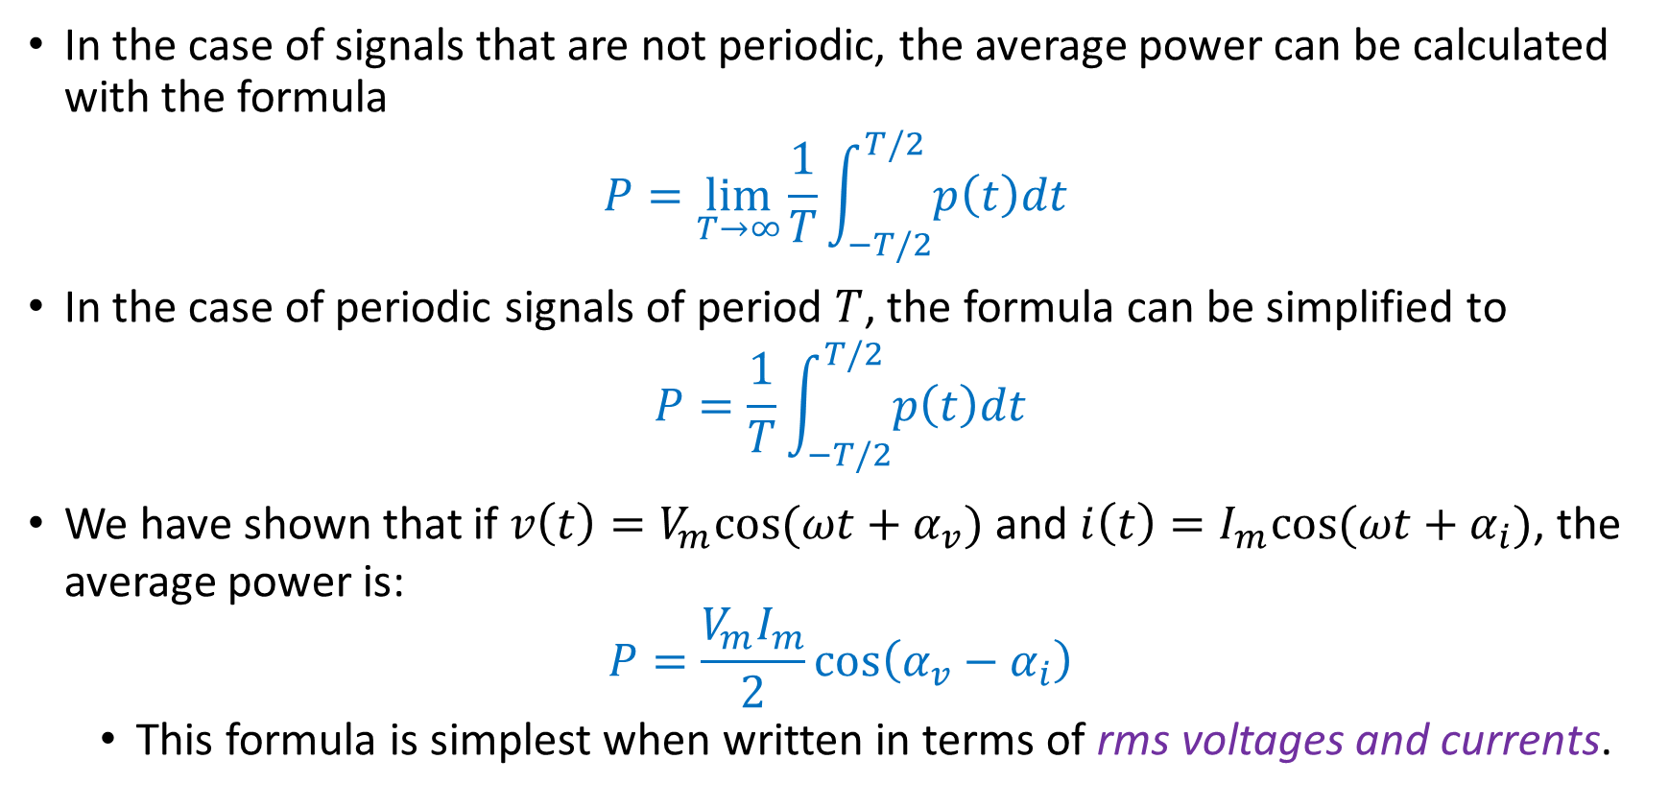
Average Power
In the case of signals that are not periodic, the average power can be calculated with the formula
$$P=\lim_{T→∞}{\frac{1}{T}\int_{−T/2}^{T/2}{p\left(t\right)dt}}$$
In the case of periodic signals of period $T$, the formula can be simplified to
$$P=\frac{1}{T}\int_{−T/2}^{T/2}{p\left(t\right)dt}$$
We have shown that if $v\left(t\right)=V_{m}cos⁡(ωt+α_{v})$ and $i\left(t\right)=I_{m}cos⁡(ωt+α_{i})$, the average power is:
$$P=\frac{V_{m}I_{m}}{2}\cos\left(α_{v}−α_{i}\right)$$
This formula is simplest when written in terms of rms voltages and currents.

Slide 10
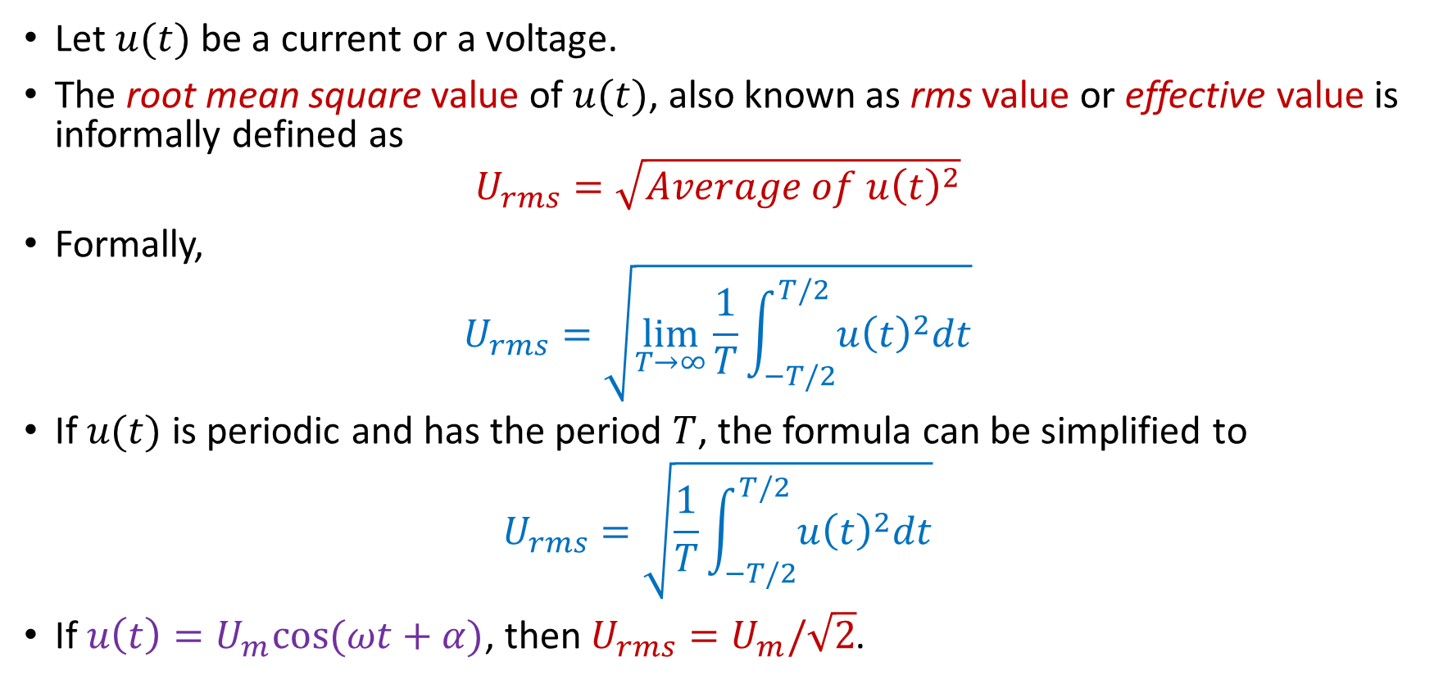
RMS Voltages and Currents
Let $u(t)$ be a current or a voltage.
The root mean square value of $u(t)$, also known as rms value or effective value is informally defined as
$$U_{rms}=\sqrt{Average of u{\left(t\right)}^{2}}$$
Formally,
$$U_{rms}=\sqrt{\lim_{T→∞}{\frac{1}{T}\int_{−T/2}^{T/2}{u{\left(t\right)}^{2}dt}}}$$
If $u(t)$ is periodic and has the period $T$, the formula can be simplified to
$$U_{rms}=\sqrt{\frac{1}{T}\int_{−T/2}^{T/2}{u{\left(t\right)}^{2}dt}}$$
If $u\left(t\right)=U_{m}cos⁡(ωt+α)$, then $U_{rms}=U_{m}/\sqrt{2}$.

Slide 11

RMS Voltages and Currents
Let $V_{rms}$ be the rms value of $v\left(t\right)=V_{m}cos⁡(ωt+α_{v})$ and $I_{rms}$ the rms value of $i\left(t\right)=I_{m}cos⁡(ωt+α_{i})$. Then:
$V_{rms}=\frac{V_{m}}{\sqrt{2}}$ and $I_{rms}=\frac{I_{m}}{\sqrt{2}}$
The average power is:
$$P=\frac{V_{m}I_{m}}{2}\cos\left(α_{v}−α_{i}\right)=V_{rms}I_{rms}cos⁡(α_{v}−α_{i})$$

Slide 12

RMS Voltages and Currents
The rms value of a signal $u(t)$ is the DC value that would produce the same average power on a resistor as $u\left(t\right).$
The rms value is the DC equivalent of an AC signal.
The wall outlet voltage is 120 V rms!
The amplitude of the wall outlet voltage is therefore $120\sqrt{2}=169.71 V$.
When measuring the value of AC signals, multimeters display the rms value.

Slide 13
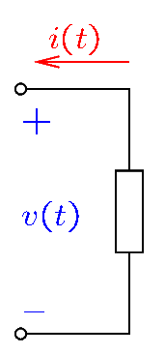
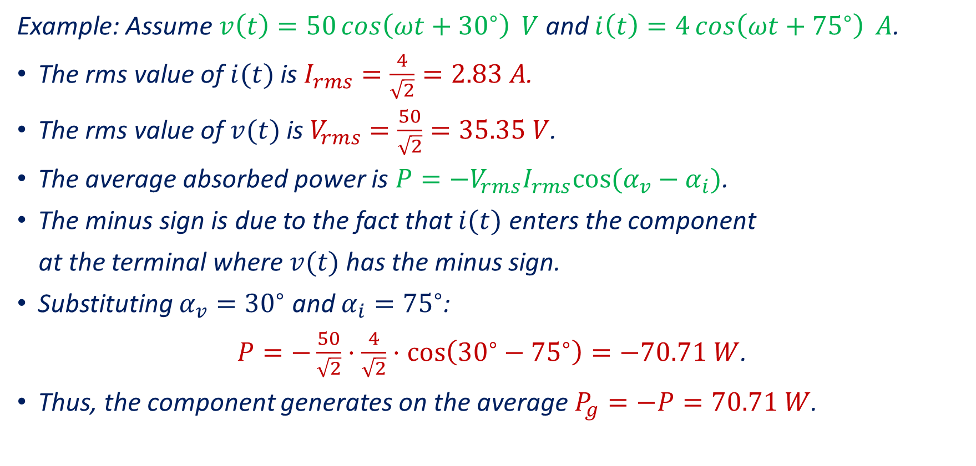
RMS Voltages and Currents—Examples
Example: Assume $v\left(t\right)=50\cos\left(ωt+{30}^{∘}\right) V$ and $i\left(t\right)=4\cos\left(ωt+{75}^{∘}\right) A$.
The rms value of $i(t)$ is $I_{rms}=\frac{4}{\sqrt{2}}=2.83 A$.
The rms value of $v(t)$ is $V_{rms}=\frac{50}{\sqrt{2}}=35.35 V$.
The average absorbed power is $P=−V_{rms}I_{rms}cos⁡(α_{v}−α_{i})$.
The minus sign is due to the fact that $i(t)$ enters the component
at the terminal where $v(t)$ has the minus sign.
Substituting $α_{v}={30}^{∘}$ and $α_{i}={75}^{∘}$:
$P=−\frac{50}{\sqrt{2}}⋅\frac{4}{\sqrt{2}}⋅\cos\left({30}^{∘}−{75}^{∘}\right)=−70.71 W$.
Thus, the component generates on the average $P_{g}=−P=70.71 W$.

Slide 14
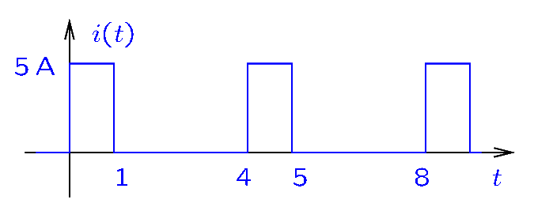
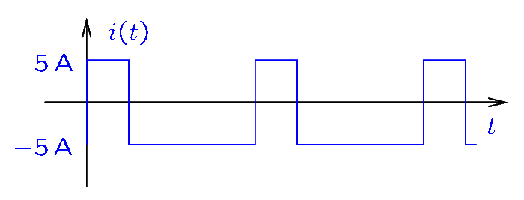
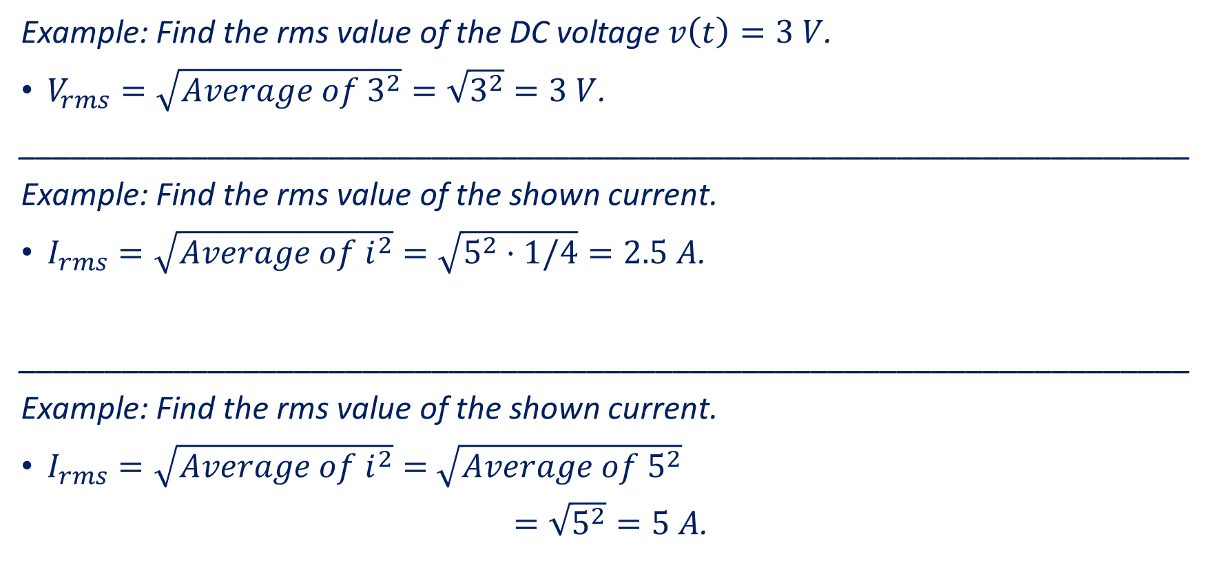
RMS Voltages and Currents—Examples
Example: Find the rms value of the DC voltage $v\left(t\right)=3 V$.
$V_{rms}=\sqrt{Average of 3^{2}}=\sqrt{3^{2}}=3 V$.
____________________________________________________________________
Example: Find the rms value of the shown current.
$I_{rms}=\sqrt{Average of i^{2}}=\sqrt{5^{2}⋅1/4}=2.5 A$.
____________________________________________________________________
Example: Find the rms value of the shown current.
$I_{rms}=\sqrt{Average of i^{2}}=$ $\sqrt{Average of 5^{2}}$
$=\sqrt{5^{2}}=5 A$.

Slide 15

RMS Voltages and Currents—Examples
Example: Find the rms value of the DC voltage $v\left(t\right)=5\cos\left(ωt\right)+3 V$.
$V_{rms}=\sqrt{Average of ({5\cos\left(ωt\right)+3)}^{2}}$
$$=\sqrt{Average of 25{(cos\left(ωt\right))}^{2}+9+30cos⁡(ωt)}$$
$=\sqrt{\frac{25}{2}+9+0}=4.63 V$.

