Slide 1
AC Analysis of Circuits
KVL, KCL, Nodal Analysis, Mesh Analysis
M.V. Iordache, EEGR2053 Electric Circuits, Spring 2020, LeTourneau University

Slide 2
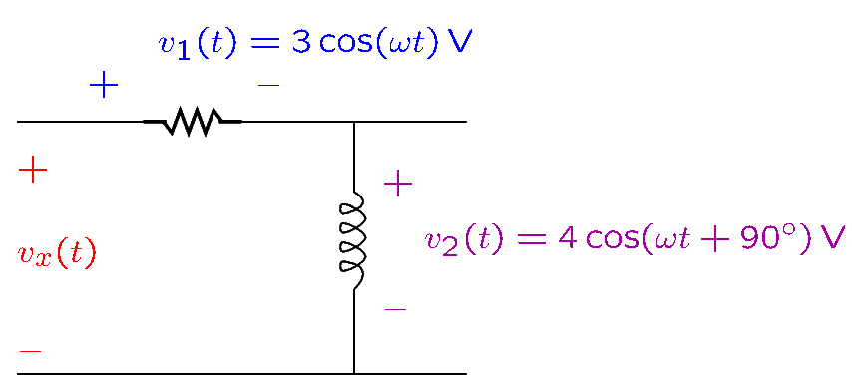
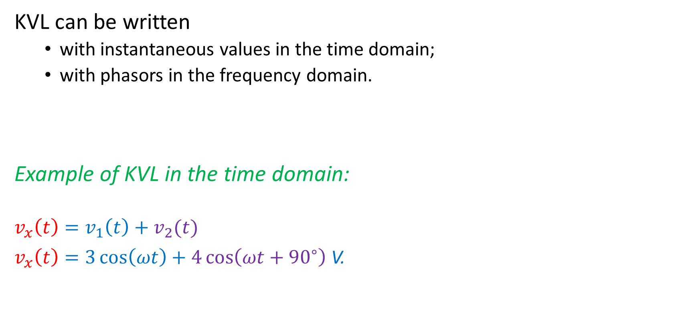
KVL
KVL can be written
with instantaneous values in the time domain;
with phasors in the frequency domain.
Example of KVL in the time domain:
$$v_{x}\left(t\right)=v_{1}\left(t\right)+v_{2}(t)$$
$v_{x}\left(t\right)=3\cos\left(ωt\right)+4\cos\left(ωt+{90}^{∘}\right)$V.
Notes:
cfig/kvl.fig

Slide 3
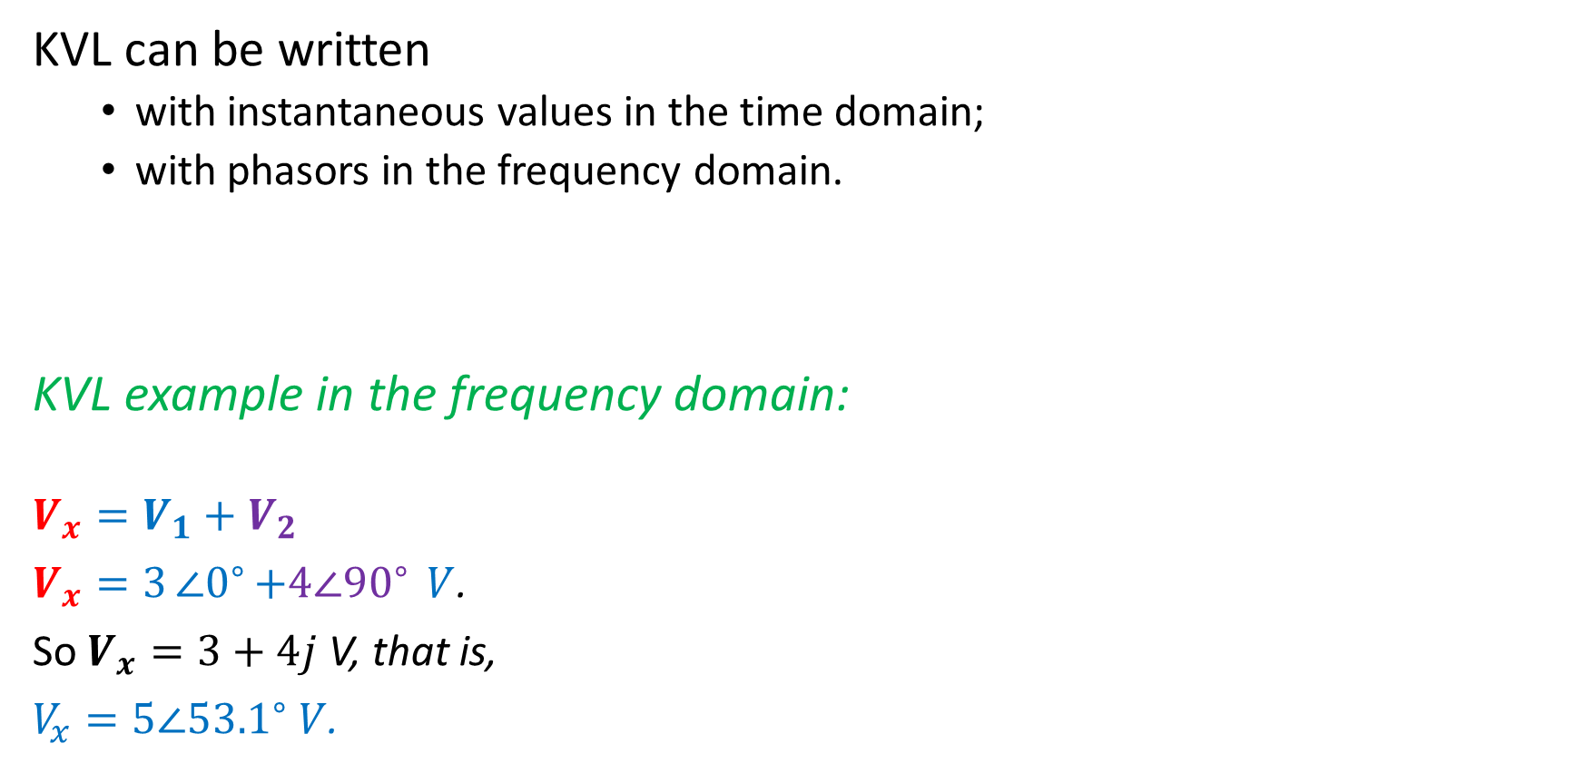
KVL
KVL can be written
with instantaneous values in the time domain;
with phasors in the frequency domain.
KVL example in the frequency domain:
$$V_{x}=V_{1}+V_{2}$$
$V_{x}=3∠0^{∘}{+4∠{90}^{∘}} V$.
So $V_{x}=3+4j$ V, that is,
$V_{x}=5∠{53.1}^{∘} V$.

Slide 4
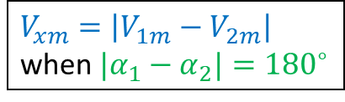
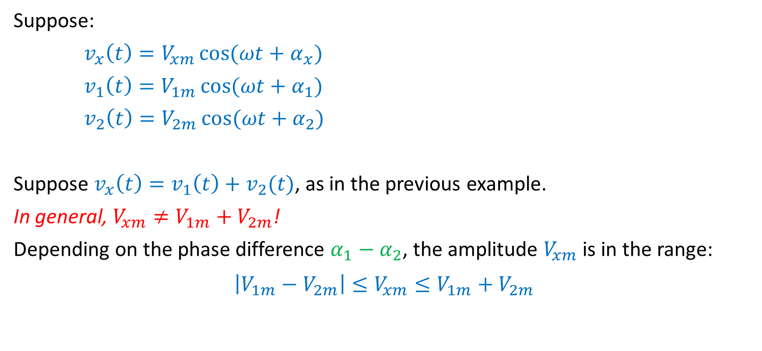
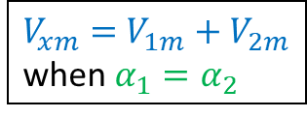
KVL Does NOT Apply to Amplitudes
Suppose:
$v_{x}\left(t\right)=V_{xm}\cos{(ωt+α_{x})}$
$v_{1}\left(t\right)=V_{1m}\cos{(ωt+α_{1})}$
$v_{2}\left(t\right)=V_{2m}\cos{(ωt+α_{2})}$
Suppose $v_{x}\left(t\right)=v_{1}\left(t\right)+v_{2}(t)$, as in the previous example.
In general, $V_{xm}≠V_{1m}+V_{2m}$!
Depending on the phase difference $α_{1}−α_{2}$, the amplitude $V_{xm}$ is in the range:
$$\left|V_{1m}−V_{2m}\right|≤V_{xm}≤V_{1m}+V_{2m}$$
$V_{xm}=\left|V_{1m}−V_{2m}\right|$
when ${|α}_{1}−α_{2}|={180}^{∘}$
$V_{xm}=$ $V_{1m}+V_{2m}$
when $α_{1}=α_{2}$

Slide 5
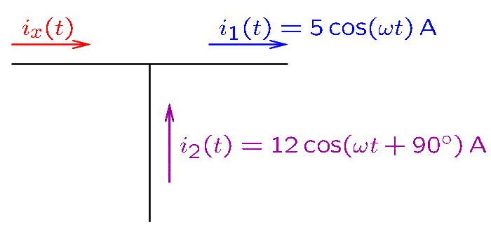
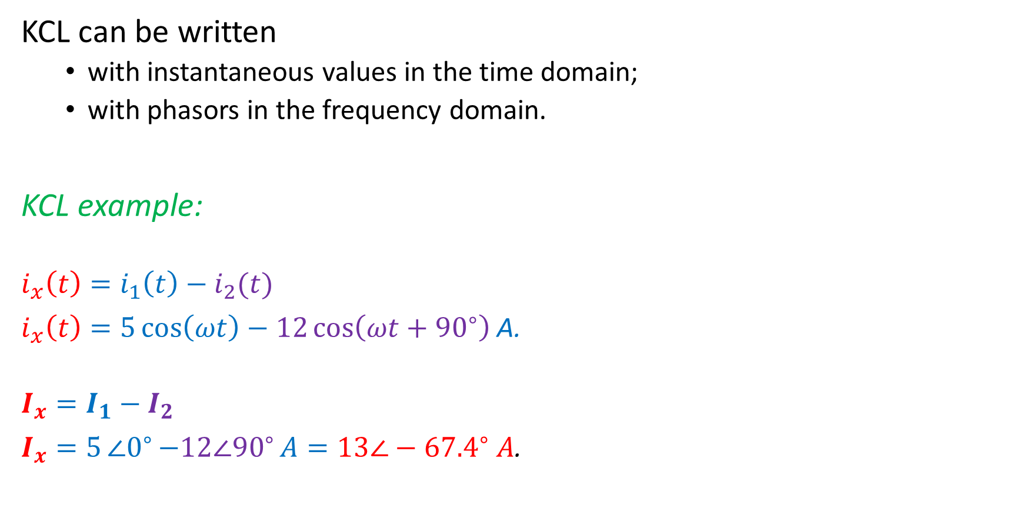
KCL
KCL can be written
with instantaneous values in the time domain;
with phasors in the frequency domain.
KCL example:
$$i_{x}\left(t\right)=i_{1}\left(t\right)−i_{2}(t)$$
$i_{x}\left(t\right)=5\cos\left(ωt\right)−12\cos\left(ωt+{90}^{∘}\right)$A.
$$I_{x}=I_{1}−I_{2}$$
$I_{x}=5∠0^{∘}{−12∠{90}^{∘}}A=13∠−{67.4}^{∘} A$.
Notes:
cfig/kcl.fig

Slide 6

KCL Does NOT Apply to Amplitudes
In the previous example:
$$i_{x}\left(t\right)=i_{1}\left(t\right)−i_{2}(t)$$
that is,
$$13\cos\left(ωt−{67.4}^{∘}\right)=5\cos\left(ωt\right)−12\cos\left(ωt+{90}^{∘}\right)$$
Note that KCL does not apply to the amplitudes:
$$13≠5−12$$

Slide 7
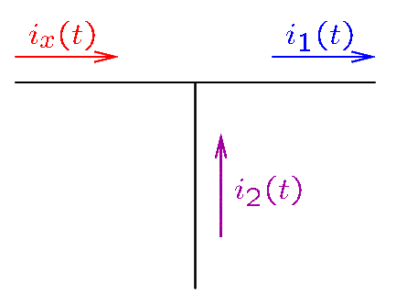
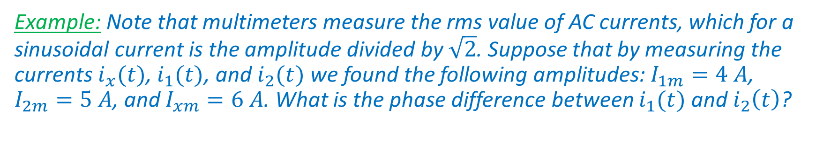
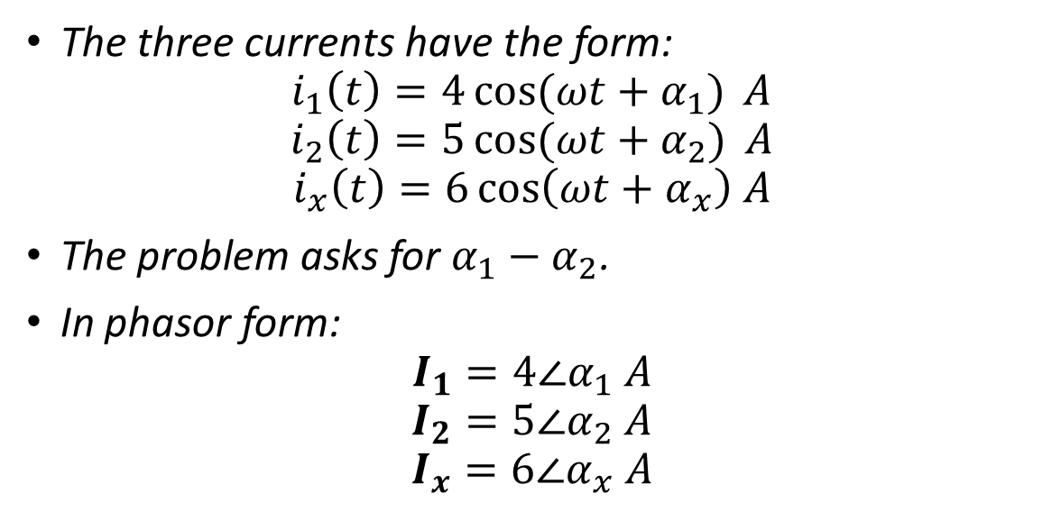
KCL Does NOT Apply to Amplitudes
Example: Note that multimeters measure the rms value of AC currents, which for a sinusoidal current is the amplitude divided by $\sqrt{2}$. Suppose that by measuring the currents $i_{x}(t)$, $i_{1}(t)$, and $i_{2}(t)$ we found the following amplitudes: $I_{1m}=4 A$, $I_{2m}=5 A$, and $I_{xm}=6 A$. What is the phase difference between $i_{1}(t)$ and $i_{2}\left(t\right)$?
The three currents have the form:
$$i_{1}\left(t\right)=4\cos{(ωt+α_{1})} A$$
$$i_{2}\left(t\right)=5\cos{(ωt+α_{2})} A$$
$$i_{x}\left(t\right)=6\cos\left(ωt+α_{x}\right) A$$
The problem asks for $α_{1}−α_{2}$.
In phasor form:
$$I_{1}=4∠α_{1} A$$
$$I_{2}=5∠α_{2} A$$
$$I_{x}=6∠α_{x} A$$
Notes:
cfig/kcl2.fig

Slide 8
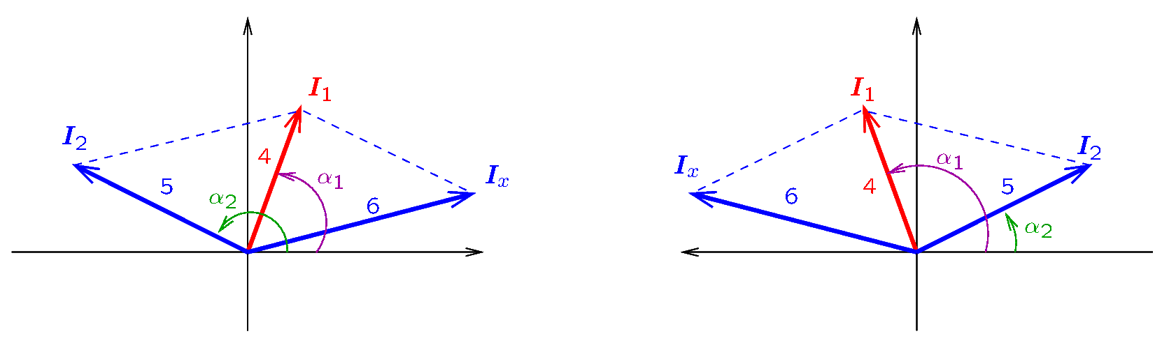
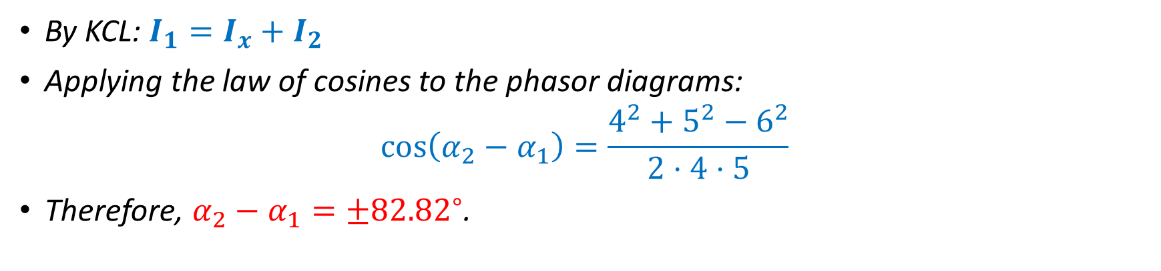
Example—Continued
By KCL: $I_{1}=I_{x}+I_{2}$
Applying the law of cosines to the phasor diagrams:
$$\cos\left(α_{2}−α_{1}\right)=\frac{4^{2}+5^{2}−6^{2}}{2⋅4⋅5}$$
Therefore, $α_{2}−α_{1}=±{82.82}^{∘}$.
Notes:
cfig/phasor2.fig

Slide 9
Analysis Methods
We consider here methods for the steady-state analysis of circuits with sinusoidal sources of voltage and current.
The following apply only in the frequency domain.
Nodal analysis
Mesh analysis
Voltage division
Current division
Source transformations
Superposition can be used in both frequency and time domains.
The Thevenin equivalent will be introduced later.
Analysis methods are applied exactly the same way as for DC circuits.
The only difference is that we work with complex numbers.

Slide 10
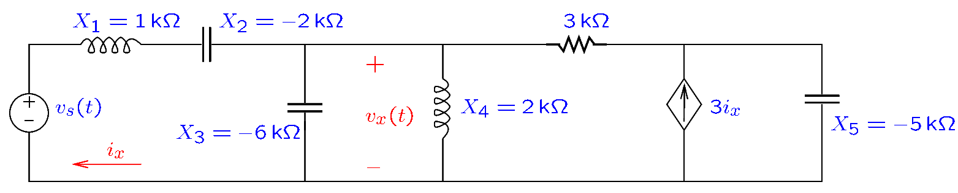
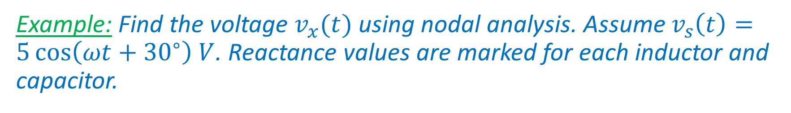
Nodal Analysis
Example: Find the voltage $v_{x}(t)$ using nodal analysis. Assume $v_{s}\left(t\right)=5\cos\left(ωt+{30}^{∘}\right) V$. Reactance values are marked for each inductor and capacitor.
In general, the first step is calculating inductor and capacitor impedances.
This step is not carried out here, since the reactances are given.
We will first draw the circuit in the frequency domain.
Notes:
cfig/acnodal.fig

Slide 11
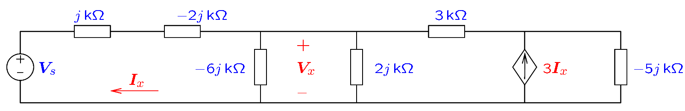
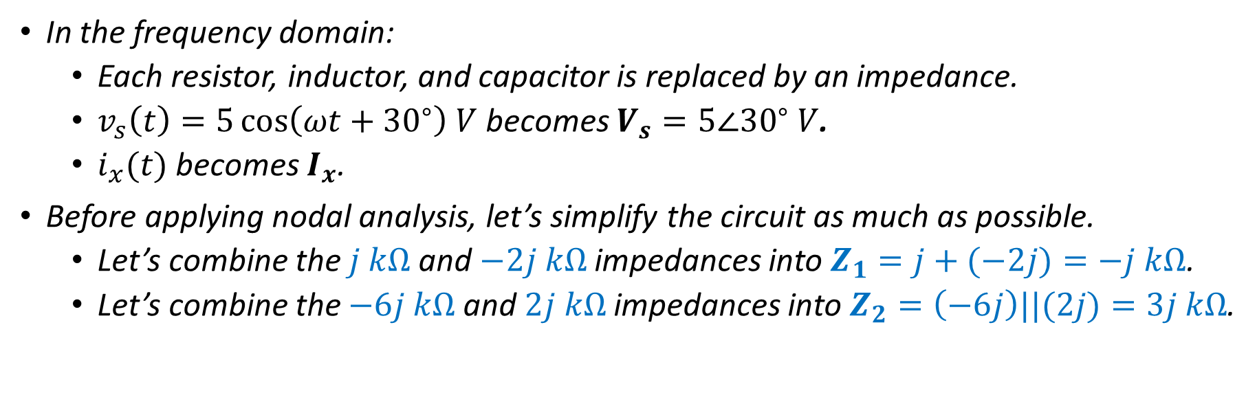
Nodal Analysis—Example
In the frequency domain:
Each resistor, inductor, and capacitor is replaced by an impedance.
$v_{s}\left(t\right)=5\cos\left(ωt+{30}^{∘}\right) V$ becomes $V_{s}=5∠{30}^{∘} V$.
$i_{x}(t)$ becomes $I_{x}$.
Before applying nodal analysis, let’s simplify the circuit as much as possible.
Let’s combine the $j kΩ$and $−2j kΩ$ impedances into $Z_{1}=j+(−2j)=−j kΩ$.
Let’s combine the $−6j kΩ$and $2j kΩ$ impedances into $Z_{2}=\left(−6j\right)||(2j)=3j kΩ$.
Notes:
cfig/acnodal2.fig

Slide 12
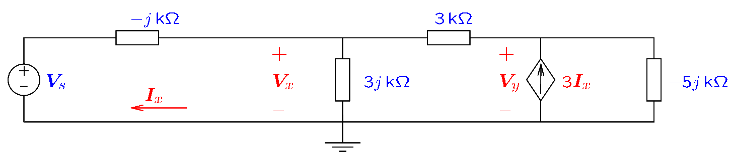
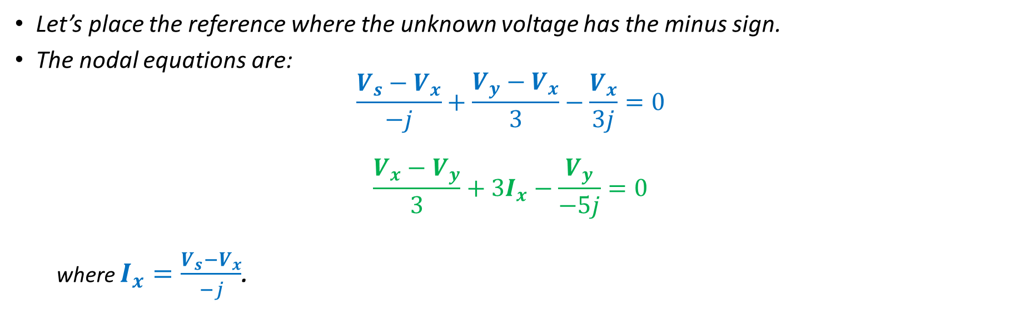
Nodal Analysis—Example
Let’s place the reference where the unknown voltage has the minus sign.
The nodal equations are:
$$\frac{V_{s}−V_{x}}{−j}+\frac{V_{y}−V_{x}}{3}−\frac{V_{x}}{3j}=0$$
$$\frac{V_{x}−V_{y}}{3}+3I_{x}−\frac{V_{y}}{−5j}=0$$
where $I_{x}=\frac{V_{s}−V_{x}}{−j}$.
Notes:
cfig/acnodal3.fig

Slide 13
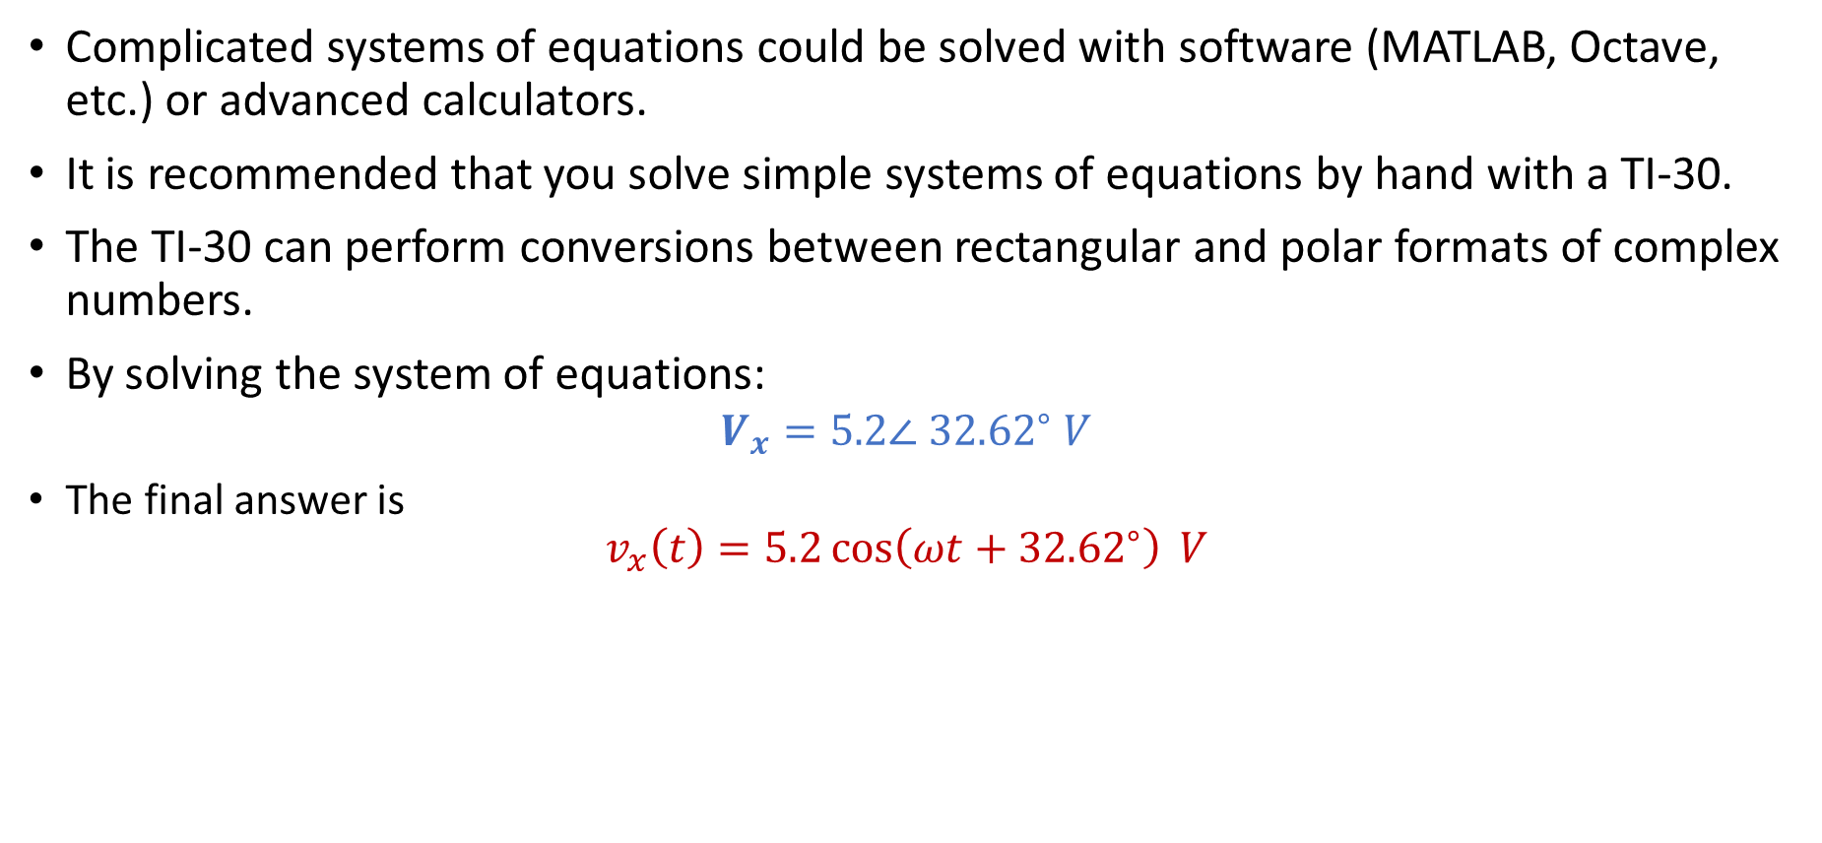
Nodal Analysis—Example
Complicated systems of equations could be solved with software (MATLAB, Octave, etc.) or advanced calculators.
It is recommended that you solve simple systems of equations by hand with a TI-30.
The TI-30 can perform conversions between rectangular and polar formats of complex numbers.
By solving the system of equations:
$$V_{x}=5.2∠ {32.62}^{∘} V$$
The final answer is
$$v_{x}\left(t\right)=5.2\cos\left(ωt+{32.62}^{∘}\right) V$$

