Slide 1
The Impedance
Impedance Review. Complex Number Review. Admittance. Application to Voltage and Current Division.
M.V. Iordache, EEGR2053 Electric Circuits, Spring 2020, LeTourneau University

Slide 2
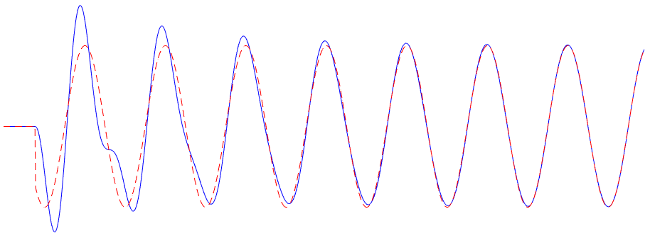
Review
When an AC circuit is turned on, there are transients (the blue curve).
In time, voltages and currents converge to steady-state values (the red curve).
Phasor analysis is the fastest way to find steady-state voltages and currents.
Notes:
out2-sine.png

Slide 3
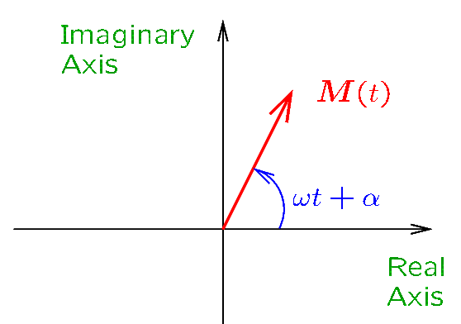
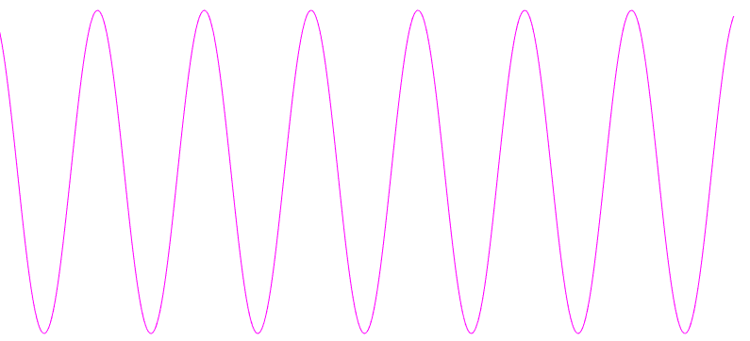

Review—Phasors
In the time domain, the signal $m\left(t\right)=M cos⁡(ωt+α)$ is a sinusoidal function.
In the frequency domain, the signal is a vector $M\left(t\right)=M∠ωt+α$ that rotates counterclockwise in the complex plane at an angular velocity $ω$.
Such rotating vectors are called PHASORS.
We use an abbreviated phasor notation: $M=M∠α$ (the $ωt$ term is dropped).
TIME DOMAIN
FREQUENCY DOMAIN

Slide 4
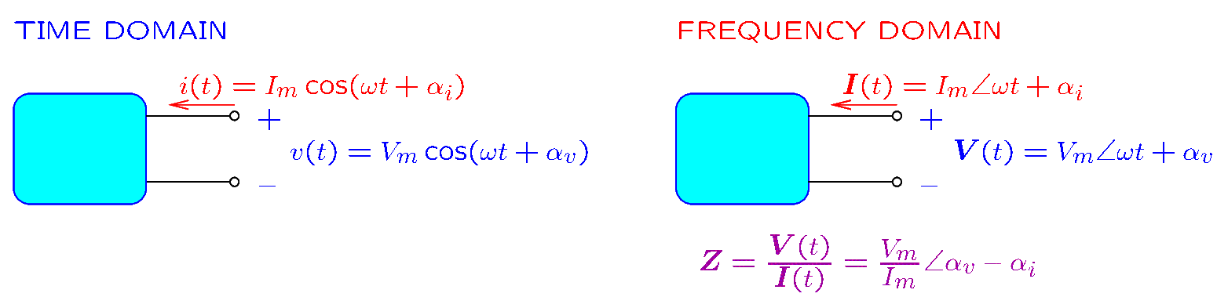
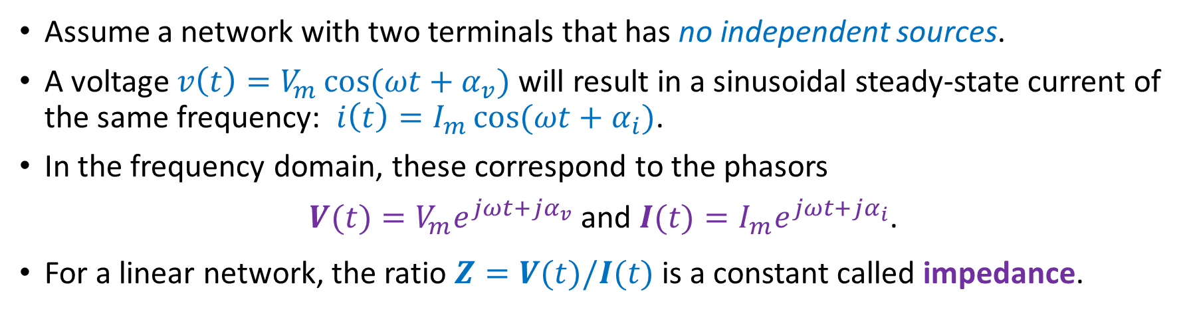
Review—Impedance
Assume a network with two terminals that has no independent sources.
A voltage $v\left(t\right)=V_{m}\cos{(ωt+α_{v})}$ will result in a sinusoidal steady-state current of the same frequency: $i\left(t\right)=I_{m}\cos{(ωt+α_{i})}$.
In the frequency domain, these correspond to the phasors
$V(t)=V_{m}e^{jωt+jα_{v}}$ and $I(t)=I_{m}e^{jωt+jα_{i}}$.
For a linear network, the ratio $Z=V(t)/I(t)$ is a constant called impedance.

Slide 5
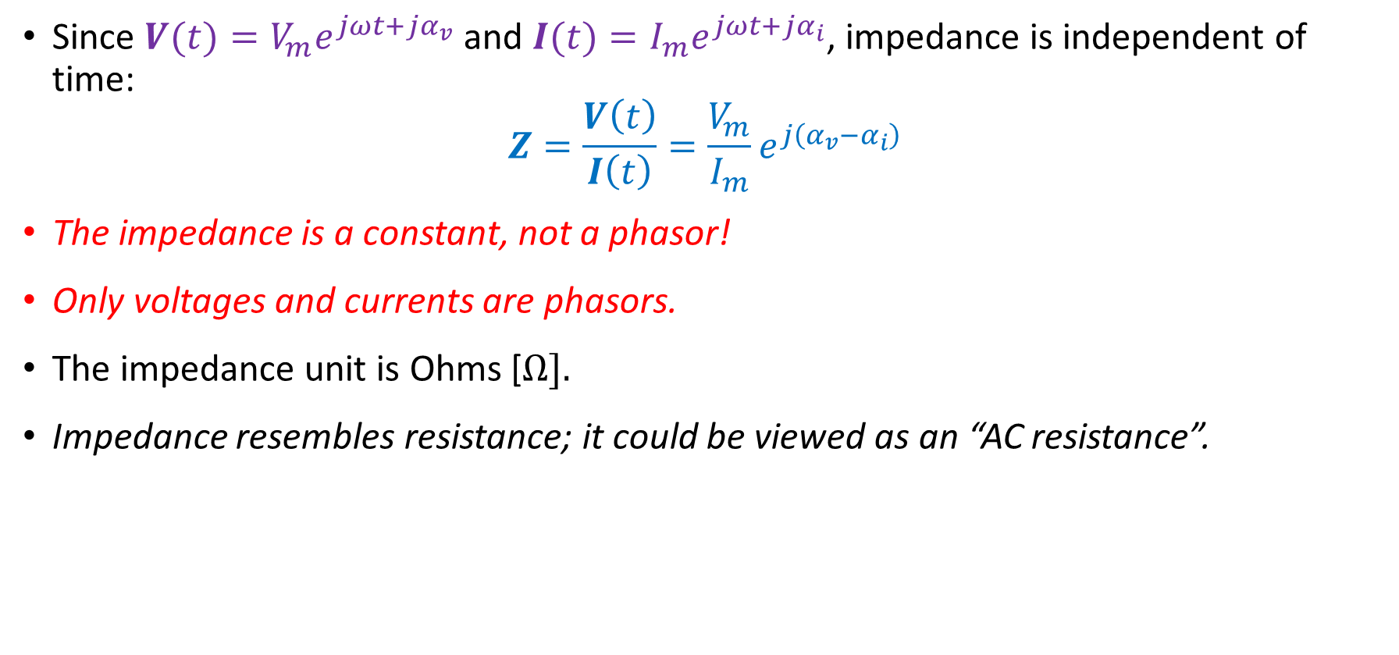
Review—Impedance
Since $V(t)=V_{m}e^{jωt+jα_{v}}$ and $I(t)=I_{m}e^{jωt+jα_{i}}$, impedance is independent of time:
$$Z=\frac{V\left(t\right)}{I\left(t\right)}=\frac{V_{m}}{I_{m}}e^{j\left(α_{v}−α_{i}\right)}$$
The impedance is a constant, not a phasor!
Only voltages and currents are phasors.
The impedance unit is Ohms [$Ω].$
Impedance resembles resistance; it could be viewed as an “AC resistance”.

Slide 6
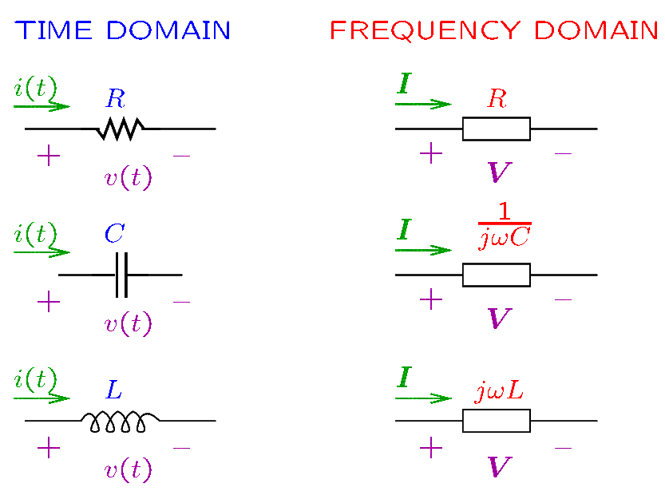
Review—Impedance
Resistors, capacitors, and inductors are represented in the frequency domain by their impedance. Memorize the impedance formulas!
Notes:
cfig/impedances.fig

Slide 7
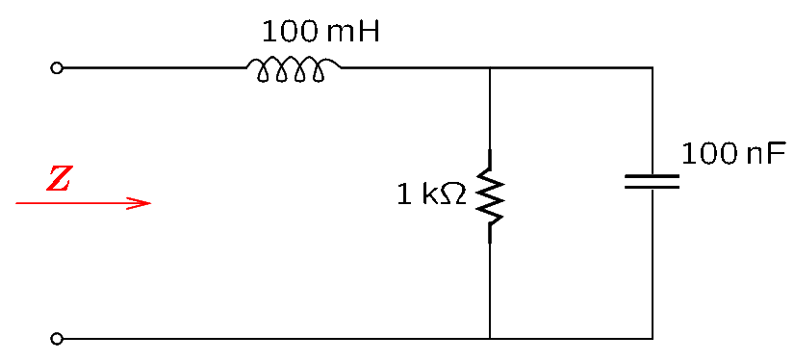
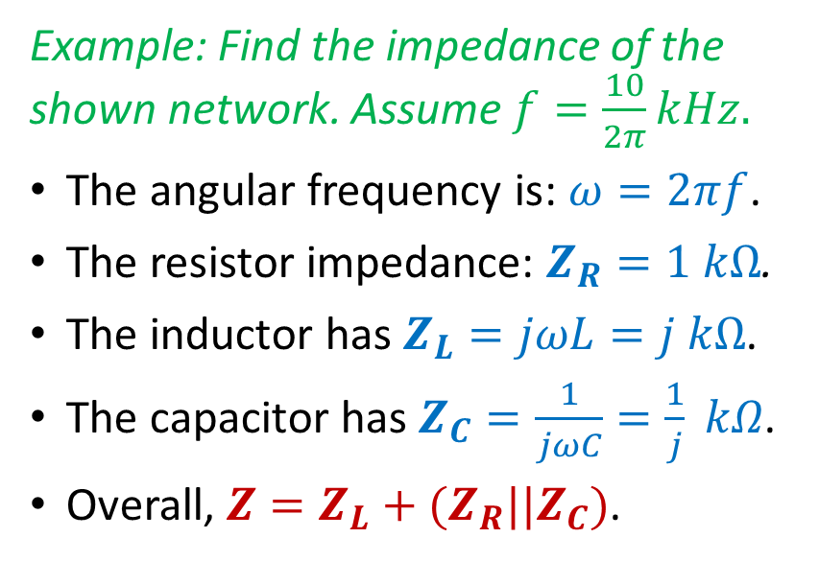
Impedance Combinations
The methods learned for DC circuits apply also to AC circuits in the frequency domain.
Series and parallel impedances are combined just like resistors.
Example: Find the impedance of the shown network. Assume $f=\frac{10}{2π}kHz.$
The angular frequency is: $ω=2πf$.
The resistor impedance: $Z_{R}=1 kΩ$.
The inductor has $Z_{L}=jωL=j kΩ$.
The capacitor has $Z_{C}=\frac{1}{jωC}=\frac{1}{j} kΩ$.
Overall, $Z=Z_{L}+(Z_{R}||Z_{C})$.
Notes:
cfig/imp1.fig

Slide 8
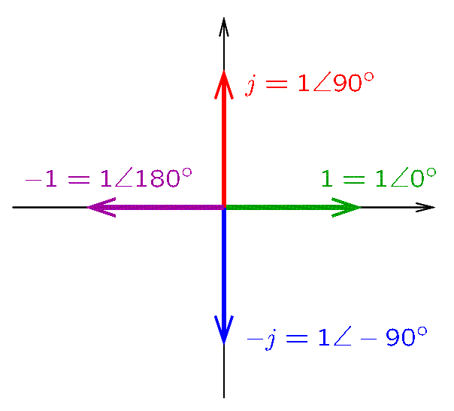
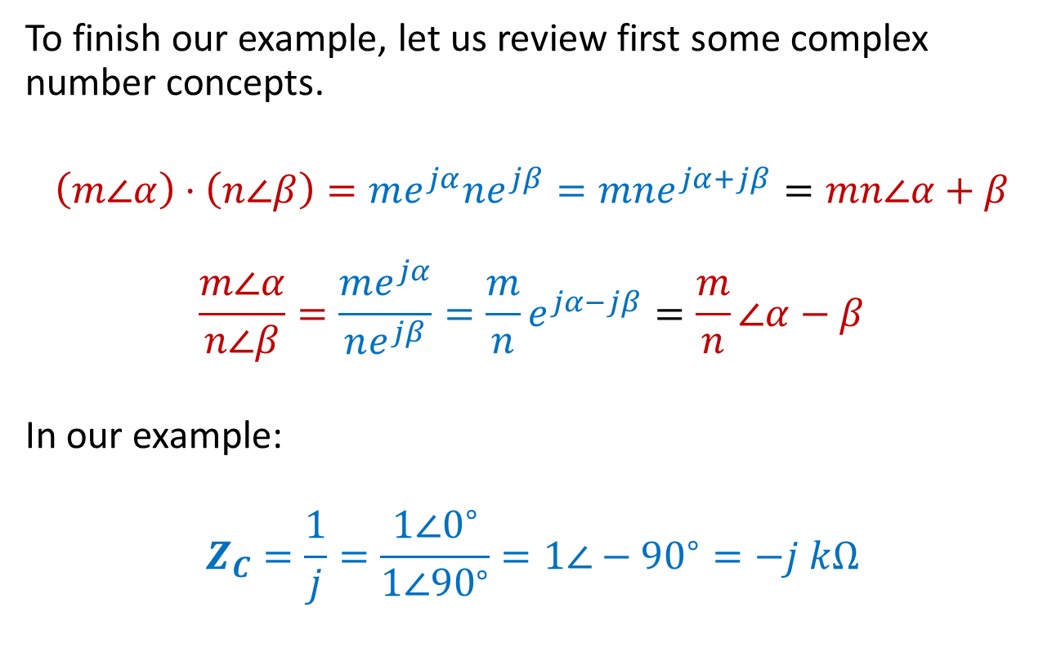
Complex Numbers—Review
To finish our example, let us review first some complex number concepts.
$$\left(m∠α\right)⋅\left(n∠β\right)=me^{jα}ne^{jβ}=mne^{jα+jβ}=mn∠α+β$$
$$\frac{m∠α}{n∠β}=\frac{me^{jα}}{ne^{jβ}}=\frac{m}{n}e^{jα−jβ}=\frac{m}{n}∠α−β$$
In our example:
$$Z_{C}=\frac{1}{j}=\frac{1∠0^{∘}}{1∠{90}^{∘}}=1∠−{90}^{∘}=−j kΩ$$
Notes:
cfig/complex3.fig

Slide 9
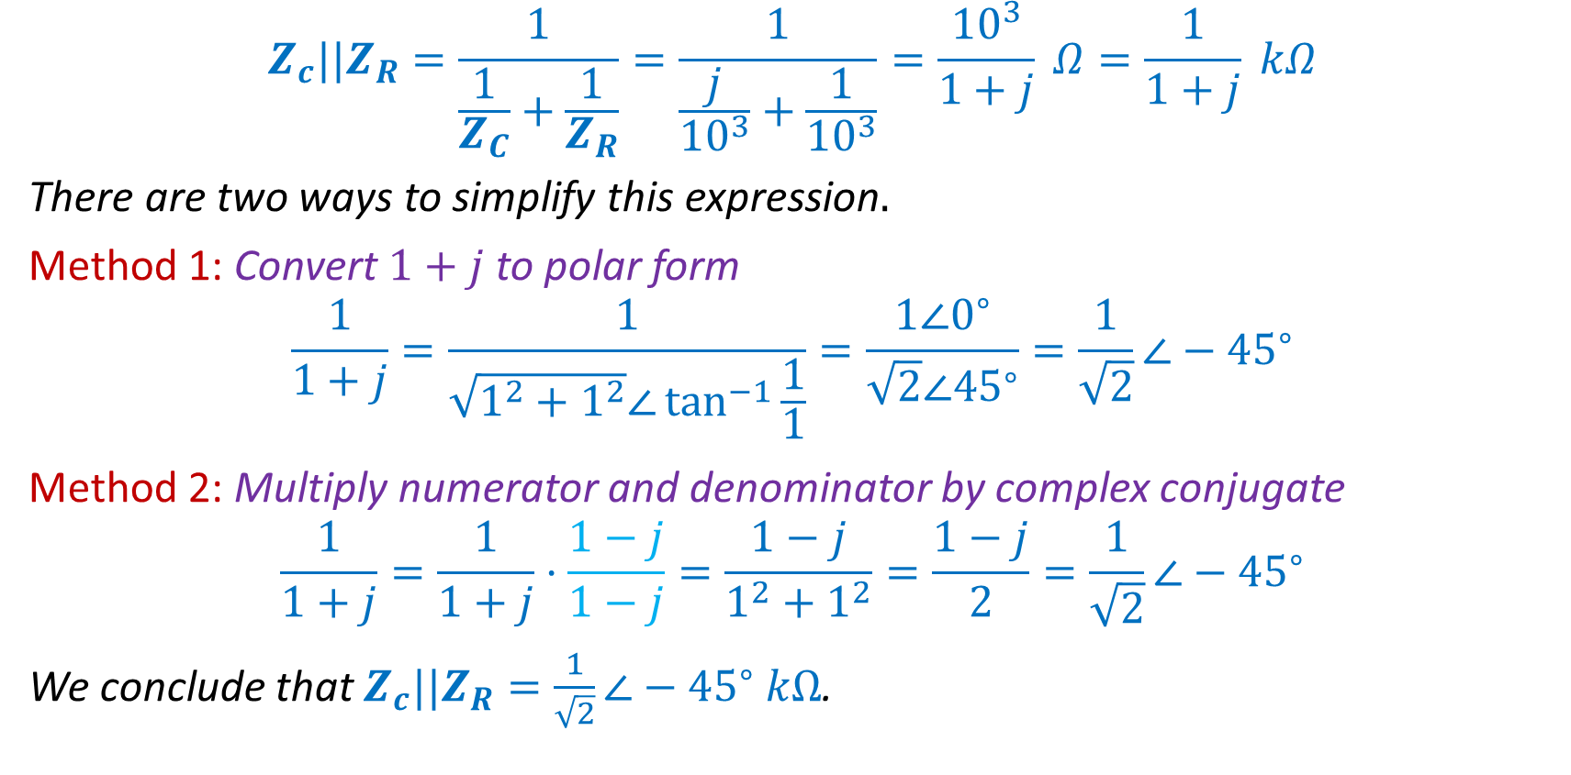
Complex Numbers—Review
$$Z_{c}||Z_{R}=\frac{1}{\frac{1}{Z_{C}}+\frac{1}{Z_{R}}}=\frac{1}{\frac{j}{{10}^{3}}+\frac{1}{{10}^{3}}}=\frac{{10}^{3}}{1+j} Ω=\frac{1}{1+j} kΩ$$
There are two ways to simplify this expression$.$
Method 1: Convert $1+j$ to polar form
$$\frac{1}{1+j}=\frac{1}{\sqrt{1^{2}+1^{2}}∠\tan^{−1}{\frac{1}{1}}}=\frac{1∠0^{∘}}{\sqrt{2}∠{45}^{∘}}=\frac{1}{\sqrt{2}}∠−{45}^{∘}$$
Method 2: Multiply numerator and denominator by complex conjugate
$$\frac{1}{1+j}=\frac{1}{1+j}⋅\frac{1−j}{1−j}=\frac{1−j}{1^{2}+1^{2}}=\frac{1−j}{2}=\frac{1}{\sqrt{2}}∠−{45}^{∘}$$
We conclude that $Z_{c}||Z_{R}=\frac{1}{\sqrt{2}}∠−{45}^{∘} kΩ$.

Slide 10
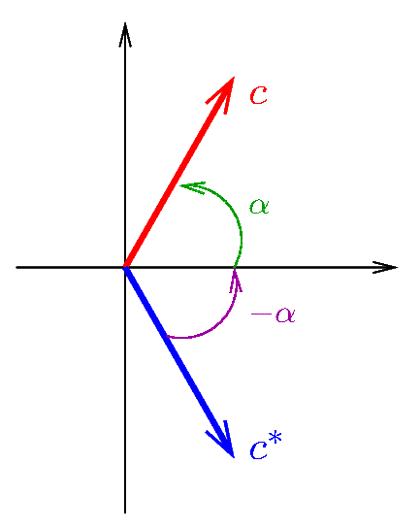
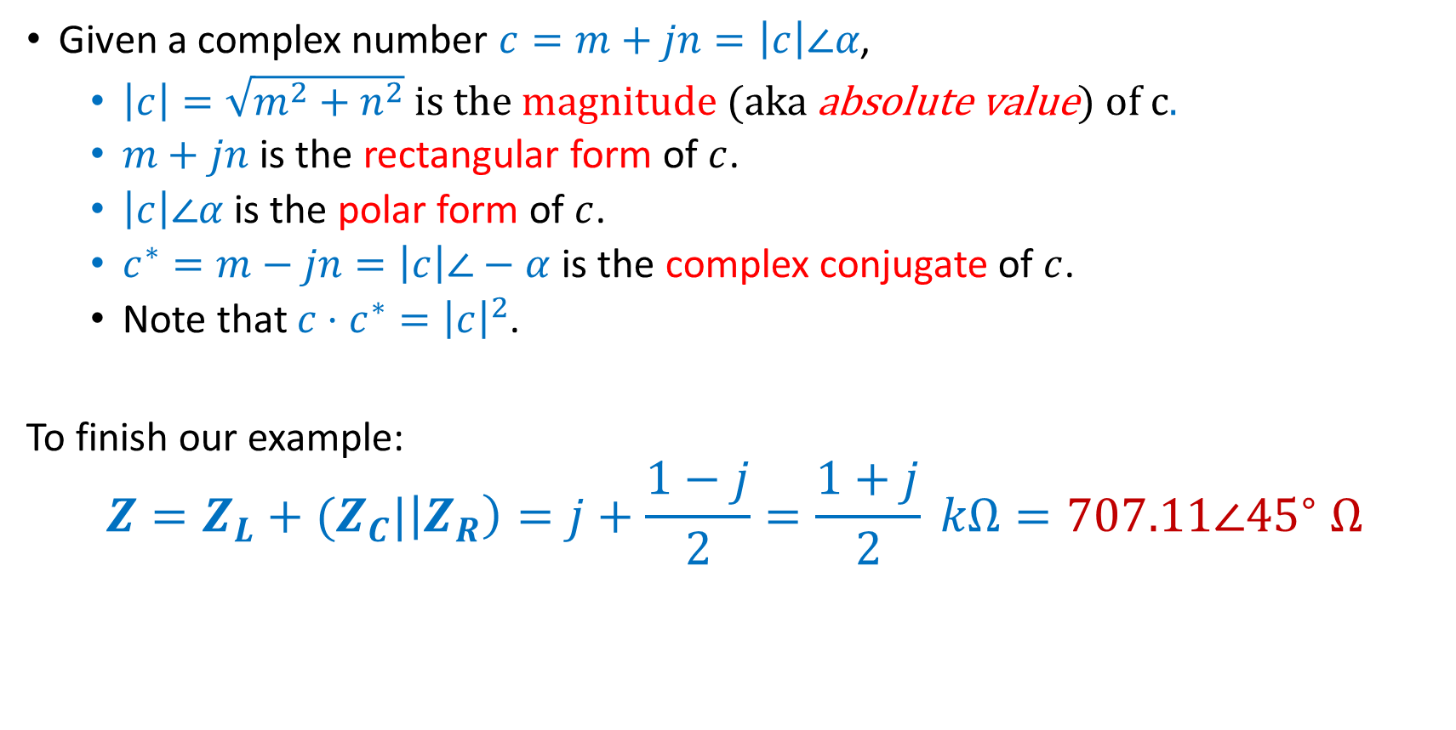
Complex Numbers—Review
Given a complex number $c=m+jn=\left|c\right|∠α$,
  $\left|c\right|=\sqrt{m^{2}+n^{2}}$ is the magnitude (aka absolute value) of c.
  $m+jn$ is the rectangular form of $c$.
  $\left|c\right|∠α$ is the polar form of $c$.
  $c^{∗}=m−jn=\left|c\right|∠−α$ is the complex conjugate of $c$.
  Note that $c⋅c^{∗}={\left|c\right|}^{2}$.
To finish our example:
$$Z=Z_{L}+(Z_{C}|\left|Z_{R}\right)=j+\frac{1−j}{2}=\frac{1+j}{2} kΩ=707.11∠{45}^{∘} Ω$$
Notes:
cfig/complex4.fig

Slide 11
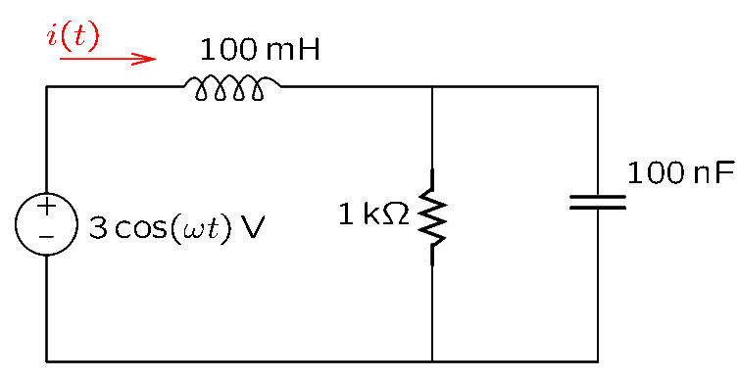
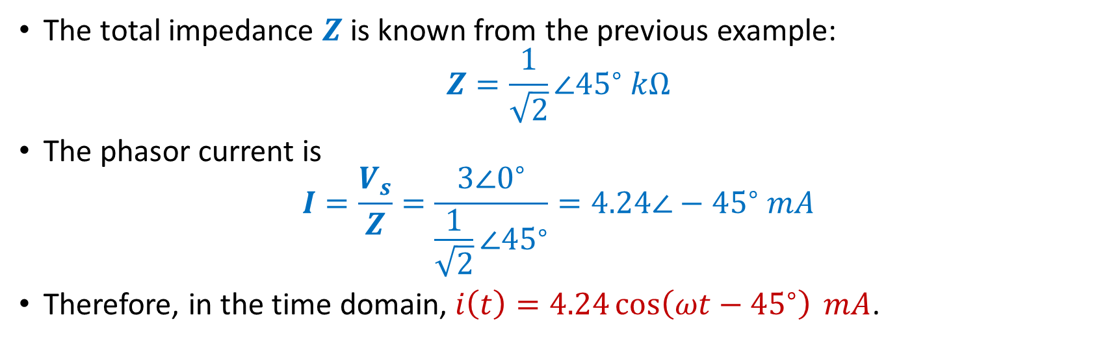
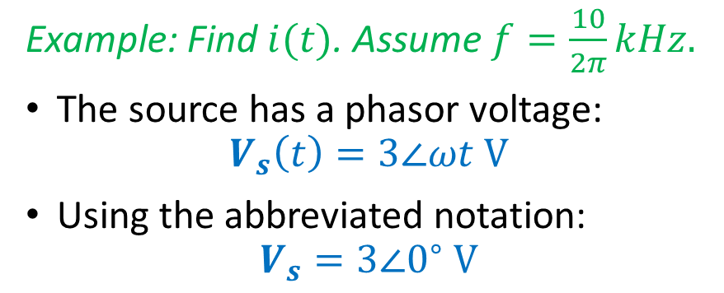
Impedance Combinations
Example: Find $i(t)$. Assume $f=\frac{10}{2π}kHz.$
The source has a phasor voltage:
$$V_{s}\left(t\right)=3∠ωt V$$
Using the abbreviated notation:
$$V_{s}=3∠0^{∘} V$$
The total impedance $Z$ is known from the previous example:
$$Z=\frac{1}{\sqrt{2}}∠{45}^{∘} kΩ$$
The phasor current is
$$I=\frac{V_{s}}{Z}=\frac{3∠0^{∘}}{\frac{1}{\sqrt{2}}∠{45}^{∘}}=4.24∠−{45}^{∘} mA$$
Therefore, in the time domain, $i\left(t\right)=4.24\cos\left(ωt−{45}^{∘}\right) mA$.
Notes:
cfig/imp2.fig

Slide 12
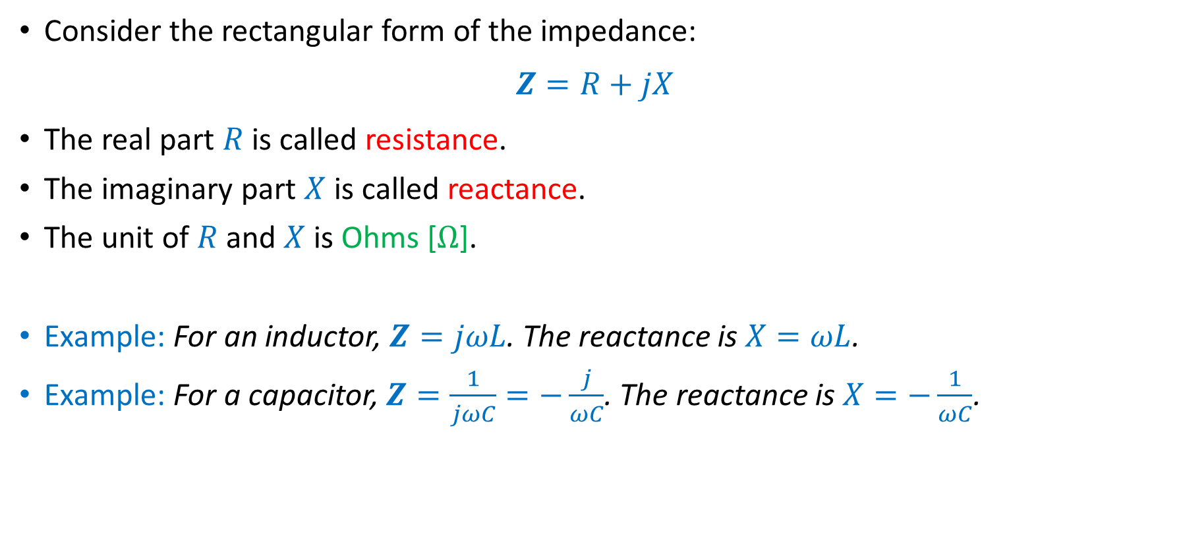
Reactance
Consider the rectangular form of the impedance:
$$Z=R+jX$$
The real part $R$ is called resistance.
The imaginary part $X$ is called reactance.
The unit of $R$ and $X$ is Ohms [$Ω$].
Example: For an inductor, $Z=jωL$. The reactance is $X=ωL$.
Example: For a capacitor, $Z=\frac{1}{jωC}=−\frac{j}{ωC}$. The reactance is $X=−\frac{1}{ωC}$.

Slide 13
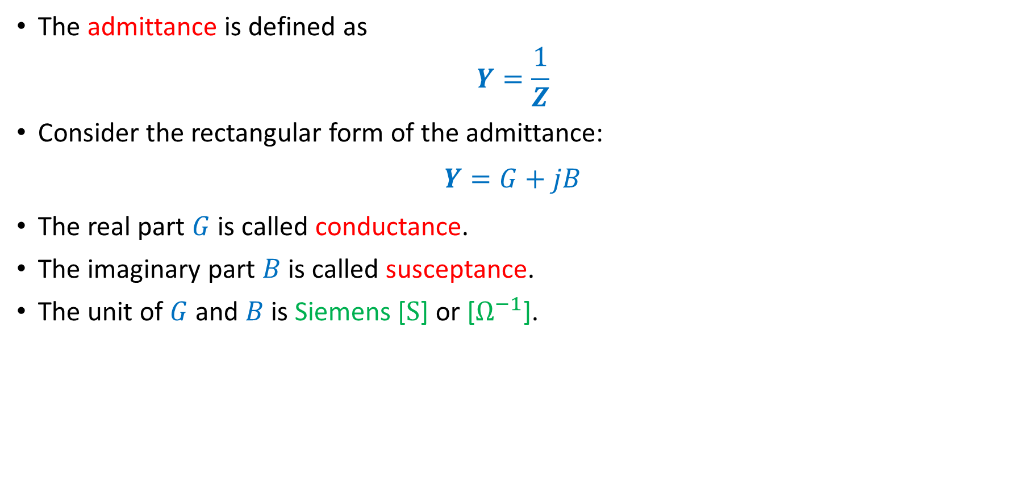
Admittance, Conductance, Susceptance
The admittance is defined as
$$Y=\frac{1}{Z}$$
Consider the rectangular form of the admittance:
$$Y=G+jB$$
The real part $G$ is called conductance.
The imaginary part $B$ is called susceptance.
The unit of $G$ and $B$ is Siemens [$S$] or [$Ω^{−1}$].

Slide 14
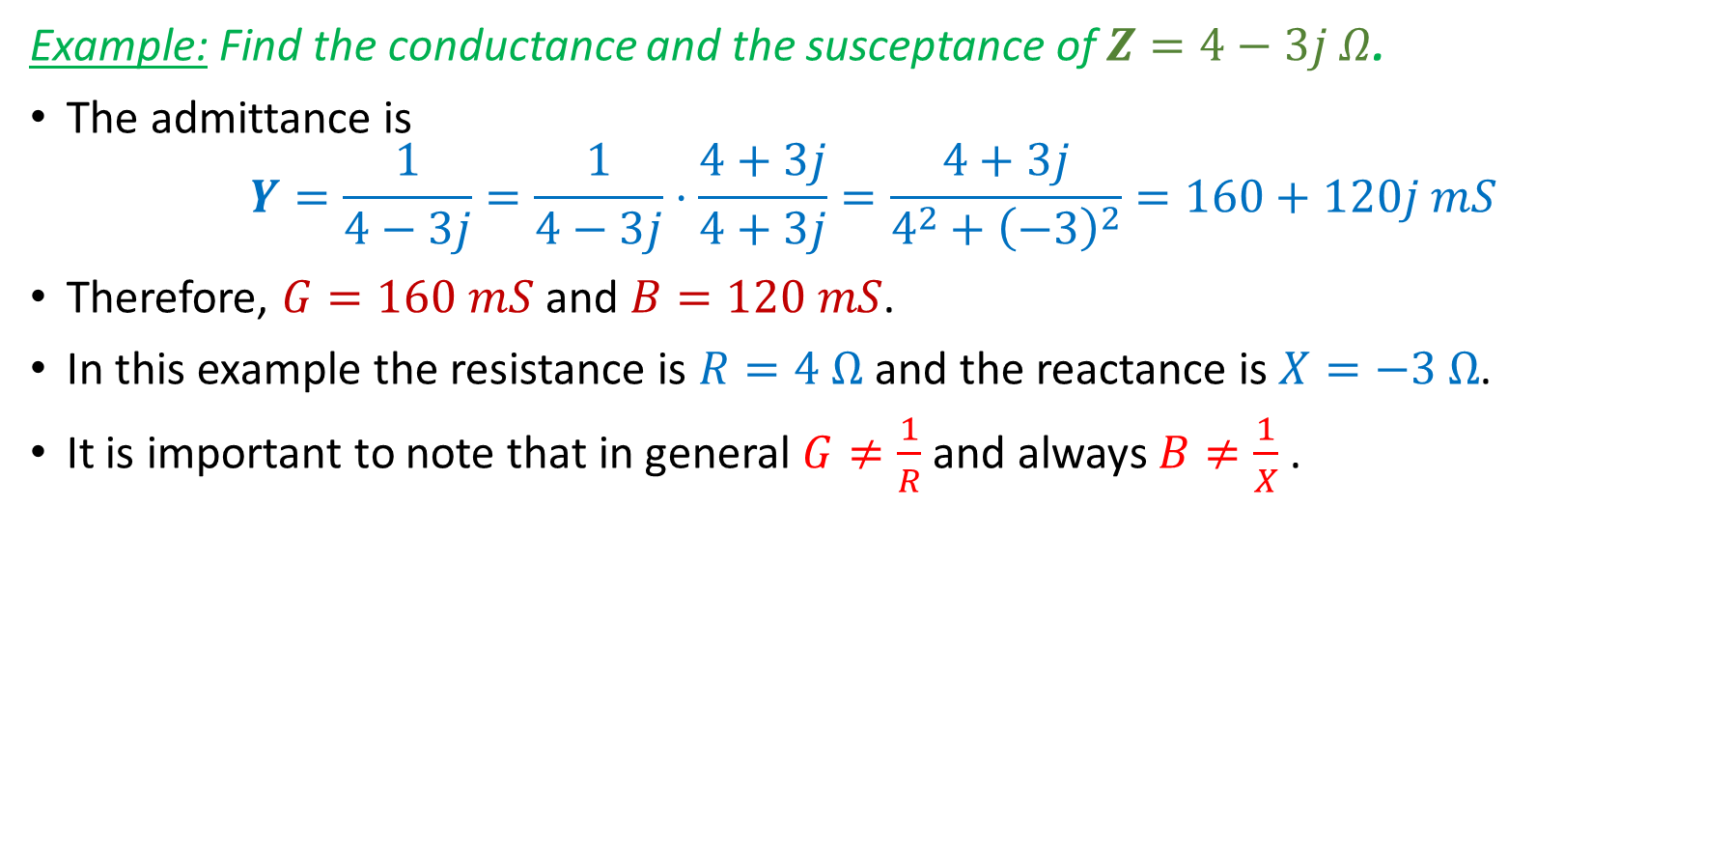
Admittance, Conductance, Susceptance
Example: Find the conductance and the susceptance of $Z=4−3j Ω$.
The admittance is
$$Y=\frac{1}{4−3j}=\frac{1}{4−3j}⋅\frac{4+3j}{4+3j}=\frac{4+3j}{4^{2}+{\left(−3\right)}^{2}}=160+120j mS$$
Therefore, $G=160 mS$ and $B=120 mS$.
In this example the resistance is $R=4 Ω$ and the reactance is $X=−3 Ω$.
It is important to note that in general $G≠\frac{1}{R}$ and always $B≠\frac{1}{X}$.

Slide 15
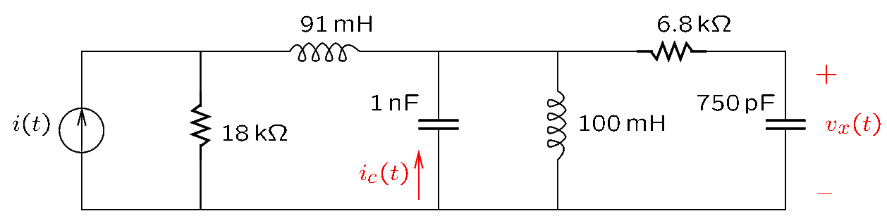
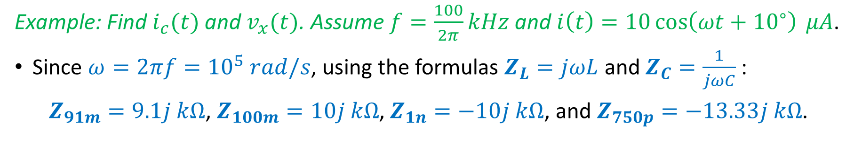
Voltage and Current Division
The methods learned for DC circuits apply also to AC circuits in the frequency domain.
In particular, this is true of voltage and current division.
Example: Find $i_{c}(t)$ and $v_{x}(t)$. Assume $f=\frac{100}{2π}kHz$ and $i\left(t\right)=10\cos\left(ωt+{10}^{∘}\right) μA$.
Since $ω=2πf={10}^{5} rad/s$, using the formulas $Z_{L}=jωL$ and $Z_{C}=\frac{1}{jωC}$:
$Z_{91m}=9.1j kΩ$, $Z_{100m}=10j kΩ$, $Z_{1n}=−10j kΩ$, and $Z_{750p}=−13.33j kΩ$.
Notes:
cfig/acdiv.fig

Slide 16
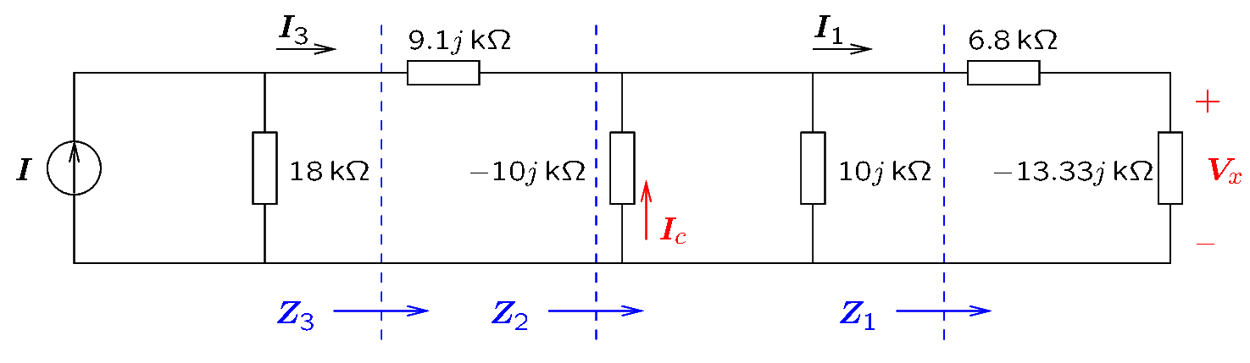

Voltage and Current Division
The frequency domain circuit is shown in the figure.
The problem will be solved as follows.
We will find first $Z_{1}$, $Z_{2}$, and $Z_{3}$.
Next, current division will be used to find $I_{3}$, $I_{c}$, and $I_{1}$.
Next, Ohm’s law will be used to find $V_{x}=−13.33j kΩ⋅I_{1}$.
The results will be converted to the time domain.
Notes:
cfig/acdivf.fig

Slide 17
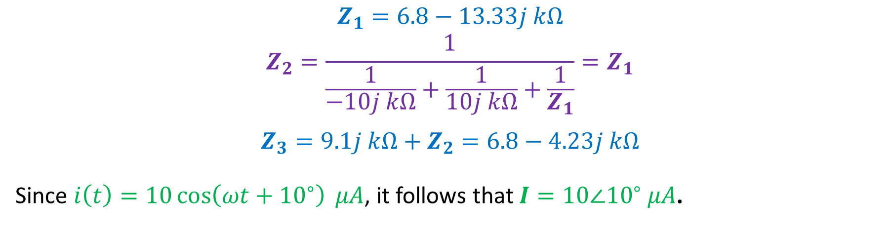
Voltage and Current Division
$$Z_{1}=6.8−13.33j kΩ$$
$$Z_{2}=\frac{1}{\frac{1}{−10j kΩ}+\frac{1}{10j kΩ}+\frac{1}{Z_{1}}}=Z_{1}$$
$$Z_{3}=9.1j kΩ+Z_{2}=6.8−4.23j kΩ$$
Since $i\left(t\right)=10\cos\left(ωt+{10}^{∘}\right) μA$, it follows that $I=10∠{10}^{∘} μA$.
Notes:
cfig/acdivf.fig

Slide 18
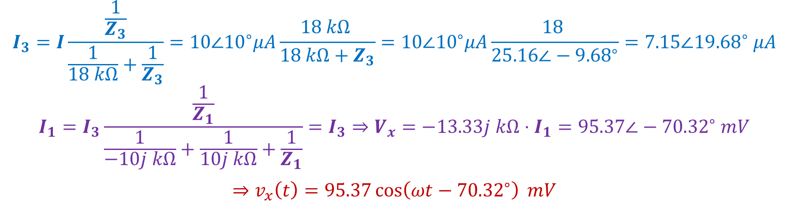
Voltage and Current Division
$$I_{3}=I\frac{\frac{1}{Z_{3}}}{\frac{1}{18 kΩ}+\frac{1}{Z_{3}}}=10∠{10}^{∘}μA\frac{18 kΩ }{18 kΩ+Z_{3}}=10∠{10}^{∘}μA\frac{18 }{25.16∠−{9.68}^{∘}}=7.15∠{19.68}^{∘} μA$$
$$I_{1}=I_{3}\frac{\frac{1}{Z_{1}}}{\frac{1}{−10j kΩ}+\frac{1}{10j kΩ}+\frac{1}{Z_{1}}}=I_{3}⇒V_{x}=−13.33j kΩ⋅I_{1}=95.37∠−{70.32}^{∘} mV$$
$$⇒v_{x}\left(t\right)=95.37\cos\left(ωt−{70.32}^{∘}\right) mV$$
Notes:
cfig/acdivf.fig

Slide 19
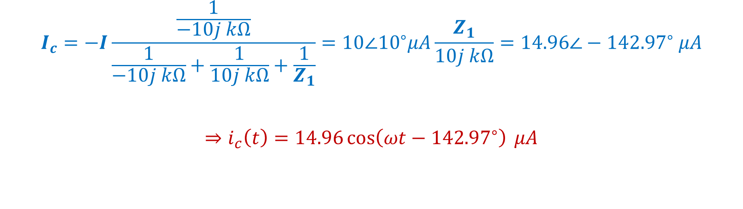
Voltage and Current Division
$$I_{c}=−I\frac{\frac{1}{−10j kΩ}}{\frac{1}{−10j kΩ}+\frac{1}{10j kΩ}+\frac{1}{Z_{1}}}=10∠{10}^{∘}μA\frac{Z_{1}}{10j kΩ}=14.96∠−{142.97}^{∘} μA$$
$$⇒i_{c}\left(t\right)=14.96\cos\left(ωt−{142.97}^{∘}\right) μA$$
Notes:
cfig/acdivf.fig

Slide 20
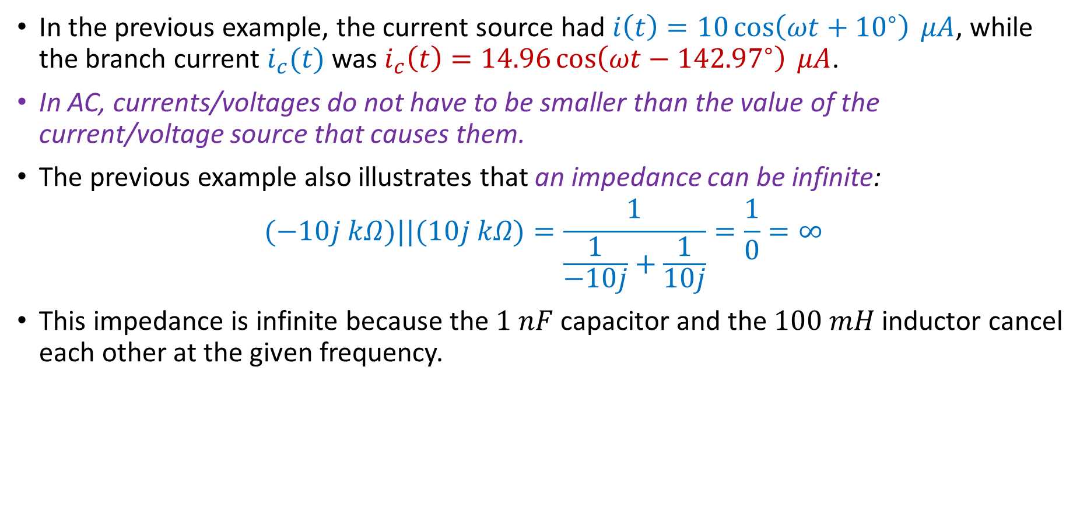
Remarks
In the previous example, the current source had $i\left(t\right)=10\cos\left(ωt+{10}^{∘}\right) μA$, while the branch current $i_{c}(t)$ was $i_{c}\left(t\right)=14.96\cos\left(ωt−{142.97}^{∘}\right) μA$.
In AC, currents/voltages do not have to be smaller than the value of the current/voltage source that causes them.
The previous example also illustrates that an impedance can be infinite:
$$(−10j kΩ)||(10j kΩ)=\frac{1}{\frac{1}{−10j}+\frac{1}{10j}}=\frac{1}{0}=∞$$
This impedance is infinite because the $1 nF$ capacitor and the $100 mH$ inductor cancel each other at the given frequency.
Notes:
cfig/acdivf.fig

