Slide 1
Phasors
Representing Sinusoidal Voltages and Currents in the Frequency Domain
M.V. Iordache, EEGR2053 Electric Circuits, Spring 2020, LeTourneau University

Slide 2
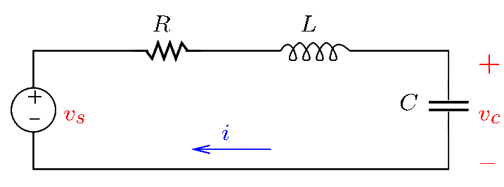
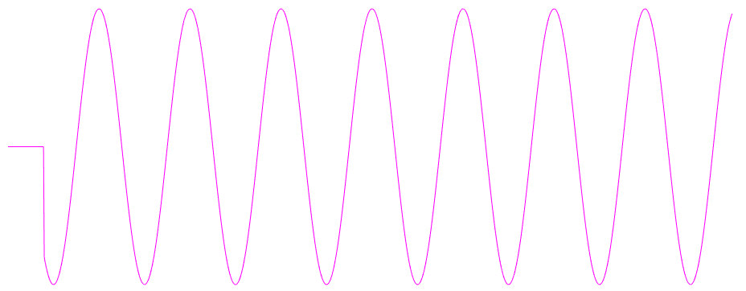
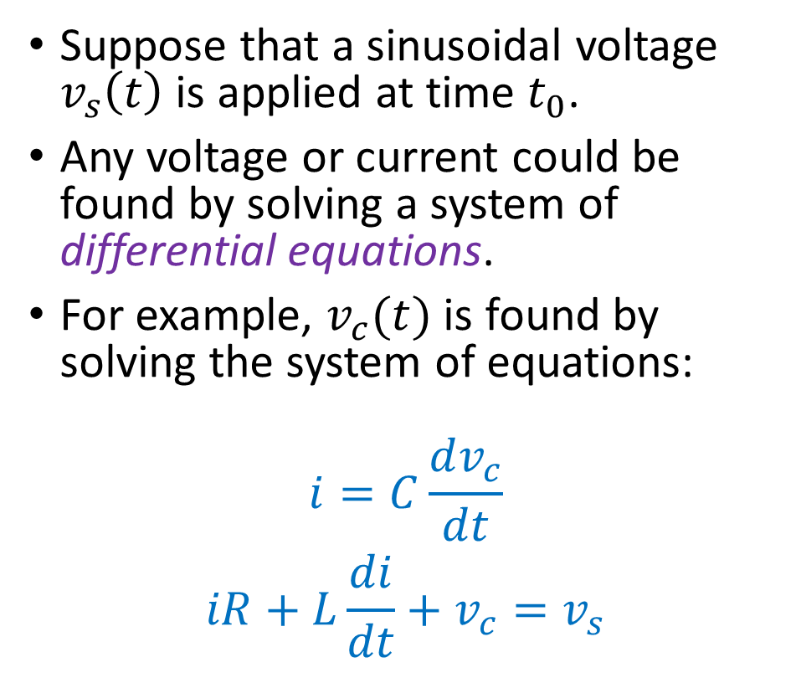
Introduction
Suppose that a sinusoidal voltage $v_{s}\left(t\right)$ is applied at time $t_{0}$.
Any voltage or current could be found by solving a system of differential equations.
For example, $v_{c}(t)$ is found by solving the system of equations:
$$i=C\frac{dv_{c}}{dt}$$
$$iR+L\frac{di}{dt}+v_{c}=v_{s}$$
Notes:
cfig/rlc.fig

Slide 3
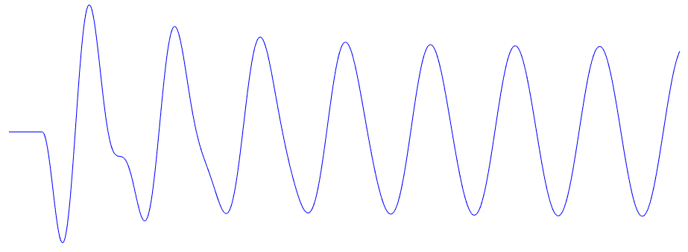
Introduction
By solving the differential equations, we obtain $v_{c}(t)$ having the following graph.
Notes:
out-sine.png

Slide 4
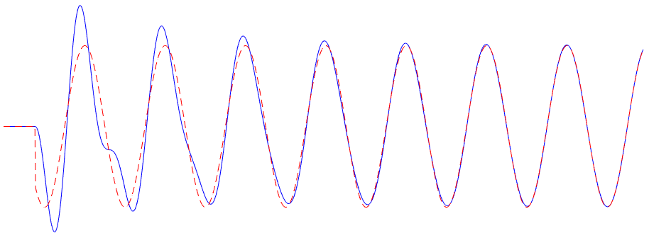

Introduction
Note that $v_{c}(t)$ converges to the red curve.
The red curve is called steady-state response.
Notes:
out2-sine.png

Slide 5
Introduction
Often, we do not care about transients, but we only need the steady-state.
The steady-state response can be obtained without solving differential equations.
To find the steady-state response, we will use this simpler method:
Convert the circuit to the frequency domain.
Solve for the unknowns in the frequency domain.
Convert the unknowns back to the time domain.

Slide 6
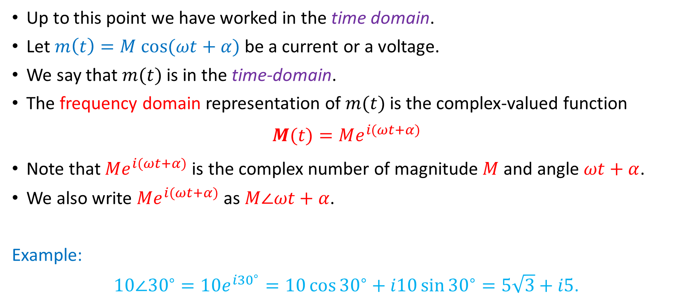
The Frequency Domain
Up to this point we have worked in the time domain.
Let $m\left(t\right)=M cos⁡(ωt+α)$be a current or a voltage.
We say that $m(t)$ is in the time-domain.
The frequency domain representation of $m(t)$ is the complex-valued function
$$M(t)=Me^{i(ωt+α)}$$
Note that $Me^{i(ωt+α)}$ is the complex number of magnitude $M$ and angle $ωt+α$.
We also write $Me^{i(ωt+α)}$ as $M∠ωt+α$.
Example:
$10∠{30}^{∘}=10e^{i{30}^{∘}}=10\cos{{30}^{∘}}+i10\sin{{30}^{∘}}=5\sqrt{3}+i5$.

Slide 7
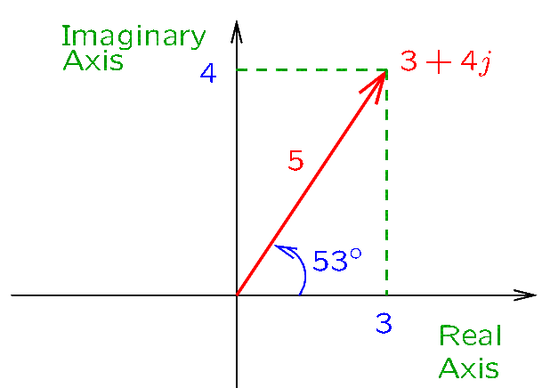
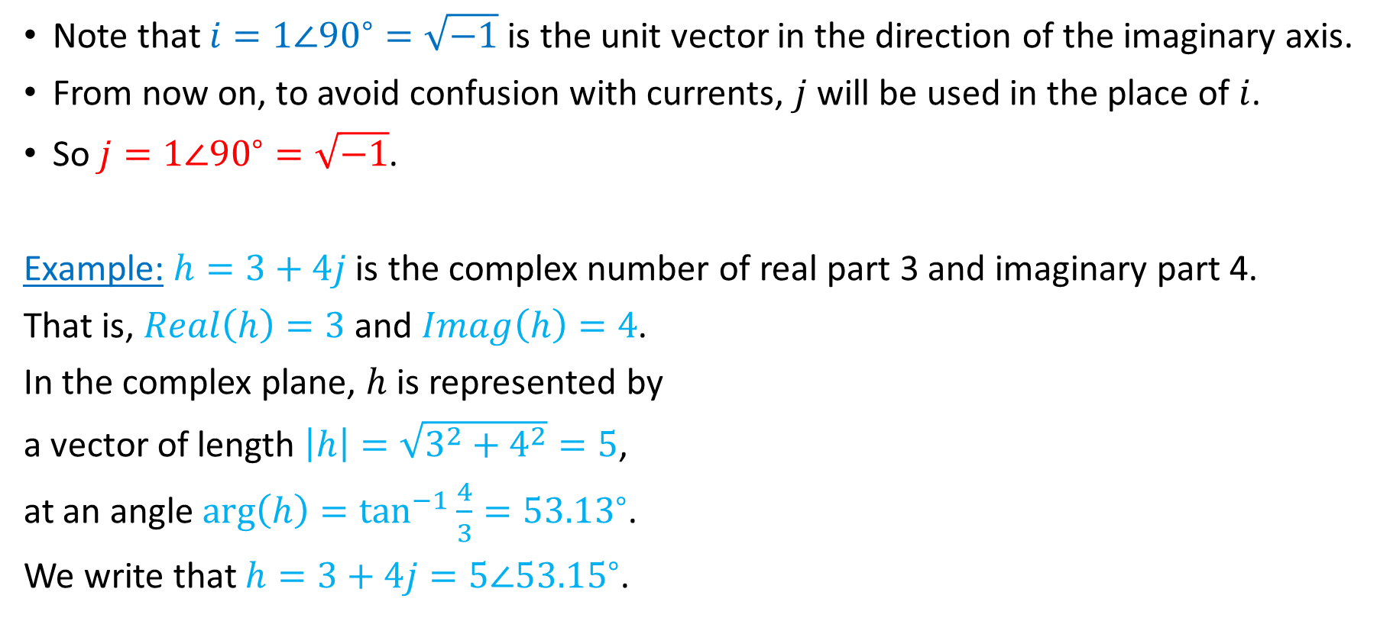
The Frequency Domain—Notation
Note that $i=1∠{90}^{∘}=\sqrt{−1}$ is the unit vector in the direction of the imaginary axis.
From now on, to avoid confusion with currents, $j$ will be used in the place of $i$.
So $j=1∠{90}^{∘}=\sqrt{−1}$.
Example: $h=3+4j$ is the complex number of real part 3 and imaginary part 4.
That is, $Real\left(h\right)=3$ and $Imag\left(h\right)=4$.
In the complex plane, $h$ is represented by
a vector of length $\left|h\right|=\sqrt{3^{2}+4^{2}}=5$,
at an angle $\arg\left(h\right)=\tan^{−1}{\frac{4}{3}}={53.13}^{∘}$.
We write that $h=3+4j=5∠{53.15}^{∘}$.

Slide 8
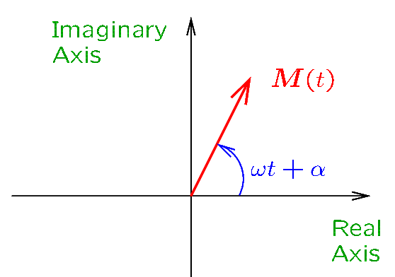
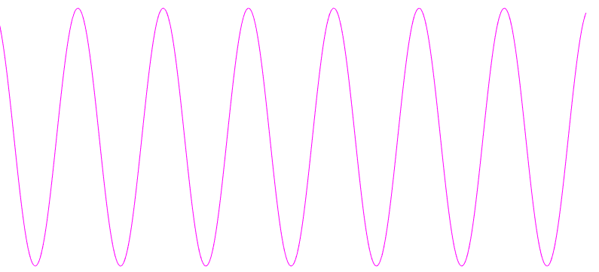

The Frequency Domain
In the time domain, the signal $m\left(t\right)=M cos⁡(ωt+α)$ is a sinusoidal function.
In the frequency domain, the signal is a vector $M\left(t\right)=M∠ωt+α$ that rotates counterclockwise in the complex plane at an angular velocity $ω$.
Such rotating vectors are called PHASORS.
TIME DOMAIN
FREQUENCY DOMAIN

Slide 9
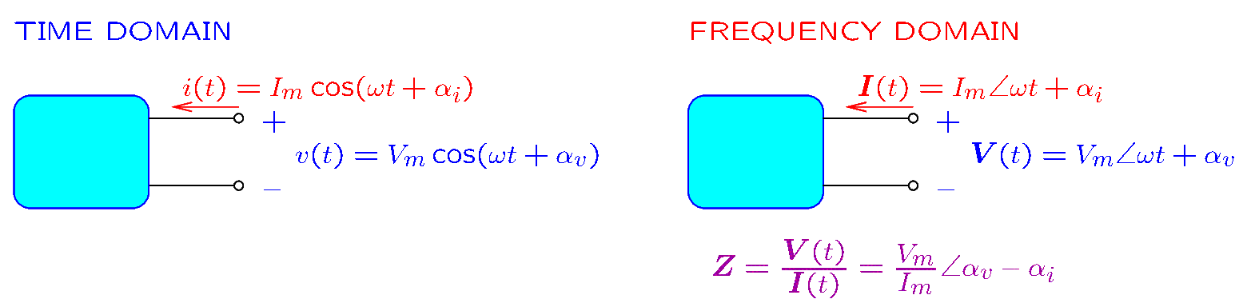
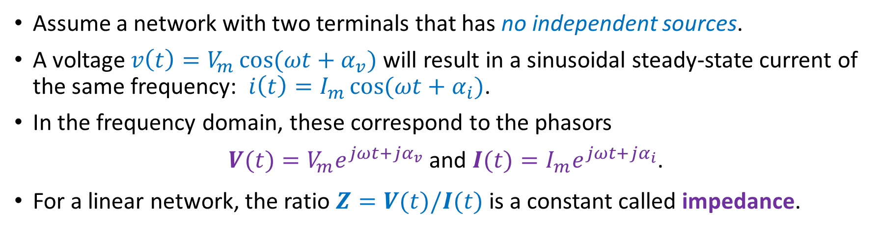
Impedance
Assume a network with two terminals that has no independent sources.
A voltage $v\left(t\right)=V_{m}\cos{(ωt+α_{v})}$ will result in a sinusoidal steady-state current of the same frequency: $i\left(t\right)=I_{m}\cos{(ωt+α_{i})}$.
In the frequency domain, these correspond to the phasors
$V(t)=V_{m}e^{jωt+jα_{v}}$ and $I(t)=I_{m}e^{jωt+jα_{i}}$.
For a linear network, the ratio $Z=V(t)/I(t)$ is a constant called impedance.

Slide 10
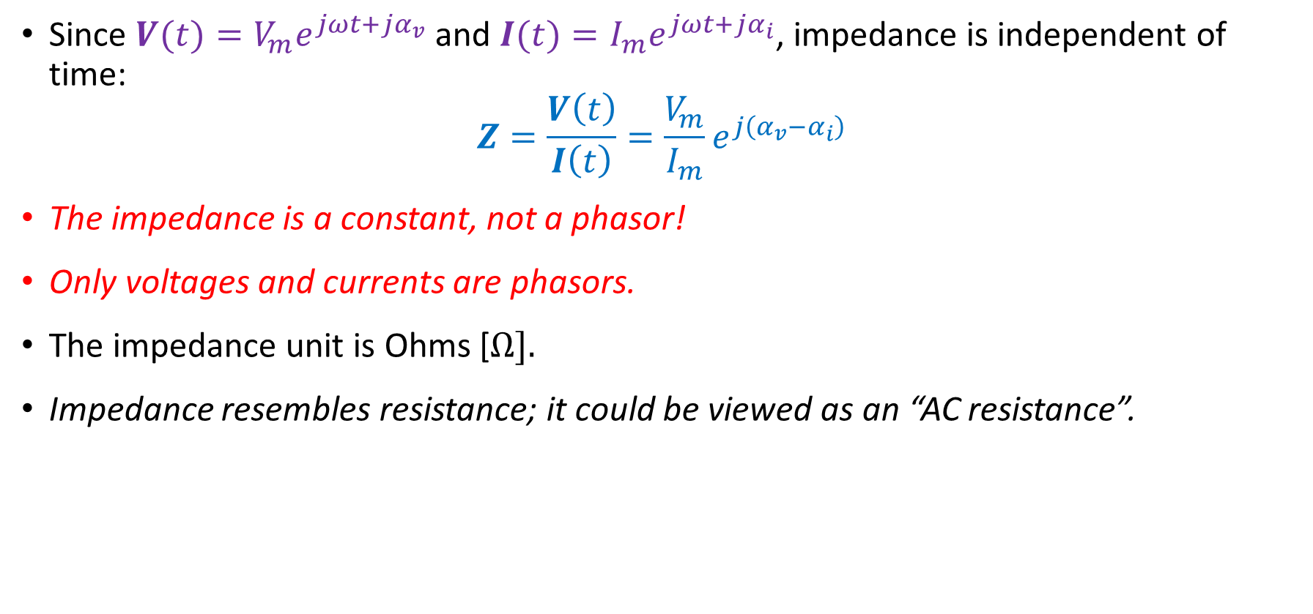
Impedance
Since $V(t)=V_{m}e^{jωt+jα_{v}}$ and $I(t)=I_{m}e^{jωt+jα_{i}}$, impedance is independent of time:
$$Z=\frac{V\left(t\right)}{I\left(t\right)}=\frac{V_{m}}{I_{m}}e^{j\left(α_{v}−α_{i}\right)}$$
The impedance is a constant, not a phasor!
Only voltages and currents are phasors.
The impedance unit is Ohms [$Ω].$
Impedance resembles resistance; it could be viewed as an “AC resistance”.

Slide 11
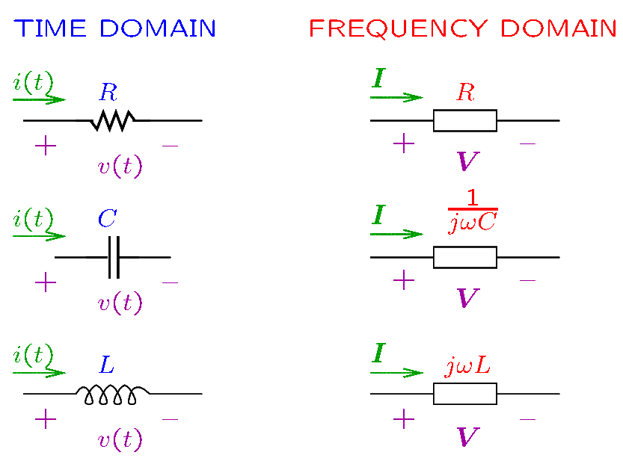
Impedance of Common Components
Resistors, capacitors, and inductors are represented in the frequency domain by their impedance.
Notes:
cfig/impedances.fig

Slide 12
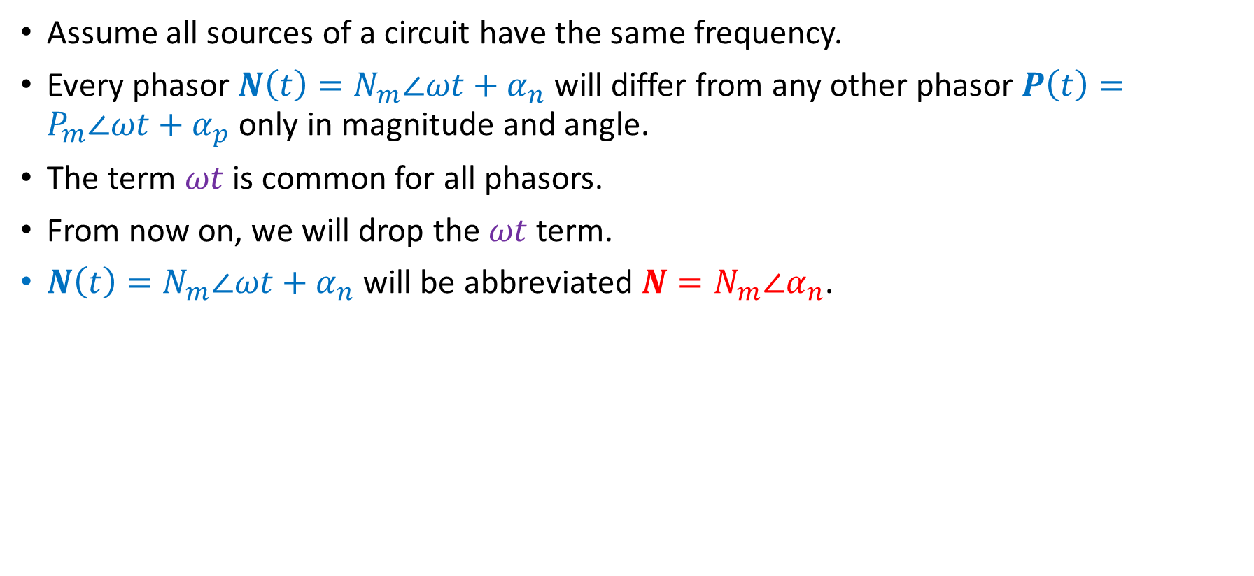
Phasors—Abbreviated Notation
Assume all sources of a circuit have the same frequency.
Every phasor $N\left(t\right)=N_{m}∠ωt+α_{n}$ will differ from any other phasor $P\left(t\right)=P_{m}∠ωt+α_{p}$ only in magnitude and angle.
The term $ωt$ is common for all phasors.
From now on, we will drop the $ωt$ term.
$N\left(t\right)=N_{m}∠ωt+α_{n}$ will be abbreviated $N=N_{m}∠α_{n}$.

Slide 13
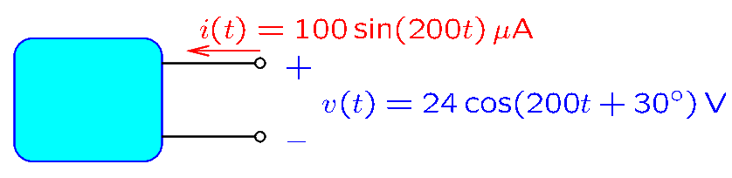
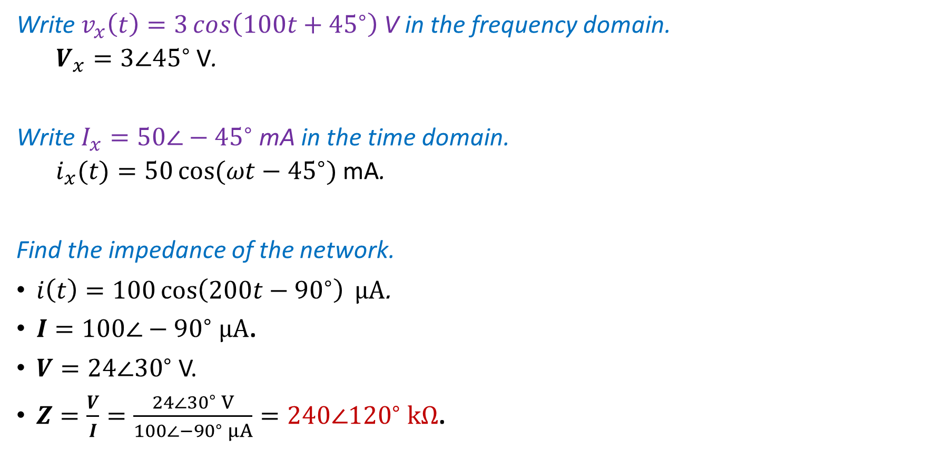
Examples
Write $v_{x}\left(t\right)=3\cos\left(100t+{45}^{∘}\right)$V in the frequency domain.
$V_{x}=3∠{45}^{∘}$V.
Write $I_{x}=50∠−{45}^{∘}$mA in the time domain.
$i_{x}(t)=50\cos{(ωt−{45}^{∘})}$mA.
Find the impedance of the network.
$i\left(t\right)=100\cos\left(200t−{90}^{∘}\right) μ$A.
$I=100∠−{90}^{∘} μA$.
$V=24∠{30}^{∘}$V.
$Z=\frac{V}{I}=\frac{24∠{30}^{∘} V}{100∠−{90}^{∘} μA}=240∠{120}^{∘} kΩ$.

Slide 14
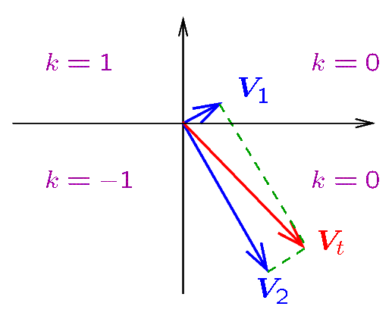
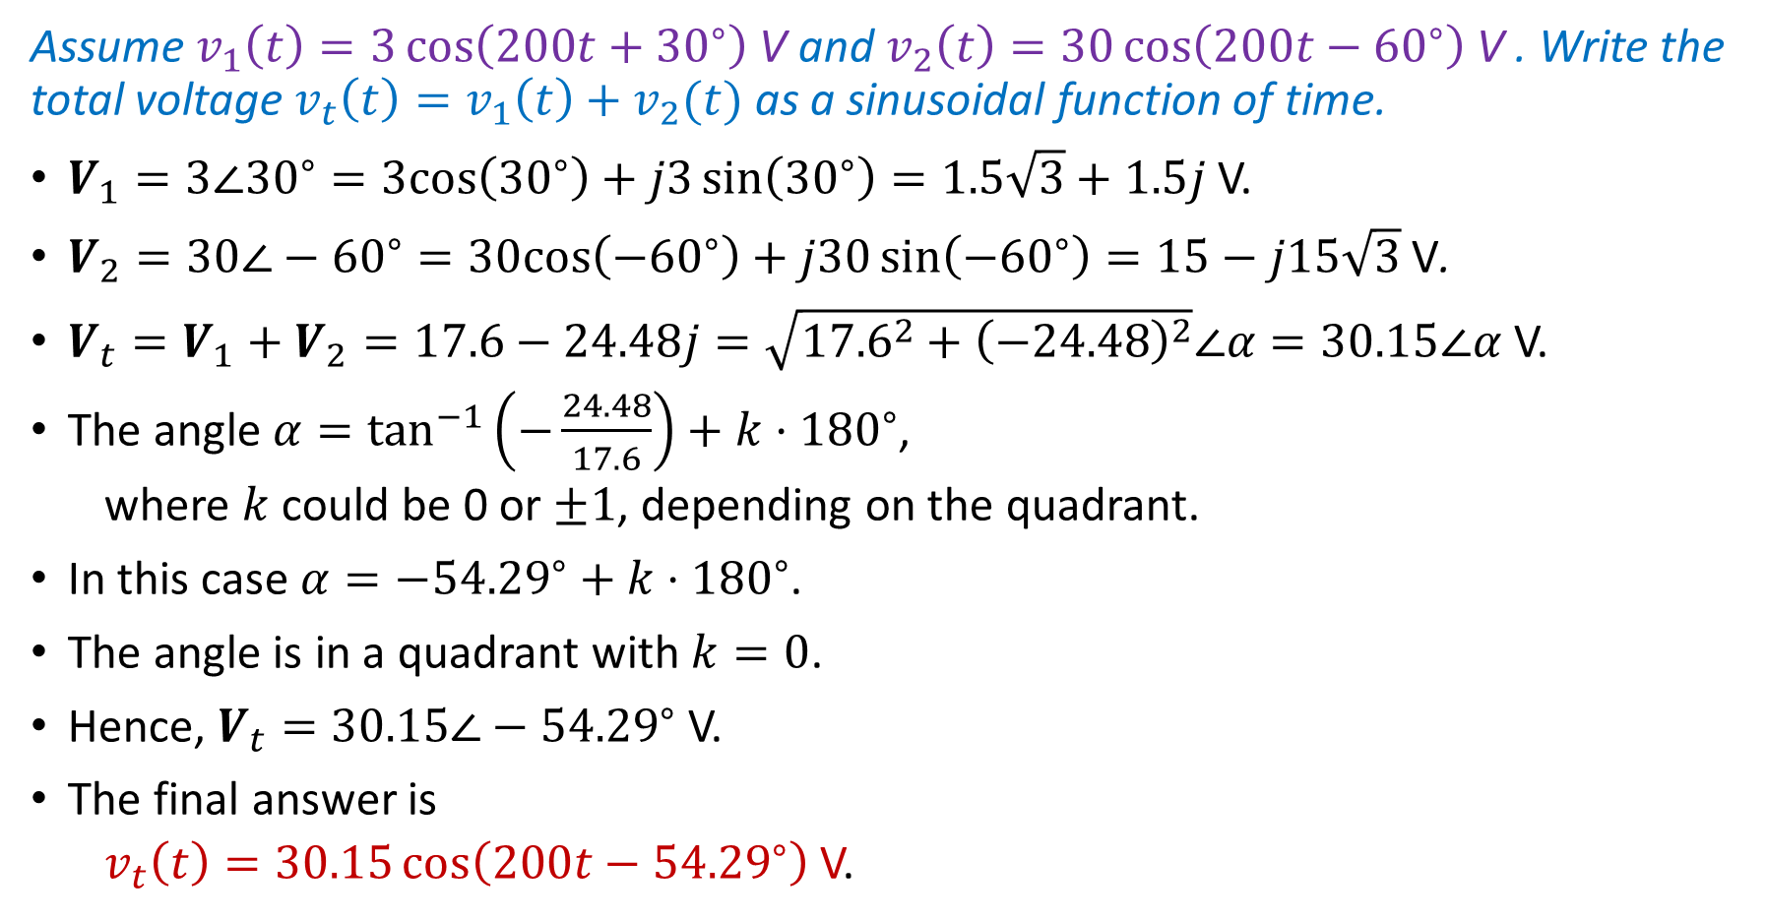
Example
Assume $v_{1}\left(t\right)=3\cos\left(200t+{30}^{∘}\right)$V and $v_{2}\left(t\right)=30\cos\left(200t−{60}^{∘}\right)$V . Write the total voltage $v_{t}\left(t\right)=v_{1}\left(t\right)+v_{2}(t)$ as a sinusoidal function of time.
$V_{1}=3∠{30}^{∘}=3cos\left({30}^{∘}\right)+j3\sin\left({30}^{∘}\right)=1.5\sqrt{3}+1.5j$V.
$V_{2}=30∠−{60}^{∘}=30cos\left(−{60}^{∘}\right)+j30\sin\left(−{60}^{∘}\right)=15−j15\sqrt{3}$V.
$V_{t}=V_{1}+V_{2}=17.6−24.48j=\sqrt{{17.6}^{2}+{\left(−24.48\right)}^{2}}∠α=30.15∠α$V.
The angle $α=\tan^{−1}\left(−\frac{24.48}{17.6}\right)+k⋅{180}^{∘}$,
where $k$ could be 0 or $±1$, depending on the quadrant.
In this case $α=−{54.29}^{∘}+k⋅{180}^{∘}$.
The angle is in a quadrant with $k=0$.
Hence, $V_{t}=$ $30.15∠−{54.29}^{∘}$V.
The final answer is
$v_{t}\left(t\right)=30.15\cos\left(200t−{54.29}^{∘}\right)$V.

