Slide 1
The Sinusoidal Function
An Outline
M.V. Iordache, EEGR2053 Electric Circuits, Spring 2020, LeTourneau University

Slide 2
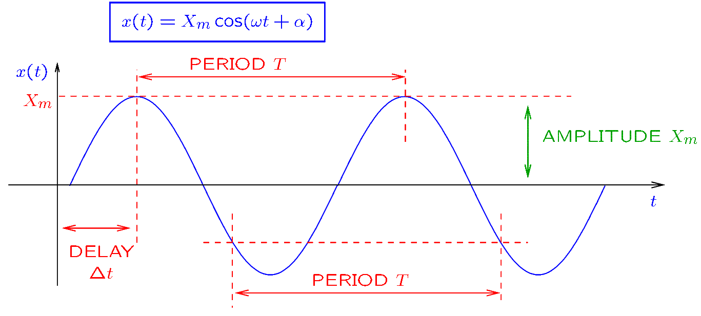
The Sinusoidal Function
Notes:
cfig/sine.fig

Slide 3
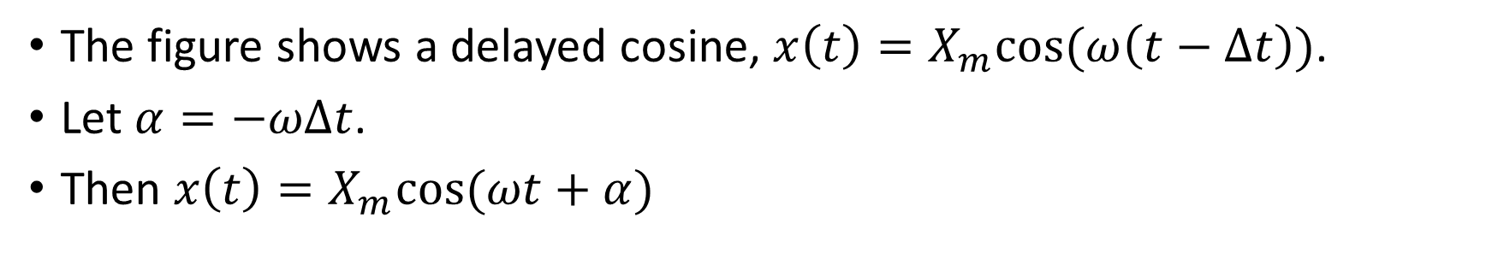
The Sinusoidal Function
The figure shows a delayed cosine, $x\left(t\right)=X_{m}cos⁡(ω\left(t−Δt\right))$.
Let $α=−ωΔt$.
Then $x\left(t\right)=X_{m}cos⁡(ωt+α)$

Slide 4

The Sinusoidal Function
Given $x\left(t\right)=X_{m}cos⁡(ωt+α)$ of period $T$:
  $ω=\frac{2π}{T}$ is the angular frequency; unit: rad/s.
  $f=\frac{1}{T}$ is the frequency; unit: Hz.
  $α$ is the phase angle.
  $X_{m}$ is the amplitude.

Slide 5
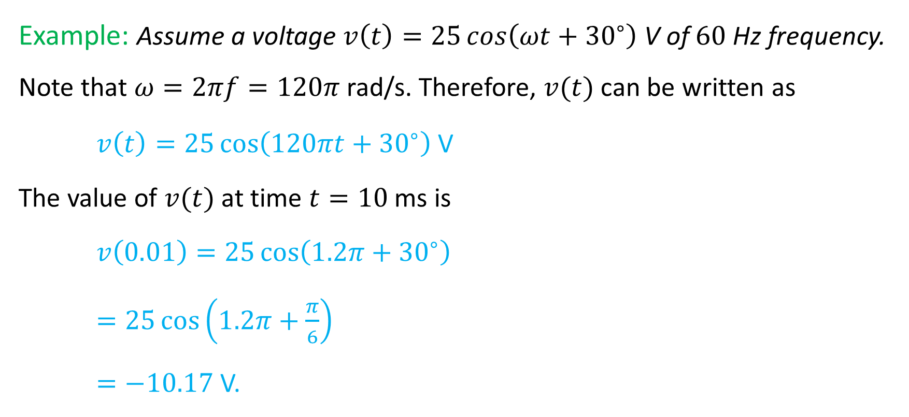
The Sinusoidal Function
Example: Assume a voltage $v\left(t\right)=25\cos\left(ωt+{30}^{∘}\right)$V of $60$Hz frequency. Note that $ω=2πf=120π$rad/s. Therefore, $v(t)$ can be written as
$v\left(t\right)=25\cos\left(120πt+{30}^{∘}\right)$V
The value of $v(t)$ at time $t=10$ms is
$v\left(0.01\right)=25\cos\left(1.2π+{30}^{∘}\right)$
$=25\cos\left(1.2π+\frac{π}{6}\right)$
$=−10.17$V.

Slide 6
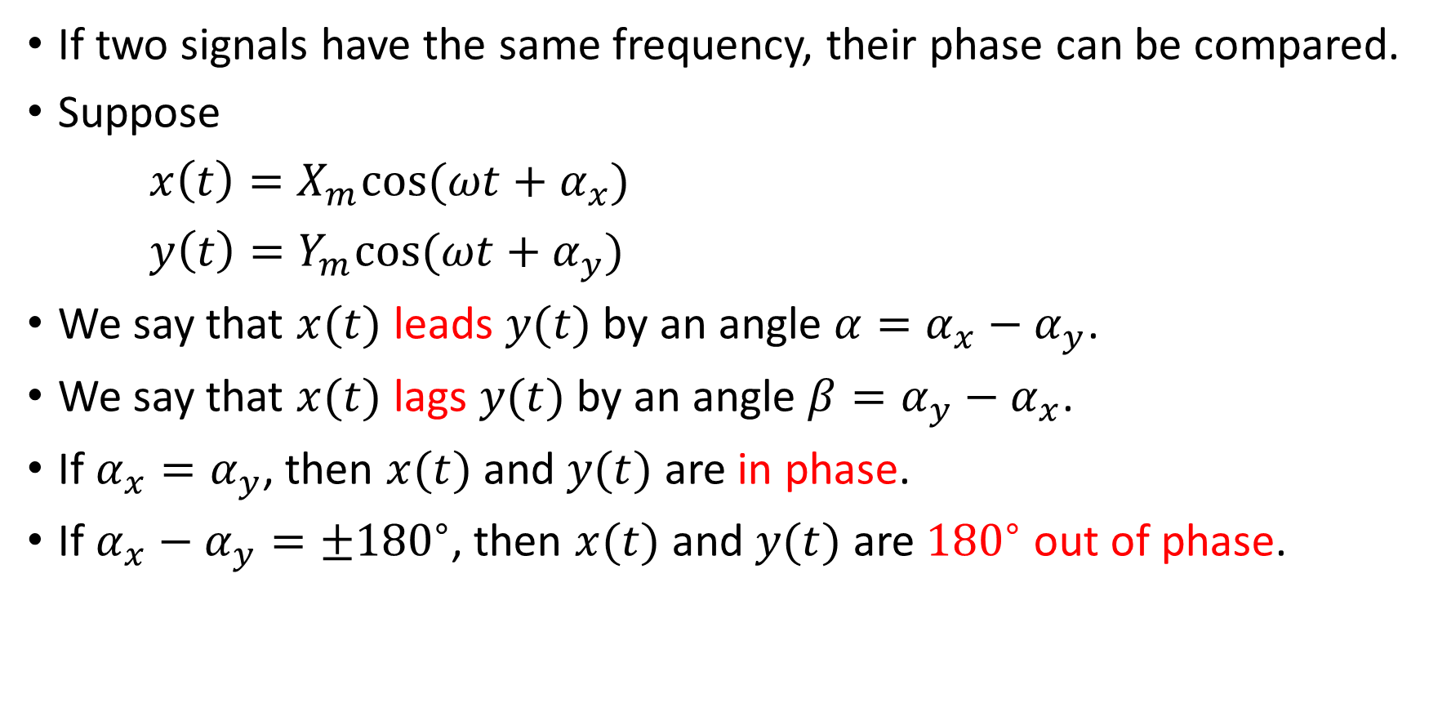
Lead/Lag relationships
If two signals have the same frequency, their phase can be compared.
Suppose
$x\left(t\right)=X_{m}cos⁡(ωt+α_{x})$
$y\left(t\right)=Y_{m}cos⁡(ωt+α_{y})$
We say that $x(t)$ leads $y(t)$ by an angle $α=α_{x}−α_{y}$.
We say that $x(t)$ lags $y(t)$ by an angle $β=α_{y}−α_{x}$.
If $α_{x}=α_{y}$, then $x(t)$ and $y(t)$ are in phase.
If $α_{x}−α_{y}=±{180}^{∘}$, then $x(t)$ and $y(t)$ are ${180}^{∘}$ out of phase.
Notes:
cfig/sine2.fig

Slide 7
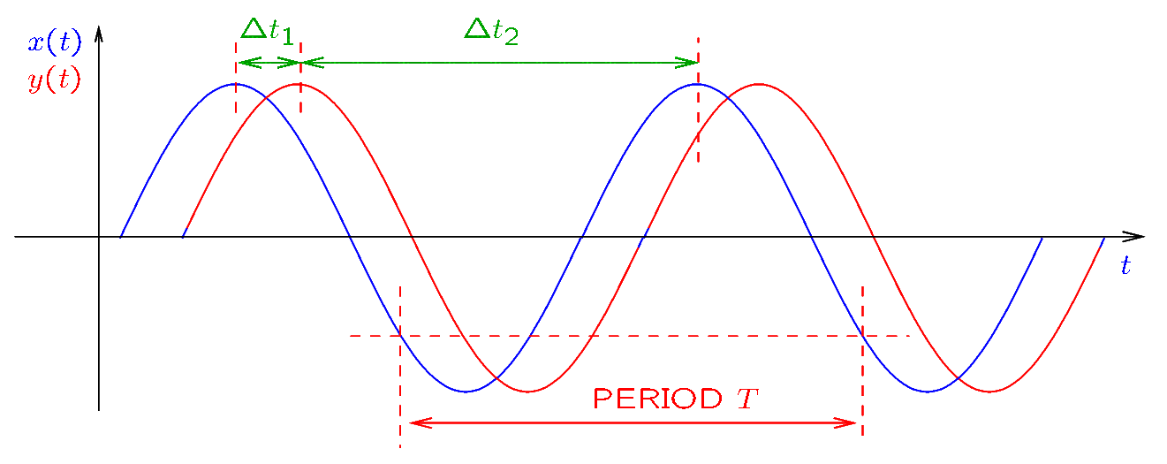
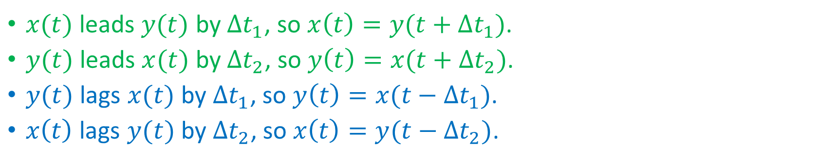
Lead/Lag relationships
$x(t)$ leads $y(t)$ by $Δt_{1}$, so $x\left(t\right)=y(t+Δt_{1})$.
$y(t)$ leads $x(t)$ by $Δt_{2}$, so $y\left(t\right)=x(t+Δt_{2})$.
$y(t)$ lags $x(t)$ by $Δt_{1}$, so $y\left(t\right)=x(t−Δt_{1})$.
$x\left(t\right)$ lags $y(t)$ by $Δt_{2}$, so $x\left(t\right)=y(t−Δt_{2})$.
Notes:
cfig/sine2.fig

Slide 8
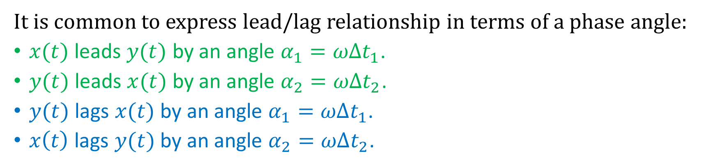
Lead/Lag relationships
It is common to express lead/lag relationship in terms of a phase angle:
$x(t)$ leads $y(t)$ by an angle $α_{1}=ωΔt_{1}$.
$y(t)$ leads $x(t)$ by an angle $α_{2}=ωΔt_{2}$.
$y(t)$ lags $x(t)$ by an angle $α_{1}=ωΔt_{1}$.
$x\left(t\right)$ lags $y(t)$ by an angle $α_{2}=ωΔt_{2}$.

Slide 9
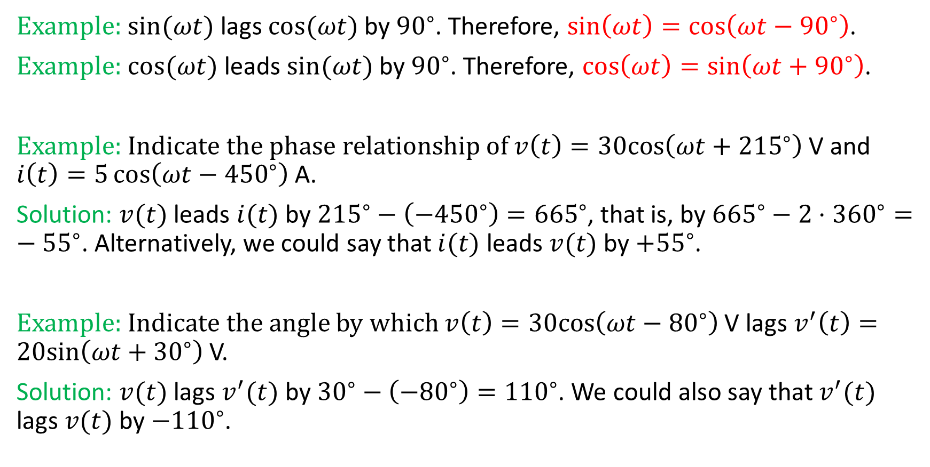
Lead/Lag relationships
Example: $sin⁡(ωt)$ lags $cos⁡(ωt)$ by ${90}^{∘}$. Therefore, $\sin\left(ωt\right)=\cos\left(ωt−{90}^{∘}\right)$.
Example: $cos(ωt)$ leads $sin⁡(ωt)$ by ${90}^{∘}$. Therefore, $\cos\left(ωt\right)=\sin\left(ωt+{90}^{∘}\right)$.
Example: Indicate the phase relationship of $v\left(t\right)=30cos\left(ωt+{215}^{∘}\right)$V and $i\left(t\right)=5\cos\left(ωt−{450}^{∘}\right)$A.
Solution: $v(t)$ leads $i(t)$ by ${215}^{∘}−\left(−{450}^{∘}\right)={665}^{∘}$, that is, by ${665}^{∘}−2⋅{360}^{∘}=−{55}^{∘}$. Alternatively, we could say that $i(t)$ leads $v(t)$ by ${+55}^{∘}$.
Example: Indicate the angle by which $v\left(t\right)=30cos\left(ωt−{80}^{∘}\right)$V lags $v^{′}\left(t\right)=20sin\left(ωt+{30}^{∘}\right)$V.
Solution: $v(t)$ lags $v^{′}(t)$ by ${30}^{∘}−\left(−{80}^{∘}\right)={110}^{∘}$. We could also say that $v^{′}(t)$ lags $v(t)$ by $−{110}^{∘}$.

Slide 10
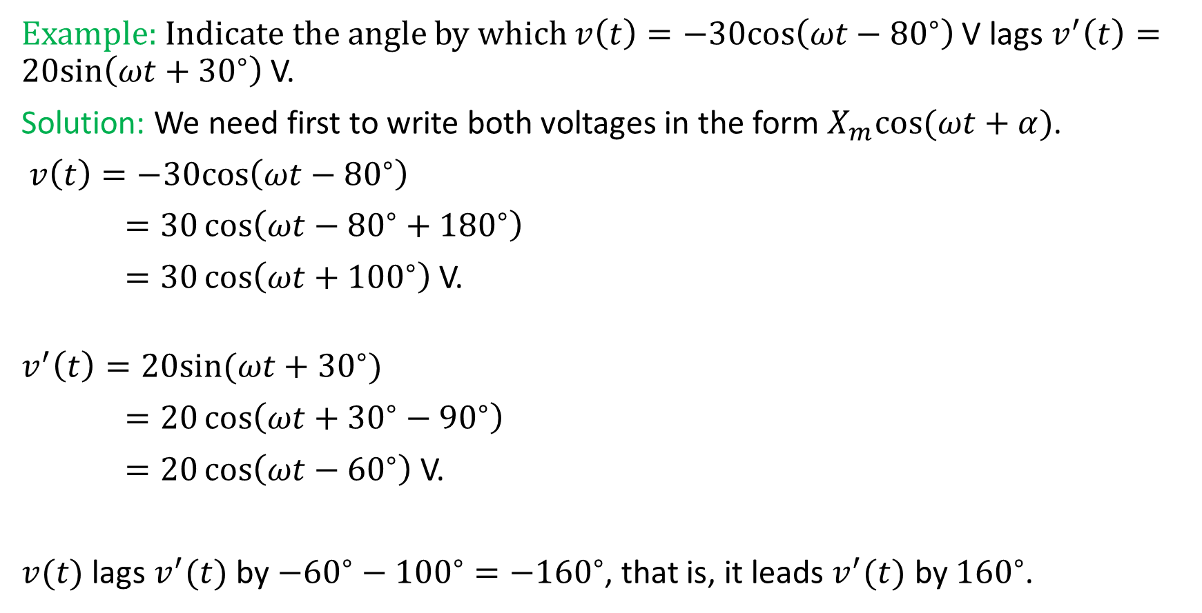
Lead/Lag relationships
Example: Indicate the angle by which $v\left(t\right)=−30cos\left(ωt−{80}^{∘}\right)$V lags $v^{′}\left(t\right)=20sin\left(ωt+{30}^{∘}\right)$V.
Solution: We need first to write both voltages in the form $X_{m}cos⁡(ωt+α)$.
$v\left(t\right)=−30cos\left(ωt−{80}^{∘}\right)$
$=30\cos\left(ωt−{80}^{∘}+{180}^{∘}\right)$
$=30\cos\left(ωt+{100}^{∘}\right)$V.
$$v^{′}\left(t\right)=20sin(ωt+{30}^{∘})$$
$=20\cos\left(ωt+{30}^{∘}−{90}^{∘}\right)$
$=20\cos\left(ωt−{60}^{∘}\right)$V.
$v(t)$ lags $v^{′}(t)$ by $−{60}^{∘}−{100}^{∘}=−{160}^{∘}$, that is, it leads $v^{′}(t)$ by ${160}^{∘}$.

