Slide 1
Frequency-Domain Measurements
M.V. Iordache, EEGR2051 Circuits and Measurements Lab, Fall 2020, LeTourneau University
See https://mviordache.name/EEGR2051 for more information.

Slide 2
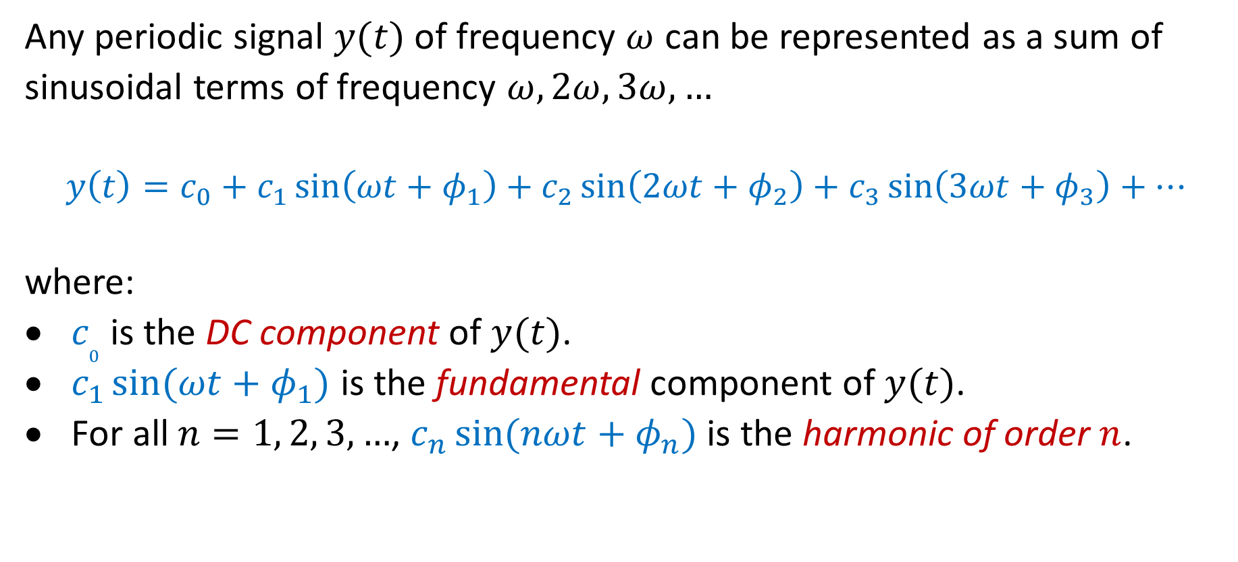
Fourier Series
Any periodic signal $y(t)$ of frequency $ω$ can be represented as a sum of sinusoidal terms of frequency $ω, 2ω, 3ω,…$
$$y\left(t\right)=c_{0}+c_{1}\sin\left(ωt+φ_{1}\right)+c_{2}\sin\left(2ωt+φ_{2}\right)+c_{3}\sin\left(3ωt+φ_{3}\right)+…$$
where:
$c_{0}$ is the DC component of $y(t)$.
$c_{1}\sin{(ωt+φ_{1})}$ is the fundamental component of $y(t)$.
For all $n=1, 2, 3, …$, $c_{n}\sin{(nωt+φ_{n})}$ is the harmonic of order $n$.

Slide 3
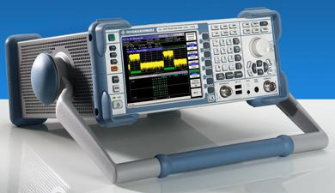
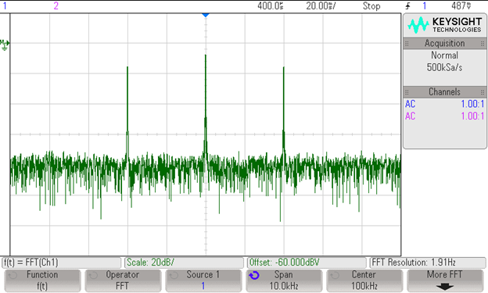
Fourier Series
Rohde-Schwarz spectrum analyzer. Image from wikipedia.org.
Harmonics can be measured with a spectrum analyzer.
Many digital oscilloscopes include an FFT option allowing to measure the harmonics of a signal.

Slide 4
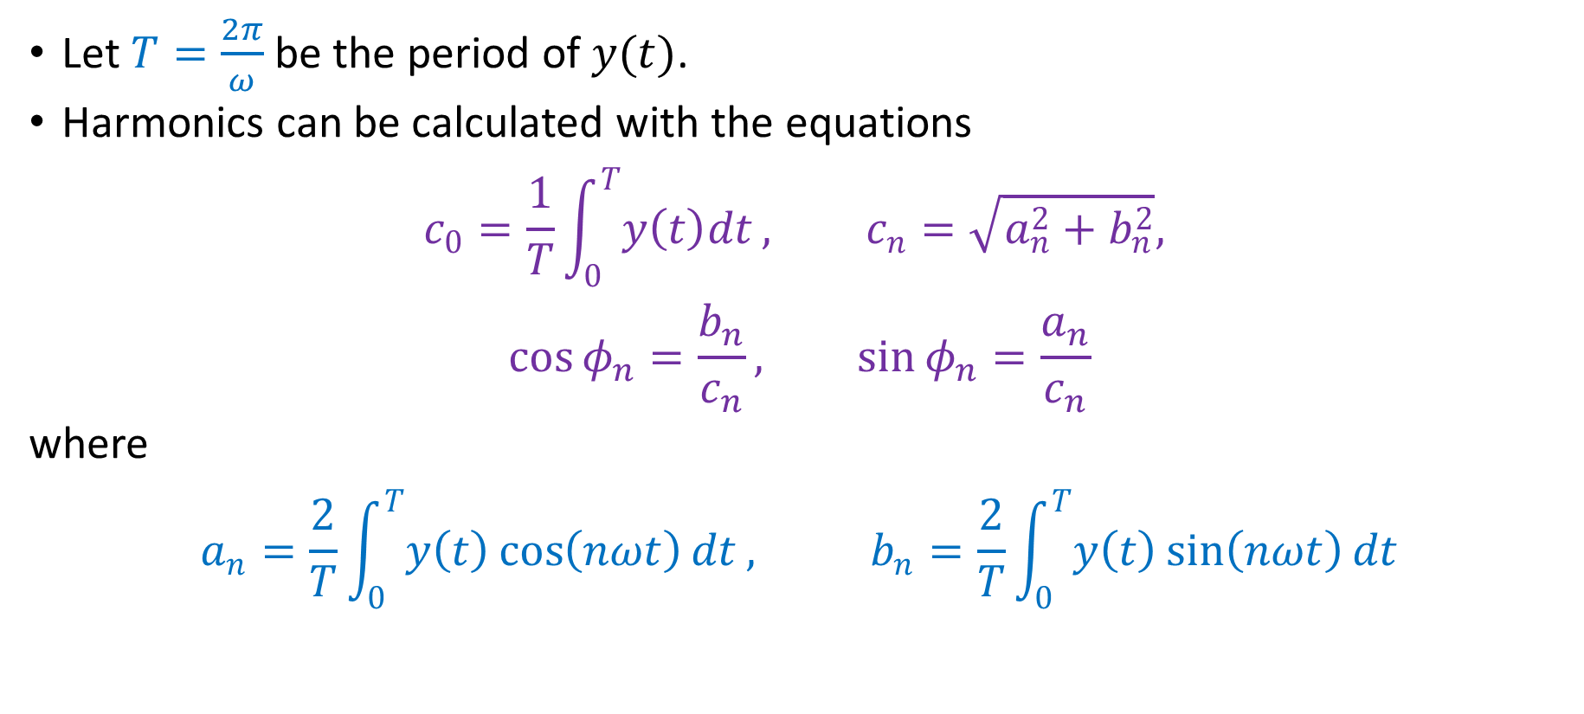
Fourier Series
Let $T=\frac{2π}{ω}$ be the period of $y(t)$.
Harmonics can be calculated with the equations
$$c_{0}=\frac{1}{T}\int_{0}^{T}{y\left(t\right)dt}, c_{n}=\sqrt{a_{n}^{2}+b_{n}^{2}},$$
$$\cos{φ_{n}}=\frac{b_{n}}{c_{n}}, \sin{φ_{n}}=\frac{a_{n}}{c_{n}}$$
where
$$a_{n}=\frac{2}{T}\int_{0}^{T}{y\left(t\right)\cos\left(nωt\right)dt}, b_{n}=\frac{2}{T}\int_{0}^{T}{y\left(t\right)\sin\left(nωt\right)dt}$$

Slide 5
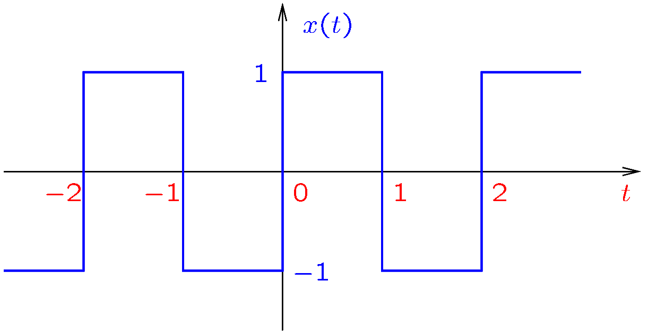
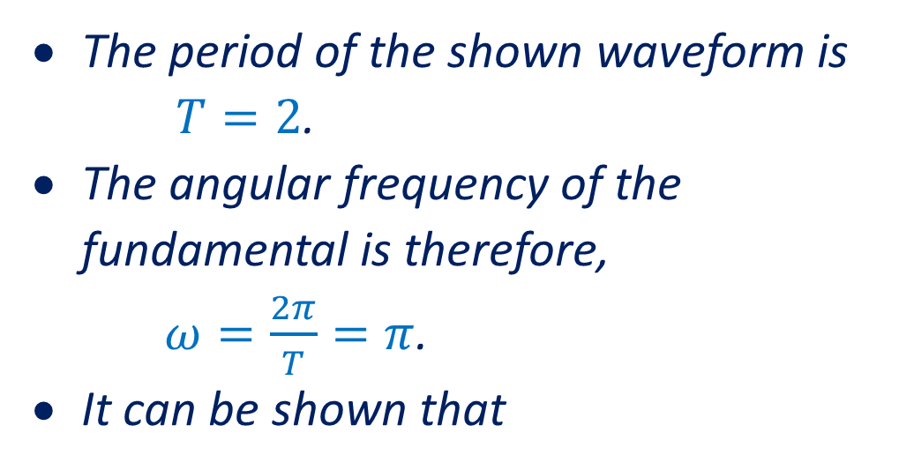
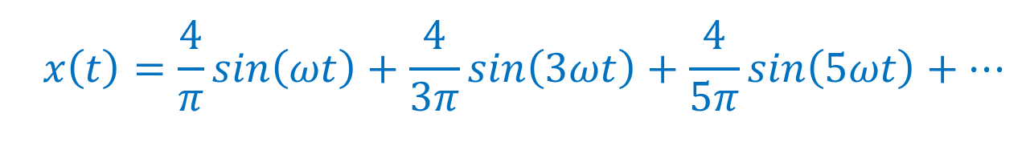
Example
The period of the shown waveform is
$T=2$.
The angular frequency of the fundamental is therefore,
$ω=\frac{2π}{T}=π$.
It can be shown that
$$x\left(t\right)=\frac{4}{π}\sin\left(ωt\right)+\frac{4}{3π}\sin\left(3ωt\right)+\frac{4}{5π}\sin\left(5ωt\right)+…$$

Slide 6
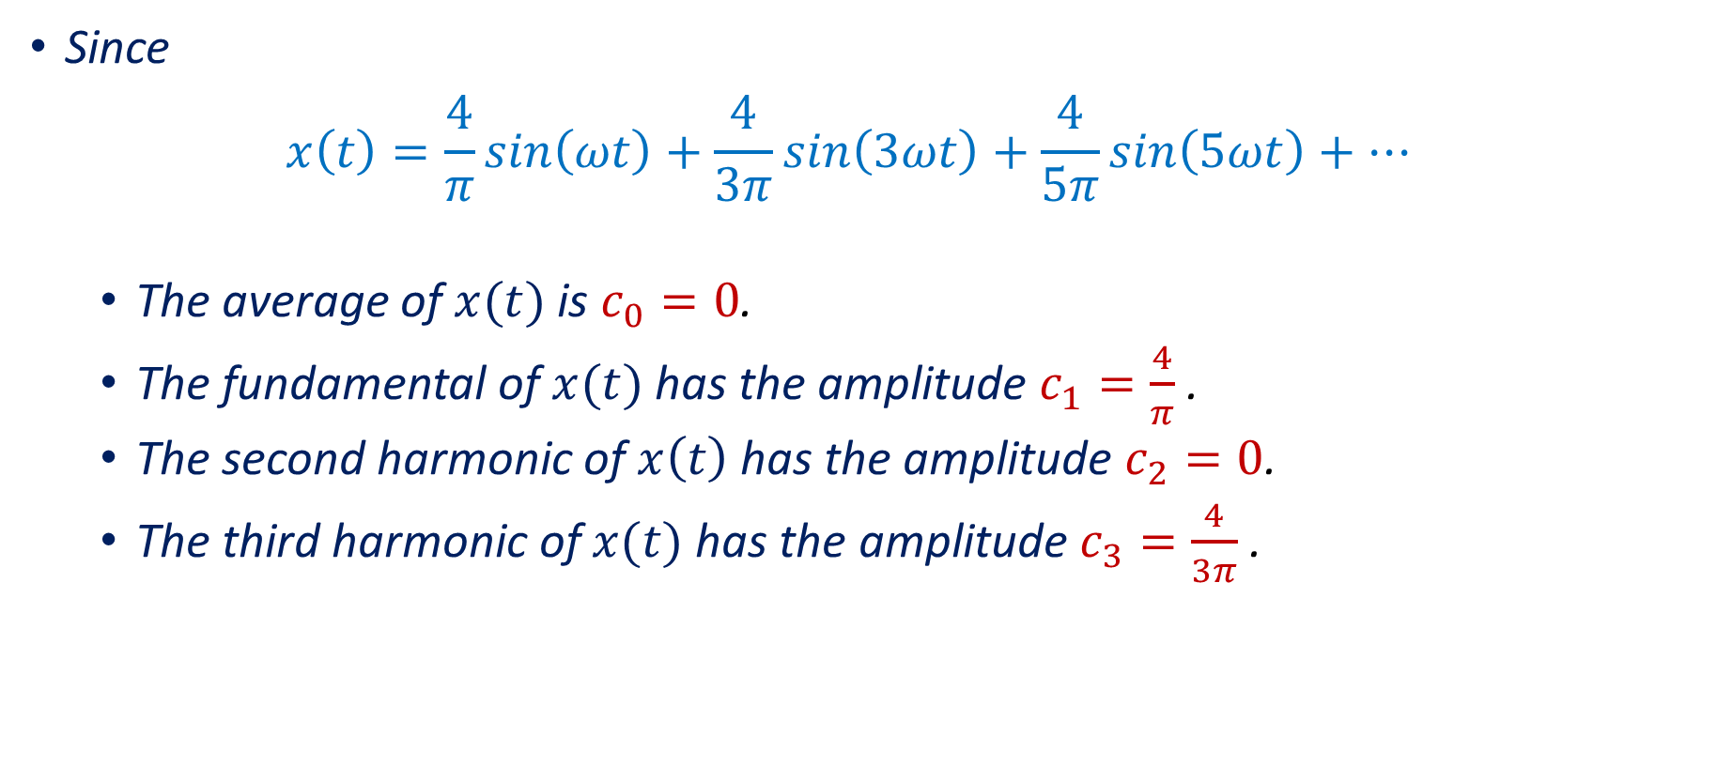
Example (continued)
Since
$$x\left(t\right)=\frac{4}{π}\sin\left(ωt\right)+\frac{4}{3π}\sin\left(3ωt\right)+\frac{4}{5π}\sin\left(5ωt\right)+…$$
The average of $x(t)$ is $c_{0}=0$.
The fundamental of $x(t)$ has the amplitude $c_{1}=\frac{4}{π}$.
The second harmonic of $x\left(t\right)$ has the amplitude $c_{2}=0$.
The third harmonic of $x(t)$ has the amplitude $c_{3}=\frac{4}{3π}$.

Slide 7
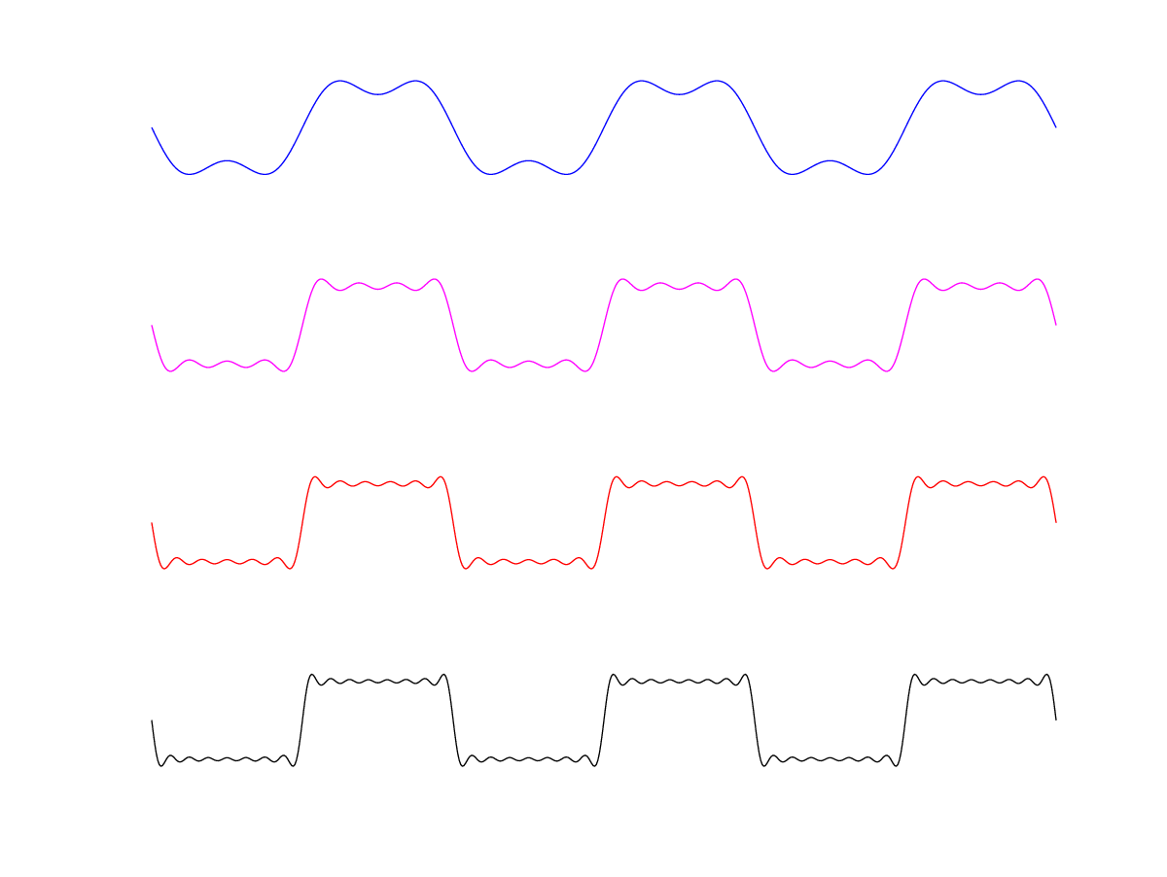
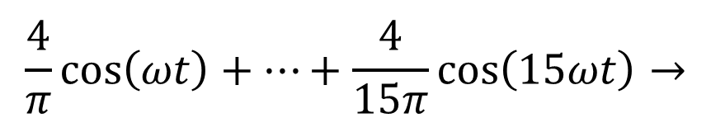
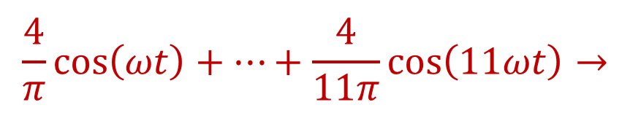
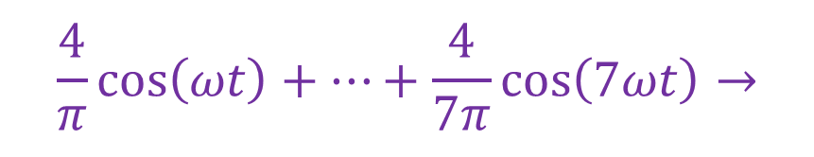
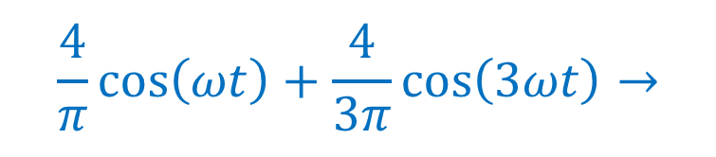
Example (continued)
The more harmonics are included, the better the approximation!
$$\frac{4}{π}\cos\left(ωt\right)+\frac{4}{3π}\cos\left(3ωt\right)→$$
$$\frac{4}{π}\cos\left(ωt\right)+…+\frac{4}{7π}\cos\left(7ωt\right)→$$
$$\frac{4}{π}\cos\left(ωt\right)+…+\frac{4}{11π}\cos\left(11ωt\right)→$$
$$\frac{4}{π}\cos\left(ωt\right)+…+\frac{4}{15π}\cos\left(15ωt\right)→$$
Notes:
fig/fseries.png

Slide 8
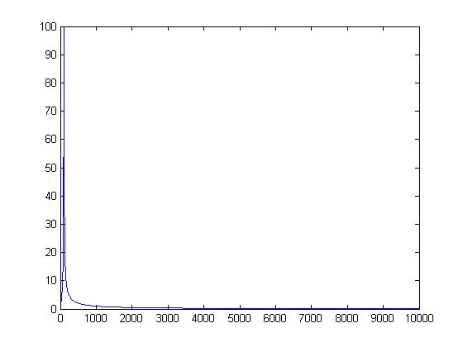
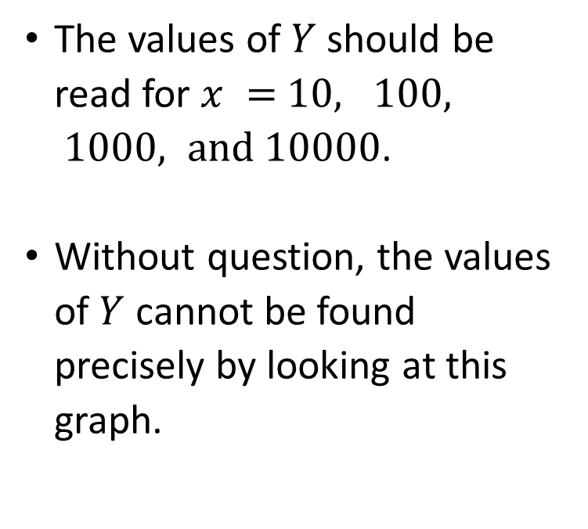
Logarithmic Scale
The figure shows the graph of $Y$ versus $x$ in blue.
The values of $Y$ should be read for $x =$ $10, 100, 1000, and 10000$.
Without question, the values of $Y$ cannot be found precisely by looking at this graph.

Slide 9
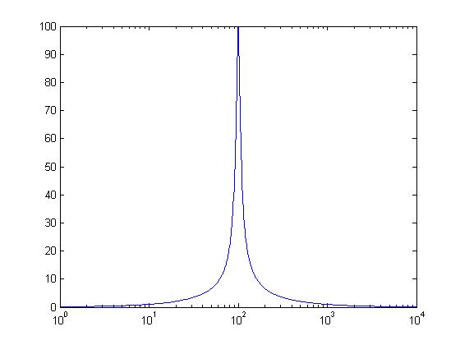
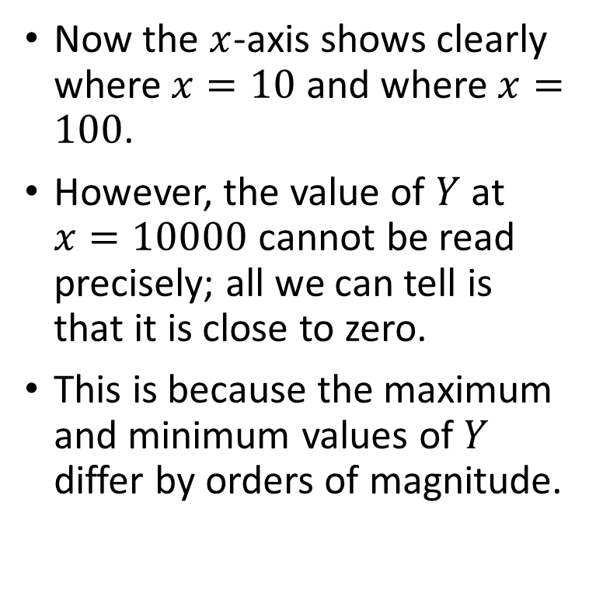
Logarithmic Scale
With a logarithmic scale on $x$, the graph shows $Y$ versus $\log_{10}{x}$ and labels the $x$-axis in terms of the values of $x$ (not in terms of $\log_{10}{x}$.)
Now the $x$-axis shows clearly where $x=10$ and where $x=100$.
However, the value of $Y$ at $x=10000$ cannot be read precisely; all we can tell is that it is close to zero.
This is because the maximum and minimum values of $Y$ differ by orders of magnitude.

Slide 10
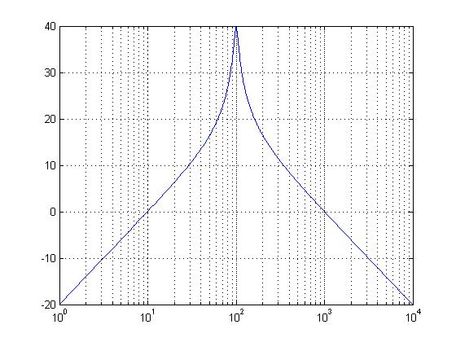
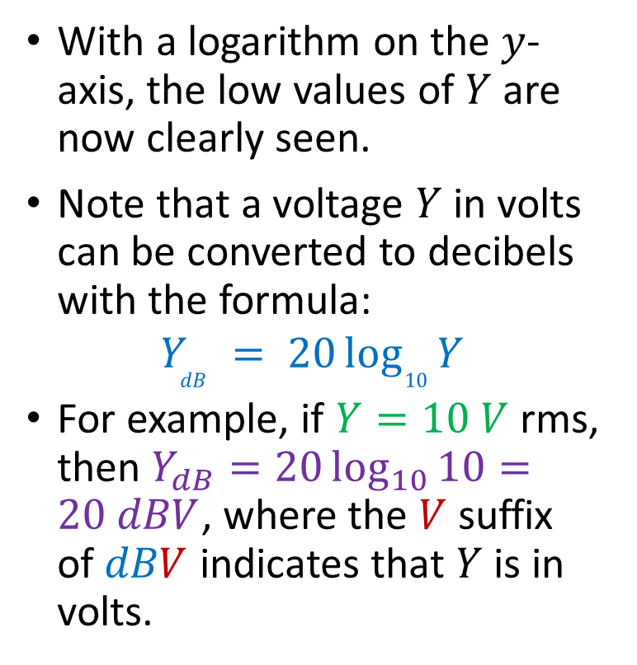
Logarithmic Scale
The plot in the figure shows $Y$ in decibels versus $x$, with logarithmic scale on the $x$-axis.
With a logarithm on the $y$-axis, the low values of $Y$ are now clearly seen.
Note that a voltage $Y$ in volts can be converted to decibels with the formula:
$$Y_{dB} = 20\log_{10}{Y}$$
For example, if $Y=10 V$ rms, then $Y_{dB}=20\log_{10}{10}=20 dBV$, where the $V$ suffix of $dBV$ indicates that $Y$ is in volts.
9
20
40
30

Slide 11
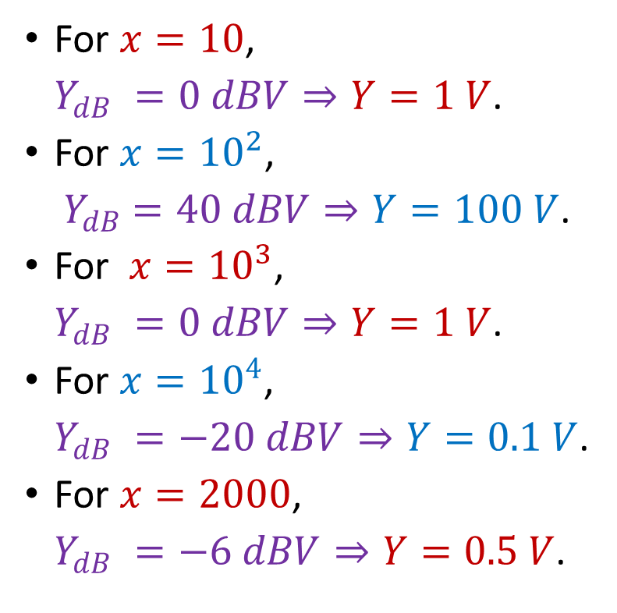
Example
The vertical gridlines help us read values that are not powers of 10.
For $x=10$,
$Y_{dB} =0 dBV⇒Y=1 V$.
For $x={10}^{2}$,
${ Y}_{dB} =40 dBV⇒Y=100 V$.
For $x={10}^{3}$,
$Y_{dB} =0 dBV⇒Y=1 V$.
For $x={10}^{4}$,
$Y_{dB} =−20 dBV⇒Y=0.1 V$.
For $x=2000$,
$Y_{dB} =−6 dBV⇒Y=0.5 V$.
9
20
40
30

Slide 12
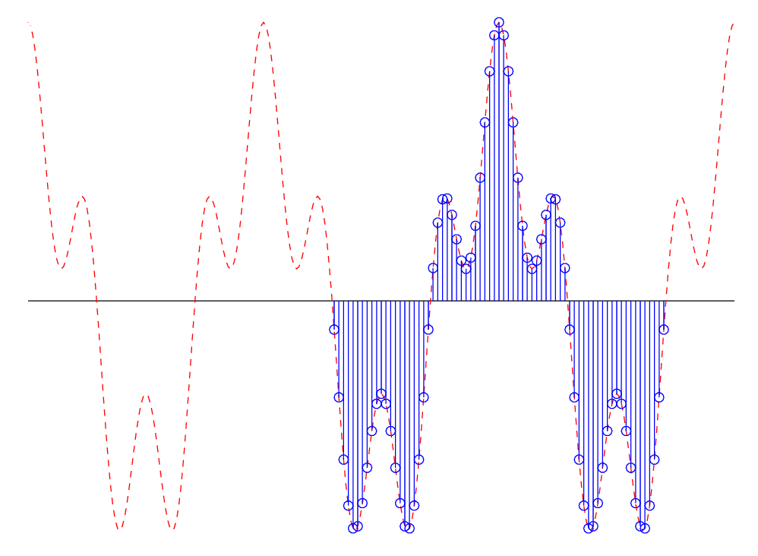

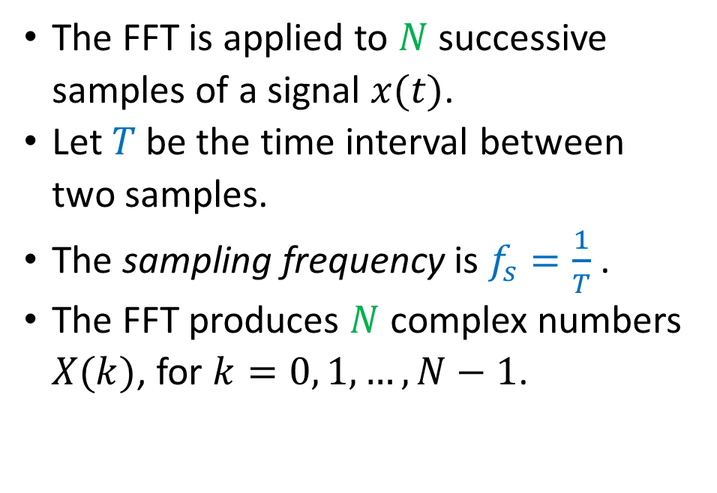
FFT
Each signal can be decomposed into a sum of sines.
The Fast Fourier Transform (FFT) algorithm provides a way to determine the sines contained into a signal.
$$x(t)$$
Samples shown in blue
The FFT is applied to $N$ successive samples of a signal $x(t)$.
Let $T$ be the time interval between two samples.
The sampling frequency is $f_{s}=\frac{1}{T}$ .
The FFT produces $N$ complex numbers $X(k)$, for $k=0, 1, …, N−1$.
Notes:
samples.png from samples.m

Slide 13
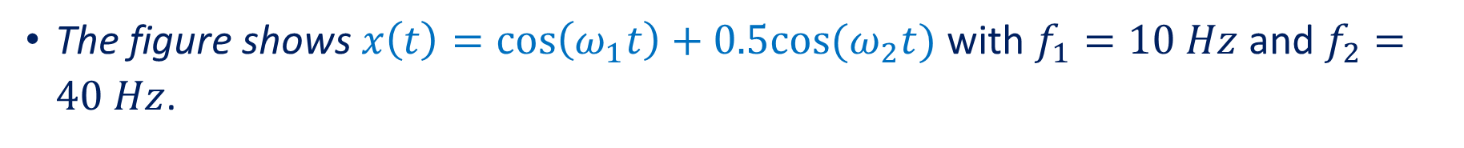
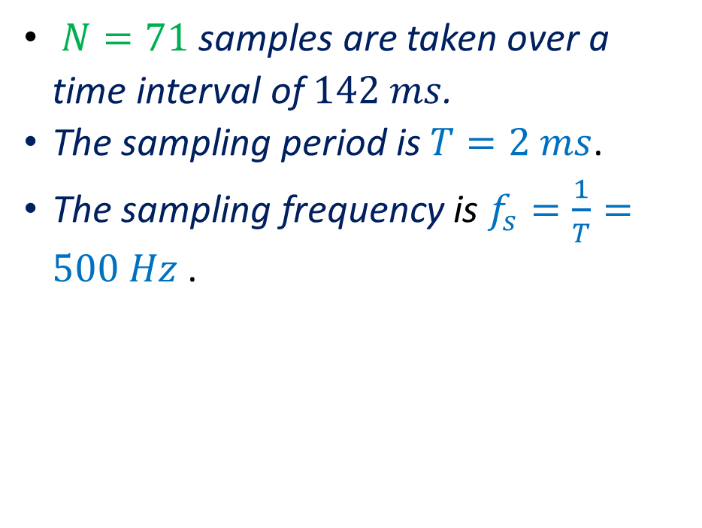
Example
The figure shows $x\left(t\right)=\cos\left(ω_{1}t\right)+0.5cos(ω_{2}t)$ with $f_{1}=10 Hz$ and $f_{2}=40 Hz$.
$N=71$ samples are taken over a time interval of $142 ms$.
The sampling period is $T=2 ms$.
The sampling frequency is $f_{s}=\frac{1}{T}=500 Hz$ .
$$x(t)$$
Samples shown in blue
Notes:
samples.png from samples.m

Slide 14
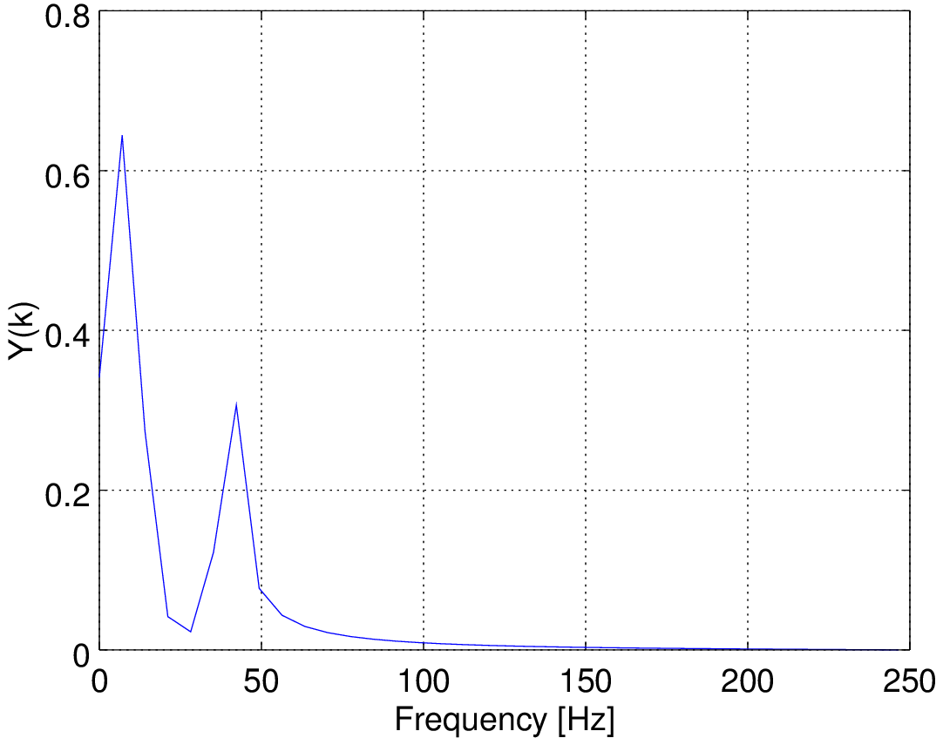
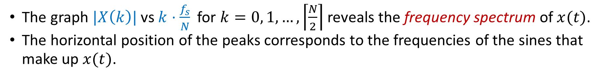


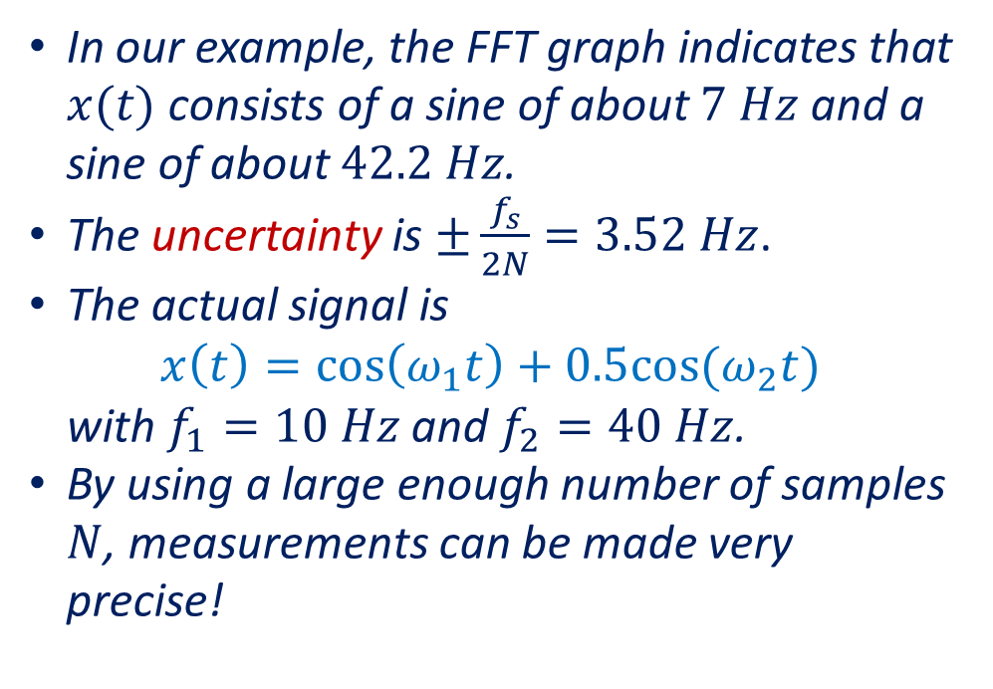
FFT
The graph $|X\left(k\right)|$ vs $k⋅\frac{f_{s}}{N}$ for $k=0, 1, …,\left\lceil \frac{N}{2}\right\rceil$ reveals the frequency spectrum of $x(t)$.
The horizontal position of the peaks corresponds to the frequencies of the sines that make up $x(t)$.
In our example, the FFT graph indicates that $x(t)$ consists of a sine of about $7 Hz$ and a sine of about $42.2 Hz$.
The uncertainty is $±\frac{f_{s}}{2N}=3.52 Hz$.
The actual signal is
$$x\left(t\right)=\cos\left(ω_{1}t\right)+0.5cos(ω_{2}t)$$
with $f_{1}=10 Hz$ and $f_{2}=40 Hz$.
By using a large enough number of samples $N$, measurements can be made very precise!
$$At≃7 Hz$$
$$At≃42.2 Hz$$
Notes:
spectr.png from samples.m

Slide 15
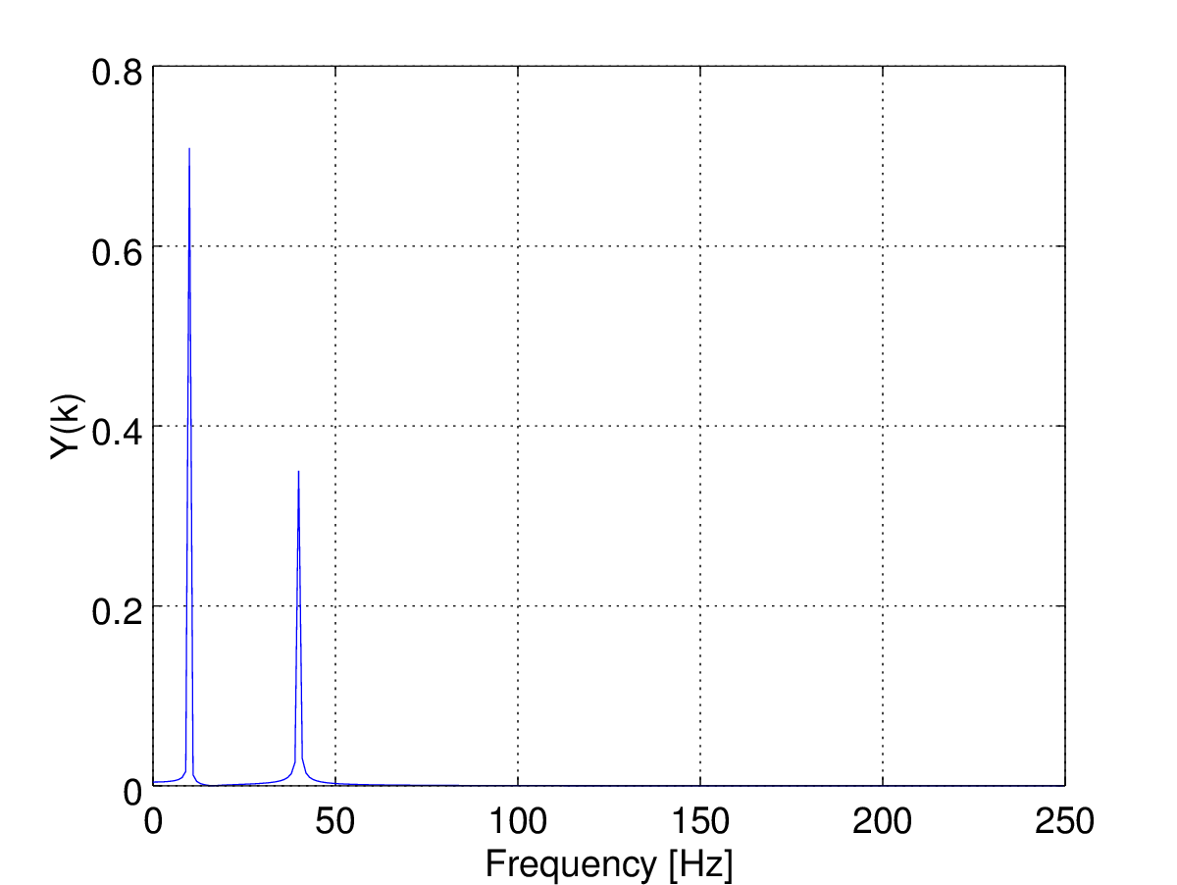


FFT
By using a large enough number of samples $N$, measurements can be made very precise!
$$N=71$$
$$N=501$$
Notes:
spectr.png and spectr2.png from samples.m

Slide 16
FFT
Even with a large number of samples, a small spectral component located close to a large component might not be visible.
To address this issue, the samples could be multiplied with the weights of a windowing function.
This reduces the base of the peaks, making it narrower.
Windowing functions available on lab oscilloscopes include:
Rectangular
Flat-top
Hamming
Blackman-Harris
The rectangular window has all weights equal to one.
It does not change the samples (it is as if no windowing function were used).

Slide 17

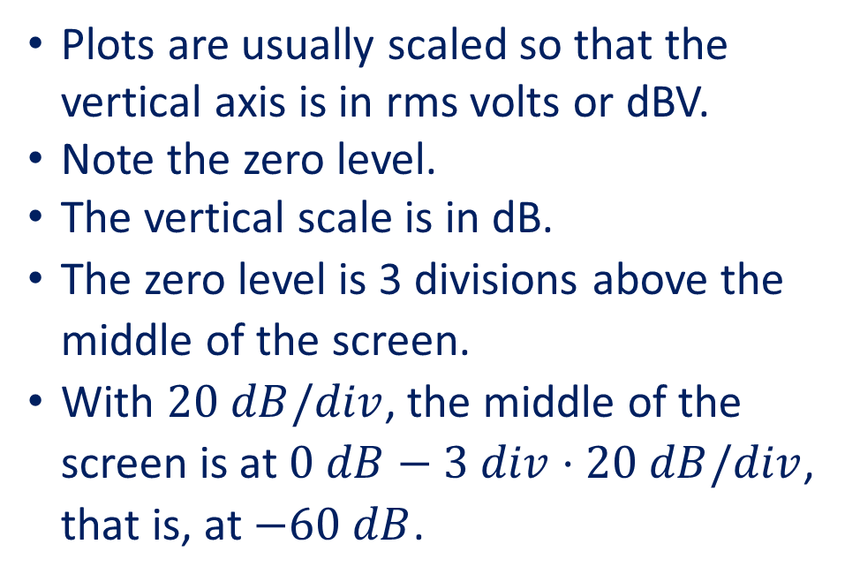
Example
The graph shows the FFT plot of a signal consisting of three sines.
Plots are usually scaled so that the vertical axis is in rms volts or dBV.
Note the zero level.
The vertical scale is in dB.
The zero level is 3 divisions above the middle of the screen.
With $20 dB/div$, the middle of the screen is at $0 dB−3 div⋅20 dB/div$, that is, at $−60 dB$.
The rightmost peak is at $0.8 div$ below the zero level.
This indicates a sine of $−0.8 div⋅20\frac{dB}{div}=−16 dBV$, that is, $158.5 mV$ rms.
Notes:
spectr.png

Slide 18

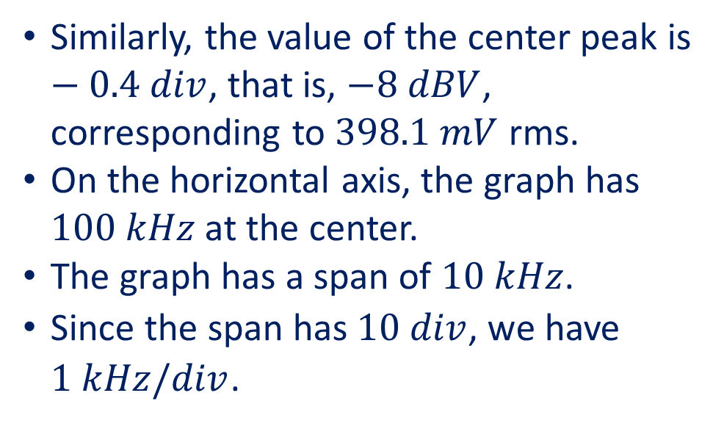
Example (continued)
Similarly, the value of the center peak is $−0.4 div$, that is, $−8 dBV$, corresponding to $398.1 mV$ rms.
On the horizontal axis, the graph has $100 kHz$ at the center.
The graph has a span of $10 kHz$.
Since the span has $10 div$, we have $1 kHz/div$.
So the center peak is at $100 kHz$.
The right peak is at $100 kHz+2 div⋅1\frac{kHz}{div}=102 kHz$.
The left peak is at $100 kHz−2 div⋅1\frac{kHz}{div}=98 kHz$.
Notes:
spectr.png

Slide 19
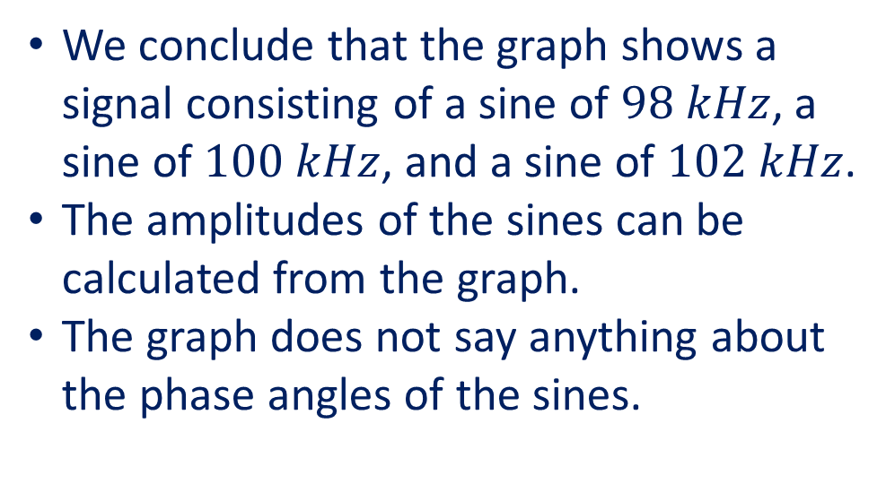
Example (continued)
We conclude that the graph shows a signal consisting of a sine of $98 kHz$, a sine of $100 kHz$, and a sine of $102 kHz$.
The amplitudes of the sines can be calculated from the graph.
The graph does not say anything about the phase angles of the sines.
Notes:
spectr.png

