Slide 1
First Order Systems. Thermal-Electrical Analogy. Interference.
M.V. Iordache, EEGR2051 Circuits and Measurements Lab, Fall 2020, LeTourneau University
See https://mviordache.name/EEGR2051 for more information.

Slide 2
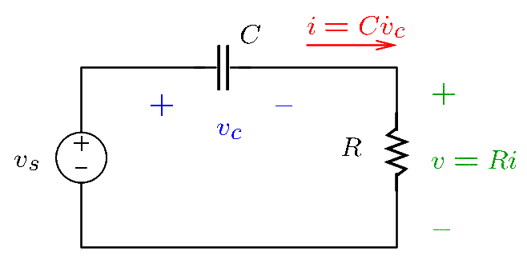
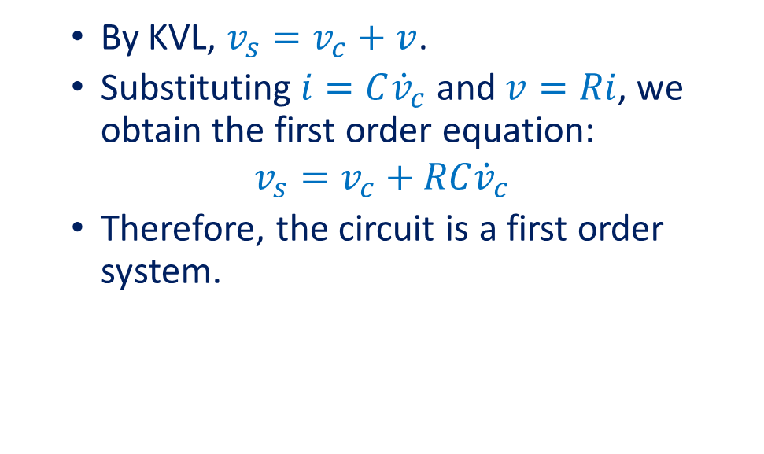
First Order Systems
First order systems are described by first order differential equations.
For example, the following circuit is a first order system.
By KVL, $v_{s}=v_{c}+v$.
Substituting $i=C{\dot{v}}_{c}$ and $v=Ri$, we obtain the first order equation:
$$v_{s}=v_{c}+RC{\dot{v}}_{c}$$
Therefore, the circuit is a first order system.

Slide 3
Thermal Analysis
Thermal analysis of electric circuits is important because electric components are damaged when the maximum admissible temperature is exceeded.
Thermal analysis can be carried out using an electric analogy in which:
Temperature corresponds to electric potential.
Power corresponds to electric current.
Energy corresponds to electric charge.
Thermal resistance corresponds to electric resistance.
Thermal resistance is measured in Kelvin degrees per watt (K/W).
Thermal capacitance corresponds to capacitance.
Thermal capacitance is measured in joules per Kelvin degrees (J/K).

Slide 4
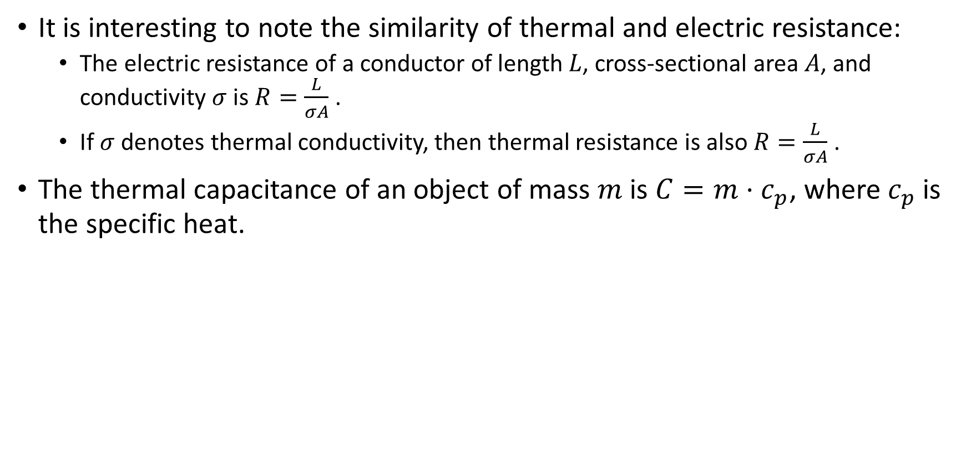
Thermal Analysis
It is interesting to note the similarity of thermal and electric resistance:
The electric resistance of a conductor of length $L$, cross-sectional area $A$, and conductivity $σ$ is $R=\frac{L}{σA}$.
If $σ$ denotes thermal conductivity, then thermal resistance is also $R=\frac{L}{σA}$.
The thermal capacitance of an object of mass $m$ is $C=m⋅c_{p}$, where $c_{p}$ is the specific heat.

Slide 5
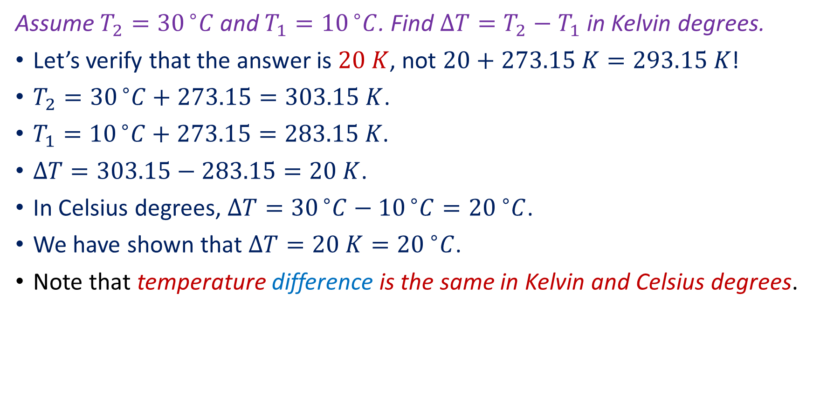
Example 1
Assume $T_{2}={30}^{ ∘}C$and $T_{1}={10}^{ ∘}C$. Find $ΔT=T_{2}−T_{1}$ in Kelvin degrees.
Let’s verify that the answer is $20 K$, not $20+273.15 K=293.15 K$!
$T_{2}={30}^{ ∘}C+273.15=303.15 K$.
$T_{1}={10}^{ ∘}C+273.15=283.15 K\text{.}$
$ΔT=303.15−283.15=20 K$.
In Celsius degrees, $ΔT={30}^{ ∘}C−{10}^{ ∘}C={20 }^{∘}C$.
We have shown that $ΔT=20 K={20 }^{∘}C$.
Note that temperature difference is the same in Kelvin and Celsius degrees.

Slide 6
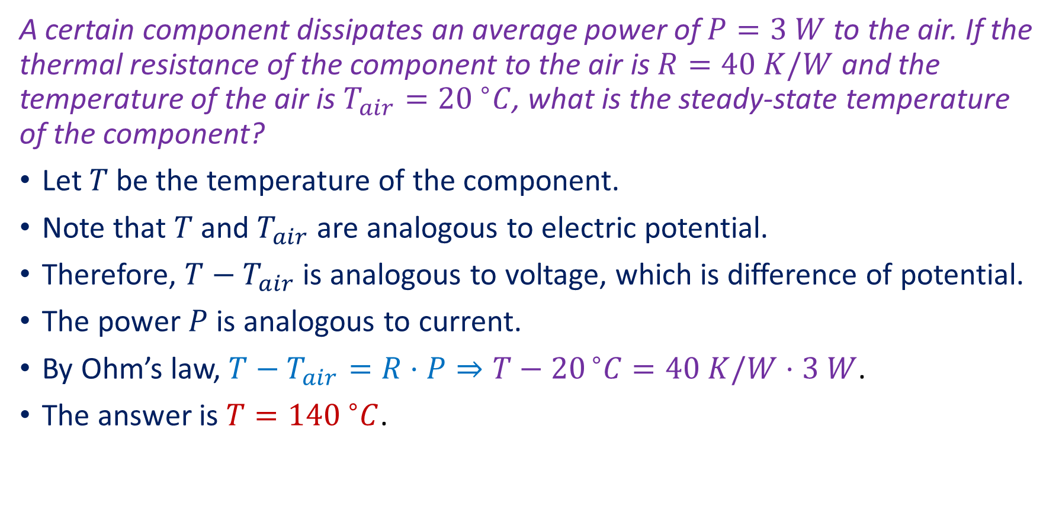
Example 2
A certain component dissipates an average power of $P=3 W$ to the air. If the thermal resistance of the component to the air is $R=40 K/W$ and the temperature of the air is ${T_{air}=20 }^{∘}C$, what is the steady-state temperature of the component?
Let $T$ be the temperature of the component.
Note that $T$ and $T_{air}$ are analogous to electric potential.
Therefore, $T−T_{air}$ is analogous to voltage, which is difference of potential.
The power $P$ is analogous to current.
By Ohm’s law, $T−T_{air}=R⋅P⇒T−{20}^{ ∘}C=40 K/W⋅3 W$.
The answer is $T={140 }^{∘}C$.

Slide 7
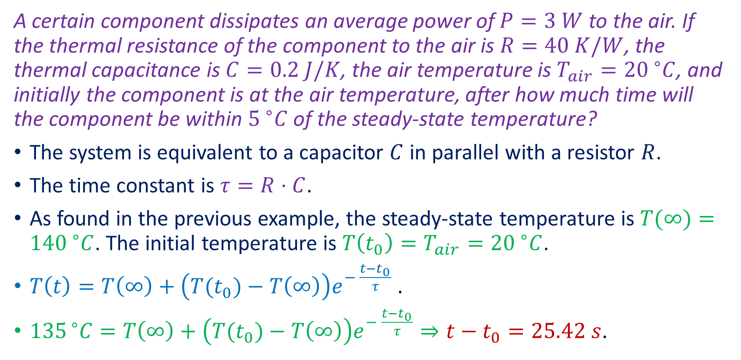
Example 3
A certain component dissipates an average power of $P=3 W$ to the air. If the thermal resistance of the component to the air is $R=40 K/W$, the thermal capacitance is $C=0.2 J/K$, the air temperature is ${T_{air}=20 }^{∘}C$, and initially the component is at the air temperature, after how much time will the component be within ${5 }^{∘}C$ of the steady-state temperature?
The system is equivalent to a capacitor $C$ in parallel with a resistor $R$.
The time constant is $τ=R⋅C$.
As found in the previous example, the steady-state temperature is $T(∞)={140 }^{∘}C$. The initial temperature is $T\left(t_{0}\right)=T_{air}={20 }^{∘}C$.
$T\left(t\right)=T\left(∞\right)+\left(T(t_{0})−T\left(∞\right)\right)e^{− \frac{t−t_{0}}{τ}}$ .
${135}^{ ∘}C=T\left(∞\right)+\left(T(t_{0})−T\left(∞\right)\right)e^{− \frac{t−t_{0}}{τ}}⇒t−t_{0}=25.42 s$.

Slide 8
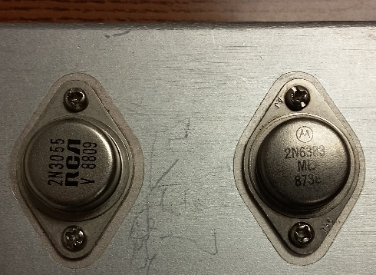
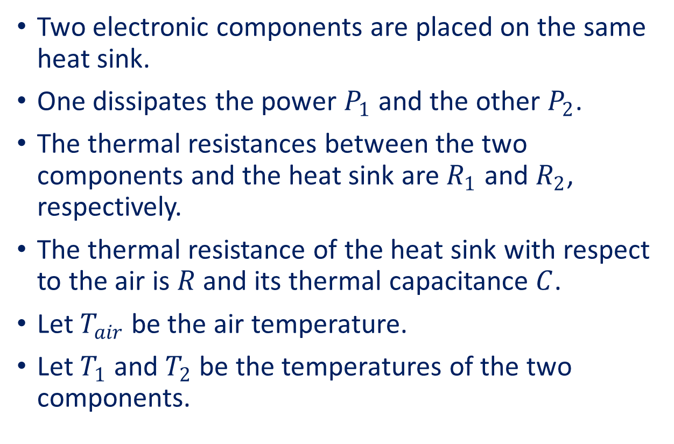
Example 4
Two electronic components are placed on the same heat sink.
One dissipates the power $P_{1}$ and the other $P_{2}$.
The thermal resistances between the two components and the heat sink are $R_{1}$ and $R_{2}$, respectively.
The thermal resistance of the heat sink with respect to the air is $R$ and its thermal capacitance $C$.
Let $T_{air}$ be the air temperature.
Let $T_{1}$ and $T_{2}$ be the temperatures of the two components.
Power transistors of a DC power supply connected to the same aluminum heat sink.

Slide 9
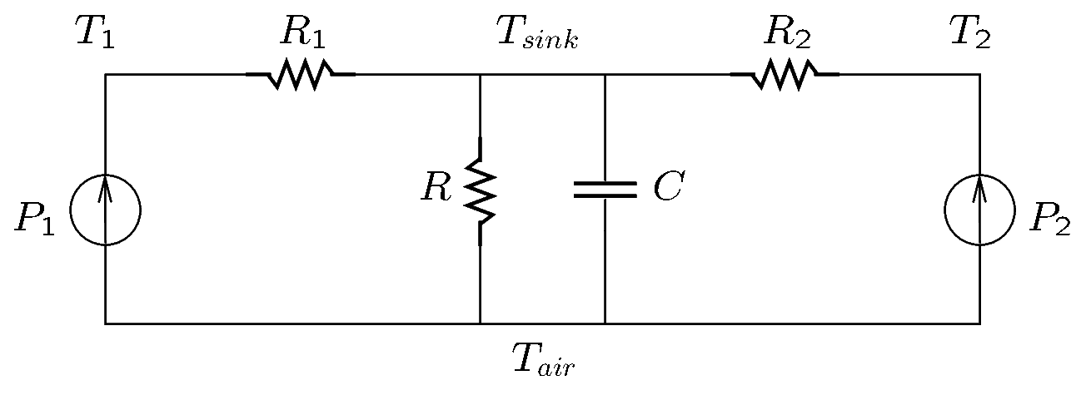
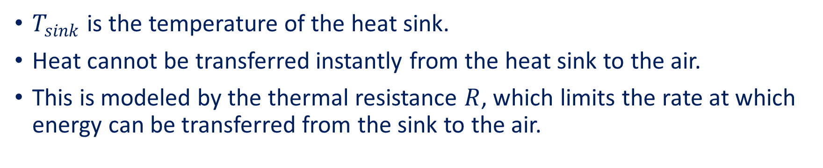
Example 4 (Continued)
The heat transfer system is analogous to the following circuit.
$T_{sink}$ is the temperature of the heat sink.
Heat cannot be transferred instantly from the heat sink to the air.
This is modeled by the thermal resistance $R$, which limits the rate at which energy can be transferred from the sink to the air.
Notes:
therm-ex.fig

Slide 10
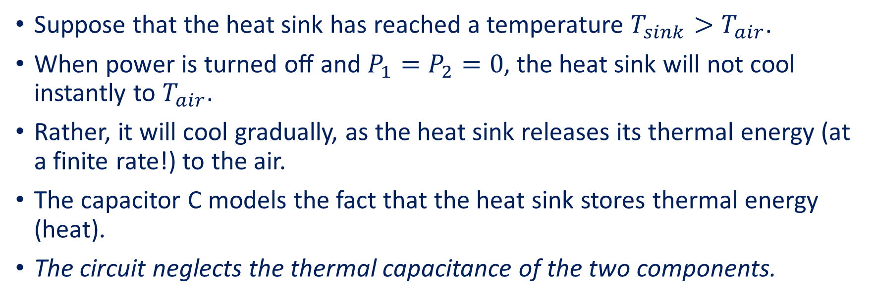
Example 4 (Continued)
Suppose that the heat sink has reached a temperature $T_{sink}>T_{air}$.
When power is turned off and $P_{1}=P_{2}=0$, the heat sink will not cool instantly to $T_{air}$.
Rather, it will cool gradually, as the heat sink releases its thermal energy (at a finite rate!) to the air.
The capacitor C models the fact that the heat sink stores thermal energy (heat).
The circuit neglects the thermal capacitance of the two components.

Slide 11
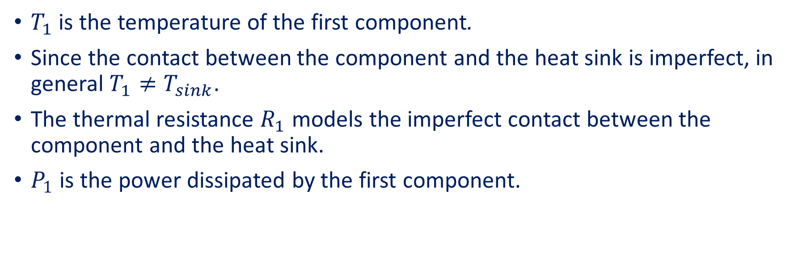
Example 4 (Continued)
$T_{1}$ is the temperature of the first component.
Since the contact between the component and the heat sink is imperfect, in general $T_{1}≠T_{sink}$.
The thermal resistance $R_{1}$ models the imperfect contact between the component and the heat sink.
$P_{1}$ is the power dissipated by the first component.

Slide 12
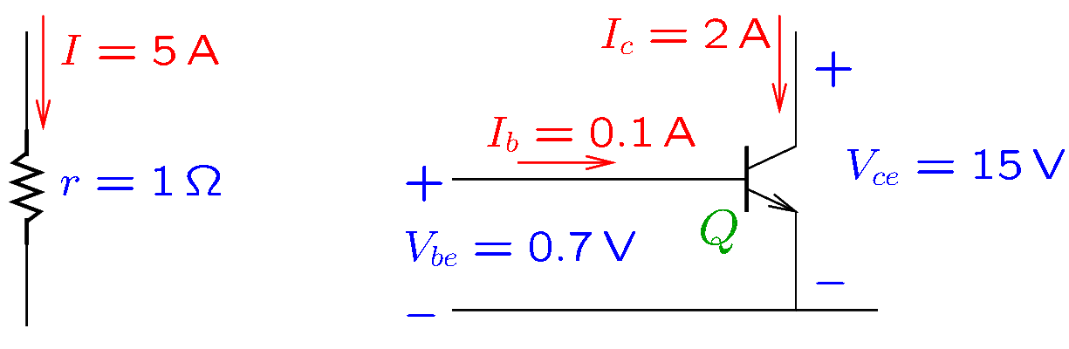
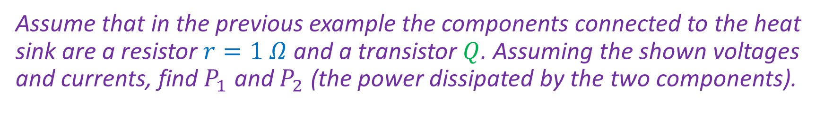
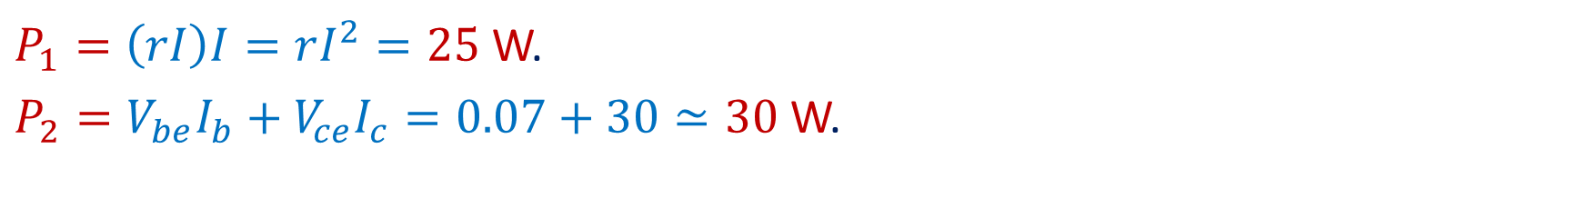
Example 5
Assume that in the previous example the components connected to the heat sink are a resistor $r=1 Ω$ and a transistor $Q$. Assuming the shown voltages and currents, find $P_{1}$ and $P_{2}$ (the power dissipated by the two components).
$P_{1}=\left(rI\right)I=rI^{2}=25$W.
$P_{2}=V_{be}I_{b}+V_{ce}I_{c}=0.07+30≃30$W.
Notes:
power.fig

Slide 13
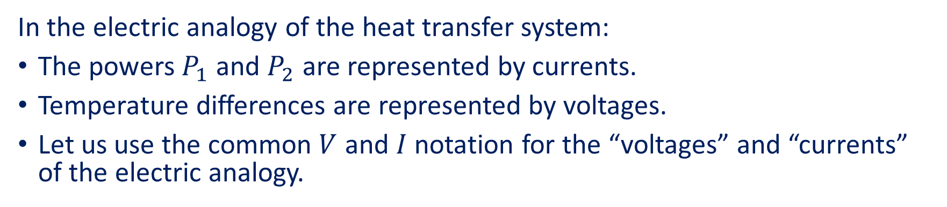
Example 6
Find the steady-state temperatures $T_{1}$ and $T_{2}$ when $P_{1}=25$W, $P_{2}=30$W, $R_{1}=2$K/W, $R_{2}=1.5$K/W, $R=1$K/W, and $T_{air}={20}^{ ∘}C$.
In the electric analogy of the heat transfer system:
The powers $P_{1}$ and $P_{2}$ are represented by currents.
Temperature differences are represented by voltages.
Let us use the common $V$ and $I$ notation for the “voltages” and “currents” of the electric analogy.

Slide 14
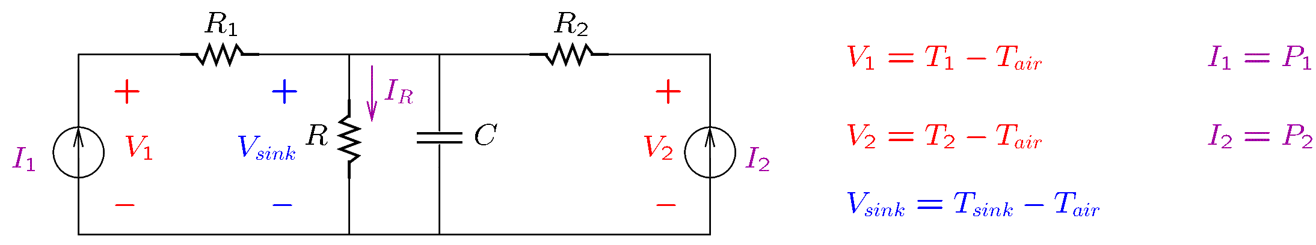
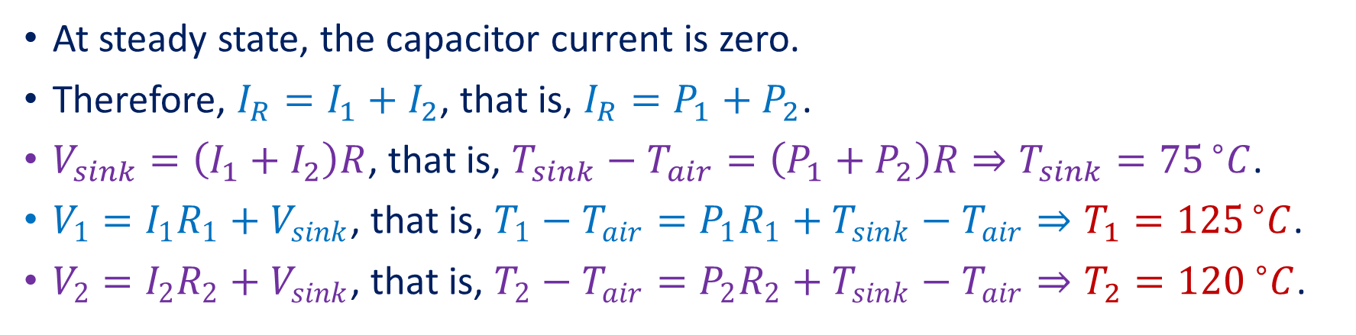
Example 6 (Continued)
Let’s use the common $V$ and $I$ notation for the “voltages” and “currents” of the electric analogy:
At steady state, the capacitor current is zero.
Therefore, $I_{R}=I_{1}+I_{2}$, that is, $I_{R}=P_{1}+P_{2}$.
$V_{sink}=\left(I_{1}+I_{2}\right)R$, that is, $T_{sink}−T_{air}=\left(P_{1}+P_{2}\right)R⇒T_{sink}={75}^{ ∘}C$.
$V_{1}=I_{1}R_{1}+V_{sink}$, that is, $T_{1}−T_{air}=P_{1}R_{1}+T_{sink}−T_{air}⇒T_{1}={125}^{ ∘}C$.
$V_{2}=I_{2}R_{2}+V_{sink}$, that is, $T_{2}−T_{air}=P_{2}R_{2}+T_{sink}−T_{air}⇒T_{2}={120 }^{∘}C$.

Slide 15
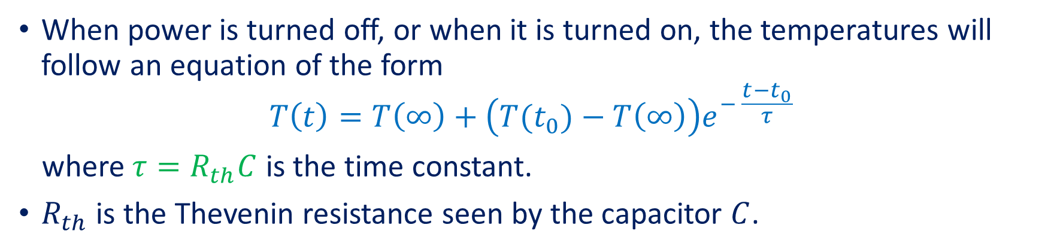
Example 7
If $R_{1}=2$K/W, $R_{2}=1.5$K/W, $R=1$K/W, and $C=10 J/K$, what is the time constant?
When power is turned off, or when it is turned on, the temperatures will follow an equation of the form
$$T\left(t\right)=T\left(∞\right)+\left(T(t_{0})−T\left(∞\right)\right)e^{− \frac{t−t_{0}}{τ}}$$
where $τ=R_{th}C$ is the time constant.
$R_{th}$ is the Thevenin resistance seen by the capacitor $C$.

Slide 16
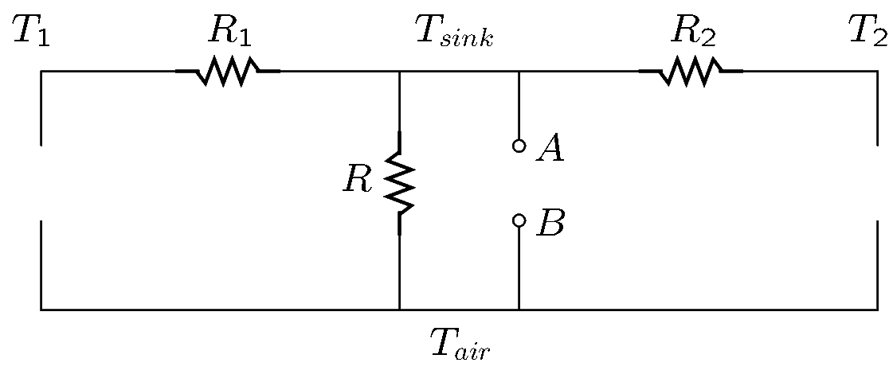
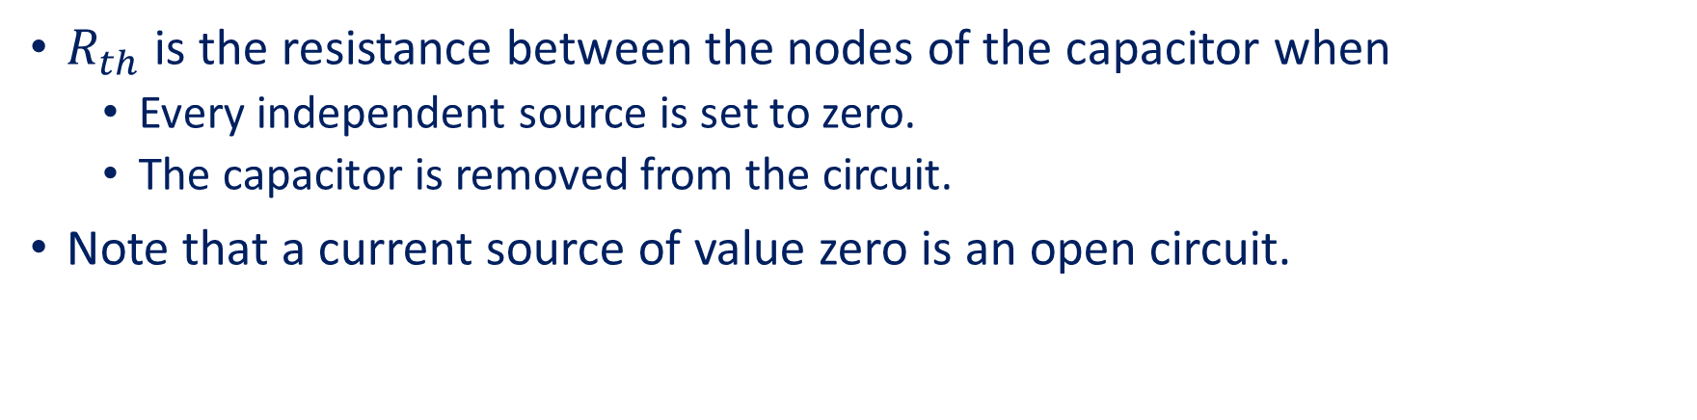

Example 7 (Continued)
$R_{th}$ is the resistance between the nodes of the capacitor when
Every independent source is set to zero.
The capacitor is removed from the circuit.
Note that a current source of value zero is an open circuit.
$R_{th}$ is the resistance between points $A$ and $B$.
Since disconnected resistors do not matter, $R_{th}=R$ and so $τ=10$s.
Notes:
therm-th.fig

Slide 17
Interference

Slide 18
Interference
In a measurement system, in addition to the signals that are measured, there are also unwanted electrical signals.
Some unwanted signals are due to interference from nearby circuit networks.
Interference signals are classified based on the source of interference and the way they are transmitted:
Capacitive interference
Inductive interference
Electromagnetic interference
Conductively coupled interference
Ground-loop interference
At this time we will consider the conductively coupled interference.

Slide 19
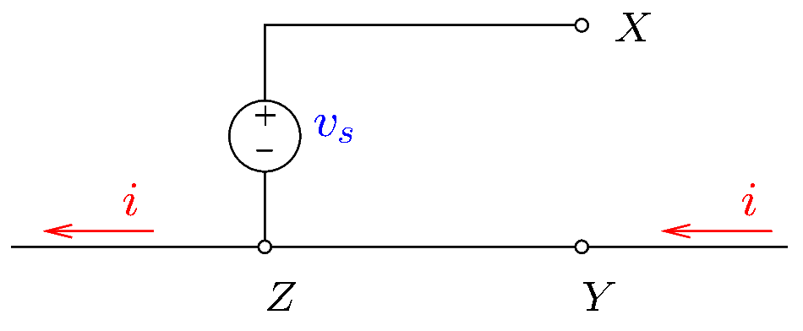
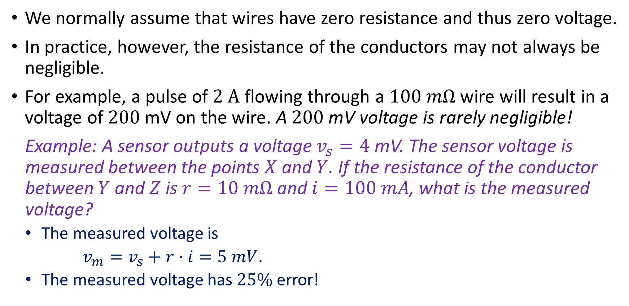
Conductively Coupled Interference
We normally assume that wires have zero resistance and thus zero voltage.
In practice, however, the resistance of the conductors may not always be negligible.
For example, a pulse of $2 A$ flowing through a $100 mΩ$ wire will result in a voltage of $200$mV on the wire. A $200$mV voltage is rarely negligible!
Example: A sensor outputs a voltage $v_{s}=4$mV. The sensor voltage is measured between the points $X$ and $Y$. If the resistance of the conductor between $Y$ and $Z$ is $r=10 mΩ$ and $i=100 mA$, what is the measured voltage?
The measured voltage is
$v_{m}=v_{s}+r⋅i=5 mV$.
The measured voltage has $25\%$ error!
Notes:
interf-c.fig

Slide 20
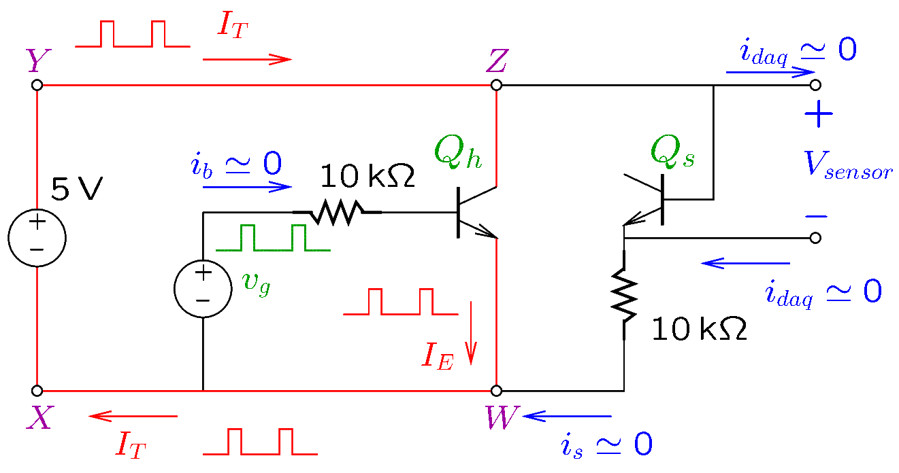
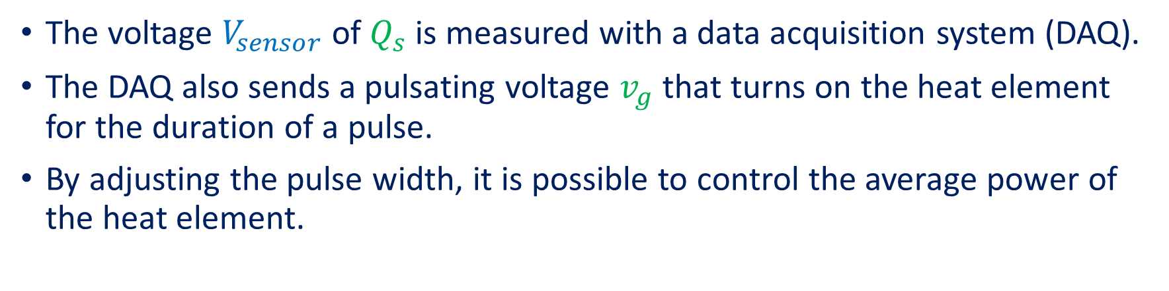
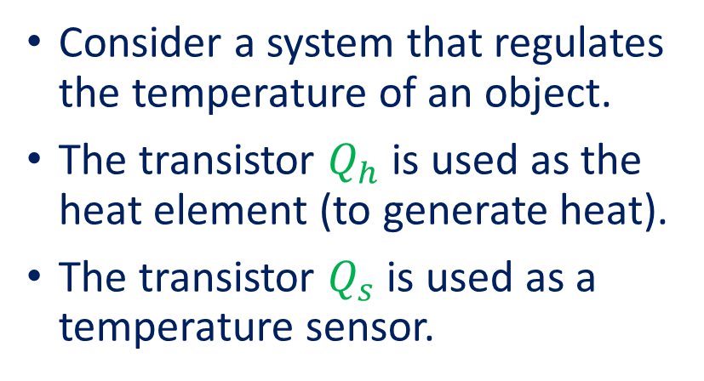
Example
Consider a system that regulates the temperature of an object.
The transistor $Q_{h}$ is used as the heat element (to generate heat).
The transistor $Q_{s}$ is used as a temperature sensor.
The voltage $V_{sensor}$ of $Q_{s}$ is measured with a data acquisition system (DAQ).
The DAQ also sends a pulsating voltage $v_{g}$ that turns on the heat element for the duration of a pulse.
By adjusting the pulse width, it is possible to control the average power of the heat element.
Notes:
therm-c1.fig

Slide 21
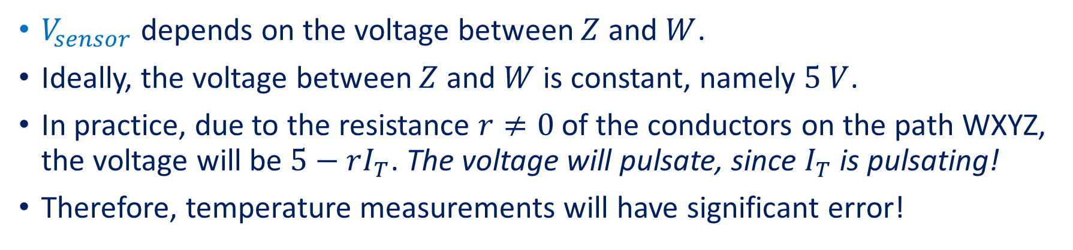
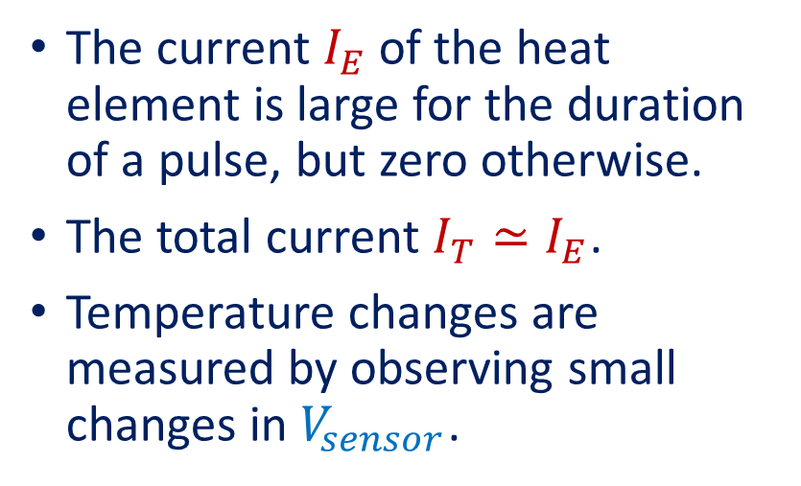
Example (Continued)
The current $I_{E}$ of the heat element is large for the duration of a pulse, but zero otherwise.
The total current $I_{T}≃I_{E}$.
Temperature changes are measured by observing small changes in $V_{sensor}$.
$V_{sensor}$ depends on the voltage between $Z$ and $W$.
Ideally, the voltage between $Z$ and $W$ is constant, namely $5 V$.
In practice, due to the resistance $r≠0$ of the conductors on the path WXYZ, the voltage will be $5−rI_{T}$. The voltage will pulsate, since $I_{T}$ is pulsating!
Therefore, temperature measurements will have significant error!
Notes:
therm-c1.fig

Slide 22
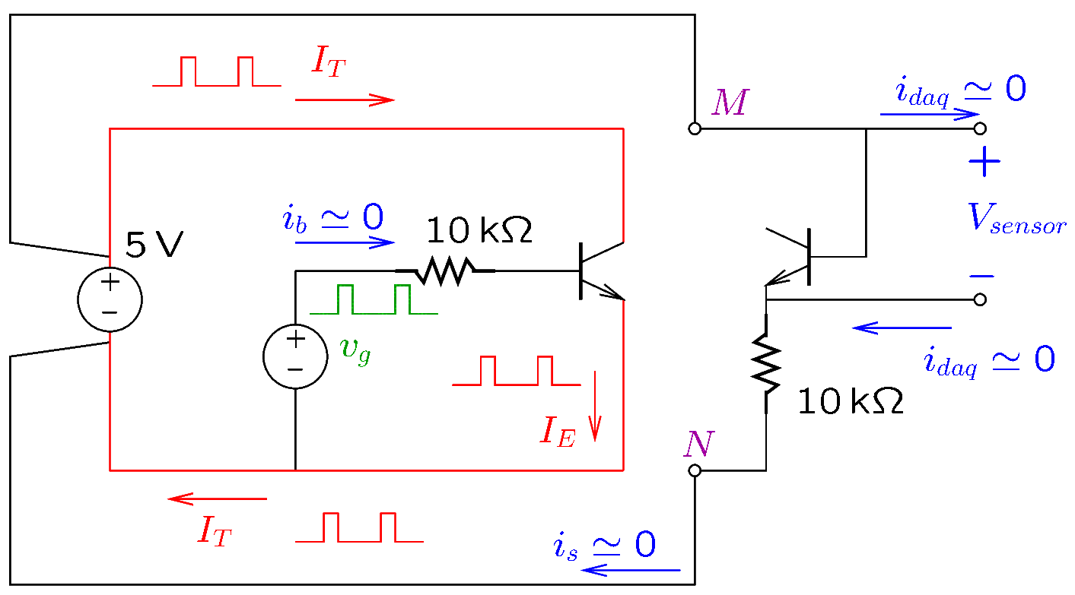
Example (Continued)
A possible solution is to ensure that the sensor network does not use any of the conductors of the heat element (shown in red).
To avoid interference, conductors that carry large amounts of current should not be part of a low-voltage network.
Notes:
therm-c2.fig

