Slide 1
Pulses. Triggering.
M.V. Iordache, EEGR2051 Circuits and Measurements Lab, Fall 2020, LeTourneau University
See https://mviordache.name/EEGR2051 for more information.

Slide 2
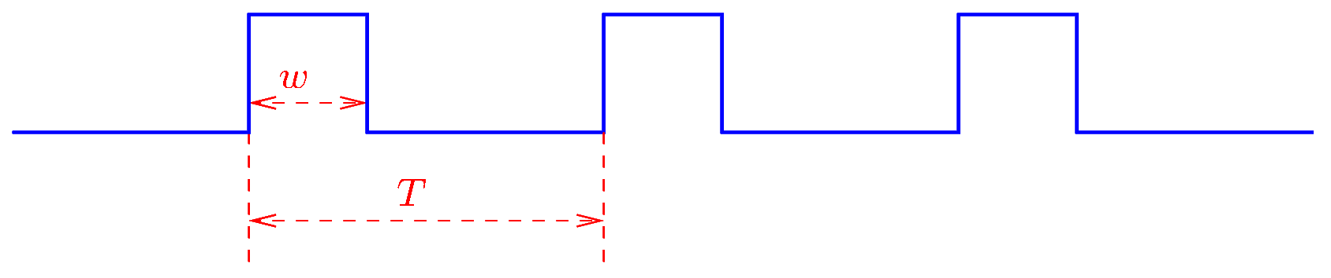
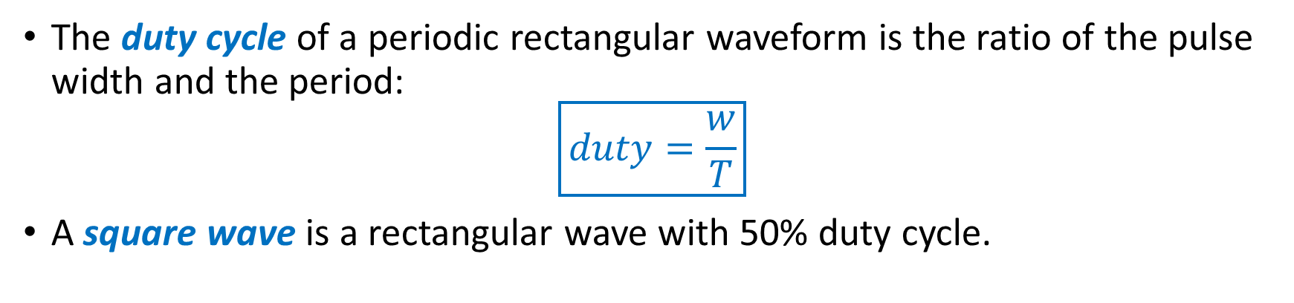
Rectangular Waveforms
The duty cycle of a periodic rectangular waveform is the ratio of the pulse width and the period:
$$\boxed{duty=\frac{w}{T}}$$
A square wave is a rectangular wave with 50% duty cycle.
Notes:
duty.png

Slide 3
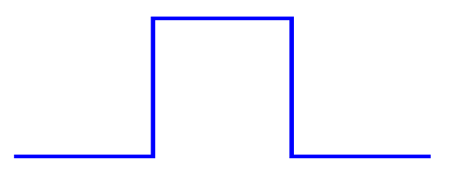
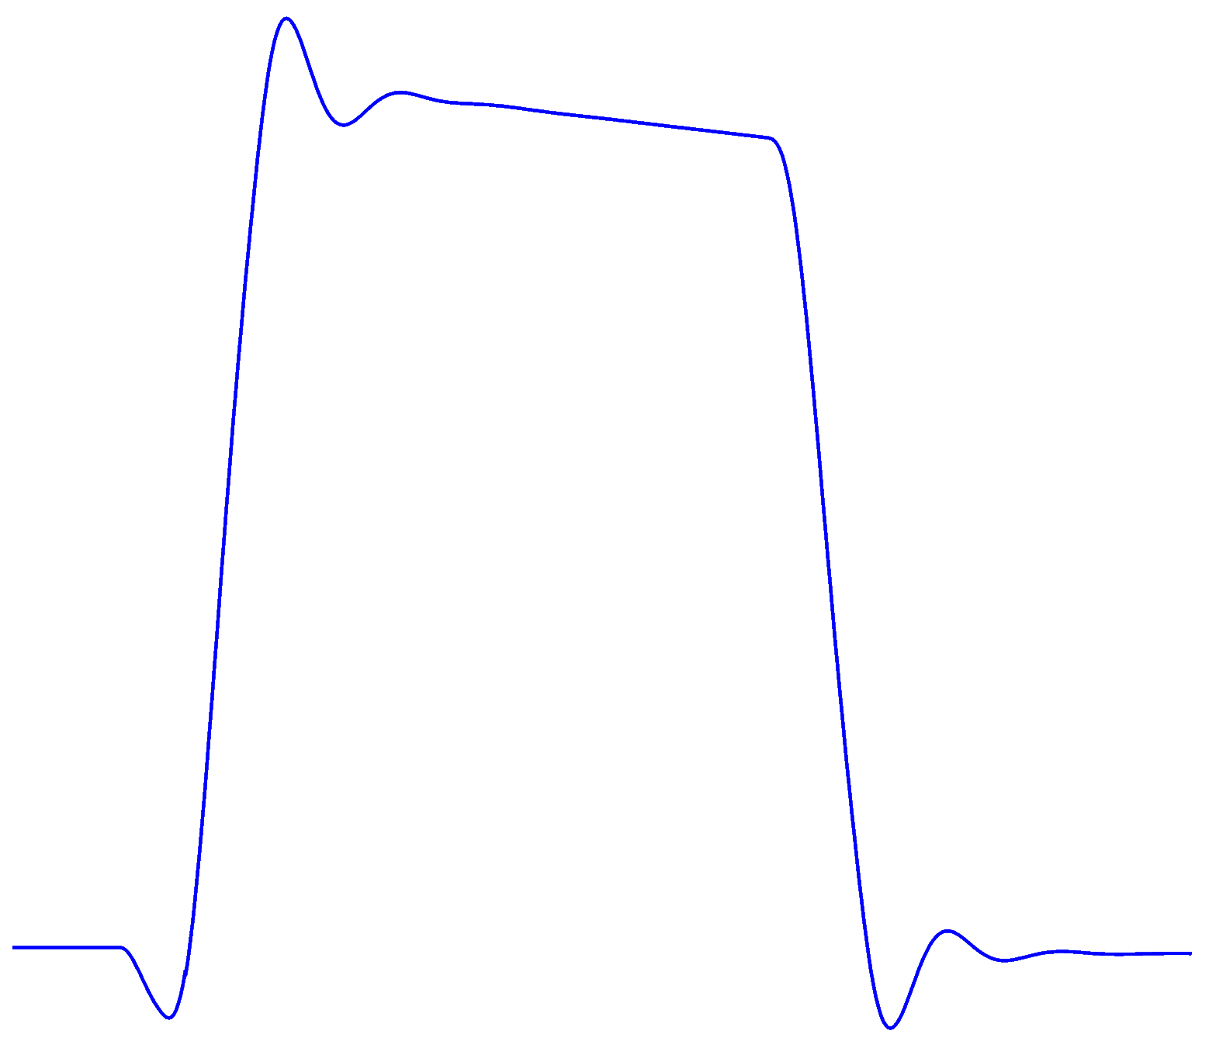
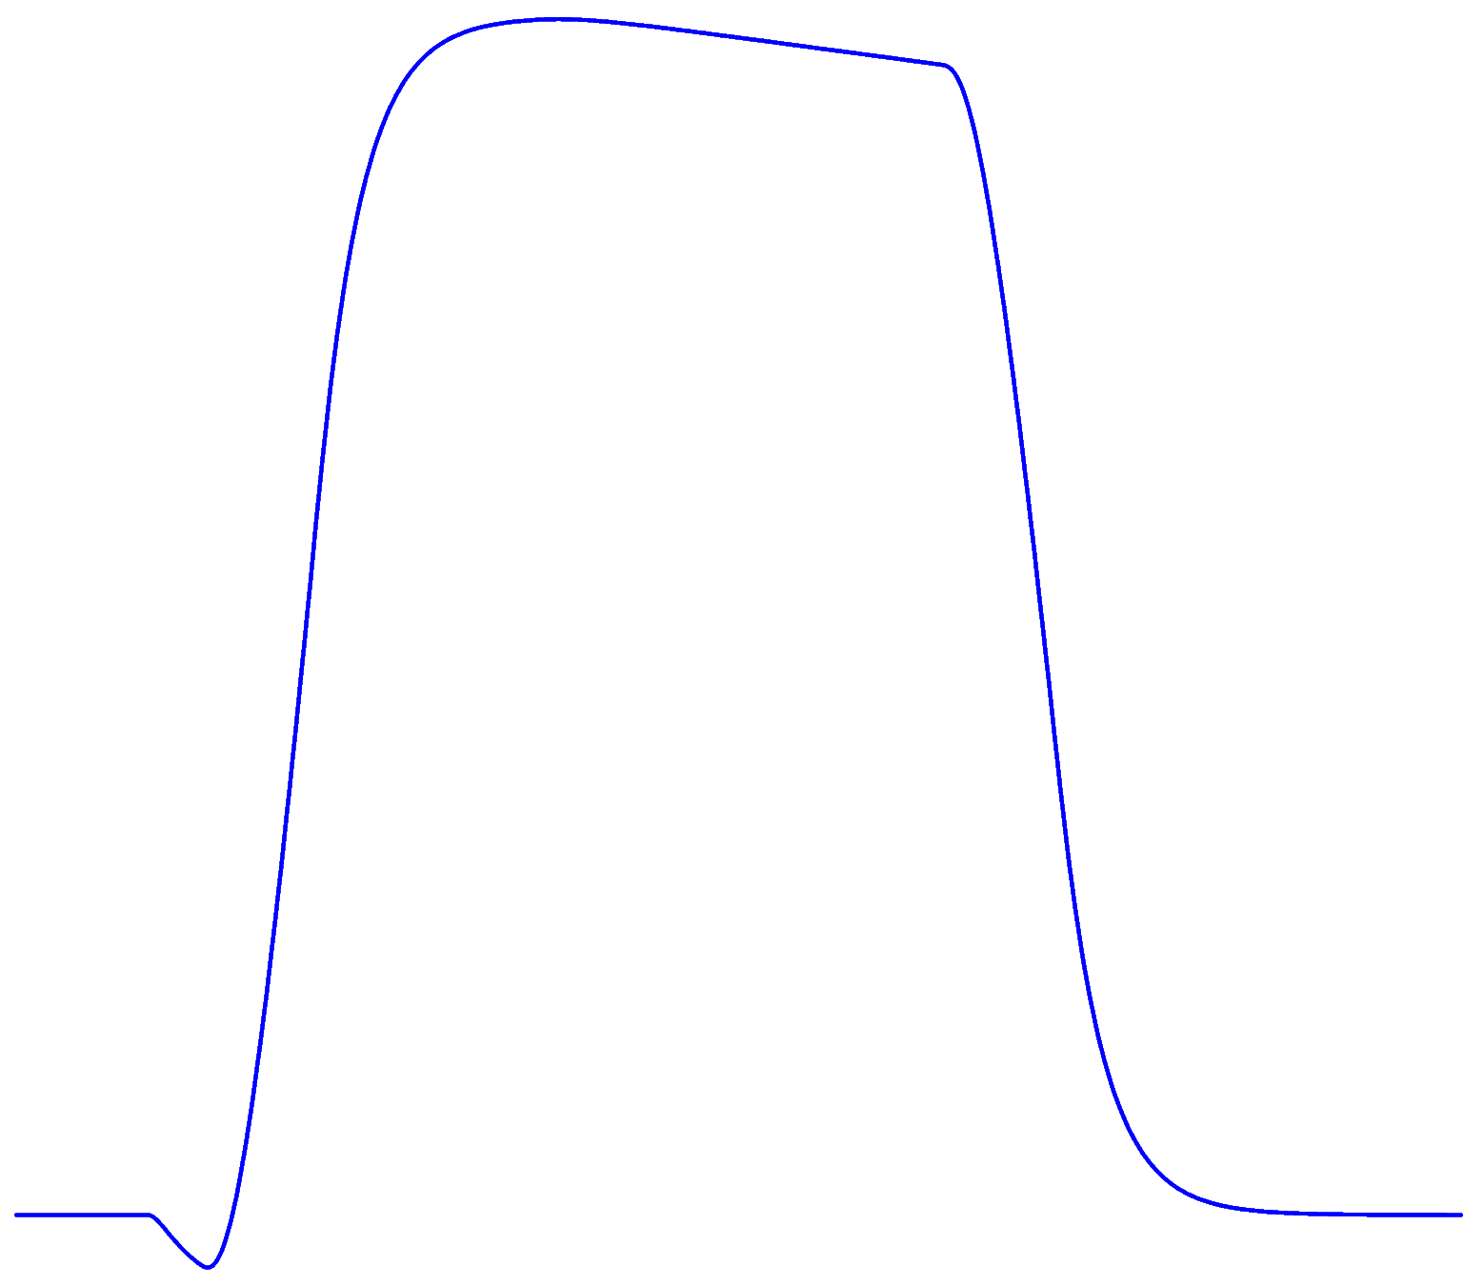
Pulses
Ideally, pulses have vertical edges.
In practice:
Edges are not vertical.
Pulses exhibit ringing or rounding.
Notes:
pulse.fig actualpulse1.fig actualpulse2.fig

Slide 4
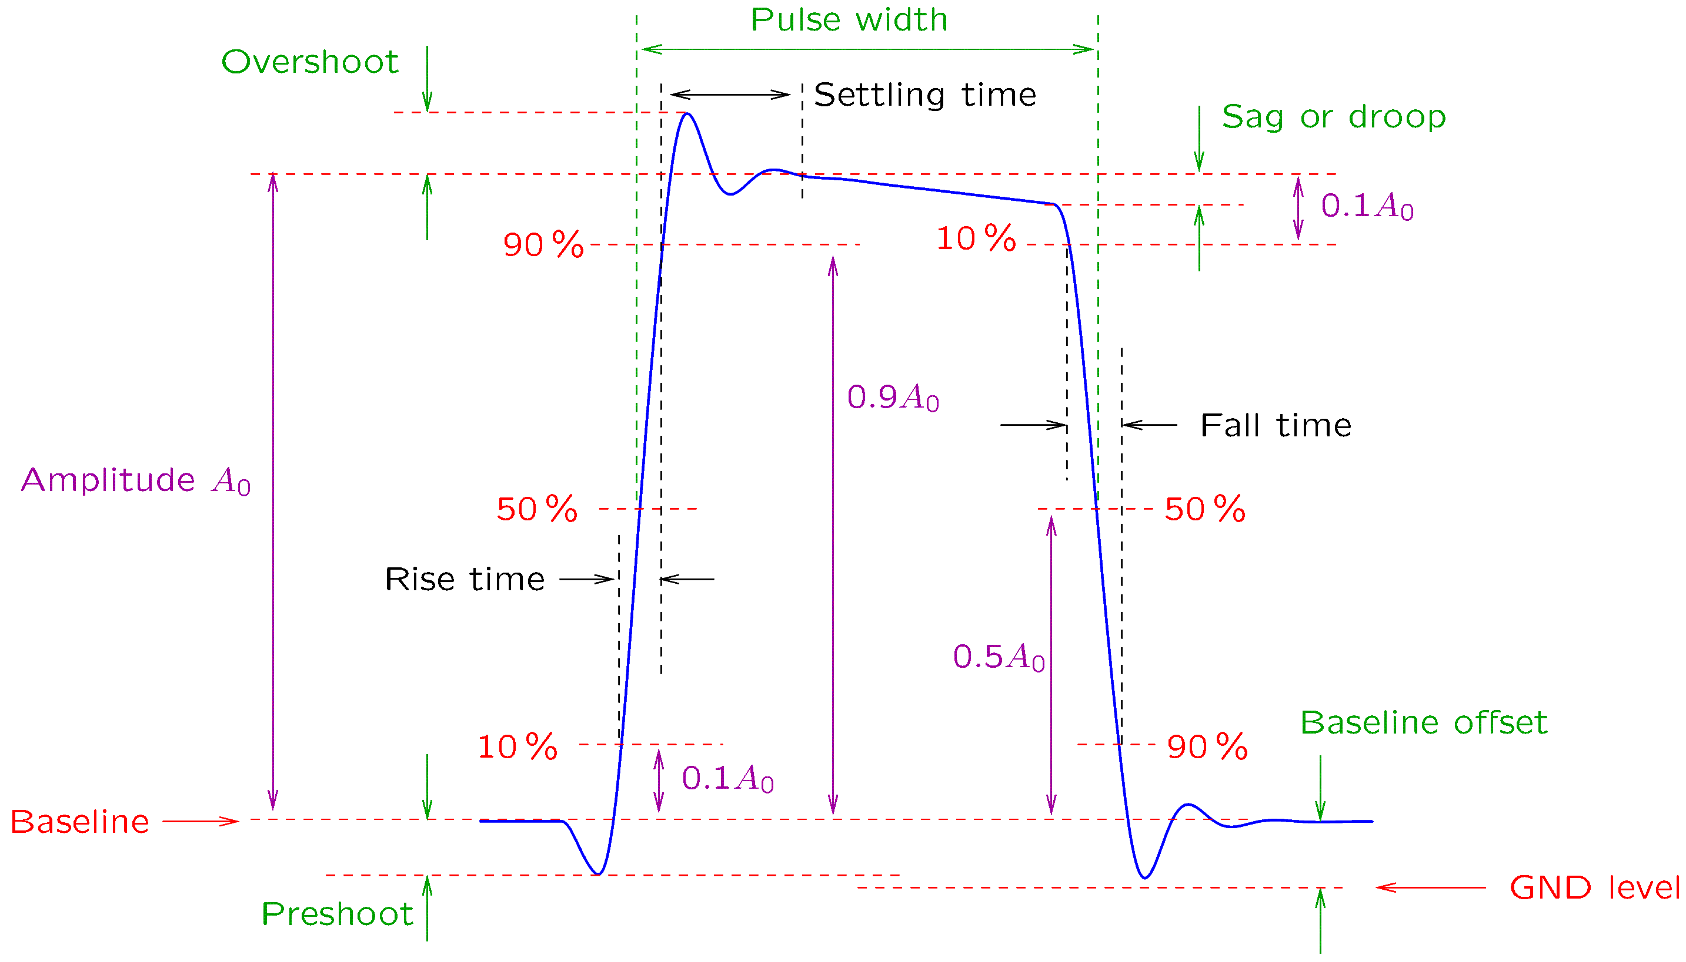
Pulse Parameters
Notes:
actualpulse3.fig

Slide 5
Pulse Parameters
Note that:
Amplitude is measured between the baseline and the level at which the signal settles (before the droop).
Pulse width is measured between the 50% points of the rising and falling edges.
Rise time and fall time are measured between the 10% and 90% levels of the signal.

Slide 6
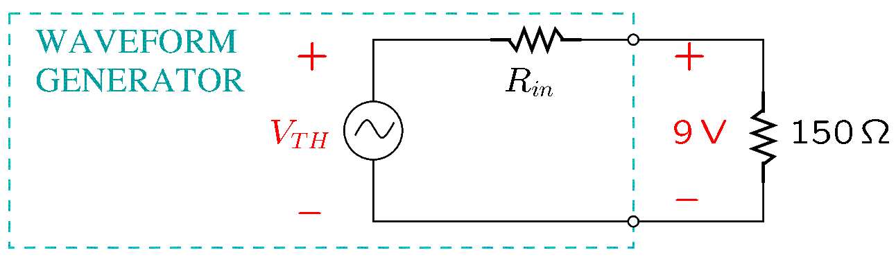
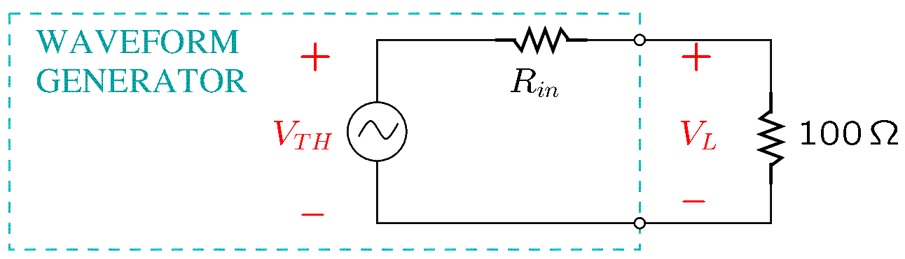
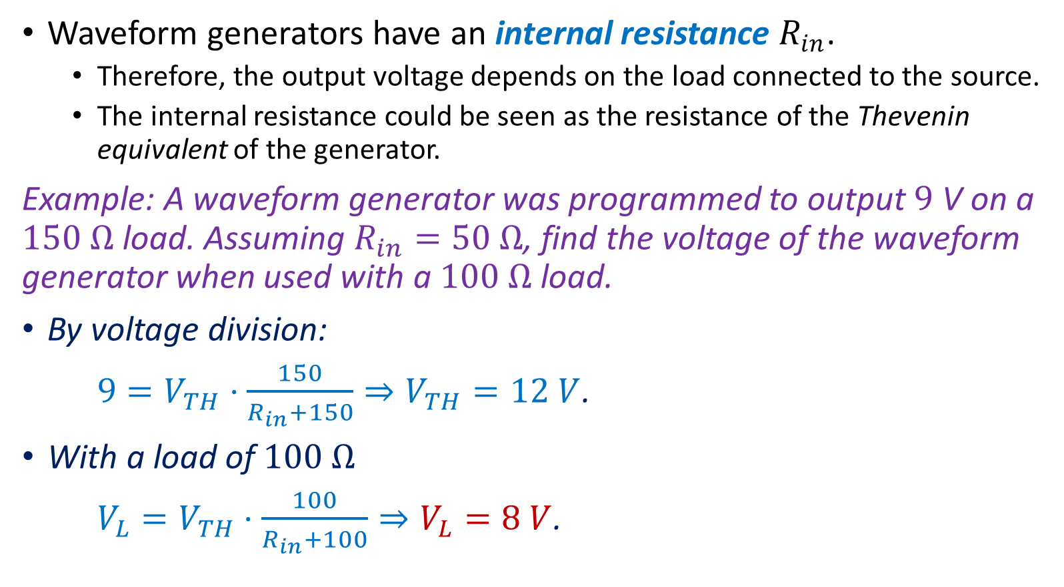
Waveform Generators
Waveform generators have an internal resistance $R_{in}$.
Therefore, the output voltage depends on the load connected to the source.
The internal resistance could be seen as the resistance of the Thevenin equivalent of the generator.
Example: A waveform generator was programmed to output $9$V on a $150 Ω$ load. Assuming $R_{in}=50 Ω$, find the voltage of the waveform generator when used with a $100 Ω$ load.
By voltage division:
$9=V_{TH}⋅\frac{150}{R_{in}+150}⇒V_{TH}=12 V$.
With a load of $100 Ω$
$V_{L}=V_{TH}⋅\frac{100}{R_{in}+100}⇒V_{L}=8 V$.
Notes:
wgen3.fig and wgen2.fig

Slide 7
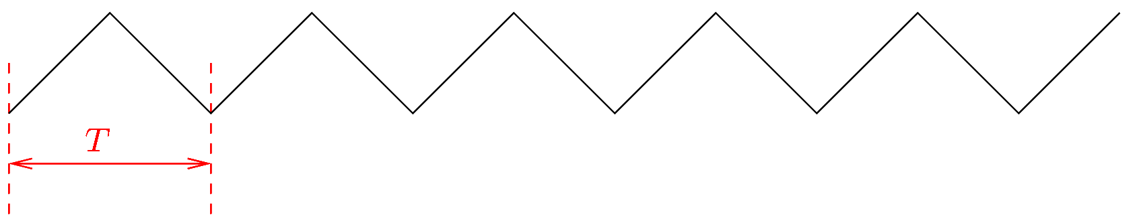
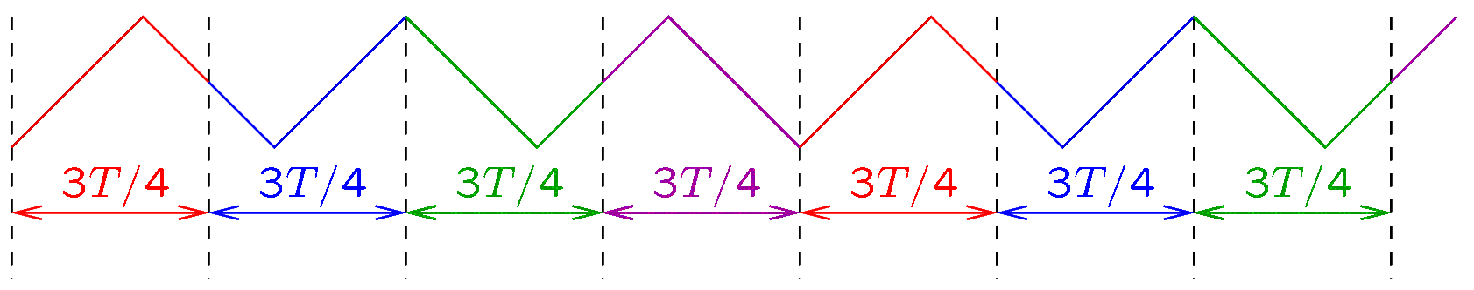
Triggering
Suppose that an oscilloscope should display the following signal of period $T$.
Suppose that the oscilloscope refreshes the screen periodically, once for every time interval of length $3T/4$.
Notes:
trig1.fig trig2.fig

Slide 8
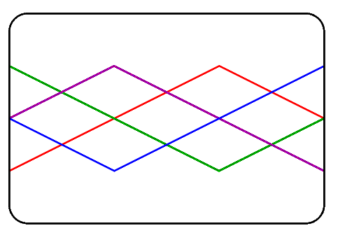
Triggering
Suppose that the oscilloscope displays each $3T/4$ segment as it is, from the left end of the screen to its right end.
The screen will appear to display several overlapping signals, though only one signal is actually present at the input!
Notes:
trig2.fig trig4.fig

Slide 9
Triggering
To obtain the correct image, the oscilloscope should refresh the screen by starting always with the same point of the signal.
This can be achieved by means of triggering.
The oscilloscope uses a trigger signal in order to display signals consistently on the screen.
The trigger signal may be:
One of the signals that is to be displayed (such as the signal of channel 1 or 2).
Some other external signal that is synchronous with the signals to be displayed.
Edge triggering is one of the most common triggering methods.
In edge triggering, the oscilloscope uses an internal DC voltage, called trigger level, and monitors the instances in which the trigger signal intersects the trigger level.
Notes:
trig2.fig trig4.fig

Slide 10
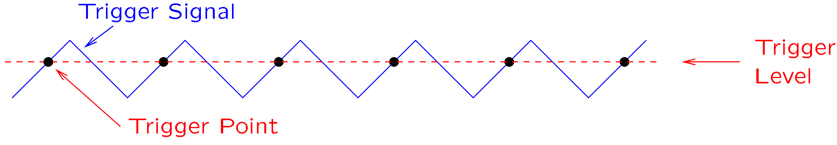
Edge Triggering
In edge triggering, the user must select the kind of edges used for triggering.
The options are:
Rising edges (positive slope).
Falling edges (negative slope)
Any edges (both rising and falling).
A trigger point is an instance in which the selected edge of the trigger signal intersects the trigger level.
For example, note the intersection points when triggering on rising edges:
Notes:
trig5.fig

Slide 11
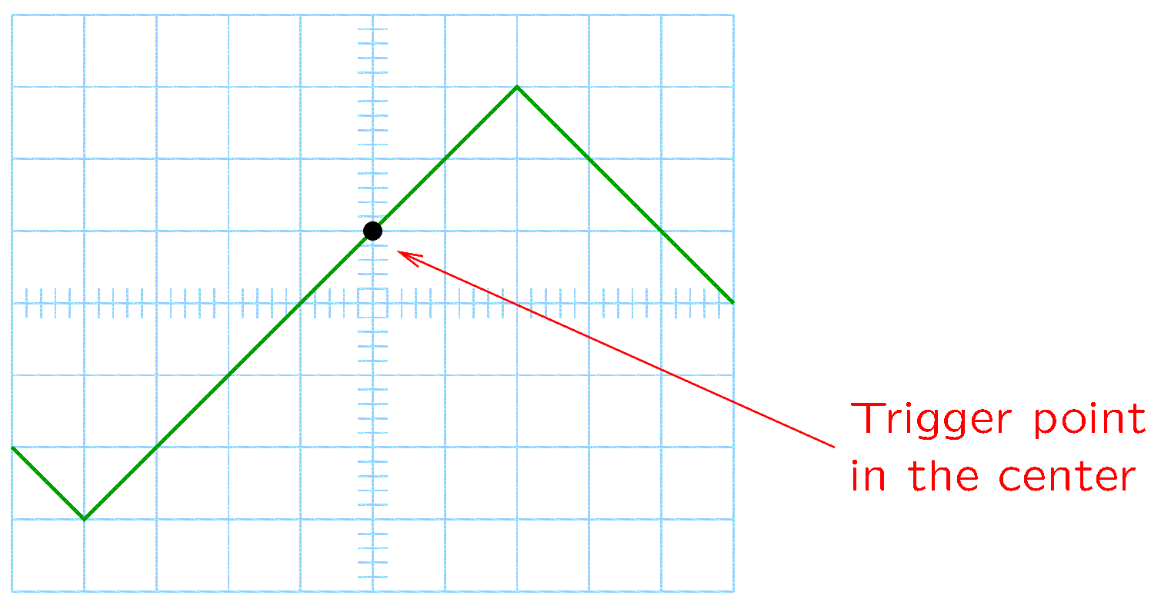
Edge Triggering
By default, the oscilloscope centers horizontally the image so that the trigger point is in the center.
If the trigger signal is displayed, the trigger point will be in the center:
Notes:
trig5.fig trig6.fig

Slide 12
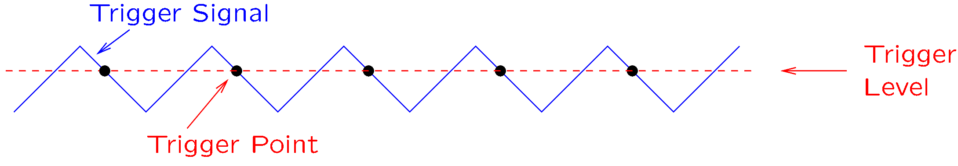
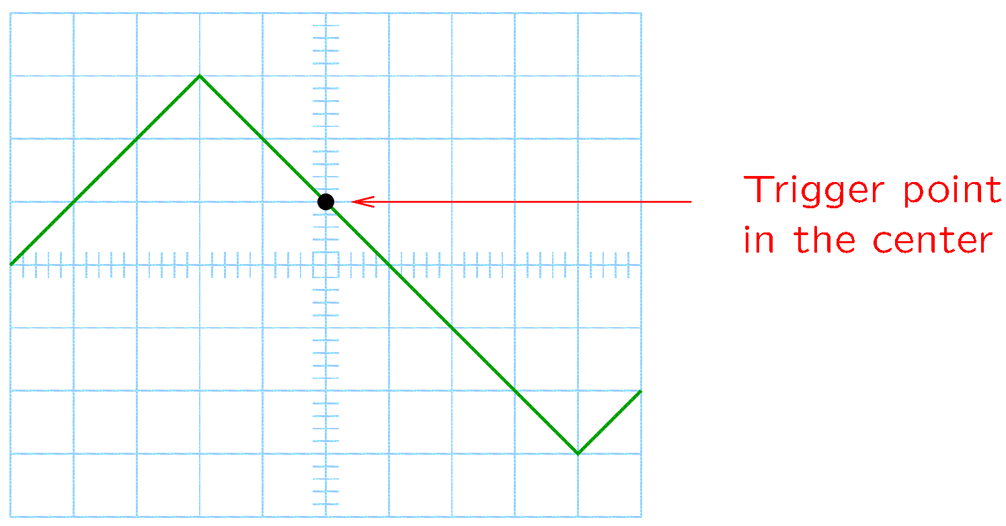
Edge Triggering
Assuming now triggering on falling edges:
Notes:
trig7.fig trig8.fig

Slide 13
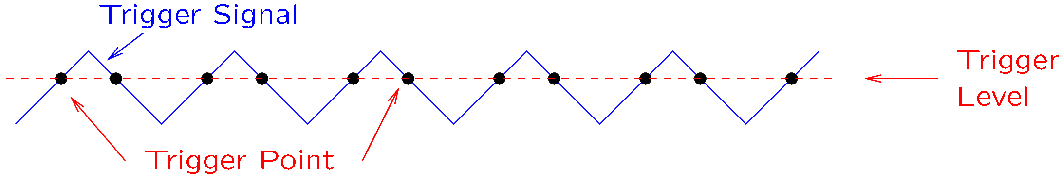
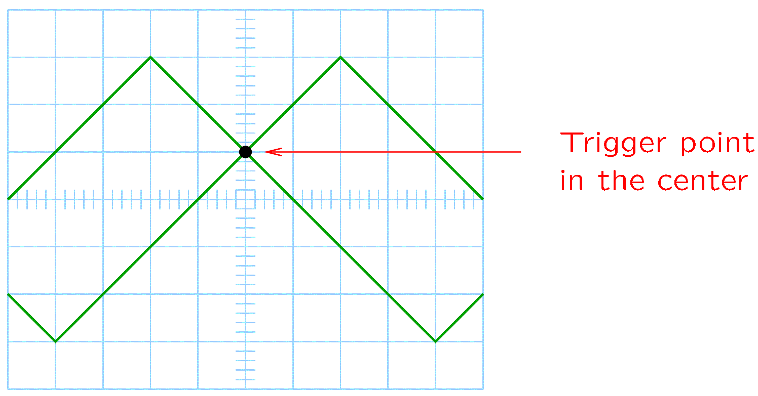
Edge Triggering
If both rising and falling edges are selected, the oscilloscope will trigger on either edge and both curves may be displayed at the same time.
Notes:
trig9.fig triga.fig

Slide 14
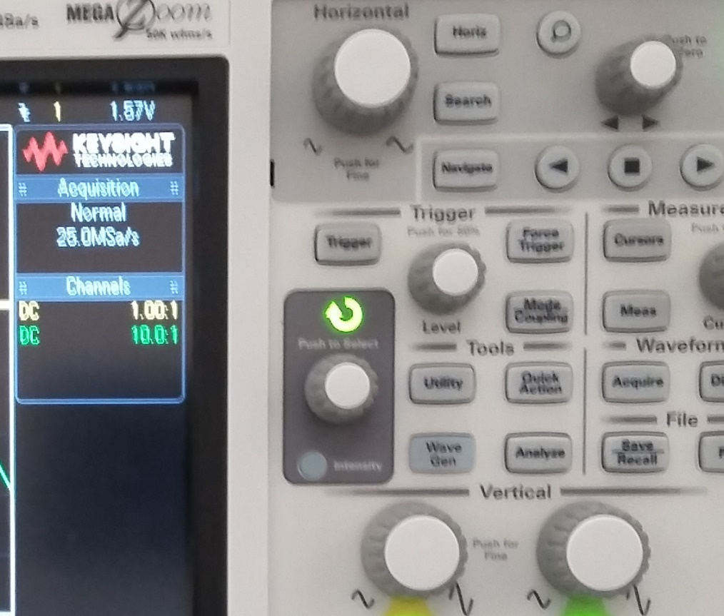
Triggering
Trigger mode, source, and level are displayed in the upper right corner.
The horizontal position of the trigger point can be adjusted with the horizontal position control.
Use the trigger menu to change the trigger mode and the trigger source.
The trigger level can be adjusted with the level control.
Notes:
trig9.fig triga.fig

Slide 15
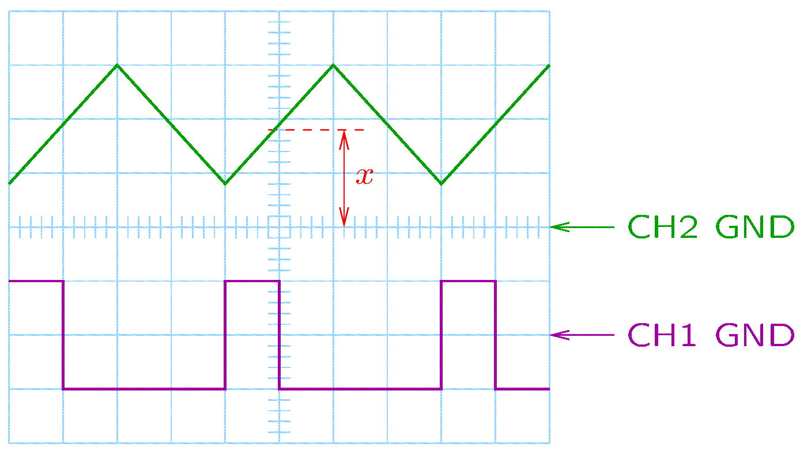
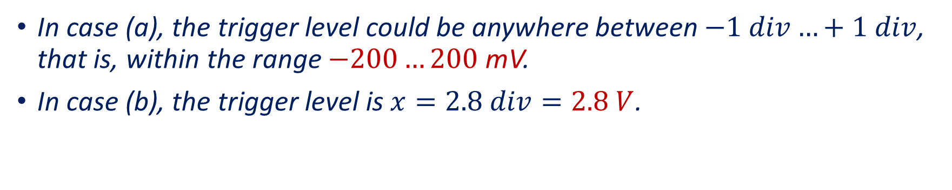
Example
CH1 has 200 mV/div and CH2 has 1 V/div. Indicate the trigger settings if:
CH1 is the trigger source.
CH2 is the trigger source.
Assuming the trigger point at the center, the oscilloscope triggers on
Falling edges (negative slope) in case (a).
Rising edges (positive slope) in case (b).
In case (a), the trigger level could be anywhere between $−1 div…+1 div$, that is, within the range $−200…200$ mV.
In case (b), the trigger level is $x=2.8 div=2.8 V$.
Notes:
trigb.fig

Slide 16
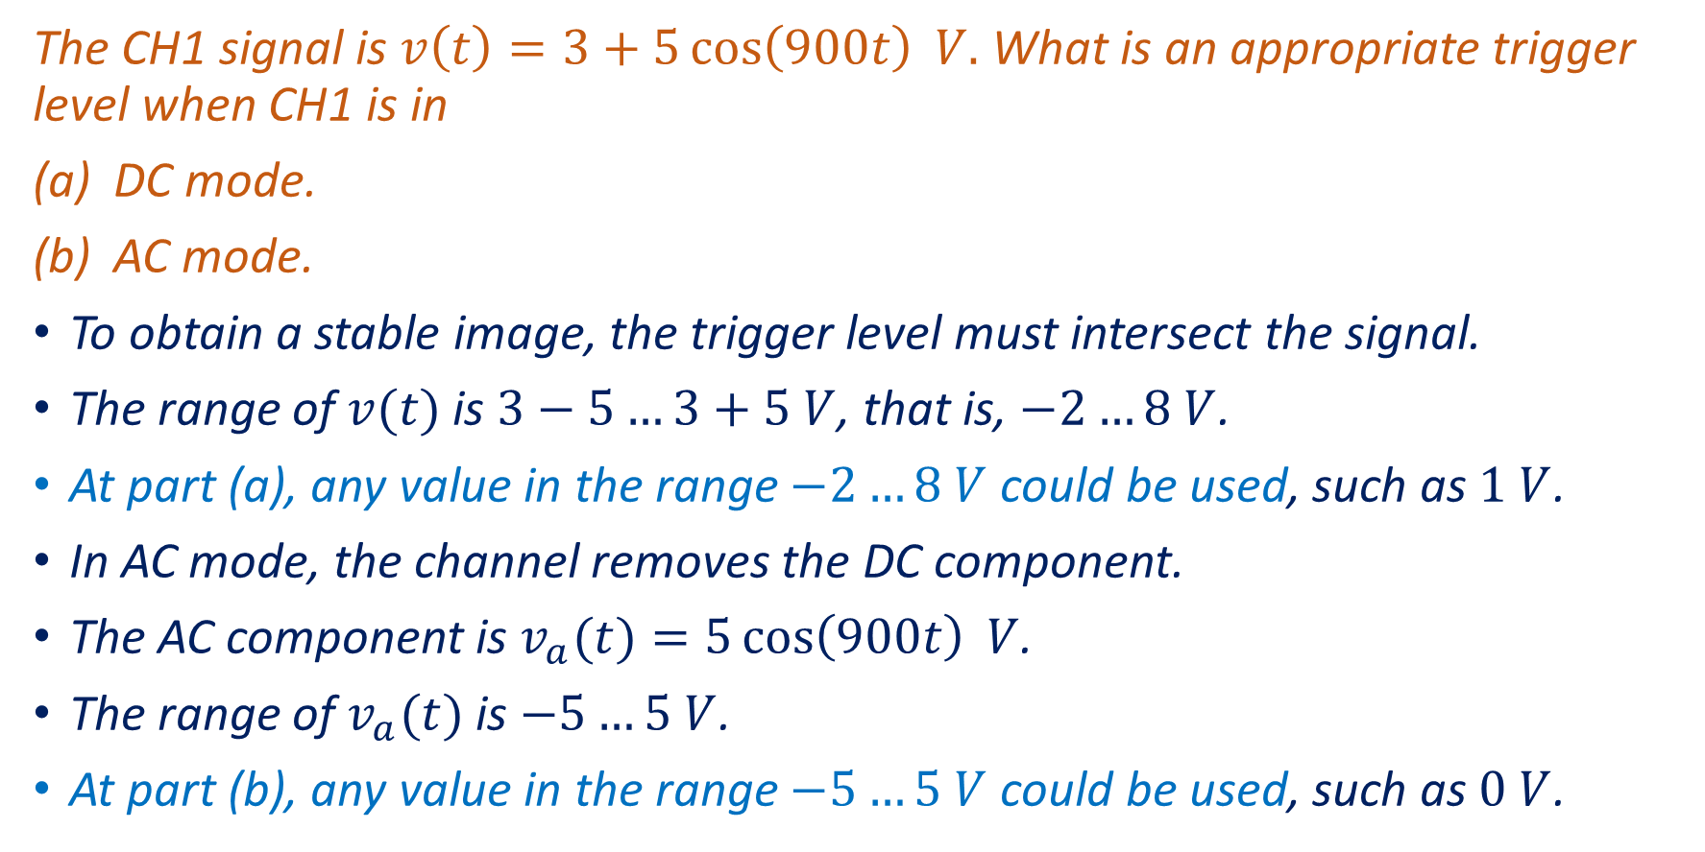
Example
The CH1 signal is $v\left(t\right)=3+5\cos\left(900t\right) V.$ What is an appropriate trigger level when CH1 is in
DC mode.
AC mode.
To obtain a stable image, the trigger level must intersect the signal.
The range of $v(t)$ is $3−5…3+5 V$, that is, $−2…8 V$.
At part (a), any value in the range $−2…8 V$ could be used, such as $1 V$.
In AC mode, the channel removes the DC component.
The AC component is $v_{a}(t)=5\cos\left(900t\right) V$.
The range of $v_{a}(t)$ is $−5…5 V$.
At part (b), any value in the range $−5…5 V$ could be used, such as $0 V$.

Slide 17
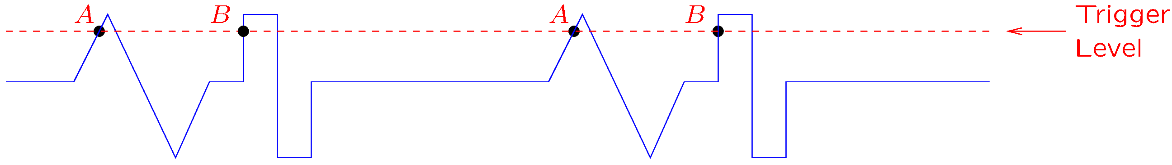
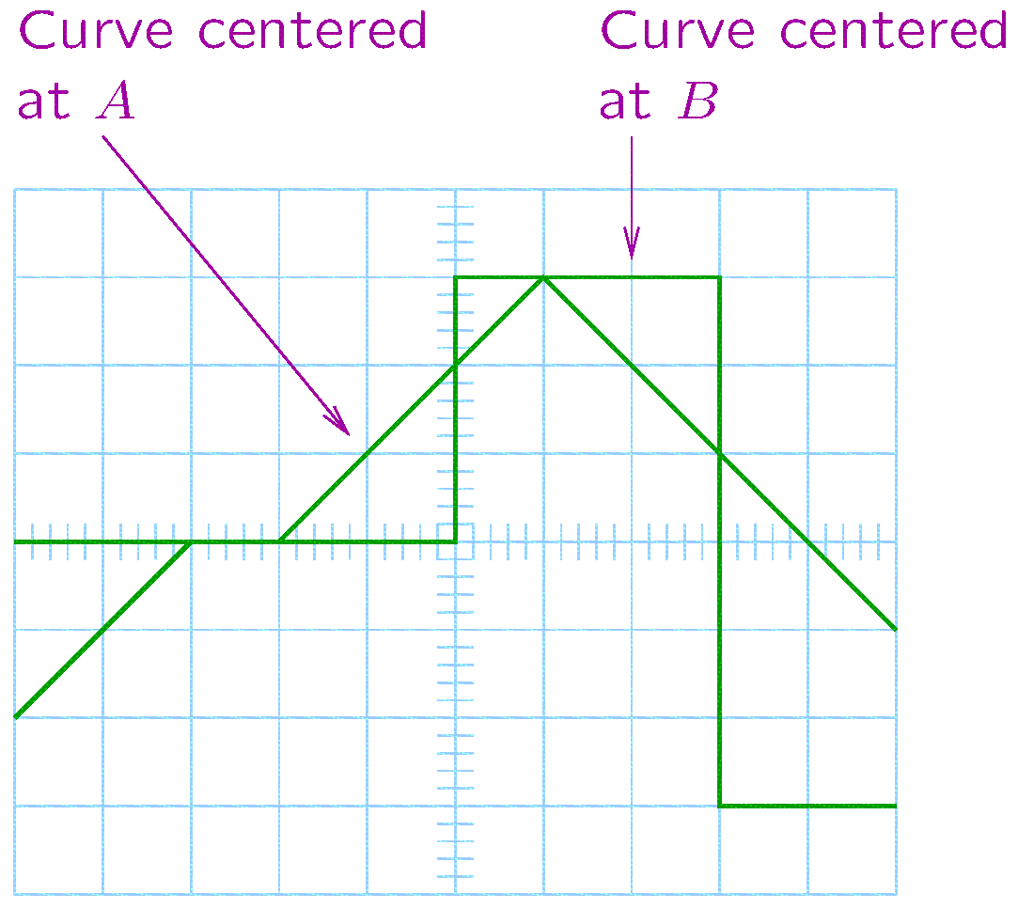
Triggering—The Holdoff Control
Suppose that the triangular part of the signal should be displayed.
The oscilloscope could trigger either at A or at B.
Two curves may be displayed at the same time:
One with A at the center.
One with B at the center.
Notes:
holdoff1.fig holdoff1d.fig

Slide 18
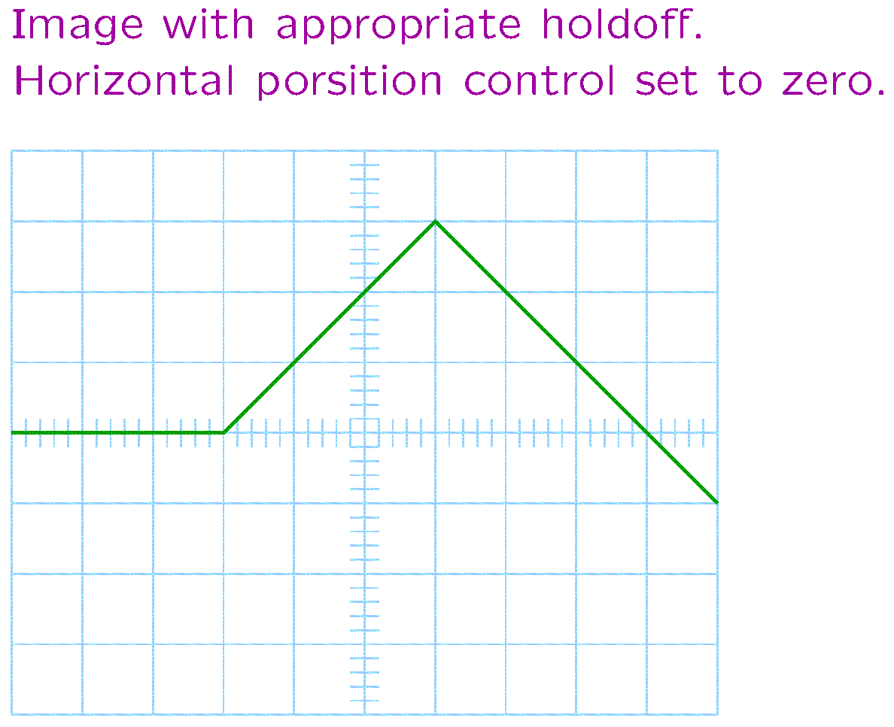
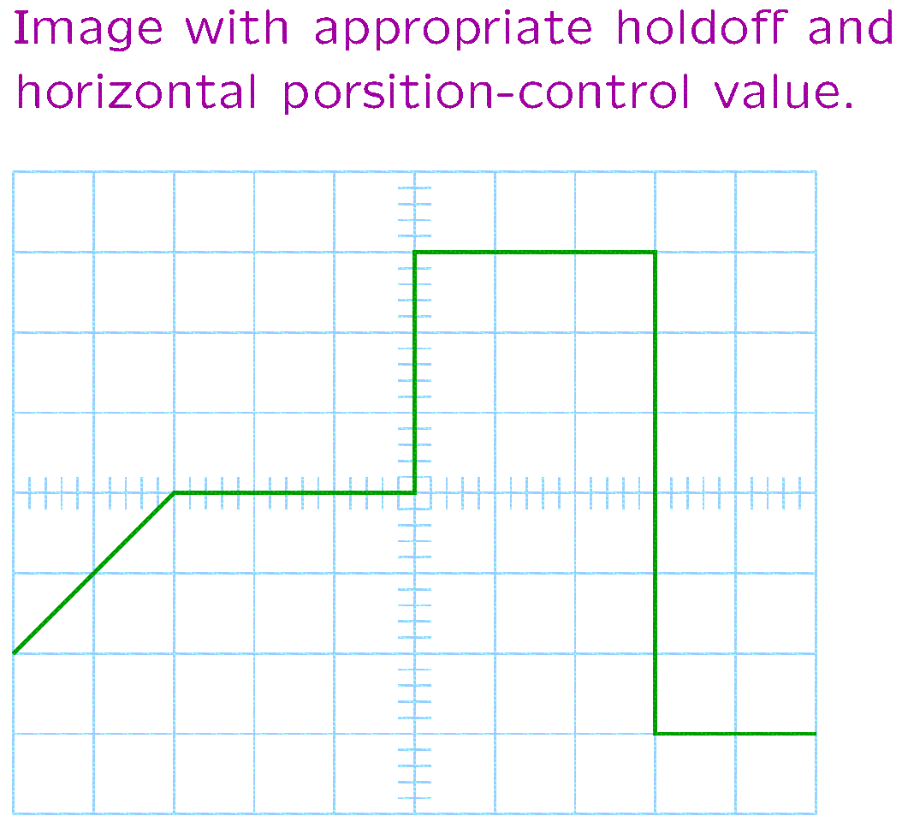
Triggering—The Holdoff Control
The holdoff is the amount of time the oscilloscope waits after a trigger before looking for another trigger point.
The holdoff control allows adjusting this amount of time.
In the previous example, the holdoff control could obtain the desired image.
Using the horizontal position control in addition to the holdoff, the rectangular part of the signal can also be displayed.
Notes:
holdoff1b.fig holdoff1a.fig

Slide 19
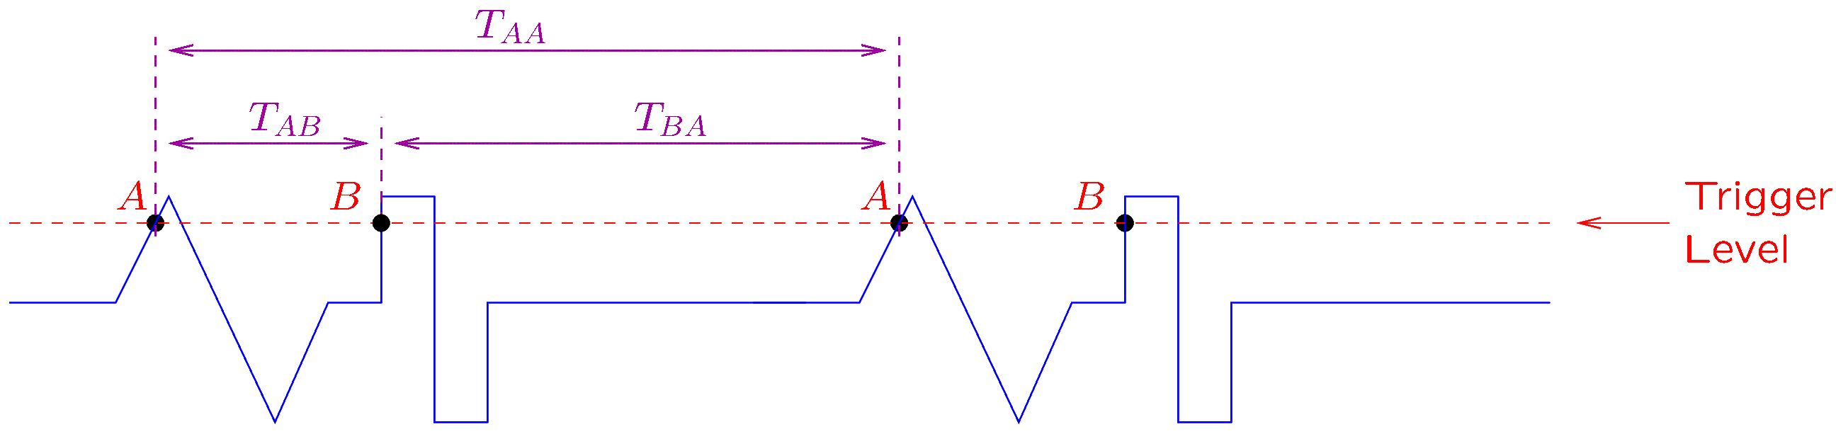
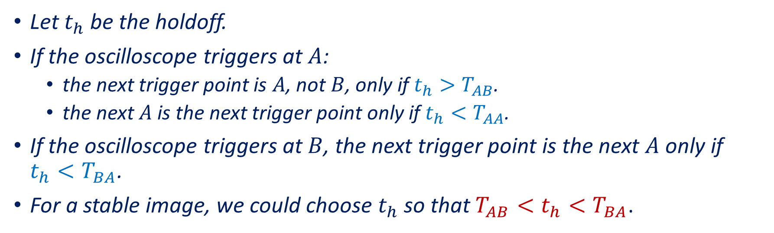
Holdoff Example
Let $t_{h}$ be the holdoff.
If the oscilloscope triggers at $A$:
the next trigger point is $A$, not $B$, only if $t_{h}>T_{AB}$.
the next $A$ is the next trigger point only if $t_{h}<T_{AA}$.
If the oscilloscope triggers at $B$, the next trigger point is the next $A$ only if $t_{h}<T_{BA}$.
For a stable image, we could choose $t_{h}$ so that $T_{AB}<t_{h}<T_{BA}$.
Notes:
holdoff2.fig

