Slide 1
Data Acquisition Systems
Analog to Digital Converters, Digital to Analog Converters, Operational Amplifiers
M.V. Iordache, EEGR2051 Circuits and Measurements Lab, Fall 2020, LeTourneau University
See https://mviordache.name/EEGR2051 for more information.

Slide 2
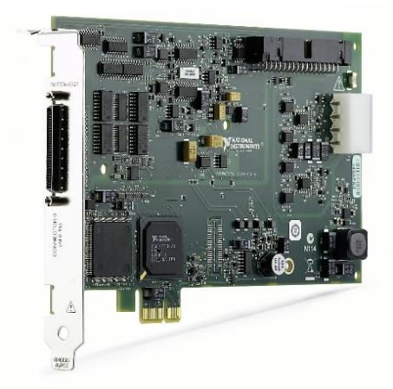
Interfacing Analog and Digital Systems
A multifunction I/O device, such as PCIe-6321 inside the lab computers, can
  Digitize analog signals from the physical world and transmit them to computer software (such as LabVIEW).
  Convert software-generated digital signals to physical analog signals.
Some of the most important components needed to interface computers to the physical world are:
  Analog to digital converters.
  Digital to analog converters.
  Electronic amplifiers.
PCIe-6321 from National Instruments
https://www.ni.com/en-us/support/model.pcie-6321.html

Slide 3
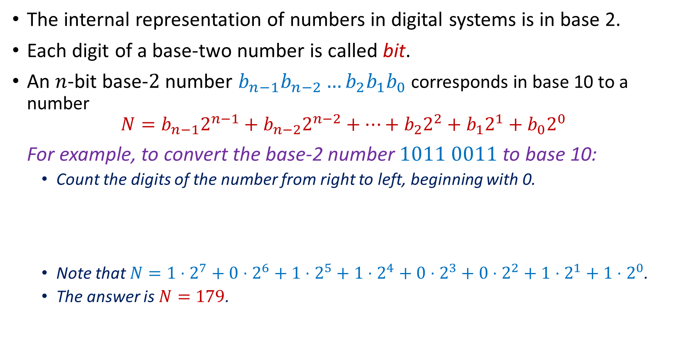
Number Representation
The internal representation of numbers in digital systems is in base 2.
Each digit of a base-two number is called bit.
An $n$-bit base-$2$ number $b_{n−1}b_{n−2}…b_{2}b_{1}b_{0}$ corresponds in base 10 to a number
$$N={b_{n−1}2}^{n−1}+b_{n−2}2^{n−2}+…+b_{2}2^{2}+b_{1}2^{1}+b_{0}2^{0}$$
For example, to convert the base-2 number $1011 0011$ to base 10:
  Count the digits of the number from right to left, beginning with 0.
  Note that $N=1⋅2^{7}+0⋅2^{6}+1⋅2^{5}+1⋅2^{4}+0⋅2^{3}+0⋅2^{2}+1⋅2^{1}+1⋅2^{0}$.
  The answer is $N=179$.
7 | 6 | 5 | 4 | 3 | 2 | 1 | 0
1 | 0 | 1 | 1 | 0 | 0 | 1 | 1

Slide 4
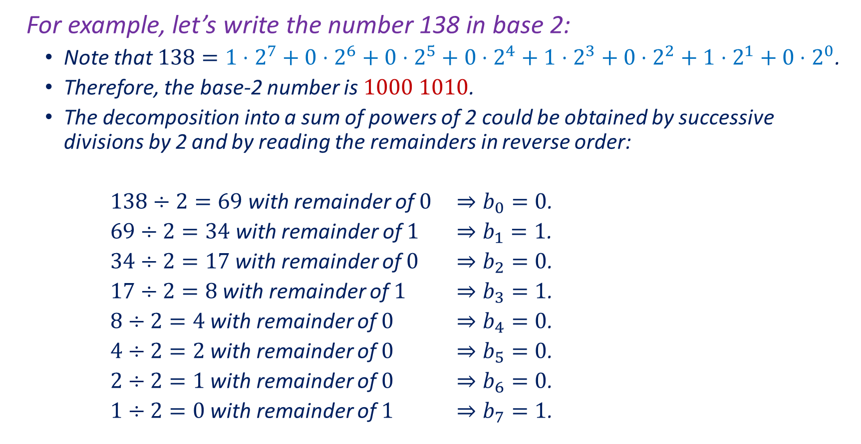
Number Representation
For example, let’s write the number 138 in base 2:
  Note that $138={1⋅2}^{7}+0⋅2^{6}+0⋅2^{5}+0⋅2^{4}+1⋅2^{3}+0⋅2^{2}+1⋅2^{1}+0⋅2^{0}$.
  Therefore, the base-2 number is $1000 1010$.
  The decomposition into a sum of powers of 2 could be obtained by successive divisions by 2 and by reading the remainders in reverse order:
  $138÷2=69$with remainder of $0$ $⇒b_{0}=0$.
  $69÷2=34$with remainder of $1$ $⇒b_{1}=1$.
  $34÷2=17$ with remainder of $0$ $⇒b_{2}=0$.
  $17÷2=8$ with remainder of $1$ $⇒b_{3}=1$.
  $8÷2=4$ with remainder of $0$ $⇒b_{4}=0$.
  $4÷2=2$ with remainder of $0$ $⇒b_{5}=0$.
  $2÷2=1$ with remainder of $0$ $⇒b_{6}=0$.
  $1÷2=0$ with remainder of $1$ $⇒b_{7}=1$.

Slide 5
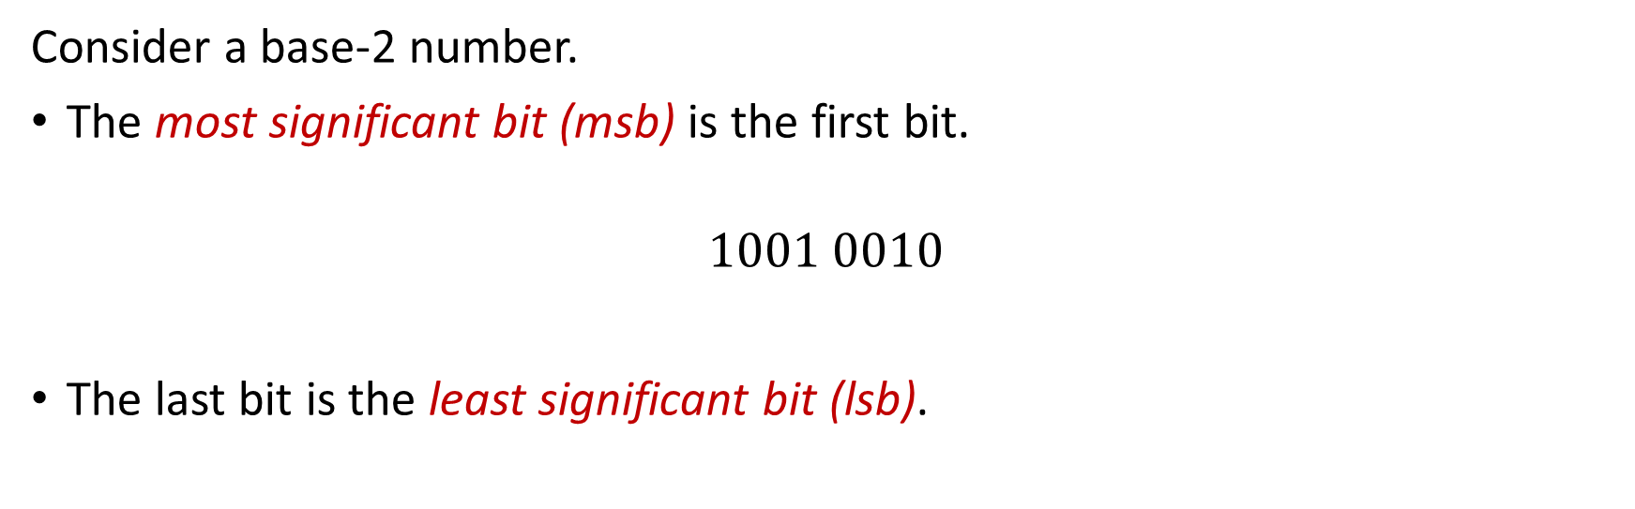
Number Representation
Consider a base-2 number.
The most significant bit (msb) is the first bit.
$$1001 0010$$
The last bit is the least significant bit (lsb).

Slide 6
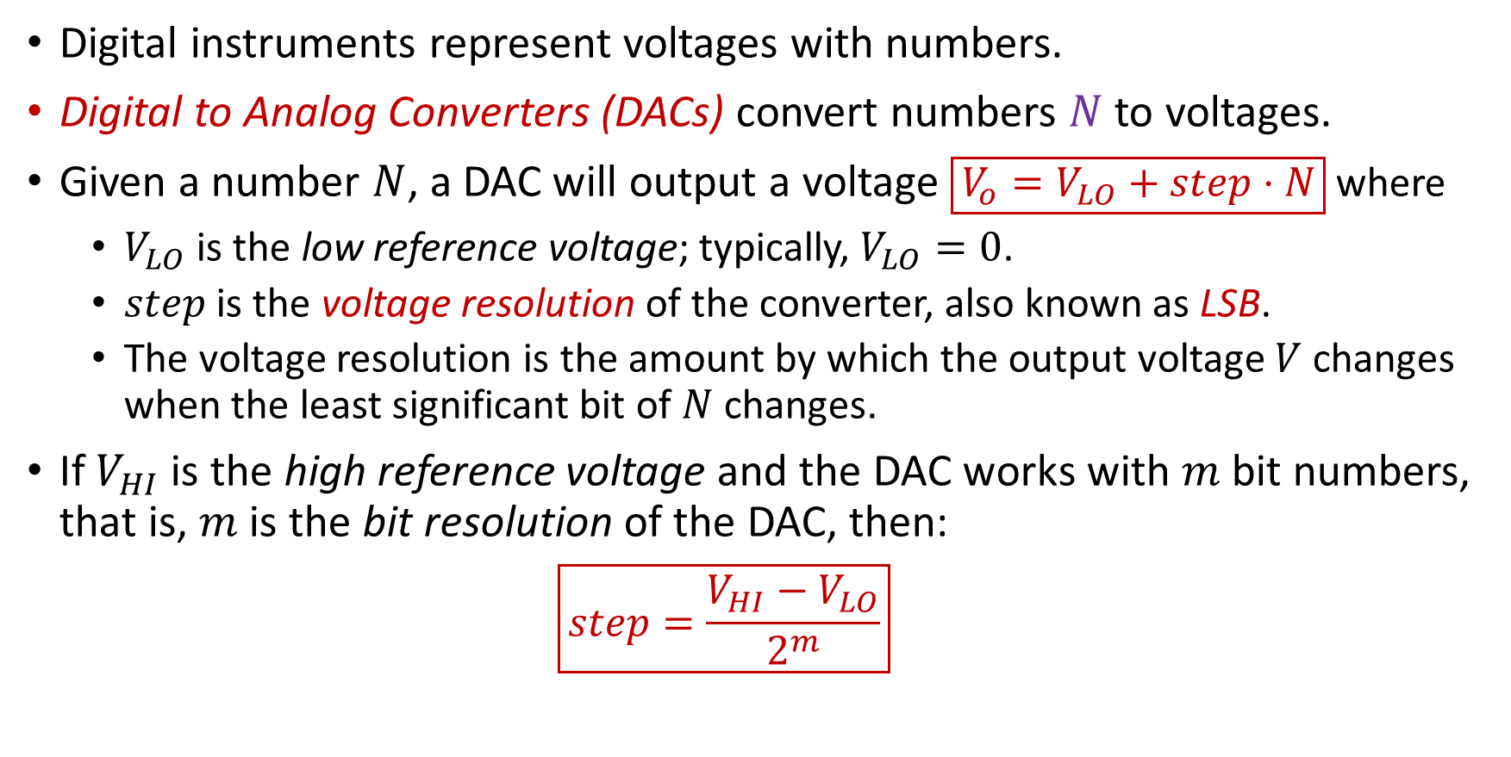
Digital to Analog Converters
Digital instruments represent voltages with numbers.
Digital to Analog Converters (DACs) convert numbers $N$ to voltages.
Given a number $N$, a DAC will output a voltage $\boxed{V_{o}=V_{LO}+step⋅N}$ where
  $V_{LO}$ is the low reference voltage; typically, $V_{LO}=0$.
  $step$ is the voltage resolution of the converter, also known as LSB.
  The voltage resolution is the amount by which the output voltage $V$ changes when the least significant bit of $N$ changes.
If $V_{HI}$ is the high reference voltage and the DAC works with $m$ bit numbers, that is, $m$ is the bit resolution of the DAC, then:
  $$\boxed{step=\frac{V_{HI}−V_{LO}}{2^{m}}}$$

Slide 7
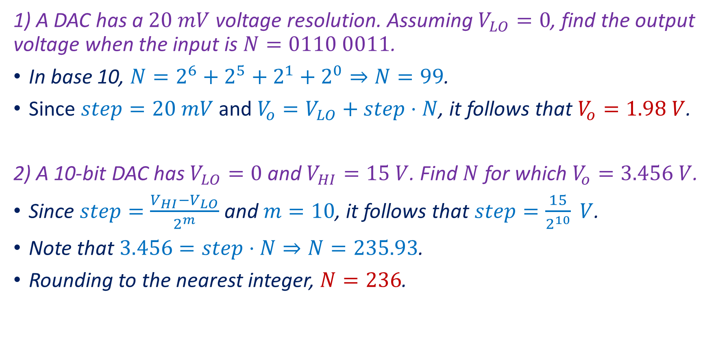
Examples
1) A DAC has a $20 mV$ voltage resolution. Assuming $V_{LO}=0$, find the output voltage when the input is $N=0110 0011$.
In base 10, $N=2^{6}+2^{5}+2^{1}+2^{0}⇒N=99$.
Since $step=20 mV$ and $V_{o}=V_{LO}+step⋅N$, it follows that $V_{o}=1.98 V$.
2) A 10-bit DAC has $V_{LO}=0$ and $V_{HI}=15 V$. Find $N$ for which $V_{o}=3.456 V$.
Since $step=\frac{V_{HI}−V_{LO}}{2^{m}}$ and $m=10$, it follows that $step=\frac{15}{2^{10}} V$.
Note that $3.456=step⋅N⇒N=235.93$.
Rounding to the nearest integer, $N=236$.

Slide 8
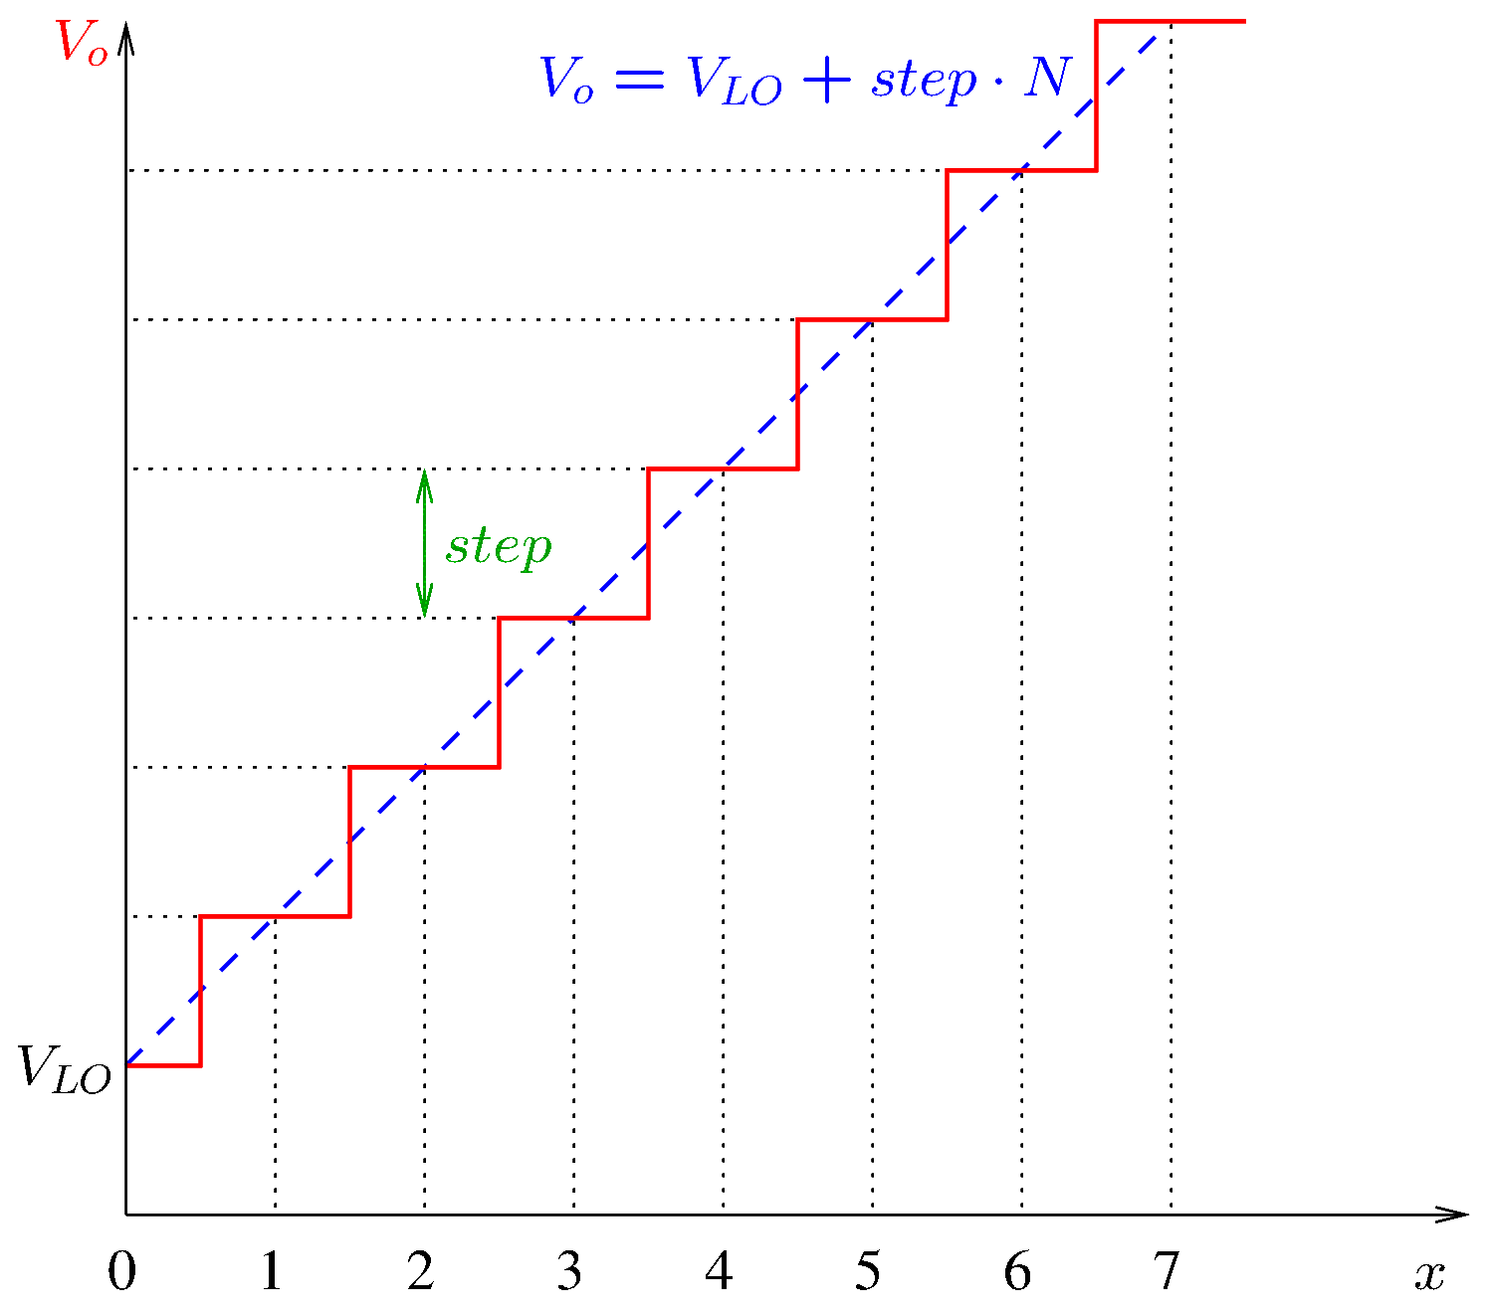
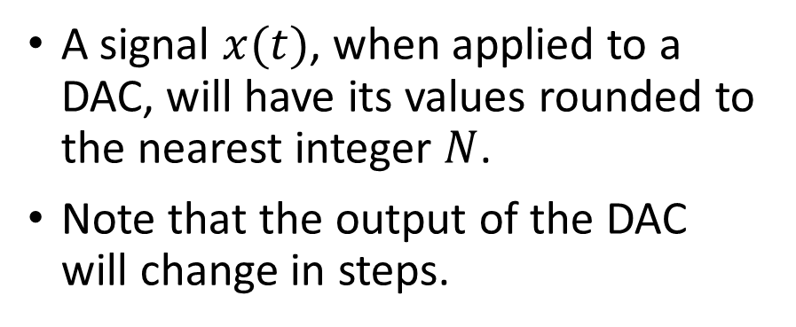
Digital to Analog Converters
A signal $x(t)$, when applied to a DAC, will have its values rounded to the nearest integer $N$.
Note that the output of the DAC will change in steps.
Notes:
dac.fig

Slide 9
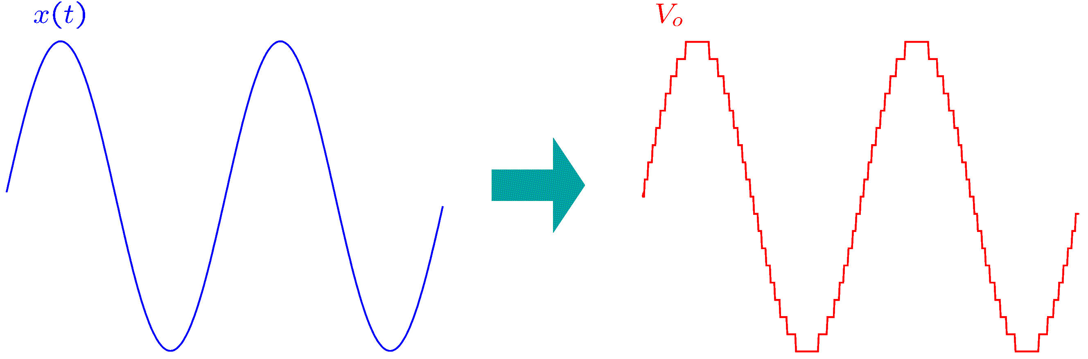
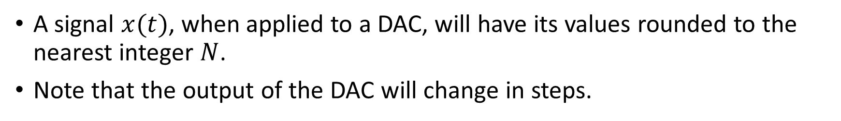
Digital to Analog Converters
A signal $x(t)$, when applied to a DAC, will have its values rounded to the nearest integer $N$.
Note that the output of the DAC will change in steps.
Notes:
dsine.fig

Slide 10
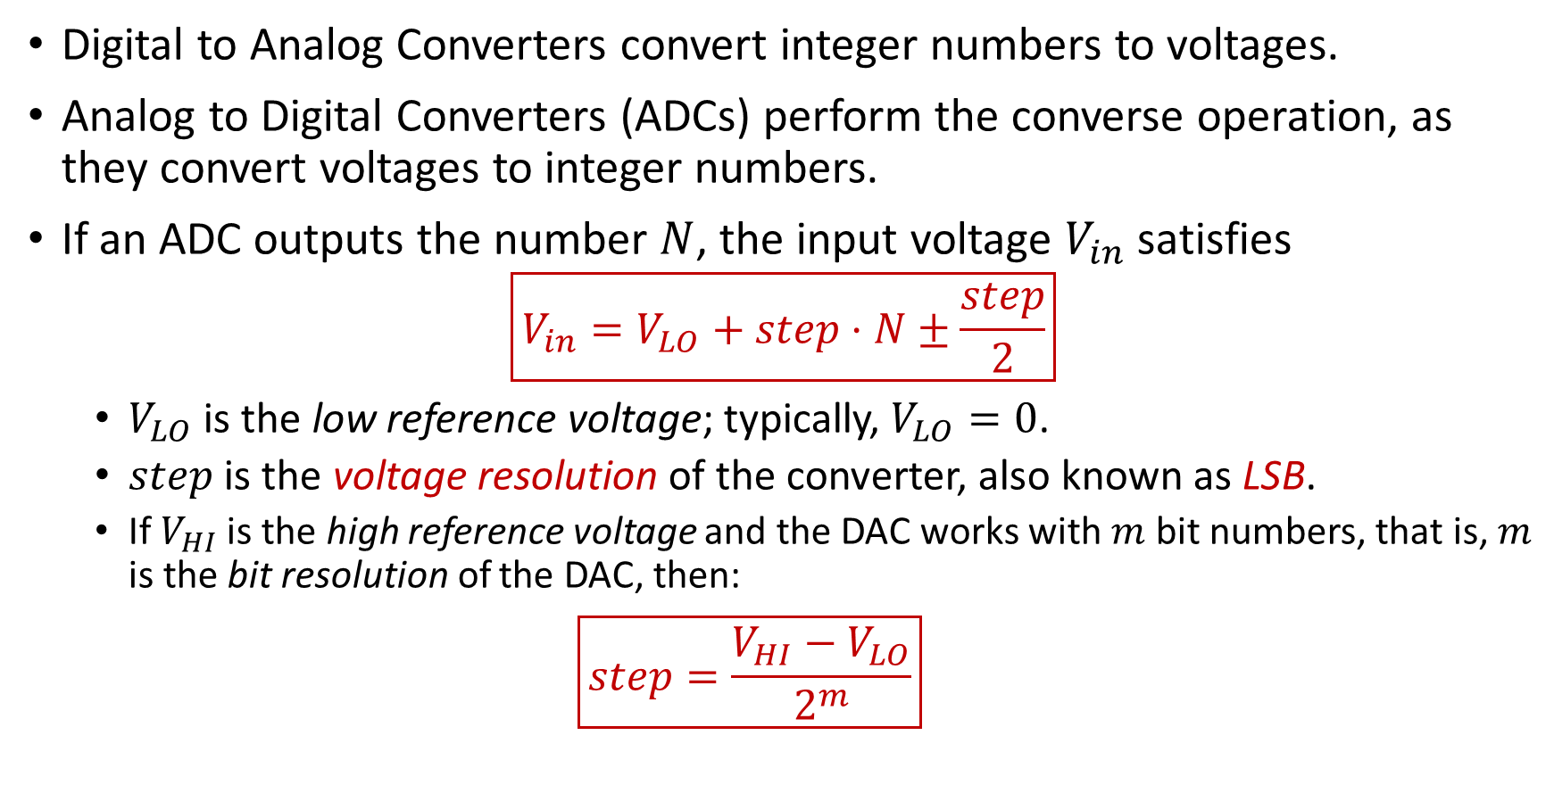
Analog to Digital Converters
Digital to Analog Converters convert integer numbers to voltages.
Analog to Digital Converters (ADCs) perform the converse operation, as they convert voltages to integer numbers.
If an ADC outputs the number $N$, the input voltage $V_{in}$ satisfies
$$\boxed{V_{in}=V_{LO}+step⋅N±\frac{step}{2}}$$
  $V_{LO}$ is the low reference voltage; typically, $V_{LO}=0$.
  $step$ is the voltage resolution of the converter, also known as LSB.
  If $V_{HI}$ is the high reference voltage and the DAC works with $m$ bit numbers, that is, $m$ is the bit resolution of the DAC, then:
  $$\boxed{step=\frac{V_{HI}−V_{LO}}{2^{m}}}$$

Slide 11
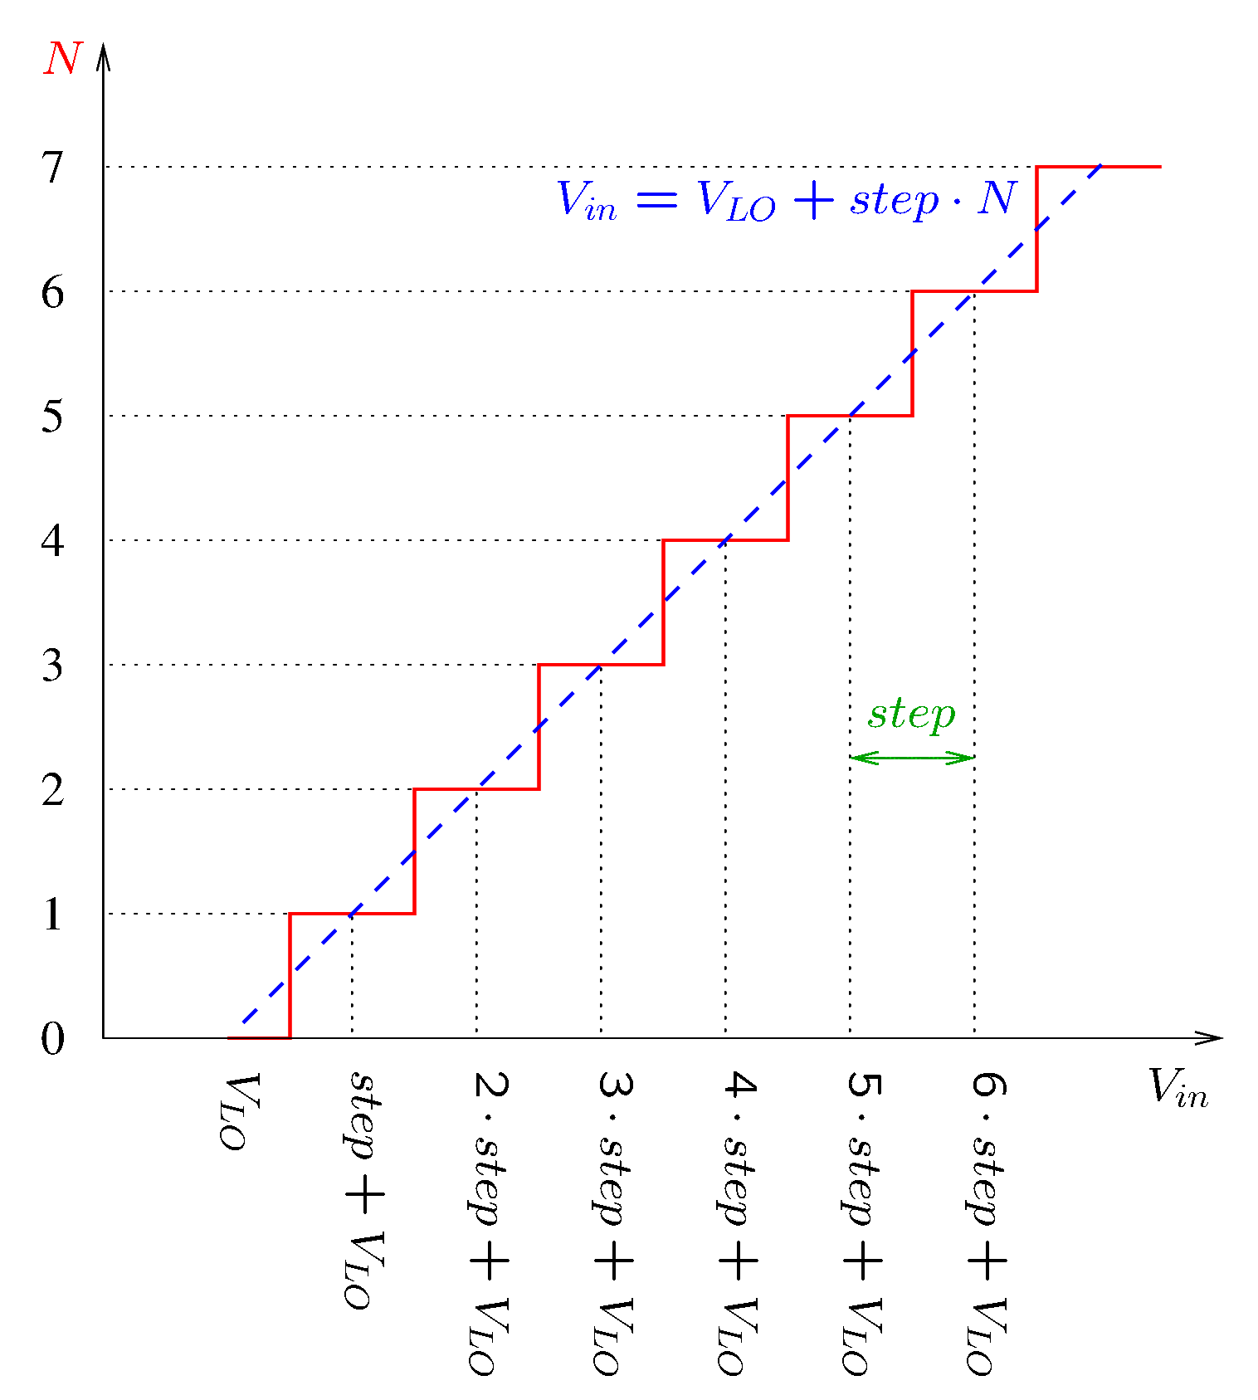
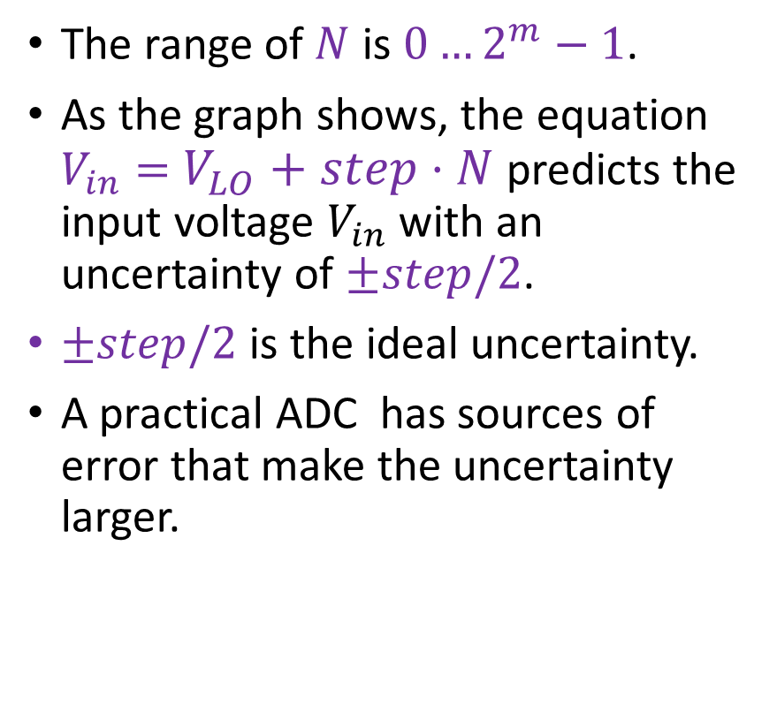
Analog to Digital Converters
The range of $N$ is $0…2^{m}−1$.
As the graph shows, the equation $V_{in}=$ $V_{LO}+step⋅N$ predicts the input voltage $V_{in}$ with an uncertainty of $±step/2$.
$±step/2$is the ideal uncertainty.
A practical ADC has sources of error that make the uncertainty larger.
Notes:
adc2.fig

Slide 12
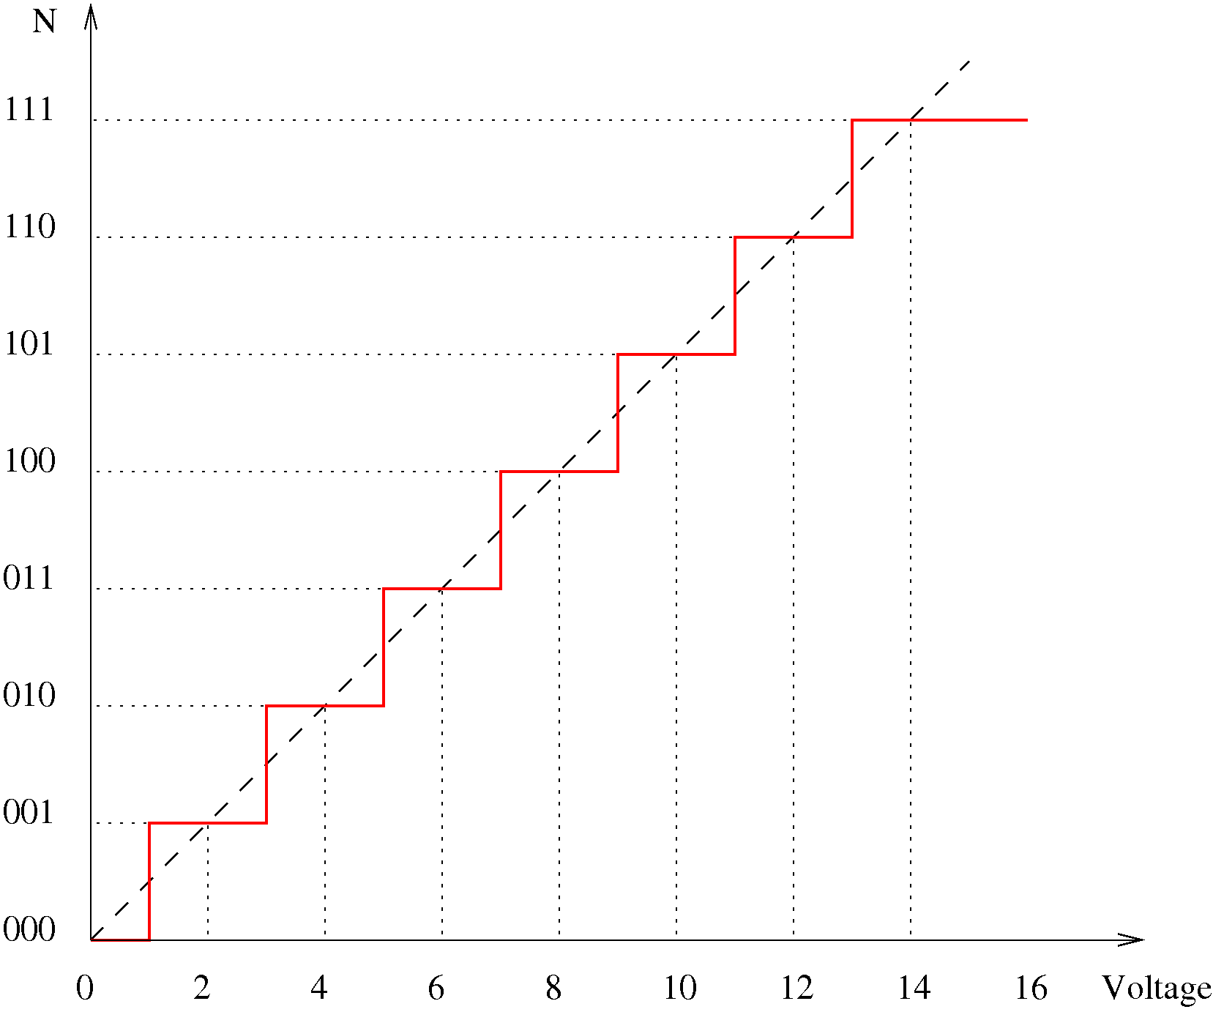
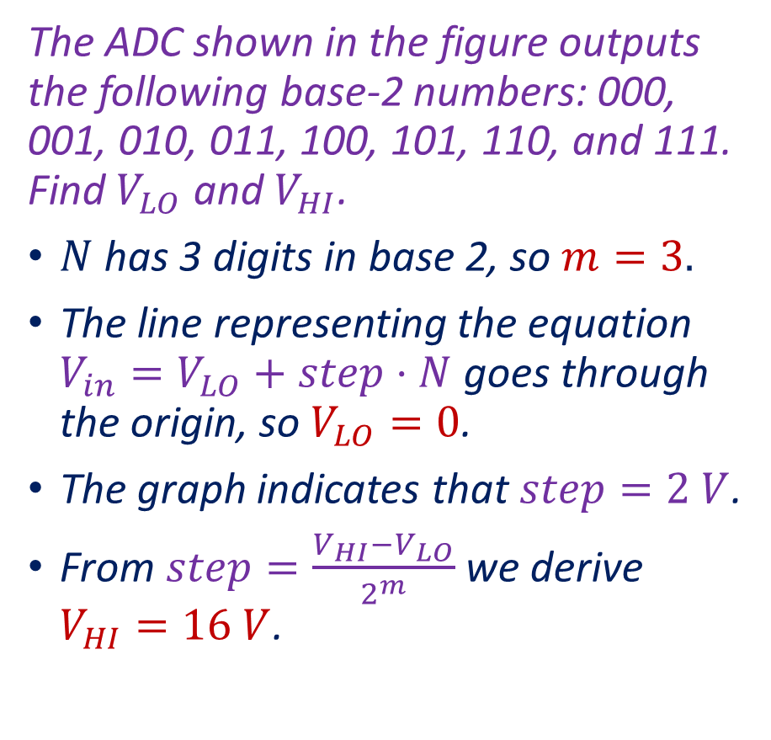
Example
The ADC shown in the figure outputs the following base-2 numbers: 000, 001, 010, 011, 100, 101, 110, and 111. Find $V_{LO}$ and $V_{HI}$.
$N$ has 3 digits in base 2, so $m=3.$
The line representing the equation $V_{in}=V_{LO}+step⋅N$ goes through the origin, so $V_{LO}=0$.
The graph indicates that $step=2 V$.
From $step=\frac{V_{HI}−V_{LO}}{2^{m}}$ we derive $V_{HI}=16 V$.
Notes:
adc.fig

Slide 13
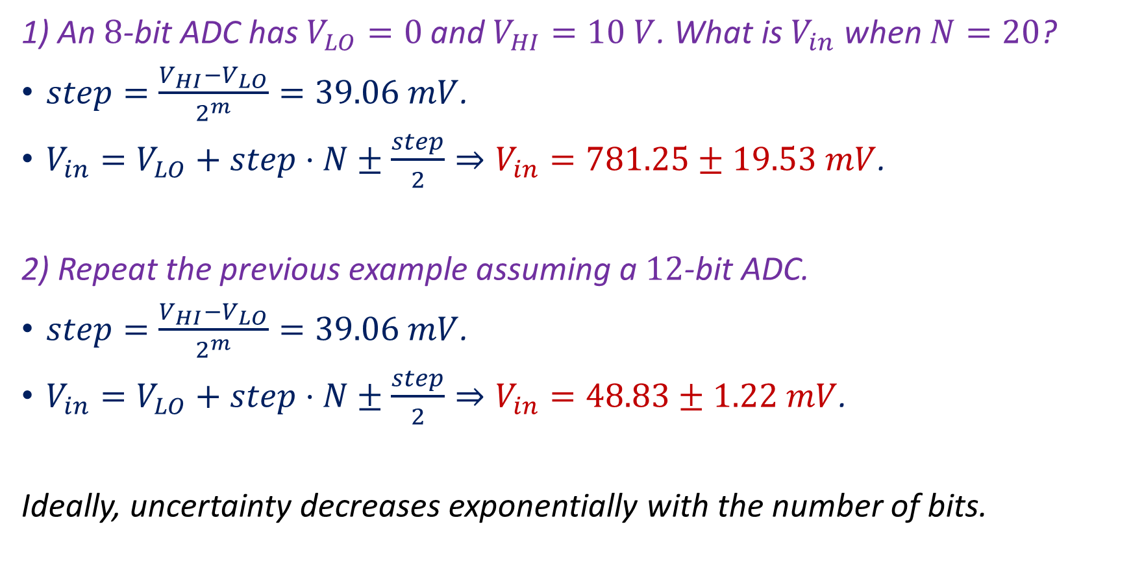
Examples
1) An $8$-bit ADC has $V_{LO}=0$ and $V_{HI}=10 V$. What is $V_{in}$ when $N=20$?
$step=\frac{V_{HI}−V_{LO}}{2^{m}}=39.06 mV$.
$V_{in}=V_{LO}+step⋅N±\frac{step}{2}⇒V_{in}=781.25±19.53 mV$.
2) Repeat the previous example assuming a $12$-bit ADC.
$step=\frac{V_{HI}−V_{LO}}{2^{m}}=39.06 mV$.
$V_{in}=V_{LO}+step⋅N±\frac{step}{2}⇒V_{in}=48.83±1.22 mV$.
Ideally, uncertainty decreases exponentially with the number of bits.

Slide 14
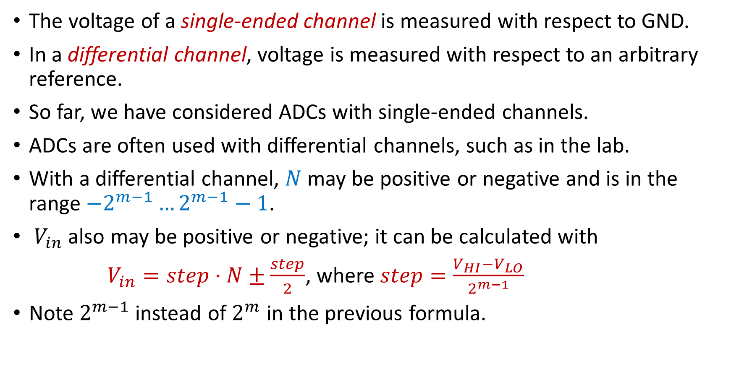
Differential Channels
The voltage of a single-ended channel is measured with respect to GND.
In a differential channel, voltage is measured with respect to an arbitrary reference.
So far, we have considered ADCs with single-ended channels.
ADCs are often used with differential channels, such as in the lab.
With a differential channel, $N$ may be positive or negative and is in the range $−2^{m−1}…2^{m−1}−1$.
$V_{in}$ also may be positive or negative; it can be calculated with
$V_{in}=step⋅N±\frac{step}{2}$, where $step=\frac{V_{HI}−V_{LO}}{2^{m−1}}$
Note $2^{m−1}$ instead of $2^{m}$ in the previous formula.

Slide 15
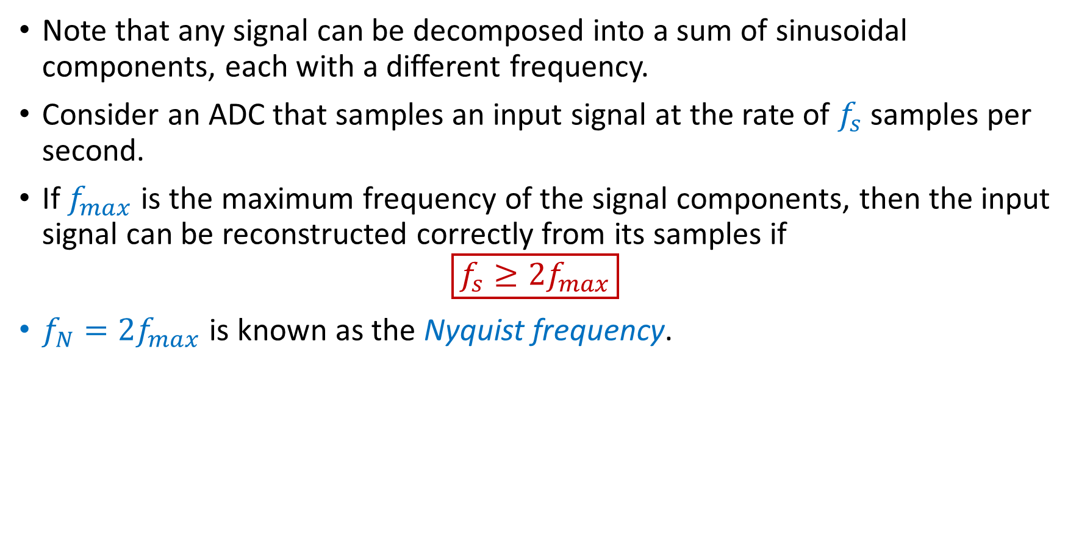
The Nyquist Frequency
Note that any signal can be decomposed into a sum of sinusoidal components, each with a different frequency.
Consider an ADC that samples an input signal at the rate of $f_{s}$ samples per second.
If $f_{max}$ is the maximum frequency of the signal components, then the input signal can be reconstructed correctly from its samples if
$$\boxed{f_{s}≥2f_{max}}$$
$f_{N}=2f_{max}$ is known as the Nyquist frequency.

Slide 16
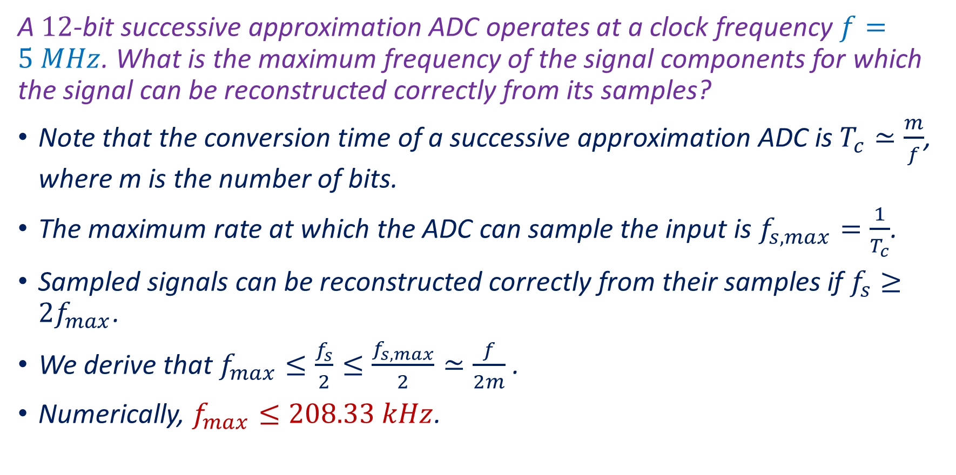
Example
A $12$-bit successive approximation ADC operates at a clock frequency $f=5 MHz$. What is the maximum frequency of the signal components for which the signal can be reconstructed correctly from its samples?
Note that the conversion time of a successive approximation ADC is $T_{c}≃\frac{m}{f}$, where m is the number of bits.
The maximum rate at which the ADC can sample the input is $f_{s,max}=\frac{1}{T_{c}}$.
Sampled signals can be reconstructed correctly from their samples if $f_{s}≥2f_{max}$.
We derive that $f_{max}≤\frac{f_{s}}{2}≤\frac{f_{s,max}}{2}≃\frac{f}{2m}$.
Numerically, $f_{max}≤208.33 kHz$.

Slide 17
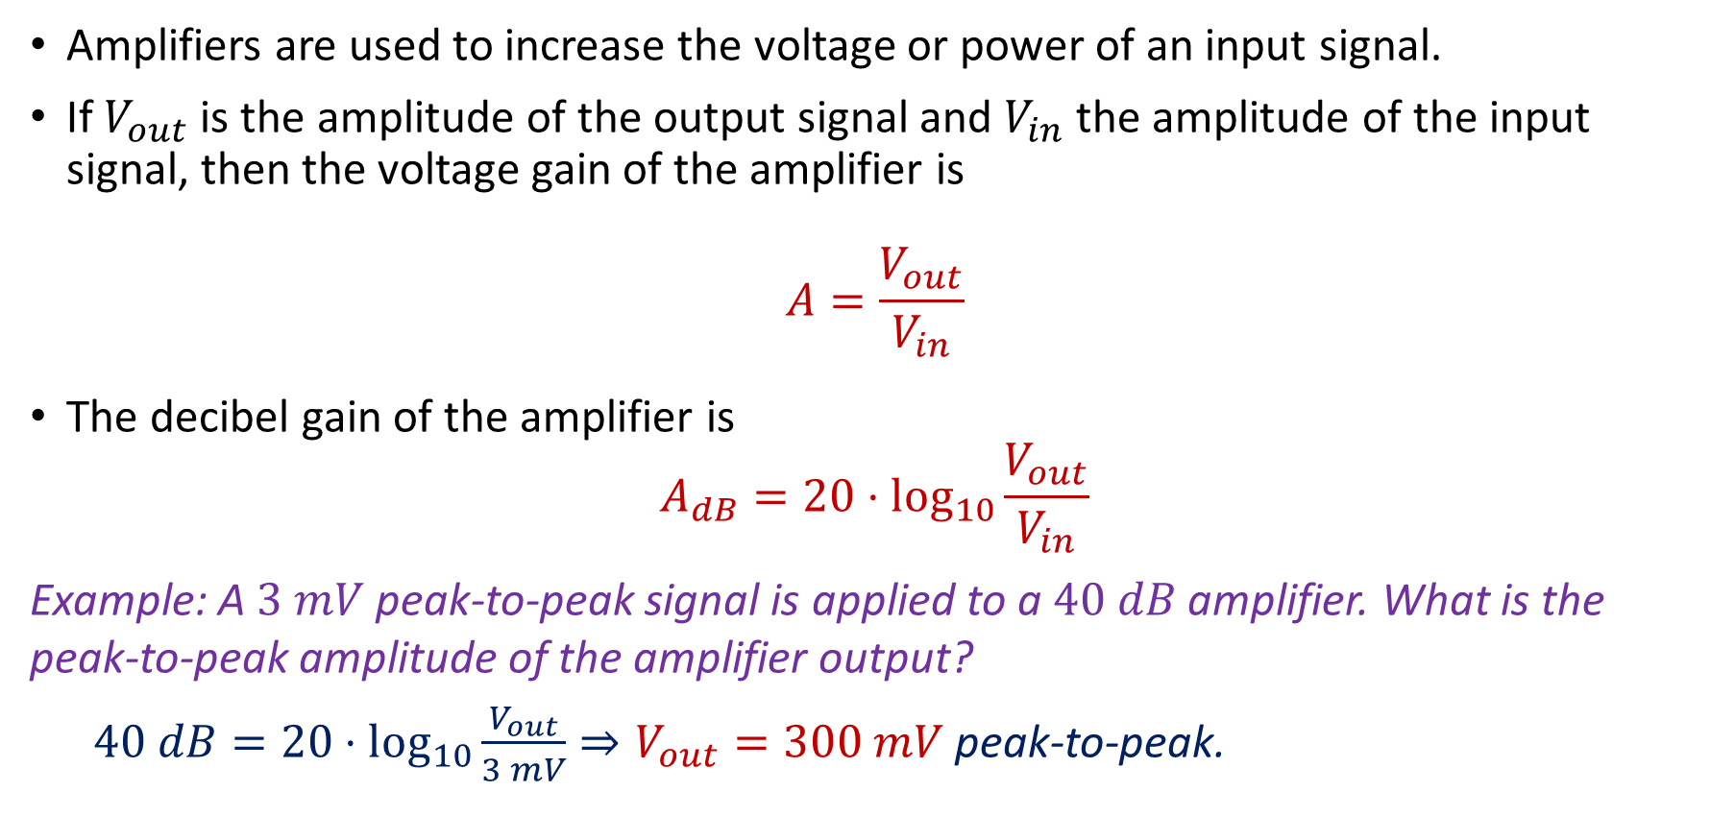
Electronic Amplifiers
Amplifiers are used to increase the voltage or power of an input signal.
If $V_{out}$ is the amplitude of the output signal and $V_{in}$ the amplitude of the input signal, then the voltage gain of the amplifier is
$$A=\frac{V_{out}}{V_{in}}$$
The decibel gain of the amplifier is
$$A_{dB}=20⋅\log_{10}{\frac{V_{out}}{V_{in}}}$$
Example: A $3 mV$ peak-to-peak signal is applied to a $40 dB$ amplifier. What is the peak-to-peak amplitude of the amplifier output?
$40 dB=20⋅\log_{10}{\frac{V_{out}}{3 mV}}⇒V_{out}=300 mV$ peak-to-peak.
Notes:
presm/opamp3.fig

Slide 18
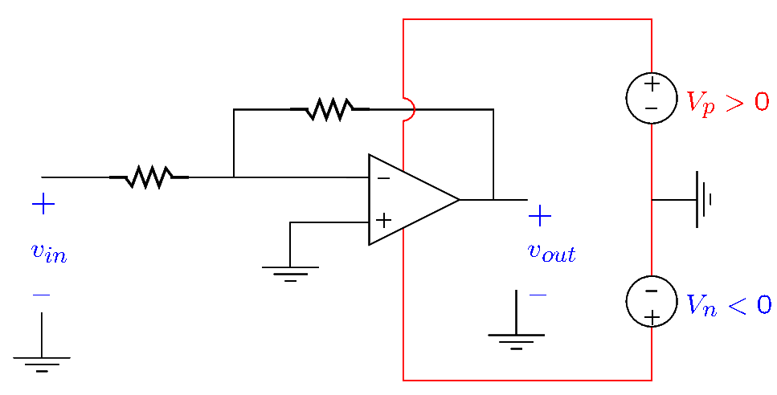
Operational Amplifiers
The figure shows an amplifier circuit that uses an operational amplifier.
Operational amplifiers are commonly used to amplify signals.
They have pins for the input and output signals (shown in black) and supply pins (shown in red) used to power the operational amplifier.
Notes:
presm/opamp3.fig

Slide 19
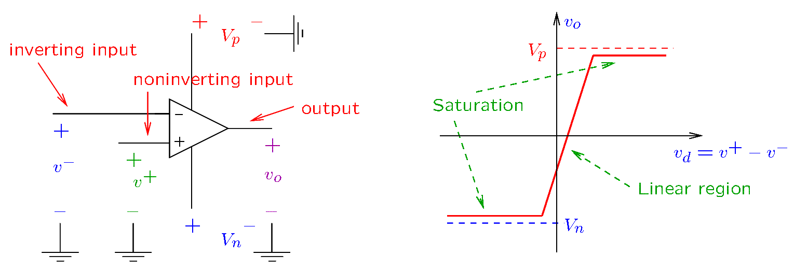
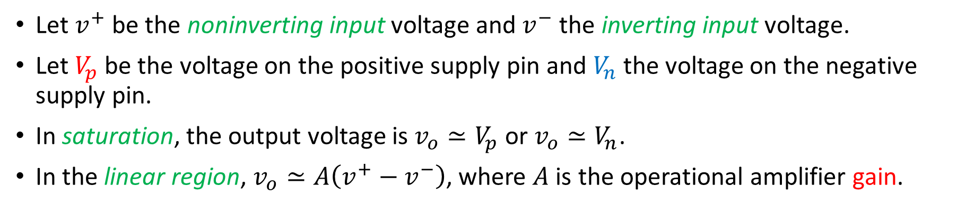
Operational Amplifiers
Let $v^{+}$ be the noninverting input voltage and $v^{−}$ the inverting input voltage.
Let $V_{p}$ be the voltage on the positive supply pin and $V_{n}$ the voltage on the negative supply pin.
In saturation, the output voltage is $v_{o}≃V_{p}$ or $v_{o}≃V_{n}$.
In the linear region, $v_{o}≃A\left(v^{+}−v^{−}\right)$, where $A$ is the operational amplifier gain.
Notes:
presm/opamp2.fig

Slide 20
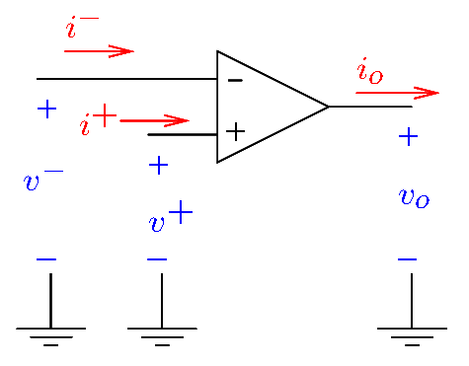
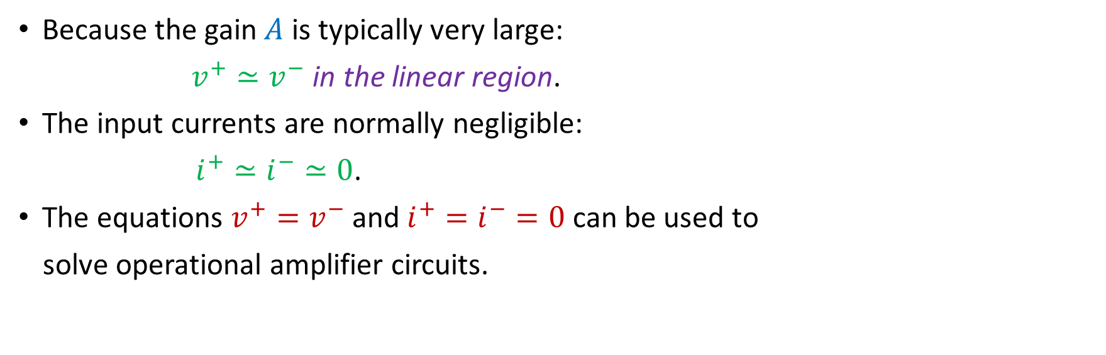
Operational Amplifiers
Because the gain $A$ is typically very large:
$v^{+}≃v^{−}$ in the linear region.
The input currents are normally negligible:
$i^{+}≃i^{−}≃0$.
The equations $v^{+}=v^{−}$ and $i^{+}=i^{−}=0$ can be used to
solve operational amplifier circuits.
Notes:
presm/opamp4.fig and opamp5.fig

Slide 21
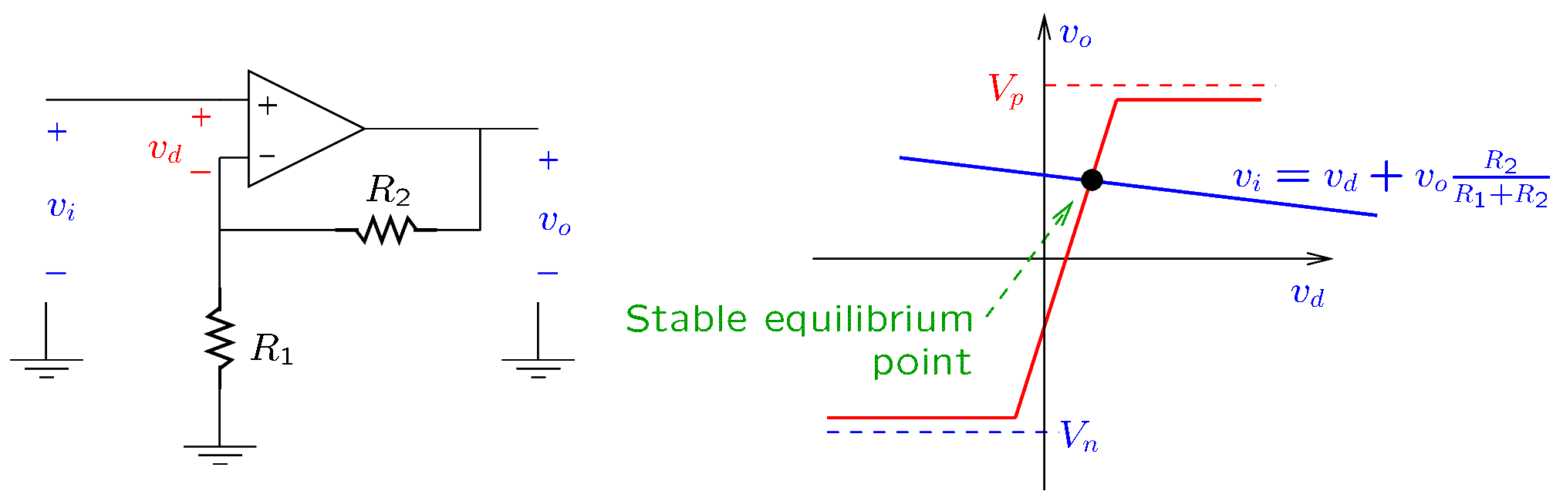
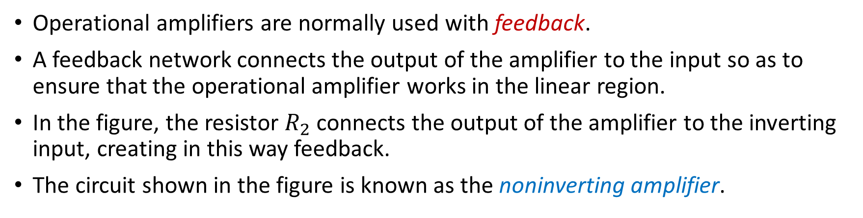
The Noninverting Amplifier
Operational amplifiers are normally used with feedback.
A feedback network connects the output of the amplifier to the input so as to ensure that the operational amplifier works in the linear region.
In the figure, the resistor $R_{2}$ connects the output of the amplifier to the inverting input, creating in this way feedback.
The circuit shown in the figure is known as the noninverting amplifier.
Notes:
presm/opampst2.fig

Slide 22
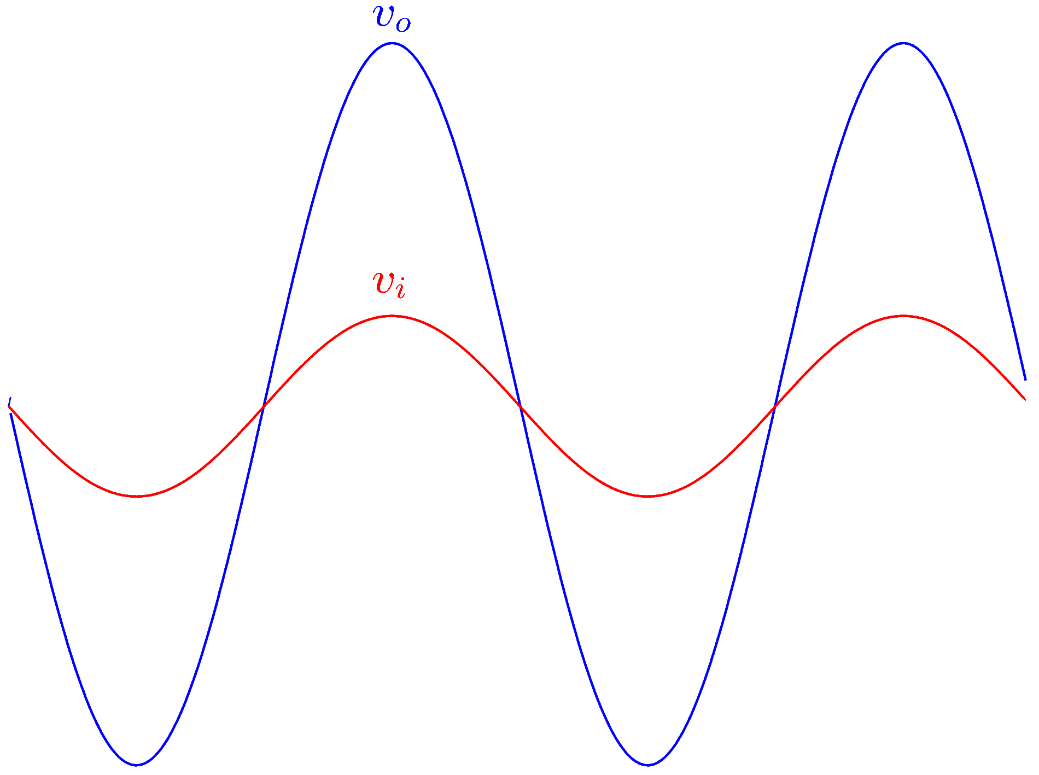
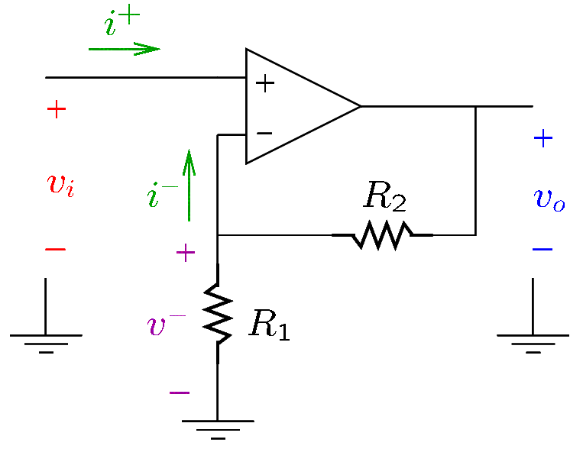
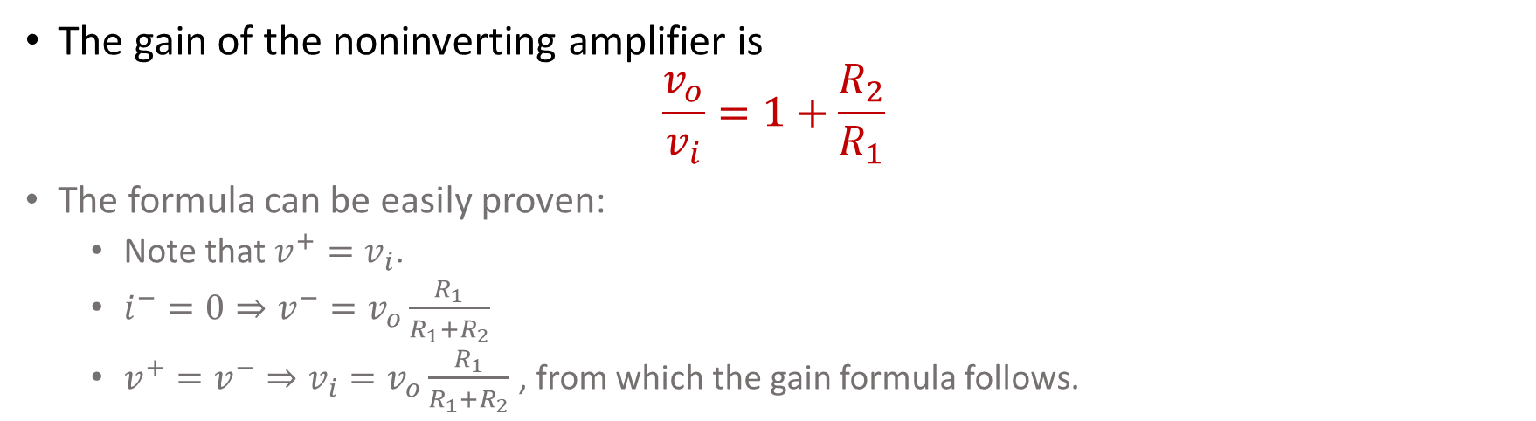
The Noninverting Amplifier
The gain of the noninverting amplifier is
$$\frac{v_{o}}{v_{i}}=1+\frac{R_{2}}{R_{1}}$$
The formula can be easily proven:
  Note that $v^{+}=v_{i}$.
  $i^{−}=0⇒v^{−}=v_{o}\frac{R_{1}}{R_{1}+R_{2}}$
  $v^{+}=v^{−}⇒v_{i}=v_{o}\frac{R_{1}}{R_{1}+R_{2}}$ , from which the gain formula follows.
Notes:
presm/opampsta.fig

Slide 23
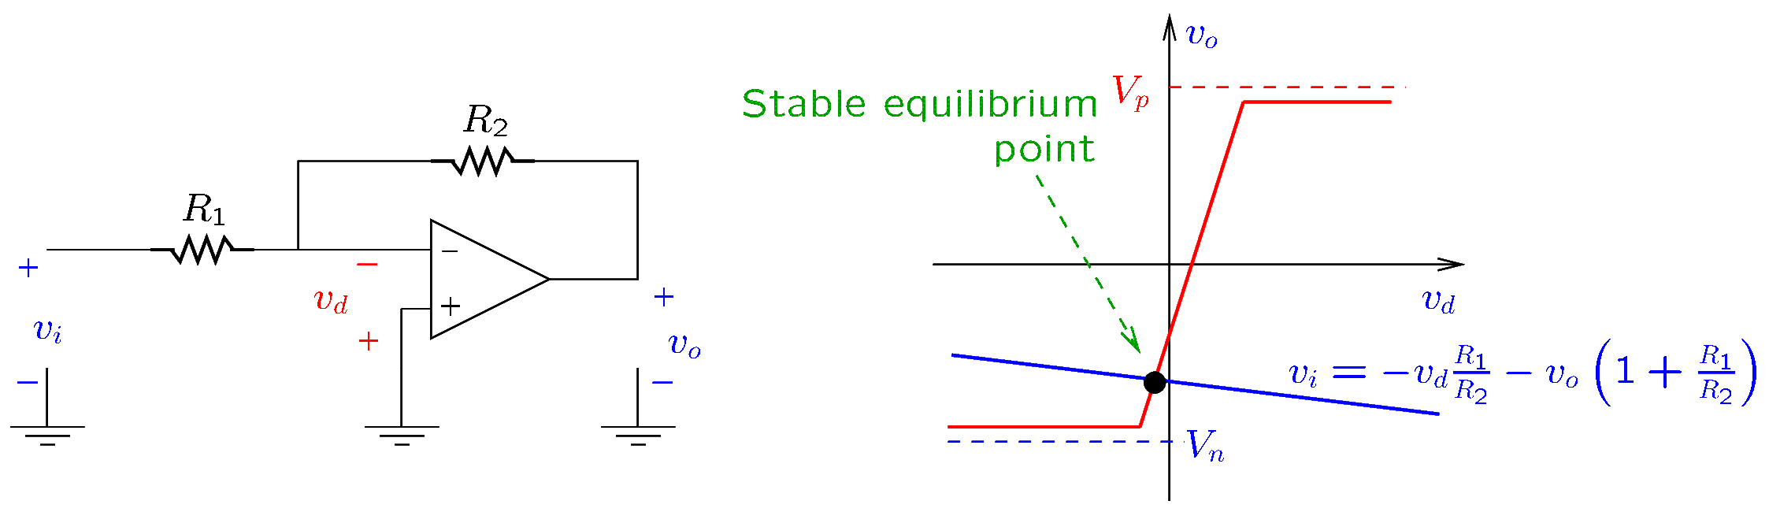
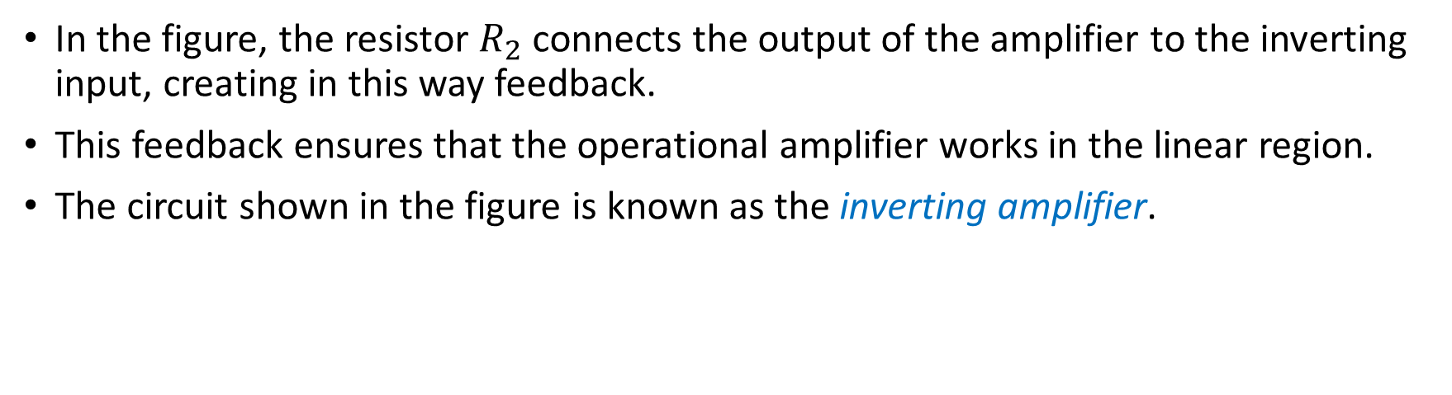
The Inverting Amplifier
In the figure, the resistor $R_{2}$ connects the output of the amplifier to the inverting input, creating in this way feedback.
This feedback ensures that the operational amplifier works in the linear region.
The circuit shown in the figure is known as the inverting amplifier.
Notes:
presm/opampst2b.fig

Slide 24
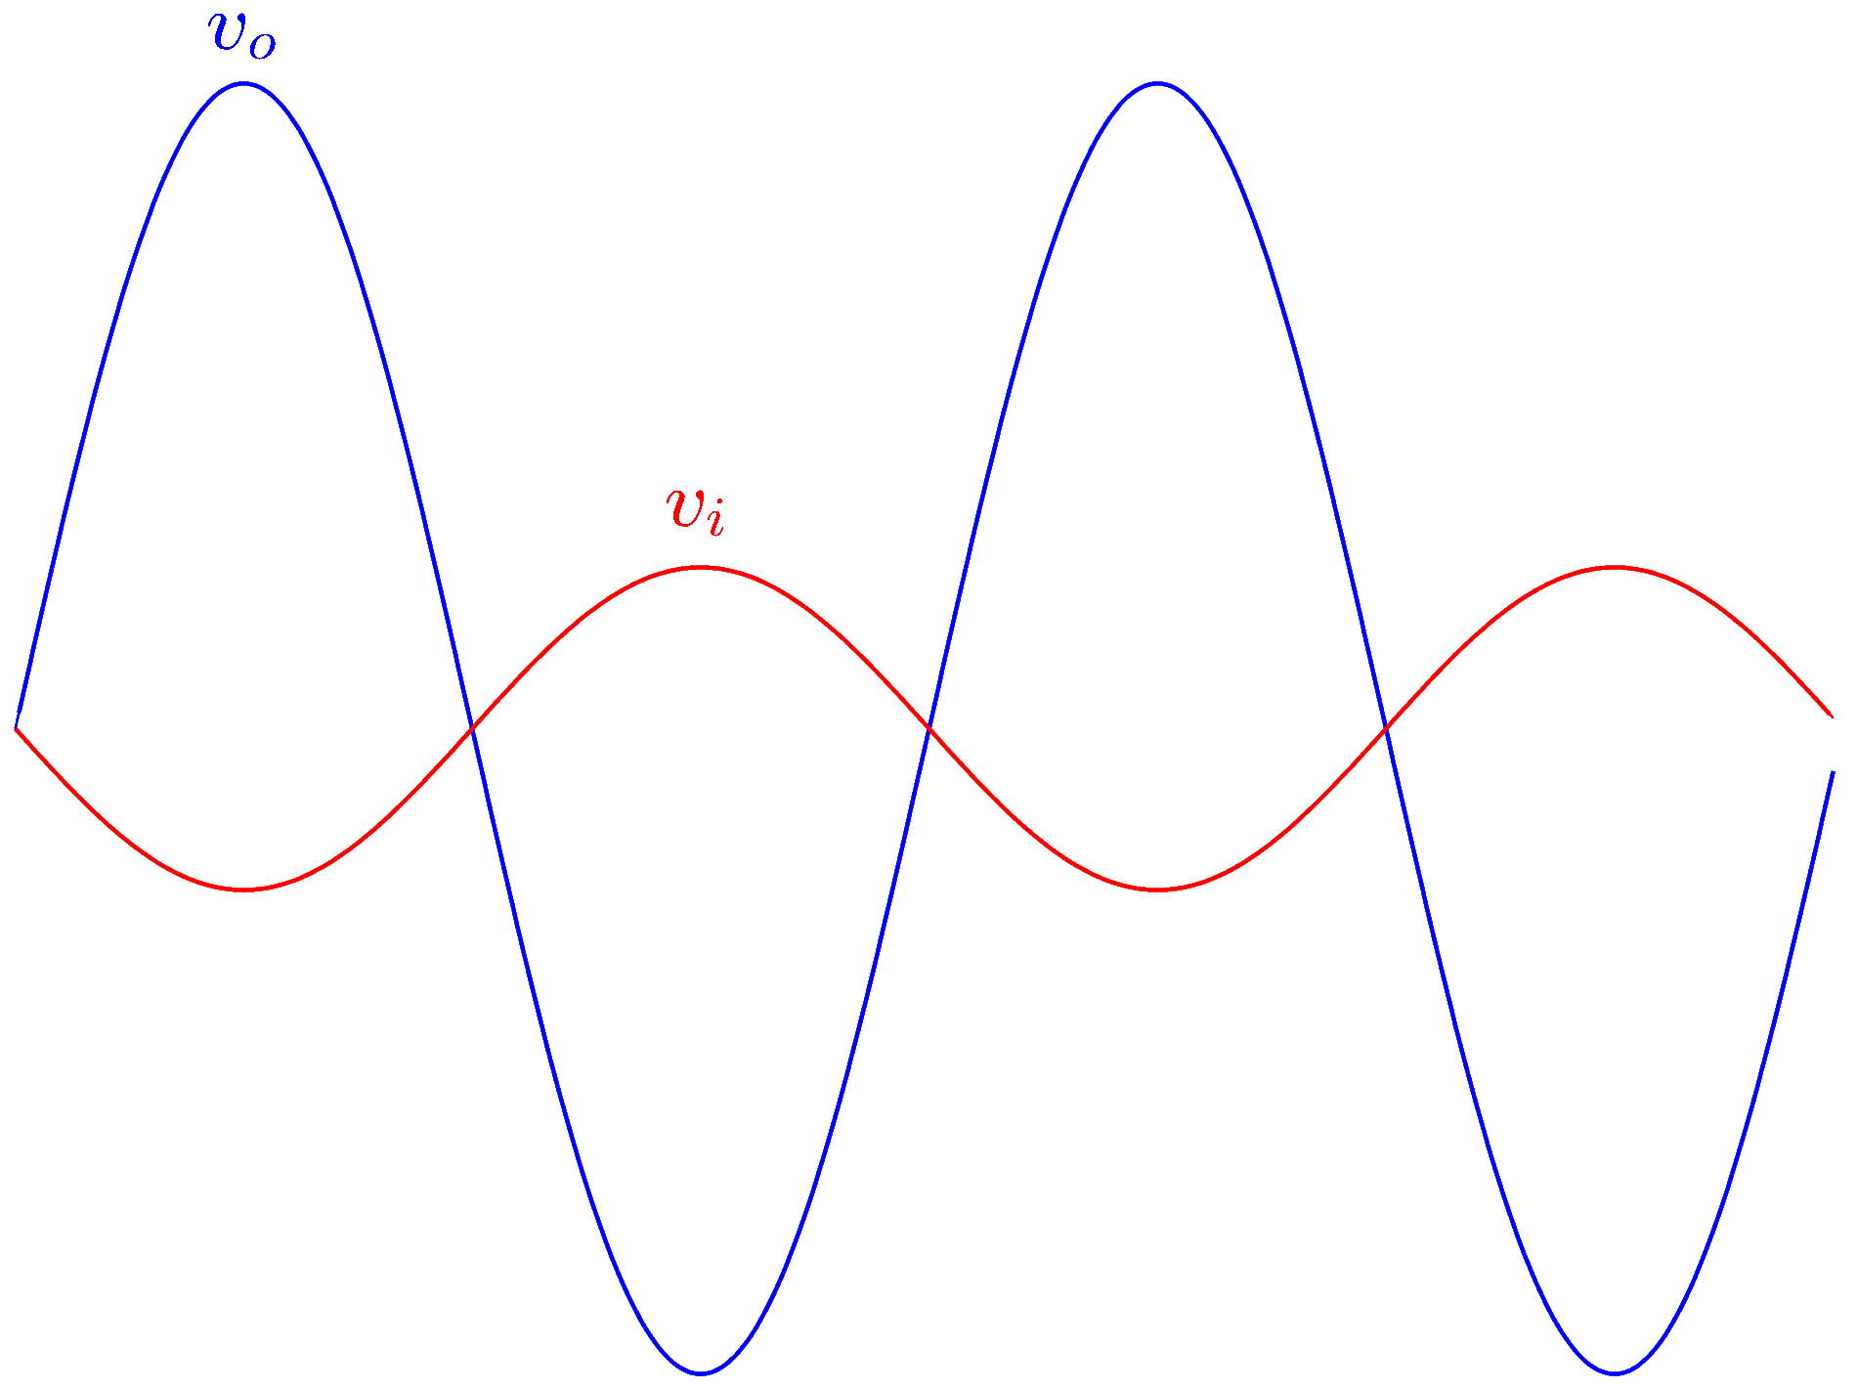
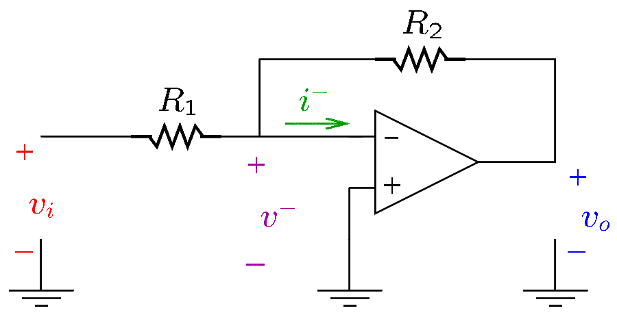
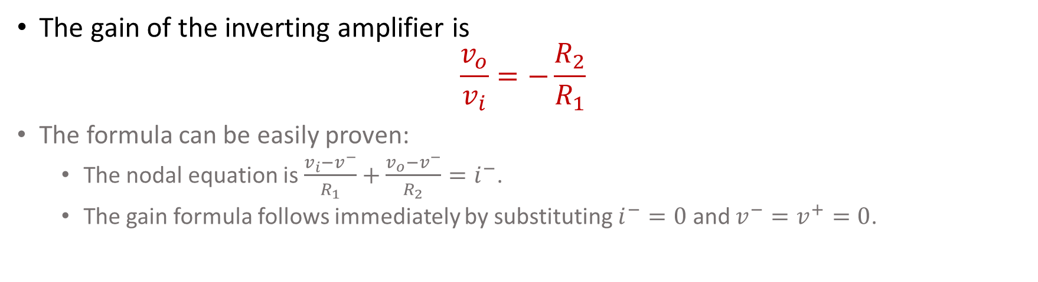
The Inverting Amplifier
The gain of the inverting amplifier is
$$\frac{v_{o}}{v_{i}}=−\frac{R_{2}}{R_{1}}$$
The formula can be easily proven:
  The nodal equation is $\frac{v_{i}−v^{−}}{R_{1}}+\frac{v_{o}−v^{−}}{R_{2}}=i^{−}$.
  The gain formula follows immediately by substituting $i^{−}=0$ and $v^{−}=v^{+}=0$.
Notes:
inverting.fig and presm/opampstb.fig

Slide 25
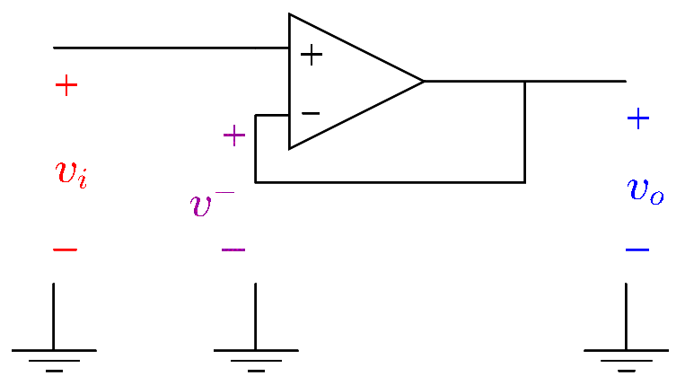
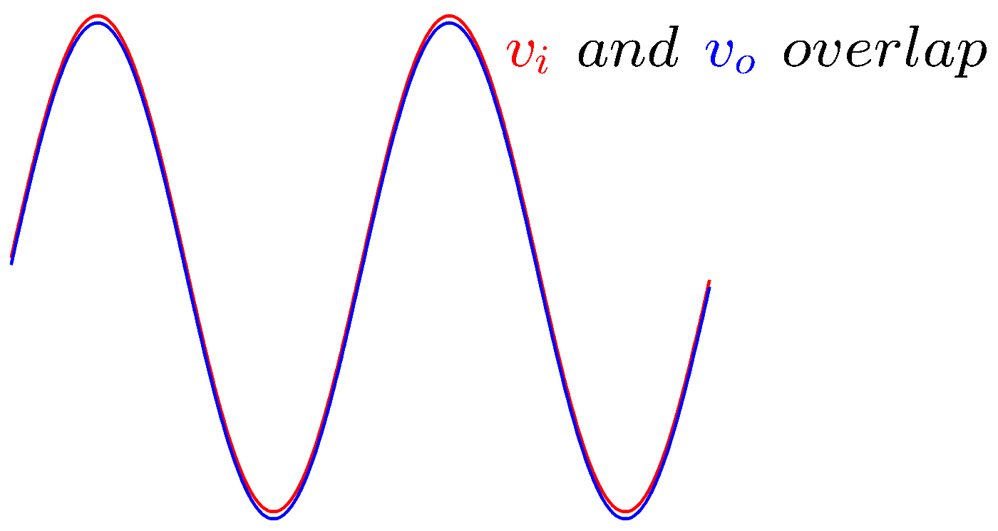
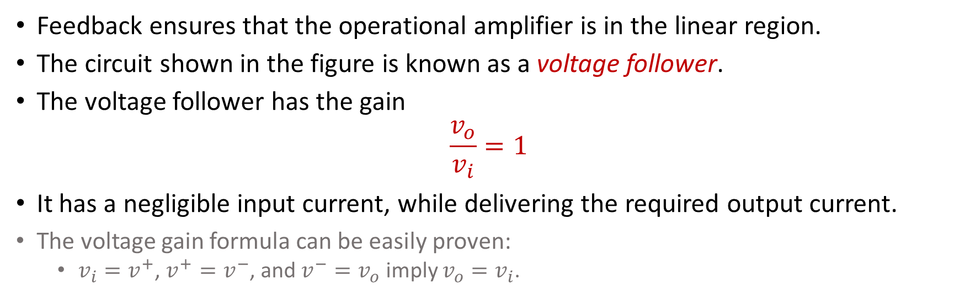
The Voltage Follower
Feedback ensures that the operational amplifier is in the linear region.
The circuit shown in the figure is known as a voltage follower.
The voltage follower has the gain
$$\frac{v_{o}}{v_{i}}=1$$
It has a negligible input current, while delivering the required output current.
The voltage gain formula can be easily proven:
  $v_{i}=v^{+}$, $v^{+}=v^{−}$, and $v^{−}=v_{o}$ imply $v_{o}=v_{i}$.
Notes:
follower.fig and presm/opampstc.fig

Slide 26
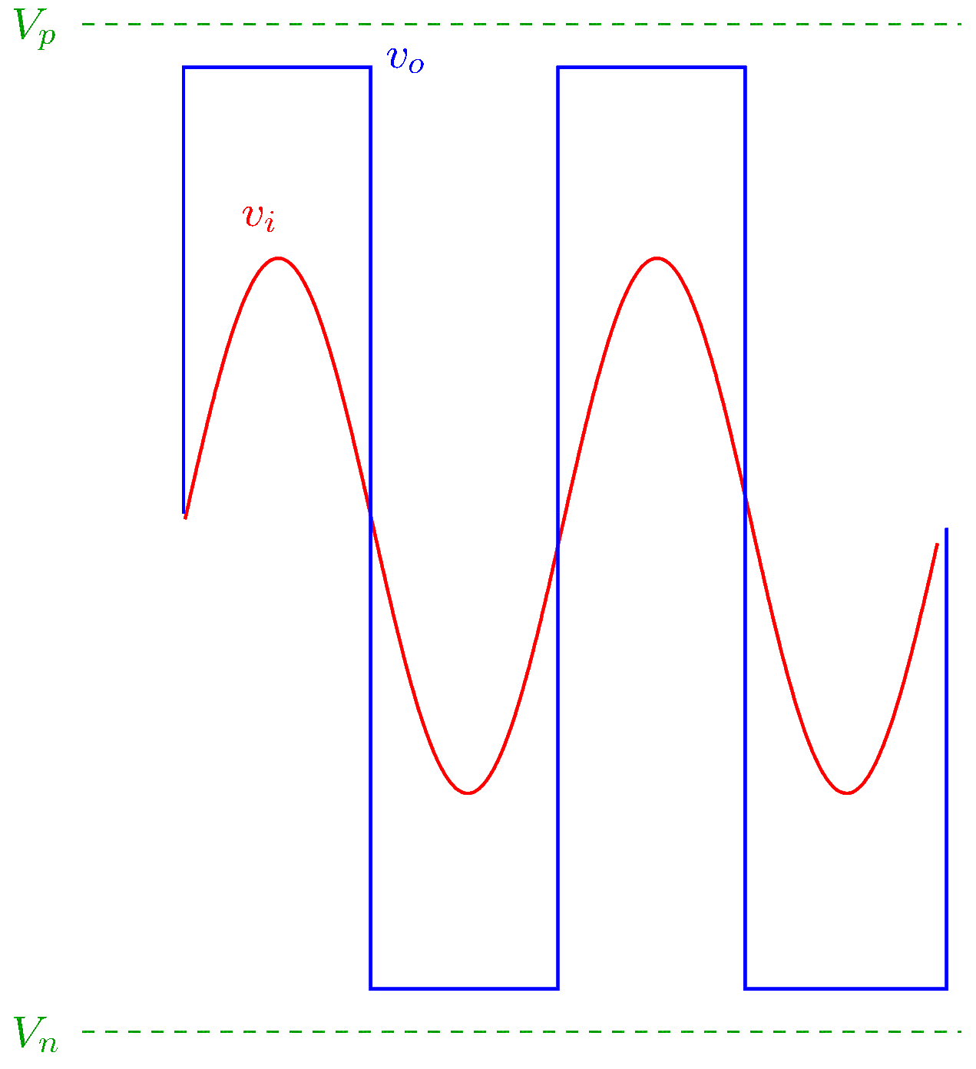
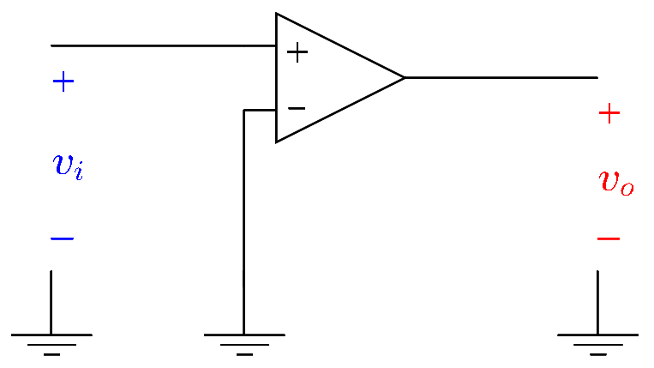
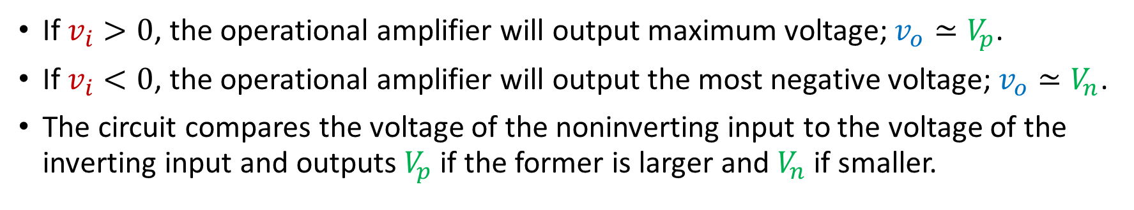
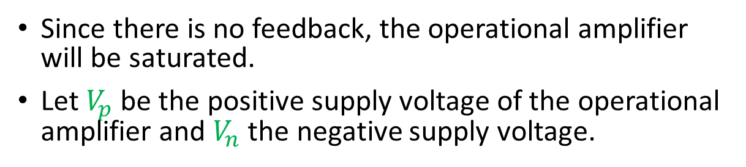
Voltage Comparator
Since there is no feedback, the operational amplifier will be saturated.
Let $V_{p}$ be the positive supply voltage of the operational amplifier and $V_{n}$ the negative supply voltage.
If $v_{i}>0$, the operational amplifier will output maximum voltage; $v_{o}≃V_{p}$.
If $v_{i}<0$, the operational amplifier will output the most negative voltage; $v_{o}≃V_{n}$.
The circuit compares the voltage of the noninverting input to the voltage of the inverting input and outputs $V_{p}$ if the former is larger and $V_{n}$ if smaller.
Notes:
comp.fig and presm/opampstc.fig

