Slide 1
Statistical Evaluation of Measurement Data and Errors
M.V. Iordache, EEGR2051 Circuits and Measurements Lab, Fall 2020, LeTourneau University
See https://mviordache.name/EEGR2051 for more information.

Slide 2
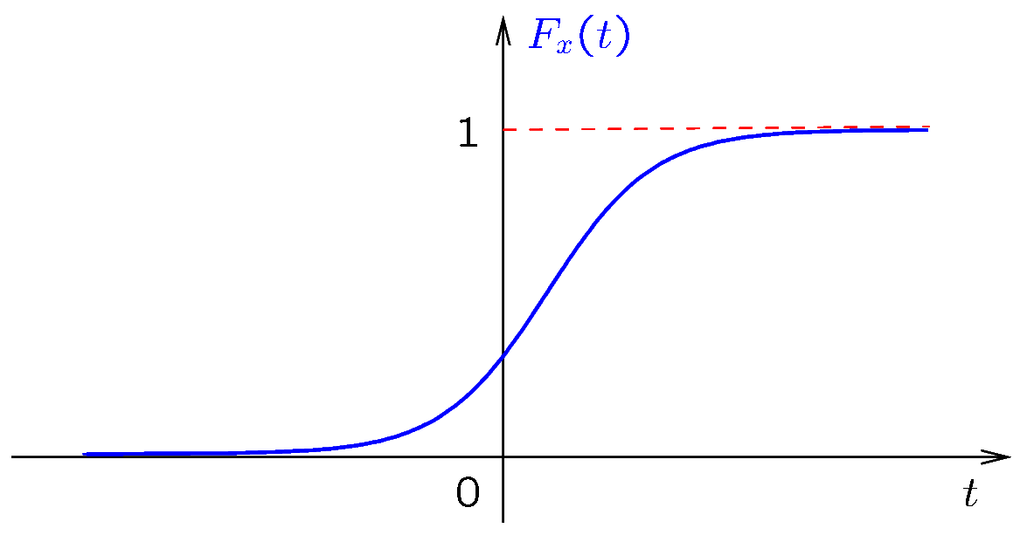
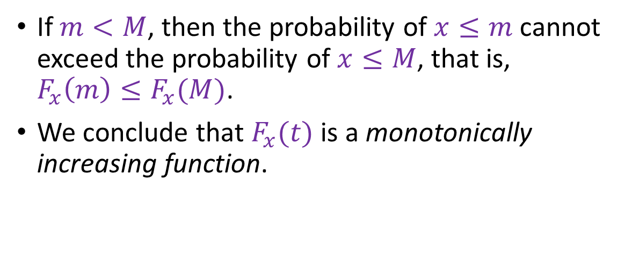
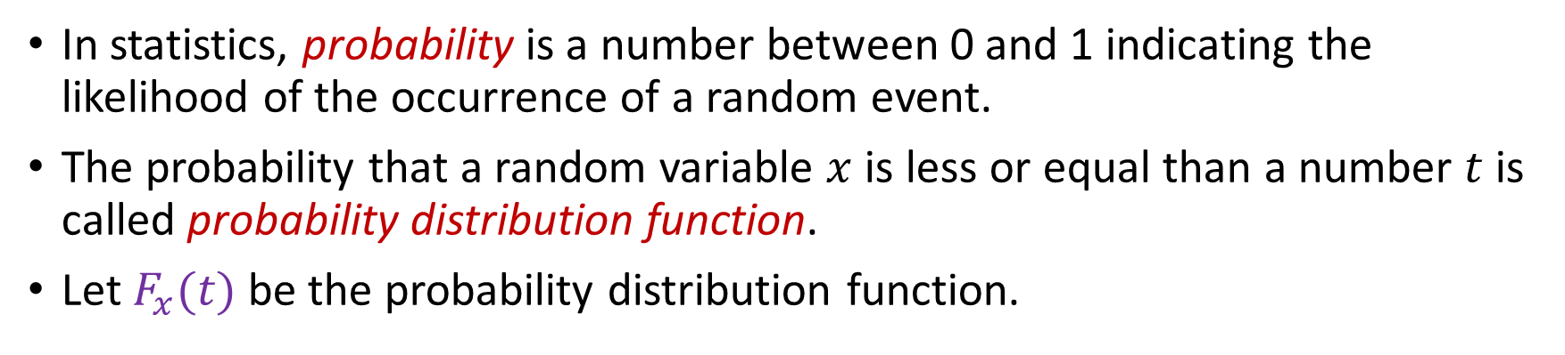
Probability Distribution
In statistics, probability is a number between 0 and 1 indicating the likelihood of the occurrence of a random event.
The probability that a random variable $x$ is less or equal than a number $t$ is called probability distribution function.
Let $F_{x}(t)$ be the probability distribution function.
If $m<M$, then the probability of $x≤m$ cannot exceed the probability of $x≤M$, that is, $F_{x}\left(m\right)≤F_{x}(M)$.
We conclude that $F_{x}(t)$ is a monotonically increasing function.
Notes:
distrib.fig
y = 1./(1+exp(-0.8*(t-1)));
plot(t,y)
axis off; print -color -SYSIZE 500 distrib-0.fig

Slide 3
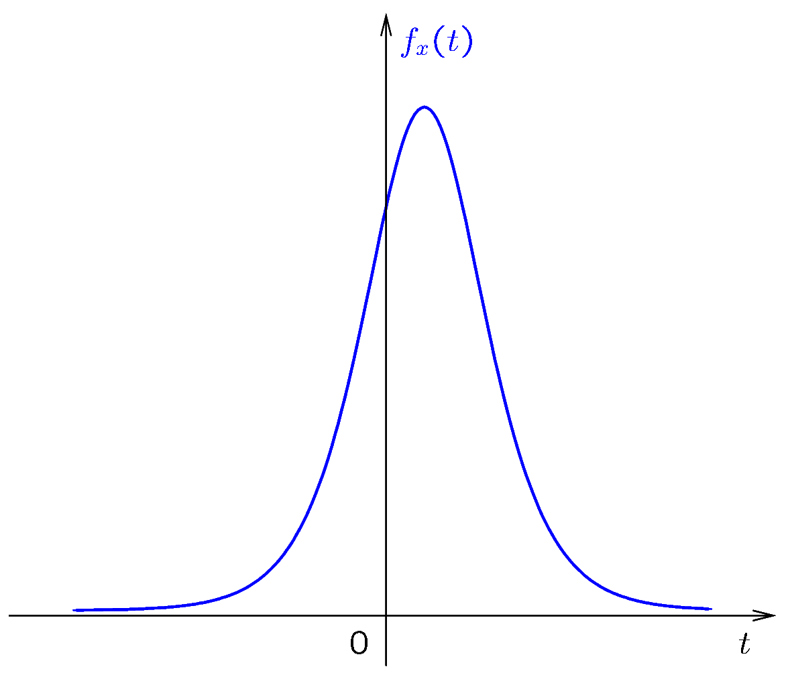
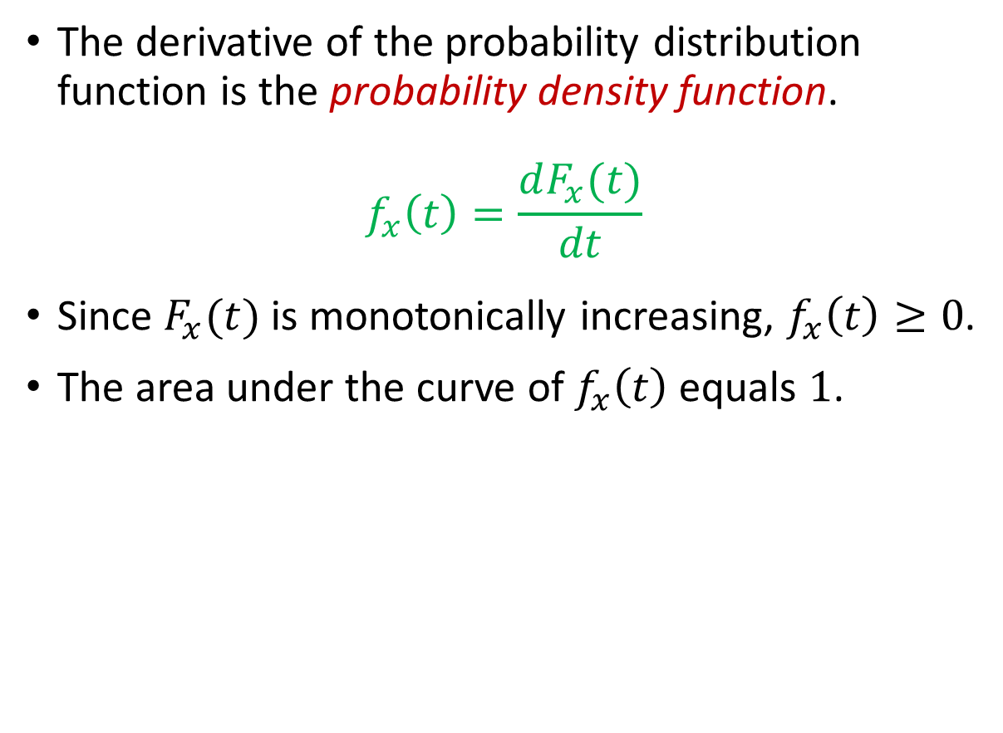
Probability Density
The derivative of the probability distribution function is the probability density function.
$$f_{x}\left(t\right)=\frac{dF_{x}(t)}{dt}$$
Since $F_{x}(t)$ is monotonically increasing, $f_{x}\left(t\right)≥0$.
The area under the curve of $f_{x}\left(t\right)$ equals $1$.
Notes:
density.fig
a = -0.8;
y = 1./(1+exp(a*(t-1))); y = y.*y; y = -a*y.*exp(a*(t-1));
plot(t,y)
axis off; print -color -SYSIZE 500 density-0.fig

Slide 4
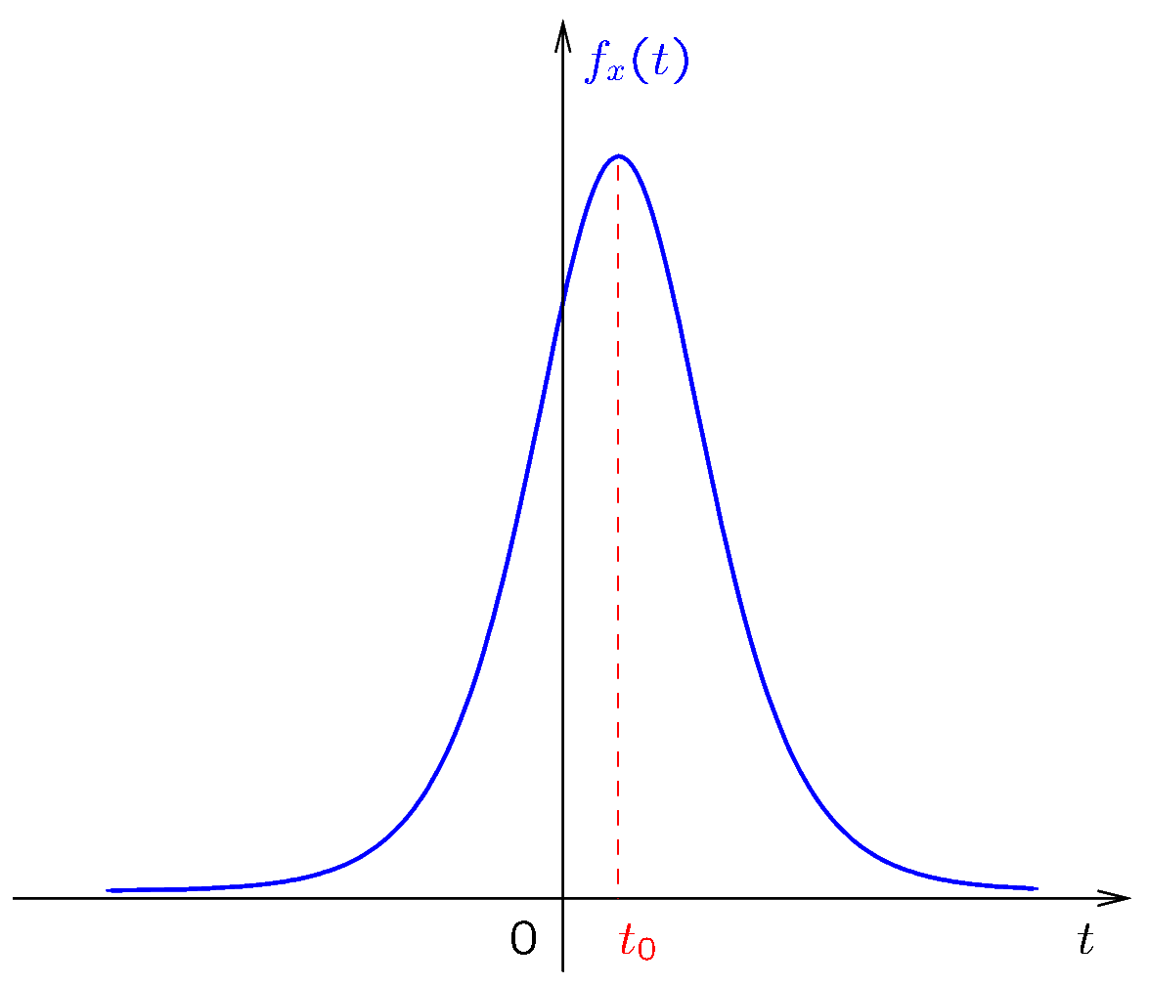
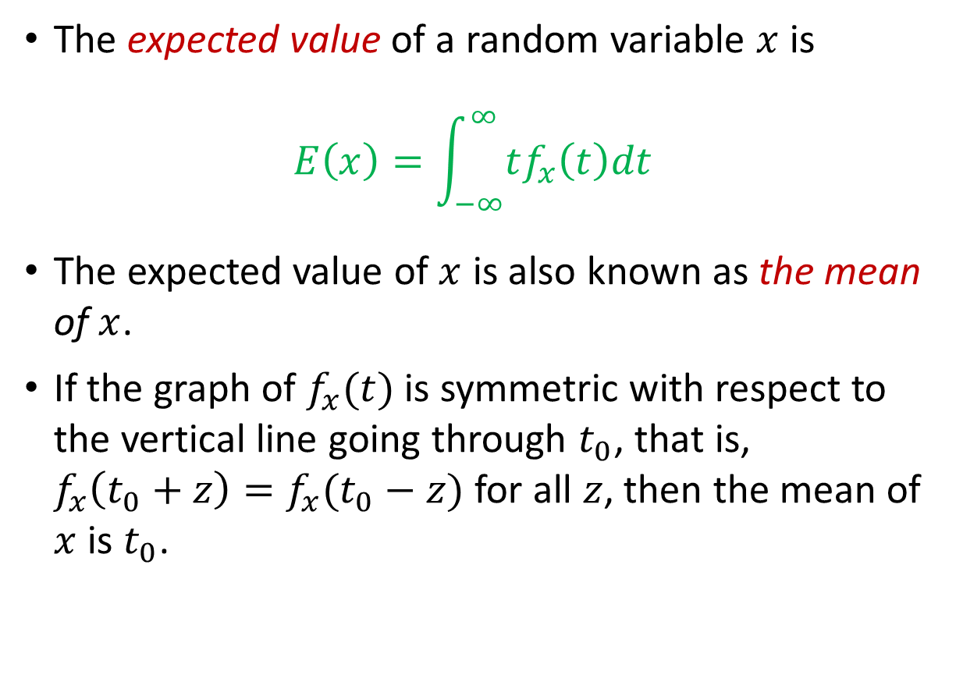
The Mean
The expected value of a random variable $x$ is
$$E\left(x\right)=\int_{−∞}^{∞}{tf_{x}\left(t\right)dt}$$
The expected value of $x$ is also known as the mean of $x$.
If the graph of $f_{x}(t)$ is symmetric with respect to the vertical line going through $t_{0}$, that is, $f_{x}\left(t_{0}+z\right)=f_{x}(t_{0}−z)$ for all $z$, then the mean of $x$ is $t_{0}$.
Notes:
density2.fig

Slide 5
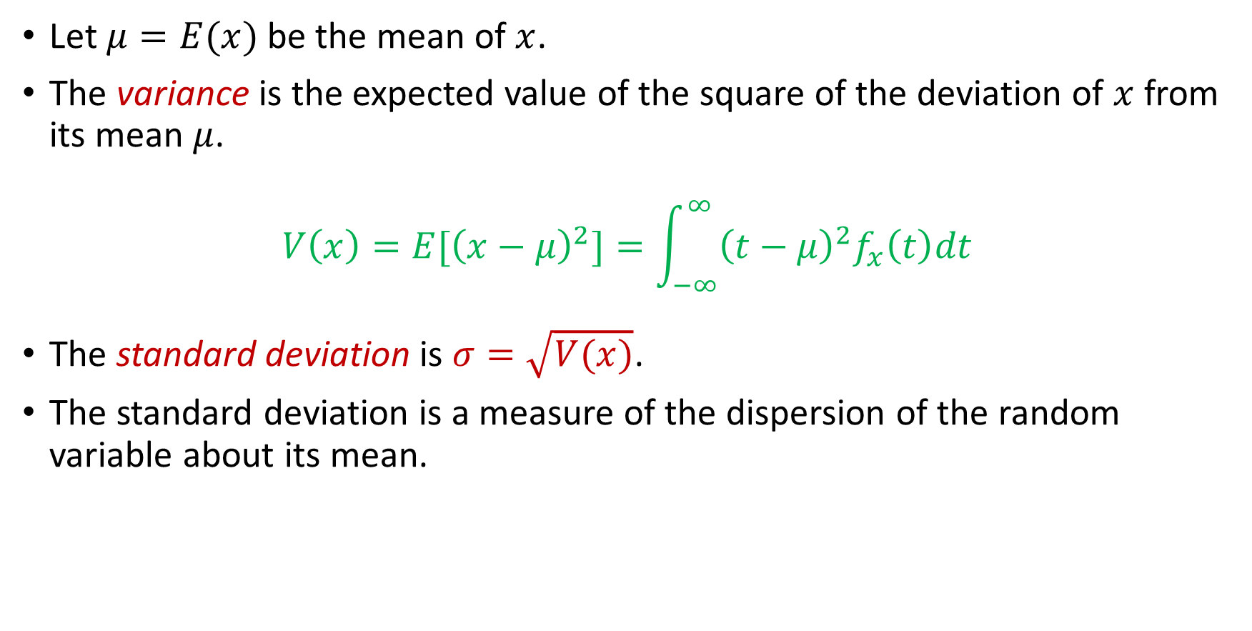
The Standard Deviation
Let $μ=E(x)$ be the mean of $x$.
The variance is the expected value of the square of the deviation of $x$ from its mean $μ$.
$$V\left(x\right)=E[{\left(x−μ\right)}^{2}]=\int_{−∞}^{∞}{{\left(t−μ\right)}^{2}f_{x}\left(t\right)dt}$$
The standard deviation is $σ=\sqrt{V(x)}$.
The standard deviation is a measure of the dispersion of the random variable about its mean.

Slide 6
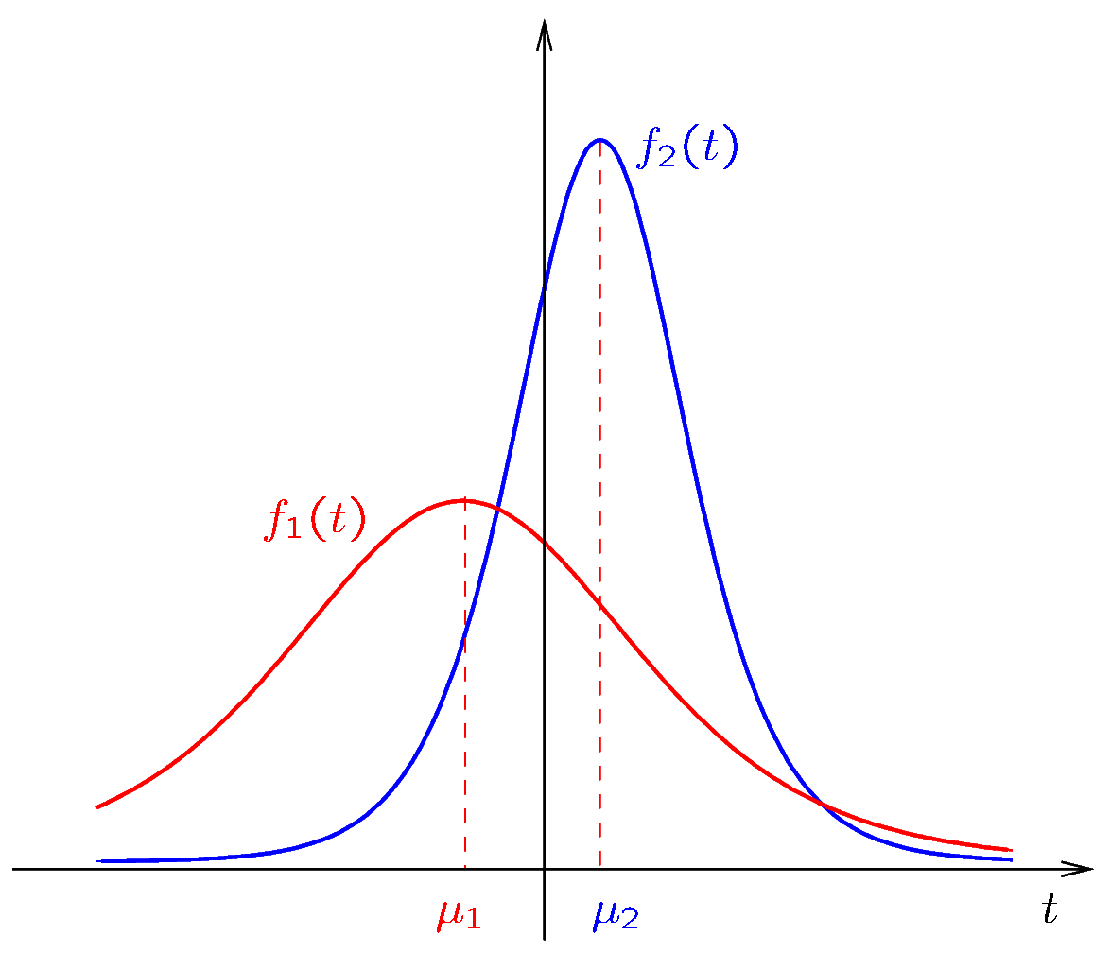
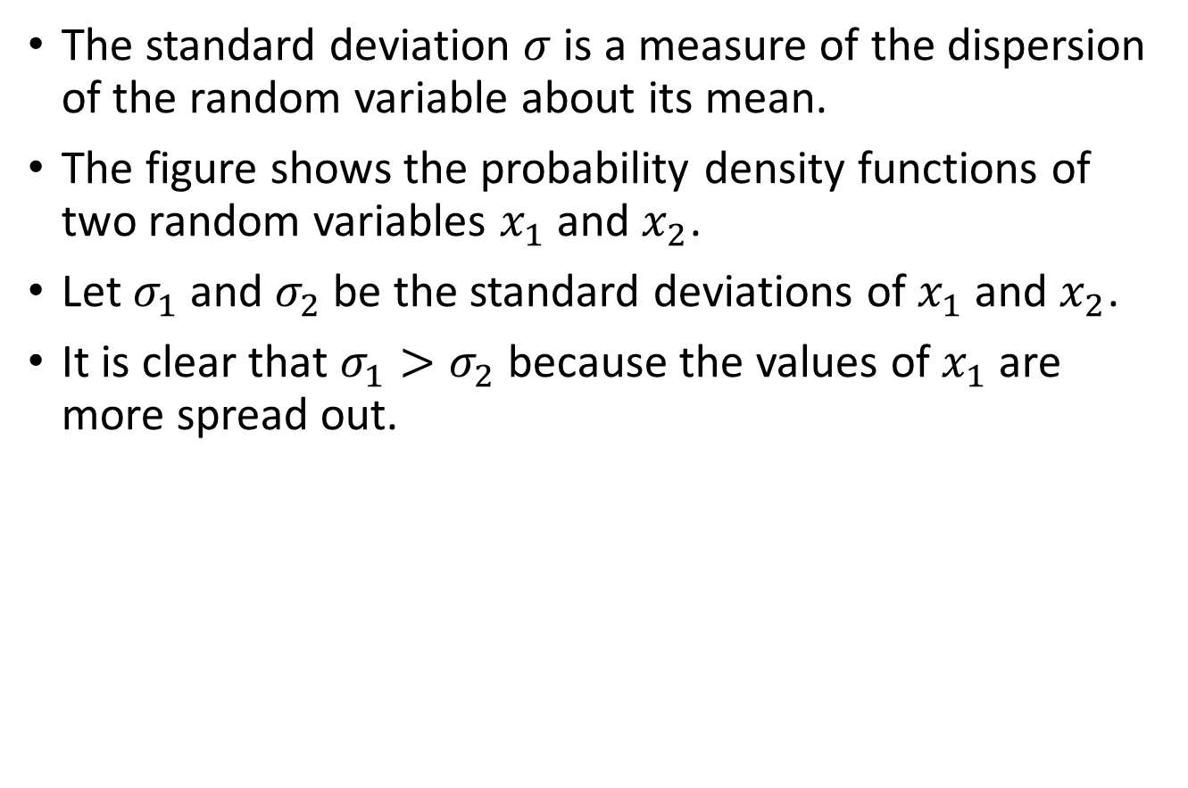
The Standard Deviation
The standard deviation $σ$ is a measure of the dispersion of the random variable about its mean.
The figure shows the probability density functions of two random variables $x_{1}$ and $x_{2}$.
Let $σ_{1}$ and $σ_{2}$ be the standard deviations of $x_{1}$ and $x_{2}$.
It is clear that $σ_{1}>σ_{2}$ because the values of $x_{1}$ are more spread out.
Notes:
density3.fig
a = -0.8; b = 1; y = 1./(1+exp(a*(t-b))); y = y.*y; y = -a*y.*exp(a*(t-b)); plot(t,y); hold on;
a = -0.4; b = -2; y = 1./(1+exp(a*(t-b))); y = y.*y; y = -a*y.*exp(a*(t-b)); plot(t,y,'r'); hold on;
axis off; print -color -SYSIZE 500 density3-0.fig

Slide 7
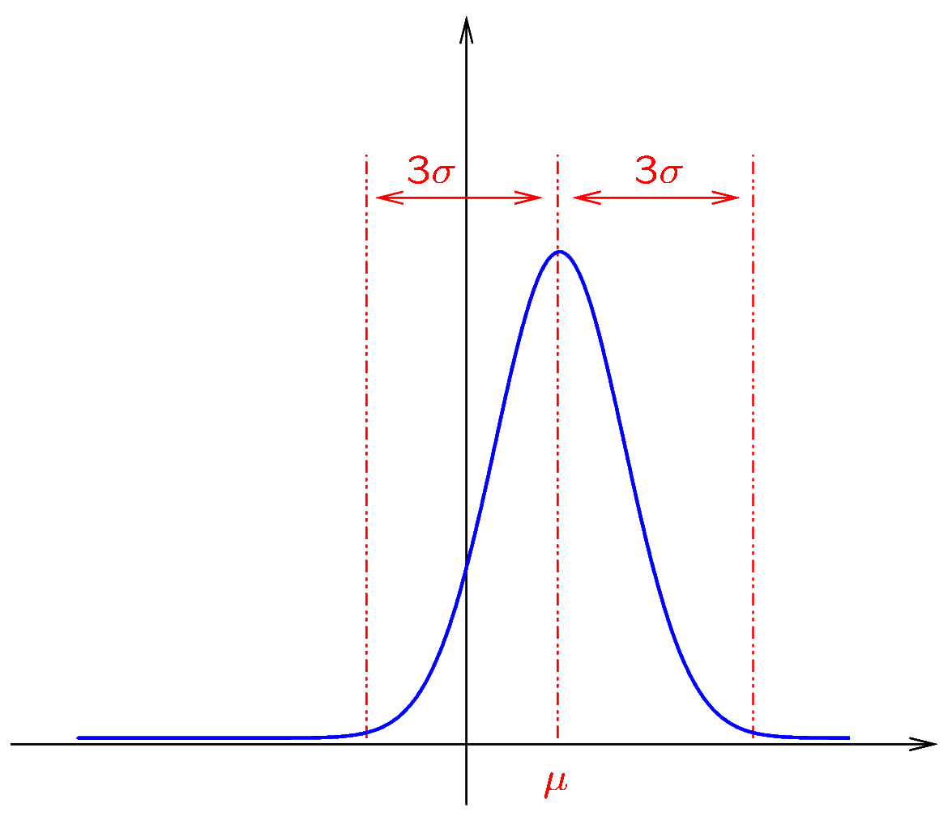
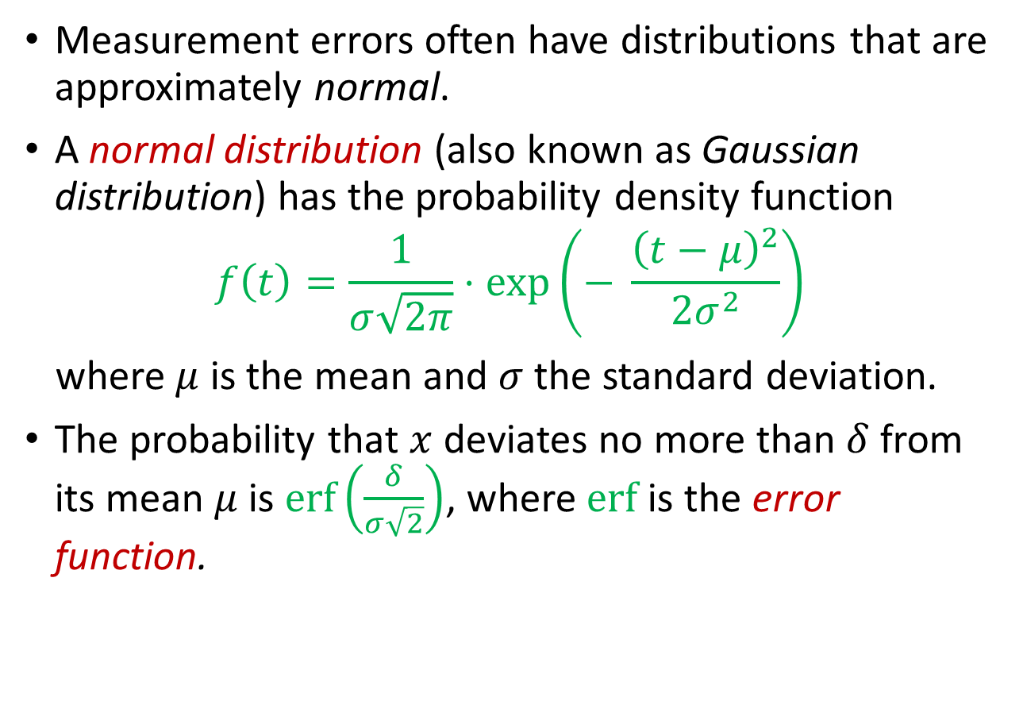
The Normal Distribution
Measurement errors often have distributions that are approximately normal.
A normal distribution (also known as Gaussian distribution) has the probability density function
$$f\left(t\right)=\frac{1}{σ\sqrt{2π}}⋅\exp\left(− \frac{{\left(t−μ\right)}^{2}}{2σ^{2}}\right)$$
where $μ$ is the mean and $σ$ the standard deviation.
The probability that $x$ deviates no more than $δ$ from its mean $μ$ is $\operatorname{erf}\left(\frac{δ}{σ\sqrt{2}}\right)$, where $erf$ is the error function.
Notes:
normal.fig
m = 1.5; s = 1; t = -6:0.02:6; y = 1/(sqrt(2*pi)*s)*exp(-(t-m).^2/(2*s^2)); plot(t,y, 'b', (m-3*s)*[1 1], [0 1.2*max(y)], 'r--', (m+3*s)*[1 1], [0 1.2*max(y)], 'r--');
axis off; print -color -SYSIZE 500 normal-0.fig

Slide 8
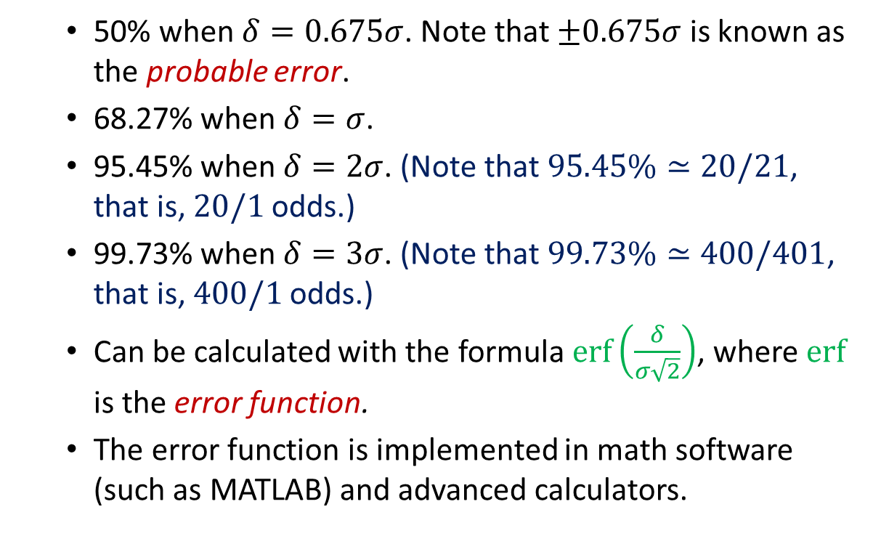
The Normal Distribution
The probability that $x$ deviates by no more than $δ$ from its mean $μ$ is
50% when $δ=0.675σ$. Note that $±0.675σ$ is known as the probable error.
68.27% when $δ=σ$.
95.45% when $δ=2σ$. (Note that $95.45\%≃20/21$, that is, $20/1$ odds.)
99.73% when $δ=3σ$. (Note that $99.73\%≃400/401$, that is, $400/1$ odds.)
Can be calculated with the formula $\operatorname{erf}\left(\frac{δ}{σ\sqrt{2}}\right)$, where $erf$ is the error function.
The error function is implemented in math software (such as MATLAB) and advanced calculators.
Notes:
normal.fig
m = 1.5; s = 1; t = -6:0.02:6; y = 1/(sqrt(2*pi)*s)*exp(-(t-m).^2/(2*s^2)); plot(t,y, 'b', (m-3*s)*[1 1], [0 1.2*max(y)], 'r--', (m+3*s)*[1 1], [0 1.2*max(y)], 'r--');
axis off; print -color -SYSIZE 500 normal-0.fig

Slide 9
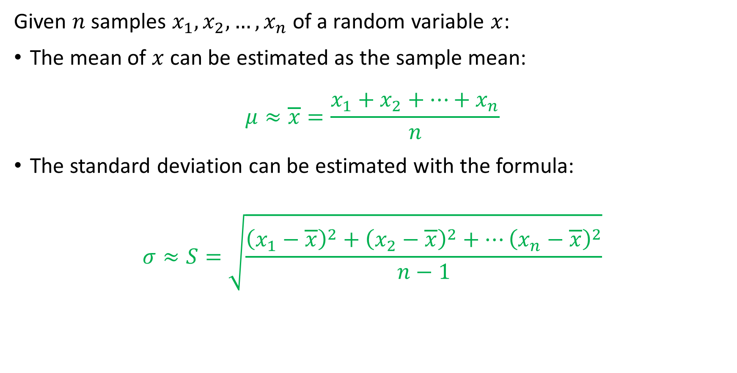
Estimating Mean and Standard Deviation
Given $n$ samples $x_{1},x_{2},…, x_{n}$ of a random variable $x$:
The mean of $x$ can be estimated as the sample mean:
$$μ≈\overline{x}=\frac{x_{1}+x_{2}+…+x_{n}}{n}$$
The standard deviation can be estimated with the formula:
$$σ≈S=\sqrt{\frac{{\left(x_{1}−\overline{x}\right)}^{2}+{\left(x_{2}−\overline{x}\right)}^{2}+…{\left(x_{n}−\overline{x}\right)}^{2}}{n−1}}$$

Slide 10
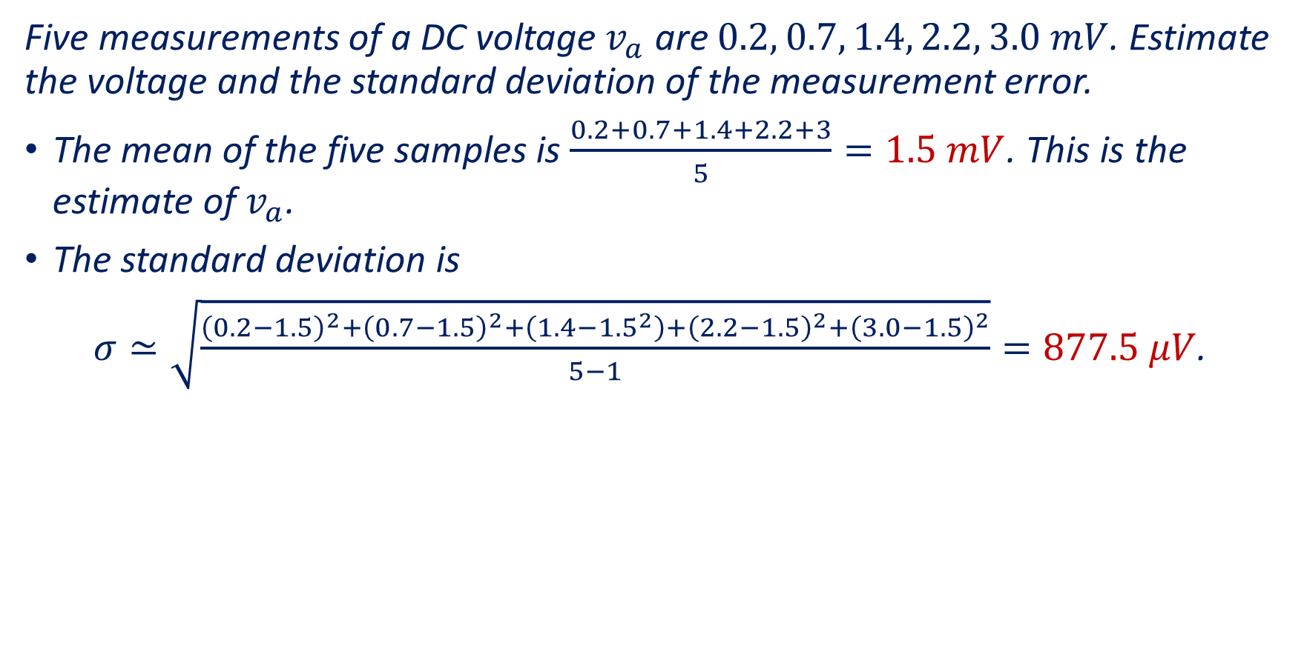
Example 1
Five measurements of a DC voltage $v_{a}$ are $0.2, 0.7, 1.4, 2.2, 3.0 mV$. Estimate the voltage and the standard deviation of the measurement error.
The mean of the five samples is $\frac{0.2+0.7+1.4+2.2+3}{5}=1.5 mV$. This is the estimate of $v_{a}$.
The standard deviation is
$σ≃\sqrt{\frac{{\left(0.2−1.5\right)}^{2}+{\left(0.7−1.5\right)}^{2}+\left(1.4−{1.5}^{2}\right)+{\left(2.2−1.5\right)}^{2}+{\left(3.0−1.5\right)}^{2}}{5−1}}=877.5 μV$.

Slide 11
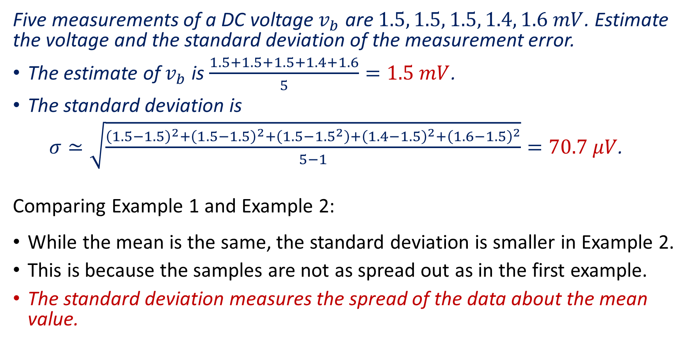
Example 2
Five measurements of a DC voltage $v_{b}$ are $1.5, 1.5, 1.5, 1.4, 1.6 mV$. Estimate the voltage and the standard deviation of the measurement error.
The estimate of $v_{b}$ is $\frac{1.5+1.5+1.5+1.4+1.6}{5}=1.5 mV$.
The standard deviation is
$σ≃\sqrt{\frac{{\left(1.5−1.5\right)}^{2}+{\left(1.5−1.5\right)}^{2}+\left(1.5−{1.5}^{2}\right)+{\left(1.4−1.5\right)}^{2}+{\left(1.6−1.5\right)}^{2}}{5−1}}=70.7 μV$.
Comparing Example 1 and Example 2:
While the mean is the same, the standard deviation is smaller in Example 2.
This is because the samples are not as spread out as in the first example.
The standard deviation measures the spread of the data about the mean value.

Slide 12
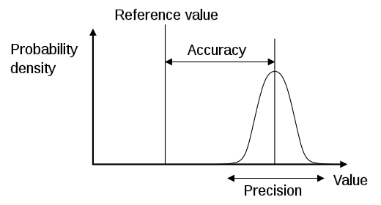
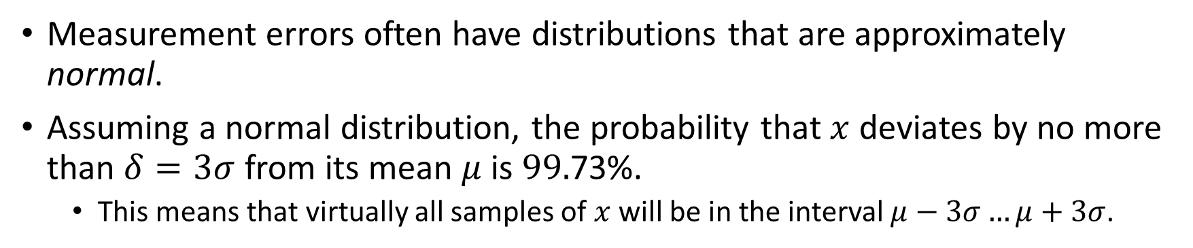
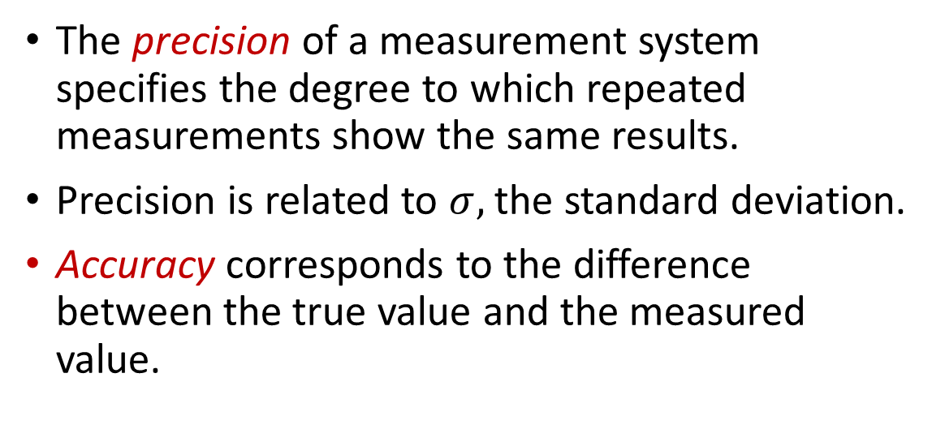
Accuracy and Precision
Measurement errors often have distributions that are approximately normal.
Assuming a normal distribution, the probability that $x$ deviates by no more than $δ=3σ$ from its mean $μ$ is $99.$73%.
This means that virtually all samples of $x$ will be in the interval $μ−3σ…μ+3σ$.
The precision of a measurement system specifies the degree to which repeated measurements show the same results.
Precision is related to $σ,$the standard deviation.
Accuracy corresponds to the difference between the true value and the measured value.
The relation between the precision and accuracy, as illustrated in Wikipedia. https://en.wikipedia.org/wiki/Accuracy_and_precision

Slide 13
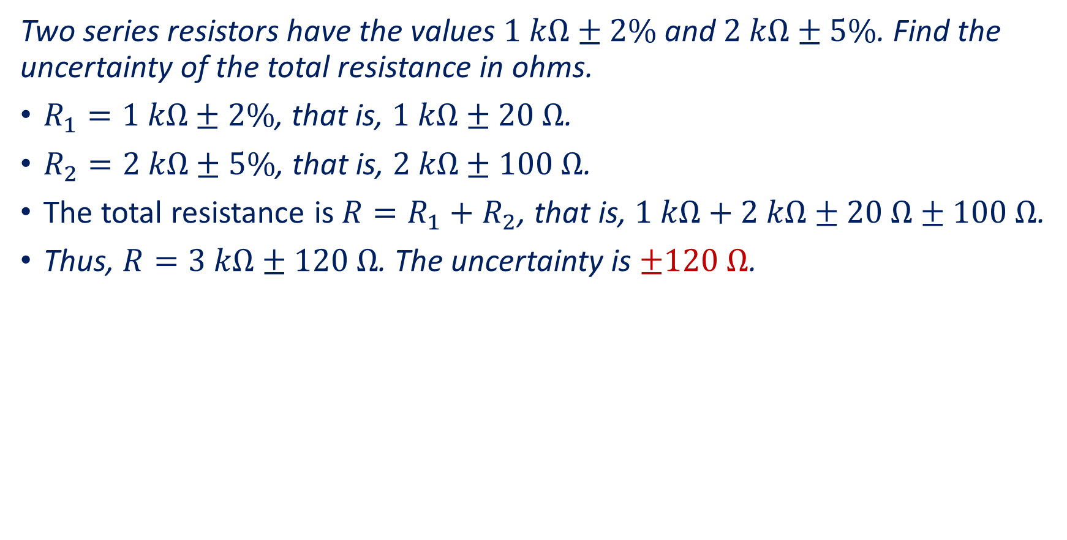
Example 3
Two series resistors have the values $1 kΩ±2\%$and $2 kΩ±5\%$. Find the uncertainty of the total resistance in ohms.
$R_{1}=1 kΩ±2\%$, that is, $1 kΩ±20 Ω$.
$R_{2}=2 kΩ±5\%$, that is, $2 kΩ±100 Ω$.
The total resistance is $R=R_{1}+R_{2}$, that is, $1 kΩ+2 kΩ±20 Ω±100 Ω$.
Thus, $R=3 kΩ±120 Ω$. The uncertainty is $±120 Ω$.

Slide 14
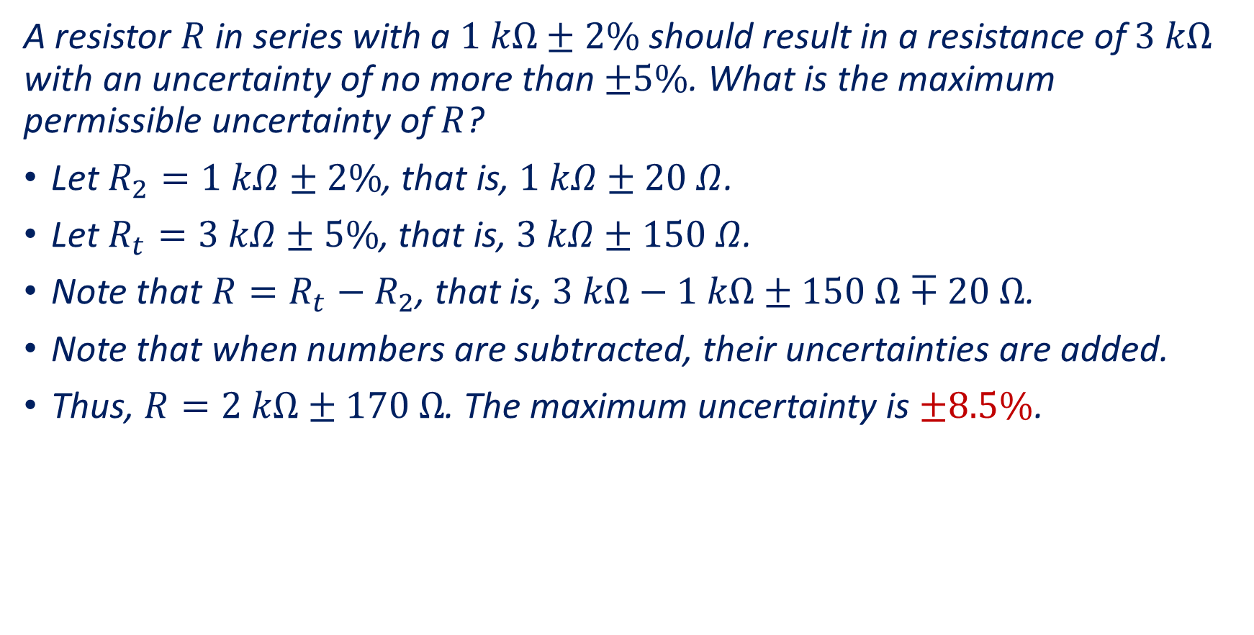
Example 4
A resistor $R$ in series with a $1 kΩ±2\%$ should result in a resistance of $3 kΩ$ with an uncertainty of no more than $±5\%$. What is the maximum permissible uncertainty of $R$?
Let $R_{2}=1 kΩ±2\%$, that is, $1 kΩ±20 Ω$.
Let $R_{t}=3 kΩ±5\%$, that is, $3 kΩ±150 Ω$.
Note that $R=R_{t}−R_{2}$, that is, $3 kΩ−1 kΩ±150 Ω∓20 Ω$.
Note that when numbers are subtracted, their uncertainties are added.
Thus, $R=2 kΩ±170 Ω$. The maximum uncertainty is $±8.5\%$.

Slide 15
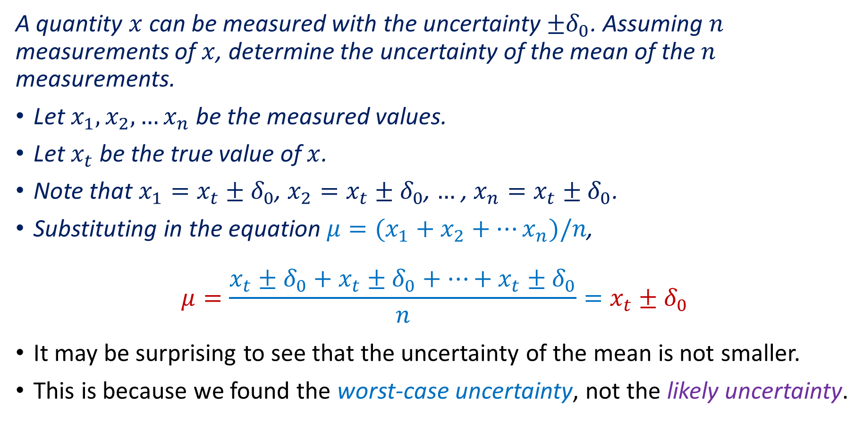
Example 5
A quantity $x$ can be measured with the uncertainty $±δ_{0}$. Assuming $n$ measurements of $x$, determine the uncertainty of the mean of the $n$ measurements.
Let $x_{1}, x_{2},…x_{n}$ be the measured values.
Let $x_{t}$ be the true value of $x$.
Note that $x_{1}=x_{t}±δ_{0}$, $x_{2}=x_{t}±δ_{0}$, $…$ , $x_{n}=x_{t}±δ_{0}$.
Substituting in the equation $μ=(x_{1}+x_{2}+…x_{n})/n$,
$$μ=\frac{x_{t}±δ_{0}+x_{t}±δ_{0}+…+x_{t}±δ_{0}}{n}=x_{t}±δ_{0}$$
It may be surprising to see that the uncertainty of the mean is not smaller.
This is because we found the worst-case uncertainty, not the likely uncertainty.

Slide 16
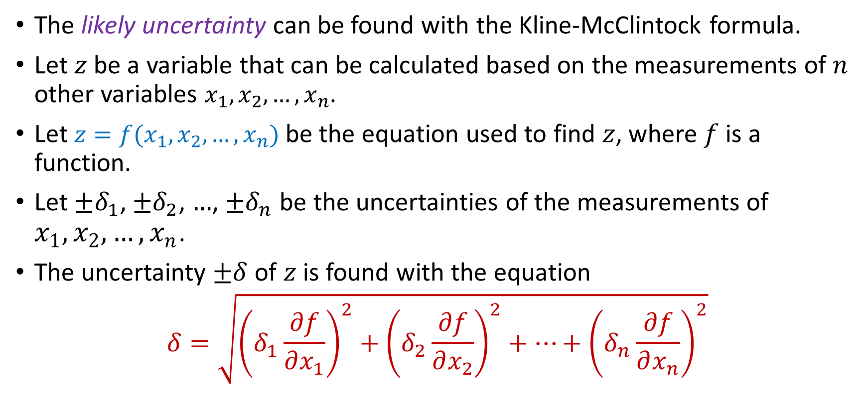
The Kline-McClintock Formula
The likely uncertainty can be found with the Kline-McClintock formula.
Let $z$ be a variable that can be calculated based on the measurements of $n$ other variables $x_{1},x_{2},…, x_{n}$.
Let $z=f(x_{1},x_{2},…, x_{n})$ be the equation used to find $z$, where $f$ is a function.
Let $±δ_{1}$, $±δ_{2}$, $…$, $±δ_{n}$ be the uncertainties of the measurements of $x_{1},x_{2},…, x_{n}$.
The uncertainty $±δ$ of $z$ is found with the equation
$$δ=\sqrt{{\left(δ_{1}\frac{∂f}{∂x_{1}}\right)}^{2}+{\left(δ_{2}\frac{∂f}{∂x_{2}}\right)}^{2}+…+{\left(δ_{n}\frac{∂f}{∂x_{n}}\right)}^{2}}$$

Slide 17
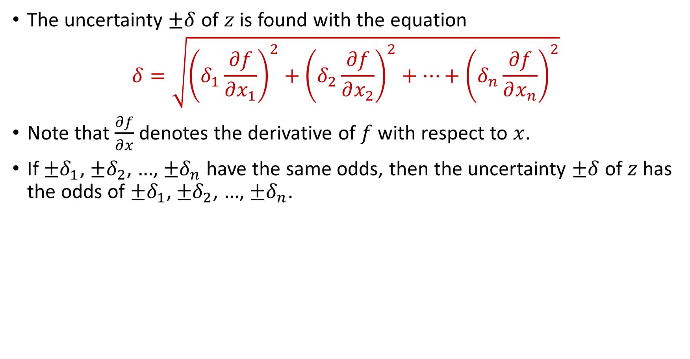
The Kline-McClintock Formula
The uncertainty $±δ$ of $z$ is found with the equation
$$δ=\sqrt{{\left(δ_{1}\frac{∂f}{∂x_{1}}\right)}^{2}+{\left(δ_{2}\frac{∂f}{∂x_{2}}\right)}^{2}+…+{\left(δ_{n}\frac{∂f}{∂x_{n}}\right)}^{2}}$$
Note that $\frac{∂f}{∂x}$ denotes the derivative of $f$ with respect to $x$.
If $±δ_{1}$, $±δ_{2}$, $…$, $±δ_{n}$ have the same odds, then the uncertainty $±δ$ of $z$has the odds of $±δ_{1}$, $±δ_{2}$, $…$, $±δ_{n}$.

Slide 18
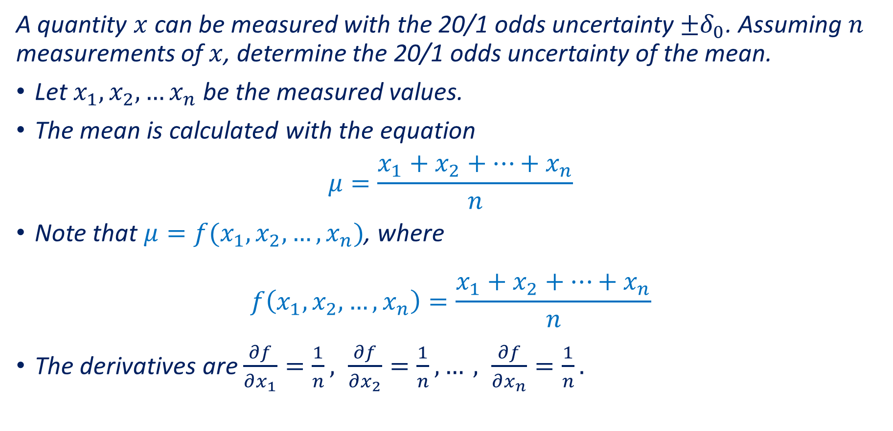
Example 6
A quantity $x$ can be measured with the 20/1 odds uncertainty $±δ_{0}$. Assuming $n$ measurements of $x$, determine the 20/1 odds uncertainty of the mean.
Let $x_{1}, x_{2},…x_{n}$ be the measured values.
The mean is calculated with the equation
$$μ=\frac{x_{1}+x_{2}+…+x_{n}}{n}$$
Note that $μ=f(x_{1},x_{2},…, x_{n})$, where
$$f\left(x_{1},x_{2},…, x_{n}\right)=\frac{x_{1}+x_{2}+…+x_{n}}{n}$$
The derivatives are $\frac{∂f}{∂x_{1}}=\frac{1}{n}, \frac{∂f}{∂x_{2}}=\frac{1}{n}, …, \frac{∂f}{∂x_{n}}=\frac{1}{n}.$

Slide 19
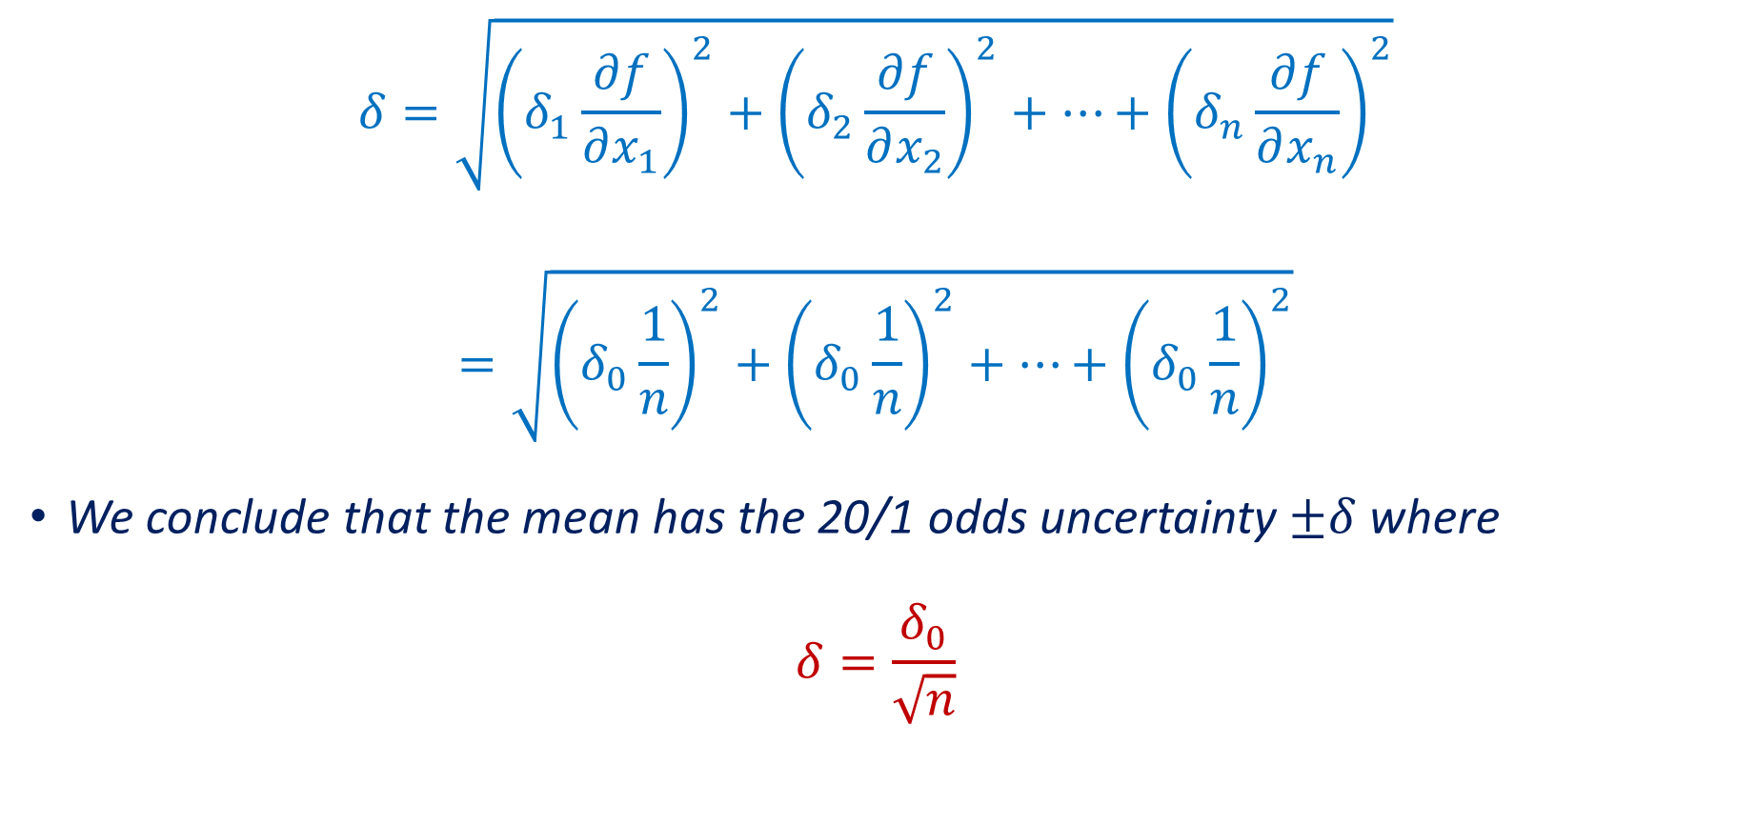
Example 6 (continued)
$$δ=\sqrt{{\left(δ_{1}\frac{∂f}{∂x_{1}}\right)}^{2}+{\left(δ_{2}\frac{∂f}{∂x_{2}}\right)}^{2}+…+{\left(δ_{n}\frac{∂f}{∂x_{n}}\right)}^{2}}$$
$$=\sqrt{{\left(δ_{0}\frac{1}{n}\right)}^{2}+{\left(δ_{0}\frac{1}{n}\right)}^{2}+…+{\left(δ_{0}\frac{1}{n}\right)}^{2}}$$
We conclude that the mean has the 20/1 odds uncertainty $±δ$ where
$$δ=\frac{δ_{0}}{\sqrt{n}}$$

Slide 20
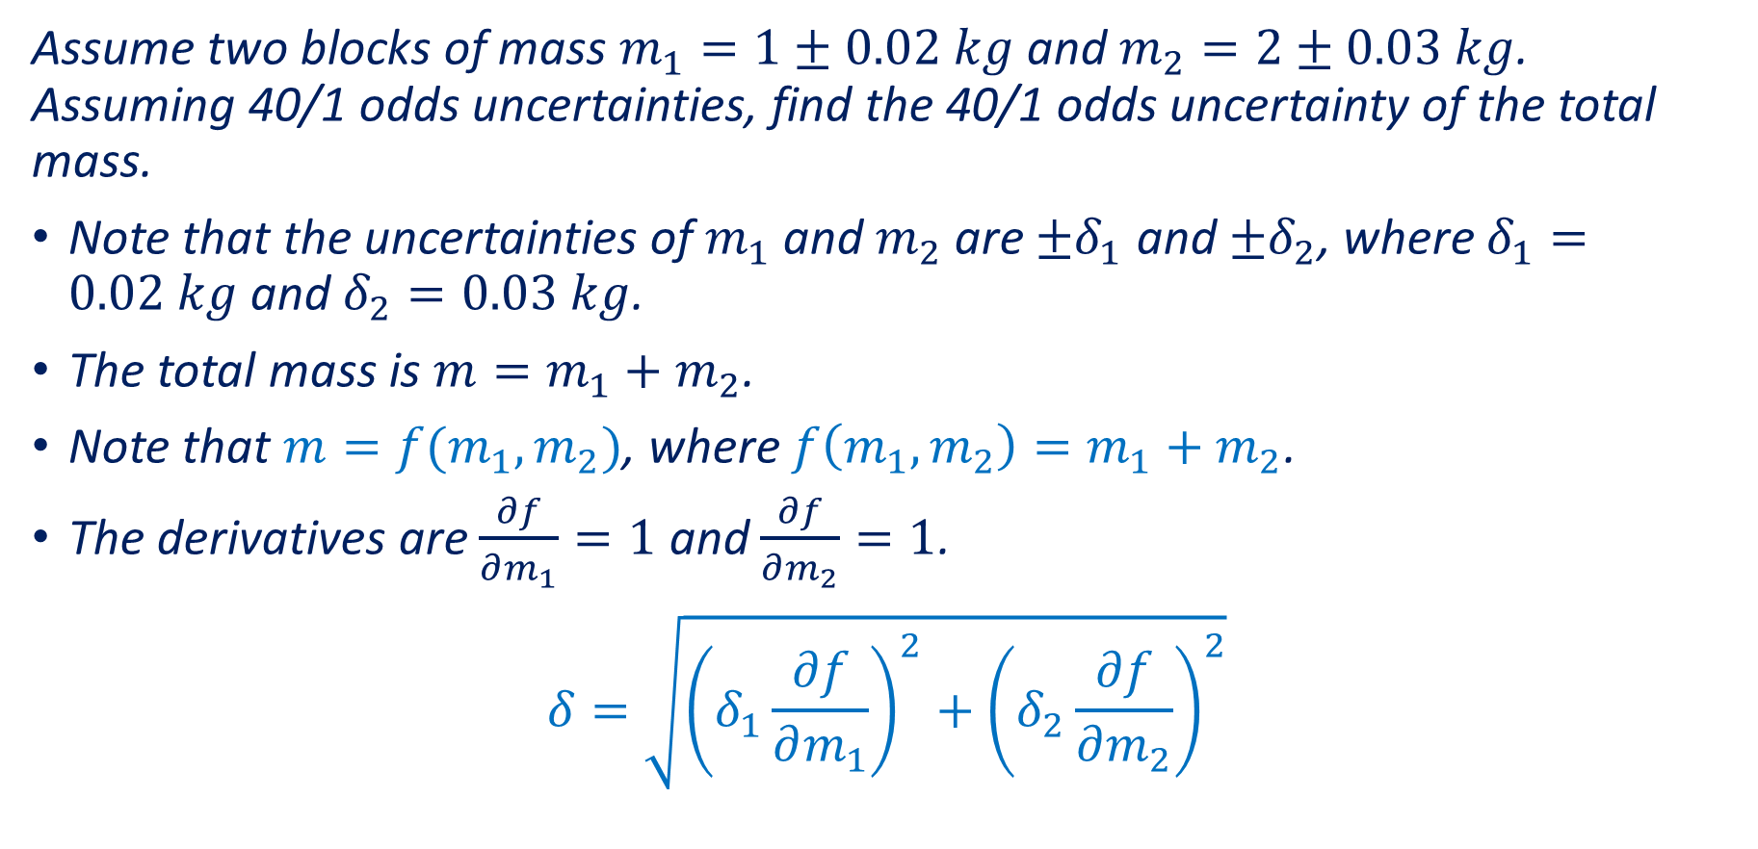
Example 7
Assume two blocks of mass $m_{1}=1±0.02 kg$ and $m_{2}=2±0.03 kg$. Assuming 40/1 odds uncertainties, find the 40/1 odds uncertainty of the total mass.
Note that the uncertainties of $m_{1}$ and $m_{2}$ are $±δ_{1}$ and $±δ_{2}$, where $δ_{1}=0.02 kg$ and $δ_{2}=0.03 kg$.
The total mass is $m=m_{1}+m_{2}$.
Note that $m=f(m_{1},m_{2})$, where $f\left(m_{1},m_{2}\right)=m_{1}+m_{2}$.
The derivatives are $\frac{∂f}{∂m_{1}}=1$ and $\frac{∂f}{∂m_{2}}=1$.
$$δ=\sqrt{{\left(δ_{1}\frac{∂f}{∂m_{1}}\right)}^{2}+{\left(δ_{2}\frac{∂f}{∂m_{2}}\right)}^{2}}$$

Slide 21

Example 7 (continued)
Substituting $\frac{∂f}{∂m_{1}}=1$ and $\frac{∂f}{∂m_{2}}=1$,
$$δ=\sqrt{δ_{1}^{2}+δ_{2}^{2}}$$
$$=\sqrt{{0.02}^{2}+{0.03}^{2}}$$
$$=0.036 kg$$
Note that the $δ=0.036 kg$ is considerably smaller than $δ_{1}+δ_{2}=0.05 kg$.

Slide 22
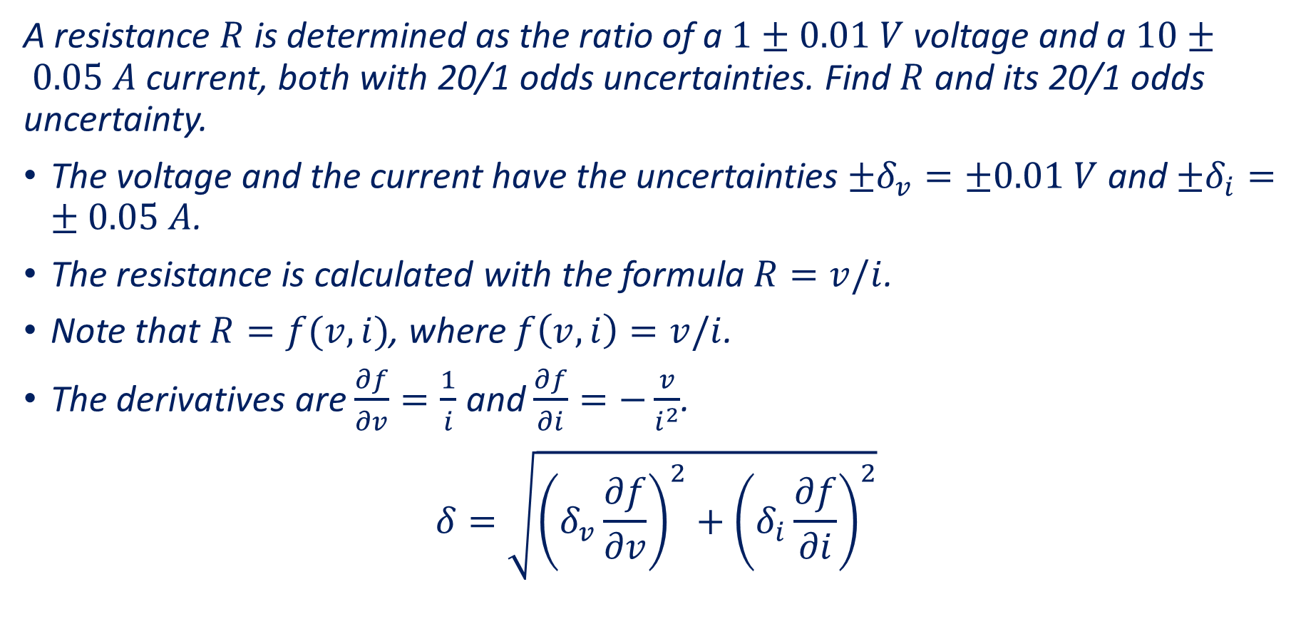
Example 8
A resistance $R$ is determined as the ratio of a $1±0.01 V$voltage and a $10± 0.05 A$ current, both with 20/1 odds uncertainties. Find $R$ and its 20/1 odds uncertainty.
The voltage and the current have the uncertainties $±δ_{v}=±0.01 V$ and $±δ_{i}=±0.05 A$.
The resistance is calculated with the formula $R=v/i$.
Note that $R=f(v,i)$, where $f\left(v,i\right)=v/i$.
The derivatives are $\frac{∂f}{∂v}=\frac{1}{i}$ and $\frac{∂f}{∂i}=−\frac{v}{i^{2}}$.
$$δ=\sqrt{{\left(δ_{v}\frac{∂f}{∂v}\right)}^{2}+{\left(δ_{i}\frac{∂f}{∂i}\right)}^{2}}$$

Slide 23
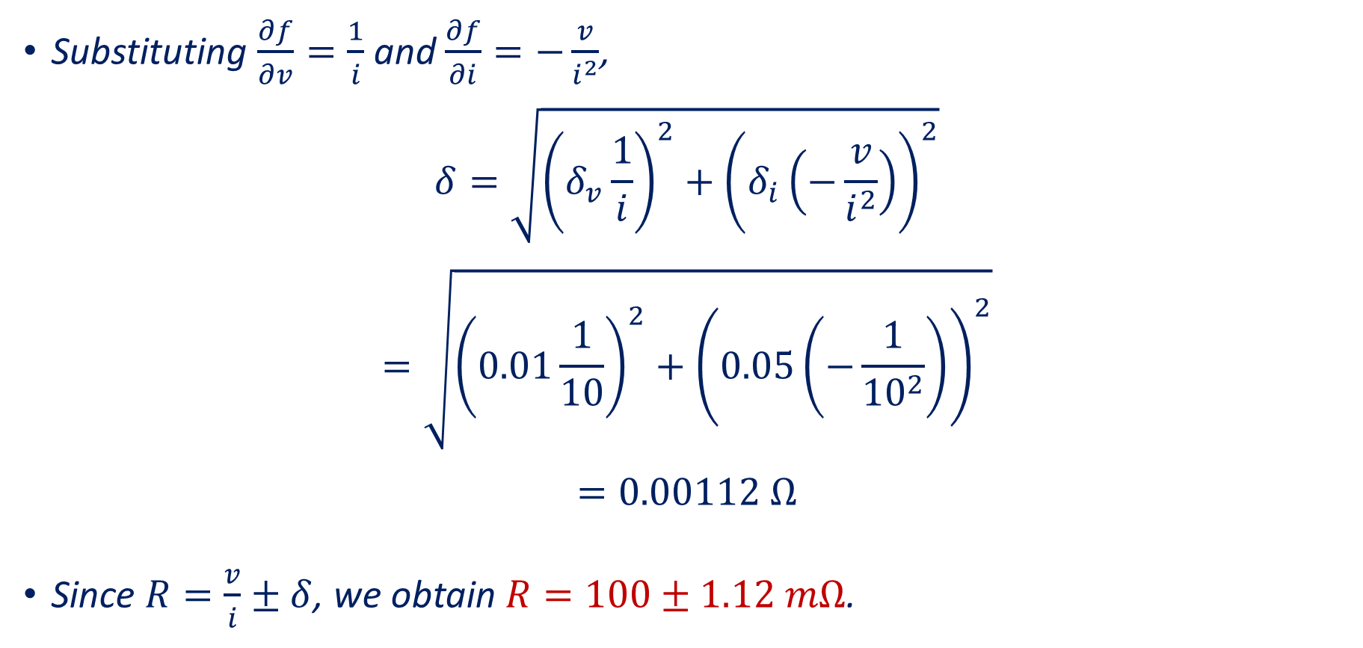
Example 8 (continued)
Substituting $\frac{∂f}{∂v}=\frac{1}{i}$ and $\frac{∂f}{∂i}=−\frac{v}{i^{2}}$,
$$δ=\sqrt{{\left(δ_{v}\frac{1}{i}\right)}^{2}+{\left(δ_{i}\left(−\frac{v}{i^{2}}\right)\right)}^{2}}$$
$$=\sqrt{{\left(0.01\frac{1}{10}\right)}^{2}+{\left(0.05\left(−\frac{1}{{10}^{2}}\right)\right)}^{2}}$$
$$=0.00112 Ω$$
Since $R=\frac{v}{i}±δ$, we obtain $R=100±1.12 mΩ$.

Slide 24
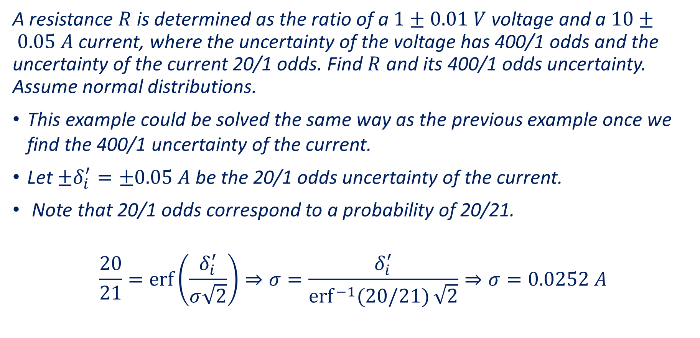
Example 9
A resistance $R$ is determined as the ratio of a $1±0.01 V$voltage and a $10± 0.05 A$ current, where the uncertainty of the voltage has 400/1 odds and the uncertainty of the current 20/1 odds. Find $R$ and its 400/1 odds uncertainty. Assume normal distributions.
This example could be solved the same way as the previous example once we find the 400/1 uncertainty of the current.
Let $±δ_{i}^{′}=±0.05 A$ be the 20/1 odds uncertainty of the current.
Note that 20/1 odds correspond to a probability of 20/21.
$$\frac{20}{21}=\operatorname{erf}\left(\frac{δ_{i}^{′}}{σ\sqrt{2}}\right)⇒σ=\frac{δ_{i}^{′}}{{erf}^{−1}{(20/21)}\sqrt{2}}⇒σ=0.0252 A$$

Slide 25
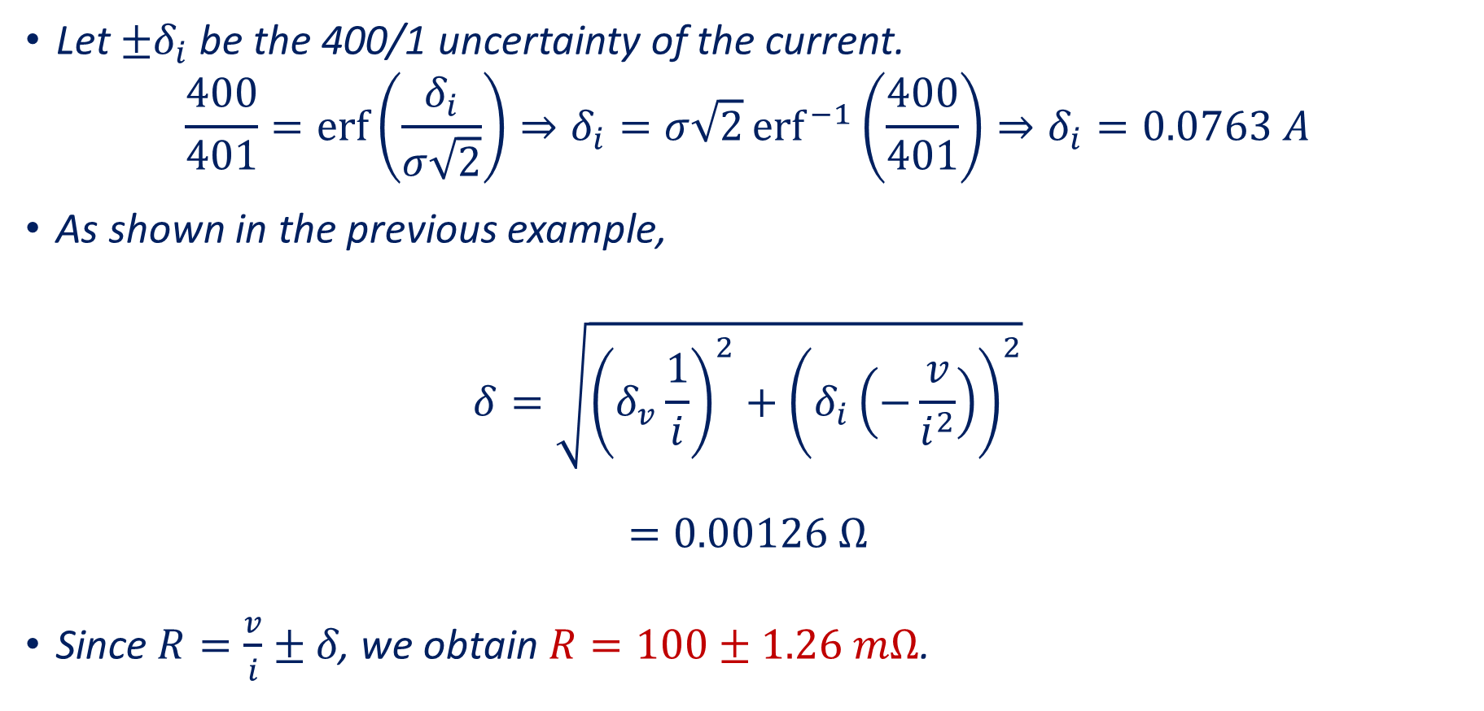
Example 9 (continued)
Let $±δ_{i}$ be the 400/1 uncertainty of the current.
$$\frac{400}{401}=\operatorname{erf}\left(\frac{δ_{i}}{σ\sqrt{2}}\right)⇒δ_{i}=σ\sqrt{2}{erf}^{−1}\left(\frac{400}{401}\right)⇒δ_{i}=0.0763 A$$
As shown in the previous example,
$$δ=\sqrt{{\left(δ_{v}\frac{1}{i}\right)}^{2}+{\left(δ_{i}\left(−\frac{v}{i^{2}}\right)\right)}^{2}}$$
$$=0.00126 Ω$$
$\text{Since} R=\frac{v}{i}±δ\text{, }\text{we} \text{obtain} R=100±1.26 mΩ\text{. }$

