Slide 1
Sources, Multimeters, and Transformers
M.V. Iordache, EEGR2051 Circuits and Measurements Lab, Fall 2020, LeTourneau University
See https://mviordache.name/EEGR2051 for more information.

Slide 2
DC Power Supplies

Slide 3
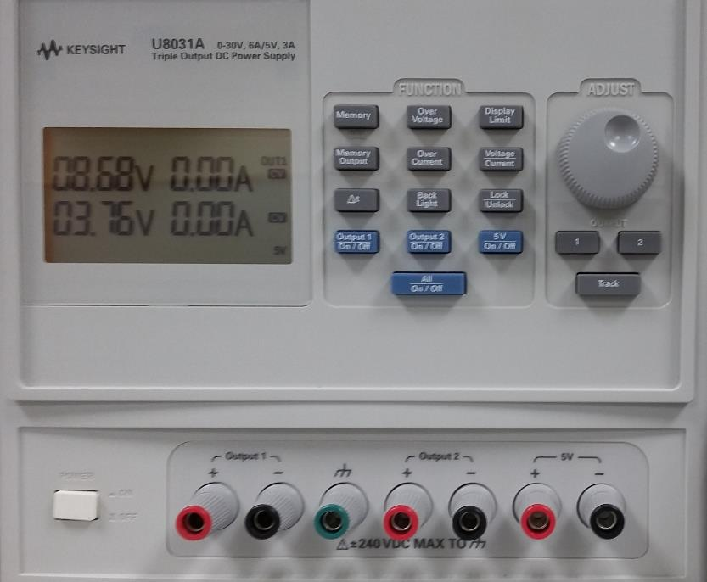
DC Power Supplies—Review
Consist of electronic circuits that convert the AC supply of the wall outlet to DC.
Typically, they can operate in
constant voltage (CV) mode.
constant current (CC) mode.
The internal resistance of DC power supplies is negligible.
In CV mode, the source resembles an ideal source of voltage.
In CC mode, the source resembles an ideal source of current.
A triple DC power supply.

Slide 4
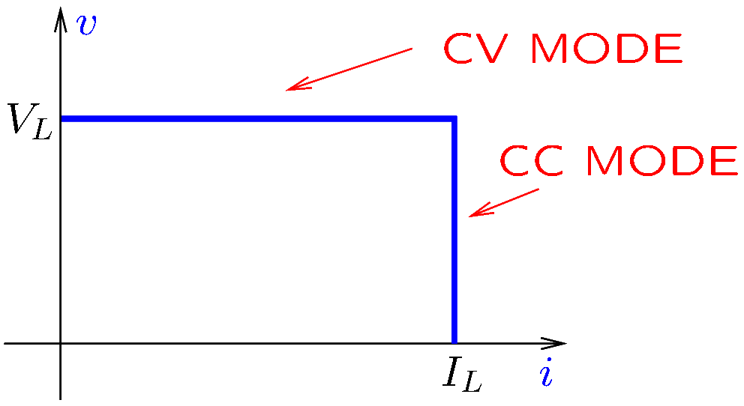
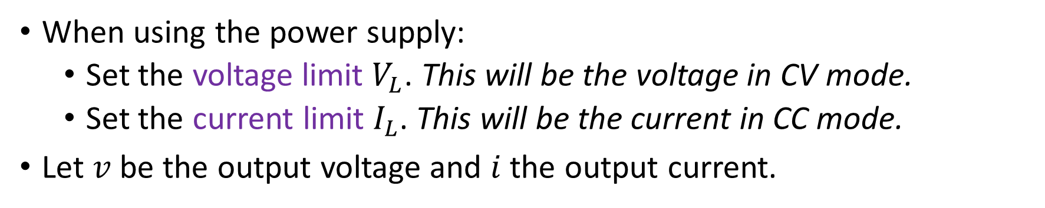
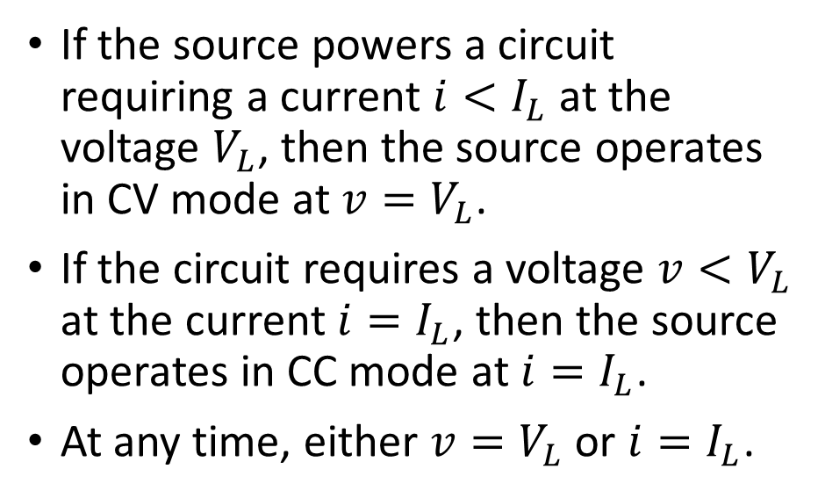
DC Power Supplies—Review
When using the power supply:
Set the voltage limit $V_{L}$. This will be the voltage in CV mode.
Set the current limit $I_{L}$. This will be the current in CC mode.
Let $v$ be the output voltage and $i$ the output current.
If the source powers a circuit requiring a current $i<I_{L}$ at the voltage $V_{L}$, then the source operates in CV mode at $v=V_{L}$.
If the circuit requires a voltage $v<V_{L}$ at the current $i=I_{L}$, then the source operates in CC mode at $i=I_{L}$.
At any time, either $v=V_{L}$ or $i=I_{L}$.
Notes:
cvcc.fig

Slide 5
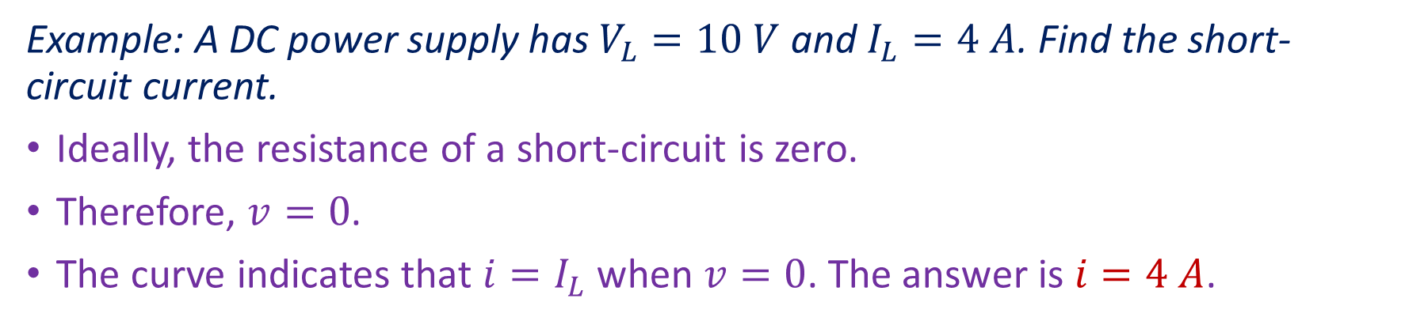
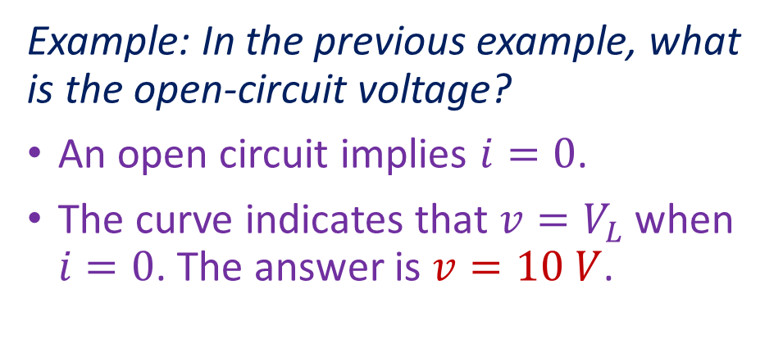
DC Power Supplies
Example: A DC power supply has $V_{L}=10 V$ and $I_{L}=4 A$. Find the short-circuit current.
Ideally, the resistance of a short-circuit is zero.
Therefore, $v=0$.
The curve indicates that $i=I_{L}$ when $v=0$. The answer is $i=4 A$.
Example: In the previous example, what is the open-circuit voltage?
An open circuit implies $i=0$.
The curve indicates that $v=V_{L}$ when $i=0$. The answer is $v=10 V$.
Notes:
cvcc.fig

Slide 6
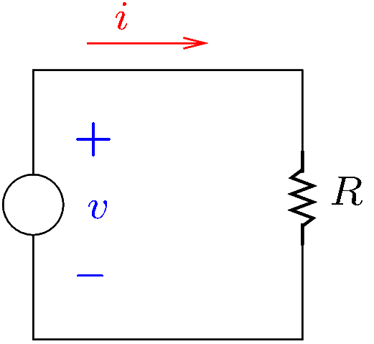
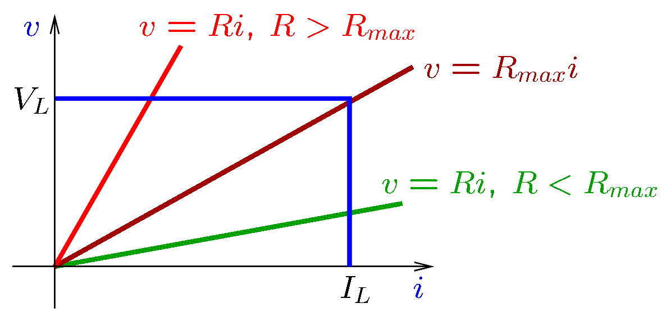
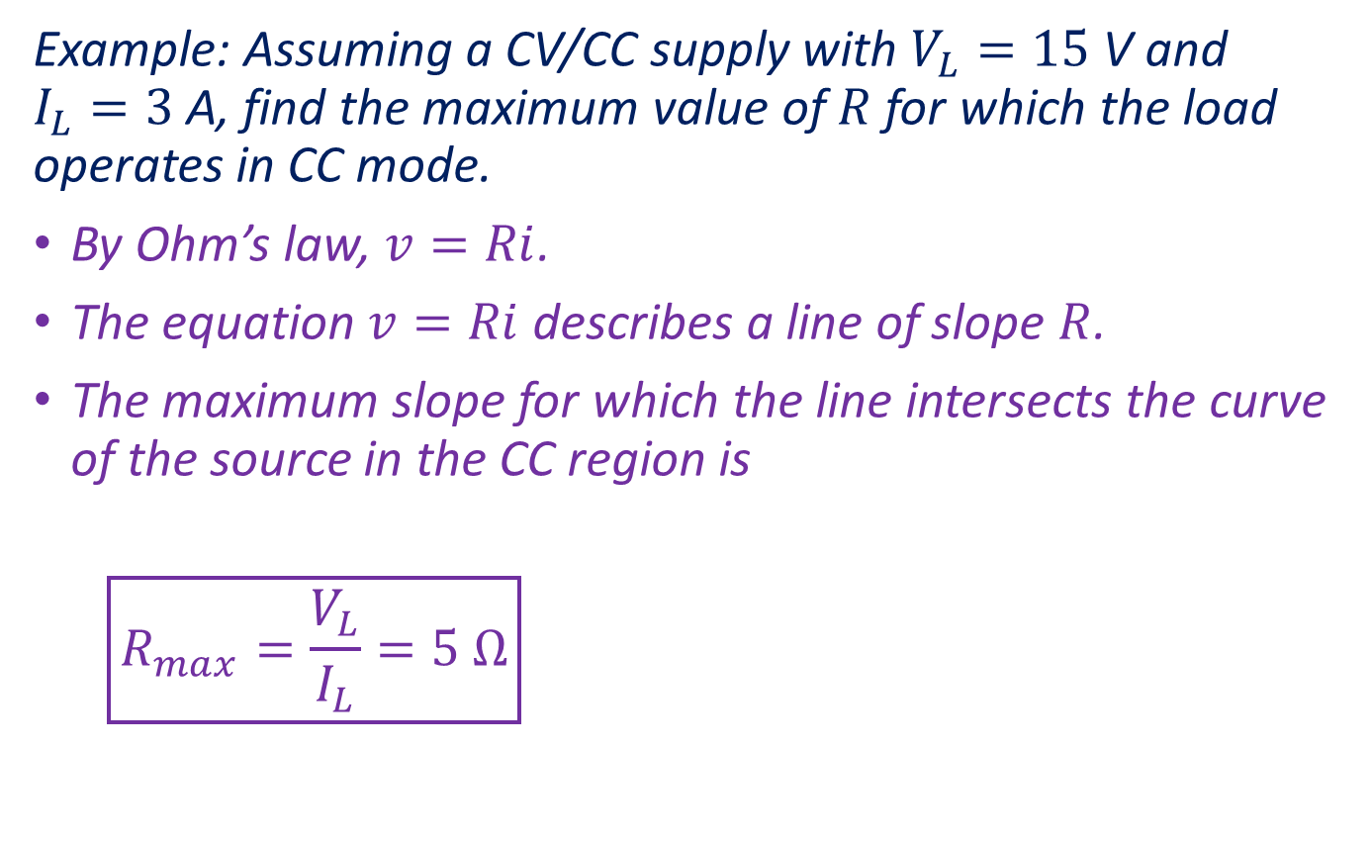
DC Power Supplies
Example: Assuming a CV/CC supply with $V_{L}=15$V and $I_{L}=3$A, find the maximum value of $R$ for which the load operates in CC mode.
By Ohm’s law, $v=Ri$.
The equation $v=Ri$ describes a line of slope $R$.
The maximum slope for which the line intersects the curve of the source in the CC region is
$$\boxed{R_{max}=\frac{V_{L}}{I_{L}}=5 Ω}$$
Notes:
cvex.fig and cvcc4.fig

Slide 7
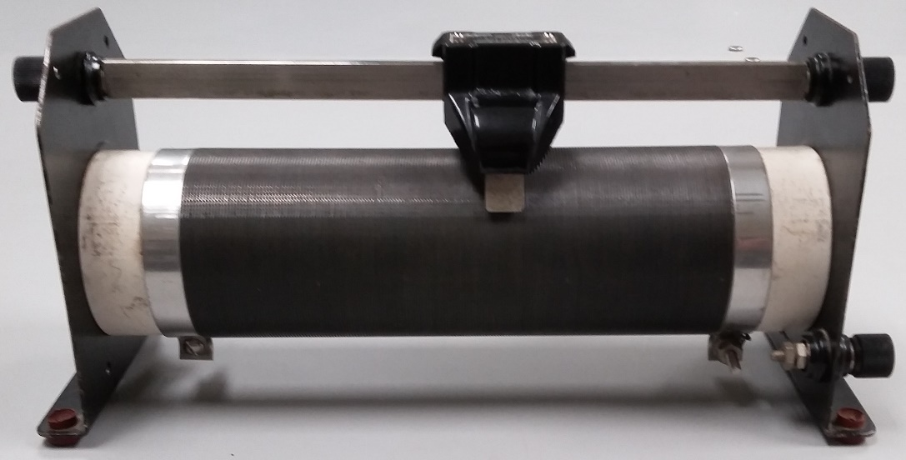
Adjusting Current and Voltage
If the voltage of a DC source cannot be changed, a simple way to adjust the load current is with a rheostat.
A rheostat is a variable resistor rated for high power levels.
In a slide rheostat:
B
slider
Resistive wire wound around an insulating tube forms a resistor.
Let X and Y be the resistor terminals.
A slider, also known as wiper, slides on a conductive bar B while touching the resistive wire.
By moving the slider left or right, it is possible to vary the resistance between B and X or B and Y.
X
Y

Slide 8
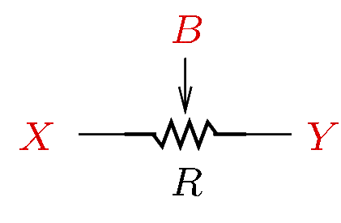
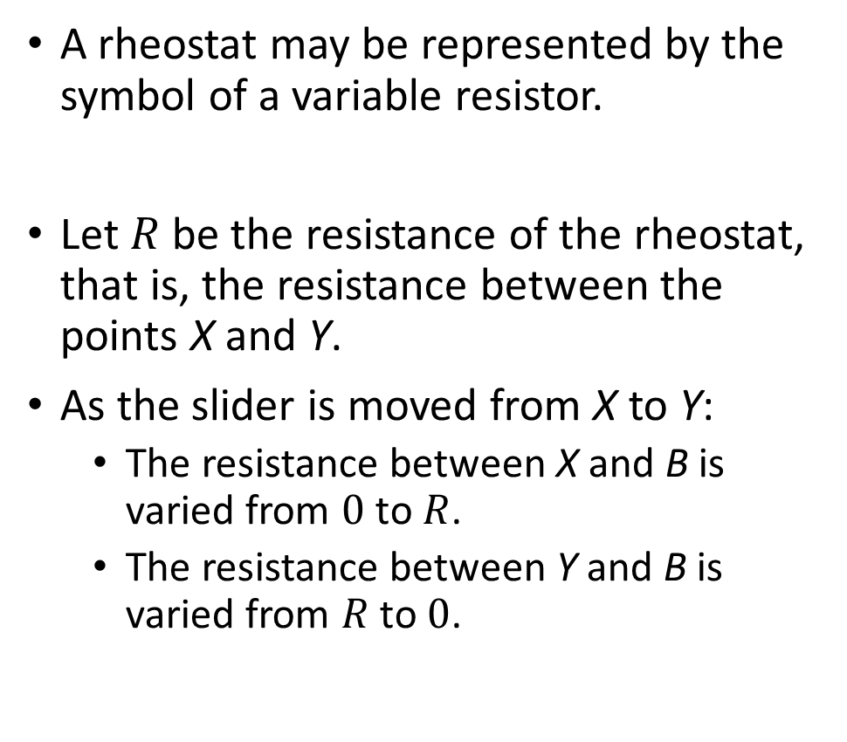
Adjusting Current and Voltage
A rheostat may be represented by the symbol of a variable resistor.
Let $R$ be the resistance of the rheostat, that is, the resistance between the points X and Y.
As the slider is moved from X to Y:
The resistance between X and B is varied from $0$ to $R$.
The resistance between Y and B is varied from $R$ to $0$.
B
slider
X
Y

Slide 9
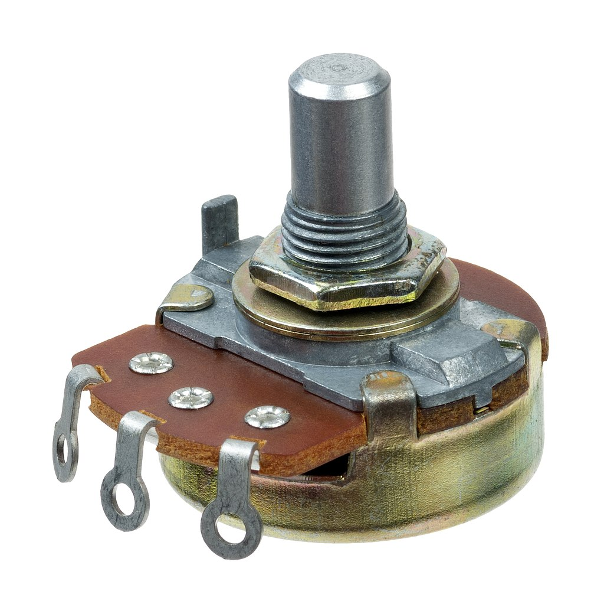
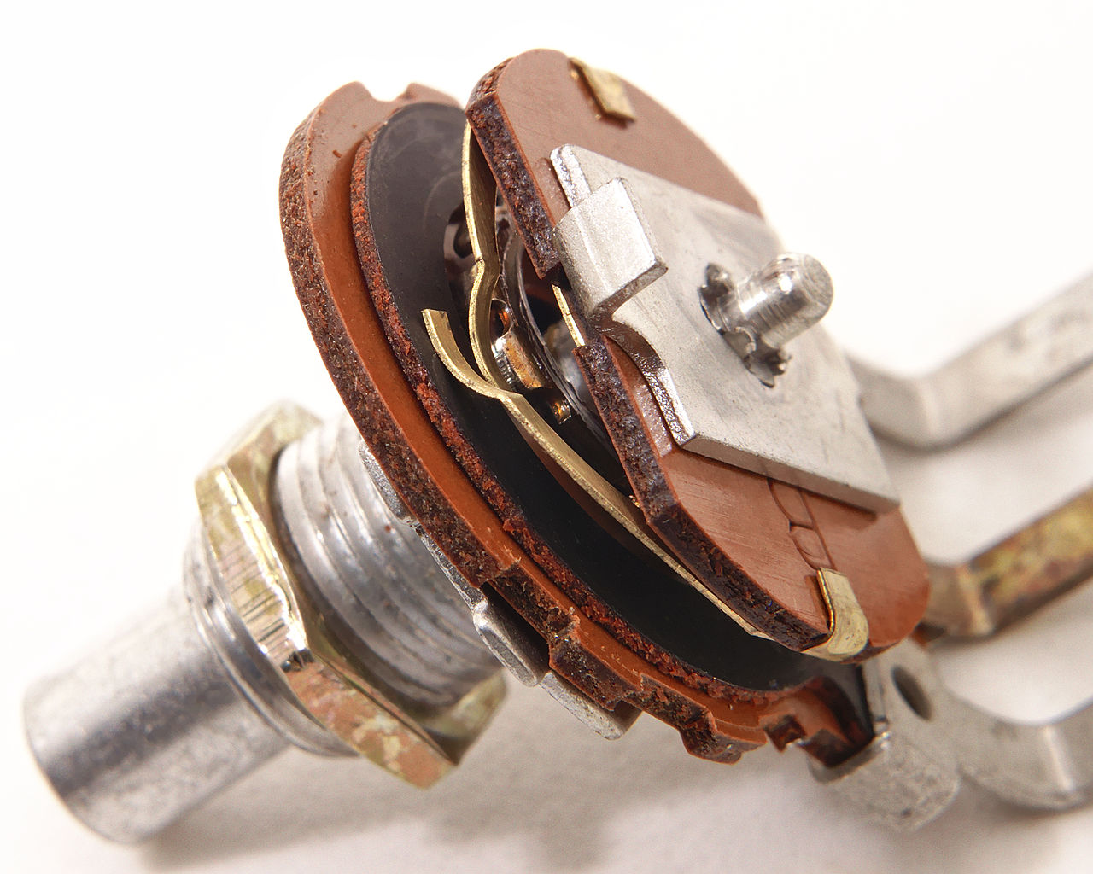
Adjusting Current and Voltage
When a load requires a small amount of current, a simple way to change its voltage is with a potentiometer.
A potentiometer is a variable resistor rated for low power levels.
A potentiometer has:
A resistive track connected to the left and right terminals.
A wiper connected to the middle terminal and attached to a rotating shaft.
The wiper touches the resistive track.
By turning the shaft, the resistance between the middle terminal and the right/left terminals is varied.
Resistive track
Wiper touching the resistive track
Images from https://commons.wikimedia.org/wiki/File:Electronic-Component-Potentiometer.jpg
and https://commons.wikimedia.org/wiki/File:Single-turn_potentiometer_with_internals_exposed,_oblique_view.jpg

Slide 10
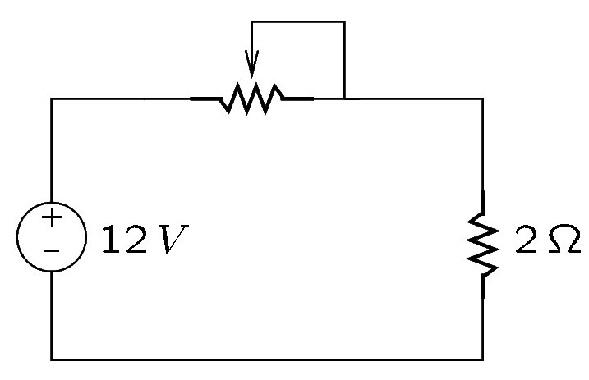
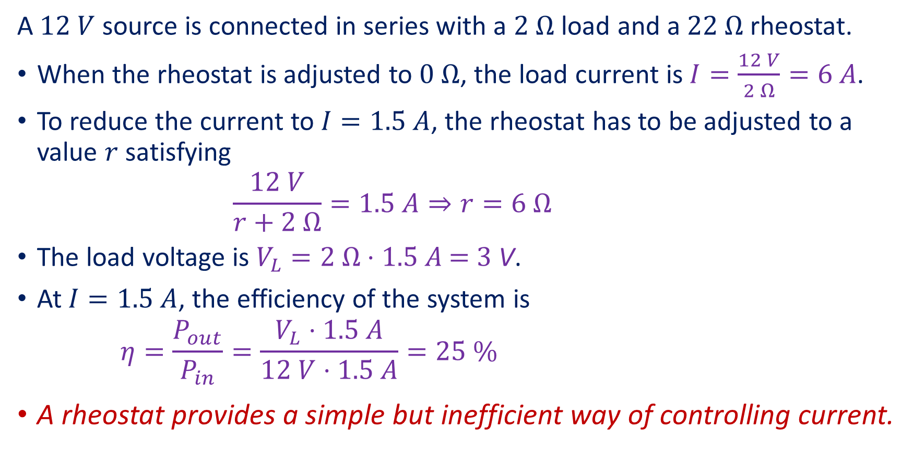
Adjusting Current and Voltage—Example
A $12 V$ source is connected in series with a $2 Ω$ load and a $22 Ω$ rheostat.
When the rheostat is adjusted to $0 Ω$, the load current is $I=\frac{12 V}{2 Ω}=6 A$.
To reduce the current to $I=1.5 A$, the rheostat has to be adjusted to a value $r$ satisfying
$$\frac{12 V}{r+2 Ω}=1.5 A⇒r=6 Ω$$
The load voltage is $V_{L}=2 Ω⋅1.5 A\text{ = 3} \text{V}$.
At $I=1.5 A$, the efficiency of the system is
$$η=\frac{P_{out}}{P_{in}}=\frac{V_{L}⋅1.5 A}{12 V⋅1.5 A}=25 \%$$
A rheostat provides a simple but inefficient way of controlling current.
Notes:
rh_ex.fig

Slide 11
Multimeters

Slide 12
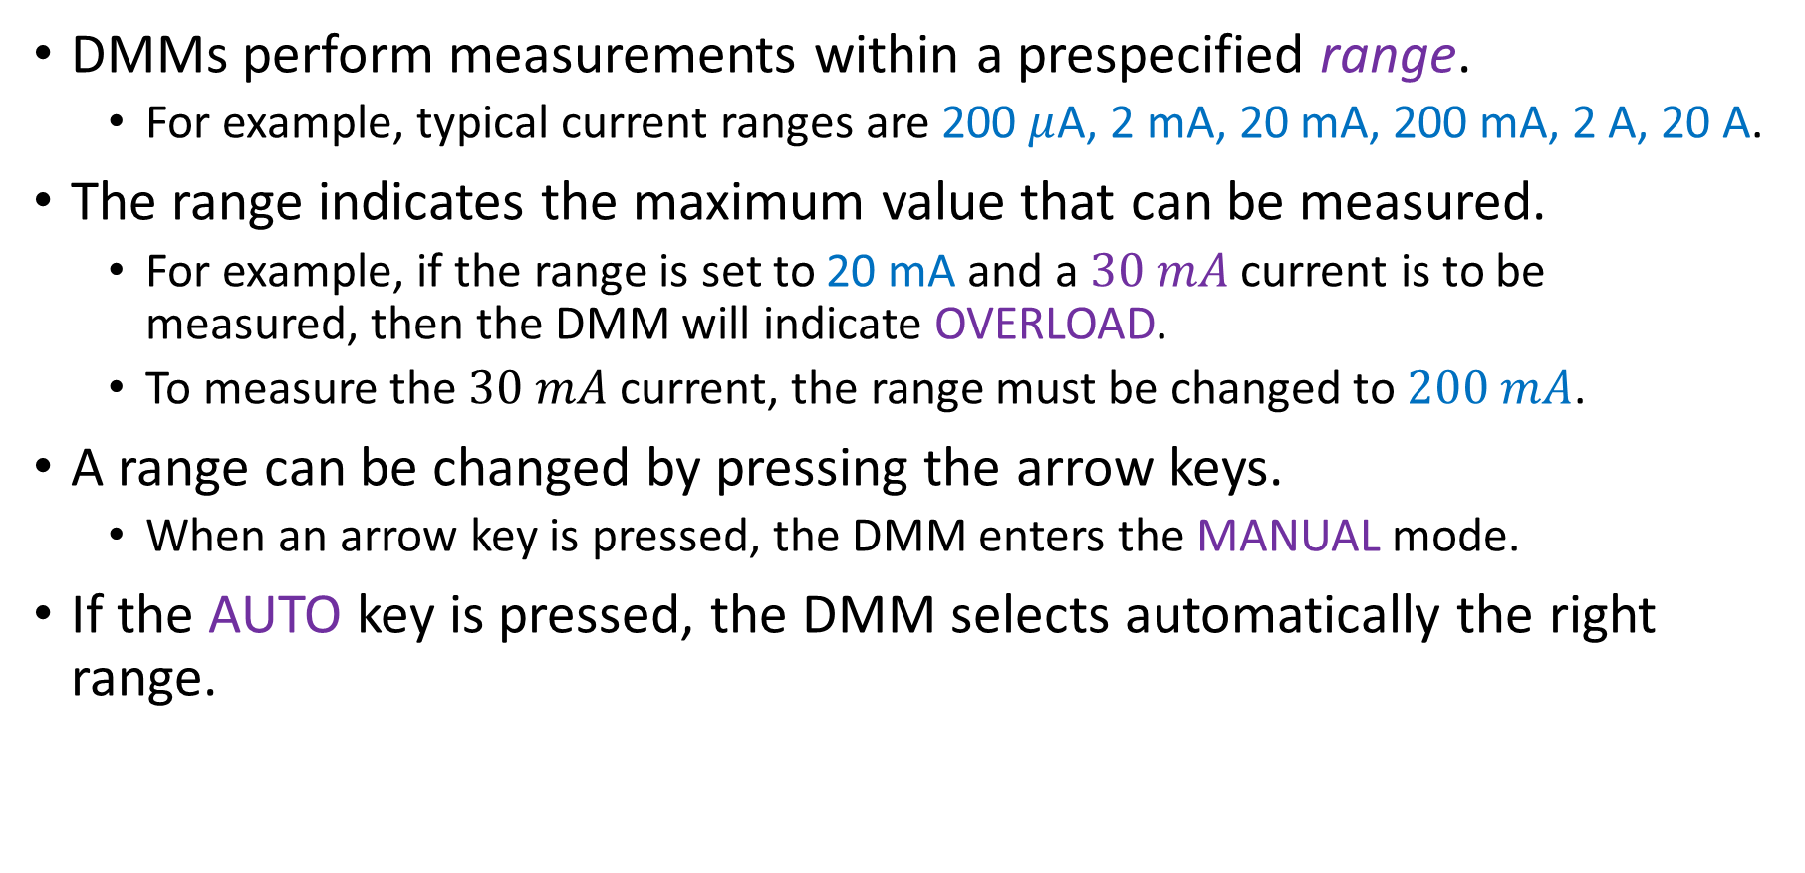
Measurement Range
DMMs perform measurements within a prespecified range.
For example, typical current ranges are 200 $μ$A, 2 mA, 20 mA, 200 mA, 2 A, 20 A.
The range indicates the maximum value that can be measured.
For example, if the range is set to 20 mA and a $30 mA$ current is to be measured, then the DMM will indicate OVERLOAD.
To measure the $30 mA$ current, the range must be changed to $200 mA$.
A range can be changed by pressing the arrow keys.
When an arrow key is pressed, the DMM enters the MANUAL mode.
If the AUTO key is pressed, the DMM selects automatically the right range.
Notes:
amp.fig

Slide 13
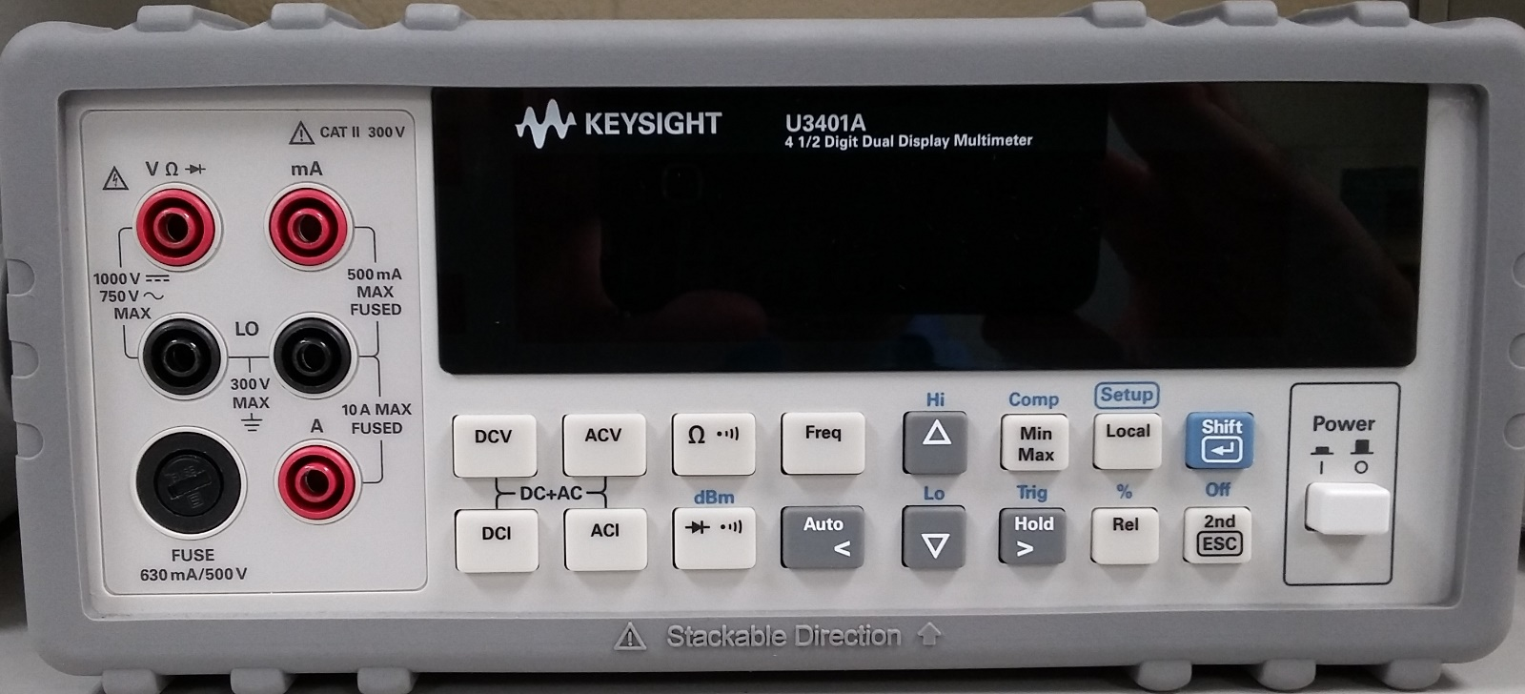
Current Measurements
DMMs typically have two current terminals:
The terminal for low-current ranges (typically, below 1A).
The terminal for high-current ranges (typically, above 1A).
Notes:
amp.fig

Slide 14
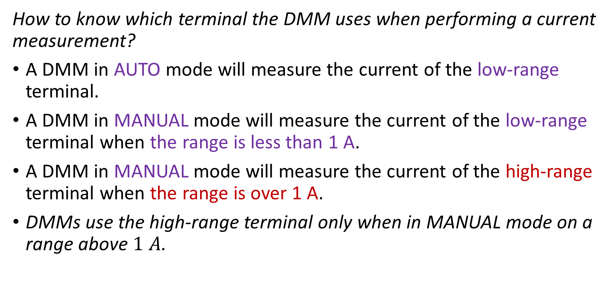
Current Measurements
How to know which terminal the DMM uses when performing a current measurement?
A DMM in AUTO mode will measure the current of the low-range terminal.
A DMM in MANUAL mode will measure the current of the low-range terminal when the range is less than 1 A.
A DMM in MANUAL mode will measure the current of the high-range terminal when the range is over 1 A.
DMMs use the high-range terminal only when in MANUAL mode on a range above $1 A$.
Notes:
rh_ex.fig

Slide 15
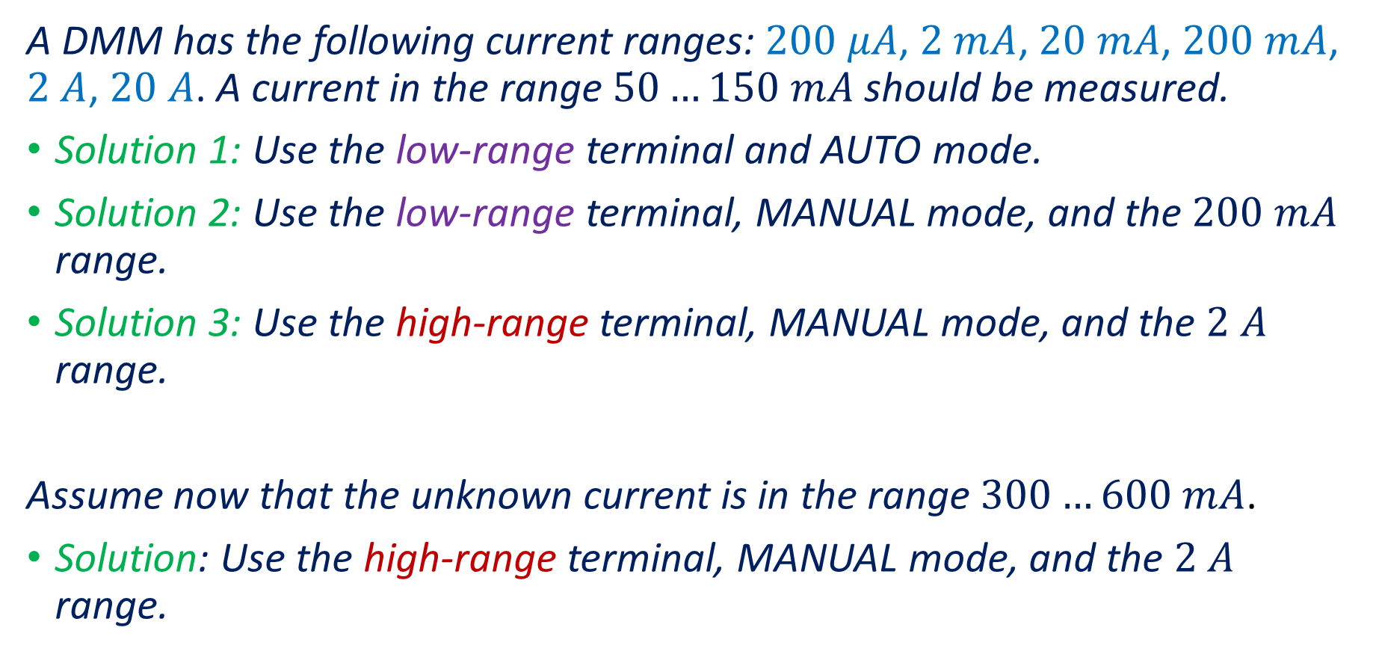
Current Measurements—Examples
A DMM has the following current ranges: $200 μA$, $2 mA$, $20 mA$, $200 mA$, $2 A$, $20 A$. A current in the range $50…150 mA$ should be measured.
Solution 1: Use the low-range terminal and AUTO mode.
Solution 2: Use the low-range terminal, MANUAL mode, and the $200 mA$ range.
Solution 3: Use the high-range terminal, MANUAL mode, and the $2 A$ range.
Assume now that the unknown current is in the range $300…600 mA$.
Solution: Use the high-range terminal, MANUAL mode, and the $2 A$ range.
Notes:
rh_ex.fig

Slide 16
The Loading Effect
Ideally, an instrument will not change the value of the variable it measures.
However, DMMs connected to a circuit act as additional circuit loads and change somewhat the currents and voltages they measure.
This is known as the loading effect.
In most cases, when a DMM is used correctly, the loading effect is not significant.
To avoid measurement error, it is necessary to determine whether a DMM loads considerably a circuit.
Notes:
amp.fig

Slide 17
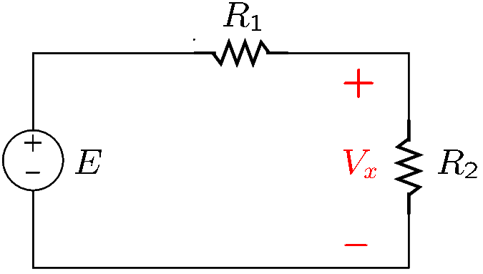
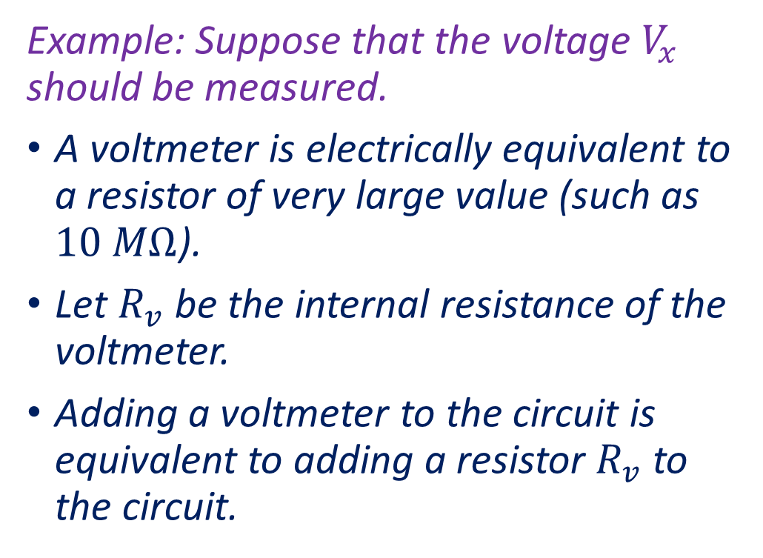
The Loading Effect—Voltage Measurements
Example: Suppose that the voltage $V_{x}$ should be measured.
A voltmeter is electrically equivalent to a resistor of very large value (such as $10 MΩ$).
Let $R_{v}$ be the internal resistance of the voltmeter.
Adding a voltmeter to the circuit is equivalent to adding a resistor $R_{v}$ to the circuit.
Notes:
vloading.fig

Slide 18
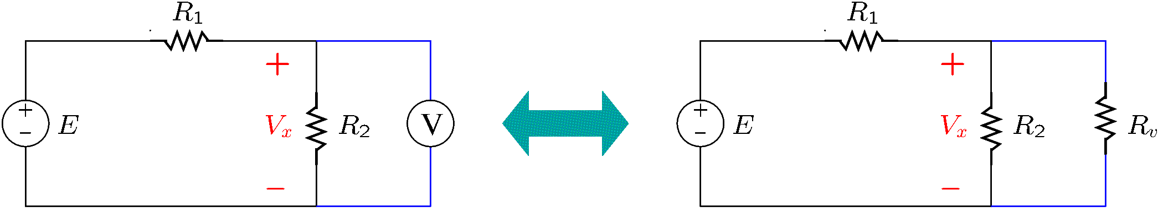
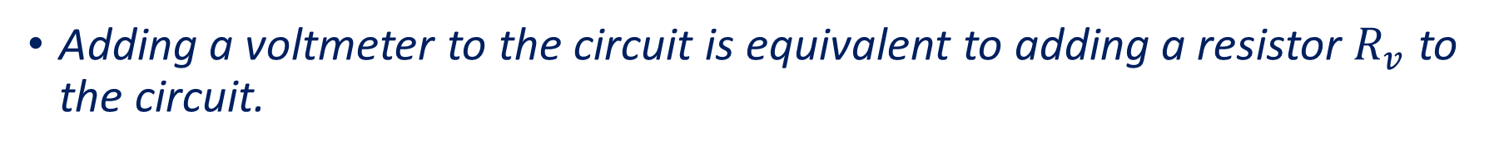
The Loading Effect—Voltage Measurements
Adding a voltmeter to the circuit is equivalent to adding a resistor $R_{v}$ to the circuit.
Notes:
vloading2.fig

Slide 19
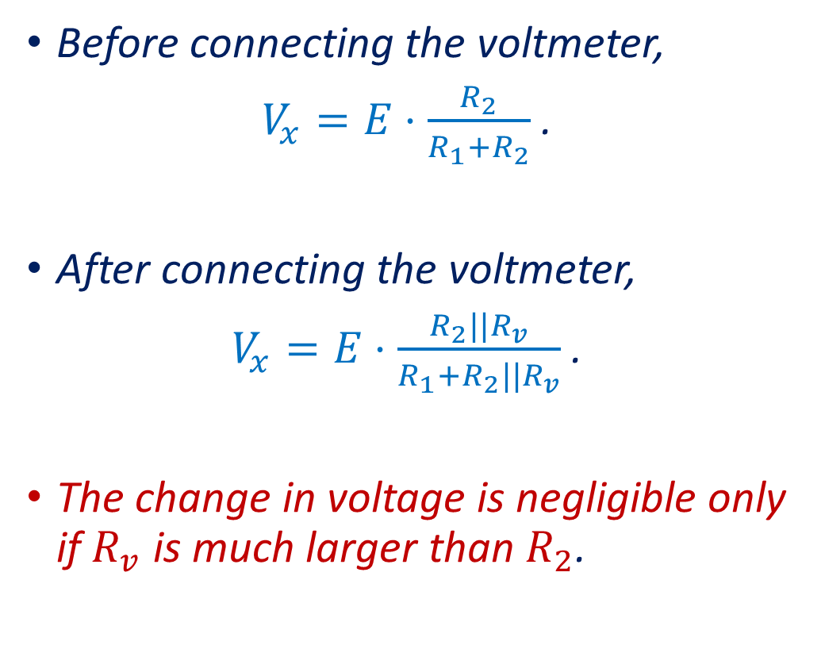
The Loading Effect—Voltage Measurements
Before connecting the voltmeter,
$V_{x}=E⋅\frac{R_{2}}{R_{1}+R_{2}}$.
After connecting the voltmeter,
$V_{x}=E⋅\frac{R_{2}||R_{v}}{R_{1}+R_{2}||R_{v}}$.
The change in voltage is negligible only if $R_{v}$ is much larger than $R_{2}$.

Slide 20
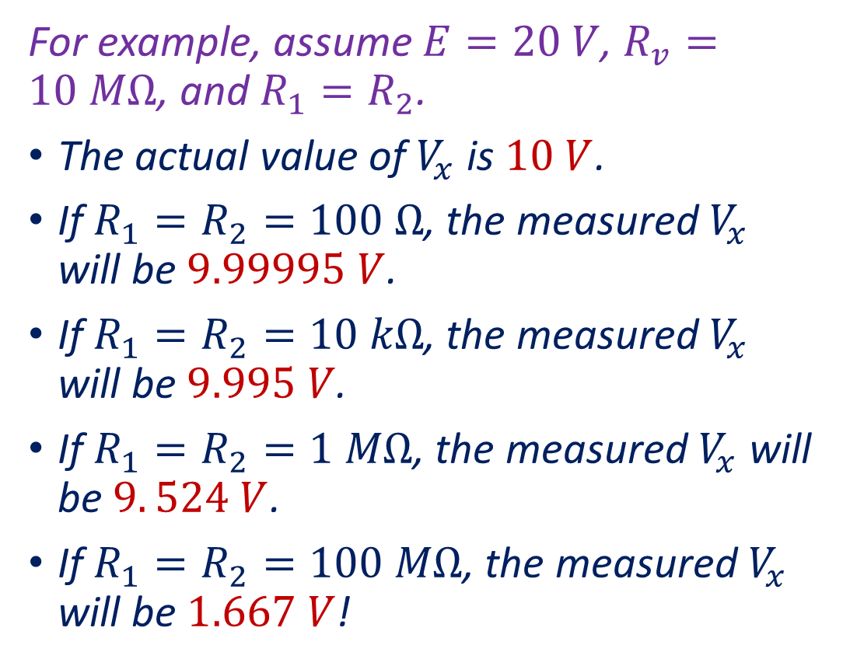
The Loading Effect—Voltage Measurements
For example, assume $E=20 V$, $R_{v}=10 MΩ$, and $R_{1}=R_{2}$.
The actual value of $V_{x}$ is $10 V$.
If $R_{1}=R_{2}=100 Ω$, the measured $V_{x}$ will be $9.99995 V$.
If $R_{1}=R_{2}=10 kΩ$, the measured $V_{x}$ will be $9.995 V$.
If $R_{1}=R_{2}=1 MΩ$, the measured $V_{x}$ will be $9. 524 V$.
If $R_{1}=R_{2}=100 MΩ$, the measured $V_{x}$ will be $1.667 V$!

Slide 21
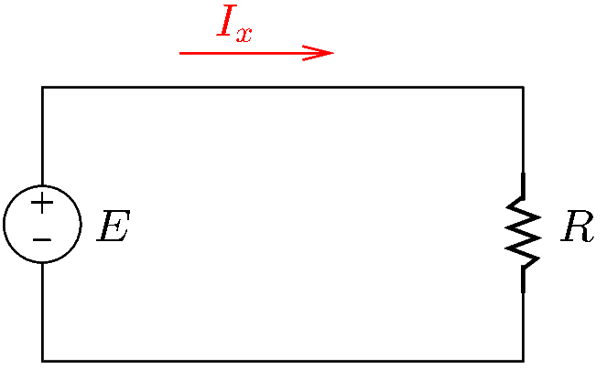
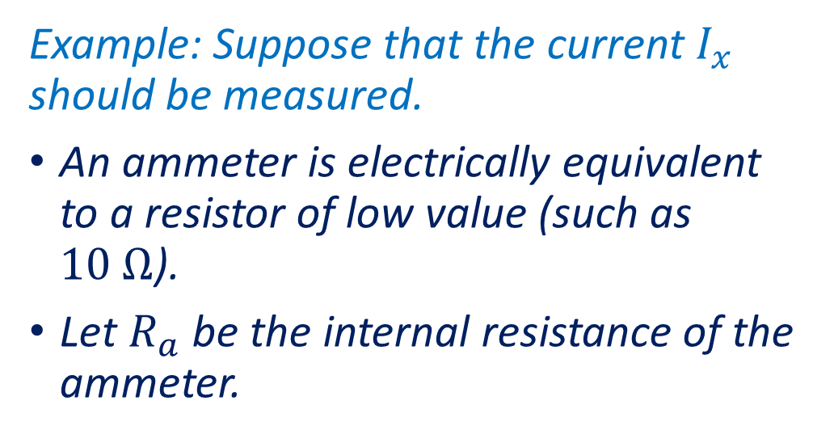
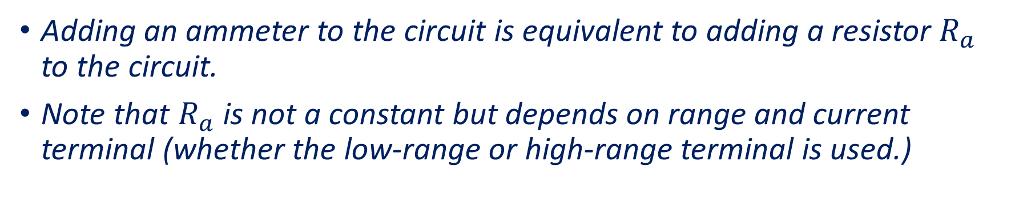
The Loading Effect—Current Measurements
Example: Suppose that the current $I_{x}$ should be measured.
An ammeter is electrically equivalent to a resistor of low value (such as $10 Ω$).
Let $R_{a}$ be the internal resistance of the ammeter.
Adding an ammeter to the circuit is equivalent to adding a resistor $R_{a}$ to the circuit.
Note that $R_{a}$ is not a constant but depends on range and current terminal (whether the low-range or high-range terminal is used.)
Notes:
aloading.fig

Slide 22
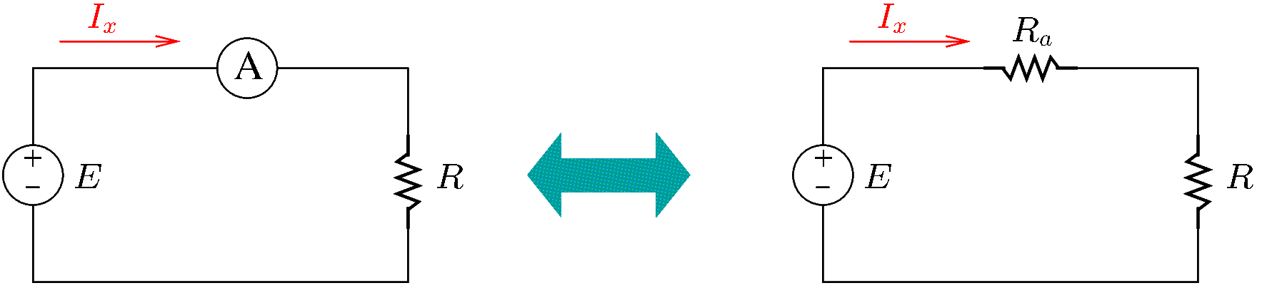

The Loading Effect—Current Measurements
Adding an ammeter to the circuit is equivalent to adding a resistor $R_{a}$ to the circuit.
Notes:
aloading2.fig

Slide 23
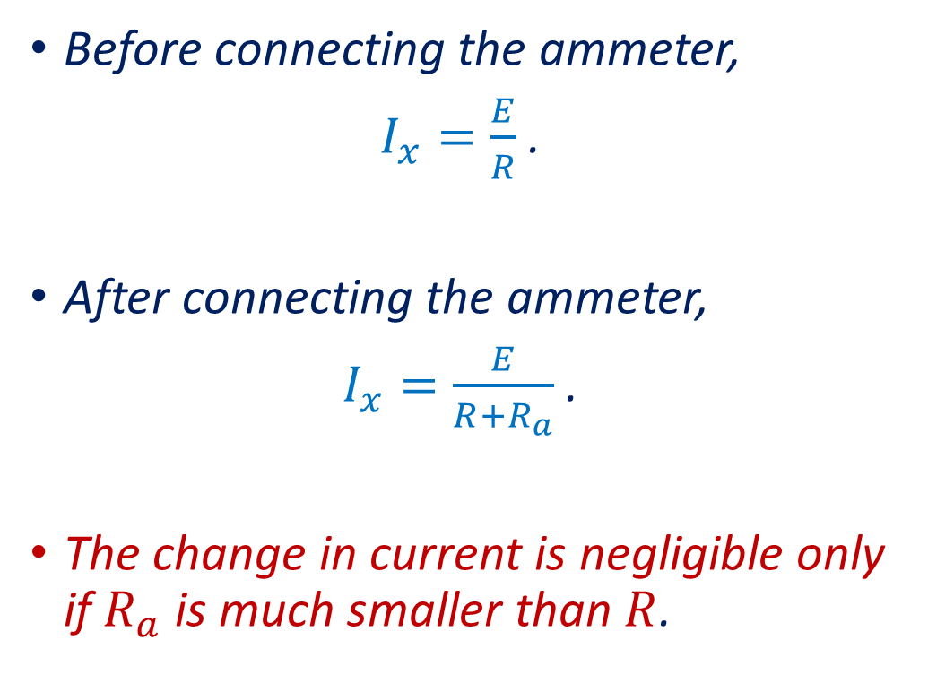
The Loading Effect—Current Measurements
Before connecting the ammeter,
$I_{x}=\frac{E}{R}$.
After connecting the ammeter,
$I_{x}=\frac{E}{R+R_{a}}$.
The change in current is negligible only if $R_{a}$ is much smaller than $R$.

Slide 24
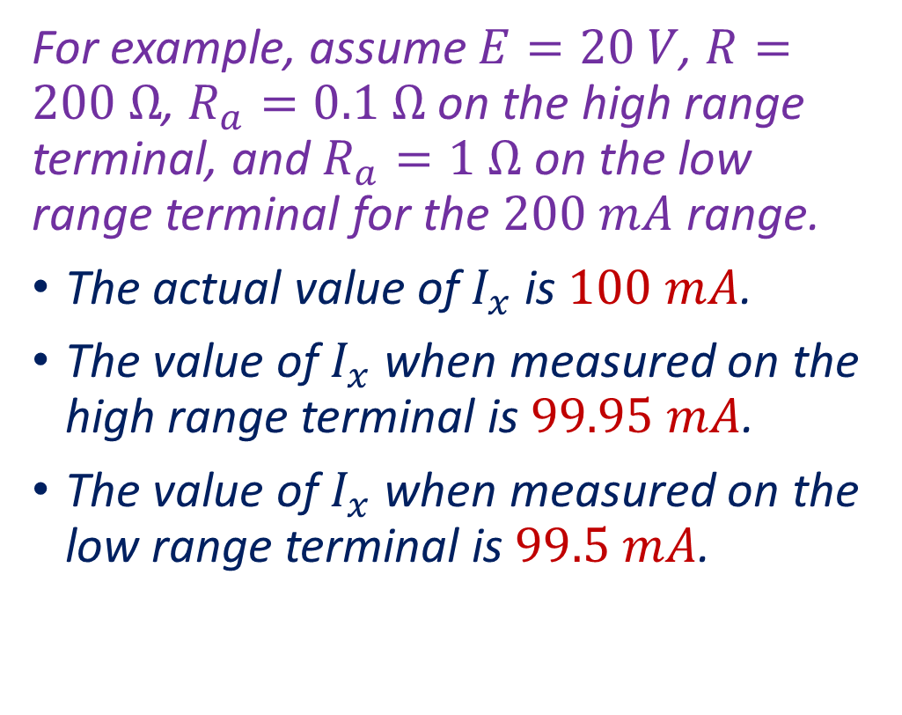
The Loading Effect—Current Measurements
For example, assume $E=20 V$, $R=200 Ω$, $R_{a}=0.1 Ω$ on the high range terminal, and $R_{a}=1 Ω$ on the low range terminal for the $200 mA$ range.
The actual value of $I_{x}$ is $100 mA$.
The value of $I_{x}$ when measured on the high range terminal is $99.95 mA$.
The value of $I_{x}$ when measured on the low range terminal is $99.5 mA$.

Slide 25
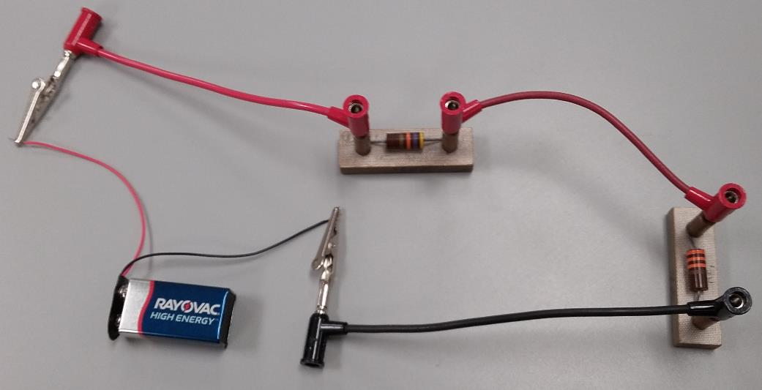
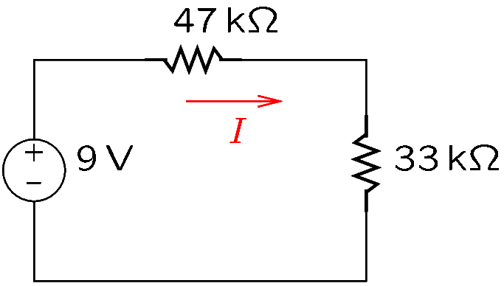

Ammeters—Review
The current of a component is measured by placing the ammeter in series with the component.
Example: The current of the $47 kΩ$ resistor should be measured.
Notes:
amp2.fig

Slide 26
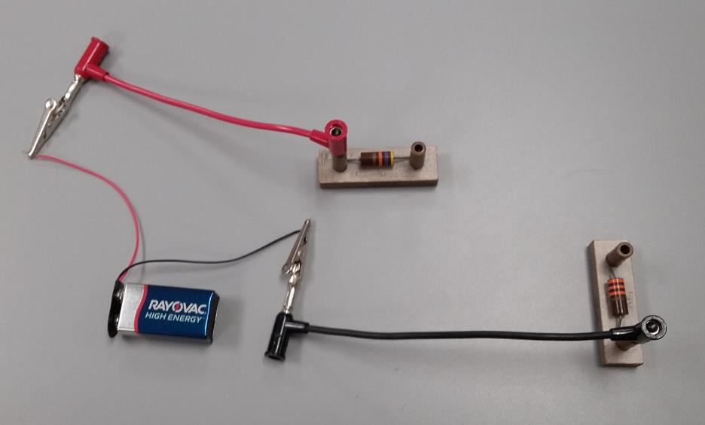
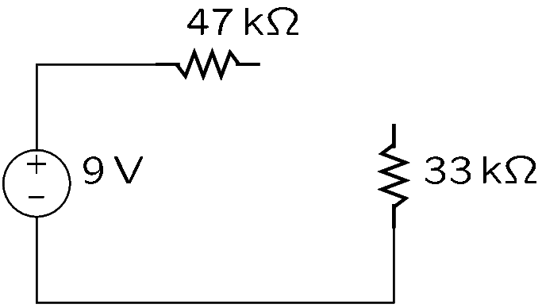
How to Measure Current—Example (Continued)
Step 1: Disconnect the resistor at one of its ends.
Notes:
amp3.fig

Slide 27
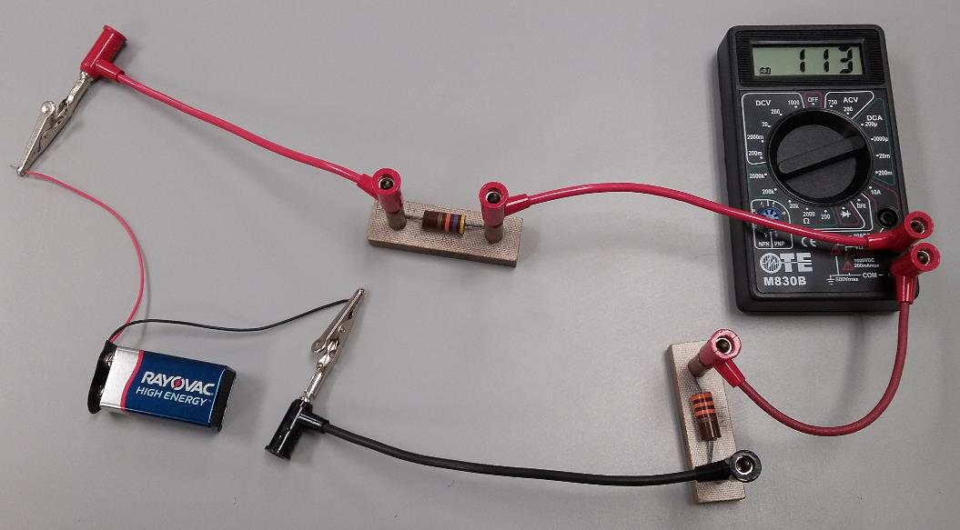
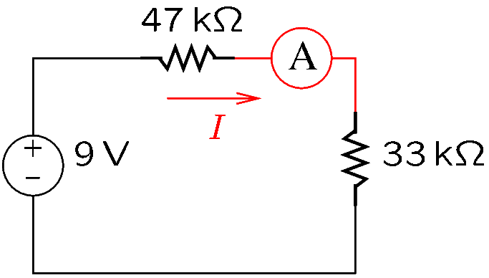

How to Measure Current—Example (Continued)
Step 2: Reconnect the resistor by means of an ammeter, so that the current to or from the resistor flows through the ammeter.
The ammeter shows a current $I=113 μA$.
Notes:
amp4.fig

Slide 28
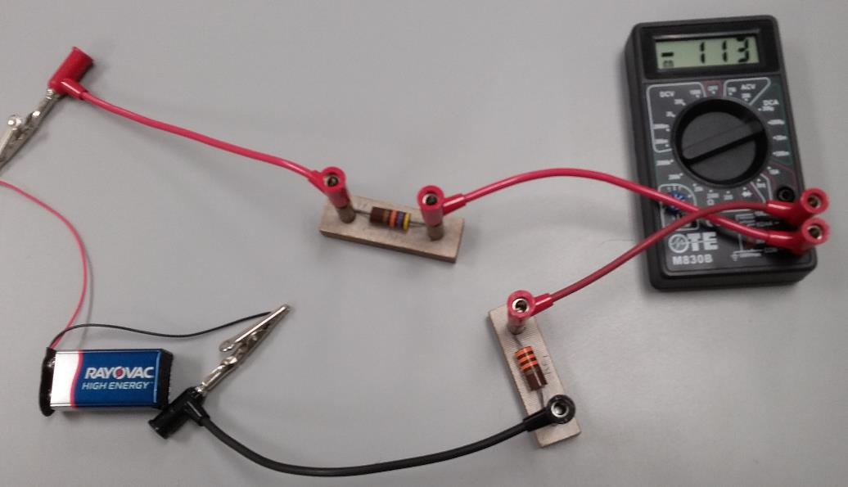

How to Measure Current—Example (Continued)
Note that by interchanging the connections of the ammeter, the sign of the measured current changes: $−113 μA$ instead of $+113 μA$.
Notes:
amp4.fig

Slide 29
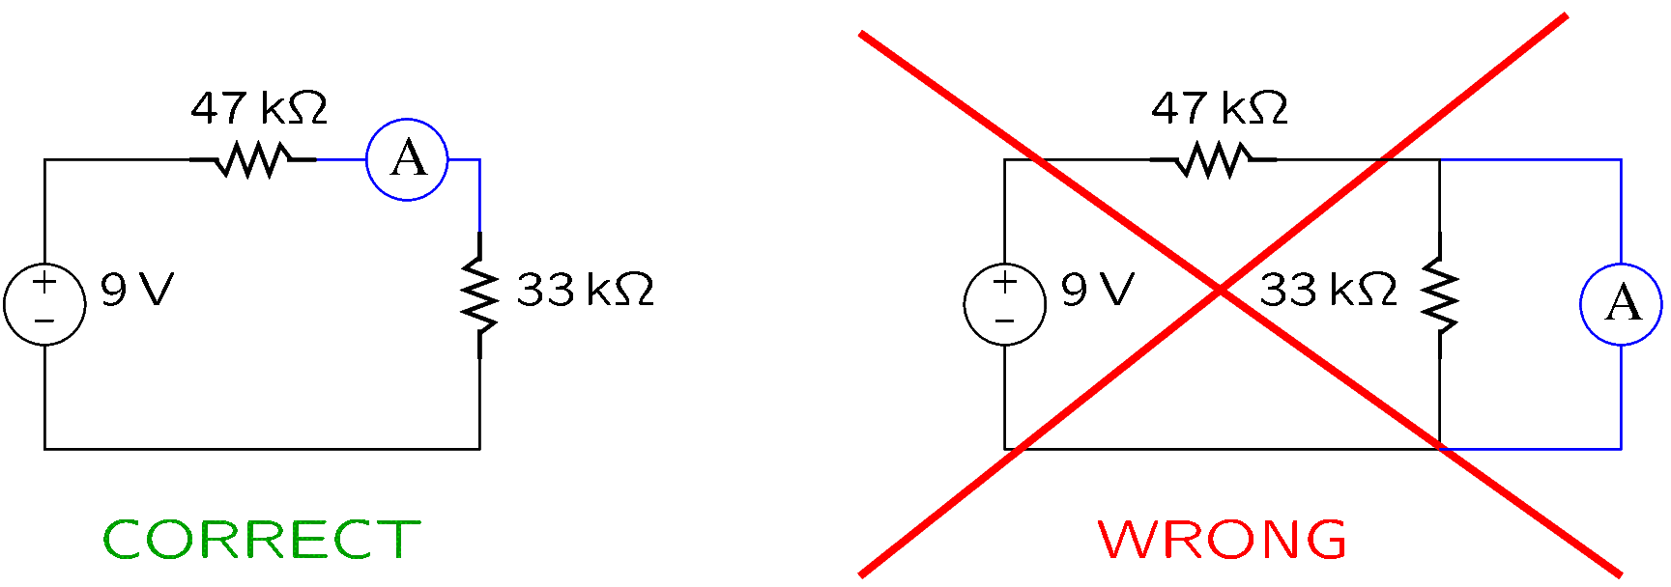
How to Measure Current—Review
Ammeters are always connected in series.
An ammeter may not be connected across a component.
Otherwise, the ammeter will show an incorrect value and the ammeter fuse may get blown.
Note that when the fuse is blown, the ammeter indicates a zero current (since no current can flow through it).
Notes:
amp4.fig

Slide 30
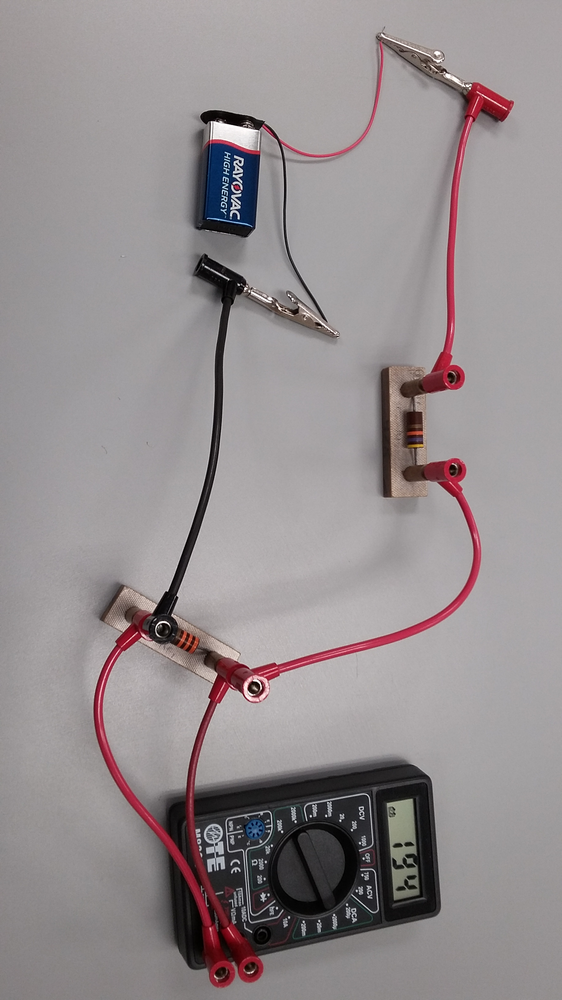
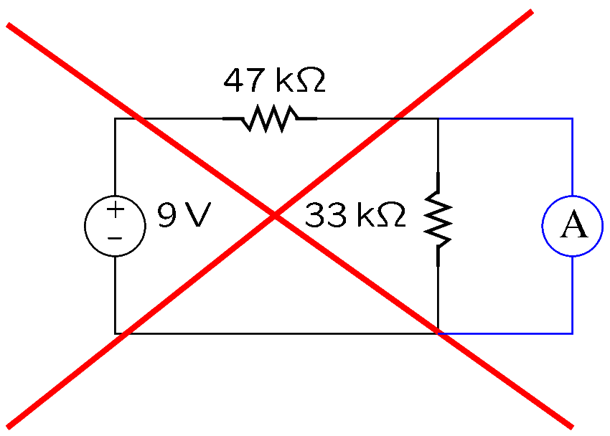

How to Measure Current—Example (Continued)
In the previous example, the current of the $33 kΩ$ resistor was $113 μA$.
The figure below shows an incorrect way to measure this current.
The measurement is wrong because the ammeter is in parallel, not in series.
Notes:
amp5.fig

Slide 31
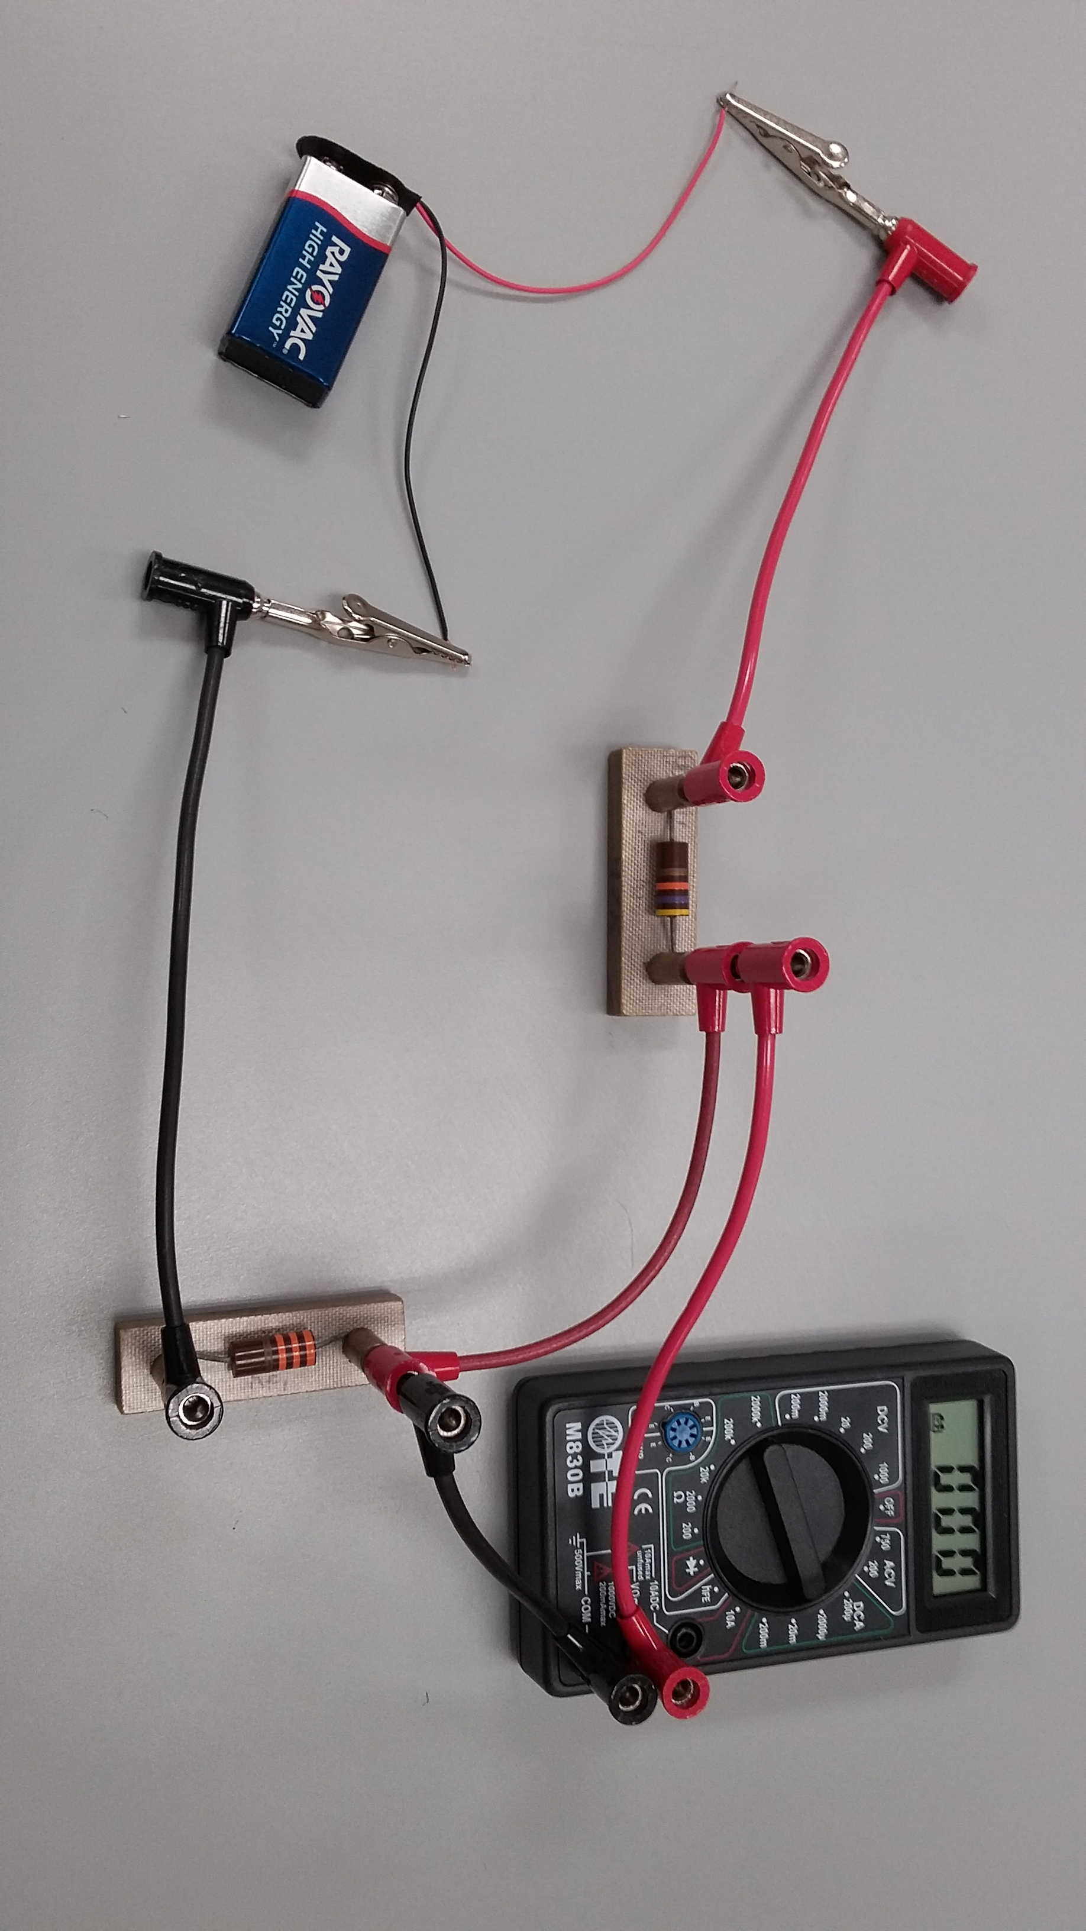
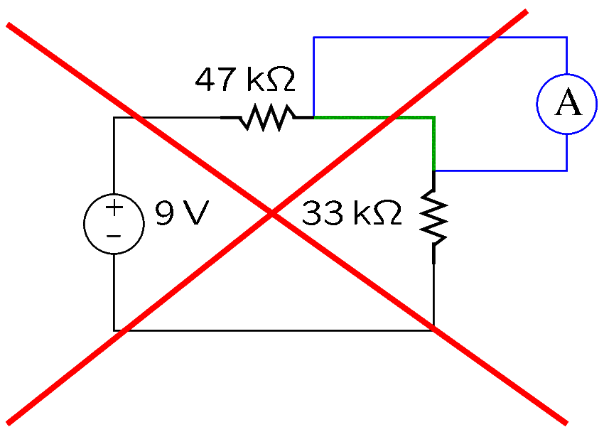
How to Measure Current—Example (Continued)
Current cannot be measured across a wire.
If the green wire is removed, the DMM will display the correct value.
Notes:
amp6.fig

Slide 32
Transformers

Slide 33
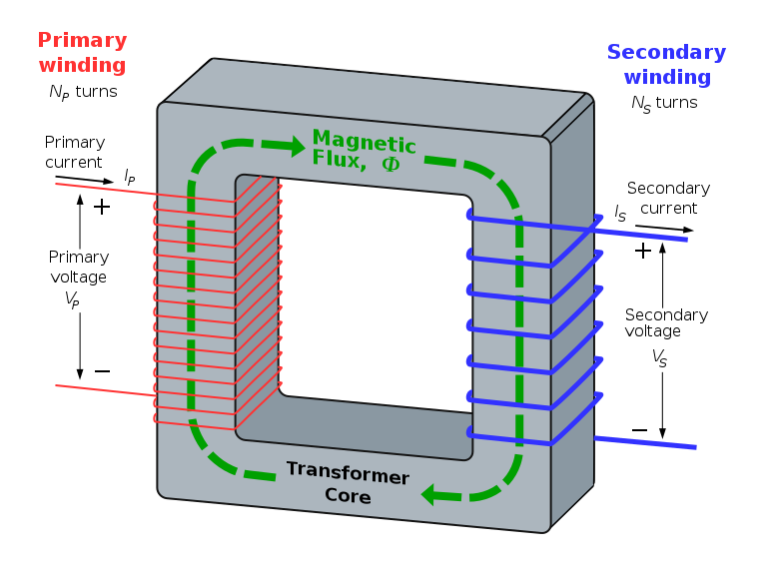
Transformers
A transformer is an AC device that transfers energy between electrically isolated circuits by means of magnetically coupled coils of wire.
A transformer consists of several coils placed on the same magnetic core.
Power is applied to the primary coil of the transformer and is transmitted by means of the magnetic field to the other coils, which are called secondary coils.
Figure downloaded from http://en.wikipedia.org/wiki/Transformer

Slide 34
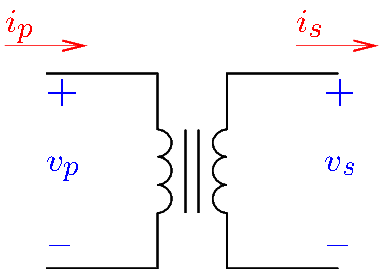

Transformers
The symbol of a transformer is shown in the figure.
Typically, transformers transfer energy at different voltage levels; a transformer can reduce or increase the input voltage.
Ideally,
$$\boxed{\frac{V_{P}}{V_{s}}=\frac{I_{s}}{I_{P}}=\frac{N_{P}}{N_{S}}}$$
where
$V_{P}$ and $V_{S}$ are the rms values of the primary and secondary voltages.
$I_{P}$ and $I_{S}$ are the rms values of the primary and secondary currents.
$N_{P}$ and $N_{S}$ are the number of turns of the primary and secondary coils.
For example, if $N_{P}=800$, $N_{S}=80$, and $V_{p}=120 V$, then $V_{S}=12 V$.
For example, if $N_{P}=1000$, $N_{S}=50$, and $I_{S}=12 A$, then $I_{P}=600 mA$.
Notes:
transf-e.fig

Slide 35



Transformers
Transformers may have more than one secondary coil.
Under simplifying assumptions, the operation of a transformer with $m$ secondary coils is described by the equations:
$$\frac{V_{P}}{V_{S1}}=\frac{N_{P}}{N_{S1}} \frac{V_{P}}{V_{S2}}=\frac{N_{P}}{N_{S2}} … \frac{V_{P}}{V_{Sm}}=\frac{N_{P}}{N_{Sm}}$$
$$N_{P}I_{P}=N_{S1}I_{S1}+N_{S2}I_{S2}+…+N_{Sm}I_{Sm}$$
where
$V_{P}$, $V_{S1}$, $…$, $V_{Sm}$ are the rms values of the primary and secondary voltages.
$I_{P}$, $I_{S1}$, $…$, $I_{Sm}$ are the rms values of the primary and secondary currents.
$N_{P}$, $N_{S1}$, $…$, $N_{Sm}$ are the number of turns of the primary and secondary coils.
Notes:
transf-e2.fig

Slide 36

Clamp-on Ammeters
Clamp-on ammeters measure the current of a conductor without physical contact.
Some clamp-on ammeters use Hall sensors to measure the magnetic field generated by the current of the conductor. They can work with both DC and AC.
Other clamp-on ammeter operate on the principle of the transformer: the measured conductor forms the primary, while an internal coil forms the secondary. Such ammeters work only with AC.
Although very convenient for making rapid current measurements, clamp-on ammeters are limited to relatively high current levels.

Slide 37


Clamp-on Ammeters
Current is measured correctly when the conductor goes between the two jaws of the instrument.
Jaws

