Slide 1
Phase Measurements. Grounding.
M.V. Iordache, EEGR2051 Circuits and Measurements Lab, Fall 2020, LeTourneau University
See https://mviordache.name/EEGR2051 for more information.

Slide 2
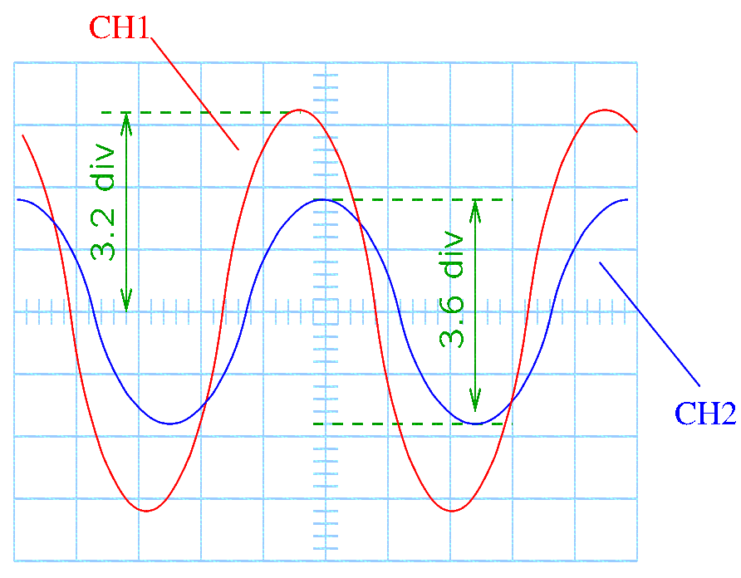
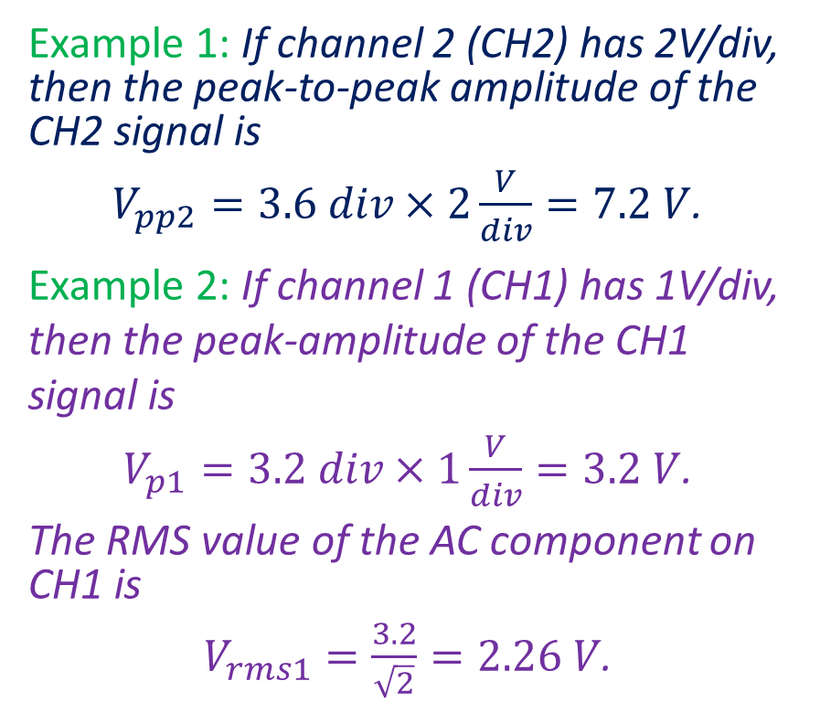
Review—Amplitude Measurements
Based on the volts/div setting (vertical sensitivity) of the oscilloscope, amplitude measurements can be easily performed.
Example 1: If channel 2 (CH2) has 2V/div, then the peak-to-peak amplitude of the CH2 signal is
$V_{pp2}=3.6 div×2\frac{V}{div}=7.2 V$.
Example 2: If channel 1 (CH1) has 1V/div, then the peak-amplitude of the CH1 signal is
$V_{p1}=3.2 div×1\frac{V}{div}=3.2 V$.
The RMS value of the AC component on CH1 is
$V_{rms1}=\frac{3.2}{\sqrt{2}}=2.26 V$.
Notes:
doc/problems/phase_a.fig

Slide 3
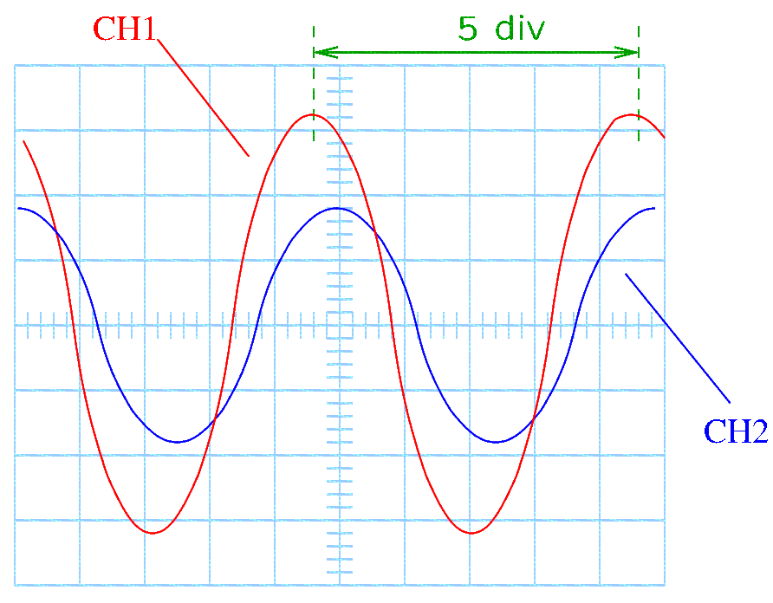
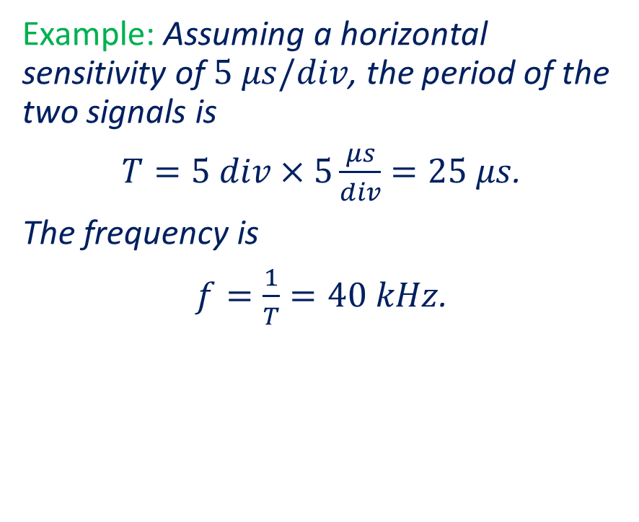
Review—Frequency Measurements
Based on the time/div setting (horizontal sensitivity) of the oscilloscope, time measurements can be easily performed.
Example: Assuming a horizontal sensitivity of $5 μs/div$, the period of the two signals is
$T=5 div×5\frac{μs}{div}=25 μs$.
The frequency is
$f=\frac{1}{T}=40 kHz$.
Notes:
doc/problems/phase_b.fig

Slide 4
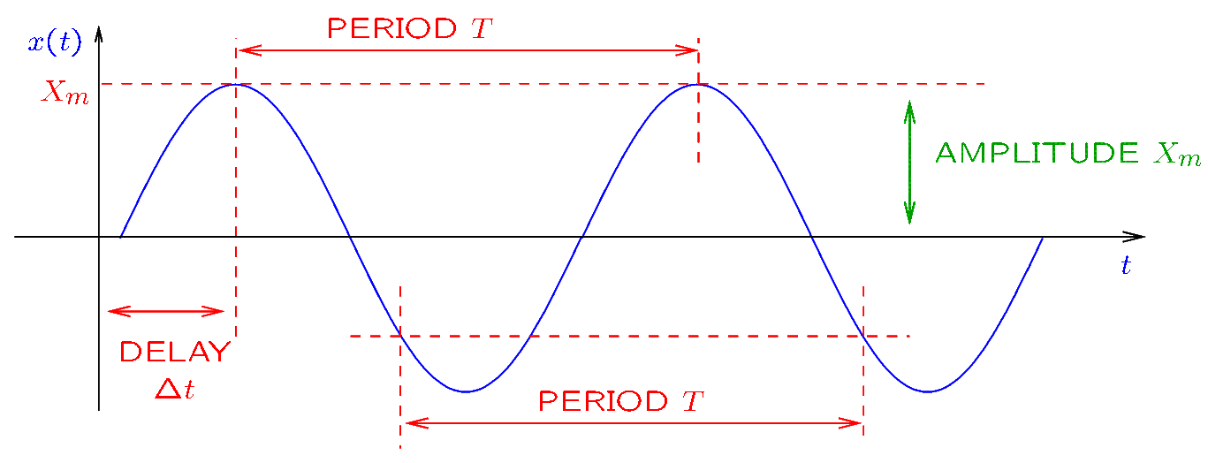
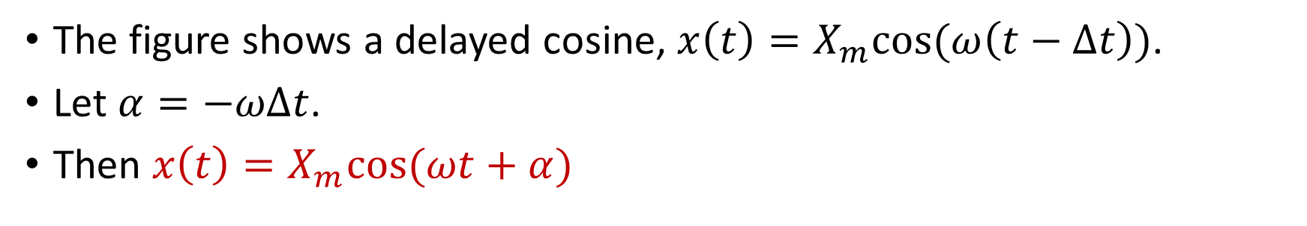
The Sinusoidal Function
The figure shows a delayed cosine, $x\left(t\right)=X_{m}cos⁡(ω\left(t−Δt\right))$.
Let $α=−ωΔt$.
Then $x\left(t\right)=X_{m}cos⁡(ωt+α)$

Slide 5

The Sinusoidal Function
Given $x\left(t\right)=X_{m}cos⁡(ωt+α)$ of period $T$:
$ω=\frac{2π}{T}$ is the angular frequency; it is measured in rad/s.
$f=\frac{1}{T}$ is the frequency; it is measured in Hz.
$α$ is the phase angle; it is measured in degrees or radians.
$X_{m}$ is the peak amplitude.

Slide 6
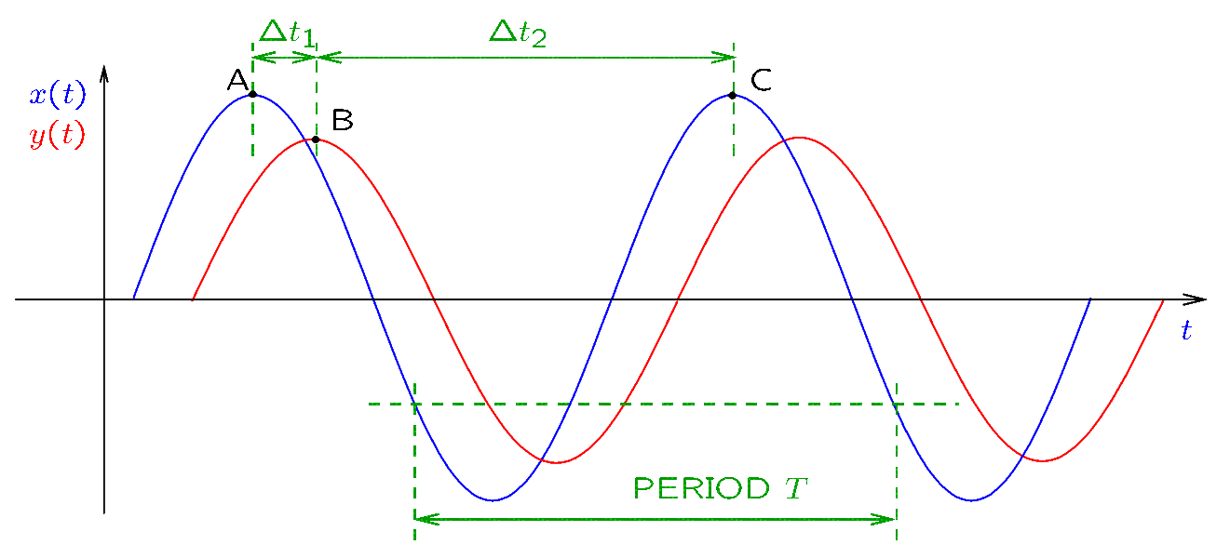
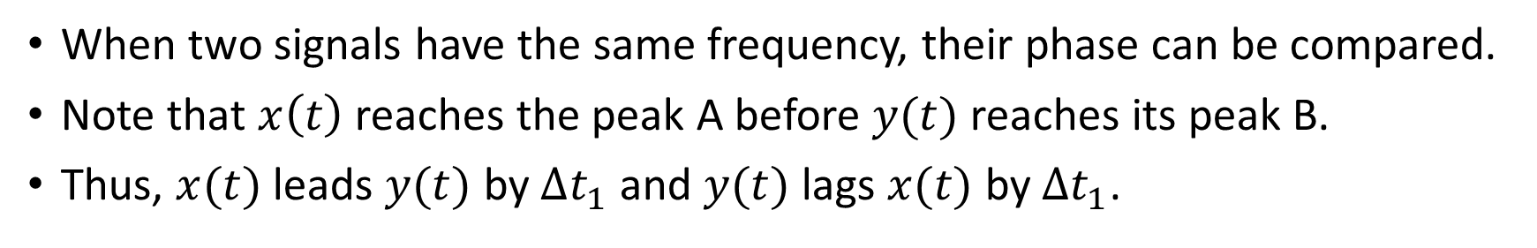
Lead/Lag Relationships
When two signals have the same frequency, their phase can be compared.
Note that $x\left(t\right)$ reaches the peak A before $y(t)$ reaches its peak B.
Thus, $x(t)$ leads $y(t)$ by $Δt_{1}$ and $y(t)$ lags $x(t)$ by $Δt_{1}$.
Notes:
cfig/phase_b.fig

Slide 7
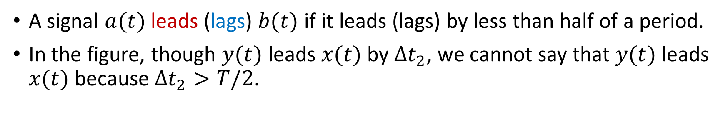
Lead/Lag Relationships
A signal $a(t)$ leads (lags) $b(t)$ if it leads (lags) by less than half of a period.
In the figure, though $y(t)$ leads $x(t)$ by $Δt_{2}$, we cannot say that $y(t)$ leads $x(t)$ because $Δt_{2}>T/2$.
Notes:
cfig/phase_b.fig

Slide 8
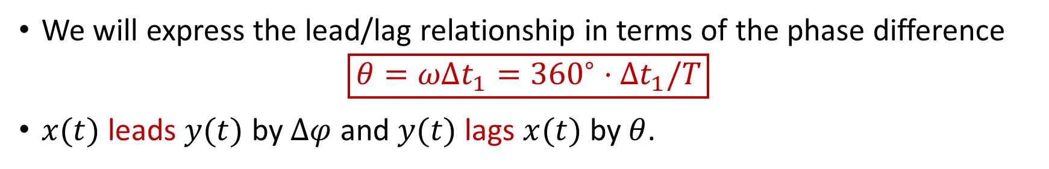
Phase Difference
We will express the lead/lag relationship in terms of the phase difference
$$\boxed{θ=ωΔt_{1}={360}^{∘}⋅Δt_{1}/T}$$
$x(t)$ leads $y(t)$ by $Δφ$ and $y(t)$ lags $x(t)$ by $θ$.
Notes:
cfig/phase_b.fig

Slide 9
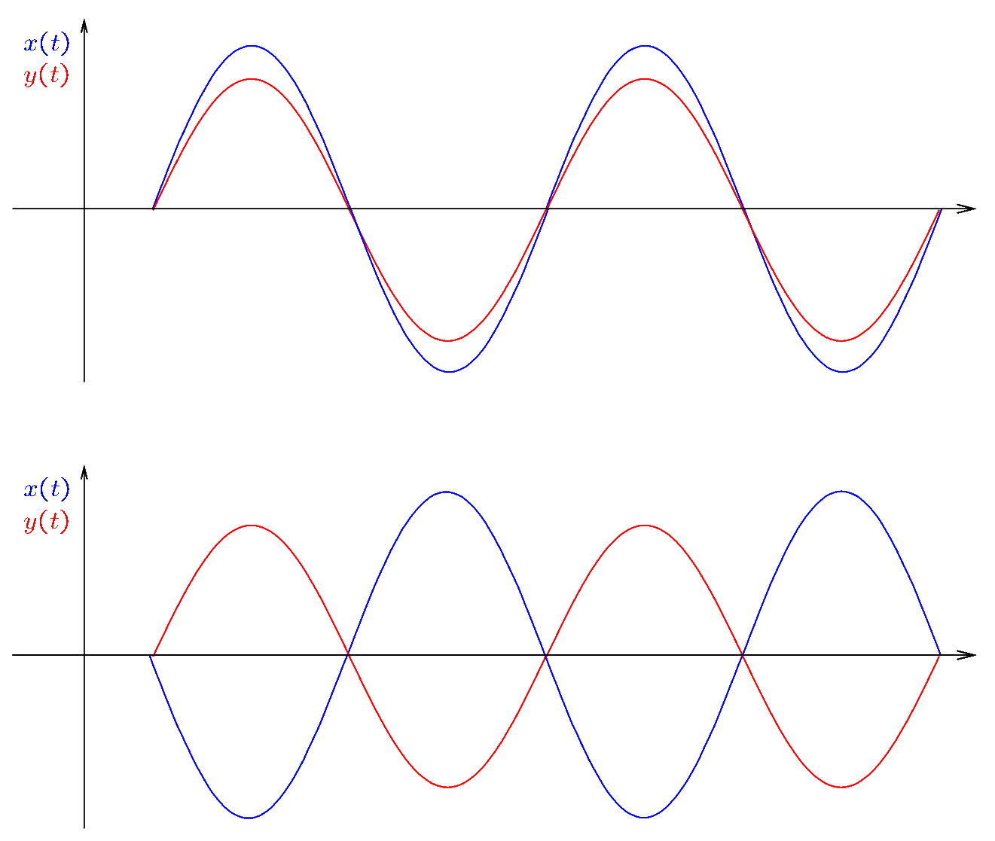
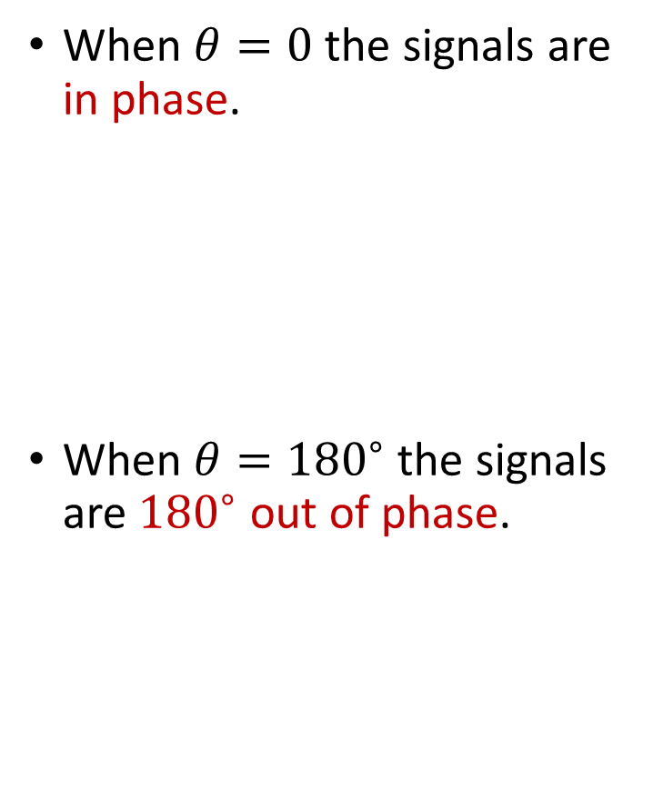
Phase Difference
When $θ=0$ the signals are in phase.
When $θ={180}^{∘}$ the signals are ${180}^{∘}$ out of phase.
Notes:
cfig/phase_c.fig

Slide 10
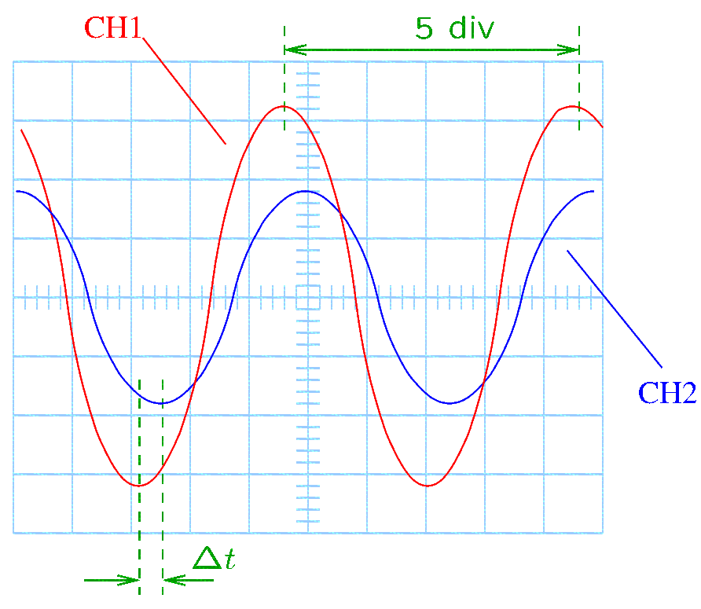
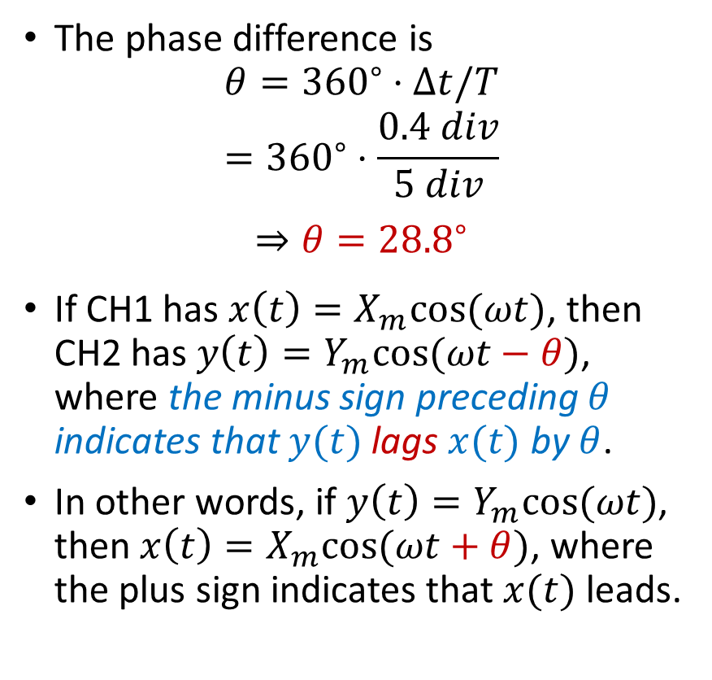
Phase Measurements—Example
Note that CH1 leads CH2.
The phase difference is
$$θ={360}^{∘}⋅Δt/T$$
$$={360}^{∘}⋅\frac{0.4 div}{5 div}$$
$$⇒θ={28.8}^{∘}$$
If CH1 has $x\left(t\right)=X_{m}cos⁡(ωt)$, then CH2 has $y\left(t\right)=Y_{m}cos⁡(ωt−θ)$, where the minus sign preceding $θ$ indicates that $y(t)$ lags $x(t)$ by $θ$.
In other words, if $y\left(t\right)=Y_{m}cos⁡(ωt)$, then $x\left(t\right)=X_{m}cos⁡(ωt+θ)$, where the plus sign indicates that $x(t)$ leads.
Notes:
doc/problems/phase_c.fig

Slide 11
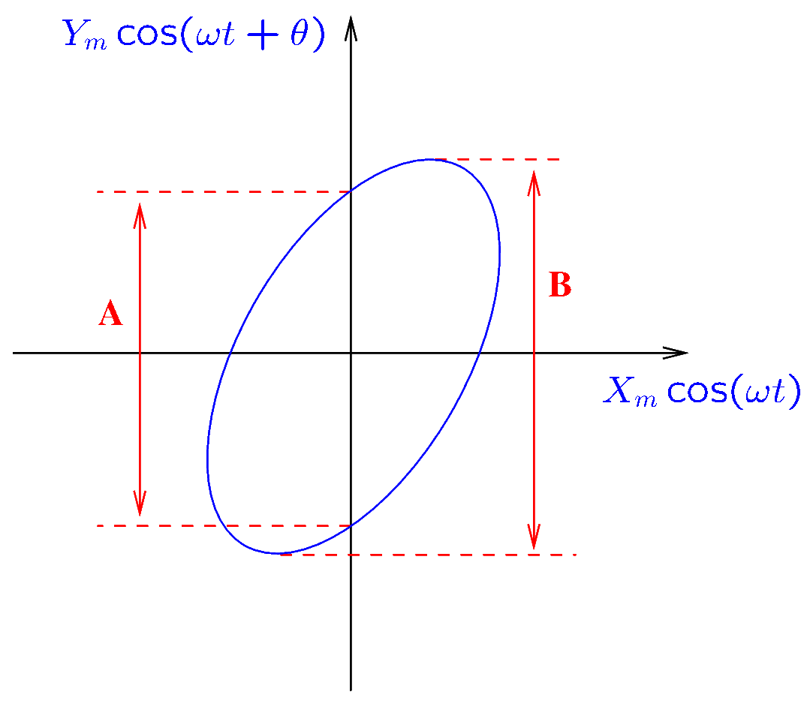
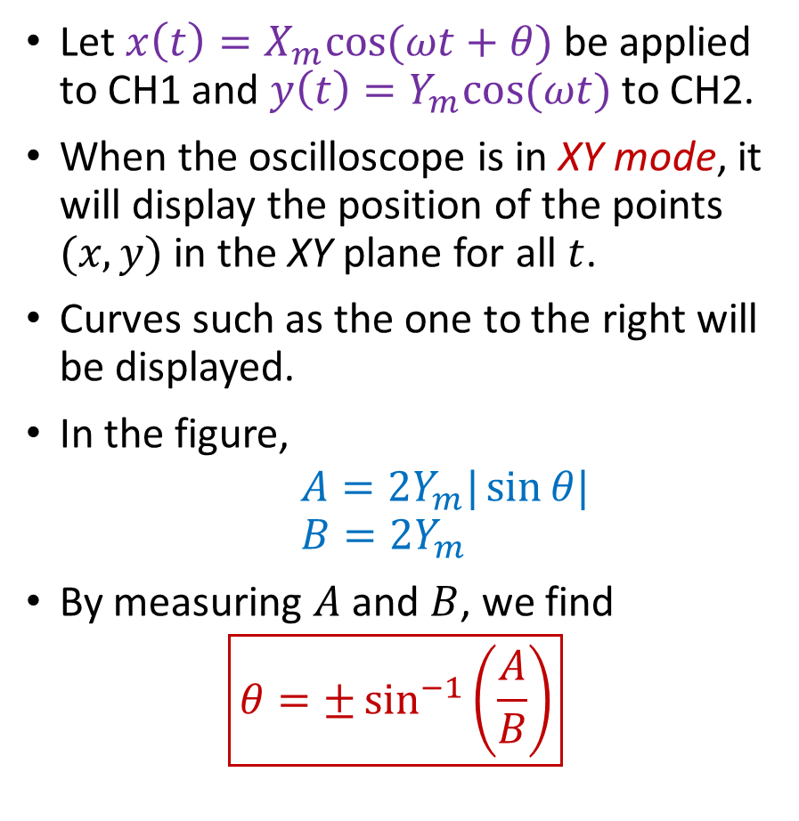
Phase Measurements—The Lissajous Pattern Method
Let $x\left(t\right)=X_{m}cos⁡(ωt+θ)$ be applied to CH1 and $y\left(t\right)=Y_{m}cos⁡(ωt)$ to CH2.
When the oscilloscope is in XY mode, it will display the position of the points $(x,y)$ in the XY plane for all $t$.
Curves such as the one to the right will be displayed.
In the figure,
$$A=2Y_{m}|\sin{θ|}$$
$$B=2Y_{m}$$
By measuring $A$ and $B$, we find
$$\boxed{θ=±\sin^{−1}\left(\frac{A}{B}\right)}$$
Notes:
doc/problems/Lissajous2.fig

Slide 12
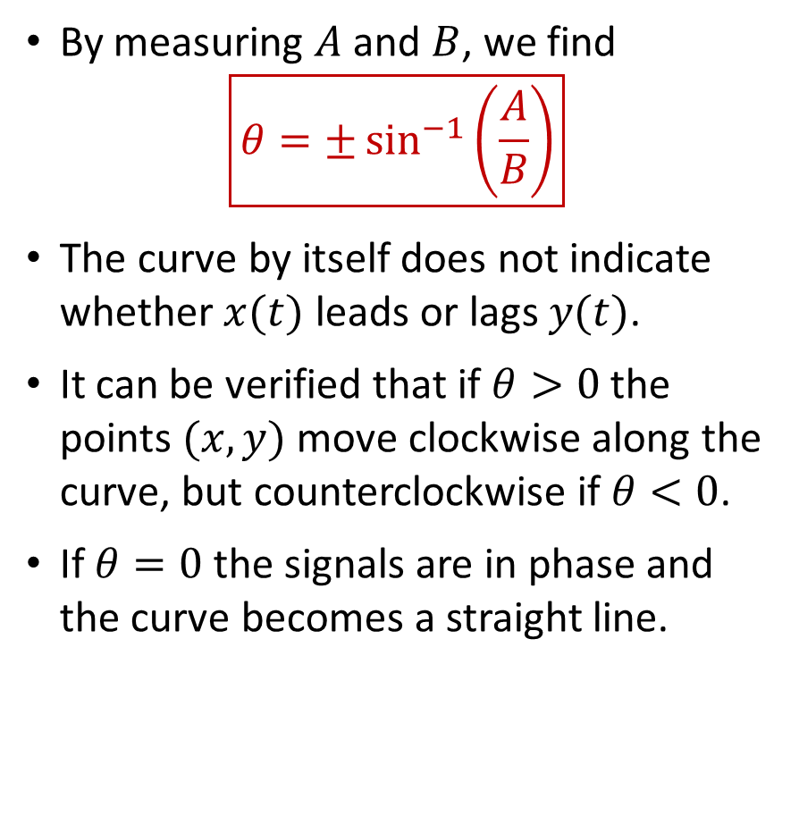
Phase Measurements—The Lissajous Pattern Method
By measuring $A$ and $B$, we find
$$\boxed{θ=±\sin^{−1}\left(\frac{A}{B}\right)}$$
The curve by itself does not indicate whether $x(t)$ leads or lags $y(t)$.
It can be verified that if $θ>0$ the points $(x,y)$ move clockwise along the curve, but counterclockwise if $θ<0$.
If $θ=0$ the signals are in phase and the curve becomes a straight line.
Notes:
doc/problems/Lissajous2.fig

Slide 13
Grounding

Slide 14
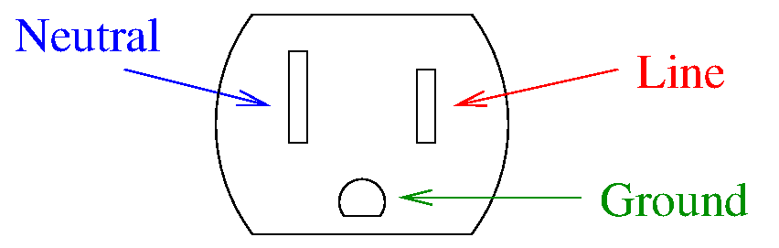

Grounding
Various instruments generate or measure voltage with respect to earth ground.
They are connected to earth ground by means of the ground terminal of the wall outlet.
Circuits connected to earth ground are said to be grounded.
Circuits that are not connected to earth ground are said to be floating.
For example, the oscilloscope and some waveform generators are grounded.
The BNC connectors of a grounded instrument will have the shield connected to ground.
Ground
Signal

Slide 15
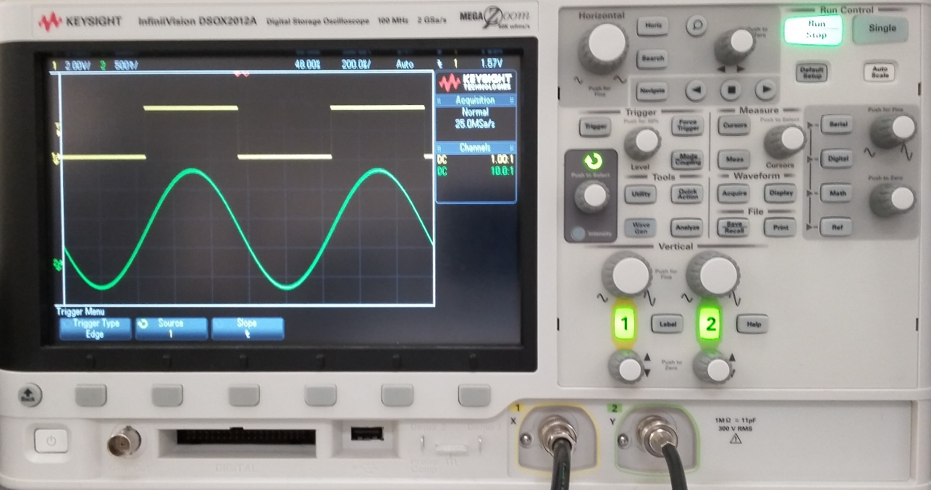
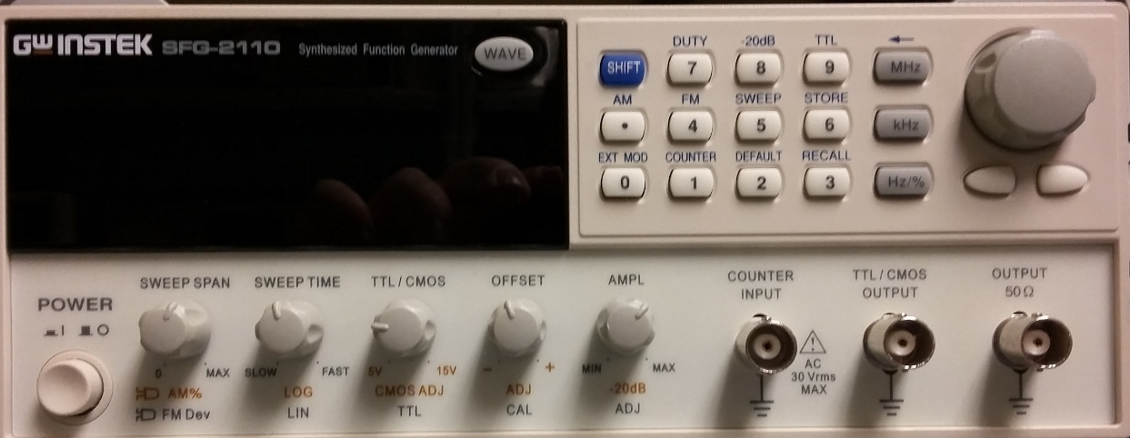
Grounding
earth ground
As soon as a grounded instrument is plugged into the wall outlet, the shield of its BNC connectors becomes earth ground.
Floating instruments do not connect input or output terminals to earth ground.
For example, any battery powered instrument is floating; some waveform generators are floating; DMMs and DC power supplies are floating.

Slide 16
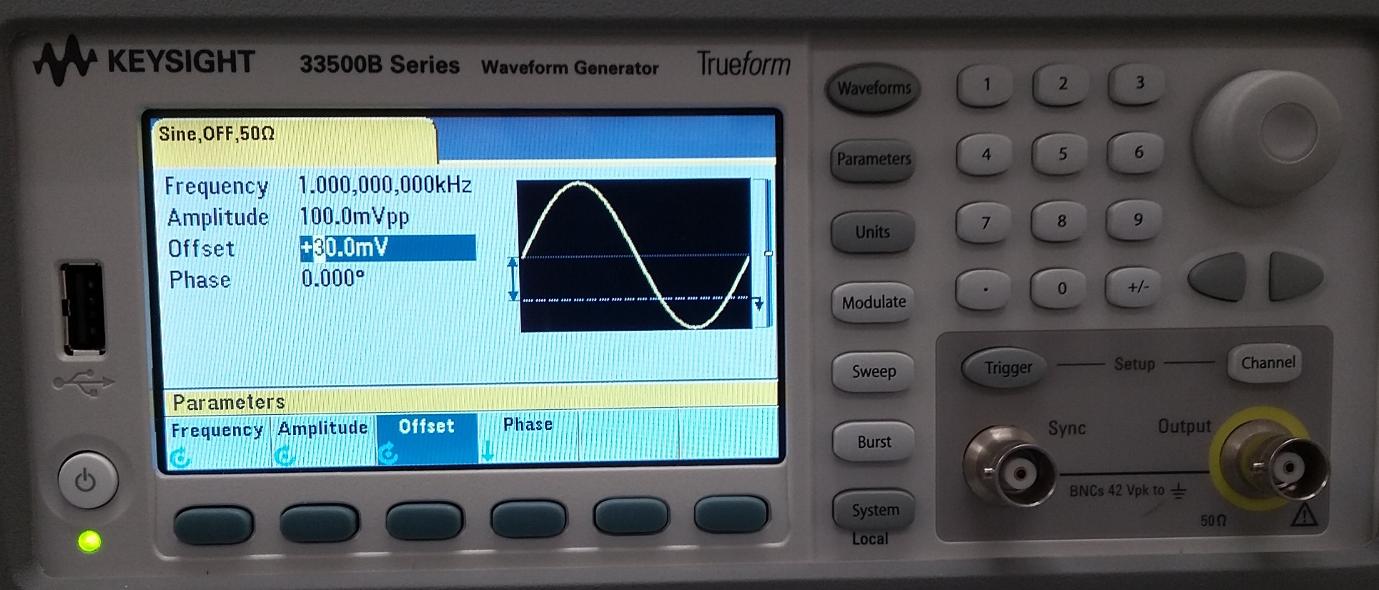
Grounding
Floating instruments also have a common point of reference, called ground, though this ground is not connected to earth ground.
The shield of the BNC connectors is normally connected to the ground reference.
ground reference
When a floating instrument is connected to a grounded instrument, the ground references will also be connected, and thus the ground of the floating instrument will become earth ground.
Since multiple instrument terminals are connected to the same ground reference, an inadequate connection of the instruments to a circuit may result in short-circuits!
The ground is abbreviated GND and has the symbol

Slide 17
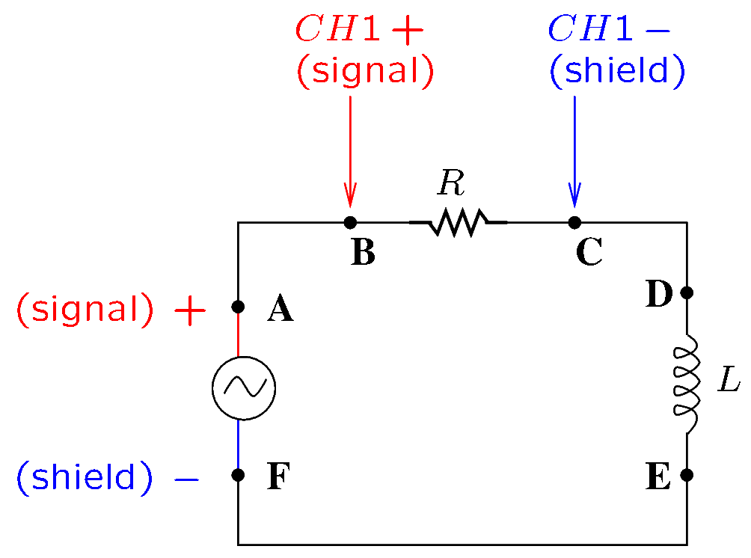
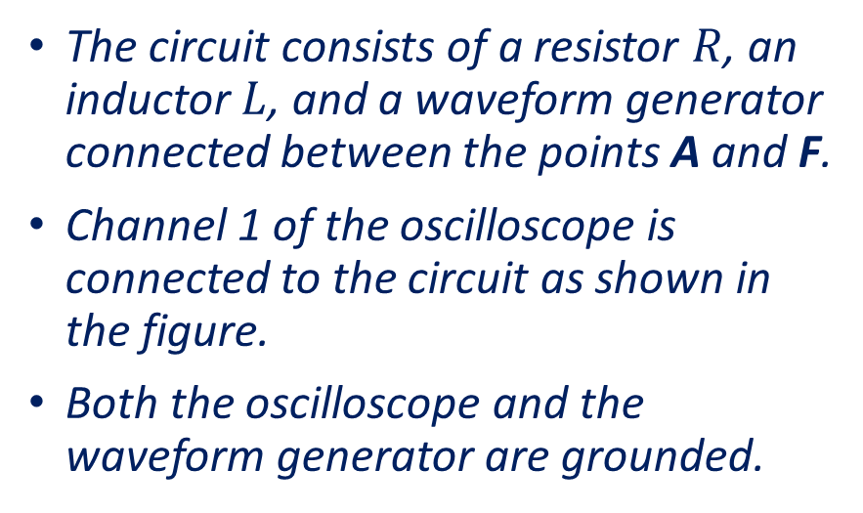
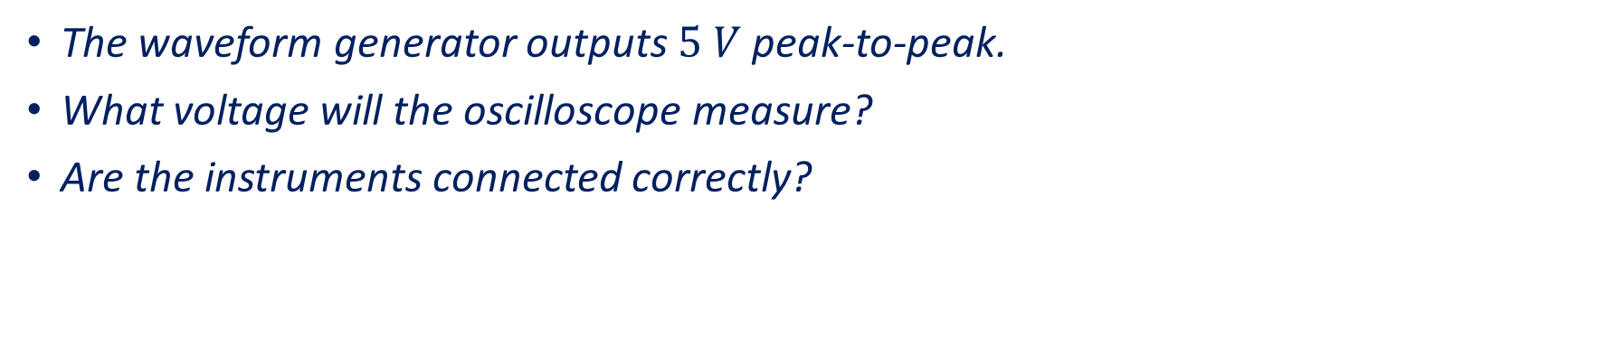
Example 1
The circuit consists of a resistor $R$, an inductor $L$, and a waveform generator connected between the points A and F.
Channel 1 of the oscilloscope is connected to the circuit as shown in the figure.
Both the oscilloscope and the waveform generator are grounded.
The waveform generator outputs $5 V$ peak-to-peak.
What voltage will the oscilloscope measure?
Are the instruments connected correctly?
Notes:
fig/gnd1

Slide 18
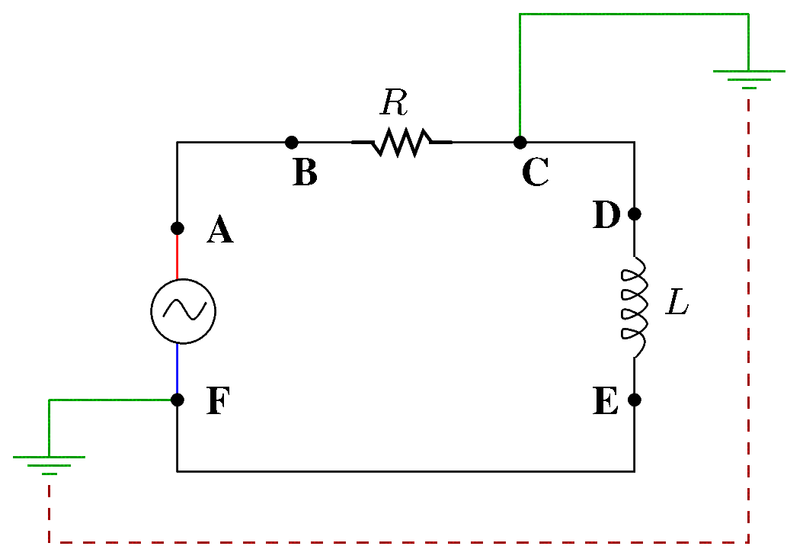
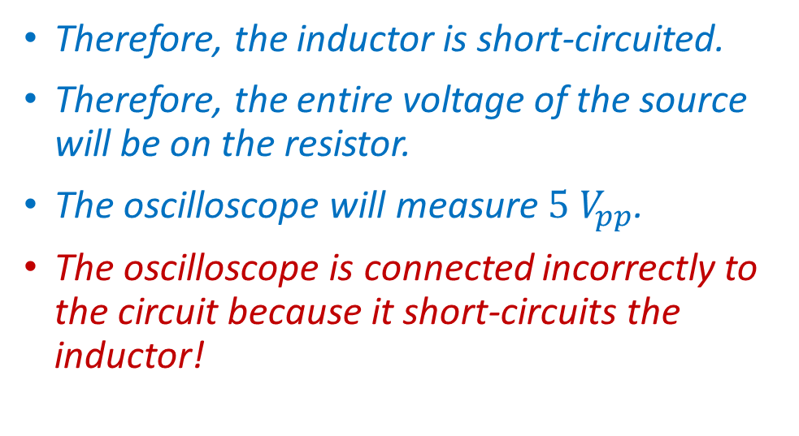
Example 1—Solution
Since both instruments are grounded, the shield is connected to earth ground for both instruments:
Point F is connected to the GND terminal of the wall outlet of the waveform generator.
Point C is connected to the GND terminal of the wall outlet of the oscilloscope.
The GND terminals of the wall outlets are connected together to the same GND.
Therefore, points C and F are connected!
Therefore, the inductor is short-circuited.
Therefore, the entire voltage of the source will be on the resistor.
The oscilloscope will measure $5 V_{pp}$.
The oscilloscope is connected incorrectly to the circuit because it short-circuits the inductor!
Notes:
fig/gnd2

Slide 19
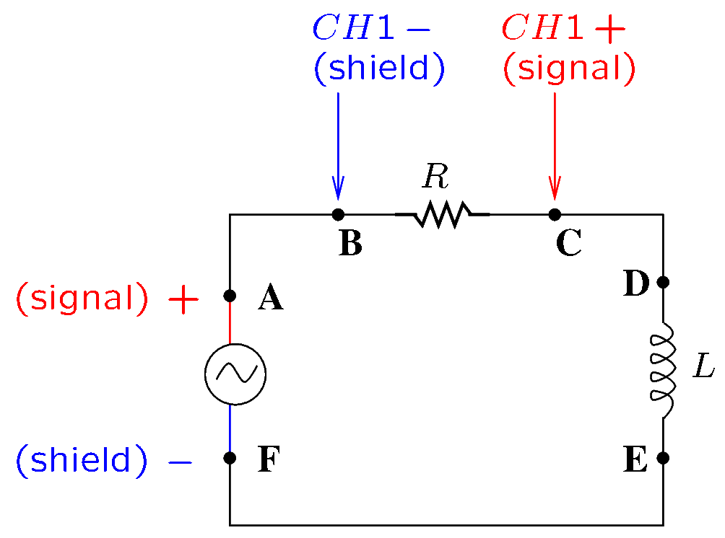
Example 2
Consider the previous circuit with the oscilloscope connections interchanged.
What voltage will the oscilloscope measure?
Are the instruments connected correctly?
Notes:
fig/gnd3

Slide 20
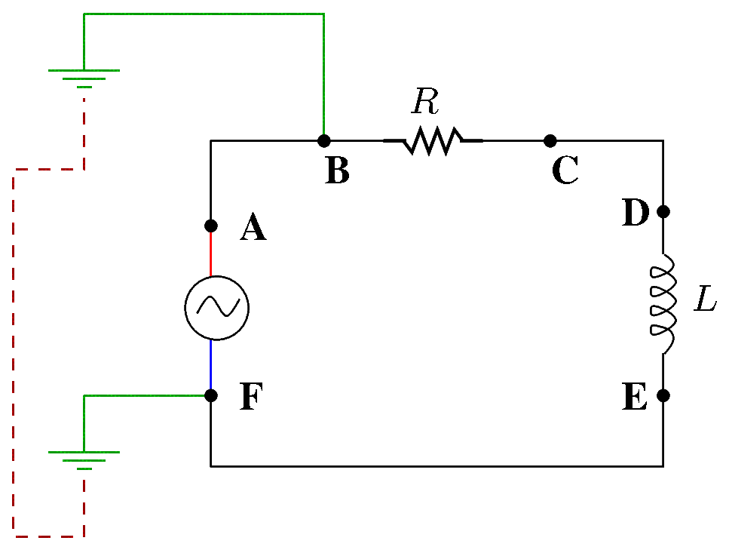
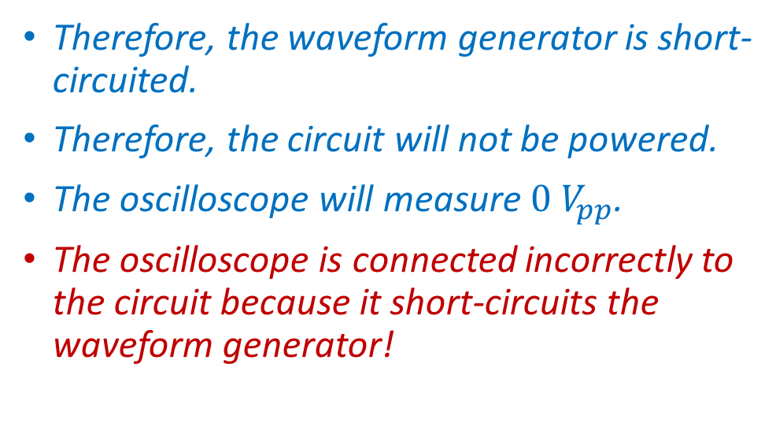
Example 2—Solution
Since both instruments are grounded, the shield is connected to earth ground for both instruments:
Point F is connected to the GND terminal of the wall outlet of the waveform generator.
Point B is connected to the GND terminal of the wall outlet of the oscilloscope.
The GND terminals of the wall outlets are connected together to the same GND.
Therefore, points C and F are connected!
Therefore, the waveform generator is short-circuited.
Therefore, the circuit will not be powered.
The oscilloscope will measure $0 V_{pp}$.
The oscilloscope is connected incorrectly to the circuit because it short-circuits the waveform generator!
Notes:
fig/gnd4

Slide 21
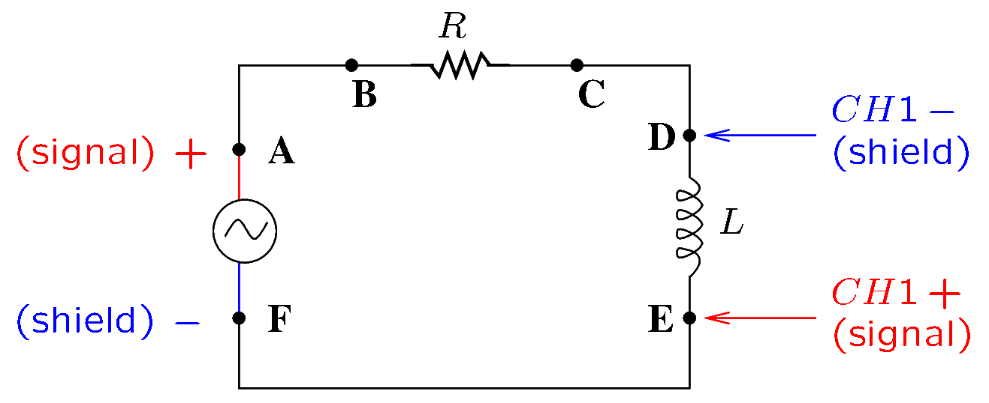
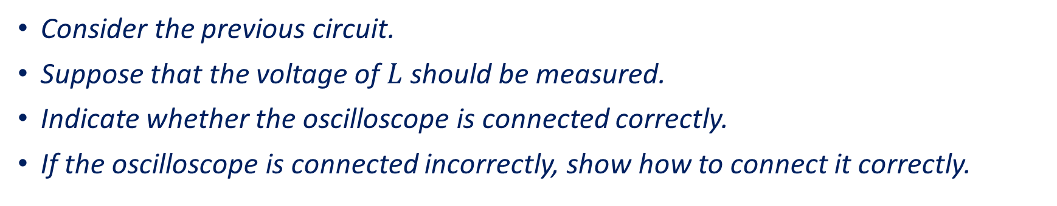
Example 3
Consider the previous circuit.
Suppose that the voltage of $L$ should be measured.
Indicate whether the oscilloscope is connected correctly.
If the oscilloscope is connected incorrectly, show how to connect it correctly.
Notes:
fig/gnd5

Slide 22
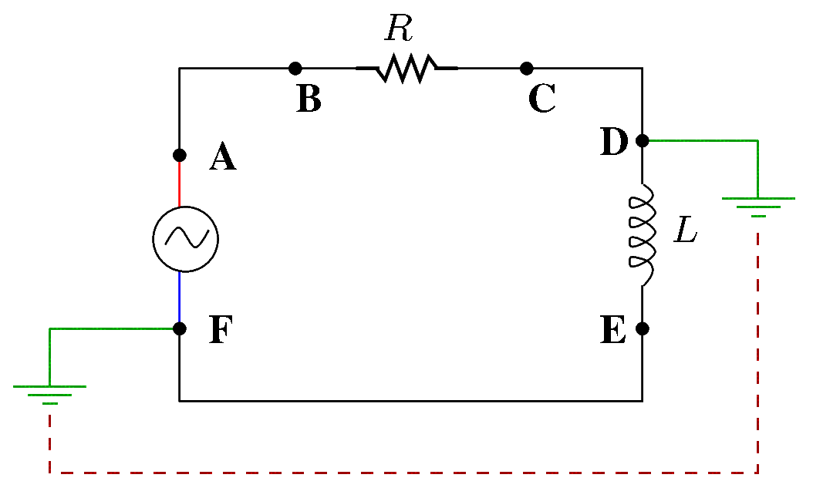
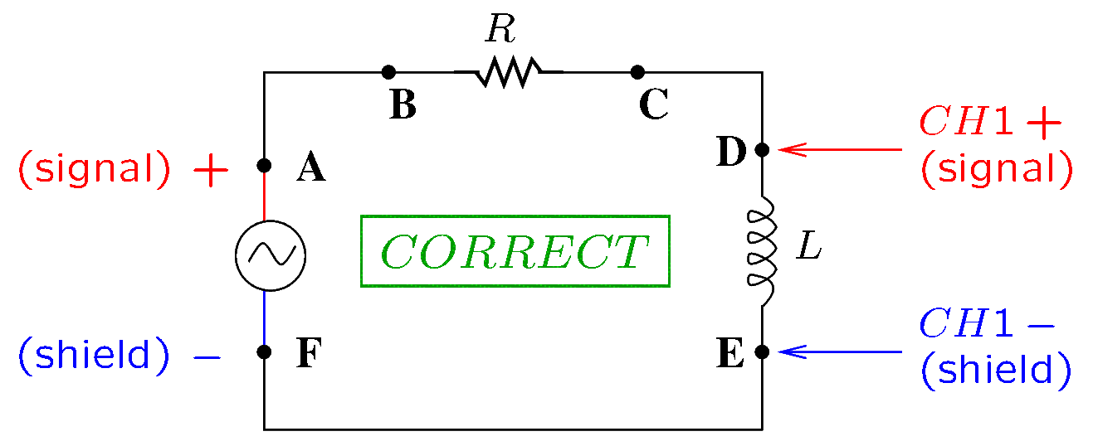
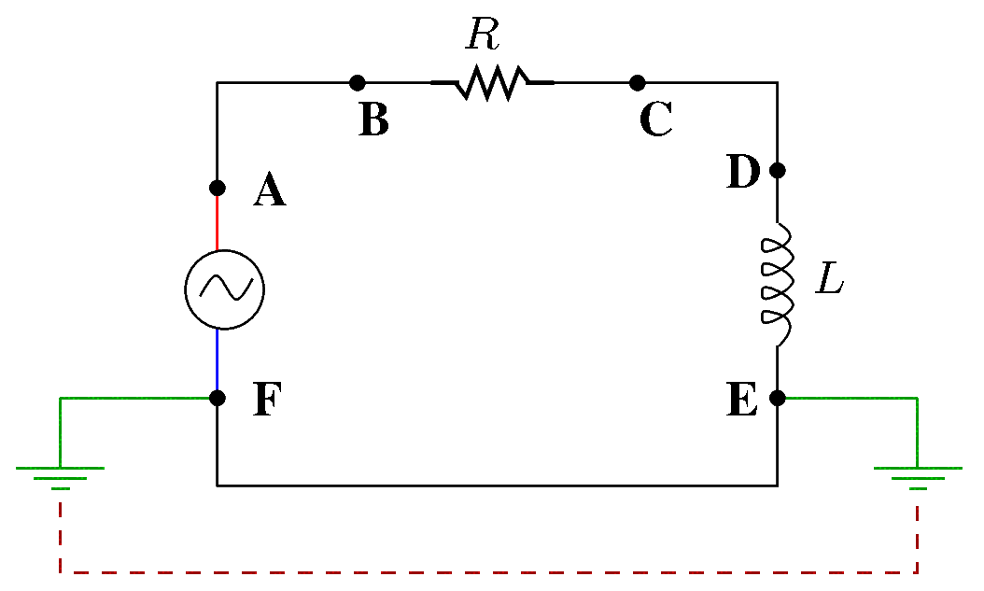
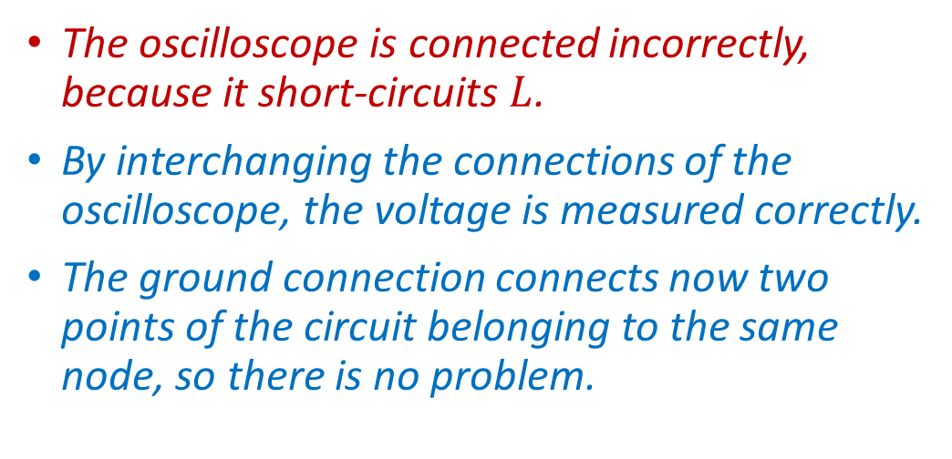
Example 3—Solution
The oscilloscope is connected incorrectly, because it short-circuits $L$.
By interchanging the connections of the oscilloscope, the voltage is measured correctly.
The ground connection connects now two points of the circuit belonging to the same node, so there is no problem.
Notes:
fig/gnd6, gnd7, gnd8

Slide 23
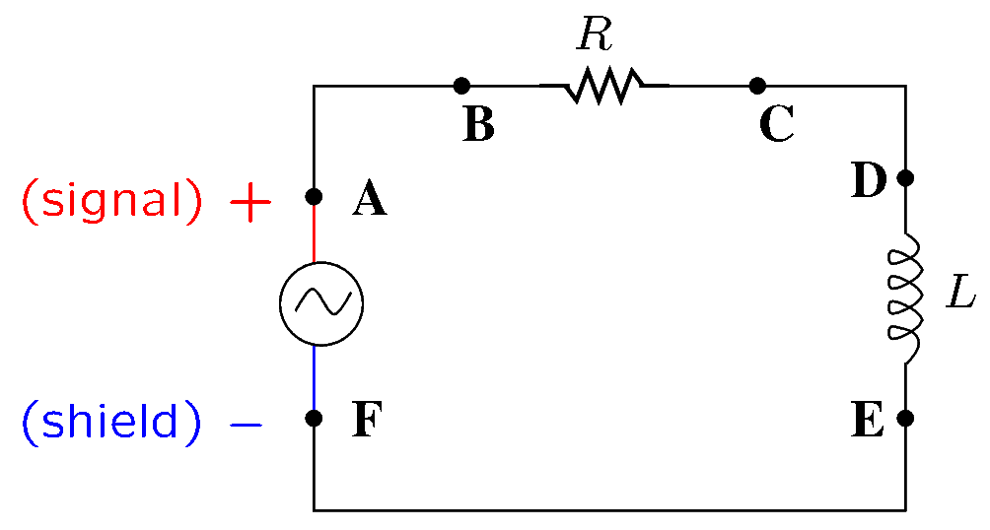
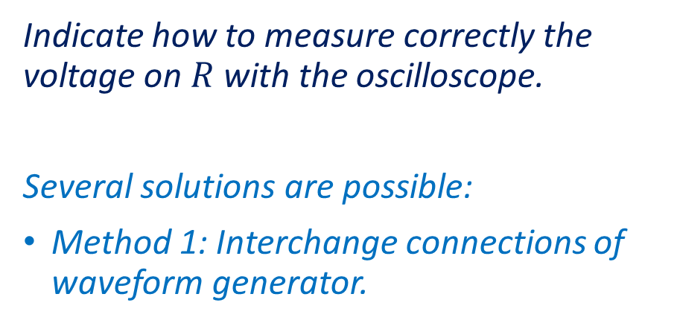
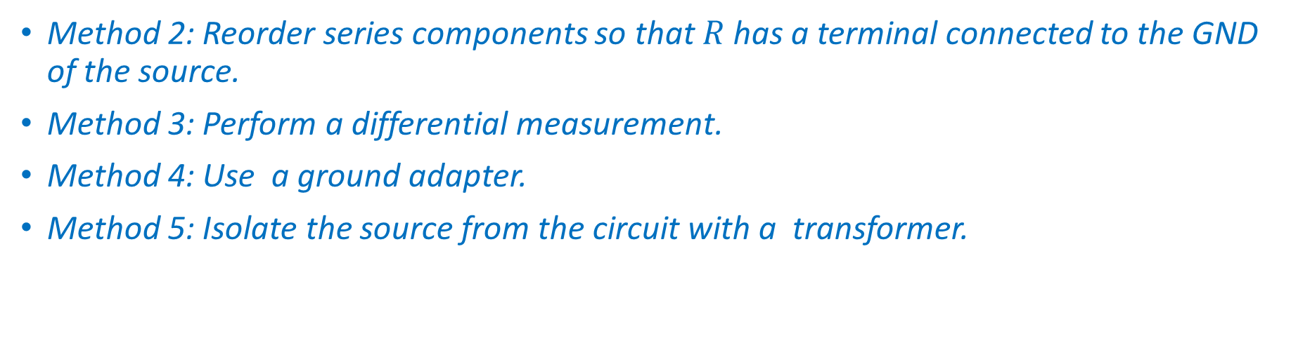
Example 4
Indicate how to measure correctly the voltage on $R$ with the oscilloscope.
Several solutions are possible:
Method 1: Interchange connections of waveform generator.
Method 2: Reorder series components so that $R$ has a terminal connected to the GND of the source.
Method 3: Perform a differential measurement.
Method 4: Use a ground adapter.
Method 5: Isolate the source from the circuit with a transformer.
Notes:
fig/gnd9

Slide 24
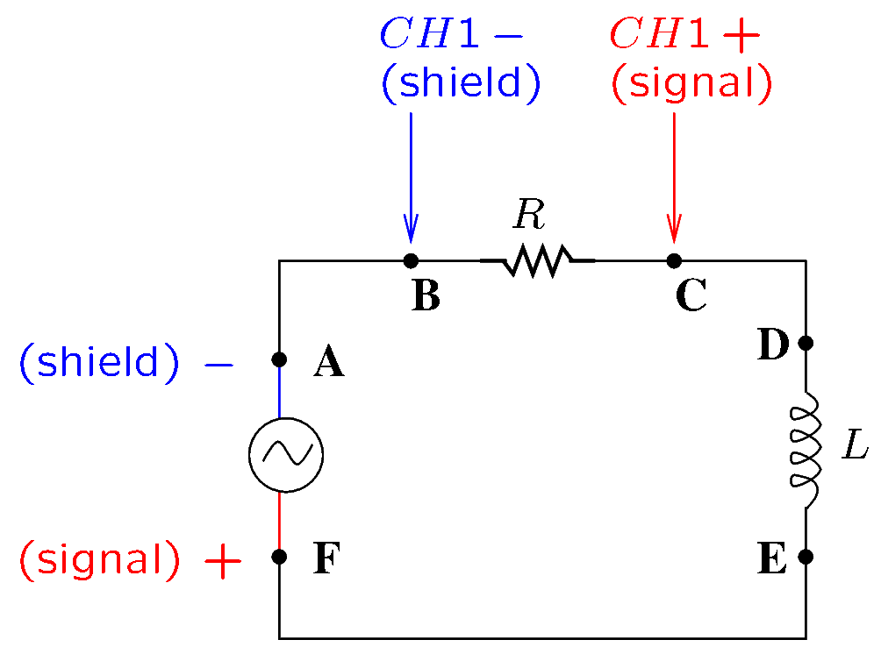
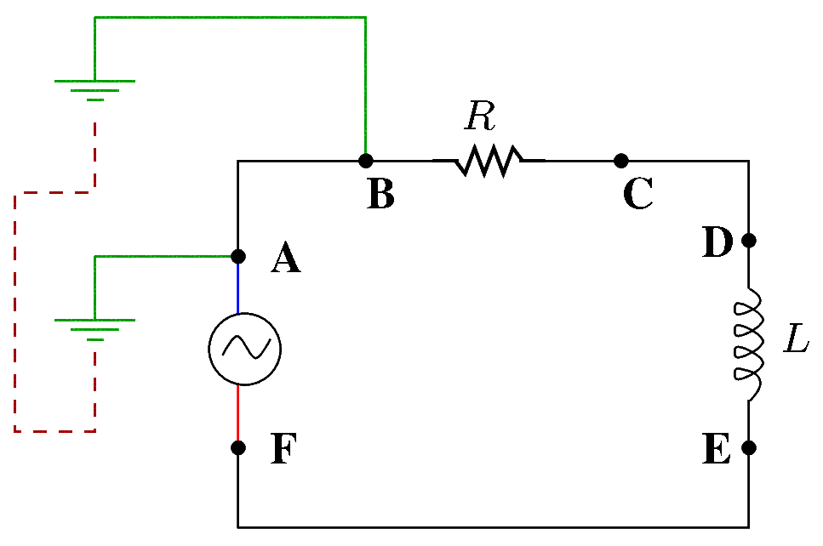
Solution 1—Interchange Source Connections
After interchanging the source connection, it is possible to connect the shield of CH1 (the GND terminal) at the point B.
The ground connection connects now two points of the circuit belonging to the same node, so there is no problem.
Notes:
fig/gnd3a, gnd4a

Slide 25
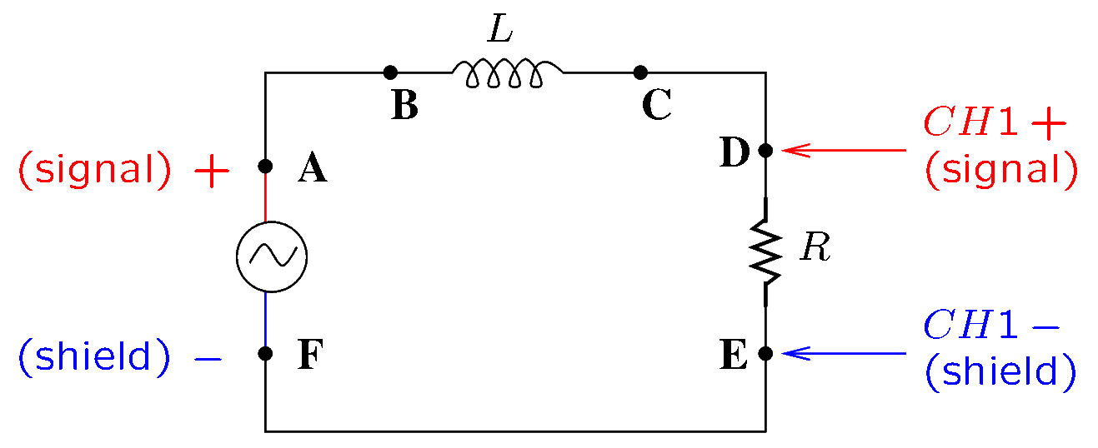
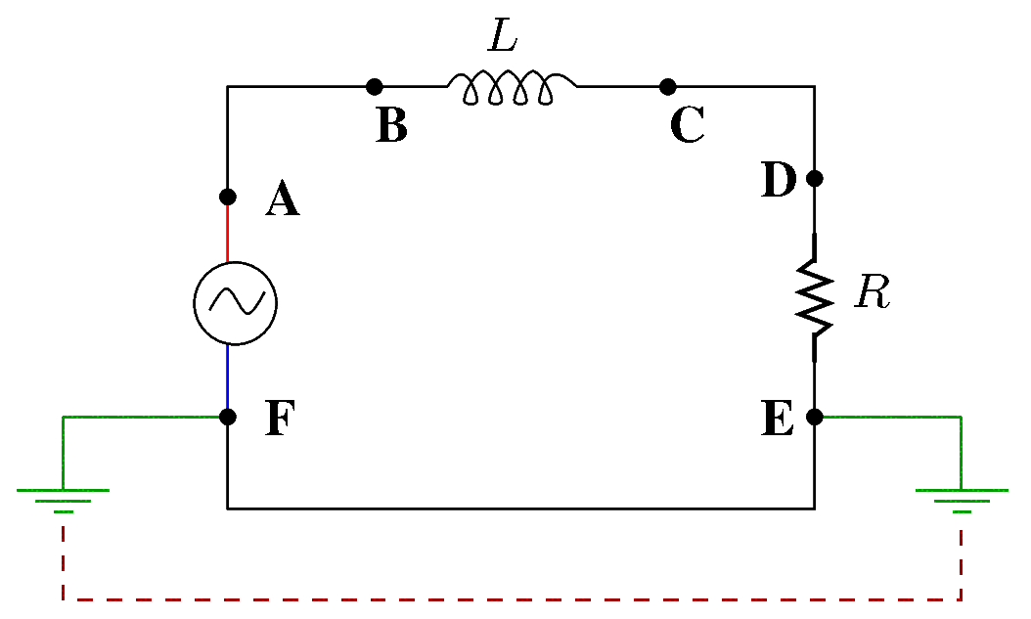
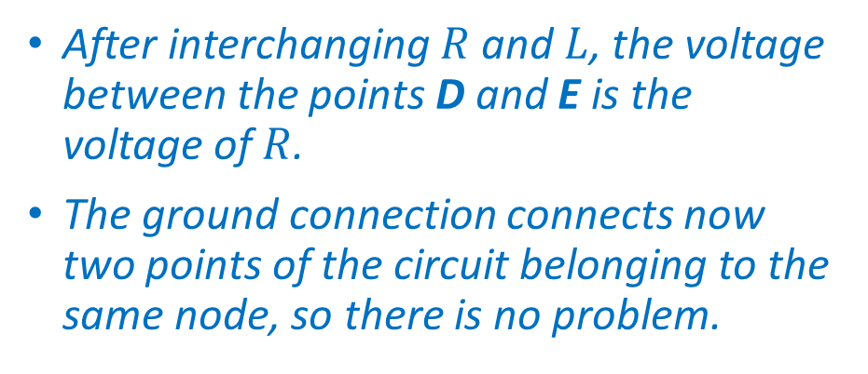

Solution 2—Interchange $R$ and $L$
After interchanging $R$ and $L$, the voltage between the points D and E is the voltage of $R$.
The ground connection connects now two points of the circuit belonging to the same node, so there is no problem.
Notes:
fig/gnd7a, gnd8a

Slide 26
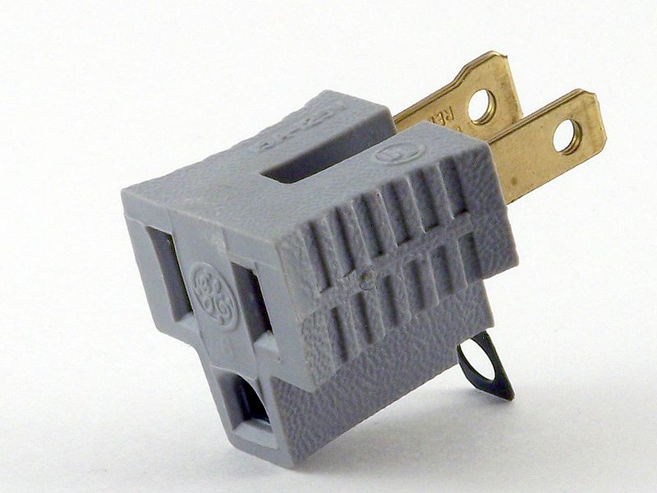
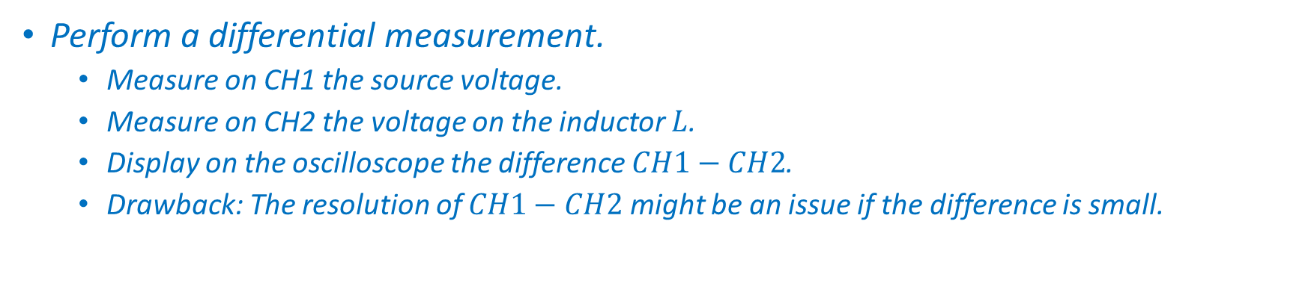
Other Solutions
Perform a differential measurement.
Measure on CH1 the source voltage.
Measure on CH2 the voltage on the inductor $L$.
Display on the oscilloscope the difference $CH1−CH2$.
Drawback: The resolution of $CH1−CH2$ might be an issue if the difference is small.
Use a three-prong/two-prong adapter.
This adapter could be used to disconnect the source or the oscilloscope from the GND of the wall outlet.
This method is unsafe and is not recommended.
Use a transformer to isolate the source from the circuit.
Transformers will be discussed later in our class.
Image from
https://en.wikipedia.org/wiki/File:Cheater_plug_edited.jpg

