Slide 1
Periodic AC Signals
M.V. Iordache, EEGR2051 Circuits and Measurements Lab, Fall 2020, LeTourneau University
See https://mviordache.name/EEGR2051 for more information.

Slide 2
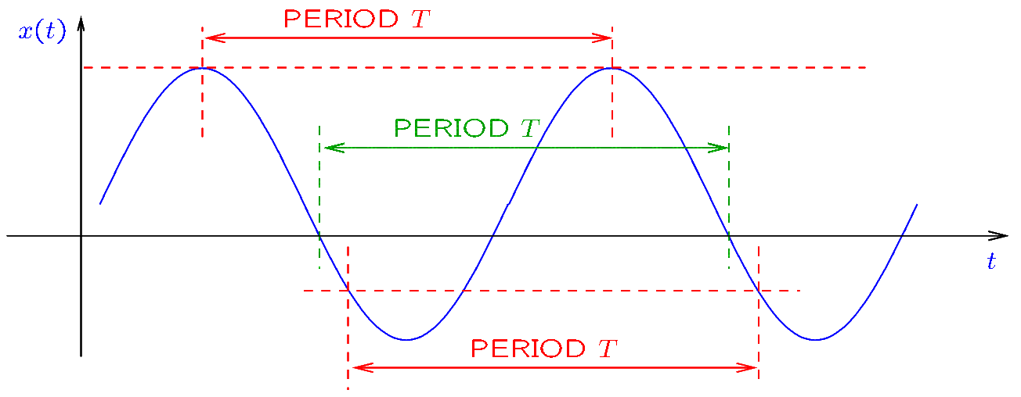
Frequency and Period
Voltages and currents can be periodic functions of time.
The period is the duration of one cycle.
The period can be found from the distance between the intersection points of the curve with a horizontal line:
Notes:
fig/sine.fig

Slide 3

Frequency and Period
The frequency is the number of cycles in one second.
  The unit of frequency is Hertz [Hz].
The frequency $f$ is related to the period $T$ by the equation
$$\boxed{f=\frac{1}{T}}$$

Slide 4

Frequency and Period
The frequency $f$ is related to the period $T$ by the equation
$$\boxed{f=\frac{1}{T}}$$
The angular frequency $ω$ in radians per second is
$$\boxed{ω=2πf}$$

Slide 5
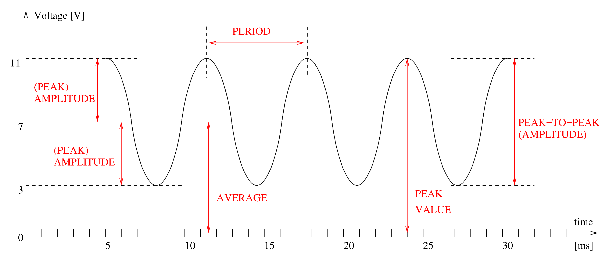

Peak-to-peak and Peak Amplitudes
In the example below, the peak amplitude is $4 V$ and the peak-to-peak amplitude is $11−3=8 V$. The period is $6.5 ms$ and the frequency $≃154 Hz$.
Notes:
doc/problems/SigDef.fig

Slide 6
Peak-to-peak and Peak Amplitudes
The peak-to-peak amplitude is the difference between the maximum and the minimum values of a signal.
The peak amplitude of a sinusoidal signal is the difference between the maximum value and the average value.
  The peak amplitude also equals the difference of the average value and the minimum value.
Peak amplitude is defined in more than one way for signals that are not sinusoidal.
In the context of sinusoidal signals, amplitude normally means peak amplitude.
In the context of arbitrary periodic signals, amplitude commonly means peak-to-peak amplitude.

Slide 7
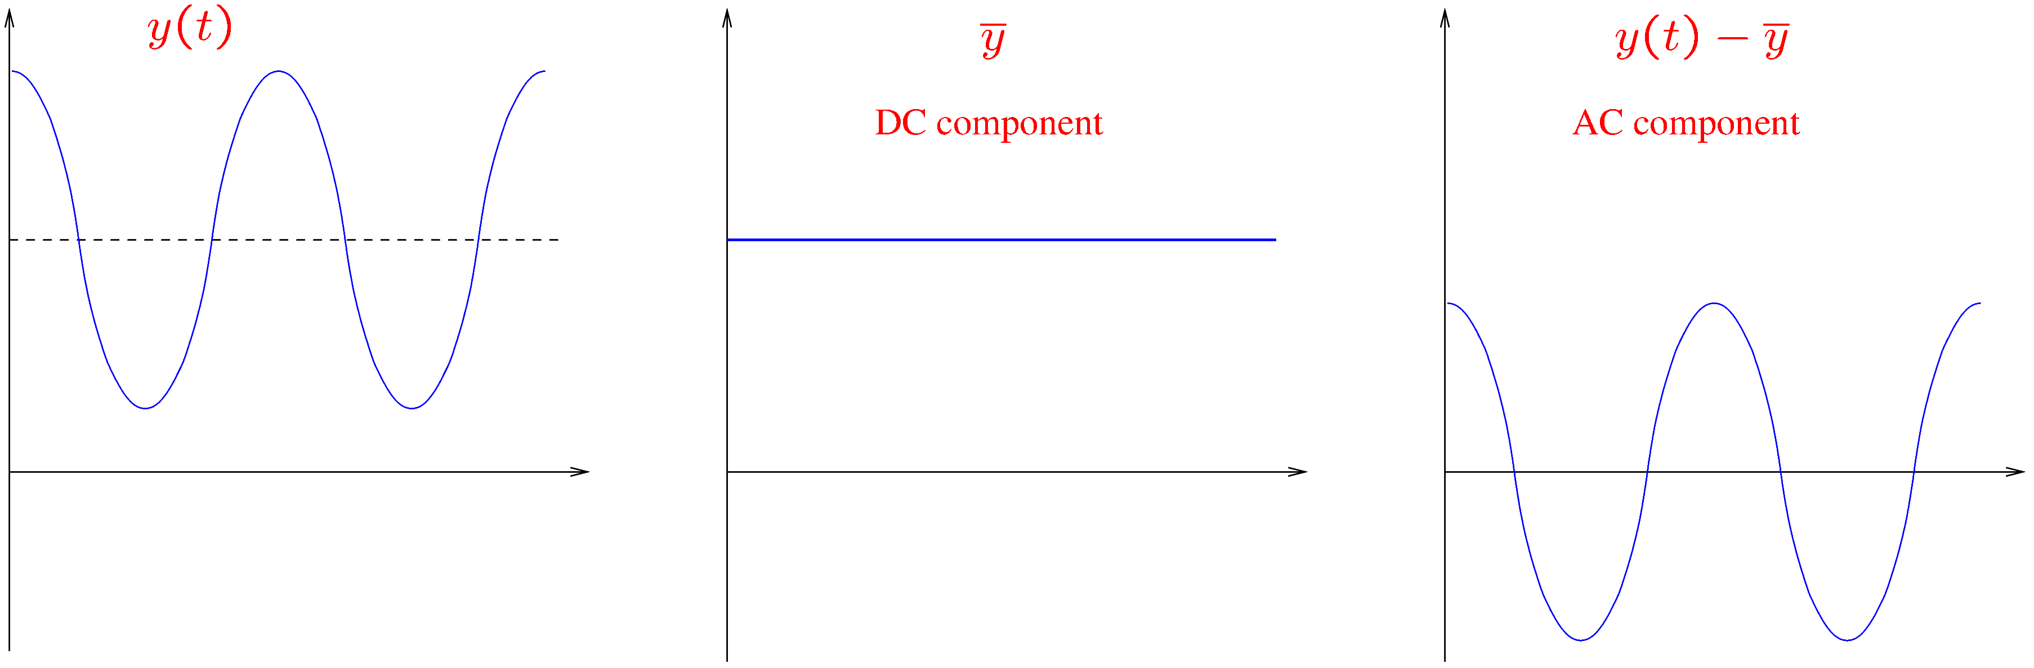

AC and DC Components
Let $y(t)$ be an arbitrary signal. Let $\overline{y}$ be the average of $y(t)$.
Any signal $y(t)$ can be decomposed into a constant (DC) signal of value $\overline{y}$ and a zero-mean alternating (AC) signal of value $y\left(t\right)−\overline{y}$.

Slide 8

AC and DC Components—Example
The DC component $\overline{y}$ has $7 V$ (it equals the average value of the signal).
The AC component $y−\overline{y}$ is a zero-mean sine of $4 V$ peak amplitude.

Slide 9
AC and DC Components
To measure the DC component (the average) of a signal with a DMM:
  Press DCV to measure voltage.
  Press DCI to measure current.
    On some DMMs, DCI is SHIFT + DCV.
  The DMM will display the average value of the signal.
To measure the AC component with a DMM:
  Press ACV to measure voltage.
  Press ACI to measure current.
    On some DMMs, ACI is SHIFT + ACV.
  The DMM will display the RMS value of the signal.

Slide 10

RMS Voltages and Currents
The RMS value is a number describing the strength of a signal.
Note that the RMS value is the DC equivalent of an AC signal.
This means that an alternating voltage of RMS value $V_{x}$ and a constant voltage of value $V_{x}$ will produce the same average power on a resistor.
Note that average power is proportional to the square of the RMS value.

Slide 11
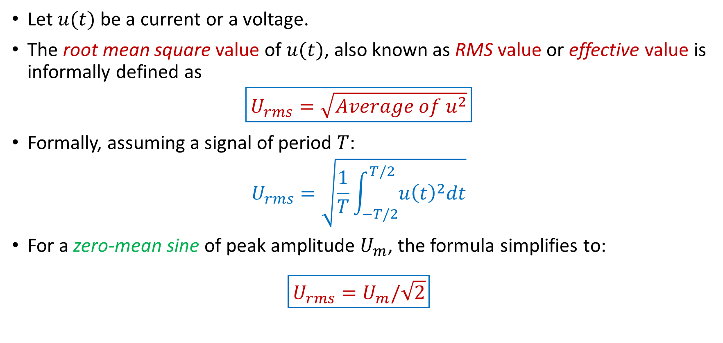
RMS Voltages and Currents
Let $u(t)$ be a current or a voltage.
The root mean square value of $u(t)$, also known as RMS value or effective value is informally defined as
$$\boxed{U_{rms}=\sqrt{Average of u^{2}}}$$
Formally, assuming a signal of period $T$:
$$U_{rms}=\sqrt{\frac{1}{T}\int_{−T/2}^{T/2}{u{\left(t\right)}^{2}dt}}$$
For a zero-mean sine of peak amplitude $U_{m}$, the formula simplifies to:
$$\boxed{U_{rms}=U_{m}/\sqrt{2}}$$

Slide 12
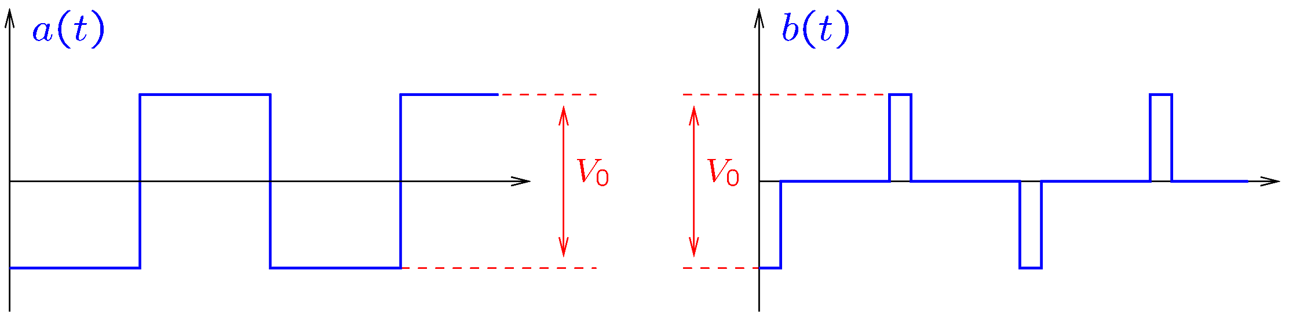

Why Do DMMs Display RMS and not Amplitude?
Amplitude is not a good indicator of the strength of a signal.
For example, while the signals $a(t)$ and $b(t)$ have the same peak-to-peak amplitude, $b(t)$ is most of the time zero.
It is clear that $b(t)$ is not as strong as $a(t)$!
The RMS values do indicate that $b(t)$ is weaker: $B_{rms}≃\frac{V_{0}}{4.8}$, while $A_{rms}=\frac{V_{0}}{2}$.

Slide 13
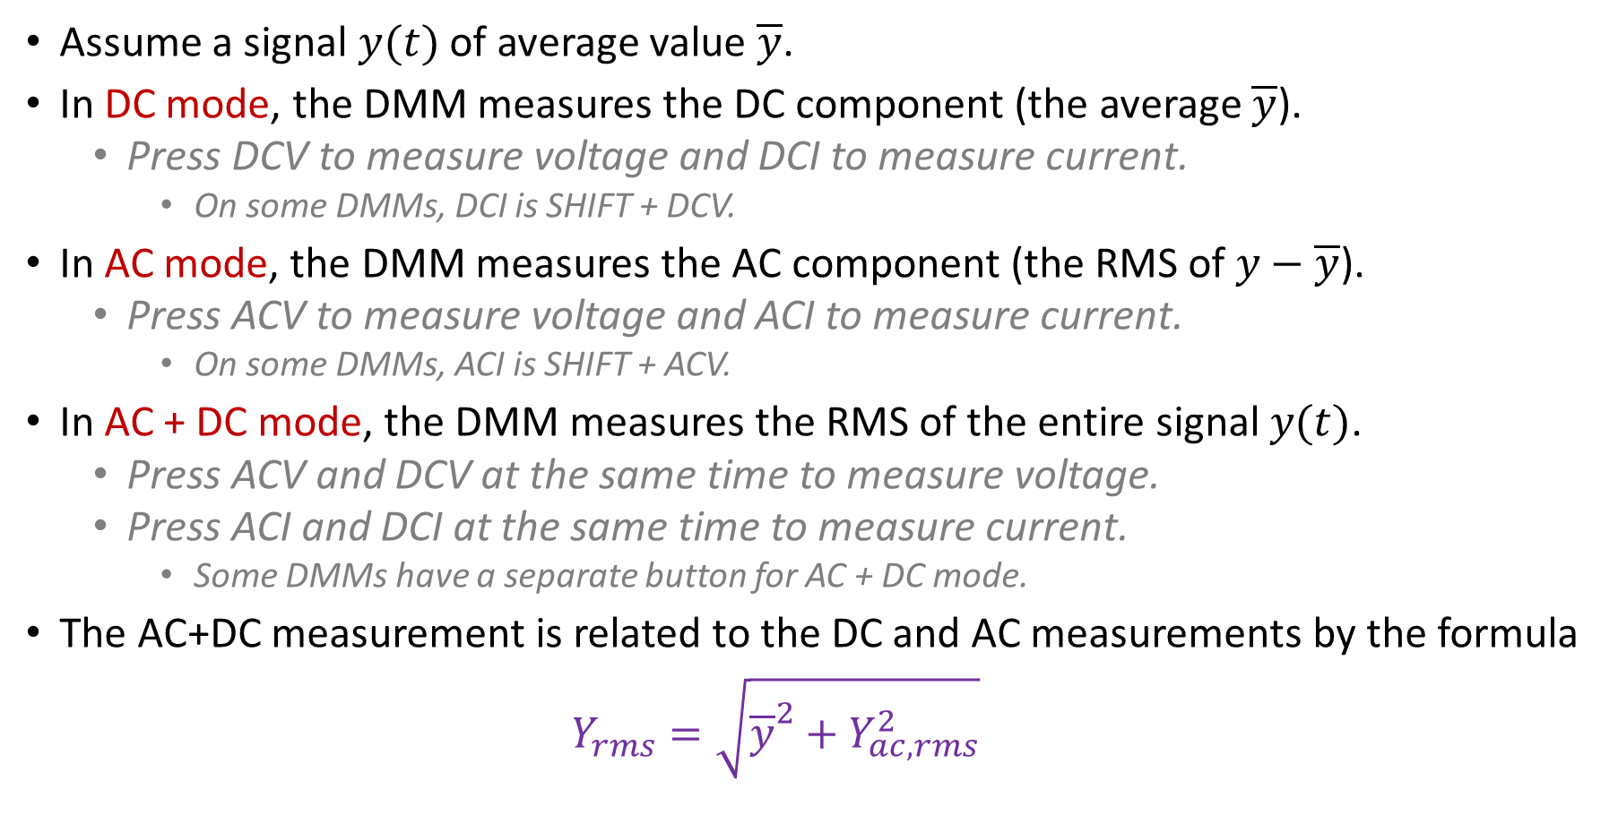
RMS Measurements
Assume a signal $y(t)$ of average value $\overline{y}$.
In DC mode, the DMM measures the DC component (the average $\overline{y}$).
  Press DCV to measure voltage and DCI to measure current.
    On some DMMs, DCI is SHIFT + DCV.
In AC mode, the DMM measures the AC component (the RMS of $y−\overline{y}$).
  Press ACV to measure voltage and ACI to measure current.
    On some DMMs, ACI is SHIFT + ACV.
In AC + DC mode, the DMM measures the RMS of the entire signal $y(t)$.
  Press ACV and DCV at the same time to measure voltage.
  Press ACI and DCI at the same time to measure current.
    Some DMMs have a separate button for AC + DC mode.
The AC+DC measurement is related to the DC and AC measurements by the formula
  $$Y_{rms}=\sqrt{{\overline{y}}^{2}+Y_{ac,rms}^{2}}$$

Slide 14
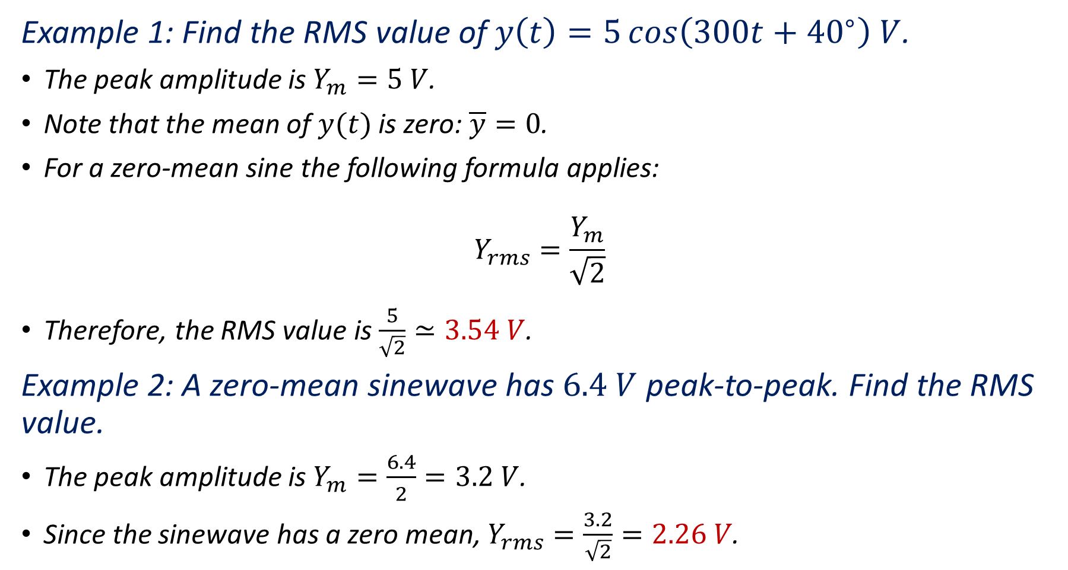
Example 1: Find the RMS value of $y\left(t\right)=5\cos\left(300t+{40}^{∘}\right) V$.
The peak amplitude is $Y_{m}=5 V$.
Note that the mean of $y(t)$ is zero: $\overline{y}=0$.
For a zero-mean sine the following formula applies:
$$Y_{rms}=\frac{Y_{m}}{\sqrt{2}}$$
Therefore, the RMS value is $\frac{5}{\sqrt{2}}≃3.54 V$.
Example 2: A zero-mean sinewave has $6.4 V$ peak-to-peak. Find the RMS value.
The peak amplitude is $Y_{m}=\frac{6.4}{2}=3.2 V$.
Since the sinewave has a zero mean, $Y_{rms}=\frac{3.2}{\sqrt{2}}=2.26 V$.

Slide 15
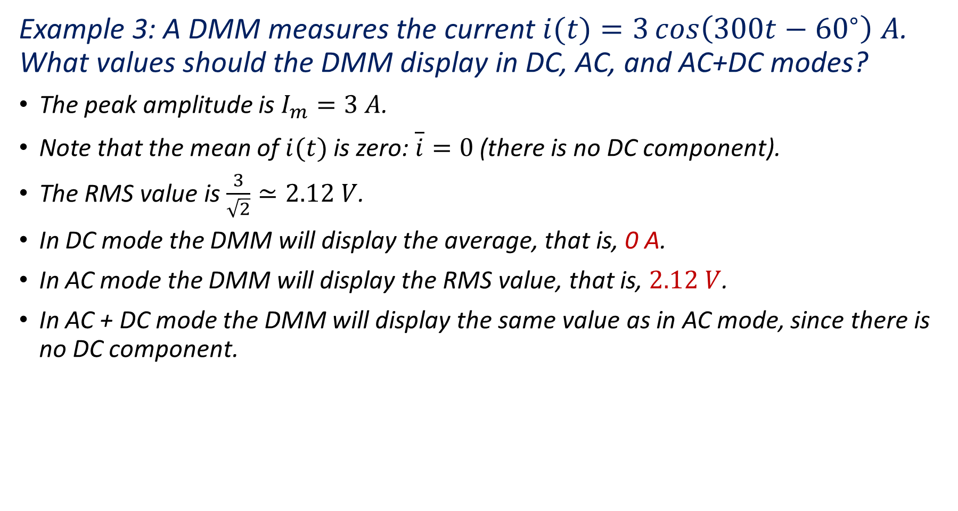
Example 3: A DMM measures the current $i(t)=3\cos\left(300t−{60}^{∘}\right) A$. What values should the DMM display in DC, AC, and AC+DC modes?
The peak amplitude is $I_{m}=3 A$.
Note that the mean of $i(t)$ is zero: $\overline{i}=0$ (there is no DC component).
The RMS value is $\frac{3}{\sqrt{2}}≃2.12 V$.
In DC mode the DMM will display the average, that is, 0 A.
In AC mode the DMM will display the RMS value, that is, $2.12 V$.
In AC + DC mode the DMM will display the same value as in AC mode, since there is no DC component.

Slide 16
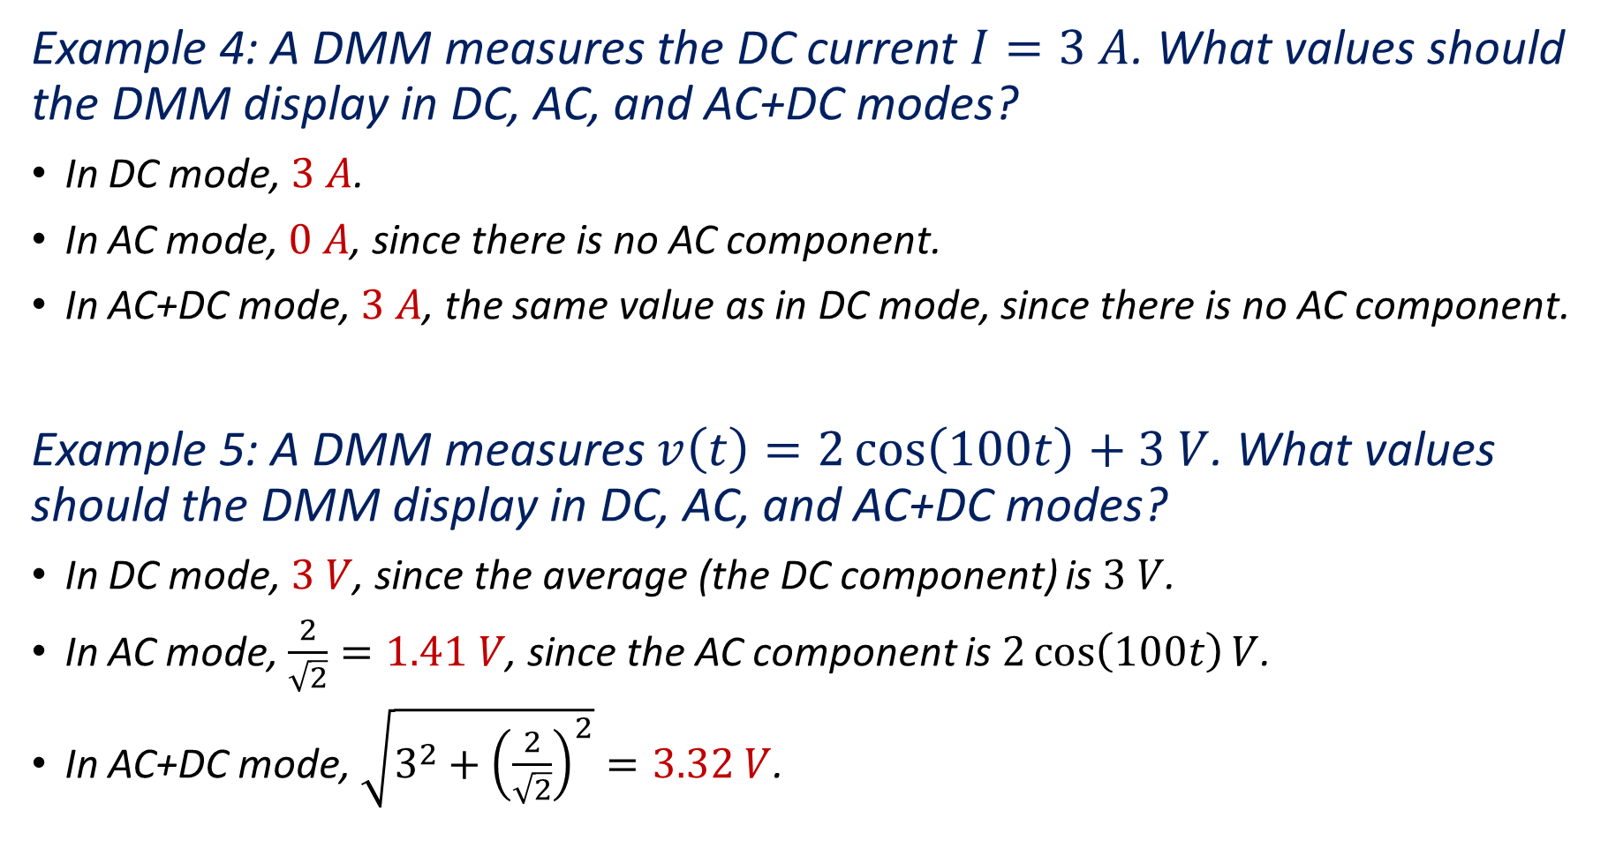
Example 4: A DMM measures the DC current $I=3 A$. What values should the DMM display in DC, AC, and AC+DC modes?
In DC mode, $3 A$.
In AC mode, $0 A$, since there is no AC component.
In AC+DC mode, $3 A$, the same value as in DC mode, since there is no AC component.
Example 5: A DMM measures $v\left(t\right)=2\cos\left(100t\right)+3 V$. What values should the DMM display in DC, AC, and AC+DC modes?
In DC mode, $3 V$, since the average (the DC component) is $3 V$.
In AC mode, $\frac{2}{\sqrt{2}}=1.41 V$, since the AC component is $2\cos\left(100t\right)V$.
In AC+DC mode, $\sqrt{3^{2}+{\left(\frac{2}{\sqrt{2}}\right)}^{2}}=3.32 V$.

Slide 17

Notation
Volts (or amperes) peak-to-peak are commonly abbreviated $V_{pp}$ (or $A_{pp}$).
RMS volts (or amperes) are commonly abbreviated $V_{rms}$ (or $A_{rms}$).
For example, the waveform in the figure has $8 V_{pp}$. Moreover, its AC component has $\frac{4}{\sqrt{2}}=2.82 V_{rms}$.

Slide 18
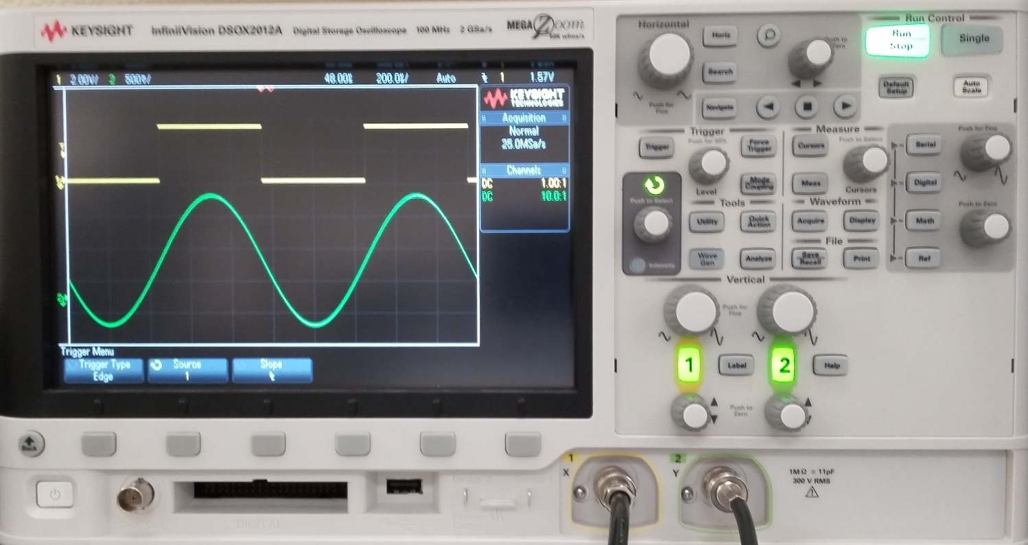
Visualizing Signals
The oscilloscope is an instrument that displays signal graphs (voltage versus time).
Signals on several channels may be displayed at the same time.
Channel 1 controls
Channel 2 controls
Channel 1 input
Channel 2
input

Slide 19
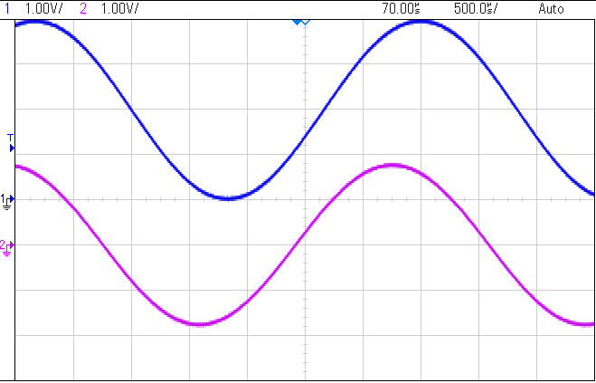

How to Read The Graphs
Channel 1 has 1V/div, that is, 1V per vertical division
Each horizontal division has $500 μs$
Channel 2 has 1V/div
Zero reference of channel 1 (position of ground reference)
Zero reference of channel 2 (position of ground reference)
1 divison
1 divison

Slide 20
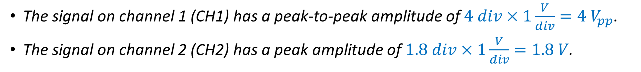
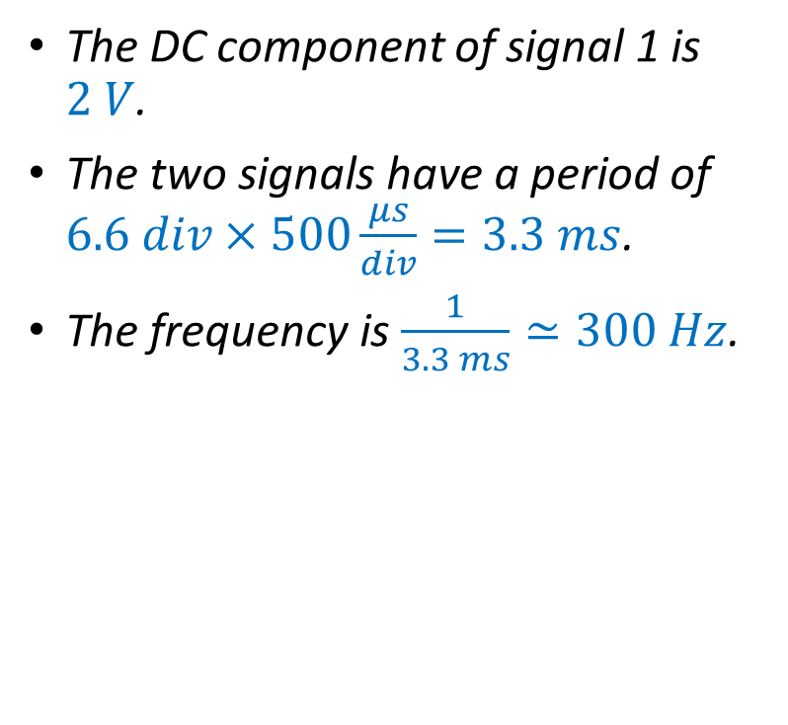
Example
The signal on channel 1 (CH1) has a peak-to-peak amplitude of $4 div×1\frac{V}{div}=4 V_{pp}$.
The signal on channel 2 (CH2) has a peak amplitude of $1.8 div×1\frac{V}{div}=1.8 V$.
The DC component of signal 1 is $2 V$.
The two signals have a period of $6.6 div×500\frac{μs}{div}=3.3 ms$.
The frequency is $\frac{1}{3.3 ms}≃300 Hz$.
1 divison
1 divison

Slide 21
Visualizing Signals
It is possible to magnify or reduce the size of the graphs by changing the volts per division (that is, the vertical sensitivity) and the time per division (that is, the horizontal sensitivity).
Shifts horizontally all graphs
Adjusts Time/div
Adjusts Volts/div for CH1
Adjusts Volts/div for CH2
Shifts vertically CH1 graph
Shifts vertically CH2 graph

Slide 22
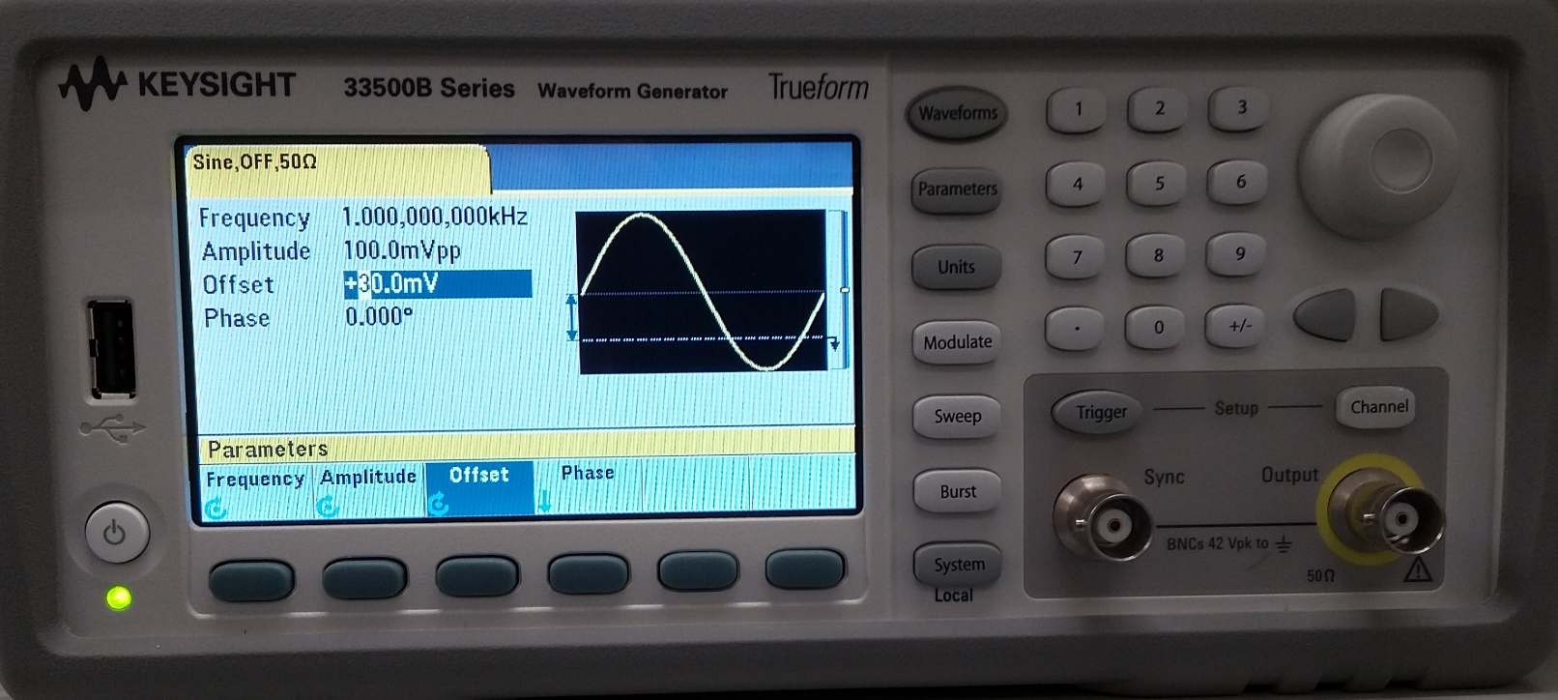
Generating AC Signals
Arbitrary waveform generators can be used to generate AC signals.
  First, select the waveform type (sine, square, …)
  Next, specify the resistance of the load.
  Next, specify waveform parameters:
    Average value (offset)
    Amplitude
    Frequency
    …

Slide 23
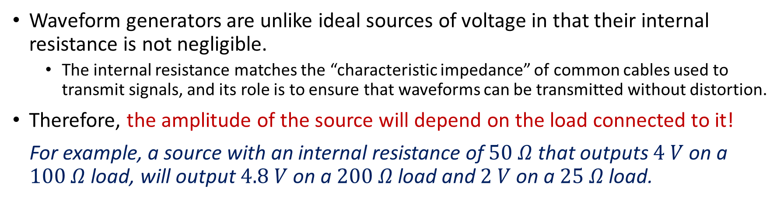
How to Adjust Amplitude
Waveform generators are unlike ideal sources of voltage in that their internal resistance is not negligible.
  The internal resistance matches the “characteristic impedance” of common cables used to transmit signals, and its role is to ensure that waveforms can be transmitted without distortion.
Therefore, the amplitude of the source will depend on the load connected to it!
For example, a source with an internal resistance of $50 Ω$ that outputs $4 V$ on a $100 Ω$ load, will output $4.8 V$ on a $200 Ω$ load and $2 V$ on a $25 Ω$ load.
To adjust the amplitude or the offset of the source:
  First, specify the resistance of the load (press Channel, then Output Load.)
  Next, specify the amplitude and offset that the source should have when driving a load that has the specified resistance (press Parameters.)

Slide 24
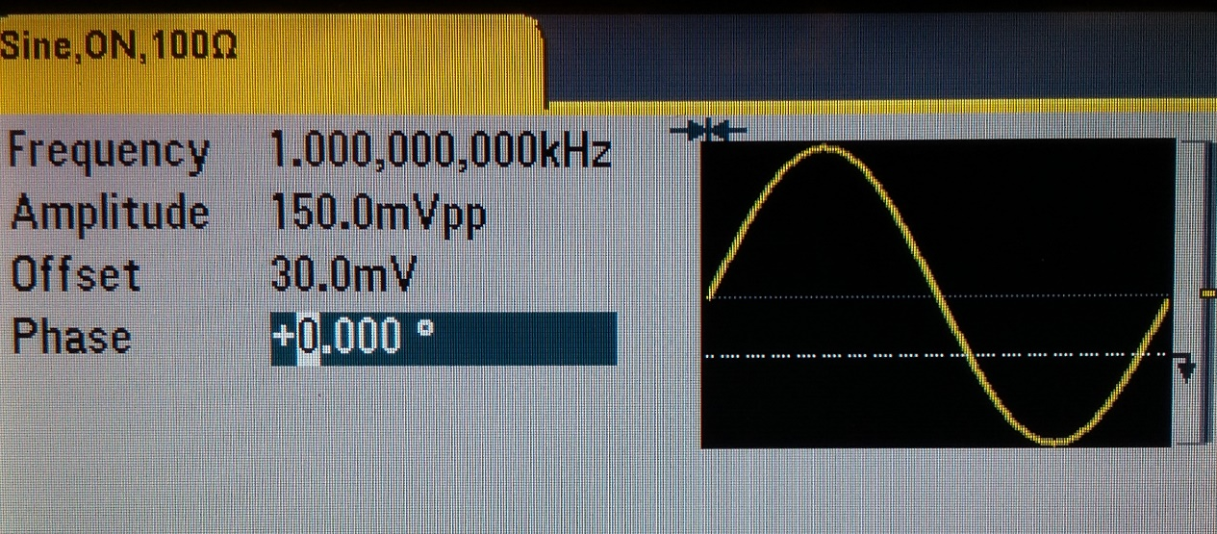

Example
Assume the settings shown in the picture and an internal resistance $r=50 Ω$. If the source powers a resistor $R=200 Ω$, what is the output voltage and the offset?
The frequency is $f=1 kHz$.
The angular frequency is $ω=2πf=6283.2 rad/s$.
The specified load resistance is $R_{L}=100 Ω$.
The output amplitude can be found by a method known as voltage division.
$$V_{s}=150⋅\frac{R_{L}+r}{R_{L}}⋅\frac{R}{R+r}=180 mV_{pp}$$
The output offset is
$$V_{o}=30⋅\frac{R_{L}+r}{R_{L}}⋅\frac{R}{R+r}=36 mV$$
The output signal is $v\left(t\right)=\frac{180}{2}⋅\sin\left(6283.2t\right)+36=90⋅\sin\left(6283.2t\right)+36 mV$.

Slide 25
How to Adjust Amplitude
If the load is not equivalent to a resistor or if the resistance of the load does not equal the specified value of the output load, the amplitude and the offset displayed by the source should be ignored, as they will be different from the actual amplitude and offset of the signal.

Slide 26
Adjusting Amplitude—The Easy Way
To adjust the amplitude or the offset of the source:
  Measure its value with an oscilloscope or a DMM.
  Adjust it with the rotary knob and the arrow keys until its measured value is right.

