Slide 1
Interference Signals
M.V. Iordache, EEGR2051 Circuits and Measurements Lab, Fall 2020, LeTourneau University
See https://mviordache.name/EEGR2051 for more information.

Slide 2
Interference
In a measurement system, in addition to the signals that are measured, there are also unwanted electrical signals.
Some unwanted signals are due to interference from nearby circuit networks.
Interference signals are classified based on the source of interference and the way they are transmitted:
Capacitive interference
Inductive interference
Electromagnetic interference
Conductively coupled interference

Slide 3
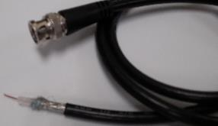
Capacitive Interference
Manifests itself near conductors that have a significant time varying voltage.
A conductor will create a voltage in a neighbor conductor as if they were connected by a low-valued capacitor.
Capacitive interference needs to be addressed when it is strong enough to affect the signals carried by a conductor.
Capacitive interference is eliminated by surrounding the conductor with a conductive shield connected to GND.
Examples of shielded cables include
BNC cables.
USB cables.
Shield
Signal conductor

Slide 4
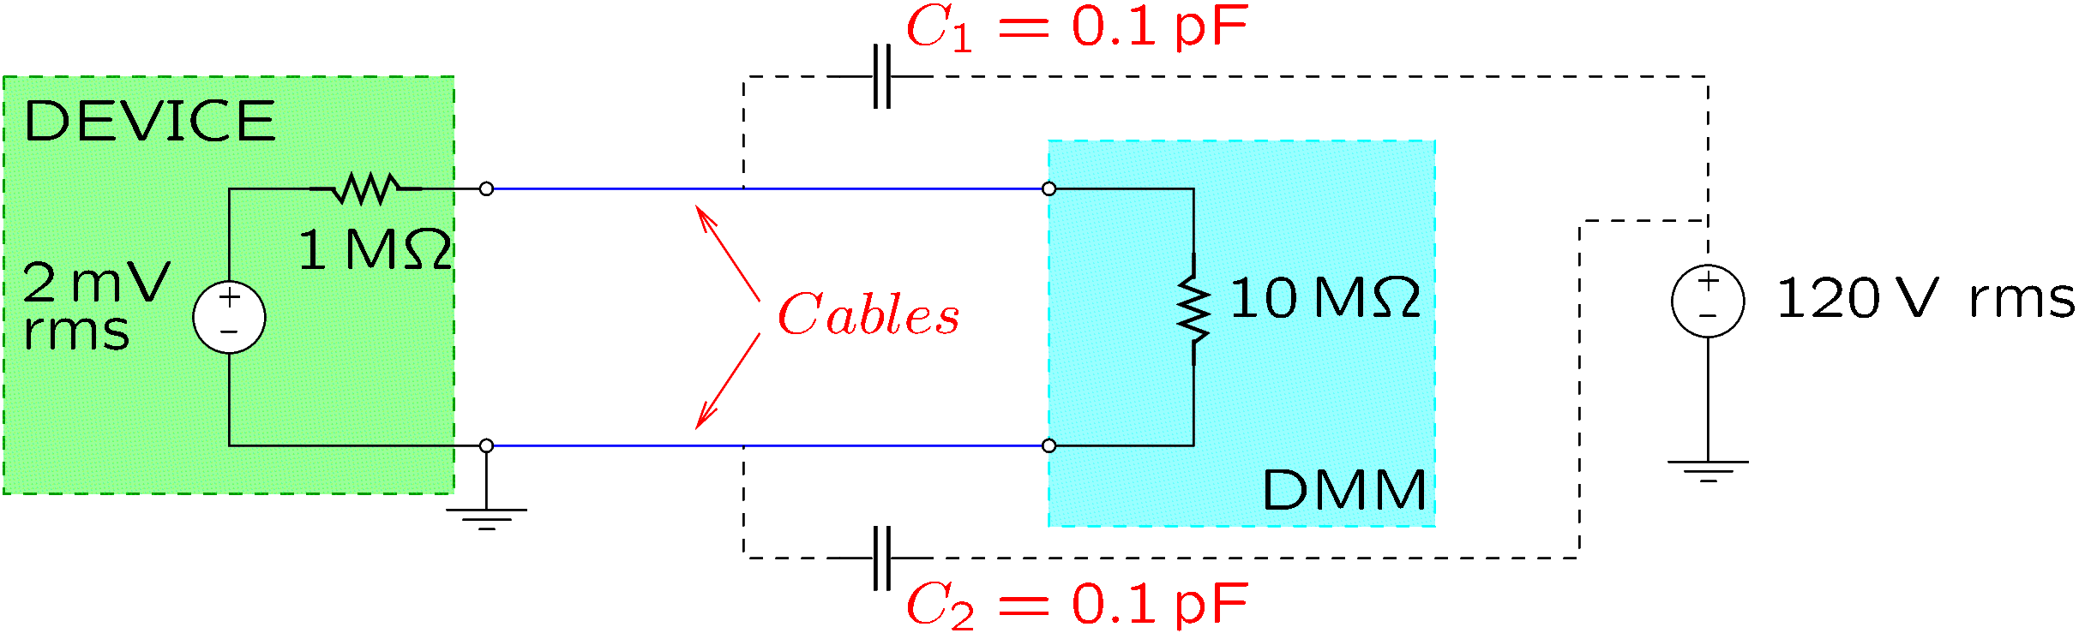
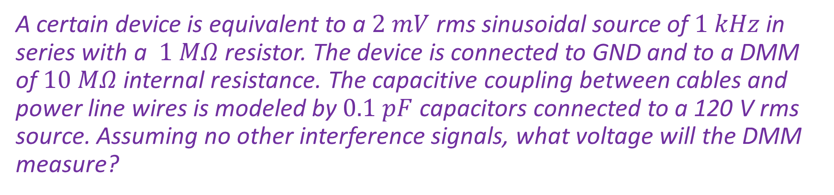
Example
A certain device is equivalent to a $2 mV$ rms sinusoidal source of $1 kHz$ in series with a $1 MΩ$ resistor. The device is connected to GND and to a DMM of $10 MΩ$ internal resistance. The capacitive coupling between cables and power line wires is modeled by $0.1 pF$ capacitors connected to a 120 V rms source. Assuming no other interference signals, what voltage will the DMM measure?
Notes:
interf-c.fig

Slide 5
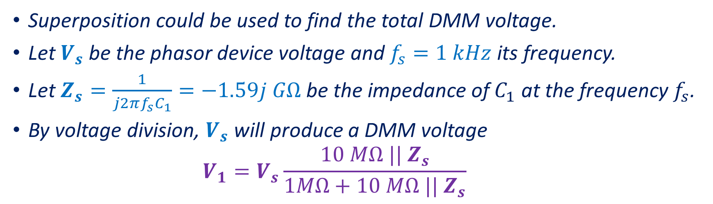
Example (continued)
Superposition could be used to find the total DMM voltage.
Let $V_{s}$ be the phasor device voltage and $f_{s}=1 kHz$ its frequency.
Let $Z_{s}=\frac{1}{j2πf_{s}C_{1}}=−1.59j GΩ$ be the impedance of $C_{1}$ at the frequency $f_{s}$.
By voltage division, $V_{s}$ will produce a DMM voltage
$$V_{1}=V_{s}\frac{10 MΩ || Z_{s}}{1MΩ+10 MΩ || Z_{s}}$$

Slide 6
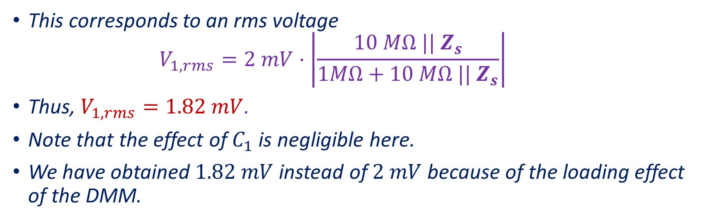
Example (continued)
This corresponds to an rms voltage
$$V_{1,rms}=2 mV⋅\left|\frac{10 MΩ || Z_{s}}{1MΩ+10 MΩ || Z_{s}}\right|$$
Thus, $V_{1,rms}=1.82 mV$.
Note that the effect of $C_{1}$ is negligible here.
We have obtained $1.82 mV$ instead of $2 mV$ because of the loading effect of the DMM.

Slide 7
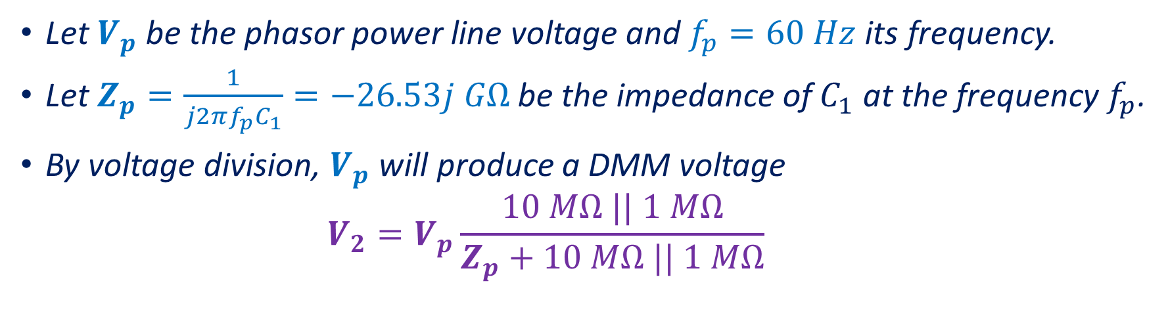
Example (continued)
Let $V_{p}$ be the phasor power line voltage and $f_{p}=60 Hz$ its frequency.
Let $Z_{p}=\frac{1}{j2πf_{p}C_{1}}=−26.53j GΩ$ be the impedance of $C_{1}$ at the frequency $f_{p}$.
By voltage division, $V_{p}$ will produce a DMM voltage
$$V_{2}=V_{p}\frac{10 MΩ || 1 MΩ}{Z_{p}+10 MΩ || 1 MΩ}$$

Slide 8
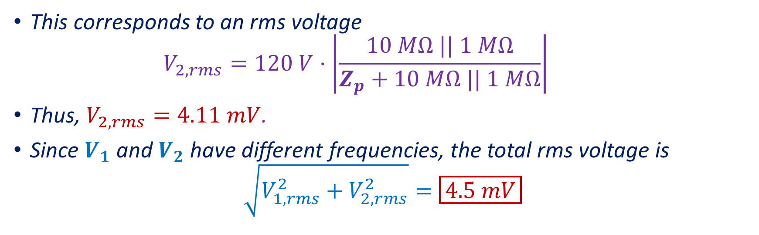
Example (continued)
This corresponds to an rms voltage
$$V_{2,rms}=120 V⋅\left|\frac{10 MΩ || 1 MΩ}{Z_{p}+10 MΩ || 1 MΩ}\right|$$
Thus, $V_{2,rms}=4.11 mV$.
Since $V_{1}$ and $V_{2}$ have different frequencies, the total rms voltage is
$$\sqrt{V_{1,rms}^{2}+V_{2,rms}^{2}}=\boxed{4.5 mV}$$

Slide 9
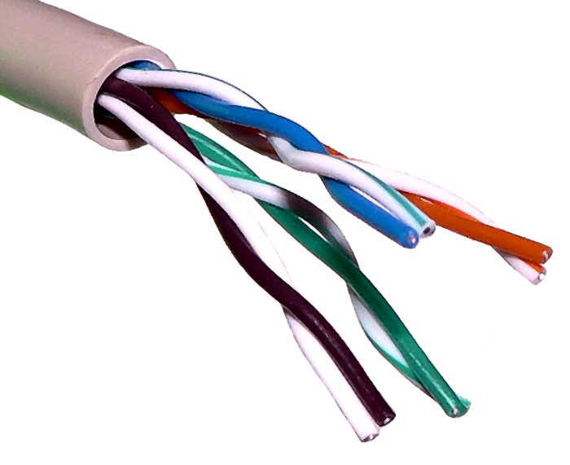
Inductive Interference
Manifests itself near conductors that have a significant time varying current.
Currents create a magnetic field.
A time varying magnetic field will induce voltages in conductors.
To reduce inductive interference:
The critical parts of a circuit should be as far as possible from the sources of the magnetic field.
Magnetic shielding can be applied, using a material with high magnetic permeability.
Twisted pairs of wires could be used to reduce the area between conductors and in this way the induced voltage.
Unshielded twisted pair cable with different twist rates
From https://en.wikipedia.org/wiki/Twisted_pair

Slide 10
Electromagnetic Interference (EMI)
Part of the energy associated with the fluctuations of charge or current in a conductor is radiated in the form of electromagnetic waves.
This phenomenon is used to generate radio waves for communication.
Since electromagnetic waves have both magnetic and electric fields, EMI resembles both capacitive and inductive interference.
Near the source of interference, capacitive interference and inductive interference are significant, while EMI can be neglected.
Far from the source of interference, capacitive interference and inductive interference are negligible, while EMI can be significant.
EMI can be eliminated by means of a conductive shield connected to GND (just as capacitive interference).

Slide 11
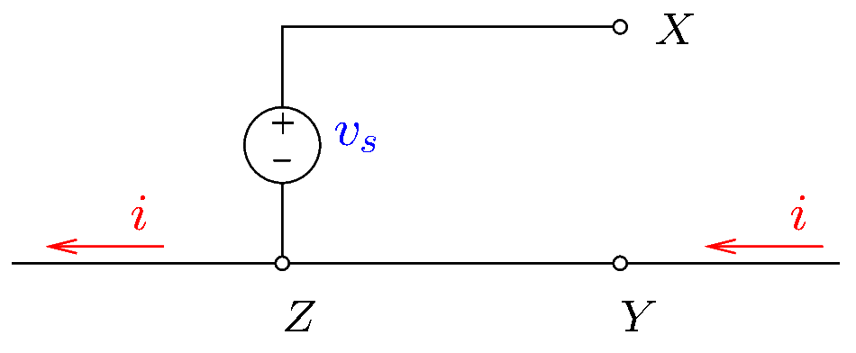
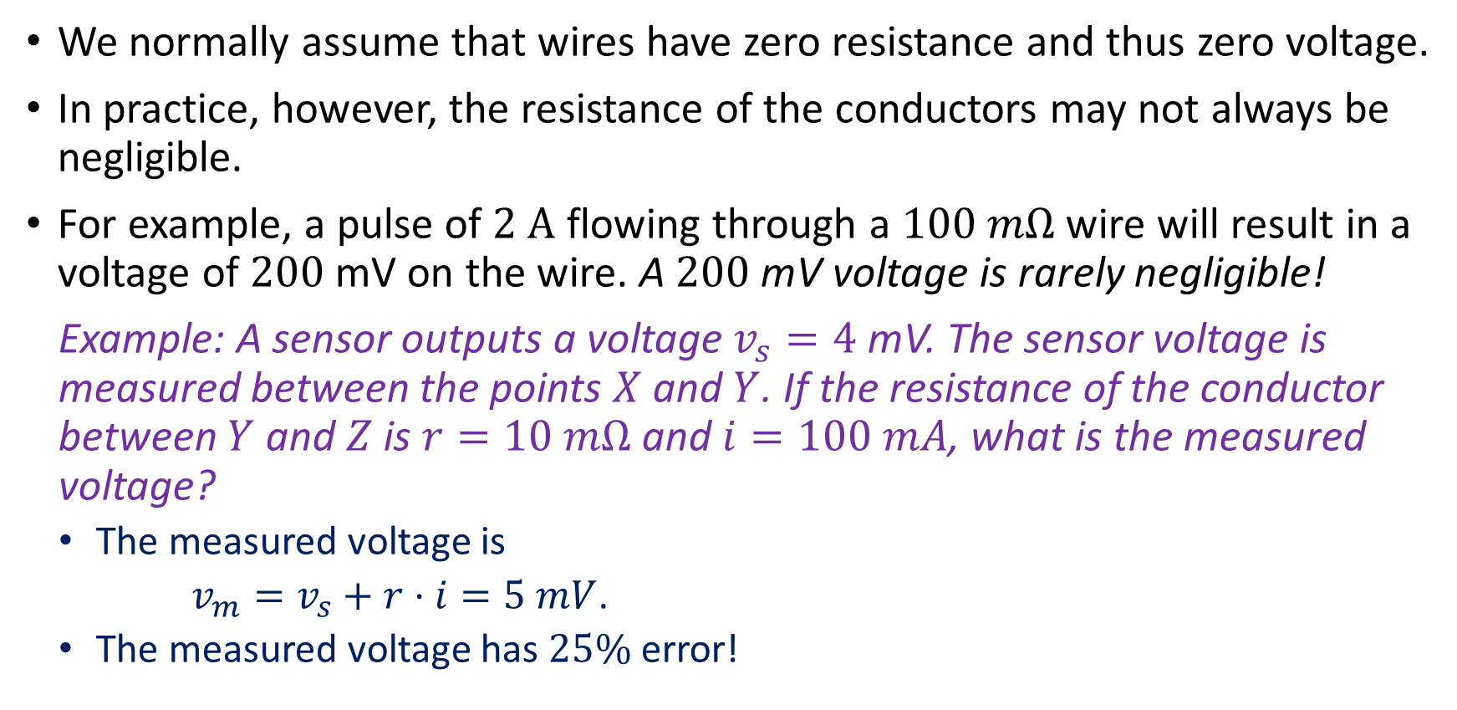
Conductively Coupled Interference
We normally assume that wires have zero resistance and thus zero voltage.
In practice, however, the resistance of the conductors may not always be negligible.
For example, a pulse of $2 A$ flowing through a $100 mΩ$ wire will result in a voltage of $200$mV on the wire. A $200$mV voltage is rarely negligible!
Example: A sensor outputs a voltage $v_{s}=4$mV. The sensor voltage is measured between the points $X$ and $Y$. If the resistance of the conductor between $Y$ and $Z$ is $r=10 mΩ$ and $i=100 mA$, what is the measured voltage?
The measured voltage is
$v_{m}=v_{s}+r⋅i=5 mV$.
The measured voltage has $25\%$ error!
Notes:
interf_c.fig

Slide 12
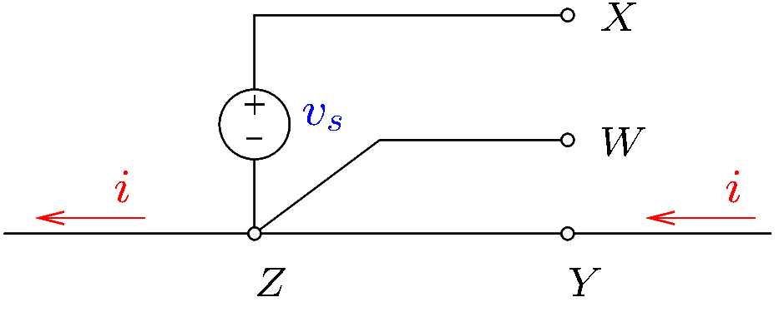

Conductively Coupled Interference
To eliminate conductively coupled interference, high currents should be routed through conductors that are not used for the transmission of small signals.
In the previous example, the sensor voltage could be measured correctly between $X$ and $W$.
Notes:
interf_c2.fig

Slide 13
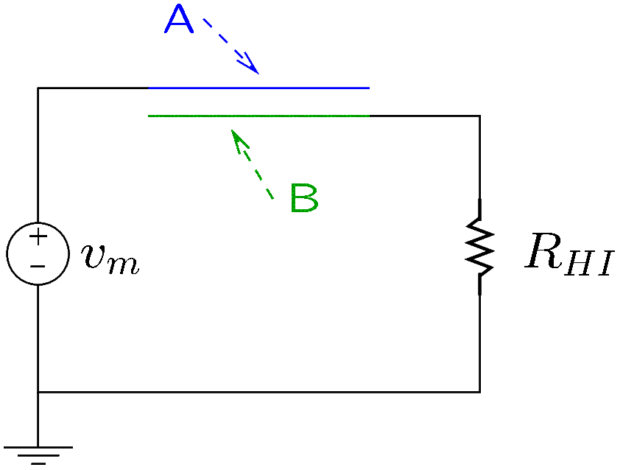
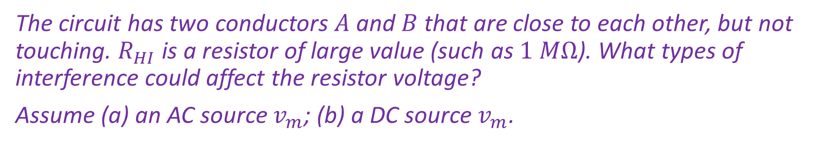
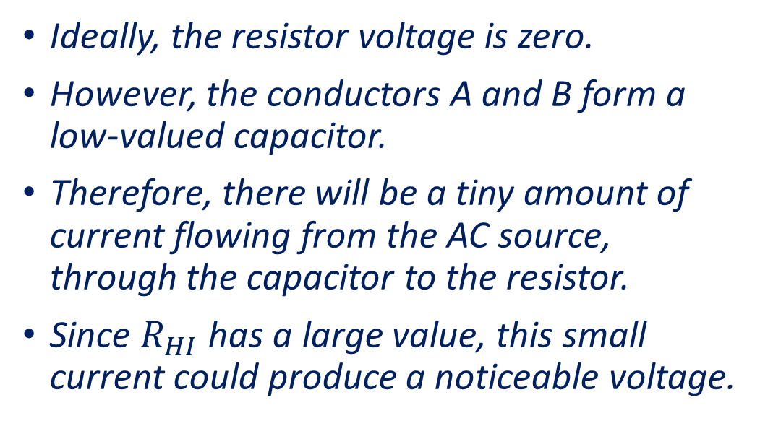
Example 1
The circuit has two conductors $A$ and $B$ that are close to each other, but not touching. $R_{HI}$ is a resistor of large value (such as $1 MΩ$). What types of interference could affect the resistor voltage?
Assume (a) an AC source $v_{m}$; (b) a DC source $v_{m}$.
Ideally, the resistor voltage is zero.
However, the conductors A and B form a low-valued capacitor.
Therefore, there will be a tiny amount of current flowing from the AC source, through the capacitor to the resistor.
Since $R_{HI}$ has a large value, this small current could produce a noticeable voltage.
Notes:
interfex1.fig

Slide 14
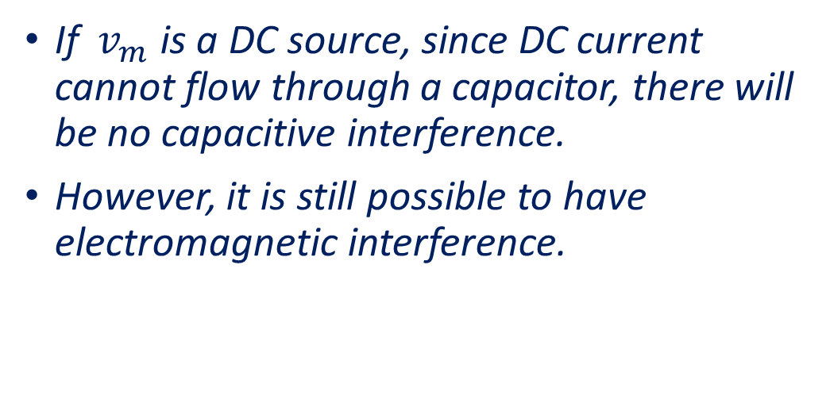
Example 1 (continued)
Thus, in the AC case, there will be capacitive interference.
Since the current is very small, inductive interference and conductively coupled interference are negligible.
Electromagnetic interference may be present, since the conductors are not shielded.
If $v_{m}$ is a DC source, since DC current cannot flow through a capacitor, there will be no capacitive interference.
However, it is still possible to have electromagnetic interference.
Notes:
interfex1.fig

Slide 15
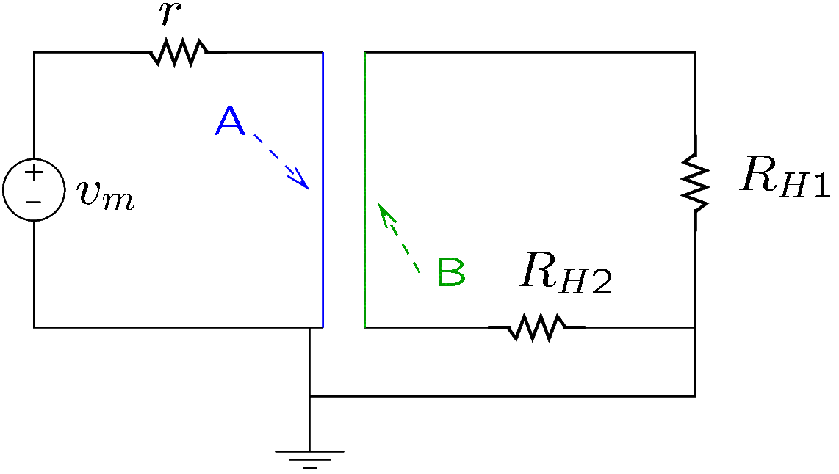
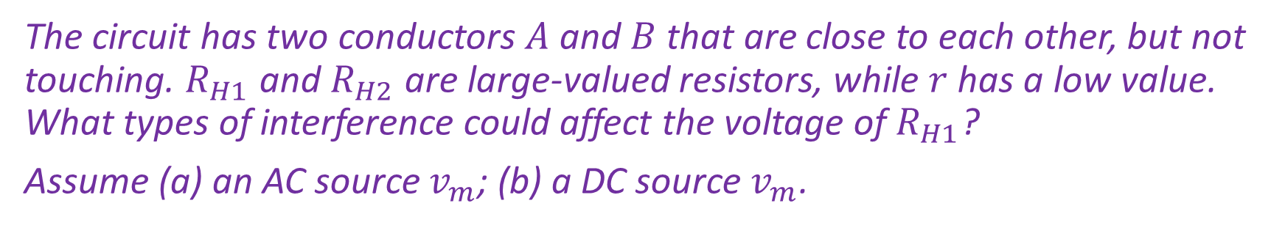
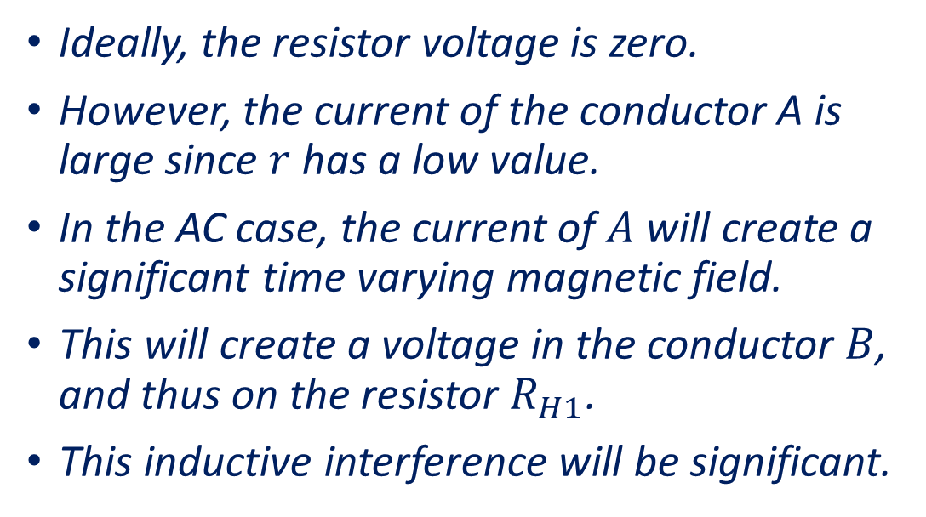
Example 2
The circuit has two conductors $A$ and $B$ that are close to each other, but not touching. $R_{H1}$ and $R_{H2}$ are large-valued resistors, while $r$ has a low value. What types of interference could affect the voltage of $R_{H1}$?
Assume (a) an AC source $v_{m}$; (b) a DC source $v_{m}$.
Ideally, the resistor voltage is zero.
However, the current of the conductor A is large since $r$ has a low value.
In the AC case, the current of $A$ will create a significant time varying magnetic field.
This will create a voltage in the conductor $B$, and thus on the resistor $R_{H1}$.
This inductive interference will be significant.
Notes:
interfex2.fig

Slide 16
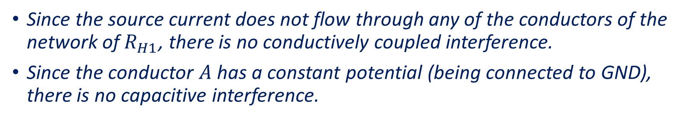
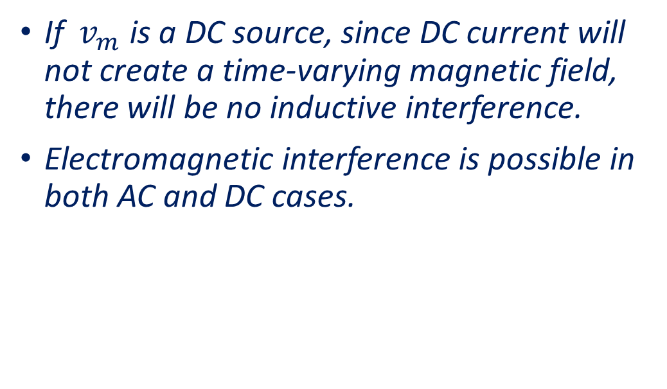
Example 2 (continued)
Since the source current does not flow through any of the conductors of the network of $R_{H1}$, there is no conductively coupled interference.
Since the conductor $A$ has a constant potential (being connected to GND), there is no capacitive interference.
If $v_{m}$ is a DC source, since DC current will not create a time-varying magnetic field, there will be no inductive interference.
Electromagnetic interference is possible in both AC and DC cases.
Notes:
interfex2.fig

Slide 17
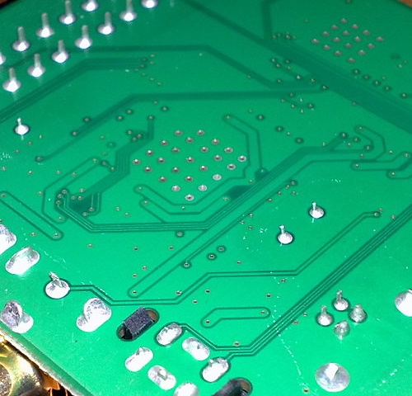
Grounding
On a printed circuit board, the ground plane is a large area of copper connected to the GND of the circuit.
Copper conductors connecting components of the circuit are known as (signal) traces.
The resistance of the GND plane, though very small, is not zero.
Therefore, the ground points of a circuit may not be at exactly the same potential due to currents flowing through the ground plane.
Picture from https://en.wikipedia.org/wiki/Ground_plane
Notes:
interf_c.fig

Slide 18
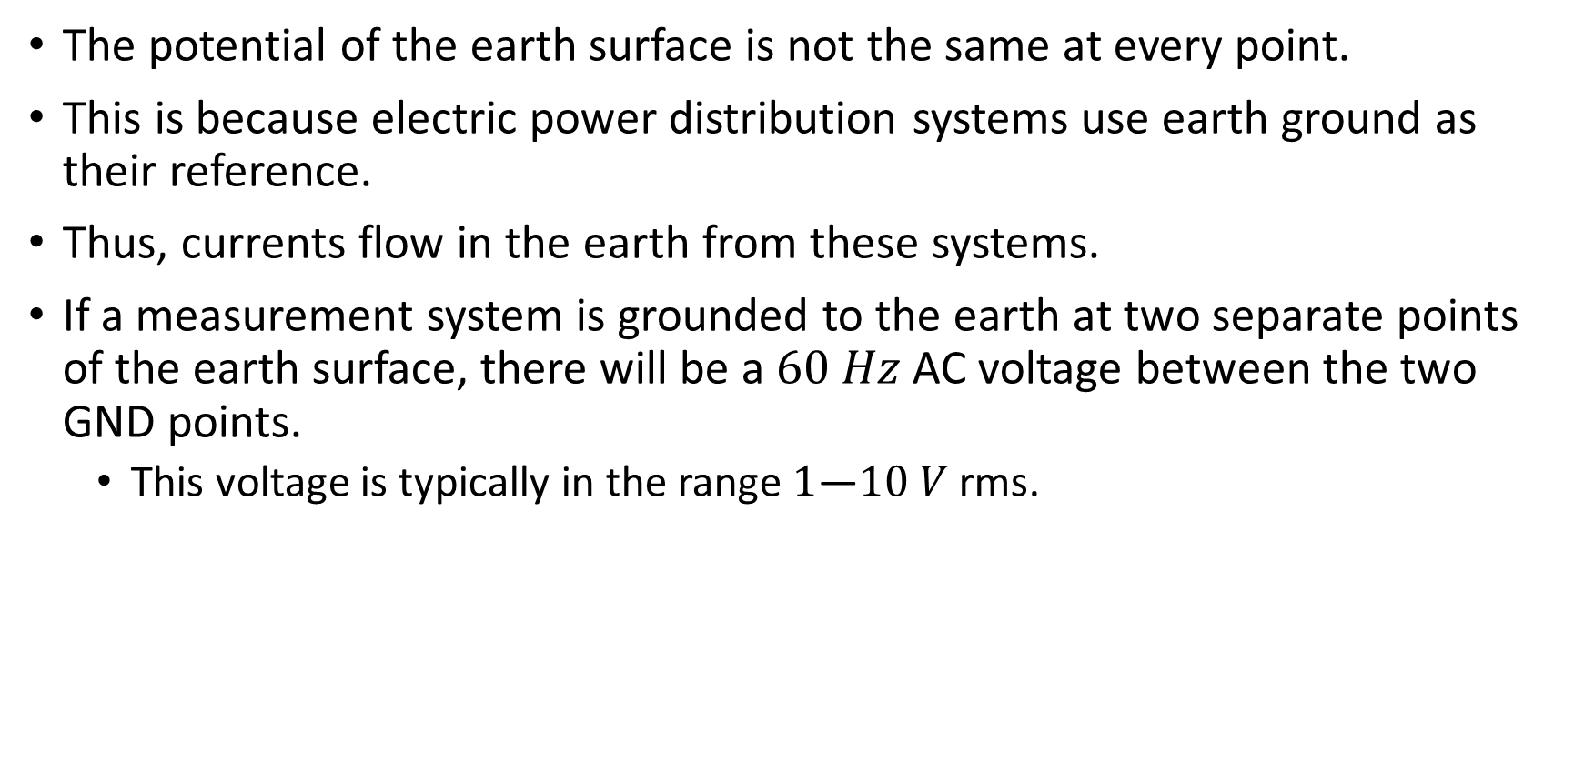
Grounding
The potential of the earth surface is not the same at every point.
This is because electric power distribution systems use earth ground as their reference.
Thus, currents flow in the earth from these systems.
If a measurement system is grounded to the earth at two separate points of the earth surface, there will be a $60 Hz$AC voltage between the two GND points.
This voltage is typically in the range $1$—$10 V$ rms.
Notes:
interf_c.fig

Slide 19
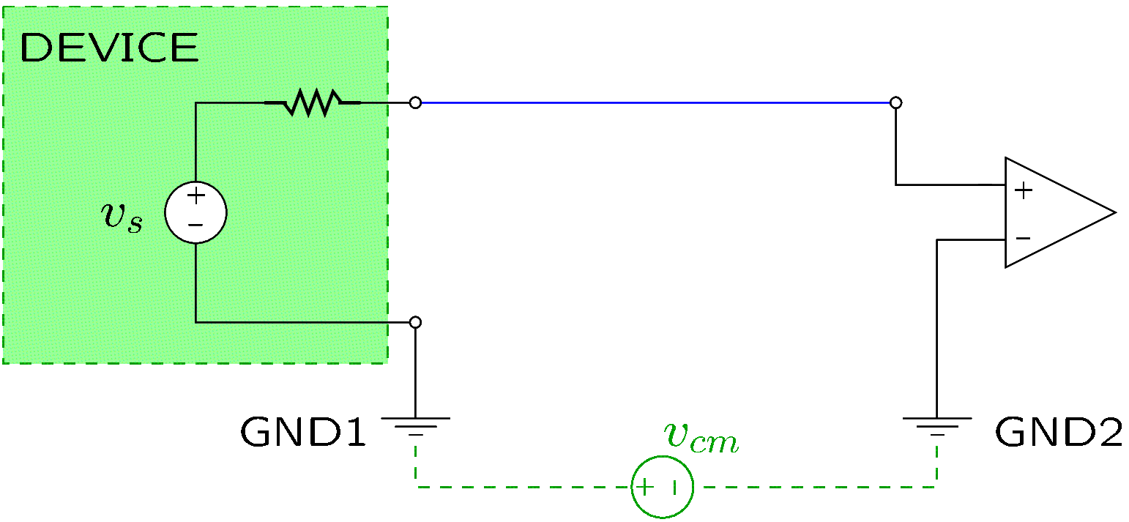
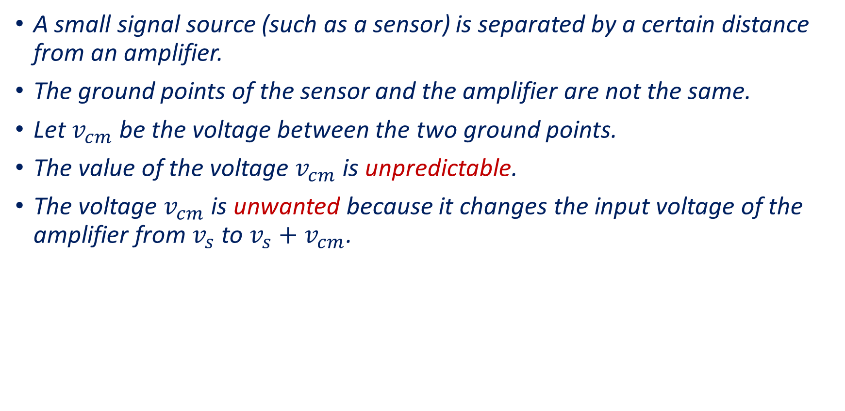
Grounding—Example
A small signal source (such as a sensor) is separated by a certain distance from an amplifier.
The ground points of the sensor and the amplifier are not the same.
Let $v_{cm}$ be the voltage between the two ground points.
The value of the voltage $v_{cm}$ is unpredictable.
The voltage $v_{cm}$ is unwanted because it changes the input voltage of the amplifier from $v_{s}$ to $v_{s}+v_{cm}$.
Notes:
interf_c3.fig

Slide 20
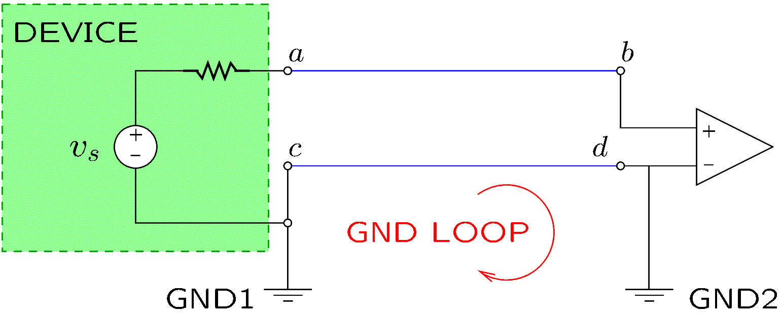
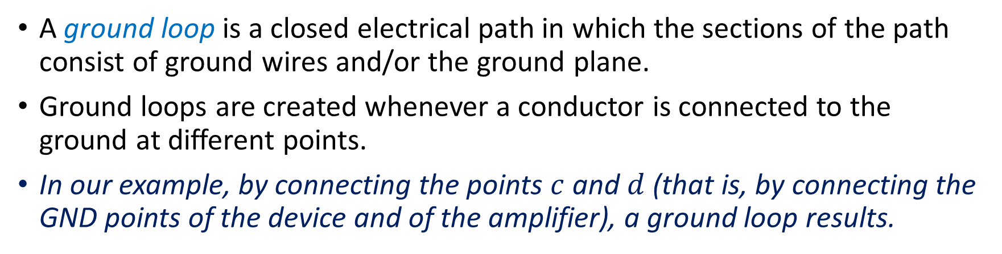
Ground Loops
A ground loop is a closed electrical path in which the sections of the path consist of ground wires and/or the ground plane.
Ground loops are created whenever a conductor is connected to the ground at different points.
In our example, by connecting the points $c$ and $d$ (that is, by connecting the GND points of the device and of the amplifier), a ground loop results.
Notes:
interf_c4.fig

Slide 21
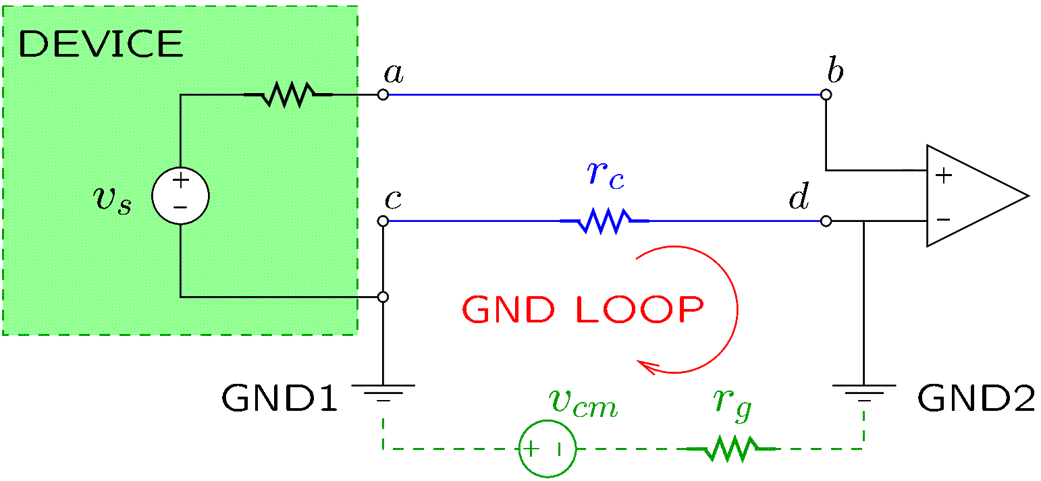
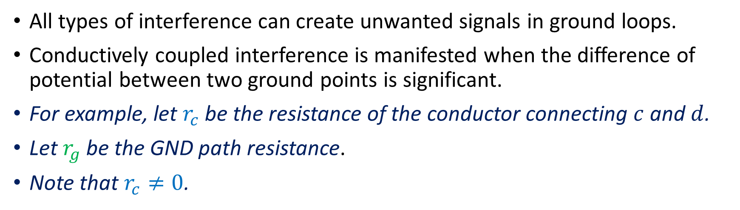
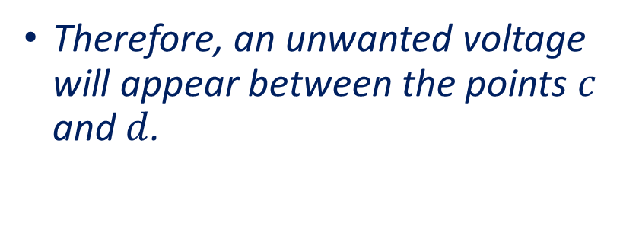
Ground Loops
All types of interference can create unwanted signals in ground loops.
Conductively coupled interference is manifested when the difference of potential between two ground points is significant.
For example, let $r_{c}$ be the resistance of the conductor connecting $c$ and $d$.
Let $r_{g}$ be the GND path resistance.
Note that $r_{c}≠0$.
Therefore, an unwanted voltage will appear between the points $c$ and $d$.
Notes:
interf_c4.fig

Slide 22
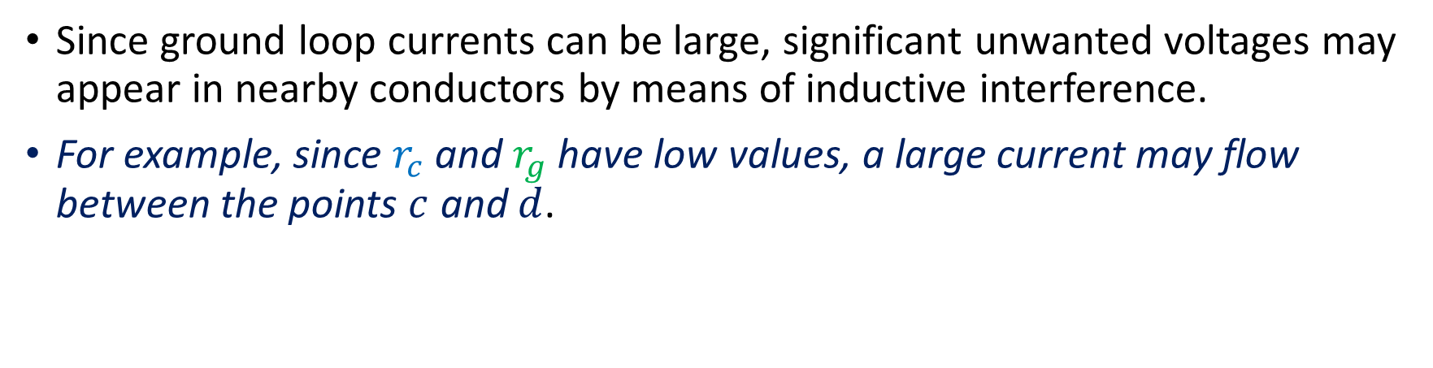
Ground Loops
Since ground loop currents can be large, significant unwanted voltages may appear in nearby conductors by means of inductive interference.
For example, since $r_{c}$ and $r_{g}$ have low values, a large current may flow between the points $c$ and $d$.
If the conductor connecting the points 𝑎 and 𝑏 is nearby, an unwanted voltage will be induced in it by inductive interference.
Notes:
interf_c4.fig

Slide 23
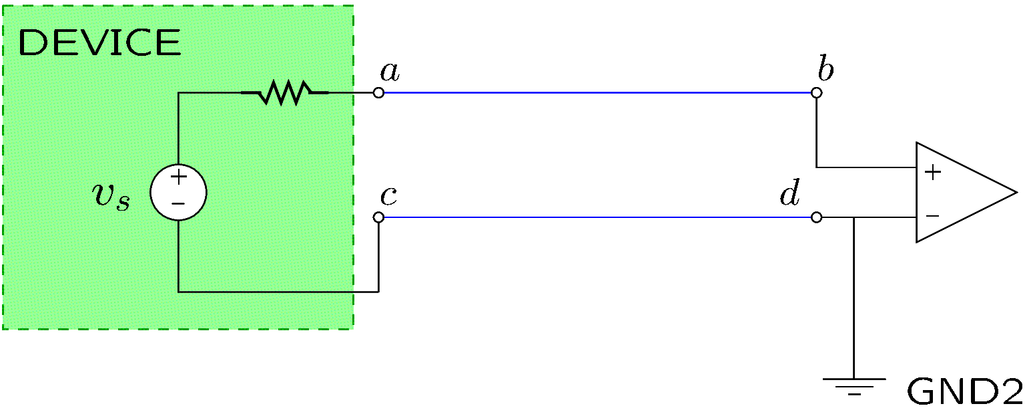
Ground Loops
To avoid interference, a single ground point should be used, if possible.
The best practice is to select the single ground point close to the device that is most susceptible to interference.
In our example, the inductive interference of ground loop currents and the conductively coupled interference are eliminated by using a single ground point.
If the device is not close to the amplifier, the signal path should be shielded to eliminate capacitive and electromagnetic interference.
Notes:
interf_c5.fig

Slide 24
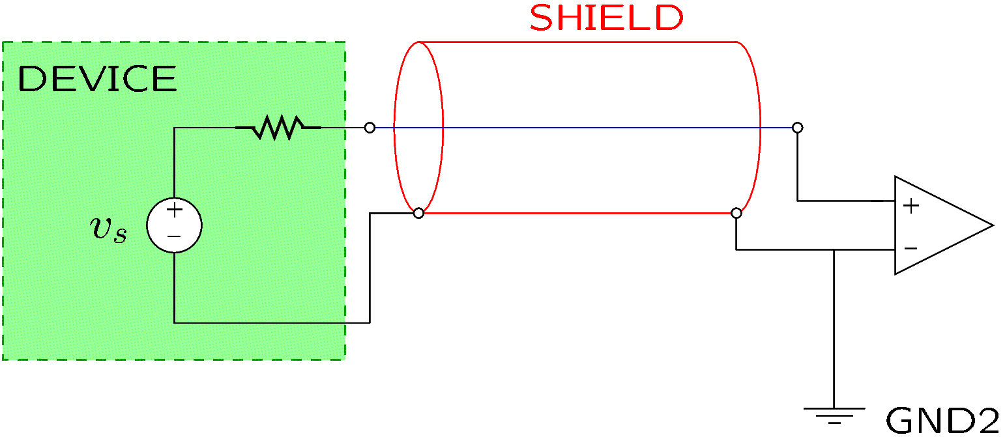
Ground Loops
If the device is not close to the amplifier, the signal path should be shielded to eliminate capacitive and electromagnetic interference.
The shield is effective when grounded.
When connecting the device with a cable, coaxial cable (such as BNC) should be used.
On a printed circuit board, a ground plane under a trace or near a trace acts as a shield.
Notes:
interf_c6.fig

