Slide 1
Connecting Electric Circuits. Digital Multimeters. Power Sources.
M.V. Iordache, EEGR2051 Circuits and Measurements Lab, Fall 2020, LeTourneau University
See https://mviordache.name/EEGR2051 for more information.

Slide 2
How to Connect Electric Circuits

Slide 3
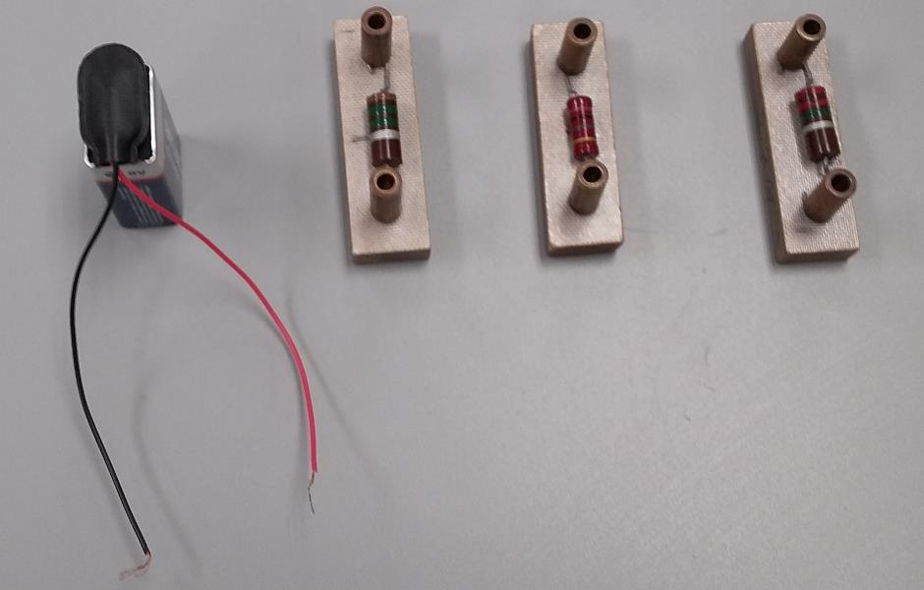
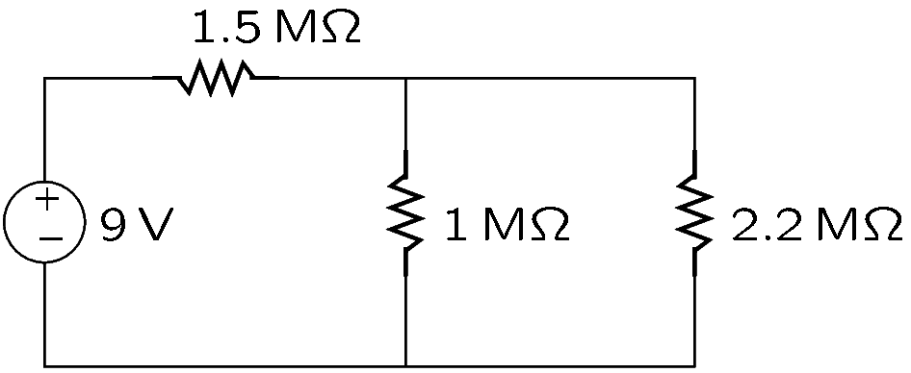
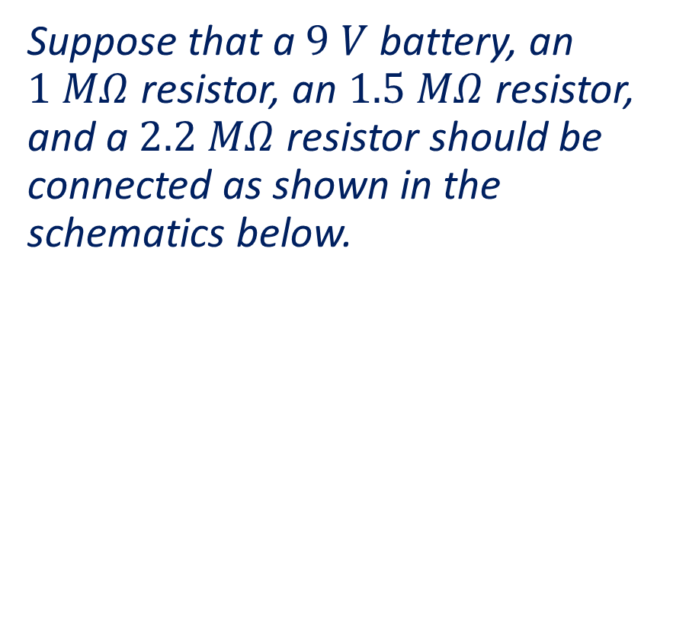
Example
Suppose that a $9 V$ battery, an $1 MΩ$ resistor, an $1.5 MΩ$ resistor, and a $2.2 MΩ$ resistor should be connected as shown in the schematics below.
RESISTORS
Notes:
Fig/con2.png

Slide 4
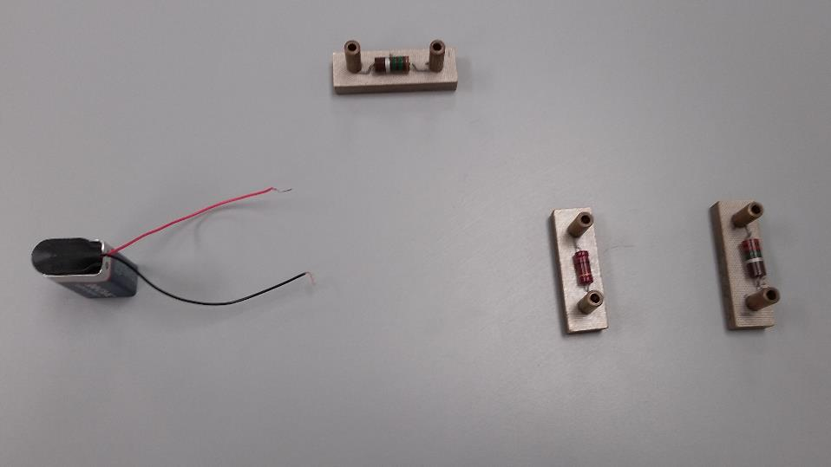
Place the components in the order shown in the schematics.
In the schematics, the lines represent cables or other conductors that should connect the components.
Notes:
Fig/con2.png

Slide 5
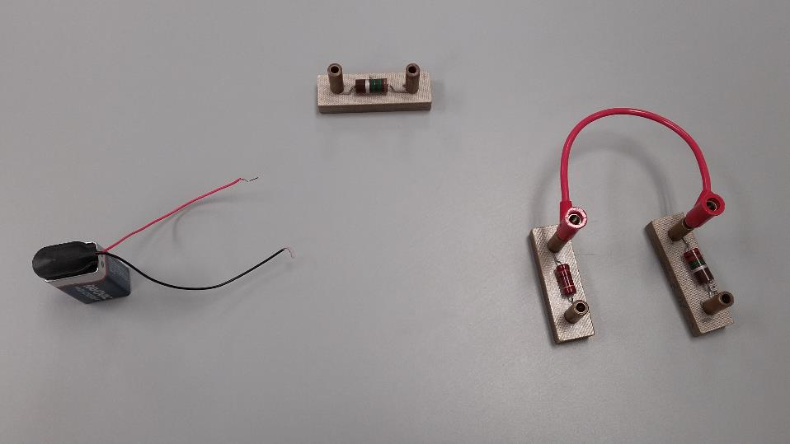
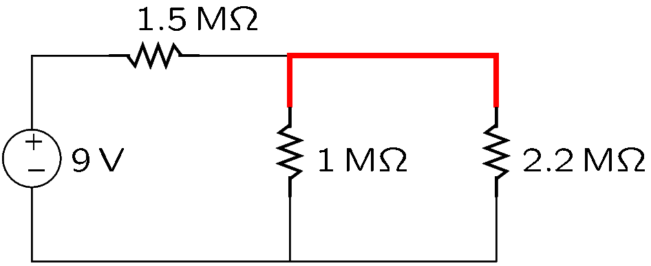
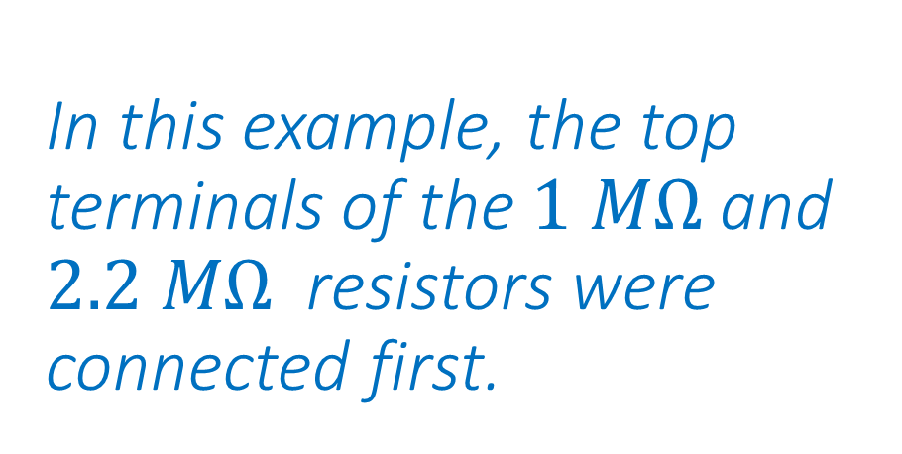
In this example, the top terminals of the $1 MΩ$ and $2.2 MΩ$ resistors were connected first.
Begin making the connections shown on the schematics.
Notes:
Fig/con3.png

Slide 6
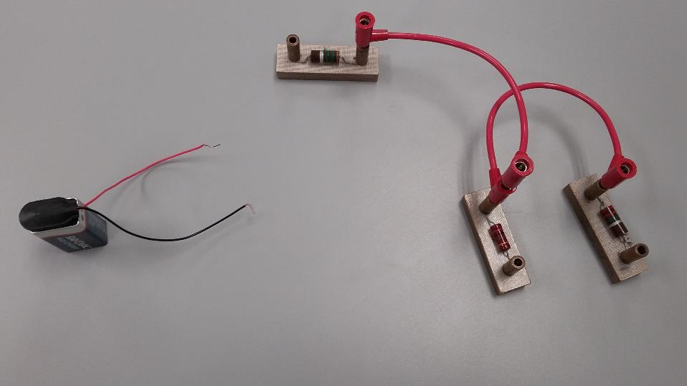
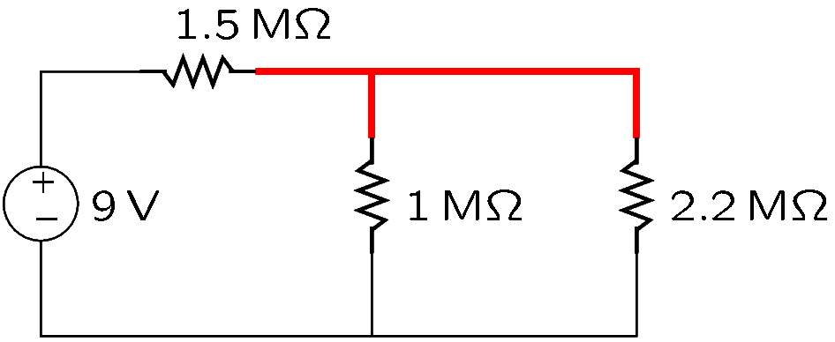
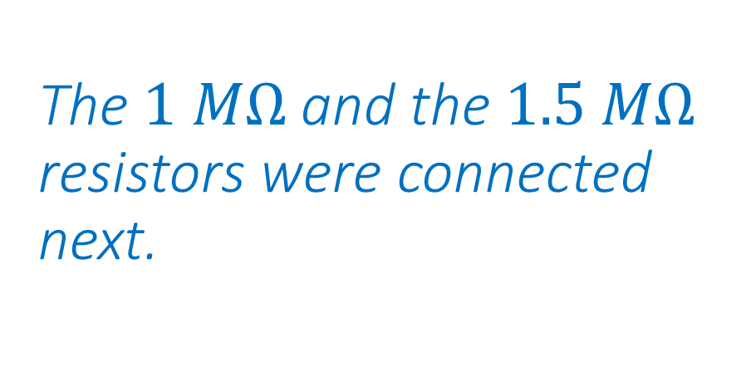
The $1 MΩ$ and the $1.5 MΩ$ resistors were connected next.
Notes:
Fig/con4.png

Slide 7
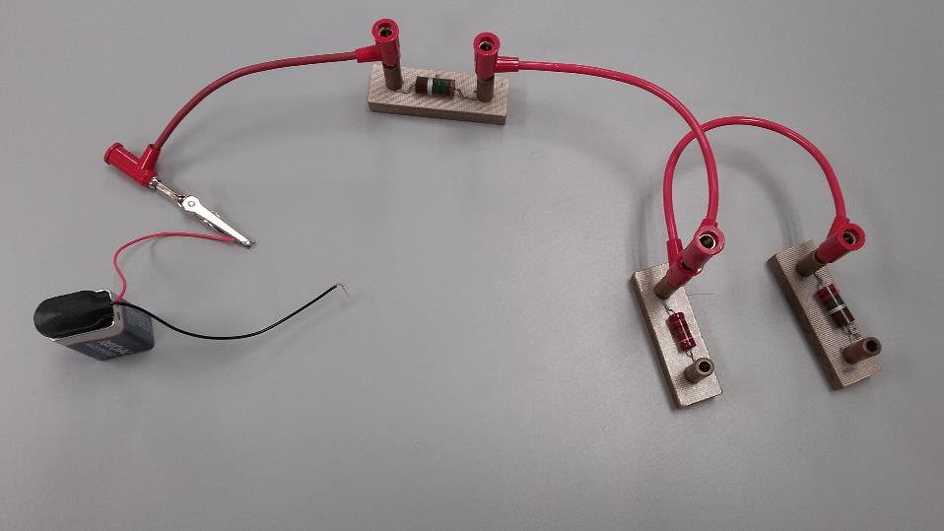
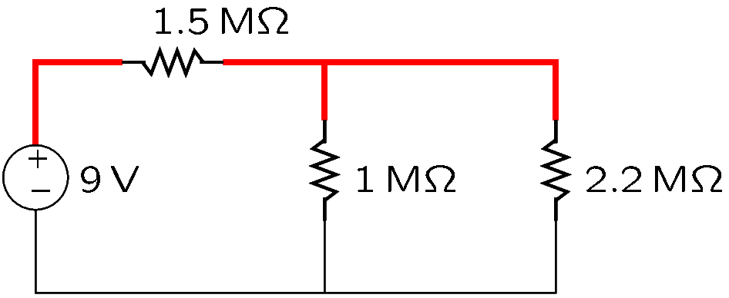
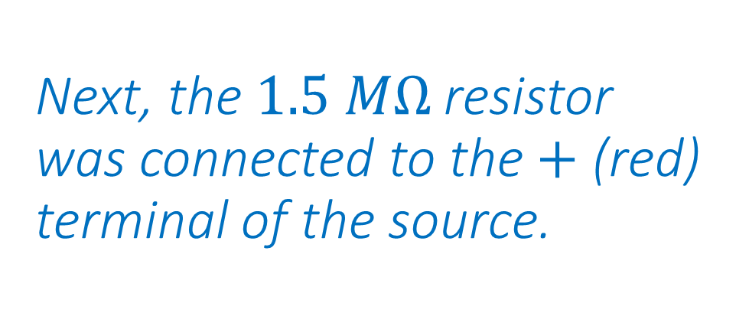
Next, the $1.5 MΩ$ resistor was connected to the $+$ (red) terminal of the source.
Notes:
Fig/con5.png

Slide 8
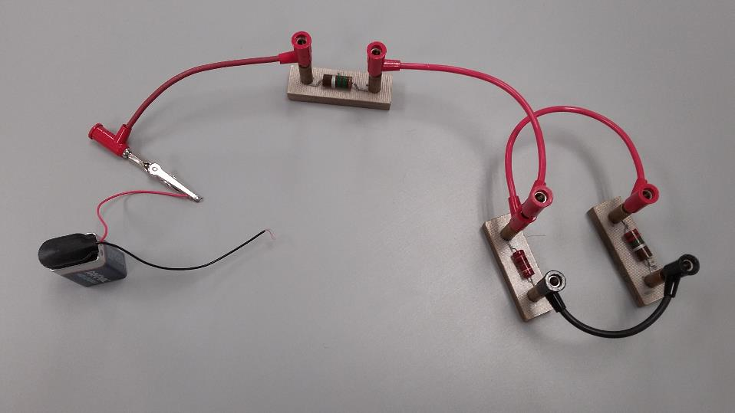
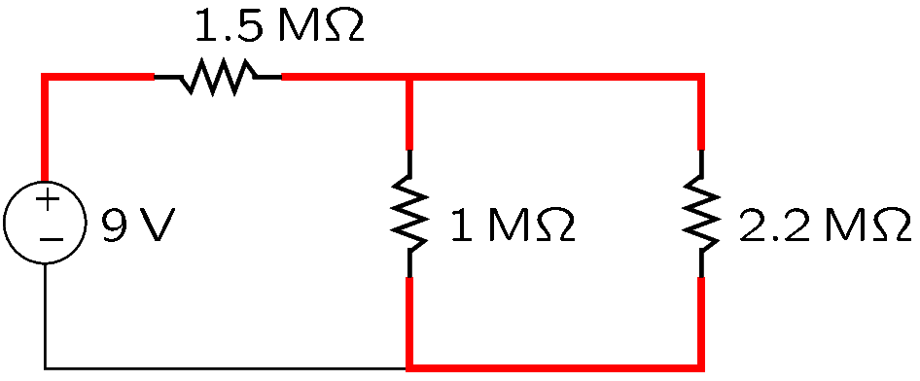
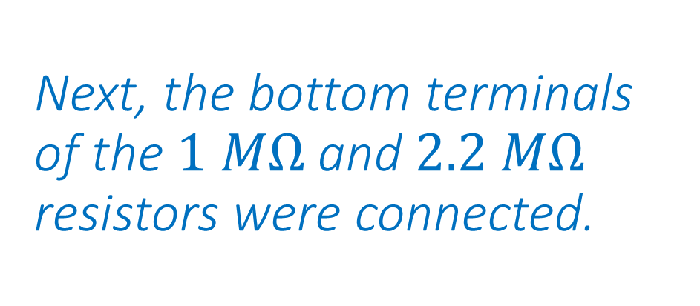
Next, the bottom terminals of the $1 MΩ$ and $2.2 MΩ$ resistors were connected.
Notes:
Fig/con6.png

Slide 9
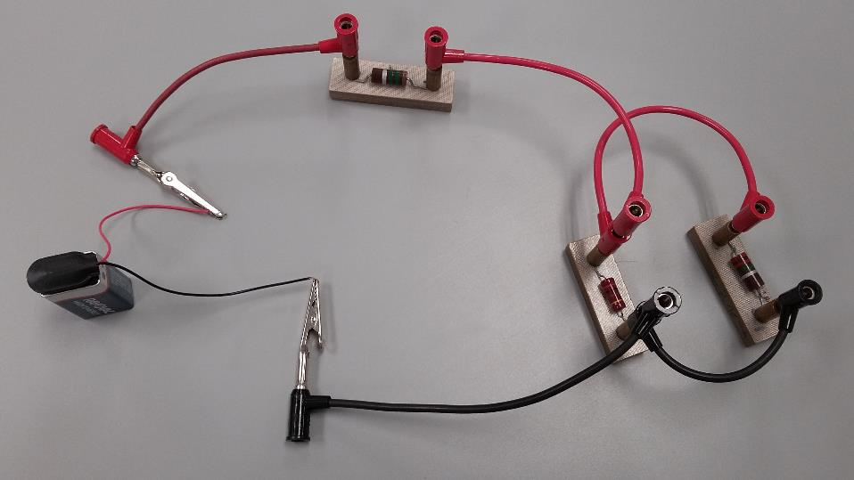
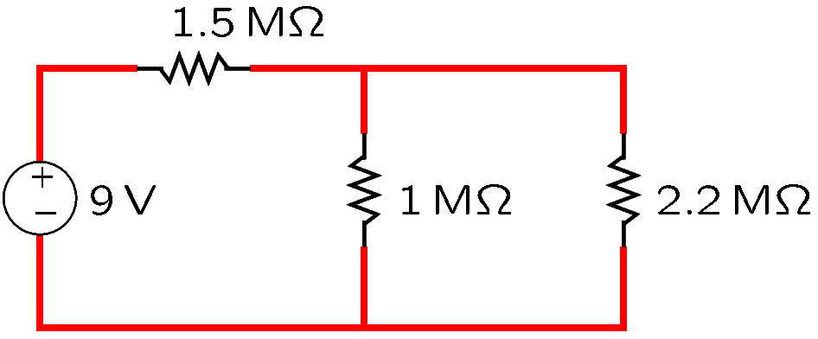
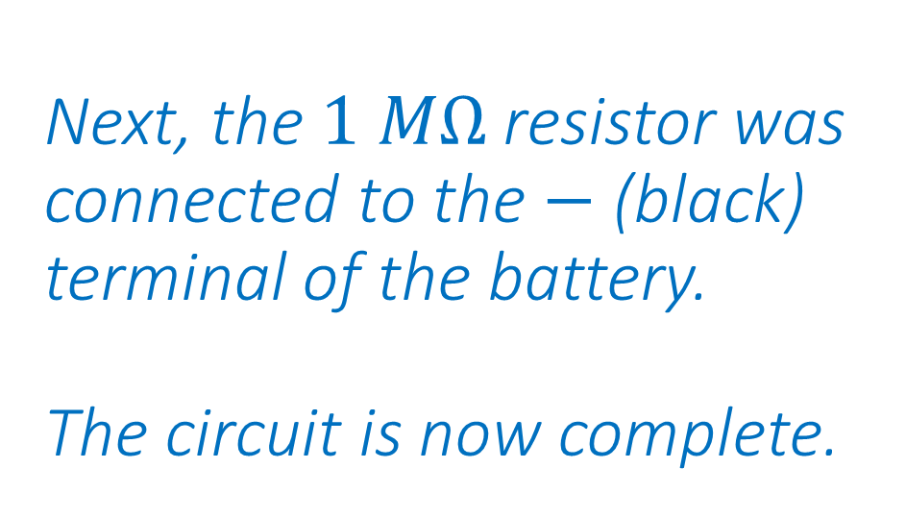
Next, the $1 MΩ$ resistor was connected to the $−$ (black) terminal of the battery. The circuit is now complete.
Notes:
Fig/con7.png

Slide 10
A circuit will be easier to debug if you use black cables for connections to the minus terminal of the source and red cables for all other connections.
Make all connections shown on the schematics.
Ensure that the circuit has no other connections besides those on the schematics.
Notes:
Fig/con7.png

Slide 11
Digital Multimeters

Slide 12
Digital Multimeters (DMMs)
A voltmeter measures Volts (voltage).
An ammeter measures Amperes (current).
An ohmmeter measures Ohms (resistance).
A DMM can be operated either as a voltmeter, or as an ammeter, or as an ohmmeter.

Slide 13
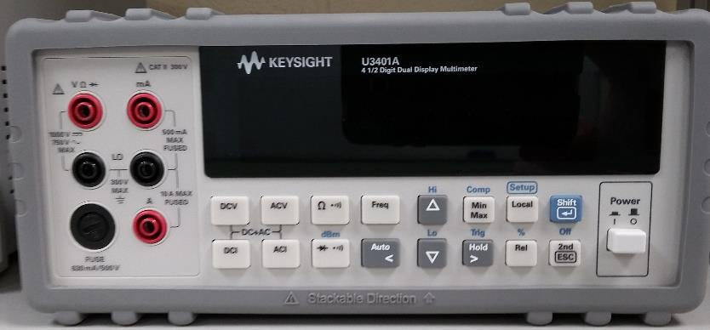
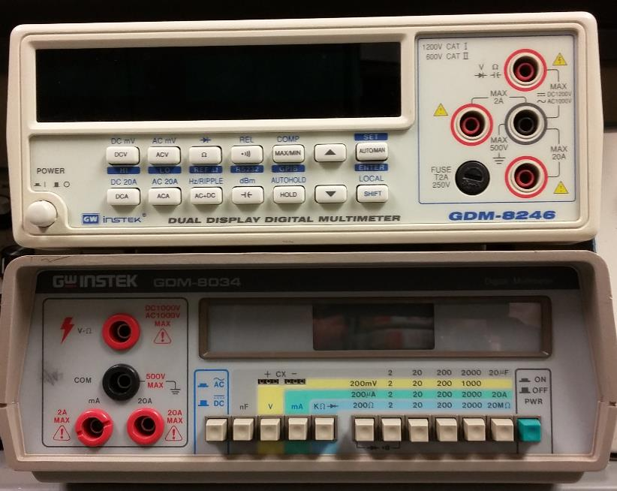
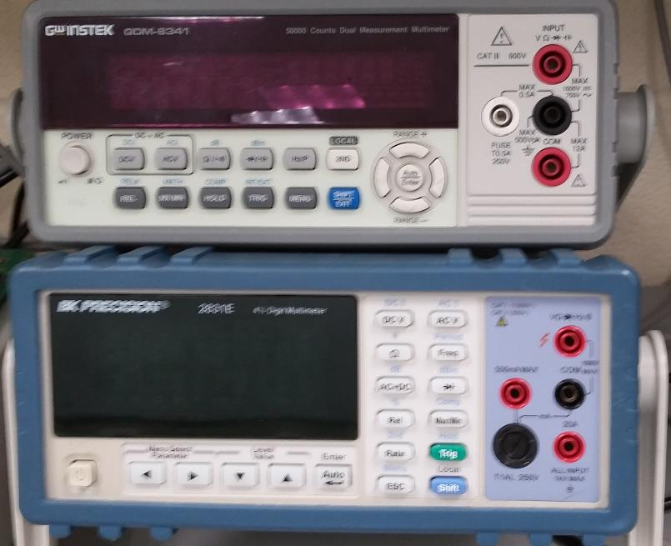
Benchtop DMMs
Are usually powered from the wall outlet.

Slide 14
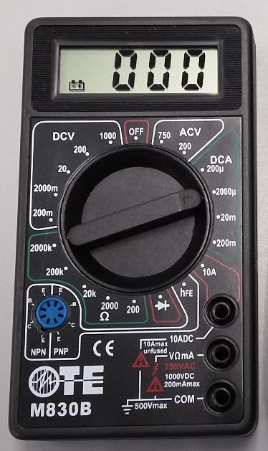
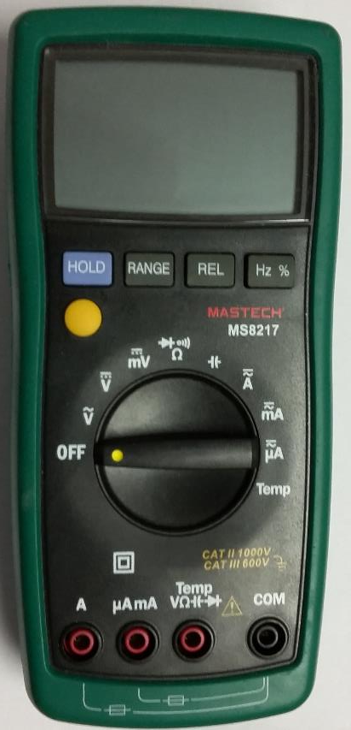
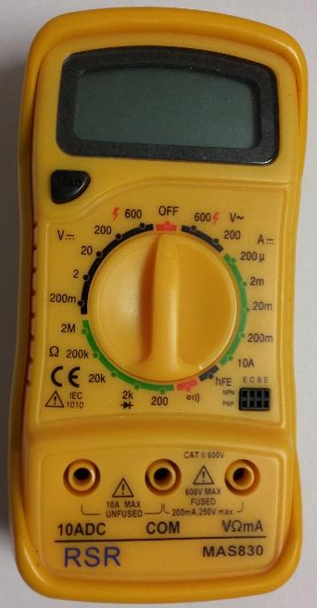
Handheld DMMs
Are battery powered.
They are usually less precise than benchtop DMMs.

Slide 15
Digital Multimeters—Example
To measure voltage with the multimeter shown below:
Press DCV to measure DC Volts.
Measure the unknown voltage using the terminals marked with V and COM.

Slide 16

Digital Multimeters—Example
To measure resistance:
Press $Ω$ to measure ohms.
Measure the resistance using the terminals marked with $Ω$ and COM.

Slide 17
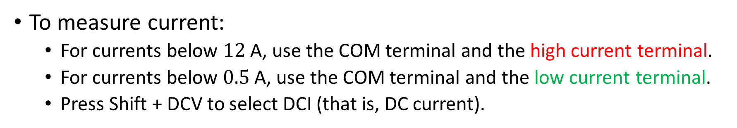
Digital Multimeters—Example
To measure current:
For currents below $12$A, use the COM terminal and the high current terminal.
For currents below $0.5$A, use the COM terminal and the low current terminal.
Press Shift + DCV to select DCI (that is, DC current).

Slide 18
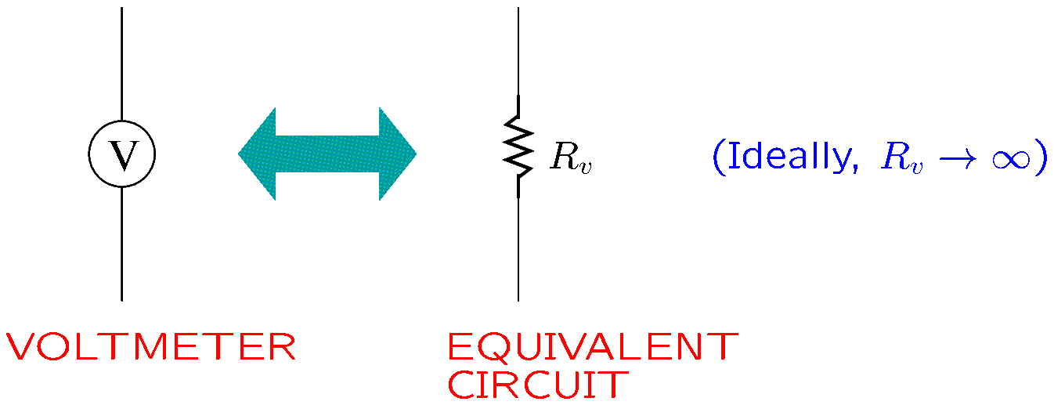

Voltmeters
A voltmeter is equivalent to a resistor of very high value (ideally, $∞$).
Notes:
volt.fig

Slide 19
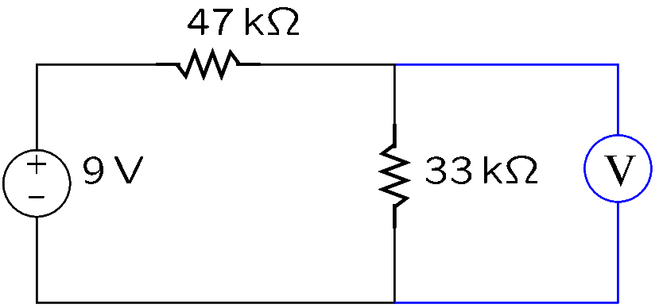
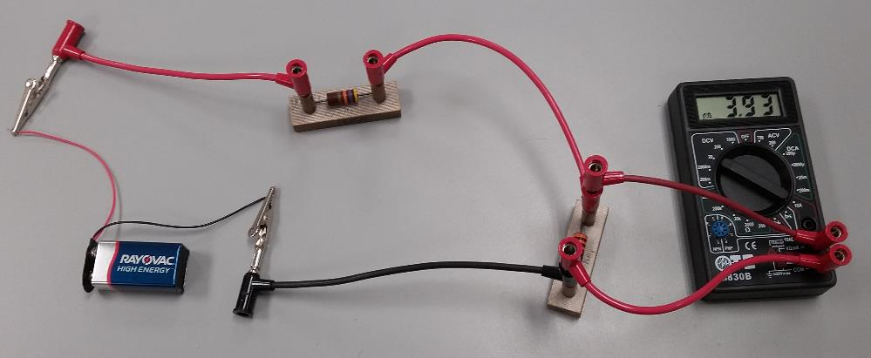

Voltmeters
The voltage of a component is measured by connecting the voltmeter across the component.
Example: The DMM was connected as in the figure to measure the voltage of the $33 kΩ$ resistor.
Notes:
volt2.fig

Slide 20
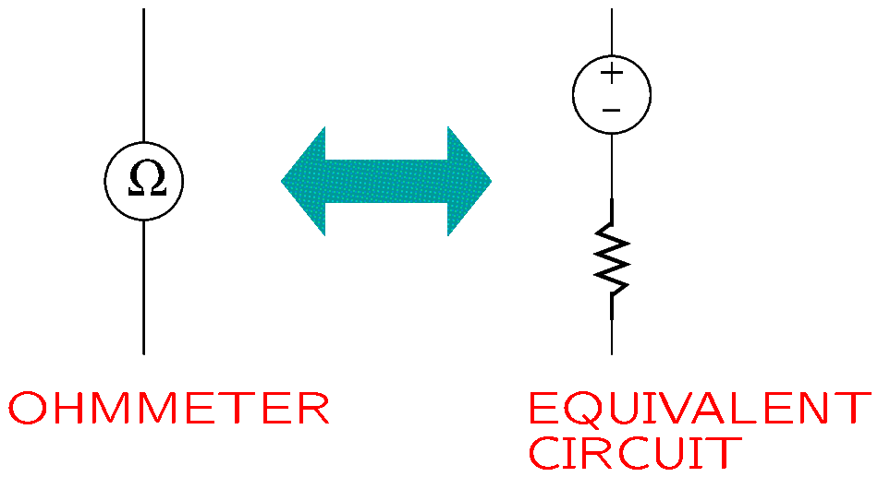
Ohmmeters
An ohmmeter is equivalent to a resistor in series with a source of voltage.
An ohmmeter applies voltage to create a current and determine the unknown resistance value.
Notes:
ohm.fig

Slide 21
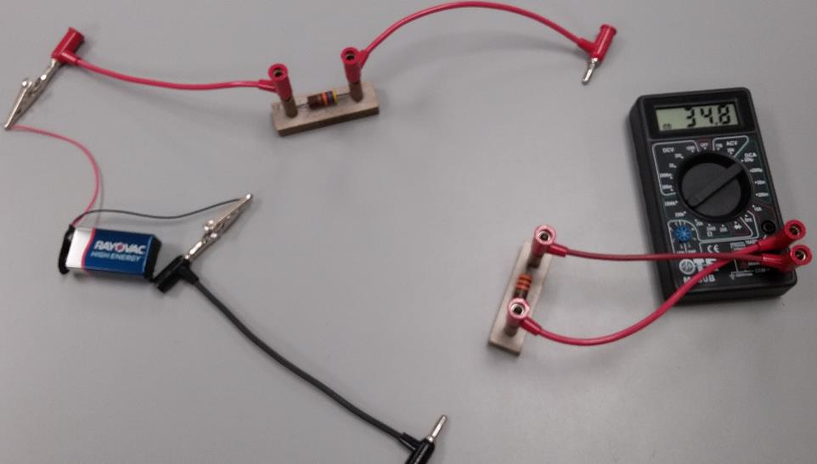
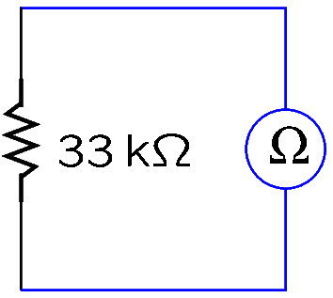
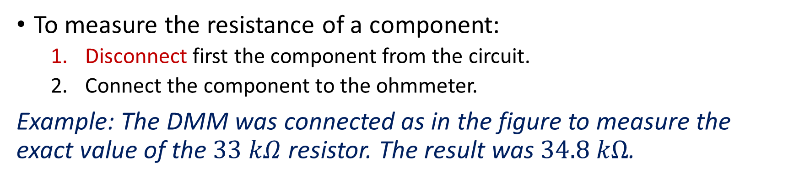
Ohmmeters
To measure the resistance of a component:
Disconnect first the component from the circuit.
Connect the component to the ohmmeter.
Example: The DMM was connected as in the figure to measure the exact value of the $33 kΩ$ resistor. The result was $34.8 kΩ$.
Notes:
ohm2.fig

Slide 22
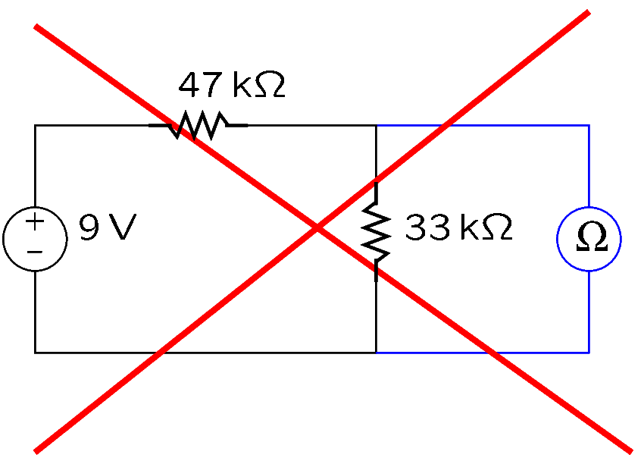
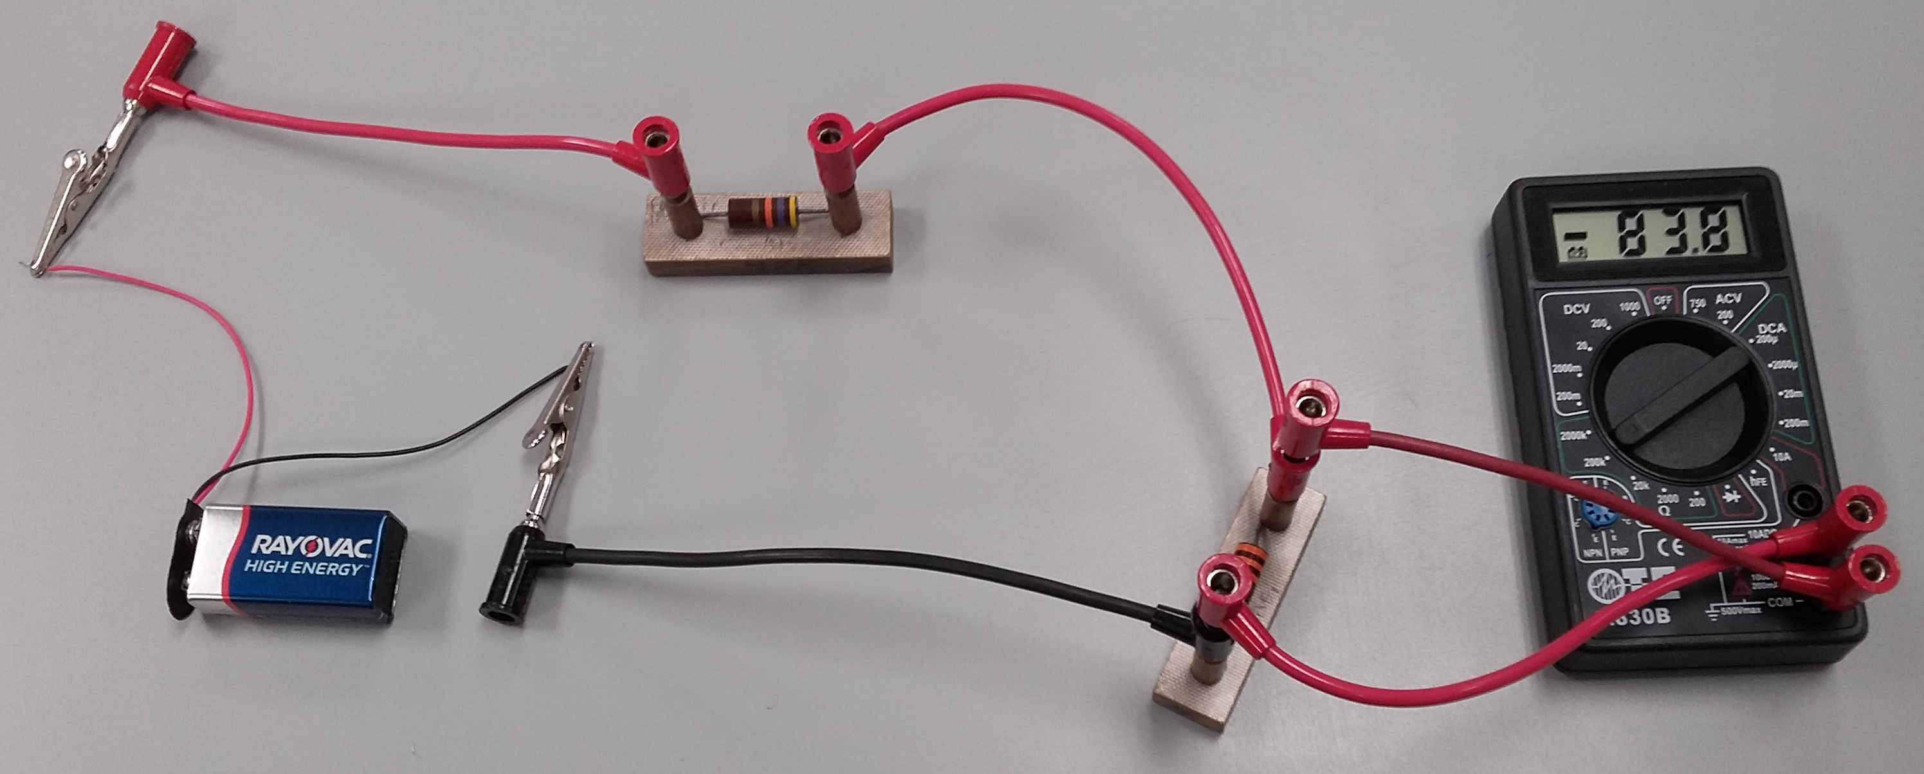
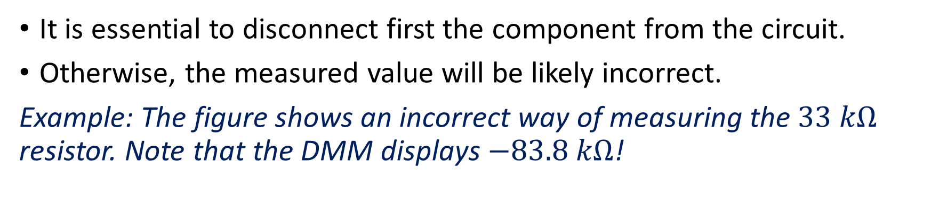
Ohmmeters
It is essential to disconnect first the component from the circuit.
Otherwise, the measured value will be likely incorrect.
Example: The figure shows an incorrect way of measuring the $33 kΩ$ resistor. Note that the DMM displays $−83.8 kΩ$!
Notes:
ohm3.fig

Slide 23
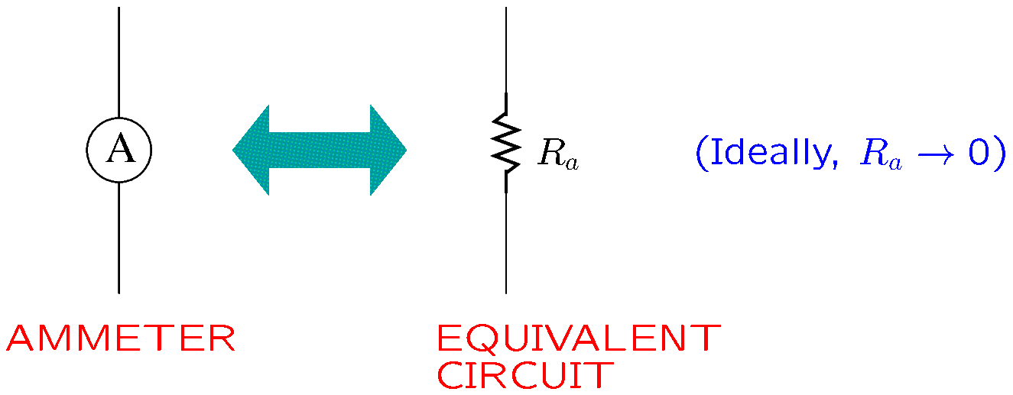

Ammeters
An ammeter is equivalent to a resistor of very low value (ideally, $0$).
Notes:
amp.fig

Slide 24
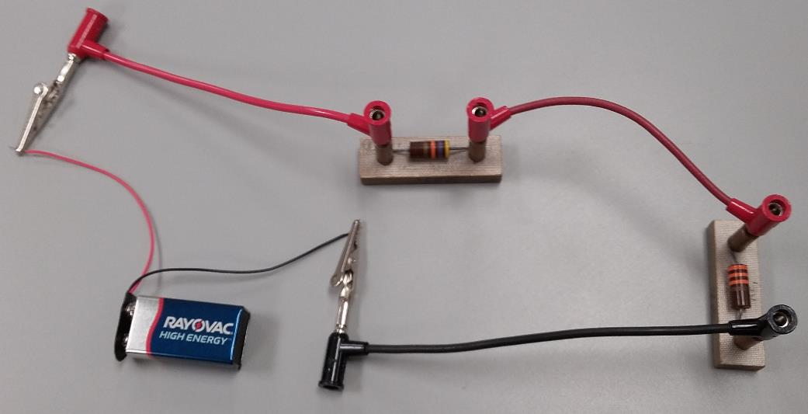
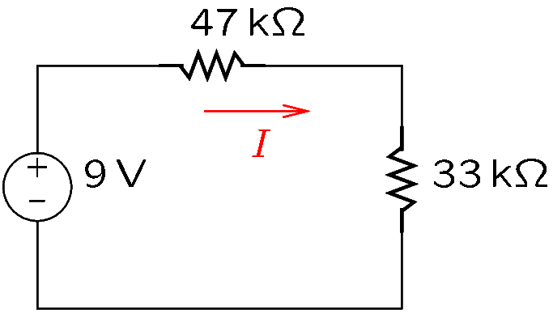

Ammeters
The current of a component is measured by placing the ammeter in series with the component.
Example: The current of the $47 kΩ$ resistor should be measured.
Notes:
amp2.fig

Slide 25
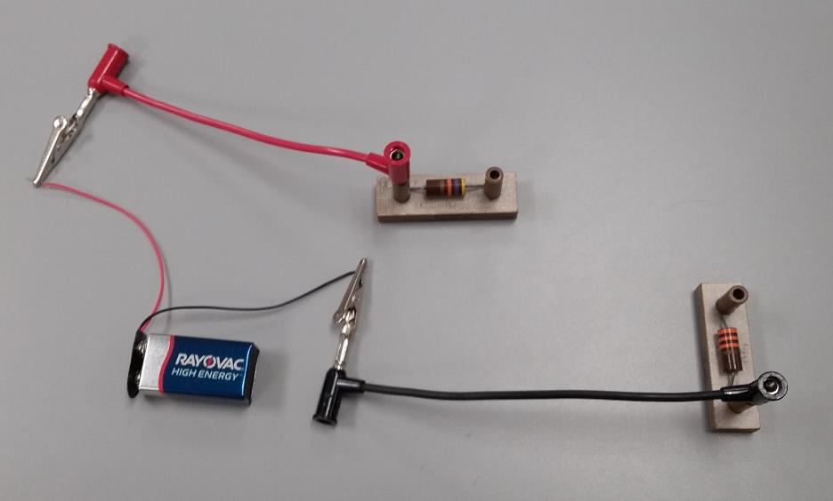
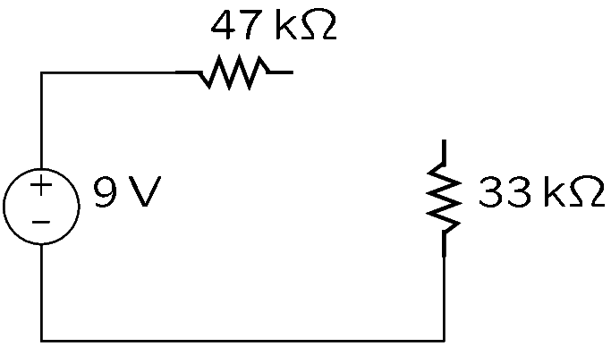
How to Measure Current—Example (Continued)
Step 1: Disconnect the resistor at one of its ends.
Notes:
amp3.fig

Slide 26
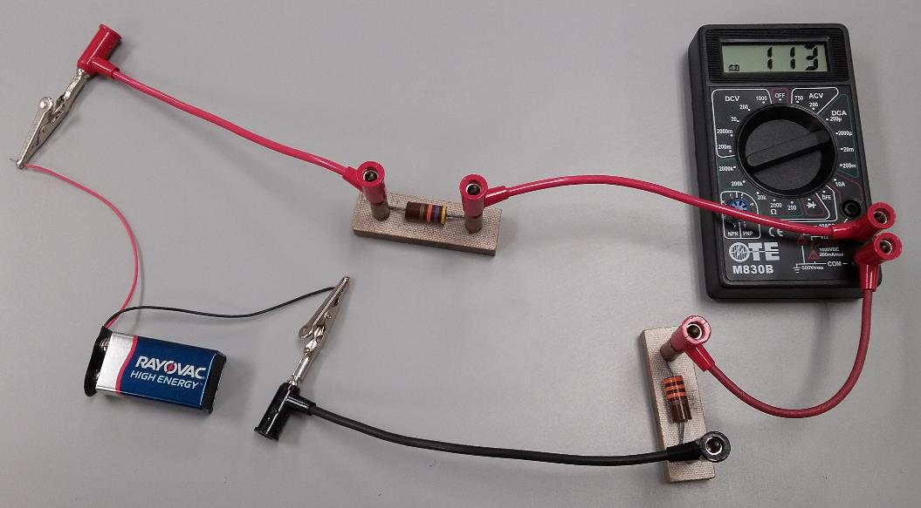
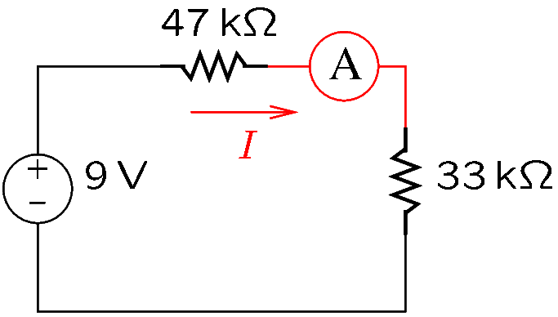

How to Measure Current—Example (Continued)
Step 2: Reconnect the resistor by means of an ammeter, so that the current to or from the resistor flows through the ammeter.
The ammeter shows a current $I=113 μA$.
Notes:
amp4.fig

Slide 27
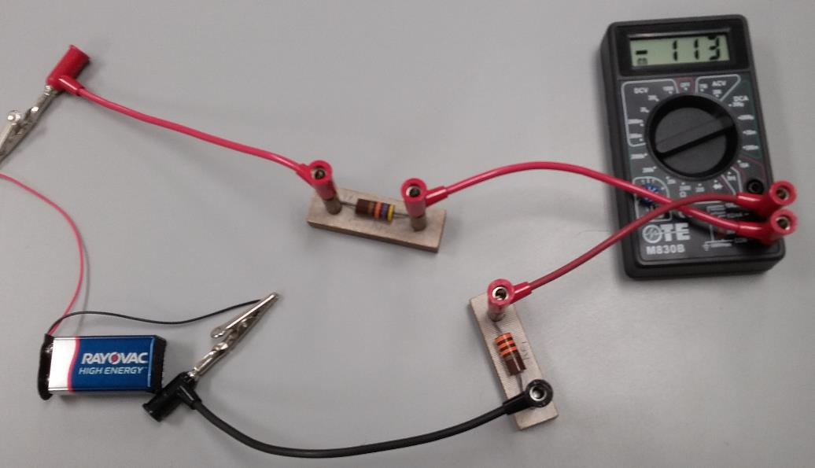

How to Measure Current—Example (Continued)
Note that by interchanging the connections of the ammeter, the sign of the measured current changes: $−113 μA$ instead of $+113 μA$.
Notes:
amp4.fig

Slide 28

How to Measure Current
Ammeters are always connected in series.
An ammeter may not be connected across a component.
Otherwise, the ammeter will show an incorrect value and the ammeter fuse may get blown.
Note that when the fuse is blown, the ammeter indicates a zero current (since no current can flow through it).
Notes:
amp4.fig

Slide 29



How to Measure Current—Example (Continued)
In the previous example, the current of the $33 kΩ$ resistor was $113 μA$.
The figure below shows an incorrect way to measure this current.
The measurement is wrong because the ammeter is in parallel, not in series.
Notes:
amp5.fig

Slide 30


How to Measure Current—Example (Continued)
Current cannot be measured across a wire.
If the green wire is removed, the DMM will display the correct value.
Notes:
amp6.fig

Slide 31

Ammeters
DMMs can measure current on several ranges.
Typical ranges are 200 $μ$A, 2 mA, 20 mA, 200 mA, 2 A, 20 A.
You can select the range that the DMM should use.
The range value indicates the maximum current that can be measured on that range.
There are two current terminals:
The terminal for the low-current ranges (below 1A).
The terminal for the high-current ranges (1A and above).
Notes:
amp.fig

Slide 32

Ammeters
In a range below $1 A$, the DMM measures the current of the terminal for low-current ranges.
In a range above 1 A, the DMM measures the current of the terminal for high-current ranges.
Example 1: A $3.7 mA$ current flowing into the low-current terminal should be measured.
In the $200 μA$ range, the DMM will display OL (overload, since $3.7 mA> 200 μA$.)
In the $2 mA$ range, the DMM will display OL (overload, since $3.7 mA> 2 mA$.)
In the $20 mA$ and $200 mA$ ranges, the DMM will display $3.7 mA$.
In the $2 A$ and $20 A$ ranges, the value displayed by the DMM will be incorrect, since the high current ranges measure the other terminal (the high current terminal).
Notes:
amp.fig

Slide 33

Ammeters
Example 2: A $75 mA$ current flowing into the high current terminal should be measured.
In the $200 μA$, $2 mA$, $20 mA$ and $200 mA$ ranges, the value displayed by the DMM will be incorrect, since the low current ranges measure the other terminal.
In the $2 A$ and $20 A$ ranges, the DMM will display $0.075 A$ (which is correct.)
Using a terminal for low-current ranges when measuring a high current will result in a reading of zero, because the fuse will be blown.
When measuring an unknown current, assume a large current value and use the high current terminal (so as to protect the instrument).
If the current turns out to be low, use the low current terminal for better accuracy.
Notes:
amp.fig

Slide 34
DC Power Sources

Slide 35


Batteries
Are DC sources of voltage.
Batteries are made of one or more cells connected in series and/or parallel.
Connected in series, the voltage output equals the sum of the voltages of each cell.
Connected in parallel, the voltage output is the same as the voltage of one cell.
An electrolyte is an electrically conducting solution that contains ions.
An electrode is an electrical conductor used to make contact with the electrolyte.
A cell consists of electrolyte and two electrodes.
The six $1.5 V$ series-connected cells of a $9 V$ battery.

Slide 36

Batteries
The capacity of a battery is commonly given in ampere-hours (A-h).
In principle, a $3$A-h battery could deliver $1$A for 3 hours.
In practice, the current is limited by the internal resistance of the battery.
A fresh battery has a negligible internal resistance (approximately $0 Ω$.)
A discharged battery will have a high internal resistance.
A fresh battery resembles an ideal source of voltage.

Slide 37

DC Power Supplies
Consist of electronic circuits that convert the AC supply of the wall outlet to DC.
Typically, they can operate in
constant voltage (CV) mode.
constant current (CC) mode.
The internal resistance of DC power supplies is negligible.
In CV mode, the source resembles an ideal source of voltage.
In CC mode, the source resembles an ideal source of current.
A triple DC power supply.

Slide 38



DC Power Supplies
When using the power supply:
Set the voltage limit $V_{L}$. This will be the voltage in CV mode.
Set the current limit $I_{L}$. This will be the current in CC mode.
Let $v$ be the output voltage and $i$ the output current.
If the source powers a circuit requiring a current $i<I_{L}$ at the voltage $V_{L}$, then the source operates in CV mode at $v=V_{L}$.
If the circuit requires a voltage $v<V_{L}$ at the current $i=I_{L}$, then the source operates in CC mode at $i=I_{L}$.
At any time, either $v=V_{L}$ or $i=I_{L}$.
Notes:
cvcc.fig

Slide 39




DC Power Supplies—Example
Assuming a CV/CC supply with $V_{L}=12$V and $I_{L}=2$A, find the voltage and current for a load of resistance $R=10 Ω$.
By Ohm’s law, $v=Ri$.
When $v=12$V, $i=\frac{v}{R}=1.2$A.
The curve $v=Ri$ is shown in red.
The intersection point of the blue and red curves gives the operating point:
$\boxed{v=12 \text{V}}$ and $\boxed{i=1.2 \text{A}}$.
Note that the source operates in CV mode.
Notes:
cvex.fig and cvcc2.fig

Slide 40



DC Power Supplies—Example
Assuming a CV/CC supply with $V_{L}=12$V and $I_{L}=2$A, find the voltage and current for a load of resistance $R=4 Ω$.
By Ohm’s law, $v=Ri$.
When $v=12$V, $i=\frac{v}{R}=3$A.
The curve $v=Ri$ is shown in red.
The intersection point of the blue and red curves gives the operating point:
$\boxed{i=2 \text{A}}$and $\boxed{v=Ri=8 \text{V}}$.
Note that the source operates in CC mode.
Notes:
cvcc3.fig

